Slide 1
The Cartesian plane
Explicit teaching

Slide 2
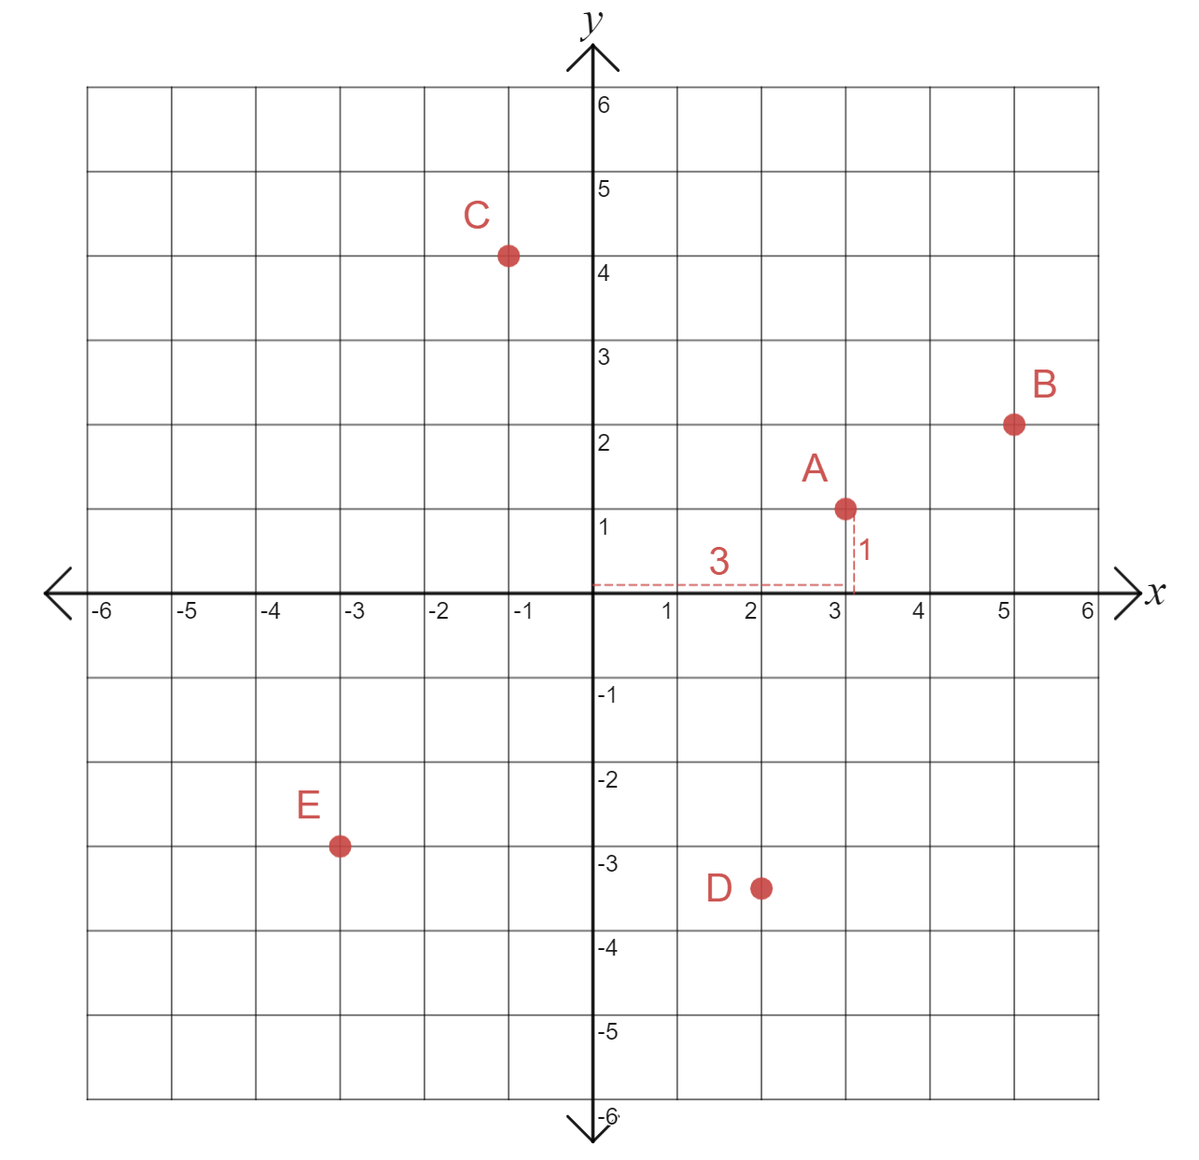
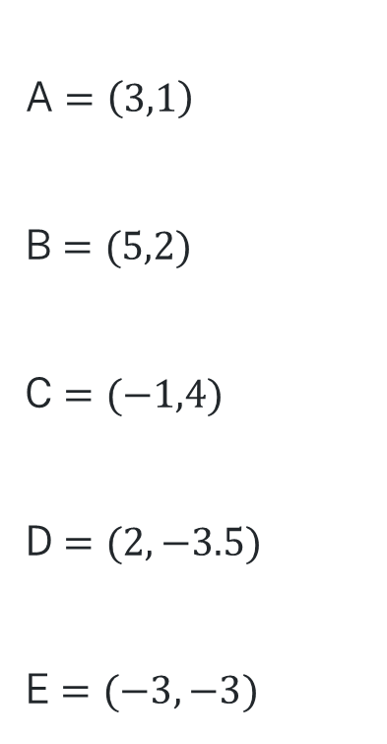
Placing coordinates on the Cartesian plane
A $=\left(3,1\right)$
B $=(5,2)$
C $=(−1,4)$
D $=(2,−3.5)$
E $=(−3,−3)$

Slide 3
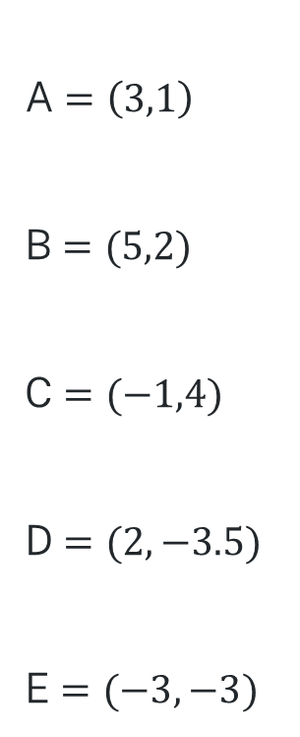
Placing coordinates on the Cartesian plane
A $=\left(3,1\right)$
B $=(5,2)$
C $=(−1,4)$
D $=(2,−3.5)$
E $=(−3,−3)$
Where are the 3 and the 1 in the graph?
What do the negative numbers tell us?
Can you write a coordinate that is above B and to the right of E?

Slide 4
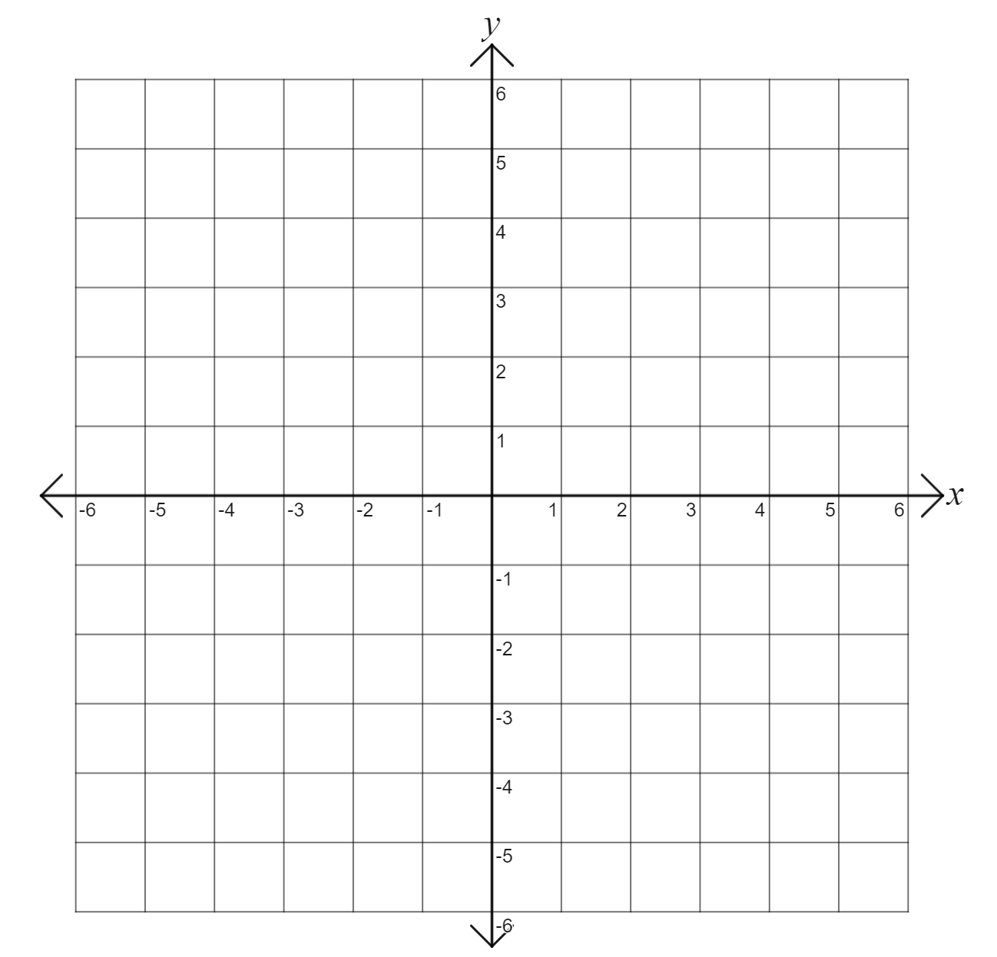
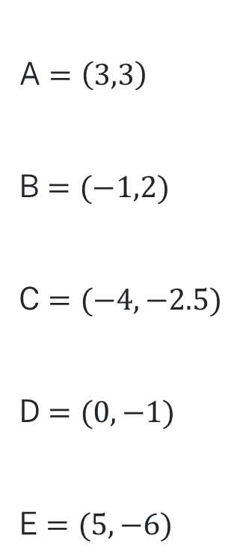
Your turn - Placing coordinates on the Cartesian plane
A $=\left(3,3\right)$
B $=(−1,2)$
C $=(−4,−2.5)$
D $=(0,−1)$
E $=(5,−6)$

Slide 5
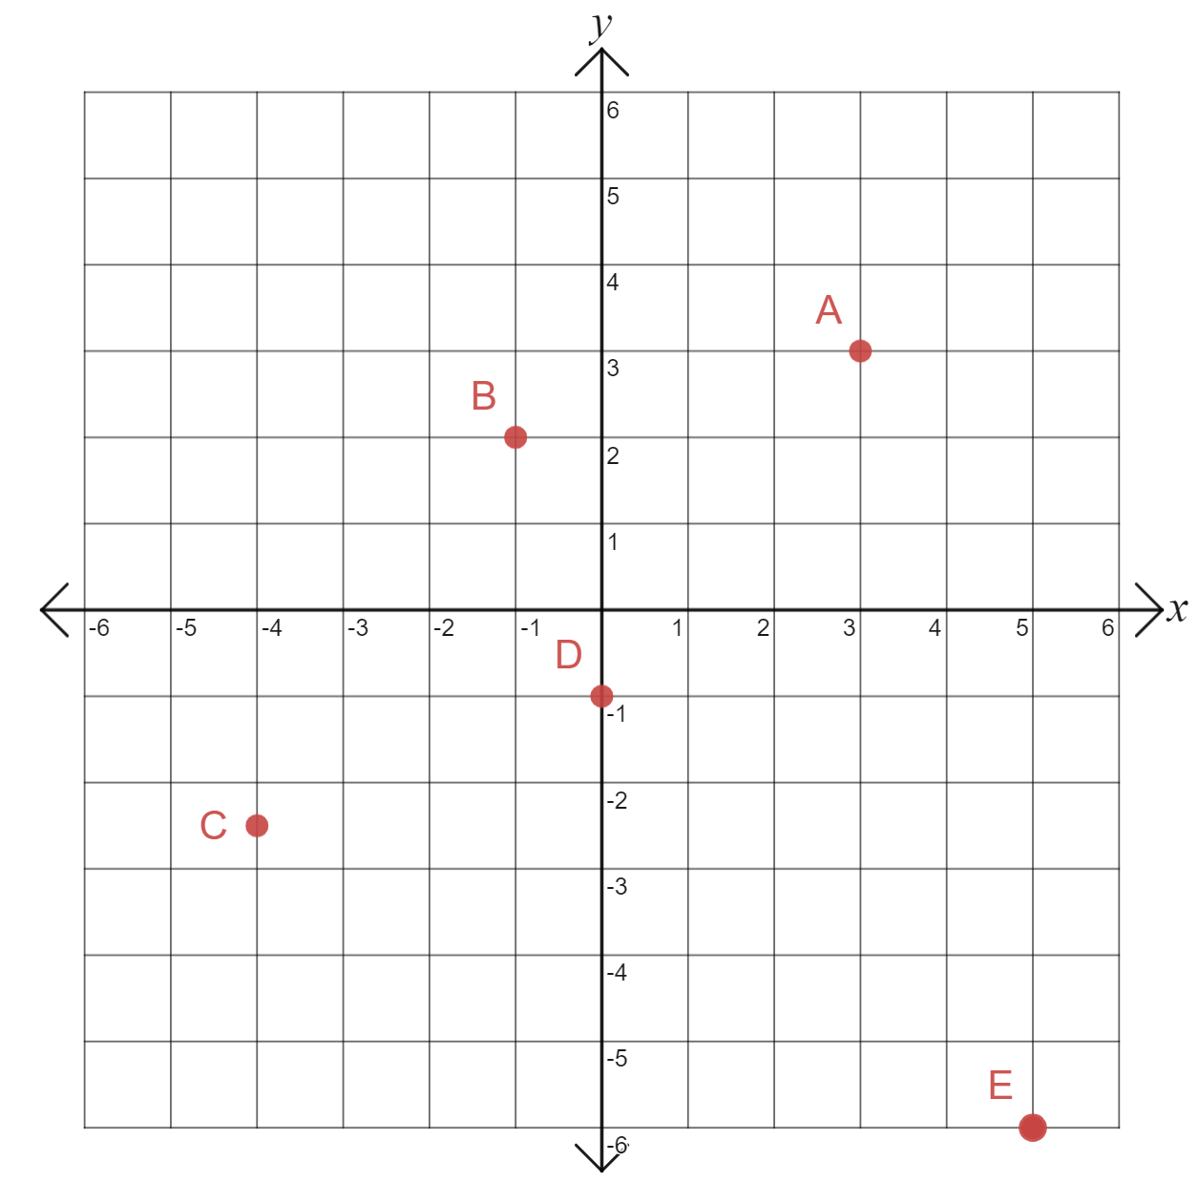
Your turn - Solution
A $=\left(3,3\right)$
B $=(−1,2)$
C $=(−4,−2.5)$
D $=(0,−1)$
E $=(5,−6)$

