Slide 1
Fractions and decimals and percentages – oh my!
Explicit teaching

Slide 2
Getting started
The etymology of percent
Percent is a compound word.
Per - each one part of something.
Cent - one hundred (from the Latin word centum)
Combined, this provides us with a definition of percent meaning ‘parts of a whole expressed in hundredths’

Slide 3
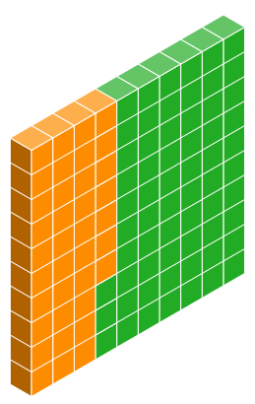
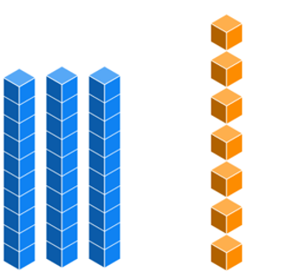
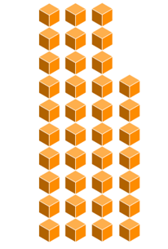
Worked example 1
Converting decimals to percentages
0.37
3 tenths
7 hundredths
37 hundredths
$$0.37=\frac{37}{100}=37\%$$

Slide 4
Prompts 1
Converting decimals to percentages
Where have all these hundredths come from?
0.37
Why have we made this out of 100?
3 tenths
7 hundredths
37 hundredths
$$0.37=\frac{37}{100}=37\%$$

Slide 5
Your turn 1a
Converting decimals to percentages
Represent $0.63$ as a percentage

Slide 6
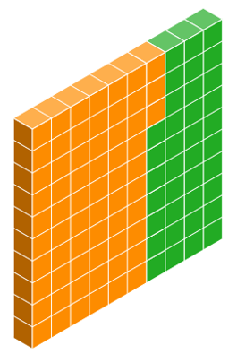
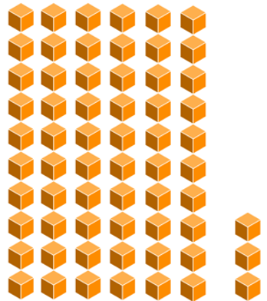
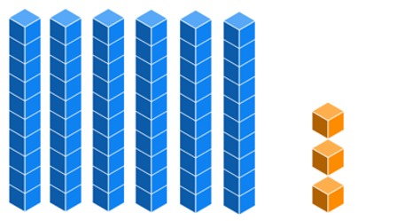
Solutions 1a
Converting decimals to percentages
$$0.63$$
6 tenths
3 hundredths
63 hundredths
$$0.63=\frac{63}{100}=63\%$$

Slide 7
Your turn 1b
Converting decimals to percentages
Represent $0.05$ as a percentage

Slide 8
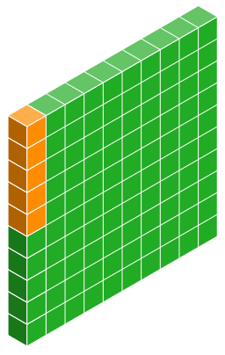
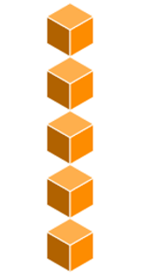
Solutions 1b
Converting decimals to percentages
$$0.05$$
5 hundredths
$$0.05=\frac{5}{100}=5\%$$

Slide 9
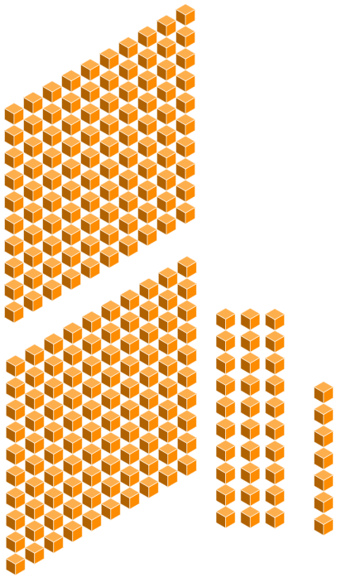
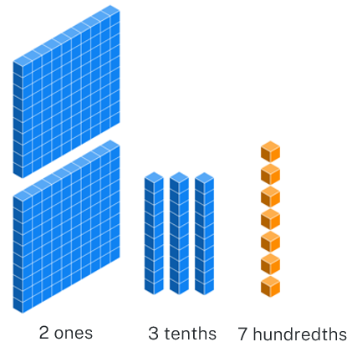
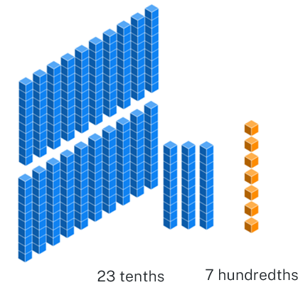
Worked example 2
Converting decimals to percentages
$$2.37$$
2 ones
3 tenths
7 hundredths
23 tenths
7 hundredths
$2.37=237$ hundredths $=237\%$

Slide 10
Prompts 2
Converting decimals to percentages
What operation can you use here?
$$2.37$$
What are these 2 “ones” as a percentage?
2 ones
3 tenths
7 hundredths
23 tenths
7 hundredths
$2.37=237$ hundredths $=237\%$

Slide 11
Your turn 2a
Converting decimals to percentages
Represent $3.11$ as a percentage

Slide 12
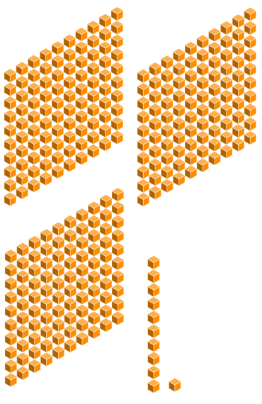
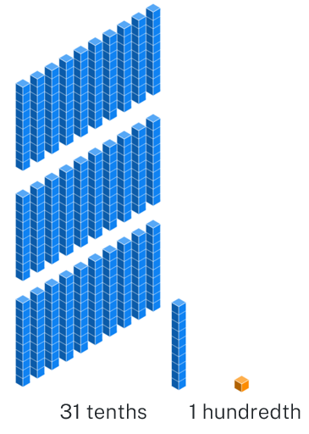
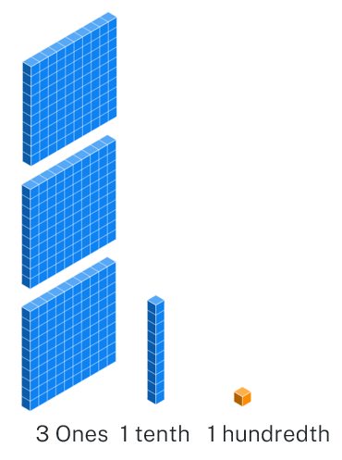
Solutions 2a
Converting decimals to percentages
$$3.11$$
3 ones
31 tenths
1 hundredth
$3.11=311$ hundredths $=311\%$
1 tenth
1 hundredth

Slide 13
Your turn 2b
Converting decimals to percentages
Represent $1.05$ as a percentage.

Slide 14
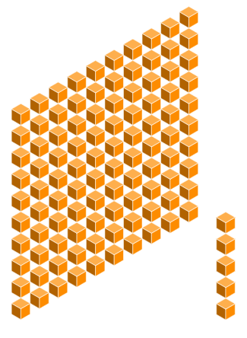
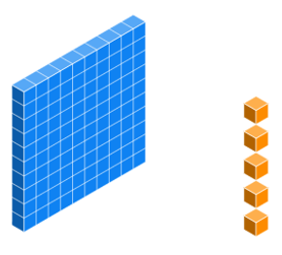
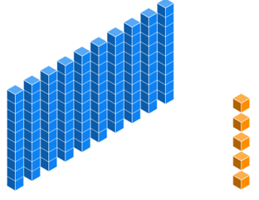
Solutions 2b
Converting decimals to percentages
$$1.05$$
1 one
5 hundredths
10 tenths
5 hundredths
$1.05=105$ hundredths $=105\%$

Slide 15
Worked example 3
Converting decimals to percentages
$16.89=1689$ hundredths
$$16.89=\left(16.89×100\right)\%=1689\%$$

Slide 16
Prompts 3
Converting decimals to percentages
What word have we seen that could explain this multiplication symbol here?
$16.89=1689$ hundredths
$$16.89=\left(16.89×100\right)\%=1689\%$$

Slide 17
Your turn 3
Converting decimals to percentages
$$37.009=$$

Slide 18
Solutions 3
Converting decimals to percentages
$37.009=3 700.9$ hundredths
$$37.009=\left(37.009×100\right)\%=3 700.9\%$$

Slide 19
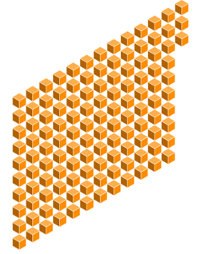
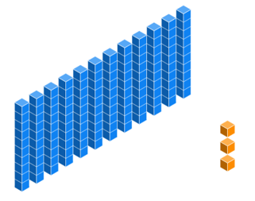
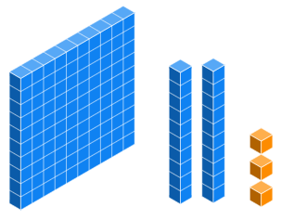
Worked example 4
Converting percentages to decimals
$$123\%=123 hundredths$$
123 hundredths
12 tenths
3 hundredths
$$123\text{\%}=1.23$$

Slide 20
Prompts 4
Converting percentages to decimals
How does the representation relate to the final answer?
$$123\%=123 hundredths$$
How do we know that the result is greater than 1?
123 hundredths
12 tenths
3 hundredths
$$123\text{\%}=1.23$$

Slide 21
Your turn 4a
Converting percentages to decimals
Represent $363\%$ as a decimal.

Slide 22
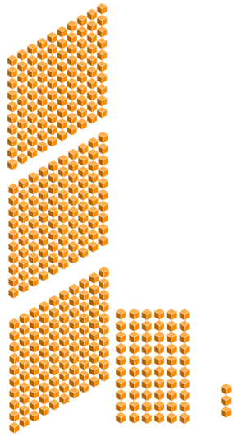
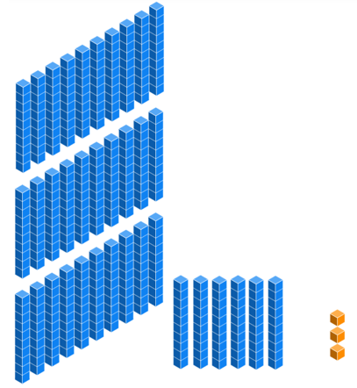
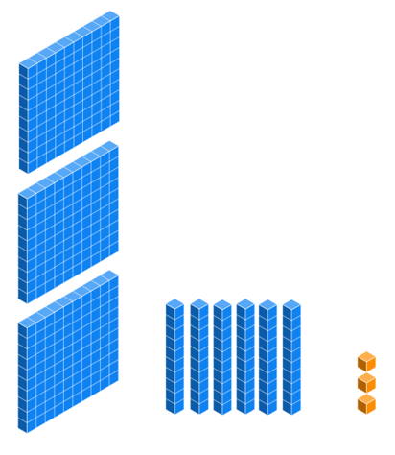
Solutions 4a
Converting percentages to decimals
$$363\%$$
363 hundredths
36 tenths
3 hundredths
3 ones
6 tenths
3 hundredths
$$363\text{\%}=3.63$$

Slide 23
Your turn 4b
Converting percentages to decimals
Represent $9\%$ as a decimal

Slide 24
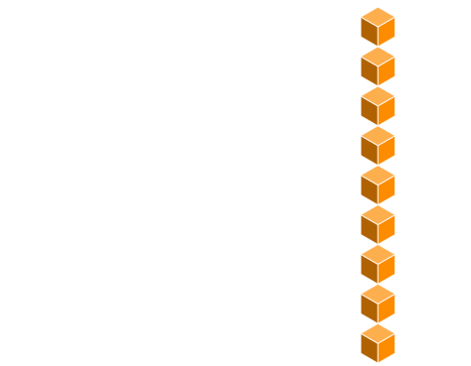
Solutions 4b
Converting percentages to decimals
$$9\%$$
$$9\text{\%}=0.09$$
0 ones
0 tenths
9 hundredths

Slide 25
Worked example 5
Converting percentages to decimals
$$18 961\%=18 961 hundredths$$
$$18 961 ÷100=189.61$$

Slide 26
Prompts 5
Converting percentages to decimals
$$18 961\%=18 961 hundredths$$
$$18 961 ÷100=189.61$$
How is this operation related to the conversion of decimals to percentages?

Slide 27
Your turn 5
Converting percentages to decimals
$$2724.4\%=$$

Slide 28
Solutions 5
Converting percentages to decimals
$2724.4\%=2724.4$ hundredths
$$2724.4÷100=27.244$$

Slide 29
Number line 1
Ordering percentages 1

Slide 30
Number line 2
Ordering percentages 2

Slide 31
Number line 3
Ordering percentages 3

Slide 32
Number line 4
Ordering percentages 4

Slide 33
Number line 5
Ordering decimals 1

Slide 34
Number line 6
Ordering decimals 2

Slide 35
Number line 7
Ordering decimals 3

Slide 36
Number line 8
Ordering decimals 4

Slide 37
Number line 9
Ordering fractions 1

Slide 38
Number line 10
Ordering fractions 2

Slide 39
Number line 11
Ordering fractions 3

Slide 40
Number line 12
Ordering fractions 4

Slide 41
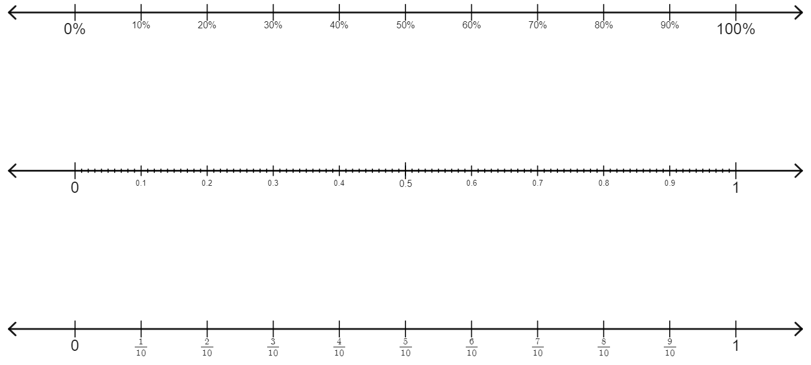
Number line 13
Ordering everything

