Slide 1
Be rational
Explicit teaching

Slide 2
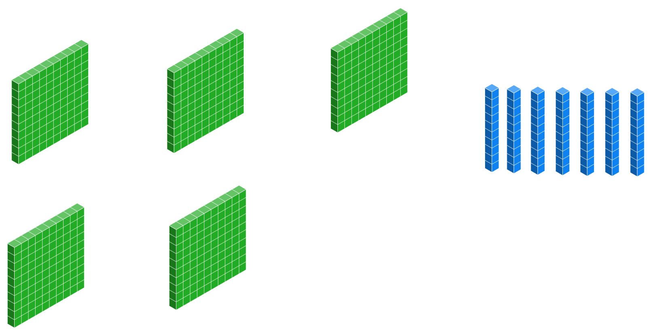
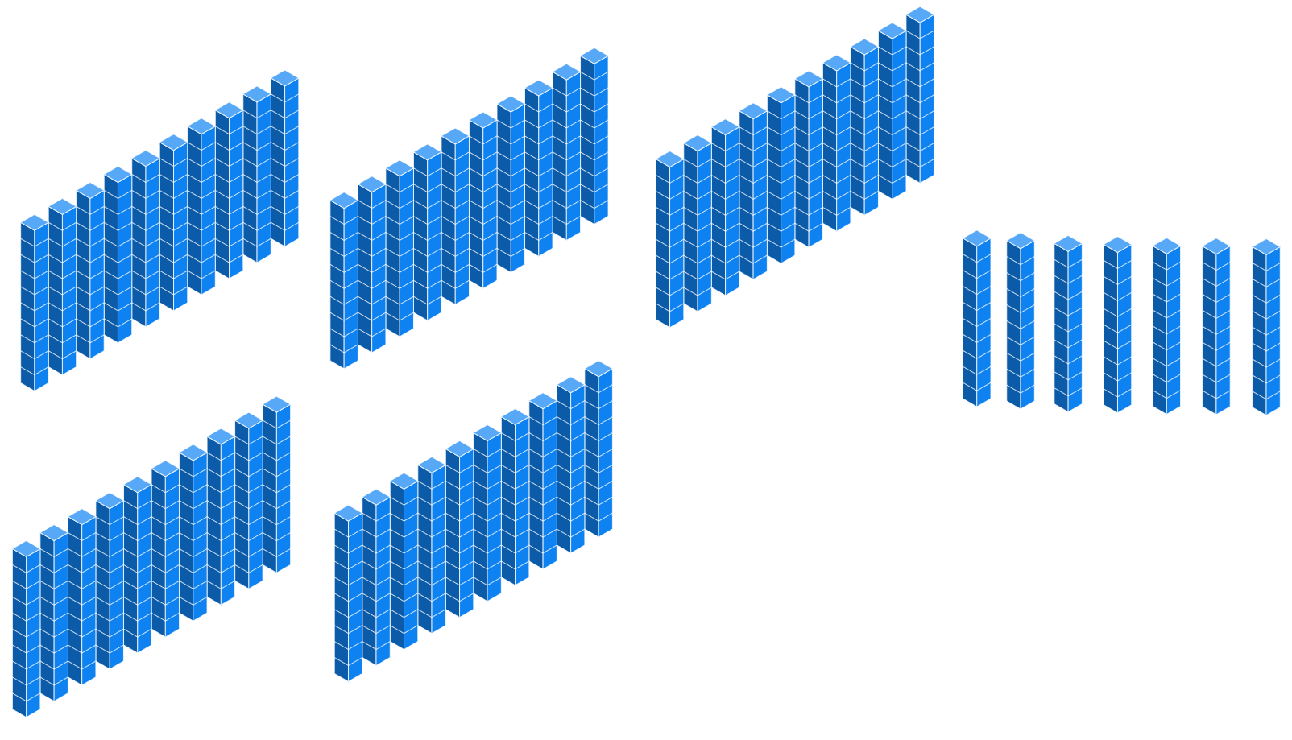
Worked example 1
Converting decimals to fractions
$0.57=\frac{57}{100}$ or 57 hundredths

Slide 3
Prompts 1
Converting decimals to fractions – Self explanation prompts
Why is this question being described as hundredth?
$0.57=\frac{57}{100}$ or 57 hundredths
How does the second diagram relate to the first?

Slide 4
Your turn 1
Your turn – Converting decimals to fractions
$$1.12=$$
$$0.042=$$

Slide 5
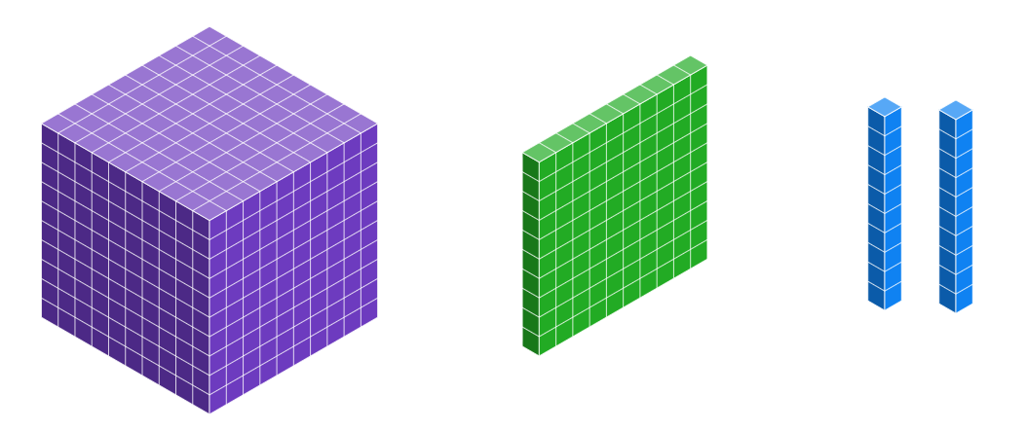
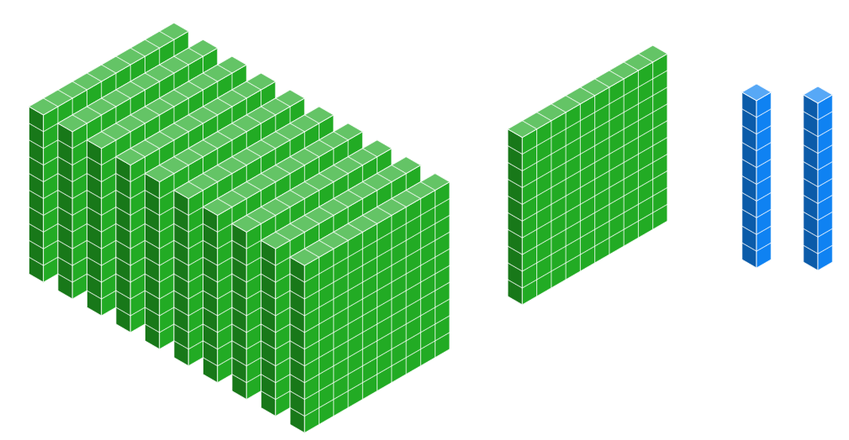
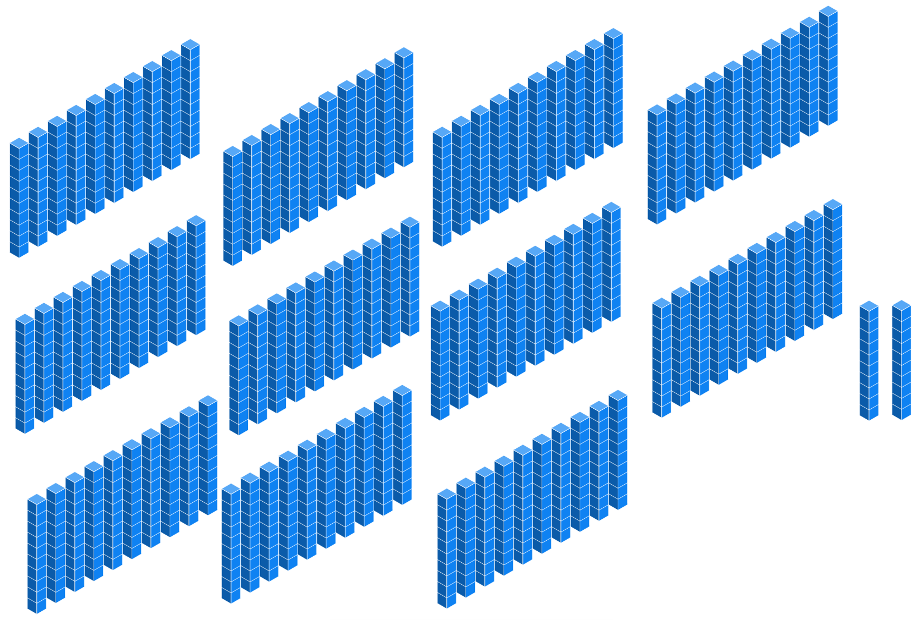
Solutions 1
Your turn
$1.12=\frac{112}{100}$ or 112 hundredths

Slide 6
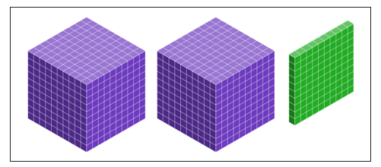
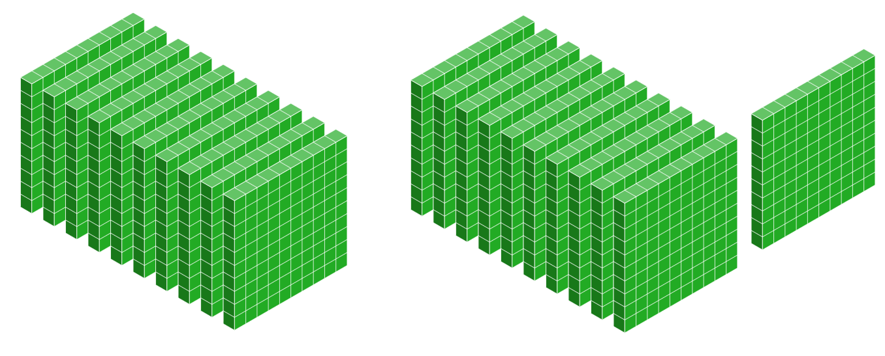
Worked example 2
Second converting decimals to fractions
$2.1=\frac{21}{10}$ or 21 tenths

Slide 7
Worked example 2 – part 2
Second converting decimals to fractions
How does the number of decimal places relate to the fraction?
$2.1=\frac{21}{10}$ or 21 tenths
Why is the second diagram better?

Slide 8
Your turn 2
Second converting decimals to fractions
$$0.042=$$

Slide 9
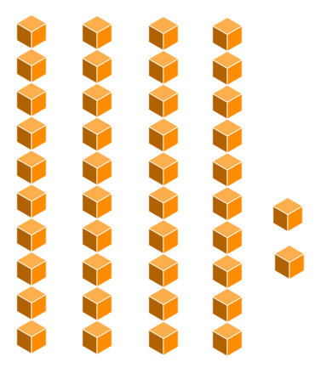
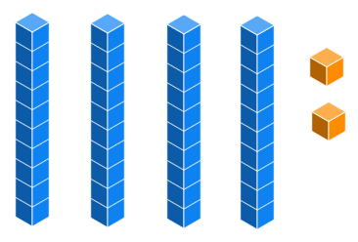
Solutions 2
Your turn
$0.042=\frac{42}{1000}$ or 42 thousandths

Slide 10
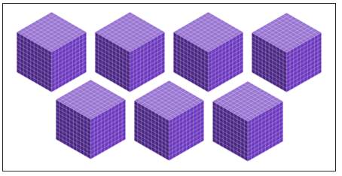
Worked example 3
Converting integers to fractions
$$7=\frac{7}{1}$$
7 “ones”

Slide 11
Prompts 3
Converting integers to fractions – Self explanation prompts
$$7=\frac{7}{1}$$
7 “ones”
How does the process for converting whole numbers to fractions relate to the process for converting decimals to fractions?

Slide 12
Your turn 3
Convert integers to fractions
$$21=$$

Slide 13
Solutions 3
Your turn
$$21=\frac{21}{1}$$

Slide 14
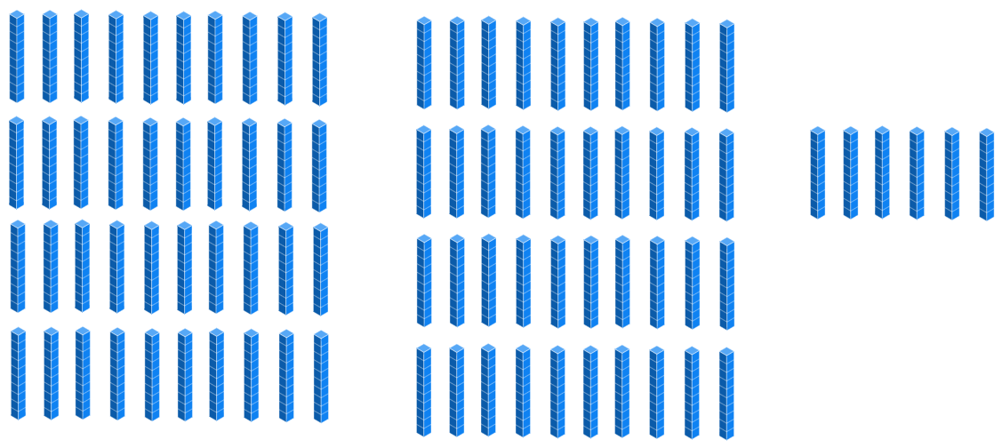
Worked example 4
Converting percentages to fractions
$86\%=\frac{86}{100}$ 86 hundredths

Slide 15
Prompts 4
Converting percentages to fractions
$86\%=\frac{86}{100}$ 86 hundredths
Why does a percentage have a denominator of 100?
What would need to happen for a percentage to be equal to a whole?

Slide 16
Your turn 4
Convert percentages to fractions
$$49\%=$$

Slide 17
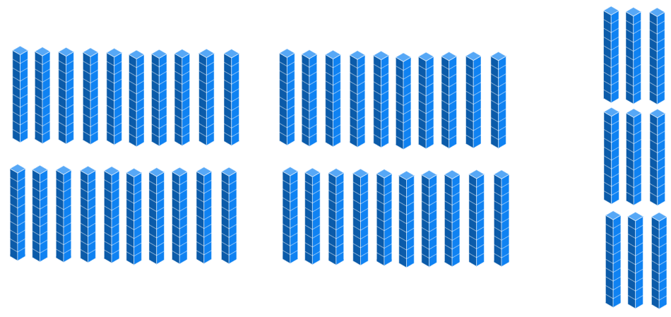
Solutions 4
Your turn
$$49\%=\frac{49}{100}$$

Slide 18
Worked examples 5
Expressing recurring decimals
Express this recurring decimal using a vinculum.
$$0.4444…=0.\dot{4}$$

Slide 19
Prompts 5
Expressing recurring decimals
Express this recurring decimal using a vinculum.
What is a vinculum?
$$0.4444…=0.\dot{4}$$
Why is it better to write a recurring decimal this way?

Slide 20
Your turn 5
Expressing recurring decimals
Express this recurring decimal using a vinculum.
$$0.8888…=$$

Slide 21
Solutions 5
Your turn
Express this recurring decimal using a vinculum.
$$0.8888…=0.\dot{8}$$

Slide 22
Worked examples 6
Expressing further recurring decimals
Express this recurring decimal using a vinculum.
$$0.171717…=0.\overline{17}$$

Slide 23
Prompts 6
Expressing further recurring decimals
Express this recurring decimal using a vinculum.
$$0.171717…=0.\overline{17}$$
What does it mean when two digits are under this bar?
How is this vinculum different?

Slide 24
Your turn 6
Expressing further recurring decimals
Express this recurring decimal using a vinculum.
$$1.312312312…=$$

Slide 25
Solutions 6
Your turn
Express this recurring decimal using a vinculum.
$$1.312312312…=1.\overline{312}$$

Slide 26
Worked examples7
Expressing complex recurring decimals
Express this recurring decimal using a vinculum.
$$2.744444…=2.7\dot{4}$$

Slide 27
Prompts 7
Expressing complex recurring decimals
Express this recurring decimal using a vinculum.
$$2.744444…=2.7\dot{4}$$
How do you know this doesn’t mean 2.747474…?
Could a number have a vinculum to the LEFT of the decimal point?

Slide 28
Your turn 7
Expressing complex recurring decimals
Express this recurring decimal using a vinculum.
$$5.75161616…=$$

Slide 29
Solutions 7
Your turn
Express this recurring decimal using a vinculum.
$$5.75161616…=5.75\overline{16}$$

