Slide 1
Approximate measurements
Explicit teaching

Slide 2
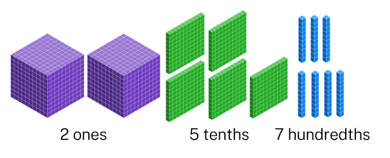
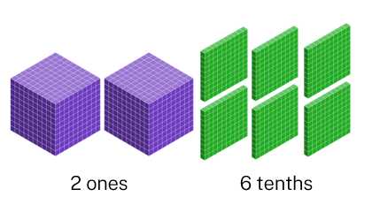
Worked example 1 – part 1
Rounding decimals to tenths
2.57 kilometres $≈$ 2.6 kilometres
5 or more
is closest to

Slide 3
Worked example 1 – part 2
Rounding decimals to tenths
Why did the tenths get larger?
2.57 kilometres $≈$ 2.6 kilometres
Why is “5 or more” important?
5 or more
is closest to
Where did this extra tenth come from?

Slide 4
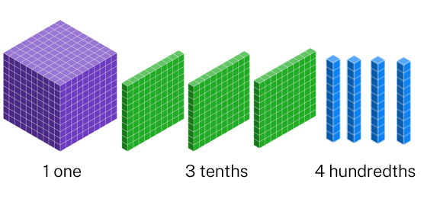
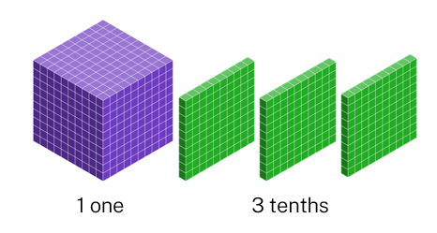
Worked example 2 – part 1
Rounding decimals to tenths
1.34 seconds $≈$ 1.3 seconds
Less than 5
is closest to

Slide 5
Worked example 2 – part 2
Rounding decimals to tenths
Why didn’t the tenths get larger?
1.34 seconds $≈$ 1.3 seconds
Why is “less than 5” important?
Less than 5
is closest to
Where did these hundredths go?

Slide 6
Your turn – example 1
Rounding decimals to tenths
Round 3.89 kilograms to the nearest tenth 3.89 kg $≈$ 3.9 kg

Slide 7
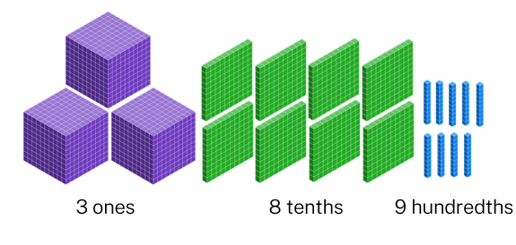
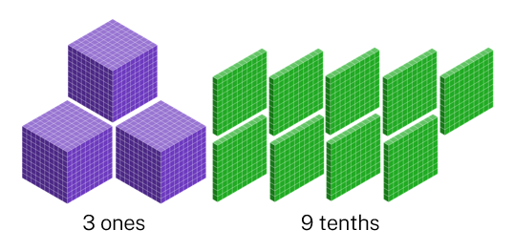
Your turn – example 1 – solutions
Your turn – Solution
Round 3.89 kilograms to the nearest tenth
5 or more
is closest to

Slide 8
Your turn – example 2
Your turn – Rounding decimals to tenths
Round 5.11 metres to the nearest tenth

Slide 9
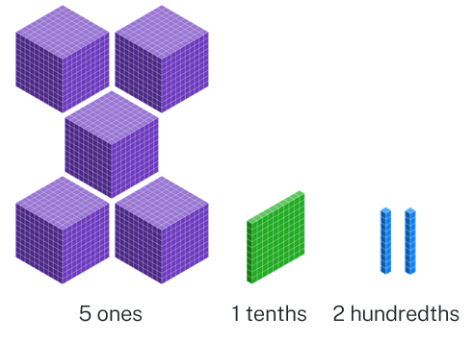
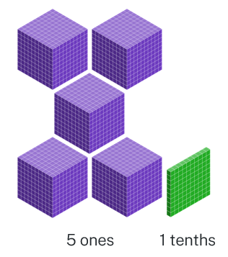
Your turn – example 2 – solutions
Your turn – Solutions
Round 5.12 metres to the nearest tenth 5.12 m $≈$ 5.1 m
Less than 5
is closest to

