Slide 1
Inventing units of measurement
Explicit teaching

Slide 2
Launch 1
No units of measurement
We are living in a world without units of measurement. How can you describe how long your hand is?

Slide 3
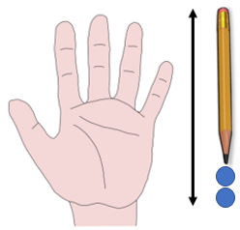
Launch 2
Measuring your hand
Why wouldn’t you say your hand is one pencil and two smarties long?

Slide 4
Explore 1
Measuring strip 1
Name your unit of measurement. Your strip of paper is 2 units long.

Slide 5
Explore 2
Measuring strip 2
Fold your paper in half to show where 1 unit of your measurement goes.

Slide 6
Explore 3
Measuring strip 3
Continue folding to get fractions when you need them.

Slide 7
Explore 4
What has happened to the paper to make one half become two quarters?
Measuring strip 4

Slide 8
Explore 5
How do we need to divide our strip of paper to get the measurements we are familiar with?
Comparing with a ruler

Slide 9
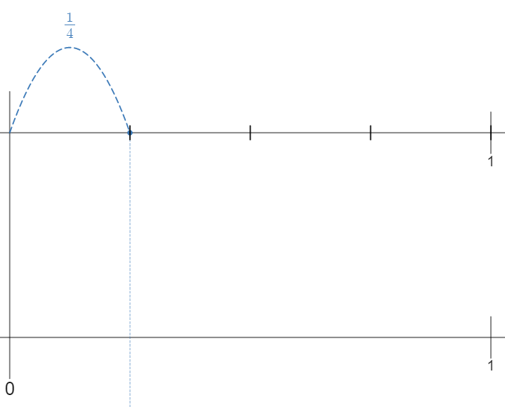
Summarise 1
Fractions to decimals 1
How do we need to divide the number line to get tenths?

Slide 10
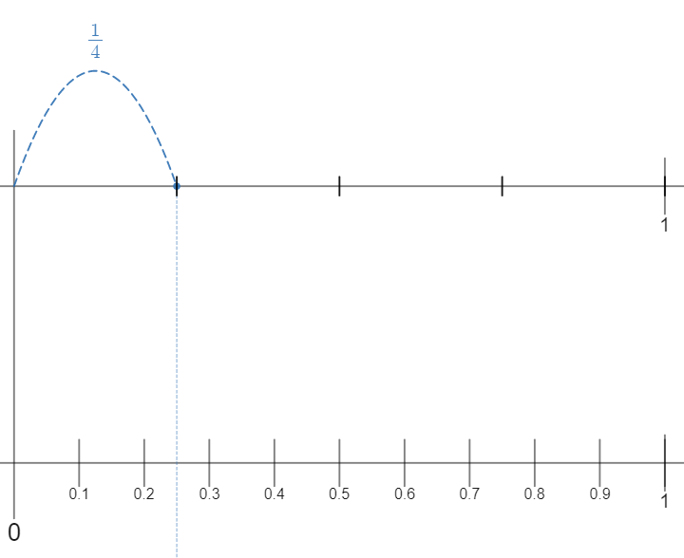
Summarise 2
Fractions to decimals 2
Can tenths be used to describe $\frac{1}{4}$?

Slide 11
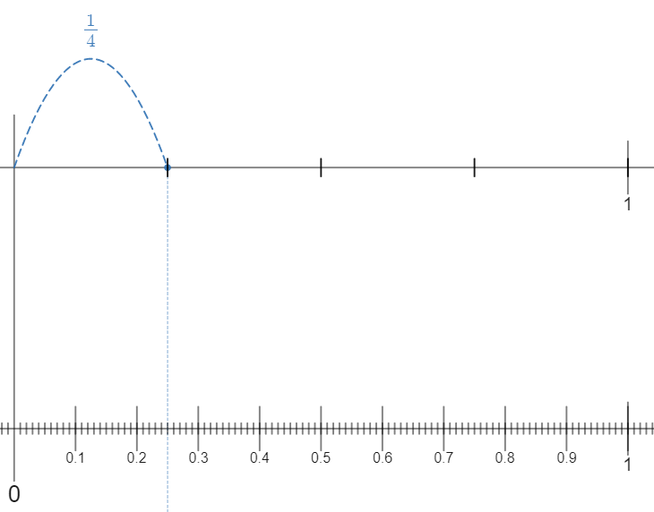
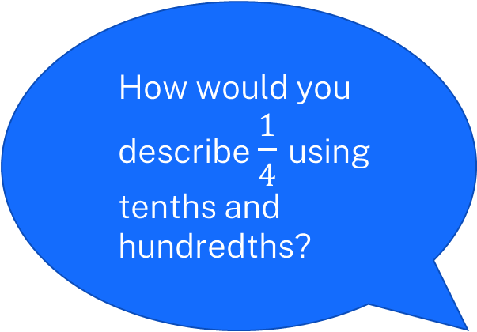
Summarise 3
Fractions to decimals 3
How would you describe $\frac{1}{4}$ using tenths and hundredths?

Slide 12
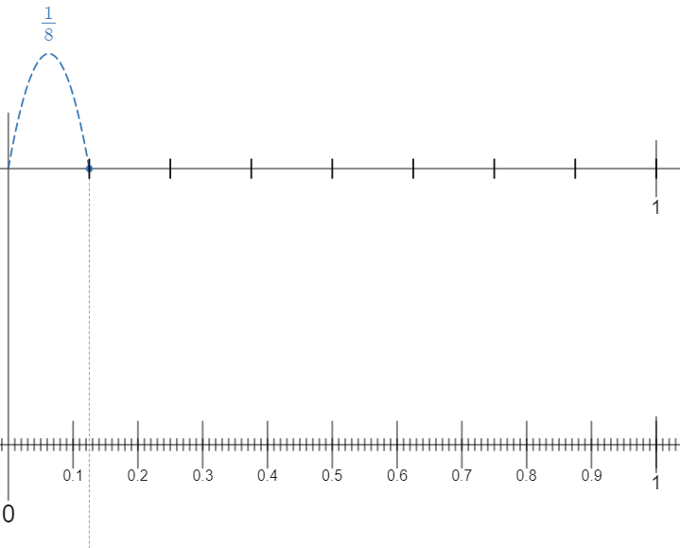
Summarise 4
Fractions to decimals 4
Are we able to use hundredths to describe $\frac{1}{8}$? Can we show the thousandths visually?

