Slide 1
Recipe for success
Explicit teaching

Slide 2
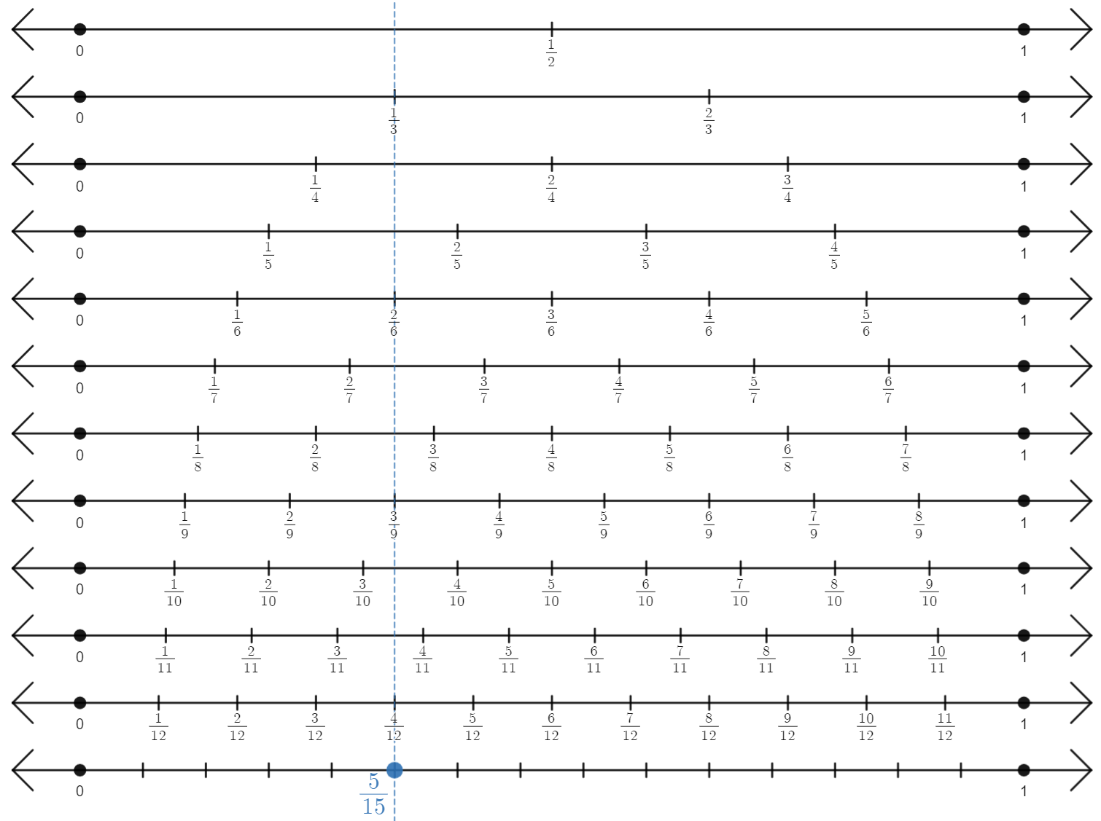
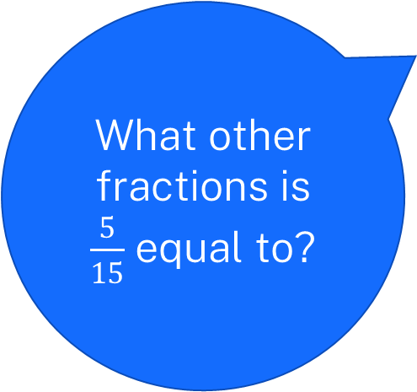
Summarise (1)
Fraction wall 1
What other fractions is $\frac{5}{15}$ equal to?
2

Slide 3
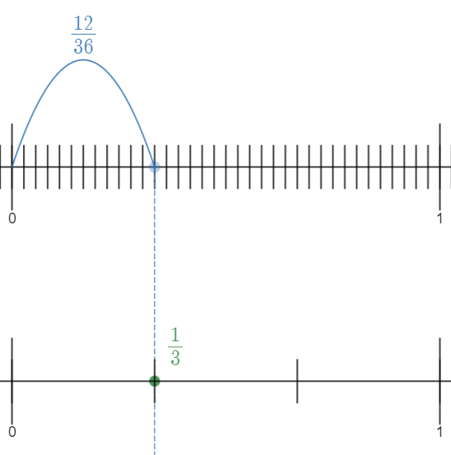
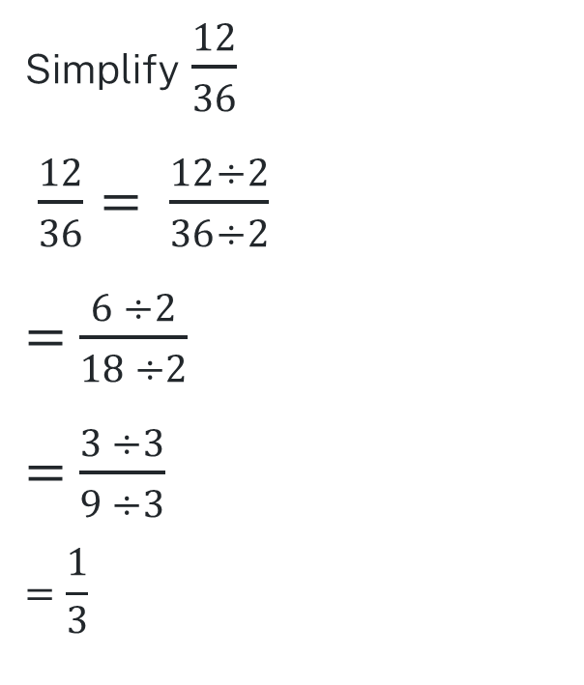
Example 1
Simplifying fractions repeatedly using common factors
Simplify $\frac{12}{36}$
$\frac{12}{36}= \frac{12÷2}{36÷2}$
$=$ $\frac{6 ÷2}{18 ÷2}$
$=$ $\frac{3 ÷3}{9 ÷3}$
$$=\frac{1}{3}$$
3

Slide 4
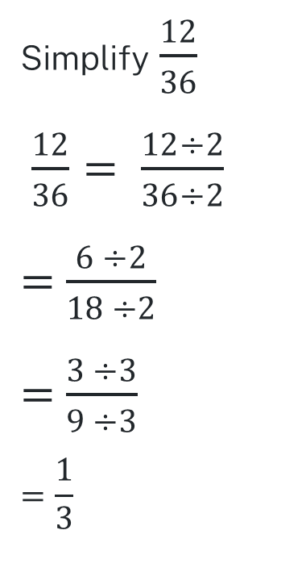
Prompts 1
Simplifying fractions repeatedly using common factors
Why are we dividing both the numerator and denominator by 2?
Simplify $\frac{12}{36}$
$\frac{12}{36}= \frac{12÷2}{36÷2}$
$=$ $\frac{6 ÷2}{18 ÷2}$
$=$ $\frac{3 ÷3}{9 ÷3}$
$$=\frac{1}{3}$$
Why don’t we divide by 2 a third time?
How do the number lines relate to this working?
4

Slide 5
Your turn 1
Simplifying fractions repeatedly using common factors
Simplify $\frac{4}{20}$
5

Slide 6
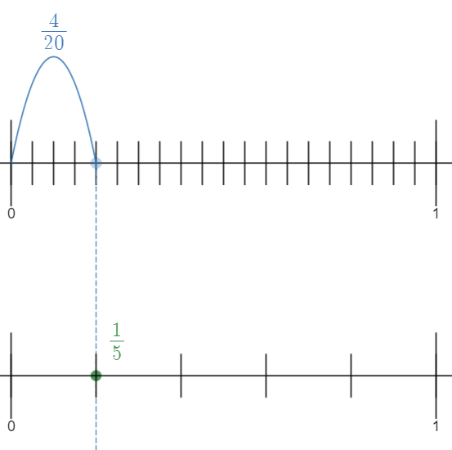
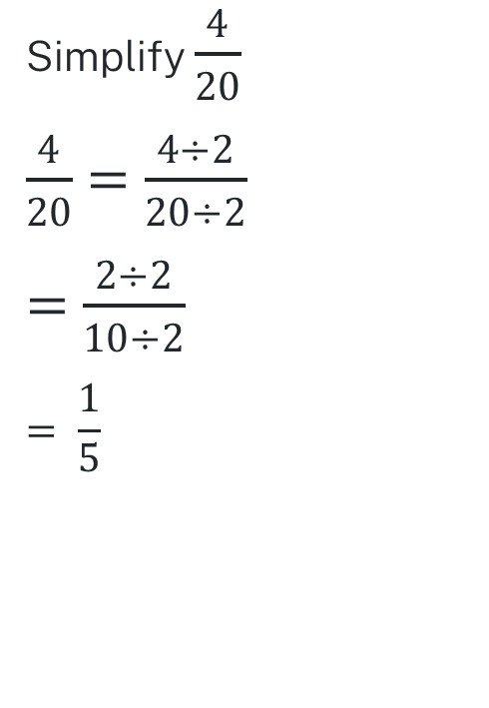
Solutions 1
Your turn solutions – Simplifying fractions repeatedly using common factors
Simplify $\frac{4}{20}$
$\frac{4}{20}$ $=$ $\frac{4÷2}{20÷2}$
$=$ $\frac{2÷2}{10÷2}$
$$= \frac{1}{5}$$
6

Slide 7
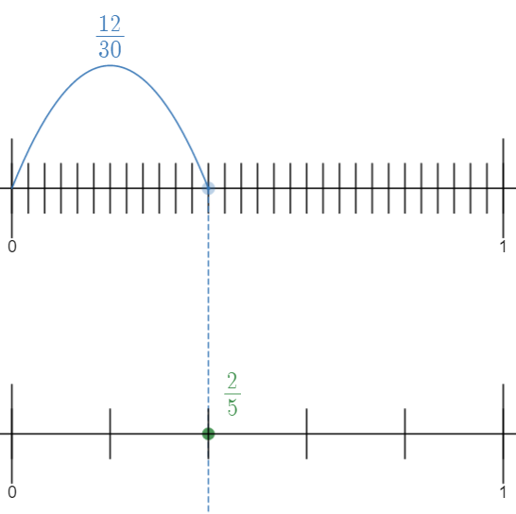
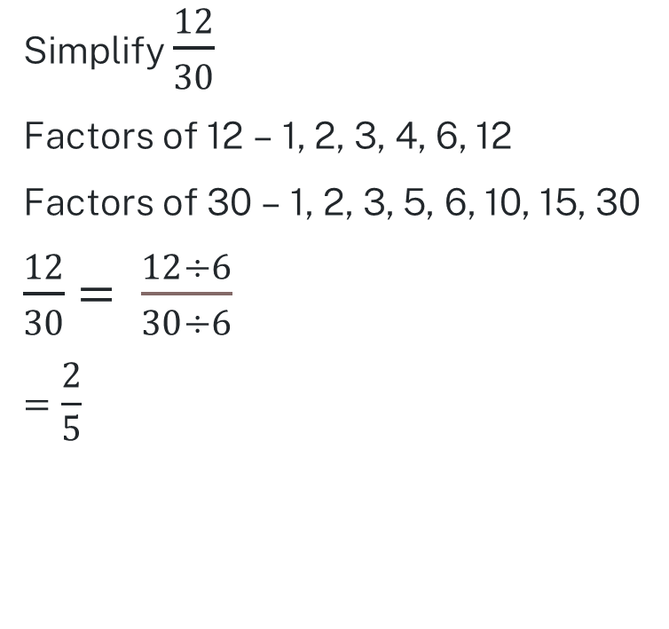
Example 2
Simplifying fractions by using the highest common factor
Simplify $\frac{12}{30}$
Factors of 12 – 1, 2, 3, 4, 6, 12
Factors of 30 – 1, 2, 3, 5, 6, 10, 15, 30
$\frac{12}{30}$ $= \frac{12÷6}{30÷6}$
$$=\frac{2}{5}$$
7

Slide 8
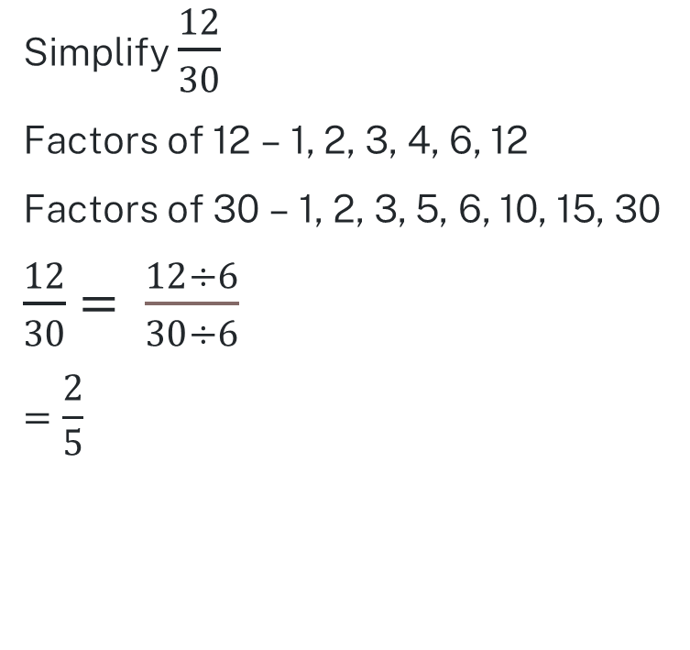
Prompts 2
Simplifying fractions by using the highest common factor
Why is 6 circled?
Simplify $\frac{12}{30}$
Factors of 12 – 1, 2, 3, 4, 6, 12
Factors of 30 – 1, 2, 3, 5, 6, 10, 15, 30
$\frac{12}{30}$ $= \frac{12÷6}{30÷6}$
$$=\frac{2}{5}$$
How does dividing by 6 help us simplify the fraction?
How do the number lines relate to this working?
8

Slide 9
Your turn 2
Simplifying fractions by using the highest common factor
Simplify $\frac{40}{56}$
9

Slide 10
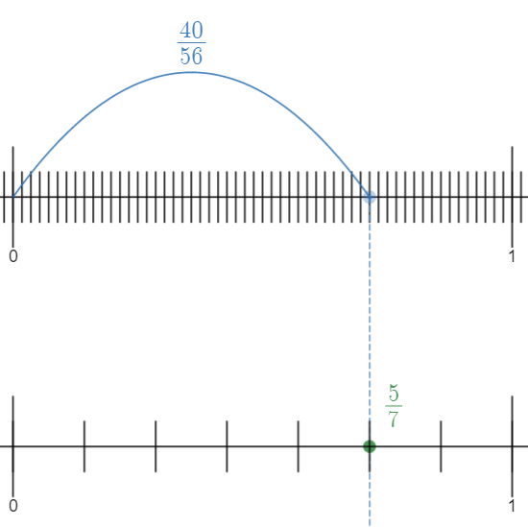
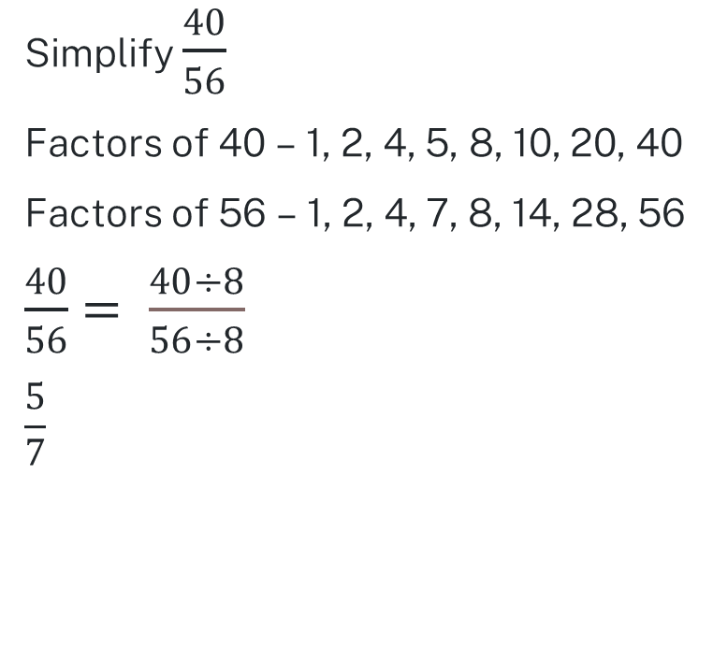
Solutions 2
Your turn solutions – Simplifying fractions by using the highest common factor
Simplify $\frac{40}{56}$
Factors of 40 – 1, 2, 4, 5, 8, 10, 20, 40
Factors of 56 – 1, 2, 4, 7, 8, 14, 28, 56
$\frac{40}{56}$ $= \frac{40÷8}{56÷8}$
$$\frac{5}{7}$$
10

