Slide 1
Celebraciones
Celebrations
NSW Department of Education

Slide 2
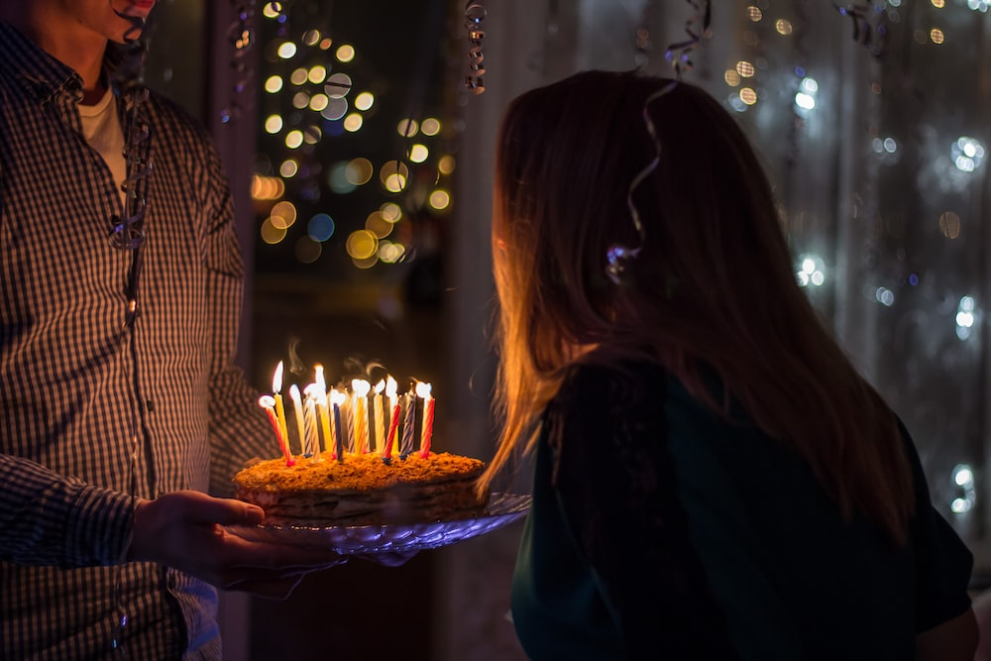
El cumpleaños
Notes:
el cumpleaños: birthday

Slide 3
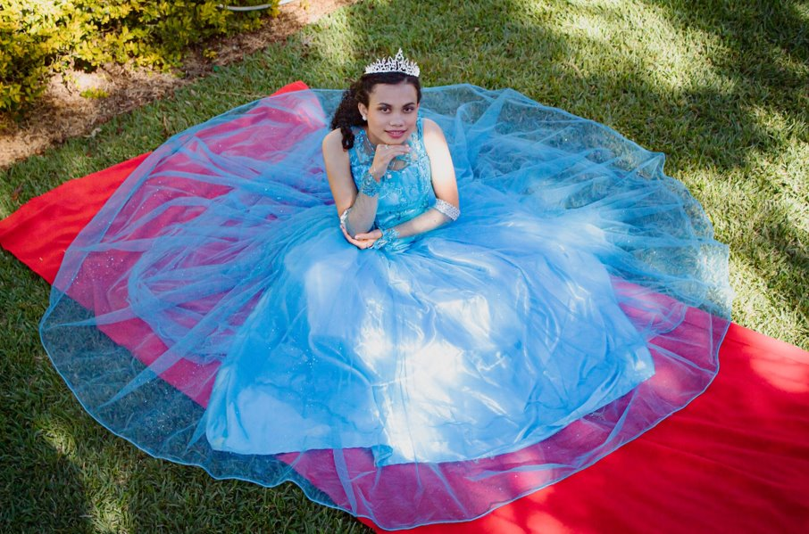
La quinceañera
Notes:
la quinceañera: a girl’s 15th birthday
This celebration marks a girl’s passage to womanhood.

Slide 4
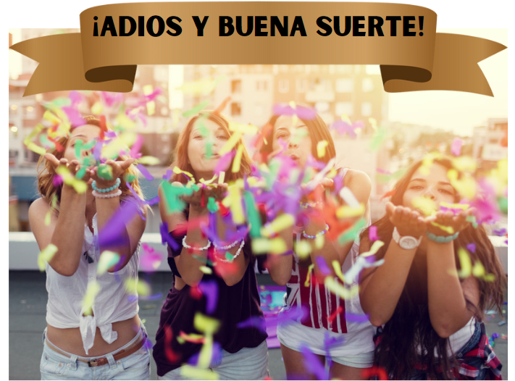
La fiesta de despedida
Notes:
la fiesta de despedida: farewell party

Slide 5
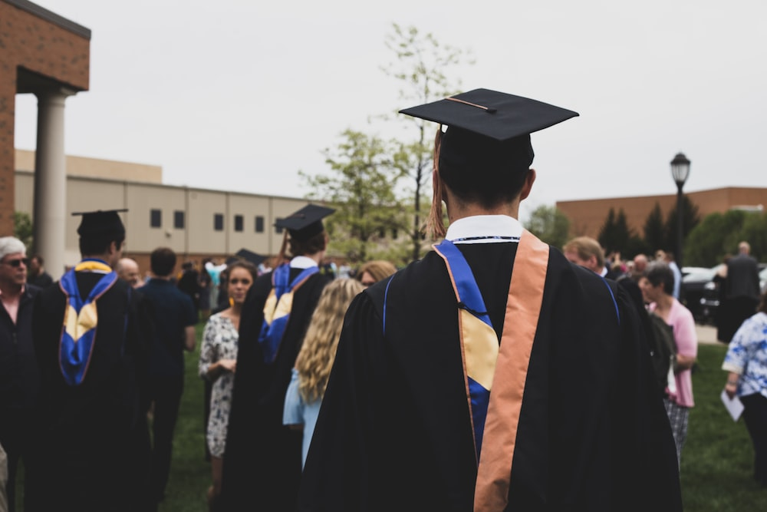
La graduación
Notes:
la graduación: graduation

Slide 6
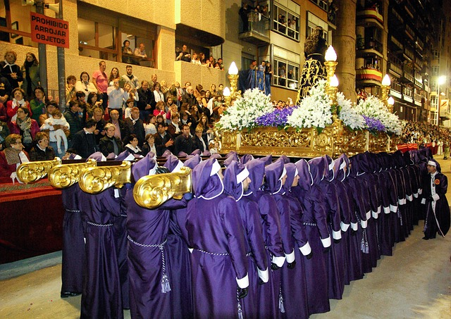
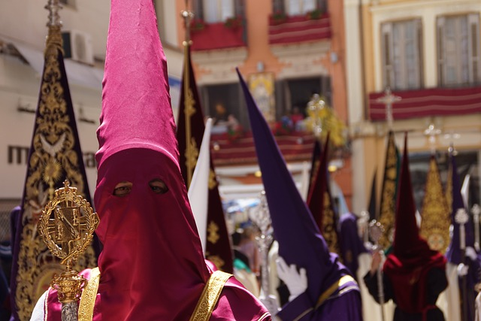
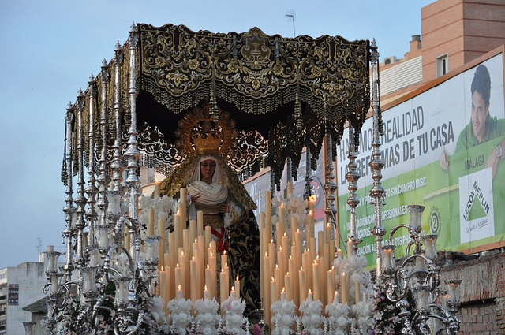
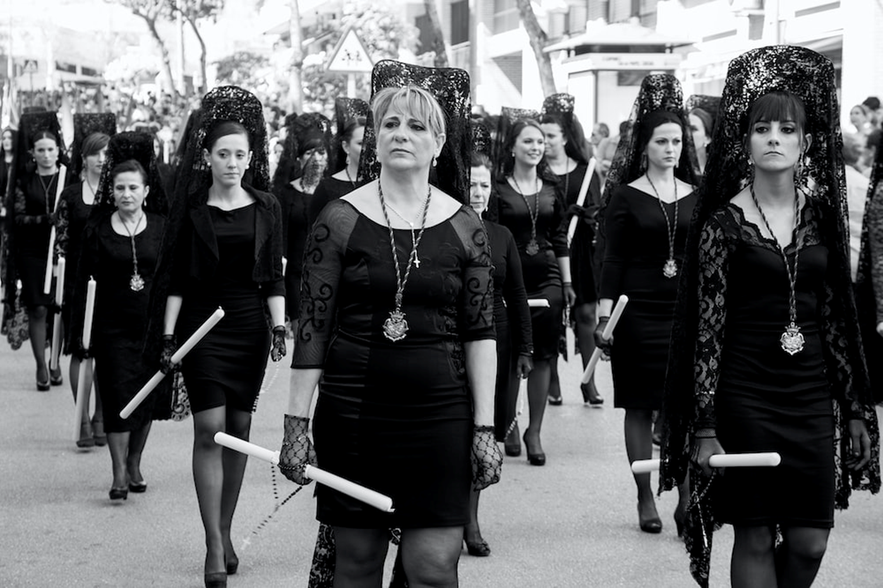
La Semana Santa y Pascua
Notes:
La Semana Santa y Pascua: Holy Week and Easter
The Holy Week processions are celebrated with great excitement in Spain and many Spanish-speaking countries. Day and night, the streets become spaces where music, flowers, and the art of religious sculptures blend together, creating a moving scene.

Slide 7
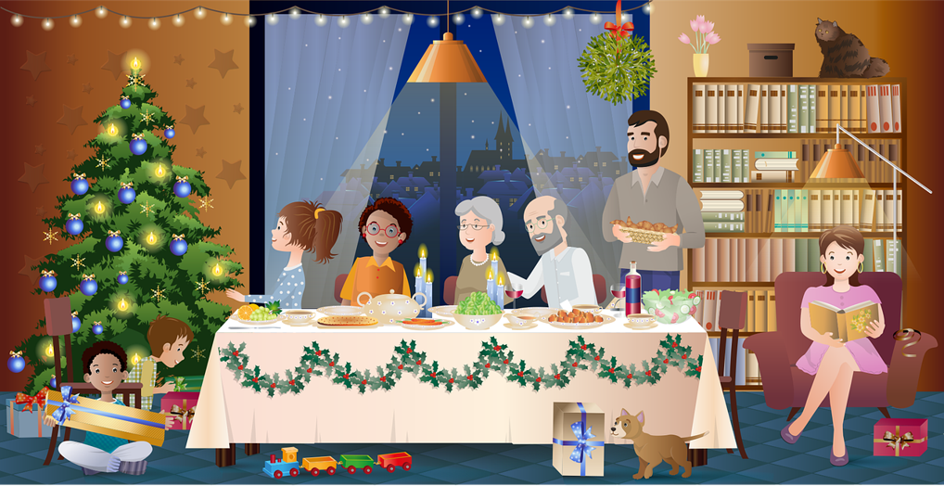
La Noche Buena
Notes:
La Noche Buena: Christmas Eve

Slide 8
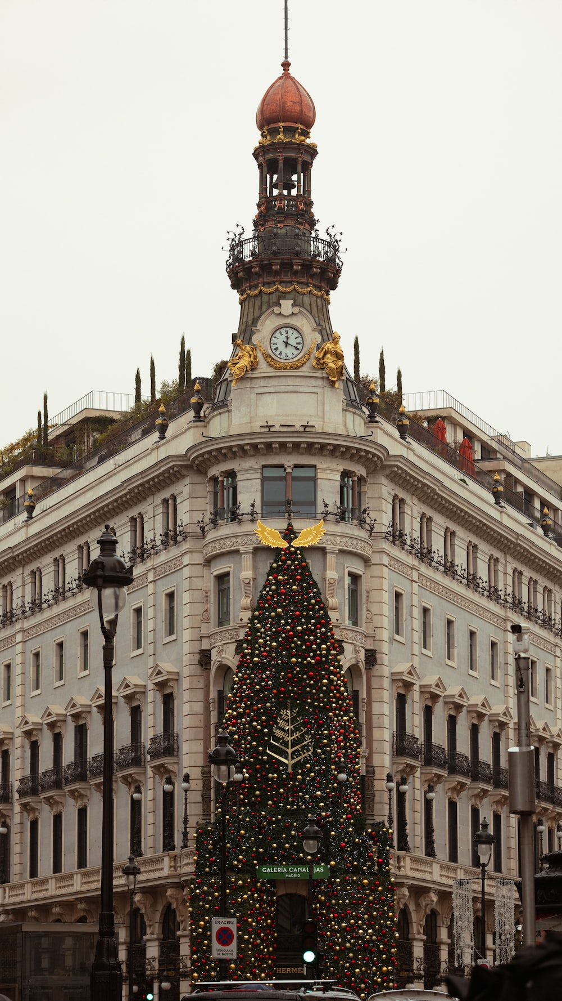
La Navidad
Notes:
La Navidad: Christmas

Slide 9
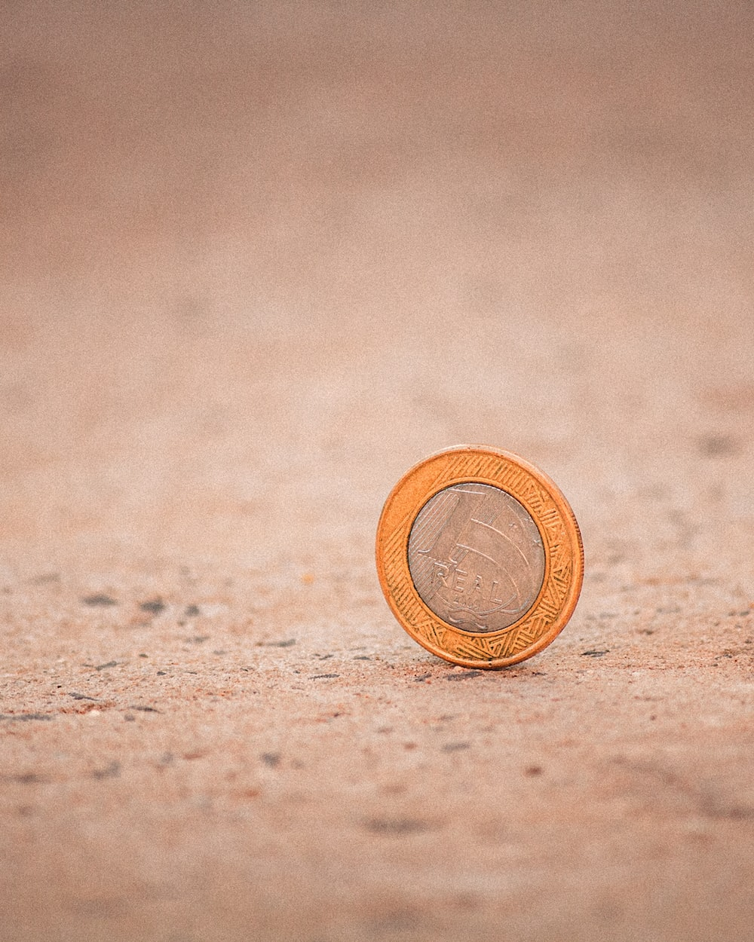
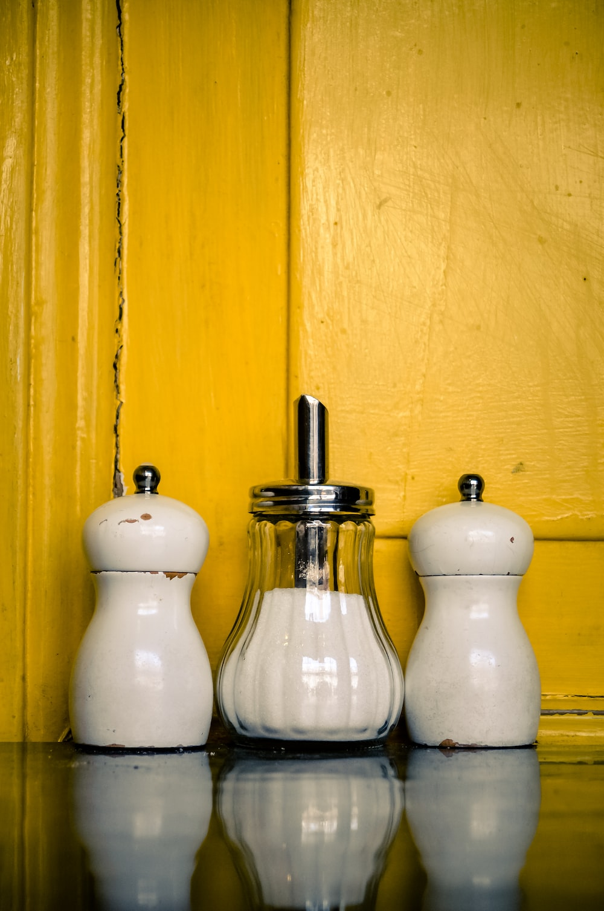
El Día de los Santos Inocentes
Notes:
El Día de los Santos Inocentes: April Fool’s Day equivalent, which takes place on 28 December

Slide 10
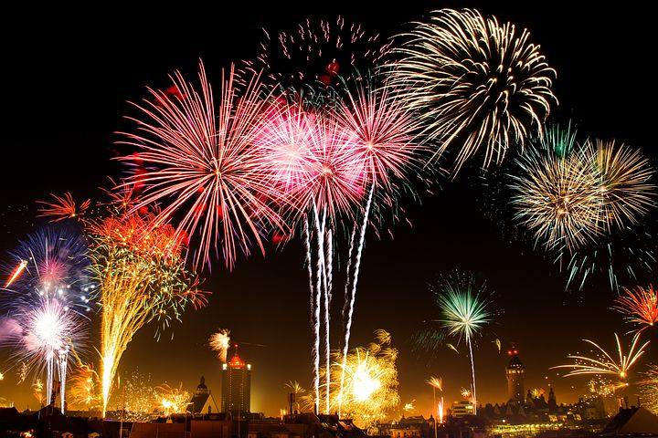
La Noche Vieja
Notes:
La Noche Vieja: New Year's Eve

Slide 11
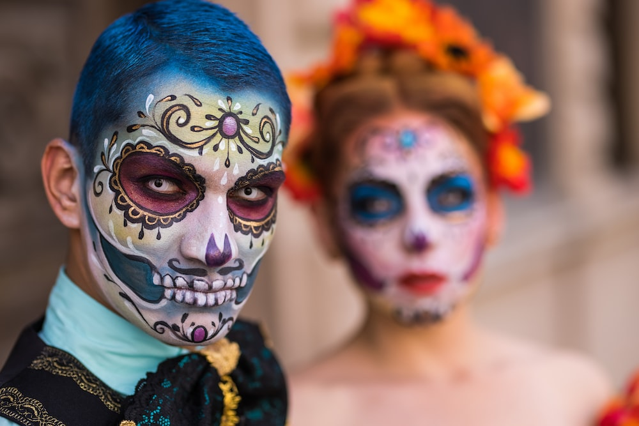
El Día de los Muertos
Notes:
El Día de los Muertos: Day of the Dead, 1 and 2 November
The Day of the Dead is a Mexican tradition honouring the memory of the deceased.

Slide 12
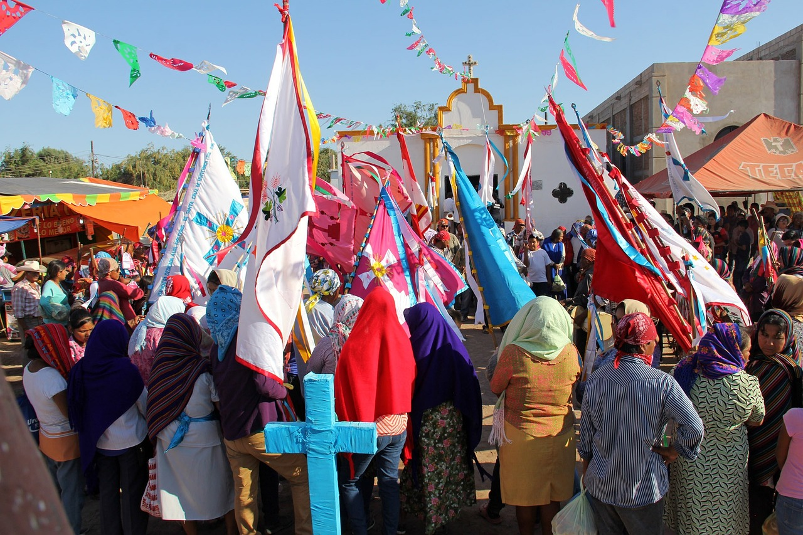
El Cinco de Mayo
Notes:
El Cinco de Mayo: 5 May
Celebrates Mexican victory over the French in 1862.

Slide 13
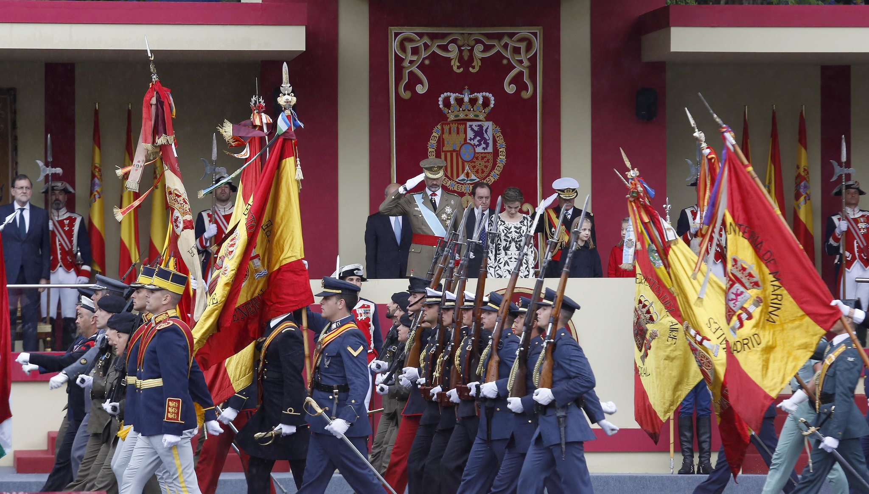
La Fiesta Nacional/El Día de la Hispanidad
Notes:
La Fiesta Nacional/El Día de la Hispanidad: The National Day of Spain
Held on 12 October, this day recognises the Spanish Empire and the colonisation of the Americas.
It is also referred to as the Day of Hispanicity.

Slide 14
Copyright
© State of New South Wales (Department of Education), 2023
The copyright material published in this resource is subject to the Copyright Act 1968 (Cth) and is owned by the NSW Department of Education or, where indicated, by a party other than the NSW Department of Education (third-party material).
Copyright material available in this resource and owned by the NSW Department of Education is licensed under a Creative Commons Attribution 4.0 International (CC BY 4.0) licence.
This licence allows you to share and adapt the material for any purpose, even commercially.
Attribution should be given to © State of New South Wales (Department of Education), 2023.
Material in this resource not available under a Creative Commons licence:
the NSW Department of Education logo, other logos and trademark-protected material
images obtained from Unsplash.com. See the website for usage terms and conditions.
Material owned by a third party that has been reproduced with permission. You will need to obtain permission from the third party to reuse its material.
Links to third-party material and websites
Please note that the provided (reading/viewing material/list/links/texts) are a suggestion only and implies no endorsement, by the New South Wales Department of Education, of any author, publisher, or book title. School principals and teachers are best placed to assess the suitability of resources that would complement the curriculum and reflect the needs and interests of their students.
If you use the links provided in this document to access a third party’s website, you acknowledge that the terms of use, including licence terms set out on the third-party’s website apply to the use which may be made of the materials on that third-party website or where permitted by the Copyright Act 1968 (Cth). The department accepts no responsibility for content on third-party websites.

Slide 15
© State of New South Wales (Department of Education) 2023

