Slide 1
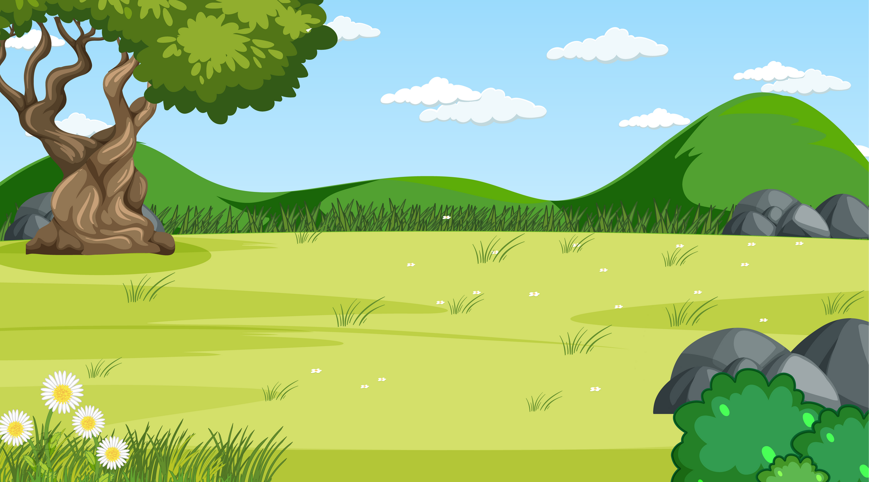
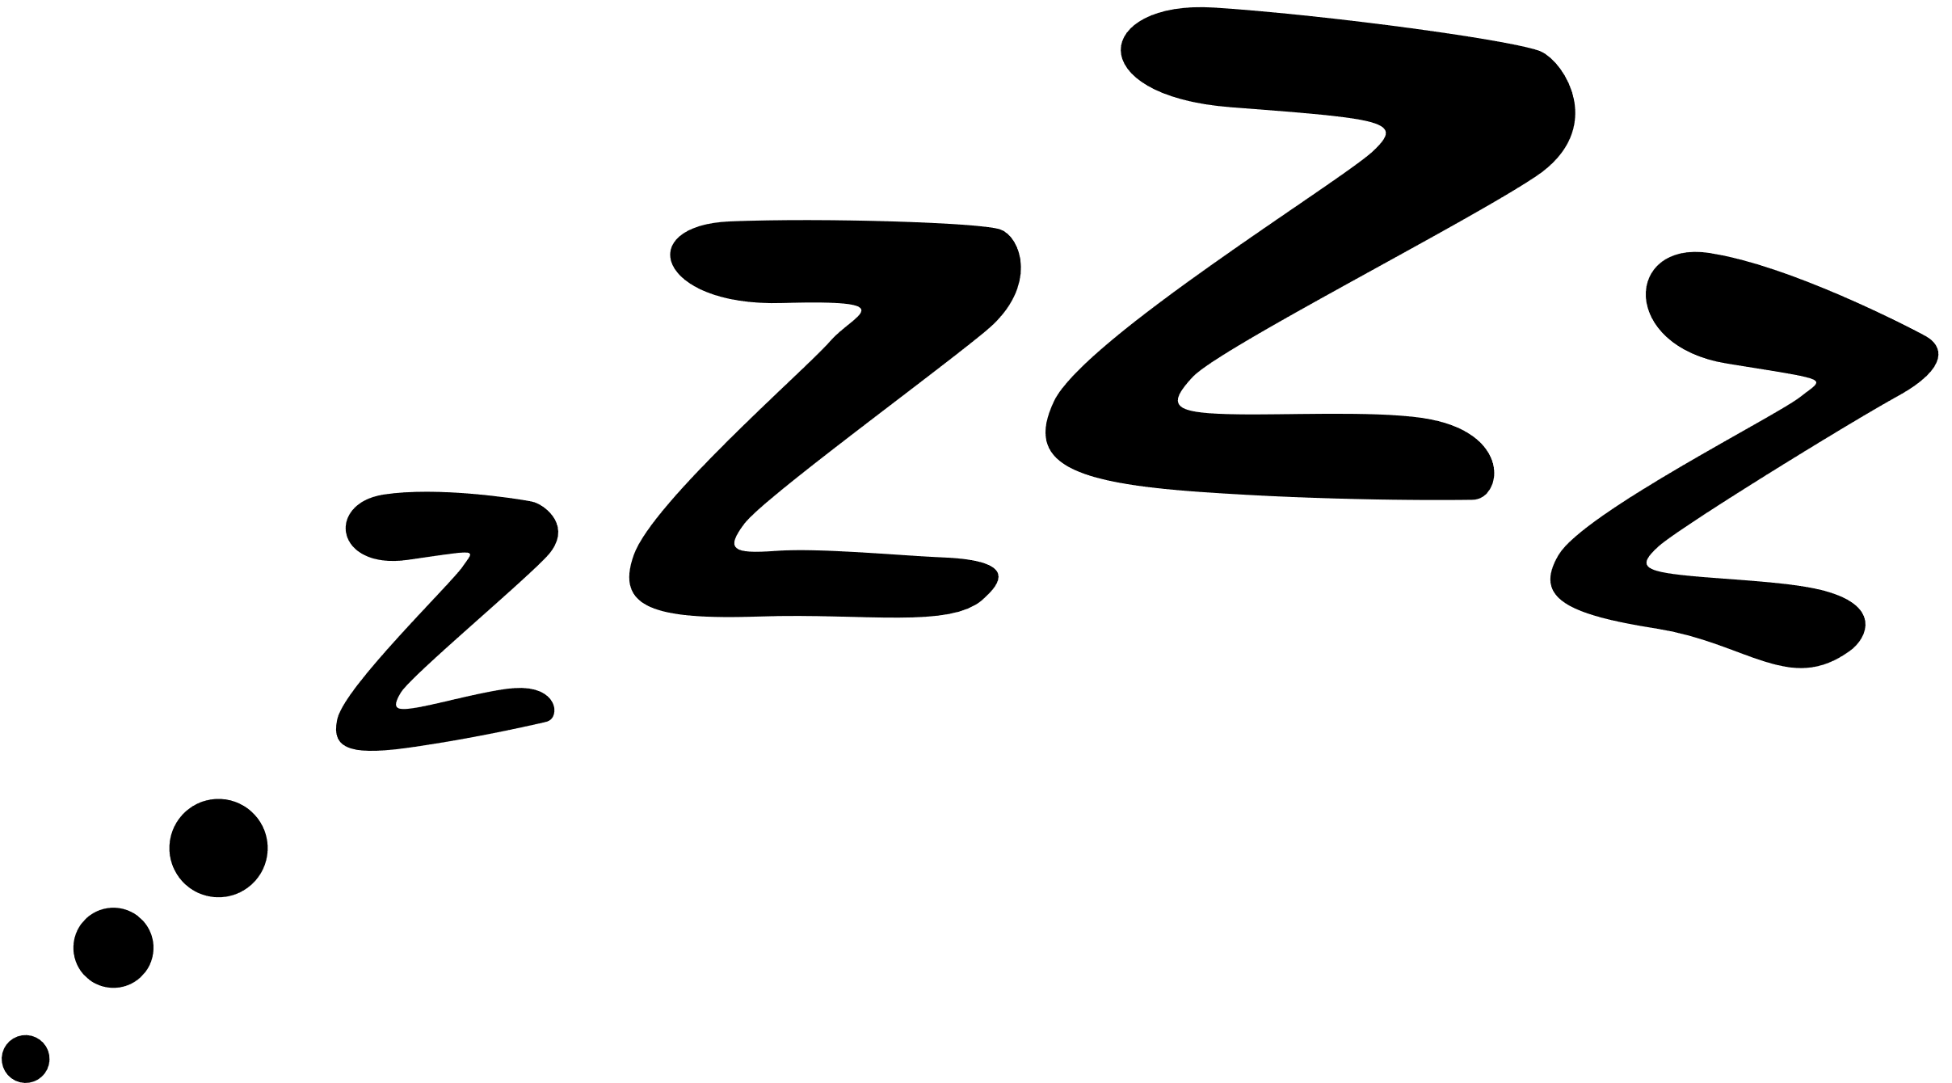
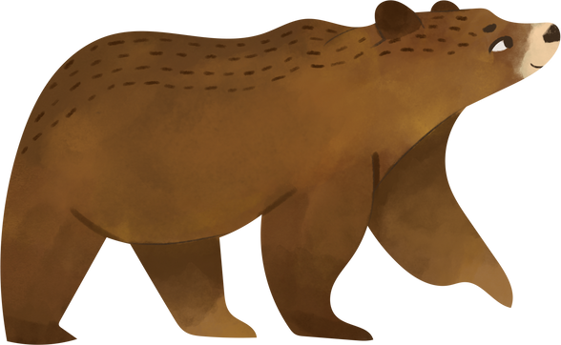
The sleepy bear

Slide 2
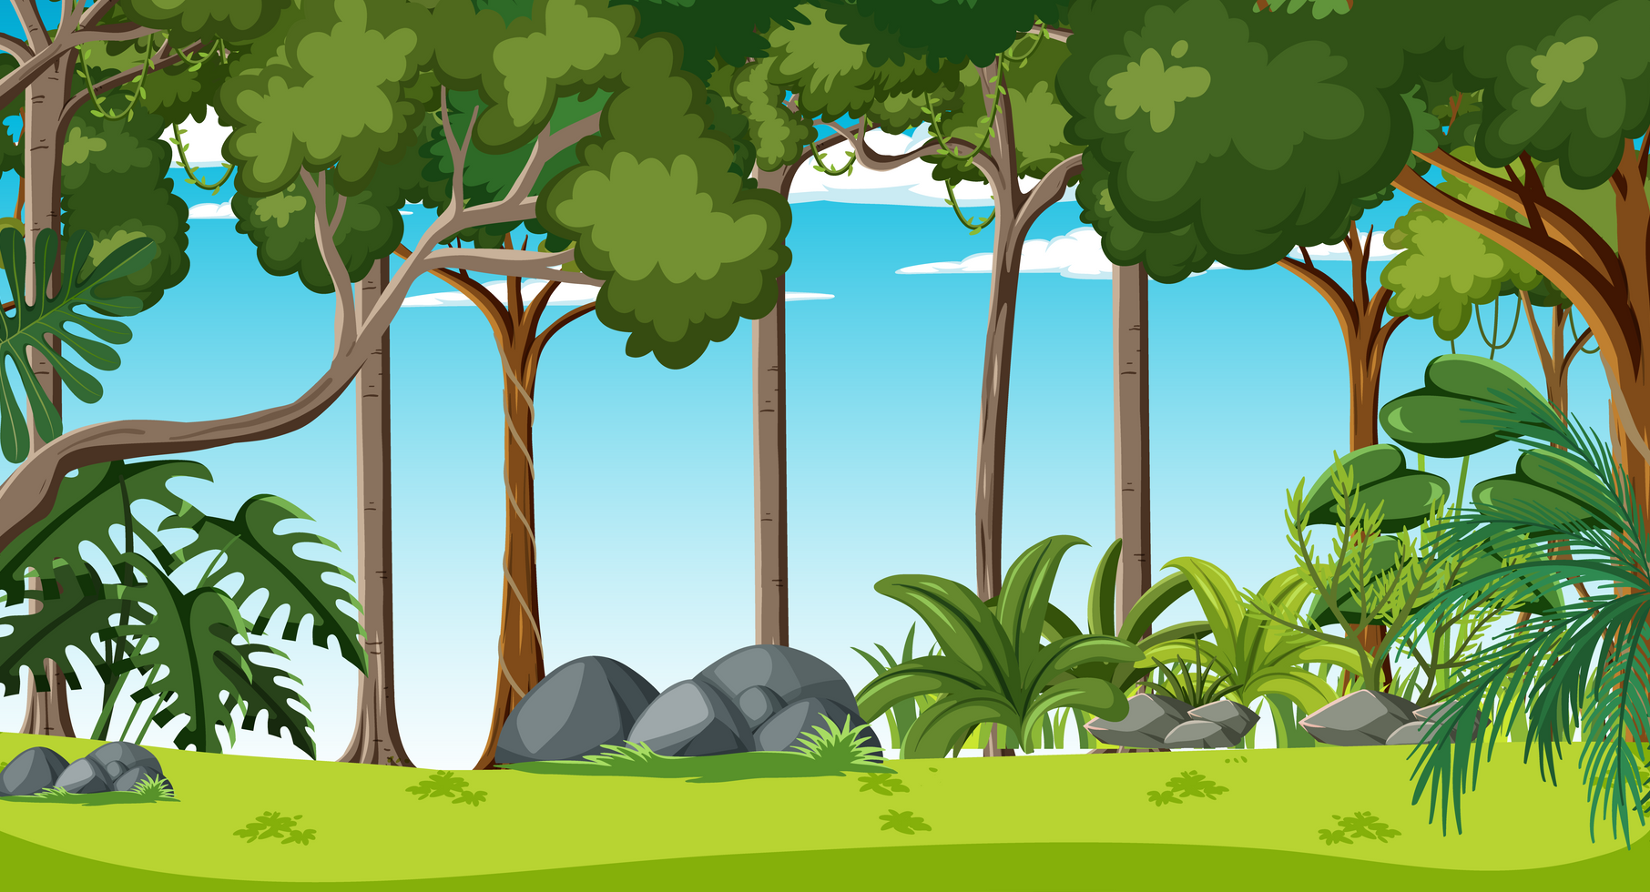
Nearly winter
It's nearly winter and Bruno the bear is sleepy. He needs to find some food before he goes to sleep for the winter.

Slide 3
Honey
On Monday, Bruno finds one golden pot of honey.

Slide 4
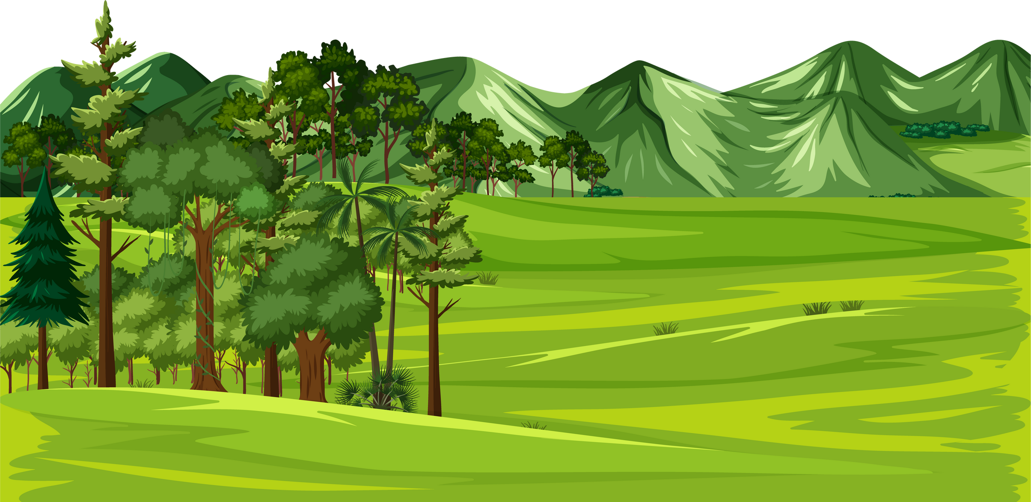
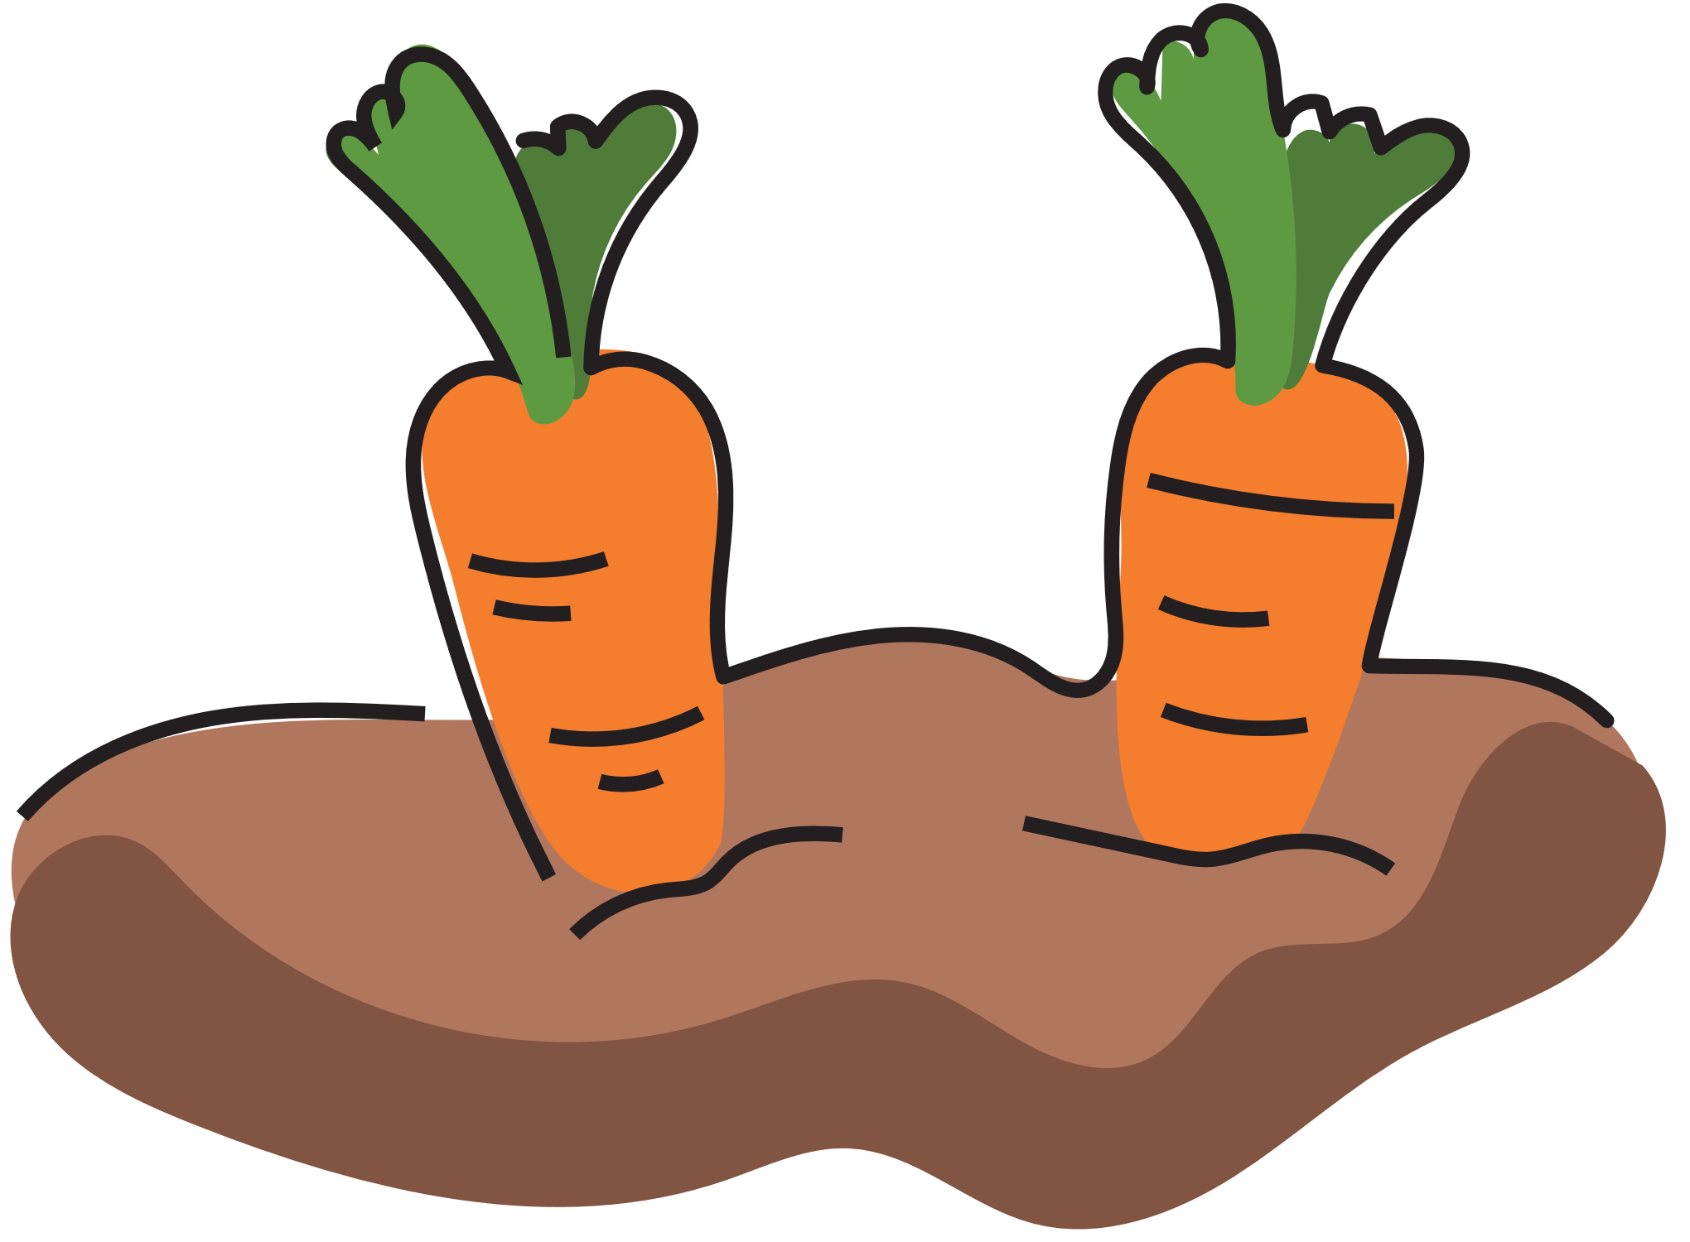
Carrots
On Tuesday, Bruno finds 2 orange carrots.

Slide 5
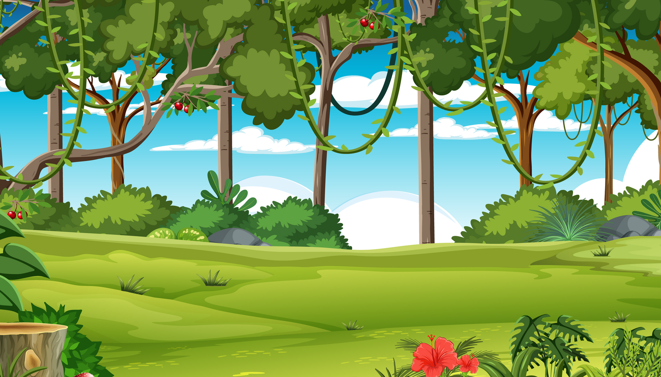
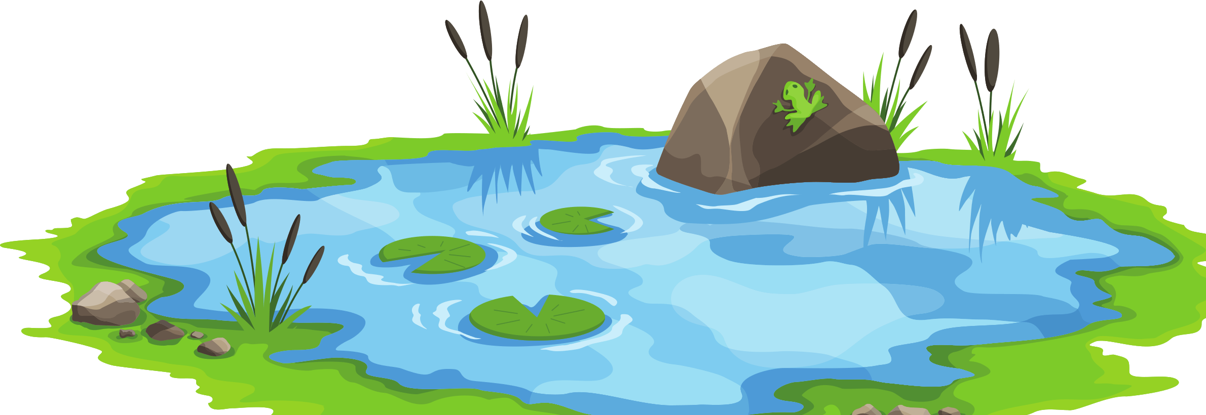
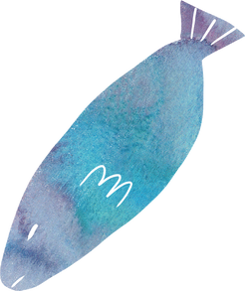
Silver fish
On Wednesday, Bruno finds three silver fish.

Slide 6
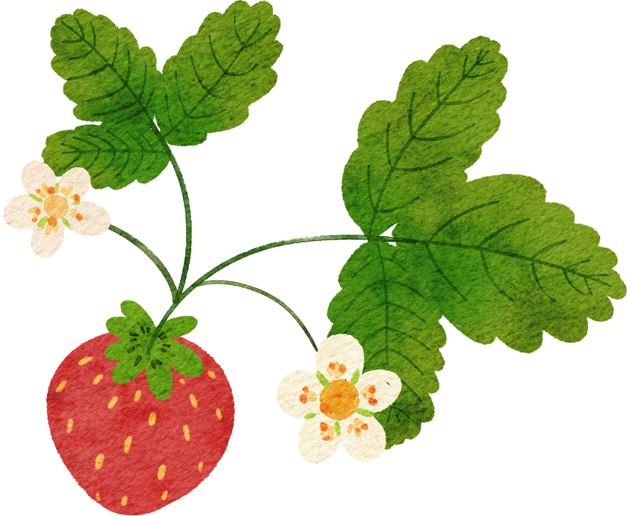
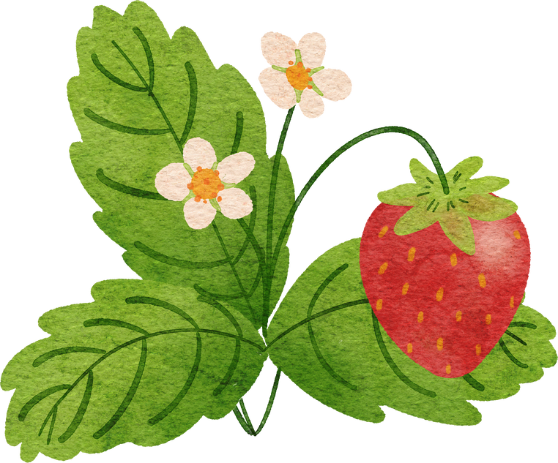
Strawberries
On Thursday, Bruno finds 4 red strawberries.

Slide 7
Cakes
What does Bruno find on Friday?
Sample response: Bruno finds five delicious cakes.

Slide 8
Sleeping in Winter
Where does Bruno sleep for winter?
Sample response: Bruno sleeps in a cave for winter

Slide 9
© State of New South Wales (Department of Education) 2023

