Slide 1
Open Your Heart to Country
By Jasmine Seymour
Annotated extracts
Notes:
Jasmine Seymour (2022). ‘Open Your Heart to Country’. Only reproduced as extracts and made available for copying and communication by NSW Department of Education for its educational purposes. This has been made possible as permission has been granted by Jasmine Seymour. This resource is licensed up until May 2026.

Slide 2
Extract 1 (a) 1
Extract 1 (a)
Symbolism of ghost gums
Notes:
The use of the ghost gums reminds responders of the spiritual connection to Country and elders.

Slide 3
Extract 1 (a) 2
Extract 1 (a)
Symbolism of ghost gums
Names of the author’s family
Notes:
Lineage is represented through the names of Dharug family from Yarramundi through to the author, Jasmine Seymour.

Slide 4
Extract 1 (a) 3
Extract 1 (a)
Connotation of word ‘soothe’
Symbolism of ghost gums
Names of the author’s family
Notes:
Connotation of word ‘soothe’ reflects the healing power of being on-Country.

Slide 5
Extract 1 (b) 1
Extract 1 (b)
Dharug language and English translation
Notes:
Dharug language and English translation – invites the reader to share in Dharug culture.

Slide 6
Extract 1 (b) 2
Extract 1 (b)
Dharug language and English translation
Contrasting colour – green and brown
Notes:
Dharug language and English translation – invites the reader to share in Dharug culture.
Contrasting colour – green and brown reflects the varying landscapes across country.

Slide 7
Extract 1 (b) 3
Extract 1 (b)
Dharug language and English translation
Symbolism of black cockatoos
Contrasting colour – green and brown
Notes:
Dharug language and English translation – invites the reader to share in Dharug culture.
Contrasting colour – green and brown reflects the varying landscapes across country.
Symbolism – black cockatoos are a Dharug totem.

Slide 8
Extract 1 (b) 4
Extract 1 (b)
Dharug language and English translation
Symbolism of black cockatoos
Contrasting colour – green and brown
Shadows of significant flora on-Country
Notes:
Dharug language and English translation – invites the reader to share in Dharug culture.
Contrasting colour – green and brown reflects the varying landscapes across country.
Symbolism – black cockatoos are a Dharug totem
Shadows of significant flora on Country – highlights the value of the land and the continuity of the relationship between the land and Aboriginal people.

Slide 9
Extract 2 (a) 1
Extract 2 (a)
Dharug language
Notes:
Dharug language – provides an alternate reading pathway. Readers can read the narrative of the text by following the Dharug language throughout.

Slide 10
Extract 2 (a) 2
Extract 2 (a)
Dharug language
Symbolism
Notes:
Dharug language – provides an alternate reading pathway. Readers can read the narrative of the text by following the Dharug language throughout.
Symbolism of the butterfly – another Dharug totem.

Slide 11
Extract 2 (b) 1
Extract 2 (b)
Symbolism of water
Notes:
Symbolism of water – the use of water here symbolises healing and sacred spaces of men’s and women’s business.

Slide 12
Extract 2 (b) 2
Extract 2 (b)
Symbolism of water
Connotation of ‘lost children’
Notes:
Symbolism of water – the use of water here symbolises healing and sacred spaces of men’s and women’s business.
Connotation of ‘lost children’ – evokes dispossession and the experiences of the Stolen Generation.

Slide 13
Extract 2 (b) 3
Extract 2 (b)
Symbolism of water
Connotation of ‘lost children’
Reference to songlines
Notes:
Symbolism of water – the use of water here symbolises healing and sacred spaces of men’s and women’s business.
Connotation of ‘lost children’ – evokes dispossession and the experiences of the Stolen Generation
Reference to songlines across country; songlines are the Aboriginal walking routes that crossed country, linking important sites and locations.

Slide 14
Extract 3 (a) 1
Extract 3 (a)
Symbolism of white cockatoo
Notes:
Symbolism of white cockatoo – totem of the Dharug.

Slide 15
Extract 3 (a) 2
Extract 3 (a)
Connotation of ‘far from home’
Symbolism of white cockatoo
Notes:
Symbolism of white cockatoo – totem of the Dharug
Connotation of ‘far from home’ – reference to the Stolen Generation living off-Country.

Slide 16
Extract 3 (a) 3
Extract 3 (a)
Connotation of ‘far from home’
Skin names
Symbolism of white cockatoo
Notes:
Symbolism of white cockatoo – totem of the Dharug
Connotation of ‘far from home’ – reference to the Stolen Generation living off-Country.
Skin names – significant cultural and kinship meaning. Skin names reflect complex family and social relationships. They differ from birth names as skin names may be given by elders or community members who have knowledge and authority in the naming process.

Slide 17
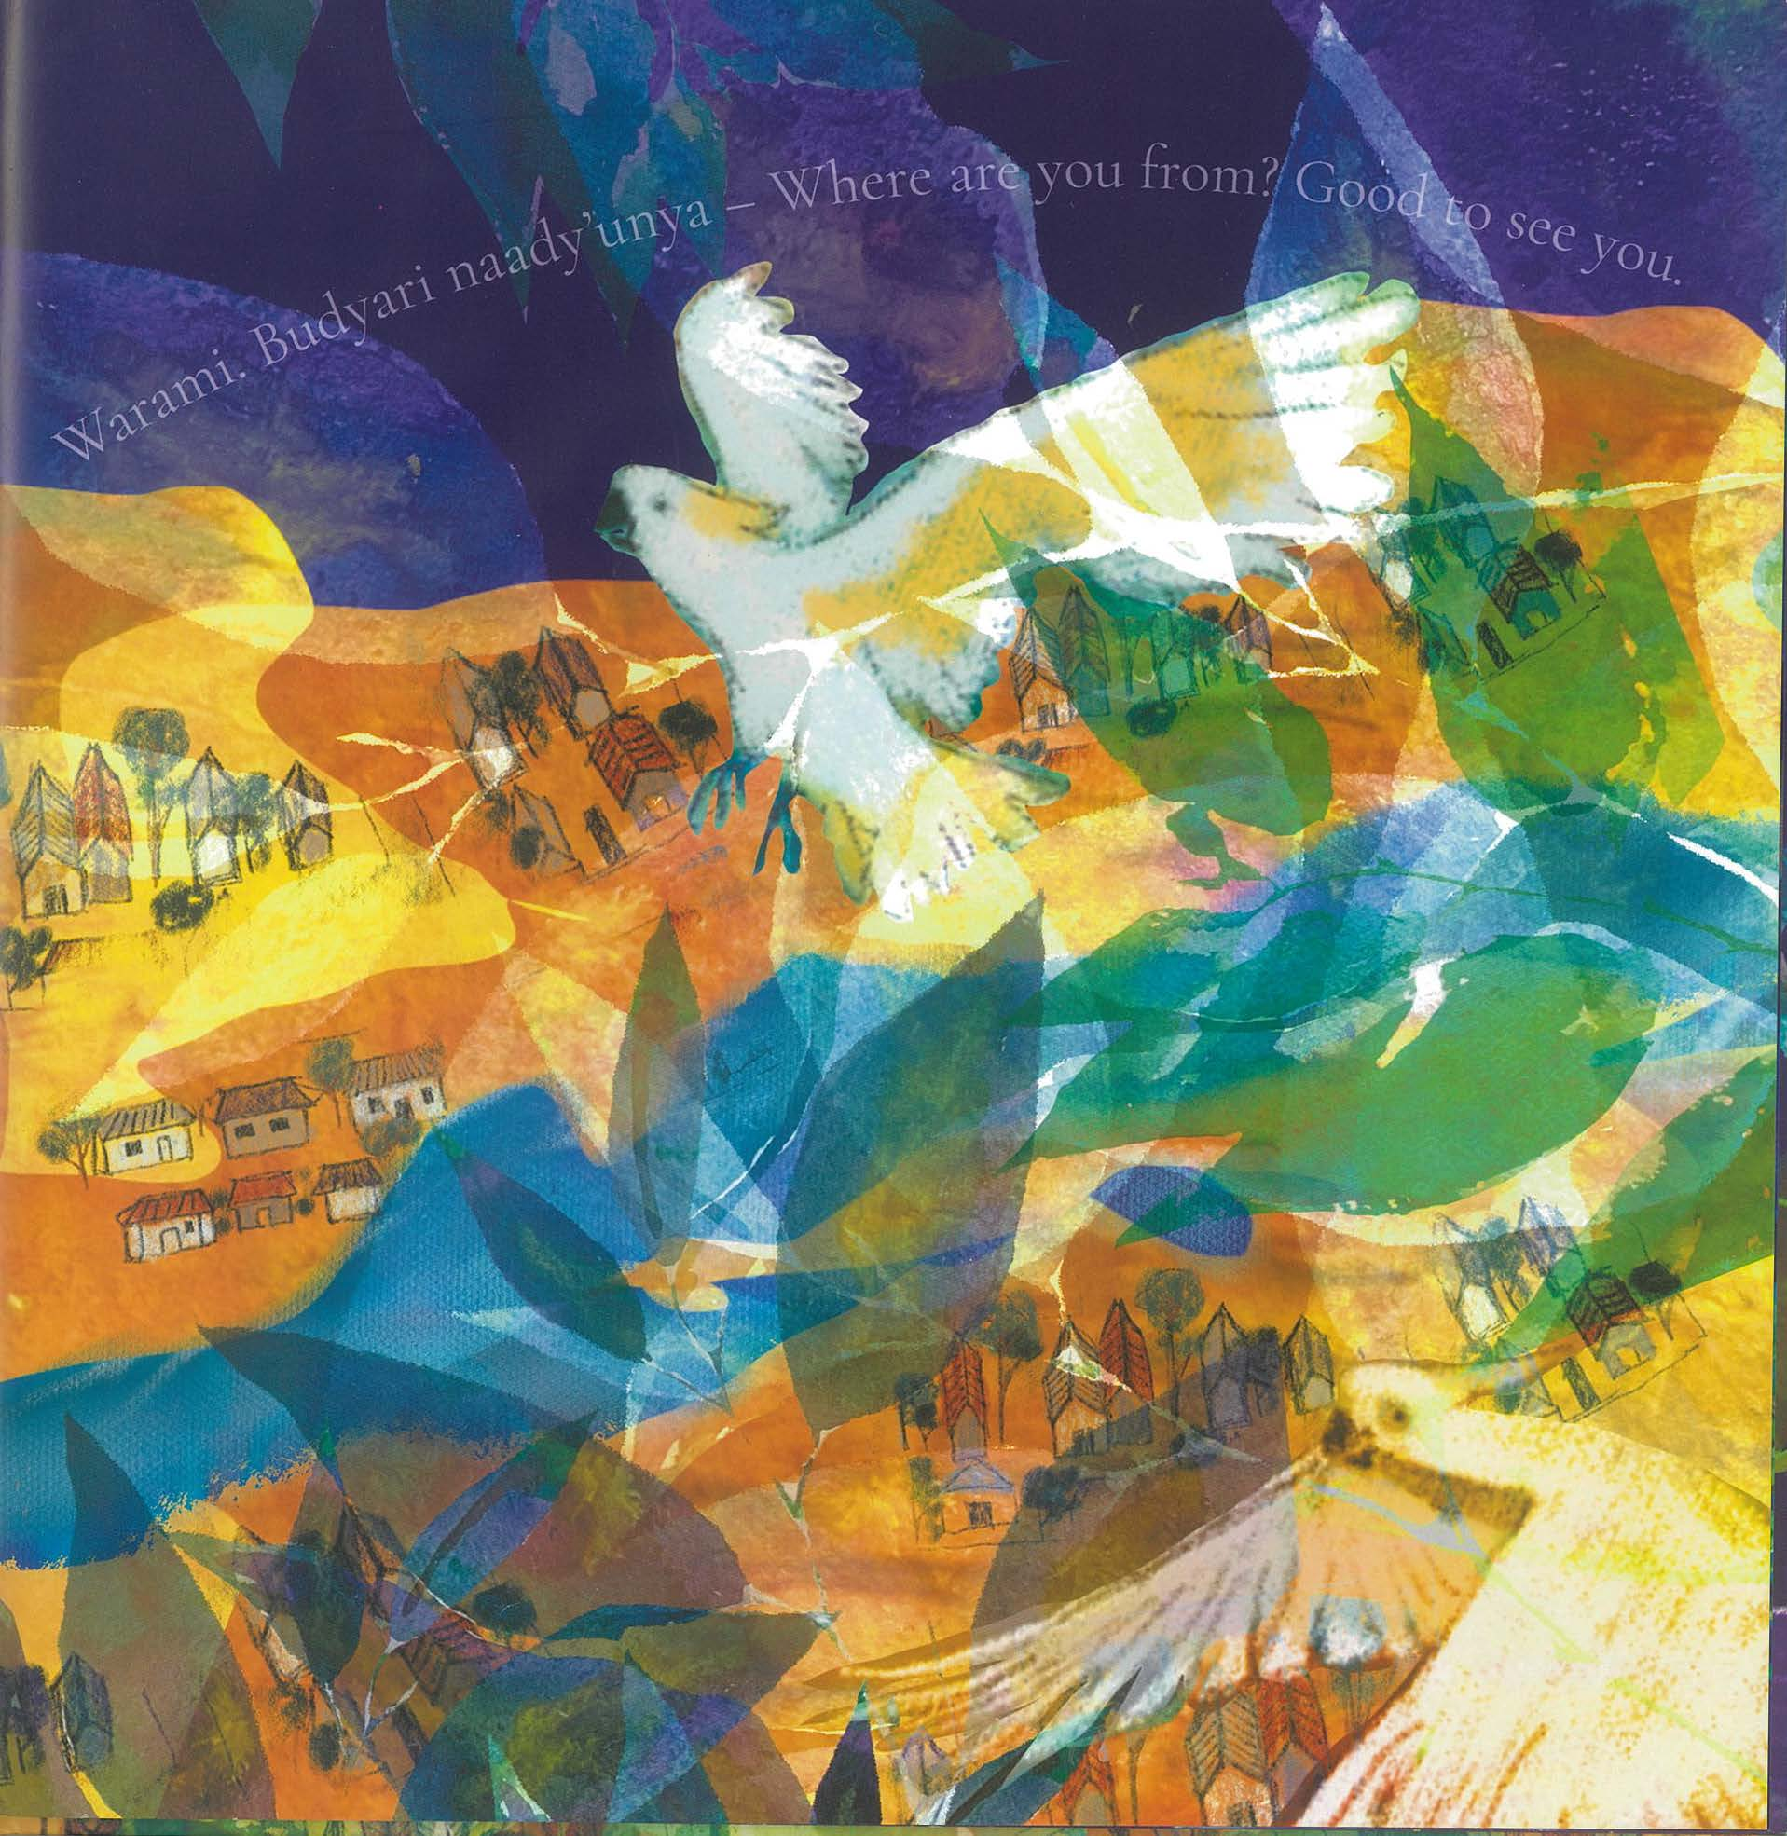
Extract 3 (b) 1
Extract 3 (b)
Question and welcome
Notes:
Question – ‘Where are you from’?’ references those who are living off-Country.
Welcome – ‘Good to see you’ is a welcome to and acknowledgement of Country protocols.

Slide 18
Extract 3 (b) 2
Extract 3 (b)
Question and welcome
Symbolism of waterways
Notes:
Question – ‘Where are you from’?’ references those who are living off-Country.
Welcome – ‘Good to see you’ is a welcome to and acknowledgement of Country protocols.
Symbolism of waterways – Nepean River was a significant place of survival, colonial war and life source for Dharug people.

Slide 19
Extract 3 (b) 3
Extract 3 (b)
Question and welcome
Symbolic use of artistic style
Symbolism of waterways
Notes:
Question – ‘Where are you from’?’ references those who are living off-Country.
Welcome – ‘Good to see you’ is a welcome to and acknowledgement of Country protocols.
Symbolism of waterways – Nepean River was a significant place of survival, colonial war and life source for Dharug people.
Symbolic use of digital collage depicting flora and fauna overlapping the houses. The houses depict a modern view of Country while the overlaid flora and fauna remind the responder of the ongoing spiritual connection to Country.

Slide 20
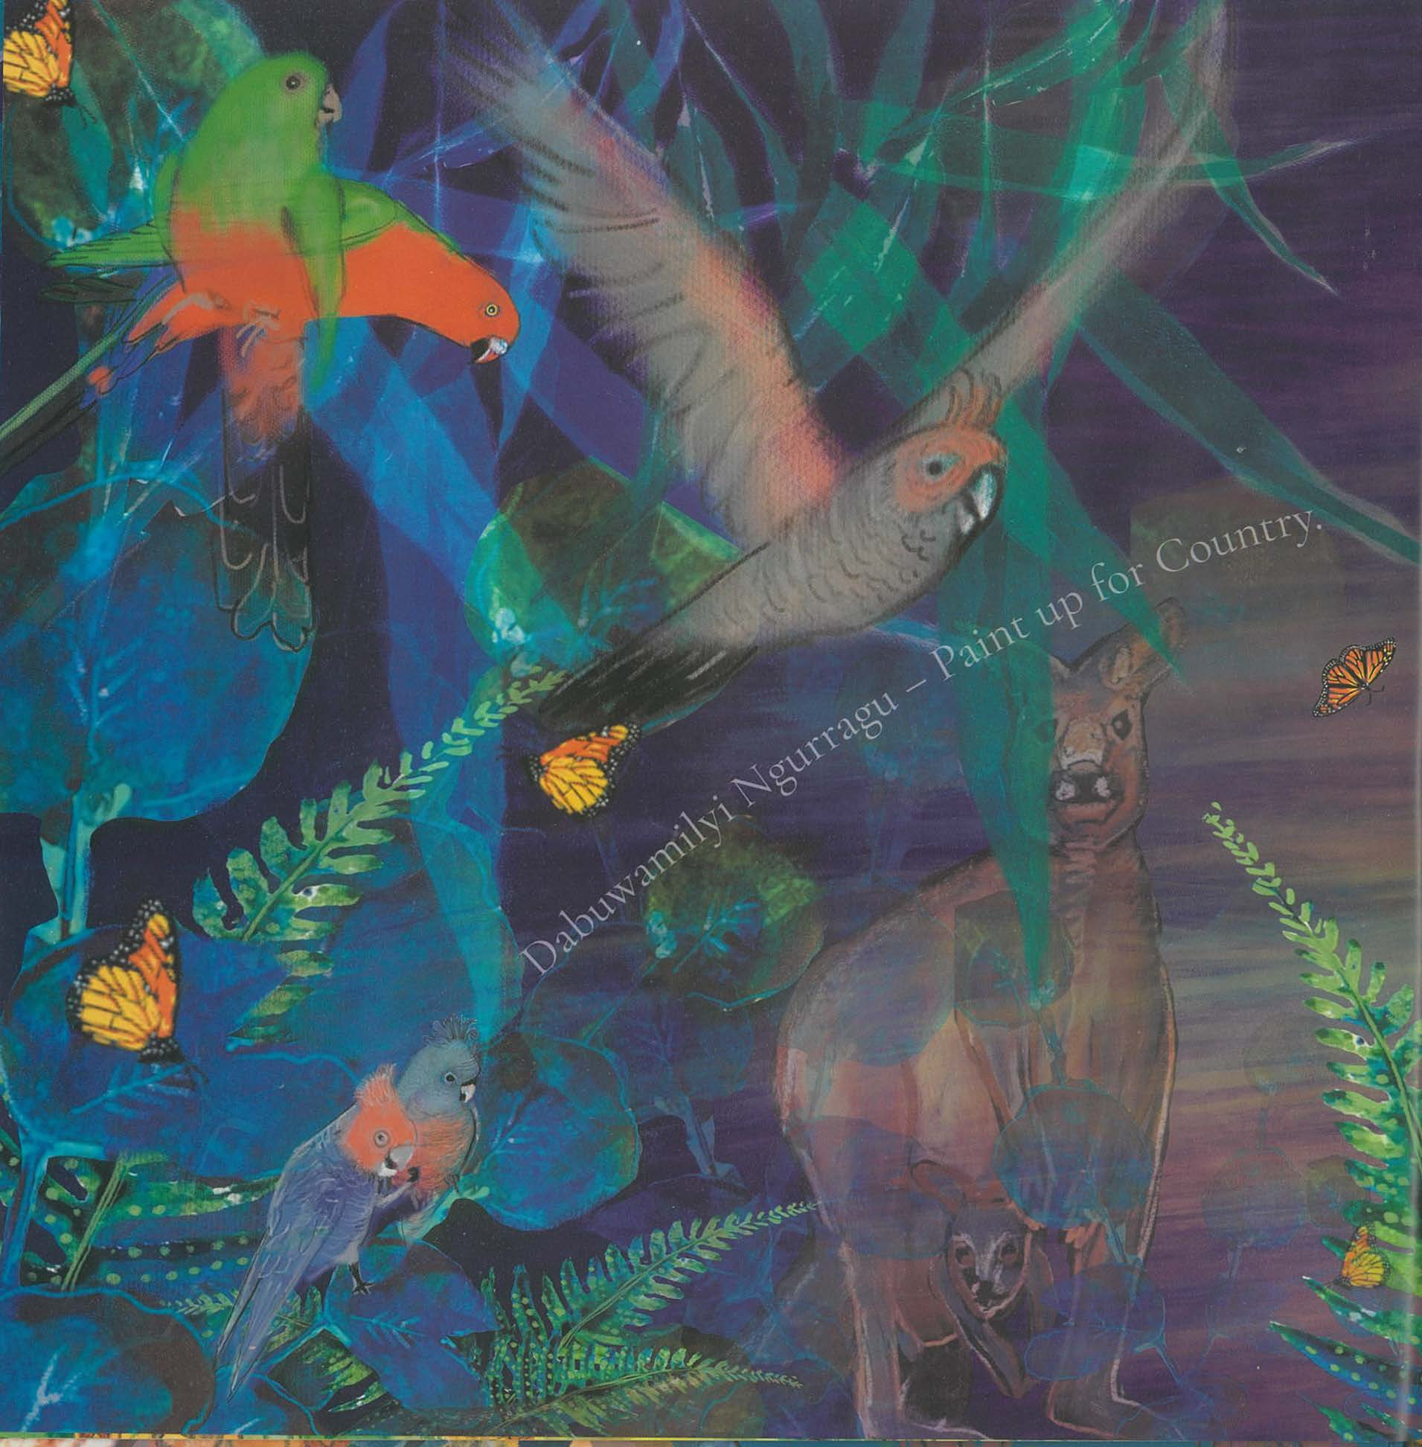
Extract 4 (a) 1
Extract 4 (a)
Imagery of fern
Notes:
Imagery of fern – the fern depicted has medicinal properties. This emphasises the healing power of the land.

Slide 21
Extract 4 (a) 2
Extract 4 (a)
Imagery ‘Paint up’
Imagery of fern
Notes:
Imagery of fern – the fern depicted has medicinal properties. This emphasises the healing power of the land.
Imagery of ‘paint up’ evokes the ceremonial practices.

Slide 22
Extract 4 (b) 1
Extract 4 (b)
Motif
Notes:
Motif – the layering of images acts as a motif throughout the text to symbolise the ever-present connection between past and present.

Slide 23
Extract 4 (b) 2
Extract 4 (b)
Motif
Symbolism
Notes:
Motif – the layering of images acts as a motif throughout the text to symbolise the ever-present connection between past and present.
Symbolism – the images of animals, birds and insects are endemic to Dharug country and hold significant meaning. These images are used throughout the text.

Slide 24
Copyright
© State of New South Wales (Department of Education), 2023
The copyright material published in this resource is subject to the Copyright Act 1968 (Cth) and is owned by the NSW Department of Education or, where indicated, by a party other than the NSW Department of Education (third-party material).
Copyright material available in this resource and owned by the NSW Department of Education is licensed under a Creative Commons Attribution 4.0 International (CC BY 4.0) license.
This license allows you to share and adapt the material for any purpose, even commercially.
Attribution should be given to © State of New South Wales (Department of Education), 2023.
Material in this resource not available under a Creative Commons license:
the NSW Department of Education logo, other logos and trademark-protected material
material owned by a third party that has been reproduced with permission. You will need to obtain permission from the third party to reuse its material.
Links to third-party material and websites
Please note that the provided (reading/viewing material/list/links/texts) are a suggestion only and implies no endorsement, by the New South Wales Department of Education, of any author, publisher, or book title. School principals and teachers are best placed to assess the suitability of resources that would complement the curriculum and reflect the needs and interests of their students.
If you use the links provided in this document to access a third-party's website, you acknowledge that the terms of use, including licence terms set out on the third-party's website apply to the use which may be made of the materials on that third-party website or where permitted by the Copyright Act 1968 (Cth). The department accepts no responsibility for content on third-party websites.
Notes:
Slide not shared

