Slide 1
Instructions for use
This resource is not a teaching and learning program. It should be used in conjunction with Design Innovation Technology 7–10 – sample program – Disruptive lighting solution.
Classroom teachers are encouraged to add and adapt slides as required to meet the needs of their students.
Save a copy of the file to make changes to the slide deck. Go to File > Download a Copy (this downloads a copy to the computer to edit in the PowerPoint app).
To convert the PowerPoint to Google Slides:
  Upload the file into Google Drive and open it.
  Go to File > Save as Google Slides.
  (Note – conversion may cause formatting changes in the slides.)

Slide 2
Disruptive lighting solution
Design Innovation Technology – Stage 5 Year X
Term X – Term X (10 weeks)
2

Slide 3
Weeks 1–2

Slide 4
1. Introduction to disruptive lighting

Slide 5
Learning intentions and success criteria (1)
We are learning about
the purpose of lighting design
the existing assumptions of lighting design
how disruptive innovation challenges existing assumptions.
I can
identify the purpose of lighting design
explain disruptive innovation
identify examples of disruptive lighting solutions
select a disruption lens for further investigation.

Slide 6
Connecting learning (1)
Brainstorm: where do you notice lighting in your daily life?
Highlight: 3 places where lighting affects behaviour.
Think, pair, share.

Slide 7
Activity 1.1 – Brainstorm
Brainstorm: Where do you notice lighting in your daily life?

Slide 8
Purposes of lighting design
Lighting serves to:
illuminate
support safety
influence behaviour
create atmosphere
support wellbeing.
Examples shown could include hospital lighting, street lighting, smart circadian lighting.

Slide 9
Existing assumptions of lighting
All users experience light the same way
Lighting is only for visibility
One lighting solution suits all spaces
Users can tolerate flickering or buzzing
Energy efficiency is more important than user comfort
Lighting is designed for average users
More lighting equals better safety
Artificial lighting should mimic daylight
Lighting is permanent and fixed

Slide 10

Check for understanding (1.1)
Which option BEST explains the purpose of lighting in design?
A. To help people see clearly and complete tasks safely
B. To provide visibility, safety, influence behaviour, create atmosphere and support wellbeing
C. To make spaces brighter and more modern-looking
D. To decorate spaces using different colours and effects
Notes:
[CLICK] to reveal answer
Answer is B.
Nearly right misconception: A - visibility and safety are important purposes of lighting, but lighting also affects mood, behaviour and wellbeing.

Slide 11
What is innovation?
Innovation can be defined as a new idea or invention that has been converted to a product or service that solves a specific problem or customer need. Designers strive for innovation. They work towards using their creativity to solve problems in new ways and coming up with ideas that are as valuable as they are radical.
Types of Innovation
Incremental, Disruptive, Radical
Incremental: small improvements to existing products, processes, or services
Disruptive: innovation that significantly changes or replaces existing products, processes or services
Radical: groundbreaking innovation that creates a new product, service or process and has a significant impact on the market or practices
Notes:
[CLICK] to reveal definition behind decorative image
Incremental: small improvements to existing products, processes, or services
[CLICK] to reveal definition behind decorative image
Disruptive: innovation that significantly changes or replaces existing products, processes or services
[CLICK] to reveal definition behind decorative image
Radical: groundbreaking innovation that creates a new product, service or process and has a significant impact on the market or practices

Slide 12
Types of innovation
Incremental – Small improvements to an existing product.
Adding dimmer switches to lamps, improving LED bulb energy efficiency, desk lamps with adjustable arms and brightness levels.
Disruptive – A new technology that changes how people use lighting.
Smart lighting systems (controlled by phone or voice assistants), motion sensor lighting that turns on automatically, Smart streetlights that adjust brightness based on traffic, Circadian lighting systems that change colour temperature during the day.
Radical – A completely new way of producing or using light.
OLED lighting panels (thin flexible lighting sheets), bioluminescent lighting using living organisms, glow-in-the-dark building materials replacing electrical lighting, light-emitting fabrics or wearable lighting

Slide 13
Check for understanding (1.2)
What is incremental innovation?
A. Creating a completely new technology that replaces existing systems
B. Making small improvements to an existing product or idea
C. Inventing a product that has never existed before
D. Copying another company’s product exactly
Notes:
[CLICK] to reveal answer
Answer is B

Slide 14
Check for understanding (1.3)
Why might disruptive innovation challenge existing products?
A. It makes products more colourful and visually appealing
B. It improves small features of existing products
C. It introduces a new approach or technology that changes how an industry works
D. It reduces the cost of materials used in production
Notes:
[CLICK] to reveal answer
Answer is C

Slide 15
Check for understanding (1.4)
How might lighting change behaviour?
A. Lighting can influence how people feel, move, and interact within a space
B. Lighting only affects how bright a room is
C. Lighting has no impact on how people behave
D. Lighting only changes the colour of objects
Notes:
[CLICK] to reveal answer
Answer is A

Slide 16
Disruption lenses
Disruption lenses as different ways of examining existing products, systems or experiences to identify assumptions, limitations, exclusions or opportunities for improvement. They help designers look critically at current designs from a particular perspective, such as sustainability, accessibility, emerging technologies, ethics, user needs or social change.
Examples:
Diverse users: users whose needs are not considered in the design.
Diverse contexts: lighting designed for one situation but used in another where it doesn’t work well.
Behaviour-changing light: lighting that intentionally influences how people act.
Low-impact systems: lighting designed to reduce environmental impact.

Slide 17
Activity 1.2 5W’s 1H – modelling (1)
Question set | Existing product: classroom fluorescent lighting
Who Who is the user or group affected by this problem? Who benefits from this design? Who might be excluded or overlooked? | Autistic users sensitive to flickering and buzzing fluorescent lights may be excluded or overlooked. Teachers and schools may benefit from low-cost, bright lighting that illuminates large spaces efficiently.
What What is the problem or need? What is currently happening? What could be improved? | The problem is that fluorescent lighting can cause sensory discomfort, eye strain and reduced concentration for some users. The lights currently provide bright, even illumination but often flicker, buzz and produce harsh glare. Adjustable brightness, softer lighting and reduced flicker could improve the experience for diverse users.
When When does the problem occur? When is the product or technology used? When might the issue have the greatest impact? | The problem often occurs during long periods of classroom learning, especially in the morning or late afternoon when students are tired or overstimulated. The lighting is used every school day for extended periods. The issue may have the greatest impact during tests, focused learning tasks or for students already experiencing sensory overload.

Slide 18
Activity 1.2 5W’s 1H – modelling (2)
Question set | Existing product: classroom fluorescent lighting
Where Where does the problem happen? Where is the product used? Where might conditions affect how well it works? | The problem happens in classrooms and other indoor learning environments using fluorescent tube lighting. Conditions such as dark rooms, lack of natural light or reflective surfaces may increase glare and discomfort.
Why Why is this a problem worth solving? Why does the current design not fully meet user needs? Why could improvement make a difference? | This is worth solving because uncomfortable lighting can negatively affect learning, focus, wellbeing and inclusion. The current design prioritises brightness, cost and efficiency over sensory comfort and flexibility. Improvements could create more inclusive, comfortable and productive learning environments for a wider range of users.
How How might the design be improved? How does the product or technology currently work? How could emerging technologies or materials help? | The design could be improved through dimmable LED systems, smart lighting controls, adjustable colour temperature or natural lighting integration. Emerging technologies such as adaptive LEDs, motion sensors and circadian lighting systems could create more responsive and user-centred classroom lighting.

Slide 19
Final thought (1)
Students choose one disruption lens and identify a problem with lighting within it:
Why does this area need improvement in lighting design?

Slide 20
2. Lighting assumption audit

Slide 21
Connecting learning (2)
Teacher to SHOW 3 lighting products
Who do you think this lighting product is designed for?
Who do you think might struggle to use it? Why?

Slide 22
Learning intentions and success criteria (2)
We are learning about
how to analyse existing lighting products
how to identify design assumptions
I can
analyse a lighting product
identify assumptions about users and contexts
explain who may be excluded.

Slide 23
Assessment task launch
Introducing the task:
Task description
Type of task: Design investigation portfolio
Suggested weighting: 20%
Students investigate how conventional lighting systems fail to meet the needs of certain users, contexts or sustainability goals.
Students will use emergent design thinking to challenge assumptions about what lighting is for, who it serves, and how it behaves.
Students select one disruption lens and use research, analysis and early experimentation to define a clear design opportunity that will guide future prototyping.

Slide 24
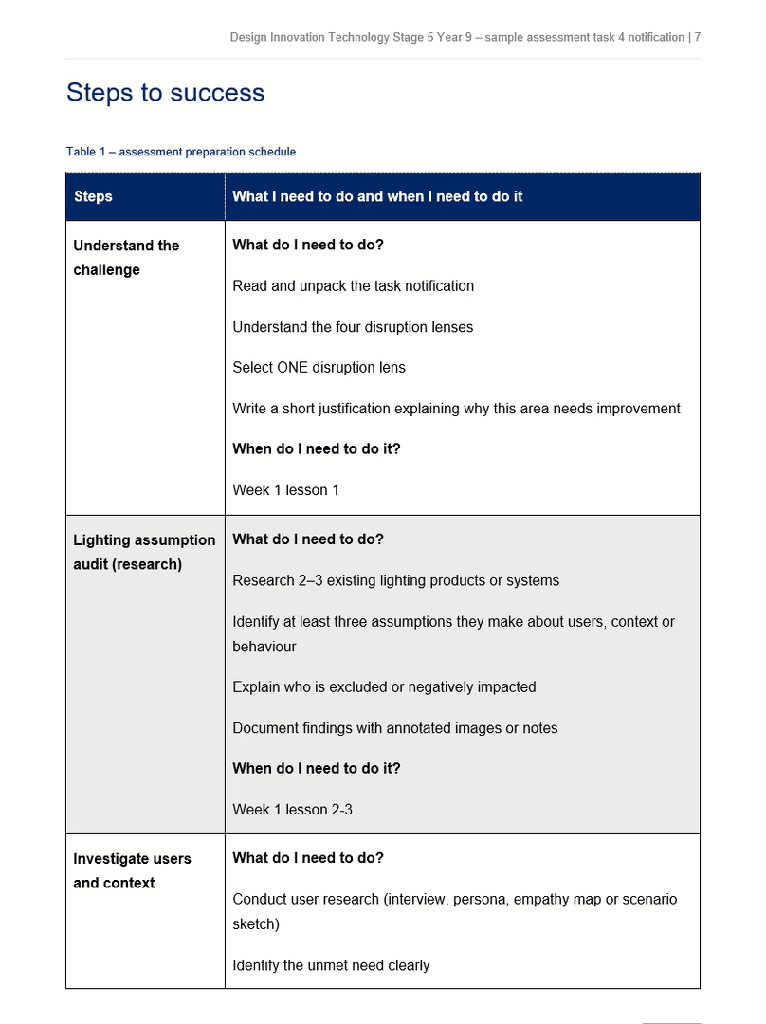
Steps to success
To do well in this task, you need to show that you can:
clearly explain and communicate your ideas using writing, sketches, annotations and photos of your experiments
analyse existing lighting and identify the assumptions designers have made
show strong understanding of your chosen user or context and explain their unmet needs
consider designer responsibilities, including social, ethical and environmental impacts
explain how current or emerging technologies could influence future lighting design
use research and experimentation to justify a clear and logical design opportunity
Notes:
[CLICK] to play a screen recording of the Steps to success part of the document as a preview of part of the assessment task given to students.

Slide 25
Activity 2.1 Lighting solution analysis
For example: a desk lamp
Functional features – What is this lighting designed to do? How well does it do it?
User – Who will use the lighting? Does it help these users see clearly? How do users experience the lighting? Are any users are excluded or disadvantaged?
Context – Where and when is the lighting used? Does it improve safety, behaviour, atmosphere or wellbeing?
Materials – What the lighting product is made from? Are there environmental impacts such as material waste, manufacture, disposal?
Energy use – How much energy the does the lighting use and how efficiently?

Slide 26

26
Sample of a lighting solution analysis
Functional features
What the lighting product can do
Adjustable arm for directing light Provides focused task lighting Built-in LED light
User
Who will use the lighting?
Students and workers People reading or crafting
Materials
What the lighting product is made from
Metal and plastic body LED light components
Context
When and where the lighting is used
Bedrooms, offices, study areas Homework or work tasks
Energy use
How much energy the lighting uses
Energy efficient LED Low power consumption

Slide 27
Assumption
What assumptions have been made by the designer for this lighting solution?
Definition
Facts/Characteristics
Assumption
Examples
Non-examples

Slide 28
Completed Frayer model for ‘assumption’
Definition
An idea designers believe to be true about users, environments or needs, which must be tested or researched.
Facts/Characteristics
Often based on prior knowledge or expectations.
May not apply to all users or situations.
May create exclusion or problems if incorrect.
Examples
Assuming all users prefer bright lighting.
Assuming classrooms only need one type of lighting.
Assuming all users have the same sensory needs.
Non-examples
User testing showing 80% of students preferred dimmable lighting.
Evidence collected through surveys or observations.
A proven safety requirement in building legislation.
Assumption

Slide 29
Check for understanding (2.1)
What happens if someone cannot reach a light switch?
The person may not be able to turn the light on or off independently.
The light will automatically adjust to the correct brightness.
The light will turn on by itself when someone enters the room.
The lighting will become more energy efficient.
Discussion – Why does this matter?
Notes:
[CLICK] to reveal answer
Answer is A

Slide 30
User assumptions
User assumption | Why this might fail
People can easily reach the light switch | Children, wheelchair users or elderly people may not reach it
Users have normal vision | Low vision users may need brighter or adjustable lighting
People can tolerate bright light | Neurodivergent users or migraine sufferers may be sensitive to glare
Users know how to operate the lighting system | Complex smart lighting apps may confuse some users
These are things designers assume about the people using the lighting.

Slide 31
Context assumptions
These are things designers assume about where the lighting is used.
Context assumption | Why this might fail
The room has fixed furniture layout | Furniture moves and lighting may not suit new layouts
Lighting will only be used indoors | Outdoor conditions require weather-resistant lighting
Users control their environment | Rental housing may prevent installing new lighting
The space is quiet and stable | Public transport or shared spaces need adaptable lighting
Lighting is used for one purpose | Rooms may be used for studying, relaxing, gaming or sleeping

Slide 32
Check for understanding (2.2)
Which option is an example of a context assumption rather than a user assumption?
A. Assuming all users prefer bright white lighting
B. Assuming autistic users can tolerate flickering fluorescent lights
C. Assuming classrooms are always used during daylight hours
D. Assuming elderly users can easily read under dim lighting
Notes:
[CLICK] to reveal answer
Answer: C
User assumptions are beliefs about the people using the product. Context assumptions are beliefs about where, when or how the product is used.

Slide 33

Assumption detective – why lighting fails
Lighting system product | User assumption | Context assumption | Impact | Possible disruption
Wall light switch | Users can reach the switch easily | Switches are placed at a standard height in all rooms | Children, wheelchair users or elderly users may not be able to turn lights on or off independently | Motion sensors, voice control, app control or adjustable switch heights

Slide 34
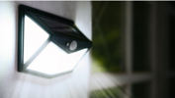

Activity 2.2 – Assumption detective table
Who might this design not work well for?
Work in pairs or groups of 3 to analyse one lighting product. Think about age, ability, environment, behaviour, energy use.
Share discoveries with the rest of the class and complete the table.
Lighting system product | User assumption | Context assumption | Impact | Possible disruption

Slide 35
Quick reflection (2)
Complete the sentence:
One assumption about lighting design I had before today was… but now I think…

Slide 36
3. Lighting failures

Slide 37
Learning intentions and success criteria (3)
We are learning about
why some lighting solutions fail users or environments
I can
explain why lighting designs fail
link design decisions to impacts.

Slide 38
Do now (3)
When has lighting annoyed you?
List examples.

Slide 39
Design failure framework
The design failure framework is a way of analysing why a product, system or design solution does not work effectively for users or contexts. Designers deliberately investigate failures, limitations, or unintended consequences to identify opportunities for improvement or innovation.
Using a design failure framework helps designers to:
identify design opportunities
challenge assumptions
design more inclusive and sustainable solutions
develop disruptive or innovative ideas

Slide 40
Key ideas in a design failure framework
User failure – The design does not meet the needs, abilities, or behaviours of users.
Example: A light switch placed too high for children or wheelchair users.
Context failure – The design does not work well in the environment where it is used.
Example: Outdoor lighting that creates glare or light pollution.
Functional failure – The design does not perform its intended task effectively.
Example: A desk lamp that does not provide enough brightness for reading.
Sustainability failure – The design wastes energy, materials, or has negative environmental impacts.
Example: Lighting that consumes excessive electricity.
Behavioural failure – The design encourages unintended or problematic behaviours.
Example: Bright street lighting that disrupts sleep cycles.

Slide 41
Activity 3.1 – Lighting failure analysis table
Students work in pairs or small groups. Each group receives one lighting failure case study to analyse. Examples: blue light sleep disruption, glare in classrooms, poorly lit walkways.
Lighting failure example | What is the problem? | Who is affected? | Why does the lighting fail? | Possible design improvement
Blue light from devices at night | Blue light suppresses melatonin and disrupts sleep | Teenagers, shift workers | Devices emit high levels of blue light at night | Night mode filters, adaptive lighting, warmer colour temperature
1
2
3

Slide 42
Activity 3.2
Share your thoughts verbally –
What assumptions did the designer make?
Who was overlooked in the design?
How could this lighting system be improved?

Slide 43
Quick reflection (3):
Complete the sentence:
One way lighting design could improve peoples’ lives is….

Slide 44
4. Understanding users in lighting design

Slide 45
Learning intentions and success criteria (4)
We are learning how
designers investigate user needs and experiences
to identify opportunities for improved lighting design.
I can
identify the needs, behaviours and frustrations of users
use user research tools to better understand design problems
explain how user needs can inform a design opportunity.

Slide 46
Connecting learning (4)
Who might struggle with typical lighting?

Slide 47
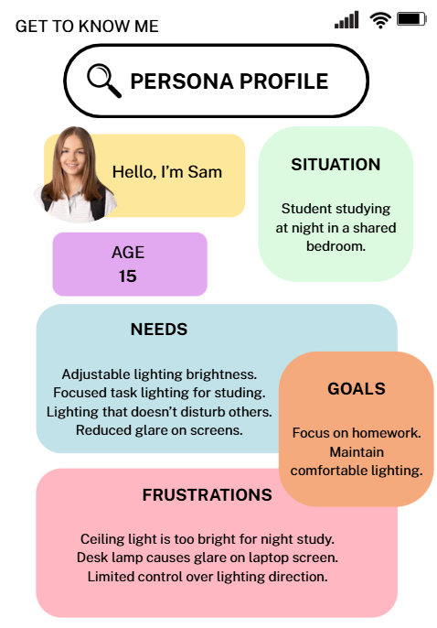
Research tools to understand users (1)
Persona user profile
A fictional profile that represents a typical user. It describes who they are, their needs, behaviours and frustrations.
Check for understanding:
What does this user need from lighting?
What frustrates them about current lighting?
What design problems can you identify?

Slide 48
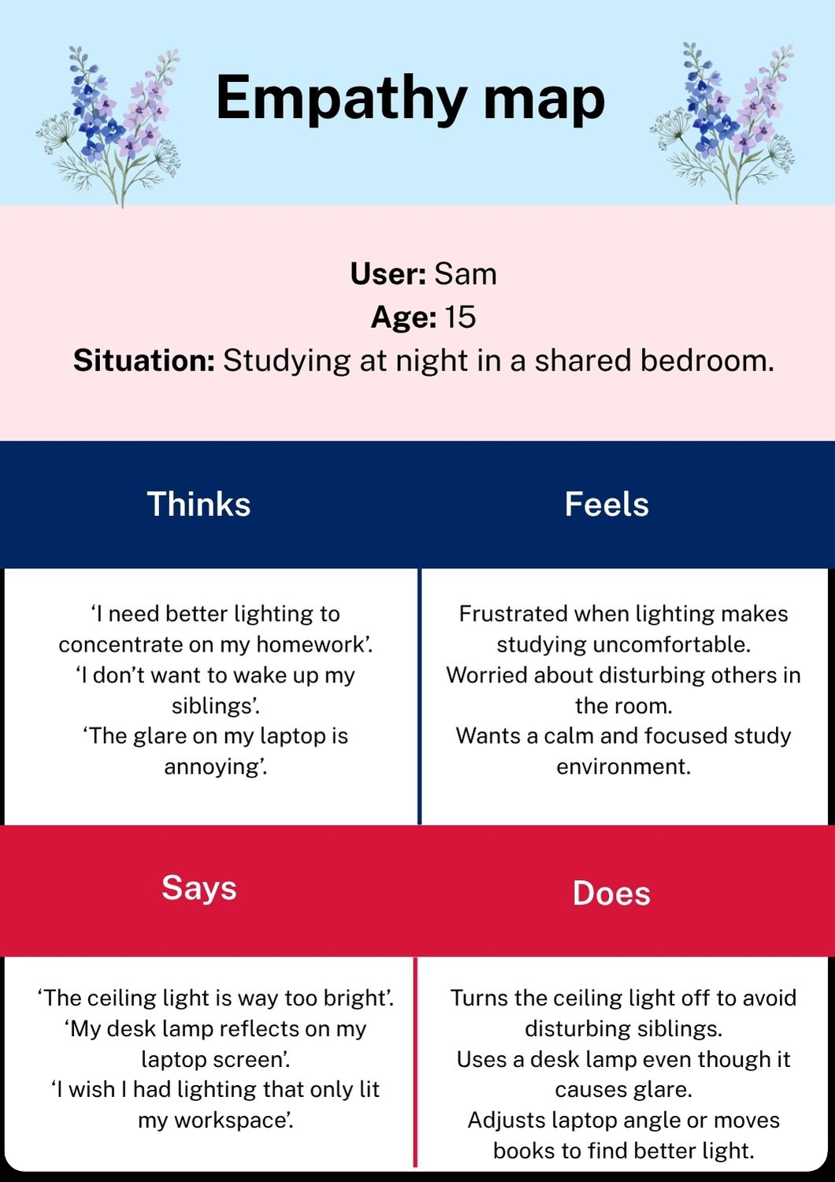
Research tools to understand users (2)
Empathy map
A tool that explores what a user thinks, feels, says and does in a particular situation.
Thinks | Feels
Says | Does

Slide 49
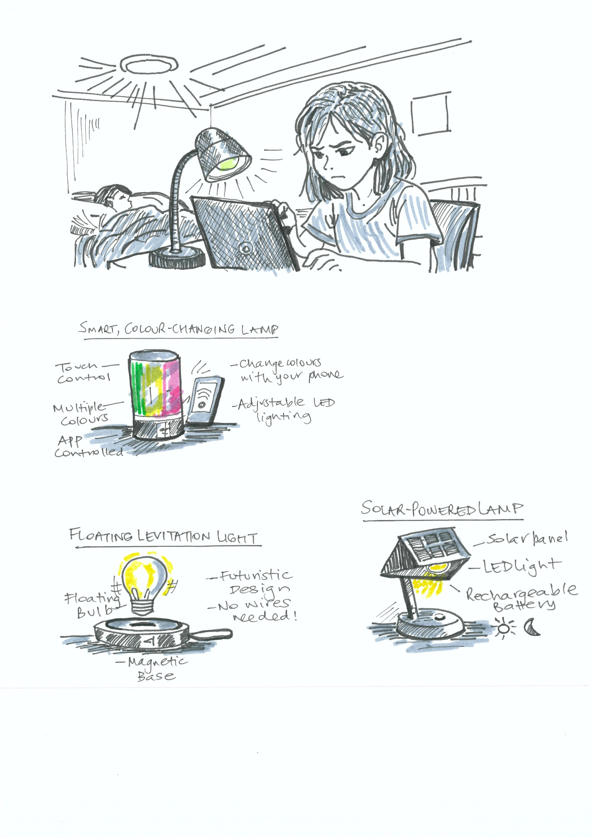
Research tools to understand users (3)
Scenario sketch
A short, illustrated story showing how a user interacts with a product or environment.
When does the user interact with lighting?
What tasks are they trying to complete?
What problems do they experience?
Late night study session with glare in a shared bedroom.

Slide 50
Activity 4.1 – Create a persona user profile
Select a user related to your chosen disruption lens (elderly person, shift worker, student studying late, person with low vision, shared bedroom user). Complete a fictional persona profile.
User name and demographics
Situation
Needs
Frustrations
Opportunities for better lighting

Slide 51
Activity 4.2 – (optional) empathy map
Thinks | Feels
Says | Does

Slide 52
Final thought (4)
Identify an unmet need of your user that will inform your design opportunity statement
My user struggles with lighting because…

Slide 53
5. Designer responsibility in lighting design

Slide 54
Learning intentions and success criteria (5)
We are learning
how designers must consider ethical, social and environmental responsibilities when creating lighting systems.
I can
explain the responsibilities designers have when designing lighting
identify ethical, social and environmental impacts of lighting systems
explain how design decisions affect people and the environment.

Slide 55
Do now (5)
Think about streetlights, phone screens and classroom lighting.
Can lighting affect people's health or wellbeing?
Can lighting affect the environment or wildlife?
Can lighting make spaces more or less safe?

Slide 56
Designer responsibilities (1)
Designers must think about how their products, systems and environments affect people, society and the environment. Before starting a design, designers consider:
Designers aim to maximise positive impacts and reduce negative impacts.
Individual/society
user needs, safety and wellbeing
cultural values and community needs
Ethics
consumer rights
privacy and responsible design decisions
Environment
energy use and sustainability
pollution, waste and product life cycle

Slide 57
Designer responsibilities (2)
Examples:
Bright pathway lighting in public parks or train stations can help people feel safer and more confident moving through spaces at night.
Adjustable lighting and reduced glare can support elderly users or people with low vision to move safely and comfortably through homes or public spaces.
Classroom lighting with reduced flicker and adjustable brightness can improve student focus, concentration and comfort during learning.
Warm lighting in hospitals or aged care settings can create calmer and less stressful environments for patients and visitors.
Inclusive lighting design can support neurodivergent users by reducing sensory overload and improving wellbeing.
Social responsibility – how a design affects people and communities.
Notes:
Teacher may show visual examples of the above.

Slide 58
Designer responsibilities (3)
Ethical responsibility
designing in a way that is fair, safe and responsible.
Examples: avoiding lighting that harms health (for example excessive blue light exposure), designing inclusive lighting systems for diverse users, ensuring products are safe and reliable.
Teacher may show visual examples of the above.

Slide 59
Designer responsibilities (4)
Environmental responsibility
considering the environmental impact of lighting systems.
Examples: reducing energy consumption with LEDs, minimising light pollution affecting wildlife, designing lighting with recyclable materials.
Teacher may show visual examples of the above.

Slide 60
Check for understanding (5.1)
What is one social impact of lighting design?
A. Lighting can influence how people feel and behave in a space
B. Lighting only changes the colour of furniture
C. Lighting has no effect on people
D. Lighting only affects electricity bills
Notes:
[CLICK] to reveal answer
Answer is A

Slide 61
Check for understanding (5.2)
Why should designers think about these impacts?
A. To make sure their design only looks interesting
B. To make sure their design considers people, society, and the environment
C. To make the design more expensive
D. To copy other designers’ ideas
Notes:
[CLICK] to reveal answer
Answer is B

Slide 62
Stretch question (5.3)
What is one environmental impact of lighting?
A. Lighting can increase energy use and contribute to environmental impact
B. Lighting only changes the brightness of a room
C. Lighting has no effect on the environment
D. Lighting only affects the size of buildings
Notes:
[CLICK] to reveal answer
Answer is A

Slide 63
Lighting responsibility analysis table
Example
Lighting example | Social impact | Ethical considerations | Environmental impact | Possible design improvement
Streetlights in residential areas | Positive: improves safety, visibility for pedestrians and drivers, supports night-time activity. Negative: can disturb sleep if light enters homes. | Designers must consider residents’ comfort and privacy. Lighting should improve safety without negatively affecting people’s wellbeing. | Positive: can reduce accidents and increase safe night travel. Negative: light pollution can disrupt wildlife such as insects and birds and waste energy. | Shielded lighting to direct light downward, motion sensors, warmer colour temperatures, smart lighting systems that dim late at night.

Slide 64
Discussion questions
Considering a lighting design’s impact and effect on behaviour
How might bright streetlighting make different people feel when walking at night?
Why might some residents feel frustrated or uncomfortable with lighting near their homes?
What behaviours might increase when people feel safe in well-lit public spaces?
How could poor lighting affect the way people use a public space?

Slide 65
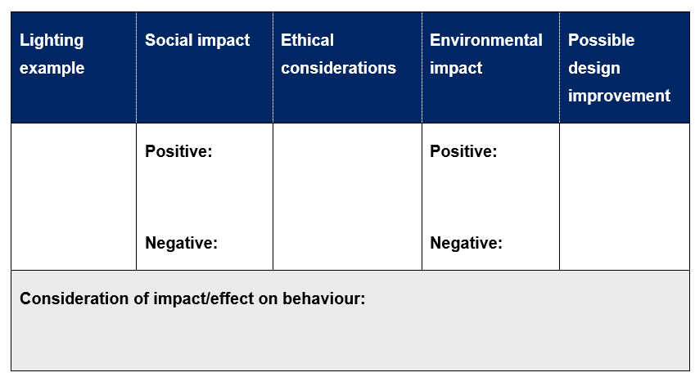
Activity 5.1 – Lighting responsibility analysis table

Slide 66
Exit ticket (5)
Complete the sentence:
One responsibility lighting designers must consider is… because…

Slide 67
Weeks 3–4

Slide 68
6. Emerging technologies in lighting design

Slide 69
Learning intentions and success criteria (6)
We are learning
how current and emerging technologies influence lighting design and create new design possibilities.
I can
identify examples of emerging lighting technologies
explain how technology changes what lighting systems can do
describe how technology may help solve lighting design problems.

Slide 70
Connecting learning (6)
How has lighting changed over time?

Slide 71
What are emerging technologies?
Emerging technologies are new or developing technologies that are beginning to change how products are designed and used. They often improve performance, efficiency, or create completely new ways of solving problems. Designers explore emerging technologies to develop smarter, more sustainable and more responsive lighting solutions.
SMART SENSORS
IOT
ADAPTIVE LIGHTING
ENERGY EFFICIENT LEDS
CIRCADIAN RHYTHM LIGHTING

Slide 72
Technology can influence:
what lighting can do
how users interact with lighting
the environmental impact of lighting systems

Slide 73
Check for understanding (6.1)
How does smart lighting improve user experience?
A. It allows users to control brightness, colour or timing automatically or with a device
B. It makes lights permanently brighter than normal lights
C. It removes the need for electricity
D. It stops lights from being turned off
Notes:
[CLICK] to reveal answer
Answer is A

Slide 74
Check for understanding (6.2)
How might technology reduce environmental impact?
A. By increasing the brightness of all lights
B. By using energy-efficient lighting such as LEDs and motion sensors
C. By making lighting systems larger
D. By leaving lights on all the time
Notes:
[CLICK] to reveal answer
Answer is B

Slide 75
Check for understanding (6.3)
What lighting problem could technology help solve?
A. Poor lighting control or wasted energy when lights are left on
B. The colour of furniture in a room
C. The shape of buildings
D. The number of windows in a house
Notes:
[CLICK] to reveal answer
Answer is A

Slide 76

Activity 6.1 – Emerging technology in lighting design
Groups and topics for this activity
Group 1 | Group 2 | Group 3
Smart sensors | Adaptive lighting | Solar lighting
Group 4 | Group 5 | Group 6
Smart lighting systems (IoT) | OLED lighting panels | Glow in the dark materials
Notes:
Reveal the questions/topics that each group will be exploring.

Slide 77
Activity 6.1 – Emerging lighting
Investigation table – research different types of lighting available within in your chosen technology
Technology | What does it do? | What problem could it solve? | Who benefits? | Design opportunity
Smart sensors
Adaptive lighting
Solar lighting
Smart lighting systems (IoT)
OLED lighting panels
Glow in the dark materials

Slide 78
Activity 6.2 – Emerging lighting investigation
Example: investigation of smart sensor lighting solutions
Technology | What does it do? | What problem could it solve? | Who benefits? | Design opportunity
Smart sensors (motion sensors) | Detect movement and automatically turn lights on or off | Lights being left on when no one is using the space | Home users, schools, offices | Energy-efficient automatic lighting
Smart sensors (presence sensors) | Detect when someone is in a room, even if they are not moving
Smart sensors (daylight sensors) |  |  |  | Lighting systems that automatically dim during the day
Smart sensors (safety sensors)
Smart sensors (occupancy sensors)
Smart sensors (environment sensors)

Slide 79
Exit ticket (6)
Write about your learning of emerging technology in lighting:
One emerging technology that could improve lighting is… because…

Slide 80
7. Planning and conducting lighting experiments

Slide 81
Connecting learning (7)
Why do designers test ideas before building a final product?

Slide 82
Learning intentions and success criteria (7)
We are learning
how designers test lighting ideas through experimentation
to gather evidence that informs design decisions.
I can
plan a simple lighting experiment
record observations and results clearly
explain what the experiment suggests for future design ideas.

Slide 83
Lighting experimentation
Designers test lighting to understand how light behaves with different materials, directions and environments. Examples of simple lighting investigations may include:
Diffusion test – how materials spread or soften light
Directional lighting test – how light can be focused or redirected
Colour temperature test – how warm or cool light affects comfort
Glare test – how surfaces reflect light
Shadow study – how light placement affects visibility
User or context testing

Slide 84
Experiment 1 – Diffusion test
Diffusion test
Aim
To test which material best diffuses light.
Method
Shine a torch through different materials (paper, tracing paper, plastic).
Results/ Observation
Images of the experimentation results with annotated observation; for example: Tracing paper spreads light more evenly. Record all results and observations in the data table.
Conclusion
Diffusion materials may reduce glare in lighting systems. They need to be in between opaque and translucent to diffuse light most effectively.

Slide 85
Check for understanding (7.1)
What is the purpose of a design experiment?
A. To test ideas and see how well a design works
B. To make the design look more colourful
C. To copy another designer’s work
D. To finish the design quickly
Notes:
[CLICK] to reveal answer
Answer is A

Slide 86
Check for understanding (7.2)
What should designers record during testing?
A. Only the final product
B. Observations, results, photos and notes about what happened
C. Only their favourite idea
D. The colour of the table they worked on
Notes:
[CLICK] to reveal answer
Answer is B

Slide 87
Check for understanding (7.3)
How can experiments help improve designs?
A. They show what works well and what needs to be changed
B. They make the design more expensive
C. They remove the need for planning
D. They stop designers from making decisions
Notes:
[CLICK] to reveal answer
Answer is A

Slide 88
Activity 7.1 – Planning lighting experiments
Students complete the scaffold to prepare for two lighting experiments.
Experiment scaffold – Experiment 1
Aim (what are you testing?) | Materials | Method | Observations | What does this suggest for design?
Experiment scaffold – Experiment 2
Aim (what are you testing?) | Materials | Method | Observations | What does this suggest for design?

Slide 89
Quick reflection (7)
One thing my lighting experiment could help me discover is…

Slide 90
8. Conducting experiments

Slide 91
Connecting learning (8)
How could the material that diffused light the best, improve a lighting design for a specific user?

Slide 92
Learning intentions and success criteria (8)
We are learning how to
test lighting ideas through practical experimentation
record evidence.
I can
conduct a lighting experiment safely
record observations clearly
document results using data tables, notes, sketches or photos.

Slide 93
Activity 8.1 – Conducting experiments
Experiment title
Aim What are you investigating?
Method What steps did you follow?
Observations What happened during the experiment? What does this suggest for lighting design? How might this influence your design idea?
Conduct your two lighting experiments and record your findings.

Slide 94
Quick reflection (8)
One thing I learned from my lighting experiment is…

Slide 95
9. Analysing experimentation results

Slide 96
Connecting learning (9)
Did your experiment work exactly as expected? Why or why not?

Slide 97
Learning intentions and success criteria (9)
We are learning to
interpret experiment results
identify design insights.
I can
explain what our experiment results show
link findings to user needs or lighting problems
identify possible directions for design improvement.

Slide 98
Check for understanding (9.1)
Why might designers test lighting before building products?
A. To make the design more expensive
B. To copy ideas from other designers
C. To understand how materials and light behave before making the final product
D. To identify problems and improve the design before production
Notes:
[CLICK] to reveal answers
Both answers C and D are the correct answers

Slide 99
Check for understanding (9.2)
How could experimentation influence design?
A. It removes the need for planning
B. It makes the design process longer without benefits
C. It provides evidence that helps designers make better decisions
D. It shows what works and what needs to be changed or improved
Notes:
[CLICK] to reveal answer
Both answers C and D are the correct answers

Slide 100
Activity 9.1 – Documenting the experimentation results
Experiment analysis scaffold – Experiment 1
What happened in the experiment? | What does this tell us about lighting? | How might this influence design ideas?
Experiment analysis scaffold – Experiment 2
What happened in the experiment? | What does this tell us about lighting? | How might this influence design ideas?

Slide 101
Share insights (9)
Which experiment result surprised you?
How could this influence your lighting design?

Slide 102
Quick reflection (9)
My experiment suggests that lighting should…

Slide 103
10. Design opportunity statement

Slide 104
Learning intentions and success criteria (10)
We are learning to
define a clear design opportunity based on research and experimentation.
I can
identify an unmet user need
explain how research and experiments inform our design direction
write a clear design opportunity statement.

Slide 105
Connecting learning (10)
What have we investigated so far that could help us identify a design opportunity?
Lighting failures
User needs
Designer responsibilities
Emerging technologies
Lighting experiments
Notes:
[CLICK] to reveal 5 circles with text inside.

Slide 106
Design opportunity statement
A design opportunity statement is a clear sentence that describes a problem or need that could be improved through design. It is based on research, user needs, and testing results, and helps guide the direction of a design solution.
It explains who the design is for, what the problem is, and what could be improved.
Example:
A student studying at night in a shared bedroom needs adjustable lighting that reduces glare and does not disturb others.

Slide 107
Activity 10.1 – Design opportunity statement scaffold table
My user | Lighting problem | Evidence from research | Evidence from experiments | Design opportunity

Slide 108
Activity 10.2 – My design opportunity statement
There is an opportunity to design a lighting system that…
This could respond to…
Further investigation is needed into…

Slide 109
Exit ticket (10)
Organise your Design Investigation Portfolio for submission.
Submit your assessment task to the teacher prior to leaving the class.

Slide 110
Weeks 5–6

Slide 111
11. Ideation and divergent thinking

Slide 112
Learning intentions and success criteria (11)
We are learning to
generate multiple lighting concepts
critique ideas collaboratively
select the most appropriate design to develop further.
I can
generate a range of lighting design ideas
communicate ideas using sketches and annotations
provide constructive peer feedback
evaluate ideas against design criteria
justify a selected concept.

Slide 113
Connecting learning (11)
What makes a lighting product innovative?

Slide 114
Where are we now?
Define the problem
Generate ideas
Digital modelling
Prototype
Test
Iterate
Communicate
Investigate Lighting
Output
✔ Design opportunity statement
✔ User research
Sketch Concepts
Designers explore multiple ideas before choosing a solution.
Output
✔ Concept sketches
✔ Design annotations
CAD Development (Onshape)
Designers transform sketches into 3D models.
Output
✔ CAD model
CAM and Fabrication
Designers build prototypes to test their ideas.
Technologies may include:
  3D printing
  laser cutting
  hand fabrication
Output
✔ Prototype model
Evaluate the Prototype
Designers test prototypes with users.
Output
✔ Test results
✔ User feedback
Improve the Design
Designers refine the solution.
Output
✔ Improved design
Present the Design
Designers share their solution using:
drawings
CAD models
prototypes
design folio
Output
✔ Final design solution
Notes:
[CLICK] to reveal arrow pointing to the stage in the design process that students are up to.

Slide 115
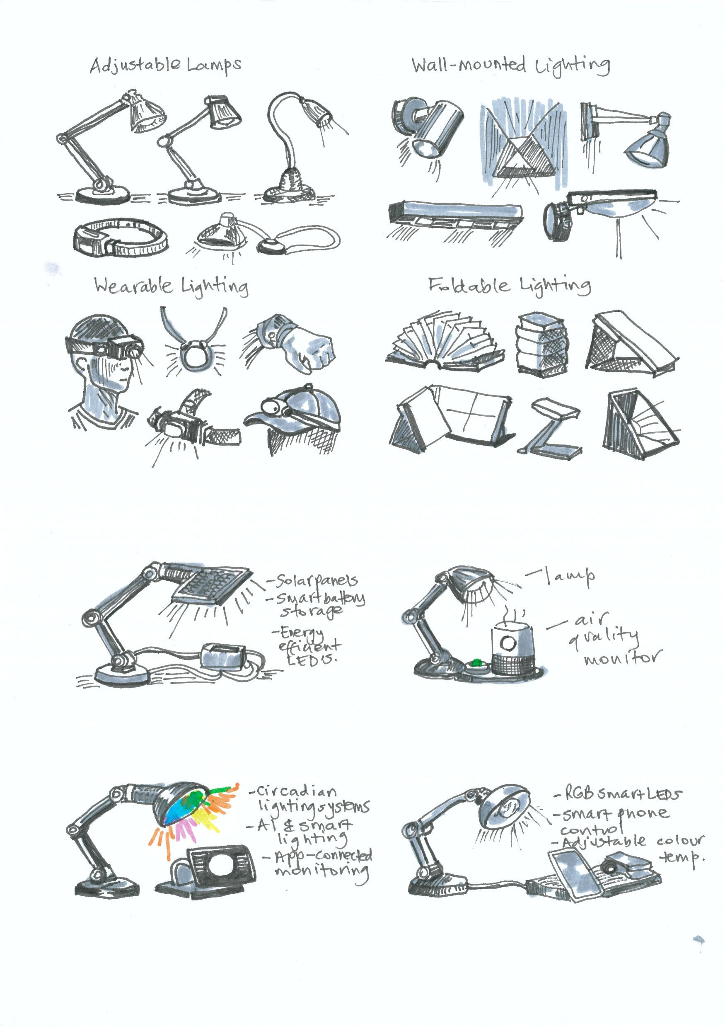
Thumbnail sketching
small quick sketches
focus on ideas, not perfect drawings
aim for 6–8 concepts
try different shapes and lighting directions
designers often sketch 10–20 ideas before selecting one
label the features of the sketches.

Slide 116
Check for understanding (11.1)
What is a thumbnail sketch?
A. A detailed technical drawing used for final manufacturing plans
B. A full-scale drawing that shows exact measurements and materials
C. A small, quick sketch used to explore and communicate early design ideas
D. A digital 3D model used to test how a product works
Notes:
[CLICK] to reveal answer
Answer is C

Slide 117
Check for understanding (11.2)
Why do designers generate multiple ideas?
A. To copy existing products more easily
B. To explore different possibilities and choose the most effective solution
C. To complete the design process more quickly
D. To make the design look more complicated
Notes:
[CLICK] to reveal answer
Answer is B

Slide 118
Check for understanding (11.3)
How could your lighting design disrupt current lighting systems?
A. By using the same materials and technologies already available
B. By copying existing lamp designs used in homes
C. By making a slightly different shape of an existing light
D. By introducing new technology or a new way lighting is used by people
Notes:
[CLICK] to reveal answer
Answer is D

Slide 119
Thumbnail sketches – example
Generate 6–8 thumbnail sketches.
Concept 1
Concept 2
Concept 3
Sketch
Sketch
Sketch
Can work off-grid, useful for outdoor areas or power outages.
Rechargeable battery allows lighting at night after daytime charging.
Could be used in remote communities or outdoor environments where electricity access is limited.
Creates a futuristic aesthetic that disrupts traditional lamp design.
No visible wires between bulb and base, improving visual appeal. Magnetic levitation technology may be expensive to manufacture. Might use more energy than a standard lamp to maintain levitation.
Allows users to customise lighting colour and brightness for different moods.
App control increases convenience and accessibility.
Energy-efficient LED technology can reduce electricity consumption. Requires smartphone connectivity, which may not suit all users.

Slide 120

Activity 11.1
Produce 6 thumbnail sketches for your lighting design in 5 minutes, including brief annotation explaining the idea.

Slide 121

Activity 11.2 – Peer critique of thumbnail sketches
Glow and grow
Glow – something strong about the idea.
Grow – something that could improve.

Slide 122
Design decision matrix
Designers often generate several possible ideas before choosing the best solution. A design decision matrix helps compare ideas using important design criteria so that decisions are logical and evidence-based.
Score each design idea against the criteria using a rating scale.
Example scoring system:
Score | Meaning
1 | Poor – does not meet the criteria
2 | Fair – partly meets the criteria
3 | Good – meets the criteria well
4 | Excellent – strongly meets the criteria

Slide 123
Activity 11.3 Design decision matrix
Criteria | Concept A | Concept B | Concept C
Function
Sustainability
Innovation
Feasibility
User needs
Total Score
Write the score for each idea in the matrix.
For the highest-ranking idea, write a short explanation answering:
Which idea scored the highest?
Why is this idea the most suitable solution?
How does it respond to your user needs or design opportunity?

Slide 124
Quick reflection (11)
I selected this lighting concept because…

Slide 125
12. Refining ideas with S.C.A.M.P.E.R and modelling

Slide 126
Learning intentions and success criteria (12)
We are learning to
refine design ideas using S.C.A.M.P.E.R
improve a concept before modelling
I can
apply S.C.A.M.P.ER to modify my design
communicate improvements through sketches
create a quick physical prototype.

Slide 127
Connecting learning (12)
What makes a design idea better than another idea?

Slide 128
Ideation and divergent thinking
S.C.A.M.P.E.R
Substitute
Combine
Traditional power source replaced with another technology
Lamp combined with another function or product
Adapt
Modify
Lamp adapted for a different environment
Lamp modified for new futures or lighting effects

Slide 129
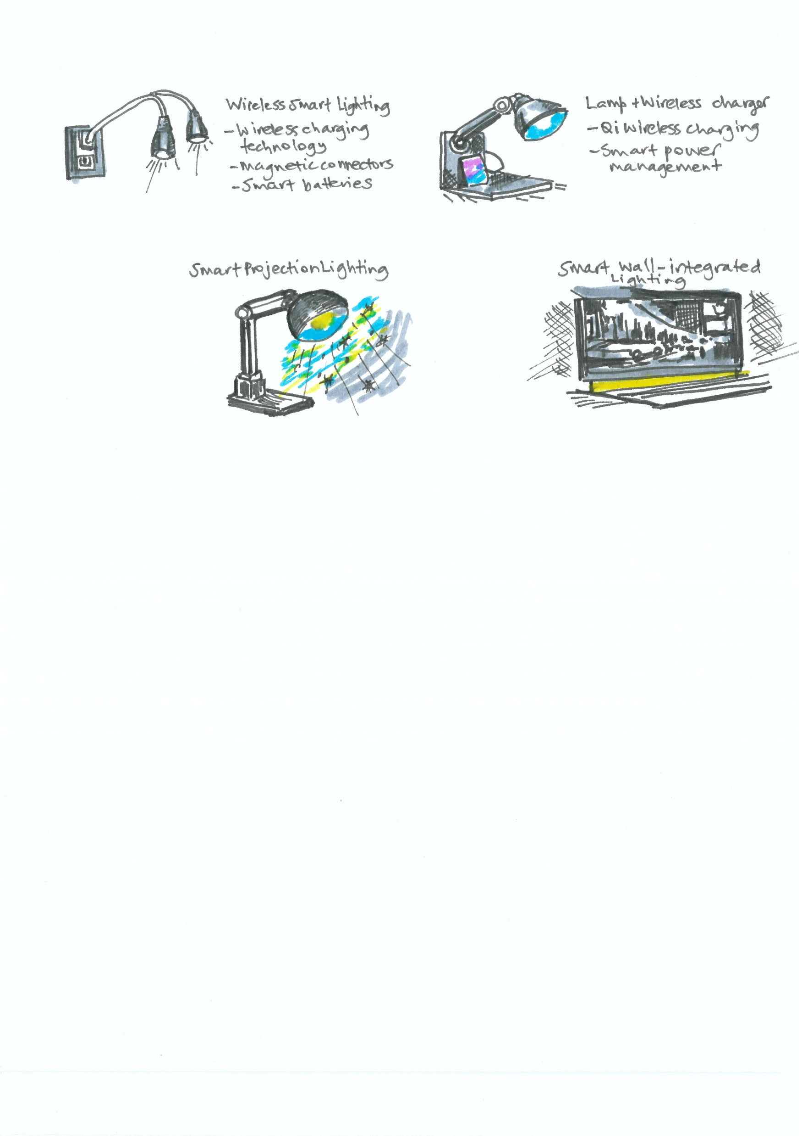
S.C.A.M.P.E.R
Put to another use
Combine
How could a lamp use wireless power?
What everyday object could be combined with a light?
Modify
Rearrange
How can a lamp create projection?
What part of the lamp can be rearranged in the design?

Slide 130
Activity 12.1 – Idea refinement using S.C.A.M.P.E.R
Take your highest-ranking concept from the Design Decision Matrix and apply S.C.A.M.P.E.R prompts to refine it further.
S.C.A.M.P.E.R prompt | Idea improvement
Substitute
Combine
Adapt
Modify
Put to another use
Eliminate
Reverse

Slide 131
Activity 12.2 – Quick physical modelling
Using aluminium foil
Practical activity – aluminium foil modelling
Students create a quick physical model using:
aluminium foil
cardboard
tape.
Purpose:
test shape
explore structure
visualise lighting direction.

Slide 132
Activity 12.3 – Peer feedback
Students share model with a partner, and they offer feedback for the concept design:
What works well?
What could improve?
Does it solve the user problem?
Students record one improvement idea for their design.

Slide 133
Exit ticket (4)
The improvements I made to my concept today after using S.C.A.M.P.E.R and quick modelling were…..

Slide 134
13. CAD introduction – On shape

Slide 135
Learning intentions and success criteria (13)
We are learning
how to use CAD software to model lighting designs.
I can
create a sketch and basic CAD shapes
use dimensions to control size
use extrude and sketch tools
save a digital model.

Slide 136
Connecting learning (13)
What advantages does CAD have over hand sketching?

Slide 137
Activity 13.1 – Getting started in On shape
Gradual release of responsibility.
1. Log in to Onshape https://cad.onshape.com
open a web browser
go to https://cad.onshape.com
log in after creating an account with school email details.

Slide 138
Getting started in On shape (2)
2. Create a new document
Select Create.
Select Document.
Name it ‘Lighting prototype’.
Select OK.
Designers organise their models inside documents so they can edit and improve designs easily.

Slide 139
Getting started in On shape (3)
Creating the lamp base
1. Start a sketch
Select Sketch to enter sketch mode in the Part Studio. The Sketch toolbar appears at the top of the screen. It contains tools like line, rectangle, arc and circle.
Select the Top plane.
2. Draw the lamp base shape
select the Centre point circle tool
click once in the centre point
drag outward to create a circle.

Slide 140
Getting started in On shape (4)
3. Add dimensions
Select the Dimension tool
Select the circle
Enter 120 mm.

Slide 141
Getting started in On shape (5)
4. Turn the sketch into 3D
Select Extrude
Select the circle
Set depth at 20 mm
Select the checkmark: ✔
You now have a 3D lamp base.

Slide 142
Activity 13.2 – Creating the cable hole
Creating a cable hole
Lighting products require space for wiring.
Select the top face of the base.
Select Sketch.
Draw a centre point circle in the centre.
Set the diameter at 10 mm.
Click the cable hole and select Extrude.
Select Through all, set depth to 20 mm and extrude direction to the bottom of the lamp base.
This cuts a hole through the base.

Slide 143
Exit ticket (13)
Students screenshot their model and upload it to the class folder.
Which CAD tool helped you most today?

Slide 144
14. CAD modelling

Slide 145
Learning intentions and success criteria (14)
We are learning to
develop the main structural components of our lighting design using CAD modelling.
I can
create additional sketches
add structural components
develop the core form of our lighting design.

Slide 146
Connecting learning (14)
What parts make up a typical lamp?

Slide 147
Activity 14.1 – Creating the lamp stem
Select the top surface of the base
Click Sketch
Draw a circle in the centre
Diameter: 15 mm
Click Extrude
Height: 120 mm
You now have the lamp stem

Slide 148
Activity 14.2 – Creating the lamp shade
Select the top of the stem.
Select Sketch, then Sketch plane – Mate connector.
Draw a large circle.
Set the diameter at 140 mm.
Select Extrude.
Set the depth at 40 mm.

Slide 149
Hollowing the shade
Real lampshades are hollow.
Select the Shell tool.
Select the top and bottom faces.
Set the thickness at 2 mm.
Now the lampshade has a hollow interior.

Slide 150
Adding lighting components – adding housing for LED, opening for light diffusion.
Students continue developing their CAD model.
Model should now include:
lamp base
stem or support structure
shade or light housing

Slide 151
Share insights (14)
What challenge did you solve while modelling your design?

Slide 152
15. CAD refinement and preparing for production

Slide 153
Learning intentions and success criteria (15)
We are learning to
refine CAD models
prepare files for digital manufacturing.
I can
refine my CAD model
adjust scale and proportions
export files suitable for fabrication.

Slide 154
Connecting learning (15)
Why must CAD models be accurate before manufacturing?

Slide 155
Activity 15.1 – Refining the design
Chunk 1 – Model refinement
• fillet (rounded edges) • chamfer (angled edges) • adjusting proportions.
Refine your model to improve aesthetics, safety, function, ergonomics.
Chunk 2 – Preparing files for manufacture
3D printing → STL
Laser cutting → DXF
Chunk 3 – Scaling and final adjustments
Students check • dimensions • wall thickness greater than 2mm • base is stable • parts are connected • adjust proportions • refine shapes • export final CAD file.
Students save final model and exported file.

Slide 156
Share insights (15)
What modification improved your design the most?

Slide 157
Weeks 7–8

Slide 158
16. Safety review and prototype production

Slide 159
Learning intentions and success criteria (16)
We are learning about
safe work practices
preparing digital files for the manufacturing process.
I can
identify hazards associated with workshop technologies
describe safe operating procedures for equipment
export files for digital manufacturing.

Slide 160
Connecting learning (16)
Examine the images of workshop equipment (or look around your workspace).
Identify three potential hazards.

Slide 161
Prototype fabrication – over 2 lessons
Chunk 1 – Workshop safety principles
• personal protective equipment • safe workspace setup • supervision requirements.
Chunk 2 – Preparing files for CAM for 3D printing (STL) or laser cutting (DXF).
Chunk 3 – Students fabricate prototype components.

Slide 162
Final thought (17)
What worked well during fabrication?

Slide 163
18. Prototype assembly

Slide 164
Learning intentions and success criteria (18)
We are learning to
assemble prototypes
conduct initial functional testing.
I can
assemble prototype components
evaluate functionality
identify improvements.

Slide 165
Connecting learning (18)
What makes a prototype successful?

Slide 166
Prototype assembly
Chunk 1 – Assembly techniques
connecting components
securing lighting elements
Chunk 2 – Functional testing
structural stability
lighting direction
brightness
Students assemble prototype.
Students conduct initial tests.
Students record observations.

Slide 167
Share insights (18)
What improvements are needed for your design?

Slide 168
19. Prototype testing

Slide 169
Connecting learning (19)
Why do designers test prototypes before producing final products?

Slide 170
Learning intentions and success criteria (19)
We are learning to
test prototypes
evaluate performance
identify areas for improvement
I can
conduct structured prototype testing
record observations and results
identify strengths and weaknesses of my design.

Slide 171
Prototype testing
Undertake prototype testing to
identify design flaws
improve usability
collect evidence for evaluation.
Rotate through testing tasks
Brightness test- how effectively does the light illuminate a surface?
Glare test- is the light comfortable to look at?
User interaction test- is the product easy to use?

Slide 172
Activity 19.1 – Prototype testing
observations
user feedback
performance issues
Students document
Test | Result | Observation
Brightness
Glare
Usability test
Stability test

Slide 173
Quick write (19)
What surprised you about testing your prototype?

Slide 174
20. Prototype evaluation

Slide 175
Learning intentions and success criteria (20)
We are learning to
analyse prototype performance
identify improvements.
I can
evaluate design performance
identify design strengths and weaknesses
propose improvements.

Slide 176
Connecting learning (20)
Which part of your design worked best?

Slide 177
Activity 20.1 – Evaluating prototype solutions
Criteria | Considerations | Evaluation
User needs | Does it solve the problem?
Functionality | Does it work effectively?
Sustainability | Are materials environmentally responsible?
Aesthetics | Does the design look appealing?
Students identify • strengths • weaknesses • improvements for iteration.
This lighting design successfully improves…
However, the design could be improved by…

Slide 178
Final thought (20)
What will you change in your design?

Slide 179
Weeks 9–10

Slide 180
21. Iteration design: improving the CAD model

Slide 181
Connecting learning (21)
What is the most important change that your design needs?

Slide 182
Learning intentions and success criteria (21)
We are learning to
modifying our CAD models to improve design performance.
I can
modify CAD models based on evaluation
refine structural and functional features.

Slide 183
CAD refinement – over 3 lessons
Iteration involves test → evaluate → improve.
CAD refinement
adjusting dimensions
modifying shapes
adding structural features.
Students update CAD models implementing improvements.
Examples: adjust lamp height, change shade shape, add diffusion holes.
Students export their completed file for production over the next 3 lessons.

Slide 184
Share insights (21)
What improvement did you make to your design today?

Slide 185
22. Prototype production, assembly and evaluation

Slide 186
Connecting learning (22)
What problems might occur during fabrication?

Slide 187
Learning intentions and success criteria (22)
We are learning to
fabricate, assemble and evaluate components required for our final lighting prototype over 3 lessons.
I can
use fabrication equipment safely
produce prototype components accurately
troubleshoot fabrication issues
assemble prototype components
evaluate structural stability and lighting performance
identify minor improvements.

Slide 188
Production, assembly, evaluation
Students fabricate prototype components. Examples: laser cut lamp shade, 3D print base, produce structural elements.
Students conduct quick quality checks • accurate dimensions • clean cuts • structural integrity.
Students use assembly techniques • securing components • connecting lighting elements • ensuring structural stability.
Students complete initial functionality testing • stability test • lighting direction test • usability test.
Students record observations in their folio.

Slide 189
Check for understanding (22.1)
Why should prototypes be tested during assembly?
A. To make the product look more decorative
B. To reduce the amount of planning required
C. To avoid documenting design changes
D. To identify problems early and improve the design before the final product is completed
Notes:
[CLICK] to reveal answer
Answer is D

Slide 190
Check for understanding (22.2)
What might indicate a structural problem in a prototype or product?
A. The product slightly moves when touched but still supports weight safely
B. The product bends, cracks or becomes unstable during testing and use
C. The product flexes a little under pressure but returns to its original shape
D. The product has minor surface scratches after assembly
Notes:
[CLICK] to reveal answer
Answer is B

Slide 191
23. Final testing, photography and evaluation

Slide 192
Connecting learning (25)
What problem was your lighting design trying to solve?

Slide 193
Learning intentions and success criteria (25)
We are learning to
test our final lighting prototype
document the product using photography
evaluate how effectively the design meets the identified user need.
I can
test the final prototype for functionality and usability
photograph the design clearly for documentation
annotate and explain key design features
evaluate how well the design meets user needs and specifications.

Slide 194
Activity 23.1 – Final prototype testing
Students test final products against design specifications and user needs.
Examples of final prototype testing could be:
Functionality test – does the lamp illuminate the intended area?
Glare test – is the light comfortable to look at?
Usability test – is the design easy to interact with?

Slide 195
Activity 23.2 – Product photography
Students photograph their prototypes from multiple angles.
Use a neutral background.
Photograph from multiple angles.
Include close-ups of key features.
Ensure lighting shows design details.
Students insert images into their design folio.

Slide 196
Activity 23.3 – Final evaluation
Write an evaluation of your final prototype addressing user needs, functionality, sustainability, aesthetics, future improvements.
Strengths of the design
Limitations or weaknesses
Future improvements
Reflection on the design process.
A scaffold is provided in the student support resource- design folio template.

Slide 197
References
This presentation contains NSW Curriculum and syllabus content. The NSW Curriculum is developed by the NSW Education Standards Authority. This content is prepared by NESA for and on behalf of the Crown in the right of the State of New South Wales. The material is protected by Crown copyright.
Please refer to the NESA Copyright Disclaimer for more information https://www.nsw.gov.au/education-and-training/nesa/copyright.
NESA holds the only official and up-to-date versions of the NSW Curriculum and syllabus documents. Please visit NESA https://www.nsw.gov.au/education-and-training/nesa and NSW Curriculum https://curriculum.nsw.edu.au.
Design Innovation and Technology 7–10 Syllabus© NSW Education Standards Authority (NESA) for and on behalf of the Crown in right of the State of New South Wales, 2025.

Slide 198
Copyright
© State of New South Wales (Department of Education), 2026
The copyright material published in this resource is subject to the Copyright Act 1968 (Cth) and is owned by the NSW Department of Education or, where indicated, by a party other than the NSW Department of Education (third-party material).
Copyright material available in this resource and owned by the NSW Department of Education is licensed under a Creative Commons Attribution 4.0 International (CC BY 4.0) license.
This license allows you to share and adapt the material for any purpose, even commercially.
Attribution should be given to © State of New South Wales (Department of Education), 2026.
Material in this resource not available under a Creative Commons license:
the NSW Department of Education logo, other logos and trademark-protected material
Material owned by a third party that has been reproduced with permission. You will need to obtain permission from the third party to reuse its material.
Links to third-party material and websites
Please note that the provided (reading/viewing material/list/links/texts) are a suggestion only and implies no endorsement, by the New South Wales Department of Education, of any author, publisher, or book title. School principals and teachers are best placed to assess the suitability of resources that would complement the curriculum and reflect the needs and interests of their students.
If you use the links provided in this document to access a third-party’s website, you acknowledge that the terms of use, including licence terms set out on the third-party’s website apply to the use which may be made of the materials on that third-party website or where permitted by the Copyright Act 1968 (Cth). The department accepts no responsibility for content on third-party websites.

