Slide 1
Instructions for use
Learning episode 4
This resource is not a teaching and learning program. It should be used in conjunction with Computing Technology 7-10 – Analysing data.
Classroom teachers are encouraged to add and adapt slides as required to meet the needs of their students.
Save a copy of the file to make changes to the slide deck. Go to File > Download a Copy (this downloads a copy to the computer to edit in the PowerPoint app).
To convert the PowerPoint to Google Slides:
  Upload the file into Google Drive and open it.
  Go to File > Save as Google Slides.
  (Note – conversion may cause formatting changes in the slides.)

Slide 2

Enterprise systems – analysing data
Computing Technology – Stage 5
Research and plan
Weeks 9 – 10
Notes:
This slide deck complements the teacher support resource, assessment tasks and program of learning. Teachers are advised to issue the support resource either through their LMS or printed as a student workbook

Slide 3
Learning episodes
1
Identify and define
6
Real world scenarios
2
Data types
7
  Spreadsheets and databases
3
8
Digital solutions
Purpose and people
4
9
Test and evaluate
Research and Plan
5
10
Exploring careers
Visualise and model
Notes:
This slide indicates the plan for 10 learning episodes and the current slide deck 7 Spreadsheets and databases

Slide 4
4. Research and plan

Slide 5
Learning intentions and success criteria
We are learning how
data analysis has evolved in response to people's needs and opportunities.
We can
research historically significant events in data analysis
explain why these events were important to people
correctly order these historically significant events on a timeline.
Notes:
Notes for teachers:
Learning intentions and success criteria are best co-constructed with students. Adapt the learning intention as required and add matching success criteria.
For more information See ⁠AITSL or the NSW Department of Education explicit teaching strategies, ⁠Sharing learning intentions and ⁠Sharing success criteria
LISC is not necessarily presented at the beginning of the lesson. Teacher needs to consider most effectual time to introduce
LISC should be revisited during the lesson to support students' evaluation of their learning
Describe how data analysis in your topic has evolved in response to people's needs and opportunities

Slide 6
Describe how data analysis has evolved in response to people's needs and opportunities
Read together
“…the earliest preserved records of writing are not … poems, great speeches love letters or novels, but rather examples of data analysis.
Sumerian scribes produced lists of ploughmen employed by the state and preserved this data on clay tablets making the first database in the process. These inscriptions also calculated their wages directly from this raw data, so the discipline of data analytics was born too….” Deryck Brailsford

Slide 7
Jigsaw research
Work in teams to research one historically significant event from the following list:
A brief, brief history of Data Analytics
The development of the binary number system
Census through the ages
Florence Nightingale, data journalist
A Brief History of Social Media
A Brief History of the Internet
How VisiCalc’s Spreadsheets Changed the World
A Brief History of Database Management
Data.NSW
Describe how data analysis in your topic has evolved in response to people's needs and opportunities.
Teams add their research to a class timeline.
Notes:
Census through the ages
(Earliest recorded around 3800 BCE and continuing through history)
The development of the binary number system
(Formalised by Leibniz in the late 17th century, c. 1679–1703)
Florence Nightingale, data journalist
(Mid-19th century, 1850s)
A brief, brief history of Data Analytics
(Gains prominence in the 20th century)
A Brief History of Database Management
(1960s–1970s)
A Brief History of the Internet
(Late 1960s onwards)
How VisiCalc’s Spreadsheets Changed the World
(1979)
A Brief History of Social Media
(Late 1990s–early 2000s onwards)
Data.NSW
(2010s onwards)

Slide 8
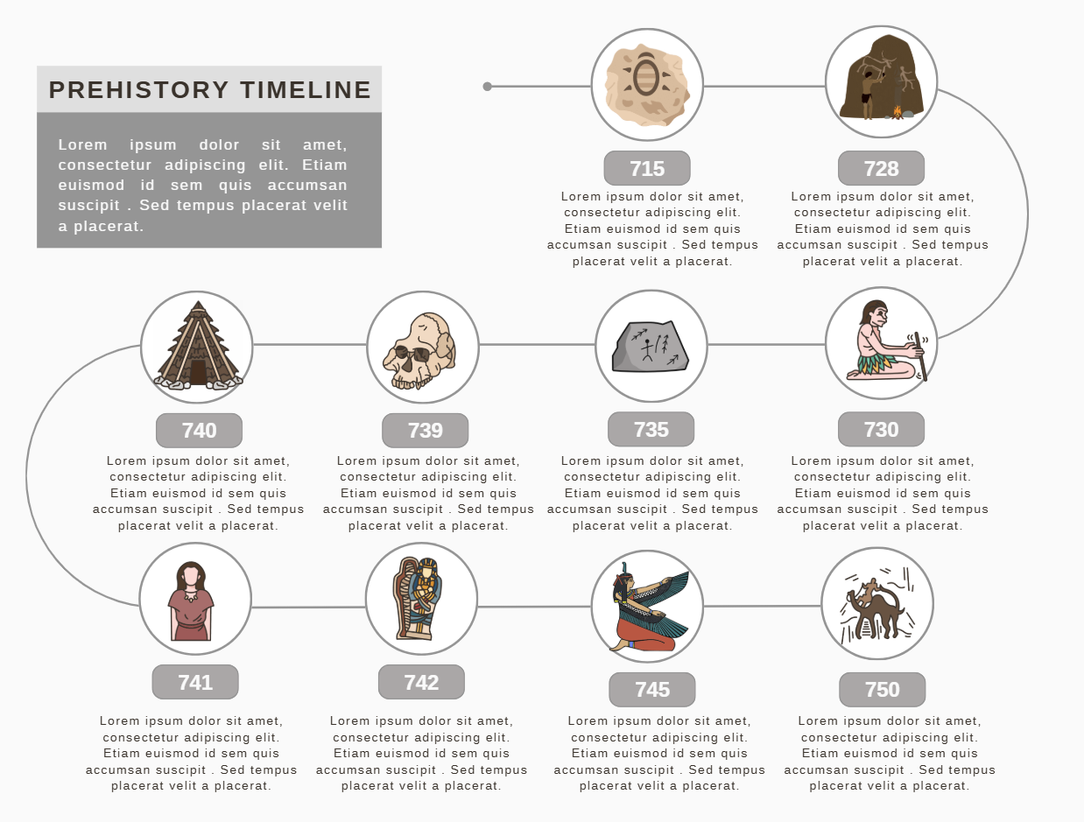
Canva
Timeline templates
sample
Canva.com/templates

Slide 9

Knowledge check – concluding the lesson
End of section student skills formative assessment checklist
Students can: | Checkbox
identify historically significant events in data analysis explain why these events were important to people order these historically significant events on a timeline

Slide 10
References
This presentation contains NSW Curriculum and syllabus content. The NSW Curriculum is developed by the NSW Education Standards Authority. This content is prepared by NESA for and on behalf of the Crown in the right of the State of New South Wales. The material is protected by Crown copyright.
Please refer to the NESA Copyright Disclaimer for more information https://educationstandards.nsw.edu.au/wps/portal/nesa/mini-footer/copyright.
NESA holds the only official and up-to-date versions of the NSW Curriculum and syllabus documents. Please visit the NSW Education Standards Authority (NESA) website https://educationstandards.nsw.edu.au/wps/portal/nesa/home and the NSW Curriculum website https://curriculum.nsw.edu.au.
Computing Technology 7-10 Syllabus © NSW Education Standards Authority (NESA) for and on behalf of the Crown in right of the State of New South Wales, 2024.
NSW Department of Education (n.d.) Digital learning selector, Peer discussion and conferencing, accessed 21 April 2026.
NSW Department of Education (n.d.) Explicit teaching: Activating prior knowledge, accessed 21 April 2026.
NSW Department of Education (n.d.) Explicit Teaching: Checking for understanding, accessed 21 April 2026.
NSW Department of Education (n.d.) Explicit teaching: Chunking and sequencing learning, accessed 21 April 2026.
NSW Department of Education (n.d.) Explicit teaching: Connecting learning, accessed 21 April 2026.
NSW Department of Education (n.d.) Explicit teaching: Modelling technique guide, accessed 21 April 2026.
NSW Department of Education (n.d.) Explicit teaching, Using effective questioning, accessed 24 September 2025.

Slide 11
References (1)
Brittanica (May 2026) Census accessed 31 August 2022.
Cassel D (2 June 2019) ‘How VisiCalc’s Spreadsheets Changed the World’, The New Stack: Tech Life, accessed 31 August 2022.
Deryck B. (Sept 2020) A brief, brief history of Data Analytics LinkedIn website, accessed 1 May 2026.
Foote KD (25 October 2021) ‘A Brief History of Database Management’, Dataversity: Information Management Articles, accessed 31 August 2022.
Internet Society (1997) A Brief History of the Internet website, accessed 1 May 2026.
Luis Llamas (2026) Origin and History of the Binary System website, accessed 1 May 2026.
Maryville University (May 2020) The Evolution of Social Media: How Did It Begin, and Where Could It Go Next? Blog accessed 1 May 2026.
NSW Government Data.NSW website, accessed 1 May 2026.
Rogers S (Aug 2010) Florence Nightingale, datajournalist: information has always been beautiful Guardian website, accessed 1 May 2026.

Slide 12
Copyright
© State of New South Wales (Department of Education), 2026
The copyright material published in this resource is subject to the Copyright Act 1968 (Cth) and is owned by the NSW Department of Education or, where indicated, by a party other than the NSW Department of Education (third-party material).
Copyright material available in this resource and owned by the NSW Department of Education is licensed under a Creative Commons Attribution 4.0 International (CC BY 4.0) licence.
This licence allows you to share and adapt the material for any purpose, even commercially.
Attribution should be given to © State of New South Wales (Department of Education), 2026.
Material in this resource not available under a Creative Commons licence:
the NSW Department of Education logo, other logos and trademark-protected material
Material owned by a third party that has been reproduced with permission. You will need to obtain permission from the third party to reuse its material.
Links to third-party material and websites
Please note that the provided (reading/viewing material/list/links/texts) are a suggestion only and implies no endorsement, by the New South Wales Department of Education, of any author, publisher, or book title. School principals and teachers are best placed to assess the suitability of resources that would complement the curriculum and reflect the needs and interests of their students.
If you use the links provided in this document to access a third party’s website, you acknowledge that the terms of use, including licence terms set out on the third-party’s website apply to the use which may be made of the materials on that third-party website or where permitted by the Copyright Act 1968 (Cth). The department accepts no responsibility for content on third-party websites.

