Slide 1
Instructions for use
Learning episode 3
This resource is not a teaching and learning program. It should be used in conjunction with Computing Technology 7-10 – Analysing data.
Classroom teachers are encouraged to add and adapt slides as required to meet the needs of their students.
Save a copy of the file to make changes to the slide deck. Go to File > Download a Copy (this downloads a copy to the computer to edit in the PowerPoint app).
To convert the PowerPoint to Google Slides:
  Upload the file into Google Drive and open it.
  Go to File > Save as Google Slides.
  (Note – conversion may cause formatting changes in the slides.)

Slide 2

Enterprise systems – analysing data
Computing Technology – Stage 5
Purpose and people
Weeks 5 – 8
Notes:
This slide deck complements the teacher support resource, assessment tasks and program of learning. Teachers are advised to issue the support resource either through their LMS or printed as a student workbook

Slide 3
Learning episodes
1
Identify and define
6
Real world scenarios
2
Data types
7
  Spreadsheets and databases
3
8
Digital solutions
Purpose and people
4
9
Test and evaluate
Research and Plan
5
10
Exploring careers
Visualise and model
Notes:
This slide indicates the plan for 10 learning episodes and the current slide deck 7 Spreadsheets and databases

Slide 4
3. Purpose and people

Slide 5
Learning intentions and success criteria (0)
We are learning to
describe the purpose of analysing data.
We can
explain how data analysis helps describe:
  what happened
  why it happened
  and predict what might happen in the future.
apply data analysis to a familiar information system.
Notes:
Notes for teachers:
Learning intentions and success criteria are best co-constructed with students. Adapt the learning intention as required and add matching success criteria.
For more information See ⁠AITSL or the NSW Department of Education explicit teaching strategies, ⁠Sharing learning intentions and ⁠Sharing success criteria
LISC is not necessarily presented at the beginning of the lesson. Teacher needs to consider most effectual time to introduce
LISC should be revisited during the lesson to support students' evaluation of their learning

Slide 6
What questions can and can’t be answered using data?(1)
A:
What is the average age of students in Year 10 at our school?
B:
Why do students prefer maths over science?

Slide 7
What questions can and can’t be answered using data?(2)
A:
“What is the best way to motivate students?
B:
How many students received a distinction in the last maths test?
This could be opinion/speculation and needs evidence
Notes:
This example shows that it’s not just ‘numbers’ that can be data – pre-empting this misconception

Slide 8
What questions can and can’t be answered using data?(3)
A:
What will education look like in 50 years?
B:
How has the school’s attendance rate changed over the past five years?

Slide 9
What questions can and can’t be answered using data?(4)
A:
How many books were borrowed from the school library last month?
B:
What makes a subject interesting?
Notes:
What is the average age of students in Year 10 at our school?
How many students received a distinction in the last maths test?
What is the percentage of students who walk to school versus those who use public transport?
Which subject has the highest enrolment in Year 11?
How has the school’s attendance rate changed over the past five years?
What is the median score of students in the latest English exam?
How many books were borrowed from the school library last month?
What is the gender distribution in Year 12?
Questions that can’t be answered using data (opinion/speculation/non-empirical):
Why do students prefer maths over science?
What is the best way to motivate students?
Which teacher is the most inspiring?
Should the school have a longer lunch break?
What will education look like in 50 years?
Is homework important for learning?
What makes a subject interesting?
How do students feel about school uniforms?

Slide 10
What questions can and can’t be answered using data?(5)
A:
What is the gender distribution in Year 12?
B:
How do students feel about school uniforms?

Slide 11
Quantitative and qualitative data
Quantitative data = numbers (how many, how much)
Quantitative data is information that can be counted or measured.
It’s all about numbers
Qualitative data = words/descriptions (qualities, opinions)
Qualitative data is descriptive and deals with characteristics or qualities that can’t be measured with numbers.
Sentiment data = feelings and attitudes (positive, negative, neutral)
Sentiment data is a special type of qualitative data that involves identifying feelings or attitudes (positive, negative, or neutral) expressed in text or speech.

Slide 12

Describe the purpose of analysing data (1)
Analysing data means looking closely at information to understand it better.
It helps us describe what happened, why it happened, and can even predict what might happen in the future.
When you analyse data, you can also come up with new questions that help you learn more.

Slide 13
Describe the purpose of analysing data (2)
Tracking student attendance (worked example)
The school collects attendance data every day.
By analysing this data, teachers and school leaders can see which days have the most absences and find out why students might be missing school on those days.
For example, if many students are absent right before a holiday, the school might understand a pattern. This helps the school plan better and support students who might be struggling.
Think about some of the Information systems at your school

Slide 14
Describe the purpose of analysing data (3)
Information systems at your school
Jigsaw activity:
Each student joins one of the four groups.
Students leave their “home” group to join an expert group.
Each expert group researches the following questions
(next slide)
Monitoring academic performance
Behaviour and wellbeing
School canteen
Sports carnival results

Slide 15
Describe the purpose of analysing data (4)
Monitoring academic performance
Behaviour and wellbeing
School canteen
Sports carnival results
Think about some of the Information systems at your school
i) What type of data is collected in your topic?
ii) How is this data analysed?
iii) What decisions can be made from analysing this data?
iv) How does analysing this data benefit the school community?
v) Can you give a specific example related to your topic?
Students return to their homegroups, share their findings and create a presentation to share with the class

Slide 16
Describe the purpose of analysing data (5)
Check for understanding: Information systems outside of school.
the weather
sports data
agriculture
farmbeats
environmental research
social justice
gapminder.
Re-assign students to a topic “outside of school”
Each group answers the question:
How does analysing this data benefit the user?
Notes:
Suggested information systems outside of school can range from the personal to local community to global scales.

Slide 17
Check for understanding
Which is quantitative data and which is qualitative data?
A:
Number of students in a class (e.g., 25 students)
B:
Student feedback on a lesson (e.g., “I found the lesson interesting.”)
Notes:
A=quantitative B=qualitative

Slide 18

Knowledge check – concluding the lesson
End of section student skills formative assessment checklist
Students can: | Checkbox
describe the purpose of analysing data. differentiate between quantitative and qualitative data. explain how data analysis helps us: describe what happened describe why it happened predict what might happen in the future apply data analysis to a familiar information system

Slide 19
Learning intentions and success criteria (1)
We are learning to
describe inputs, storage, transmission, processes and outputs in data analysis.
We can
explain how a fitness tracker analyses data
describe the inputs, storage, transmission, processes and outputs of other information systems.
Notes:
Notes for teachers:
Learning intentions and success criteria are best co-constructed with students. Adapt the learning intention as required and add matching success criteria.
For more information See ⁠AITSL or the NSW Department of Education explicit teaching strategies, ⁠Sharing learning intentions and ⁠Sharing success criteria
LISC is not necessarily presented at the beginning of the lesson. Teacher needs to consider most effectual time to introduce
LISC should be revisited during the lesson to support students' evaluation of their learning

Slide 20
Describe inputs, storage, transmission, processes and outputs in data analysis (1)
How fitness trackers work.
Controlling physical systems
Complete the table.
Fitness Tracker | Description
Inputs | Daily step counts, heart rate profiles, and locations visited. Sensors and manual entry.
Storage | Within device then uploaded activity data to a cloud service/server.
Transmission | Fitbit to mobile phone: Bluetooth Mobile phone to server/cloud.
Processes | Record, store, and exchange. Algorithms convert raw data into statistical displays.
Output | Visualised information on a mobile phone screen app.
Notes:
Fitness trackers are an accessible and familiar device for analysing data.Other devices include: smartphones, smart watches, Game consoles, digital cameras,, music devices, e-readers

Slide 21
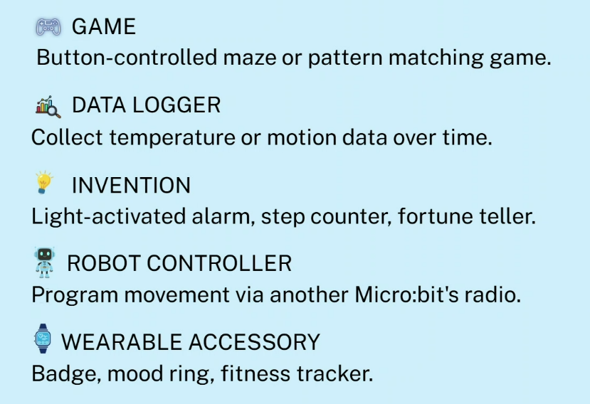

How do microbits collect data ?
Microsoft MakeCode for micro:bit
© Micro:bit Educational Foundation

Slide 22
Describe inputs, storage, transmission, processes and outputs in data analysis (2)
Check for understanding: In your groups complete the table.
Example | Solutions
Inputs
Storage
Transmission
Processes
Output
Examples include:
the weather bureau
sports data
agriculture
farmbeats
environmental research
social justice
gapminder.
Notes:
For example: Inputs:
Data from weather sensors and instruments (temperature, humidity, wind speed, air pressure)
Satellite images and radar data
Historical weather data
Reports from meteorological stations and weather balloons
Storage:
Collected data is stored in databases and servers for analysis and historical reference
Large volumes of satellite images and sensor readings are archived
Transmission:
Data is transmitted from remote weather stations and satellites to central data centres
Real-time data is transmitted via communication networks (e.g., satellite links, internet)
Alerts and forecasts are transmitted to media and public services
Processes:
Data processing and cleaning to remove errors
Analysis using computer models and simulations to predict weather patterns
Data fusion combining information from different sources for accuracy
Generation of weather forecasts and warnings
Output:
Weather forecasts (daily, weekly)
Severe weather warnings (storms, floods, heatwaves)
Reports and visualisations such as maps and graphs
Public information through websites, apps, and media broadcasts

Slide 23
Knowledge check – concluding the lesson (1)
End of section student skills formative assessment checklist
Students can: | Checkbox
describe the inputs, storage, transmission, processes and outputs in data analysis. describe how a fitness tracker works. identify the inputs, storage, transmission, processes and outputs of other information systems explain how a microbit collects data.

Slide 24
Learning intentions and success criteria (2)
We are learning to
define functional and non functional requirements of data analysis.
We can
plot nonfunctional and functional requirements on a spectrum
apply non functional and functional requirements to a fitness tracker
describe user and test cases for a fitness tracker.
Notes:
Notes for teachers:
Learning intentions and success criteria are best co-constructed with students. Adapt the learning intention as required and add matching success criteria.
For more information See ⁠AITSL or the NSW Department of Education explicit teaching strategies, ⁠Sharing learning intentions and ⁠Sharing success criteria
LISC is not necessarily presented at the beginning of the lesson. Teacher needs to consider most effectual time to introduce
LISC should be revisited during the lesson to support students' evaluation of their learning

Slide 25
Functional and non-functional requirements
functional
non-functional
What it does
outputs
results
security
flexibility
How well it does it
inputs
processes
portability
reliability
performance
Notes:
At one end, functional requirements define what the system must do to fulfil user needs, focusing on concrete inputs, outputs and features. Moving along the cline toward non-functional requirements, the focus shifts to how well the system performs those functions, concerned with quality attributes that affect user satisfaction and system effectiveness.

Slide 26
Specify the functional and non-functional aspects of the data analysis example
Complete examples of functional and non-functional requirements for a fitness tracker in the table below
Functional | Non-functional
Accurate step counts | User friendliness
Accurate heart rate | Password protected
Record, store, and exchange algorithms | Battery life
Convert raw data into statistical displays
Correct screen display
Mobile phone screen app
.

Slide 27
Describe user cases and develop test cases of inputs and expected outputs
Fitness tracker example.
User Case | Test Input | Expected Output
Step count tracking | User walks 100 steps | Display shows 100 steps
Heart rate monitoring | User rests (input: resting) | Heart rate displays, e.g., 65 bpm
Heart rate monitoring | User exercises (input: running) | Heart rate displays, e.g., 120 bpm
Sleep tracking | User sleeps 8 hours (input) | Display shows 8 hours sleep and sleep quality
Kilojoule tracking | User inputs food (2000 kJ) | Daily kilojoule count increases by 2000 kJ
Distance tracking | User runs 5 km | Distance displayed is 5 km
Goal achievement | User reaches 10,000 steps goal | Notification: "Goal achieved!"
Sync with mobile app | User syncs tracker with app | App is updated with latest tracker data
Notes:
Watch:
How Accurate Is Your Fitness Tracker? (7:20)
Read:
Study Ranks the Most Accurate Fitness Trackers​ | WellnessPulse
Is Your Fitness Tracker Really Accurate? Here’s the Truth - HealthEvoke

Slide 28
Check for understanding
Which is a functional and which is a non-functional requirement?
A:
The device must have a battery life of at least 5 days before needing to be recharged.
B:
The Fitbit must record and display the number of steps taken by the user each day.
Notes:
A= non functionl B= functional

Slide 29
Knowledge check – concluding the lesson (2)
End of section student skills formative assessment checklist
Students can: | Checkbox
define functional and non functional requirements of data analysis. plot nonfunctional and functional requirements on a spectrum. apply non functional and functional requirements to a fitness tracker. describe user and test cases for a fitness tracker.

Slide 30
Learning intentions and success criteria (3)
We are learning to
understand the social impacts and ethical and legal responsibilities in analysing data
considering the perspectives of diverse groups when analysing data.
We can
debate the use of facial recognition systems
acknowledge the diversity of our community and the implications of data analysis
describe the role of Indigenous data.
Notes:
Notes for teachers:
Learning intentions and success criteria are best co-constructed with students. Adapt the learning intention as required and add matching success criteria.
For more information See ⁠AITSL or the NSW Department of Education explicit teaching strategies, ⁠Sharing learning intentions and ⁠Sharing success criteria
LISC is not necessarily presented at the beginning of the lesson. Teacher needs to consider most effectual time to introduce
LISC should be revisited during the lesson to support students' evaluation of their learning

Slide 31
Social, ethical and legal responsibilities when analysing data
Scenario
To improve the tracking of student attendance, a suggestion has been made to equip the school office with a facial recognition camera and software to mark the roll automatically.
Research this technology.
Complete the PMI on the next slide.
Debate the scenario with a for and against argument.

Slide 32
Facial recognition system for school attendance
+
?
Plus
Minus
Interesting

Slide 33
Explore data analysis considering the perspectives of diverse groups…
How diverse is your community?
Complete the Think-Pair-Share activity to answer this question.
Discuss how this diversity (or lack of it) within your school community effect's identity, sense of belonging and different perspectives.
Visit SBS Australian Census Explorer and compare 3 places from across NSW.
How diverse is your community?
How could this information inform government planners and policy makers?

Slide 34
How diverse is our community?
What do I know? | What do I want to know? | What have I learned? | How can I learn more?
In our class: culturally and linguistically diverse people. ages groups genders people with disability | In the wider community: How diverse is your community?
K
What do I know?
W
What do I want to know?
L
What have I learned?
H
How can I learn more?

Slide 35
Aboriginal and Torres Strait Islander people's data
Indigenous data. Teacher provides a series of 5 “Why” questions for each.
What role does Aboriginal and Torres Strait Islander peoples data play:
preservation of cultural heritage and cultural knowledge’s
improving social, economic and health outcomes
empowering communities
Notes:
Observation: Indigenous data plays a role in preserving cultural heritage and cultural knowledge.
5 Whys:
Why is Indigenous data important for preserving cultural heritage?
Why does preserving cultural heritage require detailed and accurate data?
Why might cultural knowledge be lost without proper documentation and data?
Why is it important to maintain access to cultural knowledge for future generations?
Why does Indigenous data support the transmission of cultural practices and languages?
2. Improving social, economic and health outcomes
Observation: Indigenous data helps improve social, economic, and health outcomes.
5 Whys:
Why is Indigenous data necessary for improving social, economic, and health outcomes?
Why do policies and programs need accurate Indigenous data to be effective?
Why can a lack of data lead to inadequate support or resources for Indigenous communities?
Why is targeted intervention based on Indigenous data more effective in addressing disparities?
Why does improved data-driven decision-making result in better social and health outcomes?
3. Empowering communities
Observation: Indigenous data empowers communities.
5 Whys:
Why does Indigenous data empower communities?
Why does having control over data increase community autonomy?
Why is owning data important for self-determination and decision-making?
Why does community access to data enable them to advocate for their rights and needs?
Why does empowerment through data contribute to stronger cultural identity and wellbeing?

Slide 36
Check for understanding
Why is indigenous data important
Indigenous data is critical because it empowers self-determination, protecting cultural identity and enabling First Nations communities to guide their own futures.
Without community-led governance over how this information is collected and used, historical data practices risk perpetuating disadvantage and misrepresenting community needs.
Notes:
Aboriginal and Torres Strait Islander peoples data is often referred to as Indigenous data. Indigenous data is critical because it empowers self-determination, protecting cultural identity and enabling First Nations communities to guide their own futures.
Without community-led governance over how this information is collected and used, historical data practices risk perpetuating disadvantage and misrepresenting community needs.

Slide 37
Knowledge check – concluding the lesson (3)
End of section student skills formative assessment checklist
Students can: | Checkbox
describe social, ethical and legal responsibilities in analysing data consider the perspectives of diverse groups when analysing data debate the use of facial recognition systems in schools explain the diversity of communities and the implications of data analysis describe the role of Indigenous data.

Slide 38
Learning intentions and success criteria (4)
We are:
describing simple types of data compression
exploring the applications of small and big datasets
We can:
explain why data compression is important
  describe the types and examples of data compression.
Define big and small data sets and provide examples of where they are used.
Notes:
Notes for teachers:
Learning intentions and success criteria are best co-constructed with students. Adapt the learning intention as required and add matching success criteria.
For more information See ⁠AITSL or the NSW Department of Education explicit teaching strategies, ⁠Sharing learning intentions and ⁠Sharing success criteria
LISC is not necessarily presented at the beginning of the lesson. Teacher needs to consider most effectual time to introduce
LISC should be revisited during the lesson to support students' evaluation of their learning

Slide 39
Explain simple compression of data and types of compression
Why Compress?
Reduces file size: compression shrinks the amount of storage space needed for files.
Smaller files make it easier to manage, store, and share data.
Faster transfers: compressed data can be sent over networks faster, which is critical for emails, websites, and cloud storage.
Saves bandwidth and costs: less data to transmit means reduced bandwidth usage and potentially lower costs for storage and data transfers.
Efficient backup and archiving: compression makes backups and archives more efficient and less expensive.
.

Slide 40
Compression
Two main types
Compression Type | Description | Examples | Typical Uses
Lossless | No data lost during compression. Original data can be fully restored. | ZIP, PNG, GIF, FLAC | Text files, documents, software, images where data integrity is vital
Lossy | Some data is lost during compression. Restored data is not exactly the same as original. | JPEG, MP3, MP4 | Multimedia files (images, audio, video) where smaller file size is more important than exact reproduction

Slide 41
Small and big data sets
small
big
library book loans
online movie ratings
census data
class survey
daily weather
HSC results
personal budget
attendance records
sports competition results
satellite data
global social media posts

Slide 42
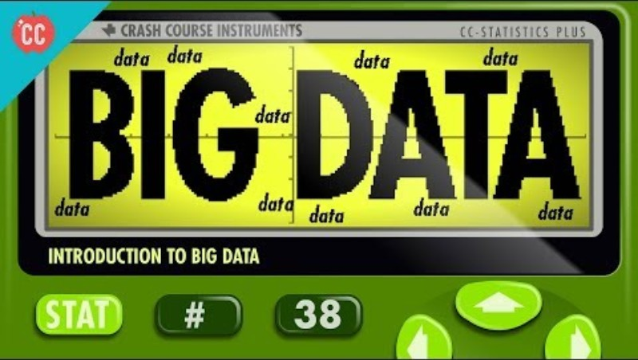
Big data

Slide 43
Introduction to big data
Consider the following quotes from the video:
Big Data includes everything from which videos we click (and how long we watch them) on YouTube to our likes on Facebook.
It can say a lot about us - and increasingly more and more sophisticated algorithms are being designed to learn about us from our clicks and not-clicks.
Some ways Big Data impacts on our lives from what liking Hello Kitty says about us to how Netflix chooses just the right thumbnail to encourage us to watch more content.
Think Pair Share your daily interactions with Big data

Slide 44
3-2-1 things I learned from Introduction to big data
List 3 things I learned from Introduction to big data:
3
1.
2.
3.
List 2 questions you have about these things:
2
1.
2.
Give 1 reason why it’s important to learn about these things:
1
1.

Slide 45
Check for understanding
Which file types are lossy compression and which are lossless?
A:
ZIP, PNG and GIF
B:
JPEG, MP3 and MP4
Notes:
A= lossless B= lossy

Slide 46
Knowledge check – concluding the lesson (4)
End of section student skills formative assessment checklist
Students can: | Checkbox
explain why data compression is important and describe the types with examples define big and small data sets and provide examples of where they are used.

Slide 47
References
This presentation contains NSW Curriculum and syllabus content. The NSW Curriculum is developed by the NSW Education Standards Authority. This content is prepared by NESA for and on behalf of the Crown in the right of the State of New South Wales. The material is protected by Crown copyright.
Please refer to the NESA Copyright Disclaimer for more information https://educationstandards.nsw.edu.au/wps/portal/nesa/mini-footer/copyright.
NESA holds the only official and up-to-date versions of the NSW Curriculum and syllabus documents. Please visit the NSW Education Standards Authority (NESA) website https://educationstandards.nsw.edu.au/wps/portal/nesa/home and the NSW Curriculum website https://curriculum.nsw.edu.au.
Computing Technology 7-10 Syllabus © NSW Education Standards Authority (NESA) for and on behalf of the Crown in right of the State of New South Wales, 2024.
NSW Department of Education (n.d.) Digital learning selector, Peer discussion and conferencing, accessed 21 April 2026.
NSW Department of Education (n.d.) Explicit teaching: Activating prior knowledge, accessed 21 April 2026.
NSW Department of Education (n.d.) Explicit Teaching: Checking for understanding, accessed 21 April 2026.
NSW Department of Education (n.d.) Explicit teaching: Chunking and sequencing learning, accessed 21 April 2026.
NSW Department of Education (n.d.) Explicit teaching: Connecting learning, accessed 21 April 2026.
NSW Department of Education (n.d.) Explicit teaching: Modelling technique guide, accessed 21 April 2026.
NSW Department of Education (n.d.) Explicit teaching, Using effective questioning, accessed 24 September 2025.

Slide 48
References (1)
Code sports (2026) Code sports stats website , accessed May 1 , 2026
Commonwealth of Australia (2022) BoM [website], accessed 31 August 2022.
Crash Course (2018) Intro to Big Data: Crash Course Statistics #38 [video] YouTube, accessed 31 August 2022.
Gadgets 360 (28 October 2021) ‘How Accurate Is Your Fitness Tracker? We Put This to the Test’ [video], Gadgets 360, YouTube, accessed 31 August 2022.
Gapminder (n.d.) Gapminder [website], accessed 31 August 2022.
Micro:bit Educational Foundation (2022) ‘Controlling physical systems with sensors (55 mins)’, Courses, micro:bit website, accessed 1 May 2026.
Micro:bit Educational Foundation (2022) ‘Step counter’, Make it: code it, micro:bit website, accessed 31 August 2022.
SBS (2020) SBS Australian Census Explorer, SBS News website, accessed 31 August 2022.

Slide 49
Copyright
© State of New South Wales (Department of Education), 2026
The copyright material published in this resource is subject to the Copyright Act 1968 (Cth) and is owned by the NSW Department of Education or, where indicated, by a party other than the NSW Department of Education (third-party material).
Copyright material available in this resource and owned by the NSW Department of Education is licensed under a Creative Commons Attribution 4.0 International (CC BY 4.0) licence.
This licence allows you to share and adapt the material for any purpose, even commercially.
Attribution should be given to © State of New South Wales (Department of Education), 2026.
Material in this resource not available under a Creative Commons licence:
the NSW Department of Education logo, other logos and trademark-protected material
Material owned by a third party that has been reproduced with permission. You will need to obtain permission from the third party to reuse its material.
Links to third-party material and websites
Please note that the provided (reading/viewing material/list/links/texts) are a suggestion only and implies no endorsement, by the New South Wales Department of Education, of any author, publisher, or book title. School principals and teachers are best placed to assess the suitability of resources that would complement the curriculum and reflect the needs and interests of their students.
If you use the links provided in this document to access a third party’s website, you acknowledge that the terms of use, including licence terms set out on the third-party’s website apply to the use which may be made of the materials on that third-party website or where permitted by the Copyright Act 1968 (Cth). The department accepts no responsibility for content on third-party websites.

