Slide 1
Instructions for use
Learning episode 2
This resource is not a teaching and learning program. It should be used in conjunction with Computing Technology 7-10 – Analysing data.
Classroom teachers are encouraged to add and adapt slides as required to meet the needs of their students.
Save a copy of the file to make changes to the slide deck. Go to File > Download a Copy (this downloads a copy to the computer to edit in the PowerPoint app).
To convert the PowerPoint to Google Slides:
  Upload the file into Google Drive and open it.
  Go to File > Save as Google Slides.
  (Note – conversion may cause formatting changes in the slides.)

Slide 2

Enterprise systems – analysing data
Computing Technology – Stage 5
Data types
Weeks 3 and 4
Notes:
This slide deck complements the teacher support resource, assessment tasks and program of learning. Teachers are advised to issue the support resource either through their LMS or printed as a student workbook

Slide 3
Learning episodes
1
Identify and define
6
Real world scenarios
2
Data types
7
  Spreadsheets and databases
3
8
Digital solutions
Purpose and people
4
9
Test and evaluate
Research and Plan
5
10
Exploring careers
Visualise and model
Notes:
This slide indicates the plan for 10 learning episodes and the current slide deck 7 Spreadsheets and databases

Slide 4
2. Data types

Slide 5
Learning intentions and success criteria (1)
We are learning to
represent characters, images and sounds using number codes.
We can
recognise how these number codes are manipulated, stored and communicated by digital systems
understand that number codes are made from binary digits
use spreadsheets to demonstrate that digital systems use binary numbers to make number codes.
Notes:
Notes for teachers:
Learning intentions and success criteria are best co-constructed with students. Adapt the learning intention as required and add matching success criteria.
For more information See ⁠AITSL or the NSW Department of Education explicit teaching strategies, ⁠Sharing learning intentions and ⁠Sharing success criteria
LISC is not necessarily presented at the beginning of the lesson. Teacher needs to consider most effectual time to introduce
LISC should be revisited during the lesson to support students' evaluation of their learning

Slide 6
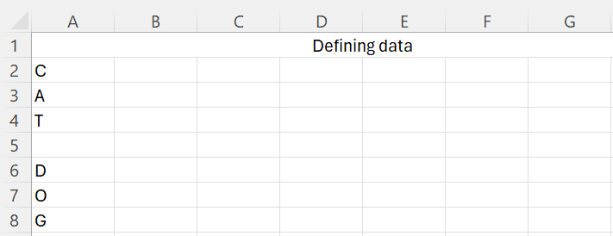
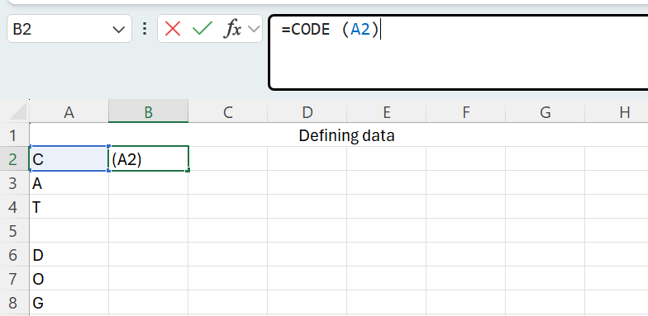
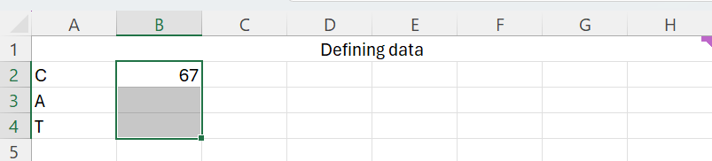
Number codes (1)
ASCII in Excel
Using the same spreadsheet
enter the letters for C A T and D O G
down column A
In cell B2 type =CODE (A2)
Press enter.
What do you notice?
Hold the left mouse button down
and drag to select cells B2: B5

Slide 7
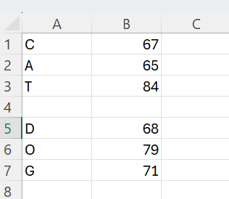
Number codes (2)
ASCII in Excel
Repeat the process for D O G
In cell B5 type =CODE (A6)
Do you see a pattern emerging between the letters and corresponding numbers?
What other animal or word could you use to confirm your suspicions?
Notes:
A = 65
C= 67
D =68
Students could choose any beginning with “B”

Slide 8
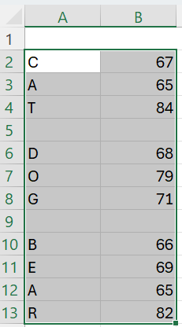
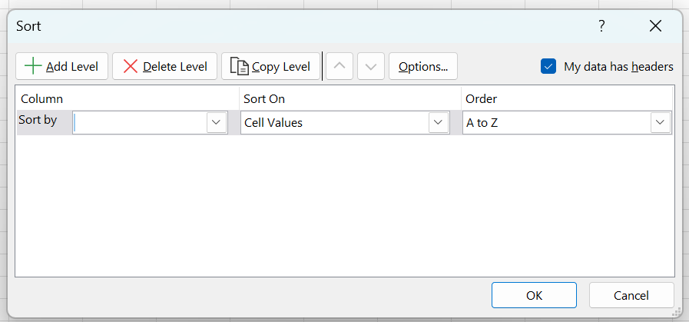
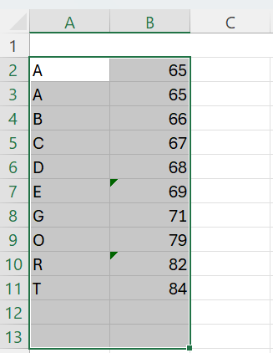
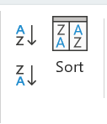
SORT
Hold the left mouse button down
and drag to select cells A2: B13
From the Data tab choose Sort
then Sort by Column B
Sort On Cell Values
A to Z
Can you complete the alphabet?
Notes:
A = 65
C= 67
D =68
Students could choose any beginning with “B”

Slide 9
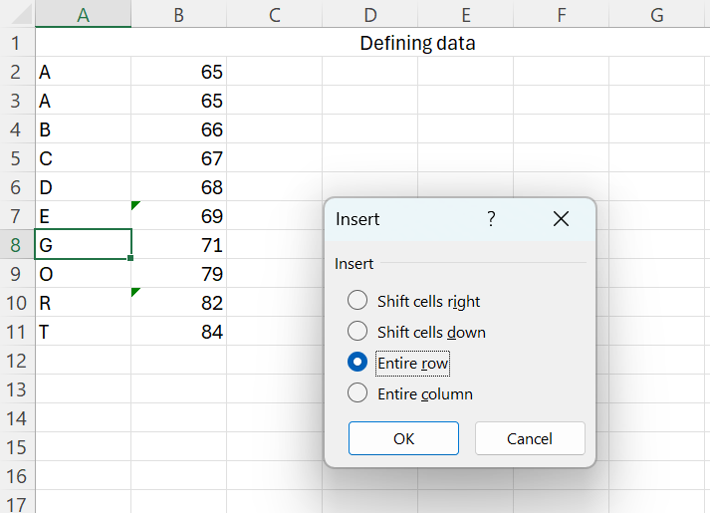
The alphabet
Filling the missing letters
Select cell A8 , right click and choose Insert then Entire row
Add the letter “F” and repeat these steps until all letters are shown
Notes:
A = 65
C= 67
D =68
Students could choose any beginning with “B”

Slide 10
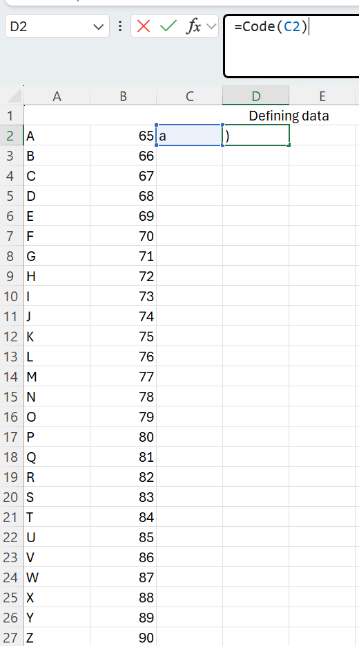
What about lower case letters?
Alphabet
Repeat all the steps to find the number code for each upper case letter to find each lower case letter.
What do you notice?
Notes:
Students should notice that the difference between A(65) and a (97) is 32. This is the same for every letter .Why?

Slide 11
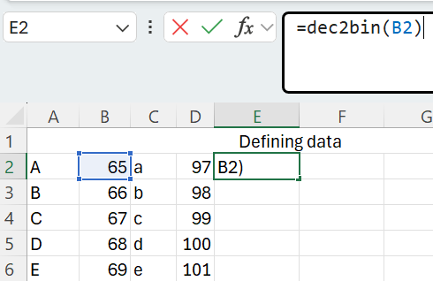
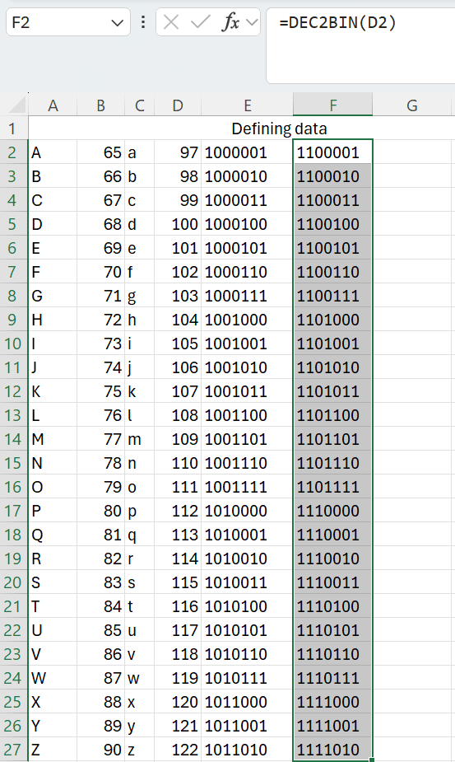
How are these numbers represented inside the computer ?
Converting decimal to binary
In Cell E2 type =dec2bin(B2)
Hold the left mouse button down
and drag to select cells E2: E27
Repeat these steps for the lower case numbers in F2 type =dec2bin(D2)
Notes:
Dec is decimal and bin is binary

Slide 12
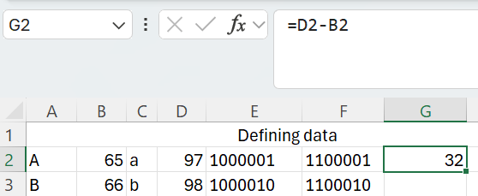
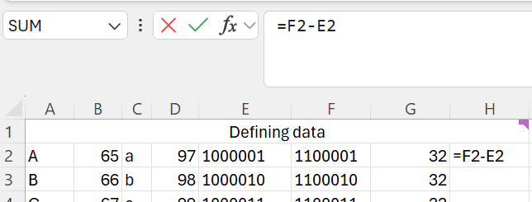
Making sense of these numbers
What is the number difference between upper case “A” and lower case “a”
To work this out subtract the number for upper case “A” (65) from lower case “a” (97)
In cell G2 type: =D2-B2
Now do the same for the binary numbers.
Fill down to see the result for all 32!
Notes:
Dec is decimal and bin is binary

Slide 13
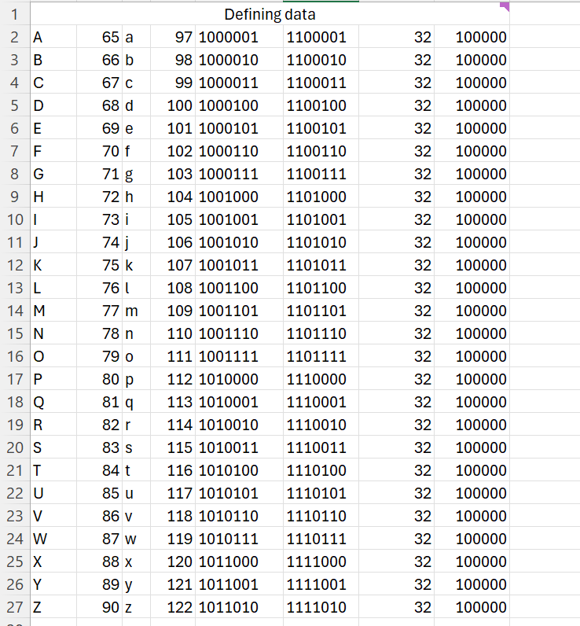
Can you see the pattern?(1)
Understanding binary
Humans count with ten digits: 0 through to 9
Computers only have two digits: 0 and 1
Think of a light switch.
It can be ON (1) OR OFF ( 0)
When humans count above nine
they go to the next column to get to ten…
then 99 to next column 100 etc..
Computers can only count up to one before
going to the next column!
Notes:
Our decimal system has ten digits 0-9.
Computers can only think in two digits 1 and 0

Slide 14
Can you see the pattern?(2)
Understanding binary
Each bit in this byte represents a number value shown:
128 | 64 | 32 | 16 | 8 | 4 | 2 | 1
0 | 1 | 0 | 0 | 0 | 0 | 0 | 1
This byte represents a 1 in the sixty fours column and a 1 in the ones column. 64 +1 = 65 . Can you find it on the spreadsheet?
Look at lower case “a”. How is that represented?
What's the biggest number that can be represented with one byte?
1 | 1 | 1 | 1 | 1 | 1 | 1 | 1
Notes:
Students should notice that the spreadsheet uses 7 bit ASCII.
Lower case “a” is97: 1100001. The extra one is in the 32nd bit!
One byte = 255

Slide 15

Counting
Explain these steps to an Alien that (because she only has 3 fingers) doesn’t understand counting in base 10.
Algorithms
In our decimal (base 10) number system we have
ten digits: 0,1, 2, 3, 4, 5, 6, 7, 8, 9
1000 | 100 | 10 | 1
1 | 5 | 3 | 9
1,539 can be described as:
1000 X 1 + 100 X 5 + 10 X 3 + 1 X 9
How it works
When we count past nine
we go to the next column.
Screenshots of Canva reproduced for non-commercial, educational purposes under the Canva for Education terms.
Rewrite these instructions as an algorithm using a loop.
(iteration)
Notes:
Start with One:
Humans look at a group or collection and say, “How many?” They begin with the first item, which is called “one.”
Add One Each Time:
To keep track of more objects, they add one at a time. Each new total has a name: “two,” “three,” “four,” and so on.
Remember the Amount:
For every count, humans use a special word to describe the total, until they reach “ten,” which for us is a group of ten things.
Repeat This Process:
To count higher, humans keep adding one and naming each new total. This is how humans know exactly how much there is.
A Sequence:
The process is like moving along a path—each step forward is another count. Humans always start at the beginning and step forward one at a time.

Slide 16
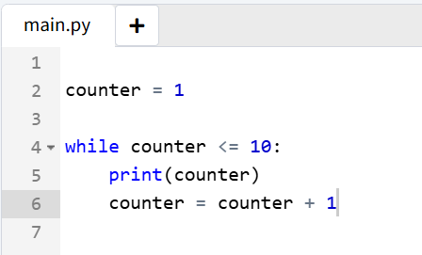
Algorithms (1)
Counting to ten
counter = 1
WHILE counter <= 10 DO
PRINT counter
counter = counter + 1
END WHILE
1
2
3
4
5
6
7
8
9
10
** Process exited - Return Code: 0 **
In Python
Notes:
Definition A step-by-step procedure required to solve a problem. Algorithms may be presented in many ways, e.g. written instructions, flow charts or using a computer programming language. This is a simple solution.
More experienced coders may recreate exactly the process of counting up to and past Ten, then one hundred, a thousand and so on.

Slide 17
Algorithms (2)
What does the algorithm look like that is inside the =dec2bin spreadsheet function?
How it works:
Start with the decimal number.
Use a loop to divide the number by 2 repeatedly.
At each step, check if the remainder is 1 or 0 (selection).
Add that binary digit to the left of the result (sequence).
Repeat (iteration) until the number is reduced to zero.
Example for decimal 10:
10 // 2 = 5, remainder 0 → binary digit is 0
5 // 2 = 2, remainder 1 → binary digit is 1
2 // 2 = 1, remainder 0 → binary digit is 0
1 // 2 = 0, remainder 1 → binary digit is 1
Read digits bottom-up: 1010
Rewrite these steps as an algorithm

Slide 18
The algorithm inside the =dec2bin spreadsheet function
number = decimal input # Sequence: Assign input value
binary = "" # Sequence: Set up result string
WHILE number > 0 DO # Iteration: Repeat the process
remainder = number % 2 # Sequence: Find out if current bit is 0 or 1
IF remainder == 1 THEN # Selection: Decide which bit to add
binary = "1" + binary
ELSE # Selection: Otherwise, add 0
binary = "0" + binary
END IF
number = number // 2 # Sequence: Move to the next digit (divide by 2)
END WHILE
PRINT binary # Sequence: Output the result
Control structure | Meaning
Sequence | Steps in the algorithm
Selection/branching | An instruction in a computer program or algorithm that causes different actions to be performed depending on specified conditions.
Iteration/loops | Repeating processes over gain
Symbols | Meaning
# | Comments in the code
% | Gives the remainder after dividing one number by another.
= = | Equal to
// | Divided by
Notes:
Definition of function: A term used in programming to describe a self-contained sequence of instructions that performs a specific task or tasks and is designed to be able to be reused throughout the program. Functions often accept some kind of input, perform some process on that input, and return a result that can be used by other parts of a program. Most programming languages allow for user-defined functions, but will also provide pre-defined functions.

Slide 19

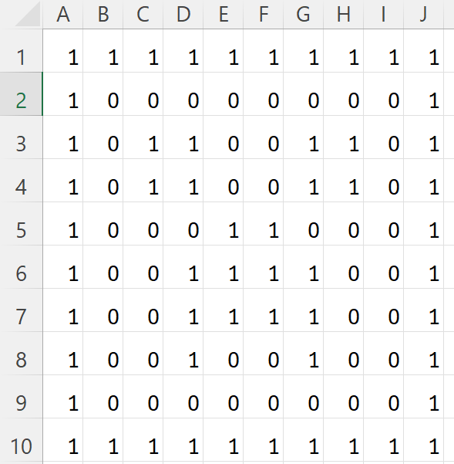
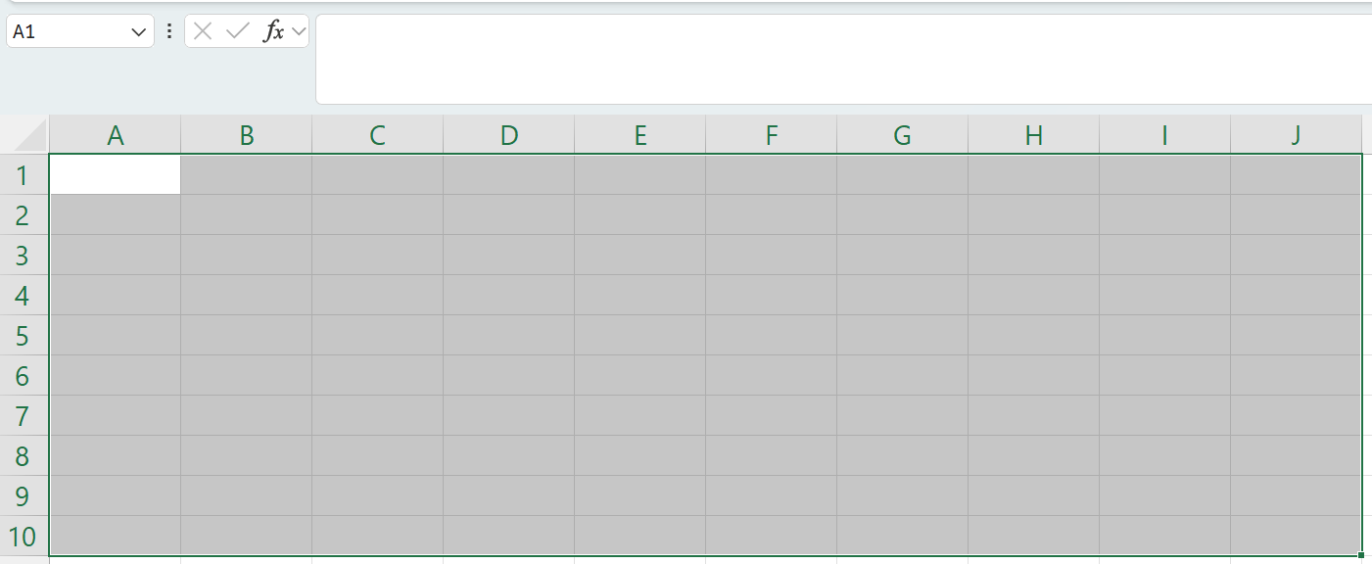
Images (1)
Using excel to represent images as bitmaps
Select Format cells.
Make the width 2.71 and the height 20.
Create a 10 X 10 grid in Excel
( columns A to J, Rows 1 to 10 ).
Each cell represents one picture element ( a pixel).
Fill cells with numbers: 0 (for white) and 1 (for black).
As shown
Notes:
Explain how each cell’s number represents a pixel’s colour, turning numbers into images.
Steps
Select the cell (or group of cells) you want to make square.
Adjust Column Width:
Right-click the column letter at the top (e.g., "A") and choose Column Width.
Enter a value (e.g., "20").
Adjust Row Height:
Right-click the row number on the left (e.g., "1") and choose Row Height.
Enter a value that matches the column width you just set.
Note: In Excel, column width and row height use different units, so they won’t look exactly the same numerically. For example, try setting the column width to “2.71” and the row height to “20”, which often produces a square.
Summary
Column width: Measured by characters (relative, changes with font)
Row height: Measured by points (absolute, like physical inches or cm)
This difference is why a "square" cell requires different numbers for width and height.

Slide 20
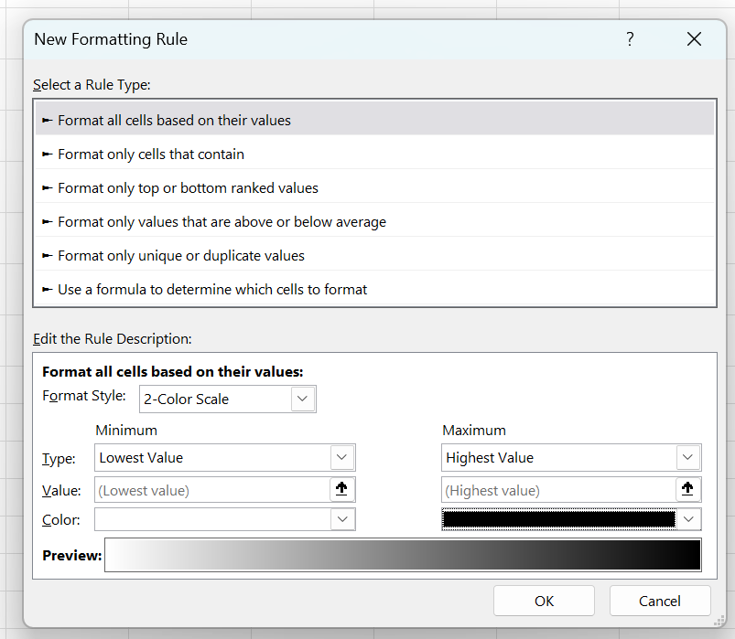
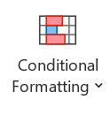
Images (2)
Using excel to represent images as bitmaps
  Select the whole grid.
  Go to Home > Conditional Formatting > New Rule.
  Choose "Format all cells based on their values".
  Set rules for lowest value (white) and highest value (black).
Notes:
Explain how each cell’s number represents a pixel’s colour, turning numbers into images.
Steps
Select the cell (or group of cells) you want to make square.
Adjust Column Width:
Right-click the column letter at the top (e.g., "A") and choose Column Width.
Enter a value (e.g., "20").
Adjust Row Height:
Right-click the row number on the left (e.g., "1") and choose Row Height.
Enter a value that matches the column width you just set.
Note: In Excel, column width and row height use different units, so they won’t look exactly the same numerically. For example, try setting the column width to “2.71” and the row height to “20”, which often produces a square.

Slide 21
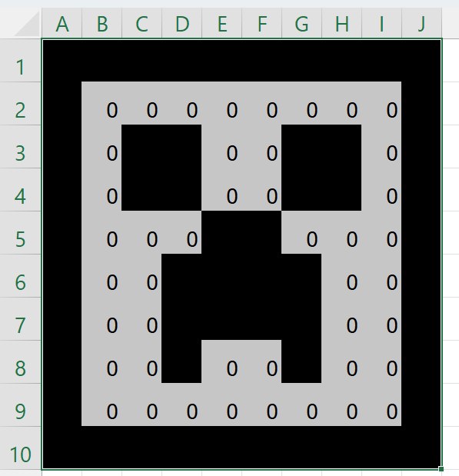
Images (3)
Using excel to represent images as bitmaps
Design and create your own image as a bitmap in Excel
by using a different pattern of zeros and ones.
Notes:
Our Creeper is a bit spotty. Experiment with the Conditional formatting tool to remove the appearance of the zeros.

Slide 22
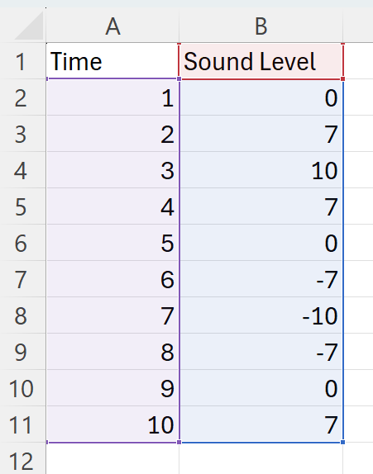
Sound (1)
Using excel to represent sampling sound waves
Sound waves are vibrations in the air that we hear.
These waves can be measured at regular intervals, and each measurement is called a "sample".
A microphone converts sound waves into electrical signals.
These signals are measured (sampled) and stored as numbers.
Computers can use these numbers to recreate and play back sound.
Add a new spreadsheet and the time and sound level data

Slide 23
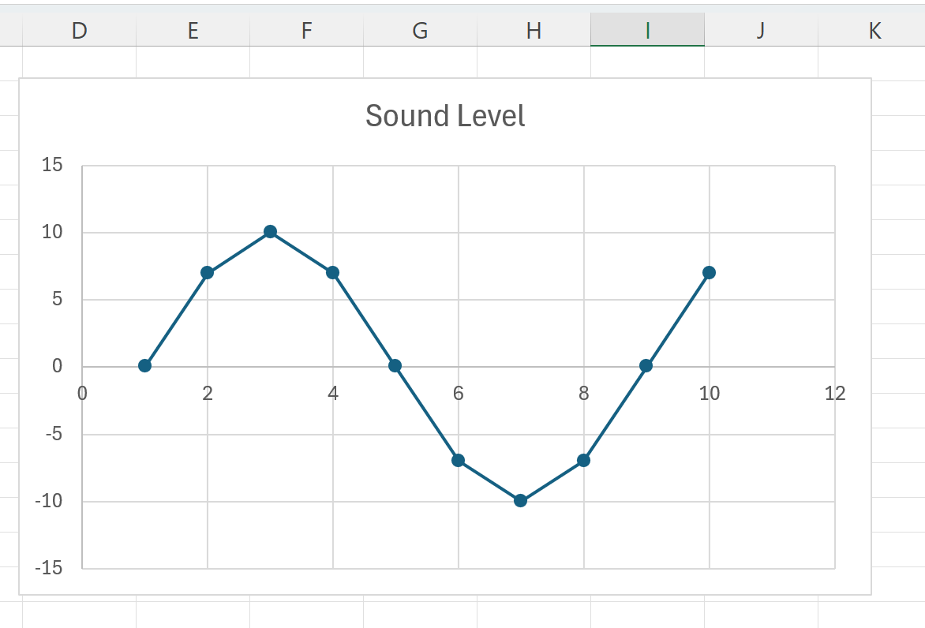
Sound (2)
Highlight cells ( A:2 B:11). Go to Insert Line graph.
The graph “draws” the sound waves represented by the numbers.
using excel to represent sampling sound waves
Sound can be measured as numbers.
Microphones turn sound into numbers,
which computers can store and play back.
Numbers can create a wave that represent sound.
Notes:
The more detailed (or frequent) the samples taken from a sound wave, the closer these numbers match the original wave. This creates higher quality sound when played back because it captures more of the wave’s details and smoothness.
In other words, more samples mean less information is lost, so the sound you hear from a computer or device is more accurate and realistic.

Slide 24
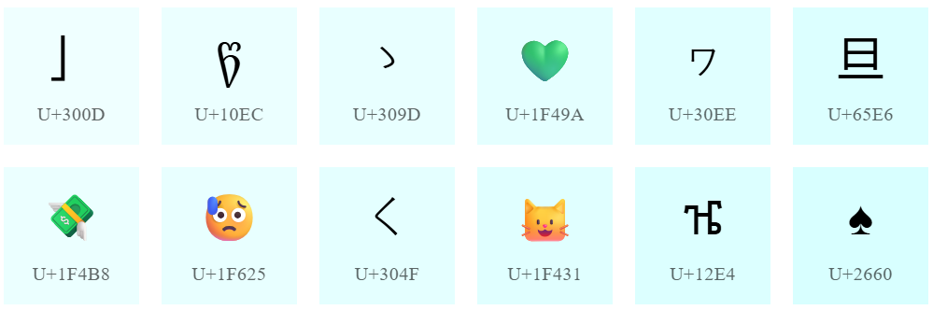
How number codes have evolved (1)
Characters
In the past, computers used a simple code called ASCII. Each letter, number, or symbol was assigned a number
( for example, capital A = 65).
Today, we use Unicode, which can represent characters from hundreds of languages (like Chinese, Arabic, emojis). Unicode uses more numbers and complex coding to cover global communication.
People wanted computers to handle many languages and symbols, not just English.
Unicode – The World Standard for Text and Emoji

Slide 25


How number codes have evolved (2)
Old computers displayed images as simple blocks of colour (like pixel art), with each block coded by a single small number.
Now high-quality photos use code to represent millions of colours and tiny pixels, with advanced formats like JPEG and PNG compressing the data.
As technology improved, people wanted clearer, more realistic pictures on screens and in printing.
Images
Screenshots of Canva reproduced for non-commercial, educational purposes under the Canva for Education terms.

Slide 26
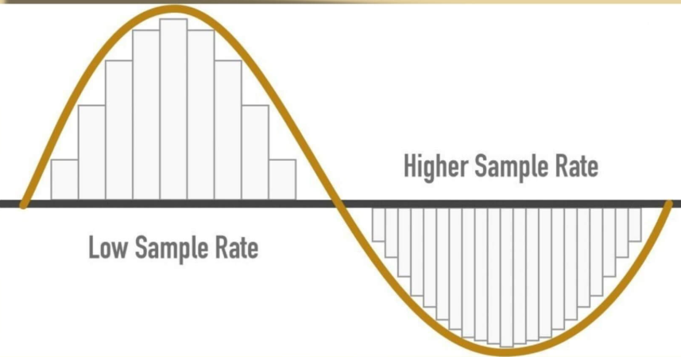
How number codes have evolved (3)
Sound was recorded at very low detail, with few samples per second—resulting in scratchy, robotic audio.
Today, sample rates (like CD audio: 44,100 samples per second) and advanced compression create clear music and voice recordings in formats such as MP3 and WAV.
Rates of 192 kHz are used for professional recordings
Better quality was desired for music, movies, and communication; advances in storage and processing made this possible.
Sounds
Screenshots of Canva reproduced for non-commercial, educational purposes under the Canva for Education terms.

Slide 27
Check for understanding
Convert the binary numbers into decimal and ASCII letters
0 | 1 | 0 | 0 | 0 | 0 | 0 | 1
0 | 1 | 0 | 0 | 0 | 0 | 1 | 0
0 | 1 | 1 | 0 | 0 | 0 | 0 | 1
Notes:
65 = A, 66 = B , 97= a

Slide 28

Knowledge check – concluding the lesson
End of section student skills formative assessment checklist
Students can: | Checkbox
represent characters, images and sounds using number codes. recognise how number codes are manipulated, stored and communicated by digital systems. explain that number codes are made from binary digits . categorise data and information. demonstrate how digital systems use binary numbers to make number codes using spreadsheets.

Slide 29
Learning intentions and success criteria (2)
We are learning to
differentiate between data and information.
We can
recognise data as raw facts
recognise information as data given meaning
organise, process and analyse data to make information.
Notes:
Notes for teachers:
Learning intentions and success criteria are best co-constructed with students. Adapt the learning intention as required and add matching success criteria.
For more information See ⁠AITSL or the NSW Department of Education explicit teaching strategies, ⁠Sharing learning intentions and ⁠Sharing success criteria
LISC is not necessarily presented at the beginning of the lesson. Teacher needs to consider most effectual time to introduce
LISC should be revisited during the lesson to support students' evaluation of their learning

Slide 30
Differentiate between data and information
Data is raw facts or figures.
It could be numbers, words, or symbols that don’t have much meaning on their own.
For example, a list of numbers like 10, 20, 30 is data.
Information is what you get when data is processed or organised in a way that makes sense and helps you understand something.
Using the example above, if those numbers represent the scores of students on a test, then that organised and meaningful result is information.
To differentiate between data and information means to understand that data is raw and unprocessed, while information is data that has been given meaning or context.
.

Slide 31
Information
Syllabus glossary definition
“The presentation of data in a manner that is readily understood”.
Syllabus content: Differentiate between data and information
Differentiate means to recognise or explain the difference between two or more things.
"differentiate between data and information," means understanding what makes data and information different from each other.

Slide 32
Data is not the same thing as information (1)
Data
Information
raw facts, numbers or observations
e.g. 85, 90, 78
analysed facts, numbers or observations
The average test score was 84%, showing strong overall performance.
On their own, data don’t explain anything - we must organise data and analyse it in order to get information.
Data + meaning = information

Slide 33
Data is not the same thing as information (2)
Data
Information
raw facts, numbers or observations
Data: 85, 90, 78
Data: August 10 cows, September 12 cows, October 15 cows
analysed facts, numbers or observations
Information: The average test score was 84%, showing strong overall performance.
Information: The herd size increased over a 3 month period

Slide 34
Which is data? A or B (1)
A:
72, 68, 75, 70
B:
The average temperature this week was 71◦C

Slide 35
Which is data? A or B (2)
A:
Yes, No, Yes, Yes, No
B:
3 out of 5 students said they enjoy maths
Data doesn’t have to be numbers
Notes:
This example shows that it’s not just ‘numbers’ that can be data – pre-empting this misconception

Slide 36
Which is information? A or B (1)
A:
15
B:
The resource has been downloaded 15 times

Slide 37
Which is information? A or B (2)
A:
8:12, 8:18, 8:05
B:
The class arrived on average at 8:11am, earlier than yesterday

Slide 38
Which is information? A or B (3)
A:
Names on a roll: Alex, Priya, Sam, Jordan
B:
There are more students in Year 9 than Year 8 at this school

Slide 39
Turn and talk
Turn and talk with your partner to complete this sentence
Data is ____________, but information is _________________
Share your answer with the class

Slide 40
Check for understanding: Which is information? A or B
A:
85, 90, 78
B:
The average test score was 84%, showing strong overall performance
Notes:
Check for understanding

Slide 41
Knowledge check – concluding the lesson (1)
End of section student skills formative assessment checklist
Students can: | Checkbox
differentiate between data and information. recognise data as raw facts recognise information as data given meaning categorise data and information. organise, process and analyse data to make information.

Slide 42
References
This presentation contains NSW Curriculum and syllabus content. The NSW Curriculum is developed by the NSW Education Standards Authority. This content is prepared by NESA for and on behalf of the Crown in the right of the State of New South Wales. The material is protected by Crown copyright.
Please refer to the NESA Copyright Disclaimer for more information https://educationstandards.nsw.edu.au/wps/portal/nesa/mini-footer/copyright.
NESA holds the only official and up-to-date versions of the NSW Curriculum and syllabus documents. Please visit the NSW Education Standards Authority (NESA) website https://educationstandards.nsw.edu.au/wps/portal/nesa/home and the NSW Curriculum website https://curriculum.nsw.edu.au.
Computing Technology 7-10 Syllabus © NSW Education Standards Authority (NESA) for and on behalf of the Crown in right of the State of New South Wales, 2024.
NSW Department of Education (n.d.) Digital learning selector, Peer discussion and conferencing, accessed 21 April 2026.
NSW Department of Education (n.d.) Explicit teaching: Activating prior knowledge, accessed 21 April 2026.
NSW Department of Education (n.d.) Explicit Teaching: Checking for understanding, accessed 21 April 2026.
NSW Department of Education (n.d.) Explicit teaching: Chunking and sequencing learning, accessed 21 April 2026.
NSW Department of Education (n.d.) Explicit teaching: Connecting learning, accessed 21 April 2026.
NSW Department of Education (n.d.) Explicit teaching: Modelling technique guide, accessed 21 April 2026.
NSW Department of Education (n.d.) Explicit teaching, Using effective questioning, accessed 24 September 2025.

Slide 43
References
The Organic Chemistry Tutor (2018) Binary to Decimal Using Excel! [video] YouTube , accessed 10 June (2026)
Unicode (2026) Unicode – The World Standard for Text and Emoji website, accessed 10 June (2026)

Slide 44
Copyright
© State of New South Wales (Department of Education), 2026
The copyright material published in this resource is subject to the Copyright Act 1968 (Cth) and is owned by the NSW Department of Education or, where indicated, by a party other than the NSW Department of Education (third-party material).
Copyright material available in this resource and owned by the NSW Department of Education is licensed under a Creative Commons Attribution 4.0 International (CC BY 4.0) licence.
This licence allows you to share and adapt the material for any purpose, even commercially.
Attribution should be given to © State of New South Wales (Department of Education), 2026.
Material in this resource not available under a Creative Commons licence:
the NSW Department of Education logo, other logos and trademark-protected material
Material owned by a third party that has been reproduced with permission. You will need to obtain permission from the third party to reuse its material.
Links to third-party material and websites
Please note that the provided (reading/viewing material/list/links/texts) are a suggestion only and implies no endorsement, by the New South Wales Department of Education, of any author, publisher, or book title. School principals and teachers are best placed to assess the suitability of resources that would complement the curriculum and reflect the needs and interests of their students.
If you use the links provided in this document to access a third party’s website, you acknowledge that the terms of use, including licence terms set out on the third-party’s website apply to the use which may be made of the materials on that third-party website or where permitted by the Copyright Act 1968 (Cth). The department accepts no responsibility for content on third-party websites.

