Slide 1
Instructions for use
Learning episode 8
This resource is not a teaching and learning program. It should be used in conjunction with Computing Technology 7-10 – Analysing data.
Classroom teachers are encouraged to add and adapt slides as required to meet the needs of their students.
Save a copy of the file to make changes to the slide deck. Go to File > Download a Copy (this downloads a copy to the computer to edit in the PowerPoint app).
To convert the PowerPoint to Google Slides:
  Upload the file into Google Drive and open it.
  Go to File > Save as Google Slides.
  (Note – conversion may cause formatting changes in the slides.)

Slide 2

Enterprise systems – analysing data
Computing Technology – Stage 5
Digital solutions
Weeks 17 – 18
Notes:
This slide deck complements the teacher support resource, assessment tasks and program of learning. Teachers are advised to issue the support resource either through their LMS or printed as a student workbook

Slide 3
Learning episodes
1
Identify and define
6
Real world scenarios
2
Data types
7
  Spreadsheets and databases
3
8
Digital solutions
Purpose and people
4
9
Test and evaluate
Research and Plan
5
10
Exploring careers
Visualise and model
Notes:
This slide indicates the plan for 10 learning episodes and the current slide deck 7 Spreadsheets and databases

Slide 4
8. Digital solutions

Slide 5
Learning intentions and success criteria
We are learning to
improve an existing information system.
We can work collaboratively to
investigate a real-world scenario
  design an improved system.
Notes:
Notes for teachers:
Learning intentions and success criteria are best co-constructed with students. Adapt the learning intention as required and add matching success criteria.
For more information See ⁠AITSL or the NSW Department of Education explicit teaching strategies, ⁠Sharing learning intentions and ⁠Sharing success criteria
LISC is not necessarily presented at the beginning of the lesson. Teacher needs to consider most effectual time to introduce
LISC should be revisited during the lesson to support students' evaluation of their learning

Slide 6
Project
Library borrowing, Schools musical ticketing system, Canteen ordering system or Sports / swimming carnival system
Groups will:
investigate and understand the current system
identify the systems data requirements
design an improved system
develop a data model
collect or simulate data
analyse the data
create data visualisations.
Notes:
Investigate and understand current system
Students research and discuss the current process of organising the school’s sports or swimming carnival.
identify key components such as participant registration, event scheduling, result recording, and awards distribution.
Discuss challenges and limitations of the current system from the perspective of students, teachers, and organisers.
Identify data requirements
Determine what important data needs to be collected (e.g., participant details, event types, heat assignments, timings, scores, records).
Decide on attributes associated with each entity (e.g., participant name, age, event category, team house, time recorded).
Identify potential events for the system (e.g., registration, heat start/end, results submission).
Design an improved system
Propose new features that could improve the carnival, such as:
Digital registration and real-time updates.
Automated timing and scoring.
Leaderboards and live data visualisation.
Notifications for participants and spectators.
Sketch or wireframe the system interface and flow.
Develop a data model
Create diagrams or tables illustrating the entities, attributes, and relationships within the system.
Example: participant, event, heat, result.
5. Collect or simulate data
Gather example data (either real or simulated) for participants and results.
Organise data appropriately in spreadsheets or databases.
6. Analyse the data
Use spreadsheet software or data analysis tools to process the data.
Identify trends such as fastest participants, team performance, average times or distances.
7. Create data visualisations
Design charts, graphs, or dashboards to visualise carnival results and insights (e.g., bar charts for medals per house, line graphs for heat times, pie charts of participant distribution).
Discuss which types of charts best represent different types of data.

Slide 7
Project (example)
Schools musical ticketing system : planning and data specification
In your project notebook document the data specification, ownership, and protection plan.
1. Identify the data required:
(e.g., ticket buyer's name, contact, number of tickets, payment information).
2. Who owns the data? (the school/department).
3. What responsibilities around data protection do they have?.
Explore privacy laws related to PII
4. How will data be protected (e.g., encryption, access controls).
.
Notes:
Objectives:
Specify what data is collected for the ticketing system.
Identify data ownership and privacy considerations.
Document decisions in a project notebook.

Slide 8
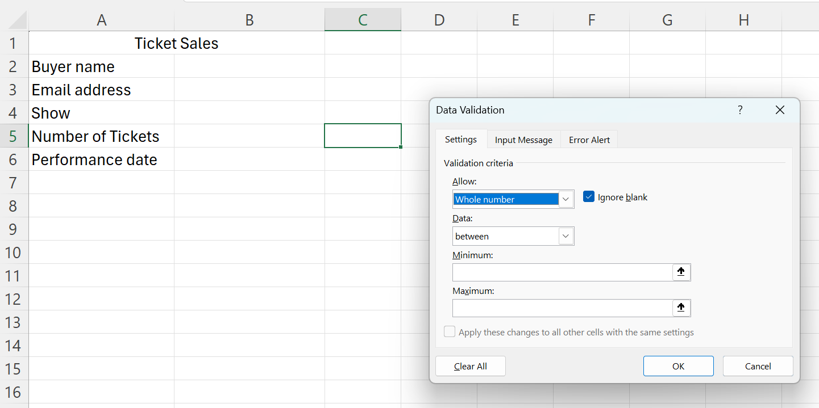
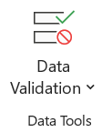
Project example (1)
Schools musical ticketing system : Data Collection and Validation
In your project notebook: Screenshot a digital form design or interfaces for ticket sales that enforce validation (e.g., valid email format, ticket number limits).
Notes:
Validate Number of Tickets (Limit Quantity)
Select the cell where users will input the number of tickets (e.g., B3).
Go to the Data tab → Data Validation → Data Validation.
In the dialogue box:
Under Allow, select Whole Number.
Under Data, select between.
Set minimum (e.g., 1) and maximum (e.g., 10) to limit ticket number.
Optionally, set an Input Message and an Error Alert to guide users.

Slide 9
Project example (2)
Schools musical ticketing system : Data collection and validation
Validation | Excel | Description
Ticket Number Limits | Data Validation: Whole Number | Set min/max values for ticket quantity
Date Restrictions | Data Validation: Date | Restrict dates to range or future dates
Protect Form Layout | Cell Locking & Sheet Protection | Lock labels, unlock input cells
Email Format Checking | Data Validation: Custom Formula | Use formula to check presence of @ and .
Userform | VBA Userform Creation | Program a custom form with advanced validation
These validation methods are differentiated from easiest to hardest.
Notes:
Ticket Number Limits – Simple and quick to set up.
Date Restrictions – Slightly more steps but still straightforward.
Protect Form Layout – Requires worksheet protection and cell locking; not difficult, but needs some care.
Email Format Checking – Requires a custom formula, a bit more complexity.
Userform (VBA) – Advanced, involves programming and form design uses macros which could

Slide 10
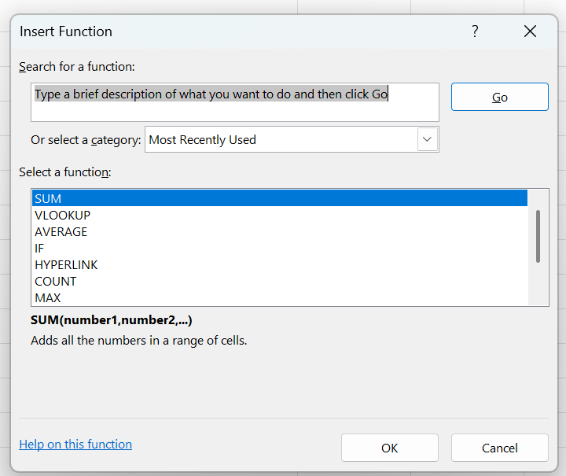
Project example (3)
Schools musical ticketing system : Using spreadsheets for data management
Document in your notebook spreadsheet design and formula used:
Formulas (SUM, COUNTIF)
aggregate functions (AVERAGE, MAX)
lookup functions (VLOOKUP or XLOOKUP)
Filter and sort data by ticket types, sales date, or show.
Use conditional formatting to
highlight sold-out sessions or VIP tickets.
Group data for weekly sales analysis.
Notes:
Objectives:
Summarise, filter, group, sort data using spreadsheets.
Use complex formulas, aggregate and lookup functions.
Apply conditional formatting.

Slide 11
Project example (4)
Schools musical ticketing system : data analysis and decision making
Create a dashboard summarising key metrics (tickets sold, revenue, remaining seats).
Implement decision formulas (for example, IF statements to suggest discount offers if sales are low).
Explore optimisation scenarios (for example, adjust pricing or ticket allocation).
Use predictive functions to forecast demand for different show dates.
Explain decision outcomes in the project notebook.
Notes:
Present data using dashboards or reports in spreadsheets.
Use decision formulas and optimisation for ticket availability or pricing.
Make predictions and decisions based on data.

Slide 12
Project example (5)
Information | Formula / Tool
Tickets Sold | =SUM(Number_of_Tickets) or PivotTable sum
Total Revenue | =SUM(Total_Price) or PivotTable sum
Remaining Seats | =Total_Seats - SUMIF(Date Range, Selected_Date, Tickets Sold)
Tickets Sold Chart | Column Chart from Pivot Table or summary data
Revenue Chart | Pie or Bar Chart
Seat Availability | Bar Chart with conditional formatting
Schools musical ticketing system : data analysis and decision making
Notes:
Present data using dashboards or reports in spreadsheets.
Use decision formulas and optimisation for ticket availability or pricing.
Make predictions and decisions based on data.

Slide 13
Project example (6)
Schools musical ticketing system : database integration and management
Import ticketing data from spreadsheets into a simple relational database.
Practice inserting new ticket sales entries and updating existing records.
Generate reports using queries (e.g., total tickets sold per show, customer purchase history).
Discuss advantages of databases over spreadsheets for larger datasets.
Record database structure, queries, and report insights in the notebook.
These tasks were demonstrated.
Notes:
Objectives:
Load, insert, update data in a database.
Analyse data from a database to make reports and decisions.

Slide 14
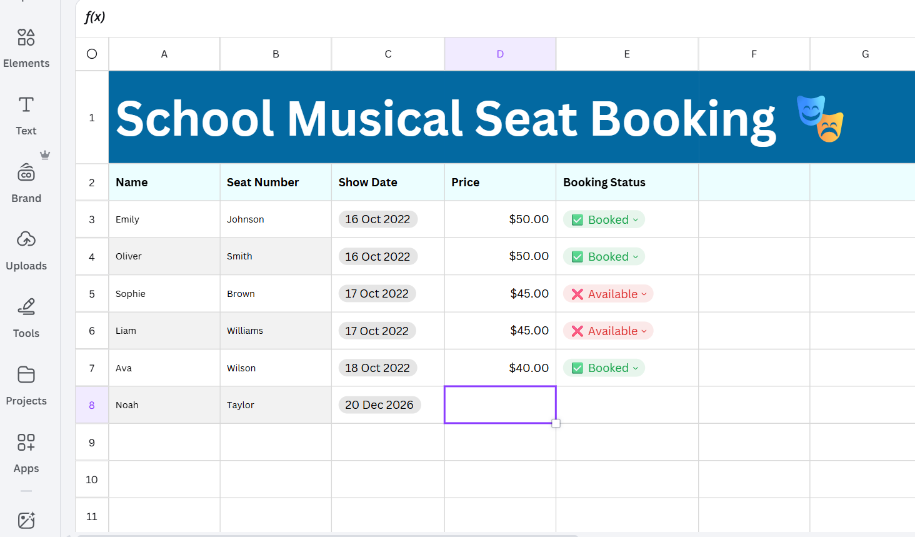
Project example (7)
Schools musical ticketing system : data visualisation and online interactive sharing
Visualisation with Canva

Slide 15
Project example (8)
Schools musical ticketing system : data visualisation and online interactive sharing
Use tools to create graphs and charts (sales trends, seat occupancy).
Develop an interactive webpage or app showing real-time ticket availability.
Include features like filtering by date or seat category.
Share the solution online, considering data privacy and user access controls.
Document design choices, visualisation code snippets, and feedback received.
Blend with Designing for User Experience.
Notes:
Create interactive visualisations of ticket sales data.
Use visualisation libraries (e.g., charting tools or coding libraries).
Share information online through interactive solutions.

Slide 16

Knowledge check – concluding the lesson
End of section student skills formative assessment checklist
Students can: | Checkbox
improve an existing information system. work collaboratively to: investigate a real-world scenario design an improved system

Slide 17
References
This presentation contains NSW Curriculum and syllabus content. The NSW Curriculum is developed by the NSW Education Standards Authority. This content is prepared by NESA for and on behalf of the Crown in the right of the State of New South Wales. The material is protected by Crown copyright.
Please refer to the NESA Copyright Disclaimer for more information https://educationstandards.nsw.edu.au/wps/portal/nesa/mini-footer/copyright.
NESA holds the only official and up-to-date versions of the NSW Curriculum and syllabus documents. Please visit the NSW Education Standards Authority (NESA) website https://educationstandards.nsw.edu.au/wps/portal/nesa/home and the NSW Curriculum website https://curriculum.nsw.edu.au.
Computing Technology 7-10 Syllabus © NSW Education Standards Authority (NESA) for and on behalf of the Crown in right of the State of New South Wales, 2024.
NSW Department of Education (n.d.) Digital learning selector, Peer discussion and conferencing, accessed 21 April 2026.
NSW Department of Education (n.d.) Explicit teaching: Activating prior knowledge, accessed 21 April 2026.
NSW Department of Education (n.d.) Explicit Teaching: Checking for understanding, accessed 21 April 2026.
NSW Department of Education (n.d.) Explicit teaching: Chunking and sequencing learning, accessed 21 April 2026.
NSW Department of Education (n.d.) Explicit teaching: Connecting learning, accessed 21 April 2026.
NSW Department of Education (n.d.) Explicit teaching: Modelling technique guide, accessed 21 April 2026.
NSW Department of Education (n.d.) Explicit teaching, Using effective questioning, accessed 24 September 2025.

Slide 18
References (1)
Law in order (2023) Protection of Personally Identifiable Information (PII) A Growing Concern, Blog, accessed 10 June,2026
NSW Curriculum (2026) Computing Technology 7–10 Syllabus (2022) website, accessed 10 June 2026.
Vigderman A and Turner G (2 June 2022) ‘What is Personally Identifiable Information (PII)?’, security.org website, accessed 10 June 2022.

Slide 19
Copyright
© State of New South Wales (Department of Education), 2026
The copyright material published in this resource is subject to the Copyright Act 1968 (Cth) and is owned by the NSW Department of Education or, where indicated, by a party other than the NSW Department of Education (third-party material).
Copyright material available in this resource and owned by the NSW Department of Education is licensed under a Creative Commons Attribution 4.0 International (CC BY 4.0) licence.
This licence allows you to share and adapt the material for any purpose, even commercially.
Attribution should be given to © State of New South Wales (Department of Education), 2026.
Material in this resource not available under a Creative Commons licence:
the NSW Department of Education logo, other logos and trademark-protected material
Material owned by a third party that has been reproduced with permission. You will need to obtain permission from the third party to reuse its material.
Links to third-party material and websites
Please note that the provided (reading/viewing material/list/links/texts) are a suggestion only and implies no endorsement, by the New South Wales Department of Education, of any author, publisher, or book title. School principals and teachers are best placed to assess the suitability of resources that would complement the curriculum and reflect the needs and interests of their students.
If you use the links provided in this document to access a third party’s website, you acknowledge that the terms of use, including licence terms set out on the third-party’s website apply to the use which may be made of the materials on that third-party website or where permitted by the Copyright Act 1968 (Cth). The department accepts no responsibility for content on third-party websites.

