Slide 1
Instructions for use
Learning episode 7
This resource is not a teaching and learning program. It should be used in conjunction with Computing Technology 7-10 – Analysing data.
Classroom teachers are encouraged to add and adapt slides as required to meet the needs of their students.
Save a copy of the file to make changes to the slide deck. Go to File > Download a Copy (this downloads a copy to the computer to edit in the PowerPoint app).
To convert the PowerPoint to Google Slides:
  Upload the file into Google Drive and open it.
  Go to File > Save as Google Slides.
  (Note – conversion may cause formatting changes in the slides.)

Slide 2

Enterprise systems – analysing data
Computing Technology – Stage 5
Spreadsheets and databases
Weeks 15 – 16
Notes:
This slide deck complements the teacher support resource, assessment tasks and program of learning. Teachers are advised to issue the support resource either through their LMS or printed as a student workbook

Slide 3
Learning episodes
1
Identify and define
6
Real world scenarios
2
Data types
7
  Spreadsheets and databases
3
8
Digital solutions
Purpose and people
4
9
Test and evaluate
Research and Plan
5
10
Exploring careers
Visualise and model
Notes:
This slide indicates the plan for 10 learning episodes and the current slide deck 7 Spreadsheets and databases

Slide 4
7. Spreadsheets and databases

Slide 5
Learning intentions and success criteria
We are learning to
choose the right tool: spreadsheet or database for data analysis.
We can
compare the usability of data using a spreadsheet or database to analyse the same dataset.
Notes:
Notes for teachers:
Learning intentions and success criteria are best co-constructed with students. Adapt the learning intention as required and add matching success criteria.
For more information See ⁠AITSL or the NSW Department of Education explicit teaching strategies, ⁠Sharing learning intentions and ⁠Sharing success criteria
LISC is not necessarily presented at the beginning of the lesson. Teacher needs to consider most effectual time to introduce
LISC should be revisited during the lesson to support students' evaluation of their learning

Slide 6
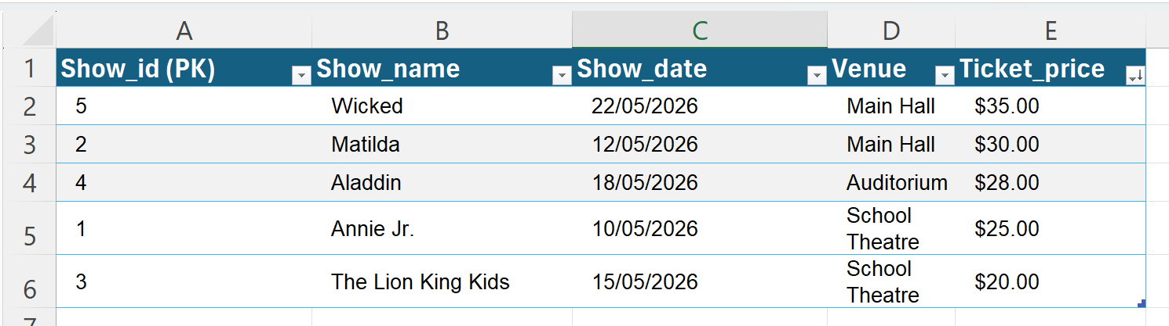
Compare the usability of data using a spreadsheet or database to analyse the same dataset (1)
Use Sort and/or Filter to answer the following:
The most expensive ticket price
The least expensive ticket price.
The most recent purchase
The most popular show
School musical ticketing system
Notes:
Students may answer these questions from observation though should be encouraged to imagine hundreds or thousands of entries

Slide 7
Compare the usability of data using a spreadsheet or database to analyse the same dataset (2)
School musical ticketing system
Watch:
Importing Data from Excel to Microsoft Access
Follow the steps to import your School Musical ticketing system
( Library book borrowing or Canteen Ordering or Sports Carnival) from Excel into Access.

Slide 8
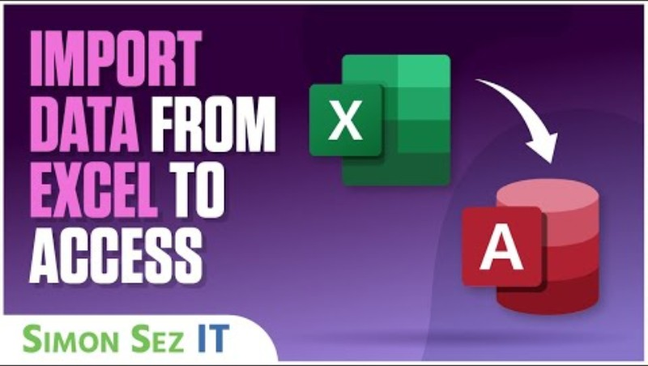
Import data from Excel to Access

Slide 9
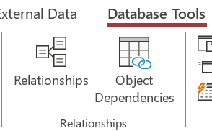
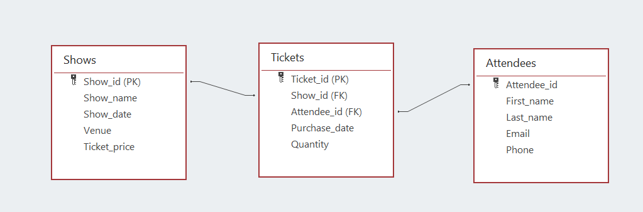
Compare the usability of data using a spreadsheet or database to analyse the same dataset(2)
School musical ticketing system
Use the relationships tab
to link these tables via their PK and FK
PK = Primary Key, FK= Foreign Key

Slide 10
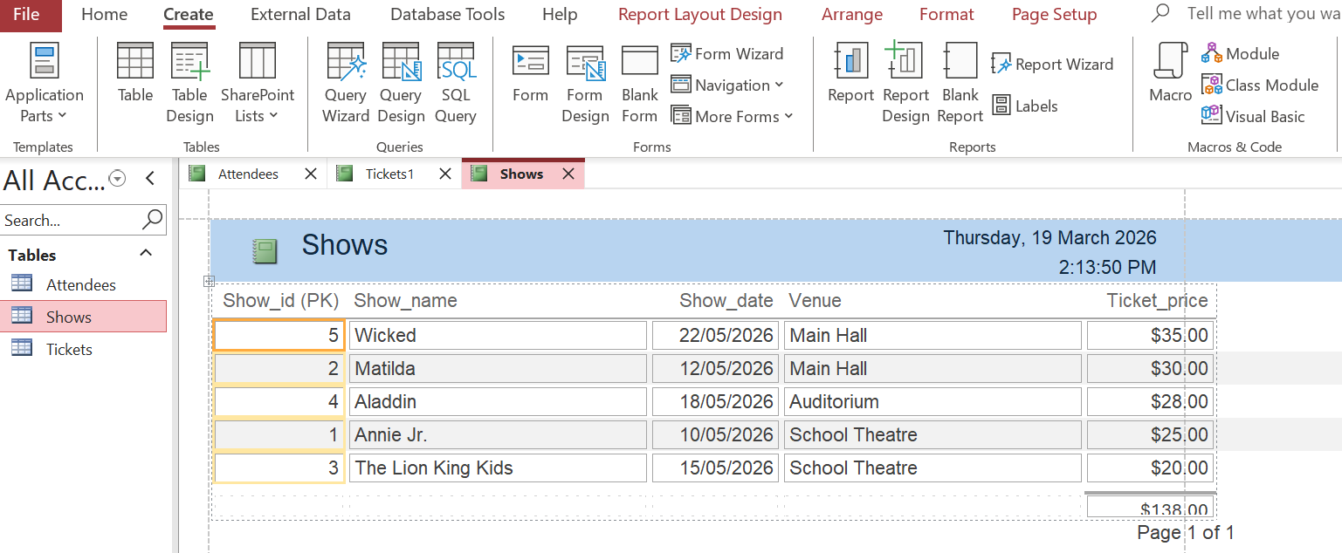
Compare the usability of data using a spreadsheet or database to analyse the same dataset(3)
School musical ticketing system: Reports
Use Create Report

Slide 11
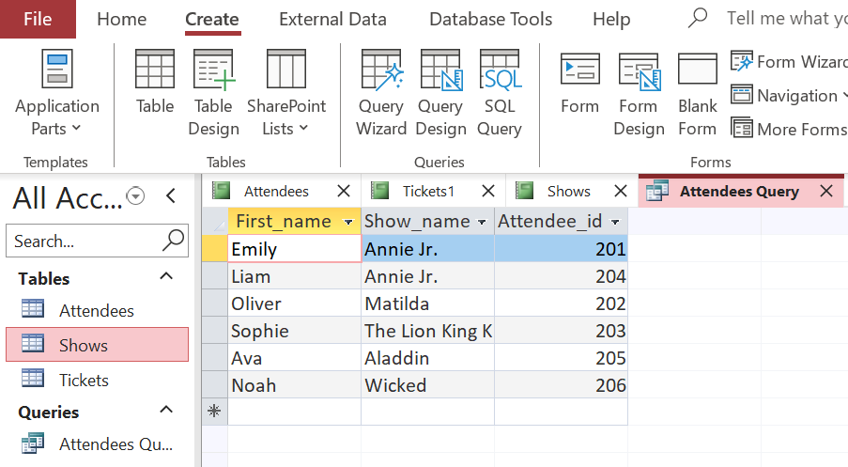
Compare the usability of data using a spreadsheet or database to analyse the same dataset(4)
School musical ticketing system: Query
Use Query Wizard to see who is attending each show

Slide 12
Spreadsheet or database ?
Spreadsheet
Database
Handles large and complex datasets efficiently
Supports advanced queries (SQL)
Multi-user access and permissions
Data integrity and validation
Automated backups and scaling.
Easy use for small datasets
Visual interface (drag-and-drop, cell editing)
Built-in functions and charts
Quick “what-if” analysis
Individual or small team access.
Store data in tables
Sort, filter, search
Export/import data
Basic data analysis.
Notes:
Talk alouds :SQL (Structured Query Language): A programming language used to manage and manipulate data in a relational database. It allows users to query, insert, update, and delete data efficiently.
Data Integrity: The accuracy, consistency, and reliability of data stored in a database over its entire lifecycle. It ensures that the data remains correct and unaltered except through authorised operations.
Validation: The process of checking data for correctness and completeness before it is entered into a database. Validation helps prevent errors by ensuring data meets predefined rules or formats.

Slide 13
Producing and implementing
Develop a digital solution using a range of software to interpret and represent data
to create information for a real-world scenario
Real- world scenarios could include:
library book borrowing system
schools musical ticketing system
canteen ordering system
sports / swimming carnival system
or other negotiated with the teacher.

Slide 14
Check for understanding (1)
Complete the table on the differences between Spreadsheets and Databases for the School Musical ticketing system
Spreadsheet | Database
Easy to set up and use (good for beginners) | More complicated to set up, but more powerful

Slide 15
Check for understanding (2)
Complete the table on the differences between Spreadsheets and Databases for the School Musical ticketing system
Spreadsheet | Database
Easy to set up and use (good for beginners) | More complicated to set up, but more powerful
All information kept in one place | Information separated into different tables
Can become messy with lots of data | Handles large amounts of data more easily
Harder to prevent mistakes and double entries | Easier to keep data accurate and organised
Searching and sorting can be slow | Quick searches, sorting, and filtering
Good for simple ticket sales | Best for complicated ticketing systems (e.g. multiple shows, lots of buyers)
Changes affect the whole sheet | Changes only affect the right table
Less secure; anyone can edit (if shared) | More secure; can control who edits what
No special tools needed | Needs database software (like Microsoft Access or online databases)

Slide 16

Knowledge check – concluding the lesson
End of section student skills formative assessment checklist
Students can: | Checkbox
model real world events with data compare the usability of spreadsheet and database to create a School Musical Ticket booking system

Slide 17
References
This presentation contains NSW Curriculum and syllabus content. The NSW Curriculum is developed by the NSW Education Standards Authority. This content is prepared by NESA for and on behalf of the Crown in the right of the State of New South Wales. The material is protected by Crown copyright.
Please refer to the NESA Copyright Disclaimer for more information https://educationstandards.nsw.edu.au/wps/portal/nesa/mini-footer/copyright.
NESA holds the only official and up-to-date versions of the NSW Curriculum and syllabus documents. Please visit the NSW Education Standards Authority (NESA) website https://educationstandards.nsw.edu.au/wps/portal/nesa/home and the NSW Curriculum website https://curriculum.nsw.edu.au.
Computing Technology 7-10 Syllabus © NSW Education Standards Authority (NESA) for and on behalf of the Crown in right of the State of New South Wales, 2024.
NSW Department of Education (n.d.) Digital learning selector, Peer discussion and conferencing, accessed 21 April 2026.
NSW Department of Education (n.d.) Explicit teaching: Activating prior knowledge, accessed 21 April 2026.
NSW Department of Education (n.d.) Explicit Teaching: Checking for understanding, accessed 21 April 2026.
NSW Department of Education (n.d.) Explicit teaching: Chunking and sequencing learning, accessed 21 April 2026.
NSW Department of Education (n.d.) Explicit teaching: Connecting learning, accessed 21 April 2026.
NSW Department of Education (n.d.) Explicit teaching: Modelling technique guide, accessed 21 April 2026.
NSW Department of Education (n.d.) Explicit teaching, Using effective questioning, accessed 24 September 2025.

Slide 18
References (1)
Simon Sez IT (2023) Importing Data from Excel to Microsoft Access [video] YouTube, accessed 24 September 2025.

Slide 19
Copyright
© State of New South Wales (Department of Education), 2026
The copyright material published in this resource is subject to the Copyright Act 1968 (Cth) and is owned by the NSW Department of Education or, where indicated, by a party other than the NSW Department of Education (third-party material).
Copyright material available in this resource and owned by the NSW Department of Education is licensed under a Creative Commons Attribution 4.0 International (CC BY 4.0) licence.
This licence allows you to share and adapt the material for any purpose, even commercially.
Attribution should be given to © State of New South Wales (Department of Education), 2026.
Material in this resource not available under a Creative Commons licence:
the NSW Department of Education logo, other logos and trademark-protected material
Material owned by a third party that has been reproduced with permission. You will need to obtain permission from the third party to reuse its material.
Links to third-party material and websites
Please note that the provided (reading/viewing material/list/links/texts) are a suggestion only and implies no endorsement, by the New South Wales Department of Education, of any author, publisher, or book title. School principals and teachers are best placed to assess the suitability of resources that would complement the curriculum and reflect the needs and interests of their students.
If you use the links provided in this document to access a third party’s website, you acknowledge that the terms of use, including licence terms set out on the third-party’s website apply to the use which may be made of the materials on that third-party website or where permitted by the Copyright Act 1968 (Cth). The department accepts no responsibility for content on third-party websites.

