Slide 1
Instructions for use
Learning episode 6
This resource is not a teaching and learning program. It should be used in conjunction with Computing Technology 7-10 – Analysing data.
Classroom teachers are encouraged to add and adapt slides as required to meet the needs of their students.
Save a copy of the file to make changes to the slide deck. Go to File > Download a Copy (this downloads a copy to the computer to edit in the PowerPoint app).
To convert the PowerPoint to Google Slides:
  Upload the file into Google Drive and open it.
  Go to File > Save as Google Slides.
  (Note – conversion may cause formatting changes in the slides.)

Slide 2

Enterprise systems – analysing data
Computing Technology – Stage 5
6 Real-world scenarios
Weeks 13 – 14
Notes:
This slide deck complements the teacher support resource, assessment tasks and program of learning. Teachers are advised to issue the support resource either through their LMS or printed as a student workbook

Slide 3
Learning episodes
1
Identify and define
6
Real world scenarios
2
Data types
7
  Spreadsheets and databases
3
8
Digital solutions
Purpose and people
4
9
Test and evaluate
Research and Plan
5
10
Exploring careers
Visualise and model
Notes:
This slide indicates the plan for 10 learning episodes and the current slide deck 7 Spreadsheets and databases

Slide 4
6. Real-world scenarios

Slide 5
Learning intentions and success criteria (1)
We are modelling
entities, events and their attributes using structured data
the relationships between entities and events using relational data.
We can
identify the entities, events and attributes in a Library book borrowing scenario.
Notes:
Notes for teachers:
Learning intentions and success criteria are best co-constructed with students. Adapt the learning intention as required and add matching success criteria.
For more information See ⁠AITSL or the NSW Department of Education explicit teaching strategies, ⁠Sharing learning intentions and ⁠Sharing success criteria
LISC is not necessarily presented at the beginning of the lesson. Teacher needs to consider most effectual time to introduce
LISC should be revisited during the lesson to support students' evaluation of their learning

Slide 6
When was the last time you borrowed a library book?
Class incursion to the Library to understand the process.
Write down the steps to borrowing a book:
What data was involved?

Slide 7
Model entities, events and their attributes using structured data
Search:
Book title, Author, Subject
Select book
Book ID, Barcode, Physical location
Scan book
Book ID, Barcode
Scan library card
Student ID/barcode
Record borrow
Book ID, Student id Borrow date/time
Exit, scan check
Barcode to leave
Library book borrowing scenario
Steps and processes to borrowing a book.
The data used in each step.
Entities= Student, Library and book
Attributes = the data for each entity
Events= the borrowing process
Notes:
Students compare their recollections with an actual incursion to the Library to better understand the processes

Slide 8
Modelling tools
entity
= Book, Student, Librarian, Library card, Library system
process
= Search, Select, Scan, Provide, Record, Exit
Data store
Data flow
= Book barcode, Student ID, Dates, Title, Transaction ID
Notes:
o explain the book borrowing system from the school library in a way that highlights entities, attributes, and events, you can create a Process Diagram (such as a Data Flow Diagram or a simplified Activity Diagram). Here's a suggested structure and description for the diagram:
Suggested Process Diagram: Book Borrowing System
Entities:
Student
Attributes: Student ID, Name, Grade, Contact Info
Library System
Attributes: Book Inventory, Borrow Records
Book
Attributes: Book ID, Title, Author, Availability Status
Librarian
Attributes: Librarian ID, Name
Process Flow (Events/Activities):
Student Requests a Book
Event: Student selects or asks for a book.
Data/attributes involved: Student ID, Book ID
Check Book Availability
Event: Library system checks if the book is available.
Attributes checked: Book Availability Status
Record Borrowing
Event: If available, system records that the student has borrowed the book.
Attributes updated: Borrow Records (Student ID, Book ID, Borrow Date, Due Date)
Book Availability updated to "Not Available"
Issue Book to Student
Event: Librarian hands over the book to the student.
Return Book (Optional - can be included)
Event: Student returns the book.
System updates Borrow Records and Book Availability Status.
Diagram Representation Tips:
Use rectangles or squares for entities (Student, Book, Librarian, Library System).
Use circles or rounded shapes for processes/events (Request Book, Check Availability, Record Borrowing, Issue Book, Return Book).
Use arrows to show the flow or interactions between entities and processes.
Annotate with attributes next to entities or processes where relevant.
This approach helps students clearly distinguish between:
Entities (things: Student, Book, Librarian, Library System)
Attributes (details about entities, like Student ID, Book Title)
Events/Processes (actions that change the state, like borrowing and returning books)
If you'd like, I can help you create a step-by-step example or a visual template for this diagram!
propose a data flow diagram to show this
Certainly! Here’s how you can structure a Data Flow Diagram (DFD) to represent the book borrowing system in a school library. This DFD will help students understand the interaction between entities, the flow of data, and the system processes.
Level 1 Data Flow Diagram: Book Borrowing System
Entities
Student
Librarian
Processes
Request Book
Check Availability
Record Borrowing
Issue Book
Data Stores
Book Inventory
Borrow Records
DFD Structure
[Student] [Librarian]
| |
| Request Book | Handle Request
|----------------->|------------------|
| |
[1. Request Book] ----------------------|
| |
| Book Request (Student ID, Book ID)|
V |
[2. Check Availability] -----------------|
| |
| Book Inventory Query |
|-----------> [Book Inventory] |
| |
| Availability Status|
<-------------| |
|
| If available,
| Record Borrowing (Student ID, Book ID, Borrow Date)
|---------> [3. Record Borrowing] -----|
|
| Update Borrow Records
|-----> [Borrow Records]
|
|
| Issue Book to Student
|---------> [4. Issue Book] -----------|
|
| Give Book (Physical entity)
V
[Student receives Book]
Explanation
Student initiates a request, passing their student ID and the desired book’s ID.
Librarian (or system process) receives and handles the request.
Check Availability process queries Book Inventory to see if the book is available.
If available, the Record Borrowing process updates Borrow Records with student ID, book ID, and borrow date; the status in Book Inventory is also updated.
The Issue Book process completes the transaction, and the student receives the book.
Data flows (arrows) show movement of information between processes, stores, and entities.
Diagramming Tips
Draw entities as rectangles (Student, Librarian).
Draw processes as circles or rounded rectangles (Request Book, etc.).
Draw data stores as open-ended rectangles or parallel lines (Book Inventory, Borrow Records).
Draw data flows as arrows labelled with the information passed (e.g., Book Request, Borrowing Record).
If you want a diagram in a particular format (for example, using DFD symbols or a basic text sketch), let me know and I can help further!

Slide 9
Library book borrowing
Borrowing
Student
Book
Librarian
Entities:
Student, Book , Librarian
Attribute’s:
Book barcode, Student ID, Dates, Title, Transaction ID
Events: Borrowing (Search, Select, Scan, Provide, Record, Exit)
Notes:
The student (entity) scans their library card (event). The book (entity) is scanned at the counter (event). The borrowing transaction ties together:
Student and book (entities),
scan/provide/record actions (events),
Student ID, book barcode, borrow date (attributes).
Scan book (event) uses book barcode (attribute).
Record transaction (event) stores date, transaction ID, Student ID, book ID (attributes).
Book (entity) has title, barcode, due date (attributes).Student (entity) has name, ID, card barcode (attributes).

Slide 10
What problems arise from record book borrowing on a single spreadsheet?
Book ID | Title | Author | Publisher | Category | Loan ID | Loan Date | Student ID | Name | Address | Contact | DOB
Repeating information ( for example where a student borrows two books or more)
Mistakes and inconsistencies
Hard to find information
More difficult to add new types of information
Notes:
Repeating Information:
Every time a book is borrowed, you have to write down all the book details (Title, Author, Publisher, etc.) again, even though the book doesn't change.
You also have to write the same student details (Name, Address, DOB) every time they borrow a book.
This makes the spreadsheet very big and messy because of lots of repeated info.
Mistakes and Inconsistencies:
Because you enter the same information many times, it’s easy to make mistakes (e.g., spelling a student’s name differently or entering a wrong publisher’s name).
If you want to update details (like correcting the publisher’s name), you have to change EVERY row where that book appears, which takes a long time and you might miss some.
Hard to Find Information:
If you want to know all the books one student borrowed, or all the loans on a certain date, it’s hard to search and summarise because everything is jumbled together.
Sorting and filtering can be confusing with so many mixed data types in one table.
More Difficult to Add New Types of Information:
If you decide later to add new details, like “Return Date” or “Condition of the Book,” the spreadsheet grows and becomes even more complicated.

Slide 11

Knowledge check – concluding the lesson
End of section student skills formative assessment checklist
Students can: | Checkbox
model entities, events and their attributes using structured data model the relationships between entities and events using relational data identify the entities, events and attributes in a Library book borrowing scenario

Slide 12
Learning intentions and success criteria (2)
We are learning to
model real world events with data.
We can
identify the entities and their attributes to describe the events.
Notes:
Notes for teachers:
Learning intentions and success criteria are best co-constructed with students. Adapt the learning intention as required and add matching success criteria.
For more information See ⁠AITSL or the NSW Department of Education explicit teaching strategies, ⁠Sharing learning intentions and ⁠Sharing success criteria
LISC is not necessarily presented at the beginning of the lesson. Teacher needs to consider most effectual time to introduce
LISC should be revisited during the lesson to support students' evaluation of their learning

Slide 13
Jigsaw activity: allocate teams for each scenario
Identify the entities, list possible attributes and describe the events
Students enrolling in a school to study courses in a subject area.
Registering for a team or event.
Footballer playing a game in a team against an opposition team.
Pokémon trainer catching a Pokémon and adding to her Pokédex.
Customer placing an order on an e-commerce website
Doctor scheduling appointments for patients in a clinic
Airline passenger checking in for a flight online.
Teacher grading student assignments and recording marks.

Slide 14

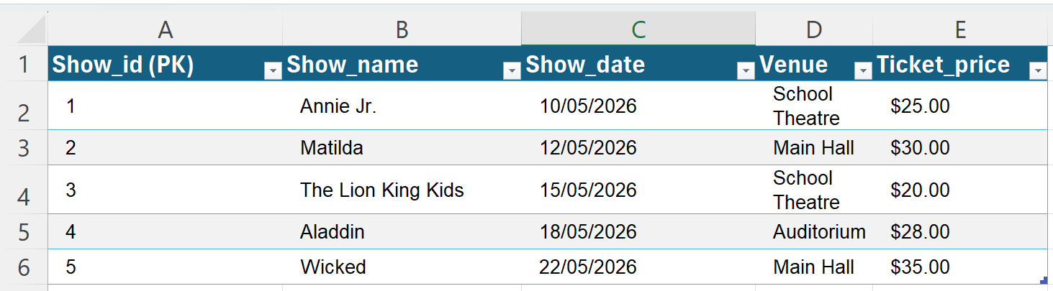
Project (example)
Field | Format | Description
Show_id | Integer (number, whole number) | Unique identifier for the show (PK)
Show_name | Text (string) | Name of the musical/show
Show_date | Date (YYYY-MM-DD) | Date of the show
Venue | Text (string) | Location/venue of the show
Ticket_price | Decimal (e.g., $25.00) | Price per ticket
School musical ticketing system
Open Excel
Add sheets
Rename these to:
Create the table in Show with the fields shown.
5. Format the data with the datatypes above
Notes:
Format cells by right clicking on the cell and selecting Format

Slide 15

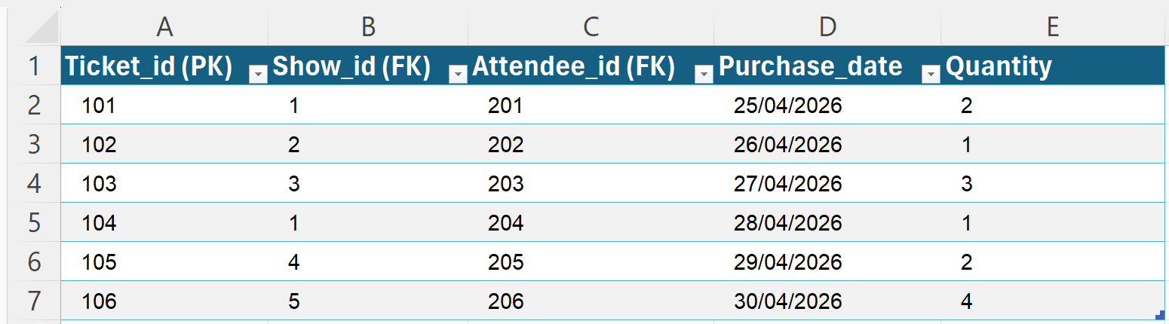
Project: Continued
Field | Format | Description
Ticket_id | Integer (whole number) | Unique identifier for each ticket (PK)
Show_id | Integer (whole number) | Foreign key linking to Shows table
Attendee_id | Integer (whole number) | Foreign key linking to Attendees table
Purchase_date | Date (YYYY-MM-DD) | Date the ticket was purchased
Quantity | Integer (whole number) | Number of tickets purchased
School musical ticketing system
In the Tickets sheet
Create the table with the fields shown.
3. Format the data with the datatypes above
Notes:
Format cells by right clicking on the cell and selecting Format

Slide 16

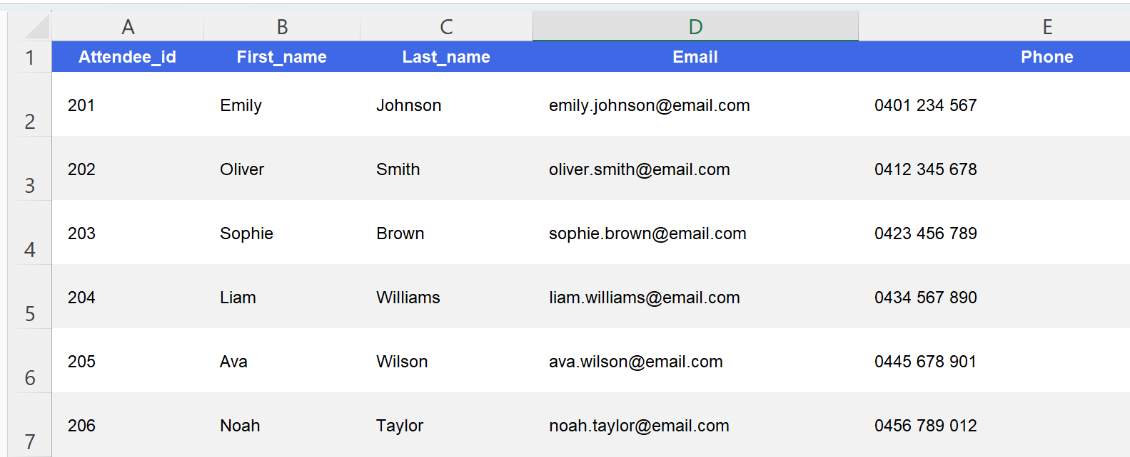
Project: Continued (1)
Field | Format | Description
Attendee_id | Integer (whole number) | Unique identifier for attendee (PK)
First_name | Text (string) | Attendee’s first name
Last_name | Text (string) | Attendee’s last name
Email | Text (string) | Attendee’s email address
Phone | Text (string) | Attendee’s phone number
School Musical ticketing system
In the Attendees sheet
Create the table with the fields shown.
3. Format the data with the datatypes above
Class discussion:
Privacy
and Cybersecurity
Notes:
Data used here is fictious .Students can discuss data privacy and cybersecurity measures while creating their spreadsheets.
Students can also discuss inclusivity issues.Do all cultures have a first and second name?

Slide 17
Other school based systems
Canteen Ordering System
menu_items
- item_id (PK)
- item_name
- price
- category (e.g., snack, drink)
orders
- order_id (PK)
- student_id (FK)
- item_id (FK)
- order_date
- quantity
students
- student_id (PK)
- first_name
- last_name
- grade
- parent_email
Sports or Swimming Carnival System
events
- event_id (PK)
- event_name
- event_date
- event_type (e.g., swimming, running)
participations
- participation_id (PK)
- event_id (FK)
- student_id (FK)
- result_time / score
- position
students
- student_id (PK)
- first_name
- last_name
- grade
- emergency_contact
What data types (formats) would be used for each of these fields ?

Slide 18
Check for understanding
Benefits of separating tables for a school musical ticketing system
Keeps things organised: Each table only contains one type of information.
Makes updating easier: If someone’s contact details change, you only need to update one spot.
Reduces mistakes: You don’t have to repeat information, so less chance of errors.
Easy searching: You can quickly find who bought a ticket or which seats are sold for a show.
Notes:
Keeps things organised: Each table only contains one type of information.
Makes updating easier: If someone’s contact details change, you only need to update one spot.
Reduces mistakes: You don’t have to repeat information, so less chance of errors.
Easy searching: You can quickly find who bought a ticket or which seats are sold for a show.

Slide 19
Knowledge check – concluding the lesson (1)
End of section student skills formative assessment checklist
Students can: | Checkbox
model real world events with data. use a spreadsheet to create a School Musical Ticket booking system.

Slide 20
References
This presentation contains NSW Curriculum and syllabus content. The NSW Curriculum is developed by the NSW Education Standards Authority. This content is prepared by NESA for and on behalf of the Crown in the right of the State of New South Wales. The material is protected by Crown copyright.
Please refer to the NESA Copyright Disclaimer for more information https://educationstandards.nsw.edu.au/wps/portal/nesa/mini-footer/copyright.
NESA holds the only official and up-to-date versions of the NSW Curriculum and syllabus documents. Please visit the NSW Education Standards Authority (NESA) website https://educationstandards.nsw.edu.au/wps/portal/nesa/home and the NSW Curriculum website https://curriculum.nsw.edu.au.
Computing Technology 7-10 Syllabus © NSW Education Standards Authority (NESA) for and on behalf of the Crown in right of the State of New South Wales, 2024.
NSW Department of Education (n.d.) Digital learning selector, Peer discussion and conferencing, accessed 21 April 2026.
NSW Department of Education (n.d.) Explicit teaching: Activating prior knowledge, accessed 21 April 2026.
NSW Department of Education (n.d.) Explicit Teaching: Checking for understanding, accessed 21 April 2026.
NSW Department of Education (n.d.) Explicit teaching: Chunking and sequencing learning, accessed 21 April 2026.
NSW Department of Education (n.d.) Explicit teaching: Connecting learning, accessed 21 April 2026.
NSW Department of Education (n.d.) Explicit teaching: Modelling technique guide, accessed 21 April 2026.
NSW Department of Education (n.d.) Explicit teaching, Using effective questioning, accessed 24 September 2025.

Slide 21
Copyright
© State of New South Wales (Department of Education), 2026
The copyright material published in this resource is subject to the Copyright Act 1968 (Cth) and is owned by the NSW Department of Education or, where indicated, by a party other than the NSW Department of Education (third-party material).
Copyright material available in this resource and owned by the NSW Department of Education is licensed under a Creative Commons Attribution 4.0 International (CC BY 4.0) licence.
This licence allows you to share and adapt the material for any purpose, even commercially.
Attribution should be given to © State of New South Wales (Department of Education), 2026.
Material in this resource not available under a Creative Commons licence:
the NSW Department of Education logo, other logos and trademark-protected material
Material owned by a third party that has been reproduced with permission. You will need to obtain permission from the third party to reuse its material.
Links to third-party material and websites
Please note that the provided (reading/viewing material/list/links/texts) are a suggestion only and implies no endorsement, by the New South Wales Department of Education, of any author, publisher, or book title. School principals and teachers are best placed to assess the suitability of resources that would complement the curriculum and reflect the needs and interests of their students.
If you use the links provided in this document to access a third party’s website, you acknowledge that the terms of use, including licence terms set out on the third-party’s website apply to the use which may be made of the materials on that third-party website or where permitted by the Copyright Act 1968 (Cth). The department accepts no responsibility for content on third-party websites.

