Slide 1
Instructions for use
Learning episode 5
This resource is not a teaching and learning program. It should be used in conjunction with Computing Technology 7-10 – Analysing data.
Classroom teachers are encouraged to add and adapt slides as required to meet the needs of their students.
Save a copy of the file to make changes to the slide deck. Go to File > Download a Copy (this downloads a copy to the computer to edit in the PowerPoint app).
To convert the PowerPoint to Google Slides:
  Upload the file into Google Drive and open it.
  Go to File > Save as Google Slides.
  (Note – conversion may cause formatting changes in the slides.)

Slide 2

Enterprise systems – analysing data
Computing Technology – Stage 5
5 Visualise and model
Weeks 11 – 12
Notes:
This slide deck complements the teacher support resource, assessment tasks and program of learning. Teachers are advised to issue the support resource either through their LMS or printed as a student workbook

Slide 3
Learning episodes
1
Identify and define
6
Real world scenarios
2
Data types
7
  Spreadsheets and databases
3
8
Digital solutions
Purpose and people
4
9
Test and evaluate
Research and Plan
5
10
Exploring careers
Visualise and model
Notes:
This slide indicates the plan for 10 learning episodes and the current slide deck 7 Spreadsheets and databases

Slide 4
5. Visualise and model

Slide 5
Learning intentions and success criteria (1)
We are learning to
visualise and model data
identify issues relating to data analysis.
We can
recognise and apply data visualisation principles
Describe ownership of data, privacy and cybersecurity.
Notes:
Notes for teachers:
Learning intentions and success criteria are best co-constructed with students. Adapt the learning intention as required and add matching success criteria.
For more information See ⁠AITSL or the NSW Department of Education explicit teaching strategies, ⁠Sharing learning intentions and ⁠Sharing success criteria
LISC is not necessarily presented at the beginning of the lesson. Teacher needs to consider most effectual time to introduce
LISC should be revisited during the lesson to support students' evaluation of their learning

Slide 6
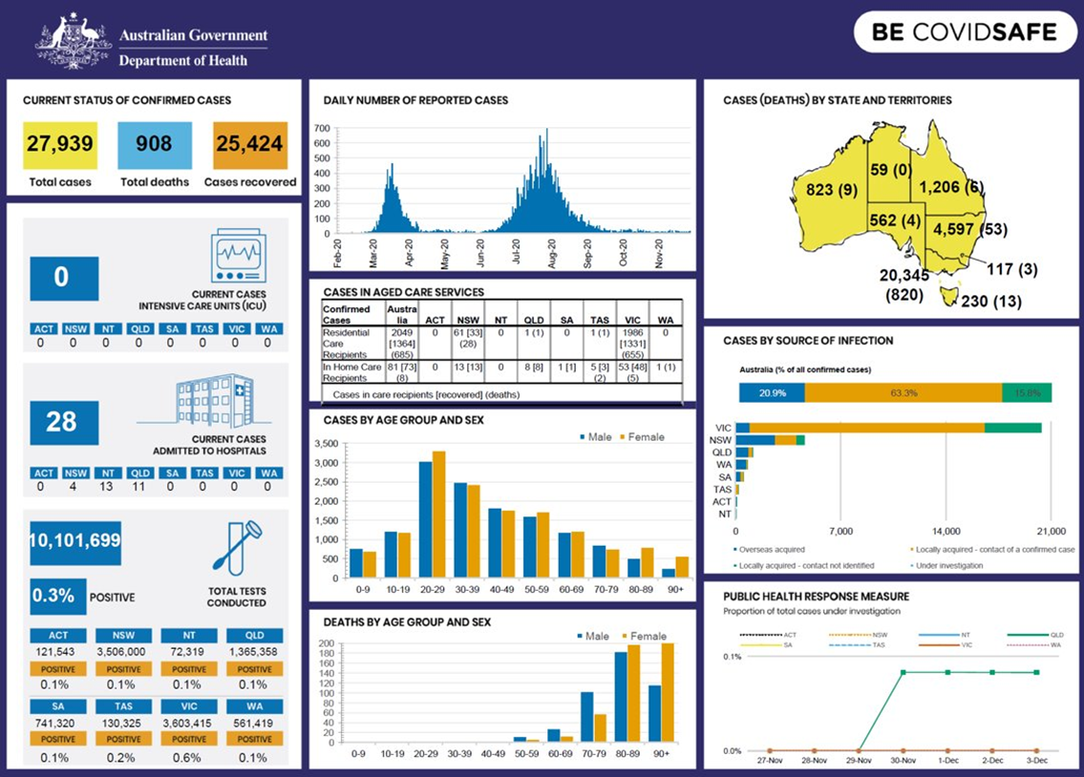
Data visualisation
Key data visualisation principles for effective and meaningful presentation of data
1. Clarity
2. Accuracy
3. Simplicity
4. Appropriate Choice of Visualisation
5. Effective Use of Colour
6. Consistency
7. Context
8. Focus
9. Readability
10. Accessibility
Use these key principles as a checklist to evaluate the data visualisation on the following slide.
Notes:
1. Clarity: The visualisation should convey information clearly and be easy to interpret.
Avoid overcrowding with too much information.
2. Accuracy: Graphs and charts must represent data truthfully—no distorted scales or misleading representations. Ensure the axes and proportions are correct.
3. Simplicity Use simple designs and minimise unnecessary decoration. Highlight the essential message without distractions.
4. Appropriate Choice of Visualisation Select chart types that suit the data (e.g., bar charts for comparisons, line graphs for trends).Avoid using complex or inappropriate graphics.
5. Effective Use of Colour Use colours to differentiate data groups, but ensure they don’t confuse or mislead. Colours should be accessible, including for people with colour vision deficiencies.
6. Consistency Use consistent fonts, colours, and scales across related visualisations for easier comparison.
7. Context Clearly label elements: include titles, axis labels, legends, and units.Make sure users understand what the data represents.
8. Focus Direct attention to the main insights—use design elements (scale, colour, layout) to emphasise important data.
9. Readability Text should be legible; contrasts should separate elements well. Visualisations should be readable at different sizes and on different devices.
10. Accessibility Use colour schemes and design choices that are inclusive of those with visual impairments. Provide alternatives such as data tables or captions.

Slide 7

Explore design principles and issues relevant to analysing data, including visualisation principles
What is data visualisation?
What is the main message or story that the graphics/charts are trying to convey?
Describe how the data becomes information including the use of graphics, colours and charts.
Australia Government Department of Health 2020
Notes:
What is the main message or story that the graphic/chart is trying to convey?
How does the choice of colours influence the readability and understanding of the data?
Are the colours used in the chart accessible to people with colour vision deficiencies? Why or why not?
Does the chart have sufficient contrast between elements (such as text and background)?
Is the data presented in the most appropriate visual form (e.g., bar chart, line graph, pie chart)? Why was this form chosen?
Are labels, legends, and axes clearly visible and easy to interpret?
Is there any unnecessary decoration (e.g., images, effects) that might distract from the data analysis?
Does the visualisation use accurate scaling, and is the data proportional on the axes?
Are any trends, patterns or outliers visible in the chart, and how does the design help highlight them?
How does the layout (positioning of elements) help or hinder understanding of the information?
Has the chart avoided misleading techniques, such as truncated axes or inappropriate aggregation of data?
Does the chart give a balanced and unbiased representation of the data—are all relevant data points included?
Is there a clear title or caption that explains what the visualisation represents?
How might the design principles change if the audience for the visualisation is very young or has limited data literacy?
In what ways could this graphic be improved to make it easier to analyse or interpret for a wider audience?
some key data visualisation principles for effective and meaningful presentation of data:
1. Clarity
The visualisation should convey information clearly and be easy to interpret.
Avoid overcrowding with too much information.
2. Accuracy
Graphs and charts must represent data truthfully—no distorted scales or misleading representations.
Ensure the axes and proportions are correct.
3. Simplicity
Use simple designs and minimise unnecessary decoration.
Highlight the essential message without distractions.
4. Appropriate Choice of Visualisation
Select chart types that suit the data (e.g., bar charts for comparisons, line graphs for trends).
Avoid using complex or inappropriate graphics.
5. Effective Use of Colour
Use colours to differentiate data groups, but ensure they don’t confuse or mislead.
Colours should be accessible, including for people with colour vision deficiencies.
6. Consistency
Use consistent fonts, colours, and scales across related visualisations for easier comparison.
7. Context
Clearly label elements: include titles, axis labels, legends, and units.
Make sure users understand what the data represents.
8. Focus
Direct attention to the main insights—use design elements (scale, colour, layout) to emphasise important data.
9. Readability
Text should be legible; contrasts should separate elements well.
Visualisations should be readable at different sizes and on different devices.
10. Accessibility
Use colour schemes and design choices that are inclusive of those with visual impairments.
Provide alternatives such as data tables or captions.

Slide 8
Explore design principles and issues relevant to analysing data, including data trails
Digital footprints
A Digital footprint is like the marks you leave when you walk on a sandy beach.
Every time you do something online—like posting on social media, sending a message, or visiting a website—you leave behind information that shows where you've been and what you've done.
This is your digital footprint.
It stays there and can be seen or tracked by others, like friends, companies, or even hackers.

Slide 9
Explore design principles and issues relevant to analysing data, including data trails (1)
Data trails
Data trails are similar but a bit more detailed.
Imagine if, instead of just footprints, you also dropped little notes, receipts, and photos along your path on the beach.
A data trail is all the specific pieces of information collected about your online activities—things like the times you accessed a site, the IP addresses, clicks you made, and data that websites or apps keep about you.
It’s a trail of data that can be followed to learn exactly what you did and when.

Slide 10
10
Digital footprint
Data trail
Broad record of your online presence:
Includes visible online actions (posting, messaging, visiting sites).
Can be seen or tracked by others (friends, companies).
Refers to lasting marks from online behaviour.
records of your online actions
used to learn about what you do online
tracked and viewed by others
contribute to your online privacy and security concerns
Detailed pieces of information about your online activity.
Includes timestamps, IP addresses, clicks, and detailed records kept by websites/apps.
Can be followed for a step-by-step history of what you did and when.
Often collected and used by companies, apps, and analytics tools.

Slide 11
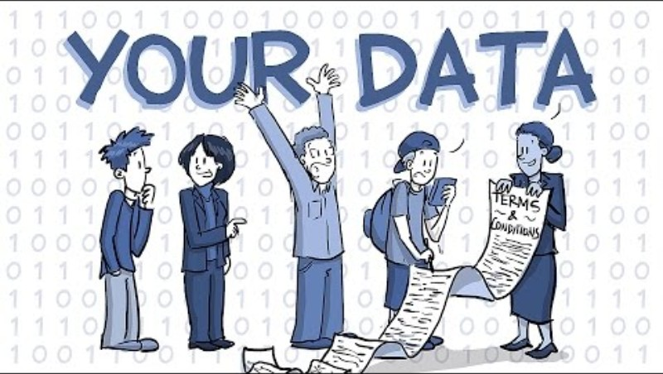
Your data

Slide 12
Explore design principles and issues relevant to analysing data, including ownership of data (1)
Questions - Think, Pair, Share
What kinds of data do you create or share when you use apps, websites, or social media?
Who do you think owns the data you generate online?
Is it you, the app or website provider, or someone else?
  Why do you think that is the case?
Notes:
How can you take responsibility for protecting your own data? What habits or tools might help?
Should schools, governments, or communities have a role in educating or regulating data ownership? Why or why not?
How might attitudes toward data ownership change as new technologies (e.g., artificial intelligence, IoT) emerge?
If you create content online (photos, videos, texts), who owns that content, and how could data ownership impact your rights as a creator?
In what ways might data ownership be different for minors compared to adults?

Slide 13
Explore design principles and issues relevant to analysing data, including ownership of data (2)
Questions - Think, Pair, Share
When you agree to terms and conditions or privacy policies, what are you often allowing companies to do with your data?
Do you believe you should have control over how your data is used and shared?
  What does control look like in practice?
How might companies benefit from owning or using your data?
Can you think of positive and negative examples?
Notes:
How can you take responsibility for protecting your own data? What habits or tools might help?
Should schools, governments, or communities have a role in educating or regulating data ownership? Why or why not?
How might attitudes toward data ownership change as new technologies (e.g., artificial intelligence, IoT) emerge?
If you create content online (photos, videos, texts), who owns that content, and how could data ownership impact your rights as a creator?
In what ways might data ownership be different for minors compared to adults?

Slide 14
Connected learning
Collect and interpret data adhering to privacy and cybersecurity principles
1. Revisit the hypothetical scenario:
“Your school is considering installing facial recognition cameras and software to automate student attendance. This technology collects biometric data and automatically marks the roll.”
Lawfulness and Consent
Purpose Limitation
Data Minimisation
Data Security
Transparency
Accountability
2. Think Pair Share
Rank these principles in importance for this scenario
3. Explain your thinking
Notes:
Explain each of these principles with examples related to the facial recognition system:
Lawfulness and Consent: Students must know and agree how their facial data will be used.
Purpose Limitation: The system should only use data for attendance, not other unrelated purposes.
Data Minimisation: Only the necessary biometric data should be collected.
Data Security: Measures such as encryption and access controls are essential to protect data.
Transparency: Students and parents should be informed about the system's operation and data handling.
Accountability: The school must ensure responsible management and oversight of the data.

Slide 15
Collect and interpret data adhering to privacy and cybersecurity principles
Think Pair Share: allocate a question to each group of students.
Identify privacy issues involved in the facial recognition system.
What cybersecurity risks might the school face?
How could the school address these issues to comply with privacy and cybersecurity principles?
What steps would make students and parents feel confident about the system?
What other less dramatic but still familiar examples are you aware of ?
Notes:
1. Using Student ID Cards for Attendance
Scenario: Students scan their ID cards when they enter school each morning. The system records the time and marks their attendance.
Privacy principles: Only attendance data is collected; the system doesn’t track student movements beyond arrival. Students’ names and IDs are kept confidential, and data is securely stored.
Cybersecurity principles: Only authorised staff can access attendance records; data is protected from unauthorised access.
2. Online Learning Platform Usage
Scenario: An online platform records which students log in, their participation in class activities, and their submitted assignments.
Privacy principles: The platform only collects information needed for learning and assessment, not unnecessary personal data. Students and parents are informed about what is collected.
Cybersecurity principles: Logins and passwords protect student accounts; the data is encrypted and regularly backed up.
3. School Newsletter Distribution
Scenario: Parents provide email addresses to receive school newsletters and notifications.
Privacy principles: Email addresses are only used for school communication, not shared with outside organisations or used for marketing.
Cybersecurity principles: Distribution lists are protected to prevent exposure of email addresses; only authorised staff can send newsletters.
4. Class Polls or Surveys
Scenario: A teacher runs a Google Form survey to ask students about their preferred excursion location.
Privacy principles: Surveys are anonymous or only collect necessary information (like preferences), not sensitive personal data.
Cybersecurity principles: Form results are only accessible to the teacher and are stored securely.
How These Examples Relate to Privacy and Cybersecurity Principles
Transparency: Students and parents are informed about what data is collected and why.
Data Minimisation: Only the minimum amount of data necessary is collected.
Access Control: Only those who need the data for their roles (e.g., teachers, office staff) can access it.
Data Security: Data is stored securely and backed up; passwords and encryption are used when appropriate.

Slide 16
Modelling systems
Scenario
You team are tasked with:
“ Illustrating the latest Computing Technology textbook”.
You are required to draw or illustrate with graphics the:
inputs, storage, transmission, processes, and outputs of an information system that uses data analysis. For example: Monitoring academic performance, Behaviour and wellbeing, School canteen, Sports carnival results.
These initial drawings and sketches can be abstracted into diagrammatic models of the system.
This diagram can be achieved using:
Microsoft Word >
Insert shapes >
Flowcharts
or using Lucidchart (3:34) from the Google Workspace Marketplace.

Slide 17
Check for understanding
Data visualisation is important because it helps us understand information quickly and easily.
When we have lots of numbers or facts, just looking at raw data can be confusing or boring.
But if we turn that data into charts, graphs, or pictures, it becomes much easier to see patterns, trends, and relationships.
Notes:
Data visualisation is important because it helps us understand information quickly and easily. When we have lots of numbers or facts, just looking at raw data can be confusing or boring. But if we turn that data into charts, graphs, or pictures, it becomes much easier to see patterns, trends, and relationships.

Slide 18

Knowledge check – concluding the lesson
End of section student skills formative assessment checklist
Students can: | Checkbox
visualise and model data identify issues relating to data analysis recognise and apply data visualisation principles. describe ownership of data, privacy and cybersecurity

Slide 19
Learning intentions and success criteria (2)
We are learning to
represent and store data to facilitate computation
select appropriate data types
understand data type limitations
structure data systematically.
We can
use spreadsheets to select appropriate data types and facilitate computation.
Notes:
Notes for teachers:
Learning intentions and success criteria are best co-constructed with students. Adapt the learning intention as required and add matching success criteria.
For more information See ⁠AITSL or the NSW Department of Education explicit teaching strategies, ⁠Sharing learning intentions and ⁠Sharing success criteria
LISC is not necessarily presented at the beginning of the lesson. Teacher needs to consider most effectual time to introduce
LISC should be revisited during the lesson to support students' evaluation of their learning

Slide 20
Represent and store data to facilitate computation, including selecting appropriate data types
Complete the cloze passage
Computers store all data using binary digits (0s and 1s).
Excel interprets this binary data by assigning specific data types to it.
Choosing the appropriate data types and organising data systematically is essential for accurate calculations and analysis.
Being aware of data type limitations helps prevent errors and enhances data quality.
Correct data types ensure that operations such as computations, sorting, and filtering work properly.
Fundamentally, all digital data is stored, processed, and transmitted as electrical signals representing binary digits, which gain meaning through their assigned data types.
Notes:
Computers store all data using binary digits (0s and 1s).
Excel interprets this binary data by assigning specific data types to it.
Choosing the appropriate data types and organising data systematically is essential for accurate calculations and analysis.
Being aware of data type limitations helps prevent errors and enhances data quality.
Correct data types ensure that operations such as computations, sorting, and filtering work properly.
Fundamentally, all digital data is stored, processed, and transmitted as electrical signals representing binary digits, which gain meaning through their assigned data types.

Slide 21
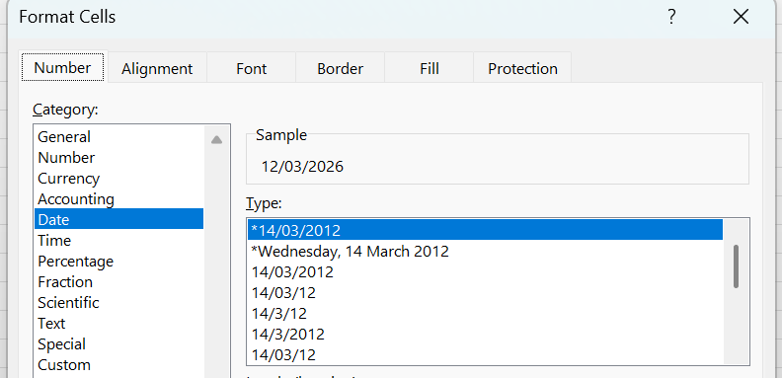
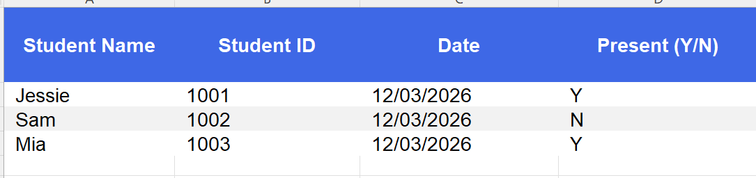
Represent and store data to facilitate computation, including selecting appropriate data types (1)
Open excel and add a tab called “roll”
Right click on each cell and select Format cells
What data type should be stored in each column?
2. Why is it important that "Student ID" is set as
a Number and not Text?
3. What issues might arise if "Date" is entered inconsistently
(e.g., 12/03/2026 versus March 12th, 2026)?
4. Extend the spreadsheet to keep the marks for 2
assessment tasks.
Which datatype should these be?
Why?
Notes:
Computers use binary digits to store all data.
Excel represents this binary data as specific data types.
Selecting correct data types and structuring data systematically ensures accurate computation and analysis.
Understanding data type limitations prevents errors and improves data quality. Choosing the right data type ensures computations, sorting, and filtering function correctly.
All digital data is stored, processed, and transmitted as electrical high and low signals represented by binary digits (zeros and ones).
These zeros and ones are then given meaning by their representation as data types
Assemsent tass should be numbers to allow for calculating totals and working out averages etc.

Slide 22
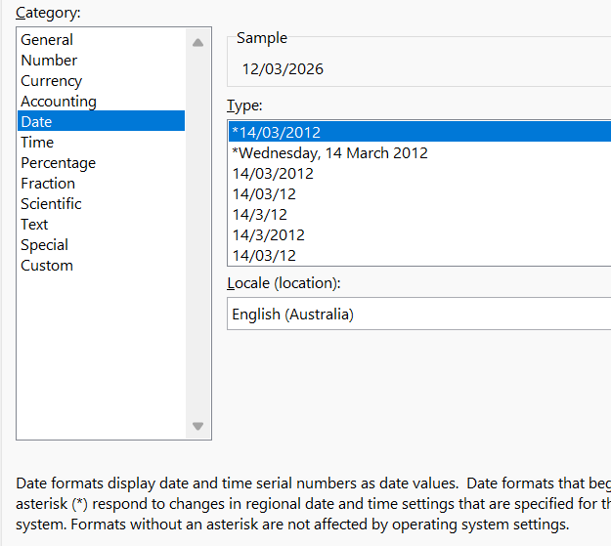
Represent and store data to facilitate computation
data type limitations
Numbers: Excel can store very large and very small numbers, but with limits. Precision errors can happen with extremely large decimals.
Text: Cells can hold up to 32,767 characters, but not ideal for storing large blocks of text.
Date/Time: Excel stores dates as serial numbers beginning from 1 January 1900. Dates outside this range may not be processed correctly.
Mixing data types in a column can cause errors (e.g., numbers stored as text cannot be summed).
Notes:
Computers use binary digits to store all data.
Excel represents this binary data as specific data types.
Selecting correct data types and structuring data systematically ensures accurate computation and analysis.
Understanding data type limitations prevents errors and improves data quality. Choosing the right data type ensures computations, sorting, and filtering function correctly.
All digital data is stored, processed, and transmitted as electrical high and low signals represented by binary digits (zeros and ones).
These zeros and ones are then given meaning by their representation as data types
Assemsent tass should be numbers to allow for calculating totals and working out averages etc.

Slide 23
Represent and store data to facilitate computation, including
structuring data systematically
Use tables:
1. Insert Table ( Crtl + T ) feature in Excel automatically manages structuring and formatting
2. Use consistent column headers and data types
3. Avoid blank rows or columns within your data
4. Separate raw data from calculated formulas and summaries
Notes:
Computers use binary digits to store all data.
Excel represents this binary data as specific data types.
Selecting correct data types and structuring data systematically ensures accurate computation and analysis.
Understanding data type limitations prevents errors and improves data quality. Choosing the right data type ensures computations, sorting, and filtering function correctly.
All digital data is stored, processed, and transmitted as electrical high and low signals represented by binary digits (zeros and ones).
These zeros and ones are then given meaning by their representation as data types
Assemsent tass should be numbers to allow for calculating totals and working out averages etc.

Slide 24
Check for understanding (1)
Data types and formats
Look at the following date: 04/07/2026
If this date is written in the Australian format (DD/MM/YYYY), what day and month does it represent?
If it is written in the US format (MM/DD/YYYY), what day and month does it represent?
Why is it important to know the difference between these date formats?

Slide 25
Knowledge check – concluding the lesson (1)
End of section student skills formative assessment checklist
Students can: | Checkbox
represent and store data to facilitate computation select appropriate data types with awareness of their limitations to structure data systematically use spreadsheets to select appropriate data types and facilitate computation.

Slide 26
References
This presentation contains NSW Curriculum and syllabus content. The NSW Curriculum is developed by the NSW Education Standards Authority. This content is prepared by NESA for and on behalf of the Crown in the right of the State of New South Wales. The material is protected by Crown copyright.
Please refer to the NESA Copyright Disclaimer for more information https://educationstandards.nsw.edu.au/wps/portal/nesa/mini-footer/copyright.
NESA holds the only official and up-to-date versions of the NSW Curriculum and syllabus documents. Please visit the NSW Education Standards Authority (NESA) website https://educationstandards.nsw.edu.au/wps/portal/nesa/home and the NSW Curriculum website https://curriculum.nsw.edu.au.
Computing Technology 7-10 Syllabus © NSW Education Standards Authority (NESA) for and on behalf of the Crown in right of the State of New South Wales, 2024.
NSW Department of Education (n.d.) Digital learning selector, Peer discussion and conferencing, accessed 21 April 2026.
NSW Department of Education (n.d.) Explicit teaching: Activating prior knowledge, accessed 21 April 2026.
NSW Department of Education (n.d.) Explicit Teaching: Checking for understanding, accessed 21 April 2026.
NSW Department of Education (n.d.) Explicit teaching: Chunking and sequencing learning, accessed 21 April 2026.
NSW Department of Education (n.d.) Explicit teaching: Connecting learning, accessed 21 April 2026.
NSW Department of Education (n.d.) Explicit teaching: Modelling technique guide, accessed 21 April 2026.
NSW Department of Education (n.d.) Explicit teaching, Using effective questioning, accessed 24 September 2025.

Slide 27
References (1)
Australian Government Department of Health (2020) Coronavirus (COVID-19) at a glance – 20 September 2020
accessed 21 April 2026.
PHD Comics Piled Higher and Deeper (2025) Who owns your data? (Hint: It's not you) [ video] YouTube, accessed
1 May 2026
State of New South Wales (Department of Education) (2023) Digital Learning Selector,
NSW Department of Education website, accessed 1 May 2026.

Slide 28
Copyright
© State of New South Wales (Department of Education), 2026
The copyright material published in this resource is subject to the Copyright Act 1968 (Cth) and is owned by the NSW Department of Education or, where indicated, by a party other than the NSW Department of Education (third-party material).
Copyright material available in this resource and owned by the NSW Department of Education is licensed under a Creative Commons Attribution 4.0 International (CC BY 4.0) licence.
This licence allows you to share and adapt the material for any purpose, even commercially.
Attribution should be given to © State of New South Wales (Department of Education), 2026.
Material in this resource not available under a Creative Commons licence:
the NSW Department of Education logo, other logos and trademark-protected material
Material owned by a third party that has been reproduced with permission. You will need to obtain permission from the third party to reuse its material.
Links to third-party material and websites
Please note that the provided (reading/viewing material/list/links/texts) are a suggestion only and implies no endorsement, by the New South Wales Department of Education, of any author, publisher, or book title. School principals and teachers are best placed to assess the suitability of resources that would complement the curriculum and reflect the needs and interests of their students.
If you use the links provided in this document to access a third party’s website, you acknowledge that the terms of use, including licence terms set out on the third-party’s website apply to the use which may be made of the materials on that third-party website or where permitted by the Copyright Act 1968 (Cth). The department accepts no responsibility for content on third-party websites.

