Slide 1
Instructions for use
Learning episode 1
This resource is not a teaching and learning program. It should be used in conjunction with Computing Technology 7-10 – Analysing data.
Classroom teachers are encouraged to add and adapt slides as required to meet the needs of their students.
Save a copy of the file to make changes to the slide deck. Go to File > Download a Copy (this downloads a copy to the computer to edit in the PowerPoint app).
To convert the PowerPoint to Google Slides:
  Upload the file into Google Drive and open it.
  Go to File > Save as Google Slides.
  (Note – conversion may cause formatting changes in the slides.)

Slide 2

Enterprise systems – analysing data
Computing Technology – Stage 5
Identify and define
Weeks 1 – 2
Notes:
This slide deck complements the teacher support resource, assessment tasks and program of learning. Teachers are advised to issue the support resource either through their LMS or printed as a student workbook. The first lessons of this course should include introducing the analysing data focus area, the glossary and the assessment tasks. These are available in the teacher support resource.

Slide 3
Learning episodes
1
Identify and define
6
Real world scenarios
2
Data types
7
  Spreadsheets and databases
3
8
Digital solutions
Purpose and people
4
9
Test and evaluate
Research and Plan
5
10
Exploring careers
Visualise and model
Notes:
This slide indicates the plan for 10 learning episodes and the current slide deck 7 Spreadsheets and databases

Slide 4
1.Identify and define

Slide 5
Learning intentions and success criteria
We are learning to
define data as used in Computing.
We can
recognise how data is used in different subjects
correctly categorise data and information
organise and describe data.
Notes:
Notes for teachers:
Learning intentions and success criteria are best co-constructed with students. Adapt the learning intention as required and add matching success criteria.
For more information See ⁠AITSL or the NSW Department of Education explicit teaching strategies, ⁠Sharing learning intentions and ⁠Sharing success criteria
LISC is not necessarily presented at the beginning of the lesson. Teacher needs to consider most effectual time to introduce
LISC should be revisited during the lesson to support students' evaluation of their learning

Slide 6
Beginning the lesson
What does the word data mean?
Notes:
Activating Prior Knowledge

Slide 7
What does the word data mean?
facts
numbers
examples
data
observations
Notes:
Typical correct understanding from Year 9 students might include:
Data is information or facts collected to be used for analysis.
Data can be numbers, measurements, observations, or descriptions.
Data is raw information that can be processed to help answer questions or make decisions.
Common misconceptions Year 9 students might have:
Data is only numbers or statistics.
Data is the same as information (not distinguishing raw data from processed information).
Data is something only scientists or adults use.
Data means computer files or digital information exclusively.
Example Year 9 student answers:
"Data is numbers we collect in science experiments."
"Data is any kind of information we write down."
"Data is what computers use."
"Data is facts and details we gather to learn about something."
How to support clarification:
Emphasise that data includes both numbers and other types of facts.
Explain data as raw facts that need to be interpreted.
Highlight that data is used by many people in different ways.
Use think alouds to categorise student responses.

Slide 8
Check for understanding: What does the word data mean?
What are 3 examples of data?
Is data the same as information?
How is data different from information?
Notes:
Check for understanding:
What are 3 examples of data? Facts, numbers, observations
Is data the same as information? No
How is data different from information? Data is information or facts collected to be used for analysis. Data are raw facts that need to be interpreted.

Slide 9
Check for understanding: What does the word data mean?(1)
What are 3 examples of data?
Facts, numbers, observations
Is data the same as information?
No
How is data different from information?
Data are raw facts that need to be interpreted to be information
Notes:
Check for understanding:
What are 3 examples of data? Facts, numbers, observations
Is data the same as information? No
How is data different from information? Data is information or facts collected to be used for analysis. Data are raw facts that need to be interpreted.

Slide 10
How have you used data in subjects like Science and Maths?
plant growth
chemical reactions/temperature
facts
numbers
investigations
definition
Science
forces and timing
observations
data
number patterns
Mathematics
objects to analyse
statistics
probability
Notes:
Definition of data in Science
Data: Information that is collected, organised and analysed for various purposes. It can be in the form of numbers, text, images or any other format that can be processed. Data can be represented using techniques such as tables, graphs and textual explanations.
Dataset: A collection of numbers or values relating to a particular subject. Datasets are normally presented in tables or represented by graphs. For example, the test scores of each student in a particular class.
Definition of data in Mathematics
Data: Facts or units of information collected together.
Dataset: A collection of numbers or values relating to a particular subject. Datasets are normally presented in tables or represented by graphs. For example, the test scores of each student in a particular class.

Slide 11
Check for understanding
Which one is a data set?
15°C
22°C
18°C
20°C
Day | Temperature
Monday | 15°C
Tuesday | 22°C
Wednesday | 18°C
Thursday | 20°C
Notes:
Definition of data in Science
Data: Information that is collected, organised and analysed for various purposes. It can be in the form of numbers, text, images or any other format that can be processed. Data can be represented using techniques such as tables, graphs and textual explanations.
Dataset: A collection of numbers or values relating to a particular subject. Datasets are normally presented in tables or represented by graphs. For example, the test scores of each student in a particular class.
Definition of data in Mathematics
Data: Facts or units of information collected together.
Dataset: A collection of numbers or values relating to a particular subject. Datasets are normally presented in tables or represented by graphs. For example, the test scores of each student in a particular class.

Slide 12
Check for understanding (1)
data set
15°C
22°C
18°C
20°C
Day | Temperature
Monday | 15°C
Tuesday | 22°C
Wednesday | 18°C
Thursday | 20°C
Notes:
Definition of data in Science
Data: Information that is collected, organised and analysed for various purposes. It can be in the form of numbers, text, images or any other format that can be processed. Data can be represented using techniques such as tables, graphs and textual explanations.
Dataset: A collection of numbers or values relating to a particular subject. Datasets are normally presented in tables or represented by graphs. For example, the test scores of each student in a particular class.
Definition of data in Mathematics
Data: Facts or units of information collected together.
Dataset: A collection of numbers or values relating to a particular subject. Datasets are normally presented in tables or represented by graphs. For example, the test scores of each student in a particular class.

Slide 13
How have you used data in Computing?
plant growth
chemical reactions/temperature
facts
experiments
numbers
definition
Science
forces and timing
data
observations
number patterns
Computing
Computing
Computing
Mathematics
encoding
encoding
encoding
abstract objects to analyse
digital processing
digital processing
digital processing
algorithms
algorithms
algorithms
storing
storing
storing
probability
statistics
transmitting
transmitting
transmitting
Notes:
Data: A discrete representation of information using number codes. Data may include characters (e.g. alphabetic letters, numbers and symbols), images, sounds and/or instructions that, when represented by number codes, can be manipulated, stored and communicated by digital systems. For example, characters may be represented using ASCII code or images may be represented by a bitmap of numbers representing each ‘dot’ or pixel.
Dataset: A collection of data combined for a specific purpose.

Slide 14
Computing Technology (Glossary)
Definition of data
“A discrete* representation of information using number codes.
Data may include characters (e.g. alphabetic letters, numbers and symbols), images, sounds and/or instructions that, when represented by number codes*, can be manipulated, stored and communicated by digital systems.
For example, characters may be represented using ASCII code or images may be represented by a bitmap of numbers representing each ‘dot’ or pixel.” *
“Discrete” means separate or distinct pieces.
“Number codes” mean that all information is turned into numbers in computers.
Different types of information like letters, pictures, and sounds all become numbers.
Notes:
“Discrete means separate or distinct pieces.”
“Number codes mean that all information is turned into numbers in computers.”
“Different types of information like letters, pictures, and sounds all become numbers.”

Slide 15
Concluding the lesson
Mathematics
Science
Computing Technology
Facts/units, numbers, datasets, tables, graphs
Collected/analysed information, text/images, experiments, data science
Number codes, ASCII, bitmaps, characters/images/sounds, digital manipulation
What is common to all subjects?
  Data is collected and can be organised,
  represented, and analysed to have
  meaning and become information.
  Data can be stored, manipulated,
  transmitted or visualised.
Notes:
Misconceptions in maths: Data is only numbers; data is graphs; only quantitative
Misconceptions in Science:Misconceptions: Data = info; only numeric; data must be perfect; data science = coding
Misconceptions: Data is binary only; data equals files; images/sounds can't be numbers. Today we were learning to define data as its used in Computing.
We recognised how data is used in different subjects.
We categorised data and information.
We organised and described data.

Slide 16

Knowledge check – concluding the lesson
End of section student skills formative assessment checklist
Students can: | Checkbox
define data as used in Computing recognise how data is used in different subjects correctly categorise data and information organise and describe data.

Slide 17
Learning intentions and success criteria (1)
We are learning to
turn data into information.
We can
I can enter data into a spreadsheet
I can recognise how to make data into information
I can correctly categorise data and information
I can organise and describe data.
Notes:
Notes for teachers:
Learning intentions and success criteria are best co-constructed with students. Adapt the learning intention as required and add matching success criteria.
For more information See ⁠AITSL or the NSW Department of Education explicit teaching strategies, ⁠Sharing learning intentions and ⁠Sharing success criteria
LISC is not necessarily presented at the beginning of the lesson. Teacher needs to consider most effectual time to introduce
LISC should be revisited during the lesson to support students' evaluation of their learning

Slide 18
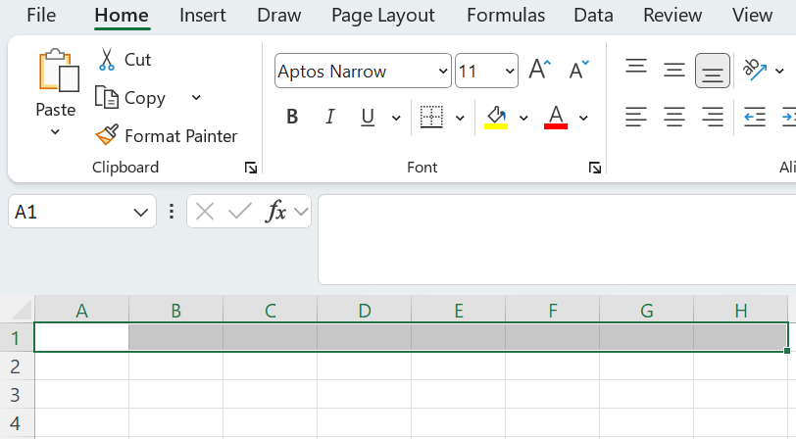
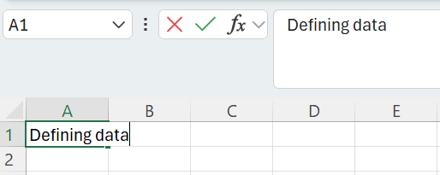

Defining data
Hold the left mouse button down
and drag to select cells A1: AH
Open an excel spreadsheet
In cell A1 type: Defining data
From the Home tab select merge and centre

Slide 19
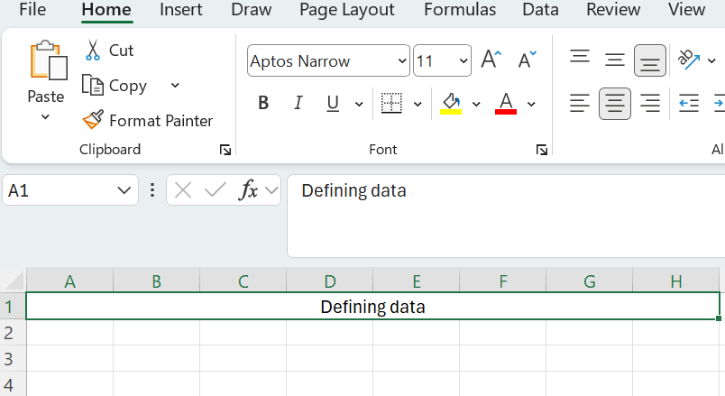

Defining data (1)
From the Insert tab choose
Comment
In the comment type:
A discrete representation of information using number codes. Data may include characters (e.g. alphabetic letters, numbers and symbols), images, sounds and/or instructions that, when represented by number codes, can be manipulated, stored and communicated by digital systems. For example, characters may be represented using ASCII code or images may be represented by a bitmap of numbers representing each ‘dot’ or pixel

Slide 20
Check for understanding (2)
Add the missing words to complete the definition.
A discrete representation of information using number codes.
Data may include characters (e.g. alphabetic letters, numbers and symbols), images, sounds and/or instructions that, when represented by number codes, can be manipulated, stored and communicated by digital systems.
For example, characters may be represented using ASCII code or images may be represented by a bitmap of numbers representing each ‘dot’ or pi .el.
Notes:
A discrete representation of information using number codes.
Data may include characters (e.g. alphabetic letters, numbers and symbols), images, sounds and/or instructions that, when represented by number codes, can be manipulated, stored and communicated by digital systems.
For example, characters may be represented using ASCII code or images may be represented by a bitmap of numbers representing each ‘dot’ or pixel.

Slide 21
Knowledge check – concluding the lesson (1)
End of section student skills formative assessment checklist
Students can: | Checkbox
turn data into information. enter data into a spreadsheet. recognise how to make data into information. categorise data and information. organise and describe data.

Slide 22
References
This presentation contains NSW Curriculum and syllabus content. The NSW Curriculum is developed by the NSW Education Standards Authority. This content is prepared by NESA for and on behalf of the Crown in the right of the State of New South Wales. The material is protected by Crown copyright.
Please refer to the NESA Copyright Disclaimer for more information https://educationstandards.nsw.edu.au/wps/portal/nesa/mini-footer/copyright.
NESA holds the only official and up-to-date versions of the NSW Curriculum and syllabus documents. Please visit the NSW Education Standards Authority (NESA) website https://educationstandards.nsw.edu.au/wps/portal/nesa/home and the NSW Curriculum website https://curriculum.nsw.edu.au.
Computing Technology 7-10 Syllabus © NSW Education Standards Authority (NESA) for and on behalf of the Crown in right of the State of New South Wales, 2024.
NSW Department of Education (n.d.) Digital learning selector, Peer discussion and conferencing, accessed 21 April 2026.
NSW Department of Education (n.d.) Explicit teaching: Activating prior knowledge, accessed 21 April 2026.
NSW Department of Education (n.d.) Explicit Teaching: Checking for understanding, accessed 21 April 2026.
NSW Department of Education (n.d.) Explicit teaching: Chunking and sequencing learning, accessed 21 April 2026.
NSW Department of Education (n.d.) Explicit teaching: Connecting learning, accessed 21 April 2026.
NSW Department of Education (n.d.) Explicit teaching: Modelling technique guide, accessed 21 April 2026.
NSW Department of Education (n.d.) Explicit teaching, Using effective questioning, accessed 24 September 2025.

Slide 23
Copyright
© State of New South Wales (Department of Education), 2026
The copyright material published in this resource is subject to the Copyright Act 1968 (Cth) and is owned by the NSW Department of Education or, where indicated, by a party other than the NSW Department of Education (third-party material).
Copyright material available in this resource and owned by the NSW Department of Education is licensed under a Creative Commons Attribution 4.0 International (CC BY 4.0) licence.
This licence allows you to share and adapt the material for any purpose, even commercially.
Attribution should be given to © State of New South Wales (Department of Education), 2026.
Material in this resource not available under a Creative Commons licence:
the NSW Department of Education logo, other logos and trademark-protected material
Material owned by a third party that has been reproduced with permission. You will need to obtain permission from the third party to reuse its material.
Links to third-party material and websites
Please note that the provided (reading/viewing material/list/links/texts) are a suggestion only and implies no endorsement, by the New South Wales Department of Education, of any author, publisher, or book title. School principals and teachers are best placed to assess the suitability of resources that would complement the curriculum and reflect the needs and interests of their students.
If you use the links provided in this document to access a third party’s website, you acknowledge that the terms of use, including licence terms set out on the third-party’s website apply to the use which may be made of the materials on that third-party website or where permitted by the Copyright Act 1968 (Cth). The department accepts no responsibility for content on third-party websites.

