Slide 1
Crack the Code
Technology Mandatory: Digital Technologies

Slide 2
Control technologies
Control technologies are all around us. They are in our homes, classrooms, shopping centres and even in our streets!
But what are they and how do they work?
Notes:
Teacher notes:
Read/explain/discuss slide

Slide 3
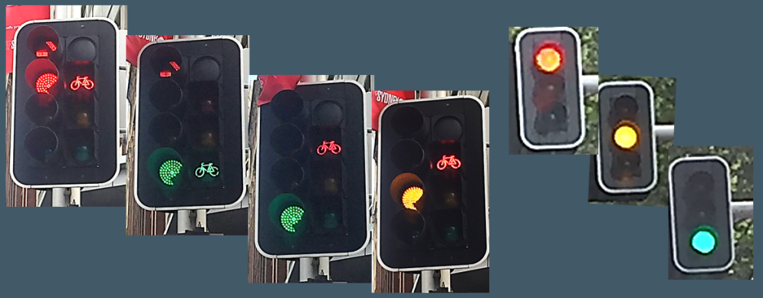
A simple example of a control technology system (1of 3)
Traffic lights
Notes:
Teacher notes:
Traffic lights function by using a timer for busy intersection or sensors on the road to send a signal to the lights that there is a car waiting. Once the light sequence activates, the green light is on for a set amount of time then it turns off and the yellow light is on for a shorter period of time, followed by the red light. The system re-activates by a time sequence or again once a care pulls up and the sensor sends a signal again and repeats the sequence.

Slide 4
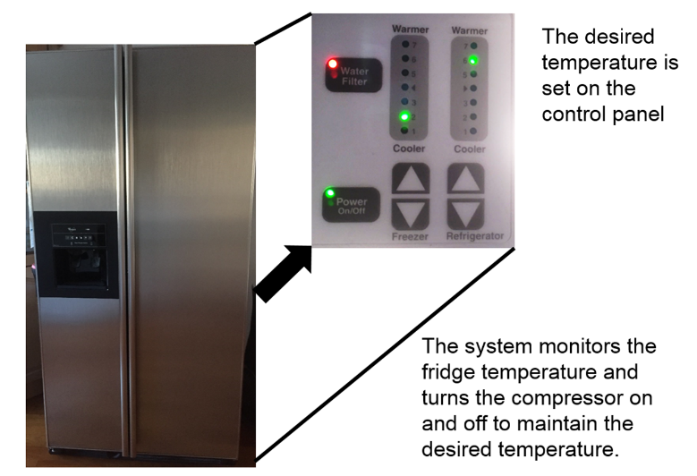
A simple example of a control technology system (2 of 3)
Refrigerator
Notes:
Teacher notes:
A refrigerator uses a temperature sensor which detects the current temperature. If the temperature is higher than the specified temperature, the compressor starts up to cool the air to the required temperature. This is the whirring sound you hear when the fridge is on. The compressor turns off when the set air temperature is met and restarts as soon as the temperature rises again.

Slide 5
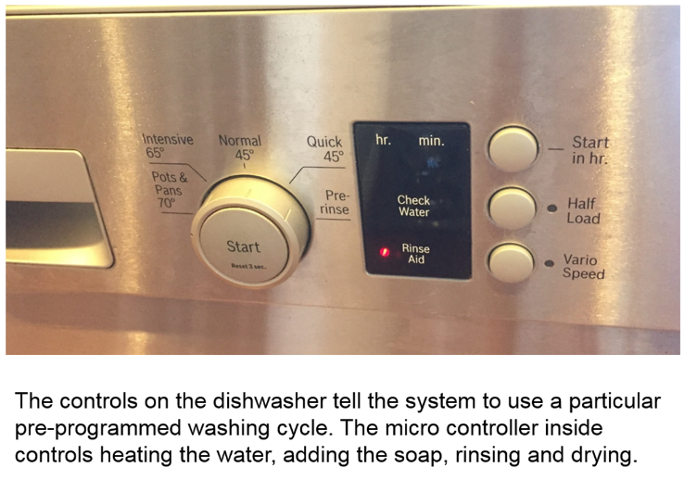
A simple example of a control technology system (3 of 3)
Dishwasher
Notes:
Teacher notes:
A dishwasher is programmed to complete a series of different functions e.g. rinse, heavy duty wash, regular wash, eco wash etc. Each process in programmed and connected to a different input (button) so when a particular button is pushed, it tells the dishwasher which process/cycle to perform. Some buttons when pushed include a combination of different cycles and the dishwasher is programmed to follow this sequence.
Additional discussion:
* Televisions
The signal sent from the remote control is captured by the Television microcontroller. The microcontroller controls the television amplifier subsystem (for example, volume, base, and treble), the picture subsystem (for example, brightness , hue, and contrast), and the receiver subsystem (channel selection).
* Other products that have control technology
Home: DVD player, Sound systems, Telephone, mobile phones, security systems, camera, sewing machine, musical instruments, exercise machines, video games consoles (Play station), Personal computers, fridges, microwave oven, cable boxes (Foxtel)
Office: Computers, printers, telephones, fax machines, security systems, air conditioners, mobile phones, pages, display boards

Slide 6
How does basic control technology work?
YouTube video LOL Elmo from Hasbro
Notes:
Teacher Notes
Play Tickle Me Elmo YouTube clip. Note: You do not need volume
Discussion
Q/ What makes Elmo move?
A/ pressing a button on his hands or feet.
Q/ What happens when you press the button on Elmo’s hands or feet?
A/ Elmo’s body moves/vibrates and his mouth opens and closes.
Q/ How do you think Elmo knows to move/vibrate when the button has been pushed? (Students may not know the answer which is OK)
A/ There is an electronic circuit inside the toy where if the button is pressed (input) the toy will move/vibrate (output).

Slide 7
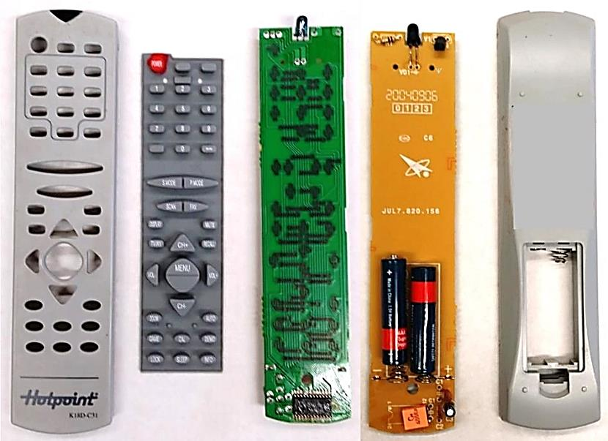
TV Remote Control Page 11
Notes:
Teacher Notes
Use the image on the slide to explain to students the components used and how they form a circuit. (Note: The answers are on the next side on the labelled diagram).
What’s this?
The Circuit in a remote control is made up of:
power supply (battery)
input devices (buttons) - Rubber membrane keypad under each key is a conducting material which bridges contacts on the PCB when pressed. i.e. closes the circuit and electricity can and does flow.
output device (infrared LED)
wires (to transmit the flow of current from the battery to the inputs and outputs)
Printed Circuit Board (PCB) (a board that holds components in place)
Microcontroller (can be thought of as small computers to control systems).
Note: If you have a tactile example that you can pull apart to show as an example, this is also useful.
Is it the microcontroller that makes this device a control technology? By itself, NO as one can envisage a microcontroller running but not controlling anything. Control technology requires at a very minimum a ‘Processor” and a ‘Output device’. For the example above, the microcontroller is what controls the Infrared transmitter and therefore makes the device a control technology.

Slide 8
TV Remote Control (continued)
Notes:
Teacher notes:
Read/explain/discuss slide

Slide 9
Input Processing Output (IPO) charts
Component categories for hardware:
Input Device (sensor)
Processor (decision maker)
Output Device (actuator)
Notes:
Teacher notes:
The input device/component receives information from it’s environment and sends the information to the processer which is programmed to send instructions to the output device/component (actuator) to perform a certain task.
There are many different sensor and actuator technologies which we will be looking at in more detail throughout this unit.
Processor Technology options include:
Microcontrollers
Microprocessors
Personal computers (laptops, desktops, tablets, etc.)
Mechanical devices (for example, pneumatics)
Electronic circuits that do not contain microcontrollers or microprocessors
Note: There are control systems that do not have inputs, however all control systems will have an output, otherwise it will have nothing to control.

Slide 10
Input Processing Output (IPO) charts example
Automatic sensor light:
Input Device (sensor)
Processor (decision maker)
Output Device (actuator)
Notes:
Teacher notes:
An outdoor sensor light on a house works by the sensor detecting movement, sending a signal to the microprocessor. The microprocessor then turns on the light to illuminate for a set period of time. The system will reactivate once the sensor detects movement again.

Slide 11
Input Processing Output (IPO) charts Example (continued)
Automatic headlights on car:
Input Device (sensor)
Processor (decision maker)
Output Device (actuator)
Notes:
Teacher notes:
Sensor detects low levels of light e.g. driving through a tunnel, driving at dusk, and sends a signal to the microprocessor which turn on the headlights. When there is increase in light detected in the environment, the lights turn off.

Slide 12
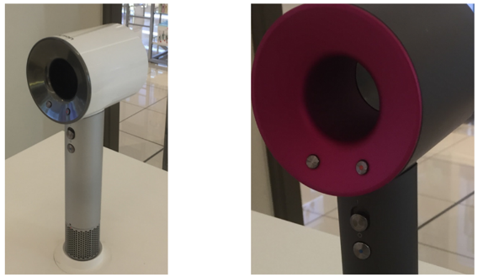
Control System Example
A more advanced example of a control system:
Dyson hairdryer
YouTube video Dyson Has Reinvented The Hair Dryer
Notes:
Teacher notes:
A traditional hairdryer works by pressing a button to turn it on and using a separate switch to choose the temperature setting. The hairdryer stays at this temperature and fan speed until it is switched off or the function is changed. This can cause heat damage to the users hair.
In this example, the Dyson hairdryer senses the air temperature it intakes and the microprocessor regulates the output temperature to ensure a more consistent temperature and avoid heat damage to the person’s hair.

Slide 13
Defining a Control Technology
On your own, brainstorm as many control technology devices as you can in your workbook.
Share your findings with the person next to you. Record any items your partner has that you don’t.
Share your brainstorm with the class to create a class definition of control technologies.
Record this definition in the glossary section of your workbook
Notes:
Teacher notes:
Read instructions to class.
Students are to complete the activity in their workbook and complete the glossary term.

Slide 14
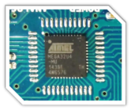
What is a Microcontroller? Page 13
A microcontroller is a programmable device that receives data from inputs in order to produce one or more outputs.
A microcontroller is made up of small microchips that contain microscopic circuits called integrated circuits that can be programmed to carry out simple functions. Once programmed, there is no need to use a computer to operate them.
Another name for a Microcontroller is a Programmable Logic Controller (PLC).
Notes:
Teacher notes:
PLCs – Typically used in machinery, essentially a microcontroller in a box. This is an older technology

Slide 15
How does a Microcontroller work?
A microcontroller can only work if it has been programmed.
The program is written on a computer which is called a sketch. The program is then uploaded to the microcontroller chip via a USB cable connection.
The microcontroller can then be disconnected from the computer an alternate power supply can be connected. This allows the microcontroller to be an independent control technology system.
Notes:
Teacher notes:
Read to class. Students complete words in glossary of terms at the start of the folio.
Note: There are many different brands of microcontrollers:
Arduino
Raspberry Pi
Lego
Arduino and Raspberry Pi are the most popular for this type of coding.

Slide 16
The Arduino Microcontroller page 14
Arduino is a company that develops microcontrollers and the software required to program them. During this unit you will be using Arduino software and a compatible microcontroller board to create your own control technology.
Look at your microcontroller and discuss as a class the parts of the board and their functions.
Notes:
Teacher notes:
See diagram in Teacher Resource Booklet and on next slide. Please note: This may vary depending if you are using a genuine Arduino board or a copy.
Printed circuit board
Microcontroller
Analogue and digital ports
Power Pins
Reset button
Power LED
USB cable connector port
DC input (connection port for connecting battery packs)

Slide 17
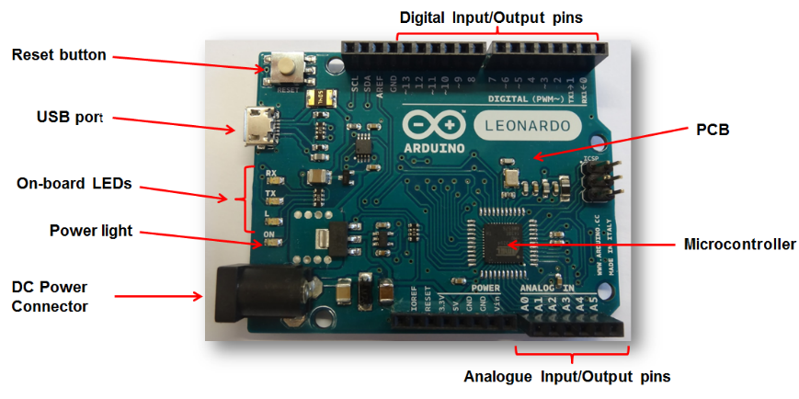
The Arduino Microcontroller (continued)
Notes:
Teacher notes:
Example of labelled board. Students are to label the diagram in their booklet.
See diagram in Teacher Resource Booklet. Please note: This may vary depending if you are using a genuine Arduino board or a copy.
Printed circuit board
Microcontroller
Analogue and digital ports
Reset button
Power LED
USB cable connector port
DC input (connection port for connecting battery packs)

Slide 18
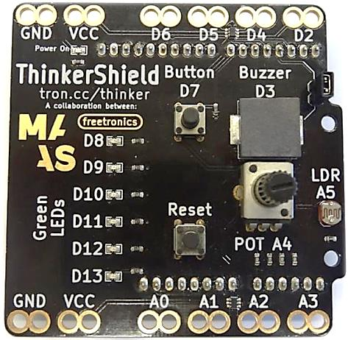
The MAAS ThinkerShield (1 of 5) Page 15
What is a shield?
The MAAS ThinkerShield was developed by the Museum of Applied Arts and Sciences Sydney, Australia.
It contains a variety of on-board components to make it easy to learn how to code without having to learn how to do electronics.
Notes:
Teacher notes:
Q/ What is a shield?
A/ Shields are used with Microcontrollers to create an easy-to-use interface for developing control technology systems. The shield fits onto the microcontroller and is connected via the analogue and digital ports that run along the side of the Arduino board. *SHOW HOW THEY FIT TOGETHER. There are many shields available that can give extra functionality such as wireless, Bluetooth, 3G/4G connection, GPS, Compass and many more.
T/ We will be using the MAAS Thinkershield with the Arduino microcontroller board to learn how to code.
https://maas.museum/product/thinkershield/
T/ You can program the Arduino microcontroller without the shield, however it will require the connection of independent input and output components and other electrical components.

Slide 19
The MAAS ThinkerShield (2 of 5)
Notes:
Reference for labelling the ThinkerShield: https://maas.museum/app/uploads/2015/05/GetOnWithIt-ONLINE-Dec15.pdf (P. 9)

Slide 20
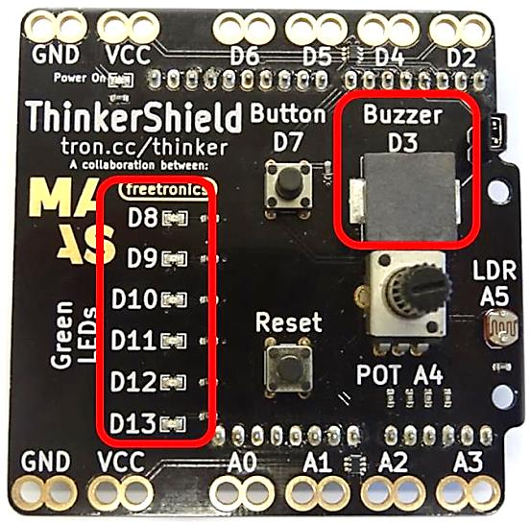
The MAAS ThinkerShield (3 of 5)
The items circled are output components. There are six Light Emitting Diodes (LEDs) and a buzzer.
Notes:
Teacher notes:
Read and explain

Slide 21
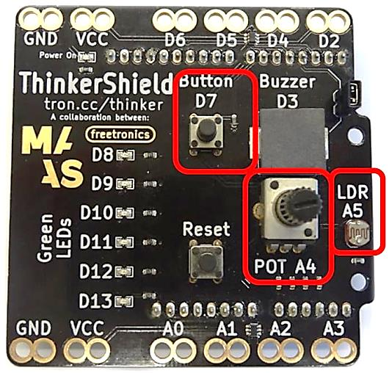
The MAAS ThinkerShield (4 of 5)
The items circled are input components. There is one pushbutton, a potentiometer and a Light Dependant resistor (LDR).
Notes:
Teacher notes:
Read and explain

Slide 22
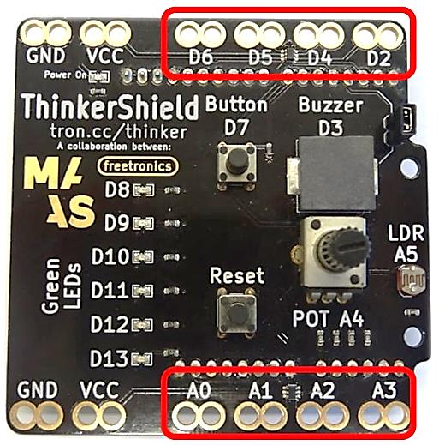
The MAAS ThinkerShield (5 of 5)
The items circled are expansion ports that allow other components to be connected to the Arduino while the shield is connected.
Notes:
Teacher notes:
Read and explain

Slide 23
Lets have a go! Page 16
Arduino Software Setup
Using the instructions in your workbook, complete the following:
Connect the Arduino board to the computer
Set the Arduino board type
Set the port number.
Notes:
Teacher notes:
Additional Resource:
Open the following webpage:
http://bit.ly/2bXTDvS
(https://maas.museum/app/uploads/2015/05/GetOnWithIt-ONLINE-Dec15.pdf (See P.6-7))
Read the instructions on P. 6-7 on how to:
Connect the ThinkerShield and Arduino Microcontroller to your computer
Select the serial port and board

Slide 24
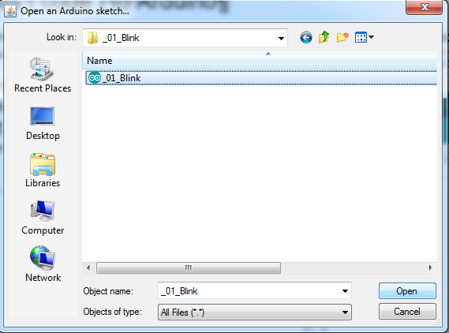
Loading the Sketch
Sketch 1: _01_Blink
Follow the instructions in your workbook to load a ready-made sketch called “_01_Blink”
Notes:
Teacher notes:
Read aloud to class:
1. Click on the File drop down menu
2. Click on Examples option. Another menu list appears.
3. Click on 01. Basics option. Another list of options appears.
4. Click on Blink. The menus will automatically disappear and the Blink sketch should appear in the code editing area.

Slide 25
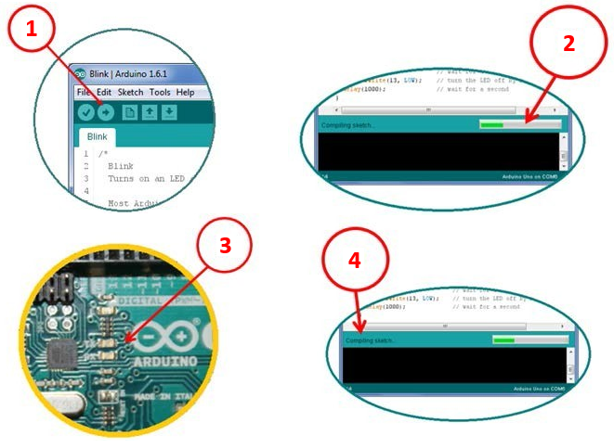
LOADING THE SKETCH (continued)
© Arduino AG CC-By-SA 3.0
Notes:
Teacher Notes:
Read aloud to class:
1. Press the UPLOAD toggle button on the tool bar (the top left corner of the window).
2. You should see a bar indicating the progress of the upload near the lower right corner of the Arduino IDE,
3. …and the lights labelled TX and RX on the Arduino board will be blinking.
4. If the upload is successful, the IDE will display the message DONE UPLOADING.

Slide 26
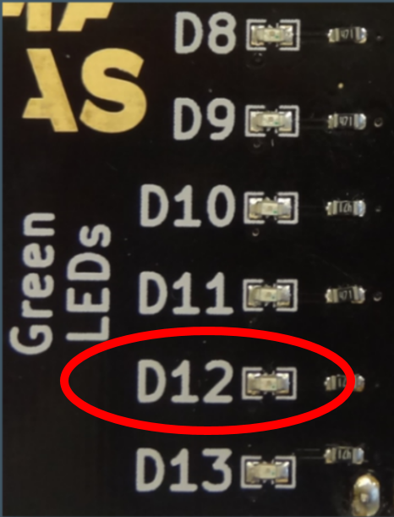
Does it work?
Initially you should see a blinking light on the Arduino board.
Notes:
Teacher notes:
Read/explain/discuss slide

Slide 27
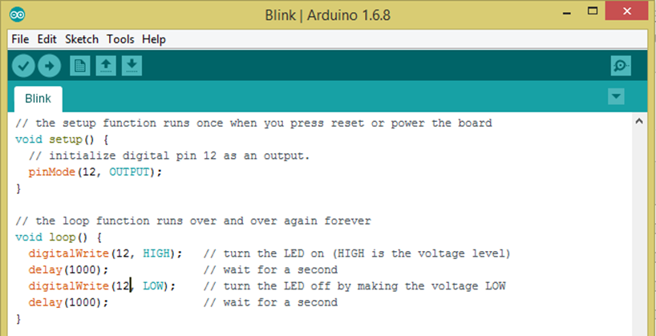
The Interactive Development Environment (IDE) Page 21
Notes:
Teacher notes:
Read/explain/discuss slide
Punctuation (semi colons, curly braces, brackets)
Coloured text (Arduino commands)

Slide 28
UNDERSTANDING THE SKETCH
Notes:
Teacher notes:
Read and explain meanings of labelled components to students. Reference: Museum of Applied Arts & Sciences (2015) Get.(on).with.it, p. 12-13
https://maas.museum/app/uploads/2015/05/GetOnWithIt-ONLINE-Dec15.pdf
Explain the components of the sketch.
Commands/Keywords: These appear in orange and have a specific meaning in Arduino language. E.g. Integer command
Comments: These appear in grey and are written in plain English to allow a person to understand the code easily
Void setup: where the rules are set up for the sketch
Void Loop: details of the commands that will repeat themselves (unless the power runs out)
Semicolon, curly braces and brackets: syntax for the code (grammar and punctuation)
Status Bar: displays the progress of the sketch upload
Debugger Area: displays information about errors in the sketch
Open the following link:
Get on with it PDF
Go to page 12-13 to see a labelled diagram of the Arduino sketch.

Slide 29
Pseudocode Page 23
Pseudocode is the term for writing programming code in plain English.
It involves writing step-by-step explicit instructions in a logical sequence.
Notes:
Teacher notes:
Example of Pseudocode for an airconditioner:
Start the program;
Measure temperature;
If temperature < 20 degrees Celsius then
turn on heat;
If temperature > 22 degrees Celsius then
turn off heat;
go back to start;

Slide 30
Arduino code vs Pseudocode
void setup() {
pinMode(12, OUTPUT);
}
void loop() {
digitalWrite(12, HIGH);
delay(1000);
digitalWrite(12, LOW);
delay(1000);
}
Turn on LED
Wait one second
Turn LED off
Wait one second
Repeat
Notes:
Each line of the sketch can be described by the pseudocode on the right.

Slide 31
Pseudocode Activity 1
In groups of three, one person is to lay on the floor, one person is to give commands and the other person needs to watch to make sure the person on the floor only does what the instructor says. Instruct the person on the floor to get up. Be really clear with your instructions, they can only do what you say.
Notes:
Teacher notes:
This activity is designed for students to understand how specific and simple instructions need to be when programming.
Discussion Q/ What was difficult?
A/ having to be specific with instructions, e.g. lift left leg 10cm off the ground, stop, bend left knee 45 degrees, place foot flat on the ground etc.

Slide 32
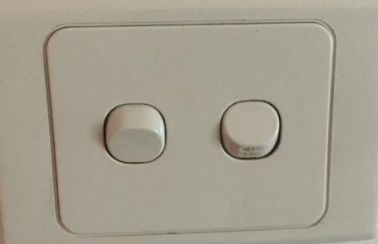
Pseudocode Activity 2
In plain English how would you write out a program (code) to make the light in the classroom blink on and off every one second?
Notes:
Teacher notes:
Workbook activity: Try to write out Pseudo-code to make the light in the room blink on and off? The table below is to get you started, it may have too many lines or it may not have enough!
Demonstrate by using the light switch in the classroom.
Switch light on
wait 1 second
switch light off
wait 1 second
Switch light on
wait 1 second
switch light off
wait 1 second

Slide 33
Making Connections
Open the Blink sketch again.
During this activity, you loaded code onto the microcontroller to make the LED blink on and off continuously.
Compare your pseudocode for turning the light on and off to your Blink sketch.
Are there any similarities?
Do they follow similar steps or sequence?
Notes:
Teacher notes:
By re-opening the blink sketch again, students are to compare their pseudocode with the code in the sketch. There will be visible connections with the sequence e.g. wait 1 second = delay

Slide 34
Arduino Language page 26
Microcontrollers are mini computers. Microcontrollers and computers use a special type of programming language referred to as code so that they know what to do, how to do it and when to do it. Without code the microcontroller does nothing.
Different Interactive Development Environments (IDEs) will use different programming languages. Just like people in different countries around the world use different languages to communicate.
Notes:
Teacher notes:
Read/explain/discuss slide

Slide 35
FlowCharts / branching diagrams
Flowcharts are used to show the processes in program.
The different shapes mean different things. These are the shapes we will be using:
Terminator
process
decision (branching)
delay
Notes:
Flowcharts can assist in planning the processing that has to happen in an algorithm. We use specific symbols for each action.
The terminator is used at the start or end to indicate where the code should begin and stop
The process rectangle should be use every time the computer needs to do something.
The Rhombus (diamond) indicates a decision such as an if statement.
The D shape is used for a delay.

Slide 36
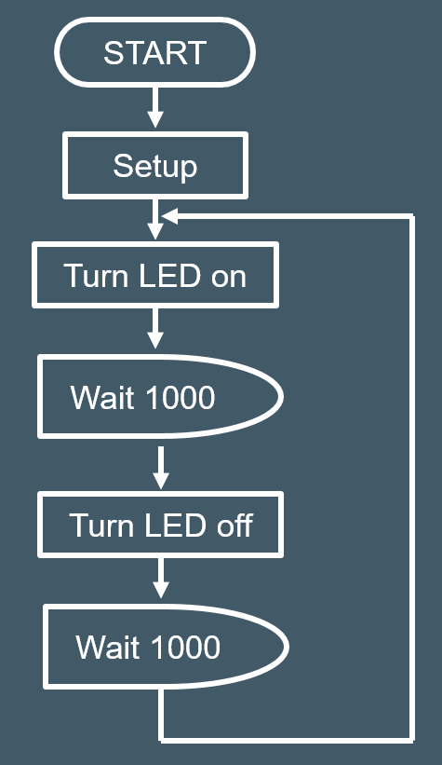
Blink sketch flow chart

Slide 37
Blink Challenges
Change how long the LED flashes for.
Make two LEDs flash together at the same time.
Chasing lights - Make the LEDs flash one after the other.
Pattern lights – Make the LEDs flash in a particular sequence.
Notes:
Teacher notes:
T/ You’ve now seen the code and pseudocode behind the Blink program. Now have a play and start changing the code to see what different things you can get it to do.
See Teacher resource for instructions as to how to complete these challenges.
Students are to complete the evaluation in their workbooks for Sketch 1: Blink. Teacher provides feedback in student workbook.

Slide 38
TROUBLESHOOTING (1 of 4)
Check the correct board has been selected in Tools Menu.
Check the port has been selected in the tools menu.
Go back to the pseudocode and flowchart.
Check that commands change colour when you type them. If a command has not changed colour it may be spelt incorrectly.
Notes:
Troubleshooting. Start with the basics/obvious. Ie connections.

Slide 39
TROUBLESHOOTING (2 of 4)
Some commands are written in camel case. This is where the words are joined but use a capital for the second word. Examples include:
pinMode
digitalWrite.

Slide 40
TROUBLESHOOTING (3 of 4)
Make sure you use the semi colon (;) at the end of each line.
Exceptions include:
void setup () {
void loop () {
Simple things such as a USB cable not plugged in fully can stop things working properly.

Slide 41
TROUBLESHOOTING (4 of 4)
Sometimes when you check your sketch, the error is in the line before or after the highlighted line.
For every opening bracket or brace ( {, there must be a closing one. ) }.
Putting the cursor on a brace will highlight its partner.

Slide 42
Binary Numbers Page 30
Computers have different programming languages, you may have heard of some of them such as C, HTML, Python or Scratch. Regardless of what language you program in they all convert to binary numbers when running through the computer. This is because computer processors only work at base level as “on” or “off”. They are a digital machine and only have zero or one (off or on) as a state to calculate. Every computer regardless of its age or specification works on binary numbers at its core. You need to understand that binary is a counting system that is used to tell a computer what to do.
Notes:
Teacher notes:
Read/explain/discuss slide

Slide 43
Binary Numbers (continued)
All a programming language does is make the binary system easier to understand and use by acting as an interpreter between plain human speak and computer speak. It is theoretically possible to program a computer using binary only, but this would be an enormous task and it is much more efficient using a programming language instead. These languages have dictionaries of commands, syntax and terminology preloaded for you to use. This is what we have already been doing with the Blink sketch in Arduino. The language that Arduino is based on is C/C++.
Notes:
Teacher notes:
Read/explain/discuss slide

Slide 44
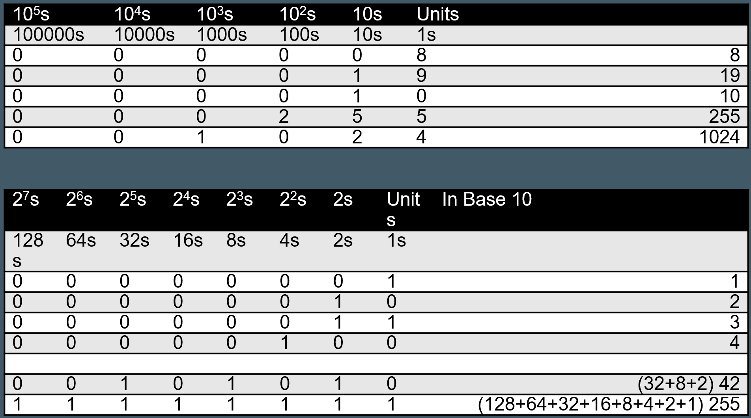
Binary
Notes:
This shows the difference between decimal and binary counting systems.

Slide 45
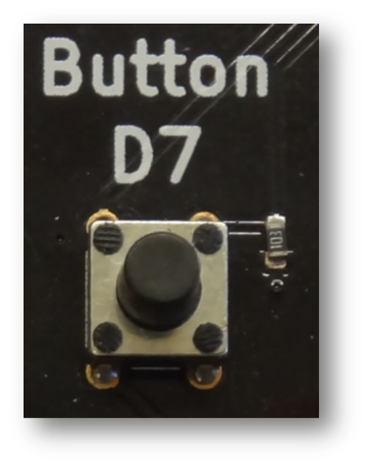
Digital Inputs: Button Page 32
Follow the instructions in your workbook to load a ready sketch called “Button”.
This sketch will allow you to use a button to control the LED on the ThinkerShield
Notes:
Teacher notes:
// Turn on LED while the button is pressed
const int LED = 13; // the pin for the LED
const int BUTTON = 7; // the input pin where the
// pushbutton is connected
int val = 0; // val will be used to store the state
// of the input pin
void setup() {
pinMode(LED, OUTPUT); // tell Arduino LED is an output
pinMode(BUTTON, INPUT); // and BUTTON is an input
}
void loop(){
val = digitalRead(BUTTON); // read the switch line
// check whether the input is HIGH (button pressed)
if (val == HIGH) { // if voltage on line
digitalWrite(LED, HIGH); // turn LED ON
} else {
digitalWrite(LED, LOW); // turn LED OFF
}
}

Slide 46
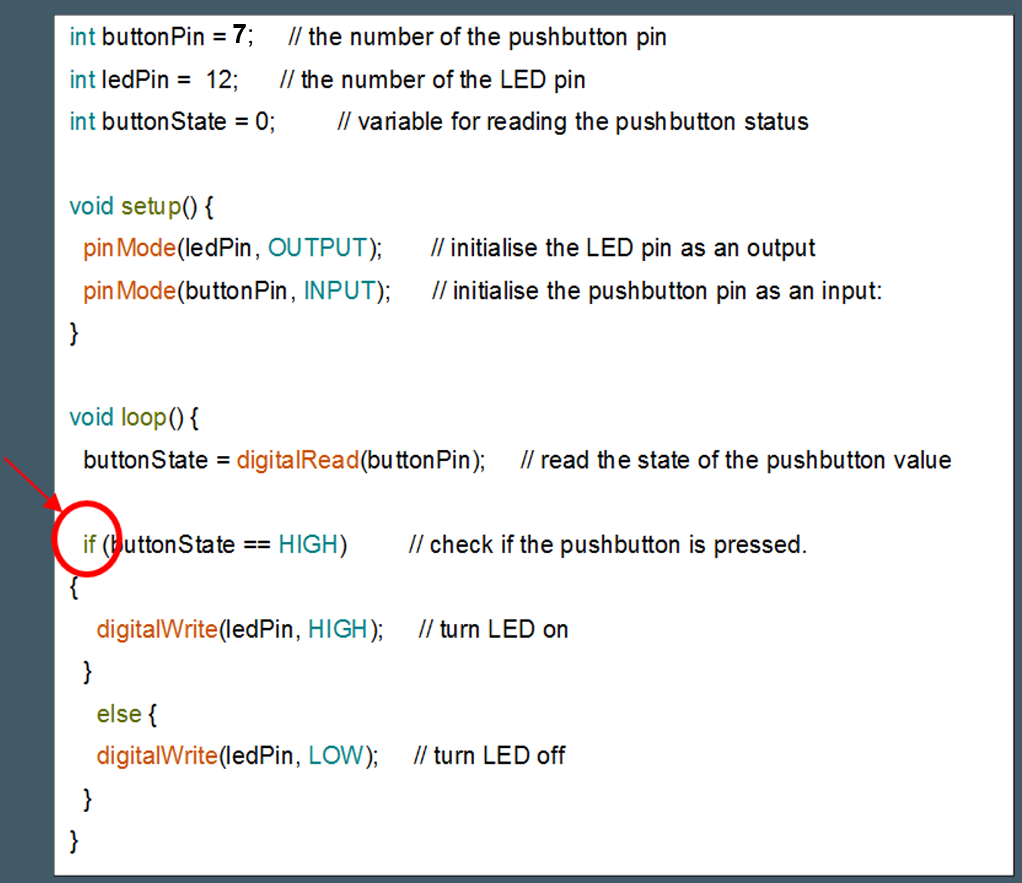
IF STATEMENTS
Allows the processer to make a decision based on an input.
Note: no semicolon used on an ‘If’ line
Notes:
Teacher Notes:
The action for the If statement is enclosed in the braces. In this sketch, the sketch is determining if the button has been pushed. If the button is pushed, the LED will turn on, if not (else) the LED will turn off.

Slide 47
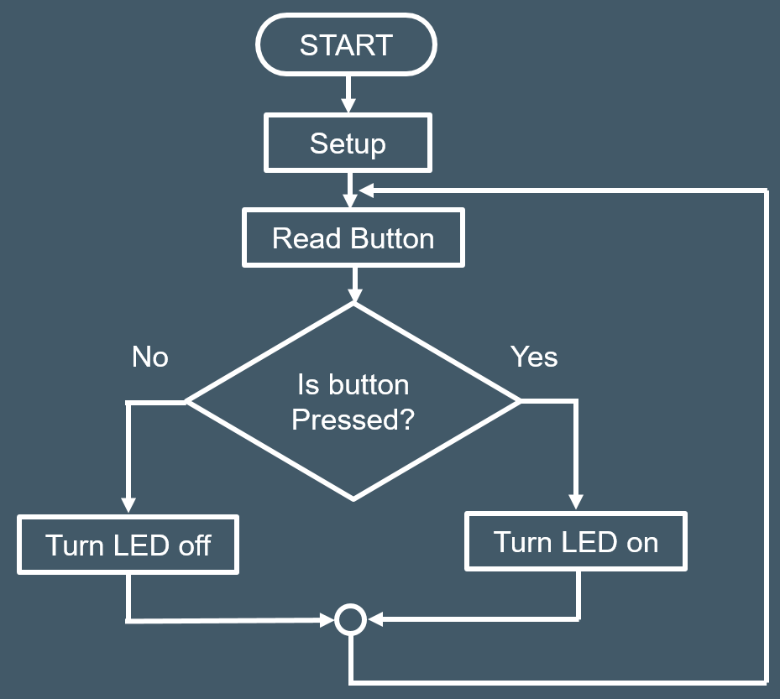
Button sketch flow chart
Notes:
Basic flowchart showing branching.

Slide 48
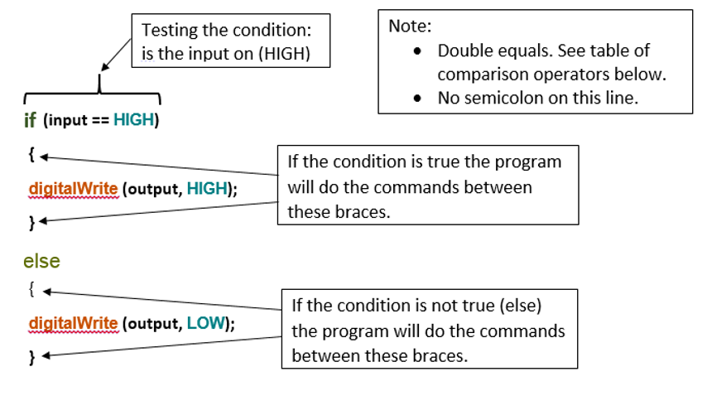
If statement syntax
Notes:
The syntax for if statements

Slide 49
comparison operators for if statement
Symbol | Meaning
== | Equal to
!= | Not equal to
< | Less than
> | Greater than
<= | Less than or equal to
>= | Greater than or equal to
Notes:
The == is used as we are comparing two values. If we are declaring a value then we use a single =

Slide 50
Commands in Arduino Page 36
Using the Integer Command
There are shortcuts in coding that tell the computer what to do with a minimum of commands/lines of code. In the challenges to tinker with you were asked to make two LED’s flash on and off at the same time.
The command you can use in your code/sketch is the “int” command. An example of how to code/sketch this is below – with the initial blink sketch comments // removed. You will notice the rest of the code is basically the same as blink, except that instead of the pin number being in the loop the name you gave the pin is there.
Notes:
Teacher notes:
Read/explain/discuss slide

Slide 51
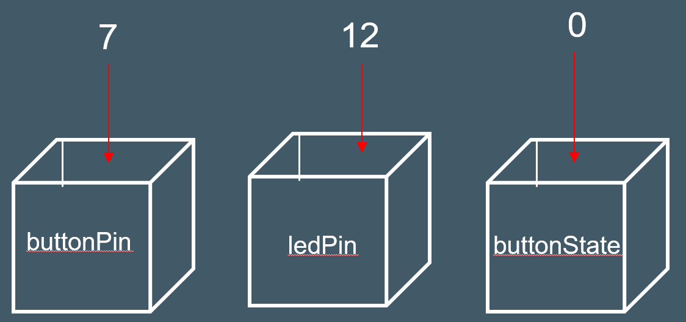
Variables
int buttonPin = 7;
int ledPin = 12;
int buttonState = 0;
Notes:
Declaring a variable is like writing a name on a cup/box and then putting a number in the box. When the computer sees the name it uses the number you put in the box.
You can change the number in the box in the code. buttonState is a good example. When we read the button, we can put a 1 or 0 in the box depending on whether the button is on or off.

Slide 52
Button Challenges Page 41
Reverse the switch action so the button/switch does the opposite to what it did in the original code/sketch.
Make two LEDs turn on when you press the button.
Make the LED stay on for 3 seconds before turning off when the button is released.
Turn the button into a “toggle switch” where the LED stays on when the button is first pressed and then turns off when the button is pressed again. ***see following slides about branching to help complete this challenge and future ones***
Notes:
Teacher notes:
Read/explain/discuss slide

Slide 53
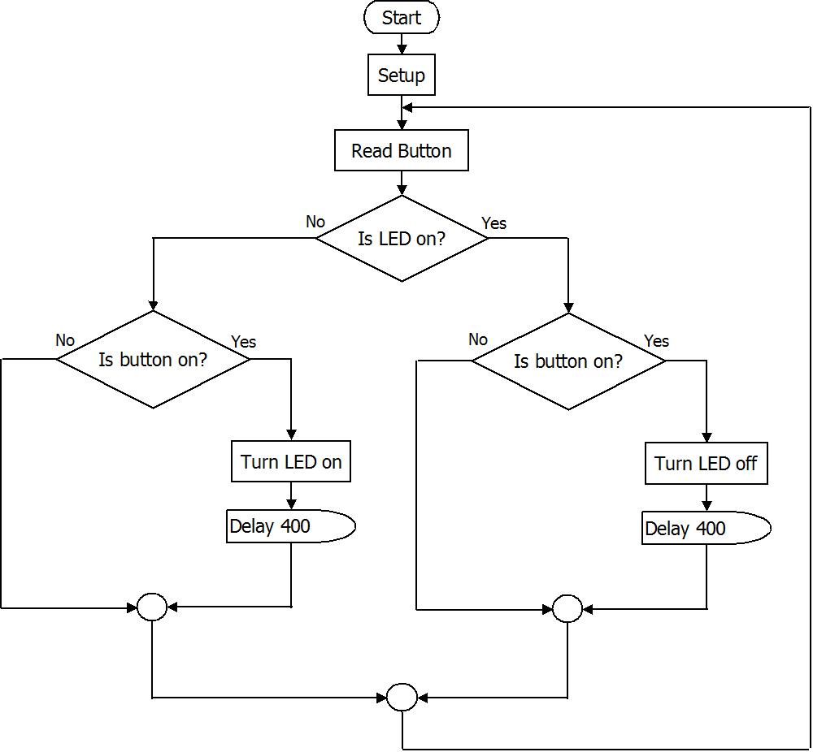
Toggle sketch
Notes:
This is a flowchart for the toggle switch. It is actually quite complex. Very few students will fully understand this in Stage 4.

Slide 54
Inputs – sensors P44
Notes:
Teacher notes:
Read/explain/discuss slide

Slide 55
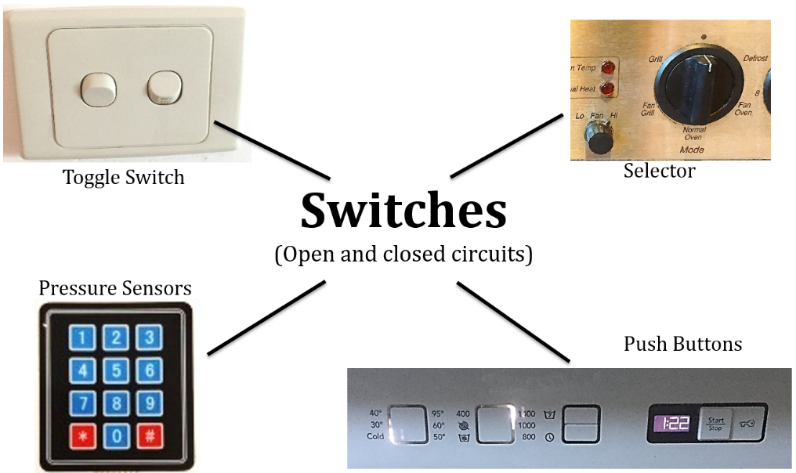
Switches – Open and closed circuits
Notes:
Teacher Notes
Switches allow the circuit to be open or closed. When a button/switch is pushed, the circuit becomes closed and becomes active. When the switch is in the off position, the circuit is open and therefore is not active.
Light switch: Moving the toggle moves the switch to the on or off position.
Rotary switch on an oven: turning the knob makes different connections for the different functions.
The keypad: these switches only stay on while the button is held down.
Push buttons on a washing machine. These only stay switched on while the button is held down.
These pushbutton switches are called momentary contact as they release once you remove your finger.

Slide 56
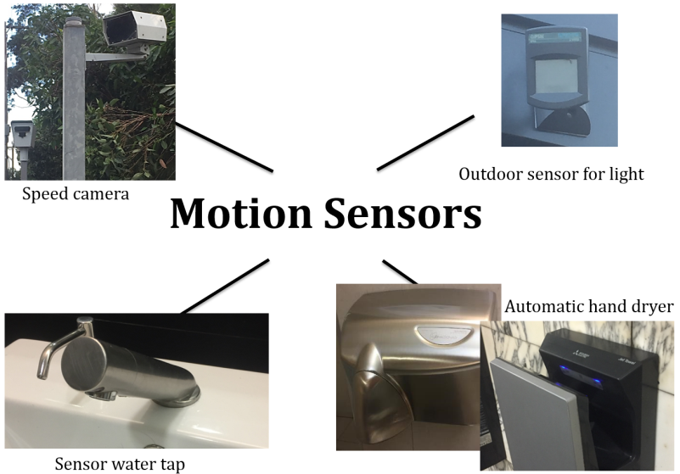
Motion Sensors
Notes:
Teacher Notes:
Motion sensors detect movement which sends a signal to the processor which activates an output.
Speed camera: when a speed is detected that is above the speed limit it takes a photo. ☹
Outdoor motion sensor: When movement is detected it turns a light on for a set period. Usually this type of detector also has a light sensor so it only works at night.
Sensor tap: When the sensor detects your hands under the spout it activates an electronic valve that lets the water flow.
Automatic hand dryers: Like the tap, they only operate when they detect your hands.

Slide 57
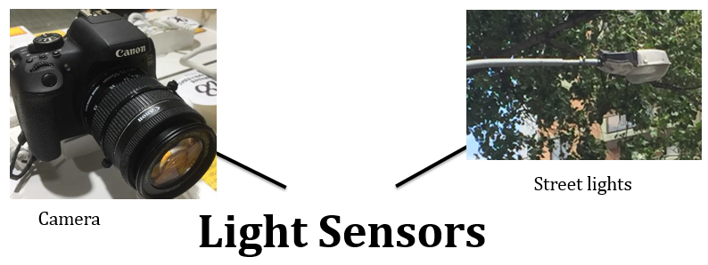
Light Sensors
Notes:
Teacher Notes:
A light sensor detects low levels of light and sends a signal to the processor which activates the output.
The camera has a very sensitive light sensor that can record an image electronically.
Street lights have a sensor so they only turn on when it is dark.

Slide 58
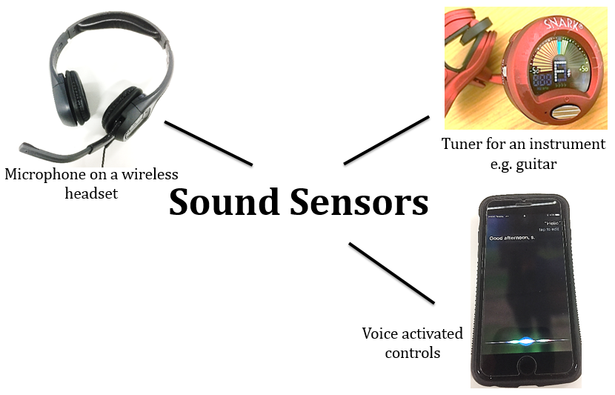
Sound Sensors
Notes:
Teacher Notes:
Sound sensors work by turning sound into an electrical signal. They are generally analogue signals and need to be converted to digital.
Microphone turns sound into an electric signal allowing it to be recorded or sent to someone else.
Guitar tuner: The guitar tuner works by detecting the frequency of the sound and comparing it to the correct frequency for each string. It then indicates which way you need to adjust the tune to make it correct.
Voice activated controls: These systems can recognise words in order to provide instructions to the microprocessor. Siri is an example of this.

Slide 59
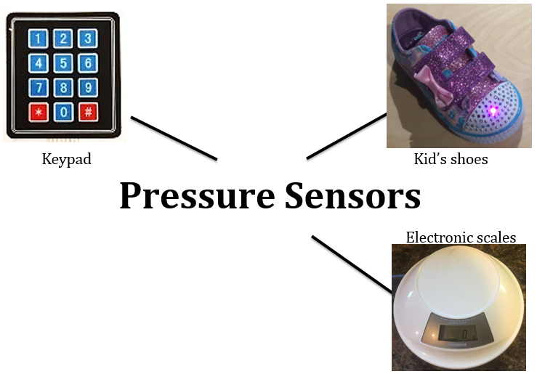
Pressure Sensors
Notes:
Teacher Notes:
Pressure sensors work by sending a signal to a processor when pressure is applied e.g. on a keypad for a house alarm. Once the signal is processed, an output occurs e.g. deactivates the house alarm
The keypad detects pressure on each button to provide a signal to the microcontroller.
Some shoes have sensors inside them to detect pressure when walking. This signal to the microprocessor makes LEDs light up.
Scales are used to measure the weight of things. It does this by detecting the pressure applied to the top.
Other pressure sensors include oil pressure sensors in an engine.

Slide 60
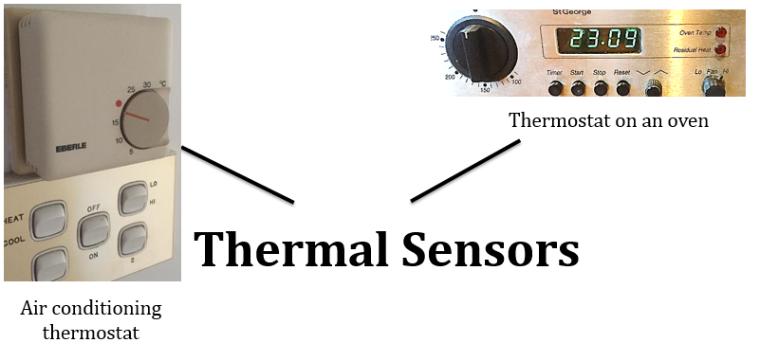
Thermal Sensors
Notes:
Teacher Notes:
Thermal sensors work by sensing a predetermined temperature which signals the processor which activates an output e.g. light turns on or off.
Air conditioning controllers are easily adjusted by the user and provide an input to the controller when the temperature is too high or too low.
Oven thermostats are similar. You can see when the temperature is low as ovens usually have a light to indicate when the element is heating the oven.

Slide 61
Mechanical Sensors – Potentiometer
Notes:
Teacher notes:
Mechanical sensors rely on something moving to trigger them. The motion could be from a person in the case of the volume control or from the speed of a wheel.
Volume control knobs can be turned by hand to adjust the volume. They have a potentiometer behind the knob that varies the input to the system so it can adjust the sound as required.
Temperature selector on an iron. This adjusts the iron controller to turn the heating element on or off to adjust the temperature. (Some irons have a mechanical temperature control and are not electronically controlled).
Micro switches are used to detect movement in mechanical systems and tell the processor when this happens so it can control other parts of the system. This switch was on a lift and stops the motors when the door is fully opened.

Slide 62
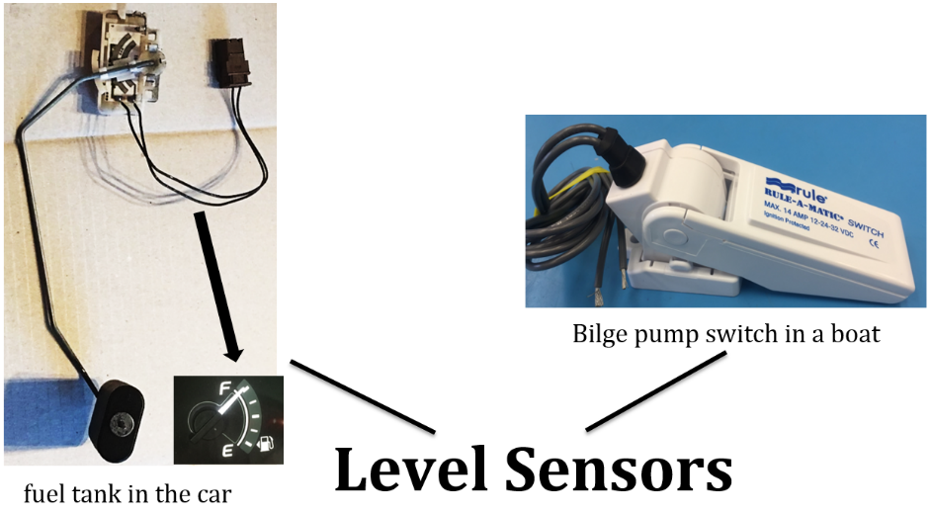
Level Sensors
Notes:
Teacher Notes:
Level sensors work by detecting the level of a liquid and sending a signal which could be either digital or analogue back to the controller. This is usually done with a float that moves up and down in the tank.
The fuel level sensor sits inside the fuel tank. A float on an arm moves a potentiometer in order to vary the voltage input to the controller.
A bilge pump switch uses a float to detect water in the bottom of a boat and can turn on an alarm or a pump.
Other level sensors are used in water tanks and brake fluid reservoirs in cars.

Slide 63
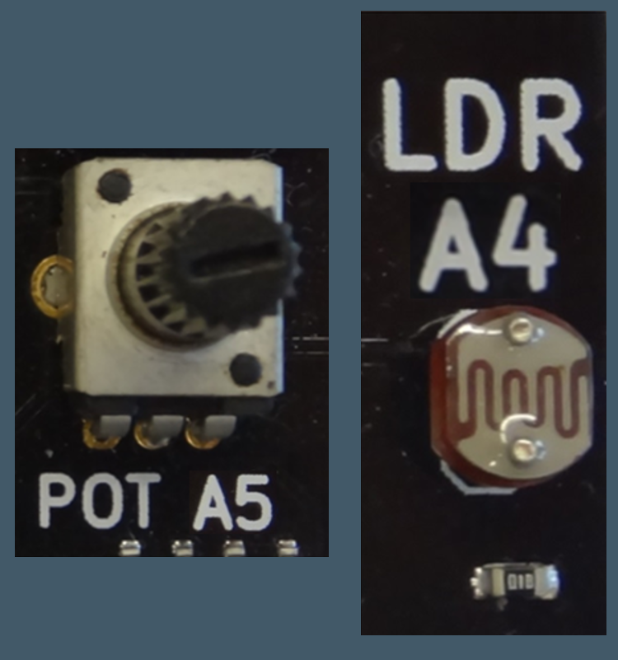
Sketch 3: Using an Analog Input Page 46
Follow the instructions in your workbook to load a sketch called “AnalogInput”.
This sketch will allow you to use a potentiometer or the Light Dependant Resistor (LDR) to control the LED on the ThinkerShield.
Notes:
Teacher notes:
Arduino code
int potSensorPin = 4; // The potentiometer wiper lead is connected to analog pin 0
int ledPin = 12; // The LED is connected to digital pin 12
int potValue; // variable to store the value read from the potentiometer.
//Expected range of values is 0 to 1023.
void setup() // this function runs once when the sketch starts up
{
pinMode(ledPin, OUTPUT);
}
void loop(){
potValue = analogRead(potSensorPin);
digitalWrite(ledPin, HIGH); // Turn the LED on
delay(potValue); // Pause for potValue milliseconds
digitalWrite(ledPin, LOW); // Turn the LED off
delay(potValue); // Pause for potValue milliseconds
}
Pseudocode for potentiometer level

Slide 64
SERIAL MONITOR
The serial monitor allows us to see what is happening on the Arduino.
To make it work we need the following:
In the declarations:
Serial.begin (9600); //This sets up the monitor.
In the loop
Serial.println (variableToPrint); //Prints the value on screen.
Notes:
The Serial.begin command goes in the setup. The number is the baud rate and must match the value in the serial monitor window.
Serial.println goes in the loop and sends a value to the computer via the USB cable.

Slide 65
Analog Input Challenges Page 48
Change the code and get multiple LED’s to flash.
Reverse the potentiometer action so the blink rate speeds up and slows down in the opposite direction to the original sketch.
Change the input to the LDR (Analog pin 4).
Notes:
Teacher notes:
Read/explain/discuss slide

Slide 66
Outputs – Actuators
Notes:
Teacher notes:
Read/explain/discuss slide

Slide 67
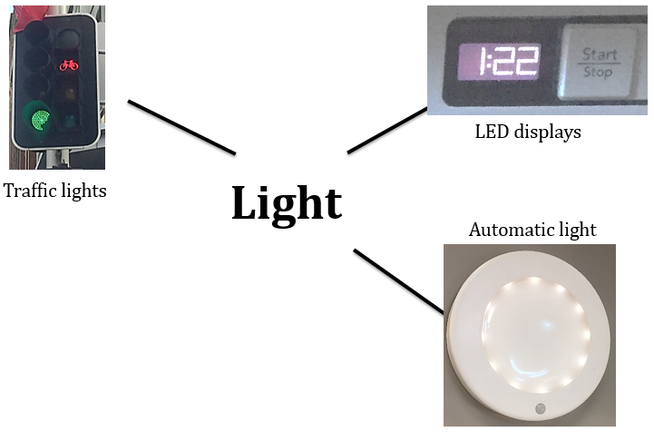
Light
Notes:
Teacher Notes:
Sensor sends signal to the processor which activates the output which is light e.g. street lights, LED Displays, children’s night light
Traffic lights control traffic based on a number of inputs including the time of day, the sensors in the road and the pedestrian pushbuttons at a crossing.
LED displays are very common now as they are easily read and are very efficient.
Automatic lights operate when they detect both dark and movement.

Slide 68
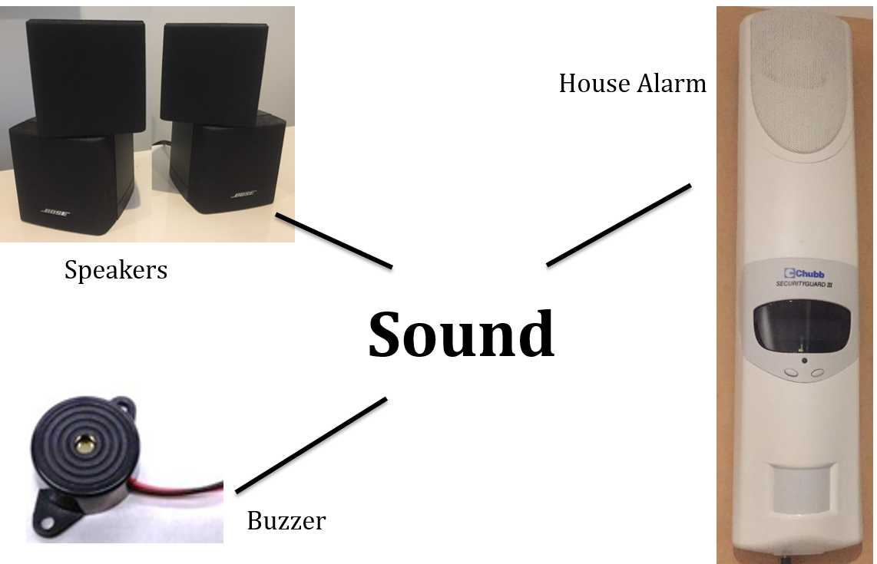
Sound
Notes:
Teacher Notes:
Sensor sends signal to the processor which activates the output which is sound e.g. speaker, house alarm speaker.
Speakers can be used to produce a wide range of sounds where as buzzers produce very basic sounds. Alarm sirens are designed to be very loud.

Slide 69
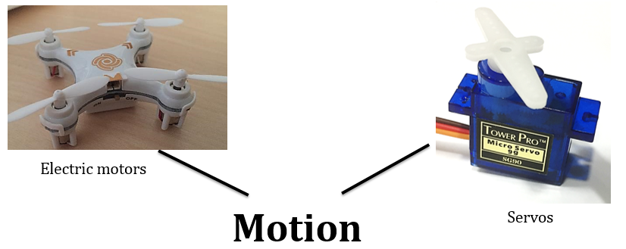
Motion
Notes:
Teacher Notes:
Sensor sends signal to the processor which activates the output which is movement e.g. Electric motors and servos.
Drones use motors that are controlles by microprocessors that receive inputs from the remote control.
Servo motors produce more precise movement that can be used to control the position of items. You may have seen them used to control the steering on remote control cars.

Slide 70
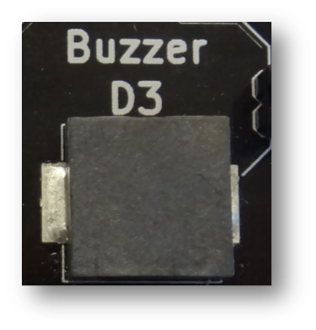
Sketch 4: Buzzer Page 54
Follow the instructions in your workbook to load a sketch called “Buzzer”.
This sketch will allow you to use a Buzzer as an output on the ThinkerShield.
Notes:
Teacher notes:
Arduino code
/*
SIREN
A loud wailing sound is produced
*/
int i = 0;
const int ALARMSOUNDER = 8;
void setup()
{
pinMode(ALARMSOUNDER, OUTPUT);
}
void loop()
{
// sound a range of loudness from low to high,
// changing every 10 milliseconds
for(i = 0; i < 255; i = i + 2)
{
analogWrite(ALARMSOUNDER, i);
delay(10);
}
// reverse the above range of loudness (high to low),
// changing every 5 millisecond
for(i = 255; i > 1; i = i - 2)
{
analogWrite(ALARMSOUNDER, i);
delay(5);
}
// for ten times, sound a high loudness, delay 1 second,
// and sound a low loudness
for(i = 1; i <= 10; i++)
{
analogWrite(ALARMSOUNDER, 200);
delay(100);
analogWrite(ALARMSOUNDER, 25);
delay(100);
}
} // end loop()

Slide 71
Buzzer Challenges
Change the code and get the buzzer to play different tones (two or more). The Arduino examples under “Digital > Tone” will help you work it out.
Code the buzzer to only come on when the button is pressed.
Code the buzzer to start playing when the button is pressed once and then stop once the button is pressed once again.
Code the buzzer to play a familiar tune e.g. imperial march from Star Wars.
Notes:
Teacher Notes:
Enhance the quality of the code
One thing you can do is replace the hard coding of the delay() function parameter used throughout the program.
Change some of the variable values
Where did the 10 and 5 milliseconds come from? It started out being one second and then altered until it sounded OK. Try it yourself. Change the delay rates. Can you come up with a better sounding siren?
Can you add a sensor to change the alarm characteristics?
Make a simple car alarm.
You will hear a rising and falling siren type alarm, similar to a car alarm.
Make use of the tone() command.
Rather than changing the loudness, we can change the frequency instead .
Use a sine wave and the tone() command
Is this right?
Complete the following

Slide 72
Extension – Pulse Width Modulation (PWM)
PWM allows us to produce an output similar to an analogue output by turning the signal on and off.
analogWrite (ledPin,0); //Output is 0V
analogWrite (ledPin,255); //Output is 5V
analogWrite (ledPin,127); //Output is equivalent to 2.5V
5V
0V
5V
0V
5V
0V
Notes:
This is an extension activity. Arduino site has an excellent explanation: https://www.arduino.cc/en/Tutorial/PWM

Slide 73
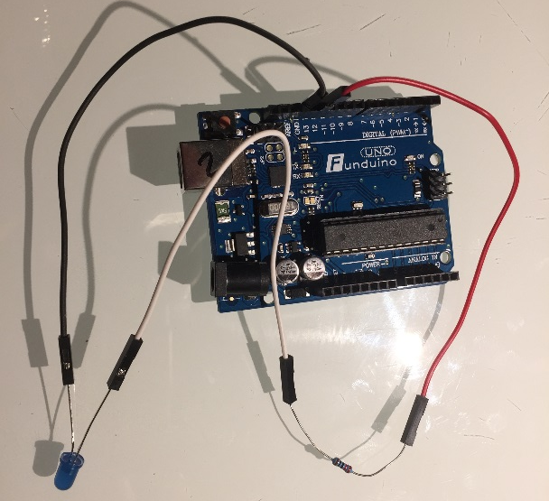
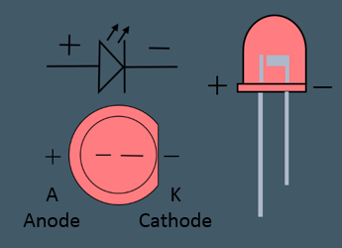
Electronics – LED basics
Must be between the output pin and ground (GND).
Long leg must go towards the output pin (see image for other indicators)
You must have a 220 Ohm resistor in line with an LED.
Notes:
LEDs MUST have a 220Ohm resistor in series or the LED will be destroyed.
Advanced explanation: This is because LEDs have virtually no resistance. If you use Ohms Law V=I*R, as the resistance gets lower, the current increases. V remains constant but the current will go up to a level that breaks the LED.

Slide 74
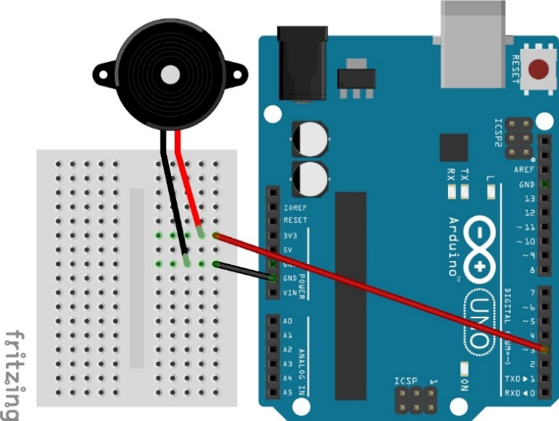
Electronics - Buzzer
Must be between the output pin and ground (GND).
Red (positive) lead must go towards the output pin.
Notes:
Buzzer is simple. Only two connections. Output and Gnd (0V).

Slide 75
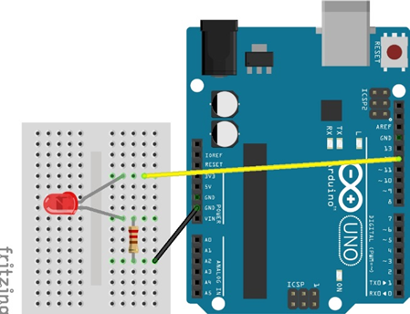
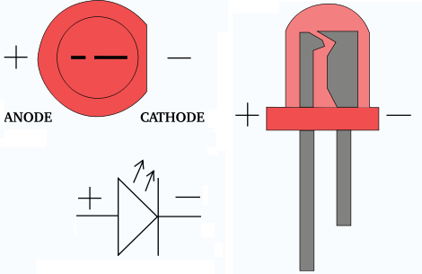
Electronics – LED
Must be between the output pin and ground (GND).
Long leg must go towards the output pin (see image for other indicators)
You must have a 220 Ohm resistor in line with an LED.

Slide 76
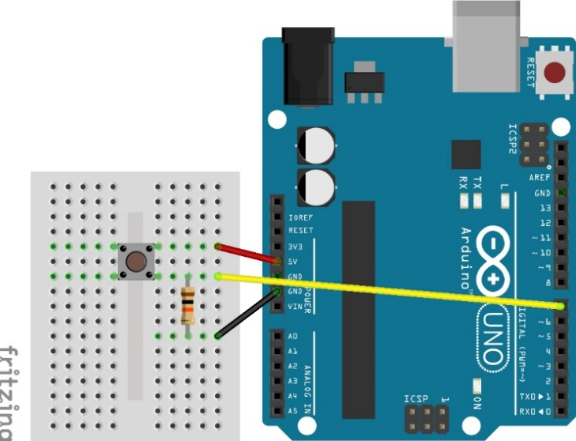
Electronics - Switches
Switch must go between the digital input pin and either +5V or GND (will return a HIGH or LOW respectively).
Must be a 10kOhm resistor between the input pin and GND or +5V. (Opposite to the switch).
This is called either a pull down or pull up resistor.
Notes:
Note use of pull down resistor to ensure pin is returned to zero volts when button is released.

Slide 77
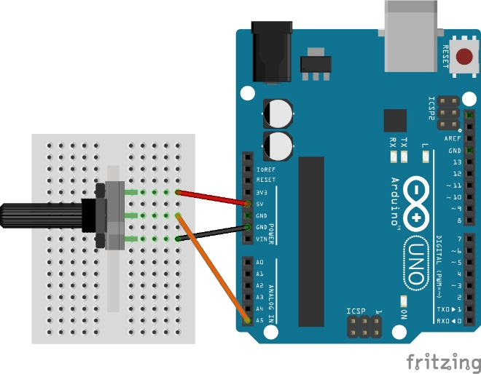
Electronics - Potentiometer
Outside legs must connect to +5V and GND.
Centre leg must connect to the input pin.

Slide 78
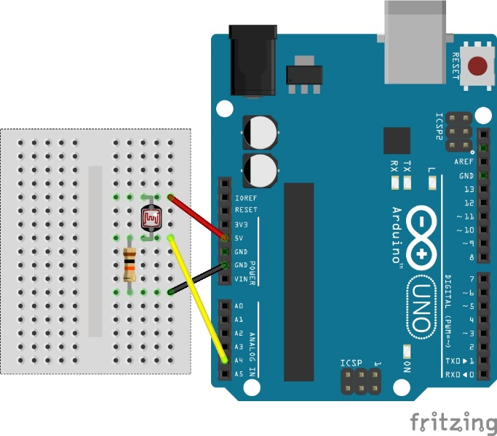
Electronics - LDR
LDR must go between the analogue input pin and either +5V or GND.
Must be a 10kOhm resistor between the input pin and GND or +5V. (Opposite to the switch).
This is called either a pull down or pull up resistor.
Notes:
Note use of 10kOhm resistor to draw pin back towards zero when resistance in LDR increases.

