Slide 1
Instructions for use
This resource is not a teaching and learning program. It should be used in conjunction with the program and teacher resource More than just a sandwich.
Classroom teachers are encouraged to add and adapt slides as required to meet the needs of their students.
Save a copy of the file to make changes to the slide deck – go to File > Download a Copy (this downloads a copy to the computer to edit in the PowerPoint app).
To convert the PowerPoint to Google Slides:
Upload the file into Google Drive and open it.
Go to File > Save as Google Slides.

Slide 2
More than just a sandwich
Technology 7–8
Stage 4
Food and agricultural practices focus area

Slide 3
Weeks 1 to 2

Slide 4
Learning intention and success criteria (1)
We are learning to:
apply safe processes and practices in the kitchen.
We can:
identify Personal Protective Equipment (PPE) required to prepare food items
use personal hygiene practices
recall key safe processes and practices to follow when preparing food items in the kitchen.
Notes:
Notes for teachers:
Learning intentions and success criteria are best co-constructed with students. Adapt the learning intention as required and add co-constructed success criteria.

Slide 5
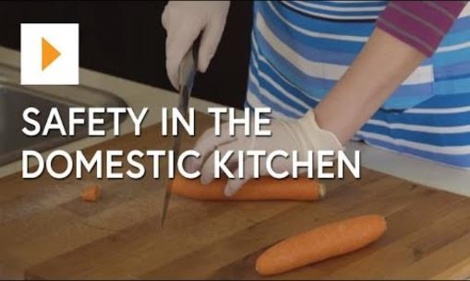
Safety in the domestic kitchen
Watch Safety In The Domestic Kitchen – Food Technology (14:20)

Slide 6
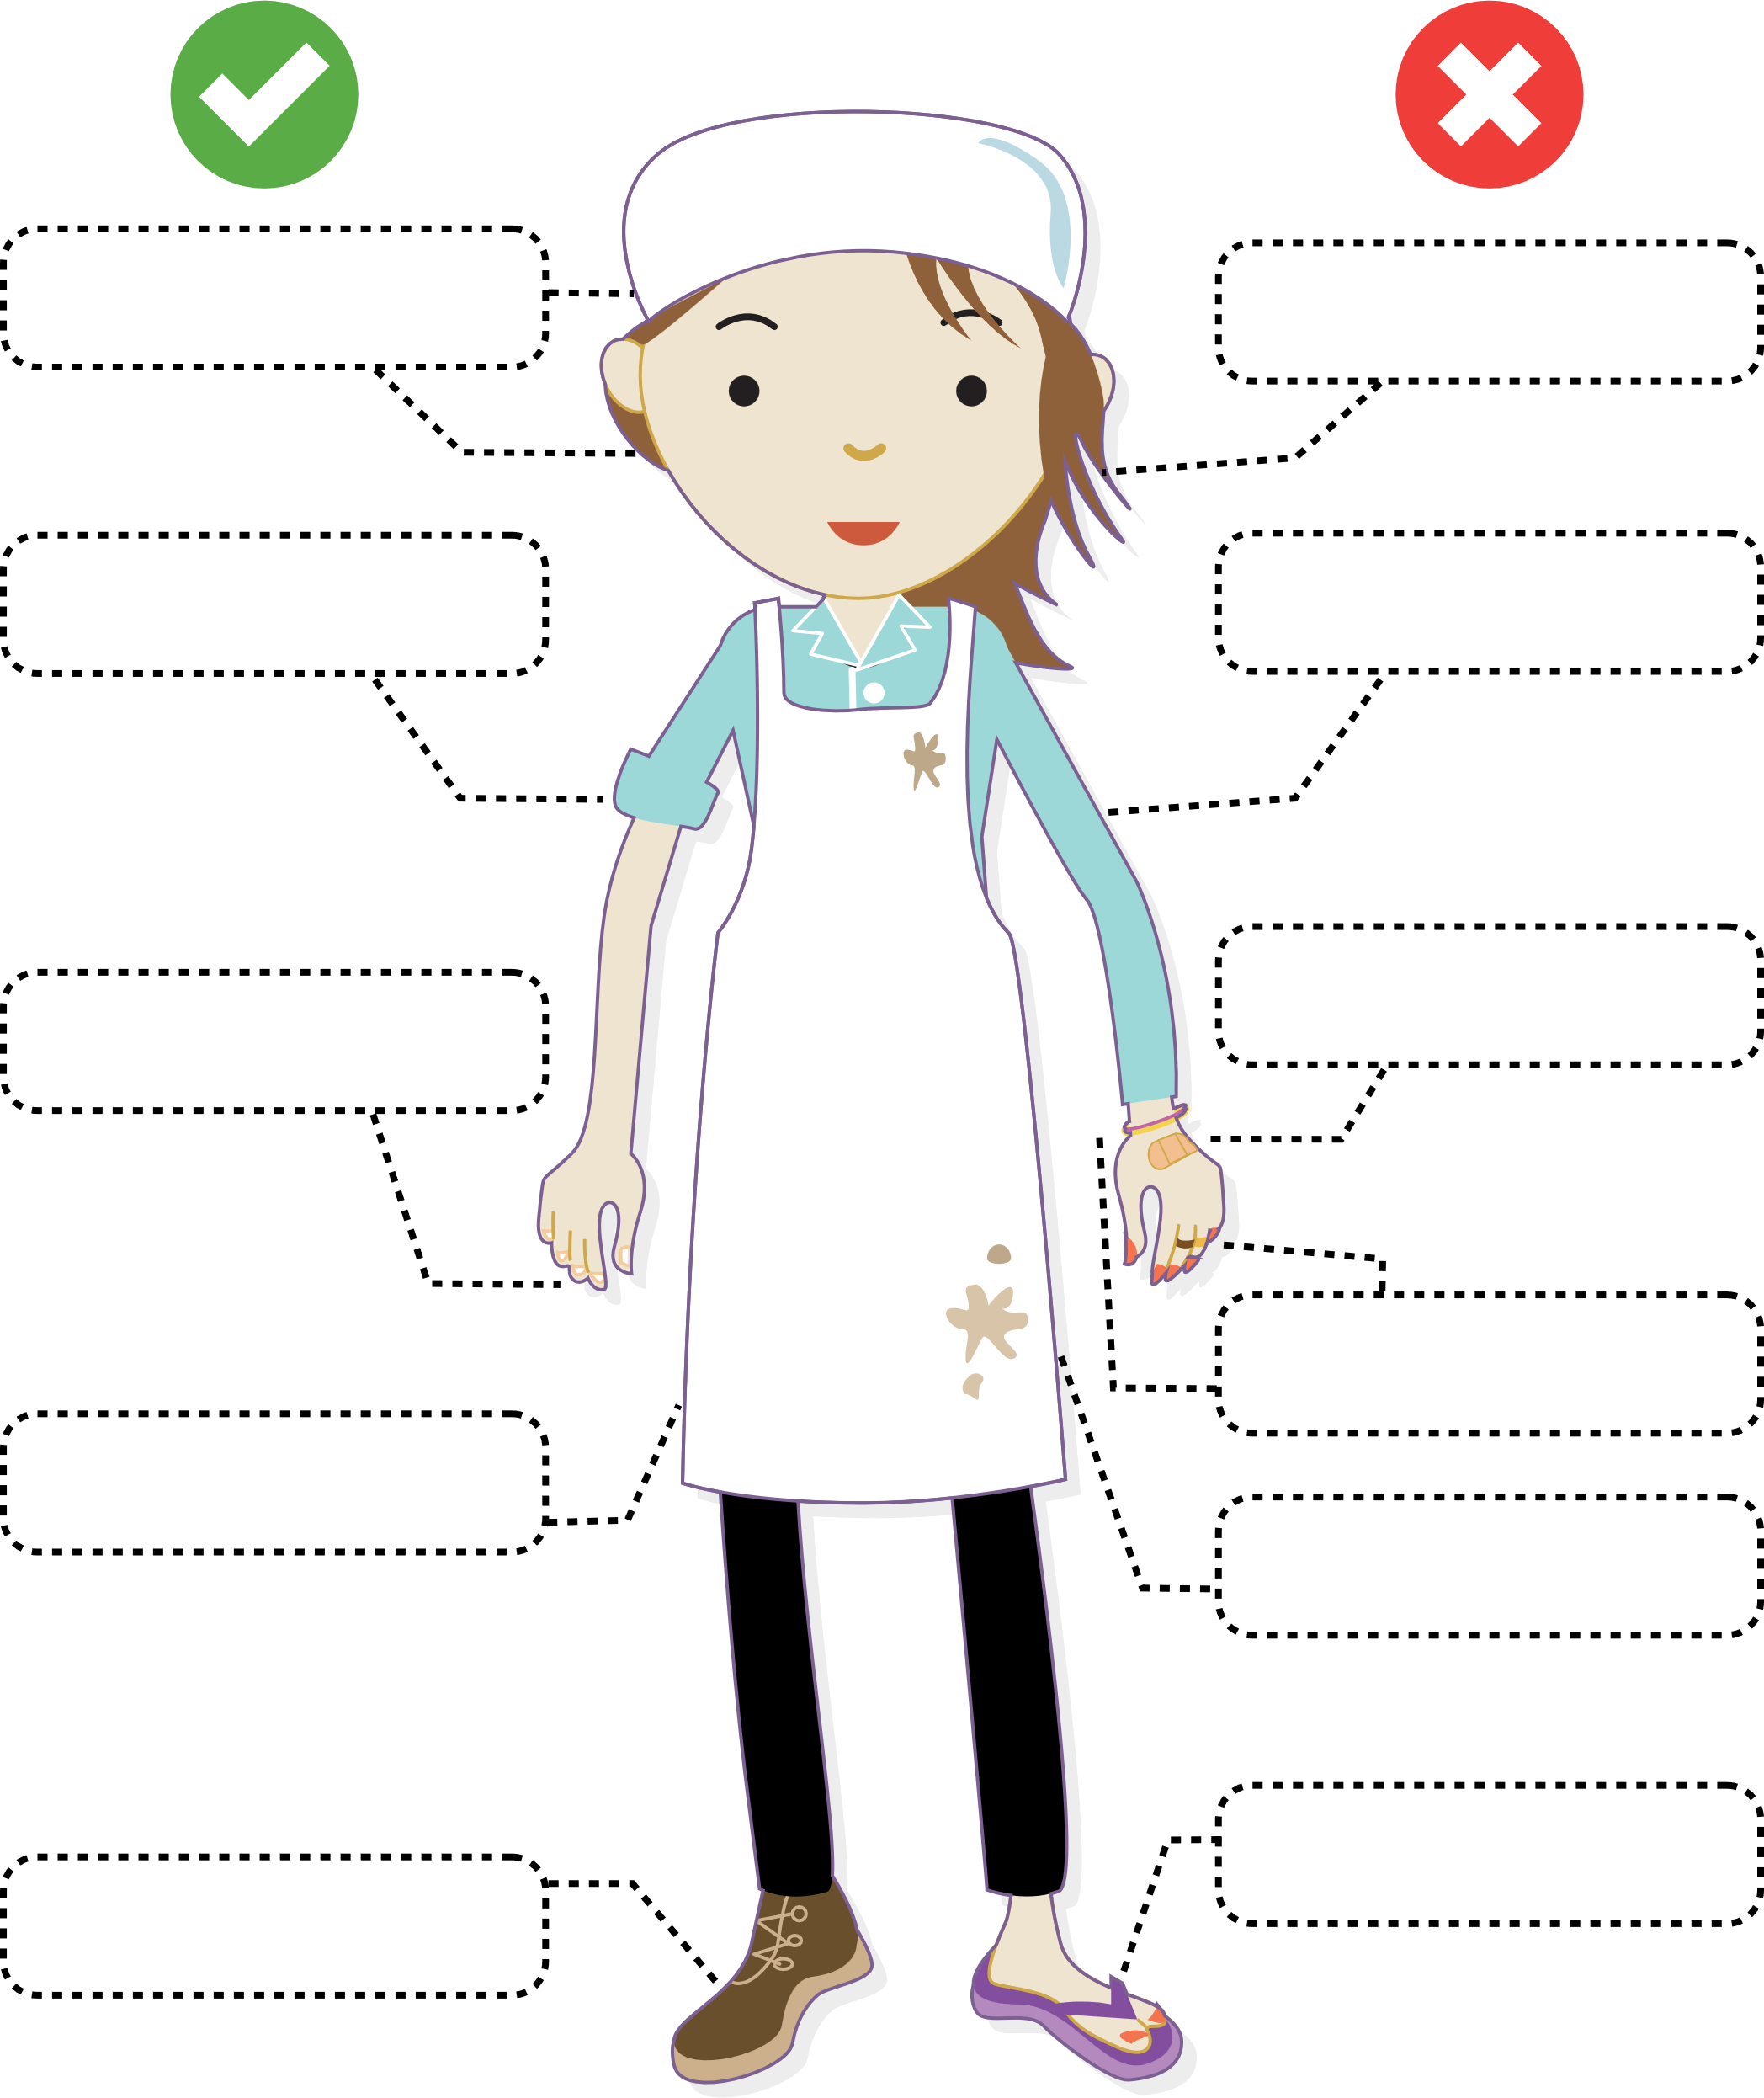
Safety and hygiene in the kitchen
Drag and drop the labels to correctly identify
safe and hygienic practices in the kitchen.
Hair tied back with appropriate covering
Enclosed leather shoes
No open toed, uncovered, non-leather shoes
Full length, clean apron
Cover cuts with band aid and apply glove
Clean, unpolished and short nails
Hair not tied back or covered
Fitted cuffed or short, sleeved shirt
Long sleeved shirt requires fitted cuff or ¾ length
No jewellery such as rings, bracelets or watches
Dirty apron

Slide 7
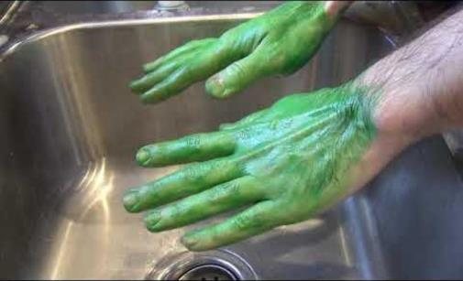
See germs! Hand washing science experiment
Watch See Germs! Hand Washing Science Experiment (1:22)

Slide 8
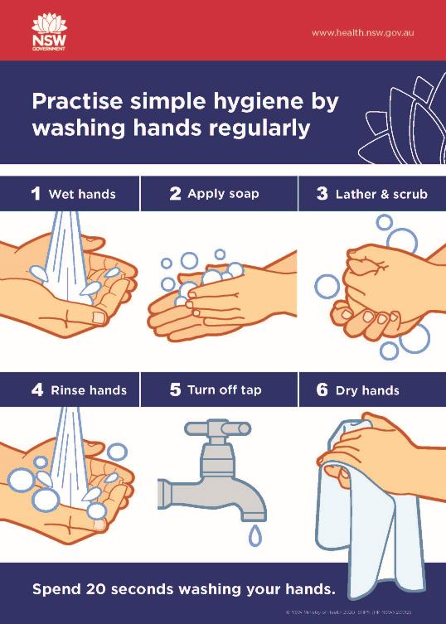
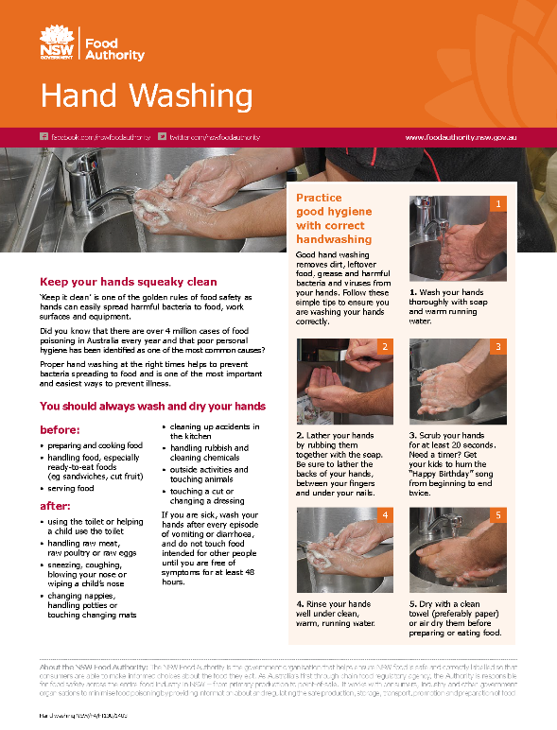
Hand washing
‘Practise simple hygiene by washing hands regularly’ by NSW Ministry of Health
is licensed under CC BY 4.0.
‘Hand Washing’ by State of New South Wales through the Food Authority
is licensed under CC BY 4.0.

Slide 9
The danger zone
Using the Drawing tools, draw a line from the labels to correctly match the temperature on the thermometer.
Bacteria grow quickly
Hot food zone 60°C to 100°C
Bacteria do not grow
Cold food zone 0° to 5°C
Refrigerated foods need to be kept at 5°C or below
Temperature danger zone 5°C to 60°C
Bacteria are destroyed
The temperature danger zone is when it is easiest
for harmful bacteria to grow in food
Hot food needs to be kept at 60°C or above
Bacteria are dormant
Frozen food zone -10°C to 0°C

Slide 10
Learning intention and success criteria (2)
We are learning to:
use tools and equipment in the kitchen.
We can:
identify and select tools and equipment required for food preparation
safely use tools and equipment for food preparation.
Notes:
Notes for teachers:
Learning intentions and success criteria are best co-constructed with students. Adapt the learning intention as required and add co-constructed success criteria.

Slide 11
Learning intention and success criteria (3)
We are learning to:
identify the characteristics and properties of foods.
We can:
identify our senses that are used to evaluate food items
use descriptive language to describe food items.
Notes:
Notes for teachers:
Learning intentions and success criteria are best co-constructed with students. Adapt the learning intention as required and add co-constructed success criteria.

Slide 12
Characteristics and properties
What is the difference?
The terms characteristics and properties are often used interchangeably, but they have subtle differences.
Characteristics | Properties
Refer to the distinguishing features that help to identify, describe or differentiate something. For example, sensory characteristics such as the taste and smell of a food item. | Are specific attributes or features that the food possesses, which are often able to be measured. For example, nutrient composition such as protein or carbohydrate levels in food items.

Slide 13
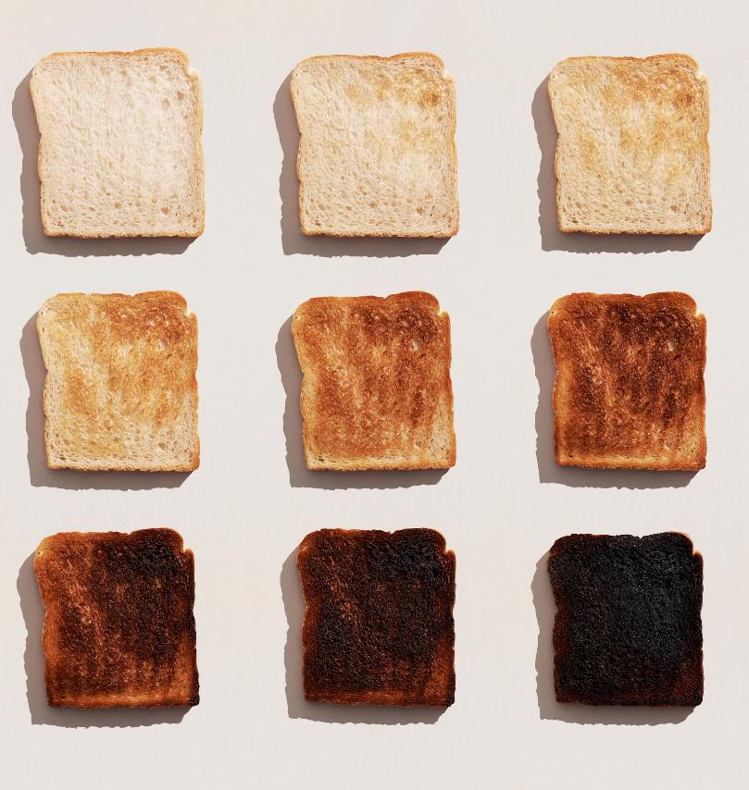
Do now activity
Describe that food product
What food product is this?
When would this food product be eaten?
Why would this food product be eaten?
What nutrient is this food product high in?
What does this food product smell like?
What does this food product taste like?
5-minute timer

Slide 14
Sensory characteristics of food (1)
Our 5 senses are taste, touch, sight, smell, sound. When using these to describe the characteristics of food we use taste, texture, appearance and aroma (smell).
Taste – how the food item tastes. What flavours can you recognise? Sour, salty, bland, sweet, and so on.
Texture – how the food feels in your mouth. Smooth, crunchy, cold, juicy, chewy, and so on.
Appearance – how the food item looks. Bright, dull, colourful, and so on.
Aroma – how the food item smells. Savoury, fishy, fruity, and so on.

Slide 15
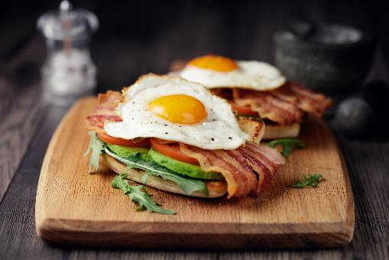
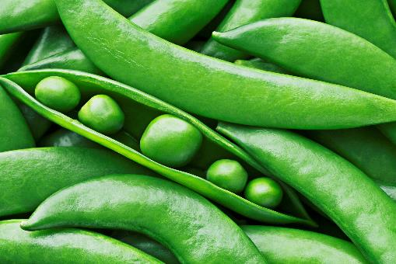
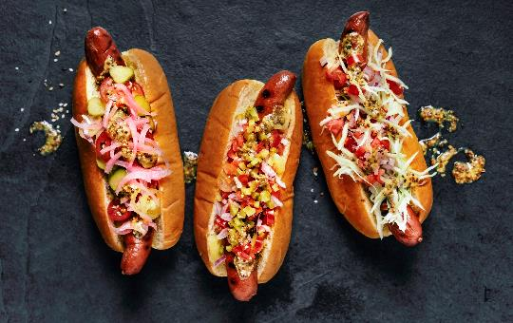
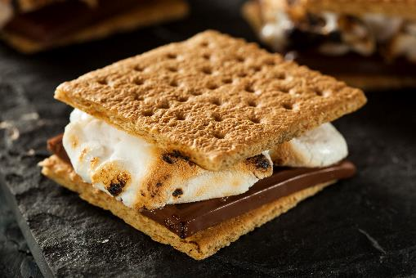
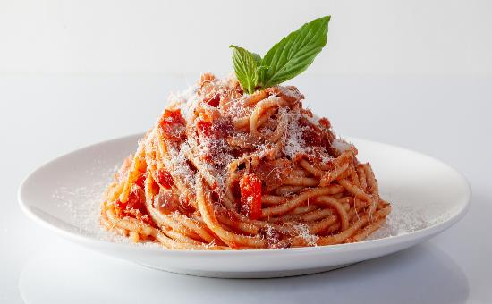
Sensory characteristics of food (2)
Describe the sensory characteristics of the food items below

Slide 16
Learning intention and success criteria (4)
We are learning to:
identify the characteristics and properties of foods.
We can:
identify the nutrients required by the body
describe how nutrients help to sustain the body
provide food examples containing these nutrients.
Notes:
Notes for teachers:
Learning intentions and success criteria are best co-constructed with students. Adapt the learning intention as required and add co-constructed success criteria.

Slide 17
Food groups and nutrition
Watch Food Groups And Nutrition (5:06)

Slide 18
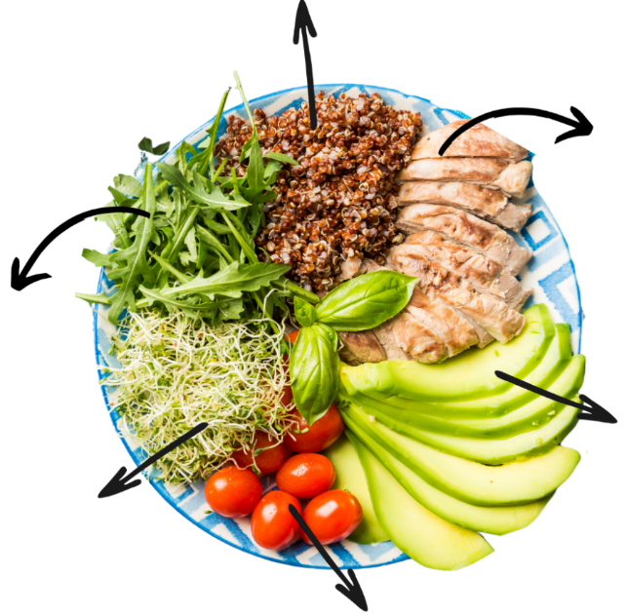
Balanced meal
Drag and drop the ingredients, nutrients and functions below to correctly identify the components of the meal.
Support body function and the immune
system
Provide energy
Promote growth and repair of muscles
and cells in the body
Maintain nerve and muscle function
Protects internal organs, move some
vitamins around the body and helps to
regulate body heat
Supports healthy cell growth and function
Rocket leaves
Chicken breast
Fats
Vitamin C
Alfalfa sprouts
Quinoa
Protein
Minerals – folate
Avocado
Cherry tomatoes
Carbohydrates
Minerals – magnesium

Slide 19
Learning intention and success criteria (5)
We are learning to:
use correct techniques and practices to produce food products.
We can:
document additional techniques to create food items
follow a recipe and use preparation techniques and equipment to produce food items
describe and implement the safe practices to follow when using knives and the sandwich press or stove.
Notes:
Notes for teachers:
Learning intentions and success criteria are best co-constructed with students. Adapt the learning intention as required and add co-constructed success criteria.

Slide 20
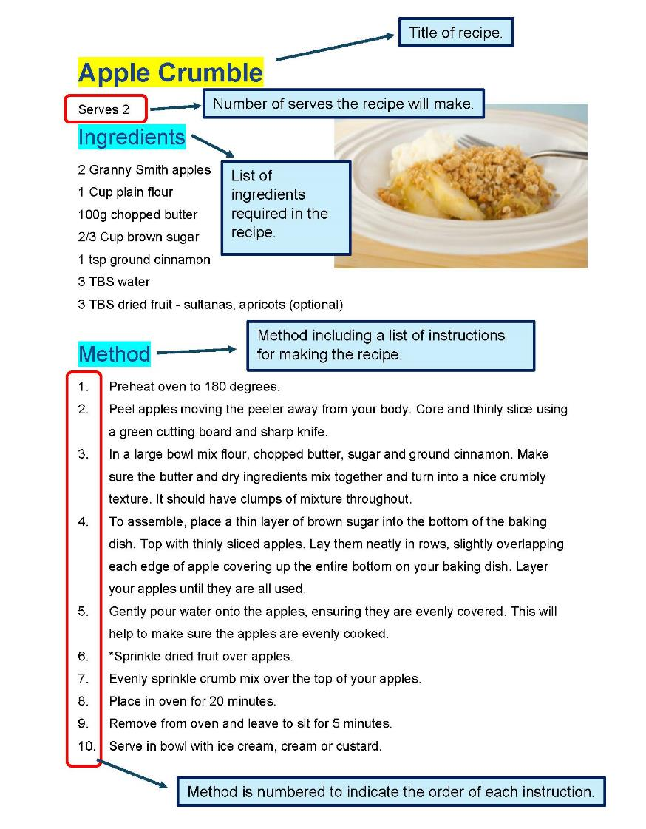
Structure of a recipe

Slide 21
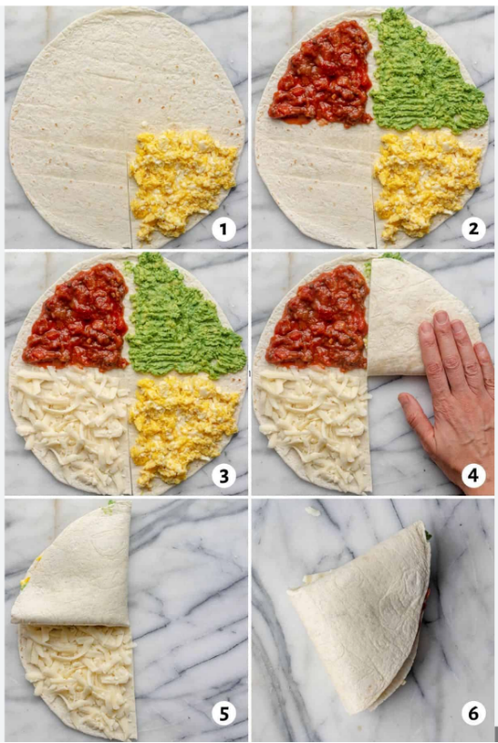
Tortilla wrap
Serves 2
Ingredients
2 Tortilla flat breads
2 TBS refried beans
$\frac{1}{2}$ cup shredded or BBQ chicken
2 TBS Mexican cheese or similar
2 TBS guacamole, homemade or purchased
2 TBS salsa
$\frac{1}{2}$ tsp olive oil

Slide 22
Tortilla wrap – method
Method
Place tortilla flat onto a cutting board. Cut a slit from the outside edge of the tortilla straight to the middle point. Fill each quarter of the tortilla in the following order: refried beans chicken guacamole salsa and cheese. Fold the tortilla triangles onto themselves until you have a layered wrap. Lightly brush olive oil over both sides of the folded wrap. Use a sandwich press to toast, or toast lightly in a frypan until cheese is melted. Note: to make guacamole, combine ¼ mashed avocado, 1 tsp sour cream, 4 finely chopped cherry tomatoes, salt and pepper and a small squeeze of lime or lemon juice.

Slide 23
Weeks 3 to 4

Slide 24
Learning intention and success criteria (6)
We are learning about:
the nutritional needs of individuals and groups.
We can:
interpret visual food selection guides
identify the nutrients required for adolescents
make suggestion of food items to meet the recommended intake of nutrients.
Notes:
Notes for teachers:
Learning intentions and success criteria are best co-constructed with students. Adapt the learning intention as required and add co-constructed success criteria.

Slide 25
What does everybody eat?
Recommended for everyone | Recommendations that are different.
Eat a variety of food | Young children and adults require different quantities.

Slide 26
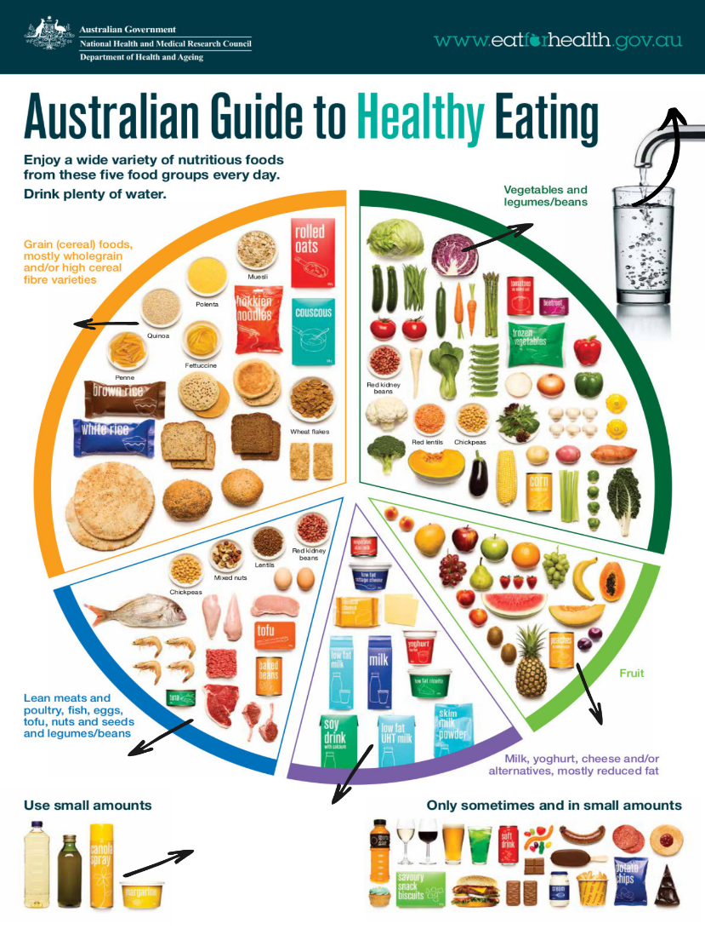
Australian Guide to Healthy Eating
Using your knowledge of the 6 essential nutrients, label the most likely nutrient(s) for each food group on the Australian Guide to Healthy Eating. Don’t forget to look outside of the round chart.
‘Australian guide to healthy eating | Eat For Health’ by Eat For Health is licensed under CC BY 4.0.

Slide 27
Reading strategies
Use the reading strategies below
1.
4.
Read the title and predict what you think the main idea of this text is.
Write your prediction down. Use full sentences.
2.
Scan the text, look at the pictures, do you recognise any words from class? Make another prediction about the main idea.
5.
Number the paragraphs by writing in the margin. How many are there?
3.
Read the first and last paragraphs, make another prediction about the main idea of the text.
6.
Read the text. Circle key terms. Underline important points and claims from the author. Use a ? for unknown terms

Slide 28
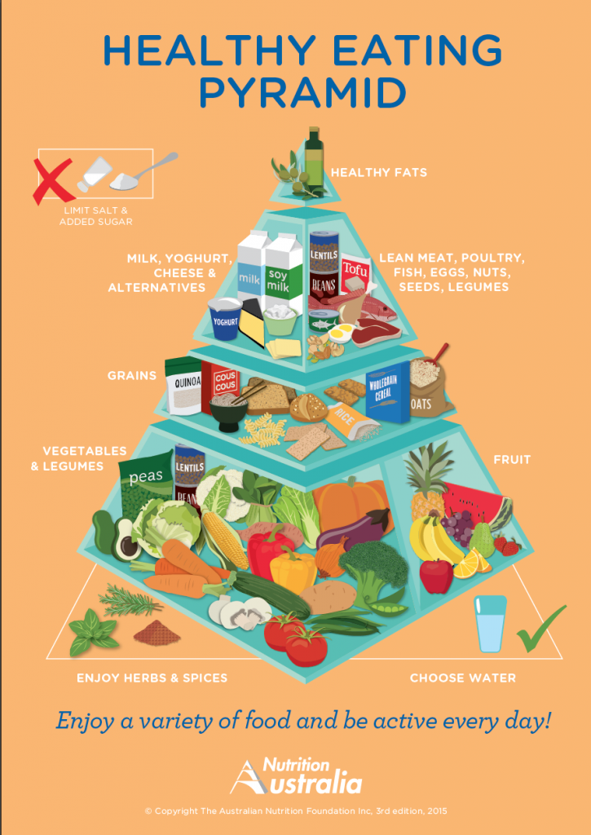
Healthy eating pyramid
Watch The Healthy Eating Pyramid (14:00)
‘Healthy Eating Pyramid’ by Nutrition Australia is © 3rd edition, 2015.

Slide 29
Learning intention and success criteria (7)
We are learning to:
use correct techniques and practices to produce food products.
We can:
document additional techniques to create food items
follow a recipe and use preparation techniques and equipment to produce food items
describe and implement the safe practices to follow when using the oven and stove.
Notes:
Notes for teachers:
Learning intentions and success criteria are best co-constructed with students. Adapt the learning intention as required and add co-constructed success criteria.

Slide 30
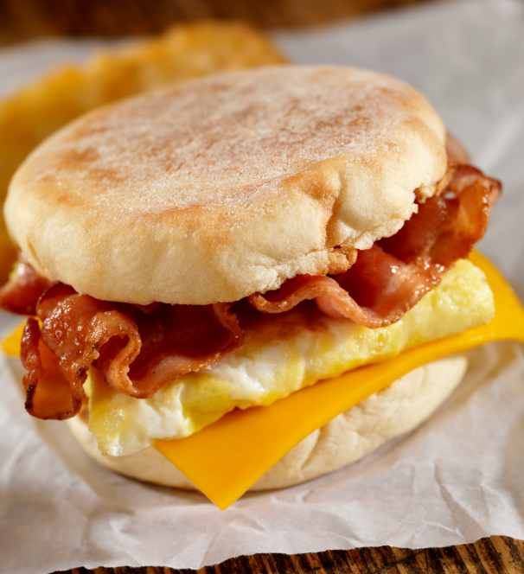
Breakfast sandwich
Serves 2
Ingredients
2 large eggs
1 TBS milk
Salt and black pepper
$\frac{1}{2}$ tsp chopped chives
1 tsp olive oil
2 rashers bacon
2 slices cheddar or tasty cheese
2 English muffins
2 tsp butter or margarine
BBQ or tomato sauce

Slide 31
Breakfast sandwich – method
Serves 2
Method
Preheat oven to 170°C. Whisk eggs together with milk, salt, pepper and chopped chives in a medium mixing bowl. Line an oven tray with baking paper, and lay bacon flat in a single layer. Place tray in oven and bake for 10 to 15 minutes. When cooked, transfer bacon onto a plate lined with paper towel to drain. When cool, break each rasher of bacon in half to be able to fit onto sandwiches. Pour olive oil into a medium frypan. Heat over medium to high heat and pour in egg mixture. Allow egg to cook until solid. Place cooked egg onto a chopping board, slice egg omelette in half. Fold each half circle into quarters to fit onto muffin. When eggs and bacon are both cooked, either toast the cut muffins in a toaster or in an oven with the muffins placed cut side up on an oven tray. Toast until edges are crispy and lightly browned. Butter the muffin. Use a spatula to place eggs and bacon onto the base of the toasted muffin. Top with cheese slice and sauce.

Slide 32
Weeks 5 to 6

Slide 33
Learning intention and success criteria (8)
We are learning about:
how the food industry contributes to sustainability.
We can:
define sustainability
describe food industries within NSW
identify community food initiatives and describe how they contribute to sustainability.
Notes:
Notes for teachers:
Learning intentions and success criteria are best co-constructed with students. Adapt the learning intention as required and add co-constructed success criteria.

Slide 34
Learning intention and success criteria (9)
We are learning to:
use correct techniques and practices to produce food products.
We can:
document additional techniques to create food items
follow a recipe and use preparation techniques and equipment to produce food items
describe and implement the safe practices to follow to avoid cross contamination of raw and cooked foods.
Notes:
Notes for teachers:
Learning intentions and success criteria are best co-constructed with students. Adapt the learning intention as required and add co-constructed success criteria.

Slide 35
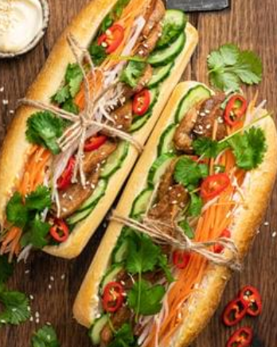
Banh mi (Vietnamese sandwich)
Serves 2
Ingredients
2 crusty long bread rolls | 1 carrot
2 TBS butter or margarine | $\frac{1}{2}$ C boiling water
2 TBS mayonnaise | 2 TBS white sugar
1 tsp olive oil | 1 tsp salt
6 slices quick-cook pork belly, or 1 chicken thigh, cooked and sliced | 50 ml rice wine or apple cider vinegar
$\frac{1}{2}$ Lebanese cucumber, finely sliced lengthways | 4–6 fresh coriander stalks
2 shallots, sliced lengthways | $\frac{1}{2}$ red chilli, chopped finely (optional)
 | 2 tsp hoisin sauce
35

Slide 36
Banh mi (Vietnamese sandwich) – method
Serves 2
Method
Using a vegetable peeler, peel carrots into thin ribbons. Pickle carrots by dissolving salt and sugar in the hot water, then add the vinegar. Add carrot to mixture and allow to stand for 20 minutes. Drain, using a sieve and use in the following recipe. Heat olive oil in a medium size frypan. Fry pork belly slices for 2 to 3 minutes until crisp and golden. Remove slices from pan and allow to drain on absorbent paper. Split rolls down the centre, spread margarine or butter and then mayonnaise. Layer in ingredients of pork belly slices, cucumber and shallots. Add drained carrot batons and coriander, sprinkle with chilli (use gloves when working with chilli). Drizzle hoisin sauce onto banh mi. Close sandwich together and secure with a paper serviette.

Slide 37
Learning intention and success criteria (10)
We are learning to:
develop our ideas.
We can:
recognise the design and production process
use steps in the design and production process to work towards a solution
record initial ideas against a criteria
communicate, receive and act on feedback from peers
contribute feedback to others.
Notes:
Notes for teachers:
Learning intentions and success criteria are best co-constructed with students. Adapt the learning intention as required and add co-constructed success criteria.

Slide 38
Weeks 7 to 8

Slide 39
Learning intention and success criteria (11)
We are learning to:
develop and communicate our ideas.
We can:
communicate our designs
provide reasons for my design against a criteria.
Notes:
Notes for teachers:
Learning intentions and success criteria are best co-constructed with students. Adapt the learning intention as required and add co-constructed success criteria.

Slide 40
Learning intention and success criteria (12)
We are learning to:
use correct techniques and practices to produce food products.
We can:
document additional techniques to create food items
follow a recipe and use preparation techniques and equipment to produce food items
describe and implement the safe practices to follow to avoid cross contamination of raw and cooked foods.
Notes:
Notes for teachers:
Learning intentions and success criteria are best co-constructed with students. Adapt the learning intention as required and add co-constructed success criteria.

Slide 41
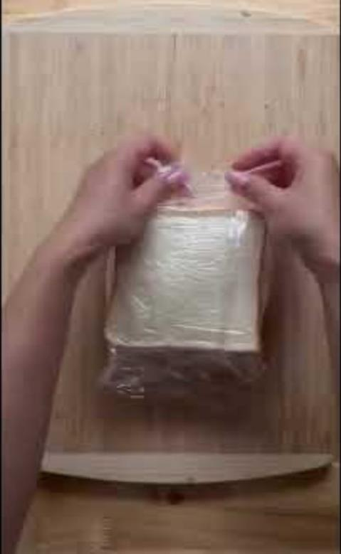
Japanese fruit sando
Watch Japanese Fruit Sando (0:59)

Slide 42
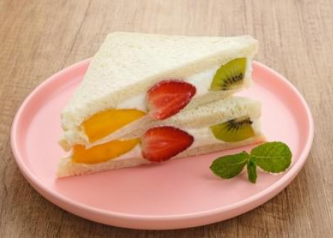
Japanese fruit sandwich
Serves 2
Ingredients
4 slices fresh white bread (toast thickness)
125 ml cream
2 tsp caster sugar
1 kiwifruit
4 strawberries
$\frac{1}{2}$ orange

Slide 43
Japanese fruit sandwich – method
Serves 2
Method
Pour cream into a clean bowl. Whip using an electric beater until soft peaks form in the cream. Gradually add caster sugar (do not add all at once). Whip cream with each small addition of sugar until hard peaks form. Do not over whip. Prepare bread by removing crusts with a serrated knife. Prepare fruit by slicing strawberries in half and then slicing orange pieces and kiwifruit rounds to be the same thickness as the strawberries. Using a spatula, spread a thin layer of cream onto one slice of bread. Assemble fruit on the bread slice with cream beginning with 3 pieces placed diagonally from one corner to the other. This is where you will slice your sandwich in half. Add more fruit to fill the bread evenly. Add whipped cream on top of the fruit to cover it fully. Wrap sandwiches in plastic wrap and place in the fridge for 30 minutes. Remove and slice with a sharp bread knife, serve straight away.

Slide 44
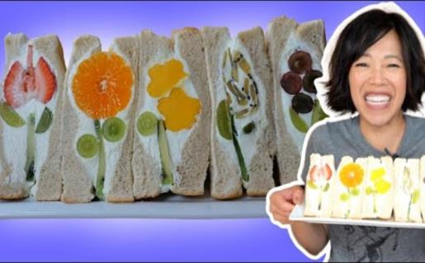
Fruit sando – Japanese fruit sandwich recipe test
Watch Fruit Sando – Japanese Fruit Sandwich Recipe Test (17:53)

Slide 45
Weeks 9 to10

Slide 46
Learning intention and success criteria (13)
We are learning to:
develop our ideas.
We can:
justify our ideas
use correct terminology when evaluating ingredients and equipment.
Notes:
Notes for teachers:
Learning intentions and success criteria are best co-constructed with students. Adapt the learning intention as required and add co-constructed success criteria.

Slide 47
Learning intention and success criteria (14)
We are learning to:
use correct techniques and practices to produce food products.
We can:
document additional techniques to create food items
follow a recipe and use preparation techniques and equipment to produce food items
accurately measure ingredients
describe and implement the safe practices to follow when using knives and the oven.
Notes:
Notes for teachers:
Learning intentions and success criteria are best co-constructed with students. Adapt the learning intention as required and add co-constructed success criteria.

Slide 48
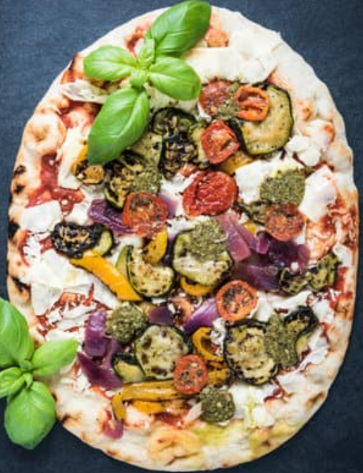
Vegetable flatbread
Serves 2
Ingredients
$1\frac{1}{2}$C self-raising flour | 1 tomato, finely sliced
1 C Greek yoghurt | $\frac{1}{2}$ red capsicum, finely sliced
$\frac{3}{4}$ cup ricotta cheese | 3 mushrooms, finely sliced
$\frac{1}{2}$ cup grated parmesan cheese | 4 basil leaves
$\frac{1}{2}$ small red onion, finely sliced | 1 TBS olive oil

Slide 49
Vegetable flatbread – method
Serves 2
Method
Preheat oven to 180°C. Mix flour and yoghurt in a bowl. Once it has come together, using your hands, knead the dough on a floured surface until smooth. Roll the dough into a large rectangle until about $\frac{1}{2}$ centimetre in thickness. Place baking paper on a large baking tray, spray the paper with non-stick spray, and transfer dough onto the tray. Spread half of the ricotta cheese onto one half of the dough. Sprinkle with half of the parmesan cheese. Carefully fold the other half of the dough on top of the cheese side. Sprinkle the remaining ricotta and parmesan. Layer the finely-sliced vegetables over the top of the dough, brush olive oil over the top of the vegetables and then sprinkle with salt and pepper and torn basil leaves. Bake for 22 to 25 minutes, until edges are slightly browned. Cut into pieces and serve hot.

Slide 50
Learning intention and success criteria (15)
We are learning to:
use correct techniques and practices to produce food products.
We can:
document additional techniques to create food items
follow a recipe and use preparation techniques and equipment to produce food items
describe and implement the safe practices to follow when using knives and the oven.
Notes:
Notes for teachers:
Learning intentions and success criteria are best co-constructed with students. Adapt the learning intention as required and add co-constructed success criteria.

Slide 51
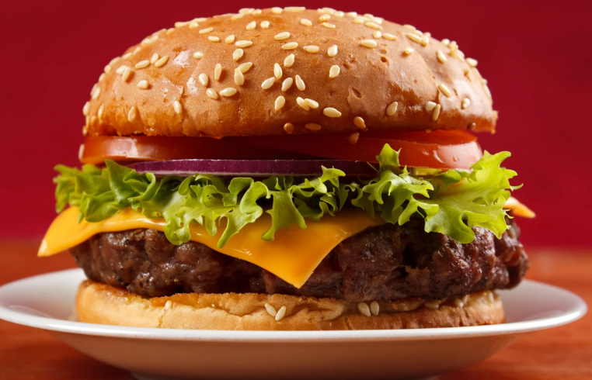
Hamburger
Serves 2
Ingredients
2 hamburger buns | 2 iceberg lettuce leaves
250 g lean beef mince | 2–4 slices beetroot
1 egg | 2 slices tasty cheese
$\frac{1}{4} C$ breadcrumbs | 1 TBS olive oil
Salt and pepper | Tomato or BBQ sauce
1 small tomato

Slide 52
Hamburger – method
Serves 2
Method
Place mince, egg, breadcrumbs and salt and pepper into a medium mixing bowl. Using your hands combine ingredients and then make 2 patties. Place patties onto a plate. Wash lettuce leaves and slice the tomato. In a medium frypan, heat olive oil and then fry the patties for 3 to 4 minutes on each side. Press patties gently using a spatula while they are frying in the pan to keep them flattened. Cut hamburger buns in half and toast buns under the grill or in a toaster. When patties are cooked through, place each onto the bottom half of the burger bun. Top patty with cheese and remaining salad ingredients. Add tomato or BBQ sauce as required.

Slide 53
Learning intention and success criteria (16)
We are learning to:
consolidate our learning.
We can:
recall the 6 essential nutrients
provide food examples of the 6 essential nutrients
suggest foods to contribute to the recommended serves for adolescents
describe preparation methods for food items
explain sustainable initiatives within the food industry.
Notes:
Notes for teachers:
Learning intentions and success criteria are best co-constructed with students. Adapt the learning intention as required and add co-constructed success criteria.

Slide 54
References (1)
This presentation contains NSW Curriculum and syllabus content. The NSW Curriculum is developed by the NSW Education Standards Authority. This content is prepared by NESA for and on behalf of the Crown in the right of the State of New South Wales. The material is protected by Crown copyright.
Please refer to the NESA Copyright Disclaimer for more information https://educationstandards.nsw.edu.au/wps/portal/nesa/mini-footer/copyright.
NESA holds the only official and up-to-date versions of the NSW Curriculum and syllabus documents. Please visit the NSW Education Standards Authority (NESA) website https://educationstandards.nsw.edu.au/wps/portal/nesa/home and the NSW Curriculum website https://curriculum.nsw.edu.au.
Technology 7–8 Syllabus © NSW Education Standards Authority (NESA) for and on behalf of the Crown in right of the State of New South Wales, 2023.
ClickView (14 July 2020) 'The Healthy Eating Pyramid' [video], ClickView, YouTube, accessed 22 April 2024.
ClickView (15 July 2020) 'Safety In The Domestic Kitchen - Food Technology' [video], ClickView, YouTube, accessed 9 April 2024.
ClickView (21 October 2020) 'Food Groups And Nutrition' [video], ClickView, YouTube, accessed 11 April 2024.
emmymade (3 July 2020) 'FRUIT SANDO -- Japanese Fruit Sandwich Recipe Test' [video], emmymade, YouTube, accessed 29 April 2024.
National Health and Medical Research Council (2021a) Australian Guide to Healthy Eating, Eat For Health website, accessed 15 April 2024.

Slide 55
References (2)
NSW Government Food Authority (n.d.) Hand Washing [PDF 233 KB], NSW Government Food Authority website, accessed 9 April 2024.
Nutrition Australia (2021) Healthy Eating Pyramid [PDF 664 KB], Nutrition Australia, accessed 22 April 2024.
Science Buddies (10 March 2020) 'See Germs! Hand Washing Science Experiment’ [video], Science Buddies, YouTube, accessed 9 April 2024.
WinnyHayes (1 July 2022) 'Japanese Fruit Sando' [video], WinnyHayes, YouTube, accessed 29 April 2024.

Slide 56
Copyright
© State of New South Wales (Department of Education), 2024
The copyright material published in this resource is subject to the Copyright Act 1968 (Cth) and is owned by the NSW Department of Education or, where indicated, by a party other than the NSW Department of Education (third-party material).
Copyright material available in this resource and owned by the NSW Department of Education is licensed under a Creative Commons Attribution 4.0 International (CC BY 4.0) license.
This license allows you to share and adapt the material for any purpose, even commercially.
Attribution should be given to © State of New South Wales (Department of Education), 2024.
Material in this resource not available under a Creative Commons license:
the NSW Department of Education logo, other logos and trademark-protected material
Material owned by a third party that has been reproduced with permission. You will need to obtain permission from the third party to reuse its material.
Links to third-party material and websites
Please note that the provided (reading/viewing material/list/links/texts) are a suggestion only and implies no endorsement, by the New South Wales Department of Education, of any author, publisher, or book title. School principals and teachers are best placed to assess the suitability of resources that would complement the curriculum and reflect the needs and interests of their students.
If you use the links provided in this document to access a third party’s website, you acknowledge that the terms of use, including licence terms set out on the third-party’s website apply to the use which may be made of the materials on that third-party website or where permitted by the Copyright Act 1968 (Cth). The department accepts no responsibility for content on third-party websites.

