Slide 1
Instructions for use
This resource is not a teaching and learning program. It should be used in conjunction with Observing the Universe program and teacher resource books.
Classroom teachers are encouraged to add and adapt slides as required to meet the needs of their students.
Save a copy of the file to make changes to the slide deck. Go to File > Download a Copy (this downloads a copy to the computer to edit in the PowerPoint app).
To convert the PowerPoint to Google Slides:
  Upload the file into Google Drive and open it.
  Go to File > Save as Google Slides.
  (Note – conversion may cause formatting changes in the slides.)

Slide 2

Observing the Universe
Stage 4
OTU PowerPoint

Slide 3
Contents 1
TRB 1
1.1
Getting to know you
1.6
The power of scientific theories and laws
1.2
How do scientists work?
1.7
Introducing the Working scientifically processes
1.3
Observing in science
1.8
Science sleuth
1.4
Branches of science
1.9
From observations to questions
1.5
Why collaborate
1.10
Measure up
Notes:
Teacher notes:
Click lesson numbers to go to specific lessons (in presentation mode). Otherwise, Ctrl+click.
Interactive features can be viewed in the slideshow

Slide 4
Contents 2
TRB 1
1.11
Putting it all together
2.2
Trace space back to you
1.12
Can plants sense gravity?
2.3
Unlocking the Universe
1.13
Applying the Working scientifically processes
2.4
What is at the centre of our Solar System?
1.14
Introducing secondary source investigations
2.5
The scale of the Solar System
TRB 2
2.1
Introducing space science – what do you know?
2.6
Seasons
Notes:
Teacher notes:
Click lesson numbers to go to specific lessons
Interactive features can be viewed in slide show

Slide 5
Contents 3
2.7
Exploring the phase of the Moon
2.12
Aboriginal and Torres Strait Peoples’ sky stories
TRB 2
2.8
Eclipses
Templates and scaffolds
2.9
Tides
2.10
Aboriginal and Torres Strait Islander Peoples’ knowledge of the Moon and tides
2.11
How Aboriginal and Torres Strait Islander Peoples use stars to predict weather
Notes:
Teacher notes:
Click lesson numbers to go to specific lessons
Interactive features can be viewed in slide show

Slide 6
How do observation and investigation guide scientific endeavours?
Notes:
Content in this section aligns with essential question 1 in the Observing the Universe Program and Teacher resource book 1

Slide 7
1.1 Getting to know you
Learning intention and success criteria
We are reviewing | I can
what we know about science. | make simple predictions and test them recall scientific terminology make connections between scientific terms.

Slide 8
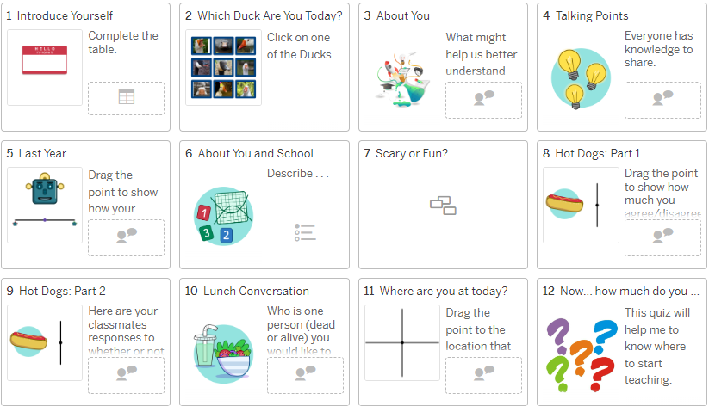
Welcome to Year 7 science
Notes:
Students should complete slides one to 11 on the Desmos activity Welcome to Year 7 science. Slides 7 and 8 provide good talking points to facilitate a class discussion or encourage students to share their thoughts in small groups.

Slide 9
1.2 How do scientists work?
Learning intention and success criteria
We are learning | I can
how observations help us increase our knowledge of the Universe. | identify that science uses observations and builds new knowledge through investigations.

Slide 10
Hexagonal thinking
Arrange your hexagons so that each side connects with a relevant term on another hexagon.
Use the arrows to draw more connections or indicate direction if required.
Notes:
Instruct students to arrange the hexagons so that each side of a hexagon connects with another hexagon containing a related term. Encourage students to use the arrows to indicate the direction of the connection if needed. Emphasise that connections should be based on logical relationships. For example, testable questions lead to predictions, which can be tested via a scientific investigation.
The cards may need to be rearranged several times until students are satisfied that their pattern illustrates the strongest connection between the terms. Encourage students to challenge each other’s thinking and explore alternative connections. When the students are happy with the arrangement of their hexagons, they should write as many sentences as possible from the array of terms in the hexagons.

Slide 11
1.3 Observing in science
Learning intention and success criteria
We are learning | I can
how observations help us increase our knowledge of the Universe. | distinguish between quantitative and qualitative observations use my senses to make observations use tools to make measurements compare the accuracy of quantitative and qualitative observations use my observations to make an inference.

Slide 12
Making observations with popping corn
Draw this table in your book
Qualitative observation | Sense used | How can this measurement be made quantitative? | Quantitative observation
Notes:
This slide supports the ‘Making observations with popping corn’ activity in TRB1.

Slide 13
Checkpoint – quantitative and qualitative observations
Classify each of the following observations as qualitative or quantitative
The mother tested the temperature of the baby’s milk by putting some drops on her wrist.
We had 15 mm of rain in the last 24 hours.
The weather is very humid.
The beach was littered with plastic bottles.
The animals in Antarctica are not afraid of humans.
The car took 8 seconds to reach a speed of 100 km/hr.
The baby gained 0.5 kg in weight last week.
Weeds are invading the national park.
The child had a red and itchy rash all over his stomach.
Notes:
Once students have classified each scenario, the animation can be activated with a click, and the qualitative observations will be outlined. You can use this to facilitate a discussion with the students and correct their understanding where required.

Slide 14
1.4 Branches of science
Learning intention and success criteria
We are learning | I can
how scientists work together to increase our knowledge of the Universe. | identify some branches of science classify various science fields into their branches or sub-branches explain how some branches of science are connected.

Slide 15
Frayer diagram – chemist
Definition
A chemist is a scientist who studies and works with chemicals. They learn about the properties and reactions of different substances, and they use this knowledge to create new materials, medicines, and products.
Word in a sentence
The chemist mixed different chemicals together to create a new type of glue.
chemist
Examples
pharmaceutical chemist, environmental chemist, biochemist, chemical engineer
Non-examples
meteorologist, doctor, mechanical engineer
Notes:
This sample response may be shared with your class to facilitate the activity. This slide is animated to bring up the sample answers one by one.

Slide 16

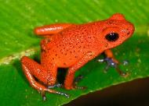
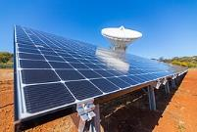
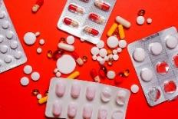
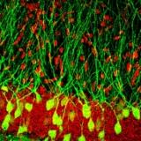

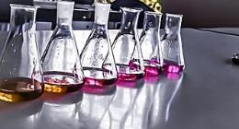
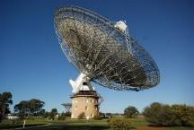
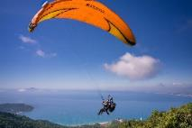
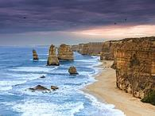


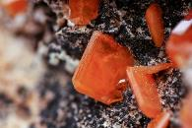
Scientree
biology
chemistry
geology
physics
Notes:
This slide may be used to support a class discussion. The branches of science (biology, chemistry, geology and physics) may be moved to name branches, and sub-branches may also be created.
Move the images on to the tree while discussing how the branches overlap, and that one image may belong to more than one branch. For example, solar panels could belong to physics or a sub-branch of biology – sustainability.
You may choose to edit the image or add more.
Strawberry poison-dart frog by Unknown Author is licensed under CC BY-SA
sparse granule cells by J Snyder is licensed under CC-BY-3.0
Biuret reaction to proteins by Балакина Наталья is licensed under CC BY 4.0
Parkes Observatory – Australia -15Aug2009 by Ian Sutton is licensed under CC-BY-2.0
New Norcia solar by European Space Agency is licensed under CC-BY-SA
12 apostles 2019 by Unknown Author is licensed under CC-BY-SA 4.0
Red Raw Minerals by Глеб Коровко is licensed under Legal Simplicity
Coloured Powders and Brush by Venus HD Make-up & Perfume is licensed under Legal Simplicity
Person Riding on Parachute by Quang Nguyen Vinh is licensed under Legal Simplicity
White Sydney Opera House by Rijan Hamidovic is licensed under Legal Simplicity
Yellow and White Red Pills on Blister Pack by A Shvets is licensed under Legal Simplicity
DNA strands by gerait is licenced under CC0 1.0 DEED

Slide 17
1.5 Why collaborate?
Learning intentions and success criteria
We are learning | I can
how scientists work together to increase our knowledge of the Universe. | identify examples of collaborative projects in science list the benefits of collaboration in scientific research.

Slide 18
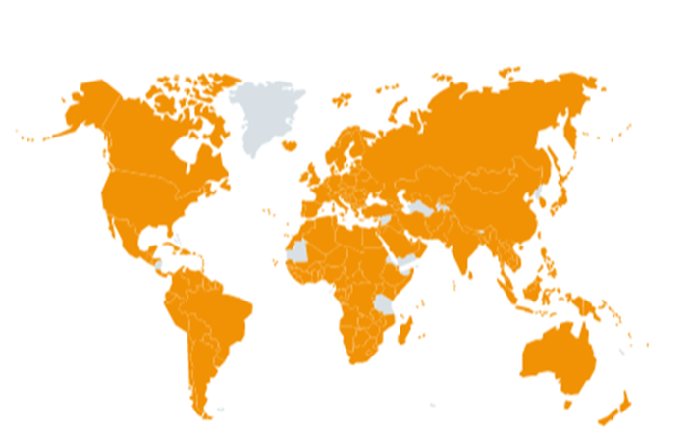
COVID 19 timeline
12 Dec 2019 – patients in a city in China become sick with an unusual pneumonia.
31 Dec 2019 – the World Health Organization in China informed of the condition.
7 Jan 2020 – the virus is isolated and named SARS CoV-1.
10 Jan 2020 – The University of Sydney posts the virus’s genetic sequence online, based on the research of many institutions here and in China. This sequence is available for scientists across the world to analyse and share.
Feb 2020 – spike protein structure (how the virus attaches itself to our cells)
discovered – necessary to develop vaccines for prevention.
March 2020 – first vaccine trials in the USA.
April 2020 – other vaccine companies around the world form partnerships to develop vaccines.
June 2020 – first effective treatment – developed in the UK, Indonesia, Nepal and Vietnam.
November 2020 – new, faster tests for the virus – developed by the UK and Slovakia.
December 2020 – first vaccine released for use in the UK.
‘Chem vs covid timeline’ by Royal Society of Chemistry is licensed under CC BY-NC-ND 4.0.
Notes:
This slide contains animations that bring up the text one by one. The numbers below align with the animation number. As you reveal each step, highlight the collaboration and how this allowed for the speed of discovery.
Ask students if they can recall the beginning of COVID-19. When and where did it first appear?
1. 12 December 2019 in a city in China.
2. The World Health Organization works to promote health and keep the world safe from disease. It is part of the United Nations. The Chinese doctors inform the WHO about the new disease.
3. Scientists have found the virus and let the world know its existence.
4. Year 7 students will not understand ‘genetic sequence’ – explain this as the unique structure of the virus. This occurred just 10 days after the World Health Organisation was informed of the disease.
5. The map shows the countries that have published the genetic sequences of the many different strains of SARS-CoV-2 to international databases. This allowed the world to know where new variants (forms) of the virus were developing
6. Spike protein will need a basic explanation—it is the part of the virus that attaches to our cells, allowing the virus to enter our cells and make us sick.
7. Usually, one company will develop a vaccine – here, we have companies from many countries forming partnerships to develop vaccines
8. Highlight the collaboration
9. Again, highlight collaboration
10. Typical vaccine development takes 10-15 years, with one company developing the vaccine costing $31-68 million. Multiple research organisations and companies worked on this, spending much more money than previously. The USA spent 31.9 billion dollars (students may need ‘billion’ defined as 1000 million). This meant the vaccine could be developed much more quickly than usual.

Slide 19
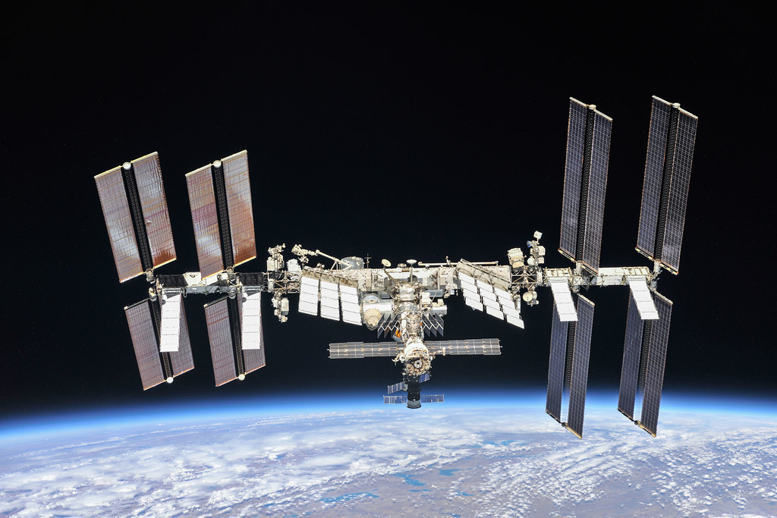
International Space Station
‘The International Space Station as of Oct. 4, 2018’ by NASA Johnson is licensed under CC BY-NC-ND 2.0.
Notes:
Introduce the International Space Station (ISS) as another example of international scientific collaboration.
Explain to the students:
What is it?
A space station that orbits approximately 400 km above the Earth.
It has been orbiting the Earth for 25 years
270+ astronauts have visited the ISS
What happens on the international space station?
Experiments are conducted in zero gravity.
Experiments are conducted into living and working in space, allowing us to send humans further into space than ever before.
Why is it called an ‘International’ Space Station?
Many countries, including the USA, Russia, Europe (10 countries), Brazil, Canada, and Japan, contributed funds to put it into space for scientists to conduct experiments.
What collaboration has occurred on the ISS?
The ISS is a product of cooperation between multiple space agencies. This collaboration brings together resources, expertise, and funding from different countries to achieve common space exploration and research goals. Without this collaboration, the progress of having a station orbiting the Earth would have taken a lot longer to accomplish.
Countries participating in the ISS program share technological advancements, research findings and operational techniques. Pooling this knowledge accelerates scientific progress and innovation, benefiting all collaborators.
Scientists worldwide can propose and conduct experiments on the ISS, fostering international scientific collaboration.
Despite differing national interests, the ISS collaborating nations work towards unified goals

Slide 20
Collaborations in science (1)
On a new page, draw a table with 4 columns and the length of the page. Put the headings in each column.
Project | What is the purpose of the project? | Who is collaborating? | What are the benefits of the collaboration?
Notes:
Explain to students that they will collaborate with other students to learn about different international collaborative projects. They will record their findings in a table, as above.

Slide 21
Collaborations in science (2)
Fill in the first row for the International Space Station
Project | What is the purpose of the project? | Who is collaborating? | What are the benefits of the collaboration?
International Space Station | Orbits approx. 400km above the Earth. Conducts experiments in zero gravity, and into living and working in space, allowing us to send humans further into space than ever before. | Space agencies from USA, Russia, Europe (10 countries), Brazil, Canada and Japan | Allows new perspectives and approaches to scientific challenges. The cost of expensive experiments is shared. Groups of experiments share the same launches and crew time.
Notes:
Model for the students how to complete the table for the ISS

Slide 22
Collaborations in science (3)
Select one of the following collaborations in science and collaborate with others to find out about it.
Project | Other websites
Human Genome Project | https://kids.britannica.com/kids/article/human-genome-project/476279 https://www.genome.gov/about-genomics/educational-resources/fact-sheets/human-genome-project
CERN | https://www.ouruniverseforkids.com/cern/
International Cancer Consortium | https://www.cancerresearchuk.org/funding-for-researchers/how-we-deliver-research/our-research-partnerships/international-cancer-genome-consortium
Human Cell Atlas | https://www.kidsnews.com.au/science/the-human-cell-atlas-global-research-project-aims-to-map-all-healthy-human-cells/news-story/46a41635feed3f741a9b1fb8a1a9b0b3
LIGO Scientific Collaboration | https://www.ligo.org/science.php
Gemini Telescopes | https://www.gemini.edu/about/gemini-telescopes-science-and-technologies
Notes:
Divide the class into groups of 4.
Each student in the group selects a different project from the list above and joins other students selecting the same project and researching their chosen project in ‘expert’ groups. Suggested websites are included above. Encourage students to collaborate to find the information about their project.

Slide 23
Collaborations in science (4)
Complete the next row of the table in your expert group.
Project | What is the purpose of the project? | Who is collaborating? | What are the benefits of the collaboration?
International Space Station | Orbits approx. 400km above the Earth. Scientists working on the ISS conduct experiments in near zero-gravity environments and on living and working in space, allowing us to send humans further into space than ever before. | Space agencies from USA, Russia, Europe (10 countries), Brazil, Canada and Japan | Allows new perspectives and approaches to scientific challenges. The cost of expensive experiments is shared. Groups of experiments share the same launches and crew time.
(Your choice)
Notes:
Students fill in the next row of their table for the international collaborative project they researched together.

Slide 24
Collaborations in science (5)
Collaborate with your home group to complete 3 more rows in the table.
Project | What is the purpose of the project? | Who is collaborating? | What are the benefits of the collaboration?
International Space Station
(Your choice)
(Other)
(Other)
(Other)
Notes:
Students then return to their home group of 4 and share their learning. They each complete the table for the three other collaborative projects they researched.

Slide 25



Reflection – 3-2-1 Things I learned today
List 3 things you learned today:
1.
2.
3.
List 2 questions you have about these things:
1.
2.
Give one reason why it's important to learn about these things:
1.
Notes:
Referring to the learning intentions and success criteria, students undertake a 3-2-1 on things I learned today. Students list 3 things they learned today, 2 questions about those things, and one reason why it is important to know about them. Note that responses must be addressed at the start of the next lesson.
Teachers should review students’ responses to ensure that they have developed a good understanding of the key concepts discussed in this learning sequence.

Slide 26
1.6 The power of scientific theories and laws
Learning intention and success criteria
We are learning | I can
how scientists use observations to form theories and laws. | define a scientific theory define a scientific law distinguish between theories and laws.

Slide 27
Venn diagram scaffold
Scientific theory
Scientific law
[Enter text here]
[Enter text here]
[Enter text here]
Notes:
This slide may help students complete a Venn diagram in Activity 5, The Power of Scientific Theories and Laws.
Watch a video such as What's the difference between a scientific law and theory? (5:11) with the class. Ask the students to brainstorm about the difference between theories and laws in groups. Emphasise to students the importance of observations and repeated experiments in developing theories and laws. Students complete a Venn diagram illustrating similarities and differences between a theory and a law.

Slide 28
Venn diagram – sample response
Scientific theory
Scientific law
provides a logical explanation about why things happen.
will never become a law.
multiple theories may provide an explanation of new scientific discovery.
continually propose, challenge, revise and even replace.
are favoured when they explain most of the data.
are favoured when they predict previously unobserved phenomena.
predicts what happens (results).
usually resist change since they would not have been adopted if they did fit the data.
occasionally are revised if new unexpected information becomes available.
does not explain why something happens.
support each other.
can be revised if new information becomes available.
both needed to understand the scientific phenomena.
Notes:
Suggested answers for the Venn diagram activity.

Slide 29
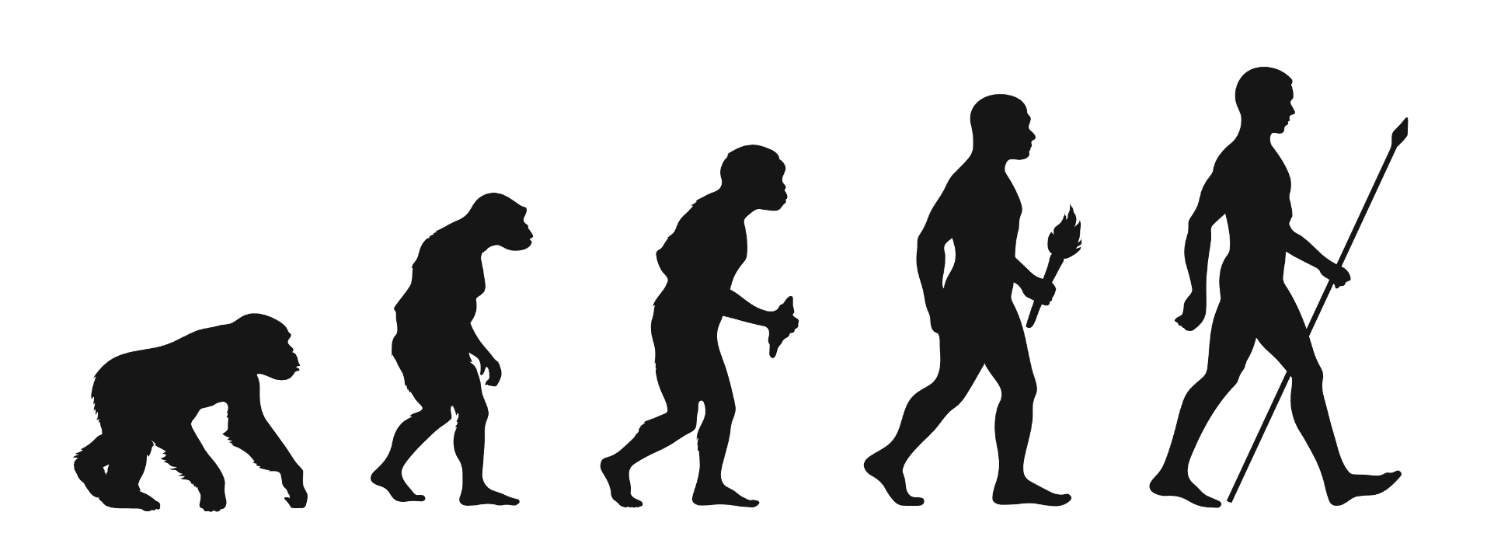
What scientific theory is represented here?
This work has been generated using BioRender.com. Any copyright subsisting in this work is owned by © State of New South Wales (Department of Education) 2024.
Notes:
Students may respond as follows:
Evolution
Theory of evolution
Theory of evolution by natural selection
Possible misconceptions:
Evolution is directional (apes to modern humans).
Evolution results in improvement (for example, ability to make and use tools).
Humans descended from apes.

Slide 30
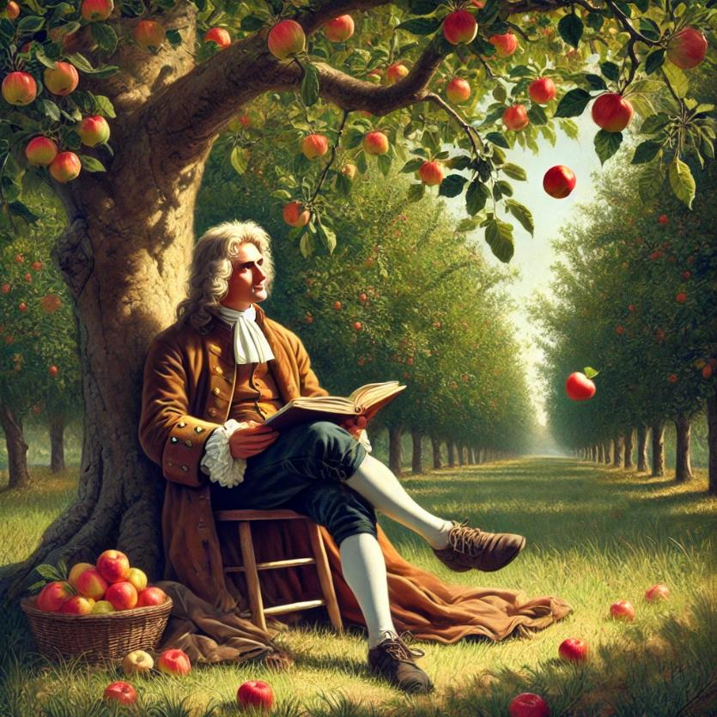
What scientific law is attributed to the event depicted in this image?
This work has been generated using artificial intelligence. Any copyright subsisting in this work is owned by © State of New South Wales (Department of Education) 2024.
Notes:
Newton’s Law of Universal Gravitation.

Slide 31
1.6 The power of scientific theories and laws – checkpoint
Which statement best explains the difference between a scientific theory and a scientific law?
A theory explains a wide range of phenomena supported by evidence and experimentation, while a law describes a specific relationship observed in nature.
A theory is a well-tested and widely accepted explanation for a natural phenomenon, while a law predicts future events based on past observations.
A theory is a proven fact about the natural world, while a law is a tentative explanation that may change over time.
A theory is a simple explanation for a complex phenomenon, while a law is a complex explanation for a simple phenomenon.
Notes:
The correct answer is a. A theory explains a wide range of phenomena supported by evidence and experimentation, while a law describes a specific relationship observed in nature.

Slide 32
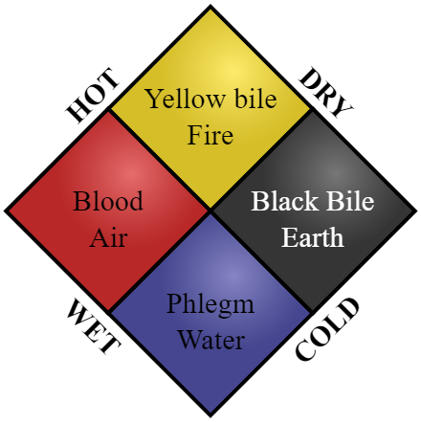
Debunked theories
Phrenology
Four humors
Martian canals
Alchemy
Geocentric model
Plum pudding model
Caloric theory
Miasma
Planet Vulcan
Hollow Earth
Spontaneous generation
Interstellar ether
‘Graphic showing the four humors in relation to the four elements’ by Lemmens T is licensed under CC0 1.0.
Notes:
Working in pairs, students select one of the debunked theories on this slide. Students research what their selected theory explained and why it was debunked. Detailed explanations are not required. Each pair then reports on their theory to the class. Ask the students: Why were all these theories debunked? The common thread is that evidence was discovered through observation and experiments that the existing theory could not explain.
Students use their example of a debunked theory to answer the question: Does having a theory disproved or adjusted weaken the credibility of science?

Slide 33
1.7 Introducing the Working scientifically processes
Learning intention and success criteria
We are learning | I can
how scientists work to increase our knowledge of the Universe. | list the Working scientifically processes used by scientists for undertaking investigations.

Slide 34
The Working scientifically processes
Place the Working scientifically processes into order
Plan some experiments
Analyse the results
Makes some observations
Conduct the experiments
Ask questions about observations
Record the results of the experiment
Make a prediction based on scientific knowledge
Let other scientists know what the experiments showed
Find out what is already known (research)
Notes:
The shapes on this slide can be moved (in non-presenter mode) to demonstrate to students the correct order of the processes.
Make some observations
Ask questions about the observations
Find out what is already known (research)
Make a prediction based on scientific knowledge
Plan some experiments
Conduct the experiments
Record the results
Analyse the results
Make a conclusion related to the prediction
Let other scientists know what the experiments showed.

Slide 35
1.8 Science sleuth
Learning intentions and success criteria
We are learning | I can
how observations help scientists increase our knowledge of the Universe | distinguish between an observation and an inference
to communicate scientific concepts. | write an evidence-based explanation.

Slide 36
Claim-Evidence-Reasoning (C-E-R) – animal tracks
Carefully study Tricky tracks 1. What do you think has happened?
Claim
State an answer to the question or prompt.
Evidence
Provide reliable information from experiments, facts or a reliable source that supports the claim.
Reasoning
Explain how the evidence supports the claim.
Helpful hints
Use key words and ideas from the question as you write your claim.
Sentence starters
In the experiment …
The data shows …
One piece of evidence is …
Sentence starters
The evidence supports the claim because …
Based on this evidence, it can be concluded that …
Your response:
Your response:
Your response:
Notes:
This slide may be used to help students prepare an explanation or claim.
The slide provides a scaffold that the teacher may alter to add or remove support as needed, or sentence starters may be altered to better suit the activity.
Teachers may use the slide to model a response using a Think Aloud technique or during joint construction of responses.

Slide 37
Sample response for activity 7 – animal tracks
Claim
State an answer to the question or prompt.
Evidence
Provide reliable information from experiments, facts or a reliable source that supports the claim.
Reasoning
Explain how the evidence supports the claim.
Helpful hints
Use key words and ideas from the question as you write your claim.
Sentence starters
In the experiment …
The data shows …
One piece of evidence is …
Sentence starters
The evidence supports the claim because …
Based on this evidence, it can be concluded that …
Your response
Two animals went looking for food. They met each other and did a mating dance.
Your response
One piece of evidence is that there are 2 sets of footprints that are coming together. The second piece of evidence shows a lot of prints going around each other in one spot.
Your response
Based on the evidence it can be concluded that the animals came towards each other and circled around each other, perhaps as a mating dance.
Notes:
This slide may guide students through the Claim-Evidence-Reasoning approach to writing an explanation.
Guide the students through the Tricky tracks activity. This activity includes teacher guidance (including sample answers), a presentation and a student worksheet.
Teacher note: The Tricky Tracks activity is an ideal opportunity to introduce the process of writing an explanation using the Claims-Evidence-Reasoning scaffold and the Think Aloud technique to model it. The modelling can be demonstrated in question 1 and completed via a joint construction in question 6. A scaffold for claim-evidence-reasoning has been provided in the Supporting PPT.
At this point, it's important to introduce causal connectives. These words link one statement to another and play a key role in structuring and connecting ideas in the learning process. Examples of causal connectives are thus, therefore, so, due to, because of, consequently, hence, for this reason, then, when, unless.

Slide 38



1.8 Science sleuth – checkpoint
Using examples, how would you explain the difference between an observation and an inference to a friend?
Think
Individual thinking time
Pair
Share your thoughts with a partner
Share
Share with a larger group or class
Notes:
Use Think-Pair-Share so that students can refine their explanations and examples.
Checkpoint sample response
An observation is something you notice using your senses. For example, if you see that the sky is grey and you feel raindrops, that is an observation. An inference is a conclusion you draw based on your observations. For instance, if you observe the grey sky, you might infer that it will rain soon. Observations are about what you directly see, hear, smell, taste, or touch, while inferences are the ideas you form based on those observations.

Slide 39
Defining observations and inferences T-chart
Observations | Inferences
What can I sense? | What do I think (based on what I sense)?
Notes:
This slide may be used to facilitate a class discussion or to model making observations and inferences.
Watch a video such as Observations and Inferences - What's the Difference (https://youtu.be/j7RRFmFrHDg). Co-construct this T-chart showing the differences between an observation and an inference.
Provide students with the image of the cracked window (next slide). Encourage students to make as many observations as possible. Then, they can brainstorm possible inferences or explanations for the observations made.

Slide 40
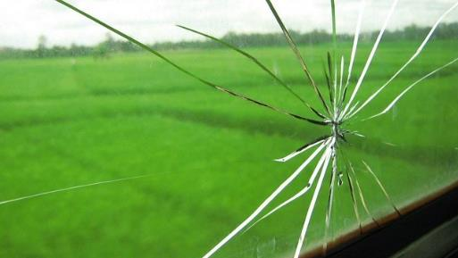
T-chart – observations
‘Broken Window’ by Adi Setiawan is licensed under CC BY-NC-SA 2.0.
Notes:
Students complete T chart for their observations and inferences for this image.

Slide 41
1.9 From observations to questions
Learning intention and success criteria
We are learning | I can
how observations help scientists increase our knowledge of the Universe. | develop testable questions based on my observations carry out an investigation designed to answer questions.

Slide 42

1.9 From observations to questions – checkpoint
State 3 criteria that make for a good scientific question
Notes:
Sample response: The question is testable, clear, and focused (not too broad).

Slide 43
1.10 Measure up
Learning intention and success criteria
We are learning | I can
to use scientific equipment to make observations. | compare the range, sensitivity and accuracy of analog and digital instruments used to measure weight use measuring instruments to measure aspects of the environment record measurements correctly using correct units.

Slide 44
Analog and digital measuring devices
Investigate the analog and digital devices displayed. What do the analog devices have in common? What do the digital devices have in common? Consider the following questions:
How is the reading displayed?
Is the whole scale visible?
Would it be possible to estimate a reading?
Present your information in a table
What analog devices have in common: | What digital devices have in common:
Notes:
Display pairs of digital and analog measuring devices that students may be familiar with. Examples include analog and digital bathroom scales, analog and digital kitchen scales, wall clock and digital clocks, analog and digital thermometers, and analog and digital tyre pressure gauges.
Students to move around and determine:
What do the analog devices have in common?
They all use a scale of numbers read by looking at where a marker points.
The whole scale is visible.
It would be possible to estimate the reading between marks on the scale
What do the digital devices have in common?
They all display a number to represent the measurement.
The whole scale of numbers is not visible.
It would not be possible to read between values displayed.

Slide 45
1.11 Putting it all together
Learning intentions and success criteria
We are learning | I can
to plan and conduct safe and valid investigations | safely follow a planned procedure to heat water and measure the temperature accurately identify the variable that is being measured identify the variable that is being changed
to use scientific equipment to make accurate observations | measure temperature accurately
to process and represent information | record measurements in a table and plot data accurately on a graph
to look for patterns in data. | accurately interpret data in a line graph.

Slide 46
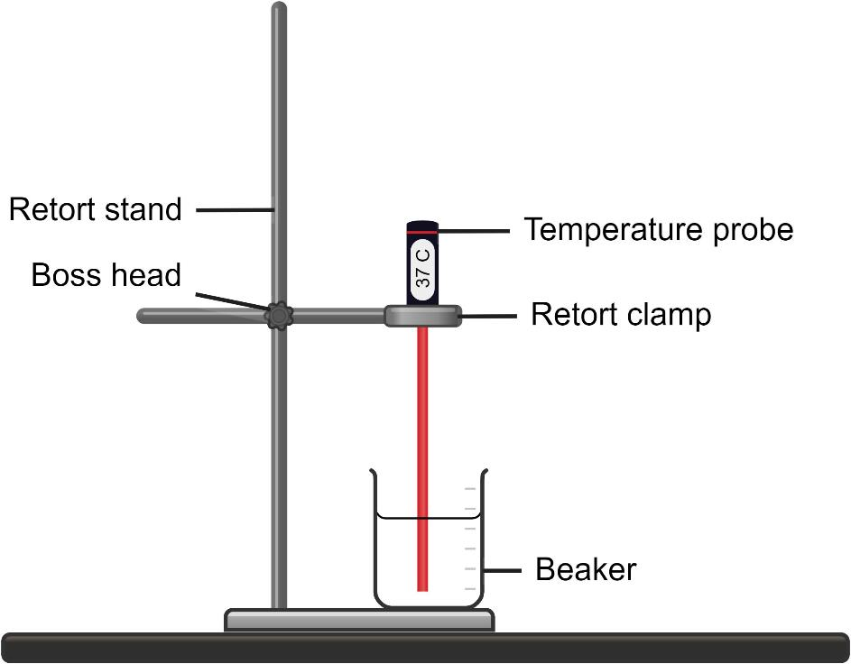
1.11 Equipment diagrams
A good line diagram
is drawn in pencil
has crisp, sharp lines without shading
has any straight lines drawn with a ruler
is drawn in 2 dimensions
has the openings of containers not closed off with a line
is large enough to show the important details
has each component labelled with a rule line without arrowheads
has label lines that do not cross over.
Note: arrowheads are only used to denote movement or process.
This work has been generated using Chemix.org. Any copyright subsisting in this work is owned by © State of New South Wales (Department of Education) 2024.

Slide 47
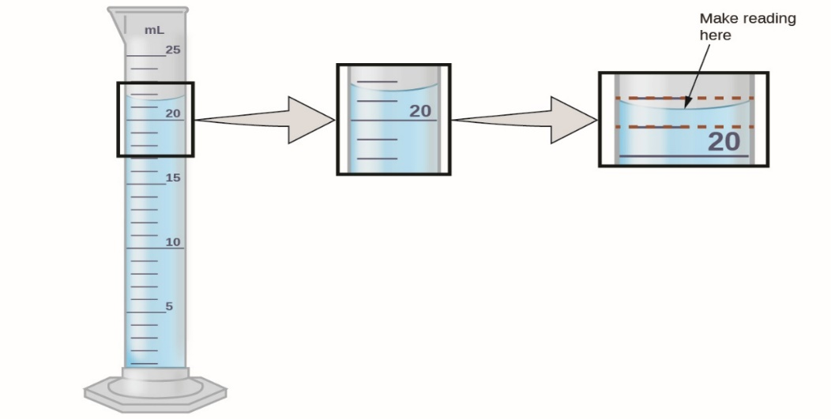
Measuring volume
How to read a measuring cylinder
‘Measuring volume’ by Unknown Author is licensed under CC BY-SA-NC 4.0
Notes:
Demonstrate how to read a measuring cylinder.
have the measuring cylinder on a flat surface
view the scale at eye level
read the bottom of the meniscus.
The minimum division of measurement that can be made is half of the smallest division on the device. In the example below, the lines represent 1mL, so the minimum measurement division is 0.5mL. Therefore, this should be read as 21.5mL. There is no need to introduce ‘plus or minus 0.5’ to year 7.

Slide 48

1.11 Putting it all together – checkpoint
You are walking past a group of students using a Bunsen burner to heat a substance in a beaker.
Describe how you can tell if the students are using the correct flame. Give reasons for your answer.
education.nsw.gov.au
Notes:
Sample response
If the flame is high, yellow, sooty and wavering, the holes must be closed. This is the wrong flame for heating. The blue flame is hotter and cleaner and should be used for heating substances

Slide 49
1.12 Can plants sense gravity?
Learning intentions and success criteria
We are learning | I can
how scientists design valid experiments | follow a planned procedure to make a series of observations and measurements over a period of time identify an independent and dependent variable and some controlled variables.
to communicate scientific concepts. | draw annotated diagrams make an evidence-based claim.

Slide 50
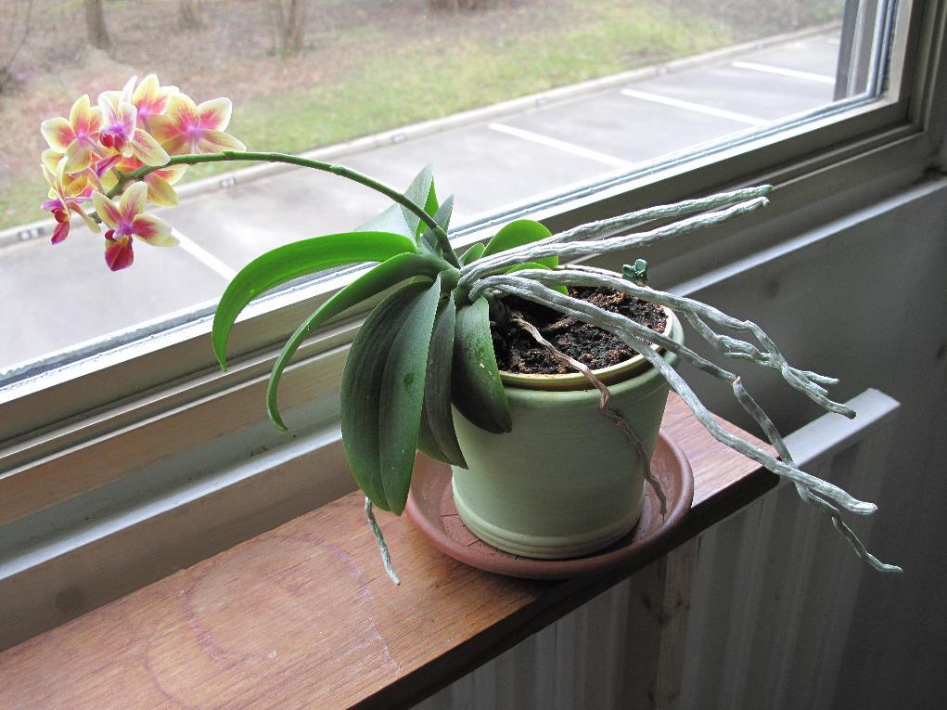
Annotating a picture or diagram
The flowers and leaves are leaning toward the window. This is because they are growing toward the light.
The roots are growing towards the inside of the room, which is darker.
‘Phototropism’ by Tangopaso is licensed under CC BY-SA 3.0
Notes:
Annotations should be clear and concise. They should not interfere with the clarity of the image.

Slide 51
1.12 Can plants sense gravity? – checkpoint
An agricultural scientist is planning an experiment to determine if a new fertiliser works better than a soluble fertiliser or pellets.
Notes:
This is an extended checkpoint; time must be allowed for students to compose a high-quality response.
Pose the scenario
Pose questions to elicit student understanding of variables
Checkpoint sample response
1. What might the agriculture scientist need to measure for this experiment?
The scientist would need to measure how tall the plants grew each week.
2. What would the scientist change in the experiment?
They would change the type of fertiliser the plants were given.
3. What would the scientist keep the same in the experiment?
The type of plant, amount of water, sun and fertiliser, soil type and pot size would be kept the same.
4. Why is it important to keep some things the same in an experiment? What could happen in this experiment if some things were not kept the same?
It is important to keep some things the same in an experiment to ensure the results are accurate and only affected by the variable you are testing. For example, if the amount of water changed, this could affect the growth of the plants, and the scientist could not accurately determine the effect of the fertiliser.
5. If you were experimenting to see which type of ball bounces the highest, what would you change, and what would you measure?
Change – the type of ball. Measure – the height of the bounce.
6. If you were testing how fast different toy cars go on a track, what might you change, and what would you need to measure?
Change – the type of toy car. Measure – the speed of the car (by measuring the time it takes to travel 2 m).

Slide 52
1.13 Applying the Working scientifically processes
Learning intentions and success criteria
We are learning | I can
to use scientific equipment to make accurate observations | make accurate measurements of length
to plan valid investigations | identify the variables the independent, dependent and controlled variables in an investigation
to process and represent information | plot data accurately on a graph
to analyse data and information | interpret graphs to identify patterns and trends
to communicate scientific concepts. | construct an evidence-based claim.

Slide 53
The Working scientifically processes (1)
Make some observations
Ask questions about the observations
Find out what is already known

Slide 54
The working scientifically processes (2)
Make a prediction based on scientific knowledge
Plan an experiment
Conduct the experiment
Record the results

Slide 55
The working scientifically processes (3)
Analyse the results
Make a conclusion related to the prediction
Let other scientists know what the experiments showed

Slide 56
1.13 Applying the Working scientifically processes – checkpoint
Finish this sentence
Identifying and controlling variables in an experiment is important because …
Give 2 examples of how we do this in the basketball experiment.
Notes:
Checkpoint sample response
Identifying and controlling variables in an experiment is important because it ensures we can accurately determine the cause-and-effect relationship. We want to see how ball pressure affects the bounce height in the basketball bounce experiment. To do this accurately, we need to control other variables like the surface on which the ball bounces, the height from which the ball is dropped, and the type and size of the ball. For example, if we did not control the drop height, we would not know if a higher bounce was due to increased ball pressure or just a higher drop.

Slide 57
1.14 Introducing secondary source investigations – investigating global warming
Learning intentions and success criteria
We are learning | I can
how secondary sources can be used for an investigation | identify the type of data sourced from other scientists when they were investigating the causes of global warming
to use data to identify trends, patterns and relationships. | identify trends in historical climate data.

Slide 58
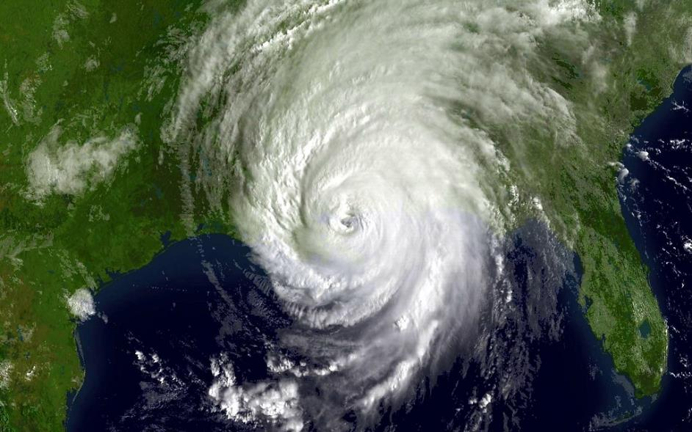
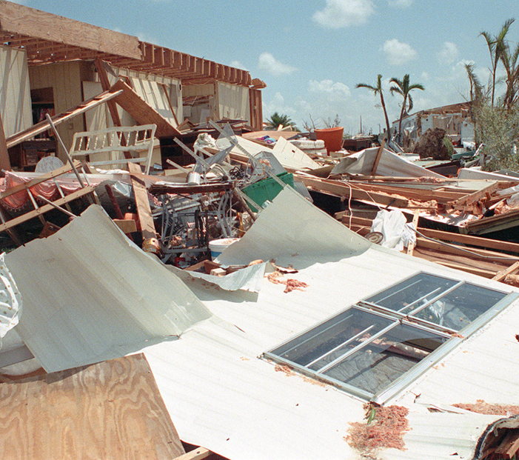
1980s – scientists were observing
Increasing numbers of severe storms
‘Hurricane Katrina shortly after landfall’ by NASA Goddard Space Flight Center is licensed under CC BY 2.0.
‘A view of destroyed buildings in the aftermath of Hurricane Andrew’ by Tucker D is licensed under PDM 1.0.
Notes:
1. Ask the students what the satellite image is. This is a hurricane – the northern hemisphere name for a cyclone.
2. The image on the right shows the damage caused by a hurricane
So here is one thing scientists were observing. This is the first part of the answer to Q1 (Student resource): What observations about the climate were scientists making in the 1980s that were causing them concern?

Slide 59
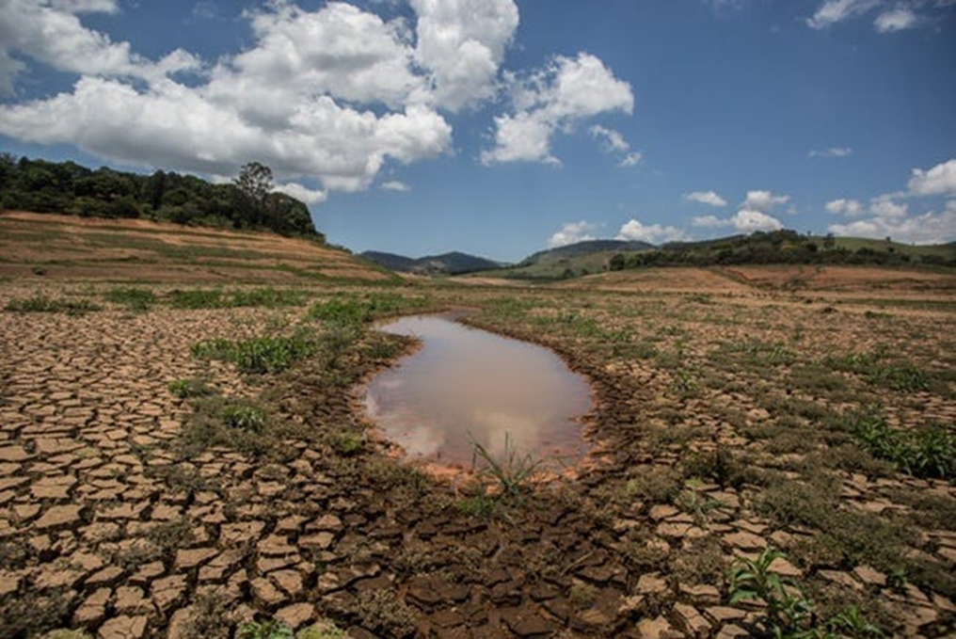
Lakes drying up
‘The end of La Nina‘ by Shread-Hewitt B is licensed under CC BY 4.0.
Notes:
They also observed that the many lakes that had always had water were drying up. ( second part of the answer to Q1 Student resource))

Slide 60
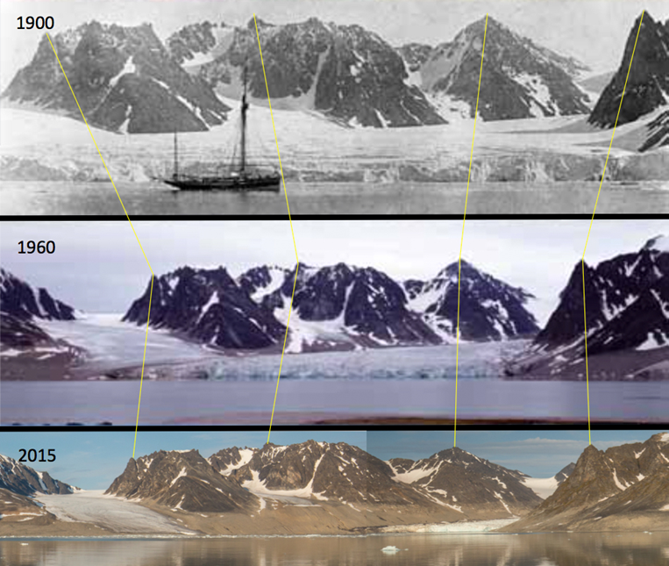
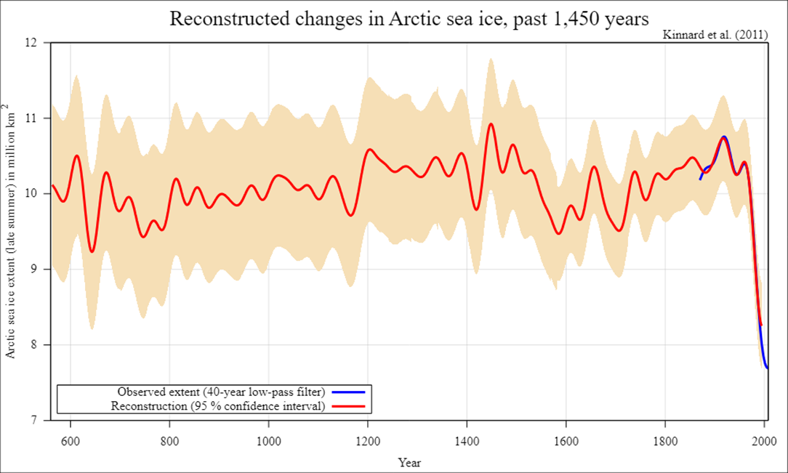
Glaciers and polar ice caps melting
‘Glacier decrease on Svalbard 1900-1960-2015’ by Weith A is licensed under
CC BY-SA 4.0.
‘Reconstructed changes in Arctic sea ice over the past 1450 years’ by DeWikiMan is licensed under
CC BY-SA 3.0.
What is the difference between the 2 types of observations shown here?
Notes:
Explain that the photos are taken of the same bay in Svalbard, an island in the Arctic. Ask students what change they can observe. In the photos, point out how the ice has retreated.
The graph shows the years from 600 to 2000 on the x-axis and the millions of square km of sea ice ( that is, ice floating on the sea) on the y-axis. What can you observe on the graph? The area of sea ice was around 10 million sq km until the last 50 years, and it has dropped to below 8 million sq km. That still sounds a lot, but it is actually a drop of 20% or 1/5.
So the scientists observed that glaciers and polar ice caps were melting. (third part of the answer for Q1 Student resource)
3. Pose the question: What is the difference between the two types of observation shown here? Guide students towards visual observations – qualitative observations and measured observations – quantitative observations. Are these showing similar trends?
What is the next step in the working scientifically process? Answer: Ask questions.
After observing all these changes, what questions would the scientists be asking?

Slide 61
What is happening
with the climate to
cause these changes?
Notes:
What was happening with the climate that caused these changes? ( the answer to Q2 student resource)
Referring to the Working scientifically flow chart, ask the students: “And to find this out, what would the scientists need to do?” Carry out some research

Slide 62
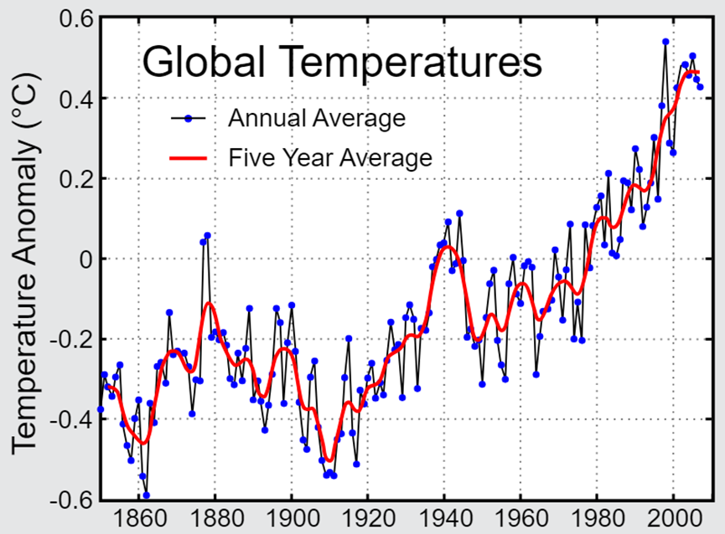
The scientists carried out some research about global temperatures
‘Instrumental temperature record’ by McInnes L and Rhode R is licensed under CC BY-SA 3.0.
Notes:
So, the scientists did some research and looked for more data. They looked at the global temperature records. This graph shows how much the average global temperature each year has varied from the average temperature from 1960 to 1990. The red line shows how much the 5-year average temperature differs from the 1960 to 1990 average.
Ask the students, “What is it showing overall?” Temperatures have been getting hotter. Many climate data were investigated.
Answer to Q3 What data did the scientists study? – they studied global temperature records.
Explain to students the difference between primary and secondary sourced data. This slide is an example of secondary data, where the information has been collected by meteorologists and used by a large number of other scientists in their investigations.

Slide 63
The scientists studied all these observations and tried to make a logical explanation about why the changes are happening.
Increasing incidence and severity of storms
Lakes drying up
Increasing global temperatures
Polar ice caps melting
Retreating glaciers
Notes:
They observed changes in the world and its climate and researched quantitative data showing that average global temperatures were increasing.
So, the next step in the Working scientifically process is? Make a prediction
Now, scientists know that carbon dioxide levels in the atmosphere can affect temperature (this is one reason why Venus is so hot), so they predicted that carbon dioxide levels may be connected to these increasing global temperatures. (answer to Q4 student resource)
What steps come after ‘predicting’ in our Working scientifically processes? Planning and conducting experiments followed by analysing data. Now this is where a secondary source investigation differs from a laboratory experiment. Instead of carrying out experiments, the scientists who were trying to find out why global temperatures were rising gathered data ( measurements) that many other scientists had made about carbon dioxide levels over many years.

Slide 64
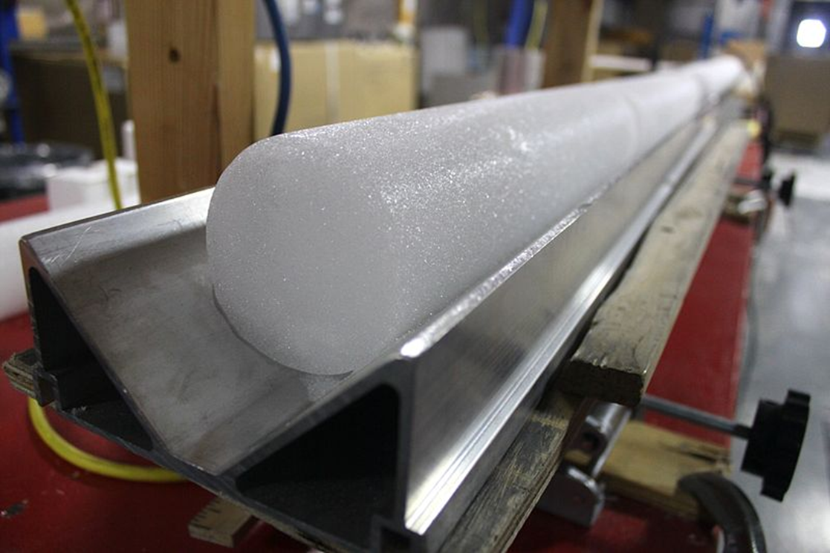
Ice core sampling
‘Antarctica WAIS Divide Field Camp 10’ by Duke E is licensed under CC BY-SA-2.0.
Notes:
Some scientists have been drilling into the ice in Antarctica and analysing the gases trapped in the ice. They measured the amount of carbon dioxide in the atmosphere when the snow had been packed down over thousands of years.
Answer to Q5 student resource: looked at data about carbon dioxide levels in the atmosphere over thousands of years.

Slide 65
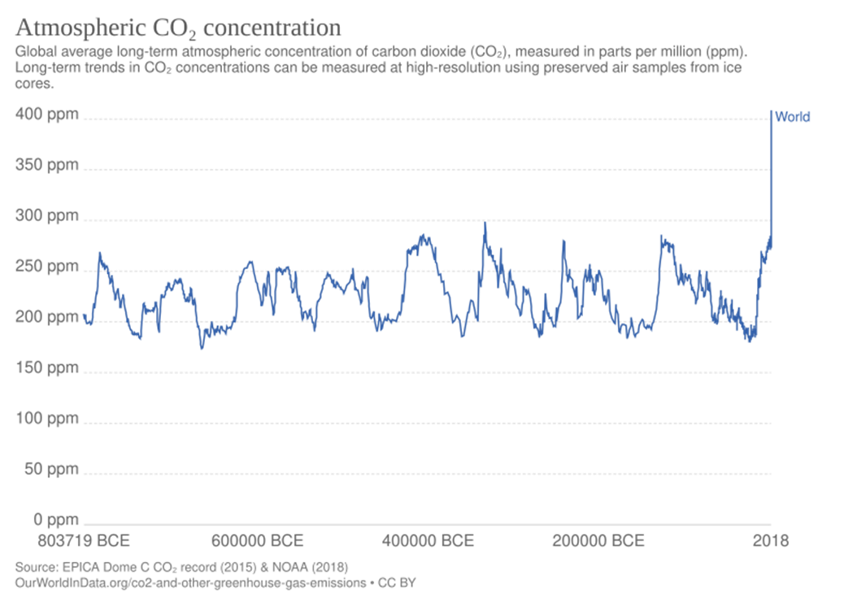
Atmospheric carbon dioxide concentration 803179 BCE to 2018
Notes:
And this is what the ice cores showed. Point out the axes – what they are measuring on the y-axis– carbon dioxide concentration – how much carbon dioxide is in the atmosphere; and what they changed on the x-axis – time. Explain BCE – before the common era – the time before year 1.
Ask students what the overall pattern or trend is shown in the graph. Over the 803,000 years, carbon dioxide levels have fluctuated (gone up and down) between 220 – 250 ppm roughly every 100,000 years. Recently, they have gone up to 400,000 ppm – almost double that. (answer to Q6 student resource).

Slide 66
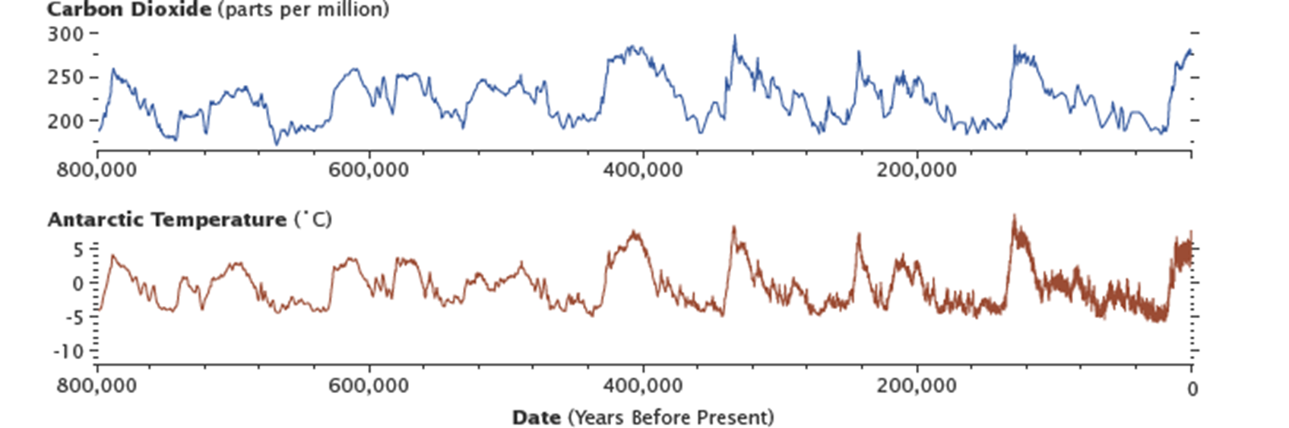
Carbon dioxide and Antarctic temperature
‘Epica CO2 temperature’ by Bveleski is licensed under CC BY-SA 4.0.
Notes:
So, the scientists analysed the carbon dioxide and temperature data. What can you see? The carbon dioxide and temperature graphs over 800,000 years go up and down together—when carbon dioxide rises, so does temperature, and when carbon dioxide falls, so does temperature.
The scientists now wanted to focus on the last few hundred years to see if this was different.

Slide 67
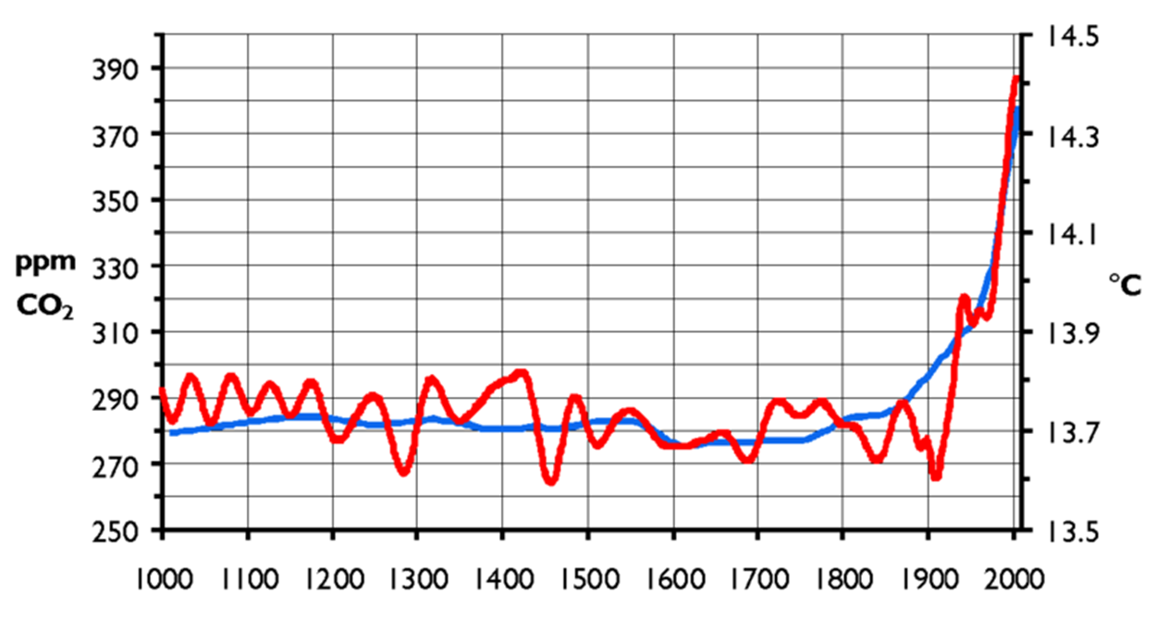
Carbon dioxide and temperature over last 1000 years
CO2 levels
temperature
‘CO2-Temp.png’ by Hanno is licensed under CC BY-SA 2.5.
Notes:
Here, we can see that they have combined the two sets of data about average global temperature and carbon dioxide levels for the last 1000 years. This is what it looks like. What does it show? Q7. Temperature and carbon dioxide levels had been fairly constant from the year 1000 to 1900. Since 1900, both carbon dioxide and temperature levels have risen significantly, much more than in the past.

Slide 68
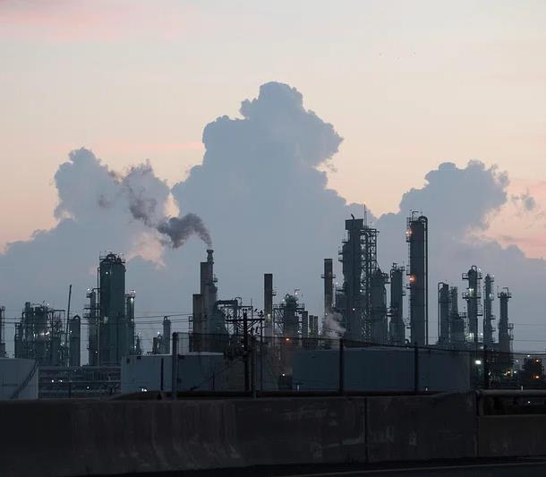
So now the scientists know what has happened…..
The Earth is getting warmer, and the carbon dioxide levels are increasing.
Why?
Power stations and the internal combustion engine in cars and trucks burn fossil fuels.
This releases carbon dioxide into the atmosphere.
‘U.S. Department of Agriculture disaster response efforts, and evidence of storm damage, in Texas, on September 19,2017’ by Cheung L is licensed under CC0 1.0.
Notes:
The numbers refer to the animation numbers
1. Scientists have found that the Earth is getting warmer, increasing carbon dioxide levels.
2. They now needed to investigate why these changes were happening. Prompt students to think about what has happened in the last few hundred years that have changed the levels of carbon dioxide in the atmosphere.
3&4. This provides the opportunity for ‘storytelling’ about the Industrial Revolution – the movement from an economy predominantly agricultural and handicrafts to one dominated by industry and machine manufacturing. It included new sources of power – coal, gas, electricity, the internal combustion engine and new means of transport. Students can now answer Q8. What significant change in the way we live has occurred over the last 200 years?
5. What do all these power stations and engines have in common? They all produce carbon dioxide. This has caused a large increase in the carbon dioxide levels in the atmosphere Answer to Q9
Lead a discussion about how scientists can use secondary data to perform investigations. Explain that the scientists cannot collect the temperature data firsthand in this investigation (because the time periods analysed are in the past, and the records go back hundreds of years).

Slide 69
Space science – from ancient ideas to modern understanding
Notes:
Content in this section aligns with essential question 2 in the program of learning and Teacher resource book 2.

Slide 70
2.1 Introducing Space science – What do you know?
Learning intention and success criteria
We are reviewing | I can
our understanding of the Universe. | describe the cause of day and night explain seasons on Earth identify the planets in our Solar System describe eclipses and phases of the Moon.

Slide 71
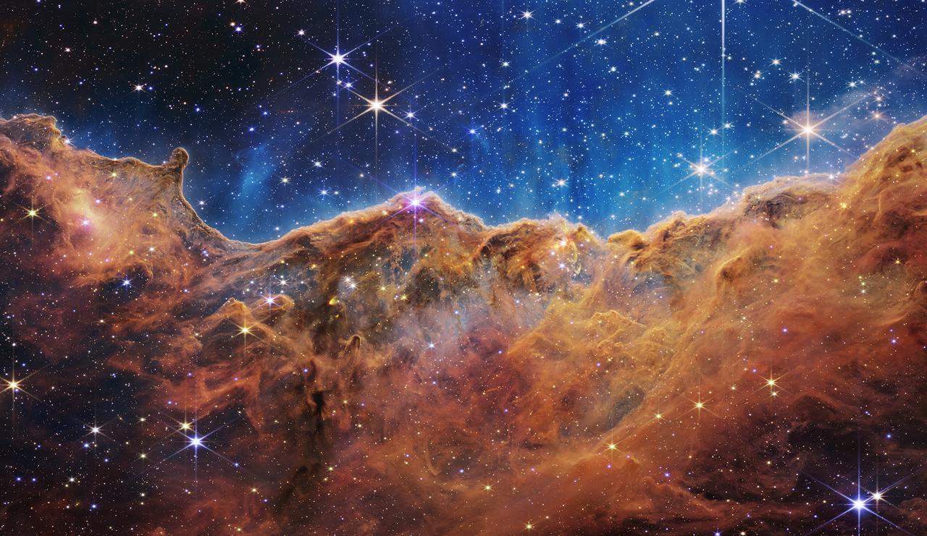
Cosmic Cliffs in Carina Nebula
‘Cosmic Cliffs in Carina Nebula’ by NASA is licensed under NASA's Images and Media policy.
Notes:
This image and the images on the following slides may be used to engage students in Space Science. Challenge your students to identify different types of celestial objects in the images. Encourage them to ask questions, make observations, and share their knowledge of space science.

Slide 72
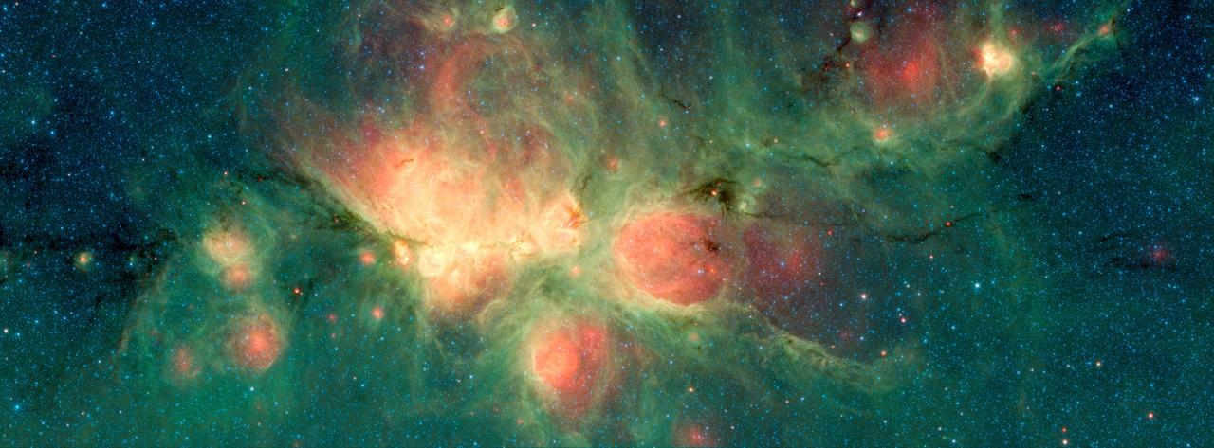
Cat’s Paw
‘Cat’s Paw’ by NASA is licensed under NASA's Images and Media policy.

Slide 73
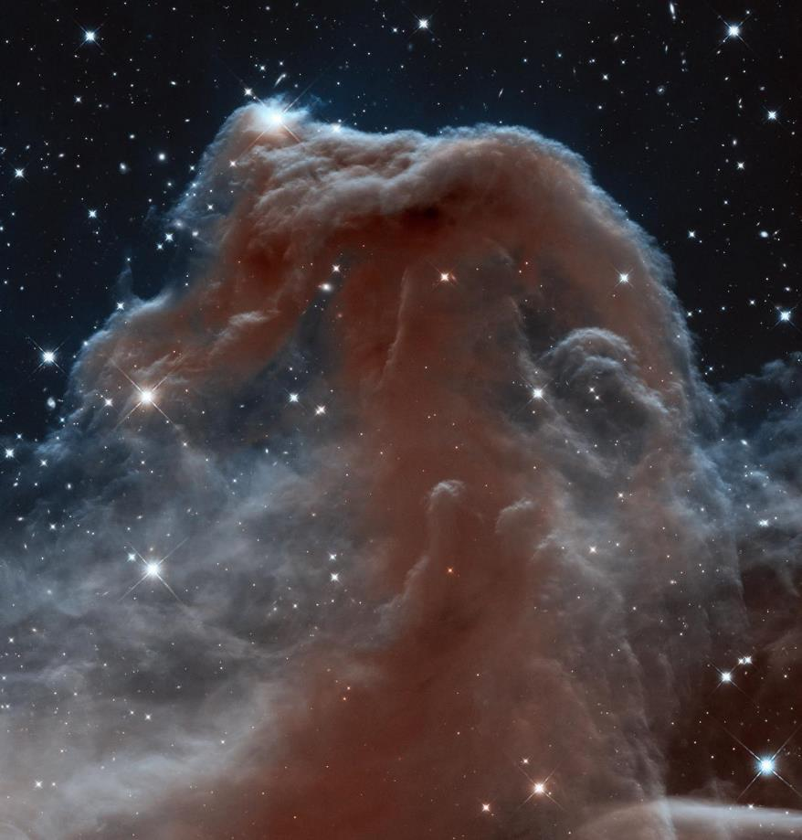
Horsehead nebula
‘Horsehead Nebula’ by NASA is licensed under NASA's Images and Media policy.

Slide 74
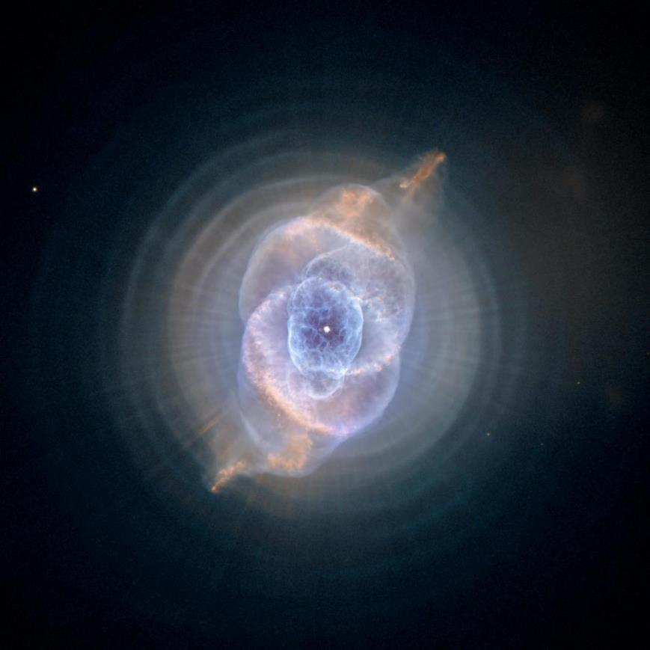
Dying Star Creates Fantasy-like Sculpture of Gas and Dust
‘Dying Star Creates Fantasy-like Sculpture of Gas and Dust’ by NASA is licensed under
NASA's Images and Media policy.

Slide 75
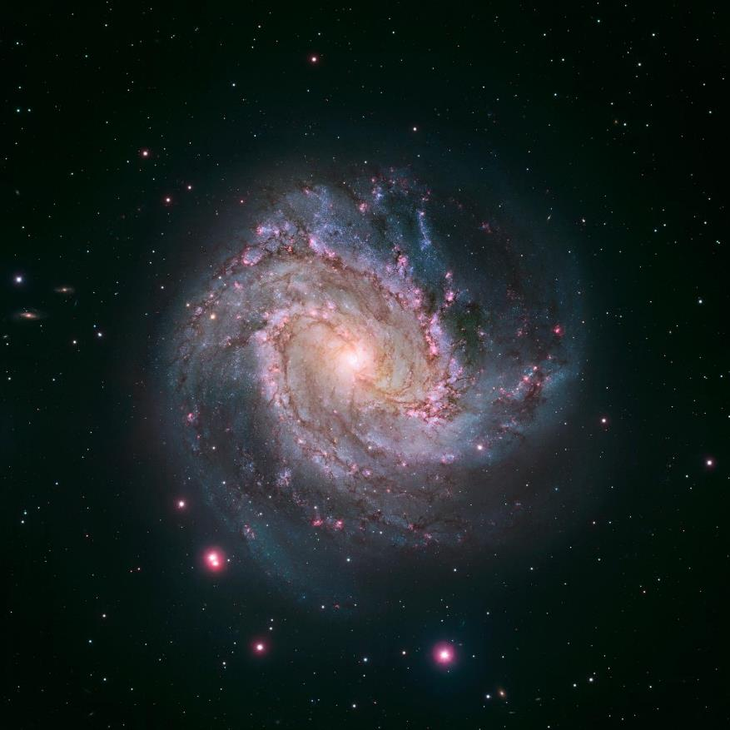
Spiral galaxy M83
‘Spiral galaxy M83’ by NASA is licensed under NASA's Images and Media policy.

Slide 76
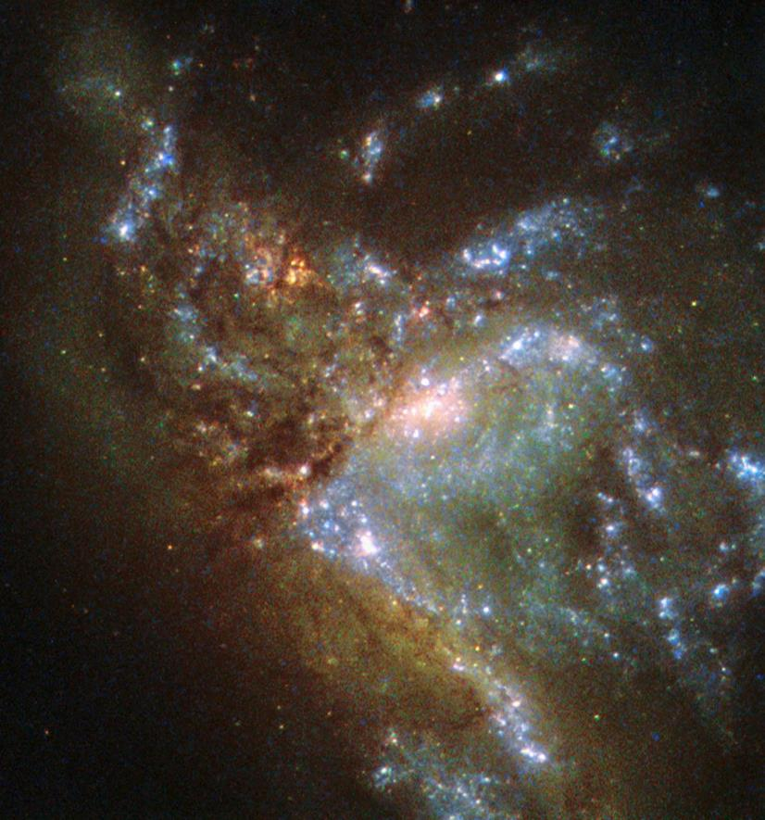
Hubble Views Two Galaxies Merging
‘Hubble Views Two Galaxies Merging’ by NASA is licensed under NASA's Images
and Media policy.

Slide 77
2.2 Trace space back to you
Learning intentions and success criteria
We are learning | I can
the benefits of research into space and the Universe | identify a range of items that have been developed or improved because of research into space exploration. make connections between advances in technology and their impact on my quality of life
to process and represent information. | find relevant information in multimedia resource.

Slide 78
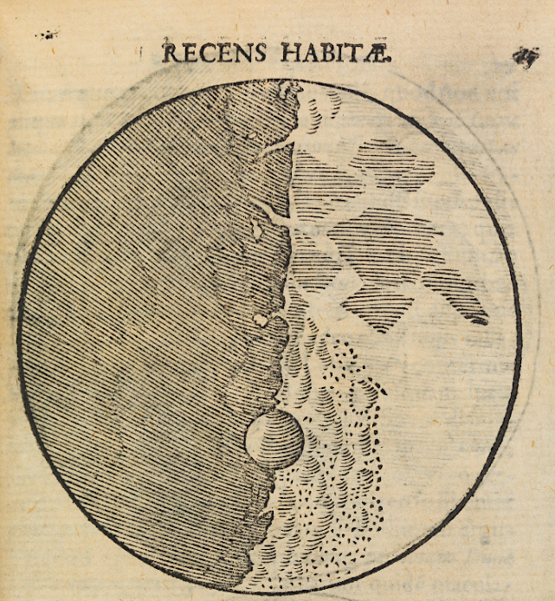
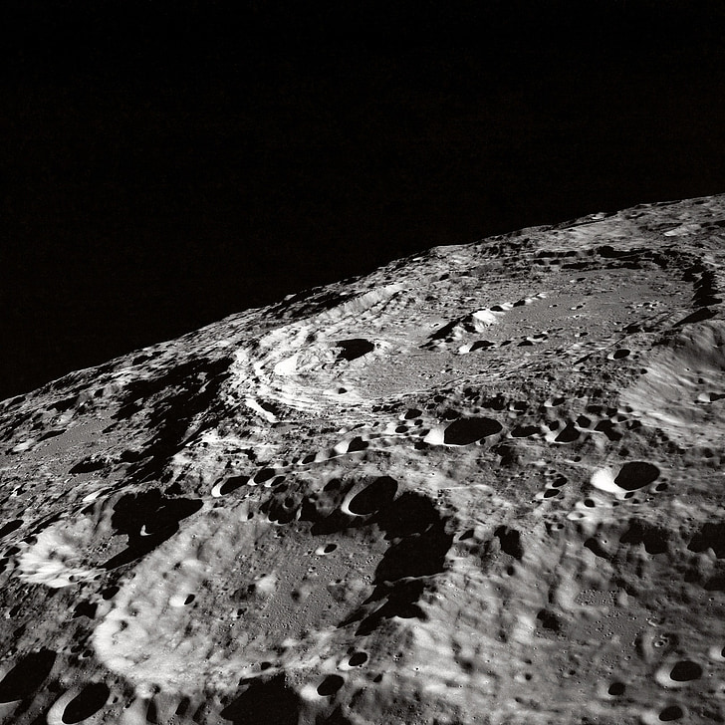
Images of the Moon
‘Galileo’s Map of the Moon’ by Welcome Images is licensed under CC-BY- 4.0.
‘Moon surface’ by Unknown Author is in the Public domain.
Notes:
Show the image of the moon as Galileo has drawn it.
Discuss the changes in understanding of the night sky. The Ancient Greeks thought the Celestial Sky was perfect. Galileo’s images showed that this was not the case. The Moon is not a perfect sphere; it has mountains on it. These were only visible with a telescope.
Display the modern image of the Moon’s surface. Discuss how changes in technology have changed our understanding. For example, limited detail is visible using the naked eye. Using a telescope adds information on the surface of the Moon, such as mountains. As technology improves, more details on the surface of the Moon are visible to us. Sampling of surface materials has also given us insight into the geology of the Moon’s surface. Physical samples have been assessed. This is costly and high-risk. New technology using the Lunar Orbiter Laser Altimeter (LOLA) USGS Releases First-Ever Comprehensive Geologic Map of the Moon | U.S. Geological Survey has created a comprehensive geological map of the Moon’s surface.

Slide 79
2.3 Unlocking the Universe
Learning intentions and success criteria
We are learning | I can
how recent advances in scientific tools used for observation have increased our knowledge of the Universe | explain how the JWST and SKAO has helped us learn about the Universe
to process and represent information. | skim a scientific text to get the general idea of the text scan a text to identify key points.

Slide 80
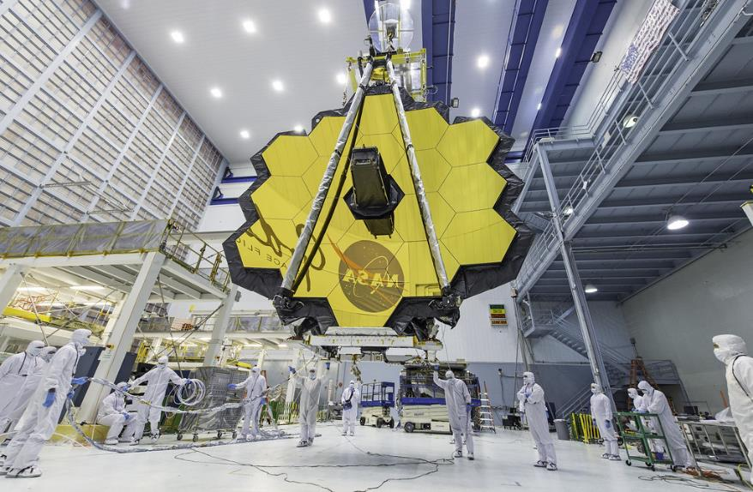
James Webb Space Telescope (JWST)
Open the NASA web page ‘What is the James Webb Space Telescope?’ and answer the questions below.
What is the James Webb Space Telescope?
List 4 tasks the JWST will be able to do.
What type of radiation does the JWST detect?
What is an exoplanet and why would we want to study the atmospheres of them?
‘James Webb Space Telescope mirror seen in full bloom’ by NASA and Stover D is licensed under CC BY 2.0.
Notes:
Sample answers and discussion information:
What is the James Webb Space Telescope?
It is the largest and most powerful space telescope ever built. It is as wide as a tennis court and as tall as a three-storey building.
Additional information: The JWST can see further than any telescope before it. It has a very large mirror composed of 18 hexagonal segments that help to reflect light. It is different from other space telescopes because it does not observe the universe with visible light; it uses infrared.
2. List 4 tasks the JWST will be able to do.
-Scientists can look at what the universe was like 200 million years after the Big Bang.
-Capture images of some of the first galaxies ever formed.
- Observe objects in our Solar System from Mars outwards.
-Look inside dust clouds to see where new planets and stars form.
-Examine the atmospheres of planets orbiting other stars.
3. What type of radiation does the JWST detect?
Infra-red
Additional information: The JWST sees in a different part of the electromagnetic spectrum to our eyes. We see visible light. However, the JWST sees infrared, just like a night vision security camera. Because JWST uses infrared light, it can see into dust clouds, so that we can see things that were previously hidden from view (think about the special cameras police use when looking for a suspect at night…there may be no visible light so that the suspect can be seen, but they can be seen with an infrared camera).
4. What are exoplanets, and why would we want to study their atmospheres?
An exoplanet is a planet orbiting another star. By studying their atmospheres’, we can find out if they hold the building blocks for life.
5. When was the JWST launched?
25th December 2021

Slide 81
2.4 What is at the centre of our Solar System?
Learning intentions and success criteria
We are learning | I can
how scientists use scientific models to increase our understanding of the Universe | explain how models are used in science to describe the Universe describe historical and current models of our solar system explain how and why models of the solar system have changed
to process and represent information. | summarise information from a variety of sources.

Slide 82
What can you say about the Sun?
Which of these statements are correct?
For each statement put an X in one column to show what you think.
 | I am sure this correct | I think this is correct | I think this is wrong | I am sure this is wrong
1. The Sun is a planet
2. The Sun is a star
3. The Sun is a huge ball of gas, and the gas is burning
Notes:
2 is correct; 1 and 3 are wrong
Question 2 labels the Sun as a star. This is important so that students can make the connection with the Sun and other stars in the sky.
The idea that the Sun is a planet is a common misunderstanding that can be challenged by comparing the Sun to planets and stars.
Thinking of the Sun as a burning ball of gas is common because this fits with our everyday experience. We also understand that air (O₂) is needed for combustion, and there is no air in space, so the Sun must get its heat and light from some other source.

Slide 83
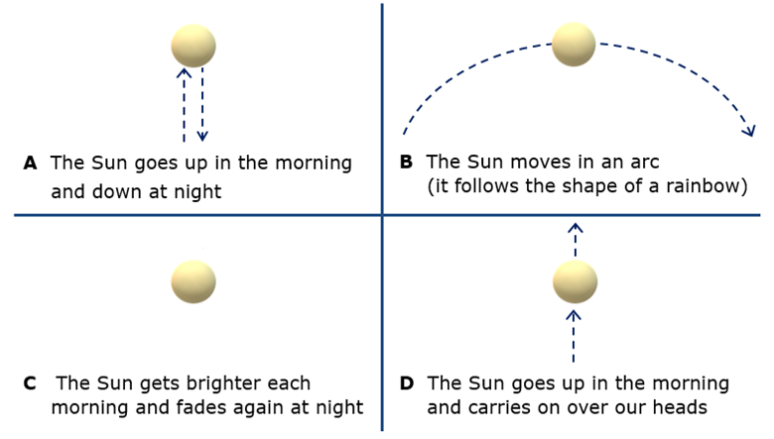
Changing Sun question 1
How does the Sun appear to change through a day?
This image is from ‘Big Idea: Earth in space’ by University of York Science Education Group and is licensed under CC BY-NC.
Notes:
Q1 Expected answer: B: The Sun moves in an arc. (NB: the arrow on the arc needs reversing if you live in the northern hemisphere. Answer D is sometimes correct if you live close to the Equator.)
A few students may hold the naïve understanding (C) that the Sun brightens and dims daily or is hidden by clouds or the Moon at night. Most will understand that the Sun appears to move in the sky and is closer to the ground in the early morning and late evening. A significant number of students will likely not be able to describe the Sun’s actual movement. It is common for students to think (wrongly) that the Sun is always directly overhead at midday.

Slide 84
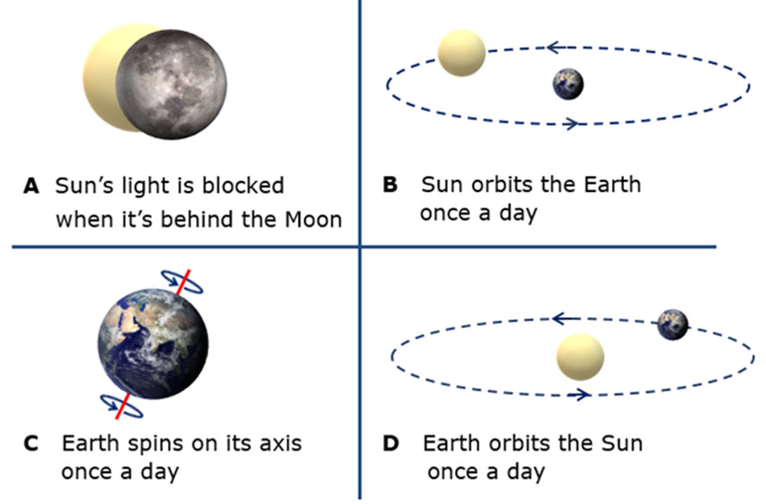
Changing Sun question 2
What is the best reason for your answer?
This image is from ‘Big Idea: Earth in space’ by University of York Science Education Group and is licensed under CC BY-NC.
Notes:
Q2 Correct answer: C: Earth spins on its axis once a day.
Answer D is a common response and partially fits the correct model of the Earth's rotation around the Sun.
Answer B shows a more egocentric view that fits with students’ observations that the Sun appears to move around the Earth and indeed makes perfect sense from the observer's point of view. Answer A is related to the false idea that the moon only appears in the sky during the nighttime.
All of these misunderstandings show persistence, perhaps because the scientific view is a more complex and less obvious explanation.
If students have misunderstandings about how the Sun appears to change throughout the day, it can help to model what happens. A simple strategy is to ask each student to stand up and turn slowly on the spot in a clockwise direction. While turning, they should point at a picture of the Sun at the front of the room. Through their spin, they will trace the movement of the Sun to show how it moves across their field of view.

Slide 85
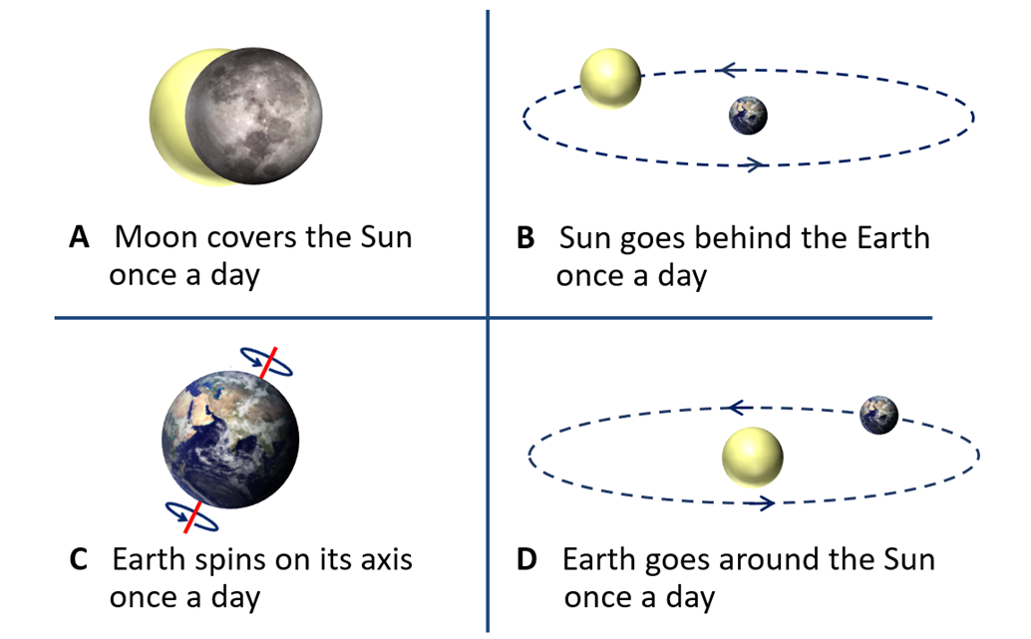
Night and day
Why do you think it gets dark at night?
This image is from ‘Big Idea: Earth in space’ by University of York Science Education Group and is licensed under CC BY-NC.
Notes:
C is the correct answer
Answer D is most common and partially fits with the correct model of the Earth going around the Sun.
Answer B shows a more egocentric view that fits with students’ observations that the Sun appears to move around the Earth and indeed makes perfect sense from the observer's point of view.
Answer A is related to the false idea that the moon only appears in the sky during the night-time.
All of these misunderstandings show persistence, perhaps because the scientific view is a more complex and less obvious explanation.
If students have misunderstandings about the cause of day and night, it can help to use a physical model to demonstrate how day and night are caused and to challenge their misunderstandings. To show day and night, illuminate a globe in a darkened room on one side with a strong light, such as an overhead projector. This will give a clear distinction between light and shade on the globe. A small piece of Blu-Tack placed on your location will show how day and night occur as the globe is spun on its axis (once per day). The correct direction to spin is anti-clockwise whilst looking down at the North Pole.

Slide 86
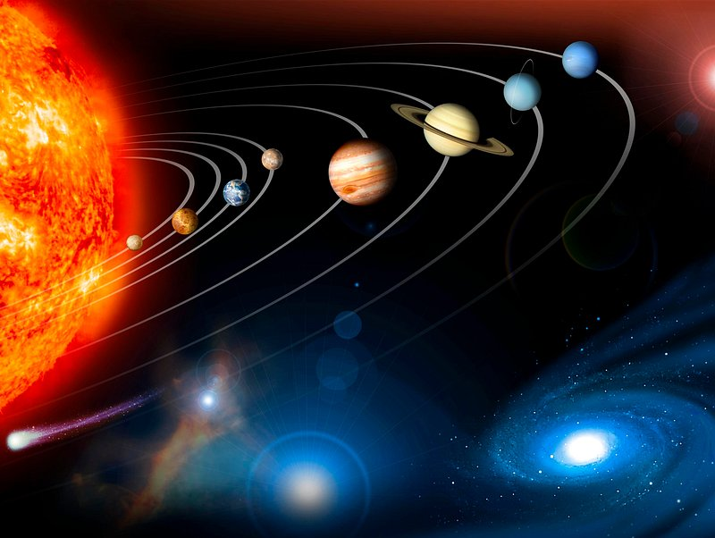
What do we think we know?
‘1500 years ago, everybody knew the Earth was the centre of the Universe. 500 years ago, everybody knew the Earth was flat… Imagine what you’ll know tomorrow.’
(Sonnenfeld 1997)
‘Planets’ by NASA is licensed under NASA's Images and Media policy.
Notes:
What does this quote mean?
How is it relevant to science?

Slide 87
2.5 The scale of the Solar System
Learning intention and success criteria
We are learning | I can
how scientists use scientific models to increase our understanding of the Universe. | use a model to describe objects in space explain some difficulties in describing the size and distance of objects in space explain what scale means when describing the size of Solar system models.

Slide 88
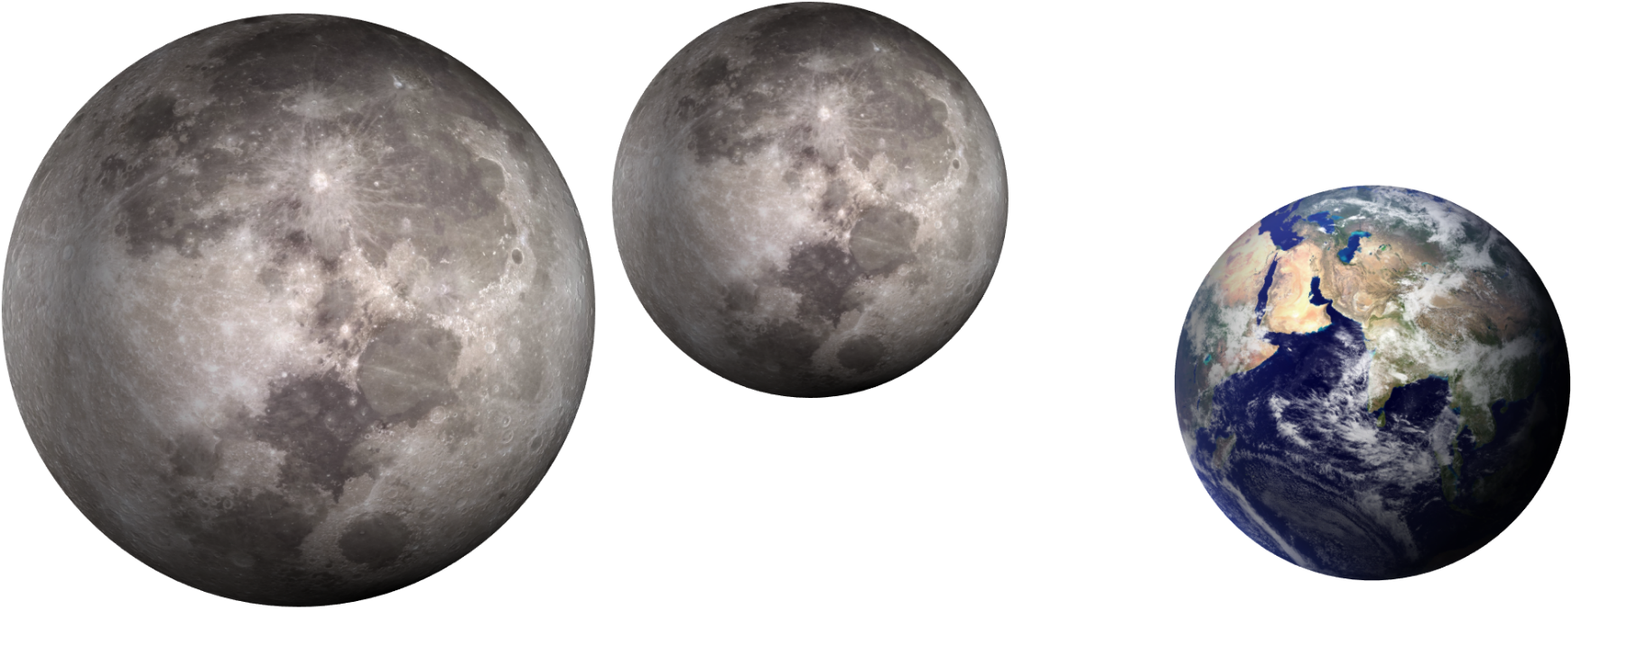
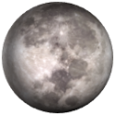
The size of space
How big is the Moon compared to the Earth?
a
b
c
d
This image is from ‘Big Idea: Earth in space’ by University of York Science Education Group and is licensed under CC BY-NC.
Notes:
This question can be used after the Earth vs. Moon activity to determine whether the students have understood the scale of size of the Moon and Earth. The correct answer is C. The Moon is approximately ¼ the diameter of the Earth.

Slide 89
2.6 Seasons
Learning intentions and success criteria
We are learning | I can
how scientists use scientific models to increase our understanding of the Universe | use models to make predictions and observations explain the relationship between the seasons and the positions of the Sun and the Earth
to process and represent information. | plot data accurately on a graph analyse data from various sources to identify patterns use a computer simulation to make accurate observations.

Slide 90
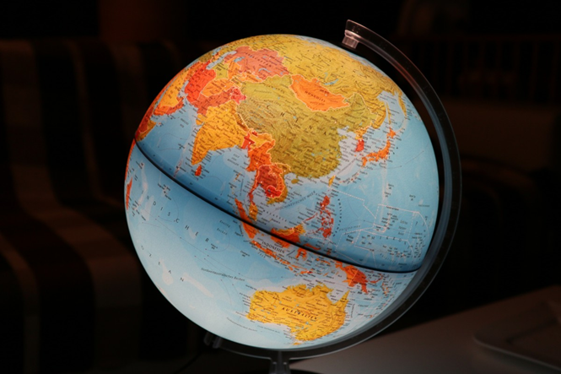
Changing seasons
Statement | I am sure this is correct | I think this is correct | I think this is wrong | I am sure this is wrong
1. The Sun is higher in the sky in summer
2. Days are longer in the summer
3. The Sun heats up more in the summer
4. It is summer in the northern hemisphere and the southern hemisphere at the same time
This image is from ‘Big Idea: Earth in space’ by University of York Science Education Group and is licensed under CC BY-NC.
Notes:
As with day and night students will come to Year 7 with a range of understandings ( and misunderstandings) of the seasons. You should use the diagnostic question about the seasons on this page to ascertain these before teaching the predictable and observable phenomena on Earth. Students should complete the confidence grid individually. This could be a pencil and paper exercise, or you could use an electronic ‘voting system’ or mini whiteboards and the PowerPoint presentation.
Expected answers
1, 2, and 3 are correct: The Sun is higher in the sky, the days are longer, and the Sun heats more strongly.
4 is wrong, because it is winter in the southern hemisphere when it is summer in the northern hemisphere, and vice-versa.
Students are likely to have different perceptions of seasonal change depending on their latitude. Students living at lower latitudes (in the northern parts of NSW) may not realise that day lengths change throughout the year, whereas this phenomenon will be more obvious for students living in more southern areas.
Students can often explain that higher temperatures in summer are caused by the Sun being higher in the sky or because the days are longer, but they do not explain the cause of these phenomena.
It is common for students to think that each season happens simultaneously across the Earth. This is likely to link with the misunderstanding that it is warmer in the summer because the Earth is closer to the Sun at that time
This question elicits observations about the changing seasons and investigates which ones students are aware of.
How to respond - what next?
If there is a range of answers, you may choose to respond through structured class discussion. Ask one student to explain why they gave the answer they did; ask another student to explain why they agree with them; ask another to explain why they disagree, and so on. This sort of discussion gives students the opportunity to explore their thinking and for you to understand their learning needs.
If students have misunderstandings about the phenomena we experience in summer, it can help them to use the internet to investigate the weather at different times of the year in different locations worldwide. Three locations away from the equator are recommended, with one in a different hemisphere from the other two. Students working in pairs or small groups will promote discussion and encourage the social construction of new ideas through dialogue.

Slide 91
Hot summer days
Why is it hotter in the summer?
Statement | I am sure this is correct | I think this is correct | I think this is wrong | I am sure this is wrong
Days are longer
The sun is hotter
The Earth is closer to the Sun
The Sun is higher in the sky
More radiation from the Sun reaches the Earth
This image is from ‘Big Idea: Earth in space’ by University of York Science Education Group and is licensed under CC BY-NC.
Notes:
It is suggested that this question be posed after students have learned about the seasons. Students should complete the confidence grid individually. This could be a pencil-and-paper exercise, or you could use an electronic ‘voting system’ or mini white boards and a PowerPoint presentation. ​
Expected answers​
Statements A, D and E are correct.​ B and C are wrong.​
Several factors combine to make the average temperature higher in summer, and they are all caused by the tilt of the Earth: days are longer so that the ground is heated for more time; and the Sun is higher in the sky, so its radiation is less spread out when it hits the ground, and it heats more strongly. Both of these contribute to more radiation from the Sun reaching each square metre of ground. An additional factor is that when the Sun appears higher in the sky, there is less atmosphere between it and the ground, so less of its radiation is scattered away from the surface. It may be helpful to introduce these ideas to extend understanding for some students. ​
If there is a range of answers, you may choose to respond through a structured class discussion. This method empowers you to guide the discussion, ask probing questions, and encourage students to explain their reasoning. It gives students the opportunity to explore their thinking and for you to really understand their learning needs. Students may choose statement B based on everyday experience. It is not the Sun itself that is hotter, but a combination of the above reasons, which explain why it feels hotter. ​
Answer C is a common misunderstanding that may persist.

Slide 92
2.7 Exploring the phases of the Moon
Learning intention and success criteria
We are learning | I can
how scientists use models to increase our understanding of the Universe. | describe the phases of the Moon explain why the phases of the Moon occur.

Slide 93
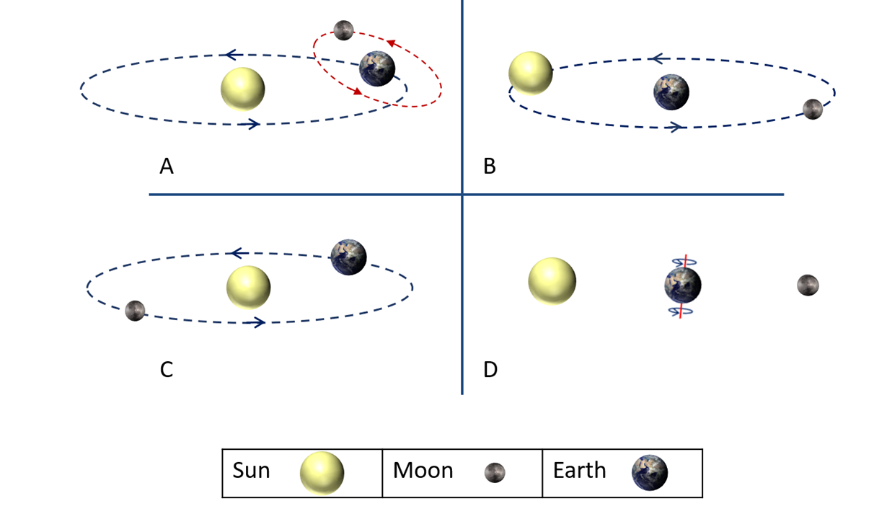
Sun, Moon and Earth
Which picture best shows how the Sun, Moon and Earth move?
This image is from ‘Big Idea: Earth in space’ by University of York Science Education Group and is licensed under CC BY-NC.
Notes:
Students need a clear understanding of the moon's movement with respect to the Earth to explain the predictable and observable phenomena on Earth. To ascertain students’ understanding from primary school, pose the questions on slides 10 and 11 before teaching about the phases of the Moon or eclipses. Students could use mini whiteboards to display their answers or set up a digital quiz, such as a Kahoot.
Model A is the correct answer. In this model, the Earth spins on its axis 365¼ times each time it orbits the Sun.
As their scientific understanding develops, students tend to move from Earth-centred to Sun-centred thinking. This is shown in the progression D – B – C - A.
All four models can explain day and night if it is assumed that the Earth can spin on its axis. With model D, explaining the changes that occur over a year is not possible.
With models B and C, it is possible to explain day and night and what happens during a year.
Answer A can also account for the changes in the shape of the Moon over a (lunar) month (of 28 days).
If students have misunderstandings about the Sun, Moon and Earth models, a physical model can help demonstrate how day and night are caused and challenge their misunderstandings.

Slide 94
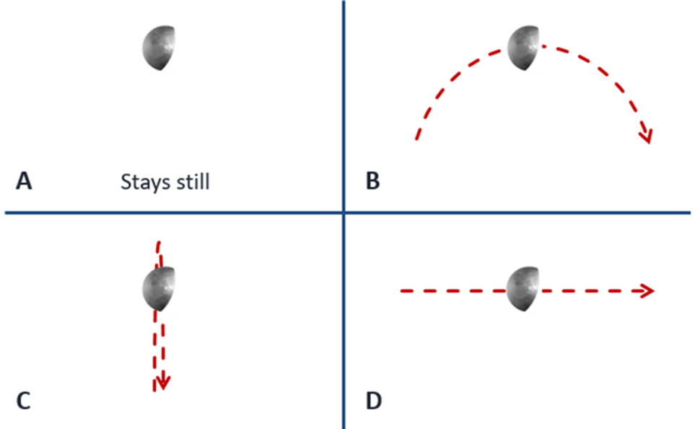
The movement of the Moon
What does the Moon do at night?
Q1
Q2
The Moon is always there and can be seen when it is dark.
The Earth spins on its axis once each day.
The Moon goes around the Earth once each day.
The Moon swaps places with the Sun
This image is from ‘Big Idea: Earth in space’ by University of York Science Education Group and is licensed under CC BY-NC.
Notes:
These questions identify what students know about the Moon's apparent movement during the night. Understanding that this apparent motion is caused by the spinning Earth rather than the Moon's movement supports an accurate understanding of the structure of space. The correct answer for both questions is B.
Students’ answers to question 2 will likely be based on their observations. Each wrong answer describes a part of the correct motion of the Moon across the sky, but the full picture is not readily observable because, at any one instance, the Moon appears still in the sky. (In the southern hemisphere, the Moon moves in an arc from right to left, in the Northern Hemisphere, from left to right)
For Q3, C and D indicate that students are using the wrong model of the Sun, Moon and Earth. Answer A suggests that they understand that the Moon can be in the sky during the day, but it also indicates that the students are likely to be using a model of the Sun orbiting the Earth and Moon once each day.

Slide 95
2.8 Eclipses
Learning intentions and success criteria
We are learning | I can
how scientists use scientific models to increase our understanding of the Universe | describe solar and lunar eclipses explain why eclipses occur
to communicate scientific concepts. | write an explanation using C-E-R.

Slide 96
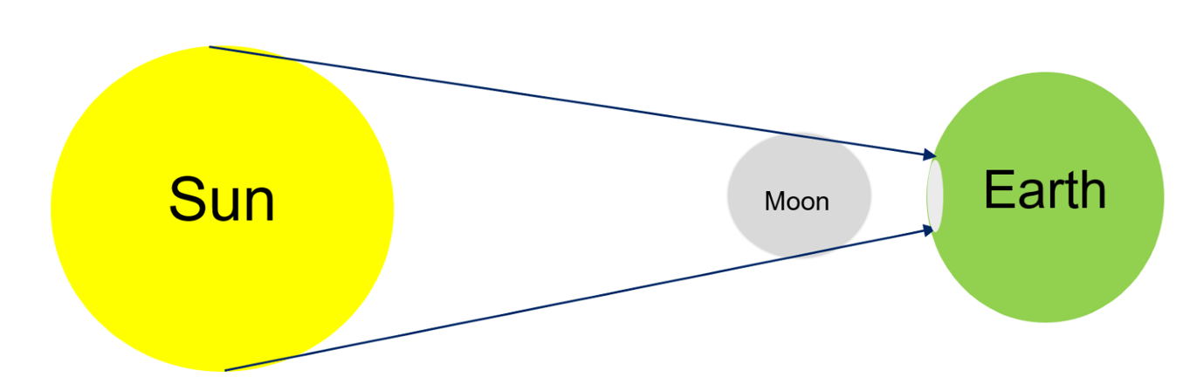
Solar eclipse diagram (not to scale)

Slide 97
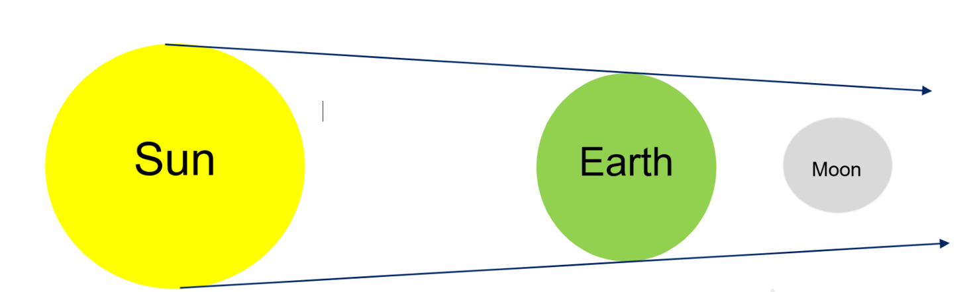
Lunar eclipse diagram (not to scale)

Slide 98
2.9 Tides
Learning intentions and success criteria
We are learning | I can
to process and represent information | extract information from videos, graphs and texts
to look for patterns in data. | explain the relationship between the orbit of the Moon and the tides explain the relationship between the phases of the Moon and tide height.

Slide 99

High and low tides

Slide 100
2.9 Tides – checkpoint
What is the main cause of tides on Earth?
The gravitational pull of the Moon and the Sun on the Earth's oceans.
The rotation of the Earth on its axis.
The Earth's distance from the Moon changing throughout the month.
Winds and ocean currents pushing the water back and forth.
Notes:
The correct answer is A.
Response B is incorrect because This answer is incorrect because the Earth's rotation affects the timing of the tides but not the cause.
Response C is incorrect because although the distance between the Earth and the Moon does vary slightly due to the Moon's elliptical orbit and has a small effect on tide height, it is not the primary cause of tides.
Response D is incorrect because winds and ocean currents can cause local variations in water movement (such as waves or surface currents), but they do not cause the rise and fall of sea levels associated with tides.

Slide 101
2.10 Aboriginal and Torres Strait Islander Peoples’ knowledge of the Moon and tides
Learning intention and success criteria
We are learning | I can
about how observations are used by Aboriginal and Torres Strait Islander Peoples to understand their environment. | explain how Aboriginal and Torres Strait Islander Peoples connected the phases of the Moon with the monthly variations in tides.

Slide 102


Reflection – word-phrase-sentence
Word
Write a word that captured your attention.
Phrase
Write a phrase that made you think.
Sentence
Write a sentence that captured the main idea.
Notes:
Word-phrase-sentence is a thinking routine from Harvard University Project Zero. Additional information on facilitating this activity can be found at https://pz.harvard.edu/sites/default/files/Word-Phrase-Sentence.pdf

Slide 103
2.11 How Aboriginal and Torres Strait Islander Peoples use stars to predict weather
Learning intentions and success criteria
We are learning | I can
about how observations are used by Aboriginal and Torres Strait Islander Peoples to understand their environment | explain how Aboriginal and Torres Strait Islander Peoples used the twinkling of stars to predict weather patterns
how scientists use models to increase understanding of the Universe. | use a model to show why stars twinkle.

Slide 104

Refraction in action
This work has been generated using BioRender.com. Any copyright subsisting in this work is owned by © State of New South Wales (Department of Education) 2024.
Notes:
Provide each group of students with a bowl of water. Direct students to half submerge a pencil half into the water at an angle. Ask them, ‘What do you notice about the pencil?’ It will appear bent or broken. Ask the students, ‘What do your legs look like when standing in water?’
Explain:
When light travels from one material (like air) into another (like water), the light appears to bend. This makes the pencil appear different. The same thing happens when you look at your legs when you are walking into a pool.
When starlight travels through the Earth’s atmosphere, it travels through air containing different amounts of water (humidity) and at different temperatures. This is the same as if the light goes through a bowl of water. Just like the pencil in the water appears to bend, the light from the stars changes as it moves through the atmosphere.

Slide 105
2.11 Word-Phrase-Sentence
Word
Write a word that captured your attention.
Phrase
Write a phrase that made you think.
Sentence
Write a sentence that captured the main idea.
Notes:
Word-phrase-sentence is a thinking routine from Harvard University Project Zero. Additional information on facilitating this activity can be found at https://pz.harvard.edu/sites/default/files/Word-Phrase-Sentence.pdf

Slide 106
2.12 Aboriginal and Torres Strait Islander Peoples’ sky stories
Learning intention and success criteria
We are learning | I can
about how observations are used by Aboriginal and Torres Strait Islander Peoples to understand their environment. | describe how Aboriginal people used the seasonal changes in the stars to inform them of seasonal changes on the ground and guide them in their hunting and gathering.

Slide 107
Aboriginal and Torres Strait Islander Peoples’ sky story traditions
Each group is to present a one-minute slide deck (maximum 3 slides).
Explain how the Aboriginal and Torres Strait Islander Peoples use their knowledge of the stars to inform them of seasonal changes in the weather or the correct time to hunt or gather a particular food source.
The slide deck should show an image of the star or star cluster and an image of the seasonal activity.

Slide 108
Sources of information
Author | Date published | Title | URL | Date accessed
Notes:
Instruct students to draw this table in their workbooks. Each source that they use to construct their presentation on Aboriginal and Torres Strait Islander Peoples’ sky stories should be recorded in this table.
Demonstrate with a website how students can look for this information.

Slide 109
Aboriginal and Torres Strait Islander Peoples’ sky story summary
Aboriginal and Torres Strait Island Peoples’ traditions link the position of the _________ at different times of the ________ to ___________ events on Earth. This allowed them to gather _________ and __________ at the ____________ and most _______________ time, and to prepare for seasonal _____________conditions.
Word bank: seasonal, year, food, weather, stars, fibre, productive, safest
Notes:
ANSWERS: Aboriginal and Torres Strait Island Peoples’ traditions link the position of the stars at different times of the year to seasonal events on Earth. This allowed them to gather food and fibre at the safest and most productive time and to prepare for seasonal weather conditions.

Slide 110
Templates and scaffolds

Slide 111
Connectives
Joining ideas |  | Ordering ideas | Location | Consequences
when | although | finally | in | so | instead
before | yet | frequently | on | therefore | however
while | once | after | beyond | in conclusion | whereas
for example | that | during | above | consequently | nevertheless
through | if | at first / firstly | opposite | as a result | besides
since | then | next | nearby | this results in | beside
where | next | meanwhile | here | because | with
later | always | simultaneously | under | when | due to
unless | eventually | in the meantime | below | this is why | in order to
until | now | before | there | so that | for this reason
additionally/ in addition | on the other hand | concurrently | behind | though | since
Notes:
This slide may be displayed to support students with their writing.
Connectives provide coherence, structure, and flow to the text. They help readers understand the relationship between ideas and guide them through the writer's arguments or narrative.

Slide 112
Evaluative language
effective | powerful | strong | pleasing | shocking
successful | reflective | worthwhile | sufficient | fantastic
clear | imaginative | beneficial | enough | great
skilful | challenging | acceptable | valid | vital
convincing | comprehensive | able | appropriate | incredible
engaging | valuable | average | adequate | efficient
suggest | relevant | suitable | competent | wonderful
emphasises | thorough | useful | powerful | inspiring
significant | noteworthy | exceptional | reliable | compelling
Notes:
This slide may be displayed to support students with their writing and help them identify the evaluative language used in a text.
Note: evaluative language is used to convey a judgement or assessment.

Slide 113
Claim-Evidence-Reasoning (C-E-R) scaffold
Claim
State an answer to the question or prompt.
Evidence
Provide reliable information from experiments, facts or a reliable source that supports the claim.
Reasoning
Explain how the evidence supports the claim.
Helpful hints
use key words and ideas from the question as you write your claim.
Sentence starters
In the experiment …
The data shows …
One piece of evidence is …
Sentence starters
The evidence supports the claim because …
Based on this evidence, it can be concluded that …
Your response
Your response
Your response
Notes:
This slide may be used to help students prepare an explanation or claim.
The slide provides a scaffold that the teacher may alter to add or remove support as needed, or sentence starters may be altered to better suit the activity.
Teachers may use the slide to model a response using a Think Aloud technique or during joint construction of responses.

Slide 114
Cornell note-taking
Cues | Notes
Summary
Notes:
This slide may be used to model or joint construction of notes.
Add keywords or questions in the ‘Cues’ column.
Add brief notes in the ‘Notes’ column.
Write a summary at the end.

Slide 115
10-minute timer
Time remaining
10
9
8
7
6
5
4
3
2
1
Time
is up
Notes:
This slide may be used as a countdown timer to show students how long they have to complete a task.
If a shorter time is required, you may select the appropriate starting point using the animation pane.

Slide 116
20-minute timer
Time remaining
10
9
8
7
6
5
4
3
2
1
Time
is up
20
19
18
17
16
15
14
13
12
11
Notes:
This slide may be used as a countdown timer to show students how long they have to complete a task.
If a shorter time is required, you may select the appropriate starting point using the animation pane.

Slide 117
Venn diagram
Object 1
Object 2
Features similar to both objects
Features of object 1
Features of object 2
Notes:
This is a Venn diagram template which can be used to identify similarities and differences between objects.

Slide 118
T-chart
Heading 1 | Heading 2
Notes:
This is a template for a T-chart. A T-chart is used to represent information. It is particularly useful when comparing and contrasting objects or providing advantages and disadvantages.

Slide 119
Frayer diagram
Definition
Facts or Characteristics
Word, term, concept
Examples
Non-examples
Notes:
Frayer diagrams are graphic organisers that help students develop or deepen awareness of unfamiliar concepts through defining the term and identifying examples and no- examples. They:
support educators with introducing new words or concepts in the classroom
activate students' prior knowledge of a topic and clarify potential misconceptions
model what deep understanding of a term entails.

Slide 120


Reflection
What did I learn today?
What connections have I made?
How will I use what I learnt?
Where can I apply my learning?
Notes:
This slide can be used to facilitate student self-reflection or as an exit ticket for any lesson. Adapt step 3 to suit the lesson and your context.

Slide 121
Reflection – Word-Phrase-Sentence
Word
Write a word that captured your attention.
Phrase
Write a phrase that made you think.
Sentence
Write a sentence that captured the main idea.
Notes:
Word-phrase-sentence is a thinking routine from Harvard University Project Zero. Additional information on facilitating this activity can be found at https://pz.harvard.edu/sites/default/files/Word-Phrase-Sentence.pdf

Slide 122
Think-Pair-Share
Think
Individual thinking time
Pair
Share your thoughts with a partner
Share
Share with a larger group or class
Notes:
Think-Pair-Share involves students thinking independently about a prompt or problem, pairing up and discussing their ideas with a classmate, and then sharing their combined knowledge with the class. It:
allows educators to change a traditional whole class discussion into a more manageable and inclusive activity where all students are given an opportunity to respond
promotes the development of students' speaking, listening and social skills

Slide 123
3-2-1 things I learned today
List 3 things you learned today:
3
1.
2.
3.
List 2 questions you have about these things:
2
1.
2.
Give 1 reason why it’s important to learn about these things:
1
1.
Notes:
3-2-1 things I learned today can be used as an exit ticket. It helps students reflect on what they have learnt in the lesson and provides feedback to the teacher on individuals progress.

Slide 124
References
This presentation contains NSW Curriculum and syllabus content. The NSW Curriculum is developed by the NSW Education Standards Authority. This content is prepared by NESA for and on behalf of the Crown in the right of the State of New South Wales. The material is protected by Crown copyright.
Please refer to the NESA Copyright Disclaimer for more information https://educationstandards.nsw.edu.au/wps/portal/nesa/mini-footer/copyright.
NESA holds the only official and up-to-date versions of the NSW Curriculum and syllabus documents. Please visit the NSW Education Standards Authority (NESA) website https://educationstandards.nsw.edu.au/wps/portal/nesa/home and the NSW Curriculum website https://curriculum.nsw.edu.au.
Science 7–10 Syllabus © NSW Education Standards Authority (NESA) for and on behalf of the Crown in right of the State of New South Wales, 2023.
AITSL (Australian Institute for Teaching and School Leadership Limited) (n.d.) Learning intentions and success criteria [PDF 251 KB], AITSL, accessed 31 July 2024.
University of York Science Education Group (n.d.) Earth in Space, Best Evidence Science Teaching, accessed 29 August 2024.
NOAA Global Monitoring Laboratory (2024) Trends in Atmospheric Carbon Dioxide (2024), Our World in Data website, accessed 29 August 2024.

Slide 125
Copyright
© State of New South Wales (Department of Education), 2024
The copyright material published in this resource is subject to the Copyright Act 1968 (Cth) and is owned by the NSW Department of Education or, where indicated, by a party other than the NSW Department of Education (third-party material).
Copyright material available in this resource and owned by the NSW Department of Education is licensed under a Creative Commons Attribution 4.0 International (CC BY 4.0) license.
This license allows you to share and adapt the material for any purpose, even commercially.
Attribution should be given to © State of New South Wales (Department of Education), 2024.
Material in this resource not available under a Creative Commons license:
the NSW Department of Education logo, other logos and trademark-protected material
Material owned by a third party that has been reproduced with permission. You will need to obtain permission from the third party to reuse its material.
Links to third-party material and websites
Please note that the provided (reading/viewing material/list/links/texts) are a suggestion only and implies no endorsement, by the New South Wales Department of Education, of any author, publisher, or book title. School principals and teachers are best placed to assess the suitability of resources that would complement the curriculum and reflect the needs and interests of their students.
If you use the links provided in this document to access a third-party’s website, you acknowledge that the terms of use, including licence terms set out on the third-party’s website apply to the use which may be made of the materials on that third-party website or where permitted by the Copyright Act 1968 (Cth). The department accepts no responsibility for content on third-party websites.

