Slide 1
Instructions for use
This resource is not a teaching and learning program. It should be used in conjunction with (Insert unit name and link).
Classroom teachers are encouraged to add and adapt slides as required to meet the needs of their students.
Save a copy of the file to make changes to the slide deck. Go to File > Download a Copy (this downloads a copy to the computer to edit in the PowerPoint app).
To convert the PowerPoint to Google Slides:
Upload the file into Google Drive and open it.
Go to File > Save as Google Slides.
(Note – conversion may cause formatting changes in the slides.)

Slide 2
Forces
Stage 4
Supporting PowerPoint
Notes:
Notes for teachers:
This PowerPoint supports the Forces teaching and learning program and the teacher resources books 1 and 2.

Slide 3
Contents – Essential question 1
1.6
Zap!
TRB 1
1.1
The forces around us
1.7
Hold me close
1.2
Use the force
1.8
Weigh up your options
1.3
Let's create a little friction
1.9
Is it attractive?
1.4
Force diagrams
1.10
Testing for attraction
1.5
Storing energy
1.11
Making magnets
Notes:
Notes for teachers:
Click lesson numbers to go to specific lessons.

Slide 4
Contents – Essential question 2
TRB 2
2.1
Simple machines around us
2.2
Investigating simple machines
2.3
Traditional knowledge of forces
2.4
Solving problems with machines
Notes:
Notes for teachers:
Click lesson numbers to go to specific lessons

Slide 5
Essential question 1
How do forces influence the motion of objects?
Notes:
Notes for teachers:
Content in this section aligns with essential question 1 in the program of learning and Teacher resource book 1

Slide 6
1.1 The forces around us
Learning intentions and success criteria
We are learning | I can
about the effects of forces in everyday situations. | identify how forces act on an object describe the result of forces acting on an object explain the difference between direct and indirect forces, using examples.
Notes:
Notes for teachers:
For more information, see ⁠AITSL or the NSW Department of Education explicit teaching strategies, ⁠Sharing learning intentions and ⁠Sharing success criteria
LISC is not necessarily presented at the beginning of the lesson. The teacher must consider the most effective time in the lesson cycle to introduce them.
LISC should be revisited during the lesson to support students' evaluation of their learning

Slide 7
1.1 Force examples
 | Forces involved
Walking | There is a push/pull between the soles of your feet and the ground when taking each step. Friction provides the traction to move, and gravity holds you to the surface.
Notes:
Notes for teachers:
Prompt students to consider activities such as walking, squashing, modelling clay, and playing ball sports to identify the forces involved. Discuss how the application of forces achieves the movement or change of shape. Sample responses have been provided in TRB1.

Slide 8
1.1 Force types
Force type and definition | Examples
Direct – requiring physical contact between objects.
Indirect – not requiring physical contact. The force is applied through a field
Notes:
Notes for teachers:
Discuss the difference between direct (contact) and indirect (non–contact) forces. Students categorise the forces from the activities on the previous slide and record them in a table. A table is provided in the Student resource – the force around us. Sample responses have been provided in TRB1.

Slide 9
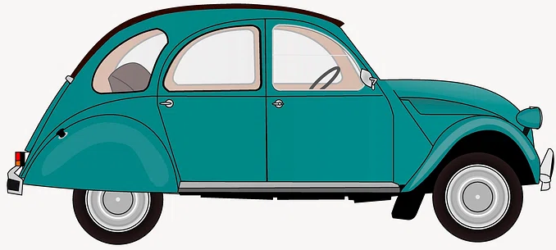
1.1 Forces on a car (1)
Normal force
Weight
The car is stationary – the forces are balanced
‘Green classic car illustration’ by Rawpixel is licensed under CC0.
Notes:
Notes for teachers:
Other sources of friction are ignored in this simplified diagram.
Explain, using the diagram, that forces can be drawn using arrows.
The base of the arrow is on the object experiencing the force
The direction of the arrow shows the direction of the force
Longer arrows show larger forces; shorter arrows show smaller forces.
The forces on this car are balanced, the car remains stationary. The weight force and the normal force are balanced, this is because they are equal (in magnitude) and opposite (in direction).
Describe the ‘normal force’ as a contact force that acts perpendicular to the contact surface between two objects. The normal force is usually represented in force diagrams as a force vector arrow perpendicular to the surface. For an object resting on a horizontal surface, like this car, the normal force balances the downward force of gravity (the weight force), preventing the object from falling through its surface.

Slide 10
1.1 Forces on a car (2)
Normal force
Applied force
Weight
The car is speeding up – the forces are unbalanced
‘Green classic car illustration’ by Rawpixel is licensed under CC0.
Notes:
Notes for teachers:
Other sources of friction are ignored in this simplified diagram.
The forces in this diagram of the car are unbalanced. The car is speeding up. There is now an unbalanced force because the applied force points to the right. The normal and weight forces are balanced, keeping the car on the ground.

Slide 11
1.1 Forces on a car (3)
Normal force
Air resistance
Applied force
Weight
The car is moving at a constant speed – the forces are balanced
‘Green classic car illustration’ by Rawpixel is licensed under CC0.
Notes:
Notes for teachers:
Other sources of friction are ignored in this simplified diagram.
The forces in this diagram are balanced as the car moves at a constant speed.
Arrows of the same size represent the air resistance and the applied force because the forces are balanced.
If the applied force arrow were larger, the car would speed up.
If the air resistance arrow were larger, the car would slow down.

Slide 12
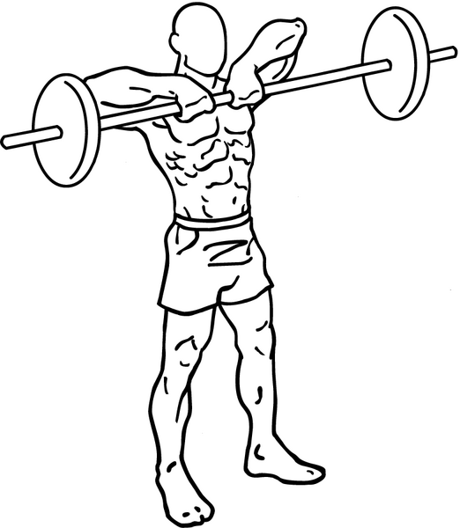
1.1 Forces on a weightlifter
Time 1
The forces are balanced – the barbell is being held steady at the athlete's chest.
Time 2
The forces are unbalanced – The barbell begins moving upwards
Applied force
Applied force
Weight
Weight
Everkinetic, Barbell-upright-rows-1, CC BY-SA 3.0
Notes:
Notes for teachers:
This slide has animations.
The applied force from the athlete in Time 1 is the same as the weight force – the barbell loaded with plates is being held steady. Notice that the arrows are drawn the same size. This is because the forces are balanced.
*CLICK*
Do you think the forces in Time 2 are balanced? (students should answer 'no' because the opposing arrows are not the same size). The forces are not balanced. Which direction do you think the barbell with plates is moving? (Students should answer ‘up’). The barbell begins moving upwards because the applied force is larger than the weight force.

Slide 13
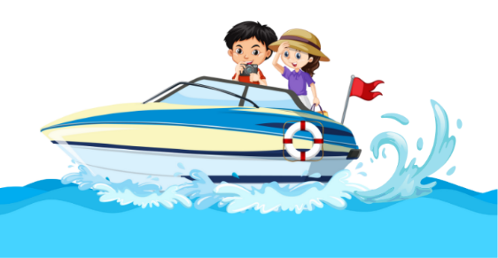
1.1 Forces on a boat
A boat is speeding up
Normal force
Applied force (from the motor)
Drag (from the air and the water)
Weight
The boat is speeding up (accelerating), because the forces are unbalanced.
Notes:
Notes for teachers:
This slide has animations.
In this scenario the boat is accelerating or speeding up. This means that the applied force must be larger than the opposing drag force from the water and the air. Normal force pushes up on the boat stopping it from sinking further into the water (this is also called buoyancy).

Slide 14
1.1 Forces on a skydiver
A sky diver has deployed their parachute and is descending to ground at a constant speed.
The sky diver is travelling at constant speed, because the forces are balanced
Air resistance
Gravitational force (weight)
Notes:
Notes for teachers:
This slide has animations.
A sky diver has deployed their parachute and is descending to the ground at constant speed. Air resistance is maximised using the parachute which traps air, this allows the sky diver to slow down the speed compared to having no parachute, allowing them to land safely. Because this scenario states the sky diver is travelling at CONSTANT speed, the forces must be balanced.

Slide 15
1.2 Use the force
Learning intentions and success criteria
We are learning | I can
about the effects of forces in everyday situations | accurately use tools to measure forces compare different forces on objects quantitatively
to use data to solve problems about forces. | record data accurately in a table compare the range and mean of data sets.
Notes:
Notes for teachers:
For more information See ⁠AITSL or the NSW Department of Education explicit teaching strategies, ⁠Sharing learning intentions and ⁠Sharing success criteria
LISC is not necessarily presented at the beginning of the lesson. Teacher needs to consider most effectual time to introduce
LISC should be revisited during the lesson to support students' evaluation of their learning

Slide 16
1.2 Checkpoint
Quick quiz to activate learning from prior lessons
Everybody – What is a force?
Mini-challenge – Identify examples of direct and indirect forces.
Super challenge – Qualitatively describe the forces on a moving car.
Notes:
Notes for teachers:
Everybody (E): What is a force?
Sample response:
A force is a push or pull between objects, which may cause one or both objects to change speed, and/or direction of their motion, and/or their shape.
Mini-challenge (MC): Identify examples of direct and indirect forces.
Sample response:
Direct forces are forces that occur when objects are physically touching each other. Examples include:
Friction: The force that resists the motion of one surface sliding over another.
Push: Opening the classroom door to enter the classroom.
Pull: Taking out your chair from under the desk so you can sit down.
Indirect forces act on objects without physical contact. Examples include:
Gravity: The force of attraction that objects with mass exert on each other.
Magnetic force: The force between magnets or magnetic materials when they attract or repel each other.
Super challenge (SC): Qualitatively describe the forces on a moving car.
Sample response:
When a car is moving, several forces are acting on it:
Driving force (or thrust): This is provided by the car's engine, pushing it forward.
Friction: The friction between the car's tyres and the road surface helps the car move forward and also allows it to stop when the brakes are applied.
Air resistance (or drag): This is the force of the air pushing against the car, trying to slow it down.
Gravity: This pulls the car towards the Earth.
Normal force: This is the force the ground exerts to support the car and counteract gravity.
These forces work together to determine how the car moves. For example, the car will speed up if the driving force is greater than the road friction and air resistance, and it will slow down if the friction and air resistance are greater.

Slide 17
1.3 Let’s create a little friction
Learning intentions and success criteria
We are learning | I can
about the effects of forces in everyday situations | measure dynamic friction in a range of situations describe examples of positive and negative impacts of frictional forces describe how to increase or decrease frictional forces where required
to use data to solve problems about forces. | accurately collect data and produce an appropriate column graph identify the cause-and-effect relationship of friction as a force for multiple examples.
Notes:
Notes for teachers:
For more information See ⁠AITSL or the NSW Department of Education explicit teaching strategies, ⁠Sharing learning intentions and ⁠Sharing success criteria
LISC is not necessarily presented at the beginning of the lesson. Teacher needs to consider most effectual time to introduce
LISC should be revisited during the lesson to support students' evaluation of their learning

Slide 18
1.3 Checkpoint
Quick quiz to activate learning from prior lessons
Everybody – How do you calculate the mean of a set of numbers?
Mini-challenge – How do we quantitatively measure force? What instrument can we use to do this?
Super challenge – In science, tables are used to record and organise data. What are the main features of a scientific table?
Notes:
Notes for teachers:
Quick quiz to activate learning from the previous lesson.
E: How do you calculate the mean of a set of numbers?
Answer: Add up all the numbers in the set and divide the sum by the total number of measiurements in the set.
MC: How do we quantitatively measure force? What instrument can we use to do this?
Answer: Force is quantitatively measured in Newtons (N). A force meter or a spring balance is the instrument used to measure force. It measures the amount of force applied to an object, often by how much it stretches a spring.
SC: In science, tables are used to record and organise data. What are the main features of a scientific table?
Answer: A scientific table should include the following features:
Title: A clear title that describes what the data in the table represents.
Column and Row Headings: Descriptive headings for each column and row to indicate what data is being recorded (e.g., time, temperature, trial number).
Units of Measurement: Indicate the units of measurement for each variable (e.g., Newtons). Units of measurement should appear in the column heading and not in the table’s body.

Slide 19
1.3 Forces Predict, Observe, Explain (POE)
Topic – Forces
Concept – Friction simulation
Predict
Observe
Explain
[insert prediction/s and reasoning]
[insert observation/s]
[insert explanation]
Notes:
Notes for teachers:
Use this slide when conducting the friction simulation outlined in TRB1
The Predict–Observe–Explain is most commonly used in an investigation or experiment.
Use this template to record responses in the editable text boxes.
Predict (Before an experiment or investigation): What do you think will happen? Why do you think that will happen?
Observe (During) What actually happened? Was it different from your prediction?
Explain (After): Why did that happen? Discuss responses.

Slide 20
1.3 Surface friction investigation
A spring balance measuring the dynamic friction of the surface material being tested
This work has been generated using Chemix.
Notes:
Notes for teachers:
A force equal and opposite to the friction force must be applied to sustain constant motion along a surface. Keep the spring balance parallel with the surface to accurately measure the force. The spring balance must be kept parallel with the surface to measure the force accurately.

Slide 21
1.4 Force diagrams
Learning intentions and success criteria
We are learning | I can
about the effects of forces in everyday situations | identify the different forces acting on a range of objects identify if a net force is balanced or unbalanced
to use data to solve problems about forces. | analyse a force diagram to determine the net force draw force diagrams representing a range of situations analyse and predict any changes to the motion of an object from a force diagram.
Notes:
Notes for teachers:
For more information See ⁠AITSL or the NSW Department of Education explicit teaching strategies, ⁠Sharing learning intentions and ⁠Sharing success criteria
LISC is not necessarily presented at the beginning of the lesson. Teacher needs to consider most effectual time to introduce
LISC should be revisited during the lesson to support students' evaluation of their learning

Slide 22
1.4 Checkpoint
Quick quiz to activate learning from prior lessons
Everybody – What is friction, and how does it affect the movement of objects?
Mini-challenge – Give examples of how you can increase and decrease friction.
Super challenge – When comparing friction on different surfaces, what considerations must you make to ensure it is a fair test?
Notes:
Notes for teachers:
Sample answers:
E: What is friction, and how does it affect the movement of objects?
Answer: Friction is a direct force that occurs when two surfaces come into contact and move against each other. It resists the motion of objects.
MC: Give examples of how you can increase and decrease friction.
Answer: Increase Friction:
Rough surfaces: Adding texture or roughness to surfaces (e.g., using sandpaper on a ramp).
More weight: Adding weight to an object to press the surfaces together more firmly.
Decrease Friction:
Smooth surfaces: Making surfaces smoother (e.g., polishing or lubricating them).
Lubricants: Applying oil, grease, or other lubricants reduces contact between surfaces.
SC: When comparing friction on different surfaces, what considerations must you make to ensure it is a fair test?
Answer: Use the same object for testing on different surfaces, apply the same force to the object, ensure all surfaces are level (or on the same incline), and use the same spring balance.

Slide 23
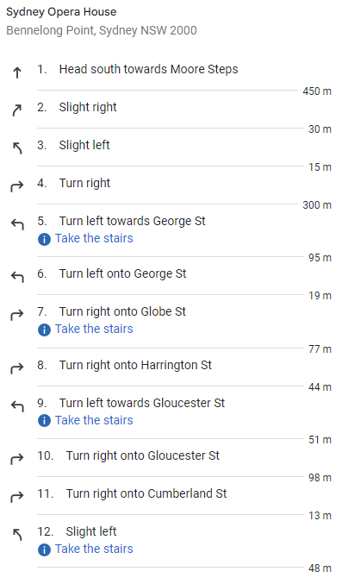
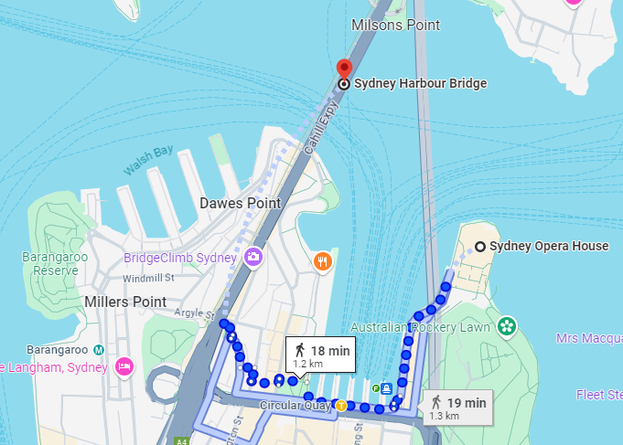
1.4 Scaled diagrams
A Google Maps example
Notes:
Teacher notes:
This slide goes with the prior learning activity in TRB1.
Highlight how the direction and magnitude are outlined in the instructions and how they are critical to effectively communicating information on how to get from the Sydney Opera House to the Sydney Harbour Bridge.
These instructions provide the clearest possible communication of complex information to ensure clarity for the end user.
Students brainstorm and discuss other applications of scaled diagrams to communicate potentially complex information, for example, house plans, star maps, anatomical diagrams, parts of a car, and road maps.

Slide 24
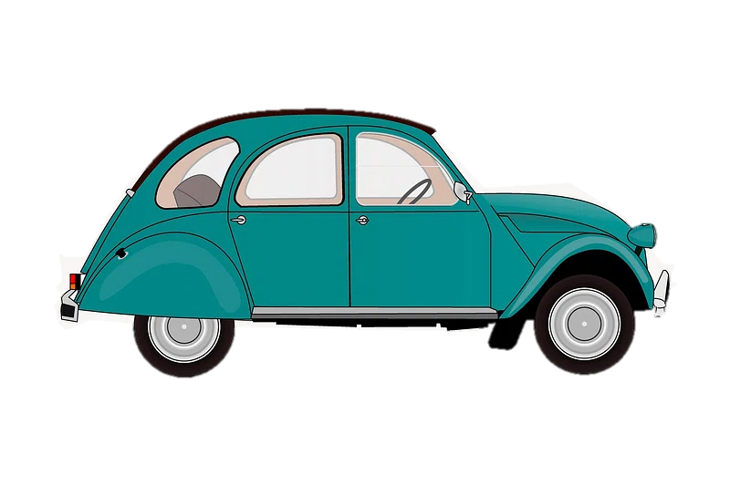
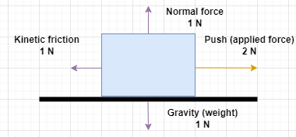
1.4 Forces on a car
The car is accelerating to the right.
Normal force
Air resistance
Applied force
This work has been generated in draw.io online.
Weight
‘Green classic car illustration’ by Rawpixel is licensed under CC0.
Notes:
Notes for teachers:
This slide has animations.
The toy car on the left represents a toy car and the forces acting on it.
Now, we are moving to drawing free-body diagrams. Let us assume that the car is a toy that has a mass of 102 g (which equates to 1 N of weight force). We will represent the car using a square.
The normal force is equivalent to the gravity in this scenario.
Notice that the arrows are of equal size for the gravity (weight) force and the normal force. The arrow for the applied force is twice the length of the kinetic friction.
**CLICK**
The free-body diagram on the right shows the forces' direction and scaled magnitude.
We know the car accelerates to the right because the applied force is greater than the opposing force (Kinetic friction).What would the force diagram look like if the car was travelling at a constant speed?

Slide 25
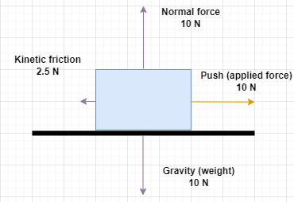
1.4 Force diagrams (1 of 2)
A block being pushed showing the forces acting on it
This work has been generated in draw.io online.
Notes:
Notes for teachers:
Force diagrams can be used to demonstrate how net force is calculated. Students could then create their own for other moving objects.
This diagram represents a free-body diagram of a block being pushed across a flat surface.
Identifying the forces:
The downward arrow represents weight due to the force of gravity acting on the block. This force is always directed to the centre of Earth.
The upward arrow represents the normal forces. It balances the weight of the block, indicating that there is no vertical movement (up away from the table or down through it).
The arrow pointing to the right shows us that an external force is being applied to push the block to the right.
The arrow pointing left shows kinetic friction opposing the block's motion.
Net force analysis
In the vertical direction, the normal force and gravity are balanced because they are both 10 N.
In the horizontal direction, the applied force is 10 N, and the kinetic friction is 2.5 N, so these forces are unbalanced.
The net horizontal force is 10 N – 2.5 N = 7.5 N.
Since there is a net force, the bloc accelerates to the right.

Slide 26
1.4 Force diagrams (2 of 2)
A block showing the net force acting on it
This work has been generated in draw.io online.
Notes:
Notes for teachers:
This diagram represents the net force acting on the block from the scenario on the previous slide.

Slide 27
1.4 Force diagrams – example
A paper plane in flight showing the forces acting on it
‘Paperairplane.png’ by Akkana is licensed under CC BY-SA 3.0. This image has been edited using draw.io online.
Notes:
Notes for teachers:
Example of force diagrams on a moving paper plane.
To make an airplane fly, we must generate a force to overcome the weight. This force, called the lift, is generated by the aeroplane's motion through the air. Lift is an aerodynamic force ("aero" stands for the air, and "dynamic" denotes motion). The lift is directed perpendicular (at a right angle) to the flight direction. As with weight, each part of the aircraft contributes to a single aircraft lift force.
As the airplane moves through the air, another aerodynamic force is present. The air resists the aircraft's motion; this resistance force is called the drag of the airplane. Like lift, many factors affect the magnitude of the drag force, such as the shape of the plane, the speed and other factors in the air.

Slide 28
1.5 Storing energy
Learning intentions and success criteria
We are learning | I can
about the effects of forces in everyday situations | identify two examples of the relationship between force and energy describe the changes in the energy stores of an object as forces are acting on it
to ask questions and make predictions about forces. | predict what would happen to an object if a force was applied to it use a force-energy diagram to represent the energy changes as forces act on an object.
Notes:
Notes for teachers:
For more information See ⁠AITSL or the NSW Department of Education explicit teaching strategies, ⁠Sharing learning intentions and ⁠Sharing success criteria
LISC is not necessarily presented at the beginning of the lesson. Teacher needs to consider most effectual time to introduce
LISC should be revisited during the lesson to support students' evaluation of their learning

Slide 29
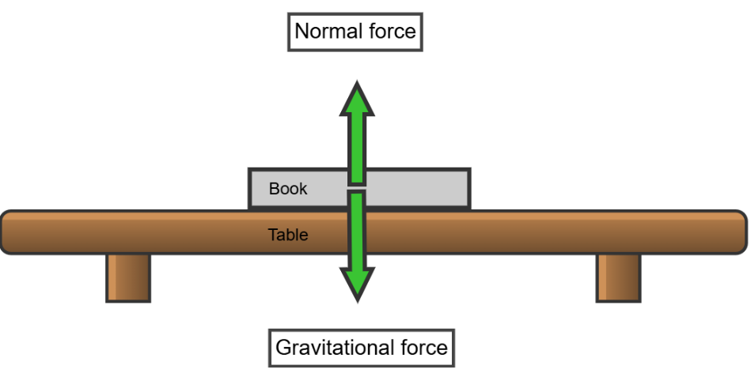
1.5 Checkpoint
Quick quiz to activate learning from prior lessons
Everybody – What are balanced forces and unbalanced forces? Give an example of each.
Mini-challenge – Draw a force diagram for a book resting on a table and label the forces acting on it. Explain why the forces are balanced.
This work has been generated using Chemix.
Notes:
Teacher notes
This slide has animations.
E: What are balanced forces and unbalanced forces? Give an example of each.
Answer: Balanced forces are forces that are equal in magnitude and opposite in direction, resulting in no change in motion. For example, a book resting on a table experiences balanced forces: the downward force of gravity is balanced by the upward normal force from the table.
Unbalanced forces are forces that are not equal and/or not opposite, causing a change in motion. For example, pushing a toy car results in unbalanced forces that cause it to accelerate.
MC: Draw a force diagram for a book resting on a table and label the forces acting on it. Explain why the forces are balanced.
Answer: The book is at rest on the table, indicating that the forces acting on it are balanced. The gravitational force (weight) pulling the book downwards is equal in magnitude and opposite in direction to the normal force exerted by the table pushing upwards. These two forces cancel each other out, resulting in no net force and no change in motion.
*Click* to show the sample force diagram for MC.

Slide 30
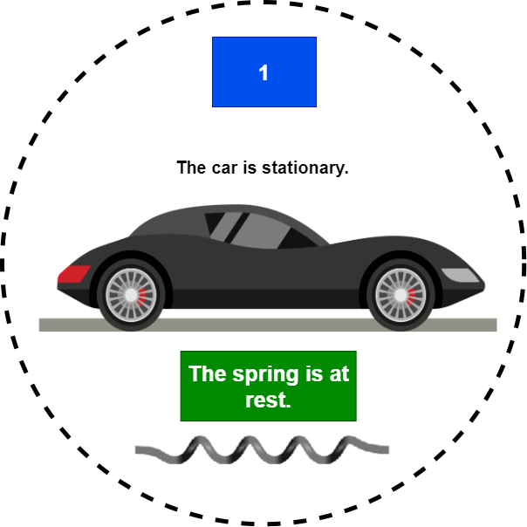
1.5 Describing energy transfers (1 of 4)
‘Retro Sports Car’ by Vectorportal.com is licensed under CC BY 4.0. This image has been edited using draw.io online, and includes image content from Chemix.
Notes:
Notes for teachers:
The diagram supports a discussion of the nature of forces used to transfer energy into and out of systems. The dashed circle around the car and spring separates the system (car with spring) from the environment. Students could redraw as force diagrams.
A system is a group of things that work together or affect each other. In this case, our system is the toy car and the spring.
At the beginning, the car and spring are not moving. There is no energy stored in the system.

Slide 31
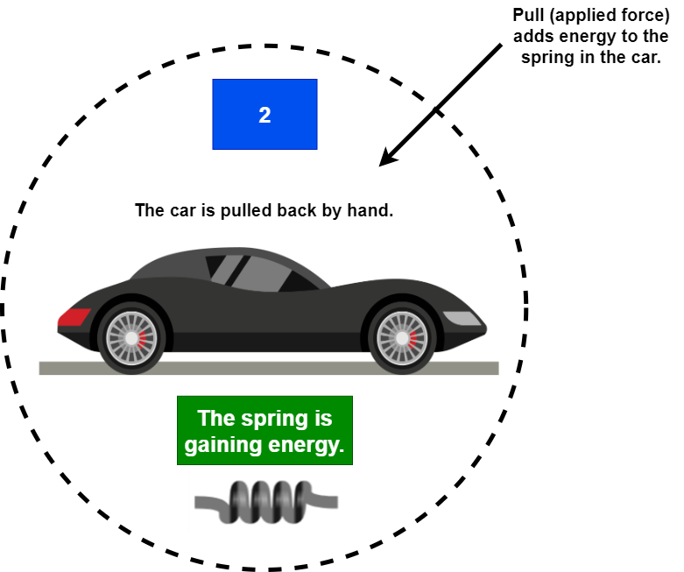
1.5 Describing energy transfers (2)
‘Retro Sports Car’ by Vectorportal.com is licensed under CC BY 4.0. This image has been edited using draw.io online, and includes image content from Chemix.
Notes:
Notes for teachers:
A person pulls the car backward. This adds energy to the system because an external force is being applied.
The arrow crossing into the system shows that energy is being transferred into the car and spring.
As the car is pulled back, the energy is stored in the spring as elastic potential energy – this means the spring is compressed and ready to push the car forward.

Slide 32
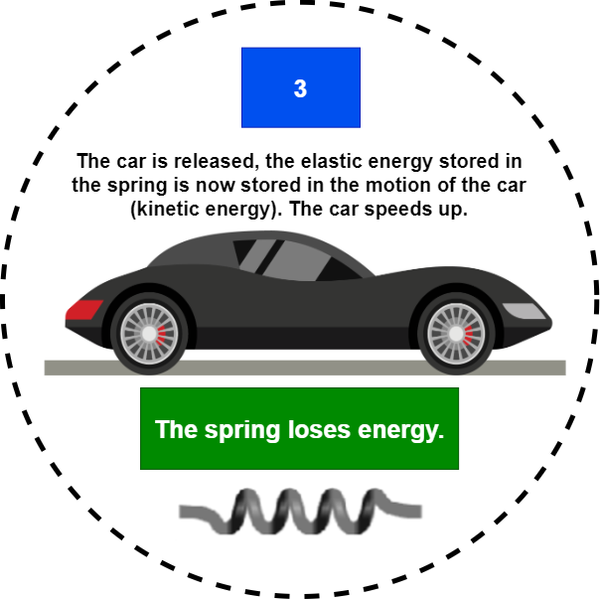
1.5 Describing energy transfers (3)
‘Retro Sports Car’ by Vectorportal.com is licensed under CC BY 4.0. This image has been edited using draw.io online, and includes image content from Chemix.
Notes:
Notes for teachers:
When the car is let go, the stored energy in the spring is transformed into kinetic energy, making the car move forward.

Slide 33
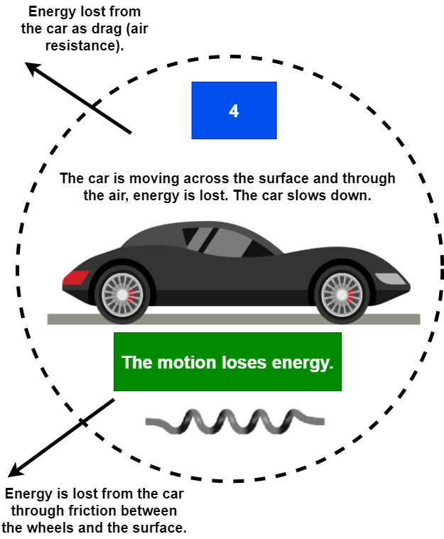
1.5 Describing energy transfers (4)
‘Retro Sports Car’ by Vectorportal.com is licensed under CC BY 4.0. This image has been edited using draw.io online, and includes image content from Chemix.
Notes:
Notes for teachers:
As the car moves across the surface, the car is slowed down by friction forces caused by the surface and the air. The car's motion reduces as energy is transferred from the car wheels to the surface and the car to the air. Eventually, the car will stop, and the forces will be balanced again, like on slide 1 of 4. Some of the kinetic energy is transferred to the surroundings as thermal energy due to friction (from the wheels and the surface) and air resistance (drag). The arrows pointing out of the system show that energy is lost.

Slide 34
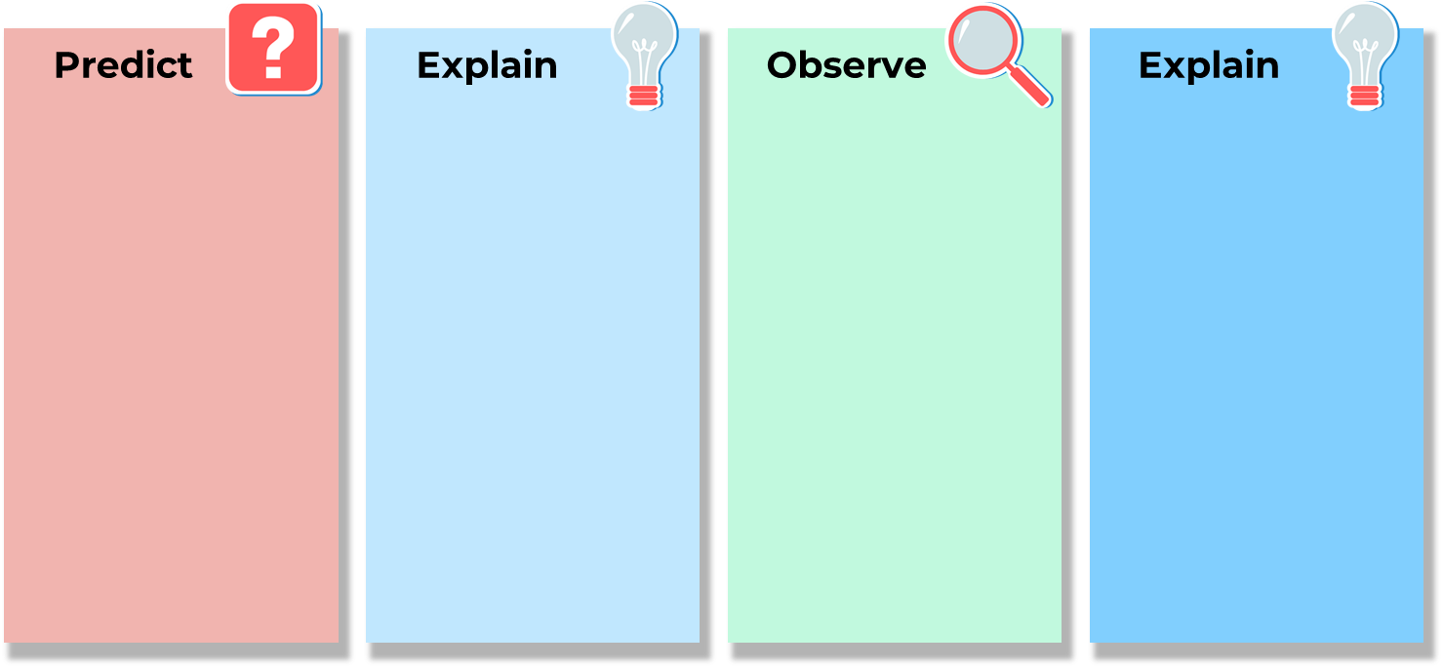
1.5 Predict-Explain-Observe-Explain
How will the amount of elastic potential energy in a toy car affect the distance travelled?
Notes:
Notes for teachers:
Investigate a selection of springs to push a toy car, using the Predict-Explain-Observe-Explain model (FOR PPT) to test assumptions about the relationship between the amount of force required to compress the spring and the amount of energy they can transfer to the toy car.

Slide 35
1.6 Zap!
Learning intentions and success criteria
We are learning | I can
about the effects of forces in everyday situations | identify examples of electrostatic forces describe why electrostatic forces are an indirect force describe electrostatic forces using the terms neutral, positive and negative charges, as well as their interactions with a range of materials
to ask questions and make predictions about forces. | make predictions about the action of electrostatic charges identify the relationship between different electrostatic charges draw conclusions based on the collected data.
Notes:
Notes for teachers:
For more information See ⁠AITSL or the NSW Department of Education explicit teaching strategies, ⁠Sharing learning intentions and ⁠Sharing success criteria
LISC is not necessarily presented at the beginning of the lesson. Teacher needs to consider most effectual time to introduce
LISC should be revisited during the lesson to support students' evaluation of their learning

Slide 36
1.6 Checkpoint
Quick quiz to activate learning from prior lessons
Everybody – What is the relationship between force and energy? Provide a simple example.
Mini-challenge – Explain, using a toy example, how a force can be applied to the toy to first store energy and then release the energy.
Notes:
Notes for teachers:
Checkpoint sample answers: Quick quiz to activate learning from the prior lesson/s.
E: What is the relationship between force and energy? Provide a simple example.
Sample response: Forces transfer energy between interacting objects, causing movement or change in direction of movement. For example, when you push a ball, you apply a force that transfers energy from you to the ball, making it roll.
MC: Explain, using a toy example, how a force can be applied to the toy firstly to store energy and then release the energy.
Sample response:
Storing energy – by winding up the toy car, you apply force to compress a spring, storing energy as elastic energy.
Releasing energy – when you let go, the spring unwinds, releasing the stored elastic energy as kinetic energy, which moves the car.

Slide 37
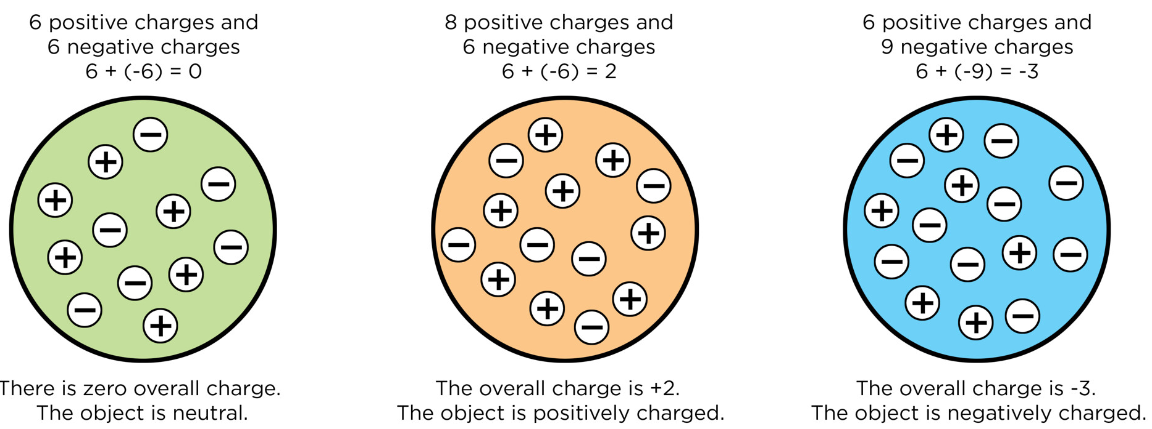
1.6 Charged objects
A neutral, positive and negative charged object
Neutral, positive and negative charges on objects’ by Siyavula Education is licensed under CC BY 4.0.
Notes:
Notes for teachers:
This is a model to initiate discussion on examples of charged objects in everyday life.
Tell students that all objects are neutrally charged in a normal state (left), with an equal number and distribution of positive and negative charges. If this balance of charges in an object is affected by some action, it will become positively or negatively charged (middle and right).

Slide 38
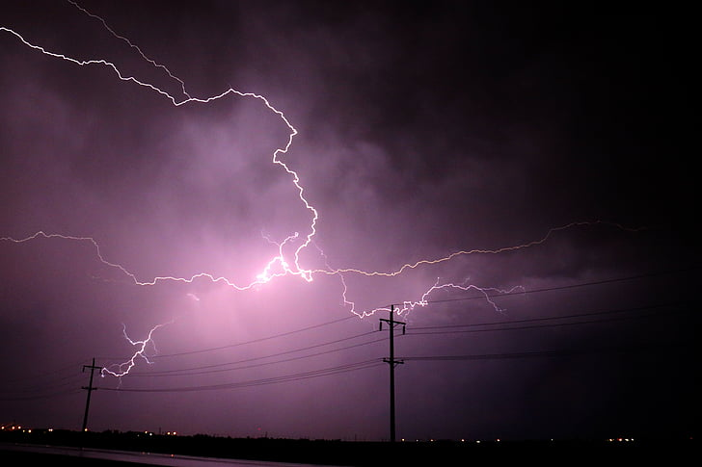
1.6 Lighting
Discharge sparks between oppositely charged areas of the environment
Lightning on sky is used under CC0 licence
Notes:
Notes for teachers:
The most extreme examples of electrostatic charges and their corresponding discharge sparks are observed in nature as the natural process of lightning strikes.
Charge formation in the clouds is due to the redistribution of positive and negative charges within them. Lightning strikes are the discharge spark between these oppositely charged areas of the environment:
Intracloud discharge is a lightning discharge between oppositely charged areas of the same cloud, typically negatively charged lower and positively charged upper cloud segments.
Intercloud discharge is a lightning discharge between oppositely charged areas of adjacent clouds.
Cloud-to-ground strikes occur where the negatively charged lower segment of the cloud discharges to a more positively charged area of the ground.
The air acts as an insulator between the charges in the clouds and between the clouds and the ground. As the storm builds, the charges continue to accumulate in the clouds. Once the charge reaches a specific level, the air can no longer insulate between the clouds and the ground, resulting in a discharge (lightning strike) between the clouds or between the clouds and the ground. This partially neutralises the charge imbalance, and the cycle repeats.

Slide 39
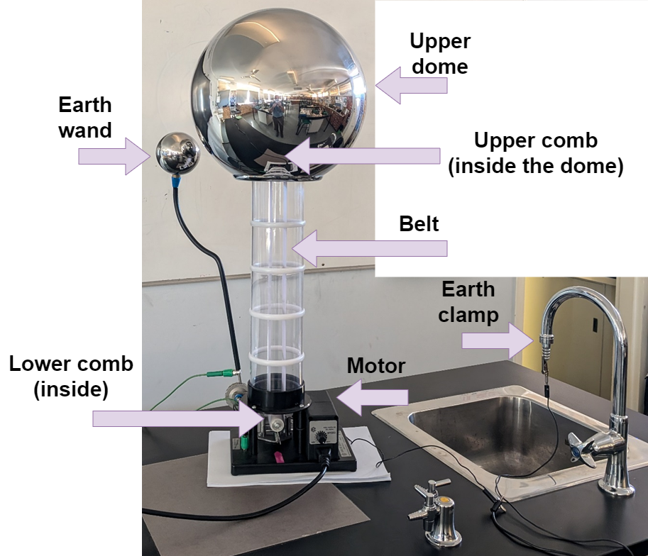
1.6 Van de Graff generator
Notes:
Notes for teachers:
The device functions as an electrostatic charge transfer and collector by:
The electrical motor powers the roller holding the belt. This non-conductive belt passes across the lower metal comb, which removes negative charges and adds positive charges to the belt, leaving behind a positively charged belt segment. The negative charges are passed to the earth wand by a connecting wire.
The positively charged belt segment travels up to the upper dome, where the upper metal comb transfers negative charges from the dome to the positively charged belt segment, leaving the metal dome surface positively charged. The belt is now neutrally charged for its return path to the lower metal comb.
The positively charged dome and negatively charged earth wand remain charged until they are brought close enough that the discharge spark can jump through the air between them. This neutralises the charge in the upper dome and the process restarts.

Slide 40
1.7 Hold me close
Learning intentions and success criteria
We are learning | I can
about the effects of forces in everyday situations | describe the gravitational forces acting on objects using the words indirect, matter and field describe how orbits occur in a gravitational field
to ask questions and make predictions about forces. | make predictions based on observations of motion and gravitational forces identify the relationship between matter, gravity, motion and orbits.
Notes:
Notes for teachers:
For more information See ⁠AITSL or the NSW Department of Education explicit teaching strategies, ⁠Sharing learning intentions and ⁠Sharing success criteria
LISC is not necessarily presented at the beginning of the lesson. Teacher needs to consider most effectual time to introduce
LISC should be revisited during the lesson to support students' evaluation of their learning

Slide 41
1.7 Checkpoint
Quick quiz to activate learning from prior lessons
Everybody – What are electrostatic forces, and what causes them?
Mini-challenge – Briefly describe an experiment to demonstrate the effects of electrostatic forces between objects.
Notes:
Notes for teachers:
E: What are electrostatic forces, and what causes them?
Answer: Electrostatic forces are the forces exerted between electrically charged objects. The attraction or repulsion between particles with electric charge causes them. Objects with opposite charges (positive and negative) attract each other, while objects with the same charge (positive-positive or negative-negative) repel each other.
MC: Briefly describe an experiment to demonstrate the effects of electrostatic forces between objects.
Experiment: By rubbing an ebonite rod with silk, the rod becomes negatively charged. If this rod is carefully positioned on a watch glass, and then another charged ebonite rod is brought close to the charged end, the negative charges repel each other, causing the ebonite rod on the watch glass to turn away.

Slide 42
1.7 Gravitational fields (1/2)
Diagram of Earth’s gravitational field lines
Gravitational field Earth lines 2 is licensed under the CC-SA 4.0 International license.
Notes:
Notes for teachers:
As with all other massive objects, the Earth has a gravitational field that extends out into space and surrounds the Earth in all directions. The Earth’s gravitational field pulls all objects in its influence towards the Earth’s centre of mass.
A gravitational field is the region around Earth where its gravitational influence can be felt. The field is visualised as a series of lines radiating toward the centre of Earth, representing the direction and strength of the gravitational force. The field gets weaker with distance from Earth’s surface (represented by the distance between the lines).
When an object is unsupported, gravity accelerates it toward Earth’s centre. This is what we perceive as ‘falling’.

Slide 43
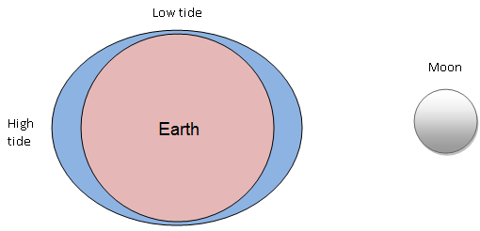
1.7 The Moon’s gravity causes tides
How tides are formed is licensed under the CC-SA 4.0 International license.
Notes:
Notes for teachers:
The Earth’s gravitational field exerts a force on all of us, the satellites surrounding the Earth and the Moon. The Sun is much larger and has a stronger gravitational field that exerts a force on the planets and a range of comets and asteroids within and beyond our solar system.
The Moon is kept in orbit around the Earth due to its gravitational pull and forward motion. The gravitational force pulls the Moon toward Earth, while the Moon’s forward motion keeps it moving around the planet. The result is a continuous curved path around Earth, called an orbit. The forces on the Moon are not balanced. It is always falling. Its sideways motion is what stops it from crashing into Earth. That is, it is essentially falling ‘around’ Earth.
The interaction of the Moon and the Earth’s gravitational fields is the cause of our tides in large bodies of water. High tides exist on the sides of the Earth closest and furthest from the Moon, and low tides exist on the perpendicular sides.

Slide 44
1.8 Weigh up your options
Learning intentions and success criteria
We are learning | I can
about the effects of forces in everyday situations | calculate the weight force of an object with a gravitational field using F=mg describe how a net force acting on an object changes the apparent weight
to ask questions and make predictions about forces. | predict the weight force experienced by an object in a range of situations convert between units of measurement.
Notes:
Notes for teachers:
For more information See ⁠AITSL or the NSW Department of Education explicit teaching strategies, ⁠Sharing learning intentions and ⁠Sharing success criteria
LISC is not necessarily presented at the beginning of the lesson. Teacher needs to consider most effectual time to introduce
LISC should be revisited during the lesson to support students' evaluation of their learning

Slide 45
1.8 Checkpoint
Quick quiz to activate learning from prior lessons
Everybody – What is gravity, and how does it affect the motion of objects on Earth?
Mini-challenge – What happens to the strength of gravitational forces when the distance between objects changes.
Super challenge – Describe how gravitational forces keep objects, like satellites or planets, in orbit.
Notes:
Notes for teachers:
E: What is gravity, and how does it affect the motion of objects on Earth?
Gravity is a force that attracts objects toward each other. On Earth, gravity pulls objects toward the centre of the planet. This force gives objects weight and causes them to fall when dropped. For example, if you drop a ball, it falls to the ground because gravity pulls it downward.
MC: What happens to the strength of gravitational forces when the distance between objects changes.
The strength of the gravitational force depends on the objects' masses and the distance between them. If the distance between two objects increases, the gravitational force between them decreases. Conversely, if the distance decreases, the gravitational force increases. For example, the gravitational pull between the Earth and the Moon keeps the Moon in orbit around the Earth. If the Moon were farther away, the gravitational force would be weaker.
SC: Describe how gravitational forces keep objects, like satellites or planets, in orbit.
Consider a satellite orbiting Earth. The gravitational force pulls the satellite toward Earth while its forward motion keeps it moving around the planet. The result is a continuous curved path around Earth, called an orbit.
If the satellite's forward speed is just right, it will stay in a stable orbit. If it moves too slowly, gravity will pull it down to Earth. If it moves too quickly, it will escape Earth's gravitational pull and move into space.

Slide 46
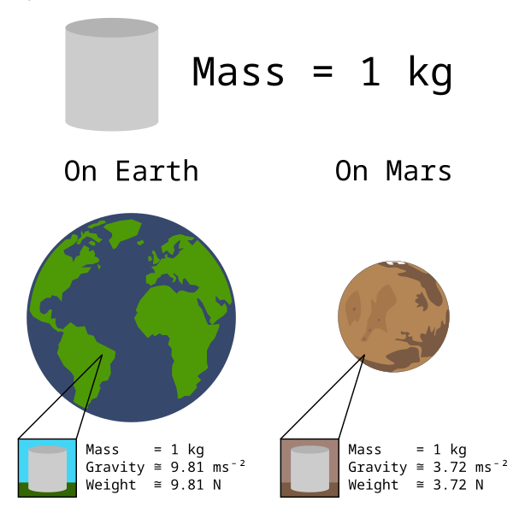
1.8 Weight
'Mass versus weight on earth and mars' by VectorVoyager is licensed under CC BY-SA-3.0.
Notes:
Notes for teachers:
Model to compare mass, gravity and weight on Earth and Mars. Noting that mass is the same no matter where you are in the universe.
As an object moves within and between different gravitational fields, the amount of matter contained within it is constant. Hence, its mass remains constant.
However, since the strength of the gravitational field changes, the weight force experienced by the object varies: the object's weight will increase in a stronger gravitational field and decrease in a weaker gravitational field.

Slide 47
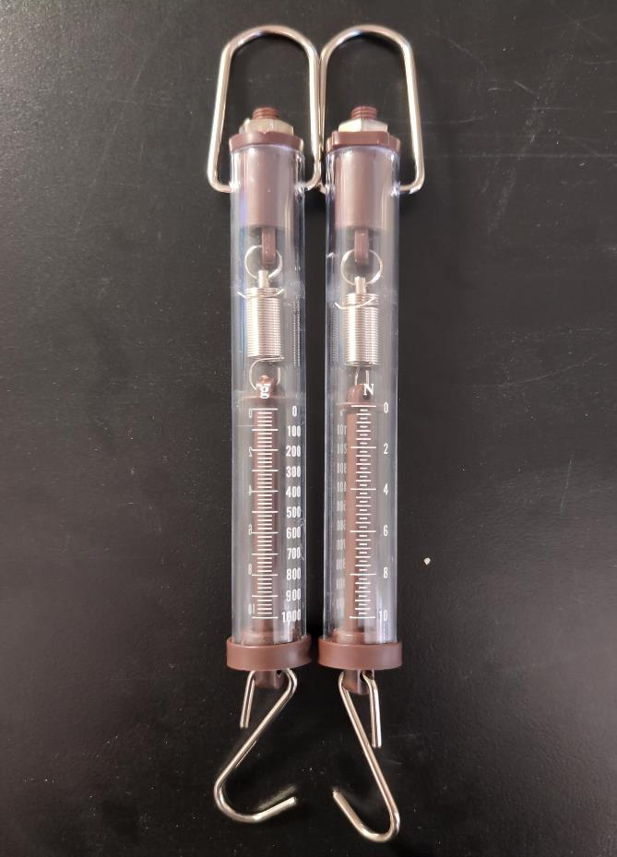
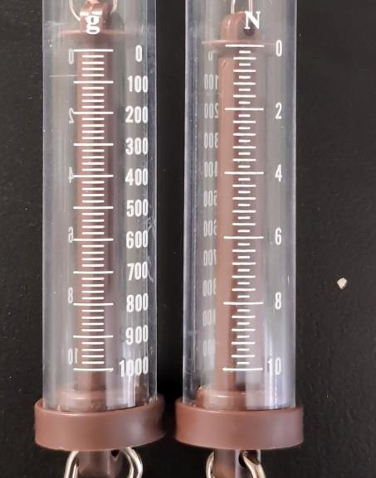
1.8 Checkpoint 2
If we took the spring balances to another planet, could it be used to measure the mass of an object accurately? Why or why not?
Notes:
Notes for teachers:
Question: If we took the spring balances to another planet, could it be used to accurately measure the mass of an object? Why or why not?
Sample response: Mass measurements made with a spring balance on another planet would not be accurate. Spring balances measure force; for example, the weight of an object. Some spring balances provide a scale for mass, however, this scale is calibrated for Earth's gravitational field. An object’s weight depends on gravity, which varies from planet to planet. So, any change in gravity will affect the accuracy of mass measurements.

Slide 48
1.9 Is it attractive
Learning intentions and success criteria
We are learning | I can
about the effects of forces in everyday situations | use the words magnetism, polarity, north, south, repel and attract to explain how a magnet works identify and describe, using the words above, the polarity in different types of magnets. Observe and map the magnetic fields of magnets
to ask questions and make predictions about forces. | make a prediction of the forces (push or pull) involved when different poles from different magnets are brought close together.
Notes:
Notes for teachers:
For more information See ⁠AITSL or the NSW Department of Education explicit teaching strategies, ⁠Sharing learning intentions and ⁠Sharing success criteria
LISC is not necessarily presented at the beginning of the lesson. Teacher needs to consider most effectual time to introduce
LISC should be revisited during the lesson to support students' evaluation of their learning

Slide 49
1.9 Checkpoint
Quick quiz to activate learning from prior lessons
Everybody – What is a force?
Mini-challenge – What are the two categories of forces? Give examples of both categories of forces.
Super challenge – How do we calculate weight force? If an object has a mass of 20 g and is in a gravitational field of 9.8 ms⁻², calculate the weight force on this object.
Notes:
Notes for teachers:
E: What is a force?
A force is a push or pull between objects, which may cause one or both objects to change speed, and/or direction of their motion, and/or their shape. Note: NESA definition
MC: What are the two categories of forces? Give examples of both categories of forces.
Direct forces (friction) and indirect forces (gravity)
SC: How do we calculate weight force? If an object has a mass of 20 g and is in a gravitational field of 9.8 ms⁻², calculate the weight force on this object.
Weight force = mass x gravity (or F = mg). Weight force = 0.02 x 9.8 = 0.2 N

Slide 50
KWLH Topic – Magnets and magnetism
What I know | What I want to know | What I learned | How I learn more
Notes:
Notes for teachers:
Display the KWLH chart on the board. Students can start their KWHL tables on magnets in their workbooks. By completing the What I know (K) and What I want to know (W) columns, you will gain insight into the range of prior knowledge and students' potential interests in this content. You will also support students' recall of prior knowledge to help them build new knowledge. Revisit the H and L columns at the end of the lesson sequence on magnetism.
Complete at the start of the learning section on magnetic forces -
What I know - Write what you already know about the topic
What I want to know - Write what you want to know about the topic
Complete at the end of the learning section on magnetic forces -
What I learned - Write what you have learned about the topic
How I learn more - Write about how you will learn more about this topic

Slide 51
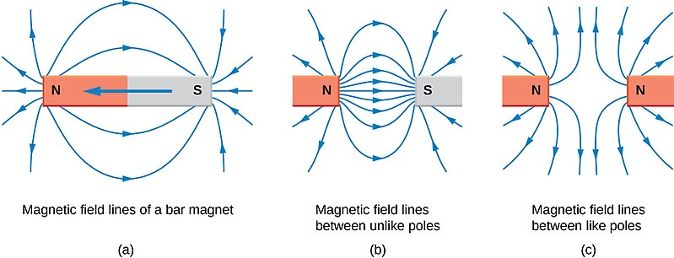
1.9 Magnetic field lines
Bar magnets and magnetic field lines
‘Openstax physics2 11.6 Bfield-barmagnet-ends’ by OpenStax Physics 2 is licensed under CC BY 4.0.
Notes:
Notes for teachers:
This model demonstrates how magnetic field lines are evident and drawn between poles.
Explain that the lines represent the magnetic field. The closeness of the lines to each other shows the strength of the magnetic field – the closer the lines, the stronger the magnetic field.

Slide 52
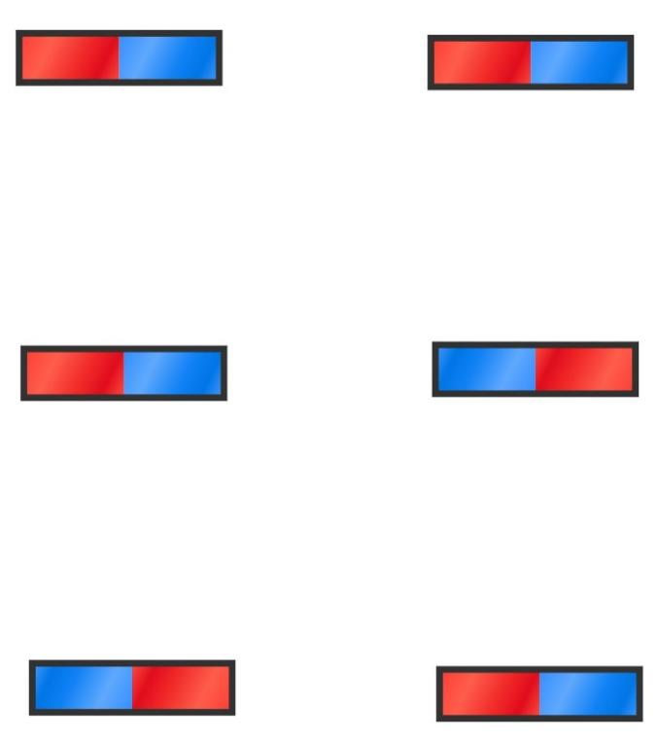
1.9 Mapping magnetic field lines
Analysis and conclusion
What patterns were evident in the magnetic field lines?
Make a prediction of what the field lines would look like beyond the page on which the iron filings were placed.
Describe what these field lines would look like in 3 dimensions. How could you model this?
This work has been generated using Chemix.
Notes:
Notes for teachers:
Students respond to the questions on the slide after completing the practical activity to map magnetic field lines.
1. What patterns were evident in the magnetic field lines?
The filings formed curved lines that emerge from one end and enter the other. The lines were closer together near the poles. The further away from the magnet, the more spread out the filings were.
2. Predict what the field lines would look like beyond the page on which the iron filings were placed.
The field lines would continue as long as the magnetic filings can still move due to the magnetic force. The lines that go straight out the end of the magnet would start to curve around to the other end of the magnet.
3.Describe what these field lines would look like in 3 dimensions.
The magnetic field lines would curve out in all directions around the magnet.

Slide 53
1.10 Testing for attraction
Learning intentions and success criteria
We are learning | I can
about the effects of forces in everyday situations | observe and map the magnetic fields of magnets
to ask questions and make predictions about forces | identify a question that can be tested make a prediction based on prior knowledge
to use data to solve problems about forces. | organise data in a table make a conclusion based on the relationship evident in the data identify how the investigation can be improved.
Notes:
Notes for teachers:
For more information See ⁠AITSL or the NSW Department of Education explicit teaching strategies, ⁠Sharing learning intentions and ⁠Sharing success criteria
LISC is not necessarily presented at the beginning of the lesson. Teacher needs to consider most effectual time to introduce
LISC should be revisited during the lesson to support students' evaluation of their learning

Slide 54
1.10 Checkpoint
Quick quiz to activate learning from prior lessons
Everybody – What are the two poles of a magnet called?
Mini-challenge – What happens when the north pole of one magnet is brought close to the south pole of another magnet? Explain why this happens.
Super challenge – Describe the behaviour of two bar magnets when their north poles are brought close together and explain the underlying reason based on the concept of magnetic fields and polarity.
Notes:
Notes for teachers:
E: What are the two poles of a magnet called?
Answer: The two poles of a magnet are called the North pole and the South pole.
MC: What happens when the north pole of one magnet is brought close to the south pole of another magnet? Explain why this happens.
Answer: When the north pole of one magnet is brought close to the south pole of another magnet, they attract each other. This happens because opposite poles of magnets attract.
SC: Describe the behaviour of two bar magnets when their north poles are brought close together and explain the underlying reason based on the concept of magnetic fields and polarity.
Answer: When the north poles of two bar magnets are brought close together, they repel each other. This repulsion occurs because like poles (north-north or south-south) create magnetic fields that push against each other.

Slide 55
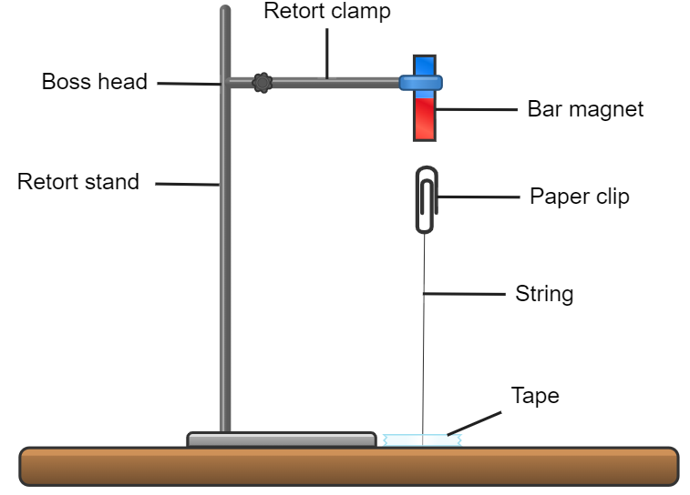
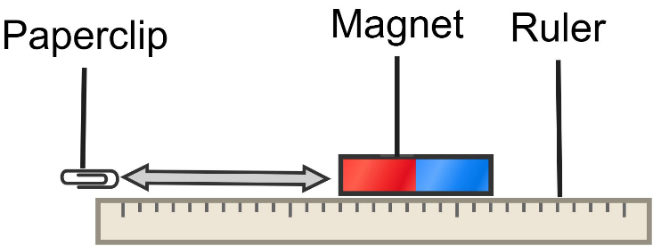
1.10 Magnetic field strength investigation
This work has been generated using Chemix.
Notes:
Notes for teachers:
This slide provides two possible options for the investigation into how distance affects magnetic field strength. Additional detail on each option is provided in TRB1.

Slide 56
1.11 Making magnets
Learning intentions and success criteria
We are learning | I can
about the effects of forces in everyday situations | describe the action of an electromagnet
to ask questions and make predictions about forces | predict the relationship between coil number on an electromagnet and its magnetic field strength
to use data to solve problems about forces. | graph data (including labelling axis, using an appropriate scale) collect, process and use data on the magnetic field strength of an electromagnet to solve problems.
Notes:
Notes for teachers:
For more information See ⁠AITSL or the NSW Department of Education explicit teaching strategies, ⁠Sharing learning intentions and ⁠Sharing success criteria
LISC is not necessarily presented at the beginning of the lesson. Teacher needs to consider most effectual time to introduce
LISC should be revisited during the lesson to support students' evaluation of their learning

Slide 57
1.11 Checkpoint
Quick quiz to activate learning from prior lessons
Everybody – What is one variable you need to keep constant when testing the effect of distance on a magnet's action?
Mini-challenge – How does the strength of the magnetic field on a metal object change as the distance between the object and a magnet increases?
Super challenge – Describe the pattern you would expect to see when using iron filings to map the magnetic field around a bar magnet
Notes:
Notes for teachers:
E: What is one variable you need to keep constant when testing the effect of distance on a magnet's action?
Answer: One factor you need to keep constant is the type of magnet used in the investigation.
MC: How does the strength of the magnetic field change as the distance between the magnet and a metal object increases?
Answer: When the north pole of one magnet is brought close to the south pole of another magnet, they attract each other. This happens because opposite poles of magnets create magnetic field lines that flow from the north pole of one magnet to the south pole of the other. These lines were visibly close together in the iron filings investigation, which indicates that the magnetic field is strong between the opposite poles of magnets when they are close. This results in a force which pulls the two magnets together.
SC: Describe the pattern you would expect to see when using iron filings to map the magnetic field around a bar magnet
Answer: The iron filings will align along the invisible magnetic field created by the magnet. You will see the filings form curved lines that extend from the north pole of the magnet to the south pole. The lines will be denser near the poles, indicating a stronger magnetic field.

Slide 58
1.11 What is an electromagnet?
An electromagnet is a magnet that produces a magnetic field when an electric current flows through it. It typically consists of a coil of wire wrapped around a core made of ferromagnetic material like iron. The magnetic field is present only when the current is flowing and disappears when the current is turned off
How ElectroMagnets Work – Middle Grade Science w/ Untamed Science (4:43)
Notes:
Notes for teachers:
Read the definition of an electromagnet with the class. Play the YouTube video by clicking on the image or the red play button.

Slide 59
1.11 Investigating the strength of electromagnets (1)
Aim – To determine the relationship between the coil number on an electromagnet and its magnetic field strength
Prediction
Step | Description | Your response
If… | How will you change the independent variable?
Then… | Predicted change to the dependent variable.
Because… | A logical reason for the change.
Notes:
Notes for teachers:
Read the aim, and support student in developing a prediction for the investigation.

Slide 60
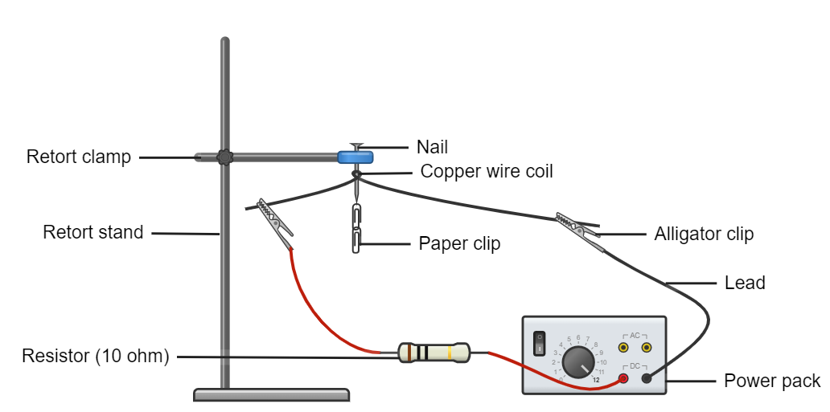
1.11 Investigating the strength of electromagnets (2)
This work has been generated using Chemix.
Notes:
Notes for teachers:
Display this slide to describe the investigation equipment setup to students.

Slide 61
1.11 Method evaluation (1)
Criteria | Assessment | Evidence in method
Is the purpose of the investigation is clearly identified through a prediction and/or aim?
What are the independent and dependent variables in the experiment? Are they clearly defined? |  | IV is … DV is…
Have all controlled variables been identified and accounted for? |  | Controlled variables are:
Is the experimental method clearly outlined in a step-by-step format using accurate equipment?
Notes:
Notes for teachers:
A scaffold for evaluating the method in an investigation.

Slide 62
1.11 Method evaluation (2)
Criteria | Assessment | Evidence in method
Are the steps logical and easy to follow?
Does the method allow the aim or prediction to be answered?
Is the data reliable? Is the sample size large enough? Has it been repeated under the same conditions to gain the same results? Is the collected data range small?
Is it evident in the method how the data will be collected, e.g. units provided, in a table?
A neat, labelled diagram of the experiment set-up is included.
Notes:
Notes for teachers:
A scaffold for evaluating the method in an investigation.

Slide 63
Essential question 2
How do simple machines make life easier?
Notes:
Notes for teachers:
Content in this section aligns with essential question 2 in the program of learning and Teacher resource book 2

Slide 64
2.1 Simple machines around us
Learning intentions and success criteria
We are learning | I can
about the effects of forces in simple machines | define a simple machine and mechanical advantage explain how a wedge, lever, ramp, screw, pulley and wheel provide mechanical advantage
to use data to solve problems when using simple machines | extract information from text and diagrams about simple machines
Notes:
Notes for teachers:
For more information See ⁠AITSL or the NSW Department of Education explicit teaching strategies, ⁠Sharing learning intentions and ⁠Sharing success criteria
LISC is not necessarily presented at the beginning of the lesson. Teacher needs to consider most effectual time to introduce
LISC should be revisited during the lesson to support students' evaluation of their learning

Slide 65
2.1 Simple machines – wedge
A wedge is a triangular shaped tool, made of hard materials, that translates effort forces perpendicularly.
A wedge is used to split, cut or secure objects.
Simple Machines – Wedges 1:50
Notes:
Notes for teachers:
The wedge is a simple machine with evidence of use dating back to the Stone Age as a tool to break down larger blocks of material. These triangular-shaped tools, made of hard materials, translate effort forces perpendicularly (the term 'perpendicular' means at an angle of 90° to a given line, plane or surface).
The triangular shape of the wedge allows force to be transferred sideways from the direction of movement, and the mechanical advantage of a wedge is given by the ratio of the length of its slope to its width. Although a short wedge with a wide angle may complete a task faster, it requires more effort force than a long wedge with a narrow angle.
Select the play button or YouTube screen shot to play Simple Machines – Wedges https://www.youtube.com/watch?v=z-MOrUvjNm8

Slide 66
2.1 Simple machines – lever
A lever consists of a rigid bar or beam that pivots around a fixed point called a fulcrum.
Parts of a lever:
Fulcrum – the fixed point which the lever pivots
Effort – the force applied to the lever to do work
Load – the object or resistance that the lever moves or lifts
There are three types of levers, 1st, 2nd and 3rd order levers.
Simple Machines – Levers 1:56
Notes:
Notes for teachers:
A lever consists of a rigid bar or beam that pivots around a fixed point called a fulcrum. There are three different types or classifications of lever: first-, second- and third-order (sometimes referred to as first class, second class and third class). The location of the effort determines if a lever is classified as a first-, second- or third-order lever. In the example on the slide, the fulcrum is in the middle, referred to as a first-class/order lever.
Select the play button or YouTube screen shot to play Simple Machines – Levers https://www.youtube.com/watch?v=_Lz383VMfkg

Slide 67
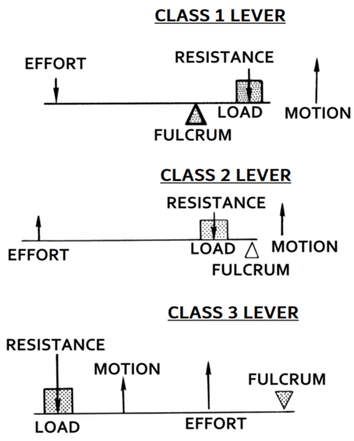
2.1 Simple machines – levers
Types of levers
Type of lever | Component in the middle of the lever | Examples
1st order | Fulcrum | Scissors, claw hammer, seesaw,
2nd order | Load | Wheelbarrow, nutcracker,
3rd order | Effort | Shovel, tweezers, stapler, tongs, fishing rod
Types of levers
’Lever (PSF).png’ by Pearson Scott Foresman is in the Public Domain.
Notes:
Notes for teachers:
Levers can be divided into three types: first-order, second-order, and third-order (also known as first-class, second-class and third-class, respectively). Each type of lever makes a task easier in a different way.
A first-order/class lever has the fulcrum in the middle (point this out in the diagram on the slide).
A second-order/class lever has the load in the middle (point this out in the diagram on the slide).
A third-order/class lever has the effort in the middle (point this out in the diagram on the slide).

Slide 68
2.1 Simple machines – inclined plane
An inclined plane is a flat surface set at an angle, which helps reduce the force need to raise or lower objects.
Examples include:
Ramps
Screws
Simple Machines – Inclined Planes 1:30
Notes:
Notes for teachers:
A ramp is an inclined plane where the vertical lift of a load is spread over a longer distance. Compared to a straight lift of the load up to the lift height, this reduces the effort required by spreading this difficult task over a longer distance. Inclined planes have been used for many years to cut paths through steep mountainous terrain to allow the transport of people and goods.
A lot of inclined planes are simply referred to as ramps.
A screw is a special type of inclined plane where the inclined plane is wound around a central shaft.
Select the play button or YouTube screen shot to play Simple Machines – Inclined Planes https://www.youtube.com/watch?v=-p_x2YmKHs8

Slide 69
2.1 Simple machines – screw
A screw is a combination of an inclined plane and wedge wrapped around a central axis.
Simple Machines – Screws 1:41
Notes:
Notes for teachers:
A screw is a combination of an inclined plane and wedge wrapped around a central axis.
The thread of a screw spreads out the effort required over a longer distance.
Select the play button or YouTube screen shot to play Simple Machines – Screws https://www.youtube.com/watch?v=h3AfKj37mbo

Slide 70
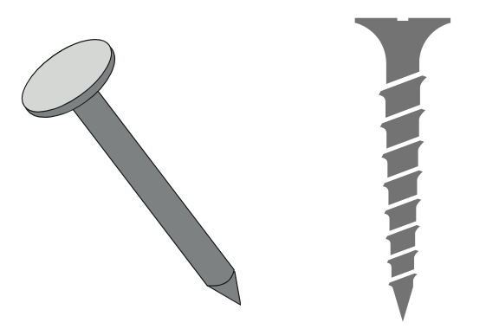
2.1 Checkpoint
Would a nail (a wedge at the tip) or a screw (an inclined plane) be easier to drive into a piece of wood?
Notes:
Notes for teachers:
Check students understanding of the simple machines covered so far. Mini whiteboards could be used to get the answer from all students initially so that you can see how the whole class is going with understanding mechanical advantage explained in the videos.
Sample response: For a nail and screw of the same length, the nail relies on the force being applied downwards on the nail head along a straight shaft. A screw uses rotational force to pull the screw thread down into the wood. The pathway of the screw thread is much longer than the length of the screw shaft so the force required is reduced by taking a longer path to complete the same task.

Slide 71
2.1 Simple machines – wheel and axle
A wheel is a simple machine consisting of a circular component that rotates around an axis, typically an axle. It is designed to reduce the effort required to move or lift a load.
Simple Machines – Wheel and Axle 1:25
Notes:
Notes for teachers:
A wheel is a simple machine with a circular component that rotates around an axis, typically an axle. It is designed to reduce the effort required to move or lift a load.
It is considered one of the greatest inventions in human history due to its vast applications in mechanical systems. The more common experience with a wheel is as a device to simplify moving heavy materials. When used under a cart or trolley, the wheel reduces the push or pull force required to shift the load, and the axle minimises the contact area of the trolley with the surface, significantly reducing frictional forces resisting changes in motion.
Select the play button or YouTube screen shot to play Simple Machines – Wheel and Axle https://www.youtube.com/watch?v=FT_5lICNVtw

Slide 72
2.1 Simple machines – gears
A gear is a type of simple machine consisting of a rotating when with evenly spaced teeth that interlock with another.
They can:
change the speed of rotation
change the direction of motion
Simple Machines – Gears (1:50)
Notes:
Notes for teachers:
A gear is a simple machine consisting of a wheel with teeth that interlock with another wheel with teeth. Gears are used to transmit force to change the direction or multiply force or speed.
Select the play button or YouTube screen shot to play Simple Machines – Gears https://www.youtube.com/watch?v=5hKTvVG6eqA

Slide 73
2.1 Simple machines – pulley
A pulley consists of a wheel with a grooved rim that holds a rope, belt or chain. It is used to change the direction of force and/or reduce the effort need to lift or move a load.
Simple Machines – Pulleys 2:26
Notes:
Notes for teachers:
A pulley consists of a wheel with a grooved rim that holds a rope, belt or chain. It is used to change the direction of force and/or reduce the effort needed to lift or move a load.
When combined, multiple pulleys form a compound pulley, which reduces the effort needed to shift a load. The mechanical advantage of a pulley is determined by the number of times the rope passes through a pulley before the load force connection. This can be complicated as some pulleys have multiple wheels, meaning the rope may pass through the same pulley twice or thrice.
Select the play button or YouTube screen shot to play Simple Machines – Pulley https://www.youtube.com/watch?v=pxD3SHMp9Es

Slide 74
2.2 Investigating simple machines
Learning intentions and success criteria
We are learning | I can
about the effects of forces in simple machines | identify the load and effort when using simple machines describe how a simple machine provides a mechanical advantage
to ask questions and make predictions when using simple machines | make predictions when using levers and pulleys
to use data to solve problems when using simple machines | accurately record data in a table calculate the mean and range of data
Notes:
Notes for teachers:
For more information See ⁠AITSL or the NSW Department of Education explicit teaching strategies, ⁠Sharing learning intentions and ⁠Sharing success criteria
LISC is not necessarily presented at the beginning of the lesson. Teacher needs to consider most effectual time to introduce
LISC should be revisited during the lesson to support students' evaluation of their learning

Slide 75
2.2 Checkpoint
Quick quiz to activate learning from prior lessons
Everybody – What are simple machines, and what are some examples of simple machines used in everyday life?
Mini-challenge – Describe how one type of simple machine, such as a lever or screw, has been used in both historical and modern contexts. Give specific examples of its use in everyday life.
Super challenge – Explain how simple machines make work easier. Discuss how the principles behind simple machines have influenced the design of modern machinery and technology.
Notes:
Notes for teachers:
E: What are simple machines, and what are some examples of simple machines used in everyday life?
A simple machine is a tool or part of a tool that changes an effort force's direction and/or magnitude. Examples of simple machines in everyday life include scissors (lever), doorknobs (wheel and axle), flagpoles (pulley), ramps (inclined plane), knives (wedge), and jar lids (screws).
MC: Describe how one type of simple machine, such as a lever or screw, has been used in both historical and modern contexts. Give specific examples of its use in everyday life.
Lever:
Historical Context: In ancient Egypt, levers were used to move large stones for building pyramids. Workers used long wooden poles as levers to lift and position heavy blocks.
Modern Context: Today, levers are used in various tools and devices to make tasks easier. For example, a seesaw on a playground is a simple lever with the fulcrum (pivot point) in the middle. Children sit on either end to balance and move up and down. Another example is a crowbar used to lift heavy objects.
SC: Explain how simple machines make work easier. Discuss how the principles behind simple machines have influenced the design of modern machinery and technology
Simple machines make work easier by allowing us to apply a smaller force over a greater distance or change the direction of the force. This means less effort is needed to move an object.
The principles of simple machines have been fundamental in developing more complex machines and technology. For example, the wheel and axle principle is used in vehicles to reduce friction and make movement more efficient.

Slide 76
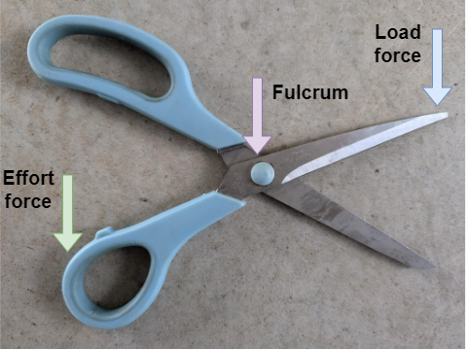
2.2 First order levers
Scissors
This work has been generated in draw.io online.
Notes:
Notes for teachers:
All first-order levers have the fulcrum in the middle.
Scissors are a combination of simple machines, they contain:
Two first order levers that work together. The effort is applied by your hand, the fulcrum is located along the sharp edge of the scissors.
A wedge along the blade that makes it easier to cut the paper.

Slide 77
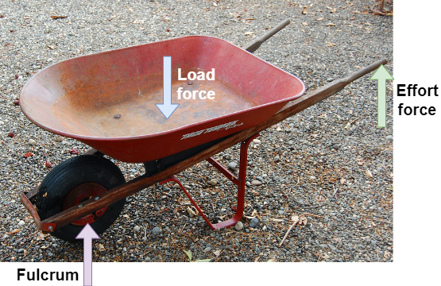
2.2 Second order levers
Wheelbarrow
‘The Old Red Wheelbarrow’ by Calaveras KT is licensed under CC BY 2.0.
Notes:
Notes for teachers:
A second-order lever has the load in the middle. A wheelbarrow has multiple simple machines, including a lever, wheel, and axle. We are focussing on the lever in this example.
The wheelbarrow is an example of a second-order lever because the load is in the middle. The fulcrum is the wheel, and a person applies the effort on the handles.

Slide 78
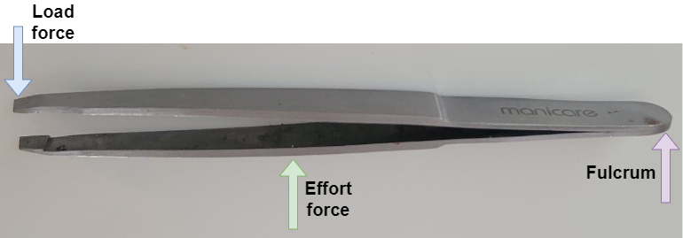
2.2 Third order levers
Tweezers
This work has been generated in draw.io online.
Notes:
Notes for teachers:
A third-order lever has the effort in the middle.
Tweezers are one example of a third-order lever because the effort is applied in the middle. The load is applied at the tip of the tweezers, and the fulcrum is at the other end.
Like scissors, tweezers are 2 levers working together (in this case, 2 third-class levers).

Slide 79
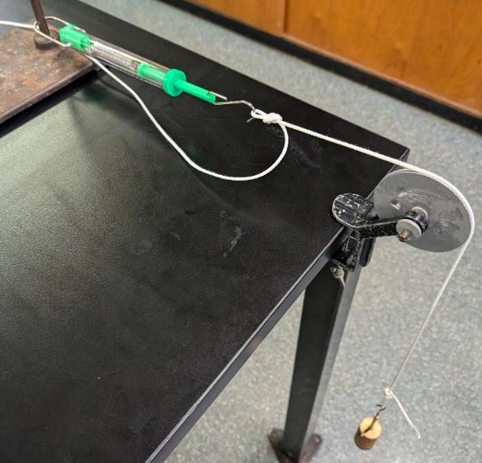
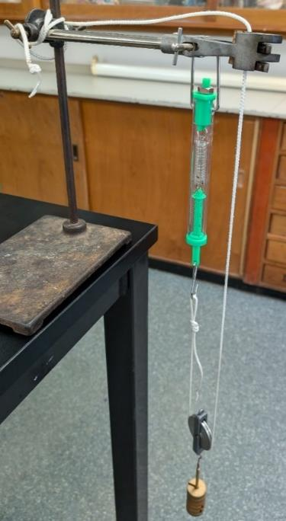
2.2 Pulley investigation
Method 2 – A bench pulley setup with a mass carrier and a spring balance.
Method 3 – A single wheel pulley setup with a mass carrier and a spring balance.
Notes:
Notes for teachers:
Use the photos to help students to set up the pulley arrangements outline in the Student resource – Investigating pulleys.

Slide 80
2.2 Power ticket checkpoint
What did we learn about…
Today? | Yesterday? | Last week? | Last month? | Older?
Pulleys | Levers | Magnetism | Gravity | Friction
[Type one fact here] | [Type one fact here] | [Type one fact here] | [Type one fact here] | [Type one fact here]
[Type a second fact here] | [Type a second fact here] | [Type a second fact here] | [Type a second fact here] | [Type a second fact here]
[Type a third fact here] | [Type a third fact here] | [Type a third fact here] | [Type a third fact here] | [Type a third fact here]
Notes:
Notes for teachers:
Power tickets are used ideally every three weeks to incorporate retrieval, spacing, interleaving and feedback. They are an opportunity for students to examine their metacognition and help to create a study tool. Facts can be refined through a think-pair-share activity.

Slide 81
2.3 Traditional knowledge of forces
Learning intentions and success criteria
We are learning | I can
about the effects of forces in simple machines | describe examples how Aboriginal knowledge of forces was applied to solve problems
to use data to solve problems when using simple machines. | identify the cause-and-effect relationship when modelling the use of a woomera.
Notes:
Notes for teachers:
For more information See ⁠AITSL or the NSW Department of Education explicit teaching strategies, ⁠Sharing learning intentions and ⁠Sharing success criteria
LISC is not necessarily presented at the beginning of the lesson. Teacher needs to consider most effectual time to introduce
LISC should be revisited during the lesson to support students' evaluation of their learning

Slide 82
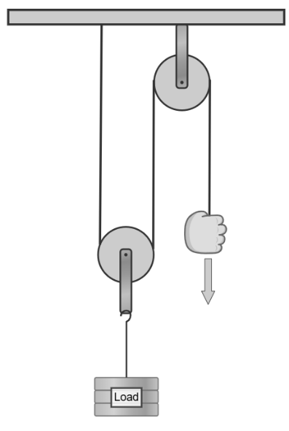
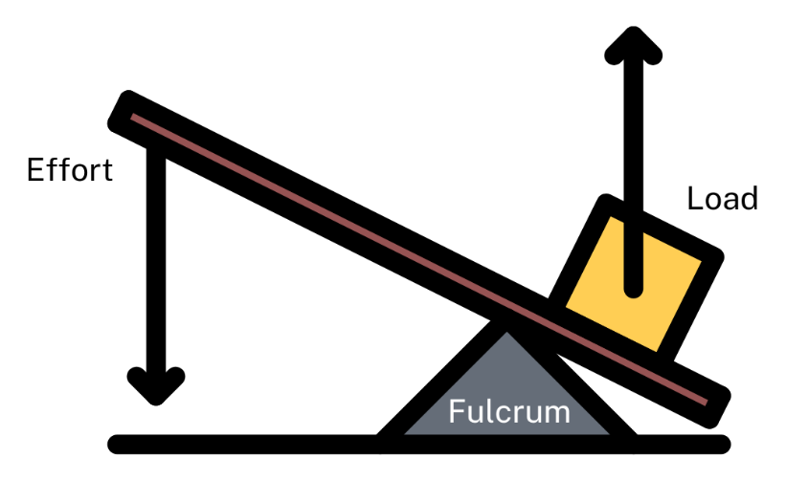
2.3 Checkpoint
Quick quiz to activate learning from prior lessons
Everybody – Determine the mechanical advantage of the pulley system.
Mini challenge – Sketch an example of a first-order lever and label the effort, fulcrum and load.
Notes:
Notes for teachers:
This slide is animated to bring up the answers.
Sample answers:
Everybody: This pulley system has a mechanical advantage of 2:1. We can determine this by counting the ropes/strings involved in the pulley (not including the one being pulled). *CLICK* the numbers show how we can count the ropes/strings.
Mini challenge: To recall which part of the lever goes in the middle for each class of lever, we can recite FLE–123, therefore in a first-order lever the fulcrum is in the middle. *CLICK* this diagram show the fulcrum in the middle with the load on one end and the effort at the other.

Slide 83
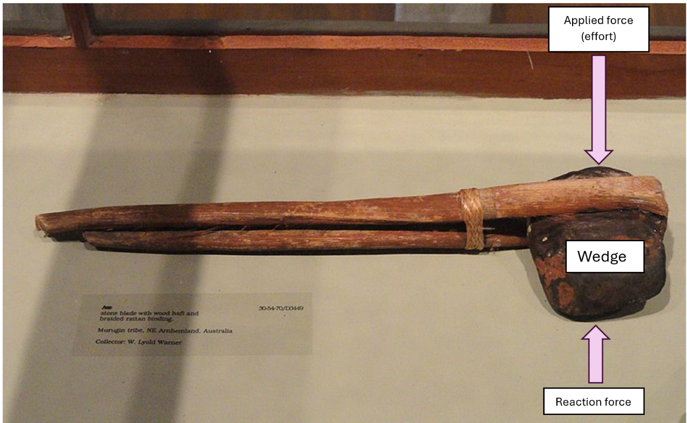
3.3 Traditional tools
Aboriginal and Torres Strait Islander People’s use of forces in tools and weapons
‘Axe, Murugin tribe, NE Arnhemland, Australia’ by Daderot is licensed under CC0 1.0.
Notes:
Notes for teachers:
The axe head would have been chipped from a larger rock and the edge ground to a point.
Resin or kangaroo sinew was used with string made from plant fibres to attach the handle.
The axe had multiple uses, including cutting wood, serving as a weapon, and cutting up food.
The axe head is a wedge.
The wedge is two inclined planes that convert the applied force into perpendicular forces over a longer distance (reducing the effort needed) to split objects. Note that the axe handle is a lever that reduces the effort needed when applying a force.

Slide 84
2.3 Aboriginal and Torres Strait Islander weapon and tool use research
Aboriginal and Torres Strait Islander technology or tool. | How was the tool made and used? | Is the tool a simple machine? Why or why not? | Insert a picture or draw a diagram of the tool. Convert to a force diagram.
Woomera
Axe
Grinding stones
Boomerang
Spear
Digging stick
Notes:
Notes for teachers:
Table to record tool and weapon use.

Slide 85
2.4 Solving problems with machines
Learning intentions and success criteria
We are learning | I can
about the effects of forces in simple machines | identify and label 3 simple machines used in the Depth study explain how each simple machine changes the magnitude of force needed when performing a task.
to ask questions and make predictions when using simple machines | identify if a question can be investigated make a prediction based on observations
to use data to solve problems when using simple machines | collect and organise force data in a table use my understanding of forces to identify relationships
Notes:
Notes for teachers:
For more information See ⁠AITSL or the NSW Department of Education explicit teaching strategies, ⁠Sharing learning intentions and ⁠Sharing success criteria
LISC is not necessarily presented at the beginning of the lesson. Teacher needs to consider most effectual time to introduce
LISC should be revisited during the lesson to support students' evaluation of their learning

Slide 86
2.4 Checkpoint
Quick quiz to activate learning from prior lessons
Everybody – Name one traditional tool used by Aboriginal and Torres Strait Islander Peoples that demonstrates their understanding of forces.
Mini-challenge – Explain how the woomera demonstrates the application of knowledge about forces by Aboriginal and Torres Strait Islander Peoples.
Notes:
Notes for teachers:
E: Name one traditional tool used by Aboriginal and Torres Strait Islander Peoples that demonstrates their understanding of forces.
Answer: One traditional tool is the woomera.
MC: Explain how the woomera demonstrates the application of knowledge about forces by Aboriginal and Torres Strait Islander Peoples.
Answer: The woomera, a spear-throwing tool, demonstrates the application of knowledge about forces by enhancing a spear's throwing force and accuracy. By extending the lever arm, the woomera allows the thrower to apply more force over a greater distance, increasing the speed and distance the spear can travel. This use of leverage and mechanics shows an understanding of the principles of force and motion.

Slide 87
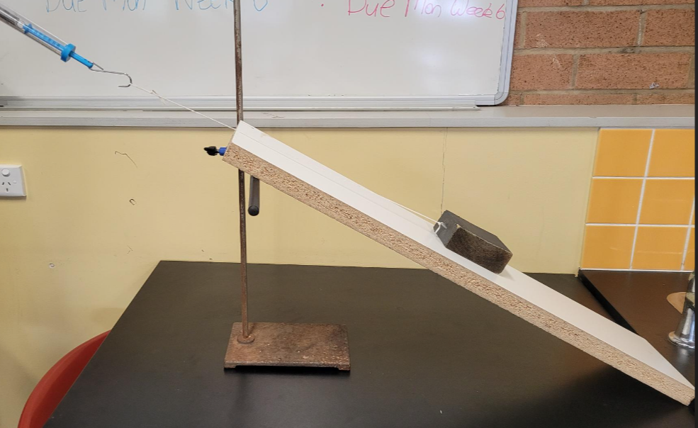
2.4 Depth study
Investigation set up
Figure – Part 1 Part B, C and D using a ramp to lift the block
Notes:
Notes for teachers:
Example of investigation setup for the Depth study.

Slide 88
Templates
Sample of templates that can be used when teaching the Forces unit.
Notes:
Notes for teachers:
These templates can be adapted for teaching the Forces unit.

Slide 89
Power ticket template
Today? | Yesterday? | Last week? | Last month? | Older?
[insert concept 1] | [insert concept 2] | [insert concept 3] | [insert concept 4] | [insert concept 5]
[Type one fact here] | [Type one fact here] | [Type one fact here] | [Type one fact here] | [Type one fact here]
[Type a second fact here] | [Type a second fact here] | [Type a second fact here] | [Type a second fact here] | [Type a second fact here]
[Type a third fact here] | [Type a third fact here] | [Type a third fact here] | [Type a third fact here] | [Type a third fact here]
Notes:
Notes for teachers:
Power tickets are used ideally every three weeks to incorporate retrieval, spacing, interleaving and feedback. They are an opportunity for students to examine their metacognition and help to create a study tool. Facts can be refined through a think-pair-share activity. Column headings can be adapted to suit context and timing.

Slide 90
Predict-Explain-Observe-Explain
Notes:
Predict-Explain-Observe-Explain scaffold

Slide 91
References
This presentation contains NSW Curriculum and syllabus content. The NSW Curriculum is developed by the NSW Education Standards Authority. This content is prepared by NESA for and on behalf of the Crown in the right of the State of New South Wales. The material is protected by Crown copyright.
Please refer to the NESA Copyright Disclaimer for more information https://educationstandards.nsw.edu.au/wps/portal/nesa/mini-footer/copyright.
NESA holds the only official and up-to-date versions of the NSW Curriculum and syllabus documents. Please visit the NSW Education Standards Authority (NESA) website https://educationstandards.nsw.edu.au/wps/portal/nesa/home and the NSW Curriculum website https://curriculum.nsw.edu.au.
Science 7–10 (2023) © Syllabus NSW Education Standards Authority (NESA) for and on behalf of the Crown in right of the State of New South Wales, 2023.
Agarwal, P. K., and Bain, P. M. (2019). Powerful teaching: Unleash the science of learning. Jossey-Bass.
AITSL (Australian Institute for Teaching and School Leadership Limited) (n.d.) Learning intentions and success criteria [PDF 251 KB], AITSL, accessed 31 July 2024.
NSW Department of Education (2024) Digital Learning Selector: Card, accessed 02 August 2024.

Slide 92
Copyright
© State of New South Wales (Department of Education), 2025
The copyright material published in this resource is subject to the Copyright Act 1968 (Cth) and is owned by the NSW Department of Education or, where indicated, by a party other than the NSW Department of Education (third-party material).
Copyright material available in this resource and owned by the NSW Department of Education is licensed under a Creative Commons Attribution 4.0 International (CC BY 4.0) license.
This license allows you to share and adapt the material for any purpose, even commercially.
Attribution should be given to © State of New South Wales (Department of Education), 2025.
Material in this resource not available under a Creative Commons license:
the NSW Department of Education logo, other logos and trademark-protected material
Material owned by a third party that has been reproduced with permission. You will need to obtain permission from the third party to reuse its material.
Links to third-party material and websites
Please note that the provided (reading/viewing material/list/links/texts) are a suggestion only and implies no endorsement, by the New South Wales Department of Education, of any author, publisher, or book title. School principals and teachers are best placed to assess the suitability of resources that would complement the curriculum and reflect the needs and interests of their students.
If you use the links provided in this document to access a third-party’s website, you acknowledge that the terms of use, including licence terms set out on the third-party’s website apply to the use which may be made of the materials on that third-party website or where permitted by the Copyright Act 1968 (Cth). The department accepts no responsibility for content on third-party websites.

