Slide 1
Instructions for use
This resource is not a teaching and learning program. It should be used in conjunction with PDHPE Year 10 – decoding reels of health information – teaching and learning program.
Classroom teachers are encouraged to add and adapt slides as required to meet the needs of their students.
Save a copy of the file to make changes to the slide deck. Go to File > Download a Copy (this downloads a copy to the computer to edit in the PowerPoint app).
To convert the PowerPoint to Google Slides:
  Upload the file into Google Drive and open it.
  Go to File > Save as Google Slides.
  (Note – conversion may cause formatting changes in the slides.)

Slide 2

Decoding reels of health information
PDHPE – Stage 5/Year 10
Term 1
Photo by Neil Soni on Unsplash

Slide 3
Learning sequences
1
Health messages
2
What shapes health messages?
3
Becoming a digital health detective
4
Taking control of your feed: practical digital wellbeing skills
5
Creating credible digital health content
Notes:
Teacher notes:
Click lesson numbers to go to specific lessons
Interactive features can be viewed in slide show

Slide 4
Health messages

Slide 5
Learning intentions and success criteria – health messages
We are learning to
identify different sources of health information and explain how messages are conveyed for specific purposes.
I can
identify a range of sources that communicate health information
describe explicit and implicit health messages communicated through a range of sources
explain how health messages may shape people’s beliefs, attitudes or decisions.
Notes:
Notes for teachers:
Learning intentions and success criteria are best co-constructed with students. Adapt the learning intention as required and add matching success criteria.
For more information See ⁠AITSL or the NSW Department of Education explicit teaching strategies, ⁠Sharing learning intentions and ⁠Sharing success criteria
LISC is not necessarily presented at the beginning of the lesson. Teacher needs to consider most effectual time to introduce
LISC should be revisited during the lesson to support students' evaluation of their learning

Slide 6

Activity – what influences our health? (1)
Graffiti walk
There are many things that influence what we see, hear and do every day.
At each station:
record examples of beliefs, behaviours, routines, images, stereotypes, advice or slogans that are relevant to each station.
include both positive and negative examples.
Move to the next station and repeat until all stations have been visited.

Slide 7

Activity – what influences our health? (2)
Turn and talk
Complete another lap and read the responses for each station.
Find a partner and discuss the following:
What ideas appear more than once?
Which areas seem to strongly shape what people think or do?

Slide 8

Activity – what counts as health information? (1)
Pair activity
Review the responses at the station you are assigned.
Circle and annotate responses that suggest:
beliefs or ideas
behaviours or routines
images or stereotypes

Slide 9
Definitions – health messages
Explicit health information
An explicit message is a message that is clear, direct and openly stated. It tells the audience exactly what to think, feel or do.
Implicit health message
An implicit message is not stated directly, but is suggested, implied or shown through images, actions, or context. The audience has to infer the meaning.
Infer
To infer means to work out something that isn’t said directly by using clues, evidence or hints.
Definitions

Slide 10
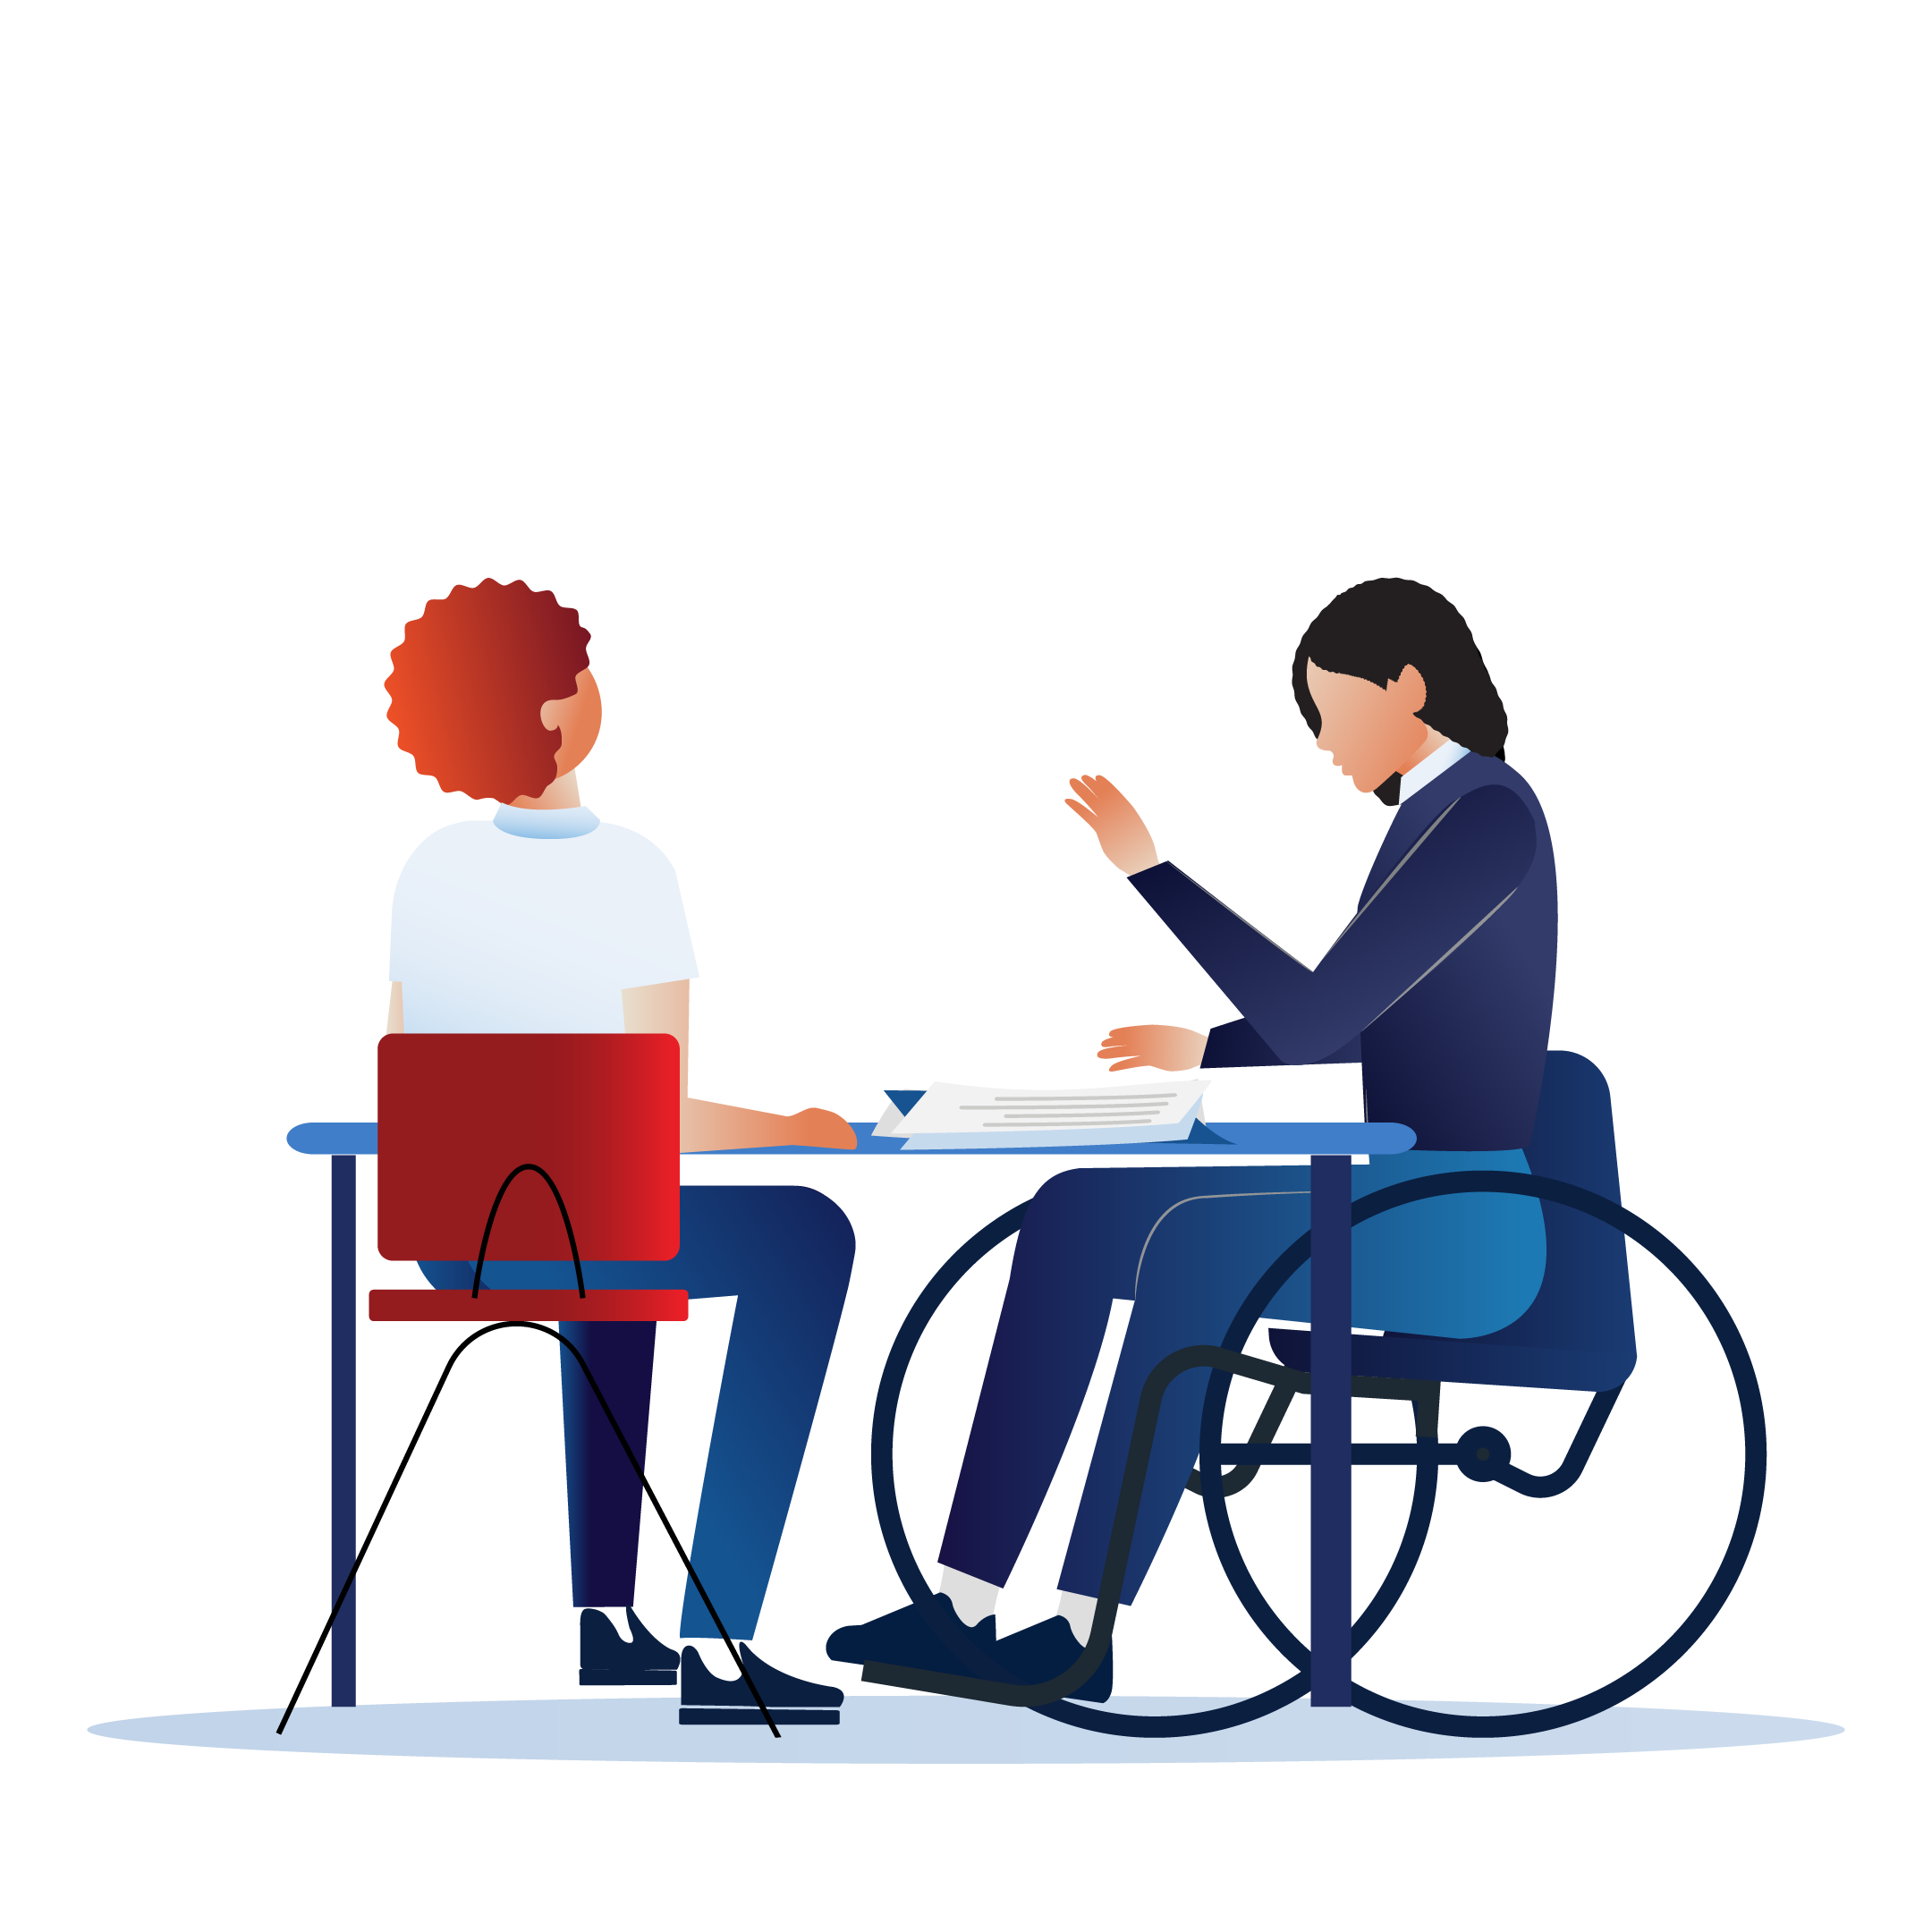
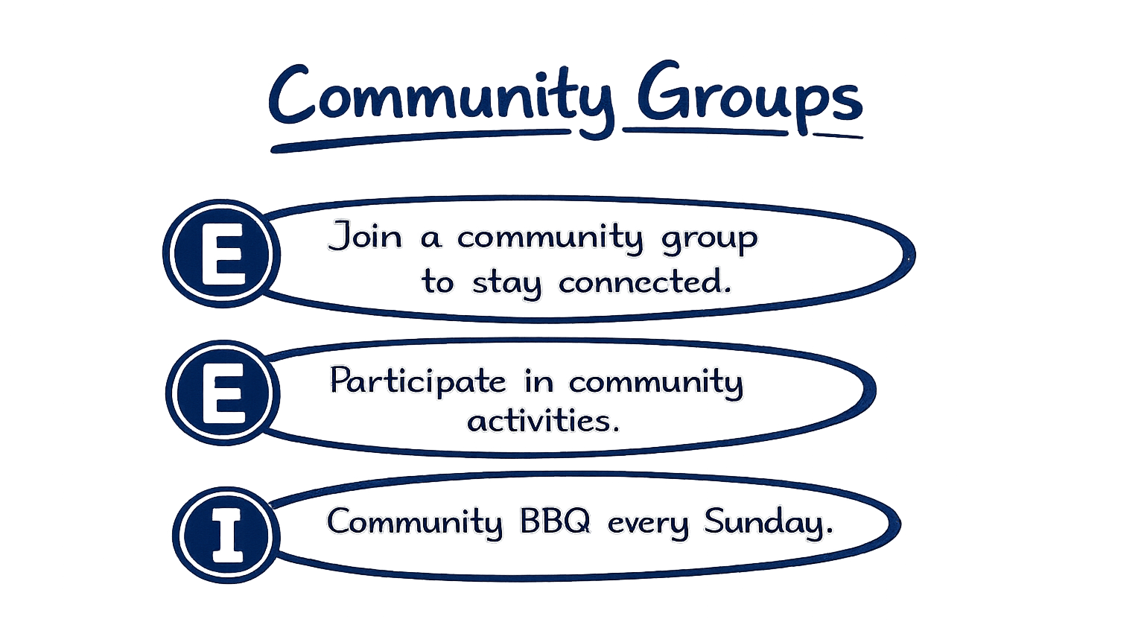
Activity – what counts as health information (2)
Pair activity
Return to your assigned graffiti sheet, and work together to complete the following:
place an “E” next to examples of explicit health messages
place an “I” next to examples of implicit health messages.

Slide 11
Activity – health messages are constructed
Guided discussion
‘Health messages don’t just appear. Someone constructs them – chooses the words, images, music and people, for a purpose’
Consider what the following terms mean in the statement:
constructs
purpose
Use word knowledge and context clues to work out what each word means.

Slide 12

Activity – deconstructing health messages
Modelled example
Model analysing the health message in the ad using the following cognitive strategy sequence:
I notice…
I wonder…
I connect…
I infer…
I conclude…

Slide 13

Activity – deconstructing health messages (guided practice)
Partner work
Analyse the health message in the ad by using the following cognitive strategy sequence:
I notice…
I wonder…
I connect…
I infer…
I conclude…

Slide 14
What shapes health messages?

Slide 15
Learning intentions and success criteria – what shapes health messages?
We are learning to
Evaluate the influence of short-form media on shaping health messages.
I can
identify design features used in short-form media
explain how design features shape the meaning of a health message
analyse how trends, platform systems and contextual factors influence the health messages people see
describe how these messages could influence a young person’s beliefs, self-perception or decisions.
Notes:
Notes for teachers:
Learning intentions and success criteria are best co-constructed with students. Adapt the learning intention as required and add matching success criteria.
For more information See ⁠AITSL or the NSW Department of Education explicit teaching strategies, ⁠Sharing learning intentions and ⁠Sharing success criteria
LISC is not necessarily presented at the beginning of the lesson. Teacher needs to consider most effectual time to introduce
LISC should be revisited during the lesson to support students' evaluation of their learning

Slide 16

Introduction to short-form media
What shapes health messages?
Short-form media refers to short videos, usually 5 to 60 seconds long, found across a variety of platforms. Examples of short-form media include:
Screens that show ads at petrol stations
YouTube Shorts
Social media platforms such as TikTok and Instagram Reels.
Short-form media is highly constructed, influencing:
what we think ‘healthy’ looks like
how we see ourselves or others
what behaviours feel normal or desirable
what content we see next (via algorithms)
Photo by AARN GIRI on Unsplash

Slide 17
Definition – contextual factors
What shapes what we see?
Contextual factors are the things around you that influence the choices you make about your health.
Contextual factors may include:
family and/or friends
culture
money
community
online content or environments.
Definitions

Slide 18
Definition - algorithms
What shapes what we see?
Algorithms are tools that decide what appears in a user’s feed.
Platforms collect signals, such as what users pause on, like, share or watch more than once. These signals are fed into algorithms to shape feeds that feel personal and relevant.
However, algorithms also support platform goals by:
creating opportunities for advertising, sponsorship and paid promotion
keeping people watching
bringing people back to the platform
This means users may see more content that supports business goals, rather than content that is accurate, realistic or supportive of wellbeing.
Definitions

Slide 19
Algorithms
Partner and whole-class discussion
Turn and talk to a partner about the following:
Why might algorithms be seen as beneficial?
What risks might algorithms present for a young person’s self-esteem, self-worth, sense of identity or reputation?
Discuss as a class.

Slide 20
Summary: how your feed is shaped

Slide 21

The invisible architecture framework
Analysing health messages – modelled think aloud
Invisible architecture framework
Layer | Consider
Layer 1 Creator choice | design choices words and images attention-grabbing features
Layer 2 Community trends | popular formats repeated ideas what seems normal
Layer 3 Platform systems | content that feels made to grab attention fast repeated types of videos or messages signs the platform is boosting certain content
Layer 4 Contextual factors | outside influences identity and values different meanings for different people

Slide 22

Activity – analysing health messages (1)
Modelled example
Model analysing the health message in the short-form social media storyboard using:
the cognitive strategy sequence (I notice, I wonder, I connect, I infer)
the Invisible Architecture Framework to complete the ‘I analyse’ step

Slide 23
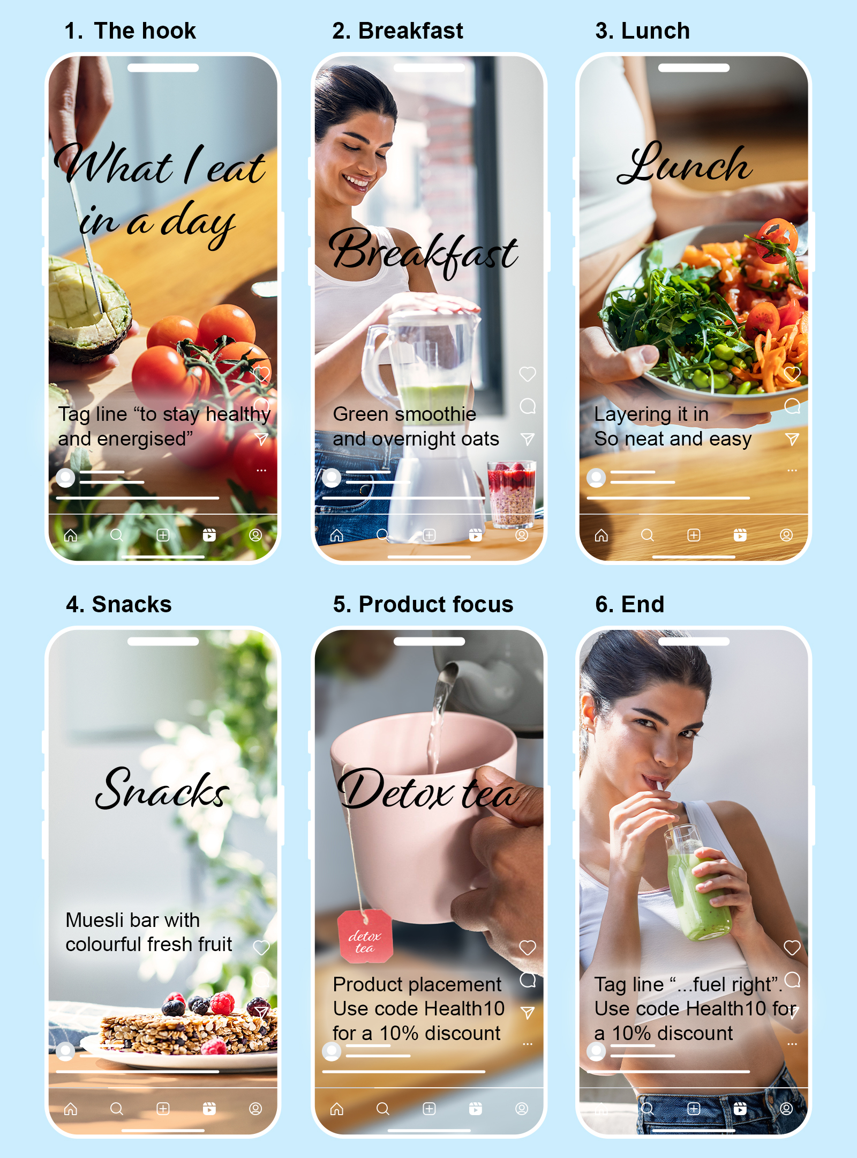
Activity – analysing a health message (2)
Guided practice – partner work
This is a storyboard for a short-form social media video (similar to TikTok or Instagram).
Creators often make deliberate choices about what they show and how health messages are presented.
Who might benefit if viewers believe this message?

Slide 24
Activity – analysing a health message (3)
Work with your partner to analyse the short-form media storyboard using the thinking routine template on your worksheet.
Thinking routine:
I notice… What stands out in the video?
I wonder… What questions does this raise?
I connect… What does this remind you of in real life or online?
I infer… What message might the creator be communicating?
I analyse… What hidden influences might be shaping the message, including creator choices, community trends, platform systems and contextual factors?

Slide 25

Exit ticket – what shapes health messages
Individual activity
Complete an exit ticket by responding to the following sentence stems:
One thing I learned about how health messages are shaped is…
One layer of the Invisible Architecture I will look for next time is… because….

Slide 26
Becoming a digital health detective

Slide 27
Learning intentions and success criteria – becoming a digital health detective
We are learning to
evaluate the credibility of health messages in short-form media.
I can
identify features that make a health message seem credible or misleading
apply the RECAP strategy to assess a health message
explain how online interactions and health messaging can influence people’s wellbeing.
Notes:
Notes for teachers:
Learning intentions and success criteria are best co-constructed with students. Adapt the learning intention as required and add matching success criteria.
For more information See ⁠AITSL or the NSW Department of Education explicit teaching strategies, ⁠Sharing learning intentions and ⁠Sharing success criteria
LISC is not necessarily presented at the beginning of the lesson. Teacher needs to consider most effectual time to introduce
LISC should be revisited during the lesson to support students' evaluation of their learning

Slide 28
Activity – what makes health information trustworthy?
Individually
Read the information and then each health message.
Put a ✓ next to statements that seem trustworthy.
Put a ? next to statements that seem questionable.
Write a short reason for each decision.
As a group
Share one message you thought was trustworthy and why.
Share one message you doubted and why.
Discuss any messages your group disagreed on.

Slide 29
Introduction to the RECAP strategy
Checking whether health information is trustworthy
Element | Consider
R: Red flags | Are there warning signs? Can I see big promises, instant results, miracle cures or extreme before-and-after pictures?
E: Expertise | Who made or shared this message? Do they have relevant health qualifications or expertise?
C: Credible evidence | Is there evidence to support the message? Does it refer to reputable organisations, research or guidelines?
A: Accuracy and balance | Is the message realistic, fair and balanced? Does it acknowledge that results can vary? Does it avoid exaggeration?
P: Purpose | Why was this made? Is it designed to share information, sell a product or gain followers? The purpose can affect how much I trust the message.
Then ask: Can I trust this message?

Slide 30
Activity – assessing the trustworthiness of health messages
Guided practice (pairs)
Watch the clip.
Use RECAP to assess the message.
Record your evidence on your worksheet.
Be ready to discuss your RECAP and final judgement, including:
How trustworthy is this message?
What is your main reason?

Slide 31

Written response – assessing the trustworthiness of health information
Individual activity
Complete a written response by responding to the following prompts:
One feature that can make a health message more trustworthy is…
One way misleading health messages could impact someone’s wellbeing, identity or safety is…

Slide 32
Taking control of your feed: practical digital wellbeing skills

Slide 33
Learning intentions and success criteria – taking control of your feed: practical digital wellbeing skills
We are learning to
use practical strategies to manage our digital environments so that online health content supports our wellbeing.
I can
identify when online health content affects my thoughts, body image or wellbeing
identify practical strategies to create a healthier and safer digital environment
apply techniques to reset or curate my feed to avoid harmful or misleading content
choose protective digital behaviours that support safer decision-making online.
Notes:
Notes for teachers:
Learning intentions and success criteria are best co-constructed with students. Adapt the learning intention as required and add matching success criteria.
For more information See ⁠AITSL or the NSW Department of Education explicit teaching strategies, ⁠Sharing learning intentions and ⁠Sharing success criteria
LISC is not necessarily presented at the beginning of the lesson. Teacher needs to consider most effectual time to introduce
LISC should be revisited during the lesson to support students' evaluation of their learning

Slide 34

Activity – Why your feed looks the way it does
Ethan watched one ‘ab workout’ video all the way through, just out of curiosity. The next day, he got five more. By the
end of the week, his
entire feed made him feel like everyone else was fitter and more disciplined.
Group work
Read Ethan’s scenario.
Consider and discuss the following questions:
What messages might Ethan start believing?
How might Ethan start feeling about himself?
How is Ethan being positioned by his feed?
How could these feelings influence his behaviour or confidence?

Slide 35
Definition – echo chambers
Why my feed looks the way it does
An echo chamber is a digital environment where similar messages, ideas or content are repeated so often that they start to feel normal, true or expected.
This happens when a person watches, likes, saves or shares similar content, and the platform keeps recommending more of it.
Over time, an echo chamber can:
narrow what a person sees
shape what they believe
influence how they feel about themselves
affect choices, habits and wellbeing
Definitions

Slide 36
Activity – skills carousel
Strategies to manage my feed
At each station
Read the scenario
Discuss the strategy with your group
Record your ideas on the worksheet
Be ready to share one key idea
As you rotate through the stations, think about:
How the strategy could protect wellbeing
When the strategy might be useful
What action someone could take straight away
Be ready to compare which strategies may be most effective in different situations.

Slide 37
Activity – curate my clicks (1)
Modelled example
Scenario 1 – Riley and tanning line content
Riley’s feed has recently become filled with videos highlighting “perfect tanning lines,” beach body shots and captions such as ‘summer-ready’ and ‘earned my stripes.’ Many of the videos show lean bodies with sharp tan lines. Lately, Riley notices that:
they compare their body and appearance to every creator they see
they feel pressure to achieve a similar look
they avoid swimming or going to the beach with friends because they do not feel confident about how their body looks in comparison
they know that scrolling through this content makes them feel worse, but because they pause, re-watch and engage with these videos, their feed keeps showing more of the same trend every day.

Slide 38
Activity – curate my clicks (2)
Scenario analysis
With your partner:
Read your scenario
Discuss the reflection questions
Complete your worksheet
Choose the strategy that would help most
Be ready to justify your choice.
Focus on:
messages being received
possible feelings and impacts
risks and influences
practical actions that could help.

Slide 39
Activity – Digital wellbeing action plan
Individual written response
Respond to each question in full sentences.
Think about:
one online pattern that could affect wellbeing
one strategy that could help
how this strategy supports wellbeing, safety, self-worth or decision-making online
one action that could be taken this week.

Slide 40
Creating credible digital health content

Slide 41
Learning intentions and success criteria – creating credible digital health content
We are learning to
apply our knowledge and skills to create credible, inclusive digital health content that promotes wellbeing.
I can
apply the RECAP strategy to guide the creation of a trustworthy health message
design a digital health post that is inclusive, realistic and supportive of wellbeing
justify my design choices using knowledge of credibility, context, algorithms and audience impact
explain how my content supports individual and community health and wellbeing.
Notes:
Notes for teachers:
Learning intentions and success criteria are best co-constructed with students. Adapt the learning intention as required and add matching success criteria.
For more information See ⁠AITSL or the NSW Department of Education explicit teaching strategies, ⁠Sharing learning intentions and ⁠Sharing success criteria
LISC is not necessarily presented at the beginning of the lesson. Teacher needs to consider most effectual time to introduce
LISC should be revisited during the lesson to support students' evaluation of their learning

Slide 42
Activity – checking for understanding (1)
Individual activity
Instructions
Work silently and independently.
Attempt every question.
Use what you remember from previous learning.
You will check and correct your answers as a class.

Slide 43
Activity – checking for understanding (2)
Answers
Part A – Invisible Architecture Framework
Layer |  | Description
Creator choice |  | The wider influences that shape how a message is interpreted, such as age, culture, identity, current issues or life experience
Community trends |  | The features of the platform that influence what people see, repeat and engage with, such as algorithms, autoplay, likes and recommendations.
Platform trends |  | The deliberate choices made when constructing a message, such as images, music, captions, editing, wording and tone.
Contextual factors |  | The social norms, popular ideas or online trends that shape what is seen as normal, desirable or worth sharing.

Slide 44
Activity – checking for understanding (3)
Answers
Part B – RECAP strategy
RECAP Strategy
R | Red flags
E | Expertise
C | Credible evidence
A | Accuracy and balance
P | Purpose

Slide 45
Activity – checking for understanding (4)
Answers
Part C – Quick application
Example post: “Do this one morning routine every day to feel happier, healthier and more confident fast.”
Which layer of the Invisible Architecture Framework is most obvious in this example? Creator choice
What is one reason this message should be checked carefully before trusting it? It makes a big promise of fast results without providing any evidence, which may be a red flag.
Which part of RECAP would help you test whether this message is trustworthy? C – Credible evidence
R – Red flags may also be accepted if students explain that the message includes exaggerated or unrealistic promises.

Slide 46
Activity – design a credible digital health post
Individual or pairs activity
Instructions
Using your ‘Short-form media content planner’ worksheet:
Choose one health topic and your audience
Plan the message and format
Use RECAP strategy to check for trustworthiness
Sketch/plan your mock-up
Justify your choices.

Slide 47
Activity – short-form media plan peer feedback
Individual or pairs activity
Read your peer’s health message design carefully.
Use your ‘Short-form media plan: peer feedback template’ to review the plan and provide feedback
Return the feedback to the original creator
After receiving feedback:
Read the feedback
Select one change you can make to improve your plan or justification
Be ready to share the core message in your plan and one deliberate choice you made to ensure your message was credible or inclusive.

Slide 48
References
This presentation contains NSW Curriculum and syllabus content. The NSW Curriculum is developed by the NSW Education Standards Authority. This content is prepared by NESA for and on behalf of the Crown in the right of the State of New South Wales. The material is protected by Crown copyright.
Please refer to the NESA Copyright Disclaimer for more information https://educationstandards.nsw.edu.au/wps/portal/nesa/mini-footer/copyright.
NESA holds the only official and up-to-date versions of the NSW Curriculum and syllabus documents. Please visit the NSW Education Standards Authority (NESA) website https://educationstandards.nsw.edu.au/wps/portal/nesa/home and the NSW Curriculum website https://curriculum.nsw.edu.au.
Personal Development, Health and Physical Education 7–10 Syllabus © NSW Education Standards Authority (NESA) for and on behalf of the Crown in right of the State of New South Wales, 2024.

Slide 49
Copyright
© State of New South Wales (Department of Education), 2026
The copyright material published in this resource is subject to the Copyright Act 1968 (Cth) and is owned by the NSW Department of Education or, where indicated, by a party other than the NSW Department of Education (third-party material).
Copyright material available in this resource and owned by the NSW Department of Education is licensed under a Creative Commons Attribution 4.0 International (CC BY 4.0) license.
This license allows you to share and adapt the material for any purpose, even commercially.
Attribution should be given to © State of New South Wales (Department of Education), 2026.
Material in this resource not available under a Creative Commons license:
the NSW Department of Education logo, other logos and trademark-protected material
Material owned by a third party that has been reproduced with permission. You will need to obtain permission from the third party to reuse its material.
Links to third-party material and websites
Please note that the provided (reading/viewing material/list/links/texts) are a suggestion only and implies no endorsement, by the New South Wales Department of Education, of any author, publisher, or book title. School principals and teachers are best placed to assess the suitability of resources that would complement the curriculum and reflect the needs and interests of their students.
If you use the links provided in this document to access a third-party’s website, you acknowledge that the terms of use, including licence terms set out on the third-party’s website apply to the use which may be made of the materials on that third-party website or where permitted by the Copyright Act 1968 (Cth). The department accepts no responsibility for content on third-party websites.

