Slide 1
How to use this presentation
This is a student-facing resource designed to support teachers in presenting the key steps of The Collaborative Investigation Process, either in the development of their own collaborative investigation or when engaging in the Technology and young people – sample program or Immediate physiological responses to aerobic training – sample program.
Teachers are encouraged to adopt and adapt this resource to the specific needs of their class.
Further information about the collaborative investigation and access to the resources listed above can be found on our Planning, programming and assessing PDHPE 11–12 webpage.

Slide 2
The collaborative investigation process
NSW Department of Education
Health and movement science

Slide 3
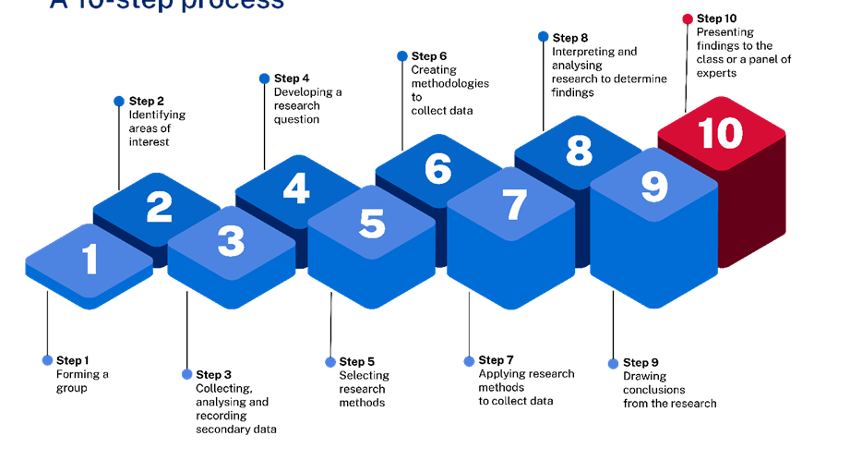
Collaborative investigation
A 10-step process

Slide 4
1. Getting to know your group
Once you are in your collaborative investigation group:
discuss your strengths as an individual and what you think you bring to the group
discuss and establish group norms, expectations, processes, boundaries and standards. How will you work together?
develop a group contract based on what you have agreed to.
Notes:
Teachers make decisions about forming groups. Reviewing the 11HMS – the collaborative investigation process support document on the Planning, programming and assessing PDHPE 11–12 webpage may help you decide on the right approach for your class.
This activity is designed to support the students in your class to lay the foundation for their group to work effectively together.

Slide 5
2. Identifying areas of interest
In your group:
brainstorm areas of interest that connect to the Health and Movement Science 11–12 Syllabus
narrow this down to opportunities for investigation
What more do you want to know about this area?
What information might you be able to collect to answer your questions?
negotiate with your group and finalise your area of interest.
Collaboration strategies
Make quality contributions
Actively listen and acknowledge contributions
Modify your communication style where necessary
Negotiate and seek input from all members
Notes:
Teachers support the groups in their class to brainstorm and refine their ideas for an area of interest. Note the call out box in blue. This is a great time to highlight key collaboration skills to your class and to praise and encourage when you see them occur in your lesson.

Slide 6
3. Collecting, analysing and recording secondary data
Research what has already been researched in your area of interest. It may be helpful to divide and allocate the reading among your group. Record specific details such as the type of resource or text, sample size and key findings.
Decide as a group where to store the information you find (for example, Google drive), including a reference list, roles and responsibilities for investigating secondary data and a time frame for when this work needs to be completed.
Discuss your findings, identify common themes and identify areas of interest that may form the basis of your investigation.

Slide 7
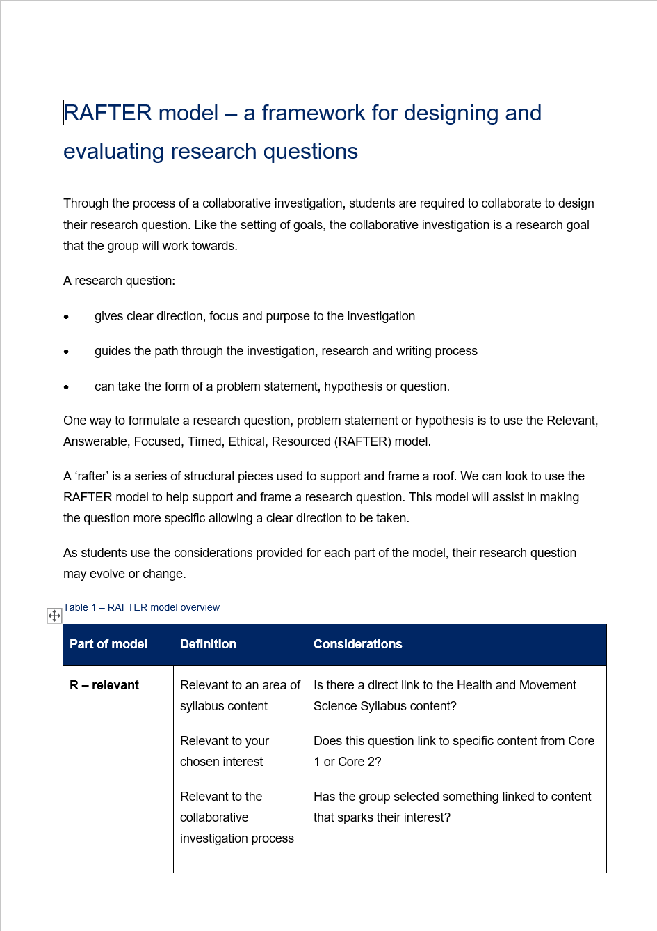
4. Develop a research question (1)
In your group:
negotiate the final topic, content, issue and population or target group based on secondary source reviews, findings and gaps in the research
create potential research questions individually related to the final agreed topic, content or issue for the investigation
present questions to your group
use a guide, such as the Relevant, Answerable, Focused, Timed, Ethical and Resourced (RAFTER) model, to make judgements on the suitability of each question.

Slide 8
4. Develop a research question (2)
In your group:
discuss and compare each question, considering how well it stood up against the RAFTER model, whether it aligns strongly with the groups’ area of interest and any other considerations you uncovered while reviewing it
establish a consensus and agree on the final research question.

Slide 9
5. Selecting research methods
In your group:
identify the most suitable research methods for the research question or problem
What information do you need to answer the question you have posed?
Where and how could you get this information?
Considerations
Ethical – relating to right or wrong conduct.
Valid – how well the research method measures what it is supposed to measure?
Reliable – will your method create repeatable/consistent results?
Credible – is the research process, methods and findings trustworthy?
Safety/risks – could anyone get hurt? How?

Slide 10
6. Creating methodologies to collect data
In your group:
create the method (step-by-step plan/process) for conducting the research, including how ethical and safety considerations and risks will be managed, for example, collecting data without names to reduce ethical issues and avoid bias
develop each research method, instruction and protocols for primary data collection, for example, questionnaire, practical application or lab protocol and recording sheet, observation sheet, interview questions, environment, instructions, equipment
discuss processes for secondary data collection, for example, storage, coding, credibility of sources
test, review and evaluate each research method using group members or other members of the class to check reliability and validity.

Slide 11
7. Applying the research method
As a group:
allocate roles and responsibilities to access and collect data
identify, source and test resources for testing and recording
organise access to the target or population group or secondary sources
seek informed consent from research participants
implement the research methods to collect and record data
use an established process and system to record and share results and data between group members.

Slide 12
8. Interpreting and analysing research to determine findings
As a group:
organise data into graphs and tables
analyse the data for trends and themes
share findings as a group and discuss all the information you have collected
evaluate the depth and quality of information in relation to the research question
determine if the data and information is enough or whether secondary sources or more primary data is required.
12

Slide 13
9. Draw conclusions
As a group:
draw conclusions from the findings to answer the research question, prove or disprove a hypothesis
ask relevant questions to deepen individual and group understanding of the content, issue or findings
identify relationships across the findings and compare to secondary data
develop arguments and justifications for the data and findings and discuss as a group
identify areas for future investigation.

Slide 14
10. Present findings
As a group:
determine the best way to present the findings, for example, verbal explanation, infographic, report, presentation, video
decide as a team and clearly define what each person’s role or responsibility is in presenting the findings
present findings
credit sources of data in a reference list.

Slide 15
References
This presentation contains NSW Curriculum and syllabus content. The NSW Curriculum is developed by the NSW Education Standards Authority. This content is prepared by NESA for and on behalf of the Crown in the right of the State of New South Wales. The material is protected by Crown copyright.
Please refer to the NESA Copyright Disclaimer for more information https://educationstandards.nsw.edu.au/wps/portal/nesa/mini-footer/copyright.
NESA holds the only official and up-to-date versions of the NSW Curriculum and syllabus documents. Please visit the NSW Education Standards Authority (NESA) website https://educationstandards.nsw.edu.au/ and the NSW Curriculum website https://curriculum.nsw.edu.au.
Health and Movement Science 11–12 Syllabus © NSW Education Standards Authority (NESA) for and on behalf of the Crown in right of the State of New South Wales, 2023.

Slide 16
Copyright
© State of New South Wales (Department of Education), 2024
The copyright material published in this resource is subject to the Copyright Act 1968 (Cth) and is owned by the NSW Department of Education or, where indicated, by a party other than the NSW Department of Education (third-party material).
Copyright material available in this resource and owned by the NSW Department of Education is licensed under a Creative Commons Attribution 4.0 International (CC BY 4.0) license.
This license allows you to share and adapt the material for any purpose, even commercially.
Attribution should be given to © State of New South Wales (Department of Education), 2024.
Material in this resource not available under a Creative Commons license:
the NSW Department of Education logo, other logos and trademark-protected material
Material owned by a third party that has been reproduced with permission. You will need to obtain permission from the third party to reuse its material.
Links to third-party material and websites
Please note that the provided (reading/viewing material/list/links/texts) are a suggestion only and implies no endorsement, by the New South Wales Department of Education, of any author, publisher, or book title. School principals and teachers are best placed to assess the suitability of resources that would complement the curriculum and reflect the needs and interests of their students.
If you use the links provided in this document to access a third party’s website, you acknowledge that the terms of use, including licence terms set out on the third-party’s website apply to the use which may be made of the materials on that third-party website or where permitted by the Copyright Act 1968 (Cth). The department accepts no responsibility for content on third-party websites.

