Slide 1
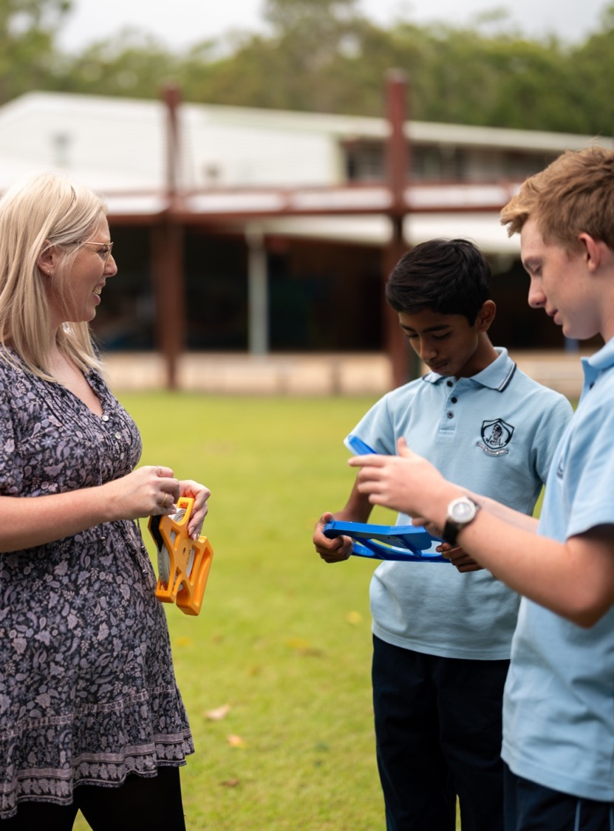
Constructing networks from a table
Mathematics Standard – Stage 6 (Year 11)
Unit 5 - Going places

Slide 2
Learning intentions and success criteria
Learning intentions
To be able to find the elapsed time in a network involving real-world situations.
To be able to use information in a table to construct a network diagram.
Success criteria
I can use my calculator to convert units of time.
I can construct a network diagram from a table
I can construct a directed network diagram from a table
I can analyse a network diagram with weighted edges to solve problems

Slide 3
Activating prior knowledge

Slide 4
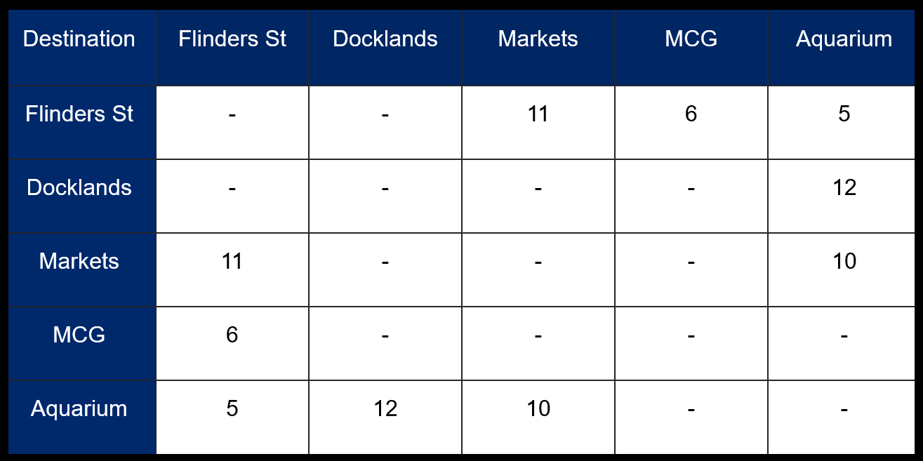
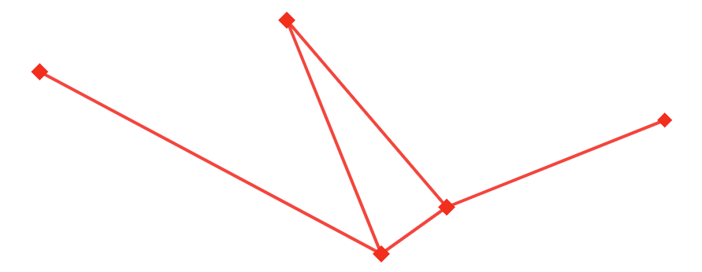
Notice and wonder
Markets
Docklands
MCG
11
10
6
12
5
Flinders St
Aquarium

Slide 5
Connecting learning

Slide 6
Sight seeing in Melbourne
Melbourne walking travel times in minutes
Destinations | Gardens (G) | Docklands (D) | Markets (M) | Aquarium (A) | Sky deck (S)
(G) | - | 65 | - | 30 | 21
(D) | 65 | - | 33 | 31 | 44
(M) | - | 33 | - | 22 | 29
(A) | 30 | 31 | 22 | - | 12
(S) | 21 | 44 | 29 | 12 | -

Slide 7
Festival of lights
Installations |  | To
 |  | (H) | (T) | (L) | (D) | (G)
From | Hoya flowers (H) | - | 5 | - | - | 11
 | Trapezoid tunnel (T) | 5 | - | - | 7 | 9
 | Laser (L) | - | - | - | - | 6
 | Dandelions (D) | - | 7 | 4 | - | -
 | Greenhouses (G) | 14 | 9 | - | - | -

Slide 8








Calculator use (1)
Convert 4600 seconds into hours, minutes and seconds.
$0$
$$DMS$$
$0$
$$DMS$$
$$4600$$
$$DMS$$
$$=$$
$$1° 16′40"$$
$$\text{1 }\text{hour}\text{ 16 }\text{minutes}\text{ 40 }\text{seconds}$$

Slide 9












Calculator use (2)
Add 12 hour 45 minutes and 6 hour 25 minutes.
DMS
$°$ ’ ”
$12$
$$DMS$$
$45$
$$DMS$$
$$+ 6$$
$$DMS$$
$25$
$$DMS$$
$$=$$
$$3° {10}^{′}$$
$$3 hours and 10 minutes$$

Slide 10
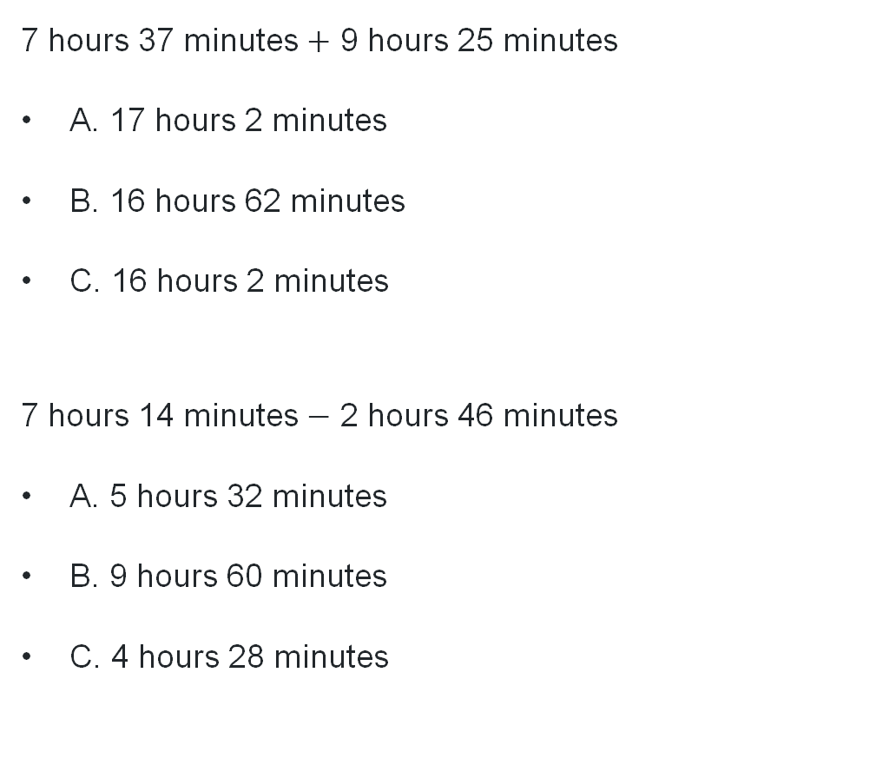
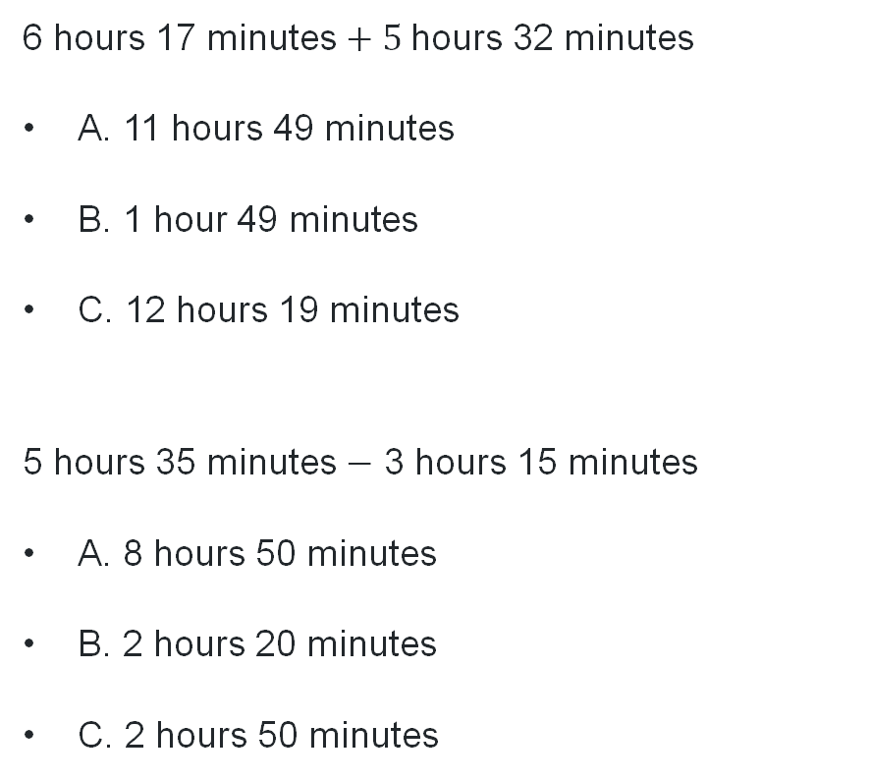
Add and Subtract time
6 hours 17 minutes $+ 5$hours 32 minutes
A. 11 hours 49 minutes
B. 1 hour 49 minutes
C. 12 hours 19 minutes
5 hours 35 minutes $−$ 3 hours 15 minutes
A. 8 hours 50 minutes
B. 2 hours 20 minutes
C. 2 hours 50 minutes
7 hours 37 minutes $+$ 9 hours 25 minutes
A. 17 hours 2 minutes
B. 16 hours 62 minutes
C. 16 hours 2 minutes
7 hours 14 minutes $−$ 2 hours 46 minutes
A. 5 hours 32 minutes
B. 9 hours 60 minutes
C. 4 hours 28 minutes

Slide 11
Releasing responsibility

Slide 12
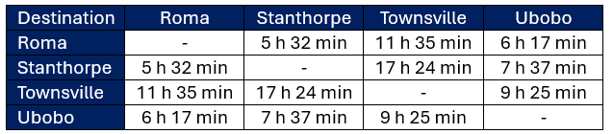
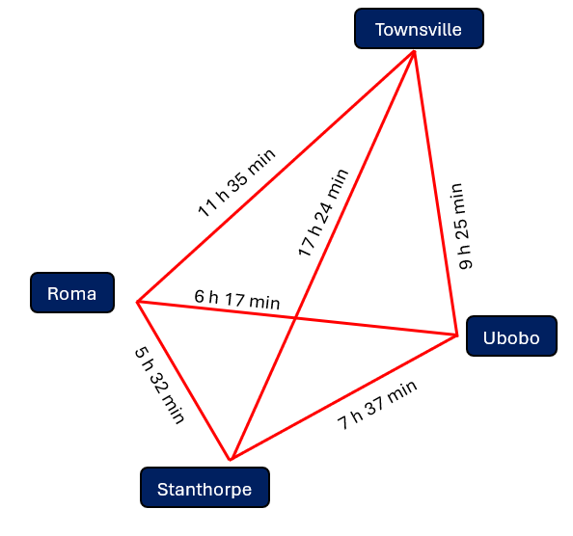
Worked example (1)
Question part a
This table shows the time it takes to travel between these country towns in Queensland.
Draw a network diagram to display this information.
What do we notice about the numbers in the table?

Slide 13
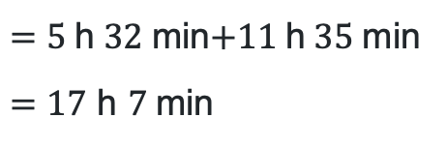
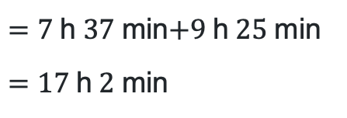
Worked example (2)
Question part b
b. Which route is the fastest from Stanthorpe to Townsville?
via Ubobo
$=7$h$37$min$+9$h$25$min
$=17$h$2$min
Why might the time for the direct route be longer?
via Roma
$=5$h$32$min$+11$h$35$min
$=17$ h $7$min
The road via Ubobo is the fastest.
How much time was saved?

Slide 14
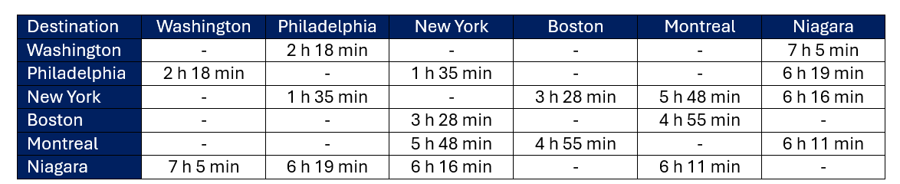
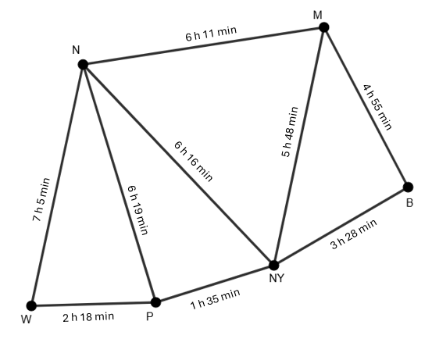
Your turn (1)
Question part a
This table shows the time it takes to travel between towns.
Draw a network diagram to display this information.

Slide 15
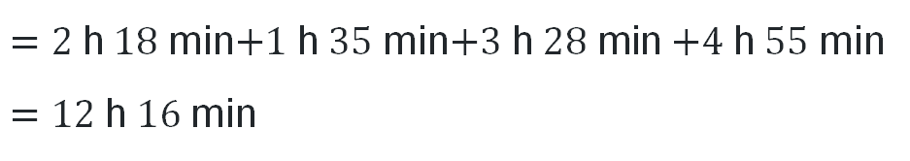
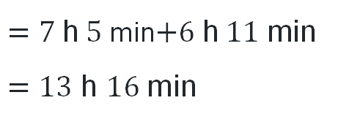
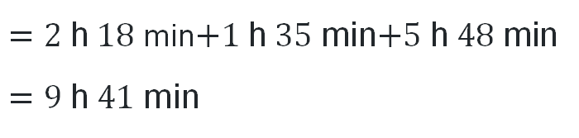
Your turn (2)
Question part b
b. How long is the quickest route from Washington to Montreal?
via New York
$=2$h$18$min$+1$h$35$min$+5$h$48$min
$=9$h$41$min
via Niagara
$=7$h$5$min$+6$h$11$min
$=13$ h $16$min
via Boston
$=2$h$18$min$+1$h$35$min$+3$h$28$min $+4$h$55$min
$=12$h$16$min
The road via New York is the quickest.

Slide 16
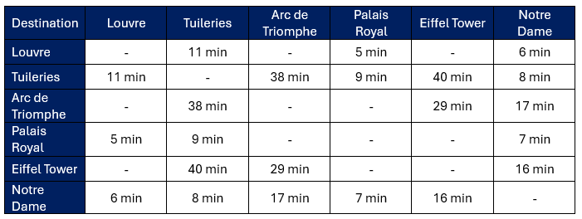
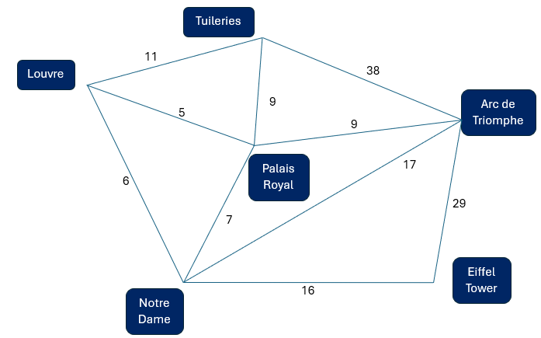
Incorrect worked example
How does the degree of the vertices help you find the error?
Spot the errors in the network diagram.
Why is this network incorrect?

Slide 17
Independent practice

Slide 18
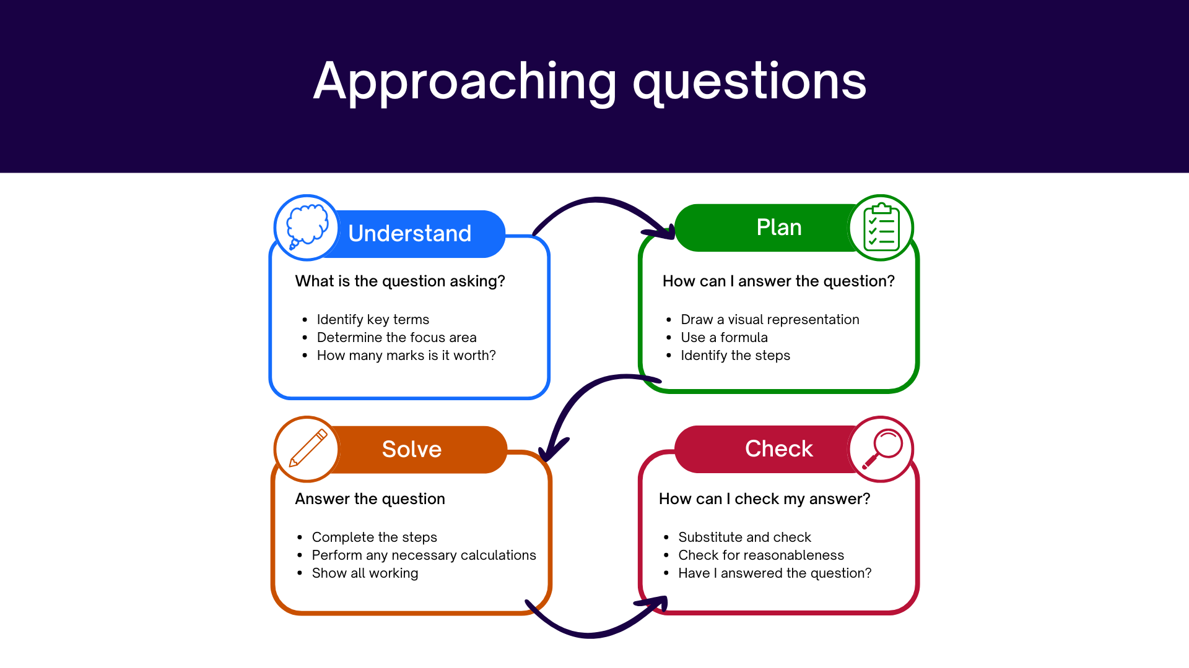
Approaching questions scaffold
…..

Slide 19
References
This presentation contains NSW Curriculum and syllabus content. The NSW Curriculum is developed by the NSW Education Standards Authority. This content is prepared by NESA for and on behalf of the Crown in the right of the State of New South Wales. The material is protected by Crown copyright.
Please refer to the NESA Copyright Disclaimer for more information https://educationstandards.nsw.edu.au/wps/portal/nesa/mini-footer/copyright.
NESA holds the only official and up-to-date versions of the NSW Curriculum and syllabus documents. Please visit the NSW Education Standards Authority (NESA) website https://educationstandards.nsw.edu.au/wps/portal/nesa/home and the NSW Curriculum website https://curriculum.nsw.edu.au.
Mathematics Standard 11–12 Syllabus © NSW Education Standards Authority (NESA) for and on behalf of the Crown in right of the State of New South Wales, 2024.

Slide 20
Copyright
© State of New South Wales (Department of Education), 2026
The copyright material published in this resource is subject to the Copyright Act 1968 (Cth) and is owned by the NSW Department of Education or, where indicated, by a party other than the NSW Department of Education (third-party material).
Copyright material available in this resource and owned by the NSW Department of Education is licensed under a Creative Commons Attribution 4.0 International (CC BY 4.0) license.
This license allows you to share and adapt the material for any purpose, even commercially.
Attribution should be given to © State of New South Wales (Department of Education), 2026.
Material in this resource not available under a Creative Commons license:
the NSW Department of Education logo, other logos and trademark-protected material
Material owned by a third party that has been reproduced with permission. You will need to obtain permission from the third party to reuse its material.
Links to third-party material and websites
Please note that the provided (reading/viewing material/list/links/texts) are a suggestion only and implies no endorsement, by the New South Wales Department of Education, of any author, publisher, or book title. School principals and teachers are best placed to assess the suitability of resources that would complement the curriculum and reflect the needs and interests of their students.
If you use the links provided in this document to access a third-party’s website, you acknowledge that the terms of use, including licence terms set out on the third-party’s website apply to the use which may be made of the materials on that third-party website or where permitted by the Copyright Act 1968 (Cth). The department accepts no responsibility for content on third-party websites.

