Slide 1
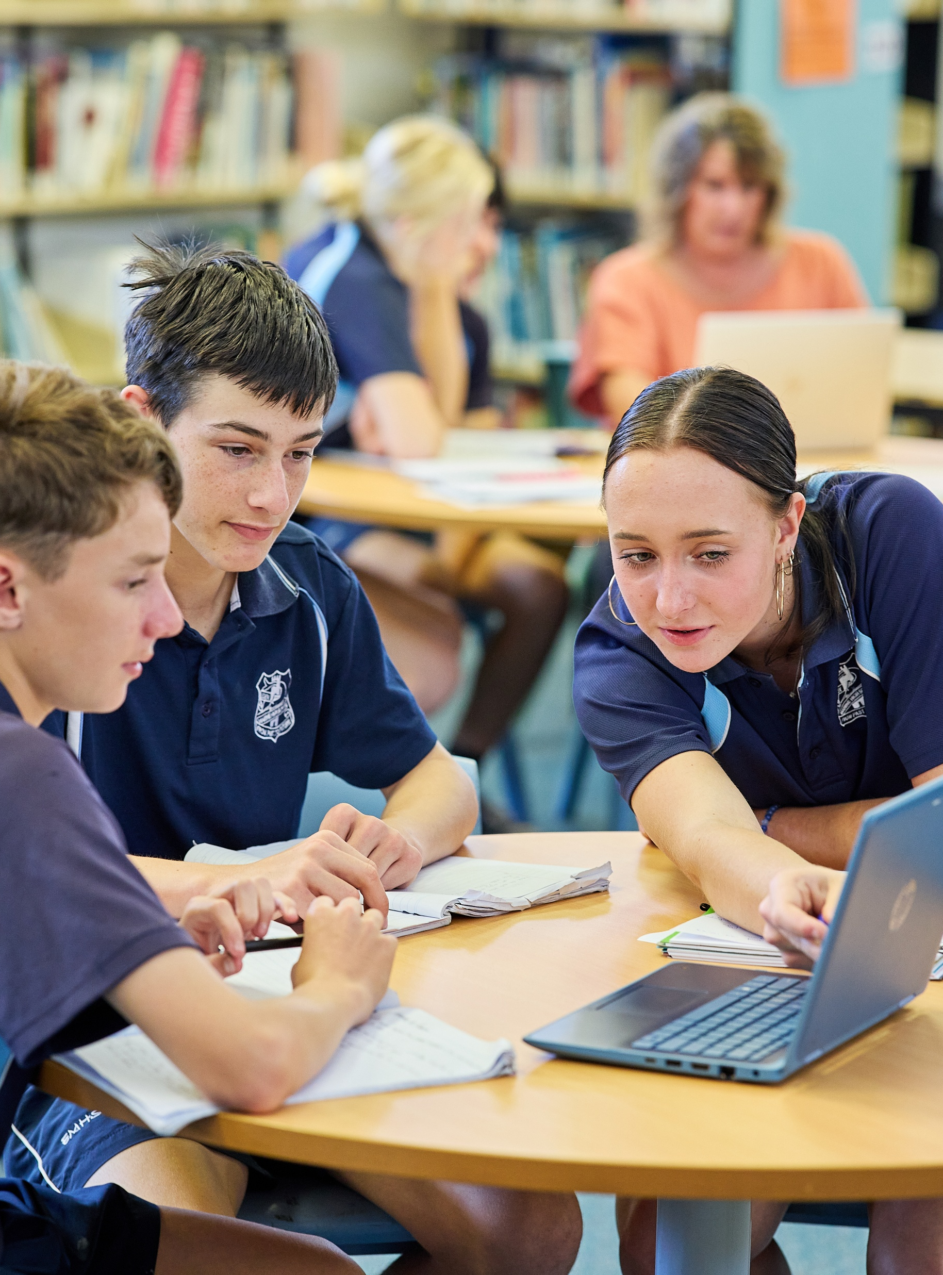
Standard deviation
Mathematics Standard – Stage 6 (Year 11)
Unit 4 –Driving Safely

Slide 2
Learning intentions and success criteria
Learning intentions
To understand standard deviation as a measure of data spread.
To be able to use standard deviation to compare and interpret datasets.
Success criteria
I can calculate the standard deviation of a dataset using a scientific calculator or digital tools.
I can explain what standard deviation reveals about data consistency and variability.
I can compare datasets using standard deviation alongside other measures of centre and spread.
I can justify which measures of centre and spread are most appropriate for a given dataset.
Notes:
Notes for teachers:
Learning intentions and success criteria are best co-constructed with students. Adapt the learning intention as required and add matching success criteria.
For more information See ⁠AITSL or the NSW Department of Education explicit teaching strategies, ⁠Sharing learning intentions and ⁠Sharing success criteria
LISC is not necessarily presented at the beginning of the lesson. Teacher needs to consider most effectual time to introduce
LISC should be revisited during the lesson to support students' evaluation of their learning

Slide 3
Connecting learning

Slide 4
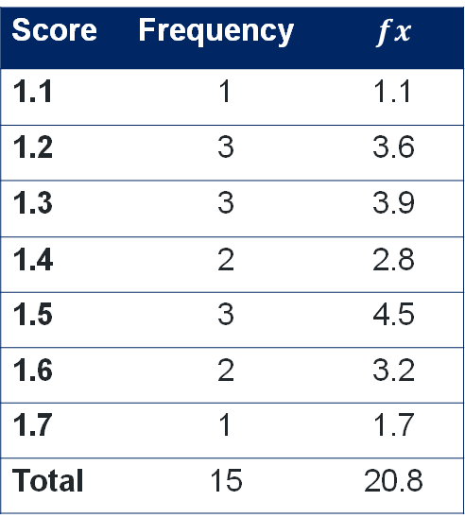
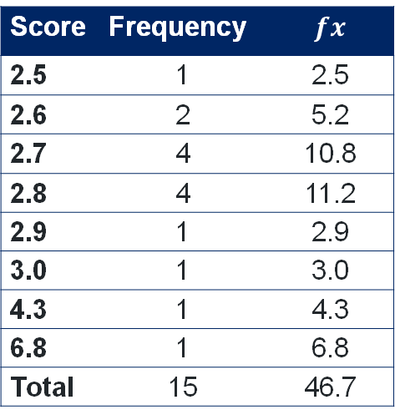
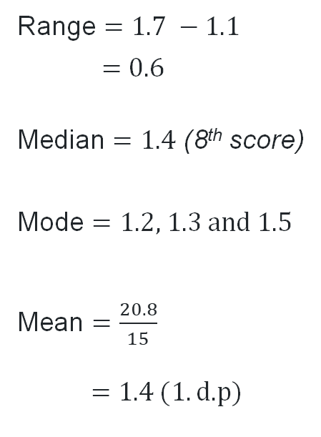
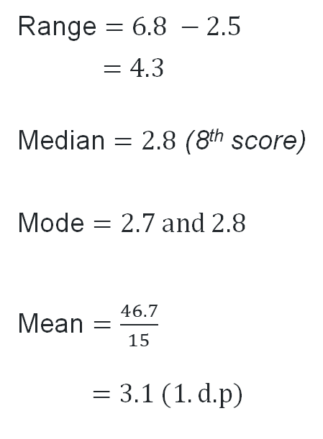
Datasets – Steering variation
Answers
Score | Frequency | $$fx$$
2.5 | 1 | 2.5
2.6 | 2 | 5.2
2.7 | 4 | 10.8
2.8 | 4 | 11.2
2.9 | 1 | 2.9
3.0 | 1 | 3.0
4.3 | 1 | 4.3
6.8 | 1 | 6.8
Total | 15 | 46.7
Range $=6.8 −2.5$
$$=4.3$$
Median $=2.8$ (8th score)
Mode $=2.7 \text{and} 2.8$
Mean $=\frac{46.7}{15}$
$=3.1 (1.\text{d}\text{.}\text{p}\text{)}$
Score | Frequency | $$fx$$
1.1 | 1 | 1.1
1.2 | 3 | 3.6
1.3 | 3 | 3.9
1.4 | 2 | 2.8
1.5 | 3 | 4.5
1.6 | 2 | 3.2
1.7 | 1 | 1.7
Total | 15 | 20.8
Range $=1.7 −1.1$
$$=0.6$$
Median $=1.4$ (8th score)
Mode $=\text{1.2, 1.3 }\text{and} 1.5$
Mean $=\frac{20.8}{15}$
$=1.4 (1.\text{d}\text{.}\text{p}\text{)}$

Slide 5
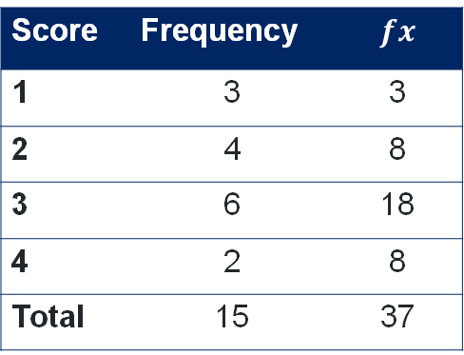
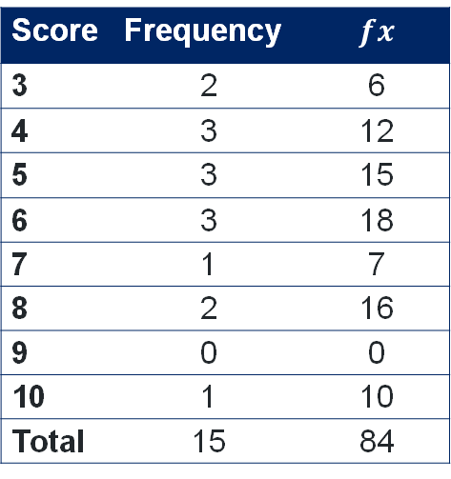
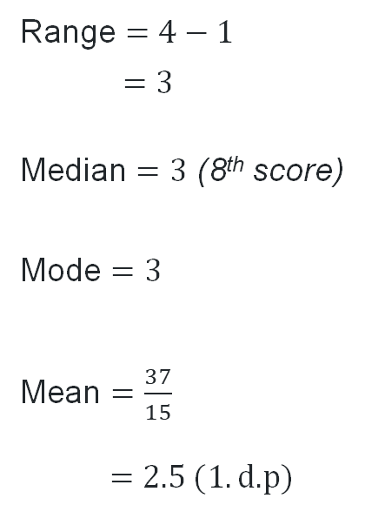
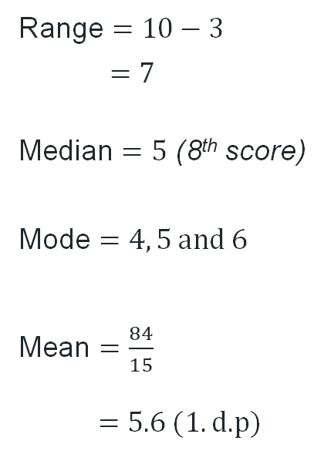
Datasets – Speed variation
Answers
Score | Frequency | $$fx$$
3 | 2 | 6
4 | 3 | 12
5 | 3 | 15
6 | 3 | 18
7 | 1 | 7
8 | 2 | 16
9 | 0 | 0
10 | 1 | 10
Total | 15 | 84
Range $=10−3$
$$=7$$
Median $=5$ (8th score)
Mode $=4, 5 \text{and} 6$
Mean $=\frac{84}{15}$
$=5.6 (1.\text{d}\text{.}\text{p}\text{)}$
Score | Frequency | $$fx$$
1 | 3 | 3
2 | 4 | 8
3 | 6 | 18
4 | 2 | 8
Total | 15 | 37
Range $=4−1$
$$=3$$
Median $=3$ (8th score)
Mode $=3$
Mean $=\frac{37}{15}$
$=2.5 (1.\text{d}\text{.}\text{p}\text{)}$

Slide 6
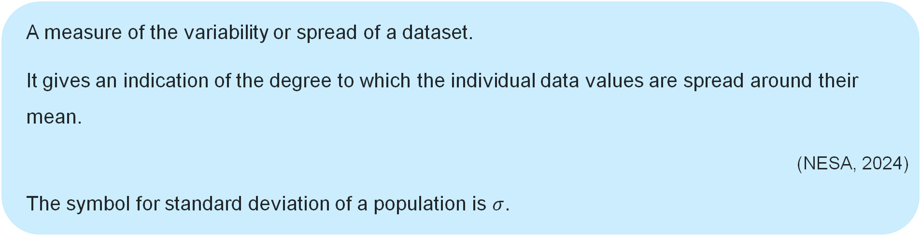
NESA Glossary
Standard deviation
A measure of the variability or spread of a dataset.
It gives an indication of the degree to which the individual data values are spread around their mean.
  (NESA, 2024)
  The symbol for standard deviation of a population is $σ$.

Slide 7
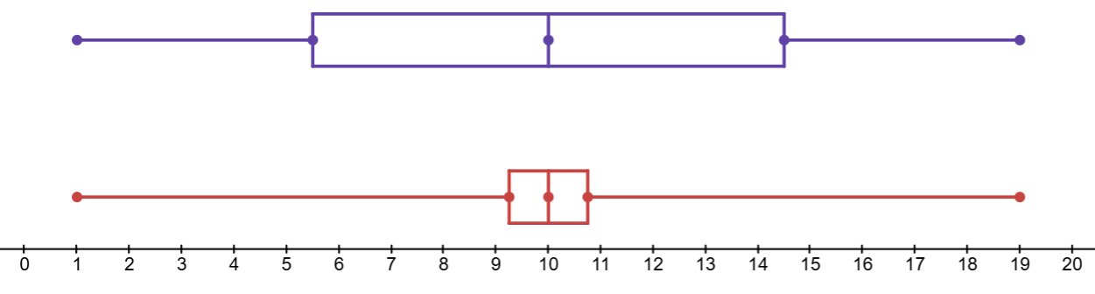
Example
Standard deviation
Dataset 1: 1, 3, 5, 7, 10, 10, 13, 15, 17, 19
Mode = 10
Median = 10
Mean = 10
Range = 18
Dataset 2: 1, 8, 9, 10, 10, 10, 10, 11, 12, 19
Mode = 10
Median = 10
Mean = 10
Range = 18
What is the same and what is different about these 2 datasets?
Standard deviation = 5.727…
Standard deviation = 4.147…
Dataset 1
Dataset 2

Slide 8
Releasing responsibility

Slide 9
Comparing using the standard deviation
Below are datasets that show how many hours of sleep students in 3 different classes got last night.
Class 1
6.5, 6.5, 7, 7, 7, 7, 7, 7, 7, 7, 7.5, 7.5, 7.5, 7.5, 8
Class 2
7, 7, 7, 7, 7, 7, 7, 7, 7, 7, 7, 7, 7, 7.5, 7.5
Class 3
6.5, 7, 7, 7, 7.5, 7.5, 7.5, 7.5, 7.5, 8, 8, 8, 8, 8.5, 9
Calculate the mean and standard deviation for each class and justify which class got the most sleep.

Slide 10
References
This presentation contains NSW Curriculum and syllabus content. The NSW Curriculum is developed by the NSW Education Standards Authority. This content is prepared by NESA for and on behalf of the Crown in the right of the State of New South Wales. The material is protected by Crown copyright.
Please refer to the NESA Copyright Disclaimer for more information https://educationstandards.nsw.edu.au/wps/portal/nesa/mini-footer/copyright.
NESA holds the only official and up-to-date versions of the NSW Curriculum and syllabus documents. Please visit the NSW Education Standards Authority (NESA) website https://educationstandards.nsw.edu.au/wps/portal/nesa/home and the NSW Curriculum website https://curriculum.nsw.edu.au.
Mathematics Standard Stage 11-12 Syllabus © NSW Education Standards Authority (NESA) for and on behalf of the Crown in right of the State of New South Wales, 2024.
.

Slide 11
Copyright
© State of New South Wales (Department of Education), 2026
The copyright material published in this resource is subject to the Copyright Act 1968 (Cth) and is owned by the NSW Department of Education or, where indicated, by a party other than the NSW Department of Education (third-party material).
Copyright material available in this resource and owned by the NSW Department of Education is licensed under a Creative Commons Attribution 4.0 International (CC BY 4.0) license.
This license allows you to share and adapt the material for any purpose, even commercially.
Attribution should be given to © State of New South Wales (Department of Education), 2025.
Material in this resource not available under a Creative Commons license:
the NSW Department of Education logo, other logos and trademark-protected material
Material owned by a third party that has been reproduced with permission. You will need to obtain permission from the third party to reuse its material.
Links to third-party material and websites
Please note that the provided (reading/viewing material/list/links/texts) are a suggestion only and implies no endorsement, by the New South Wales Department of Education, of any author, publisher, or book title. School principals and teachers are best placed to assess the suitability of resources that would complement the curriculum and reflect the needs and interests of their students.
If you use the links provided in this document to access a third-party’s website, you acknowledge that the terms of use, including licence terms set out on the third-party’s website apply to the use which may be made of the materials on that third-party website or where permitted by the Copyright Act 1968 (Cth). The department accepts no responsibility for content on third-party websites.

