Slide 1
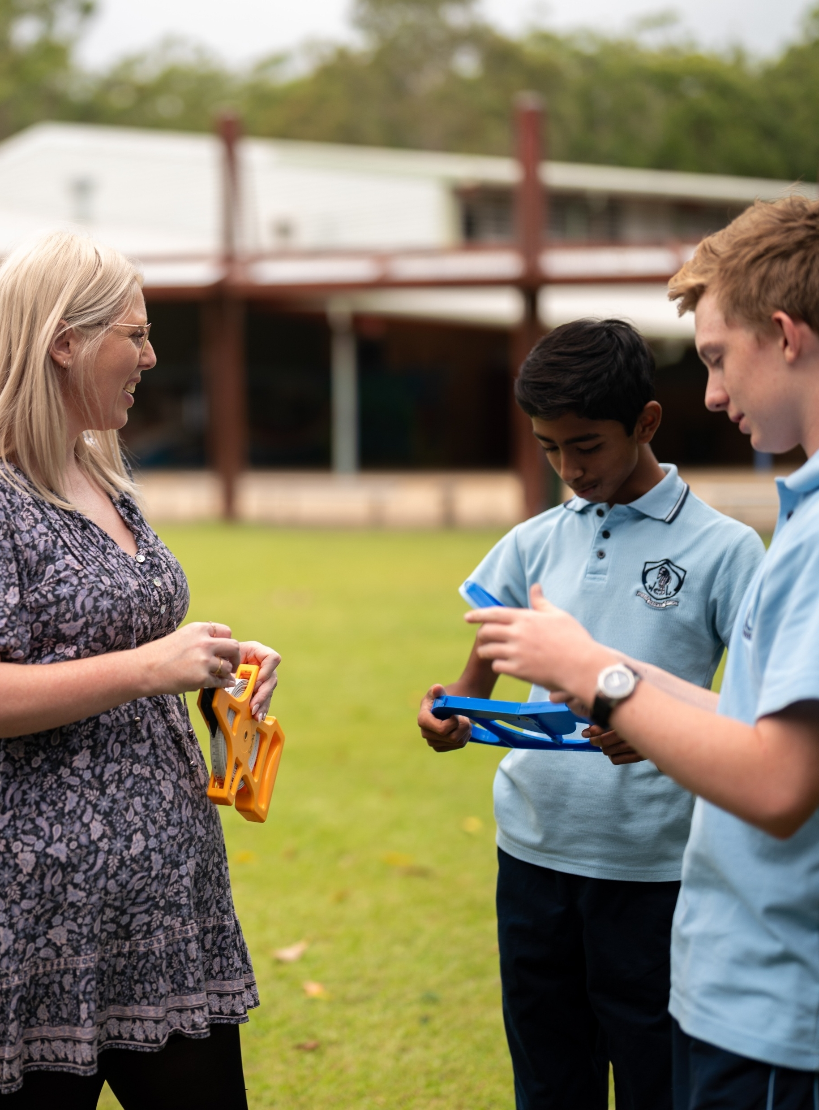
Developing simultaneous equations
Mathematics Standard – Stage 6 (Year 12)
Managing events

Slide 2
Learning intentions and success criteria
Learning intentions
To be able to develop simultaneous linear equations from a real-world context.
To understand how simultaneous equations can model and solve practical problems.
Success criteria
I can identify relationships in a context and represent them as linear equations.
I can develop simultaneous equations from written information.
I can solve simultaneous equations using a method of my choice.
I can interpret the solution in terms of the original context.

Slide 3
Activating prior knowledge

Slide 4
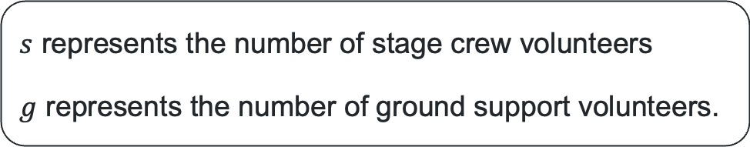
Live music concert organising committee meeting
… 10 more stage crew than ground support volunteers…
… total of 50 volunteers…
… difference between each group is 10…
… each stage crew volunteer completes 10 safety checks per hour…
… each ground support volunteer completes 5 safety checks per hour…
$s$ represents the number of stage crew volunteers
$g$ represents the number of ground support volunteers.

Slide 5
Connecting learning

Slide 6
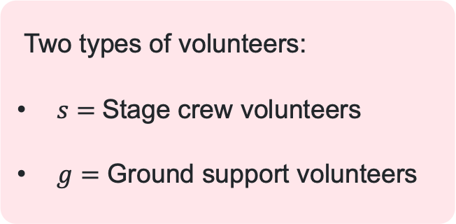
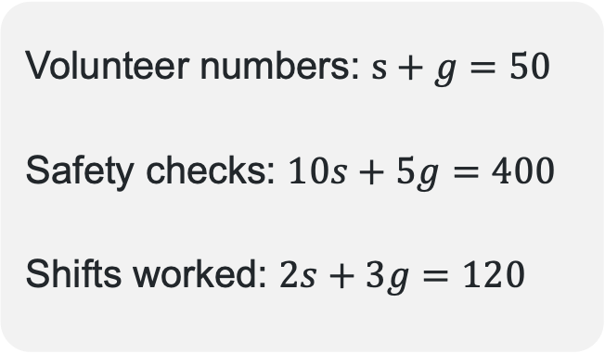
Volunteers at the live music concert
Developing equations
Two types of volunteers:
$s=$Stage crew volunteers
$g=$ Ground support volunteers
There are 50 volunteers in total
Each stage crew volunteer completes 10 safety checks per hour
Each ground support volunteer completes 5 safety checks per hour
Together they complete 400 safety checks per hour
Each stage crew volunteer works 2 shifts during the event
Each ground support volunteer works 3 shifts during the event
There are 120 total volunteer shifts worked
Volunteer numbers: $s+g=50$
Safety checks: $10s+5g=400$
Shifts worked: $2s+3g=120$

Slide 7
Releasing responsibility

Slide 8
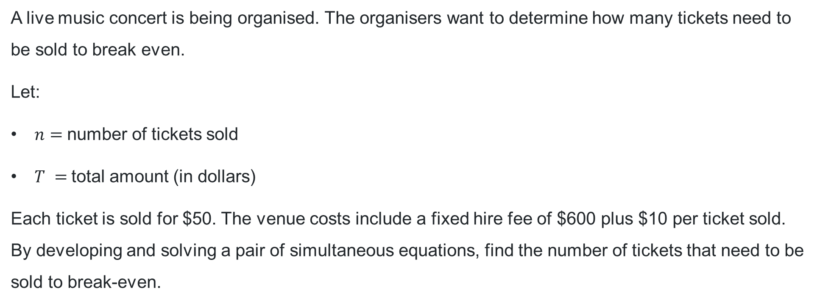
Developing simultaneous equations (1)
Worked example 1 – question
A live music concert is being organised. The organisers want to determine how many tickets need to be sold to break even.
Let:
$n=$number of tickets sold
$T =$total amount (in dollars)
Each ticket is sold for $50. The venue costs include a fixed hire fee of $600 plus $10 per ticket sold. By developing and solving a pair of simultaneous equations, find the number of tickets that need to be sold to break-even.
What might a fixed fee represent in a linear equation?

Slide 9
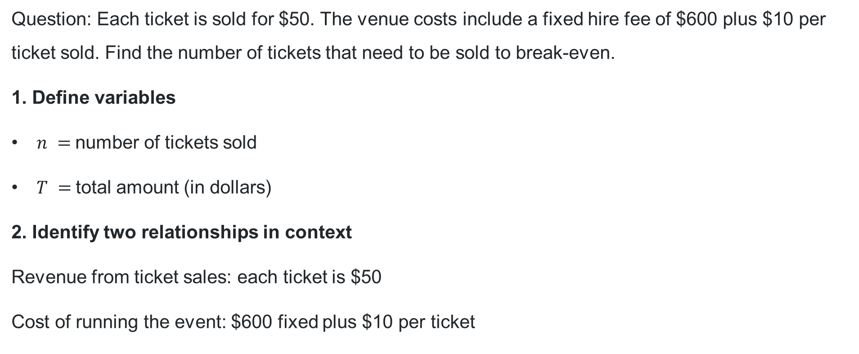
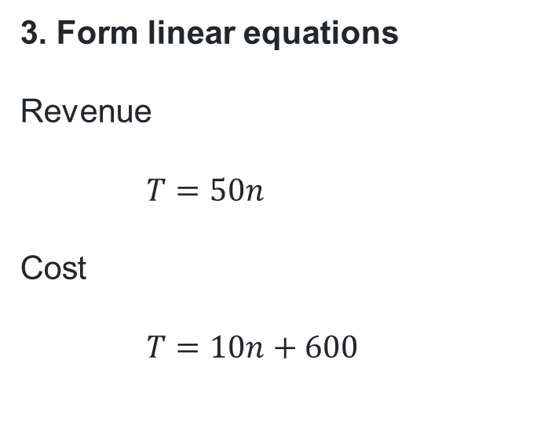
Developing simultaneous equations (2)
Worked example 1 – solution part 1
Question: Each ticket is sold for $50. The venue costs include a fixed hire fee of $600 plus $10 per ticket sold. Find the number of tickets that need to be sold to break-even.
1. Define variables
$n =$number of tickets sold
$T =$total amount (in dollars)
2. Identify two relationships in context
Revenue from ticket sales: each ticket is $50
Cost of running the event: $600 fixed plus $10 per ticket
3. Form linear equations
Revenue
$$T=50n$$
Cost
$$T=10n+600$$
What do 10 and 600 represent in the context of the problem?

Slide 10
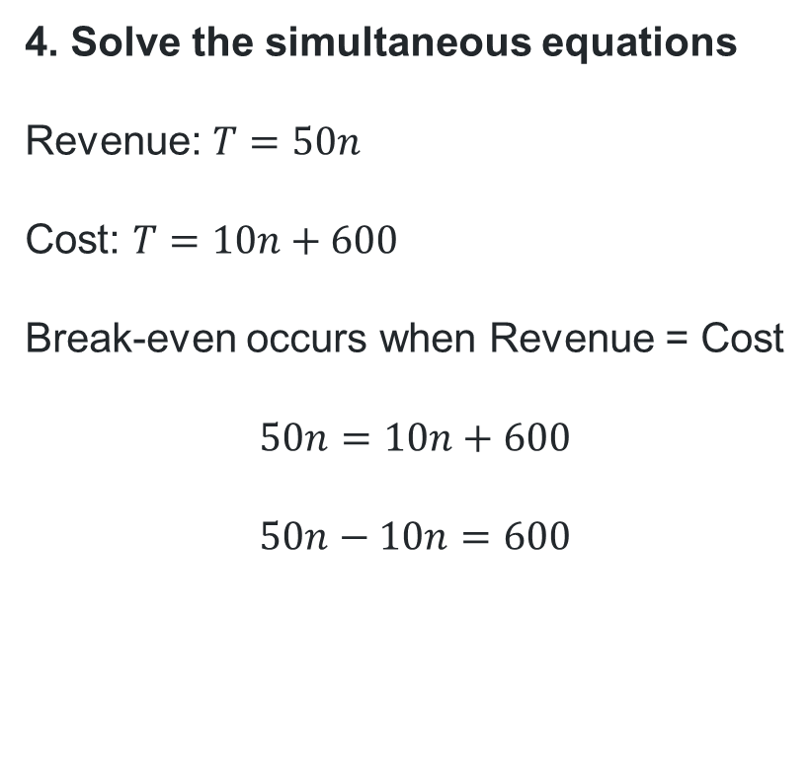
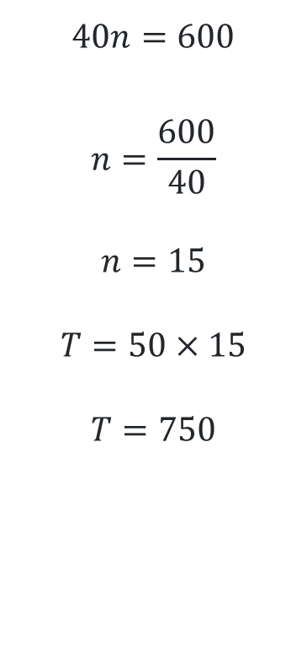
Developing simultaneous equations (3)
Worked example 1 – solution part 2
4. Solve the simultaneous equations
Revenue: $T=50n$
Cost: $T=10n+600$
Break-even occurs when Revenue = Cost
$$50n=10n+600$$
$$50n−10n=600$$
$$40n=600$$
$$n=\frac{600}{40}$$
$$n=15$$
$$T=50×15$$
$$T=750$$
Why does Revenue equal Cost?
What does this value represent in the context of the problem?

Slide 11
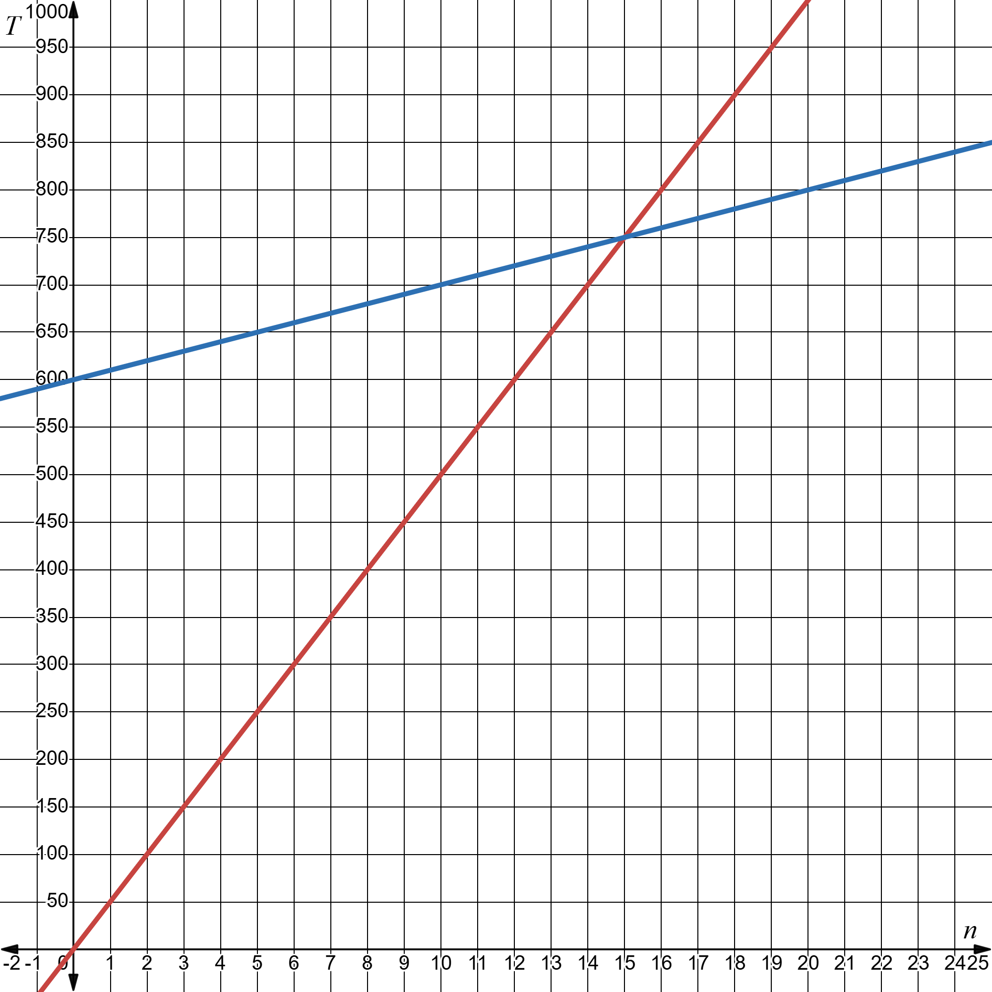
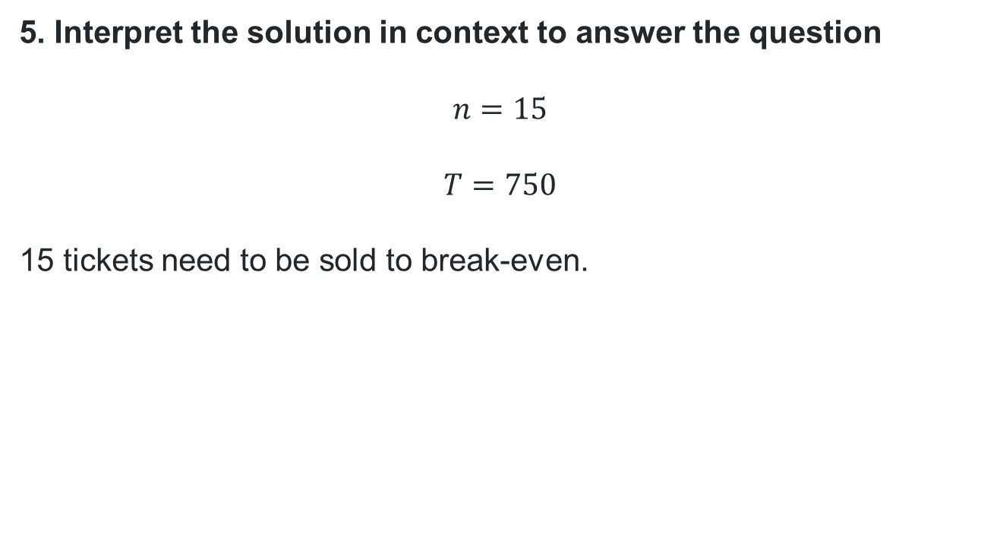
Developing simultaneous equations (4)
How does the graph support the solution?
Worked example 1 – solution part 3
5. Interpret the solution in context to answer the question
$$n=15$$
$$T=750$$
15 tickets need to be sold to break-even.
Why isn’t 750 used to answer the question?
How else could you check your solution?

Slide 12
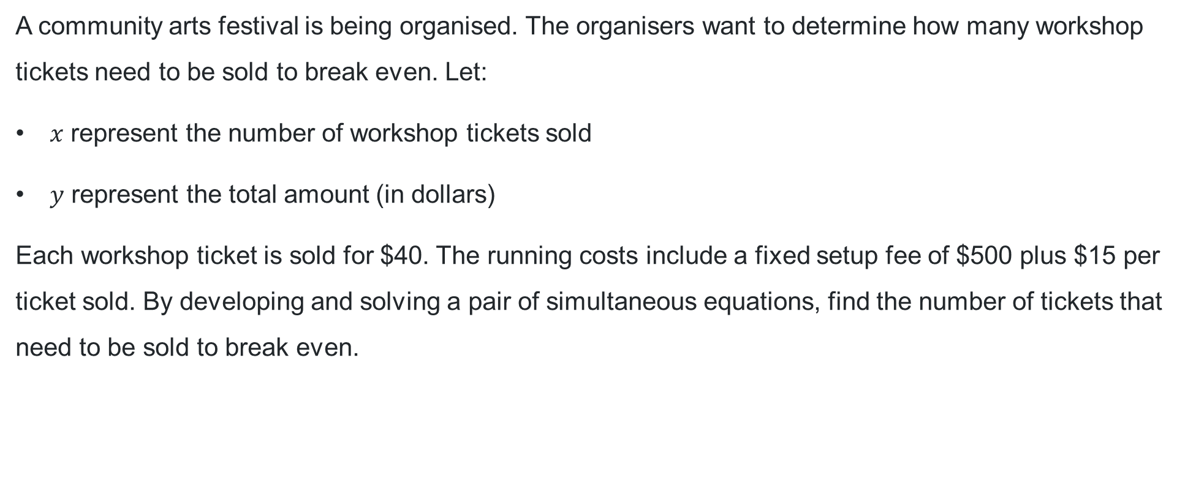
Developing simultaneous equations (5)
Your turn – question
A community arts festival is being organised. The organisers want to determine how many workshop tickets need to be sold to break even. Let:
$x$ represent the number of workshop tickets sold
$y$ represent the total amount (in dollars)
Each workshop ticket is sold for $40. The running costs include a fixed setup fee of $500 plus $15 per ticket sold. By developing and solving a pair of simultaneous equations, find the number of tickets that need to be sold to break even.

Slide 13
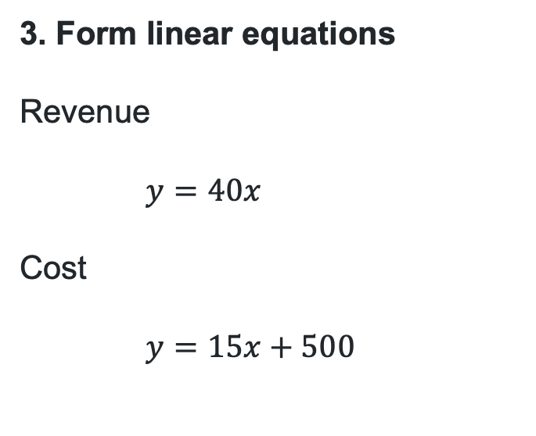
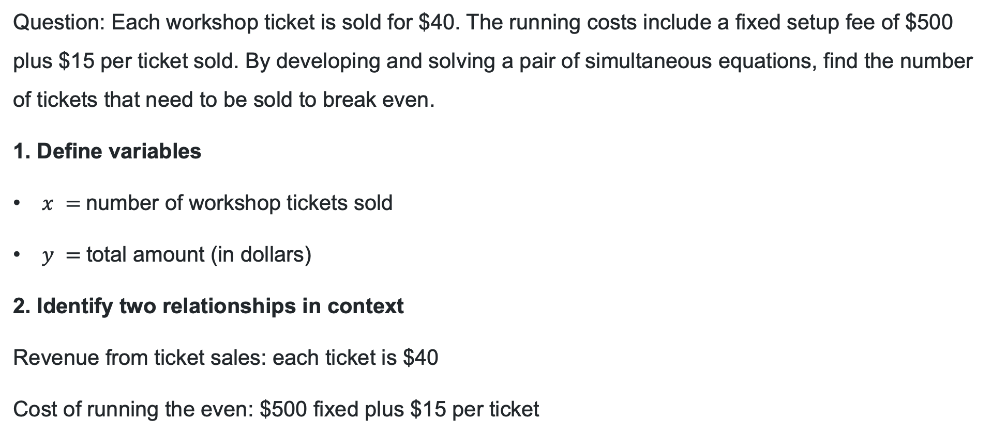
Developing simultaneous equations (6)
Your turn – solution part 1
Question: Each workshop ticket is sold for $40. The running costs include a fixed setup fee of $500 plus $15 per ticket sold. By developing and solving a pair of simultaneous equations, find the number of tickets that need to be sold to break even.
1. Define variables
$x =$number of workshop tickets sold
$y =$total amount (in dollars)
2. Identify two relationships in context
Revenue from ticket sales: each ticket is $40
Cost of running the even: $500 fixed plus $15 per ticket
3. Form linear equations
Revenue
$$y=40x$$
Cost
$$y=15x+500$$

Slide 14
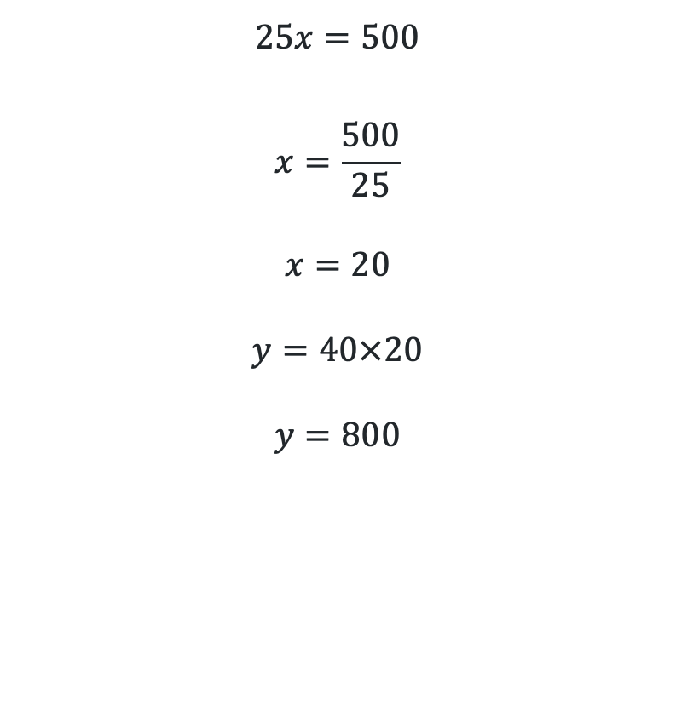
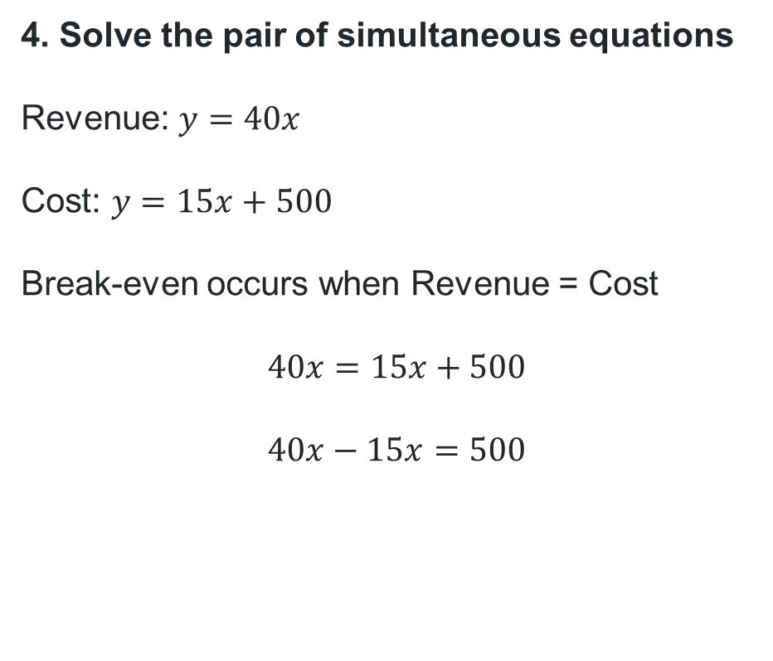
Developing simultaneous equations (7)
Your turn – solution part 2
4. Solve the pair of simultaneous equations
Revenue: $y=40x$
Cost: $y=15x+500$
Break-even occurs when Revenue = Cost
$$40x=15x+500$$
$$40x−15x=500$$
$$25x=500$$
$$x=\frac{500}{25}$$
$$x=20$$
$$y=40×20$$
$$y=800$$

Slide 15
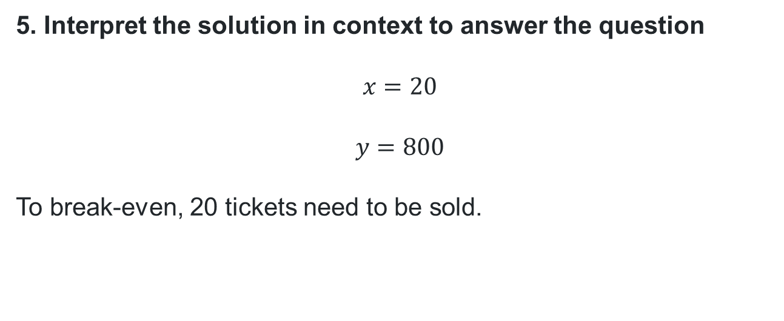
Developing simultaneous equations (8)
Your turn – solution part 3
Question: By developing and solving a pair of simultaneous equations, find the number of tickets that need to be sold to break even.
5. Interpret the solution in context to answer the question
$$x=20$$
$$y=800$$
To break-even, 20 tickets need to be sold.

Slide 16
Independent practice

Slide 17
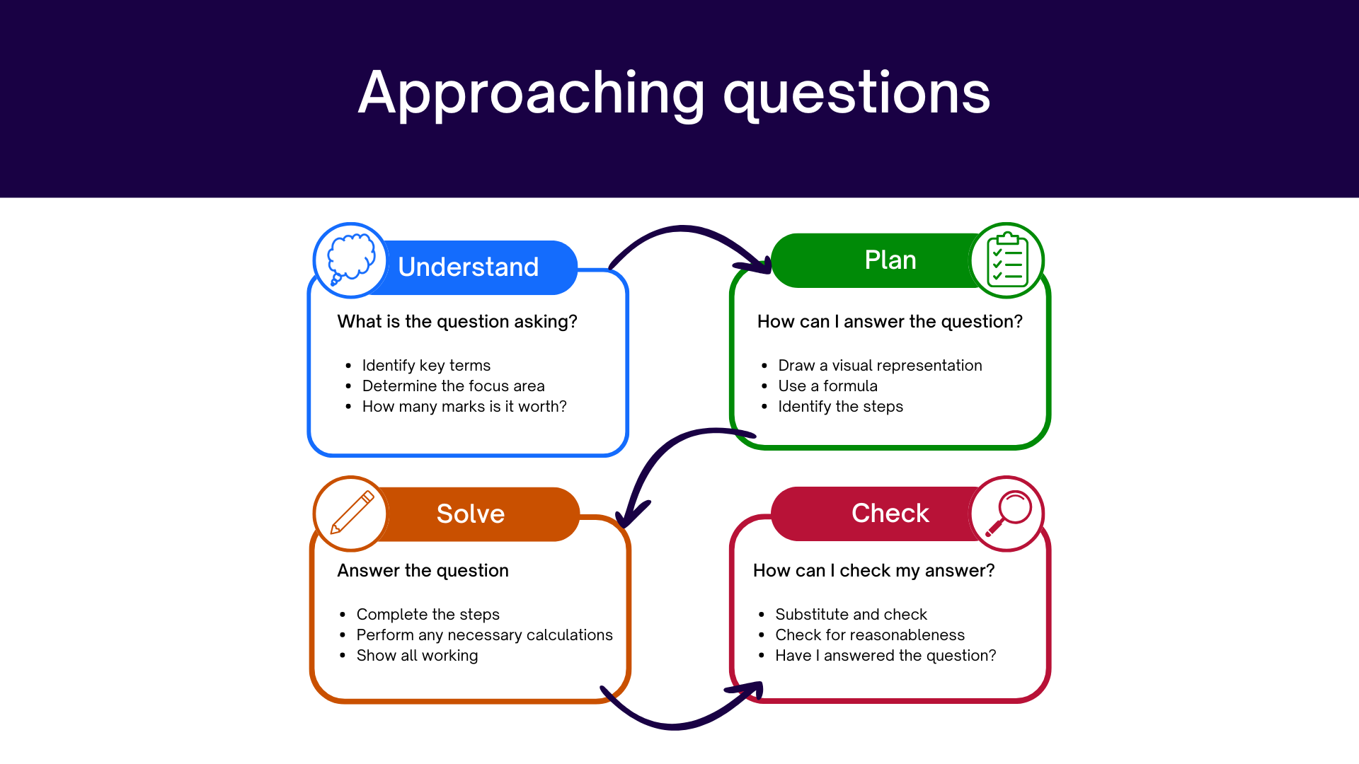
Approaching questions scaffold

Slide 18
Marker feedback
In better responses, students are able to:
Interpret the information to retrieve correct pronumerals.
Draw linear graphs neatly, with a ruler, and accurately find the point of intersection.
Areas for students to improve:
Demonstrating understanding of the need to write two equations.
Being able to accurately interpret the solution in the context of the question.
Breaking down a multi-step question into smaller parts or processes.

Slide 19
References
This presentation contains NSW Curriculum and syllabus content. The NSW Curriculum is developed by the NSW Education Standards Authority. This content is prepared by NESA for and on behalf of the Crown in the right of the State of New South Wales. The material is protected by Crown copyright.
Please refer to the NESA Copyright Disclaimer for more information https://www.nsw.gov.au/education-and-training/nesa/copyright.
NESA holds the only official and up-to-date versions of the NSW Curriculum and syllabus documents. Please visit the NSW Education Standards Authority (NESA) website https://educationstandards.nsw.edu.au/wps/portal/nesa/home and the NSW Curriculum website https://curriculum.nsw.edu.au.
Mathematics Standard 11–12 Syllabus © NSW Education Standards Authority (NESA) for and on behalf of the Crown in right of the State of New South Wales, 2024.

Slide 20
Copyright
© State of New South Wales (Department of Education), 2026
The copyright material published in this resource is subject to the Copyright Act 1968 (Cth) and is owned by the NSW Department of Education or, where indicated, by a party other than the NSW Department of Education (third-party material).
Copyright material available in this resource and owned by the NSW Department of Education is licensed under a Creative Commons Attribution 4.0 International (CC BY 4.0) license.
This license allows you to share and adapt the material for any purpose, even commercially.
Attribution should be given to © State of New South Wales (Department of Education), 2026.
Material in this resource not available under a Creative Commons license:
the NSW Department of Education logo, other logos and trademark-protected material
Material owned by a third party that has been reproduced with permission. You will need to obtain permission from the third party to reuse its material.
Links to third-party material and websites
Please note that the provided (reading/viewing material/list/links/texts) are a suggestion only and implies no endorsement, by the New South Wales Department of Education, of any author, publisher, or book title. School principals and teachers are best placed to assess the suitability of resources that would complement the curriculum and reflect the needs and interests of their students.
If you use the links provided in this document to access a third-party’s website, you acknowledge that the terms of use, including licence terms set out on the third-party’s website apply to the use which may be made of the materials on that third-party website or where permitted by the Copyright Act 1968 (Cth). The department accepts no responsibility for content on third-party websites.

