Slide 1
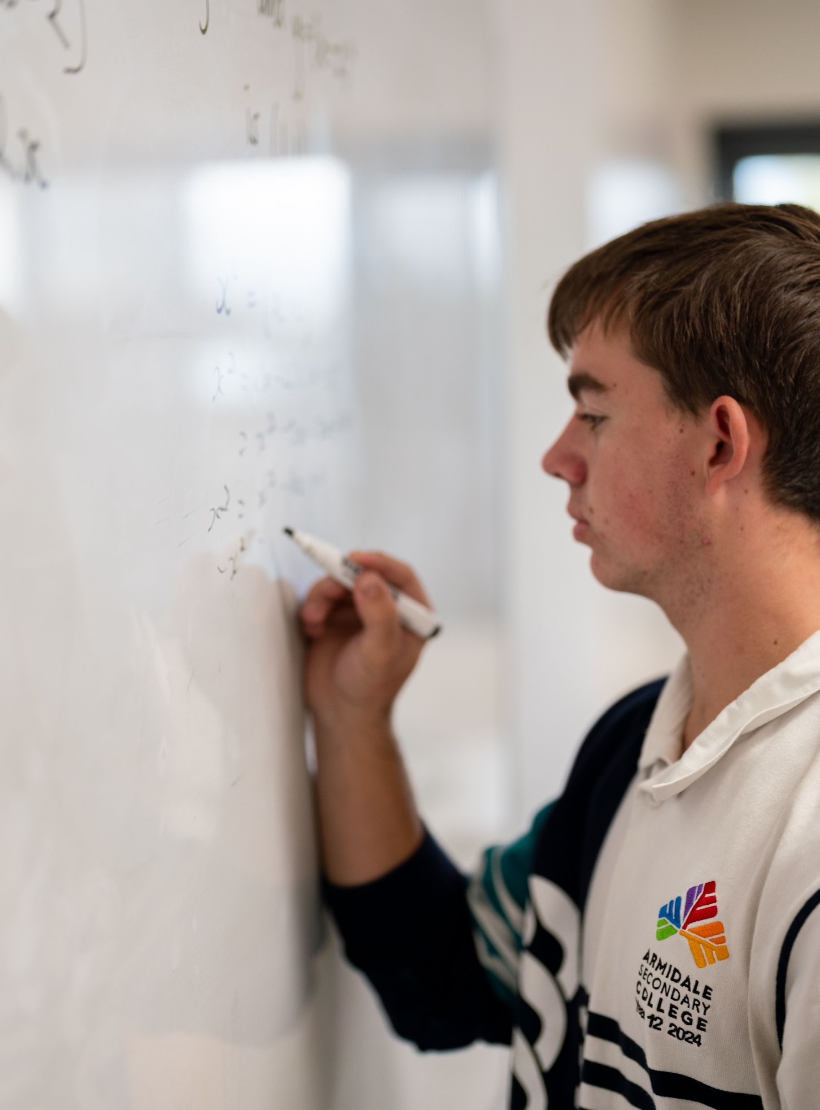
Solving simultaneous equations algebraically – part 2
Mathematics Standard – Stage 6 (Year 12)
Managing events

Slide 2
Learning intention and success criteria
Learning intention
To be able to solve pairs of simultaneous linear equations using algebraic methods.
Success criteria
I can represent a pair of simultaneous linear equations using a bar model.
I can solve a pair of simultaneous linear equations using algebraic methods.
I can choose an appropriate method to solve a pair of simultaneous linear equations.
I can interpret the solution in the context of the problem.

Slide 3
Activating prior knowledge

Slide 4
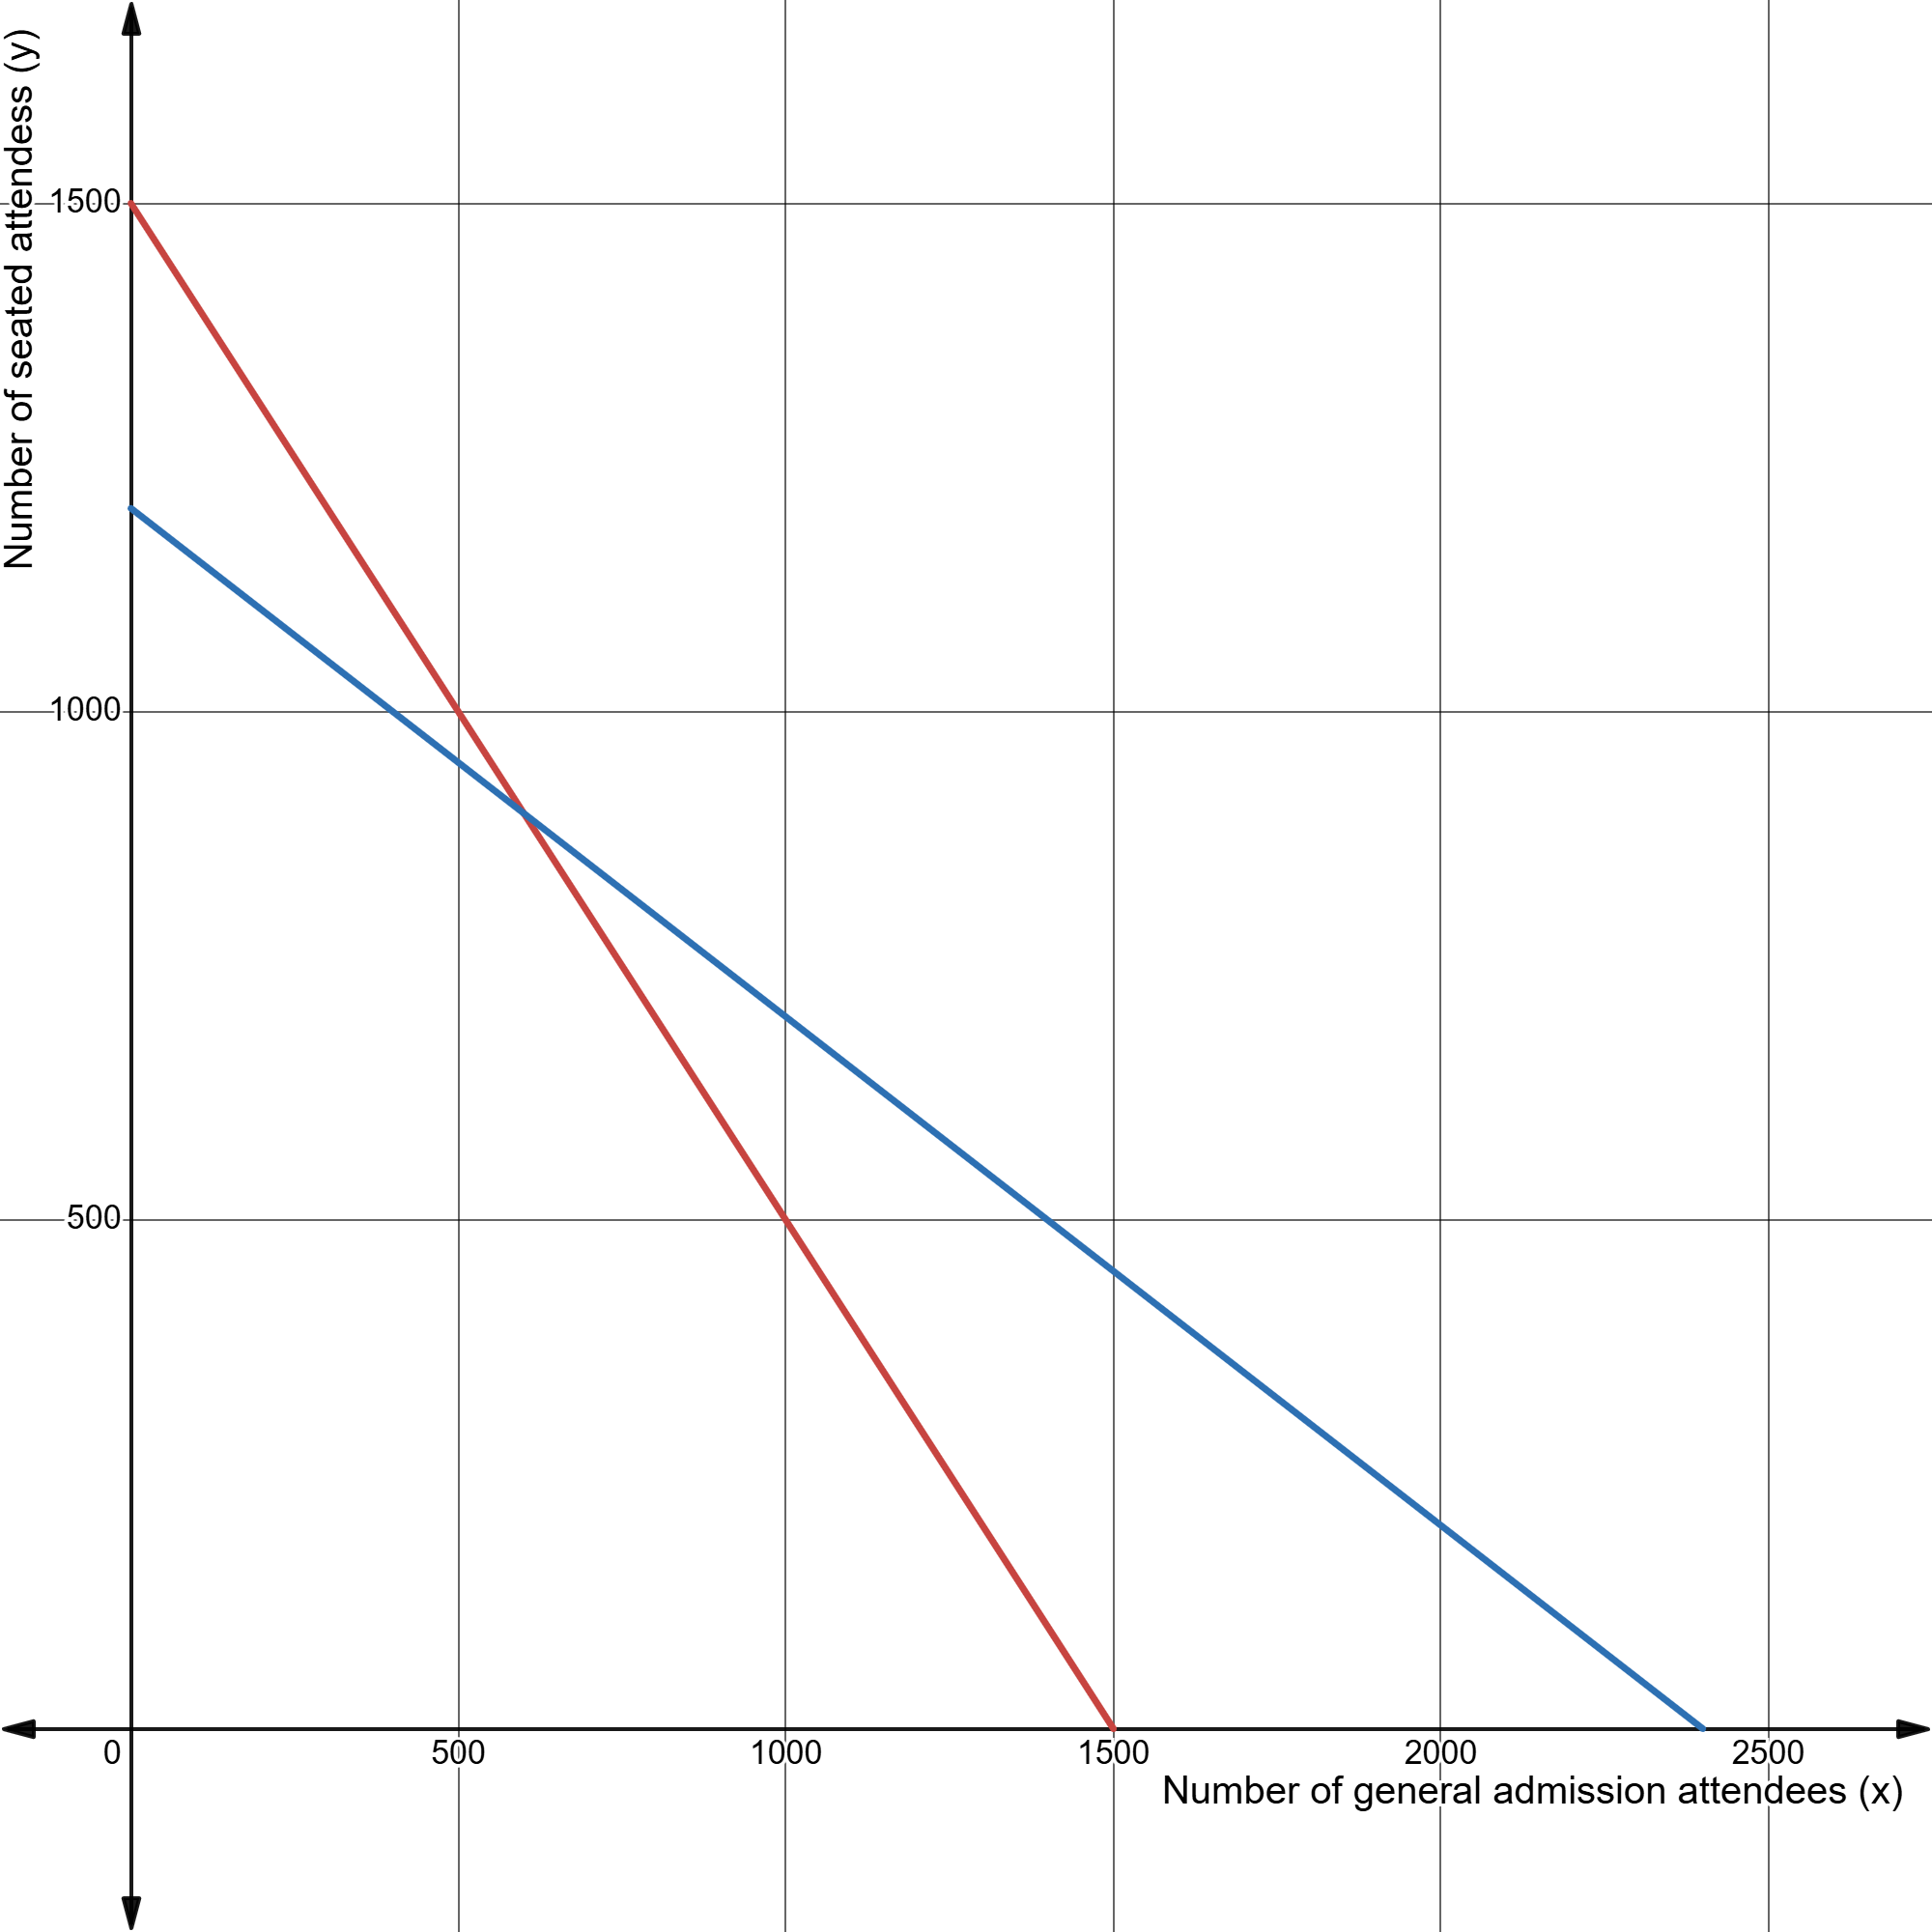
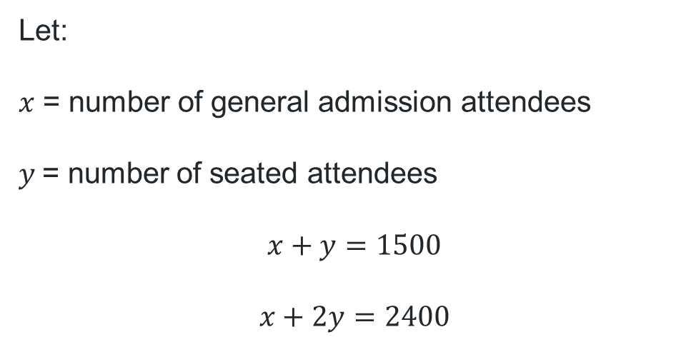
Music festival
1500 attendees.
2400 m² of useable floor space.
General admission (standing area) uses 1 m².
Seated attendee uses 2 m²
Let:
$x$ = number of general admission attendees
$y$= number of seated attendees
$$x+y=1500$$
$$x+2y=2400$$

Slide 5
Releasing responsibility

Slide 6
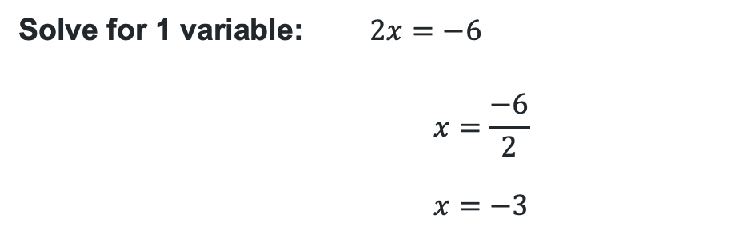
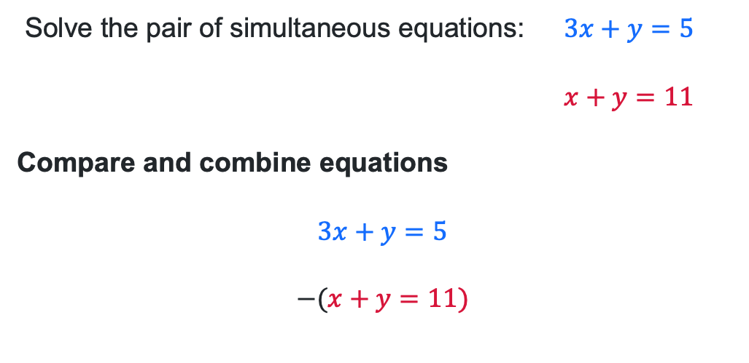



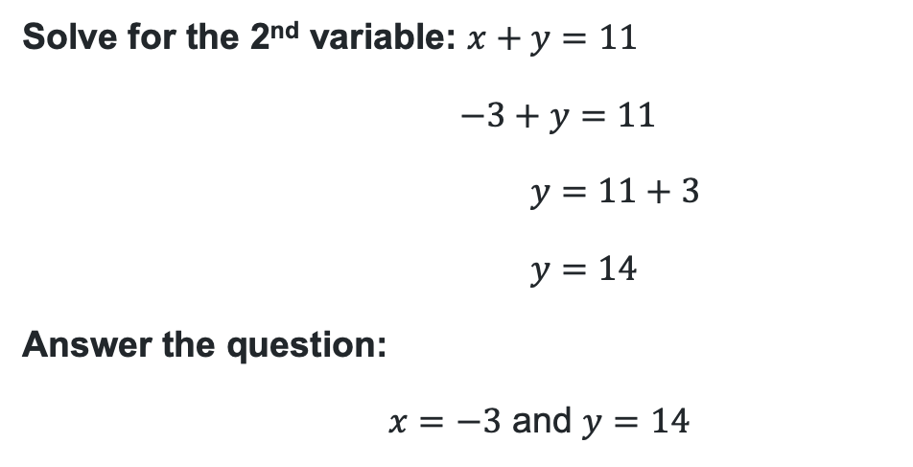

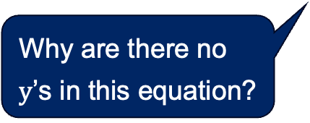
Solving simultaneous equations algebraically (1)
Worked example 1
Solve the pair of simultaneous equations: $3x+y=5$
$$x+y=11$$
Compare and combine equations
$$3x+y=5$$
$$−(x+y=11)$$
Solve for 1 variable: $2x=−6$
$$x=\frac{−6}{2}$$
$$x=−3$$
Why are there no $y$’s in this equation?
Is there another method to solve this pair of simultaneous equations?
Why would the equations have been subtracted from one another?
Solve for the 2nd variable: $x+y=11$
$$−3+y=11$$
$$y=11+3$$
$$y=14$$
Answer the question:
$x=−3$ and $y=14$
$$\begin{matrix}3x & +y & = \\ −x & −y & =\end{matrix}\begin{matrix}5 \\ −11\end{matrix}$$
$$2x$$
$$+0y$$
$$=−6$$
How might we check the solution?

Slide 7

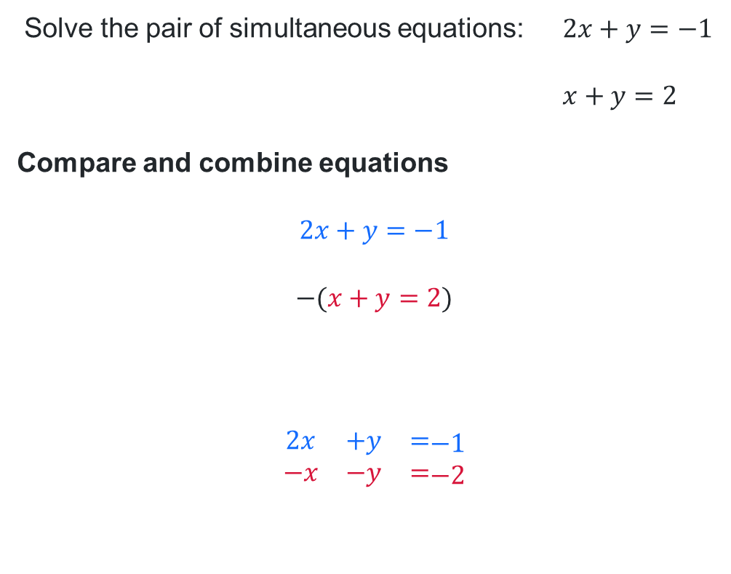
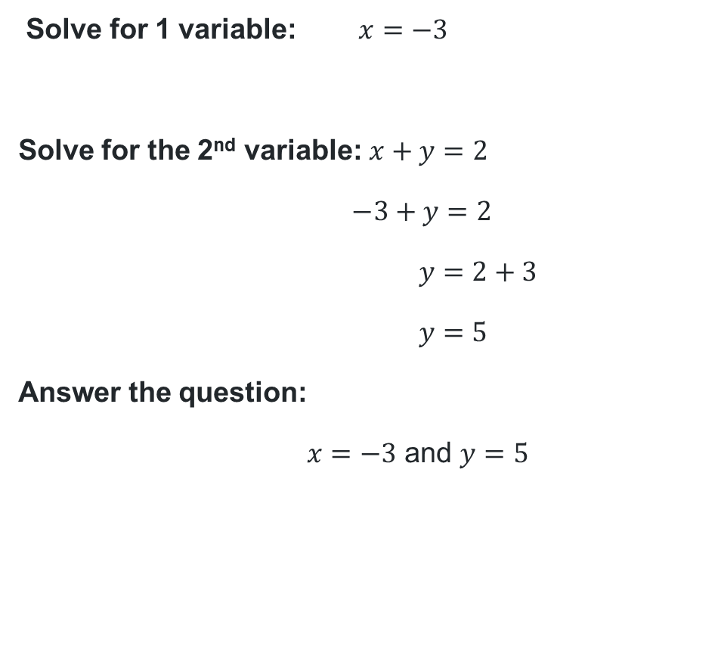


Solving simultaneous equations algebraically (2)
Your turn – Question 1
Solve the pair of simultaneous equations: $2x+y=−1$
$$x+y=2$$
Compare and combine equations
$$2x+y=−1$$
$$−(x+y=2)$$
$$\begin{matrix}2x & +y & = \\ −x & −y & =\end{matrix}\begin{matrix}−1 \\ −2\end{matrix}$$
Solve for 1 variable: $x=−3$
Solve for the 2nd variable: $x+y=2$
$$−3+y=2$$
$$y=2+3$$
$$y=5$$
Answer the question:
$x=−3$ and $y=5$
$$x$$
$$+0y$$
$$=−3$$

Slide 8
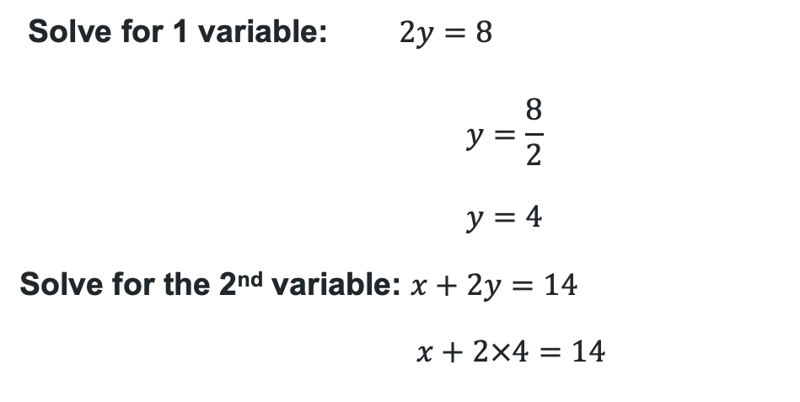
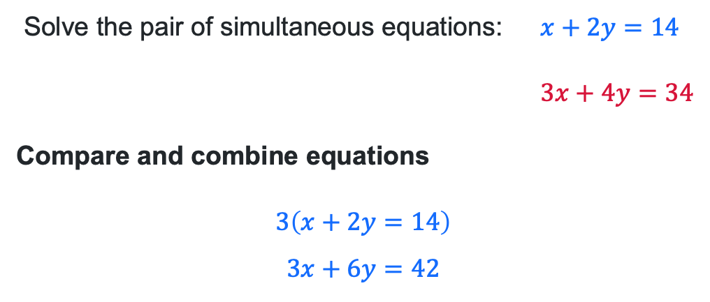




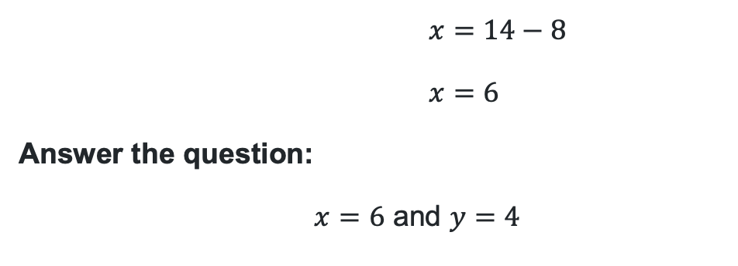
Solving simultaneous equations algebraically (3)
Worked example 2
Solve the pair of simultaneous equations: $x+2y=14$
$$3x+4y=34$$
Compare and combine equations
$$3\left(x+2y=14\right)$$
$$3x+6y=42$$
Solve for 1 variable: $2y=8$
$$y=\frac{8}{2}$$
$$y=4$$
Solve for the 2nd variable: $x+2y=14$
$$x+2×4=14$$
Why was the first equation multiplied by 3?
Where did the 4 come from?
$$3x+6y=42$$
$$−(3x+4y=34)$$
$$\begin{matrix}3x & +6y & = \\ −3x & −4y & =\end{matrix}\begin{matrix}42 \\ −34\end{matrix}$$
$$x=14−8$$
$$x=6$$
Answer the question:
$x=6$ and $y=4$
Why were the equations subtracted?
How do we check the solution?
$$0x$$
$$+2y$$
$$=8$$

Slide 9

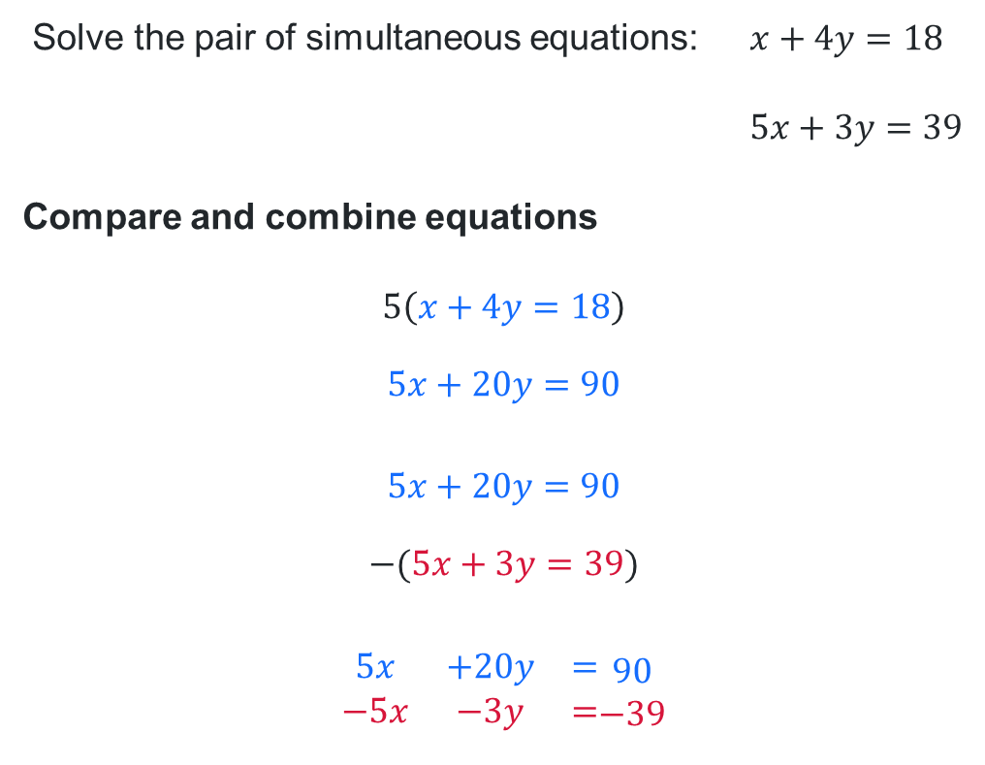
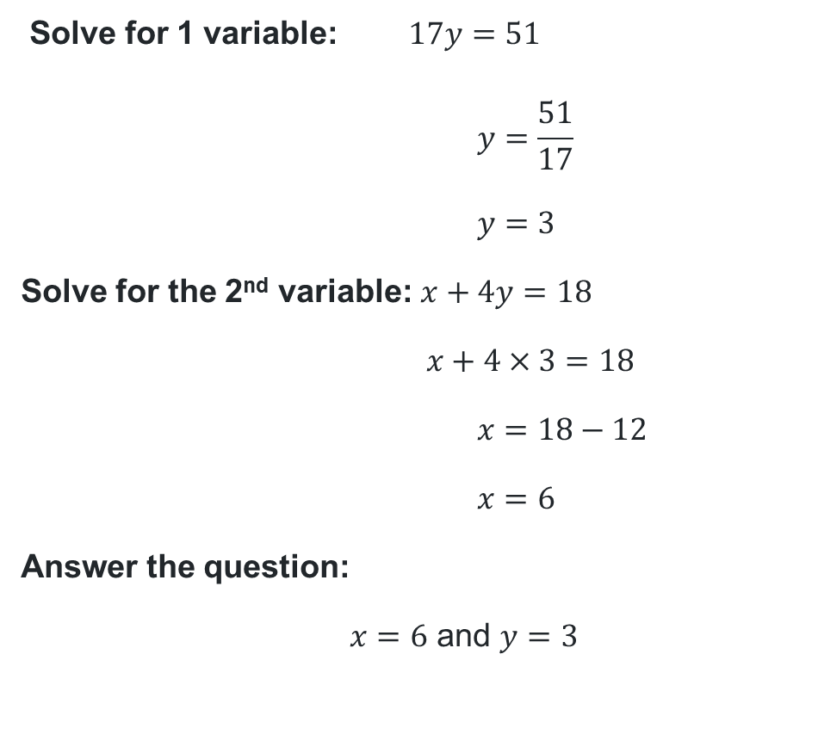


Solving simultaneous equations algebraically (4)
Your turn – Question 2
Solve the pair of simultaneous equations: $x+4y=18$
$$5x+3y=39$$
Compare and combine equations
$$5\left(x+4y=18\right)$$
$$5x+20y=90$$
$$5x+20y=90$$
$$−(5x+3y=39)$$
$$\begin{matrix}5x & +20y & = \\ −5x & −3y & =\end{matrix}\begin{matrix}90 \\ −39\end{matrix}$$
Solve for 1 variable: $17y=51$
$$y=\frac{51}{17}$$
$$y=3$$
Solve for the 2nd variable: $x+4y=18$
$$x+4×3=18$$
$$x=18−12$$
$$x=6$$
Answer the question:
$x=6$ and $y=3$
$$0x$$
$$+17y$$
$$=51$$

Slide 10
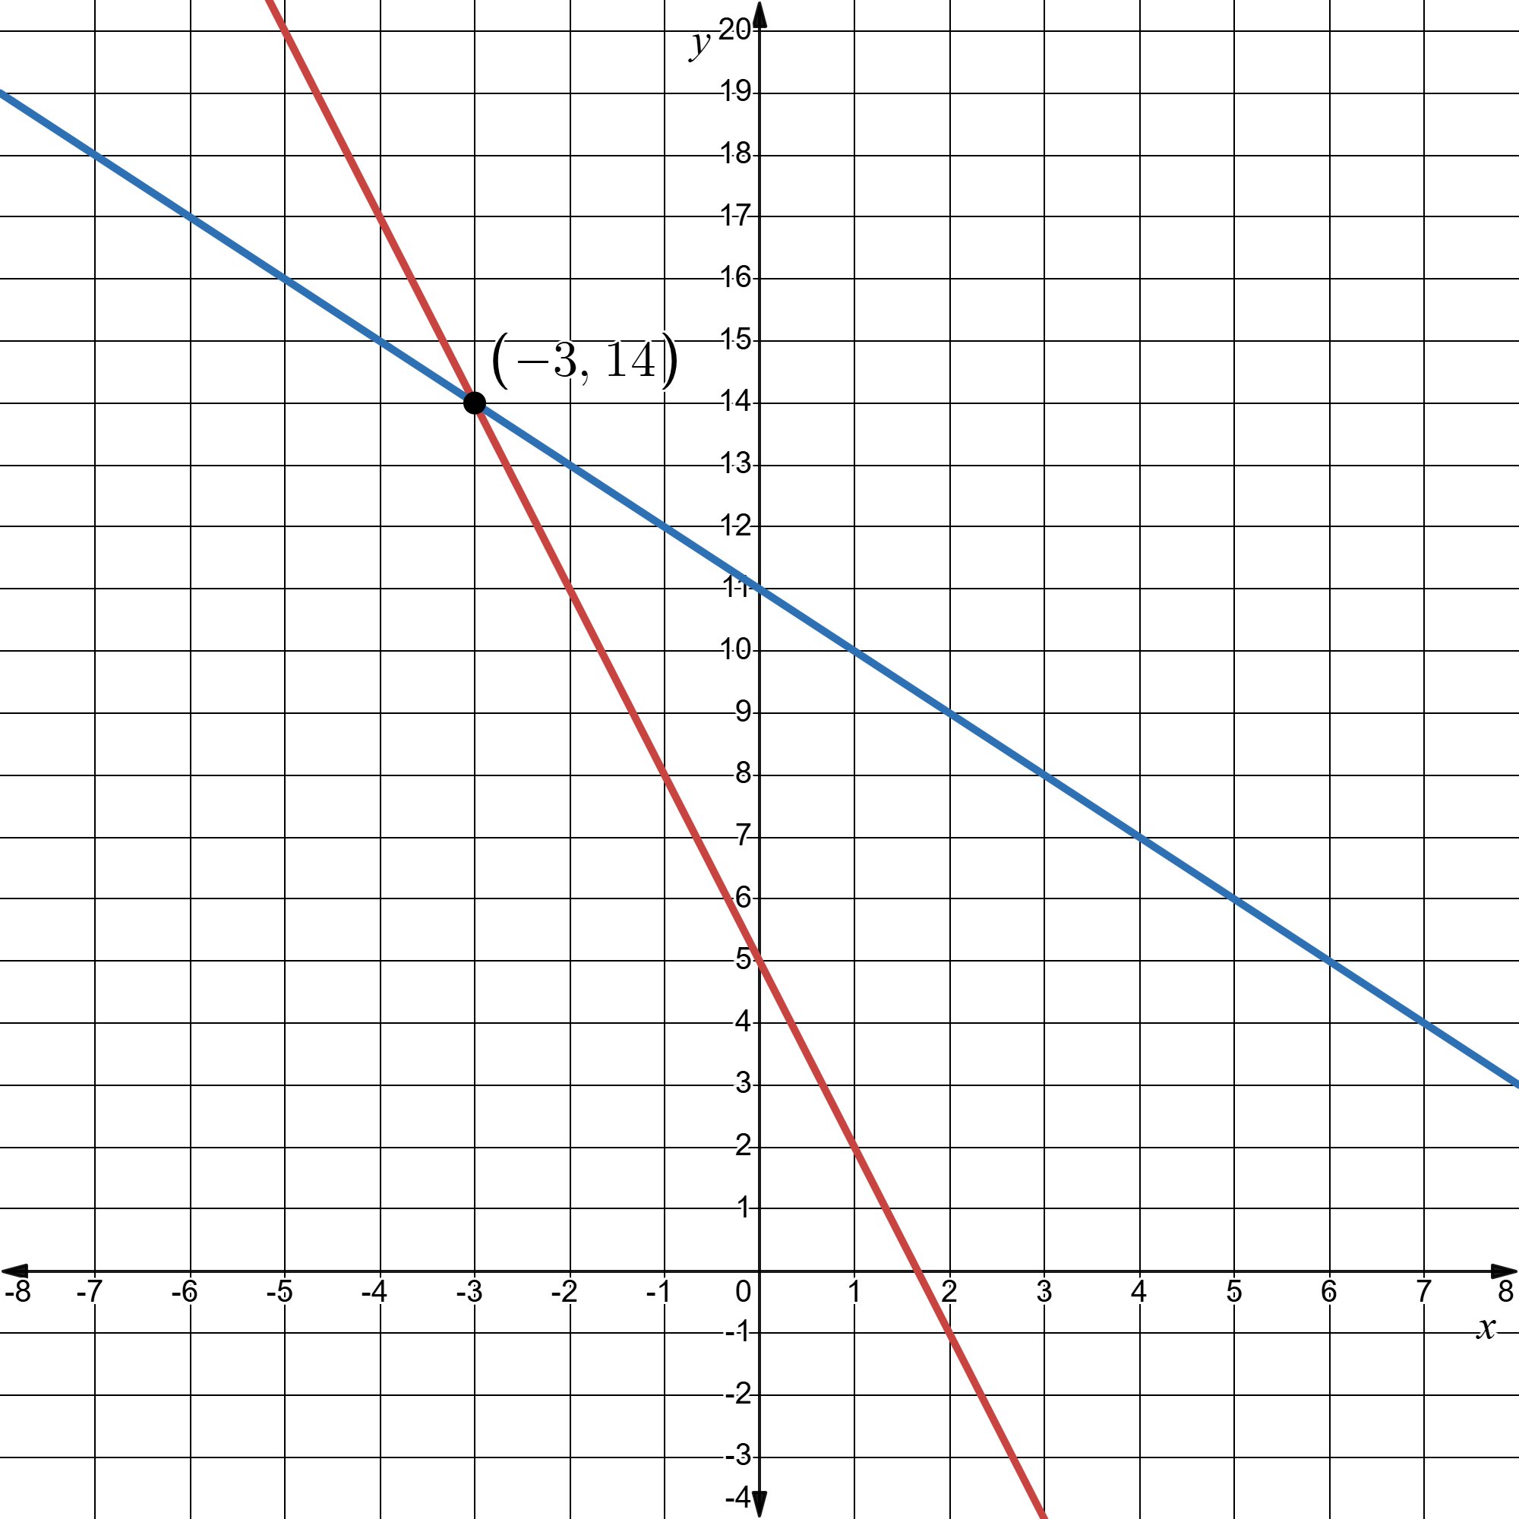
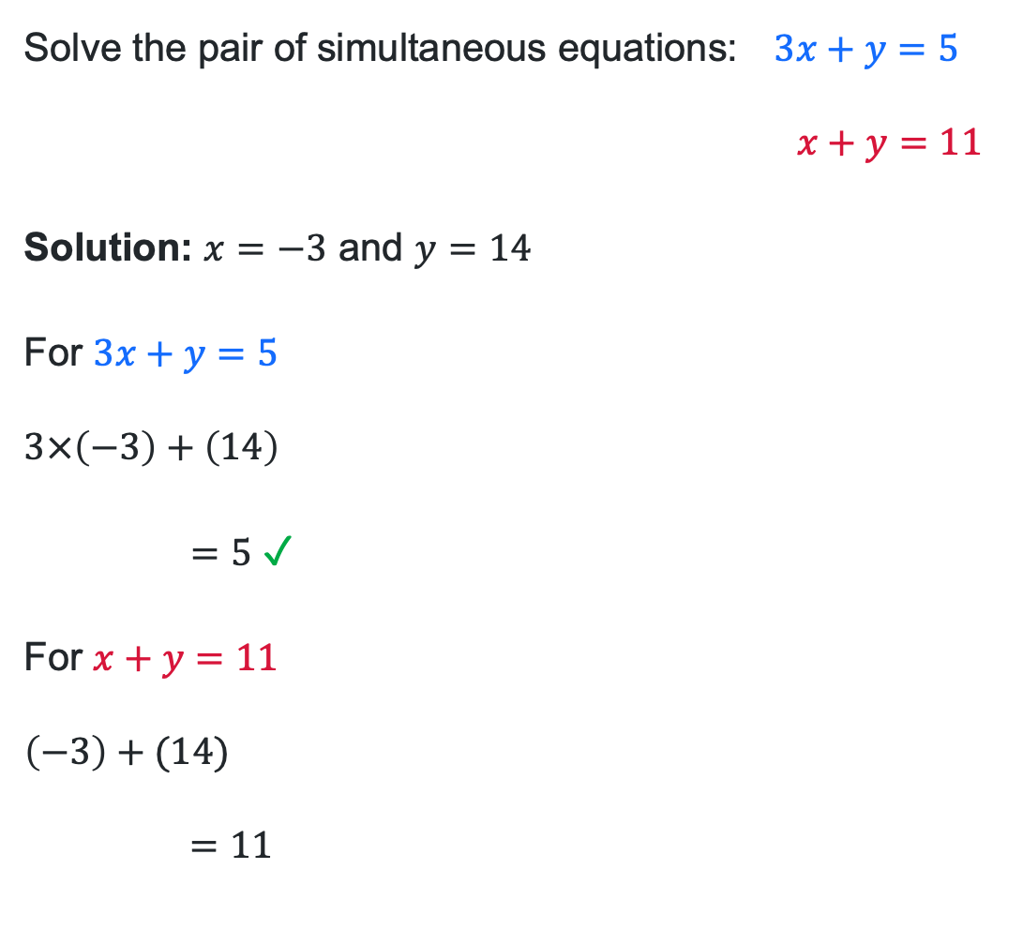
Understanding the solution – Worked example 1
Solve the pair of simultaneous equations: $3x+y=5$
$$x+y=11$$
Solution: $x=−3$ and $y=14$
For $3x+y=5$
$$3×\left(−3\right)+\left(14\right)$$
$=5$ ✓ Correct
For $x+y=11$
$$\left(−3\right)+(14)$$
$$=11$$
✓ Correct

Slide 11
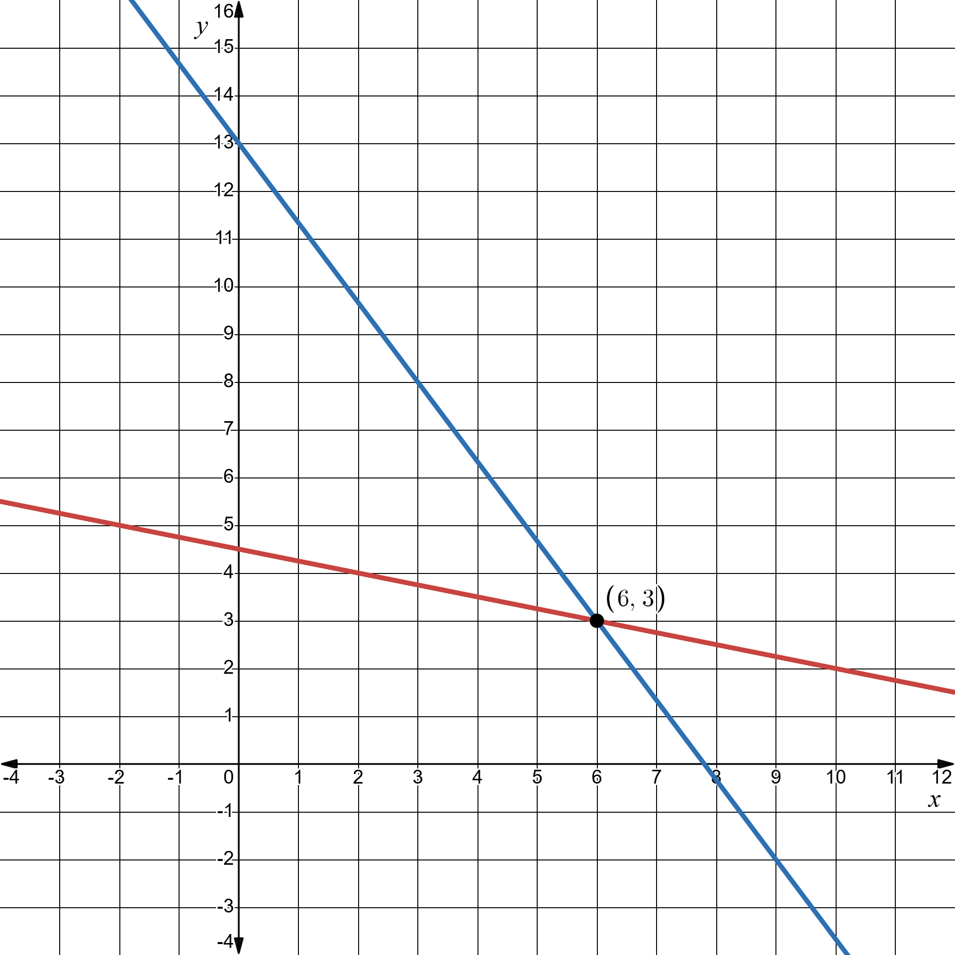
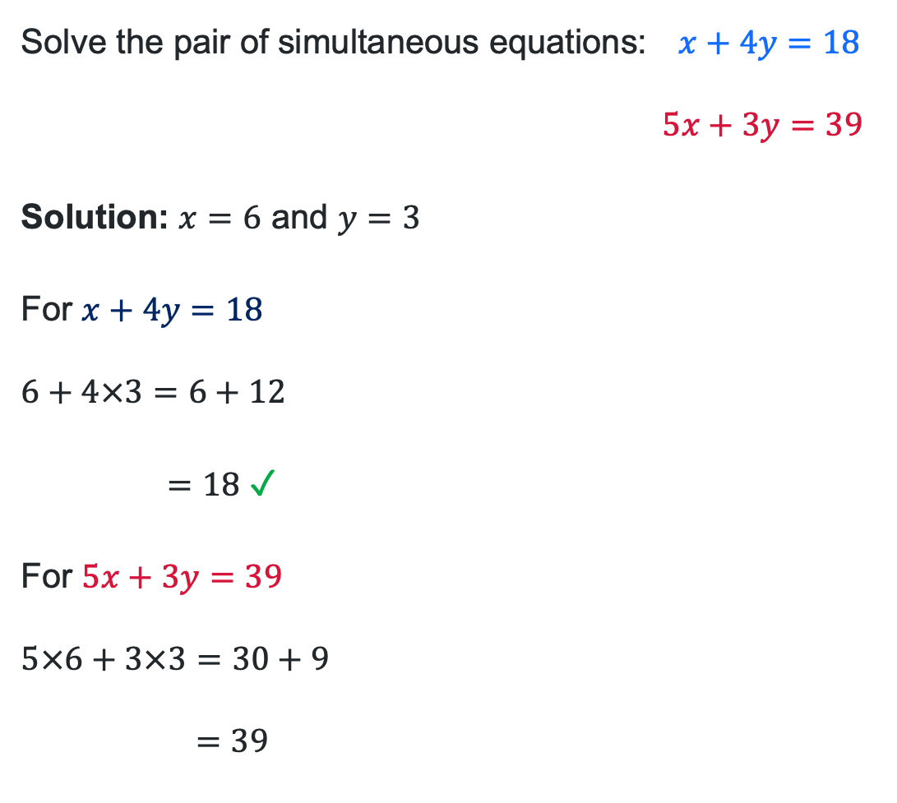
Understanding the solution – Worked example 2
Solve the pair of simultaneous equations: $x+4y=18$
$$5x+3y=39$$
Solution: $x=6$ and $y=3$
For $x+4y=18$
$$6+4×3=6+12$$
$=18$ ✓ Correct
For $5x+3y=39$
$$5×6+3×3=30+9$$
$$=39$$
✓ Correct

Slide 12

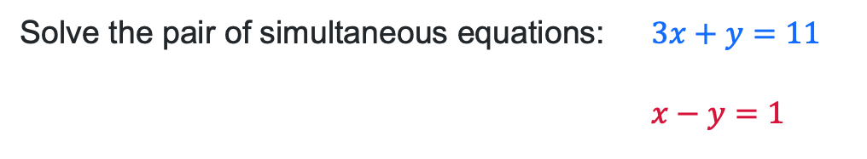



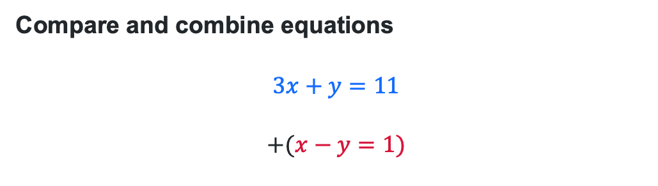
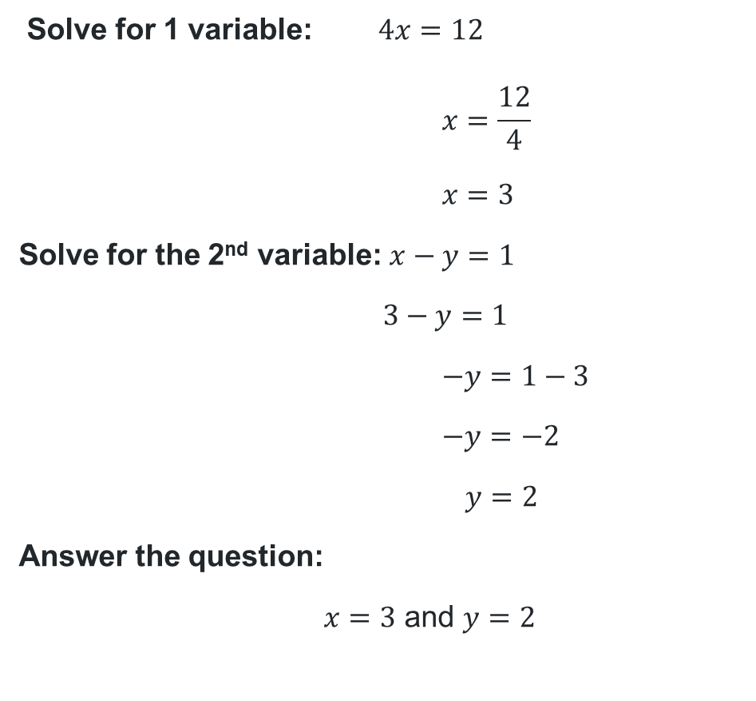
Solving simultaneous equations algebraically (5)
Adding equations to solve
Solve for 1 variable: $4x=12$
$$x=\frac{12}{4}$$
$$x=3$$
Solve for the 2nd variable: $x−y=1$
$$3−y=1$$
$$−y=1−3$$
$$−y=−2$$
$$y=2$$
Answer the question:
$x=3$ and $y=2$
Solve the pair of simultaneous equations: $3x+y=11$
$$x−y=1$$
Compare and combine equations
$$3x+y=11$$
$$+(x−y=1)$$
Is there another method to solve this pair of simultaneous equations?
Why have the equations been added?
$$\begin{matrix}3x & +y & = \\ +x & −y & =\end{matrix}\begin{matrix}11 \\ +1\end{matrix}$$
$$4x$$
$$+0y$$
$$=12$$
How can we check the solution?

Slide 13
Independent practice

Slide 14
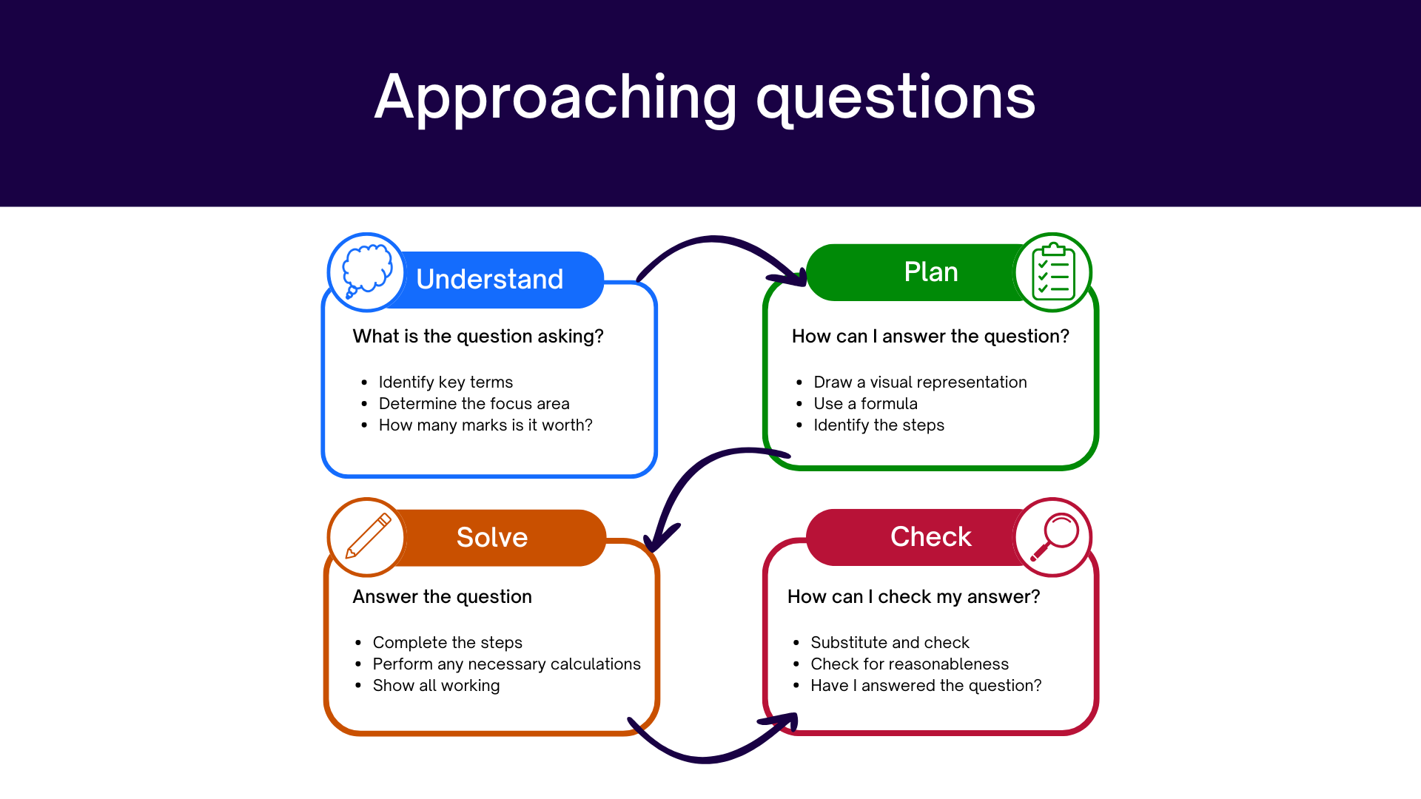
Approaching questions scaffold

Slide 15
References
This presentation contains NSW Curriculum and syllabus content. The NSW Curriculum is developed by the NSW Education Standards Authority. This content is prepared by NESA for and on behalf of the Crown in the right of the State of New South Wales. The material is protected by Crown copyright.
Please refer to the NESA Copyright Disclaimer for more information https://www.nsw.gov.au/education-and-training/nesa/copyright.
NESA holds the only official and up-to-date versions of the NSW Curriculum and syllabus documents. Please visit the NSW Education Standards Authority (NESA) website https://educationstandards.nsw.edu.au/wps/portal/nesa/home and the NSW Curriculum website https://curriculum.nsw.edu.au.
Mathematics Standard 11–12 Syllabus © NSW Education Standards Authority (NESA) for and on behalf of the Crown in right of the State of New South Wales, 2024.

Slide 16
Copyright
© State of New South Wales (Department of Education), 2026
The copyright material published in this resource is subject to the Copyright Act 1968 (Cth) and is owned by the NSW Department of Education or, where indicated, by a party other than the NSW Department of Education (third-party material).
Copyright material available in this resource and owned by the NSW Department of Education is licensed under a Creative Commons Attribution 4.0 International (CC BY 4.0) license.
This license allows you to share and adapt the material for any purpose, even commercially.
Attribution should be given to © State of New South Wales (Department of Education), 2026.
Material in this resource not available under a Creative Commons license:
the NSW Department of Education logo, other logos and trademark-protected material
Material owned by a third party that has been reproduced with permission. You will need to obtain permission from the third party to reuse its material.
Links to third-party material and websites
Please note that the provided (reading/viewing material/list/links/texts) are a suggestion only and implies no endorsement, by the New South Wales Department of Education, of any author, publisher, or book title. School principals and teachers are best placed to assess the suitability of resources that would complement the curriculum and reflect the needs and interests of their students.
If you use the links provided in this document to access a third-party’s website, you acknowledge that the terms of use, including licence terms set out on the third-party’s website apply to the use which may be made of the materials on that third-party website or where permitted by the Copyright Act 1968 (Cth). The department accepts no responsibility for content on third-party websites.

