Slide 1
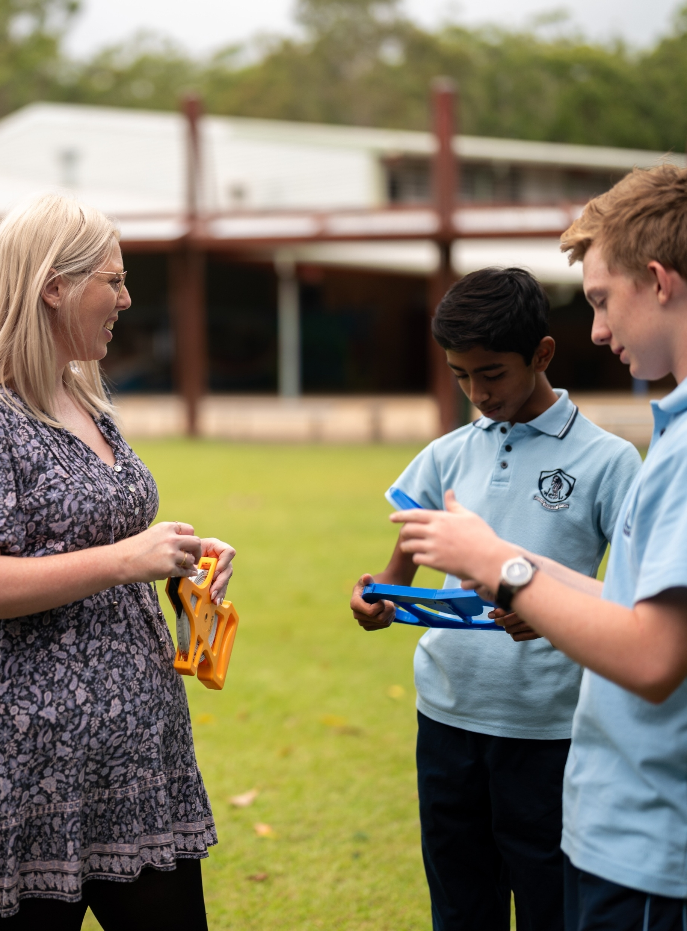
Solving simultaneous equations graphically
Mathematics Standard – Stage 6 (Year 12)
Managing events

Slide 2
Learning intentions and success criteria
Learning intentions
To be able to represent and solve pairs of linear equations graphically.
To understand how the point of intersection relates to solutions in real-world contexts.
Success criteria
I can graph a linear equation.
I can identify and interpret the point of intersection of 2 linear equations from a graph.
I can explain what the point of intersection represents in a real-world context.

Slide 3
Activating prior knowledge

Slide 4
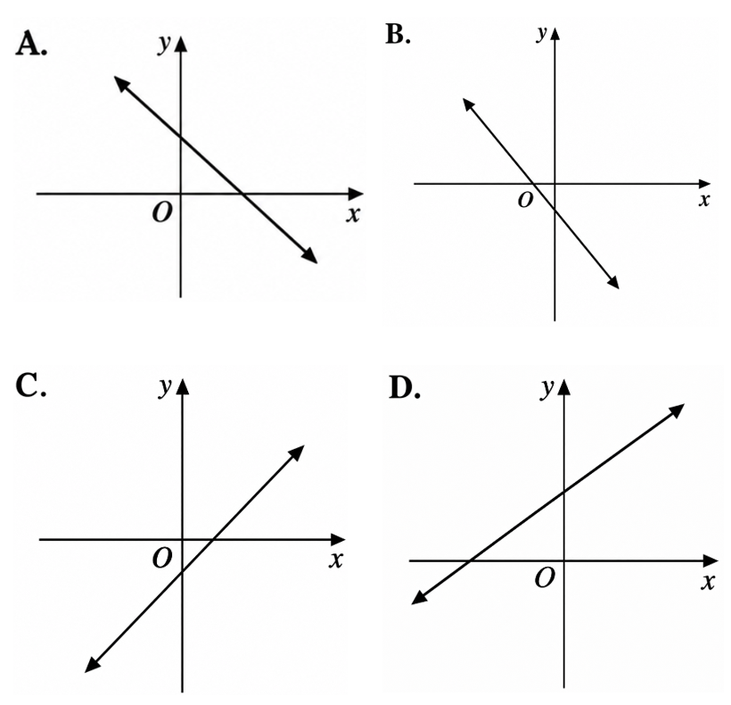
Linear graphs (1)
Which of the following could be the graph of $y=−2x+2?$

Slide 5
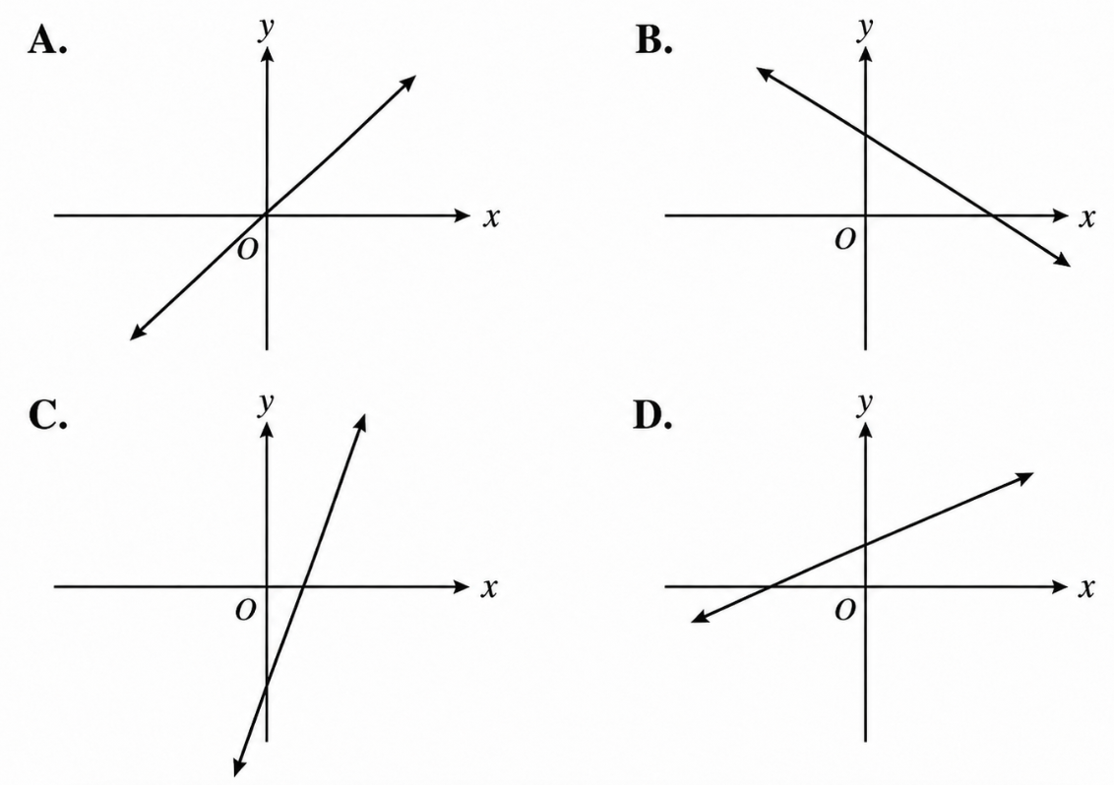
Line graphs (2)
Which of the following could be the graph of $y=3x−1?$

Slide 6
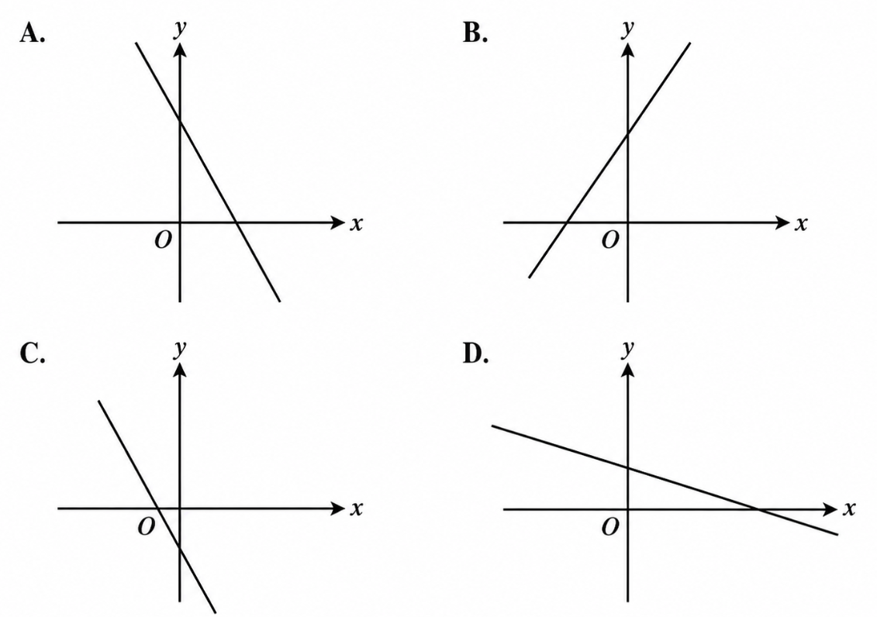
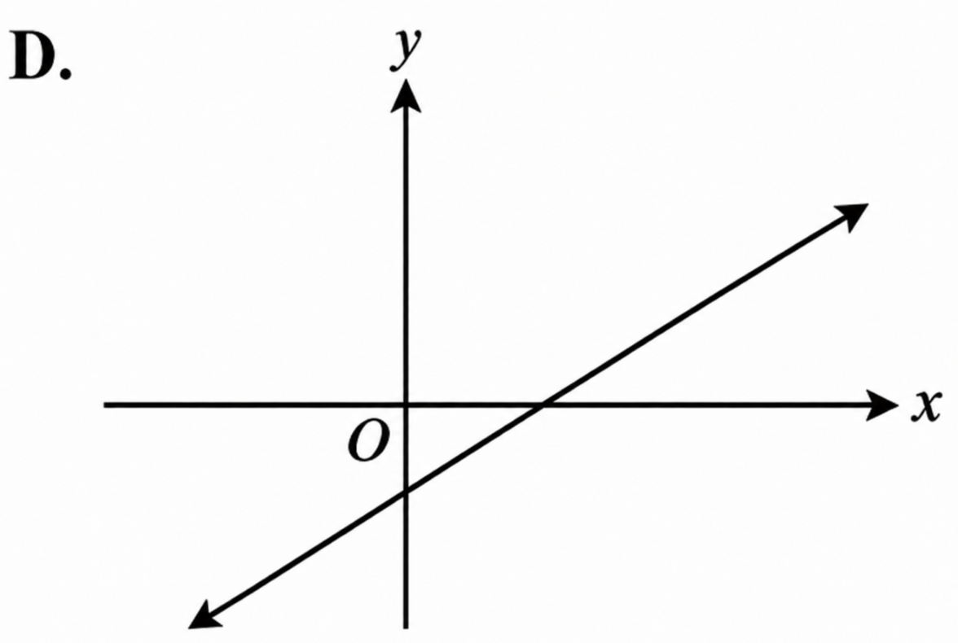
Line graphs (3)
Which of the following could be the graph of $2x+y=4$

Slide 7
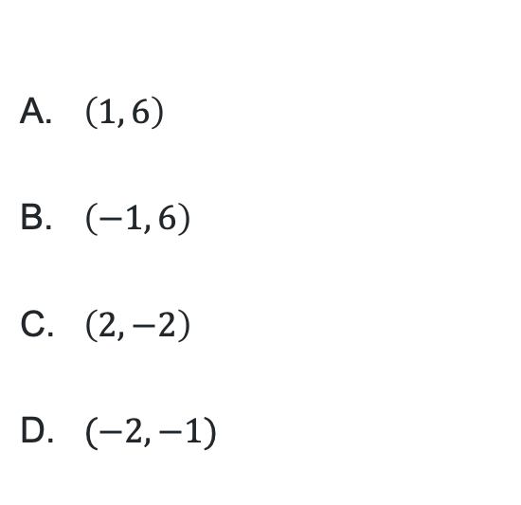
Line graphs (4)
Which point lies on the line $y=−2x+4$?
$\left(1, 6\right)$
$\left(−1, 6\right)$
$\left(2, −2\right)$
$(−2, −1)$

Slide 8
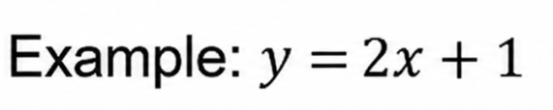
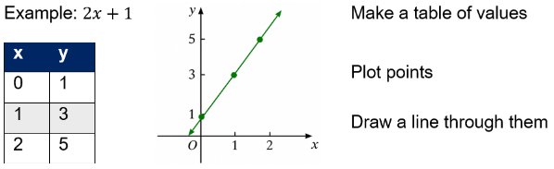
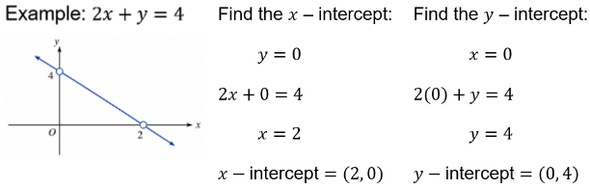
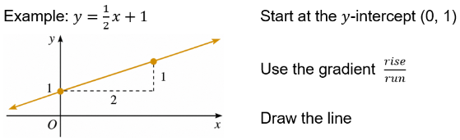
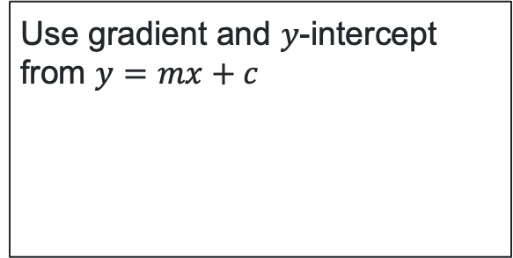
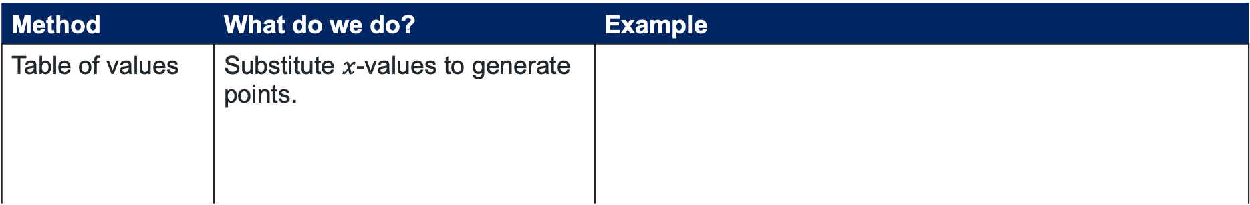
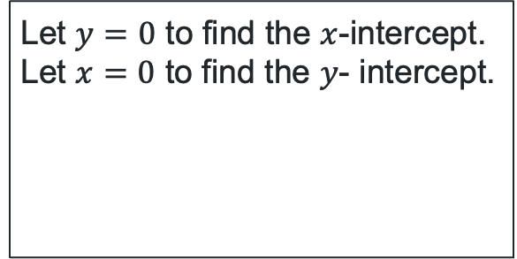
How can we graph a linear equation?
Method | What do we do? | Example
Table of values | Substitute $x$-values to generate points.
Intercepts
Let $y=0$ to find the $x$-intercept.
Let $x=0$ to find the $y$- intercept.
Gradient-intercept
Use gradient and $y$-intercept from $y=mx+c$

Slide 9
Connecting learning

Slide 10
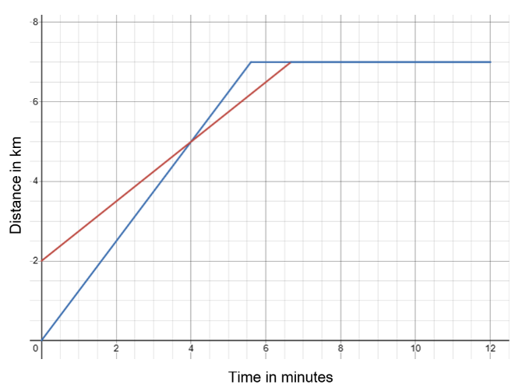
Distance-time scenario and graph
A florist has 2 delivery vans transporting floral arrangements to a wedding venue.
Van A leaves the florist warehouse and travels towards the venue.
Van B left earlier from another delivery location and is already part way along the route when tracking begins.

Slide 11
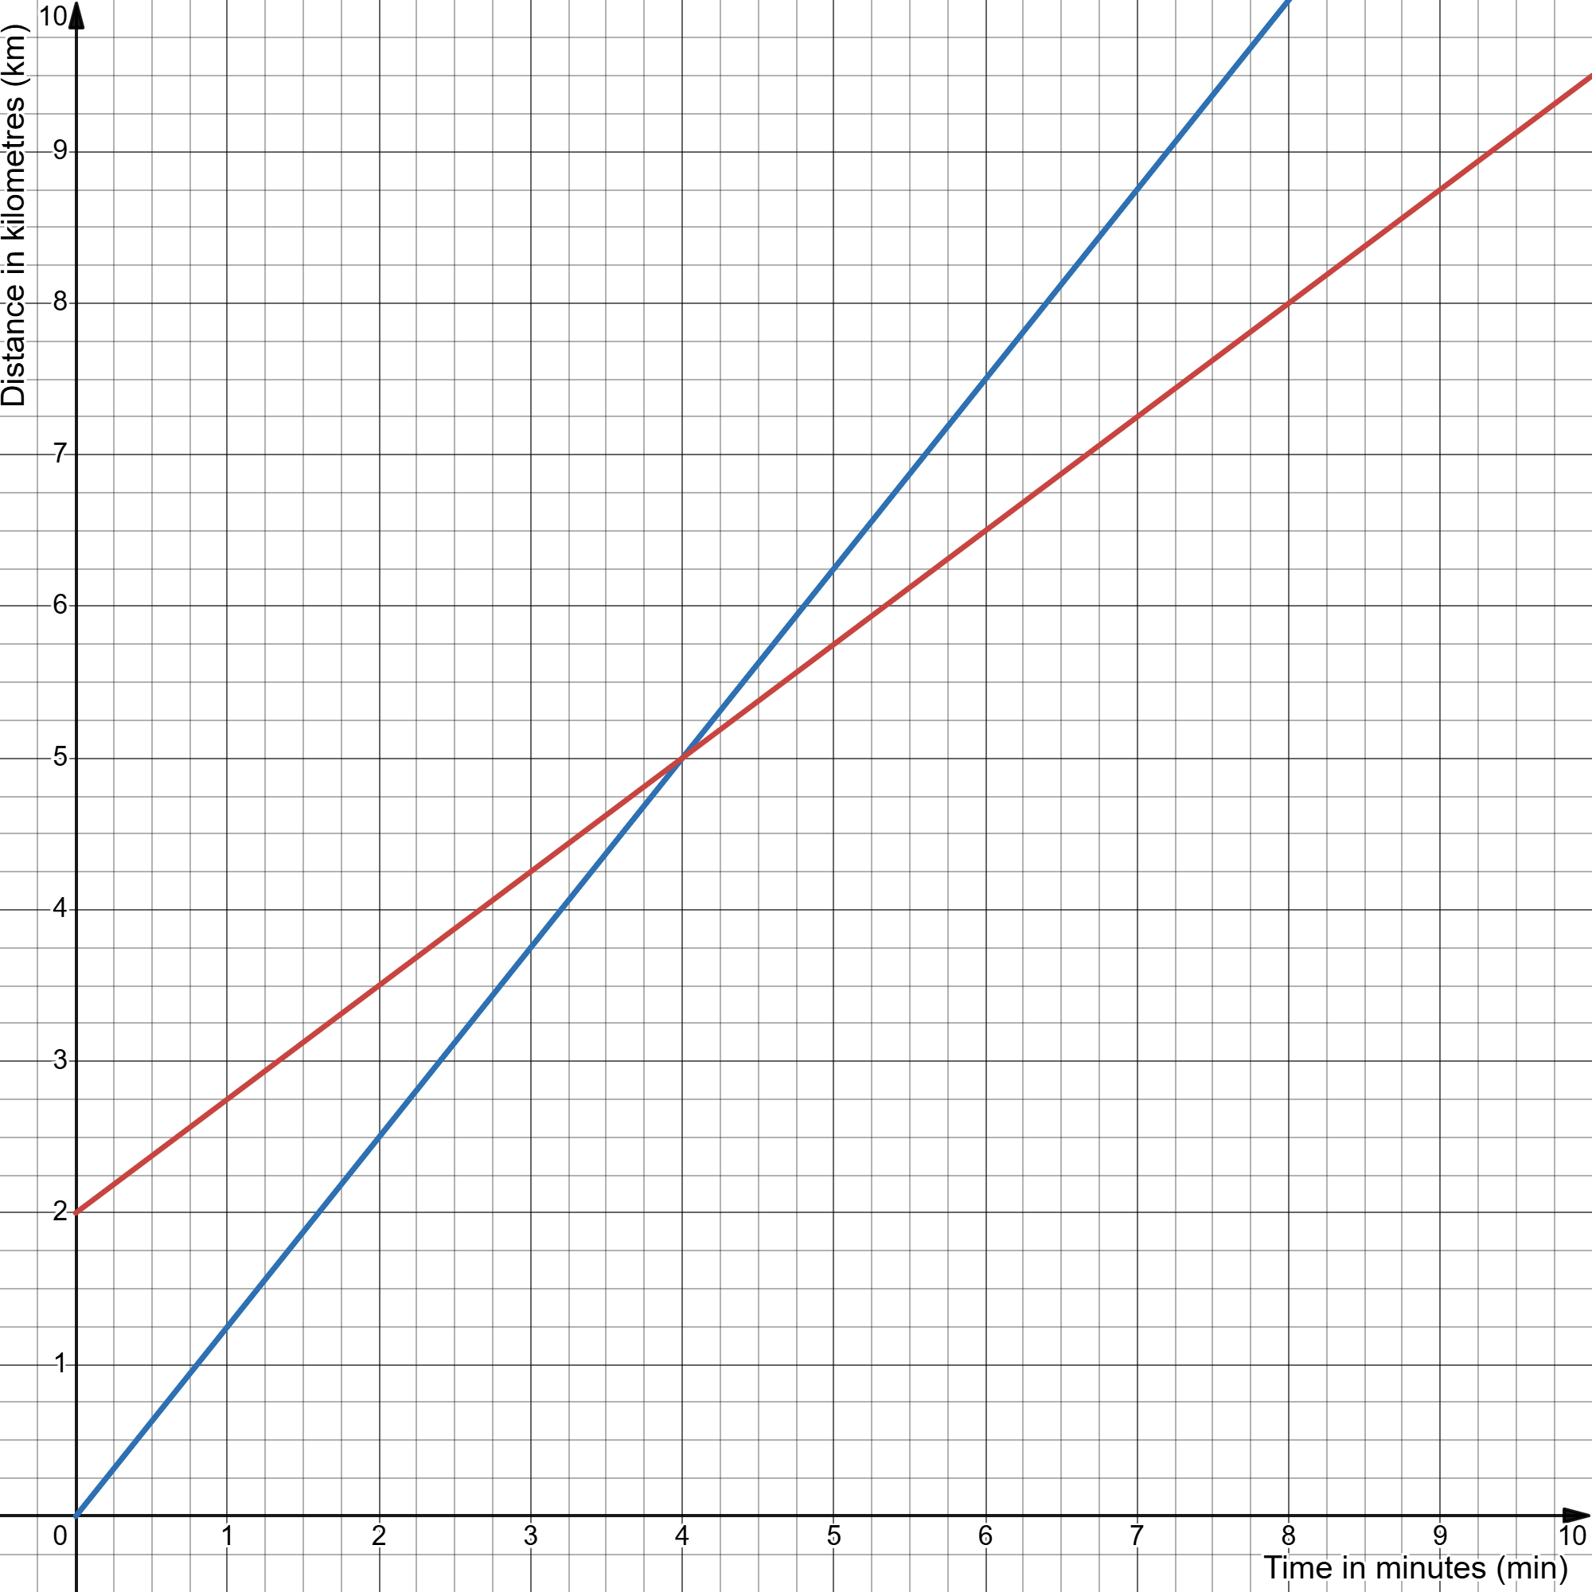
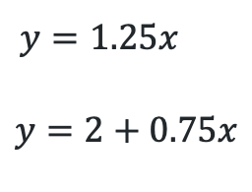
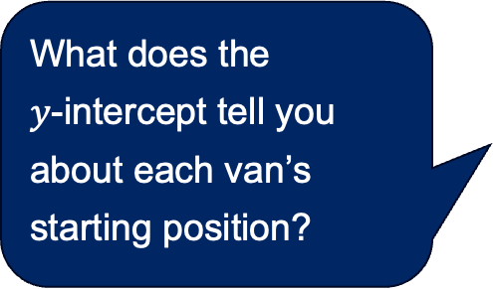
Distance-time graph
$$y=1.25x$$
$$y=2+0.75x$$
Which equation matches which van? How do you know?
What are the coordinates of the point where the 2 lines meet?
What does the
$y$-intercept tell you about each van’s starting position?
What does the gradient tell you about each van’s journey?

Slide 12
Releasing responsibility

Slide 13
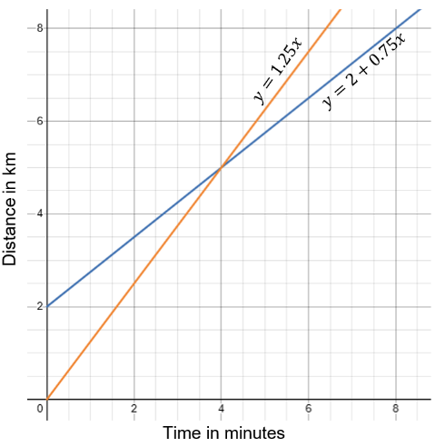
Interpreting the point of intersection
Point of intersection is (4, 5)
This means that both vans are 5 km from the florist warehouse after 4 minutes.

Slide 14
Ways to describe the point of intersection
Where do the 2 lines meet?
Solve the equations simultaneously.
What is the point of intersection?
At what time are they the same distance?
When are they the same distance?

Slide 15
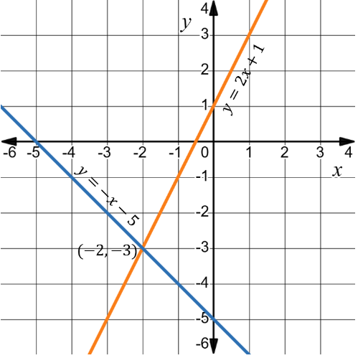
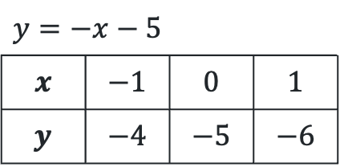
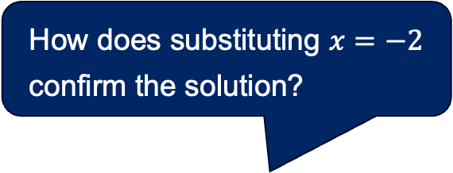
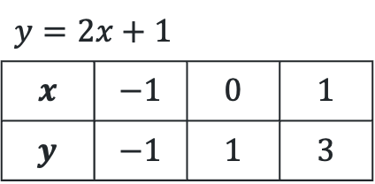
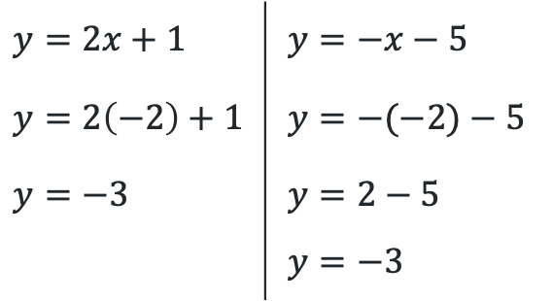

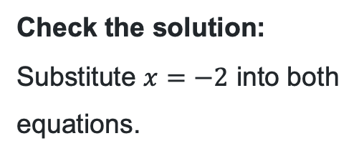


Solving simultaneous equations graphically (1)
Worked example 1
How does substituting $x=−2$ confirm the solution?
Solve the following simultaneous equations graphically.
$$y=2x+1$$
$$y=−x−5$$
$$y=2x+1$$
$$x$$ | $$−1$$ | $$0$$ | $$1$$
$$y$$ | $$−1$$ | $$1$$ | $$3$$
Check the solution:
Substitute $x=−2$ into both equations.
$$y=−x−5$$
$$x$$ | $$−1$$ | $$0$$ | $$1$$
$$y$$ | $$−4$$ | $$−5$$ | $$−6$$
$$y=2x+1$$ $$y=2\left(−2\right)+1$$ $$y=−3$$ | $$y=−x−5$$ $$y=−(−2)−5$$ $$y=2−5$$ $$y=−3$$
How does the graph show that this is the solution to the simultaneous equations?
$$∴x=−2, y=−3$$

Slide 16
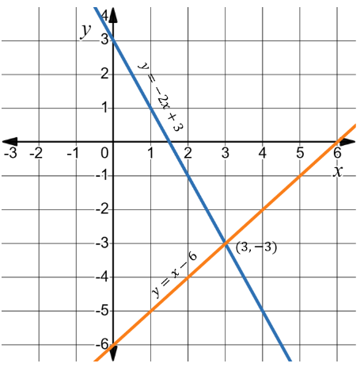
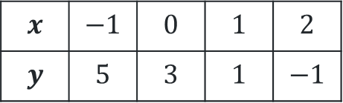


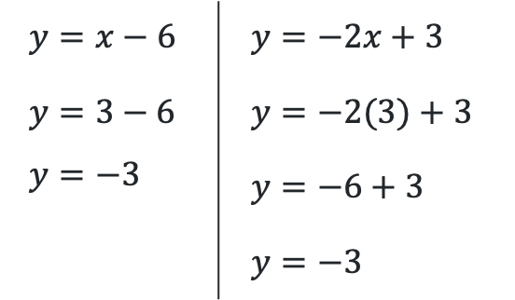
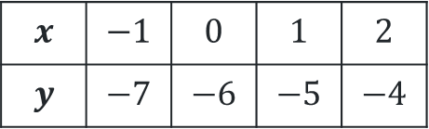
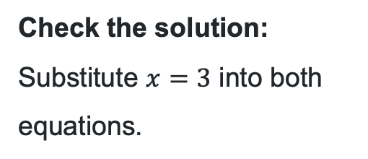



Solving simultaneous equations graphically (2)
Your turn – question 1
Solve the following simultaneous equations graphically.
$$y=x−6$$
$$y=−2x+3$$
Check the solution:
Substitute $x=3$ into both equations.
$$y=x−6$$
$$x$$ | $$−1$$ | $$0$$ | $$1$$ | $$2$$
$$y$$ | $$−7$$ | $$−6$$ | $$−5$$ | $$−4$$
$$y=x−6$$ $$y=3−6$$ $$y=−3$$ | $$y=−2x+3$$ $$y=−2(3)+3$$ $$y=−6+3$$ $$y=−3$$
$$y=−2x+3$$
$$x$$ | $$−1$$ | $$0$$ | $$1$$ | $$2$$
$$y$$ | $$5$$ | $$3$$ | $$1$$ | $$−1$$
$$∴x=3, y=−3$$

Slide 17
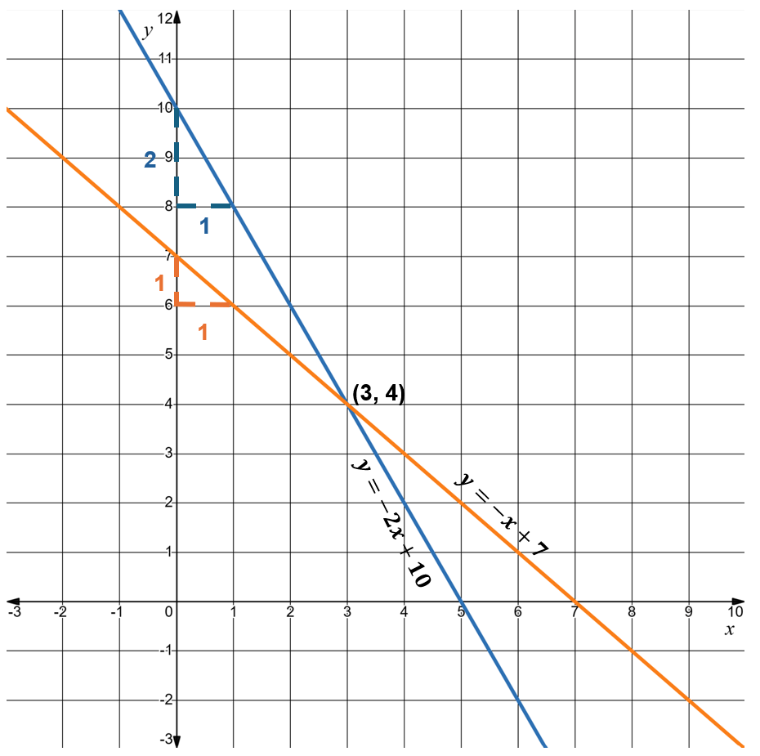
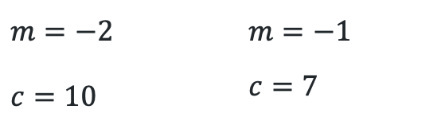




Solving simultaneous equations graphically (3)
Worked example 2
Solve the following simultaneous equations graphically.
$$2x+y=10$$
$$x+y=7$$
Graphing method – gradient and intercept
$$y=−2x+10$$ | $$y=−x+7$$
Why have we rearranged each equation before graphing?
$$m=−2$$ $$c=10$$ | $$m=−1$$ $$c=7$$
How are these values used to graph the straight lines?
$$∴x=3, y=4$$

Slide 18
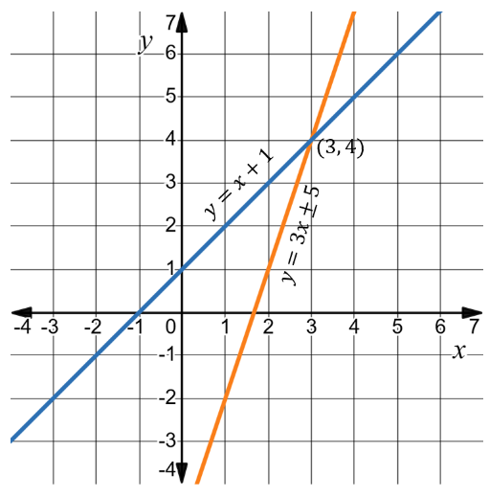


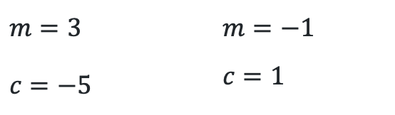
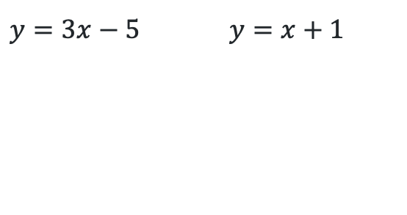

Solving simultaneous equations graphically (4)
Your turn – question 2
Solve the following simultaneous equations graphically.
$$3x−y=5$$
$$x−y=−1$$
Graphing method – gradient and intercept
$$y=3x−5$$ | $$y=x+1$$
$$m=3$$ $$c=−5$$ | $$m=−1$$ $$c=1$$
$$∴x=3, y=4$$

Slide 19
Independent practice

Slide 20
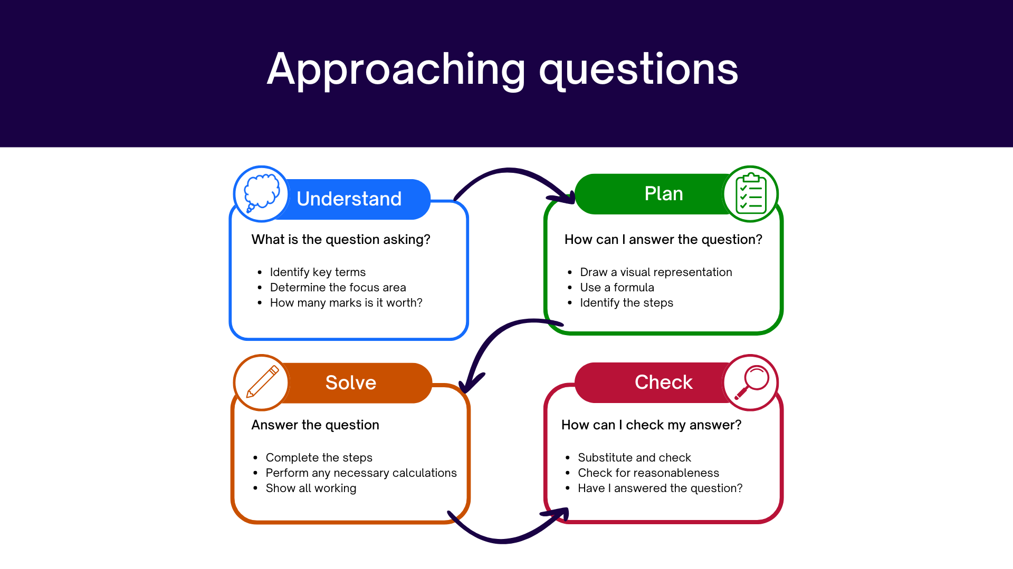
Approaching questions scaffold

Slide 21
2023 Standard 2 HSC marker feedback
Question 21
In better responses, students were able to:
draw a straight-line graph accurately from a table of values
find the point of intersection from a graph and identify the value from the correct axis
interpret the question using the graph and mathematical reasoning to determine which provider was the cheaper option and by how much.
Areas for students to improve include:
plotting points from a table onto a grid and accurately drawing a linear relationship using a ruler
using a highlighter or underlining to assist in identifying parts of the question that need to be addressed such as ‘which provider’ and ‘by how much’.
(NESA, 2023)

Slide 22
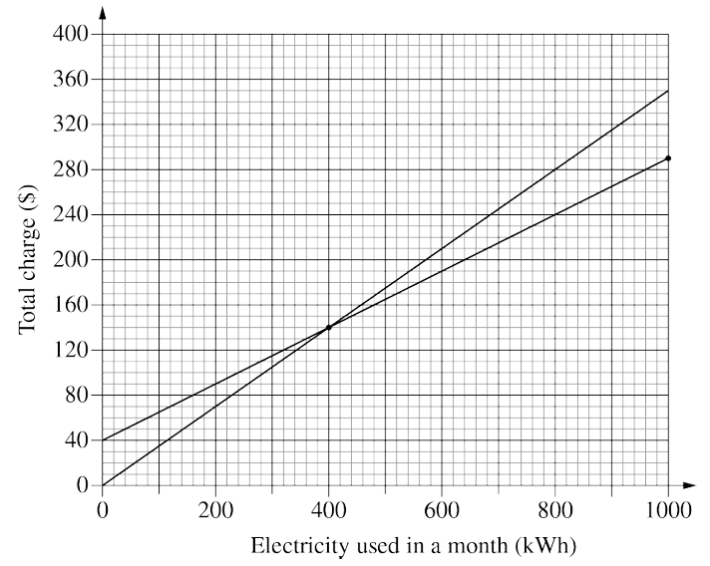
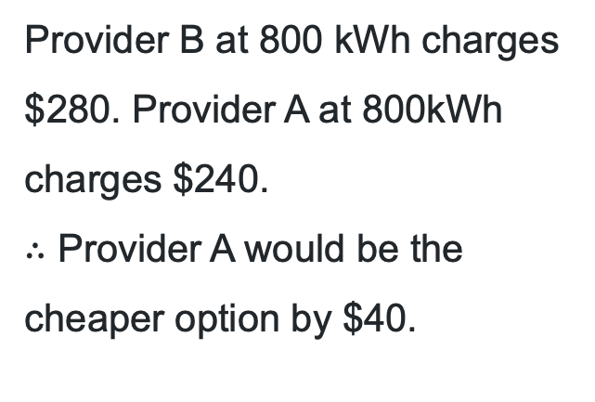
2023 Standard 2 HSC solution
Question 21
(a)
(c)
They charge the same amount at 400 kWh.
Electricity used in a month (kWh) | 0 | 400 | 1000
Monthly charge ($) | 40 | 140 | 290
(b)
(d)
Provider B at 800 kWh charges $280. Provider A at 800kWh charges $240.
$∴$ Provider A would be the cheaper option by $40.

Slide 23
2023 Standard 2 HSC marking criteria
Question 21
(a)
Criteria | Marks
Completes the table correctly | 1
(b)
Criteria | Marks
Graphs Provider A’s charges | 1
(c)
Criteria | Marks
Provides correct answer | 1
(d)
Criteria | Marks
Provides correct solution | 2
Demonstrates some progress towards identifying the cheaper option, or equivalent merit | 1
(NESA, 2023)

Slide 24
References
This presentation contains NSW Curriculum and syllabus content. The NSW Curriculum is developed by the NSW Education Standards Authority. This content is prepared by NESA for and on behalf of the Crown in the right of the State of New South Wales. The material is protected by Crown copyright.
Please refer to the NESA Copyright Disclaimer for more information https://www.nsw.gov.au/education-and-training/nesa/copyright.
NESA holds the only official and up-to-date versions of the NSW Curriculum and syllabus documents. Please visit the NSW Education Standards Authority (NESA) website https://educationstandards.nsw.edu.au/wps/portal/nesa/home and the NSW Curriculum website https://curriculum.nsw.edu.au.
Mathematics Standard 11–12 Syllabus © NSW Education Standards Authority (NESA) for and on behalf of the Crown in right of the State of New South Wales, 2024.

Slide 25
Copyright
© State of New South Wales (Department of Education), 2026
The copyright material published in this resource is subject to the Copyright Act 1968 (Cth) and is owned by the NSW Department of Education or, where indicated, by a party other than the NSW Department of Education (third-party material).
Copyright material available in this resource and owned by the NSW Department of Education is licensed under a Creative Commons Attribution 4.0 International (CC BY 4.0) license.
This license allows you to share and adapt the material for any purpose, even commercially.
Attribution should be given to © State of New South Wales (Department of Education), 2026.
Material in this resource not available under a Creative Commons license:
the NSW Department of Education logo, other logos and trademark-protected material
Material owned by a third party that has been reproduced with permission. You will need to obtain permission from the third party to reuse its material.
Links to third-party material and websites
Please note that the provided (reading/viewing material/list/links/texts) are a suggestion only and implies no endorsement, by the New South Wales Department of Education, of any author, publisher, or book title. School principals and teachers are best placed to assess the suitability of resources that would complement the curriculum and reflect the needs and interests of their students.
If you use the links provided in this document to access a third-party’s website, you acknowledge that the terms of use, including licence terms set out on the third-party’s website apply to the use which may be made of the materials on that third-party website or where permitted by the Copyright Act 1968 (Cth). The department accepts no responsibility for content on third-party websites.

