Slide 1

Double angle formulas
Mathematics Extension 1 – Stage 6 (Year 11)
Polynomials

Slide 2
Learning intentions and success criteria
Learning intentions
To understand how double angle formulas are connected to the sum and difference expansion formulas.
To be able to apply the formulas to solve problems
Success criteria
I can use the sum expansion formulas to derive the double angle formulas.
I can use double angle formulas to solve problems.
I can choose efficient strategies to simplify expressions and justify my approach.

Slide 3
Activating prior knowledge

Slide 4
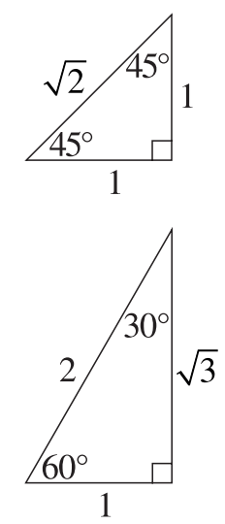


True or false?
$\sin{(30°+30°)}=2×\sin{30°}$
$\cos{(2×45°)}=2×\cos{45°}$
$\tan{120°}=2×\tan{60°}$
$\sin{2A}=2\sin{A}$
How can we show if this is true or false?

Slide 5
Connecting learning

Slide 6
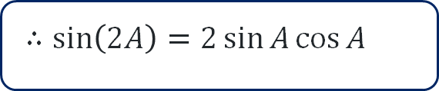
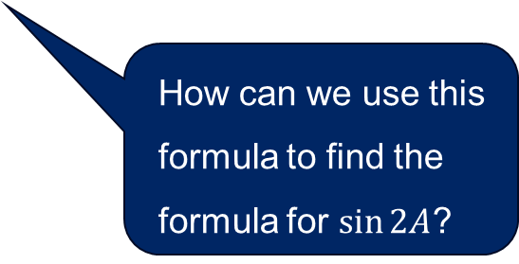
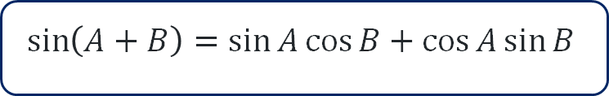
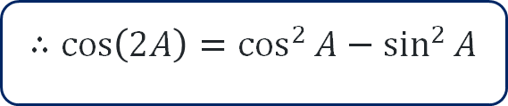

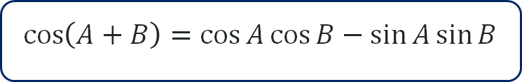
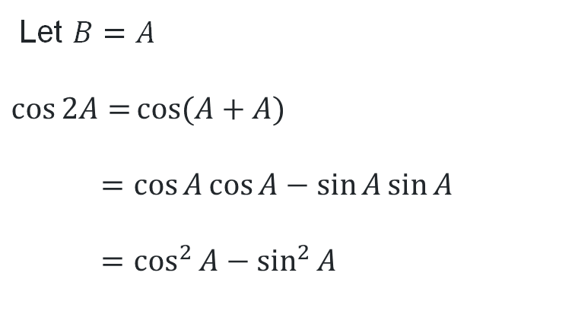
Deriving the double angle formulas (1)
$\sin{2A}$ and $\cos{2A}$
$\sin\left(A+B\right)=\sin{A}\cos{B}+\cos{A}\sin{B}$
$\cos\left(A+B\right)=\cos{A}\cos{B}−\sin{A}\sin{B}$
How can we use this formula to find the formula for $\sin{2A}$?
Let $B=A$
$$\sin{2A=}\sin{(A+A)}$$
$$=\sin{A}\cos{A}+\cos{A}\sin{A}$$
$$=2\sin{A}\cos{A}$$
Let $B=A$
$$\cos{2A=}\cos{(A+A)}$$
$$=\cos{A}\cos{A}−\sin{A}\sin{A}$$
$$=\cos^{2}{A}−\sin^{2}{A}$$
$∴sin\left(2A\right)=2\sin{A}\cos{A}$
$∴cos\left(2A\right)=\cos^{2}{A}−\sin^{2}{A}$

Slide 7

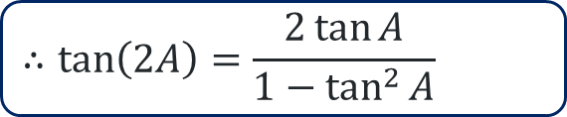

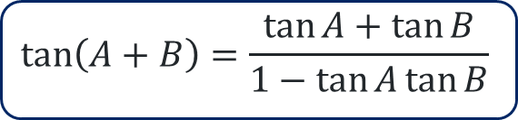

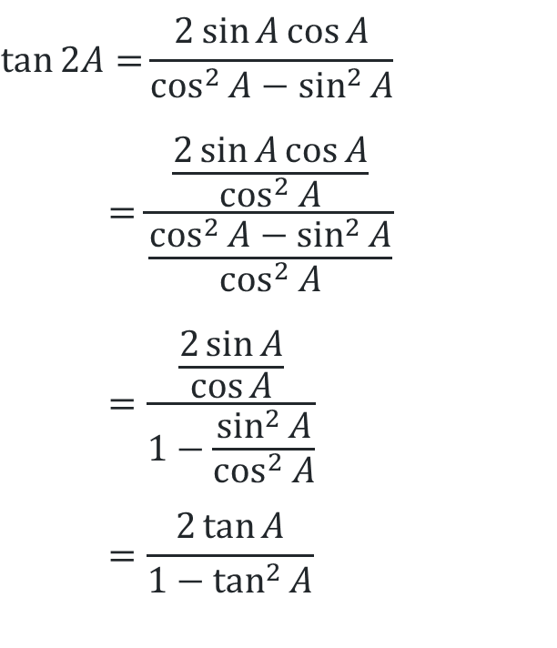
Deriving the double angle formulas (2)
$\tan{2A}$
$$\tan\left(A+B\right)=\frac{\tan{A}+\tan{B}}{1−\tan{A}\tan{B}}$$
$$\tan\left(2A\right)=\frac{\sin{(2A)}}{\cos{(2A)}}$$
Compare the 2 methods. How are they different?
Let $B=A$
$$\tan{2A=}\tan{(A+A)}$$
$$=\frac{\tan{A}+\tan{A}}{1−\tan{A}\tan{A}}$$
$$=\frac{2\tan{A}}{1−\tan^{2}{A}}$$
$$\tan{2A=}\frac{2\sin{A}\cos{A}}{\cos^{2}{A}−\sin^{2}{A}}$$
$$=\frac{\frac{2\sin{A}\cos{A}}{\cos^{2}{A}}}{\frac{\cos^{2}{A}−\sin^{2}{A}}{\cos^{2}{A}}}$$
$$=\frac{\frac{2\sin{A}}{\cos{A}}}{1−\frac{\sin^{2}{A}}{\cos^{2}{A}}}$$
$$=\frac{2\tan{A}}{1−\tan^{2}{A}}$$
Divide the numerator and denominator by $\cos^{2}{A}$
$$∴tan\left(2A\right)=\frac{2\tan{A}}{1−\tan^{2}{A}}$$

Slide 8

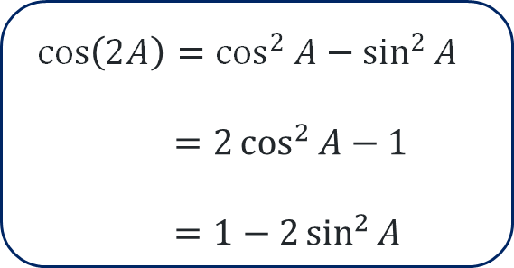

The cosine double angle formula
$\cos{2A}=\cos^{2}{A}−\sin^{2}{A}$
$\cos^{2}{x}+\sin^{2}{x}=1$
$$\sin^{2}{x=1−\cos^{2}{x}}$$
$$\cos{2A=}\cos^{2}{A}−(1−\cos^{2}{A})$$
$$=\cos^{2}{A}−1+\cos^{2}{A}$$
$$=2\cos^{2}{A}−1$$
$\cos^{2}{x}+\sin^{2}{x}=1$
$$\cos^{2}{x=1−\sin^{2}{x}}$$
$$\cos{2A=} \left(1−\sin^{2}{A}\right)−\sin^{2}{A}$$
$$=1−2\sin^{2}{A}$$
$\cos\left(2A\right)=\cos^{2}{A}−\sin^{2}{A}$
$$=2\cos^{2}{A}−1$$
$$=1−2\sin^{2}{A}$$

Slide 9
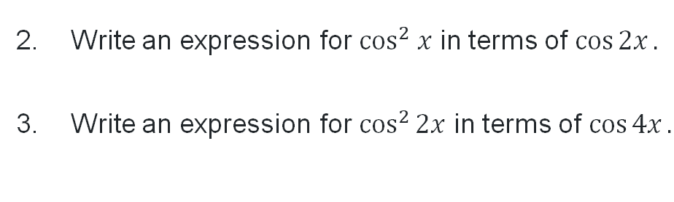

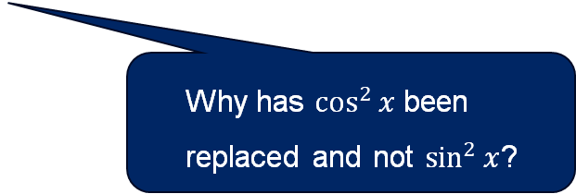
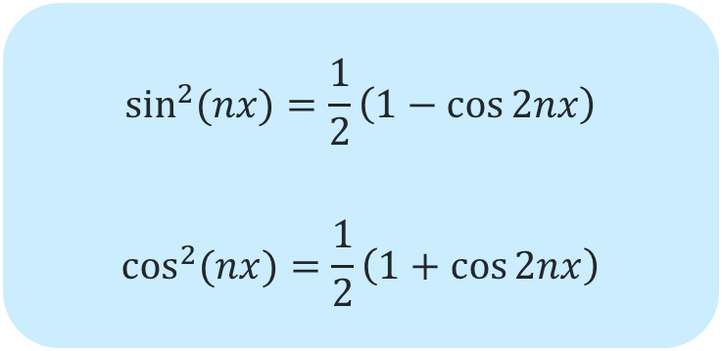
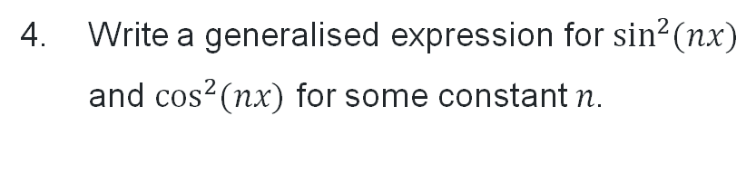
Manipulating the double angle formulas
Write an expression for $\sin^{2} x$ in terms of $\cos{2x}.$
$$\cos{2x}=\cos^{2}{x}−\sin^{2}{x}$$
$$=\left(1−\sin^{2}{x}\right)−\sin^{2}{x}$$
$$=1−2\sin^{2}{x}$$
$$2\sin^{2}{x}=1−\cos{2x}$$
$$\sin^{2}{x}=\frac{1}{2}\left(1−\cos{2x}\right)$$
Write an expression for $\cos^{2} x$ in terms of $\cos{2x}.$
Write an expression for $\cos^{2}{2x}$ in terms of $\cos{4x}.$
Write a generalised expression for $\sin^{2}{(nx)}$ and $\cos^{2}{(nx)}$ for some constant $n$.
Why has $\cos^{2}{x}$ been replaced and not $\sin^{2}{x}$?
$$\sin^{2}{(nx)}=\frac{1}{2}\left(1−\cos{2nx}\right)$$
$$\cos^{2}{(nx)}=\frac{1}{2}\left(1+\cos{2nx}\right)$$

Slide 10
Releasing responsibility

Slide 11
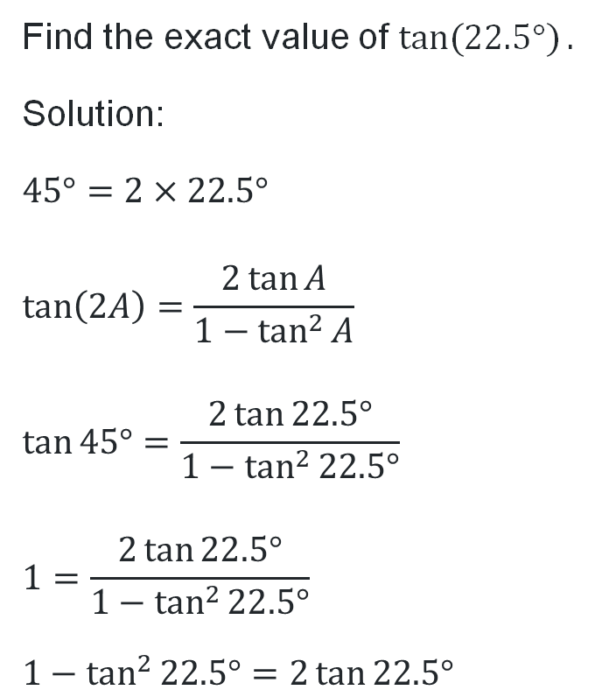

Applying the double angle formulas (1)
Worked example 1
Find the exact value of $\tan{(22.5°)}.$
Solution:
$$45°=2×22.5°$$
$$\tan\left(2A\right)=\frac{2\tan{A}}{1−\tan^{2}{A}}$$
$$\tan{45°}=\frac{2\tan{22.5°}}{1−\tan^{2}{22.5°}}$$
$$1=\frac{2\tan{22.5°}}{1−\tan^{2}{22.5°}}$$
$$1−\tan^{2}{22.5°}=2\tan{22.5°}$$
$$\tan^{2}{22.5°}+2\tan{22.5°}−1=0$$
$$\tan{22.5°=}\frac{−2±\sqrt{2^{2}−4(1)(−1)}}{2(1)}$$
$$=\frac{−2±2\sqrt{2}}{2}$$
$=−1+\sqrt{2}$ or $−1−\sqrt{2}$
$=\sqrt{2}−1$ only, since $\tan{22.5°}>0$
What formula is used here and why?
Why was one of the solutions excluded?

Slide 12
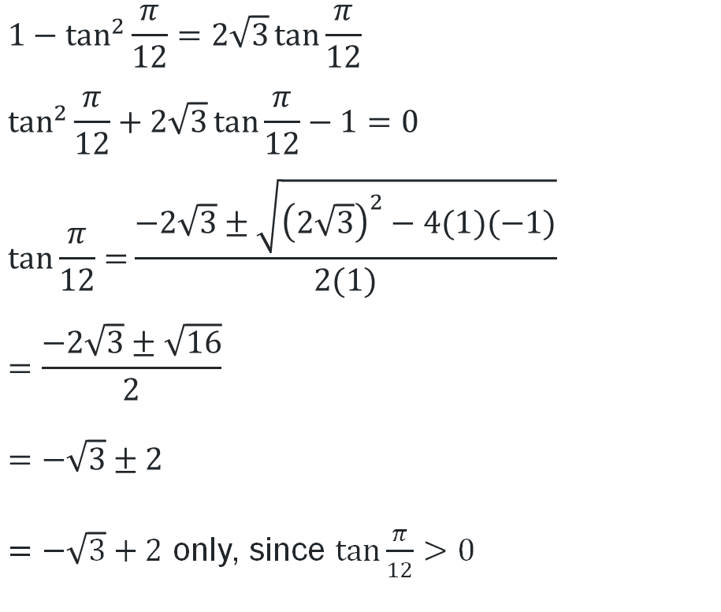
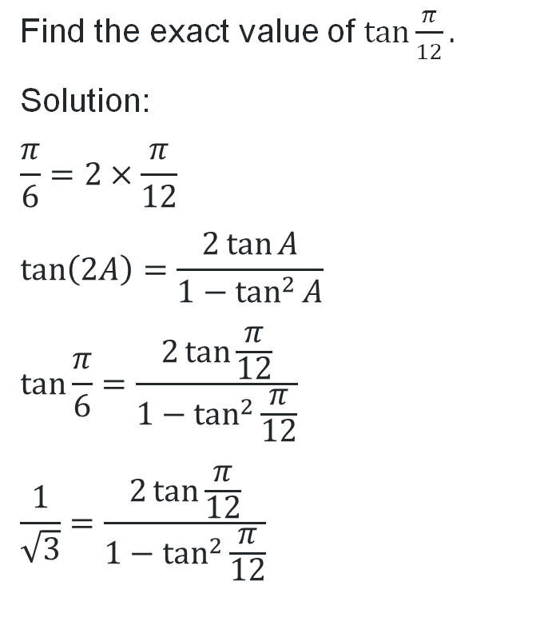
Applying the double angle formulas (2)
Your turn – question 1
Find the exact value of $\tan{\frac{π}{12}}.$
Solution:
$$\frac{π}{6}=2×\frac{π}{12}$$
$$\tan\left(2A\right)=\frac{2\tan{A}}{1−\tan^{2}{A}}$$
$$\tan{\frac{π}{6}}=\frac{2\tan{\frac{π}{12}}}{1−\tan^{2}{\frac{π}{12}}}$$
$$\frac{1}{\sqrt{3}}=\frac{2\tan{\frac{π}{12}}}{1−\tan^{2}{\frac{π}{12}}}$$
$$1−\tan^{2}{\frac{π}{12}}=2\sqrt{3}\tan{\frac{π}{12}}$$
$$\tan^{2}{\frac{π}{12}}+2\sqrt{3}\tan{\frac{π}{12}}−1=0$$
$$\tan{\frac{π}{12}=}\frac{−2\sqrt{3}±\sqrt{{\left(2\sqrt{3}\right)}^{2}−4(1)(−1)}}{2(1)}$$
$$=\frac{−2\sqrt{3}±\sqrt{16}}{2}$$
$$=−\sqrt{3}±2$$
$=−\sqrt{3}+2$ only, since $\tan{\frac{π}{12}}>0$
Is the double-angle formula the only way to solve this? Why or why not?

Slide 13
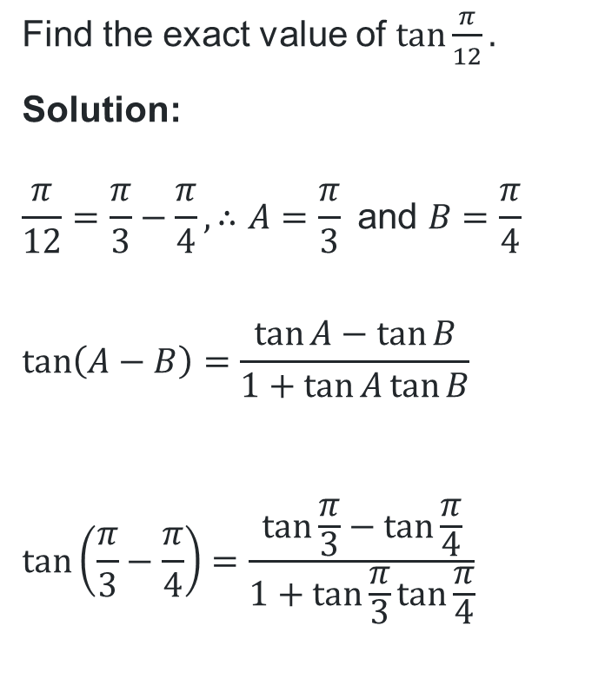
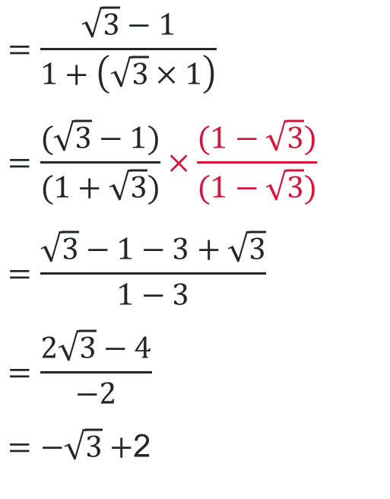
Alternative solution
Will every trigonometric expression allow the exact value to be found using a sum or difference expansion formula?
Your turn – question 1
Find the exact value of $\tan{\frac{π}{12}}.$
Solution:
$$\frac{π}{12}=\frac{π}{3}−\frac{π}{4}, ∴A=\frac{π}{3} \text{and} B=\frac{π}{4}$$
$$\tan\left(A−B\right)=\frac{\tan{A}−\tan{B}}{1+\tan{A}\tan{B}}$$
$$\tan\left(\frac{π}{3}−\frac{π}{4}\right)=\frac{\tan{\frac{π}{3}}−\tan{\frac{π}{4}}}{1+\tan{\frac{π}{3}}\tan{\frac{π}{4}}}$$
$$=\frac{\sqrt{3}−1}{1+\left(\sqrt{3}×1\right)}$$
$$=\frac{(\sqrt{3}−1)}{(1+\sqrt{3})}×\frac{(1−\sqrt{3})}{(1−\sqrt{3})}$$
$$=\frac{\sqrt{3}−1−3+\sqrt{3}}{1−3}$$
$$=\frac{2\sqrt{3}−4}{−2}$$
$=−\sqrt{3}+$2
Why does this method produce one solution whilst the other produced 2?

Slide 14
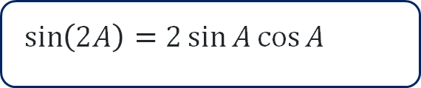
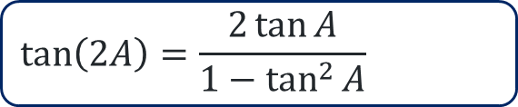
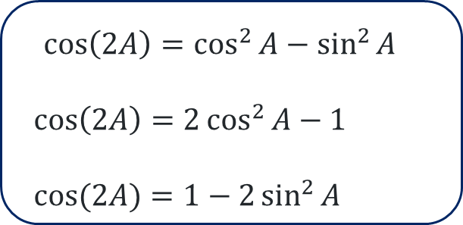
All double angle formulas
$\sin\left(2A\right)=2\sin{A}\cos{A}$
$$\cos\left(2A\right)=\cos^{2}{A}−\sin^{2}{A}$$
$$\cos\left(2A\right)=2\cos^{2}{A}−1$$
$$\cos{(2A)}=1−2\sin^{2}{A}$$
$$\tan\left(2A\right)=\frac{2\tan{A}}{1−\tan^{2}{A}}$$

Slide 15
Independent practice

Slide 16
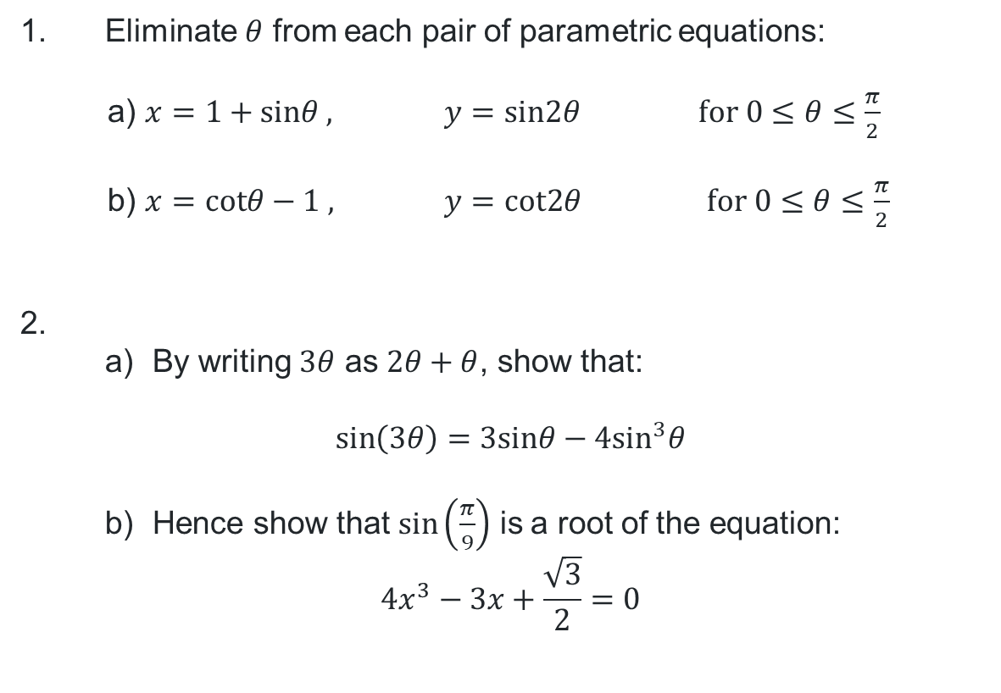
Using double angle formulas across contexts (1)
Questions
1. Eliminate $θ$ from each pair of parametric equations:
    a) $x=1+sinθ ,$ $y=sin2θ$ $for 0≤θ≤\frac{π}{2}$
    b) $x=cotθ−1 ,$ $y=cot2θ$ $for 0≤θ≤\frac{π}{2}$
2.
  By writing $3θ$ as $2θ+θ$, show that:
$$\sin\left(3θ\right)=3sinθ−4\sin^{3}θ$$
  Hence show that $\sin\left(\frac{π}{9}\right)$ is a root of the equation:
$$4x^{3}−3x+\frac{\sqrt{3}}{2}=0$$

Slide 17
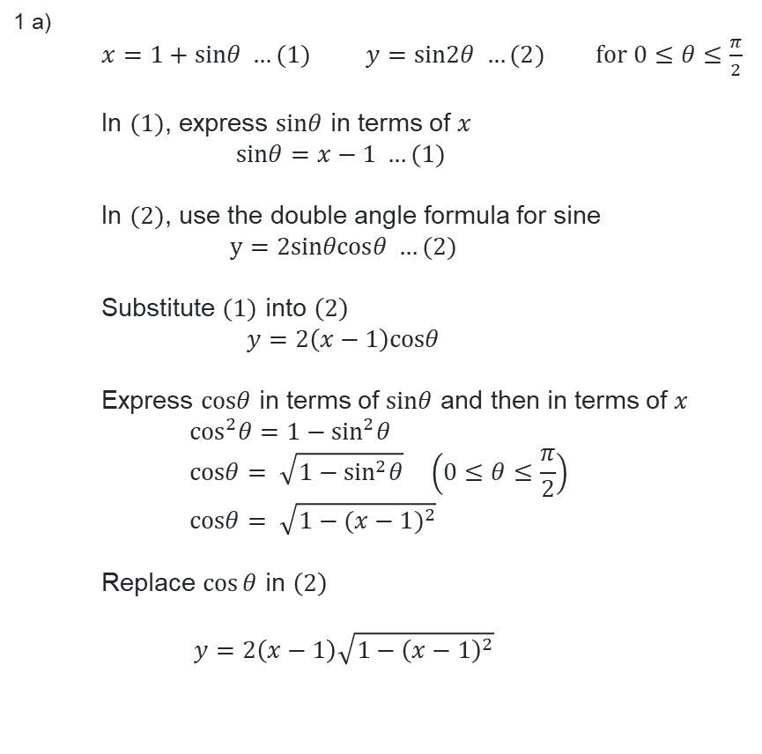
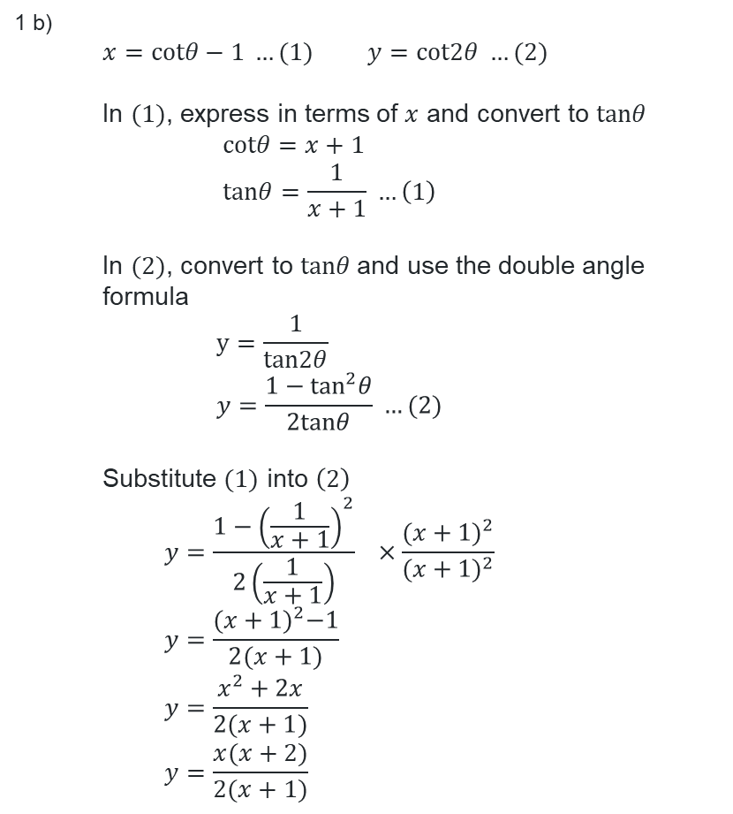
Using double angle formulas across contexts (2)
Question 1 solutions
1 b)
  $x=cotθ−1 …(1)$ $y=cot2θ …(2)$
  In $(1)$, express in terms of $x$ and convert to $tanθ$
  $$cotθ=x+1 \\ tanθ=\frac{1}{x+1} …\left(1\right)$$
  In $(2)$, convert to $tanθ$and use the double angle formula
  $$y=\frac{1}{tan2θ} \\ y=\frac{1−\tan^{2}θ}{2tanθ} …(2)$$
  Substitute $(1)$ into $\left(2\right)$
  $$y=\frac{1−{\left(\frac{1}{x+1}\right)}^{2}}{2\left(\frac{1}{x+1}\right)} ×\frac{{(x+1)}^{2}}{{(x+1)}^{2}} \\ y=\frac{{(x+1)}^{2}−1}{2(x+1)} \\ y=\frac{x^{2}+2x}{2(x+1)} \\ y=\frac{x(x+2)}{2(x+1)}$$
1 a)
  $x=1+sinθ …(1)$ $y=sin2θ …(2)$ $for 0≤θ≤\frac{π}{2}$
  In $(1)$, express $sinθ$ in terms of $x$
  $$sinθ=x−1 …(1)$$
  In $(2)$, use the double angle formula for sine
  $$y=2sinθcosθ …(2)$$
  Substitute $(1)$ into $\left(2\right)$
  $$y=2\left(x−1\right)cosθ$$
  Express $cosθ$ in terms of $sinθ$ and then in terms of $x$
    $$\cos^{2}θ=1−\sin^{2}θ \\ cosθ= \sqrt{1−\sin^{2}θ} \left(0≤θ≤\frac{π}{2}\right) \\ cosθ= \sqrt{1−{(x−1)}^{2}}$$
  Replace $\cos{θ}$ in $\left(2\right)$
  $$y=2\left(x−1\right)\sqrt{1−{\left(x−1\right)}^{2}}$$

Slide 18
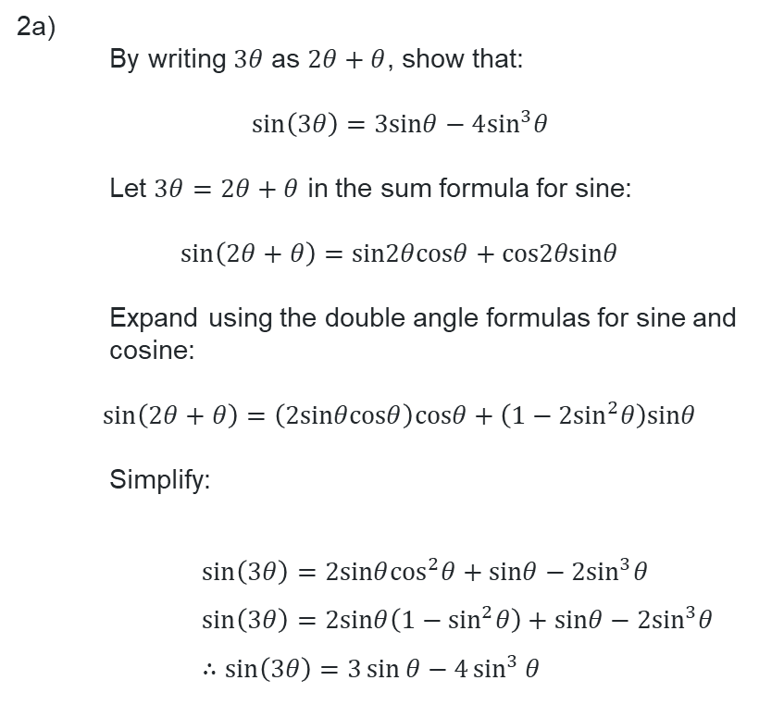
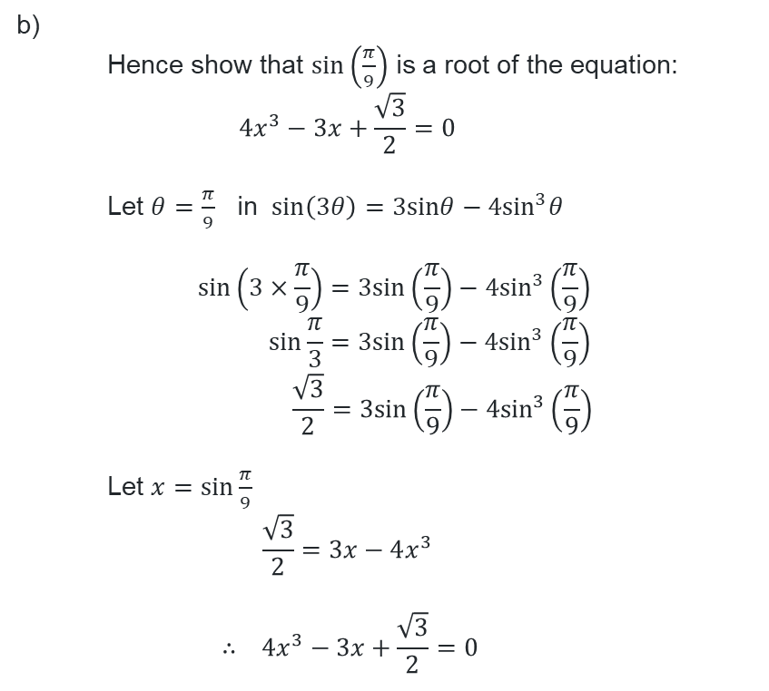
Using double angle formulas across contexts (3)
Question 2 solutions
2a)
  By writing $3θ$ as $2θ+θ$, show that:
$$\sin\left(3θ\right)=3sinθ−4\sin^{3}θ$$
  Let $3θ=2θ+θ$ in the sum formula for sine:
$$\sin\left(2θ+θ\right)=sin2θcosθ+cos2θsinθ$$
  Expand using the double angle formulas for sine and cosine:
$$\sin\left(2θ+θ\right)=\left(2sinθcosθ\right)cosθ+\left(1−{2sin}^{2}θ\right)sinθ$$
  Simplify:
    $$\sin\left(3θ\right)=2sinθ\cos^{2}θ+sinθ−2\sin^{3}θ \\ \sin\left(3θ\right)=2sinθ\left(1−\sin^{2}θ\right)+sinθ−2\sin^{3}θ \\ ∴\sin\left(3θ\right)=3\sin{θ}−4\sin^{3}{θ}$$
b)
  Hence show that $\sin\left(\frac{π}{9}\right)$ is a root of the equation:
  $$4x^{3}−3x+\frac{\sqrt{3}}{2}=0$$
  Let $θ=\frac{π}{9}$ in $\sin\left(3θ\right)=3sinθ−4\sin^{3}θ$
    $$\sin\left(3×\frac{π}{9}\right)=3sin\left(\frac{π}{9}\right)−4\sin^{3}\left(\frac{π}{9}\right) \\ \sin{\frac{π}{3}}=3sin\left(\frac{π}{9}\right)−4\sin^{3}\left(\frac{π}{9}\right) \\ \frac{\sqrt{3}}{2}=3sin\left(\frac{π}{9}\right)−4\sin^{3}\left(\frac{π}{9}\right)$$
  Let $x=sin\frac{π}{9}$
  $$\frac{\sqrt{3}}{2}=3x−4x^{3}$$
    $$∴ 4x^{3}−3x+\frac{\sqrt{3}}{2}=0$$

Slide 19
References
This presentation contains NSW Curriculum and syllabus content. The NSW Curriculum is developed by the NSW Education Standards Authority. This content is prepared by NESA for and on behalf of the Crown in the right of the State of New South Wales. The material is protected by Crown copyright.
Please refer to the NESA Copyright Disclaimer for more information https://educationstandards.nsw.edu.au/wps/portal/nesa/mini-footer/copyright.
NESA holds the only official and up-to-date versions of the NSW Curriculum and syllabus documents. Please visit the NSW Education Standards Authority (NESA) website https://educationstandards.nsw.edu.au/wps/portal/nesa/home and the NSW Curriculum website https://curriculum.nsw.edu.au.
Mathematics Extension 1 11-12 Syllabus © NSW Education Standards Authority (NESA) for and on behalf of the Crown in right of the State of New South Wales, 2024.

Slide 20
Copyright
© State of New South Wales (Department of Education), 2026
The copyright material published in this resource is subject to the Copyright Act 1968 (Cth) and is owned by the NSW Department of Education or, where indicated, by a party other than the NSW Department of Education (third-party material).
Copyright material available in this resource and owned by the NSW Department of Education is licensed under a Creative Commons Attribution 4.0 International (CC BY 4.0) license.
This license allows you to share and adapt the material for any purpose, even commercially.
Attribution should be given to © State of New South Wales (Department of Education), 2026.
Material in this resource not available under a Creative Commons license:
the NSW Department of Education logo, other logos and trademark-protected material
Material owned by a third party that has been reproduced with permission. You will need to obtain permission from the third party to reuse its material.
Links to third-party material and websites
Please note that the provided (reading/viewing material/list/links/texts) are a suggestion only and implies no endorsement, by the New South Wales Department of Education, of any author, publisher, or book title. School principals and teachers are best placed to assess the suitability of resources that would complement the curriculum and reflect the needs and interests of their students.
If you use the links provided in this document to access a third-party’s website, you acknowledge that the terms of use, including licence terms set out on the third-party’s website apply to the use which may be made of the materials on that third-party website or where permitted by the Copyright Act 1968 (Cth). The department accepts no responsibility for content on third-party websites.

