Slide 1
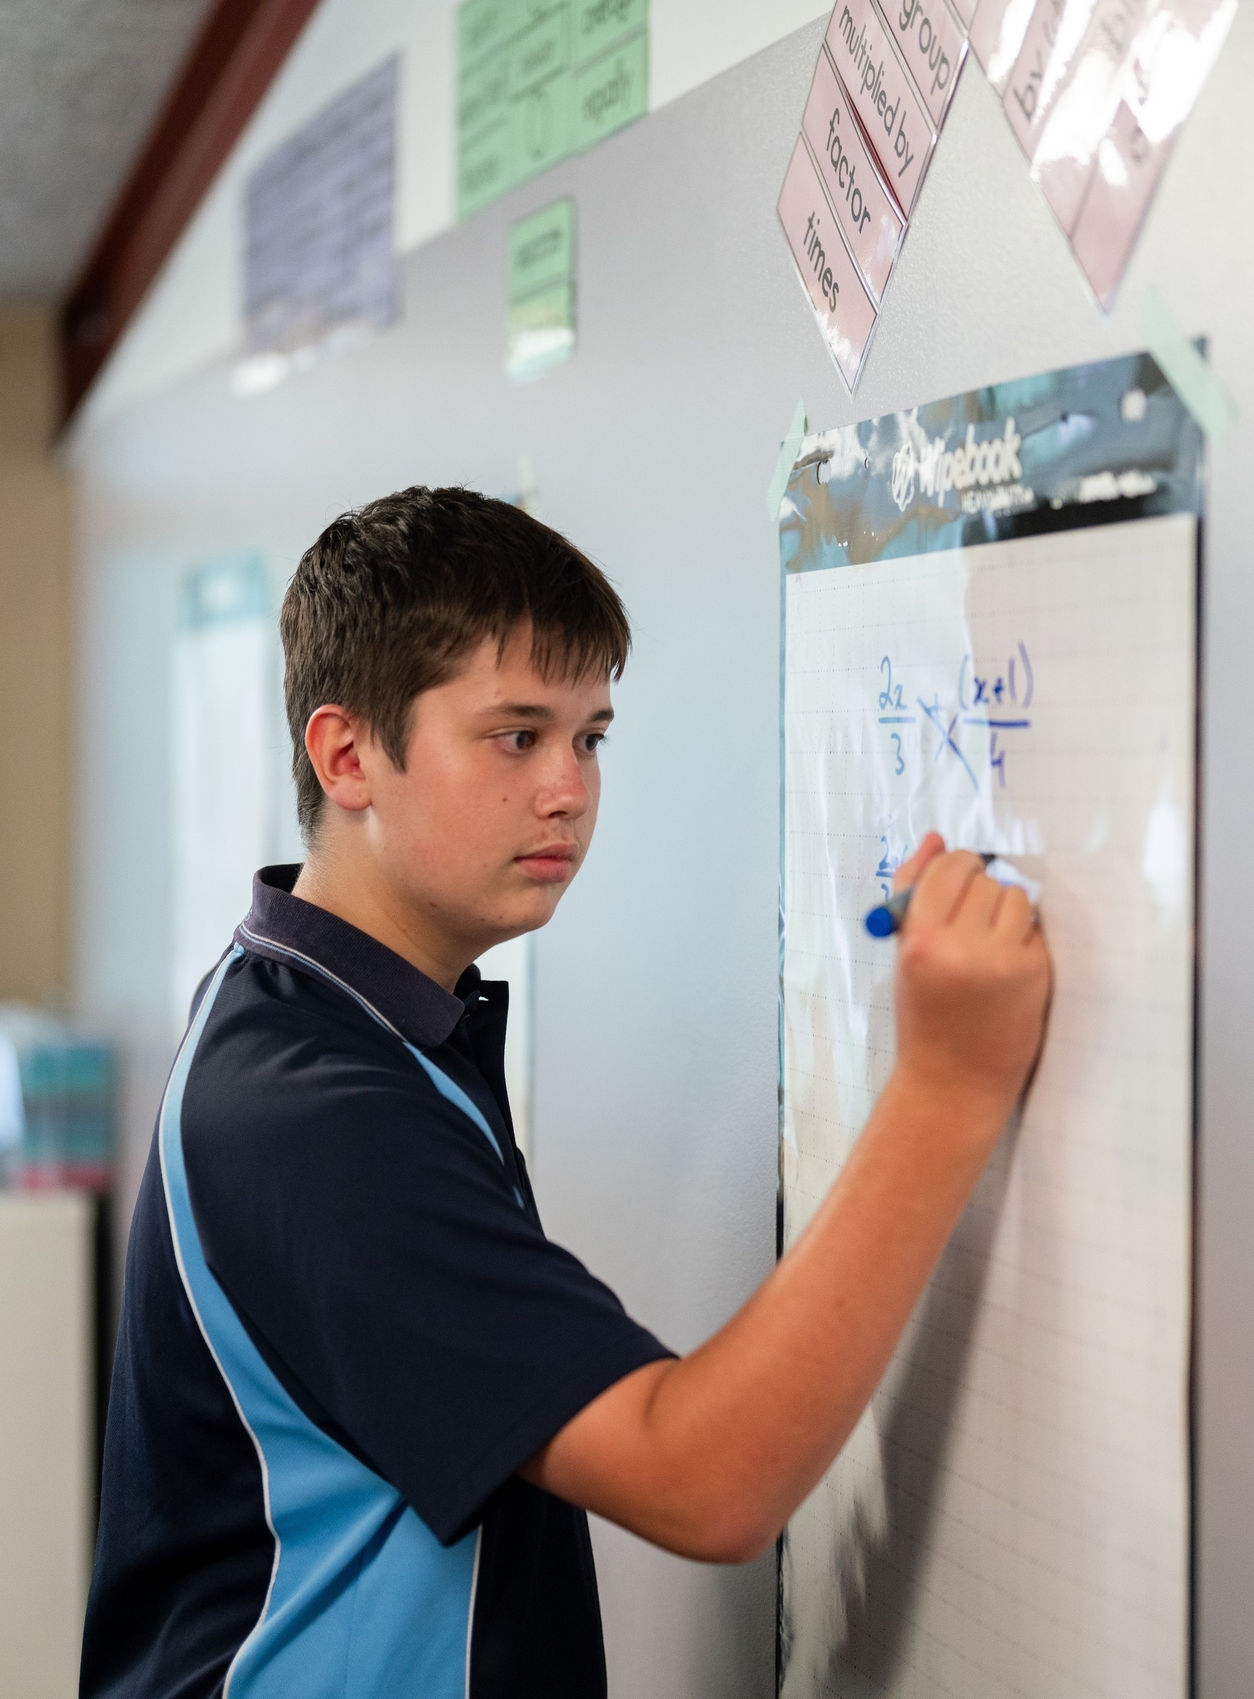
Circle parametric form
Mathematics Extension 1 – Stage 6 (Year 11)
Parametric form

Slide 2
Learning intention and success criteria
Learning intention
To understand how circles can be represented as parametric equations.
Success criteria
I can link the parametric equations for a circle to the unit circle.
I can convert the parametric equation for a circle to Cartesian form.
I can graph a circle expressed as a pair of parametric equations.

Slide 3
Activating prior knowledge

Slide 4
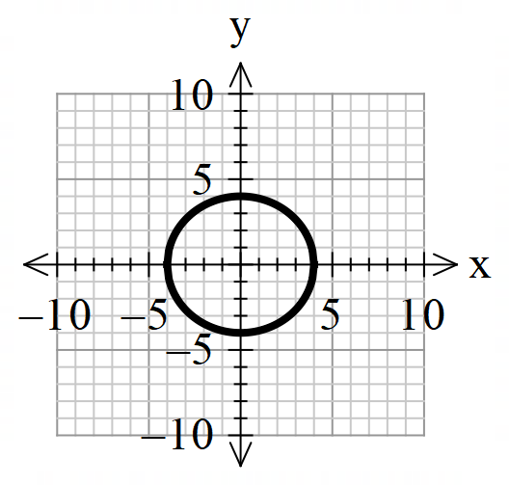
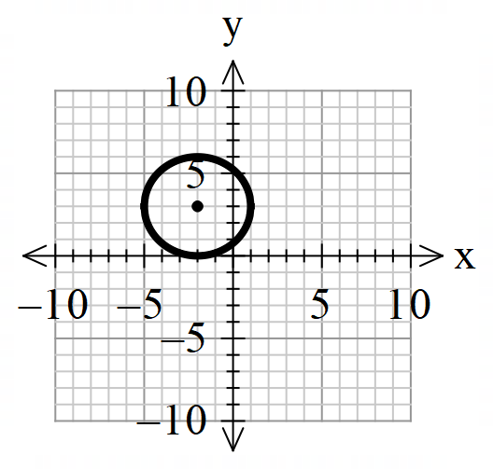
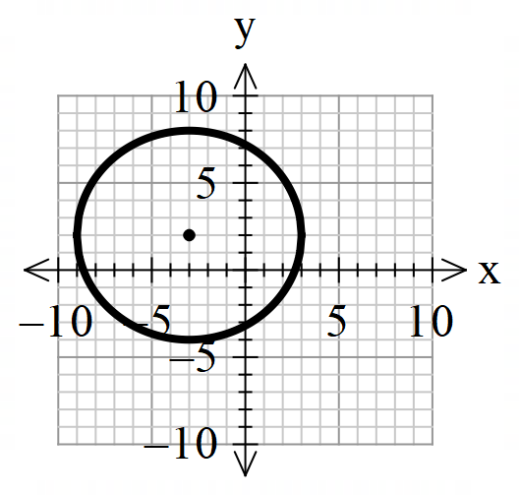
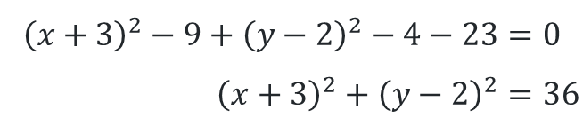



Sketch each circle
Label the radius and centre
$$x^{2}+y^{2}=16$$
$${(x+2)}^{2}+{(y−3)}^{2}=9$$
$$x^{2}+6x+y^{2}−4y−23=0$$
$${\left(x+3\right)}^{2}−9+{\left(y−2\right)}^{2}−4−23=0 \\ {\left(x+3\right)}^{2}+{\left(y−2\right)}^{2}=36$$
Radius = 4
Origin (0,0)
Radius = 3
Origin (-2,3)
Radius = 6
Origin (-3,2)

Slide 5
Connecting learning

Slide 6
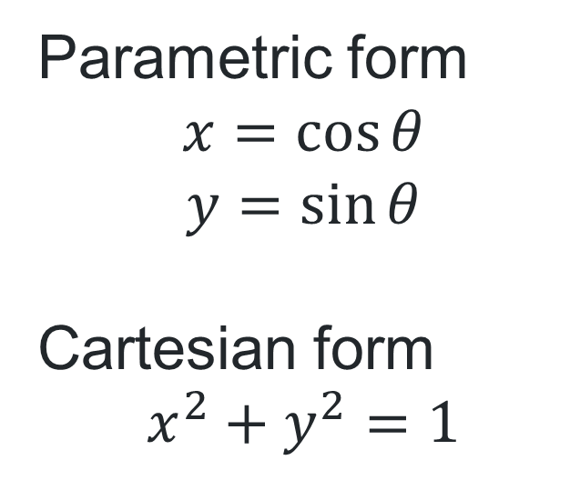
Different forms
Parametric form
$$x=\cos{θ}$$
$$y=\sin{θ}$$
Cartesian form
$$x^{2}+y^{2}=1$$

Slide 7
Releasing responsibility

Slide 8

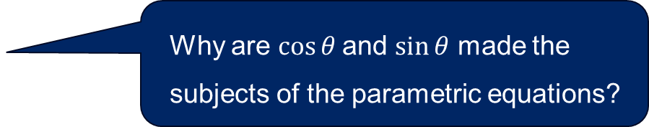
Parametric form to Cartesian (1)
Worked example 1
Convert the parametric equations $x=3\sin{θ} and$ $y=3\cos{θ}$ into a Cartesian equation.
$$x=3\sin{θ} → \sin{θ}=\frac{x}{3} \\ y=3\cos{θ} → \cos{θ}=\frac{y}{3}$$
Substitute into $\sin^{2}{θ}+\cos^{2}{θ}=1$
$${\left(\frac{x}{3}\right)}^{2}+{\left(\frac{y}{3}\right)}^{2}=1 \\ x^{2}+y^{2}=9$$
Why are $\cos{θ}$and $\sin{θ}$ made the subjects of the parametric equations?
What is this rule and why do we use it?
How would you describe this Cartesian equation?

Slide 9
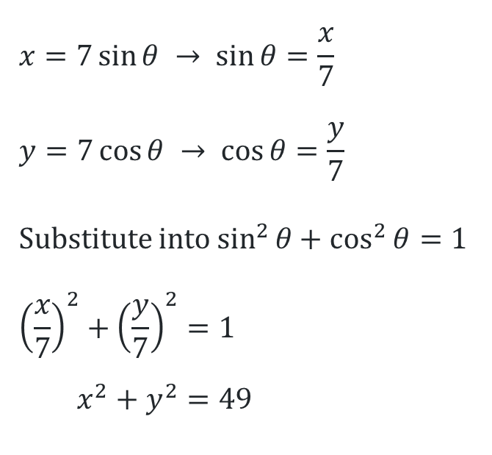
Parametric form to Cartesian (2)
Your turn – question 1
Convert the parametric equations $x=7\sin{θ} and$ $y=7\cos{θ}$ into a Cartesian equation.
$$x=7\sin{θ} → \sin{θ}=\frac{x}{7} \\ y=7\cos{θ} → \cos{θ}=\frac{y}{7}$$
Substitute into $\sin^{2}{θ}+\cos^{2}{θ}=1$
$${\left(\frac{x}{7}\right)}^{2}+{\left(\frac{y}{7}\right)}^{2}=1 \\ x^{2}+y^{2}=49$$

Slide 10
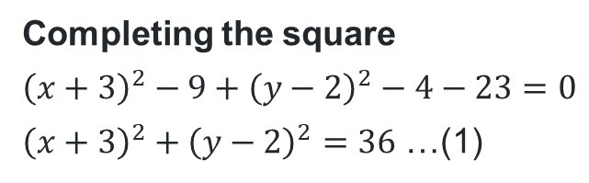


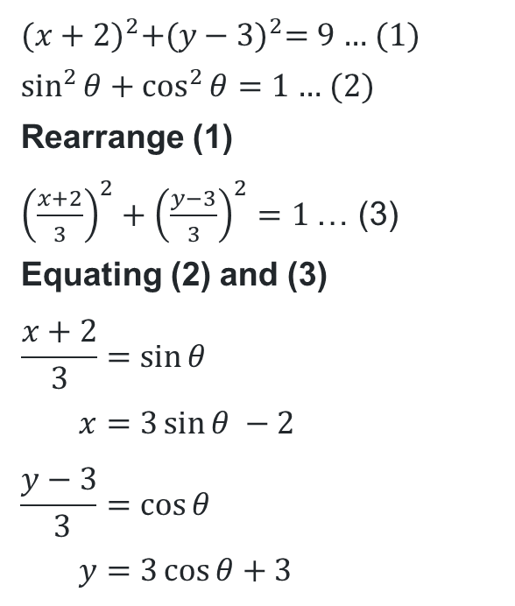

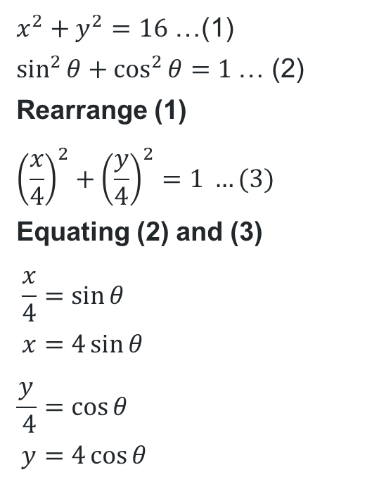
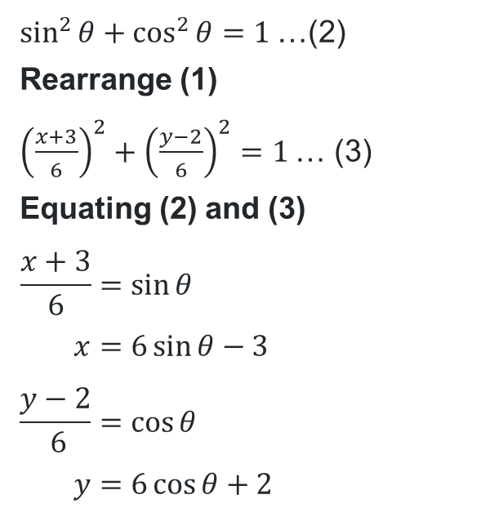
Working backwards
Write the following Cartesian equations in parametric form.
$$x^{2}+y^{2}=16$$
$${(x+2)}^{2}+{(y−3)}^{2}=9$$
$$x^{2}+6x+y^{2}−4y−23=0$$
Completing the square
$${\left(x+3\right)}^{2}−9+{\left(y−2\right)}^{2}−4−23=0$$
${\left(x+3\right)}^{2}+{\left(y−2\right)}^{2}=36$ …(1)
$x^{2}+y^{2}=16$ …(1)
$\sin^{2}{θ}+\cos^{2}{θ}=1$ … (2)
Rearrange (1)
$${\left(\frac{x}{4}\right)}^{2}+{\left(\frac{y}{4}\right)}^{2}=1 …(3)$$
Equating (2) and (3)
$$\frac{x}{4}=\sin{θ} \\ x=4\sin{θ} \\ \frac{y}{ 4}=\cos{θ} \\ y=4\cos{θ}$$
${(x+2)}^{2}+{(y−3)}^{2}=9$ … (1)
$\sin^{2}{θ}+\cos^{2}{θ}=1$ … (2)
Rearrange (1)
${\left(\frac{x+2}{3}\right)}^{2}+{\left(\frac{y−3}{3}\right)}^{2}=1$ … (3)
Equating (2) and (3)
$$\frac{x+2}{3}=\sin{θ} \\ x=3\sin{θ} −2 \\ \frac{y−3}{ 3}=\cos{θ} \\ y=3\cos{θ+3}$$
$\sin^{2}{θ}+\cos^{2}{θ}=1$ …(2)
Rearrange (1)
${\left(\frac{x+3}{6}\right)}^{2}+{\left(\frac{y−2}{6}\right)}^{2}=1$ … (3)
Equating (2) and (3)
$$\frac{x+3}{6}=\sin{θ} \\ x=6\sin{θ}−3 \\ \frac{y−2}{ 6}=\cos{θ} \\ y=6\cos{θ+2}$$

Slide 11
Independent practice

Slide 12
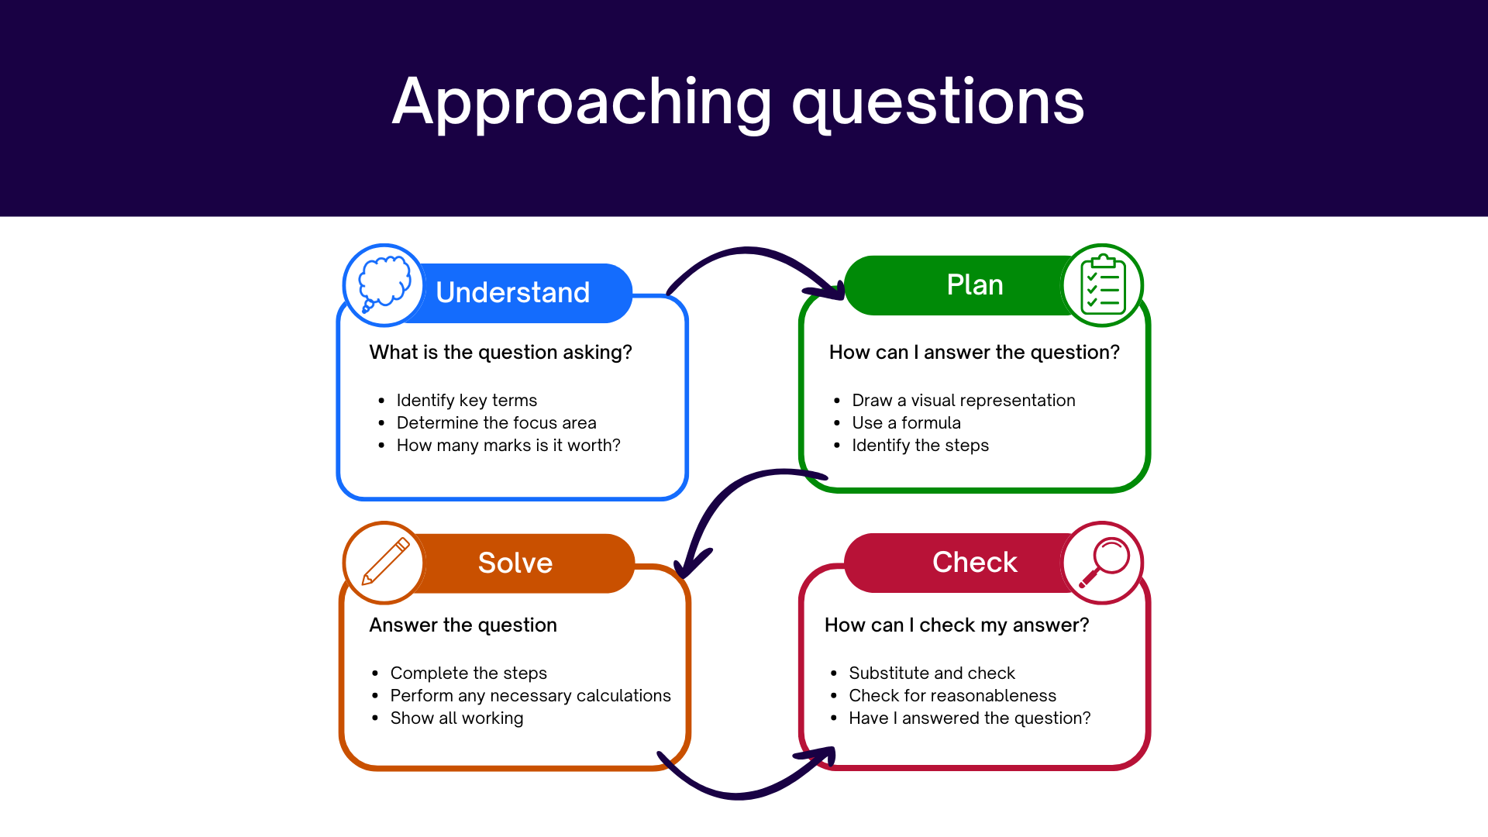
Approaching questions scaffold

Slide 13

HSC style question (1)
A function is defined parametrically by
$$x\left(t\right)=4\cos{(t)}−2 \\ y\left(t\right)=4\sin{(t)}+5$$
The points $A (2,5)$and $B(−2,9)$lie on the graph.
Show that the shortest distance along the graph from A to B is $2π.$

Slide 14
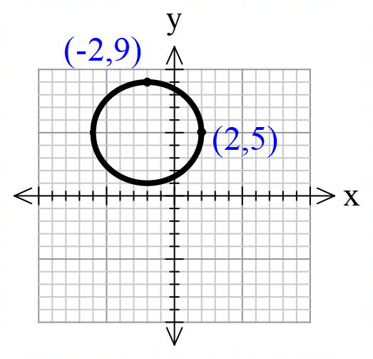
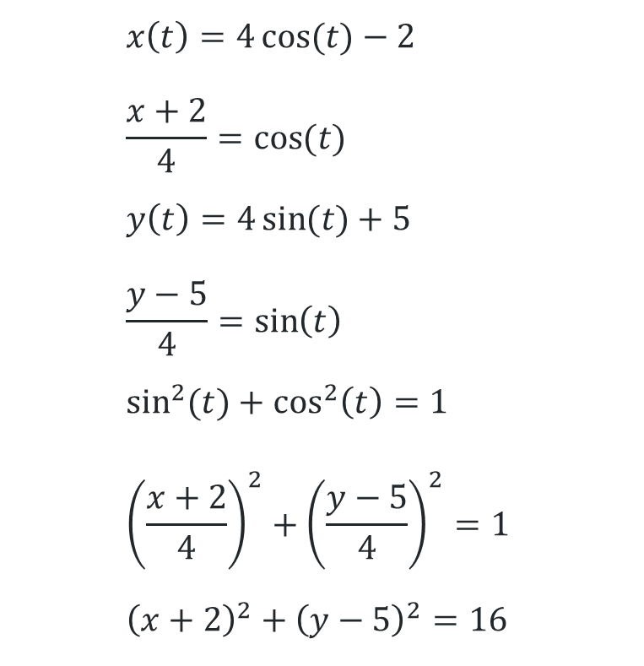
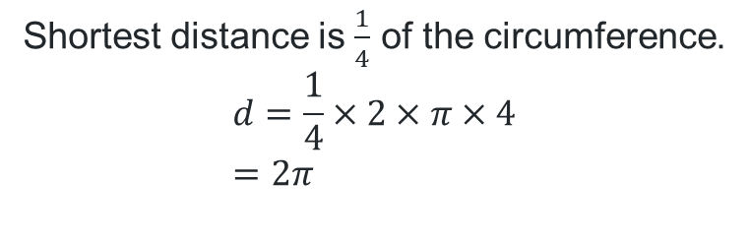
HSC style question (2)
Solution
$$x\left(t\right)=4\cos{(t)}−2 \\ \frac{x+2}{4}=\cos{(t)} \\ y\left(t\right)=4\sin{(t)}+5 \\ \frac{y−5}{4}=\sin\left(t\right) \\ \sin^{2}{(t)}+\cos^{2}\left(t\right)=1 \\ {\left(\frac{x+2}{4}\right)}^{2}+{\left(\frac{y−5}{4}\right)}^{2}=1 \\ {\left(x+2\right)}^{2}+{\left(y−5\right)}^{2}=16$$
Shortest distance is $\frac{1}{4}$ of the circumference.
$$d=\frac{1}{4}×2×π×4 \\ =2π$$

Slide 15
References
This resource contains NSW Curriculum and syllabus content. The NSW Curriculum is developed by the NSW Education Standards Authority (NESA). This content is prepared by NESA for and on behalf of the Crown in the right of the State of New South Wales. The material is protected by Crown copyright.
Please refer to the NESA Copyright Disclaimer for more information https://www.nsw.gov.au/education-and-training/nesa/copyright.
NESA holds the only official and up-to-date versions of the NSW Curriculum and syllabus documents. Please NESA https://www.nsw.gov.au/education-and-training/nesa and the NSW Curriculum https://curriculum.nsw.edu.au.
Mathematics Extension 1 11–12 Syllabus © NSW Education Standards Authority (NESA) for and on behalf of the Crown in right of the State of New South Wales, 2024.

Slide 16
Copyright
© State of New South Wales (Department of Education), 2026
The copyright material published in this resource is subject to the Copyright Act 1968 (Cth) and is owned by the NSW Department of Education or, where indicated, by a party other than the NSW Department of Education (third-party material).
Copyright material available in this resource and owned by the NSW Department of Education is licensed under a Creative Commons Attribution 4.0 International (CC BY 4.0) license.
This license allows you to share and adapt the material for any purpose, even commercially.
Attribution should be given to © State of New South Wales (Department of Education), 2026.
Material in this resource not available under a Creative Commons license:
the NSW Department of Education logo, other logos and trademark-protected material
Material owned by a third party that has been reproduced with permission. You will need to obtain permission from the third party to reuse its material.
Links to third-party material and websites
Please note that the provided (reading/viewing material/list/links/texts) are a suggestion only and implies no endorsement, by the New South Wales Department of Education, of any author, publisher, or book title. School principals and teachers are best placed to assess the suitability of resources that would complement the curriculum and reflect the needs and interests of their students.
If you use the links provided in this document to access a third-party’s website, you acknowledge that the terms of use, including licence terms set out on the third-party’s website apply to the use which may be made of the materials on that third-party website or where permitted by the Copyright Act 1968 (Cth). The department accepts no responsibility for content on third-party websites.

