Slide 1
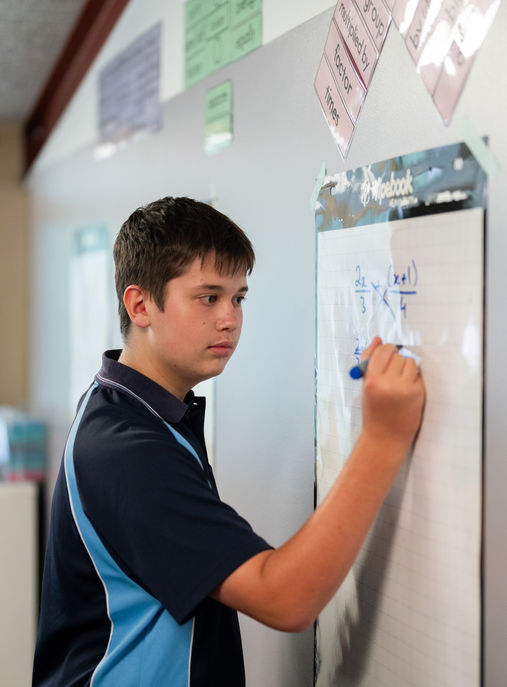
Linear and quadratic parametric form
Mathematics Extension 1 – Stage 6 (Year 11)
Parametric form

Slide 2
Learning intention and success criteria
Learning intention
To understand how linear and quadratic functions can be represented as parametric equations.
Success criteria
I can convert a pair of linear parametric equations to a Cartesian equation.
I can convert a pair of quadratic parametric equations to a Cartesian equation.
I can graph parametric equations in parametric form.
I can graph parametric equations after converting them to Cartesian form.

Slide 3
Retrieval practice

Slide 4
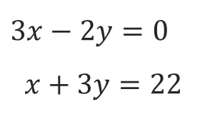
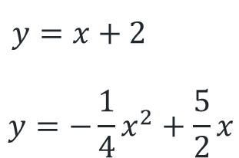
Solve each pair of equations(1)
$3x−2y=0$
$$x+3y=22$$
$y=x+2$
$$y=−\frac{1}{4}x^{2}+\frac{5}{2}x$$

Slide 5
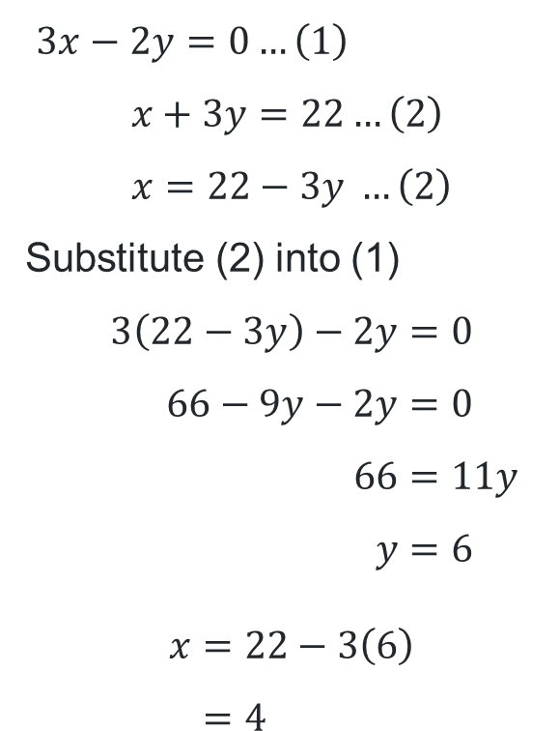
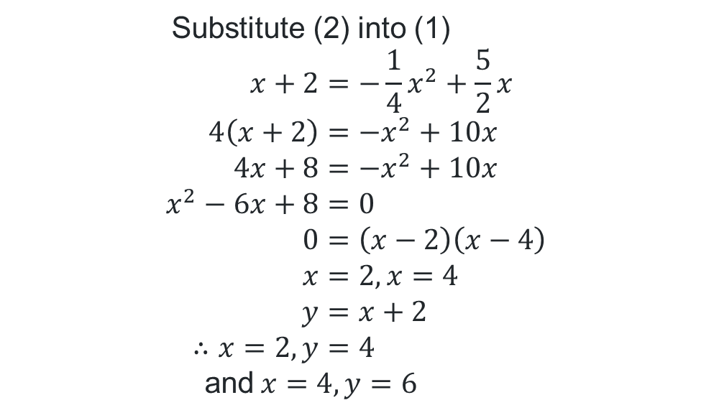
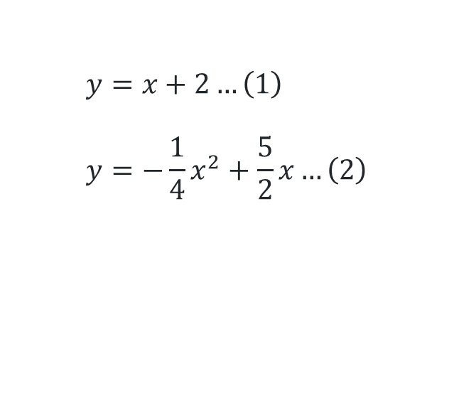
Solve each pair of equations (2)
Solutions
$$y=x+2…\left(1\right) \\ y=−\frac{1}{4}x^{2}+\frac{5}{2}x…\left(2\right)$$
$3x−2y=0…\left(1\right)$
$$x+3y=22…\left(2\right) \\ x=22−3y …\left(2\right)$$
Substitute (2) into (1)
$$3\left(22−3y\right)−2y=0 \\ 66−9y−2y=0 \\ 66=11y \\ y=6$$
$$x=22−3\left(6\right) \\ =4$$
Substitute (2) into (1)
$$x+2=−\frac{1}{4}x^{2}+\frac{5}{2}x \\ 4\left(x+2\right)=−x^{2}+10x \\ 4x+8=−x^{2}+10x \\ x^{2}−6x+8=0 \\ 0=\left(x−2\right)\left(x−4\right) \\ x=2, x=4 \\ y=x+2 \\ ∴x=2, y=4$$
and$x=4, y=6$

Slide 6
Releasing responsibility

Slide 7
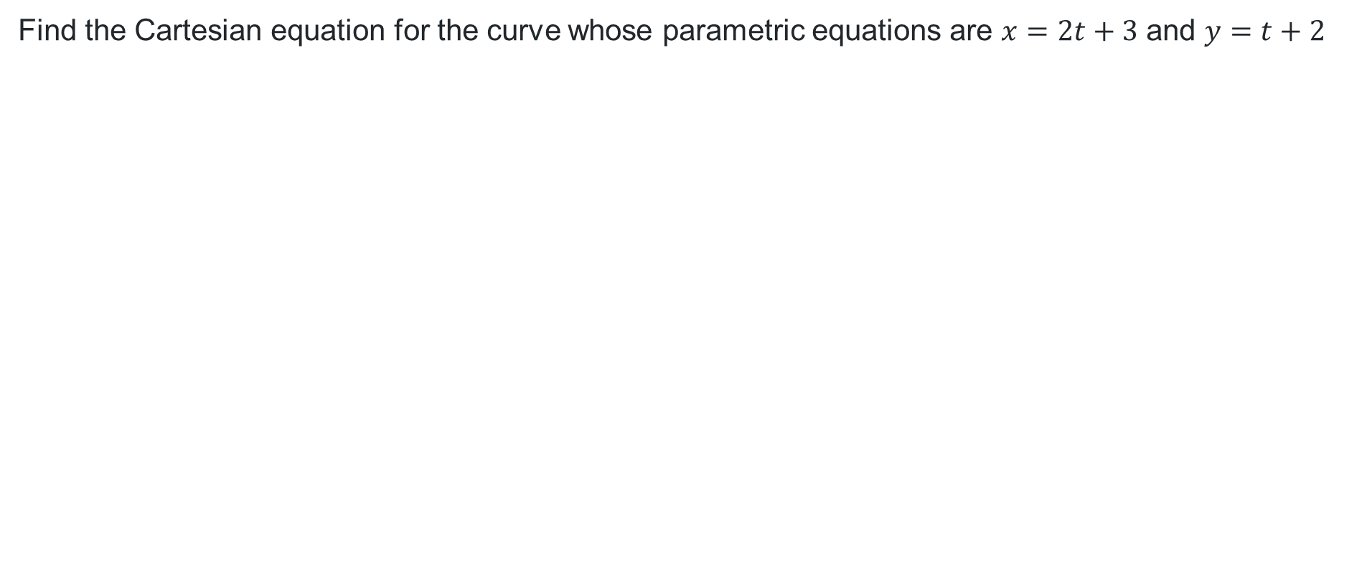
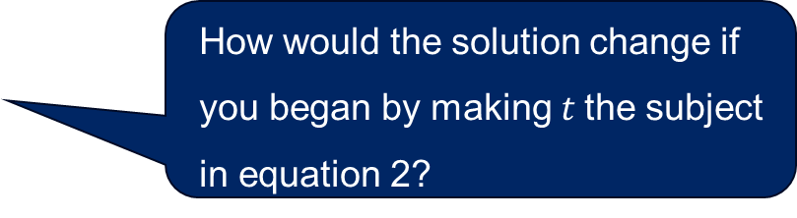
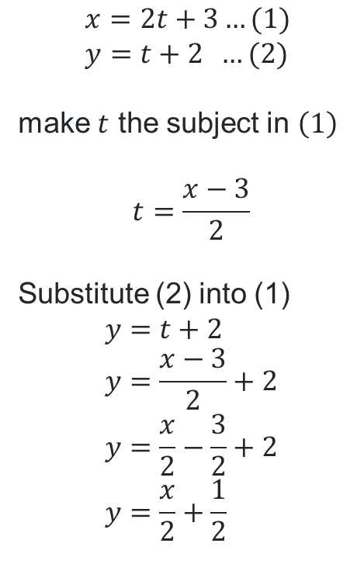
Find the Cartesian equation (1)
Worked example 1
Find the Cartesian equation for the curve whose parametric equations are $x=2t+3$ and $y=t+2$
$$x=2t+3…(1) \\ y=t+2 …(2)$$
make $t$ the subject in $\left(1\right)$
$$t=\frac{x−3}{2}$$
Substitute (2) into (1)
$$y=t+2 \\ y=\frac{x−3}{2}+2 \\ y=\frac{x}{2}−\frac{3}{2}+2 \\ y=\frac{x}{2}+\frac{1}{2}$$
How would the solution change if you began by making $t$the subject in equation 2?
What similar mathematics have you used like this?
How would you describe this Cartesian equation?

Slide 8
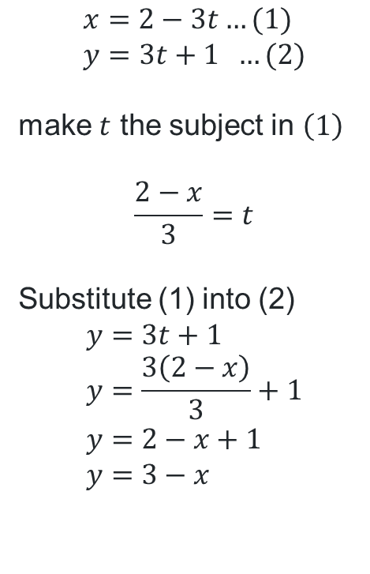

Find the Cartesian equation (2)
Your turn 1
Find the Cartesian equation for the curve whose parametric equations are $x=2−3t$ and $y=3t+1$
$$x=2−3t…(1) \\ y=3t+1 …(2)$$
make $t$ the subject in $\left(1\right)$
$$\frac{2−x}{3}=t$$
Substitute (1) into (2)
$$y=3t+1 \\ y=\frac{3\left(2−x\right)}{3}+1 \\ y=2−x+1 \\ y=3−x$$

Slide 9
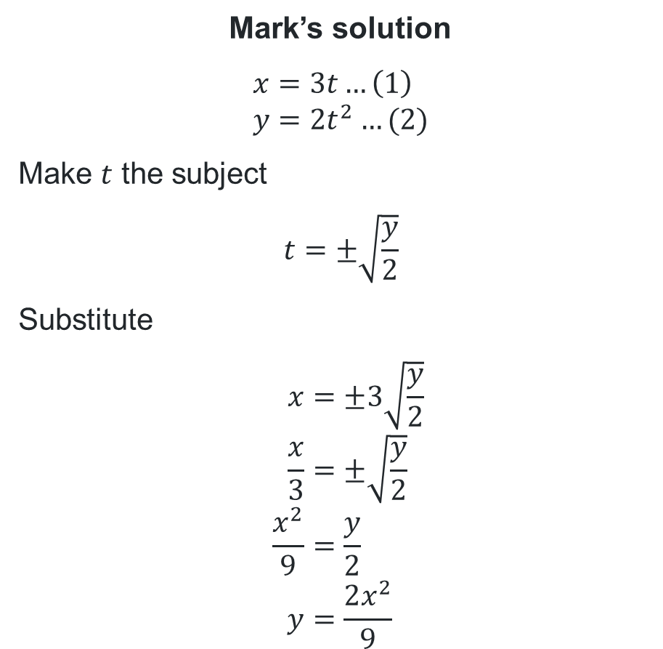
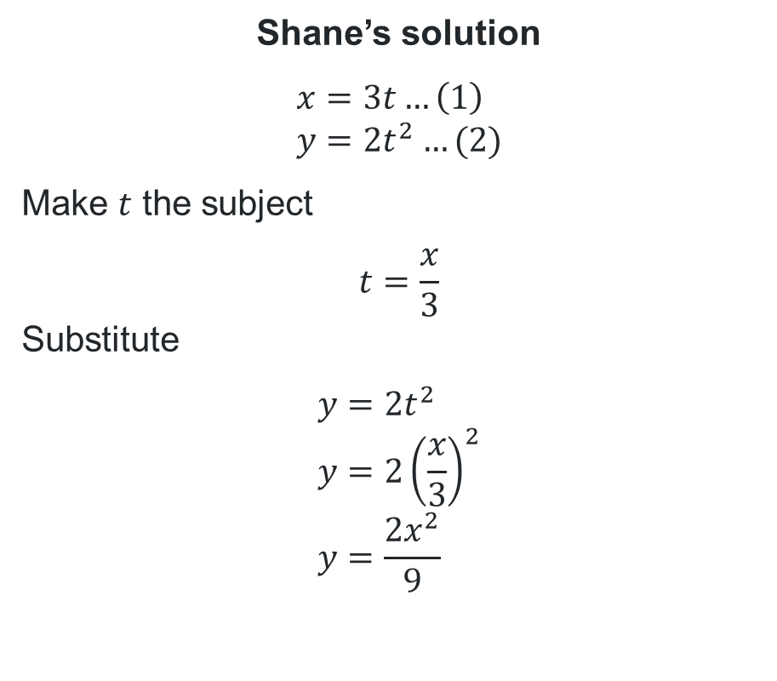
Compare the pair
Find the Cartesian equation for the following parametric equations: $x=3t, y=2t^{2}$
Shane’s solution
$$x=3t…\left(1\right) \\ y=2t^{2}…(2)$$
Make $t$ the subject
$$t=\frac{x}{3}$$
Substitute
$$y=2t^{2} \\ y=2{\left(\frac{x}{3}\right)}^{2} \\ y=\frac{2x^{2}}{9}$$
Mark’s solution
$$x=3t…\left(1\right) \\ y=2t^{2}…(2)$$
Make $t$ the subject
$$t=±\sqrt{\frac{y}{2}}$$
Substitute
$$x=±3\sqrt{\frac{y}{2}} \\ \frac{x}{3}=±\sqrt{\frac{y}{2}} \\ \frac{x^{2}}{9}=\frac{y}{2} \\ y=\frac{2x^{2}}{9}$$
What is the same?
What is different?
What is the same?
What is different?

Slide 10
Independent practice

Slide 11
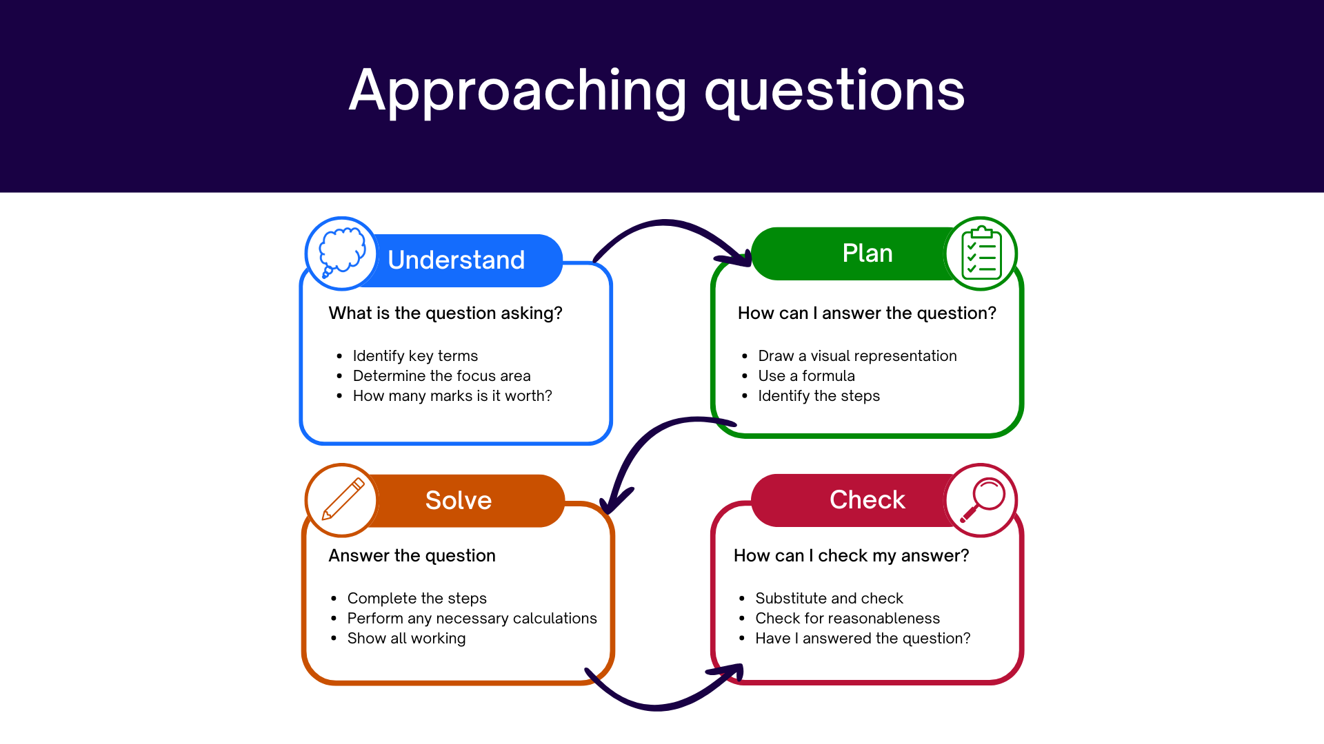
Approaching questions scaffold
11

Slide 12
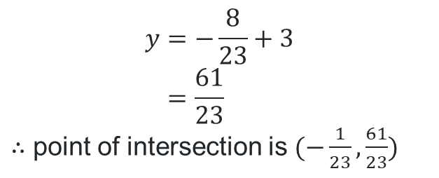
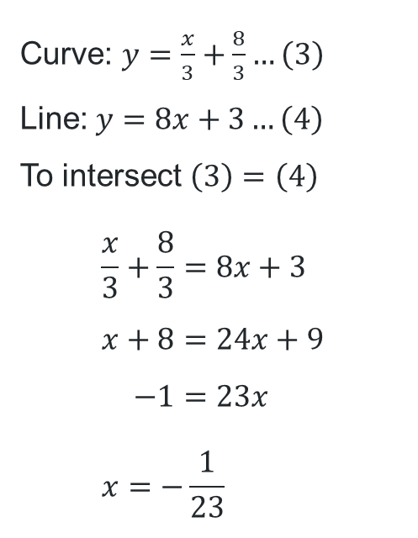
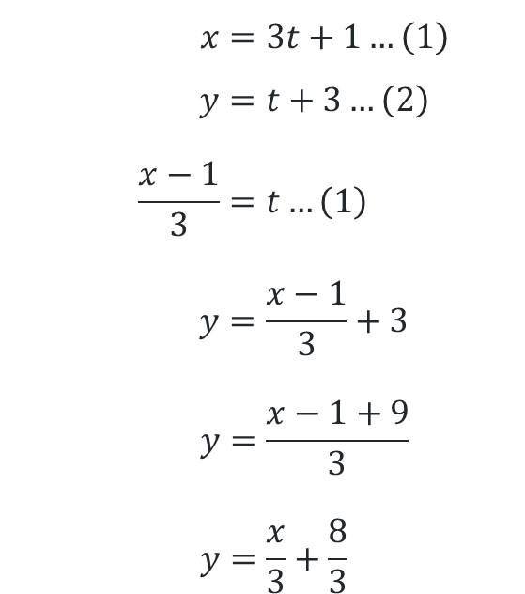
HSC-style question
Where does the line $y=8x+3$intersect the curve defined by $x=3t+1$and $y=t+3$?
Curve: $y=\frac{x}{3}+\frac{8}{3}…\left(3\right)$
Line: $y=8x+3…\left(4\right)$
To intersect $\left(3\right)=\left(4\right)$
$$\frac{x}{3}+\frac{8}{3}=8x+3 \\ x+8=24x+9 \\ −1=23x \\ x=−\frac{1}{23}$$
$$x=3t+1…\left(1\right) \\ y=t+3…\left(2\right) \\ \frac{x−1}{3}=t…\left(1\right) \\ y=\frac{x−1}{3}+3 \\ y=\frac{x−1+9}{3} \\ y=\frac{x}{3}+\frac{8}{3}$$
$$y=−\frac{8}{23}+3 \\ =\frac{61}{23}$$
$∴$ point of intersection is $(−\frac{1}{23},\frac{61}{23})$

Slide 13
References
This presentation contains NSW Curriculum and syllabus content. The NSW Curriculum is developed by the NSW Education Standards Authority. This content is prepared by NESA for and on behalf of the Crown in the right of the State of New South Wales. The material is protected by Crown copyright.
Please refer to the NESA Copyright Disclaimer for more information https://educationstandards.nsw.edu.au/wps/portal/nesa/mini-footer/copyright.
NESA holds the only official and up-to-date versions of the NSW Curriculum and syllabus documents. Please visit the NSW Education Standards Authority (NESA) website https://educationstandards.nsw.edu.au/wps/portal/nesa/home and the NSW Curriculum website https://curriculum.nsw.edu.au.
Mathematics Extension 1 11-12 Syllabus © NSW Education Standards Authority (NESA) for and on behalf of the Crown in right of the State of New South Wales, 2024.

Slide 14
Copyright
© State of New South Wales (Department of Education), 2026
The copyright material published in this resource is subject to the Copyright Act 1968 (Cth) and is owned by the NSW Department of Education or, where indicated, by a party other than the NSW Department of Education (third-party material).
Copyright material available in this resource and owned by the NSW Department of Education is licensed under a Creative Commons Attribution 4.0 International (CC BY 4.0) license.
This license allows you to share and adapt the material for any purpose, even commercially.
Attribution should be given to © State of New South Wales (Department of Education), 2026.
Material in this resource not available under a Creative Commons license:
the NSW Department of Education logo, other logos and trademark-protected material
Material owned by a third party that has been reproduced with permission. You will need to obtain permission from the third party to reuse its material.
Links to third-party material and websites
Please note that the provided (reading/viewing material/list/links/texts) are a suggestion only and implies no endorsement, by the New South Wales Department of Education, of any author, publisher, or book title. School principals and teachers are best placed to assess the suitability of resources that would complement the curriculum and reflect the needs and interests of their students.
If you use the links provided in this document to access a third-party’s website, you acknowledge that the terms of use, including licence terms set out on the third-party’s website apply to the use which may be made of the materials on that third-party website or where permitted by the Copyright Act 1968 (Cth). The department accepts no responsibility for content on third-party websites.

