Slide 1

Introduction to Parametric form
Mathematics Extension 1– Stage 6 (Year 11)
Parametric form

Slide 2
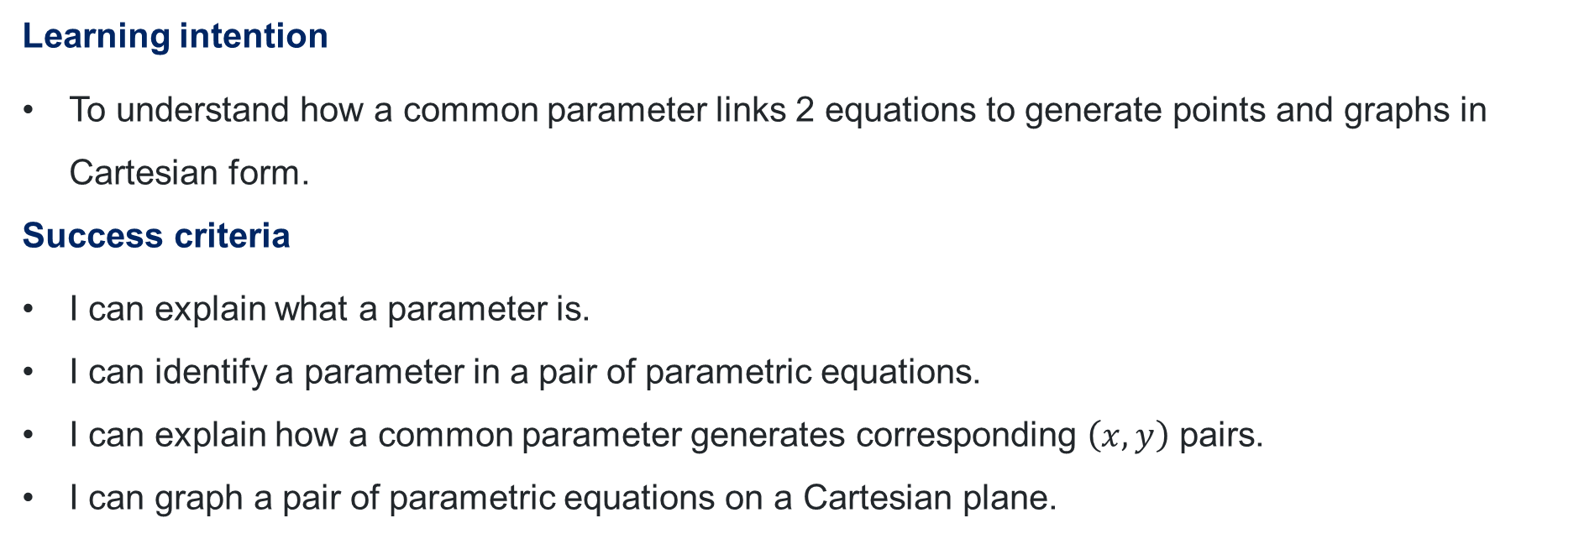
Learning intention and success criteria
Learning intention
To understand how a common parameter links 2 equations to generate points and graphs in Cartesian form.
Success criteria
I can explain what a parameter is.
I can identify a parameter in a pair of parametric equations.
I can explain how a common parameter generates corresponding $\left(x,y\right)$ pairs.
I can graph a pair of parametric equations on a Cartesian plane.

Slide 3
Activating prior knowledge

Slide 4
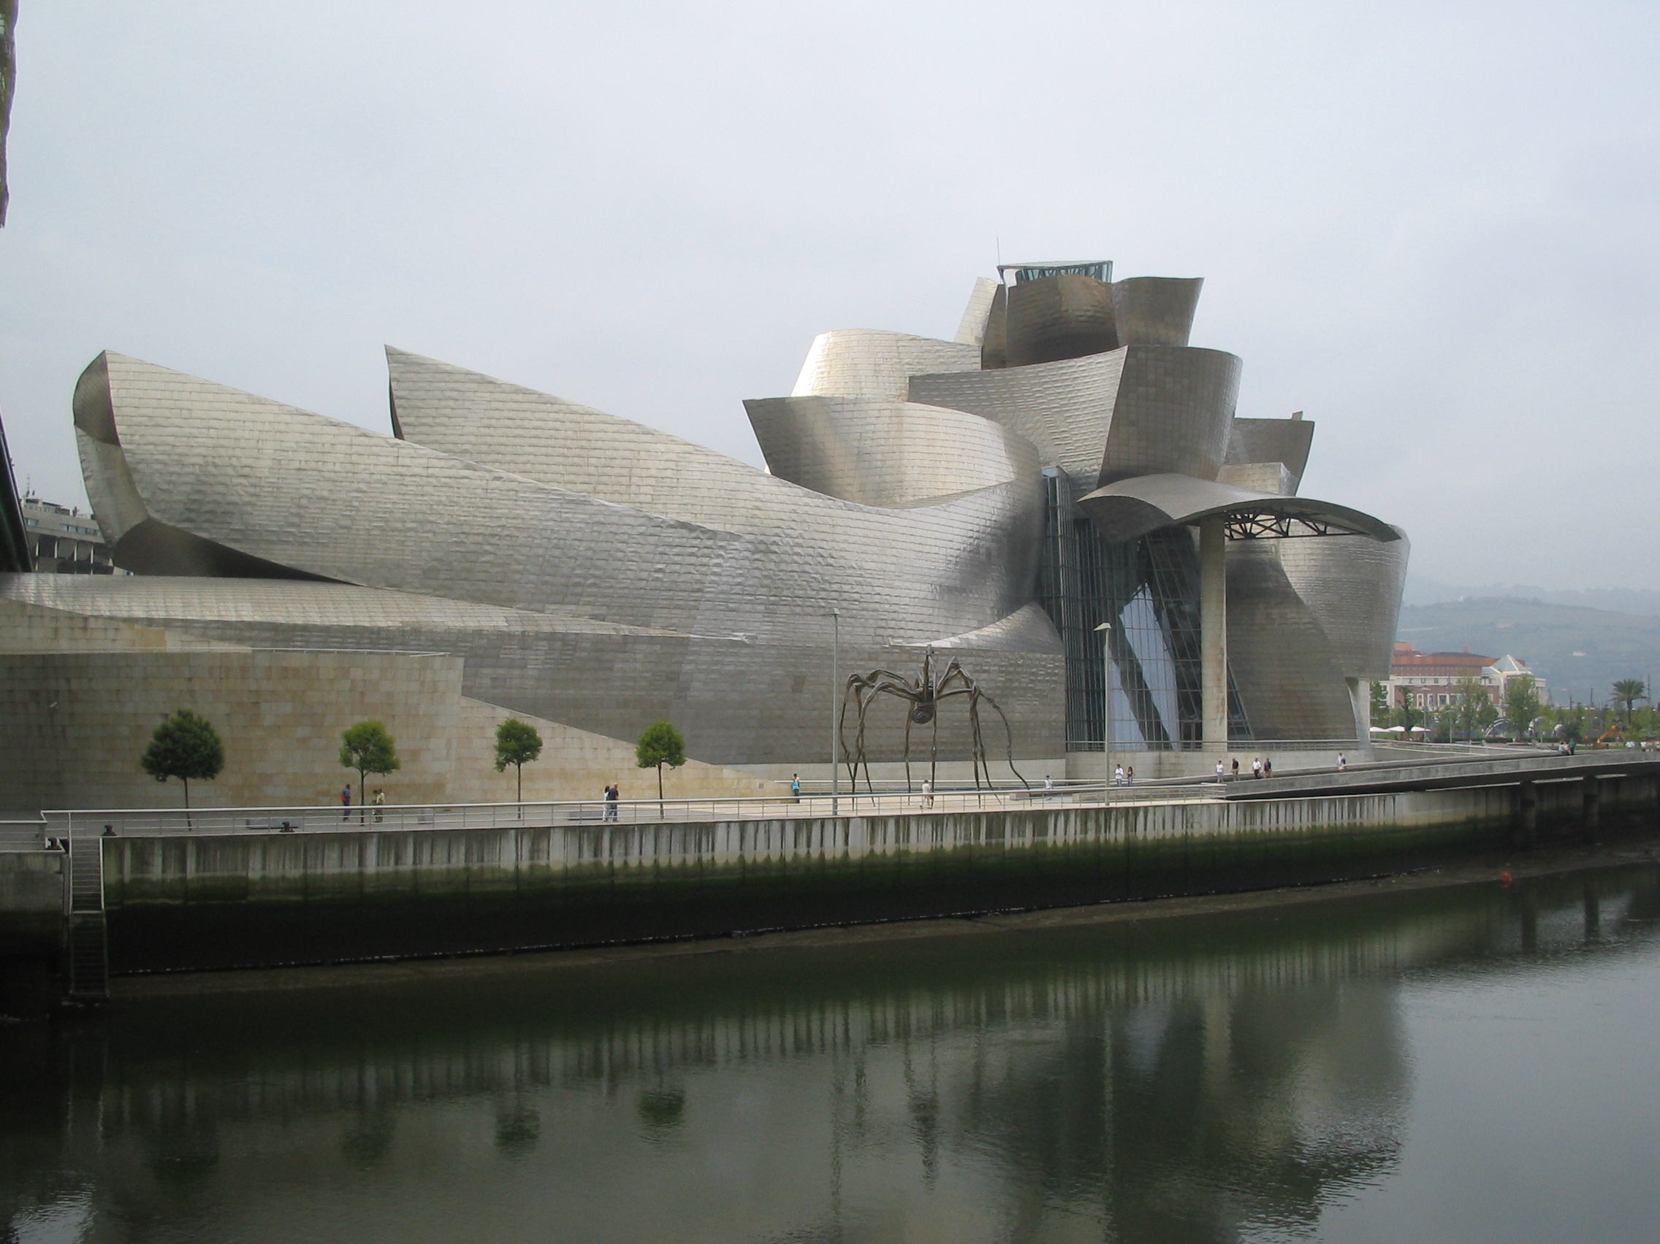
Guggenheim Museum, Bilbao, Spain
Bilbao, Spain
Guggenheim museum Bilbao’ by Riina is licenced under CC-BY-SA-2.5,2.0,1.0

Slide 5
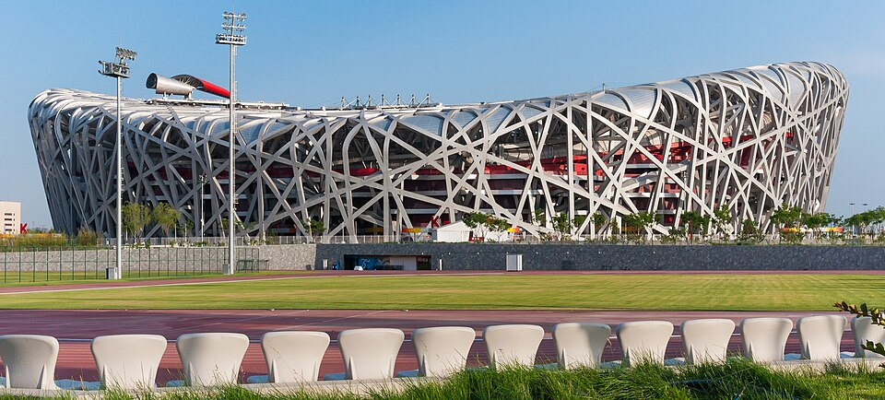
Beijing National Stadium
Beijing, China
‘Beijing China Beijing-National-Stadium-01’ by Cephoto, Uwe Aranas is licenced under CC-BY-SA-3.0

Slide 6
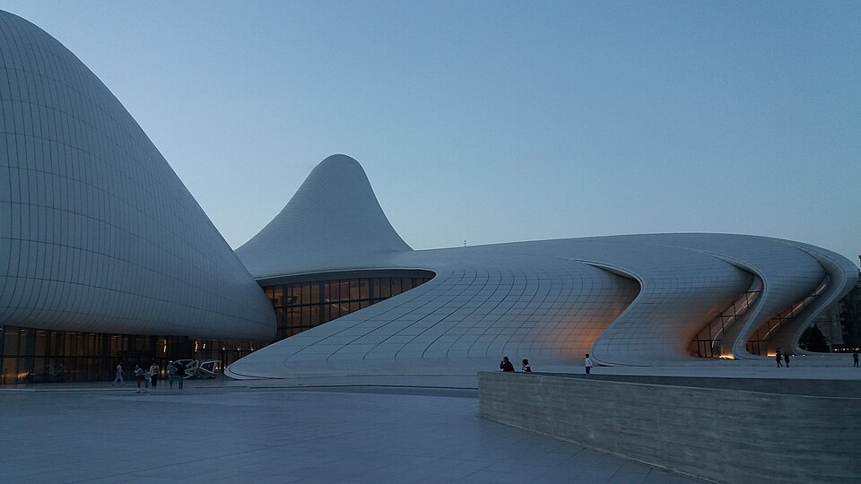
Heyder Aliyev Centre
Baku, Azerbaijan
‘Right wing of Heydar Aliyev Center, Baku Azerbaijan’ by Wertuose is licenced under CC-BY-SA-4.0

Slide 7
Connecting learning

Slide 8
Convenience store scenario
ice-cream = (sunscreen)²
sunscreen = temperature – 35
ice-cream = (temperature – 35)²

Slide 9
Releasing responsibility

Slide 10
Definition
A parameter is something that affects or controls the relationship between other variables.

Slide 11
Independent practice

Slide 12
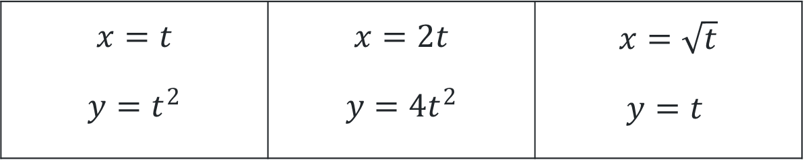

Exploring parametric form
Create a table of values and graph each pair of parametric equations.
$$x=t$$ $$y=t^{2}$$ | $$x=2t$$ $$y=4t^{2}$$ | $$x=\sqrt{t}$$ $$y=t$$
$$−3≤t≤3$$

Slide 13
References
This resource contains NSW Curriculum and syllabus content. The NSW Curriculum is developed by the NSW Education Standards Authority (NESA). This content is prepared by NESA for and on behalf of the Crown in the right of the State of New South Wales. The material is protected by Crown copyright.
Please refer to the NESA Copyright Disclaimer for more information https://www.nsw.gov.au/education-and-training/nesa/copyright.
NESA holds the only official and up-to-date versions of the NSW Curriculum and syllabus documents. Please NESA https://www.nsw.gov.au/education-and-training/nesa and the NSW Curriculum https://curriculum.nsw.edu.au.
Mathematics Extension 1 11–12 Syllabus © NSW Education Standards Authority (NESA) for and on behalf of the Crown in right of the State of New South Wales, 2024.

Slide 14
Copyright
© State of New South Wales (Department of Education), 2026
The copyright material published in this resource is subject to the Copyright Act 1968 (Cth) and is owned by the NSW Department of Education or, where indicated, by a party other than the NSW Department of Education (third-party material).
Copyright material available in this resource and owned by the NSW Department of Education is licensed under a Creative Commons Attribution 4.0 International (CC BY 4.0) license.
This license allows you to share and adapt the material for any purpose, even commercially.
Attribution should be given to © State of New South Wales (Department of Education), 2026.
Material in this resource not available under a Creative Commons license:
the NSW Department of Education logo, other logos and trademark-protected material
Material owned by a third party that has been reproduced with permission. You will need to obtain permission from the third party to reuse its material.
Links to third-party material and websites
Please note that the provided (reading/viewing material/list/links/texts) are a suggestion only and implies no endorsement, by the New South Wales Department of Education, of any author, publisher, or book title. School principals and teachers are best placed to assess the suitability of resources that would complement the curriculum and reflect the needs and interests of their students.
If you use the links provided in this document to access a third-party’s website, you acknowledge that the terms of use, including licence terms set out on the third-party’s website apply to the use which may be made of the materials on that third-party website or where permitted by the Copyright Act 1968 (Cth). The department accepts no responsibility for content on third-party websites.

