Slide 1
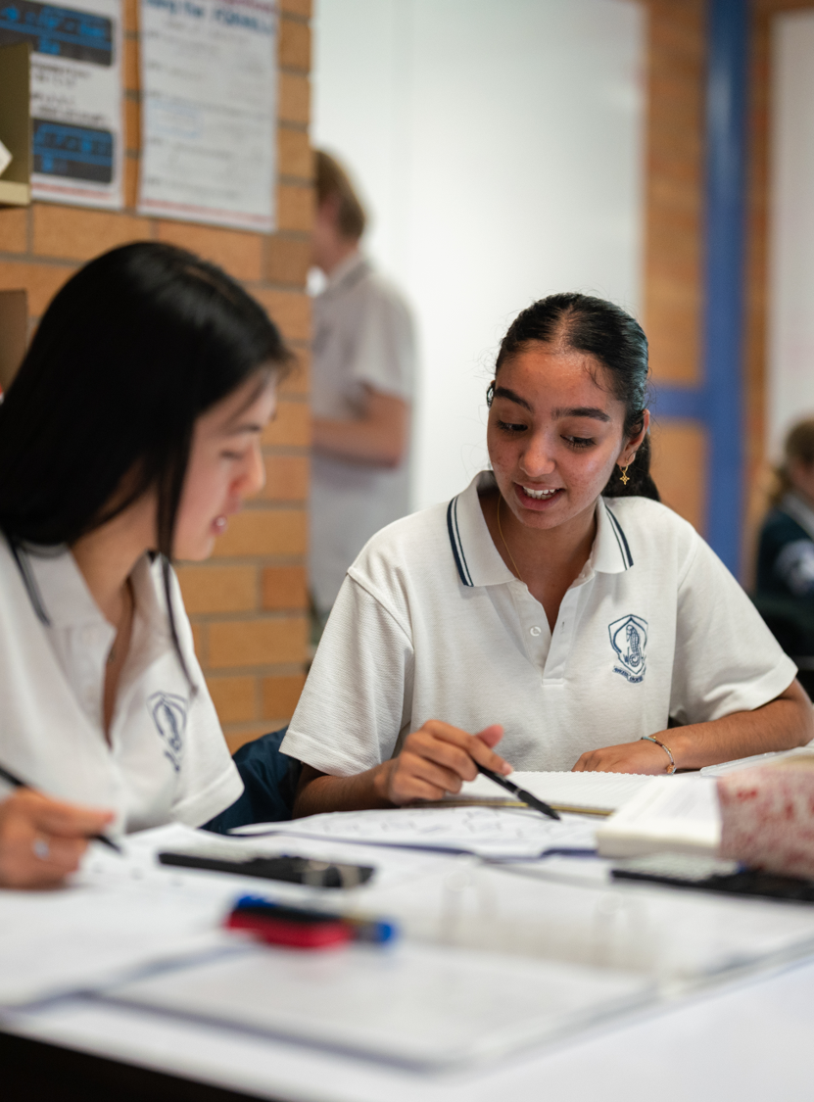
Vector equations of circles
Mathematics Extension 2 – Stage 6 (Year 12)
Vector equations of lines and curves

Slide 2
Retrieval practice

Slide 3
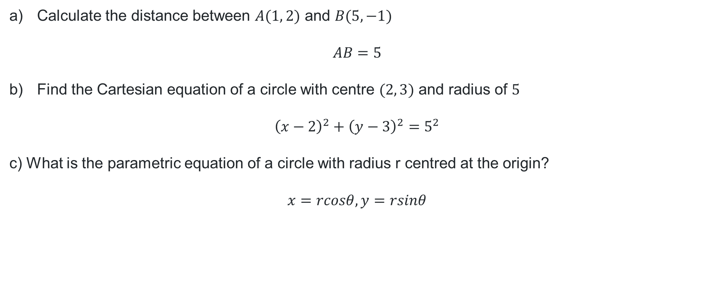
Equation of a circle
Calculate the distance between $A(1, 2)$ and $B(5, −1)$
$$AB=5$$
Find the Cartesian equation of a circle with centre $(2, 3)$ and radius of $5$
$${\left(x−2\right)}^{2}+{\left(y−3\right)}^{2}=5^{2}$$
c) What is the parametric equation of a circle with radius r centred at the origin?
$$x=rcosθ, y=rsinθ$$

Slide 4
Releasing responsibility

Slide 5
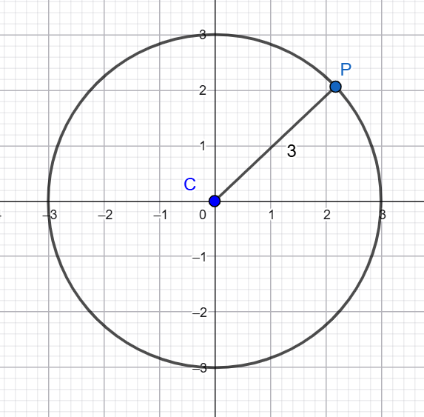
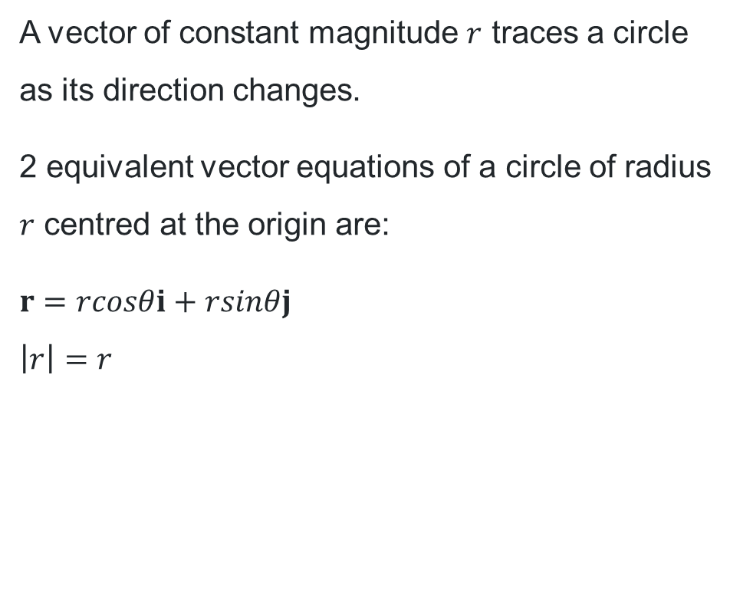
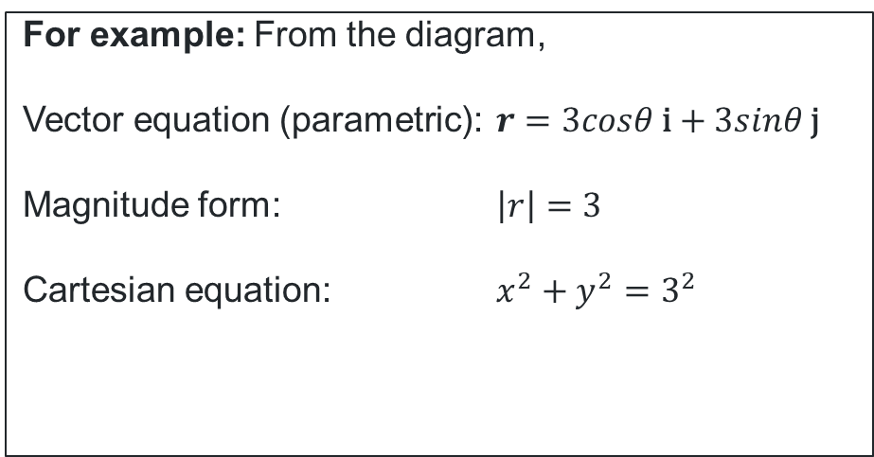
Vector equations of circles (1)
Circle centred at the origin
A vector of constant magnitude $r$ traces a circle as its direction changes.
2 equivalent vector equations of a circle of radius $r$ centred at the origin are:
$r=rcosθi+rsinθj$
$\left|r\right|=r$
For example: From the diagram,
Vector equation (parametric): $r=3cosθ \text{i}+3sinθ \text{j}$
Magnitude form: $\left|r\right|=3$
Cartesian equation: $x^{2}+y^{2}=3^{2}$

Slide 6
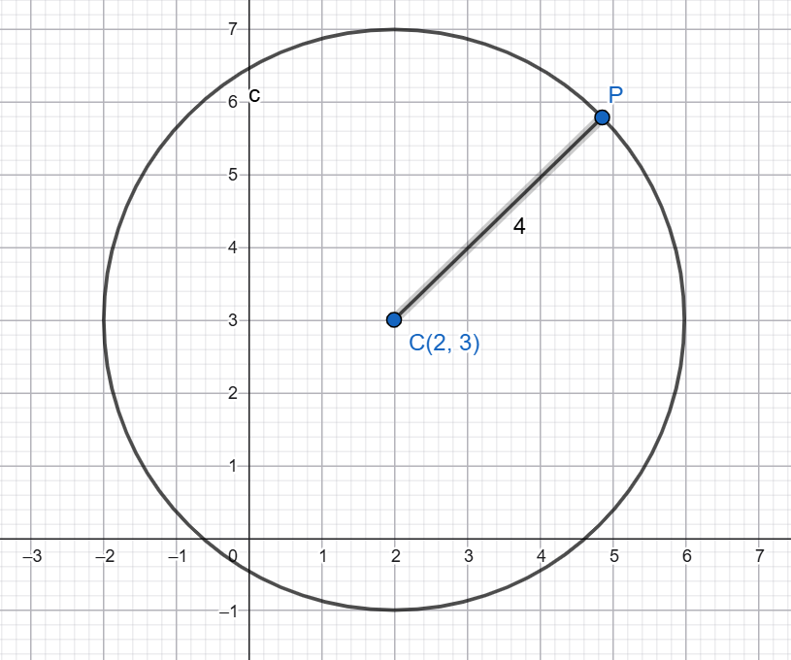
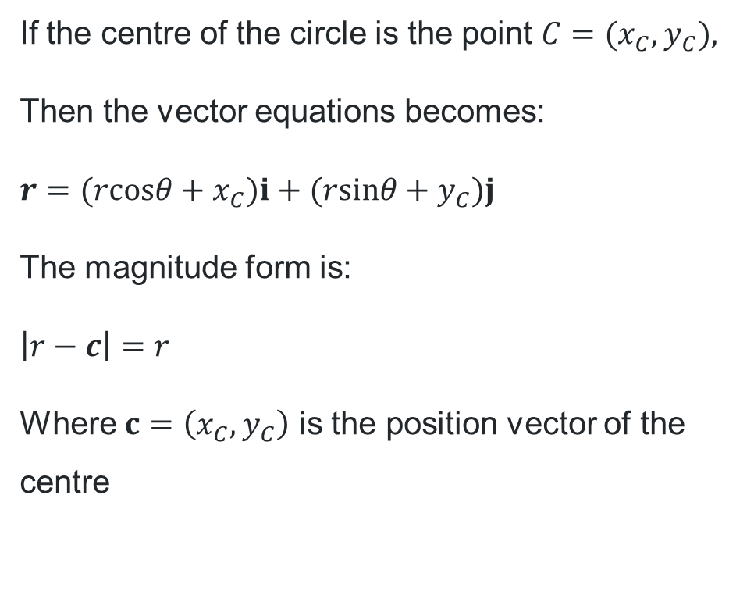
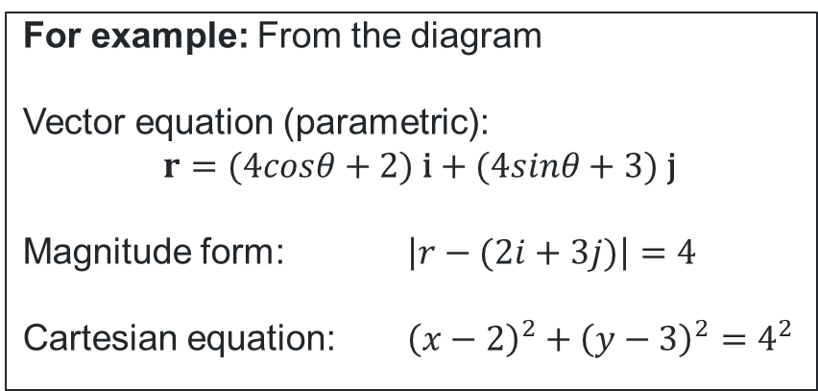
Vector equations of circles (2)
Circle centred at a point $C$
If the centre of the circle is the point $C=(x_{C},y_{C}),$
Then the vector equations becomes:
$$r=(rcosθ+x_{C})i+(rsinθ+y_{C})j$$
The magnitude form is:
$$\left|r−c\right|=r$$
Where $c=\left(x_{C},y_{C}\right)$ is the position vector of the centre
For example: From the diagram
Vector equation (parametric):
$$r=(4cosθ+2) \text{i}+(4sinθ+3) \text{j}$$
Magnitude form: $\left|r−(2i+3j)\right|=4$
Cartesian equation: ${\left(x−2\right)}^{2}+{\left(y−3\right)}^{2}=4^{2}$

Slide 7
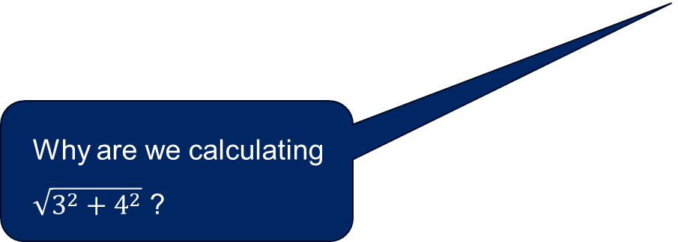
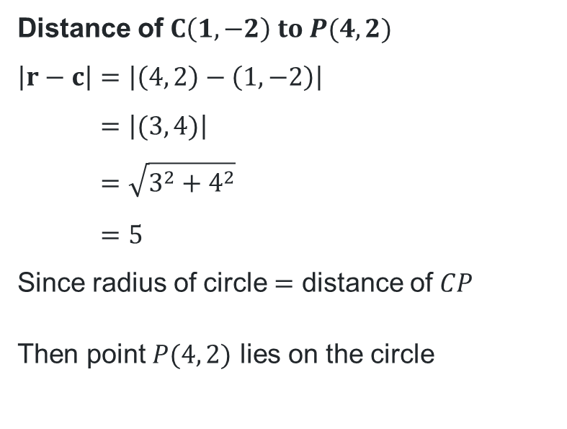
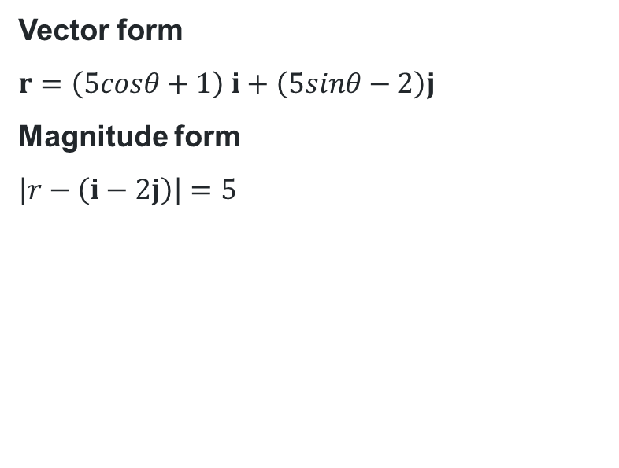
Worked example
Let a circle have centre $C(1, −2)$ and radius 5. Write the vector equation of the circle, then use it to determine whether the point $P(4, 2)$ lies inside, on, or outside the circle.
Vector form
$$r=\left(5cosθ+1\right) i+\left(5sinθ−2\right)j$$
Magnitude form
$$\left|r−\left(i−2j\right)\right|=5$$
Distance of $C\left(1,−2\right) to P(4, 2)$
$$\left|r−c\right|=\left|\left(4, 2\right)−\left(1, −2\right)\right| \\ =\left|(3, 4)\right| \\ =\sqrt{3^{2}+4^{2}} \\ =5$$
Since radius of circle $=$ distance of $CP$
Then point $P(4, 2)$ lies on the circle
Why are we calculating $\sqrt{3^{2}+4^{2}}$ ?
How would we know if the point laid inside or outside the circle?

Slide 8
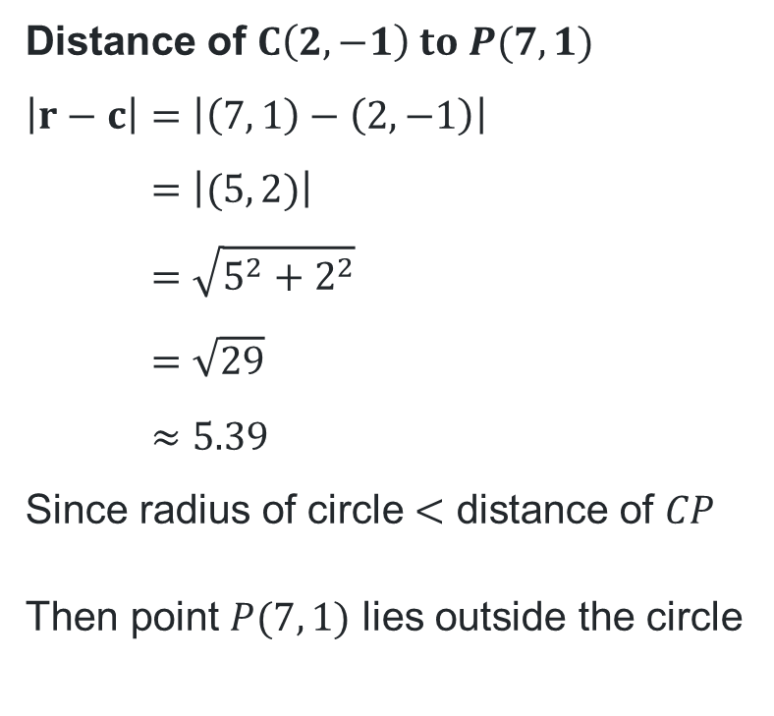
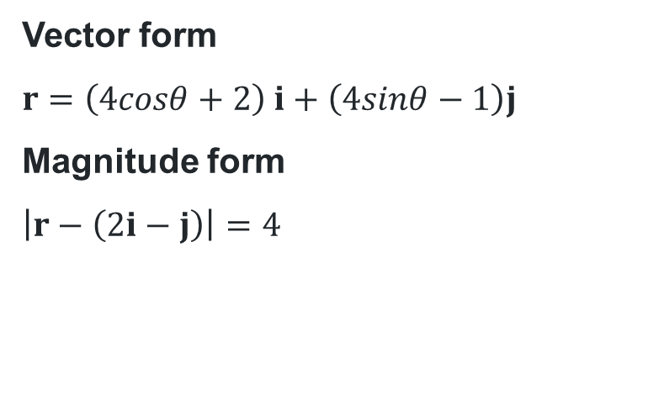
Your turn
Let a circle have centre $C(2, −1)$ and radius 4. Write the vector equation of the circle, then use it to determine whether the point $P(7, 1)$ lies inside, on, or outside the circle.
Vector form
$$r=\left(4cosθ+2\right) i+\left(4sinθ−1\right)j$$
Magnitude form
$$\left|r−\left(2i−j\right)\right|=4$$
Distance of $C\left(2,−1\right) to P(7, 1)$
$$\left|r−c\right|=\left|\left(7, 1\right)−\left(2, −1\right)\right| \\ =\left|(5, 2)\right| \\ =\sqrt{5^{2}+2^{2}} \\ =\sqrt{29} \\ ≈5.39$$
Since radius of circle $<$ distance of $CP$
Then point $P(7, 1)$ lies outside the circle

Slide 9
References
This presentation contains NSW Curriculum and syllabus content. The NSW Curriculum is developed by the NSW Education Standards Authority. This content is prepared by NESA for and on behalf of the Crown in the right of the State of New South Wales. The material is protected by Crown copyright.
Please refer to the NESA Copyright Disclaimer for more information https://educationstandards.nsw.edu.au/wps/portal/nesa/mini-footer/copyright.
NESA holds the only official and up-to-date versions of the NSW Curriculum and syllabus documents. Please visit the NSW Education Standards Authority (NESA) website https://educationstandards.nsw.edu.au/wps/portal/nesa/home and the NSW Curriculum website https://curriculum.nsw.edu.au.
Mathematics Extension 2 11–12 Syllabus © NSW Education Standards Authority (NESA) for and on behalf of the Crown in right of the State of New South Wales, 2024.

Slide 10
Copyright
© State of New South Wales (Department of Education), 2026
The copyright material published in this resource is subject to the Copyright Act 1968 (Cth) and is owned by the NSW Department of Education or, where indicated, by a party other than the NSW Department of Education (third-party material).
Copyright material available in this resource and owned by the NSW Department of Education is licensed under a Creative Commons Attribution 4.0 International (CC BY 4.0) license.
This license allows you to share and adapt the material for any purpose, even commercially.
Attribution should be given to © State of New South Wales (Department of Education), 2026.
Material in this resource not available under a Creative Commons license:
the NSW Department of Education logo, other logos and trademark-protected material
Material owned by a third party that has been reproduced with permission. You will need to obtain permission from the third party to reuse its material.
Links to third-party material and websites
Please note that the provided (reading/viewing material/list/links/texts) are a suggestion only and implies no endorsement, by the New South Wales Department of Education, of any author, publisher, or book title. School principals and teachers are best placed to assess the suitability of resources that would complement the curriculum and reflect the needs and interests of their students.
If you use the links provided in this document to access a third-party’s website, you acknowledge that the terms of use, including licence terms set out on the third-party’s website apply to the use which may be made of the materials on that third-party website or where permitted by the Copyright Act 1968 (Cth). The department accepts no responsibility for content on third-party websites.

