Slide 1
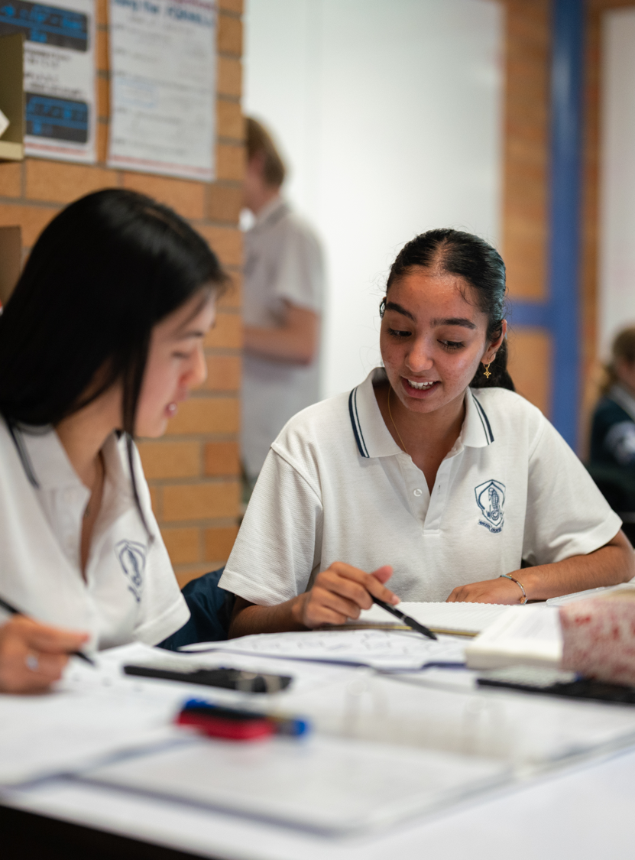
Relationships between lines
Mathematics Extension 2 – Stage 6 (Year 12)
Vector equations of lines and curves

Slide 2
Learning intentions and success criteria
Learning intentions
To be able to determine if 2 lines intersect.
To be able to find the point of intersection of 2 lines.
To understand what skew lines are.
Success criteria
I can find the point of intersection of 2 non-parallel lines in 2D.
I can determine whether 2 lines intersect in 3D.
I can find the point of intersection of 2 non-parallel lines in 3D.

Slide 3
Retrieval practice

Slide 4
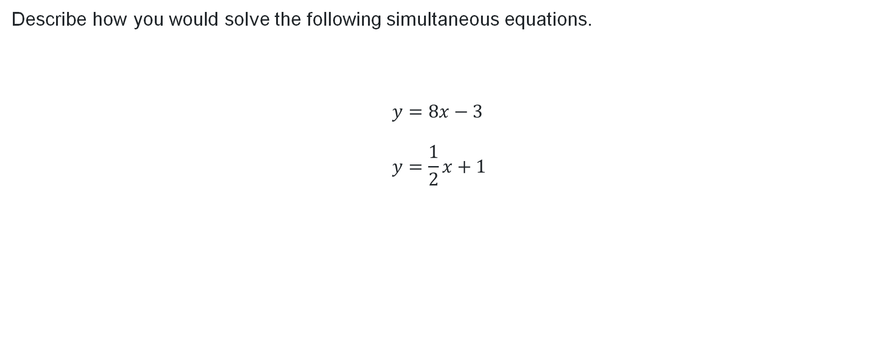
Solving simultaneous equations
Describe how you would solve the following simultaneous equations.
$$y=8x−3 \\ y=\frac{1}{2}x+1$$

Slide 5
Activating prior knowledge

Slide 6
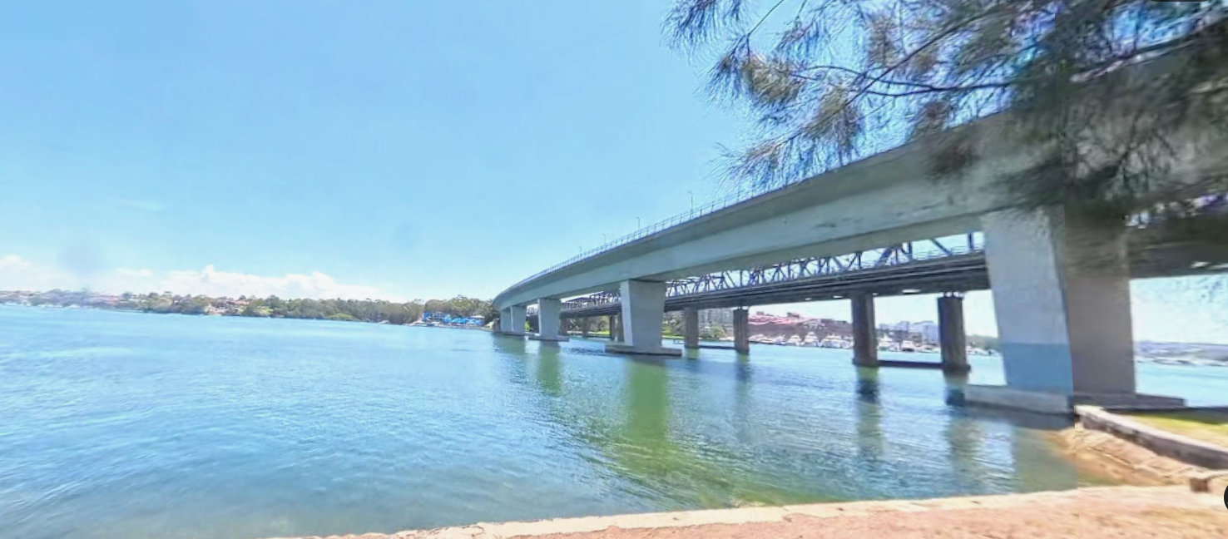
Scenario
Drone and bridge
Photo © 2026 Google Street View / Google Maps. Used for educational purposes.

Slide 7
Connecting learning

Slide 8
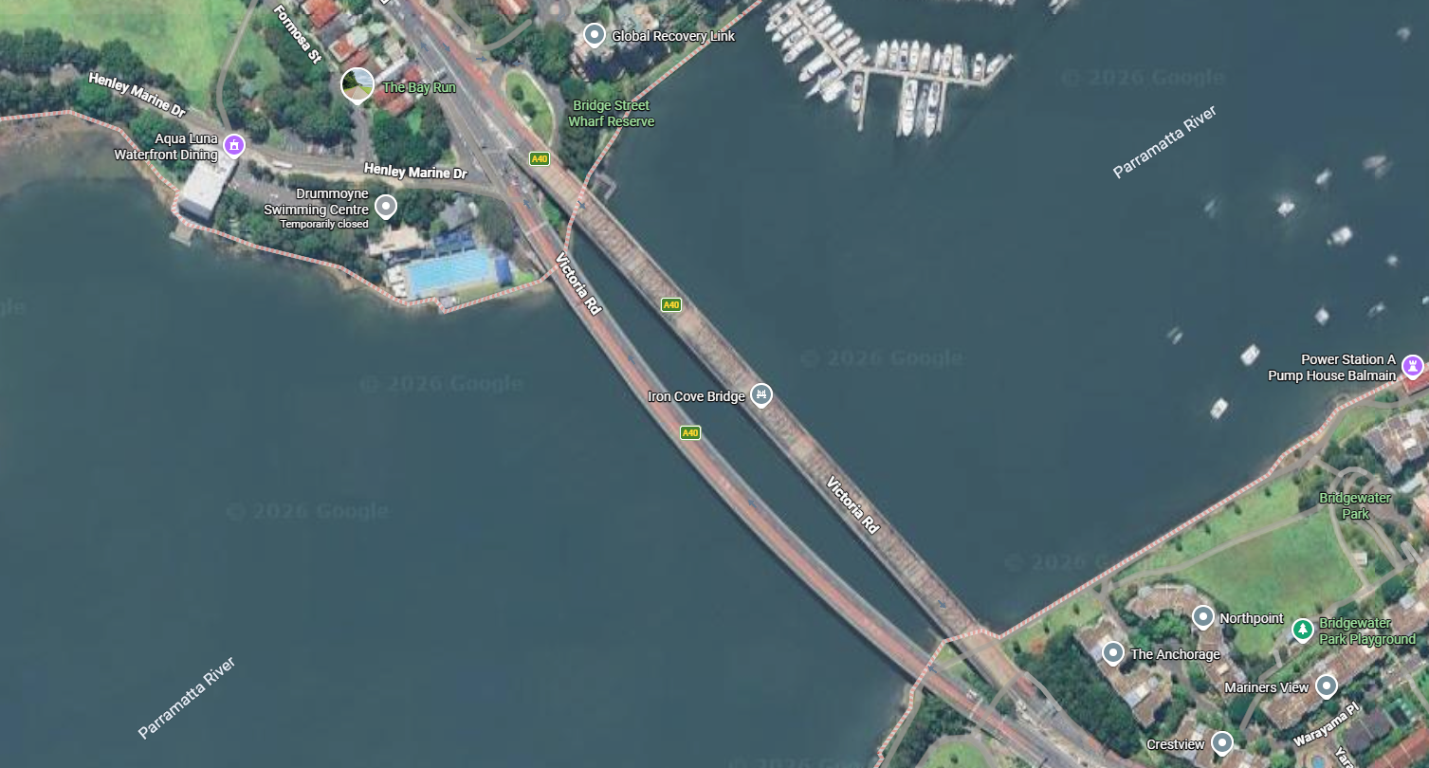
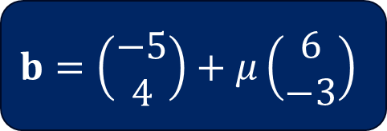
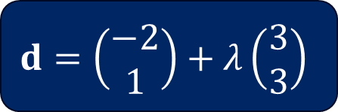
Drone context (3)
$$b=\left(\begin{matrix}−5 \\ 4\end{matrix}\right)+μ\left(\begin{matrix}6 \\ −3\end{matrix}\right)$$
$$d=\left(\begin{matrix}−2 \\ 1\end{matrix}\right)+λ\left(\begin{matrix}3 \\ 3\end{matrix}\right)$$
Map imagery © 2026 Google Maps. Data © Google and its data providers. Used for educational purposes.

Slide 9
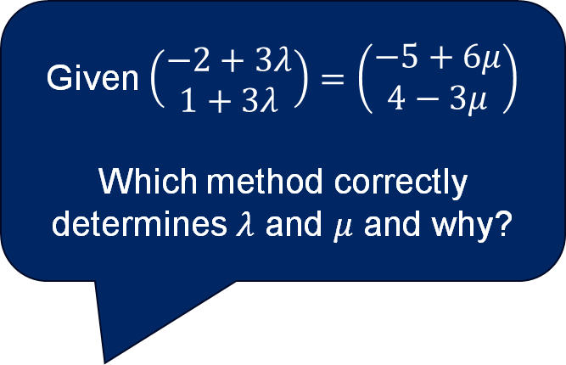
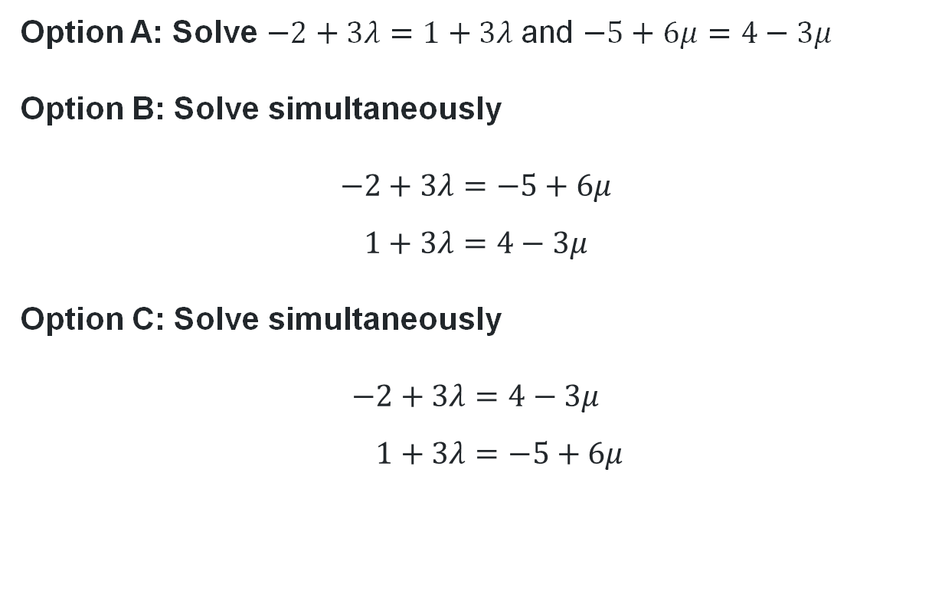
Finding the point of intersection (1)
Select the correct option
Option A: Solve $−2+3λ=1+3λ$and $−5+6μ=4−3μ$
Option B: Solve simultaneously
$$−2+3λ=−5+6μ \\ 1+3λ=4−3μ$$
Option C: Solve simultaneously
$$−2+3λ=4−3μ \\ 1+3λ=−5+6μ$$
Given $\left(\begin{matrix}−2+3λ \\ 1+3λ\end{matrix}\right)=\left(\begin{matrix}−5+6μ \\ 4−3μ\end{matrix}\right)$
Which method correctly determines $λ$ and $μ$ and why?
Why is Option B the correct method?

Slide 10
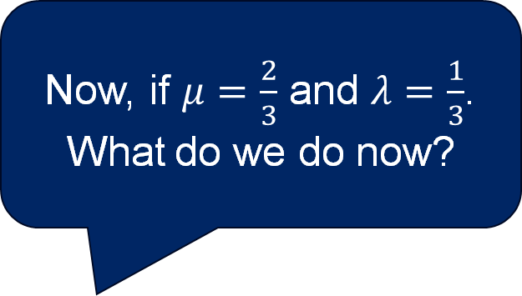
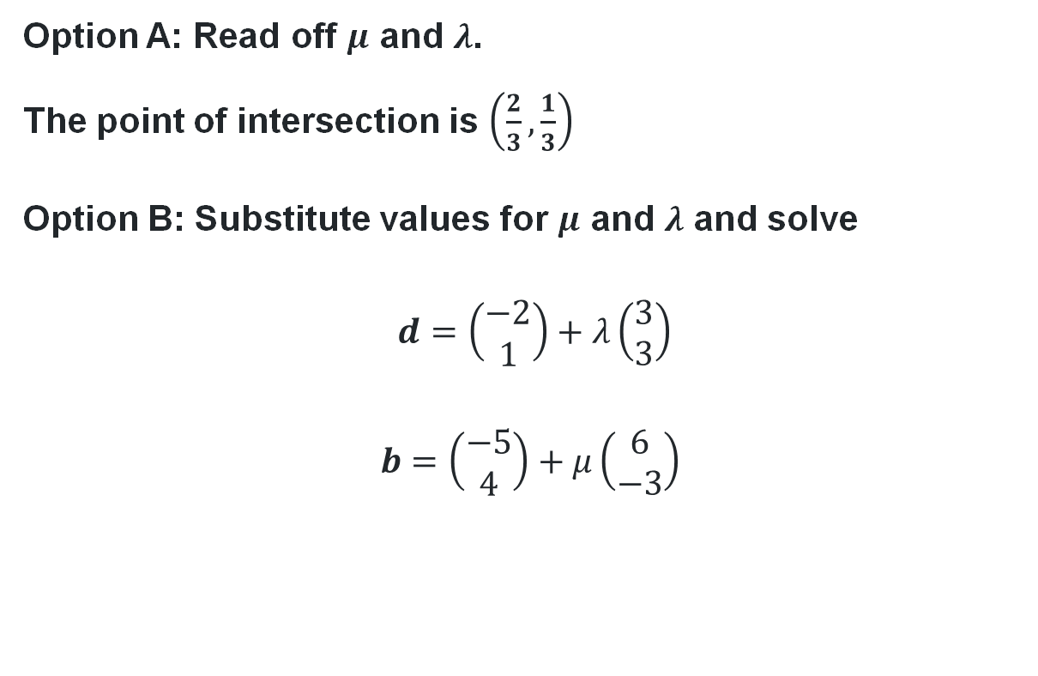
Finding the point of intersection (2)
Select the correct option
Option A: Read off $μ$ and $λ$.
The point of intersection is $\left(\frac{2}{3},\frac{1}{3}\right)$
Option B: Substitute values for $μ$ and $λ$ and solve
$d=\left(\begin{matrix}−2 \\ 1\end{matrix}\right)+λ\left(\begin{matrix}3 \\ 3\end{matrix}\right)$
$$b=\left(\begin{matrix}−5 \\ 4\end{matrix}\right)+μ\left(\begin{matrix}6 \\ −3\end{matrix}\right)$$
Now, if $μ=\frac{2}{3}$ and $λ=\frac{1}{3}$.
What do we do now?

Slide 11
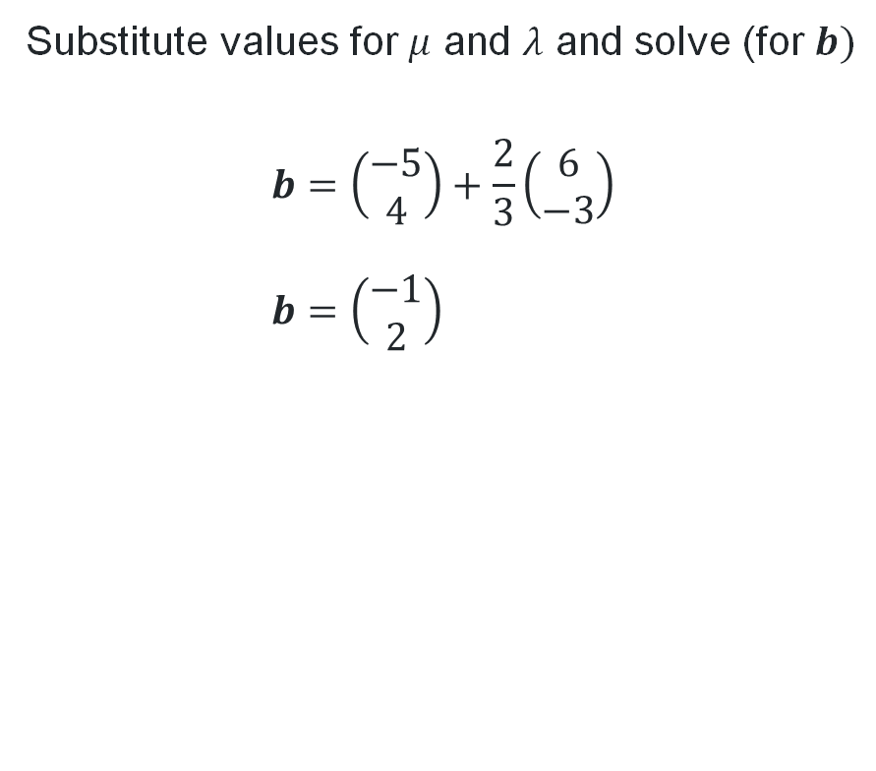
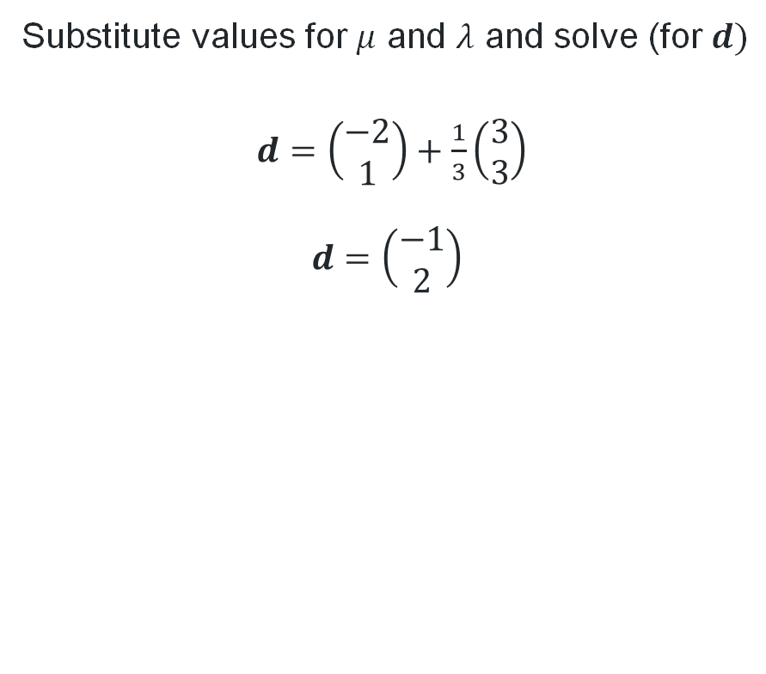
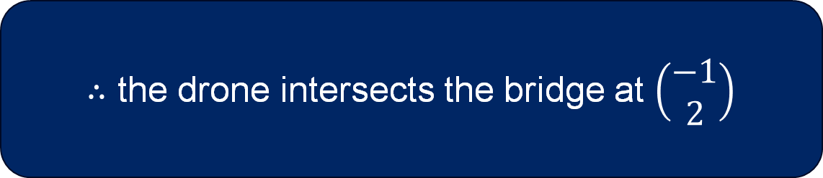
Finding the point of intersection (3)
Substitute values for $μ$ and $λ$ and solve (for $d)$
$d=\left(\begin{matrix}−2 \\ 1\end{matrix}\right)+\frac{1}{3}\left(\begin{matrix}3 \\ 3\end{matrix}\right)$
$$d=\left(\begin{matrix}−1 \\ 2\end{matrix}\right)$$
Substitute values for $μ$ and $λ$ and solve (for $b)$
$$b=\left(\begin{matrix}−5 \\ 4\end{matrix}\right)+\frac{2}{3}\left(\begin{matrix}6 \\ −3\end{matrix}\right) \\ b=\left(\begin{matrix}−1 \\ 2\end{matrix}\right)$$
$∴$ the drone intersects the bridge at $\left(\begin{matrix}−1 \\ 2\end{matrix}\right)$

Slide 12
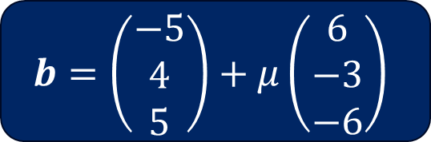
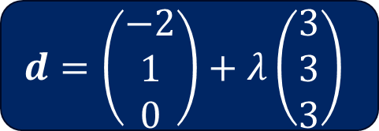
Finding the point of intersection (4)
Three dimensions
Does the path of the drone intersect the bridge in three dimensions?
$$d=\left(\begin{matrix}−2 \\ 1 \\ 0\end{matrix}\right)+λ\left(\begin{matrix}3 \\ 3 \\ 3\end{matrix}\right)$$
$$b=\left(\begin{matrix}−5 \\ 4 \\ 5\end{matrix}\right)+μ\left(\begin{matrix}6 \\ −3 \\ −6\end{matrix}\right)$$
Photo © 2026 Google Street View / Google Maps. Used for educational purposes.

Slide 13
Relationships between lines in two and three dimensions
Do you agree or disagree with each statement? Why/why not?
‘Vector lines in 2D can only be parallel or intersecting’
‘Vector lines in 3D can also only be parallel or intersecting’
In 3D, when 2 lines are not parallel or do not intersect, they are known as ‘skew lines.’

Slide 14
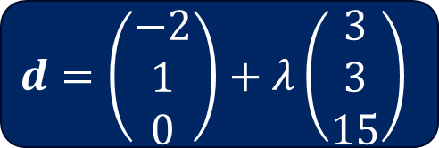
Skew lines
$$d=\left(\begin{matrix}−2 \\ 1 \\ 0\end{matrix}\right)+λ\left(\begin{matrix}3 \\ 3 \\ 15\end{matrix}\right)$$
$$b=\left(\begin{matrix}−5 \\ 4 \\ 5\end{matrix}\right)+μ\left(\begin{matrix}6 \\ −3 \\ −6\end{matrix}\right)$$
Photo © 2026 Google Street View / Google Maps. Used for educational purposes.

Slide 15
Releasing responsibility

Slide 16
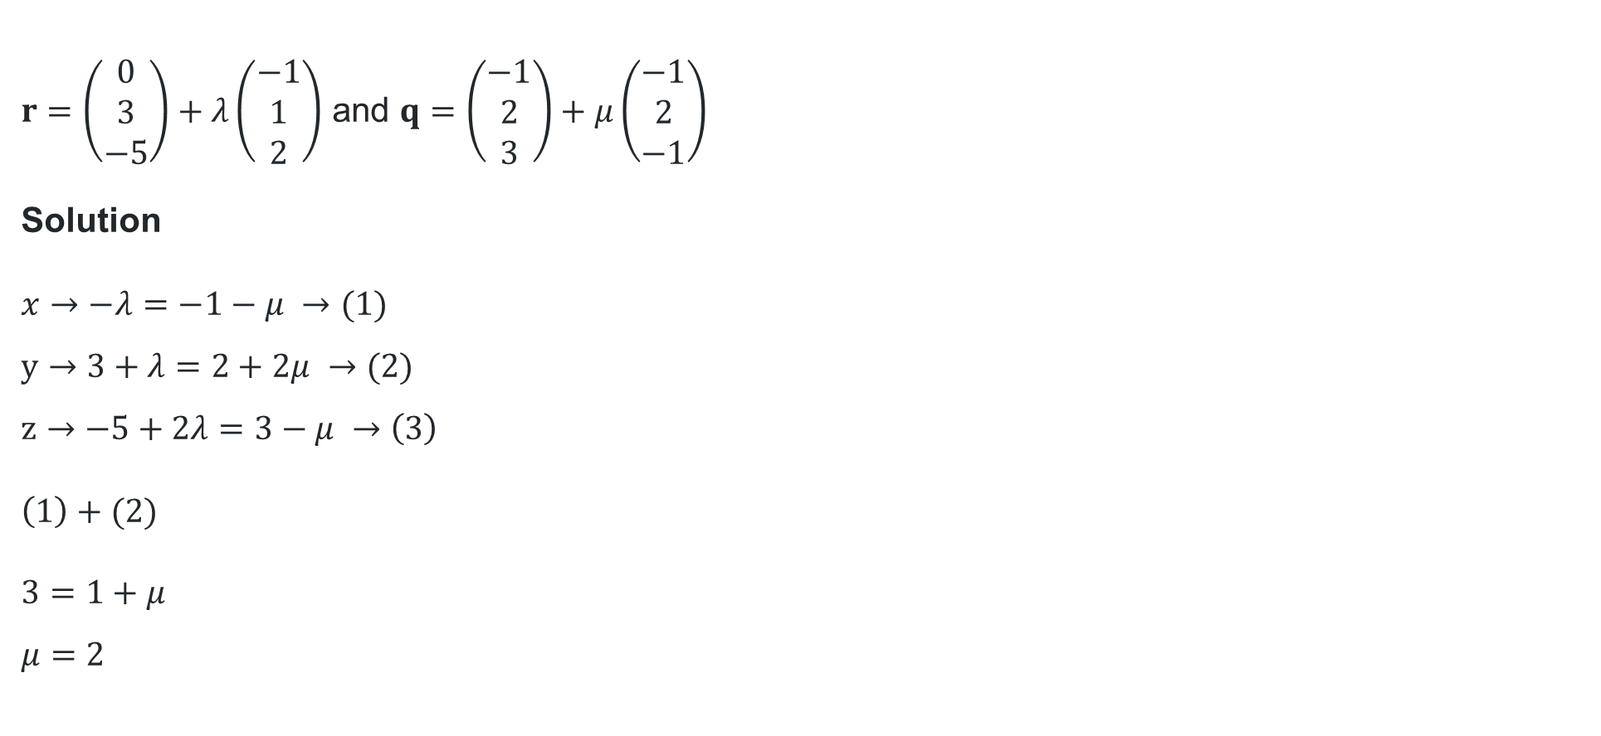

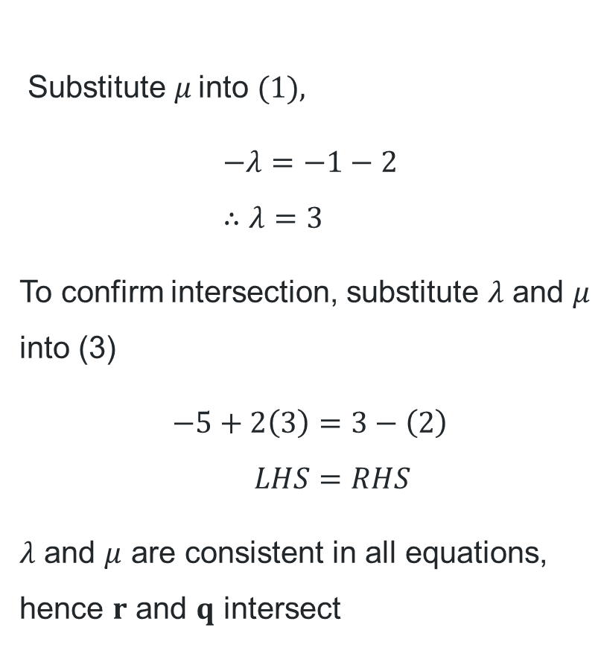
Show that the following lines intersect
Worked example – part a
$r=\left(\begin{matrix}0 \\ 3 \\ −5\end{matrix}\right)+λ\left(\begin{matrix}−1 \\ 1 \\ 2\end{matrix}\right)$ and $q=\left(\begin{matrix}−1 \\ 2 \\ 3\end{matrix}\right)+μ\left(\begin{matrix}−1 \\ 2 \\ −1\end{matrix}\right)$
Solution
$x→−λ=−1−μ →(1)$
$y→3+λ=2+2μ →(2)$
$z→−5+2λ=3−μ →\left(3\right)$
$$\left(1\right)+(2)$$
$3=1+μ$
$μ=2$
Substitute $μ$into $\text{(1), }$
$$−λ=−1−2 \\ ∴λ=3$$
To confirm intersection, substitute $λ$ and $μ$ into (3)
$$−5+2\left(3\right)=3−\left(2\right) \\ LHS=RHS$$
$λ$ and $μ$ are consistent in all equations, hence $r$ and $q$ intersect
Why do we form simultaneous equations here?
What does it mean if
$$LHS≠RHS?$$

Slide 17
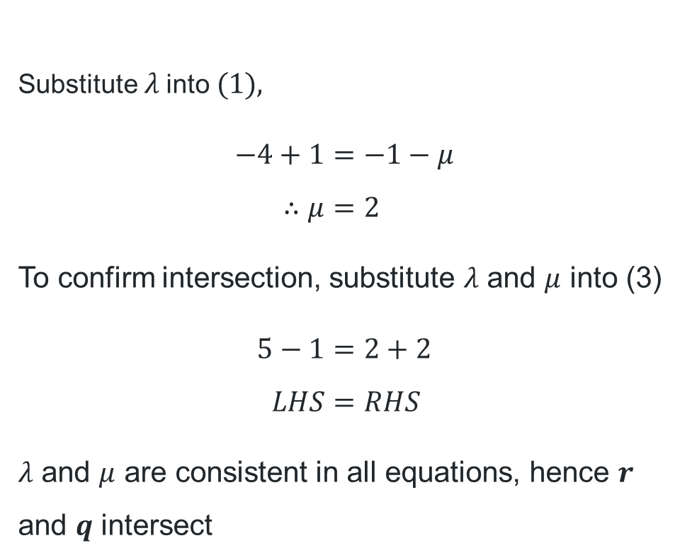
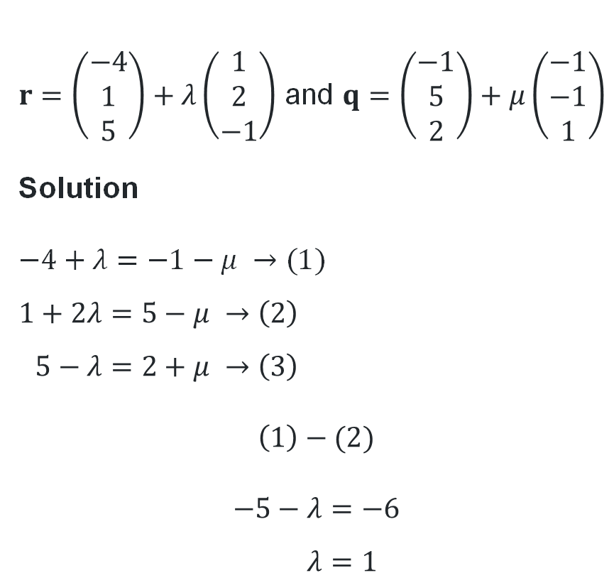
Show that the following lines intersect
Substitute $λ$into $\text{(1), }$
$$−4+1=−1−μ \\ ∴μ=2$$
To confirm intersection, substitute $λ$ and $μ$ into (3)
$$5−1=2+2 \\ LHS=RHS$$
$λ$ and $μ$ are consistent in all equations, hence $r$ and $q$ intersect
Your turn – part a
$r=\left(\begin{matrix}−4 \\ 1 \\ 5\end{matrix}\right)+λ\left(\begin{matrix}1 \\ 2 \\ −1\end{matrix}\right)$ and $q=\left(\begin{matrix}−1 \\ 5 \\ 2\end{matrix}\right)+μ\left(\begin{matrix}−1 \\ −1 \\ 1\end{matrix}\right)$
Solution
$−4+λ=−1−μ →(1)$
$$1+2λ=5−μ →\left(2\right) \\ 5−λ=2+μ →\left(3\right)$$
$$\left(1\right)−(2)$$
$$−5−λ=−6 \\ λ=1$$

Slide 18
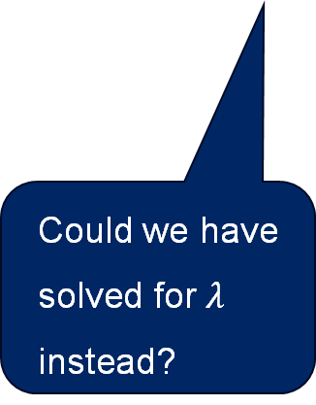
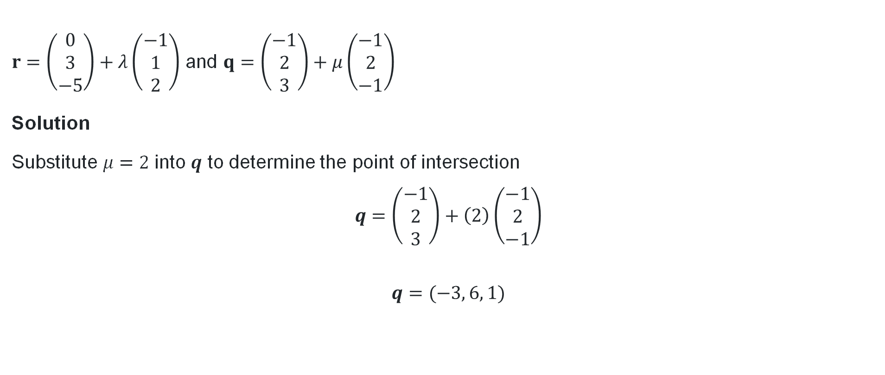
Find the point of intersection of the lines
Worked example – part b
Why did we only substitute for one parameter?
$r=\left(\begin{matrix}0 \\ 3 \\ −5\end{matrix}\right)+λ\left(\begin{matrix}−1 \\ 1 \\ 2\end{matrix}\right)$ and $q=\left(\begin{matrix}−1 \\ 2 \\ 3\end{matrix}\right)+μ\left(\begin{matrix}−1 \\ 2 \\ −1\end{matrix}\right)$
Solution
Substitute $μ=2$into $q$ to determine the point of intersection
$$q=\left(\begin{matrix}−1 \\ 2 \\ 3\end{matrix}\right)+\left(2\right)\left(\begin{matrix}−1 \\ 2 \\ −1\end{matrix}\right)$$
$$q=(−3, 6, 1)$$
Could we have solved for $λ$ instead?

Slide 19
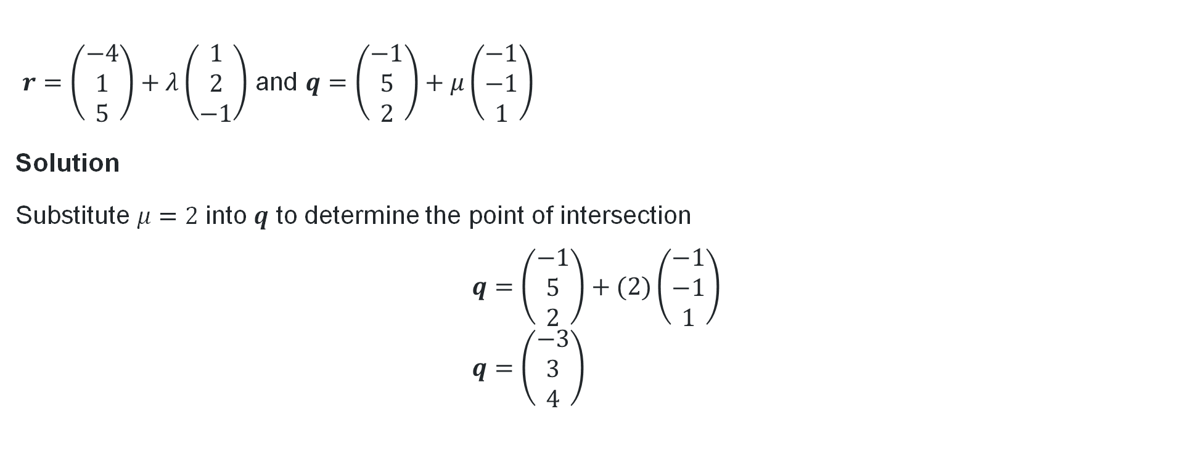
Find the point of intersection of the lines (2)
Your turn – part b
$r=\left(\begin{matrix}−4 \\ 1 \\ 5\end{matrix}\right)+λ\left(\begin{matrix}1 \\ 2 \\ −1\end{matrix}\right)$ and $q=\left(\begin{matrix}−1 \\ 5 \\ 2\end{matrix}\right)+μ\left(\begin{matrix}−1 \\ −1 \\ 1\end{matrix}\right)$
Solution
Substitute $μ=2$into $q$ to determine the point of intersection
$$q=\left(\begin{matrix}−1 \\ 5 \\ 2\end{matrix}\right)+(2)\left(\begin{matrix}−1 \\ −1 \\ 1\end{matrix}\right) \\ q=\left(\begin{matrix}−3 \\ 3 \\ 4\end{matrix}\right)$$

Slide 20
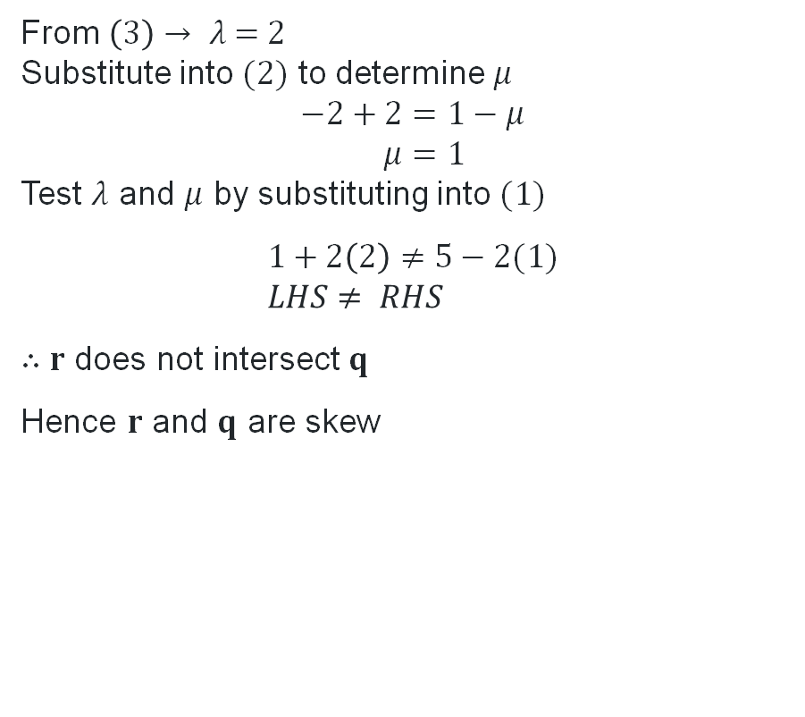
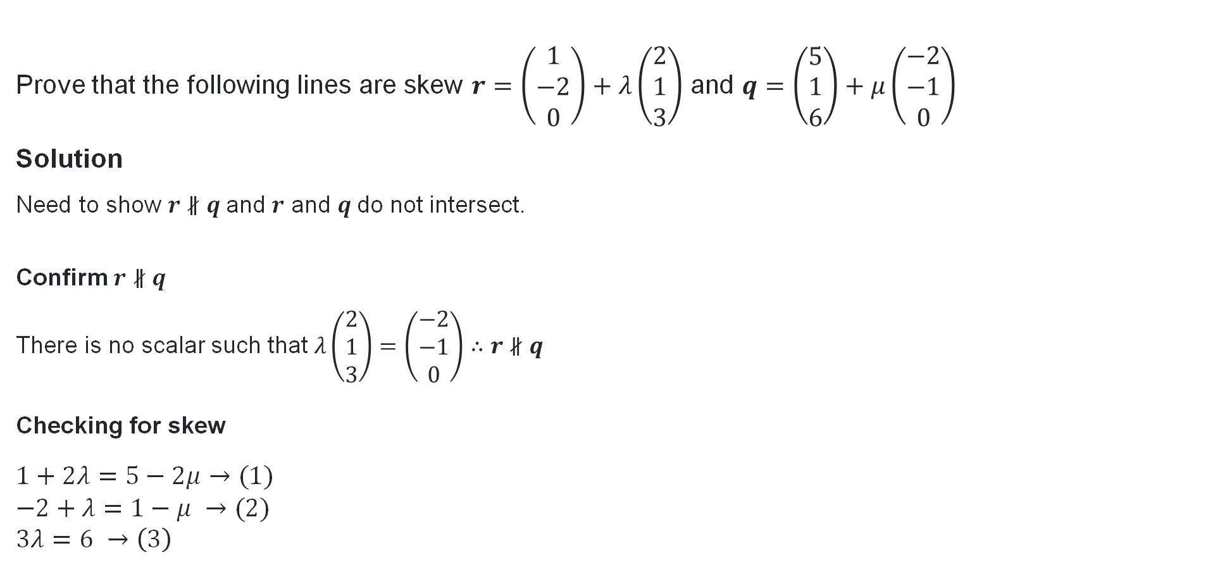
Prove that the following lines are skew
Prove that the following lines are skew $r=\left(\begin{matrix}1 \\ −2 \\ 0\end{matrix}\right)+λ\left(\begin{matrix}2 \\ 1 \\ 3\end{matrix}\right)$ and $q=\left(\begin{matrix}5 \\ 1 \\ 6\end{matrix}\right)+μ\left(\begin{matrix}−2 \\ −1 \\ 0\end{matrix}\right)$
Solution
Need to show $r∦q$and $r$ and $q$do not intersect.
Confirm $r∦q$
There is no scalar such that $λ\left(\begin{matrix}2 \\ 1 \\ 3\end{matrix}\right)=\left(\begin{matrix}−2 \\ −1 \\ 0\end{matrix}\right)∴r∦q$
Checking for skew
$1+2λ=5−2μ→(1)$
$−2+λ=1−μ →(2)$
$3λ=6 →\left(3\right)$
Worked example
From $\left(3\right)→ λ \text{= 2}$
Substitute into $(2)$ to determine $μ$
$$−2+2=1−μ \\ μ=1$$
Test $λ$ and $μ$ by substituting into $(1)$
$$1+2\left(2\right)≠5−2(1) \\ LHS≠ RHS$$
$∴r$ does not intersect$q$
Hence $r$ and $q$ are skew
Why do we consider parallel lines?
What if LHS = RHS?

Slide 21
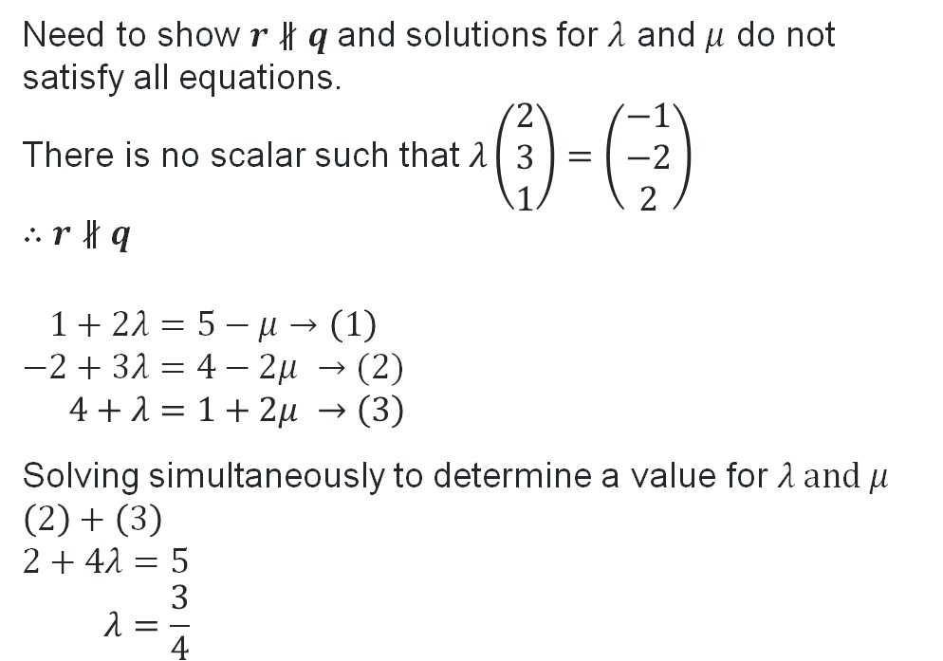
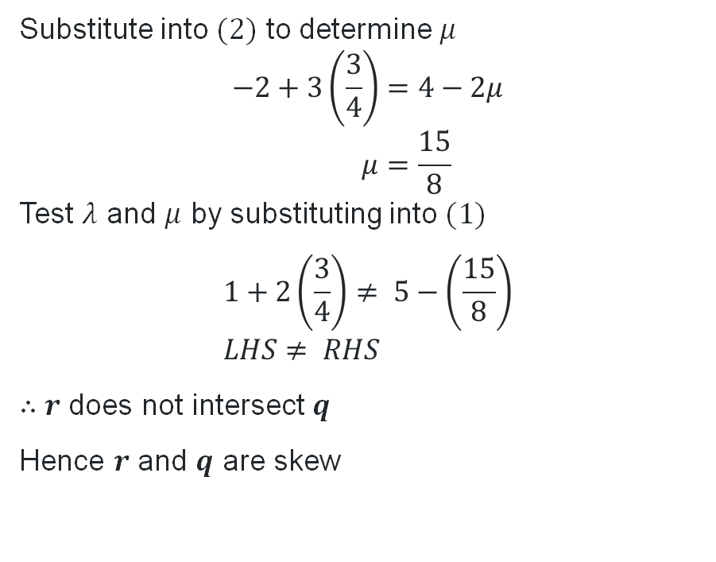
Prove that the following lines are skew (2)
Your turn
Prove that the following lines are skew $r=\left(\begin{matrix}1 \\ −2 \\ 4\end{matrix}\right)+λ\left(\begin{matrix}2 \\ 3 \\ 1\end{matrix}\right)$ and $q=\left(\begin{matrix}5 \\ 4 \\ 1\end{matrix}\right)+μ\left(\begin{matrix}−1 \\ −2 \\ 2\end{matrix}\right)$
Need to show $r∦q$and solutions for $λ$ and $μ$ do not satisfy all equations.
There is no scalar such that $λ\left(\begin{matrix}2 \\ 3 \\ 1\end{matrix}\right)=\left(\begin{matrix}−1 \\ −2 \\ 2\end{matrix}\right)$
$∴r∦q$
$$1+2λ=5−μ→\left(1\right) \\ −2+3λ=4−2μ →(2) \\ 4+λ=1+2μ →\left(3\right)$$
Solving simultaneously to determine a value for $λ \text{and} μ$
$$\left(2\right)+\left(3\right)$$
$$2+4λ=5 \\ λ=\frac{3}{4}$$
Substitute into $(2)$ to determine $μ$
$$−2+3\left(\frac{3}{4}\right)=4−2μ \\ μ=\frac{15}{8}$$
Test $λ$ and $μ$ by substituting into $(1)$
$$1+2\left(\frac{3}{4}\right)≠ 5−\left(\frac{15}{8}\right) \\ LHS≠ RHS$$
$∴r$ does not intersect$q$
Hence $r$ and $q$ are skew

Slide 22
Independent practice

Slide 23
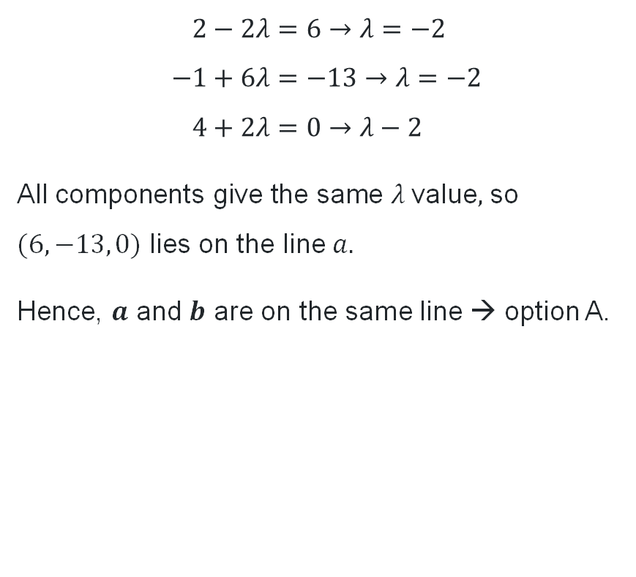
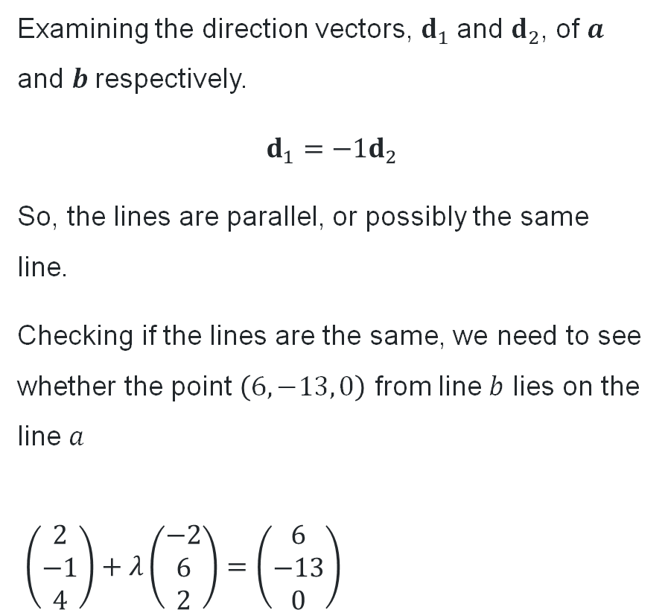
HSC-style questions (1)
Solutions – question 1
Examining the direction vectors, $d_{1}$and $d_{2}$, of $a$ and $b$respectively.
$$d_{1}=−1d_{2}$$
So, the lines are parallel, or possibly the same line.
Checking if the lines are the same, we need to see whether the point $\left(6, −13, 0\right)$ from line $b$ lies on the line $a$
$\left(\begin{matrix}2 \\ −1 \\ 4\end{matrix}\right)+λ\left(\begin{matrix}−2 \\ 6 \\ 2\end{matrix}\right)=\left(\begin{matrix}6 \\ −13 \\ 0\end{matrix}\right)$
$$2−2λ=6→λ=−2 \\ −1+6λ=−13→λ=−2 \\ 4+2λ=0→λ−2$$
All c$\text{omponents} \text{give} \text{the} \text{same} λ \text{value},$ so $(6, −13, 0)$ lies on the line $a.$
Hence, $a$ and $b$ are on the same line → option A.

Slide 24
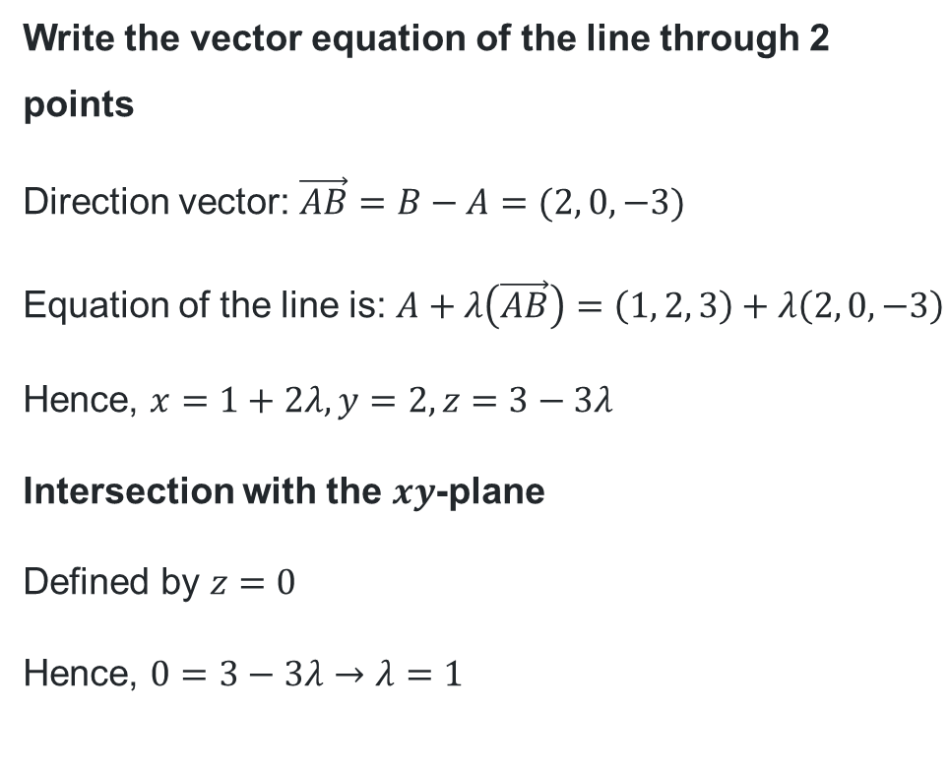
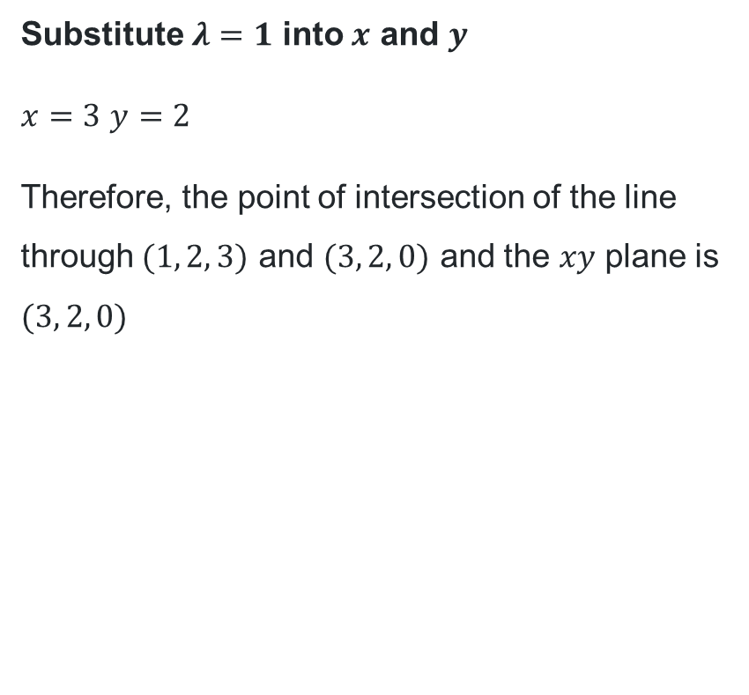
HSC-style questions (2)
Solutions – question 2
Write the vector equation of the line through 2 points
Direction vector: $\vec{AB}=B−A=(2, 0, −3)$
Equation of the line is: $A+λ\left(\vec{AB}\right)=\left(1, 2, 3\right)+λ\left(2, 0, −3\right)$
Hence, $x=1+2λ, y=2, z=3−3λ$
Intersection with the $xy$-plane
Defined by $z=0$
Hence, $0=3−3λ→λ=1$
Substitute $λ=1$ into $x$ and $y$
$x=3$ $y=2$
Therefore, the point of intersection of the line through $(1, 2, 3)$ and $(3, 2, 0)$ and the $xy$ plane is $(3, 2, 0)$

Slide 25
References
This presentation contains NSW Curriculum and syllabus content. The NSW Curriculum is developed by the NSW Education Standards Authority. This content is prepared by NESA for and on behalf of the Crown in the right of the State of New South Wales. The material is protected by Crown copyright.
Please refer to the NESA Copyright Disclaimer for more information https://educationstandards.nsw.edu.au/wps/portal/nesa/mini-footer/copyright.
NESA holds the only official and up-to-date versions of the NSW Curriculum and syllabus documents. Please visit the NSW Education Standards Authority (NESA) website https://educationstandards.nsw.edu.au/wps/portal/nesa/home and the NSW Curriculum website https://curriculum.nsw.edu.au.
Mathematics Extension 2 11–12 Syllabus © NSW Education Standards Authority (NESA) for and on behalf of the Crown in right of the State of New South Wales, 2024.

Slide 26
Copyright
© State of New South Wales (Department of Education), 2026
The copyright material published in this resource is subject to the Copyright Act 1968 (Cth) and is owned by the NSW Department of Education or, where indicated, by a party other than the NSW Department of Education (third-party material).
Copyright material available in this resource and owned by the NSW Department of Education is licensed under a Creative Commons Attribution 4.0 International (CC BY 4.0) license.
This license allows you to share and adapt the material for any purpose, even commercially.
Attribution should be given to © State of New South Wales (Department of Education), 2026.
Material in this resource not available under a Creative Commons license:
the NSW Department of Education logo, other logos and trademark-protected material
Material owned by a third party that has been reproduced with permission. You will need to obtain permission from the third party to reuse its material.
Links to third-party material and websites
Please note that the provided (reading/viewing material/list/links/texts) are a suggestion only and implies no endorsement, by the New South Wales Department of Education, of any author, publisher, or book title. School principals and teachers are best placed to assess the suitability of resources that would complement the curriculum and reflect the needs and interests of their students.
If you use the links provided in this document to access a third-party’s website, you acknowledge that the terms of use, including licence terms set out on the third-party’s website apply to the use which may be made of the materials on that third-party website or where permitted by the Copyright Act 1968 (Cth). The department accepts no responsibility for content on third-party websites.

