Slide 1
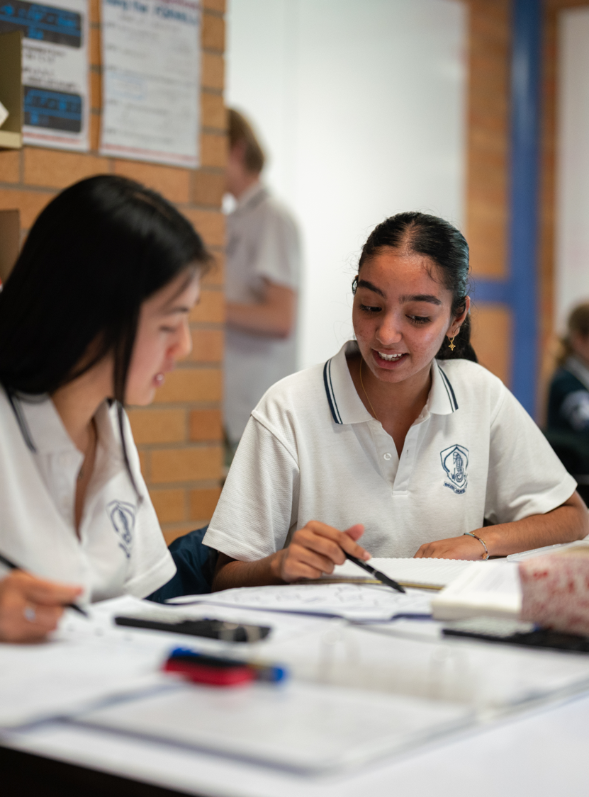
Parallel vectors in two and three dimensions
Mathematics Extension 2 – Stage 6 (Year 12)
Vector equations of lines and curves

Slide 2
Learning intentions and success criteria
Learning intention
To be able to determine whether 2 lines in vector form are parallel.
Success criteria
I can identify 2 vectors that are scalar multiples of each other.
I can justify whether 2 lines are parallel in 2D and 3D.

Slide 3
Retrieval practice

Slide 4
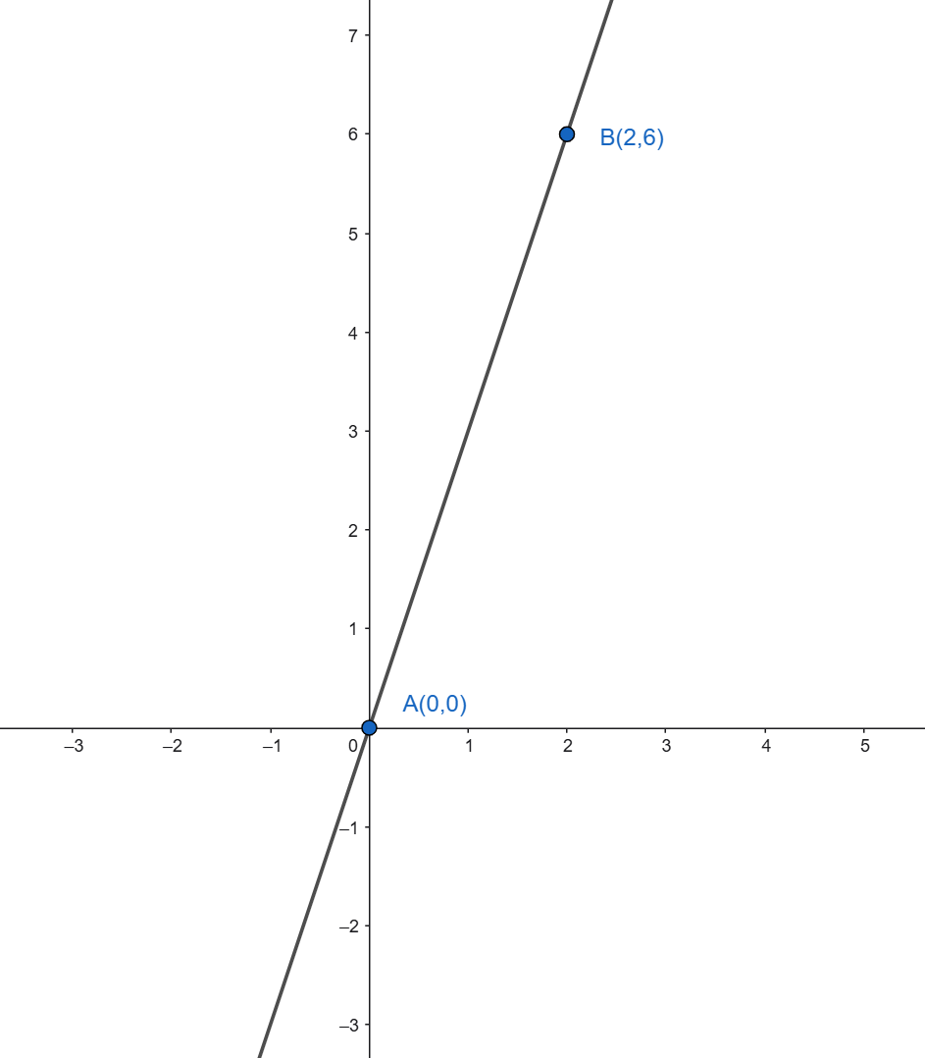
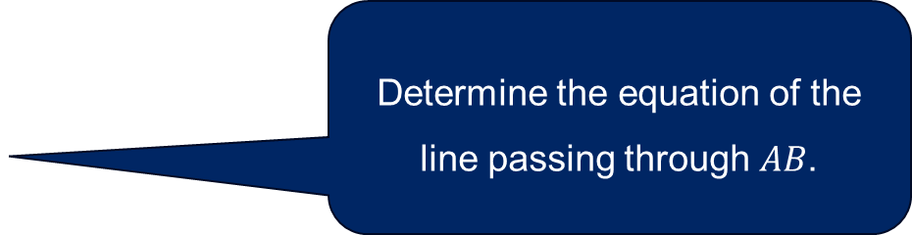
Retrieval practice (1)
Determine the equation of the line passing through $AB$.
State equations of lines that are parallel to the line AB.

Slide 5
Activating prior knowledge

Slide 6
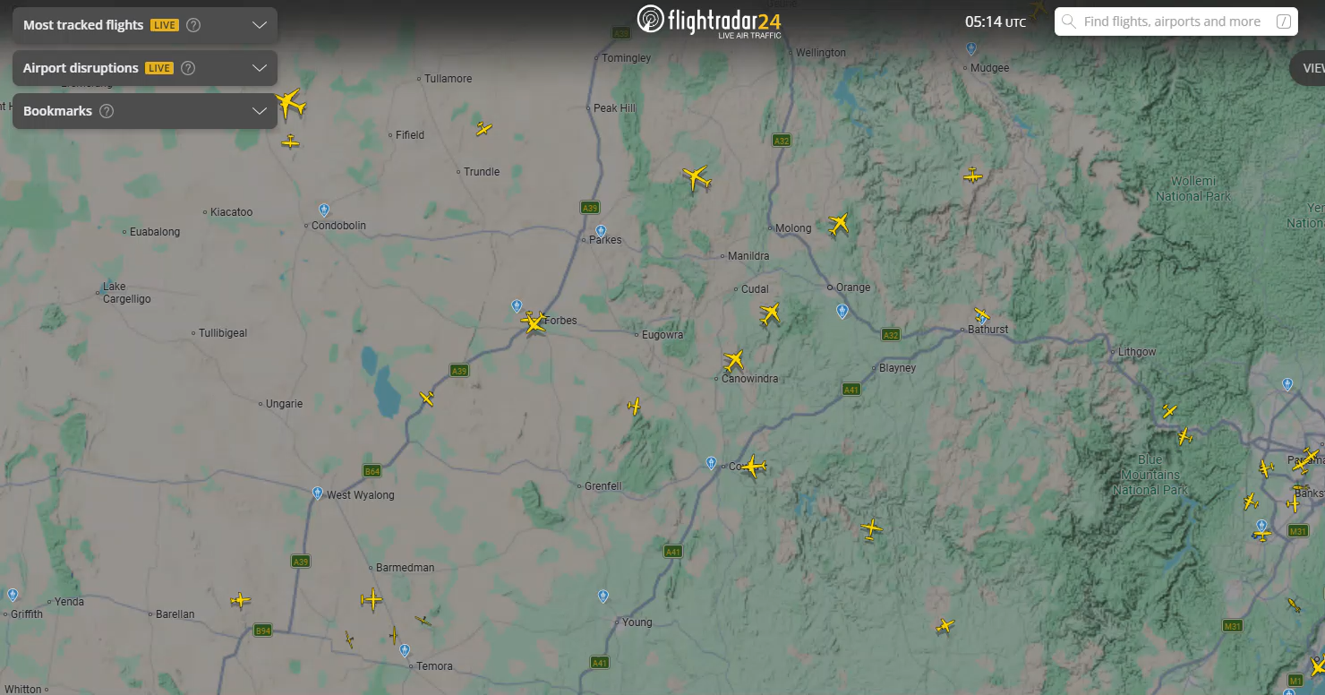
Video showing flight paths
Map and aircraft data © Flightradar24. Used under the Statutory Education Licence for educational purposes.

Slide 7
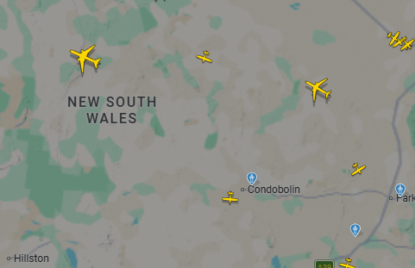
Flight paths
Map and aircraft data © Flightradar24. Used under the Statutory Education Licence for educational purposes.

Slide 8
Connecting learning

Slide 9
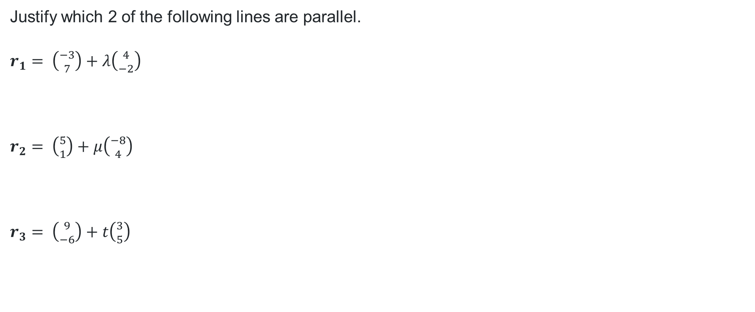
Parallel lines (1)
Justify which 2 of the following lines are parallel.
$r_{1}= \left({−3 \atop 7}\right)+λ\left({4 \atop −2}\right)$
$r_{2}= \left({5 \atop 1}\right)+μ\left({−8 \atop 4}\right)$
$r_{3}= \left({9 \atop −6}\right)+t\left({3 \atop 5}\right)$

Slide 10
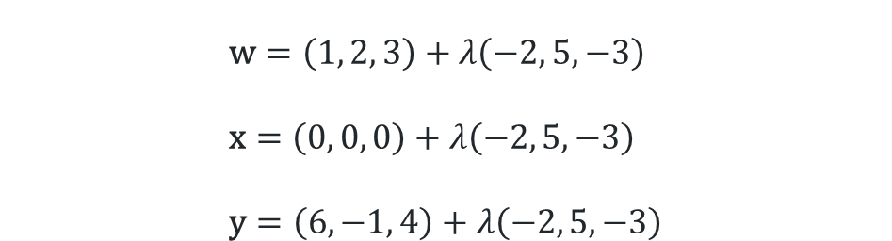
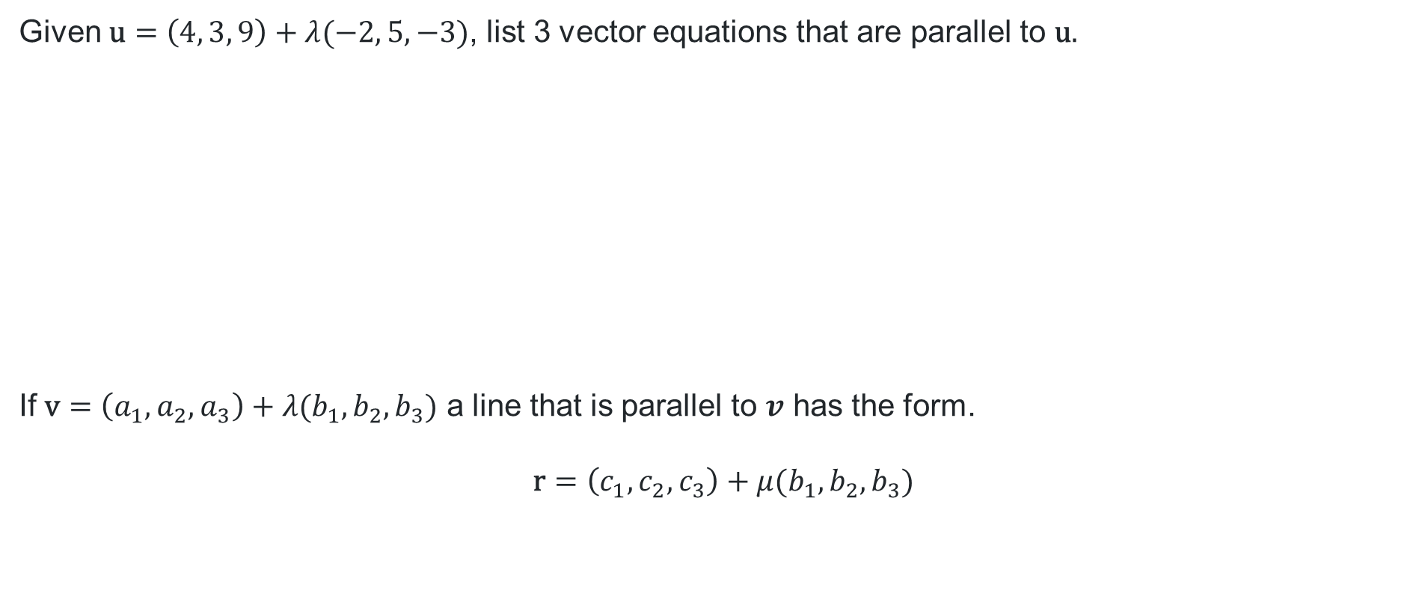
Parallel lines (2)
Given $\text{u}=\left(4, 3, 9\right)+λ(−2, 5, −3)$, list 3 vector equations that are parallel to $\text{u}\text{.}$
If $\text{v}=\left(a_{1}, a_{2},a_{3}\right)+λ(b_{1}, b_{2},b_{3})$ a line that is parallel to $v$ has the form.
$$\text{r}=\left(c_{1}, c_{2},c_{3}\right)+μ(b_{1}, b_{2},b_{3})$$
$$\text{w}=\left(1, 2, 3\right)+λ\left(−2, 5,−3\right) \\ \text{x}=\left(0, 0, 0\right)+λ\left(−2, 5,−3\right) \\ \text{y}=\left(6, −1, 4\right)+λ\left(−2, 5,−3\right)$$

Slide 11
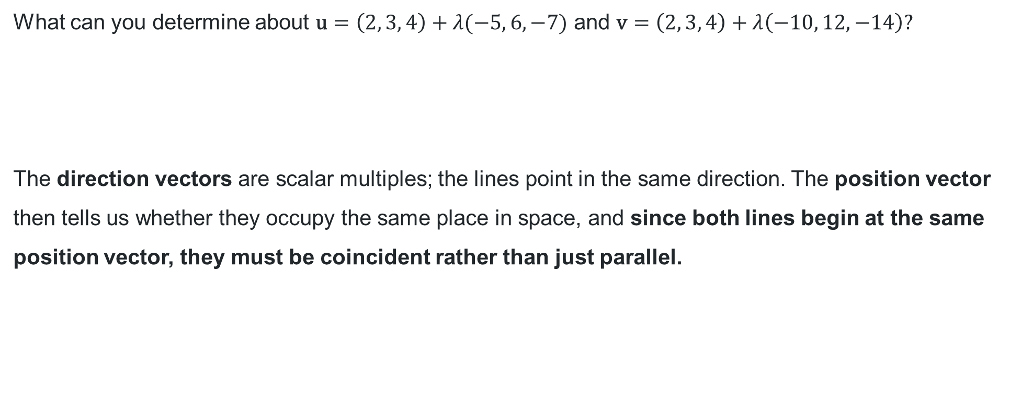
Parallel lines (3)
What can you determine about $\text{u}=\left(2, 3, 4\right)+λ(−5, 6, −7)$ and $\text{v}=\left(2, 3, 4\right)+λ\left(−10, 12, −14\right)?$
The direction vectors are scalar multiples; the lines point in the same direction. The position vector then tells us whether they occupy the same place in space, and since both lines begin at the same position vector, they must be coincident rather than just parallel.

Slide 12
Releasing responsibility

Slide 13
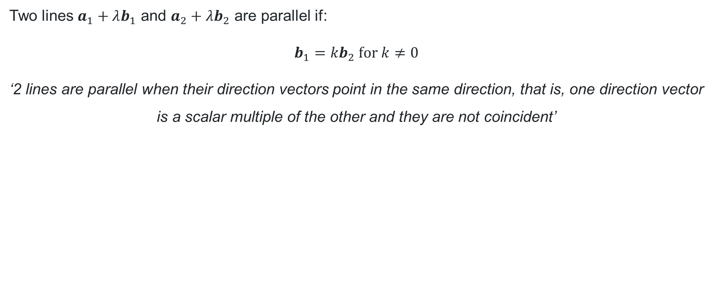
Formal definition
Two lines $a_{1}+λb_{1}$ and $a_{2}+λb_{2}$ are parallel if:
$$b_{1}={kb}_{2} \text{for} k≠0$$
‘2 lines are parallel when their direction vectors point in the same direction, that is, one direction vector is a scalar multiple of the other and they are not coincident’
What does ‘coincident’ mean?
Is this statement applicable to vectors in two dimensions and three dimensions?

Slide 14
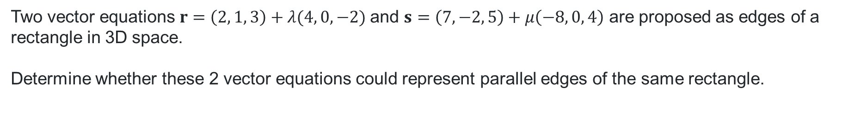
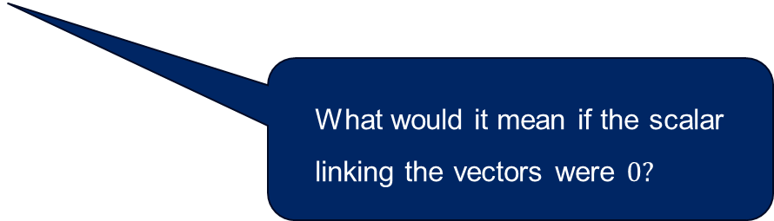
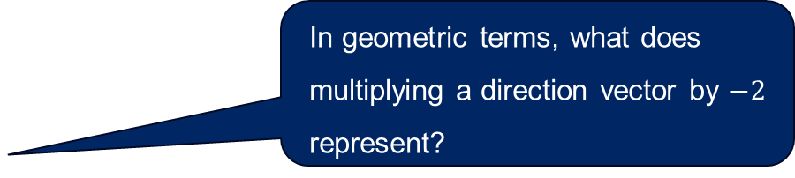
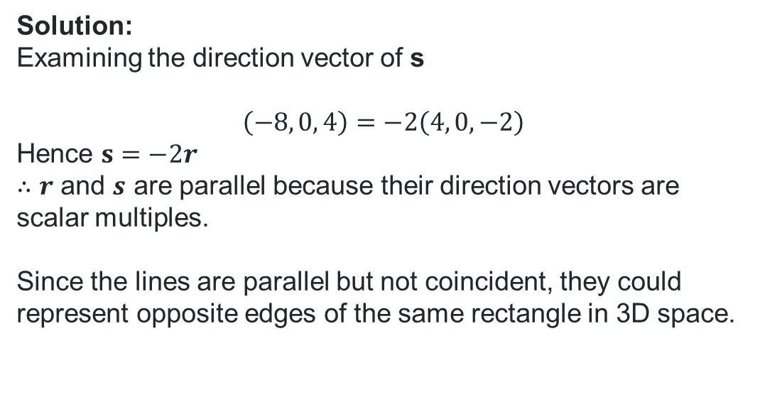
Worked example
Two vector equations$r=\left(2, 1, 3\right)+λ(4, 0, −2)$ and $s=\left(7, −2, 5\right)+μ\left(−8, 0, 4\right)$ are proposed as edges of a rectangle in 3D space.
Determine whether these 2 vector equations could represent parallel edges of the same rectangle.
In geometric terms, what does multiplying a direction vector by $−2$ represent?
Solution:
Examining the direction vector of s
$$\left(−8, 0, 4\right)=−2\left(4, 0, −2\right)$$
Hence $s=−2r$
$∴r$ and $s$ are parallel because their direction vectors are scalar multiples.
Since the lines are parallel but not coincident, they could represent opposite edges of the same rectangle in 3D space.
What would it mean if the scalar linking the vectors were $0?$

Slide 15
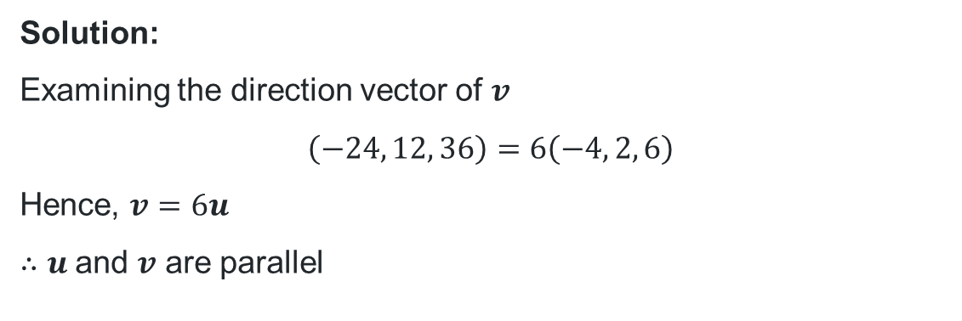
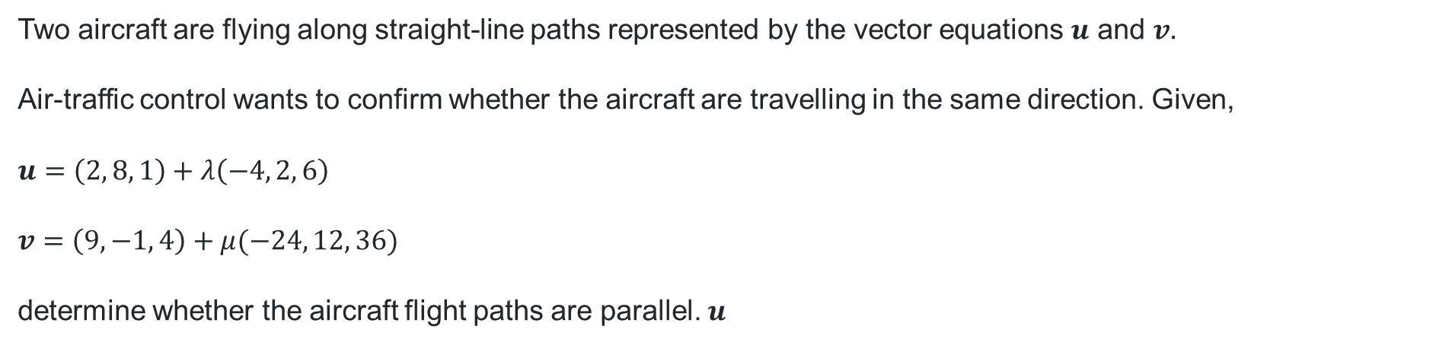
Your turn
Two aircraft are flying along straight-line paths represented by the vector equations $u$ and $v.$
Air-traffic control wants to confirm whether the aircraft are travelling in the same direction. Given,
$$u=\left(2, 8, 1\right)+λ\left(−4, 2, 6\right)$$
$$v=\left(9, −1, 4\right)+μ(−24, 12, 36)$$
determine whether the aircraft flight paths are parallel. $u$
Solution:
Examining the direction vector of $v$
$$\left(−24, 12, 36\right)=6\left(−4, 2, 6\right)$$
Hence, $v=6u$
$∴u$and $v$ are parallel

Slide 16
Independent practice

Slide 17
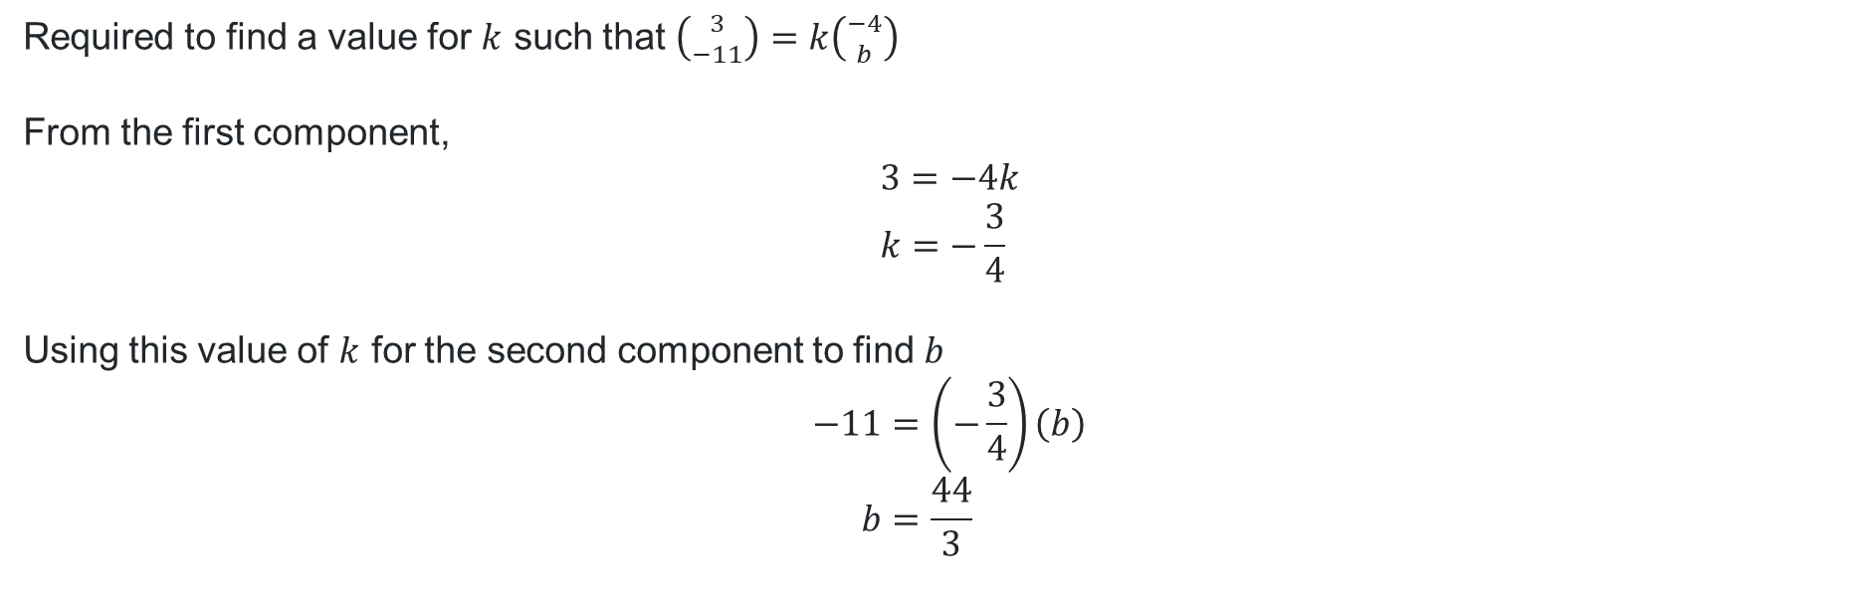
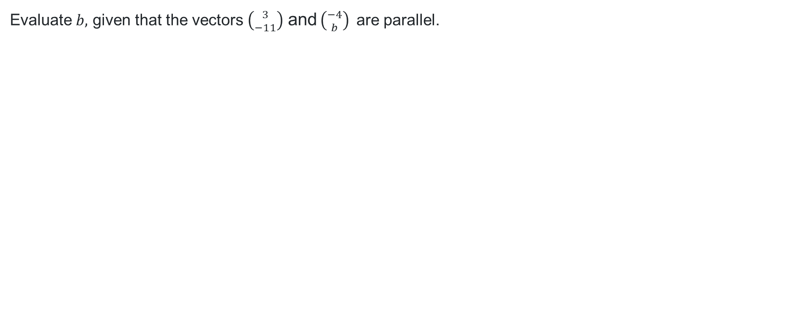
HSC-style question (1)
Evaluate $b,$ given that the vectors $\left({3 \atop −11}\right)$ and $\left({−4 \atop b}\right)$are parallel.
Required to find a value for $k$ such that $\left({3 \atop −11}\right)=k\left({−4 \atop b}\right)$
From the first component,
$$3=−4k \\ k=−\frac{3}{4}$$
Using this value of $k$ for the second component to find $b$
$$−11=\left(−\frac{3}{4}\right)\left(b\right) \\ b=\frac{44}{3}$$

Slide 18
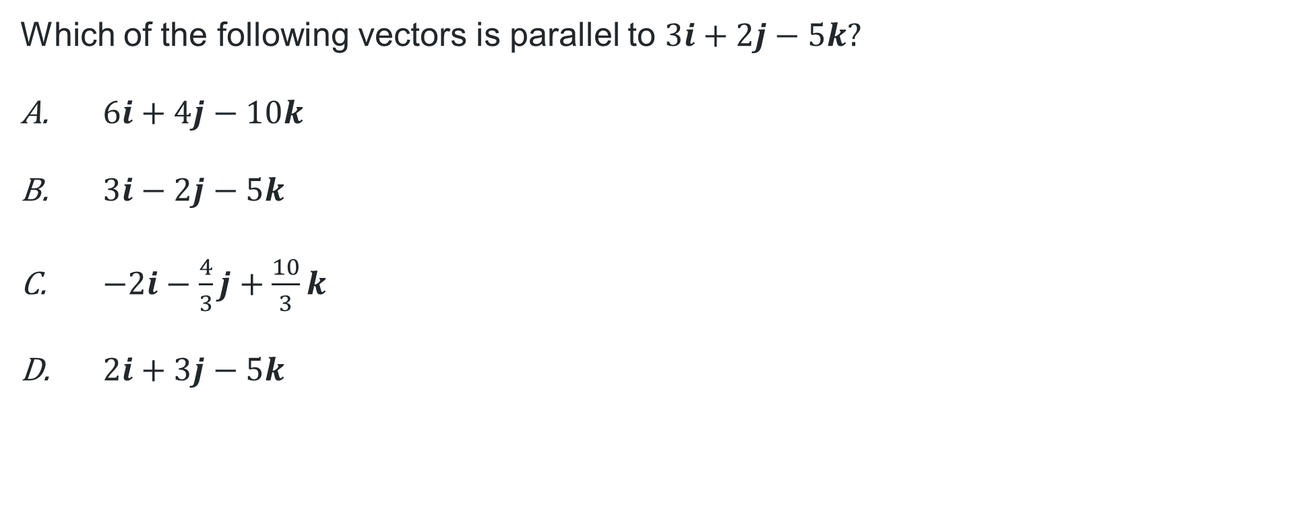
Multiple choice question
Which of the following vectors is parallel to $3i+2j−5k?$
$6i+4j−10k$
$3i−2j−5k$
$−2i−\frac{4}{3}j+\frac{10}{3}k$
$2i+3j−5k$

Slide 19
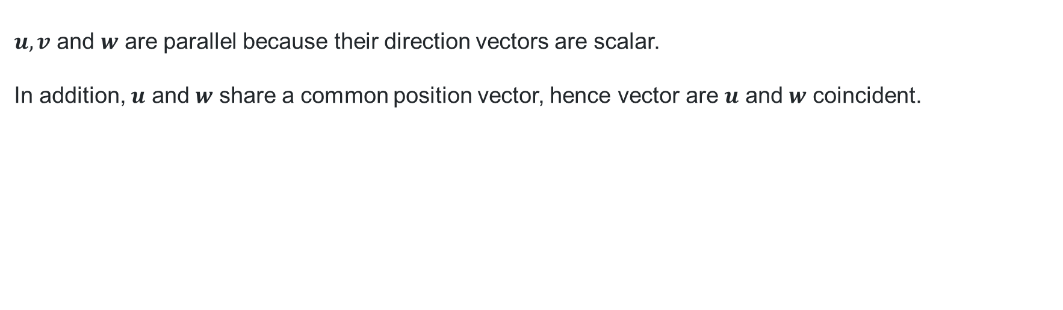
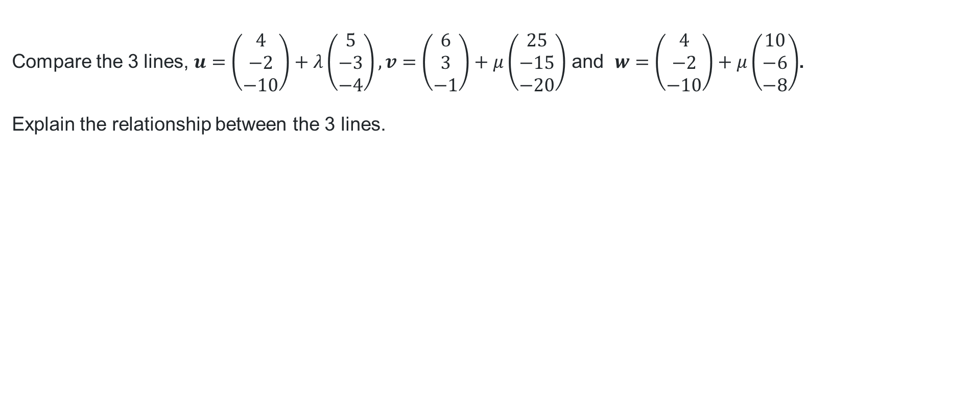
HSC-style question (2)
Compare the 3 lines, $u=\left(\begin{matrix}4 \\ −2 \\ −10\end{matrix}\right)+λ\left(\begin{matrix}5 \\ −3 \\ −4\end{matrix}\right), v=\left(\begin{matrix}6 \\ 3 \\ −1\end{matrix}\right)+μ\left(\begin{matrix}25 \\ −15 \\ −20\end{matrix}\right)$ and $w=\left(\begin{matrix}4 \\ −2 \\ −10\end{matrix}\right)+μ\left(\begin{matrix}10 \\ −6 \\ −8\end{matrix}\right)$.
Explain the relationship between the 3 lines.
$u, v$ and $w$ are parallel because their direction vectors are scalar.
In addition, $u$ and $w$ share a common position vector, hence vector are $u$ and $w$ coincident.

Slide 20
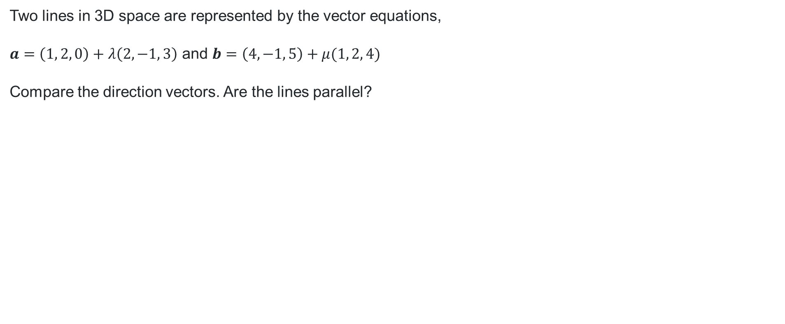
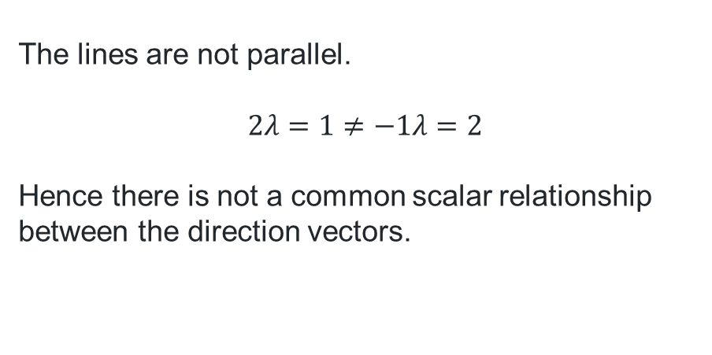
HSC-style question (3)
Two lines in 3D space are represented by the vector equations,
$a=\left(1, 2, 0\right)+λ\left(2, −1, 3\right)$ and $b=\left(4, −1, 5\right)+μ(1, 2, 4)$
Compare the direction vectors. Are the lines parallel?
“Because these lines are not parallel, they must intersect.”
The lines are not parallel.
$$2λ=1≠−1λ=2$$
Hence there is not a common scalar relationship between the direction vectors.

Slide 21
References
This presentation contains NSW Curriculum and syllabus content. The NSW Curriculum is developed by the NSW Education Standards Authority. This content is prepared by NESA for and on behalf of the Crown in the right of the State of New South Wales. The material is protected by Crown copyright.
Please refer to the NESA Copyright Disclaimer for more information https://educationstandards.nsw.edu.au/wps/portal/nesa/mini-footer/copyright.
NESA holds the only official and up-to-date versions of the NSW Curriculum and syllabus documents. Please visit the NSW Education Standards Authority (NESA) website https://educationstandards.nsw.edu.au/wps/portal/nesa/home and the NSW Curriculum website https://curriculum.nsw.edu.au.
Mathematics Extension 2 11-12 Syllabus © NSW Education Standards Authority (NESA) for and on behalf of the Crown in right of the State of New South Wales, 2024.

Slide 22
Copyright
© State of New South Wales (Department of Education), 2026
The copyright material published in this resource is subject to the Copyright Act 1968 (Cth) and is owned by the NSW Department of Education or, where indicated, by a party other than the NSW Department of Education (third-party material).
Copyright material available in this resource and owned by the NSW Department of Education is licensed under a Creative Commons Attribution 4.0 International (CC BY 4.0) license.
This license allows you to share and adapt the material for any purpose, even commercially.
Attribution should be given to © State of New South Wales (Department of Education), 2026.
Material in this resource not available under a Creative Commons license:
the NSW Department of Education logo, other logos and trademark-protected material
Material owned by a third party that has been reproduced with permission. You will need to obtain permission from the third party to reuse its material.
Links to third-party material and websites
Please note that the provided (reading/viewing material/list/links/texts) are a suggestion only and implies no endorsement, by the New South Wales Department of Education, of any author, publisher, or book title. School principals and teachers are best placed to assess the suitability of resources that would complement the curriculum and reflect the needs and interests of their students.
If you use the links provided in this document to access a third-party’s website, you acknowledge that the terms of use, including licence terms set out on the third-party’s website apply to the use which may be made of the materials on that third-party website or where permitted by the Copyright Act 1968 (Cth). The department accepts no responsibility for content on third-party websites.

