Slide 1
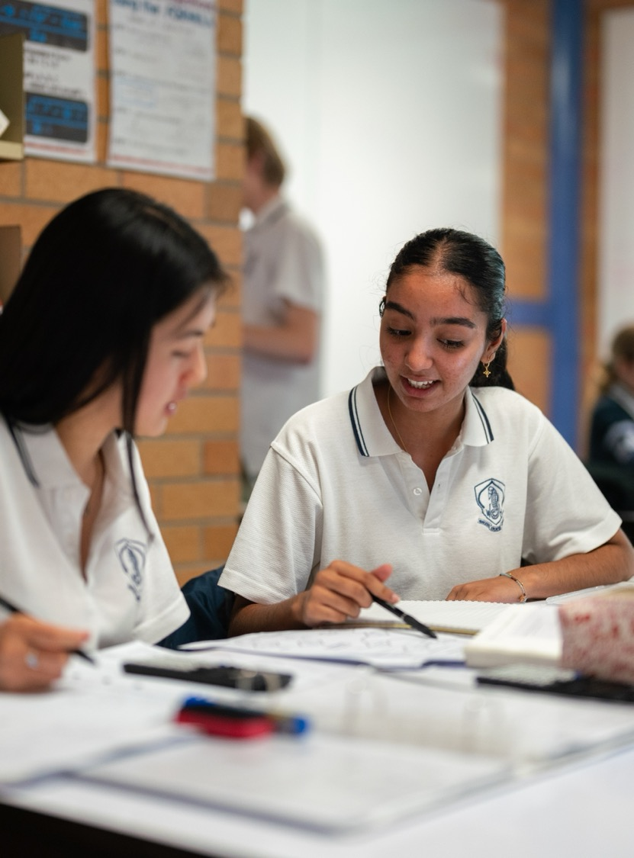
Gradient and the direction vector
Mathematics Extension 2 – Stage 6 (Year 12)
Vector equations of lines and curves

Slide 2
Learning intentions and success criteria
Learning intentions
To understand how vectors can be used to represent straight lines.
To understand the relationship between vector and Cartesian equations of lines.
Success criteria
I can define the direction vector of a line.
I can write the vector equation of a line.
I can convert between the gradient-intercept and vector equations of lines in 2D.

Slide 3
Retrieval practice

Slide 4
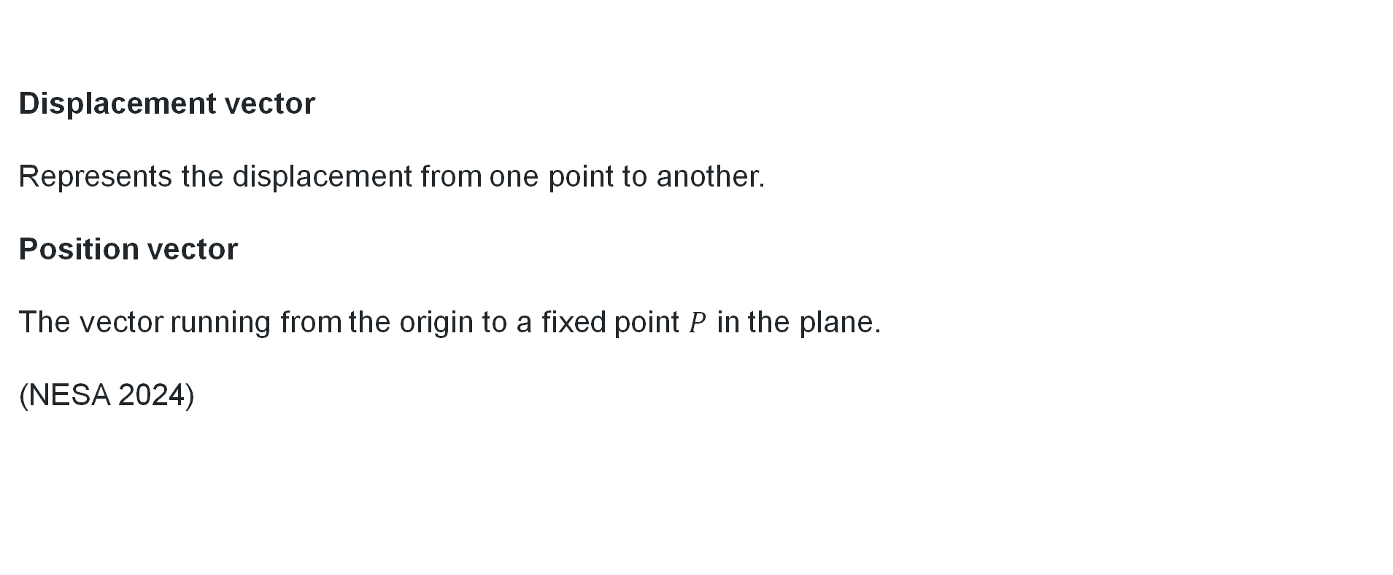
Position and displacement vectors
Think-Pair-Share
Displacement vector
Represents the displacement from one point to another.
Position vector
The vector running from the origin to a fixed point $P$ in the plane.
(NESA 2024)

Slide 5
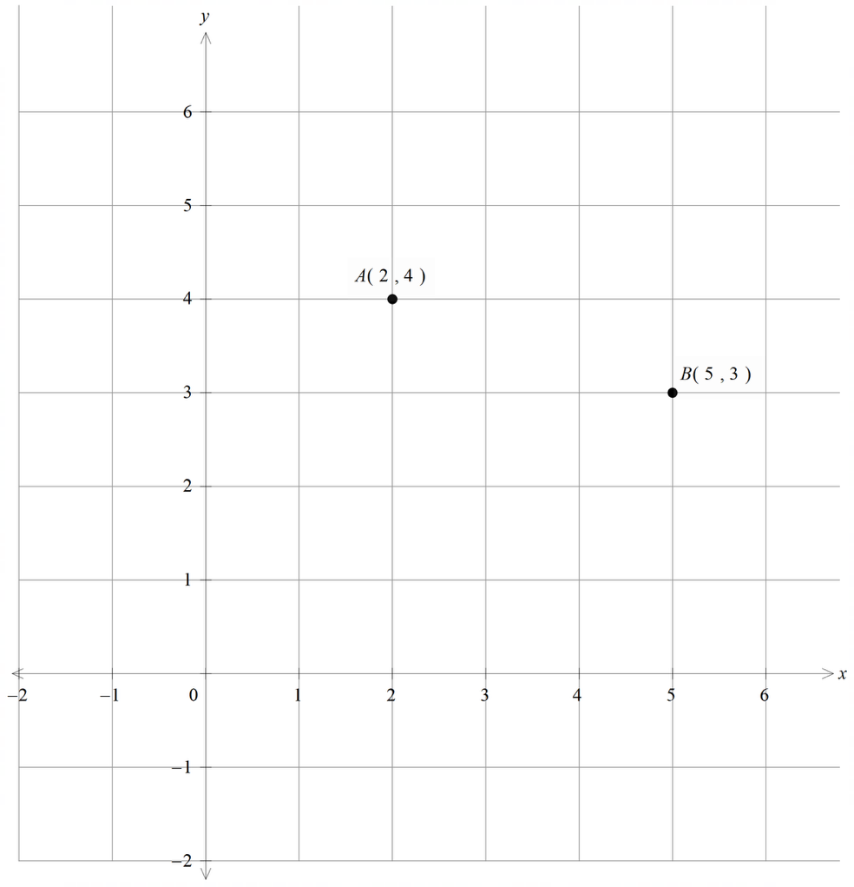
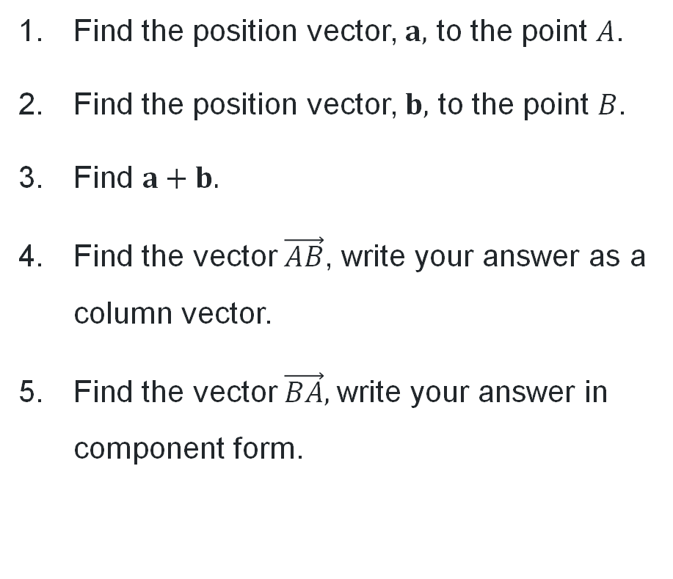
Vector basics (1)
Find the position vector, $a,$ to the point $A$.
Find the position vector, $b,$ to the point $B$.
Find $a+b.$
Find the vector $\vec{AB}$, write your answer as a column vector.
Find the vector $\vec{BA},$write your answer in component form.

Slide 6
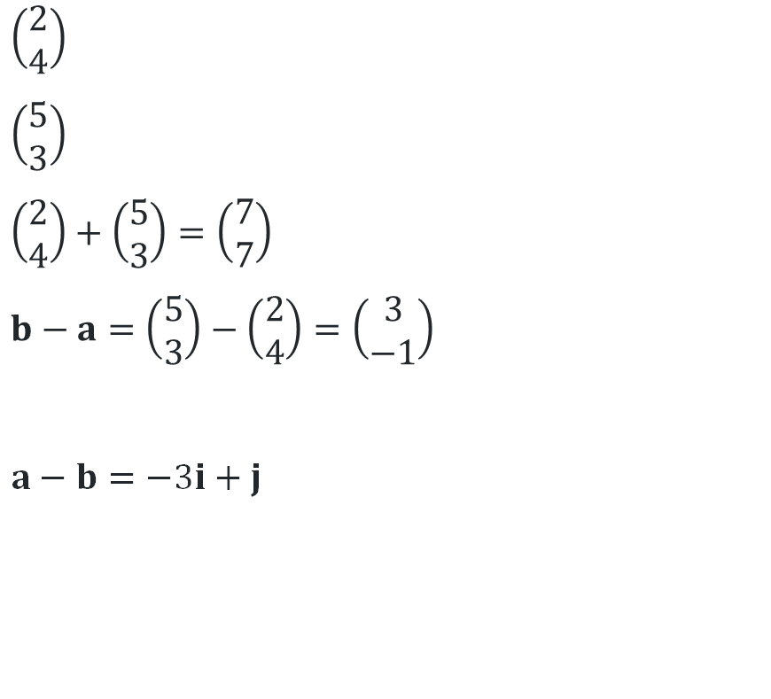
Vector basics (2)
Find the position vector, $a,$ to the point $A$.
Find the position vector, $b,$ to the point $B$.
Find $a+b.$
Find the vector $\vec{AB}$, write your answer as a column vector.
Find the vector $\vec{BA},$write your answer in component form.
$\left(\begin{matrix}2 \\ 4\end{matrix}\right)$
$\left(\begin{matrix}5 \\ 3\end{matrix}\right)$
$\left(\begin{matrix}2 \\ 4\end{matrix}\right)+\left(\begin{matrix}5 \\ 3\end{matrix}\right)=\left(\begin{matrix}7 \\ 7\end{matrix}\right)$
$b−a=\left(\begin{matrix}5 \\ 3\end{matrix}\right)−\left(\begin{matrix}2 \\ 4\end{matrix}\right)=\left(\begin{matrix}3 \\ −1\end{matrix}\right)$
$a−b=−3i+j$

Slide 7
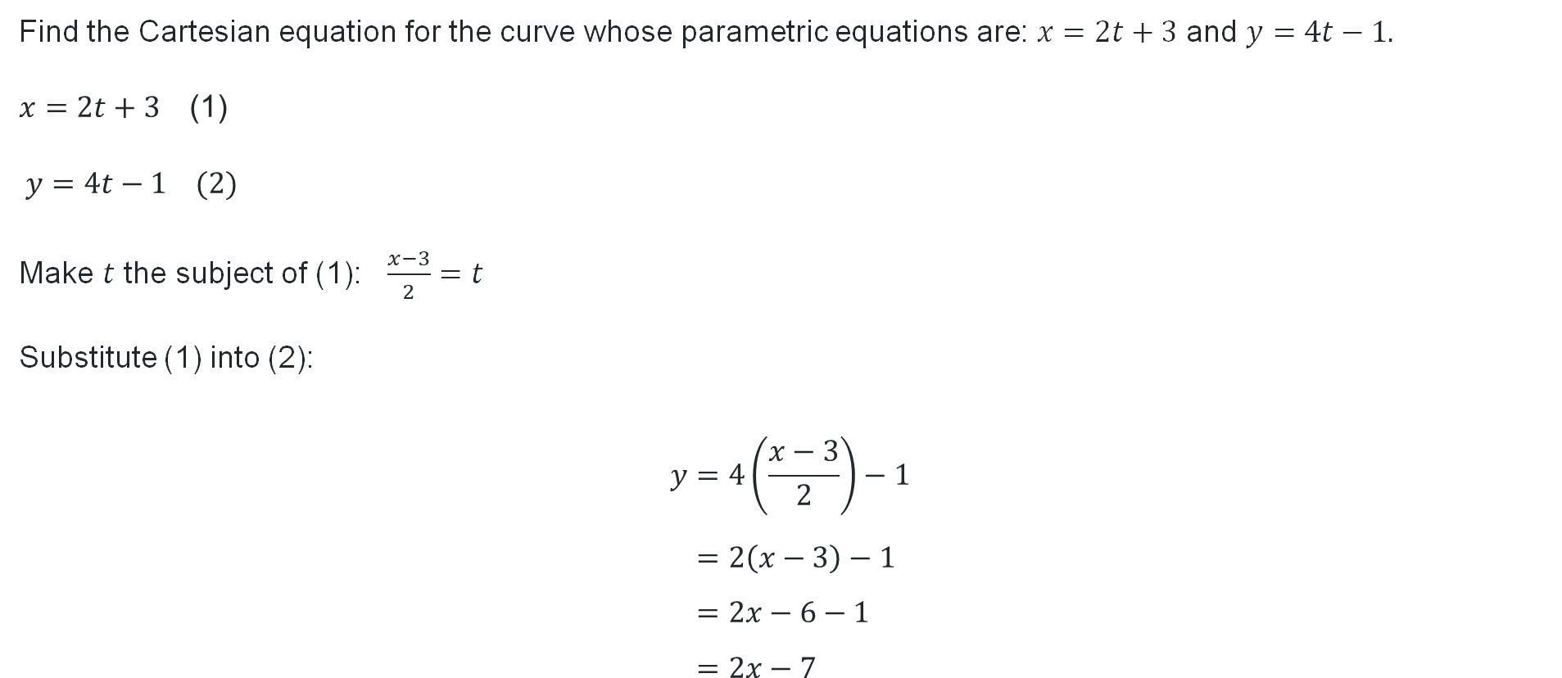
Parametric form
Find the Cartesian equation for the curve whose parametric equations are:$x=2t+3$ and $y=4t−1.$
$$x=2t+\text{3 } \text{(1)}$$
$$y=4t−1 (2)$$
Make $t$ the subject of (1): $\frac{x−3}{2}=t$
Substitute (1) into (2):
$$y=4\left(\frac{x−3}{2}\right)−1 \\ =2\left(x−3\right)−1 \\ =2x−6−1 \\ =2x−7$$

Slide 8
Releasing responsibility

Slide 9
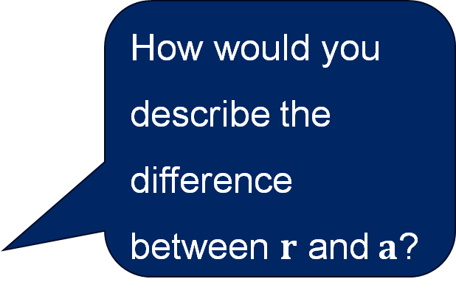
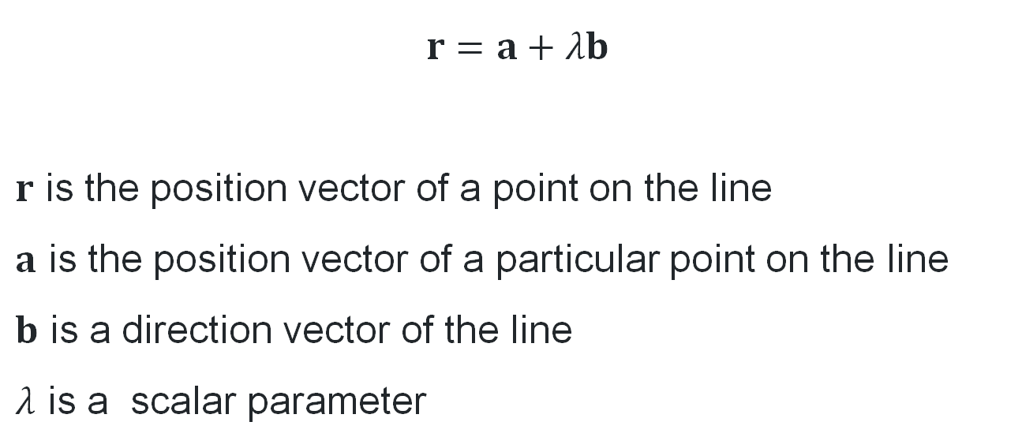
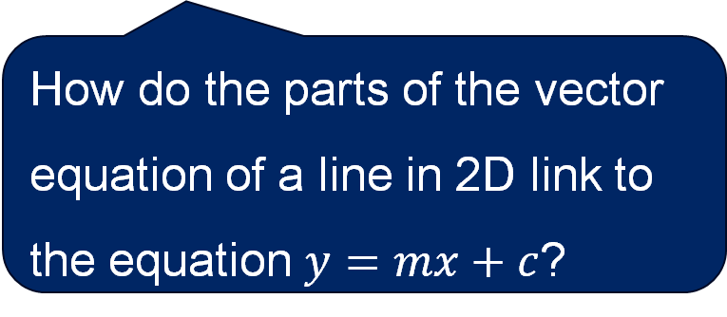
Vector equation of a line
How would you describe the difference between $r$ and$a$?
$r=a+λb$
$r$ is the position vector of a point on the line
$a$ is the position vector of a particular point on the line
$b$ is a direction vector of the line
$λ$ is a scalar parameter
How will this change if you are in 2D or 3D?
How do the parts of the vector equation of a line in 2D link to the equation $y=mx+c$?

Slide 10
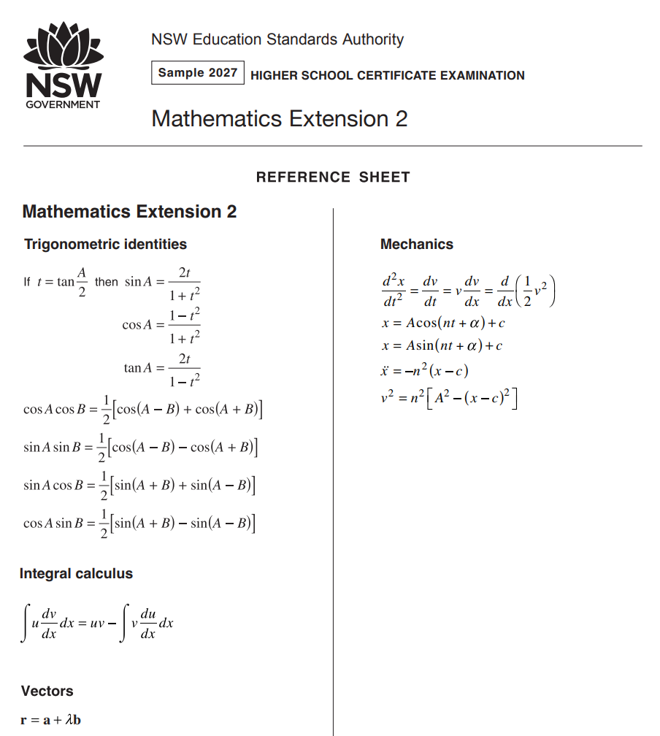
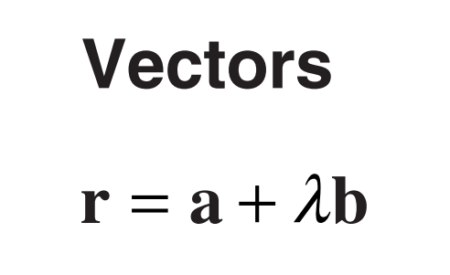
Reference sheet

Slide 11
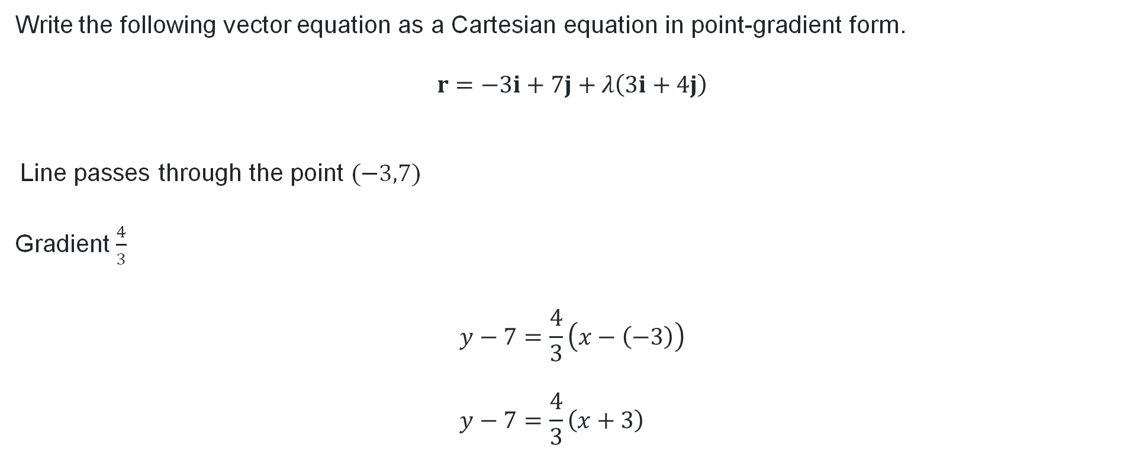
Converting from vector to point-gradient form (1)
Worked example 1
Write the following vector equation as a Cartesian equation in point-gradient form.
$$r=−3i+7j+λ\left(3i+4j\right)$$
Line passes through the point $(−3,7)$
Gradient $\frac{4}{3}$
$$y−7=\frac{4}{3}\left(x−\left(−3\right)\right) \\ y−7=\frac{4}{3}\left(x+3\right)$$
Could we have solved this in a different way?
How do we know this?

Slide 12
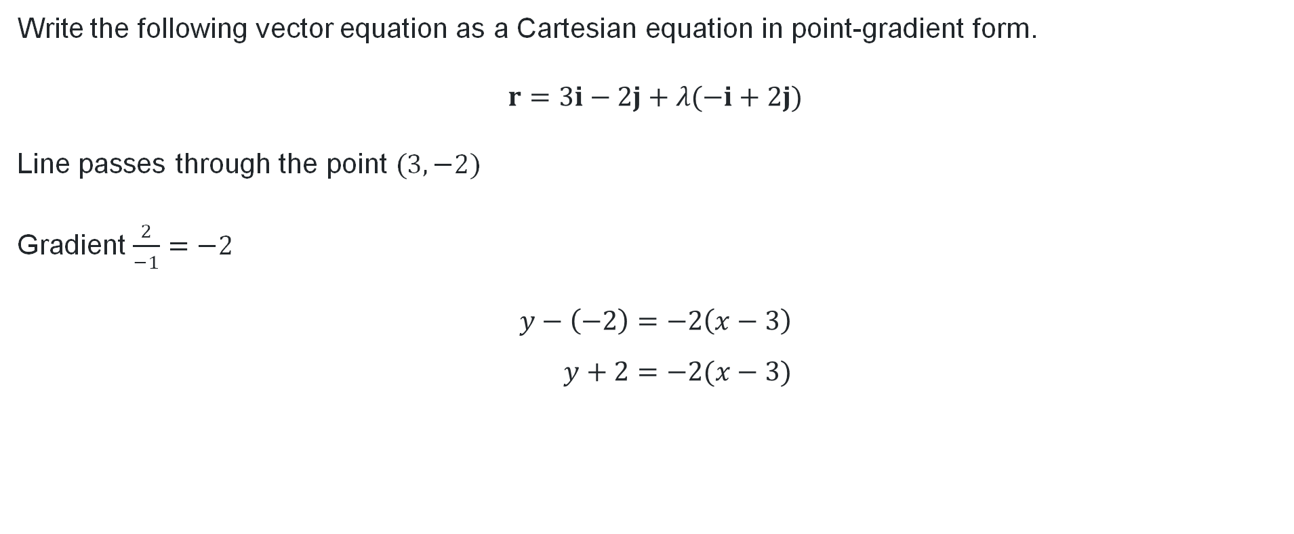
Converting from vector to point-gradient form (2)
Your turn 1
Write the following vector equation as a Cartesian equation in point-gradient form.
$$r=3i−2j+λ(−i+2j)$$
Line passes through the point $(3,−2)$
Gradient $\frac{2}{−1}=−2$
$$y−\left(−2\right)=−2\left(x−3\right) \\ y+2=−2(x−3)$$

Slide 13
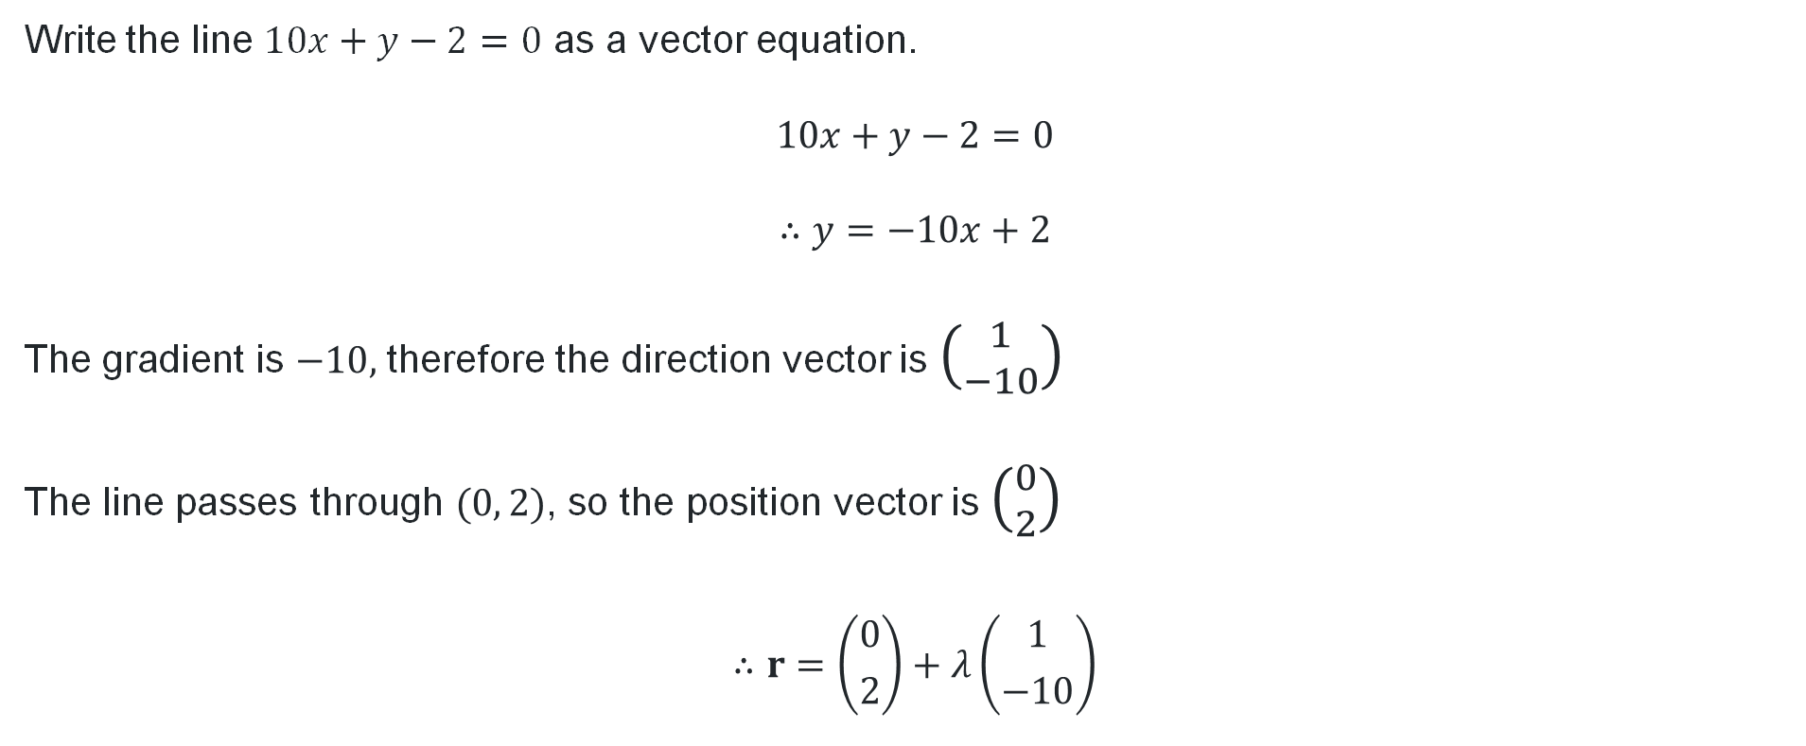
Converting from Cartesian to vector form (1)
Worked example 2
Why did we rewrite the equation?
Write the line $10x+y−2=0$ as a vector equation.
$$10x+y−2=0$$
$$∴y=−10x+2$$
The gradient is $−10,$ therefore the direction vector is $\left({1 \atop −10}\right)$
The line passes through $(0, 2)$, so the position vector is $\left({0 \atop 2}\right)$
$$∴r=\left({0 \atop 2}\right)+λ\left({1 \atop −10}\right)$$
Where did the 1 come from?
How do we know the negative sign belongs with the 10?
What happens if we put it with the 1 instead?

Slide 14
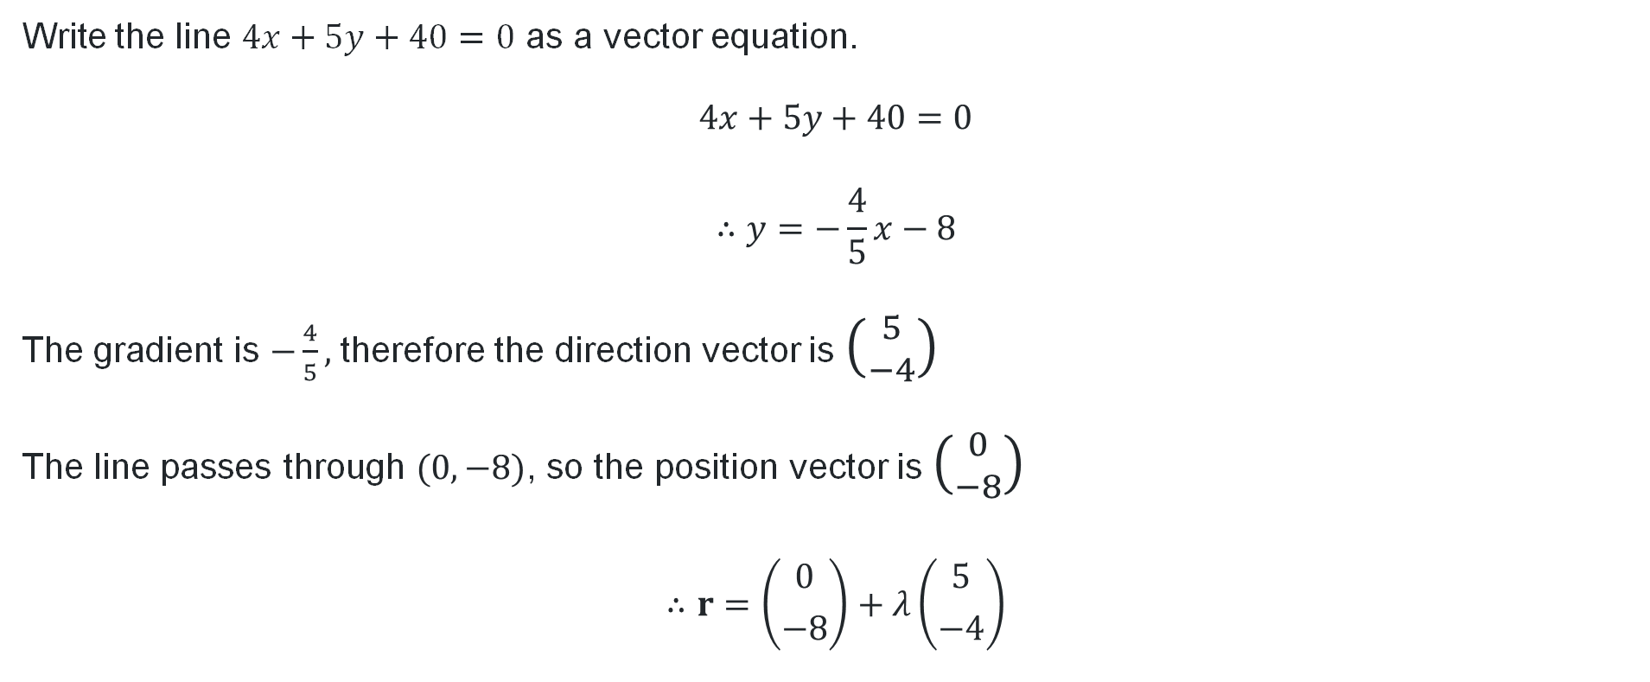
Converting from Cartesian to vector form (2)
Your turn 2
Write the line $4x+5y+40=0$ as a vector equation.
$$4x+5y+40=0$$
$$∴y=−\frac{4}{5}x−8$$
The gradient is $−\frac{4}{5},$ therefore the direction vector is $\left({5 \atop −4}\right)$
The line passes through $(0, −8)$, so the position vector is $\left({0 \atop −8}\right)$
$$∴r=\left({0 \atop −8}\right)+λ\left({5 \atop −4}\right)$$

Slide 15
Independent practice

Slide 16
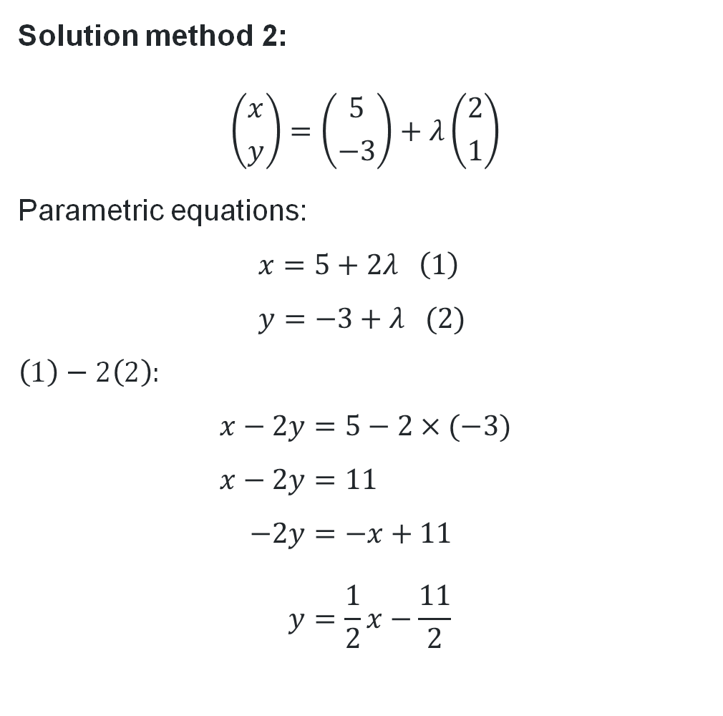

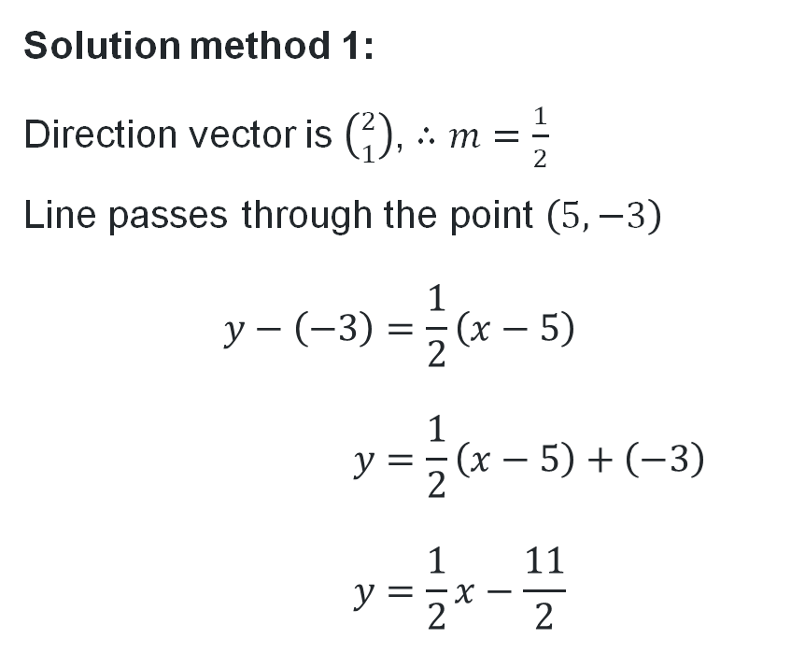
Parameter elimination
Find the Cartesian equation of the line $r=\left({5 \atop −3}\right)+λ\left({2 \atop 1}\right)$.
Solution method 1:
Direction vector is $\left({2 \atop 1}\right)$, $∴m=\frac{1}{2}$
Line passes through the point $\left(5, −3\right)$
$$y−\left(−3\right)=\frac{1}{2}\left(x−5\right) \\ y=\frac{1}{2}\left(x−5\right)+\left(−3\right) \\ y=\frac{1}{2}x−\frac{11}{2}$$
Solution method 2:
$$\left({x \atop y}\right)=\left({5 \atop −3}\right)+λ\left({2 \atop 1}\right)$$
Parametric equations:
$$x=5+2λ \left(1\right) \\ y=−3+λ (2)$$
$\left(1\right)−2\left(2\right):$
$$x−2y=5−2×(−3) \\ x−2y=11 \\ −2y=−x+11 \\ y=\frac{1}{2}x−\frac{11}{2}$$

Slide 17
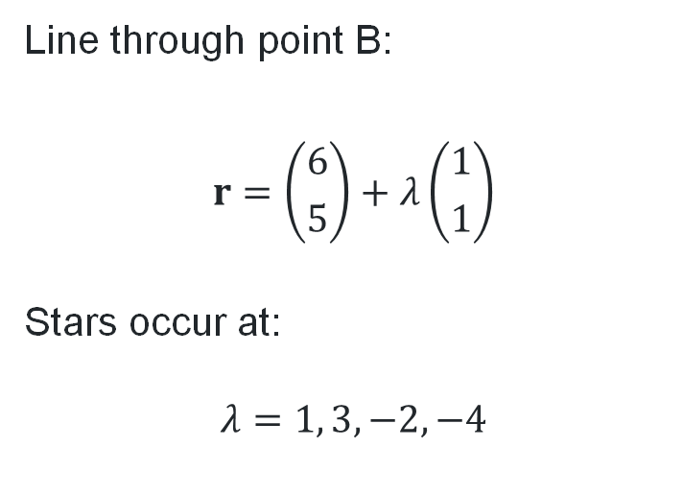
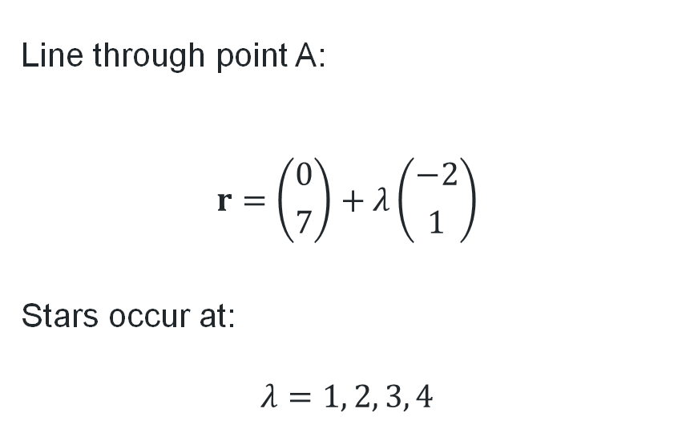
Stars and lines (1)
Using your answers to Appendix A:
Find the vector equations of the two lines.
Find the value of the parameter that corresponds to each star on the line.
Line through point A:
$$r=\left({0 \atop 7}\right)+λ\left({−2 \atop 1}\right)$$
Stars occur at:
$$λ=1, 2, 3, 4$$
Line through point B:
$$r=\left({6 \atop 5}\right)+λ\left({1 \atop 1}\right)$$
Stars occur at:
$$λ=1, 3, −2, −4$$

Slide 18
References
This presentation contains NSW Curriculum and syllabus content. The NSW Curriculum is developed by the NSW Education Standards Authority. This content is prepared by NESA for and on behalf of the Crown in the right of the State of New South Wales. The material is protected by Crown copyright.
Please refer to the NESA Copyright Disclaimer for more information https://educationstandards.nsw.edu.au/wps/portal/nesa/mini-footer/copyright.
NESA holds the only official and up-to-date versions of the NSW Curriculum and syllabus documents. Please visit the NSW Education Standards Authority (NESA) website https://educationstandards.nsw.edu.au/wps/portal/nesa/home and the NSW Curriculum website https://curriculum.nsw.edu.au.
Mathematics Extension 2 11–12 Syllabus © NSW Education Standards Authority (NESA) for and on behalf of the Crown in right of the State of New South Wales, 2024.

Slide 19
Copyright
© State of New South Wales (Department of Education), 2026
The copyright material published in this resource is subject to the Copyright Act 1968 (Cth) and is owned by the NSW Department of Education or, where indicated, by a party other than the NSW Department of Education (third-party material).
Copyright material available in this resource and owned by the NSW Department of Education is licensed under a Creative Commons Attribution 4.0 International (CC BY 4.0) license.
This license allows you to share and adapt the material for any purpose, even commercially.
Attribution should be given to © State of New South Wales (Department of Education), 2026.
Material in this resource not available under a Creative Commons license:
the NSW Department of Education logo, other logos and trademark-protected material
Material owned by a third party that has been reproduced with permission. You will need to obtain permission from the third party to reuse its material.
Links to third-party material and websites
Please note that the provided (reading/viewing material/list/links/texts) are a suggestion only and implies no endorsement, by the New South Wales Department of Education, of any author, publisher, or book title. School principals and teachers are best placed to assess the suitability of resources that would complement the curriculum and reflect the needs and interests of their students.
If you use the links provided in this document to access a third-party’s website, you acknowledge that the terms of use, including licence terms set out on the third-party’s website apply to the use which may be made of the materials on that third-party website or where permitted by the Copyright Act 1968 (Cth). The department accepts no responsibility for content on third-party websites.

