Slide 1
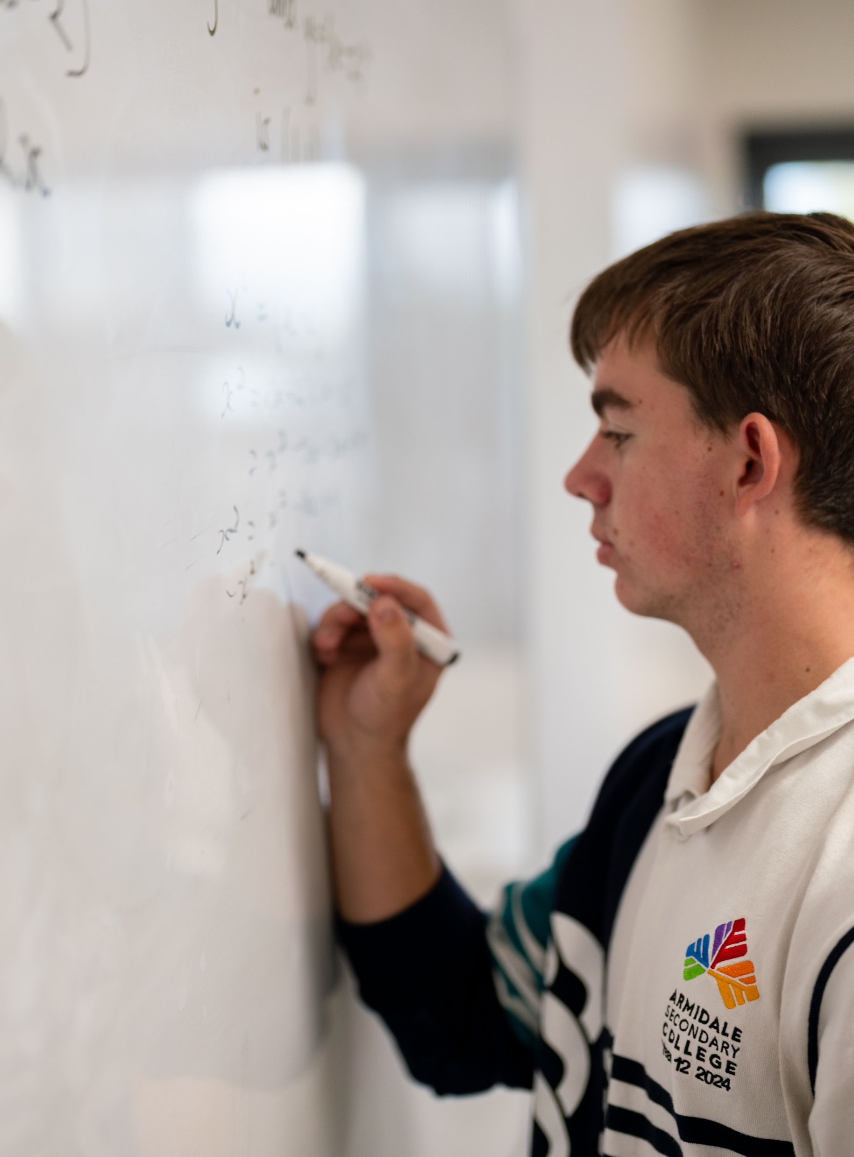
Mixed trigonometry
Mathematics Advanced – Stage 6 (Year 11)
Trigonometry

Slide 2
Learning intention and success criteria
Learning intention
To be able to apply a range of trigonometric rules to solve different types of problems.
Success criteria
I can identify whether a problem involves a right‑angled triangle or non‑right‑angled triangle and select the appropriate trigonometric rule.
I can determine when the sine rule or the cosine rule is more appropriate in non‑right‑angled triangles.
I can accurately solve trigonometric problems using a variety of rules and methods.

Slide 3
Activating prior knowledge

Slide 4
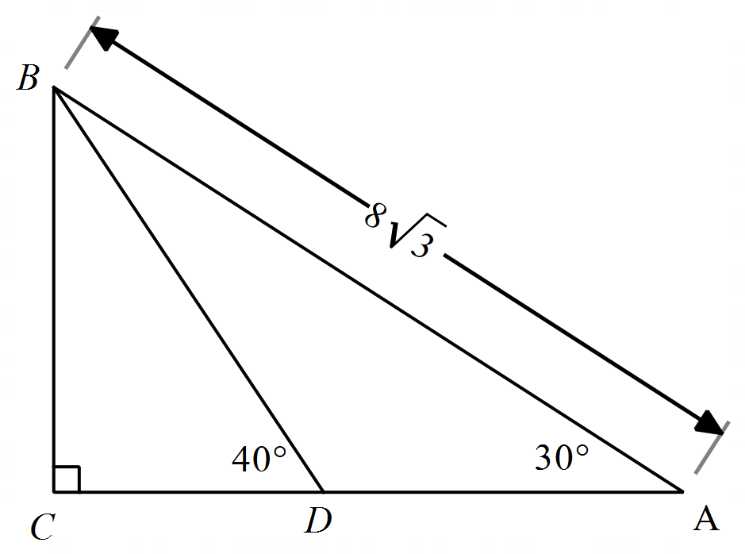
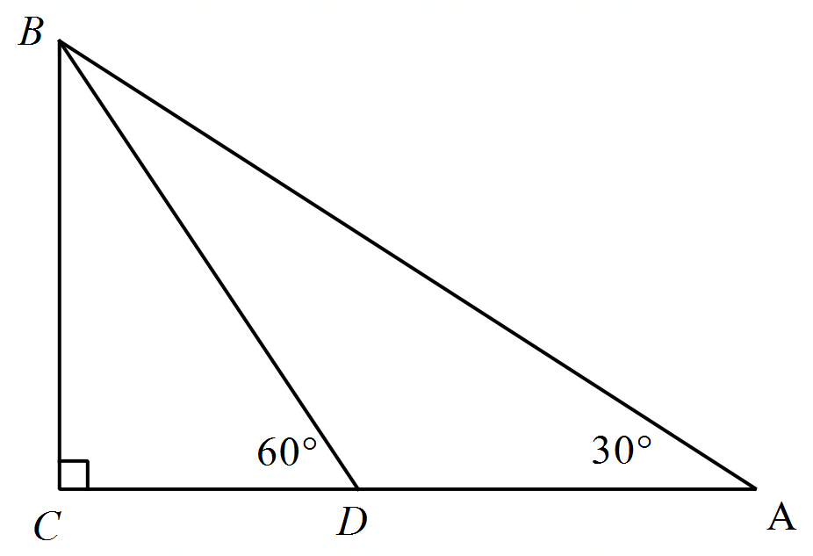

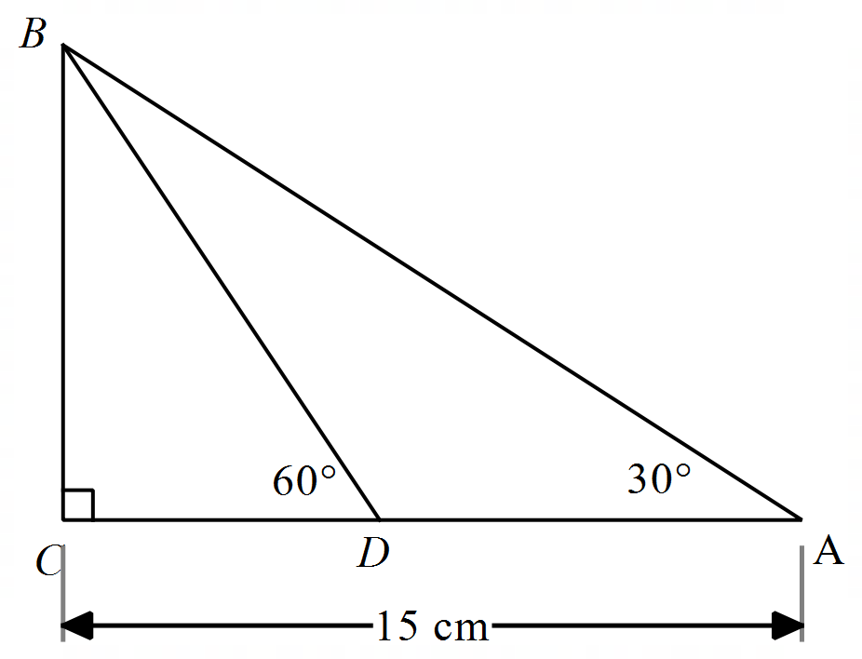
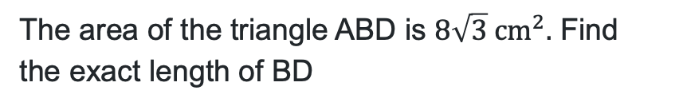
Same surface, different deep
Triangle problems
The area of the triangle ABD is $8\sqrt{3} cm^{2}.$ Find the exact length of BD
Find the length of BD.
AC is divided such that the ratio of the lengths AD:DC is 2:1. Find the length of BD.
Find the exact length of BC.

Slide 5
Connecting learning

Slide 6
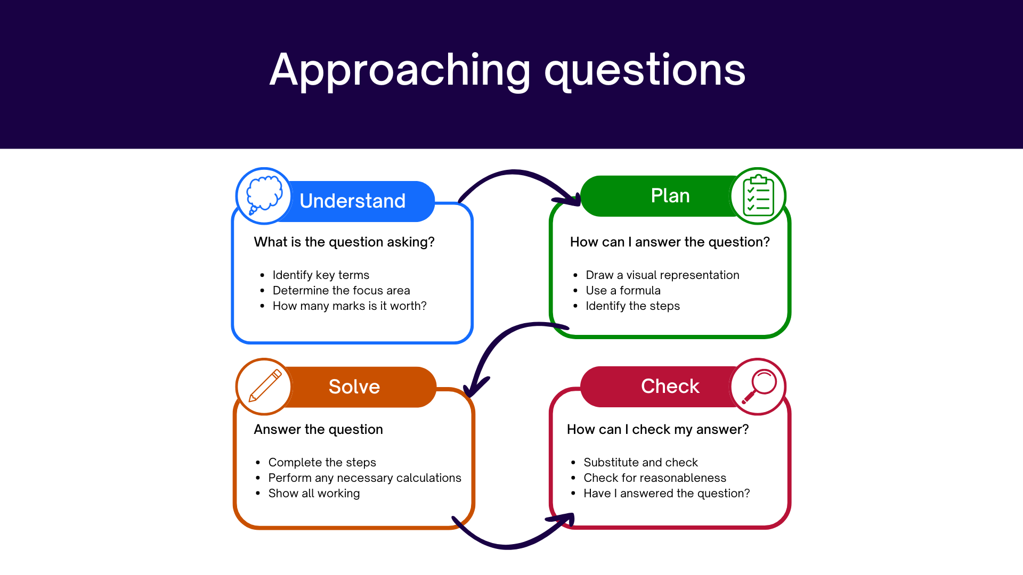
Approaching questions scaffold
…..

Slide 7
References
This presentation contains NSW Curriculum and syllabus content. The NSW Curriculum is developed by the NSW Education Standards Authority. This content is prepared by NESA for and on behalf of the Crown in the right of the State of New South Wales. The material is protected by Crown copyright.
Please refer to the NESA Copyright Disclaimer for more information https://educationstandards.nsw.edu.au/wps/portal/nesa/mini-footer/copyright.
NESA holds the only official and up-to-date versions of the NSW Curriculum and syllabus documents. Please visit the NSW Education Standards Authority (NESA) website https://educationstandards.nsw.edu.au/wps/portal/nesa/home and the NSW Curriculum website https://curriculum.nsw.edu.au.
Mathematics Advanced 11-12 Syllabus © NSW Education Standards Authority (NESA) for and on behalf of the Crown in right of the State of New South Wales, 2024.

Slide 8
Copyright
© State of New South Wales (Department of Education), 2026
The copyright material published in this resource is subject to the Copyright Act 1968 (Cth) and is owned by the NSW Department of Education or, where indicated, by a party other than the NSW Department of Education (third-party material).
Copyright material available in this resource and owned by the NSW Department of Education is licensed under a Creative Commons Attribution 4.0 International (CC BY 4.0) license.
This license allows you to share and adapt the material for any purpose, even commercially.
Attribution should be given to © State of New South Wales (Department of Education), 2026.
Material in this resource not available under a Creative Commons license:
the NSW Department of Education logo, other logos and trademark-protected material
Material owned by a third party that has been reproduced with permission. You will need to obtain permission from the third party to reuse its material.
Links to third-party material and websites
Please note that the provided (reading/viewing material/list/links/texts) are a suggestion only and implies no endorsement, by the New South Wales Department of Education, of any author, publisher, or book title. School principals and teachers are best placed to assess the suitability of resources that would complement the curriculum and reflect the needs and interests of their students.
If you use the links provided in this document to access a third-party’s website, you acknowledge that the terms of use, including licence terms set out on the third-party’s website apply to the use which may be made of the materials on that third-party website or where permitted by the Copyright Act 1968 (Cth). The department accepts no responsibility for content on third-party websites.

