Slide 1
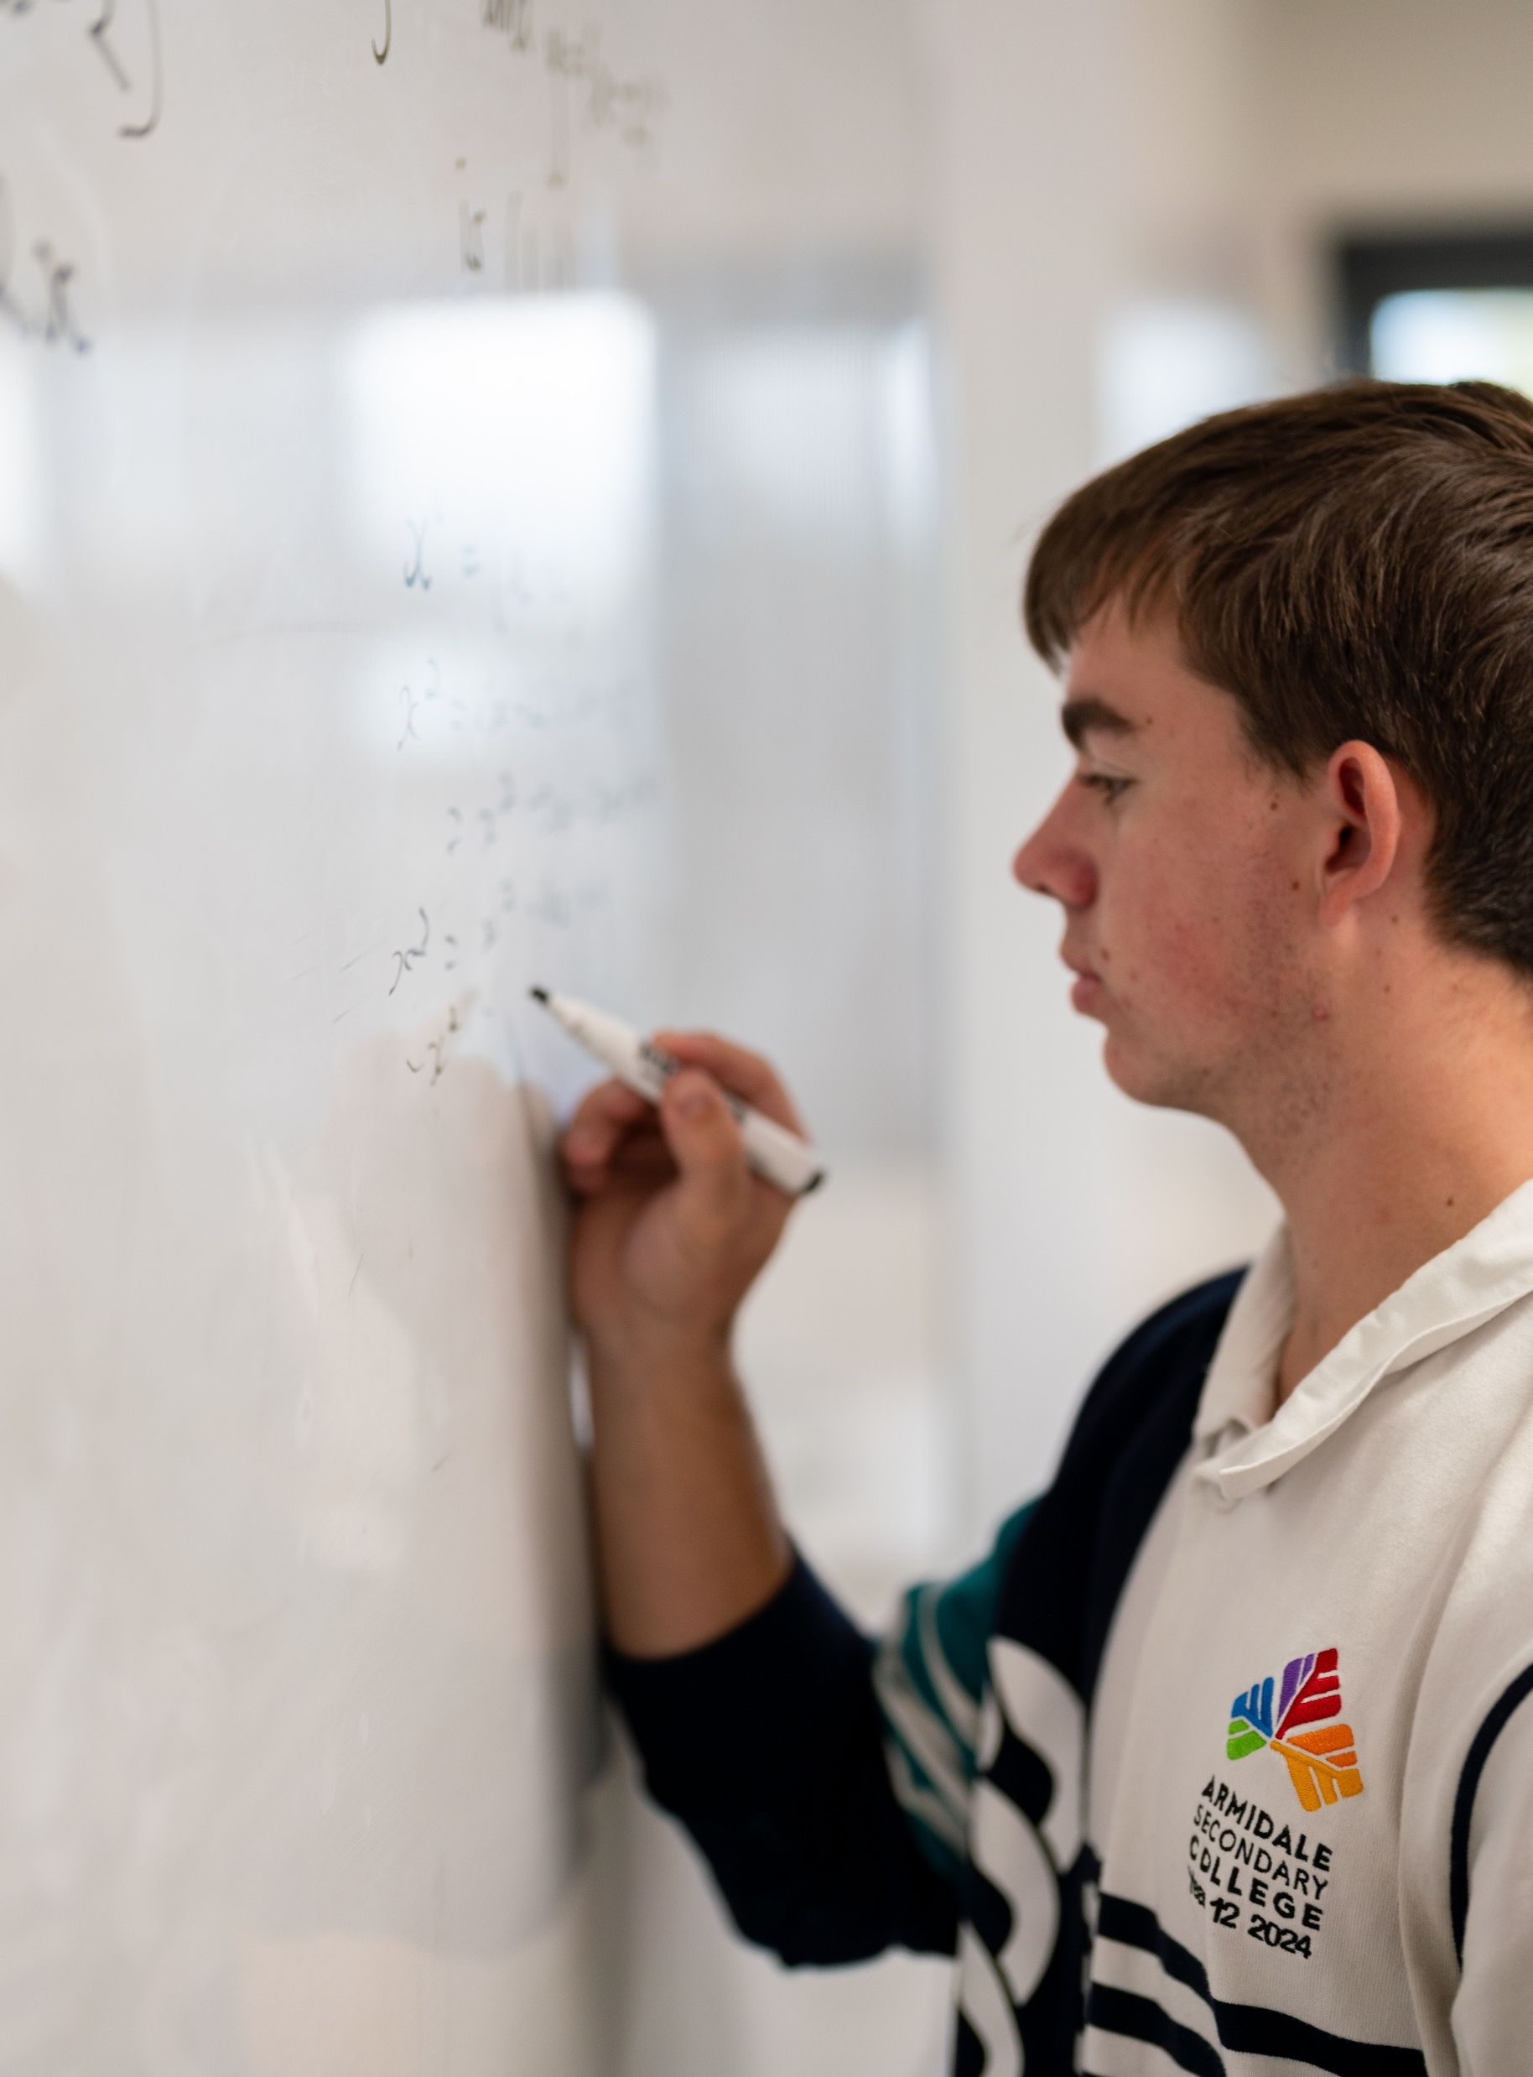
Arc length
Mathematics Advanced – Stage 6 (Year 11)
Trigonometry

Slide 2
Activating prior knowledge

Slide 3
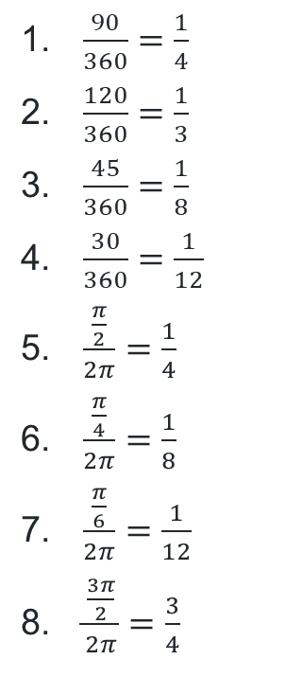
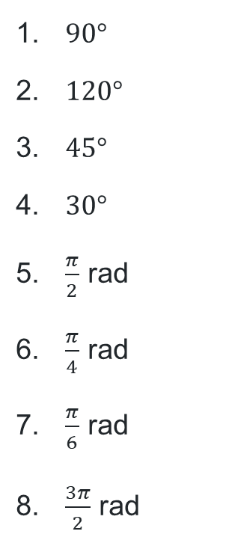
Going round in circles
For each of the following angles, determine what fraction of a full revolution they represent.
$90°$
$120°$
$45°$
$30°$
$\frac{π}{2}$ rad
$\frac{π}{4}$ rad
$\frac{π}{6}$ rad
$\frac{3π}{2}$ rad
$\frac{90}{360}=\frac{1}{4}$
$\frac{120}{360}=\frac{1}{3}$
$\frac{45}{360}=\frac{1}{8}$
$\frac{30}{360}=\frac{1}{12}$
$\frac{\frac{π}{2}}{2π}=\frac{1}{4}$
$\frac{\frac{π}{4}}{2π}=\frac{1}{8}$
$\frac{\frac{π}{6}}{2π}=\frac{1}{12}$
$\frac{\frac{3π}{2}}{2π}=\frac{3}{4}$

Slide 4
Connecting learning

Slide 5
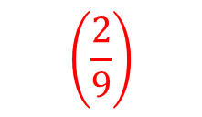
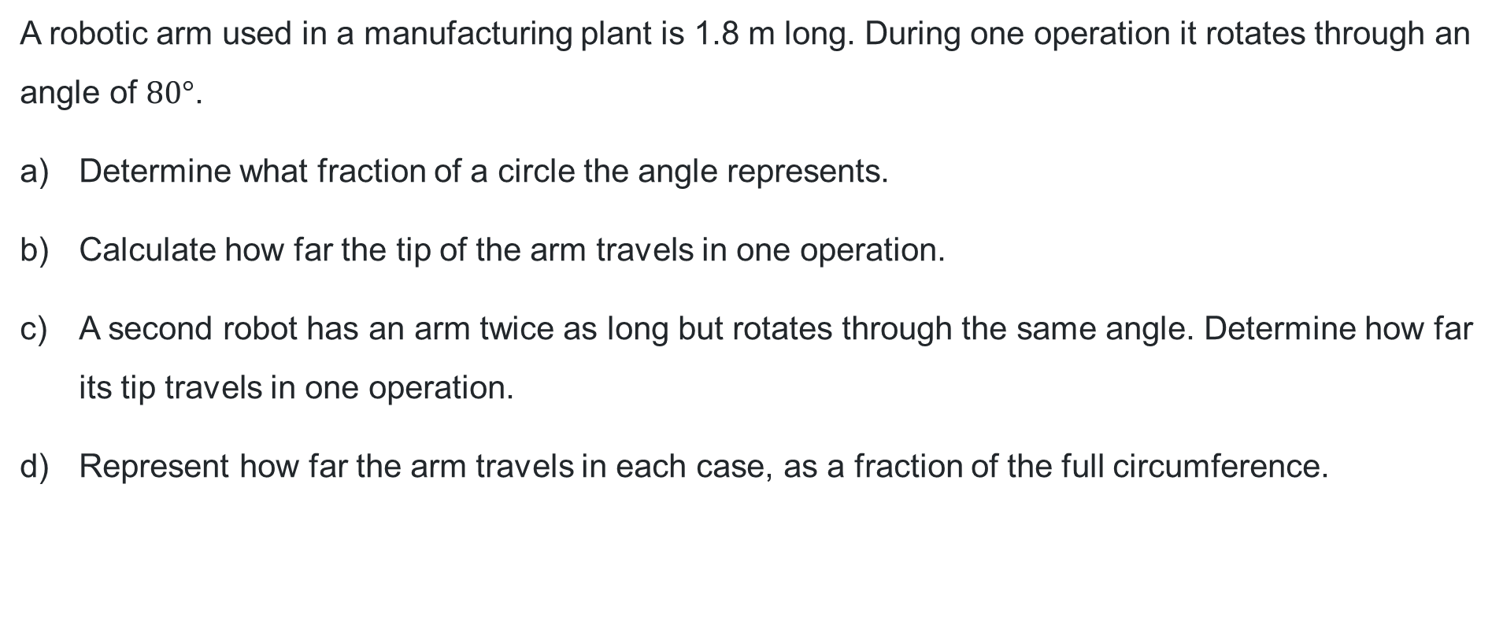
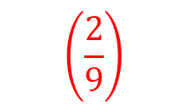


Robotics
Working in degrees
A robotic arm used in a manufacturing plant is 1.8 m long. During one operation it rotates through an angle of $80°$.
Determine what fraction of a circle the angle represents.
Calculate how far the tip of the arm travels in one operation.
A second robot has an arm twice as long but rotates through the same angle. Determine how far its tip travels in one operation.
Represent how far the arm travels in each case, as a fraction of the full circumference.
$$\left(\frac{2}{9}\right)$$
$$\left(2.5 \text{m}\right)$$
$$\left(5.03 \text{m}\right)$$
$$\left(\frac{2}{9}\right)$$

Slide 6

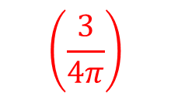
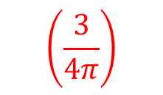

Robotics (2)
Working in radians
A robotic arm used in a manufacturing plant is 1.8 m long. During one operation it rotates through an angle of 1.5 radians.
Determine what fraction of a circle the angle represents.
Calculate how far the tip of the arm travels in one operation.
A second robot has an arm twice as long but rotates through the same angle. Determine how far its tip travels in one operation.
Represent how far the arm travels in each case, as a fraction of the full circumference.
$$\left(\frac{3}{4π}\right)$$
$$\left(2.7 \text{m}\right)$$
$$\left(5.4 \text{m}\right)$$
$$\left(\frac{3}{4π}\right)$$

Slide 7
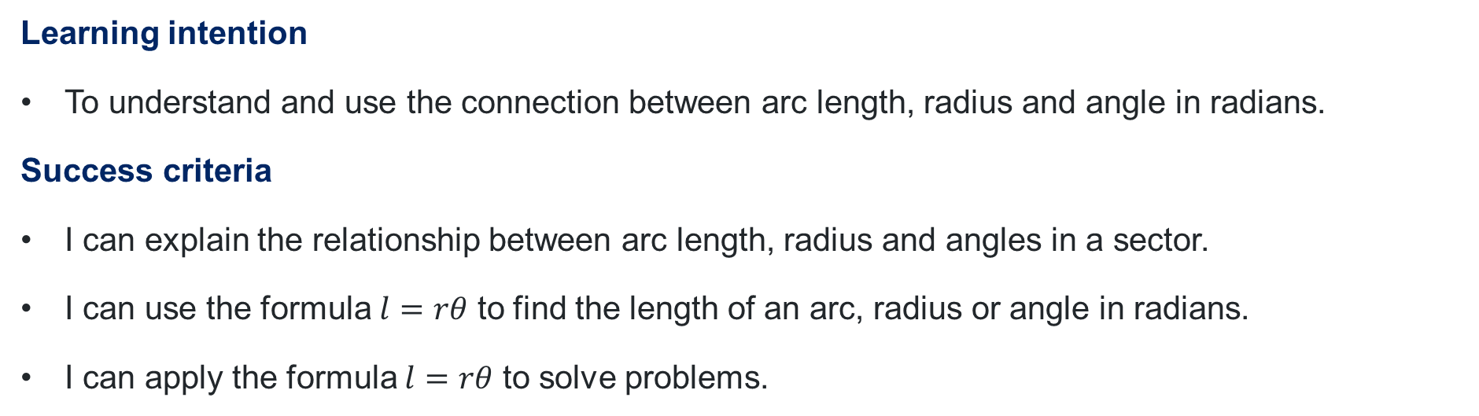
Learning intention and success criteria
Learning intention
To understand and use the connection between arc length, radius and angle in radians.
Success criteria
I can explain the relationship between arc length, radius and angles in a sector.
I can use the formula $l=rθ$ to find the length of an arc, radius or angle in radians.
I can apply the formula $l=rθ$ to solve problems.

Slide 8
Releasing responsibility

Slide 9
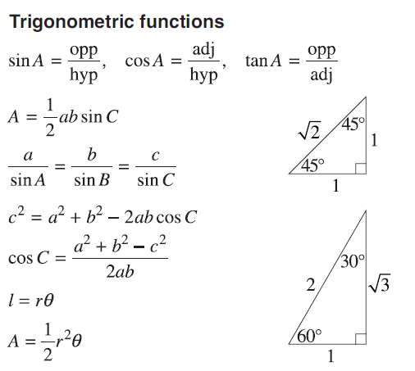
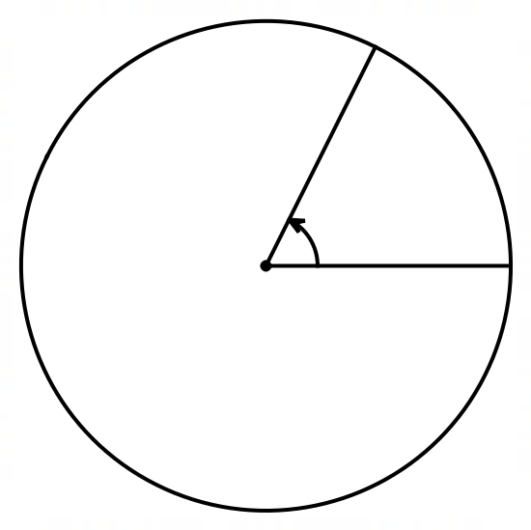


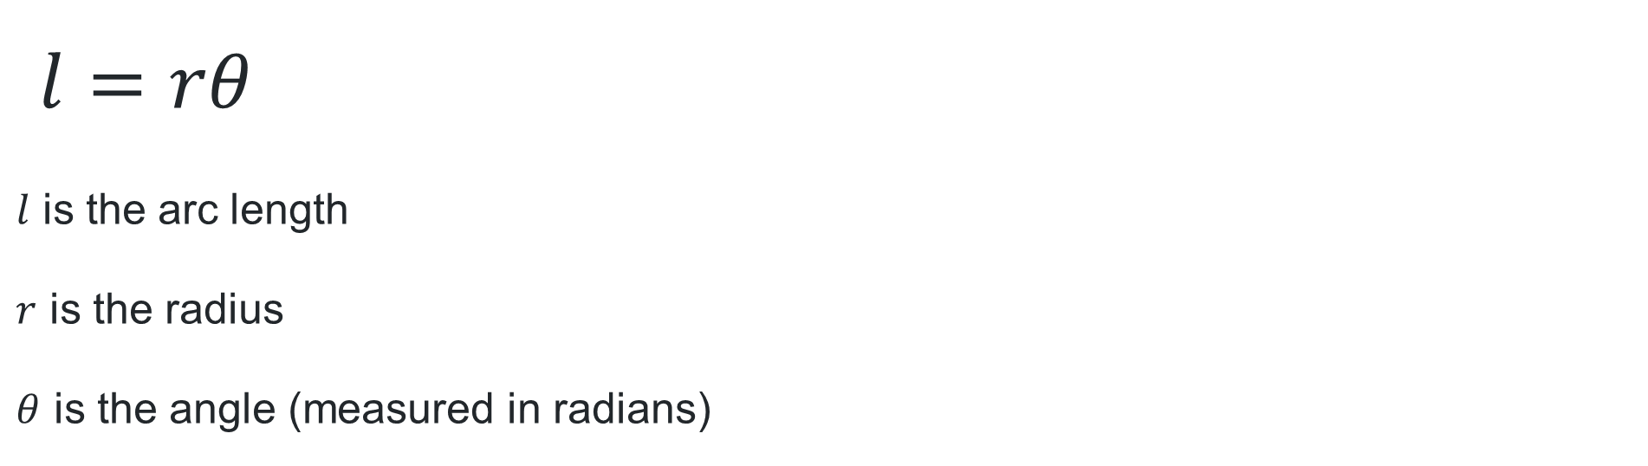

Arc length formula (1)
$l=rθ$
$l$ is the arc length
$r$ is the radius
$θ$ is the angle (measured in radians)
$$l$$
$$θ$$
$$r$$

Slide 10
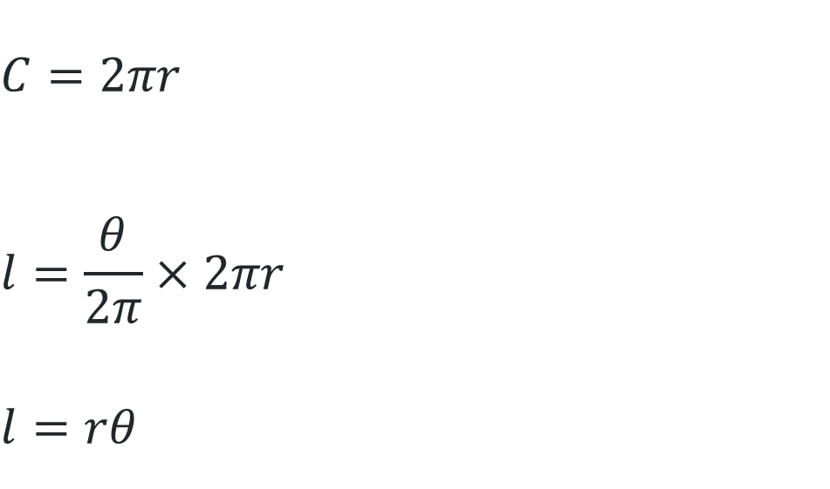



Arc length formula (2)
Where does it come from?
$$C=2πr$$
$$l=\frac{θ}{2π}×2πr$$
$$l=rθ$$
$$l$$
$$θ$$
How does this compare to the arc length formula in degrees?
$$r$$

Slide 11
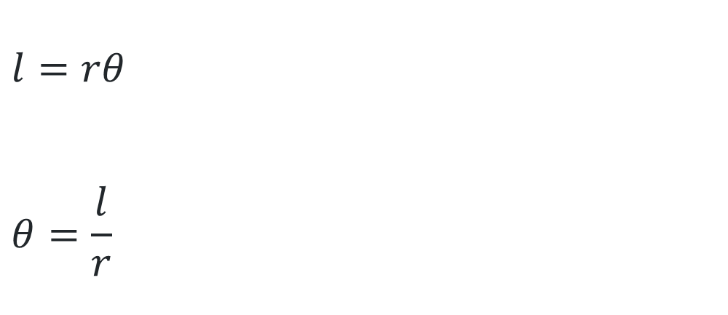
What is a radian?
$$l=rθ$$
$$θ=\frac{l}{r}$$
What happens when the radius = 1?
$$l$$
$$θ$$
$$r$$
How can this formula help us to define a radian?

Slide 12
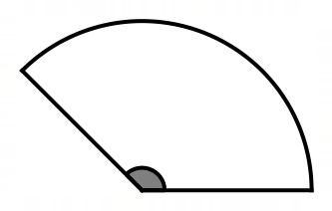
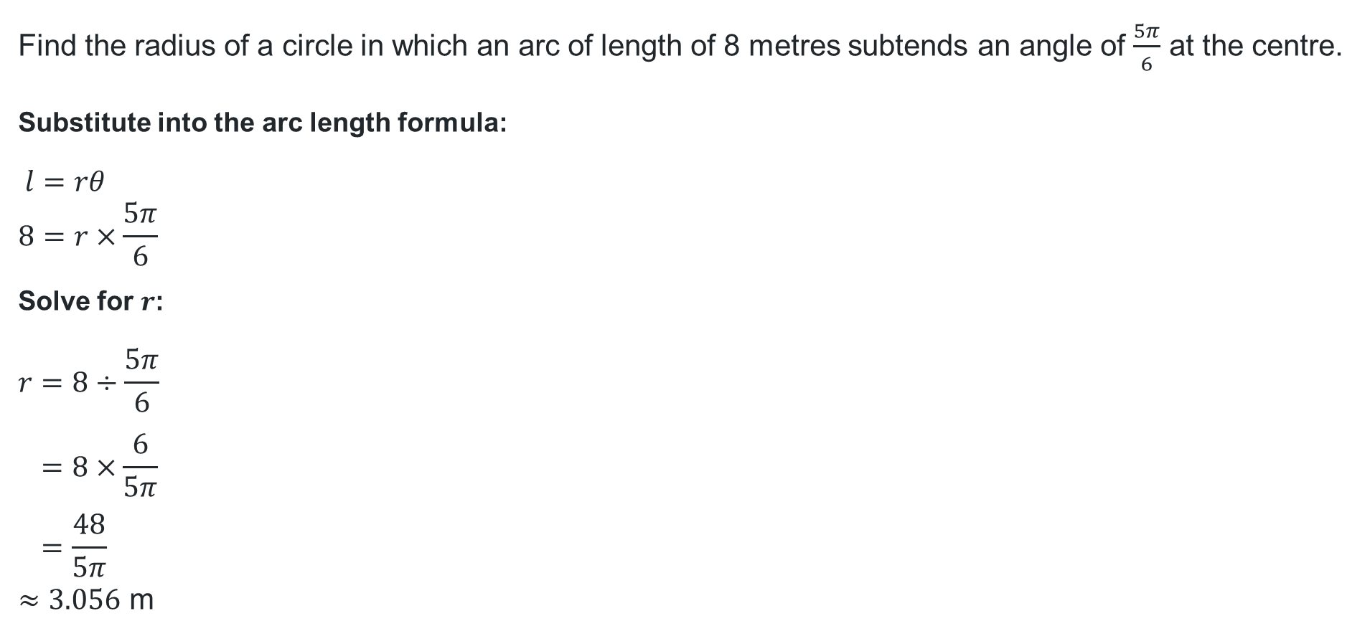
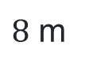

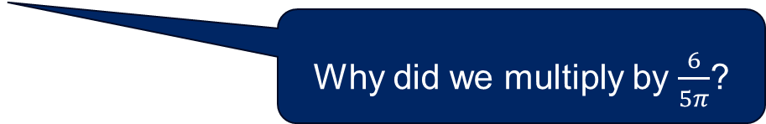

Finding the radius (1)
Worked example 1
Find the radius of a circle in which an arc of length of 8 metres subtends an angle of $\frac{5π}{6}$ at the centre.
Substitute into the arc length formula:
$$l=rθ \\ 8=r×\frac{5π}{6}$$
Solve for $r$:
$$r=8÷\frac{5π}{6} \\ =8×\frac{6}{5π} \\ =\frac{48}{5π} \\ ≈3.056 \text{m}$$
What does this mean?
$8$ m
Where has $l=8$ come from?
$$\frac{5π}{6}$$
Why did we multiply by $\frac{6}{5π}$?

Slide 13
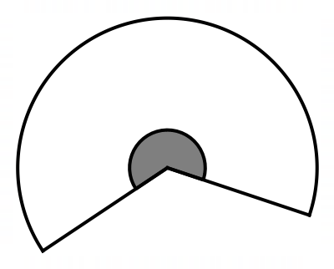
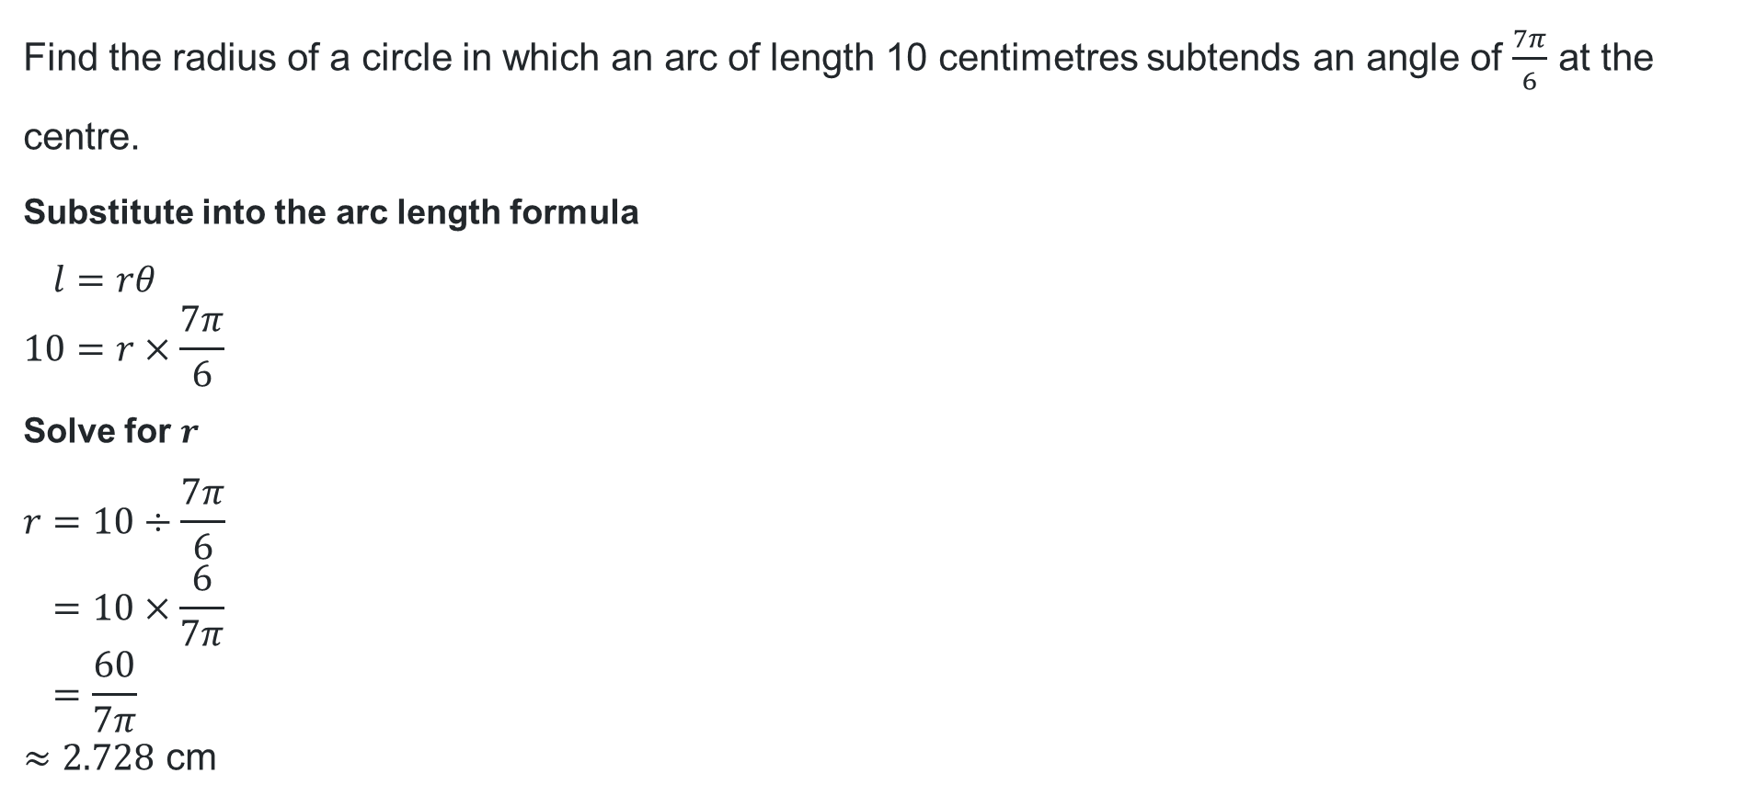
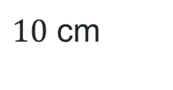
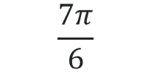
Finding the radius (2)
Your turn – Question 1
Find the radius of a circle in which an arc of length 10 centimetres subtends an angle of $\frac{7π}{6}$ at the centre.
Substitute into the arc length formula
$$l=rθ \\ 10=r×\frac{7π}{6}$$
Solve for $r$
$$r=10÷\frac{7π}{6} \\ =10×\frac{6}{7π} \\ =\frac{60}{7π} \\ ≈2.728 \text{cm}$$
$$\frac{7π}{6}$$
$10$ cm

Slide 14
Independent practice

Slide 15
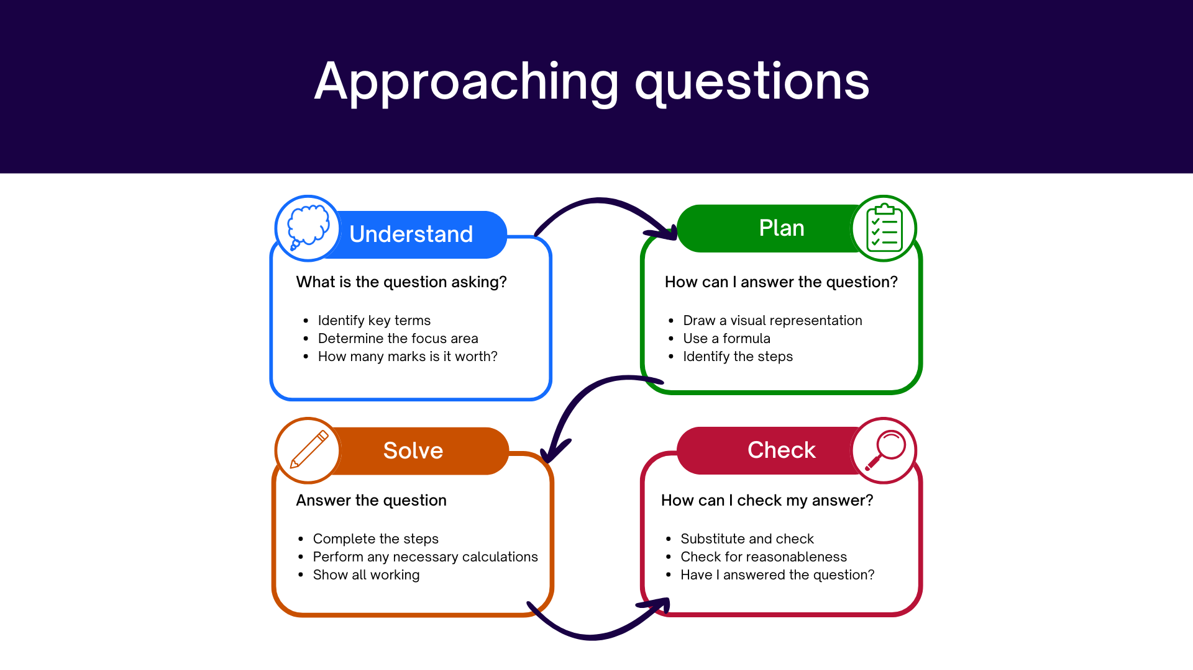
Approaching questions scaffold

Slide 16
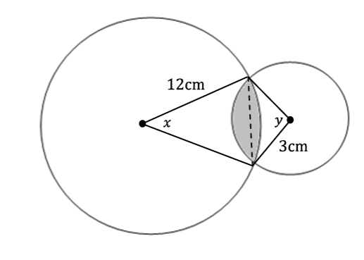
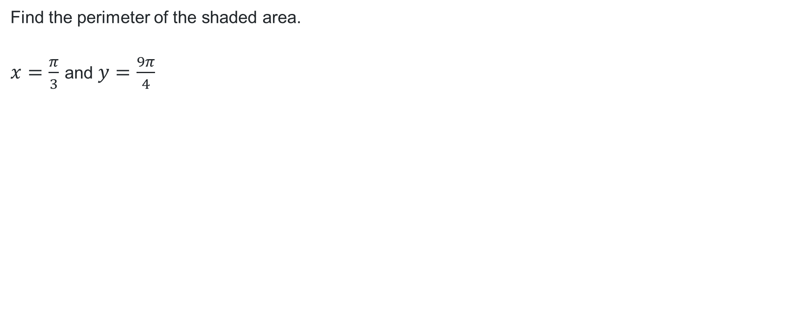


Perimeter problem (1)
Question
Find the perimeter of the shaded area.
$x=\frac{π}{3}$ and $y=\frac{9π}{4}$
$6$ cm
$3$ cm
NOT TO SCALE

Slide 17
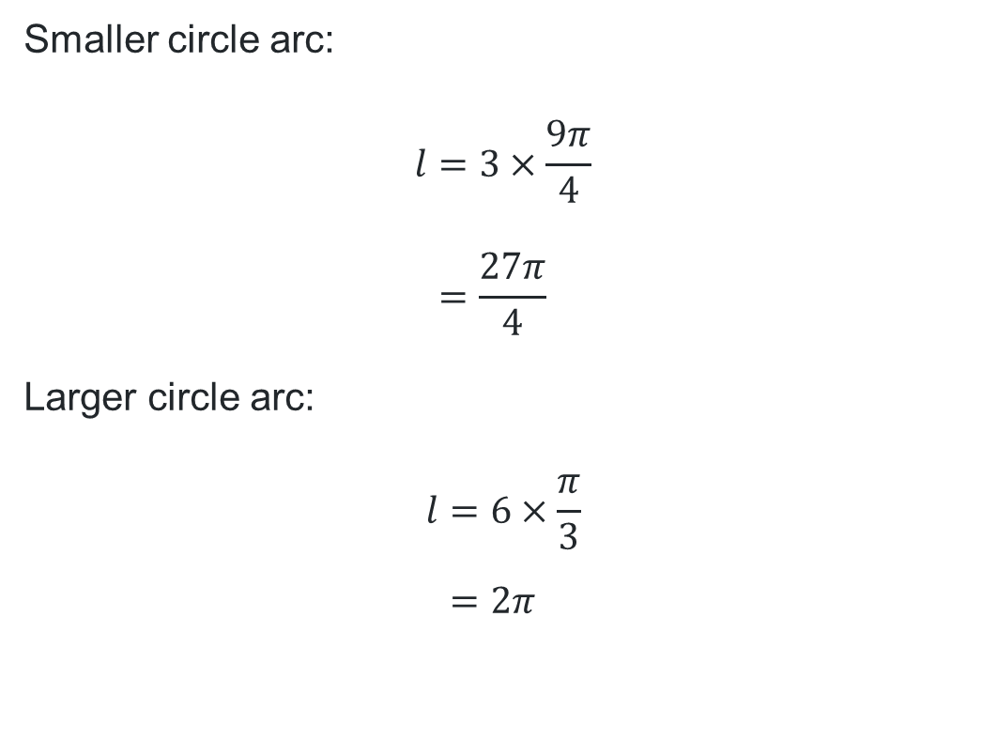
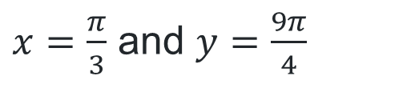
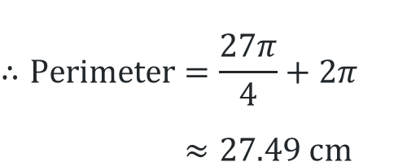
Perimeter problem (2)
Solution
$x=\frac{π}{3}$ and $y=\frac{9π}{4}$
Smaller circle arc:
$$l=3×\frac{9π}{4} \\ =\frac{27π}{4}$$
Larger circle arc:
$$l=6×\frac{π}{3} \\ =2π$$
$6$ cm
$3$ cm
$$∴Perimeter=\frac{27π}{4}+2π \\ ≈27.49 cm$$
NOT TO SCALE

Slide 18
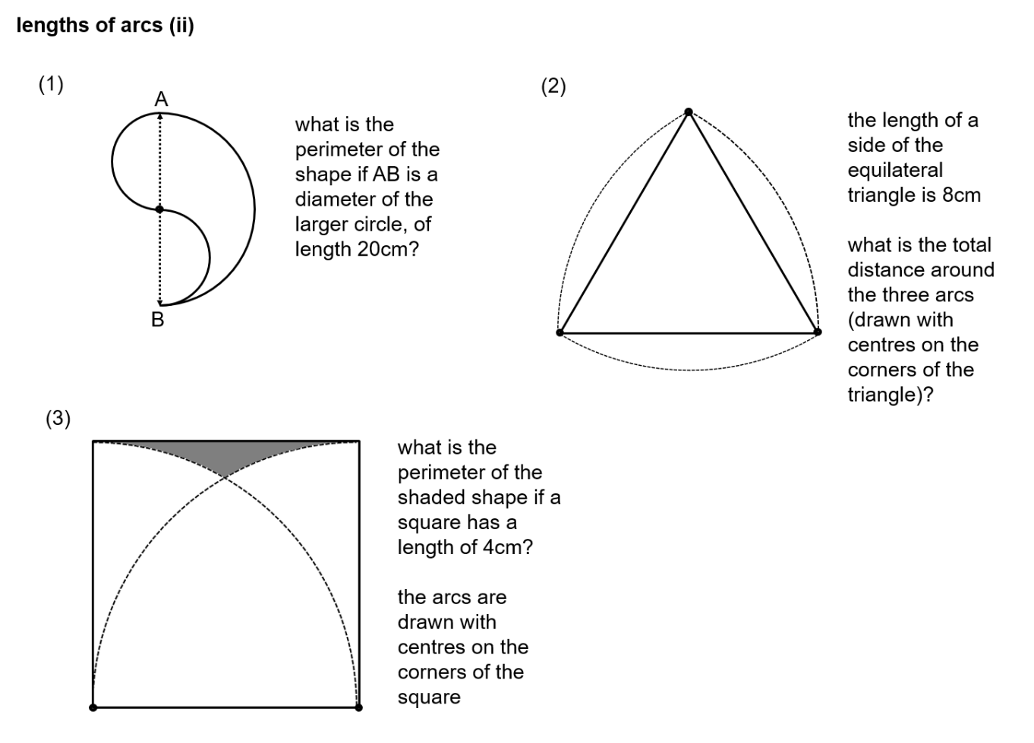
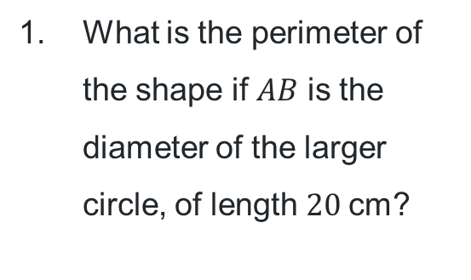
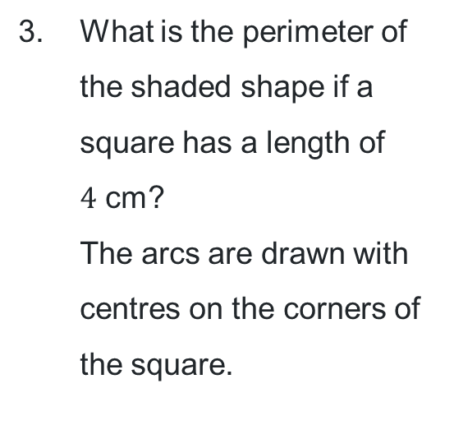
Challenge questions
What is the perimeter of the shape if $AB$ is the diameter of the larger circle, of length $20$cm?
The equilateral triangle below has side lengths of 8 cm. Three arcs have been drawn so that their centres are the corners of the triangle.
What is the total distance around the three arcs?
What is the perimeter of the shaded shape if a square has a length of
$4$ cm?
The arcs are drawn with centres on the corners of the square.

Slide 19
References
This presentation contains NSW Curriculum and syllabus content. The NSW Curriculum is developed by the NSW Education Standards Authority. This content is prepared by NESA for and on behalf of the Crown in the right of the State of New South Wales. The material is protected by Crown copyright.
Please refer to the NESA Copyright Disclaimer for more information https://educationstandards.nsw.edu.au/wps/portal/nesa/mini-footer/copyright.
NESA holds the only official and up-to-date versions of the NSW Curriculum and syllabus documents. Please visit the NSW Education Standards Authority (NESA) website https://educationstandards.nsw.edu.au/wps/portal/nesa/home and the NSW Curriculum website https://curriculum.nsw.edu.au.
Mathematics Advanced 11-12 Syllabus © NSW Education Standards Authority (NESA) for and on behalf of the Crown in right of the State of New South Wales, 2024.

Slide 20
Copyright
© State of New South Wales (Department of Education), 2026
The copyright material published in this resource is subject to the Copyright Act 1968 (Cth) and is owned by the NSW Department of Education or, where indicated, by a party other than the NSW Department of Education (third-party material).
Copyright material available in this resource and owned by the NSW Department of Education is licensed under a Creative Commons Attribution 4.0 International (CC BY 4.0) license.
This license allows you to share and adapt the material for any purpose, even commercially.
Attribution should be given to © State of New South Wales (Department of Education), 2026.
Material in this resource not available under a Creative Commons license:
the NSW Department of Education logo, other logos and trademark-protected material
Material owned by a third party that has been reproduced with permission. You will need to obtain permission from the third party to reuse its material.
Links to third-party material and websites
Please note that the provided (reading/viewing material/list/links/texts) are a suggestion only and implies no endorsement, by the New South Wales Department of Education, of any author, publisher, or book title. School principals and teachers are best placed to assess the suitability of resources that would complement the curriculum and reflect the needs and interests of their students.
If you use the links provided in this document to access a third-party’s website, you acknowledge that the terms of use, including licence terms set out on the third-party’s website apply to the use which may be made of the materials on that third-party website or where permitted by the Copyright Act 1968 (Cth). The department accepts no responsibility for content on third-party websites.

