Slide 1
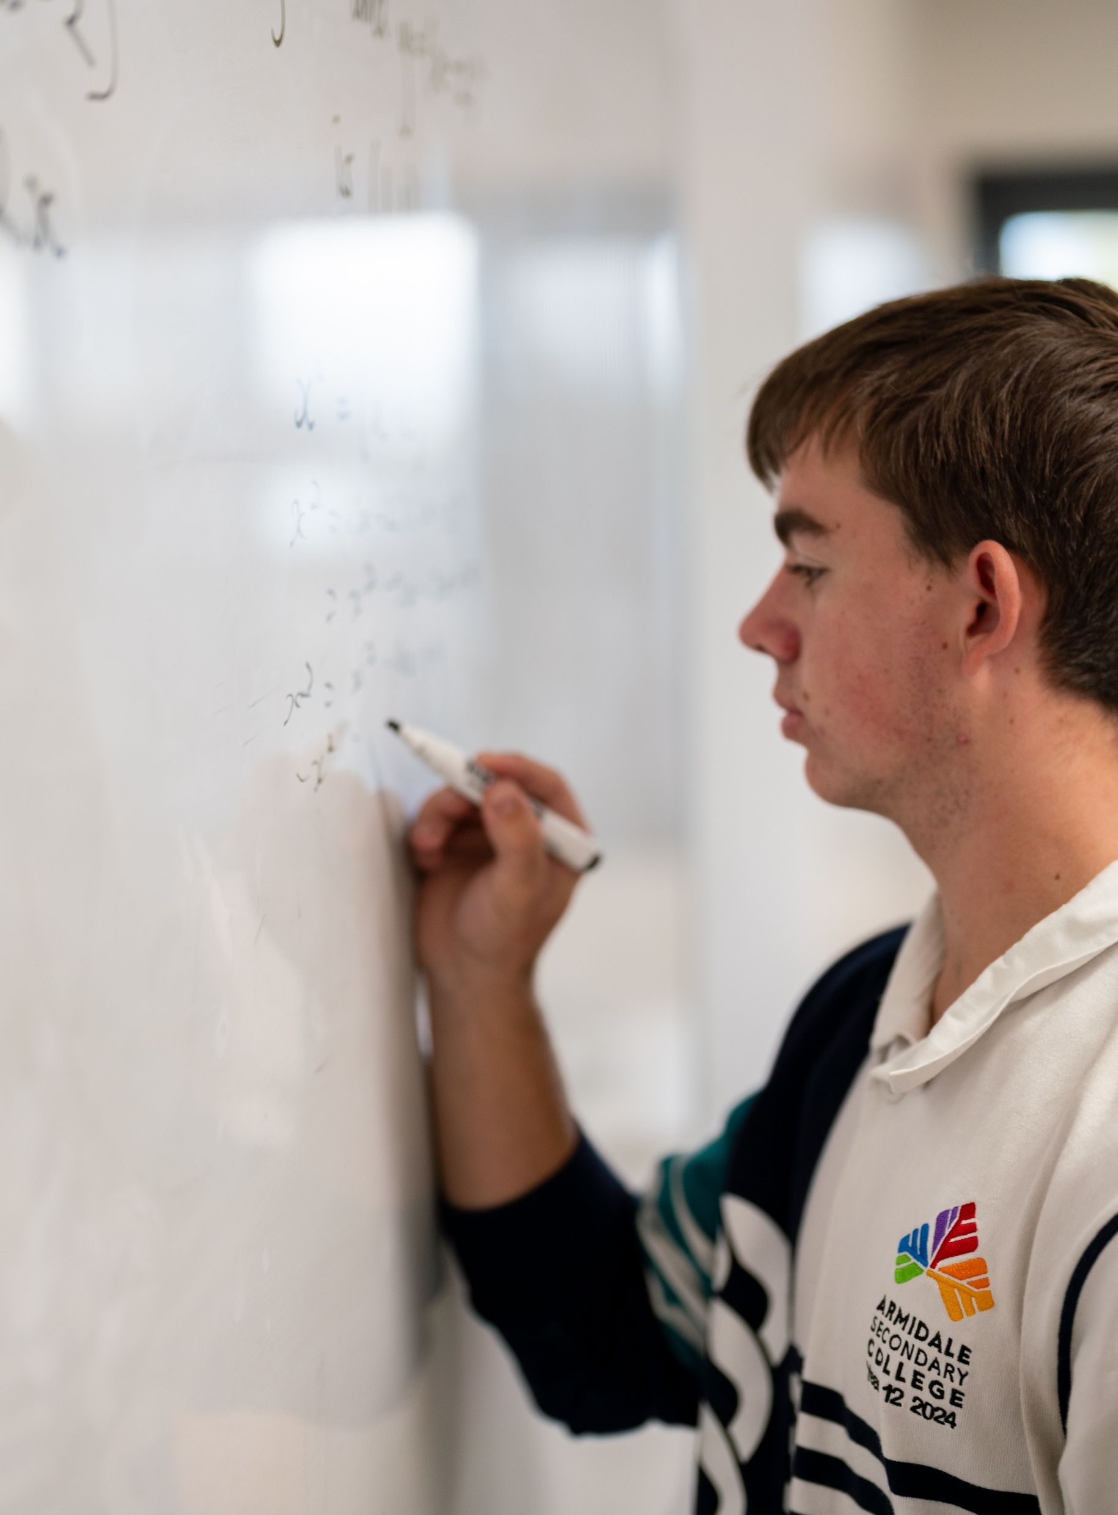
Graphing trigonometric functions
Mathematics Advanced – Stage 6 (Year 11)
Trigonometry

Slide 2
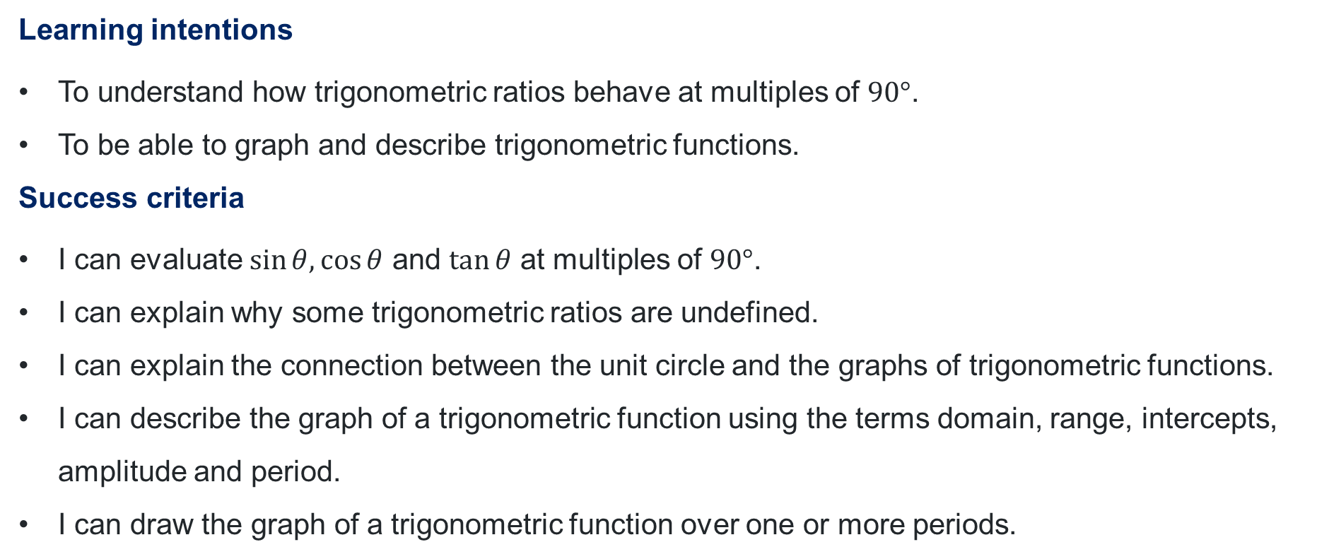
Learning intentions and success criteria
Learning intentions
To understand how trigonometric ratios behave at multiples of $90°$.
To be able to graph and describe trigonometric functions.
Success criteria
I can evaluate $\sin{θ, \cos{θ}}$ and $\tan{θ}$ at multiples of $90°$.
I can explain why some trigonometric ratios are undefined.
I can explain the connection between the unit circle and the graphs of trigonometric functions.
I can describe the graph of a trigonometric function using the terms domain, range, intercepts, amplitude and period.
I can draw the graph of a trigonometric function over one or more periods.

Slide 3
Activating prior knowledge

Slide 4
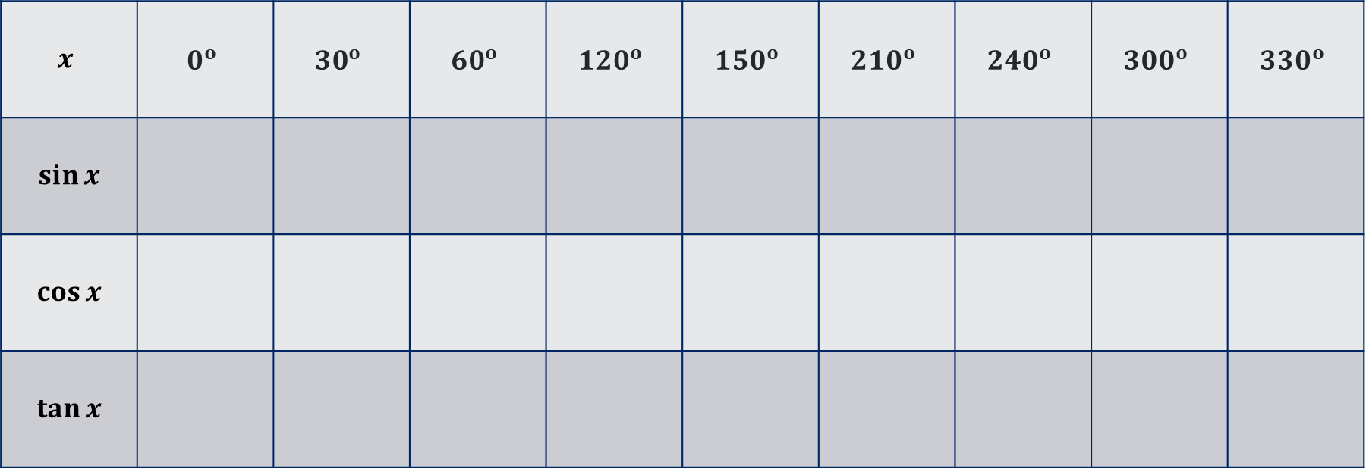
Graphing trigonometric functions (1)
The unit circle
$$x$$ | $$0^{o}$$ | $${30}^{o}$$ | $$60^{o}$$ | $${120}^{o}$$ | $$150^{o}$$ | $${210}^{o}$$ | $${240}^{o}$$ | $${300}^{o}$$ | $${330}^{o}$$
$$\sin{x}$$
$$\cos{x}$$
$$\tan{x}$$

Slide 5
Releasing responsibility

Slide 6
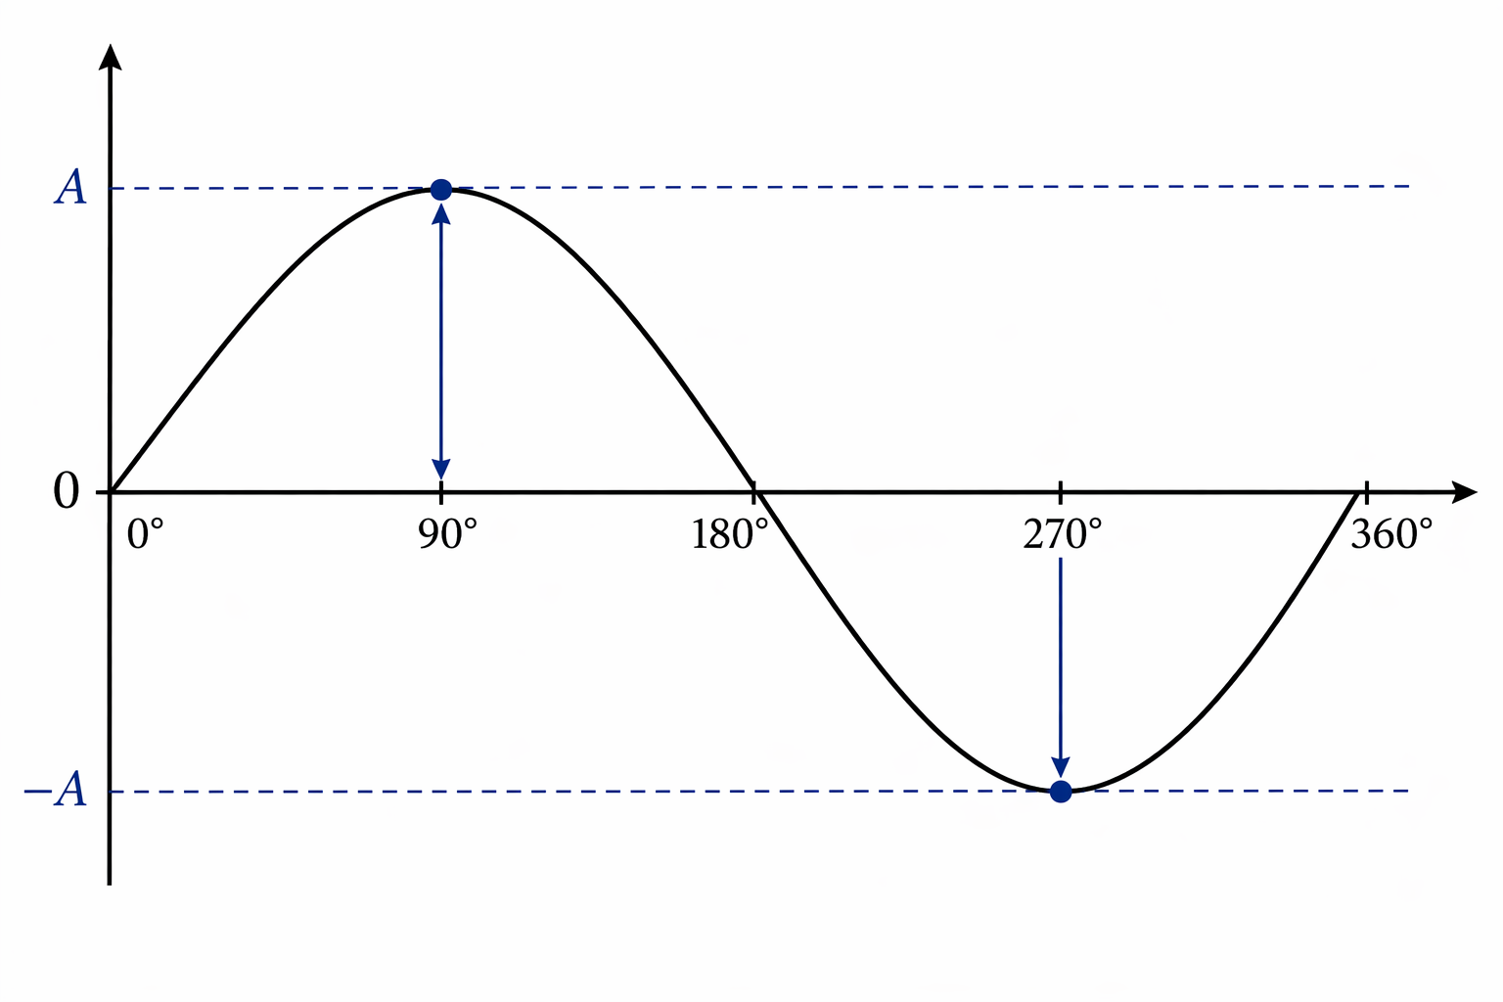
Definitions (1)
Amplitude
A sine or cosine function has amplitude $A$, that is half the distance between the maximum and minimum values.

Slide 7
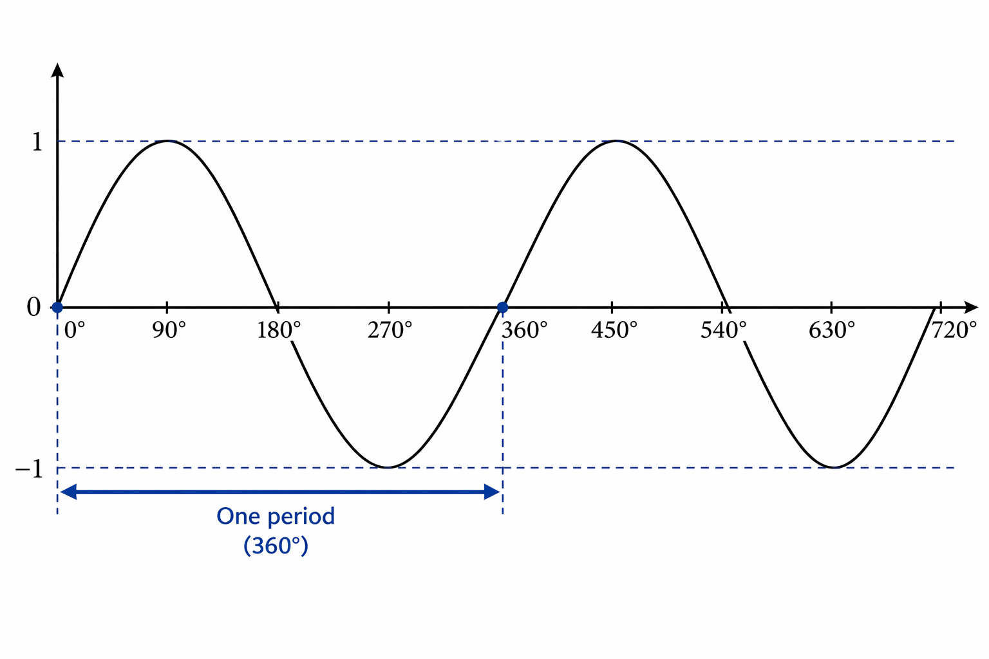
Definitions (2)
Period
A function has period $p$if its values repeat every $p$units along the $x$-axis

Slide 8
References
This resource contains NSW Curriculum and syllabus content. The NSW Curriculum is developed by the NSW Education Standards Authority (NESA). This content is prepared by NESA for and on behalf of the Crown in the right of the State of New South Wales. The material is protected by Crown copyright.
Please refer to the NESA Copyright Disclaimer for more information https://www.nsw.gov.au/education-and-training/nesa/copyright.
NESA holds the only official and up-to-date versions of the NSW Curriculum and syllabus documents. Please visit NESA https://www.nsw.gov.au/education-and-training/nesa and the NSW Curriculum https://curriculum.nsw.edu.au.
Mathematics Advanced 11-12 Syllabus © NSW Education Standards Authority (NESA) for and on behalf of the Crown in right of the State of New South Wales, 2024.
NESA (NSW Education Standards Authority (2024) ‘Glossary’, Mathematics Advanced 11–12 (2024), NESA website, accessed 22 January 2026.

Slide 9
Copyright
© State of New South Wales (Department of Education), 2026
The copyright material published in this resource is subject to the Copyright Act 1968 (Cth) and is owned by the NSW Department of Education or, where indicated, by a party other than the NSW Department of Education (third-party material).
Copyright material available in this resource and owned by the NSW Department of Education is licensed under a Creative Commons Attribution 4.0 International (CC BY 4.0) license.
This license allows you to share and adapt the material for any purpose, even commercially.
Attribution should be given to © State of New South Wales (Department of Education), 2026.
Material in this resource not available under a Creative Commons license:
the NSW Department of Education logo, other logos and trademark-protected material
Material owned by a third party that has been reproduced with permission. You will need to obtain permission from the third party to reuse its material.
Links to third-party material and websites
Please note that the provided (reading/viewing material/list/links/texts) are a suggestion only and implies no endorsement, by the New South Wales Department of Education, of any author, publisher, or book title. School principals and teachers are best placed to assess the suitability of resources that would complement the curriculum and reflect the needs and interests of their students.
If you use the links provided in this document to access a third-party’s website, you acknowledge that the terms of use, including licence terms set out on the third-party’s website apply to the use which may be made of the materials on that third-party website or where permitted by the Copyright Act 1968 (Cth). The department accepts no responsibility for content on third-party websites.

