Slide 1
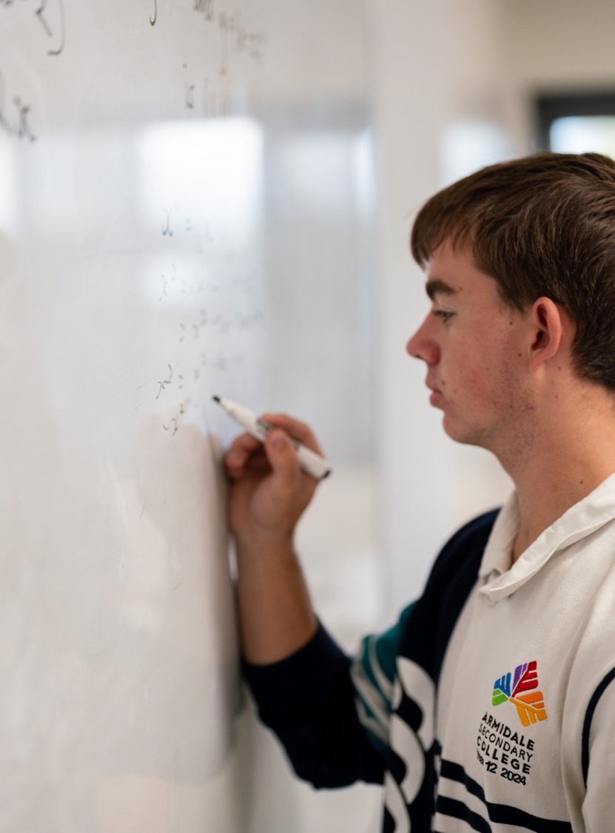
Using bearings in trigonometry
Mathematics Advanced – Stage 6 (Year 11)
Trigonometry

Slide 2
Learning intention and success criteria
Learning intention
To know how to use trigonometry to solve real-world problems involving right-angled triangles, bearings, and angles of elevation/depression.
Success criteria
I can interpret and use true bearings.
I can form and solve right-angled triangle problems using trigonometric ratios.
I can interpret angles of elevation and depression in context.
I can justify solutions using appropriate diagrams and reasoning

Slide 3
Retrieval practice

Slide 4
What does a true bearing look like?
Can this be a true bearing?
040
90
90.5
158.50
58.5
-049
Yes
No
No
Yes
No
No

Slide 5
Calculating true bearings
Find the true bearing of point B from point A
B
N
N
N
N
1.
N
2.
3.
4.
5.
6.
N
62º
62º
A
W
B
B
62º
B
62º
E
B
62º
118º
B
A
A
A
062ºT
A
062ºT
242ºT
028ºT
A
028ºT
298ºT
N
N
S
7.
8.
9.
10.
E
11.
S
12.
62º
N
B
62º
A
62º
B
62º
B
B
118º
62º
A
B
A
W
A
S
A
W
A
118ºT
118ºT
118ºT
152ºT
242ºT
118ºT
B

Slide 6
Activating prior knowledge

Slide 7
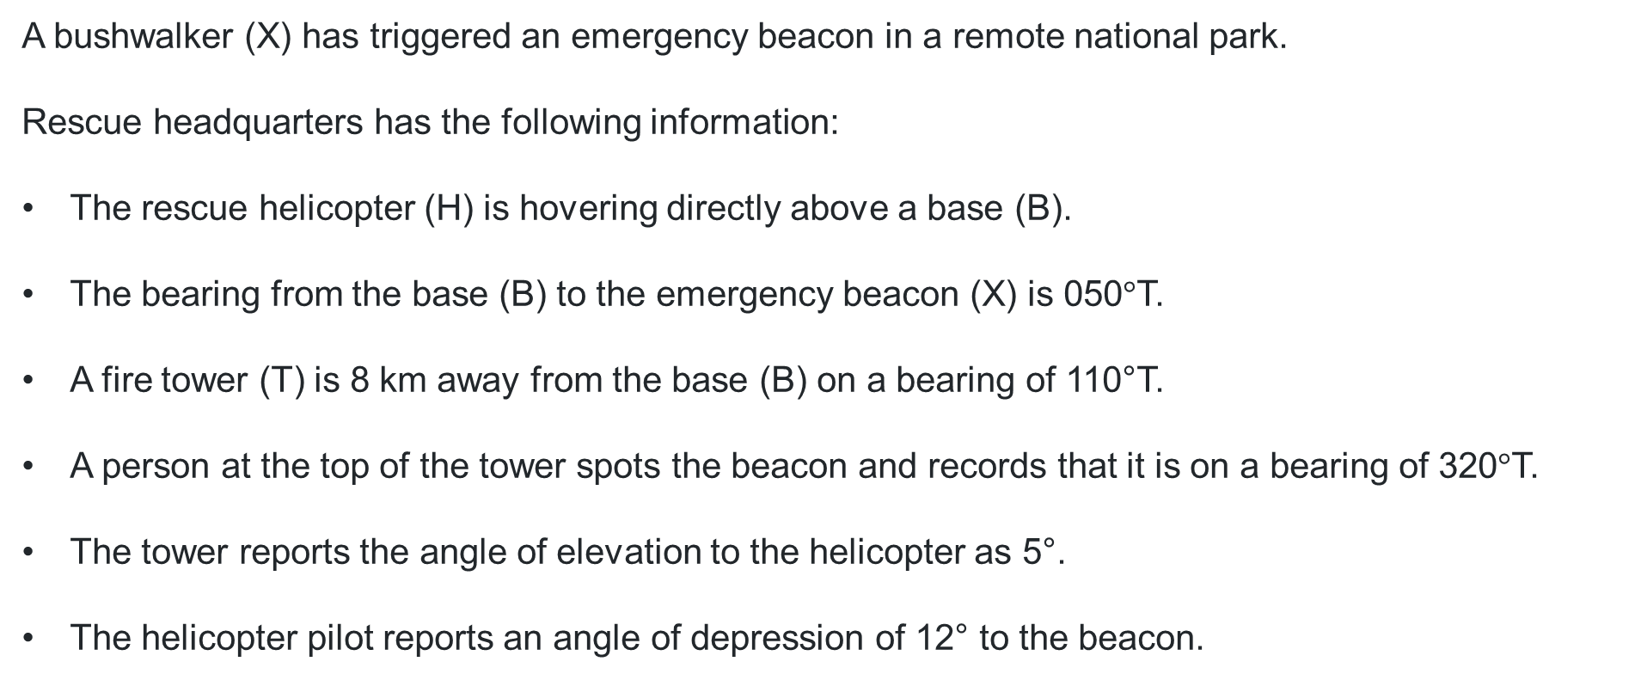
Rescue scenario
A bushwalker (X) has triggered an emergency beacon in a remote national park.
Rescue headquarters has the following information:
The rescue helicopter (H) is hovering directly above a base (B).
The bearing from the base (B) to the emergency beacon (X) is 050$°$T.
A fire tower (T) is 8 km away from the base (B) on a bearing of 110°T.
A person at the top of the tower spots the beacon and records that it is on a bearing of 320$°$T.
The tower reports the angle of elevation to the helicopter as 5°.
The helicopter pilot reports an angle of depression of 12° to the beacon.

Slide 8
Connecting learning

Slide 9
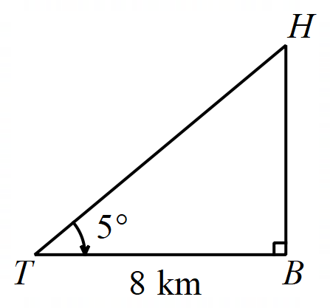
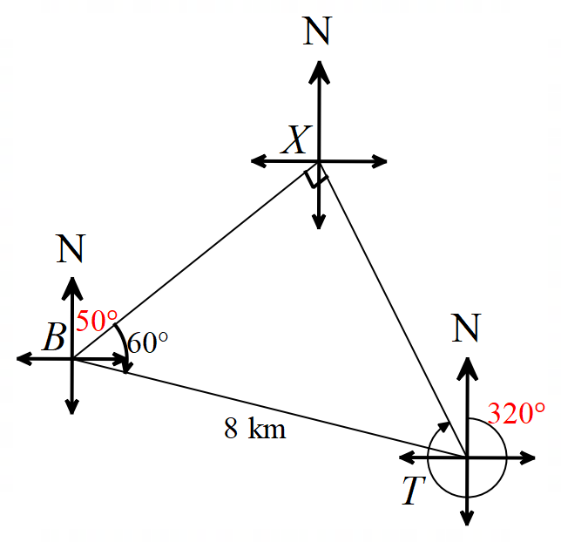
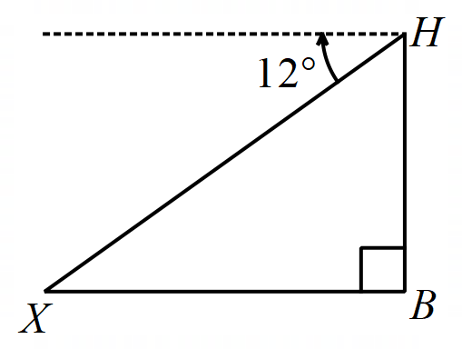
Rescue scenario diagram (1)
H = helicopter, B = base, X = bushwalker/emergency beacon, T = fire tower

Slide 10
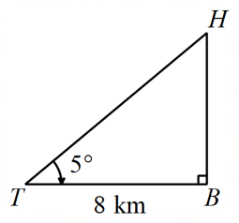
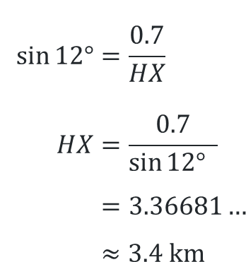
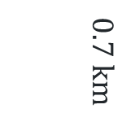
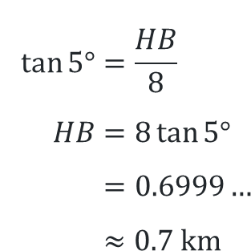
Rescue scenario diagram (2)
H = helicopter, B = base, X = bushwalker/emergency beacon, T = fire tower
Finding height of helicopter (H) above base (B)
$$\tan{5°}=\frac{HB}{8} \\ HB=8\tan{5°} \\ =0.6999… \\ ≈0.7 \text{km}$$
Finding distance from helicopter (H) to bushwalker (X)
$$\sin{12°}=\frac{0.7}{HX} \\ HX=\frac{0.7}{\sin{12°} } \\ =3.36681… \\ ≈3.4 \text{km}$$
$$0.7 km$$

Slide 11
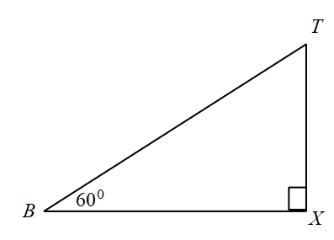
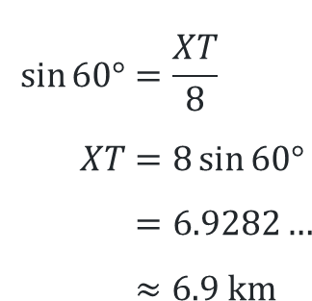
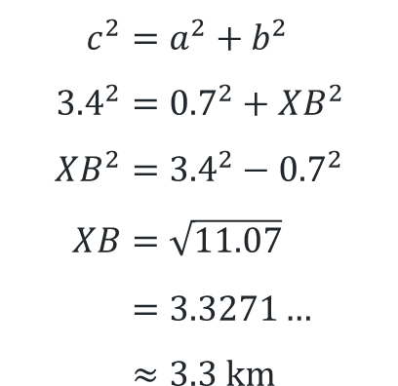
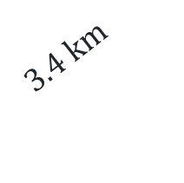
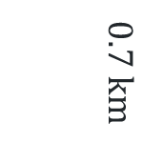
Rescue scenario diagram (3)
H = helicopter, B = base, X = bushwalker/emergency beacon, T = fire tower
Finding distance from base (B) to bushwalker (X)
$$c^{2}=a^{2}+b^{2} \\ {3.4}^{2}={0.7}^{2}+XB^{2} \\ XB^{2}={3.4}^{2}−{0.7}^{2} \\ XB=\sqrt{11.07} \\ =3.3271… \\ ≈3.3 \text{km}$$
$$0.7 km$$
$$3.4 km$$
Finding distance from fire tower (T) to bushwalker (X)
$$\sin{60°}=\frac{XT}{8} \\ XT=8\sin{60°} \\ =6.9282… \\ ≈6.9 \text{km}$$
8 km
Answer:
Therefore, the base is the closest to the bushwalker.

Slide 12
Releasing responsibility

Slide 13
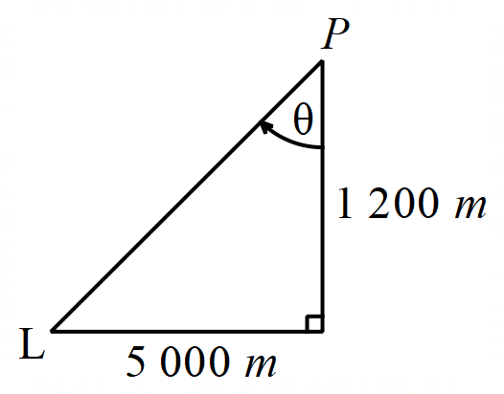
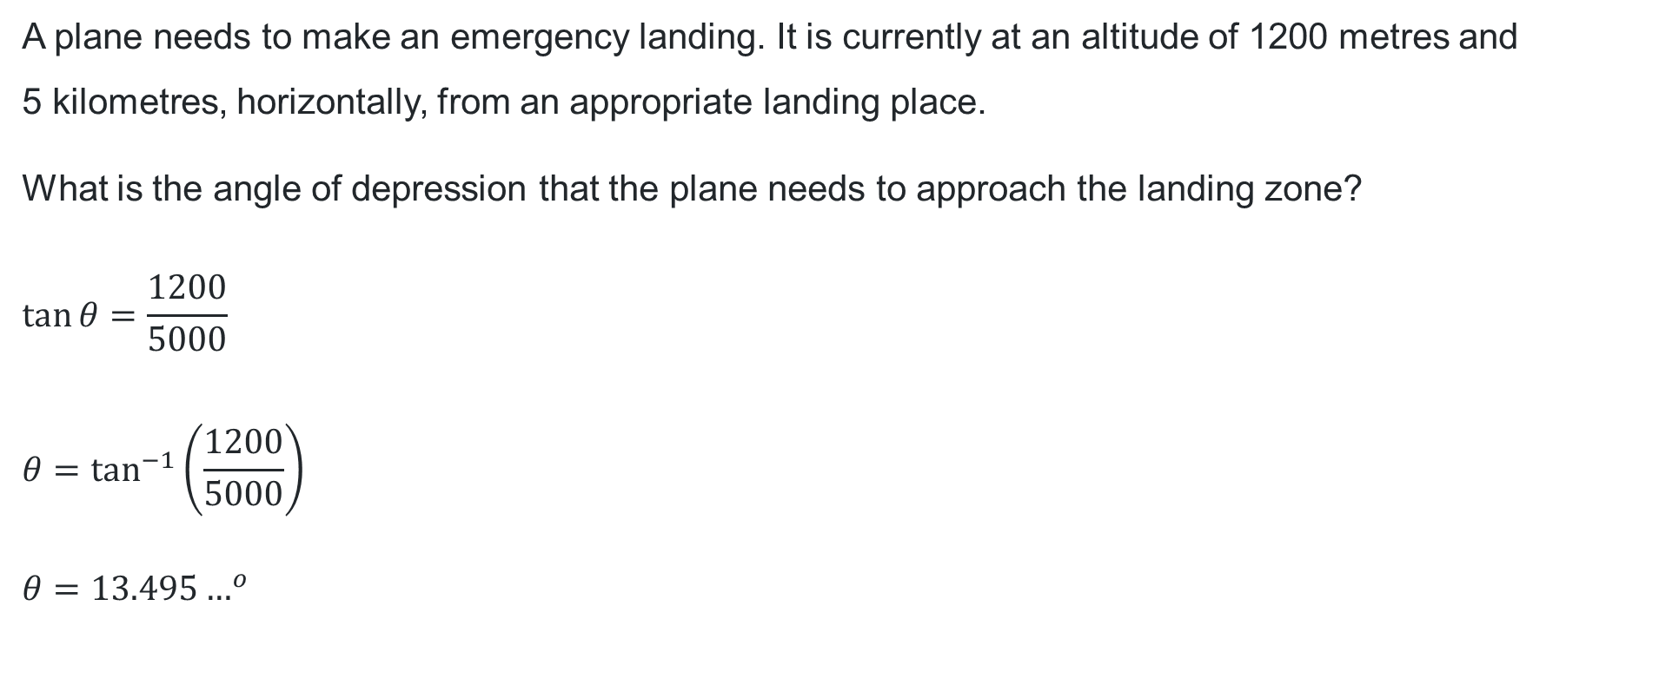
Incorrect worked example
A plane needs to make an emergency landing. It is currently at an altitude of 1200 metres and
5 kilometres, horizontally, from an appropriate landing place.
What is the angle of depression that the plane needs to approach the landing zone?
$$\tan{θ}=\frac{1200}{5000}$$
$$θ=\tan^{−1}\left(\frac{1200}{5000}\right)$$
$$θ={13.495…}^{o}$$

Slide 14
Independent practice

Slide 15
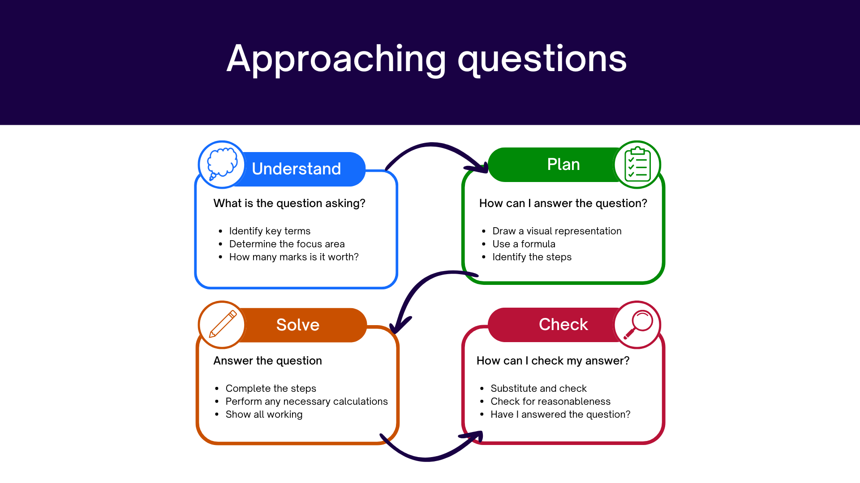
Approaching questions scaffold

Slide 16
References
This presentation contains NSW Curriculum and syllabus content. The NSW Curriculum is developed by the NSW Education Standards Authority. This content is prepared by NESA for and on behalf of the Crown in the right of the State of New South Wales. The material is protected by Crown copyright.
Please refer to the NESA Copyright Disclaimer for more information https://educationstandards.nsw.edu.au/wps/portal/nesa/mini-footer/copyright.
NESA holds the only official and up-to-date versions of the NSW Curriculum and syllabus documents. Please visit the NSW Education Standards Authority (NESA) website https://educationstandards.nsw.edu.au/wps/portal/nesa/home and the NSW Curriculum website https://curriculum.nsw.edu.au.
Mathematics Advanced 11-12 Syllabus © NSW Education Standards Authority (NESA) for and on behalf of the Crown in right of the State of New South Wales, 2024.

Slide 17
Copyright
© State of New South Wales (Department of Education), 2026
The copyright material published in this resource is subject to the Copyright Act 1968 (Cth) and is owned by the NSW Department of Education or, where indicated, by a party other than the NSW Department of Education (third-party material).
Copyright material available in this resource and owned by the NSW Department of Education is licensed under a Creative Commons Attribution 4.0 International (CC BY 4.0) license.
This license allows you to share and adapt the material for any purpose, even commercially.
Attribution should be given to © State of New South Wales (Department of Education), 2026.
Material in this resource not available under a Creative Commons license:
the NSW Department of Education logo, other logos and trademark-protected material
Material owned by a third party that has been reproduced with permission. You will need to obtain permission from the third party to reuse its material.
Links to third-party material and websites
Please note that the provided (reading/viewing material/list/links/texts) are a suggestion only and implies no endorsement, by the New South Wales Department of Education, of any author, publisher, or book title. School principals and teachers are best placed to assess the suitability of resources that would complement the curriculum and reflect the needs and interests of their students.
If you use the links provided in this document to access a third-party’s website, you acknowledge that the terms of use, including licence terms set out on the third-party’s website apply to the use which may be made of the materials on that third-party website or where permitted by the Copyright Act 1968 (Cth). The department accepts no responsibility for content on third-party websites.

