Slide 1

Translations
Mathematics Advanced – Stage 6 (Year 11)
Unit 4 – graphing transformations

Slide 2
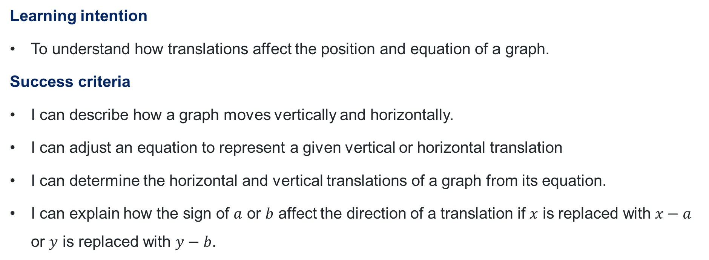
Learning intentions and success criteria
Learning intention
To understand how translations affect the position and equation of a graph.
Success criteria
I can describe how a graph moves vertically and horizontally.
I can adjust an equation to represent a given vertical or horizontal translation
I can determine the horizontal and vertical translations of a graph from its equation.
I can explain how the sign of $a$ or $b$ affect the direction of a translation if $x$ is replaced with $x−a$ or $y$ is replaced with $y−b$.
Notes:
Notes for teachers:
Learning intentions and success criteria are best co-constructed with students. Adapt the learning intention as required and add matching success criteria.
For more information See ⁠AITSL or the NSW Department of Education explicit teaching strategies, ⁠Sharing learning intentions and ⁠Sharing success criteria
LISC is not necessarily presented at the beginning of the lesson. Teacher needs to consider most effectual time to introduce
LISC should be revisited during the lesson to support students' evaluation of their learning

Slide 3
Activating prior knowledge

Slide 4
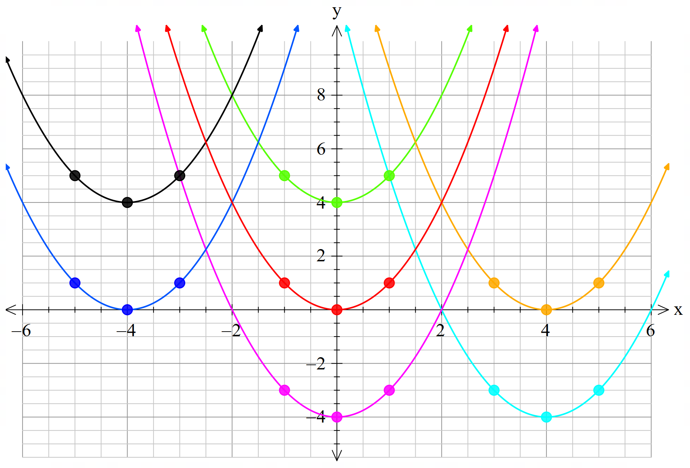
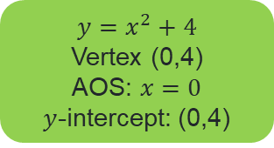
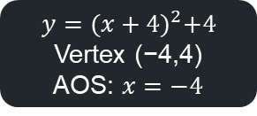
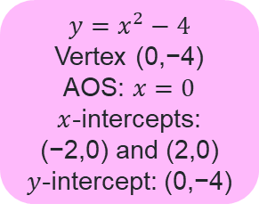
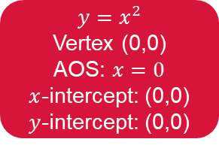
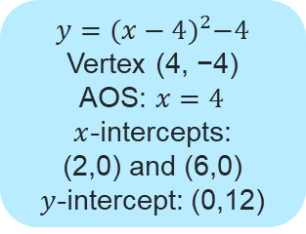
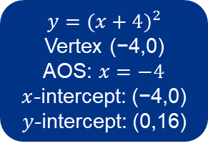
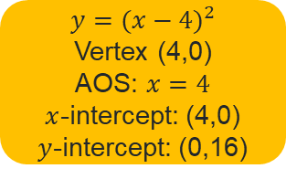
Activating prior knowledge activity
Appendix A – coloured graphs
$$y={(x+4)}^{2}+4$$
Vertex (−4,4)
AOS: $x=−4$
$$y=x^{2}+4$$
Vertex (0,4)
AOS: $x=0$
$y$-intercept: (0,4)
$$y={(x+4)}^{2}$$
Vertex (−4,0)
AOS: $x=−4$
$x$-intercept: (−4,0)
$y$-intercept: (0,16)
$$y={(x−4)}^{2}$$
Vertex (4,0)
AOS: $x=4$
$x$-intercept: (4,0)
$y$-intercept: (0,16)
$$y=x^{2}$$
Vertex (0,0)
AOS: $x=0$
$x$-intercept: (0,0)
$y$-intercept: (0,0)
$$y={(x−4)}^{2}−4$$
Vertex (4, −4)
AOS: $x=4$
$x$-intercepts: (2,0) and (6,0)
$y$-intercept: (0,12)
$$y=x^{2}−4$$
Vertex (0,−4)
AOS: $x=0$ $x$-intercepts: (−2,0) and (2,0)
$y$-intercept: (0,−4)

Slide 5
Releasing responsibility

Slide 6
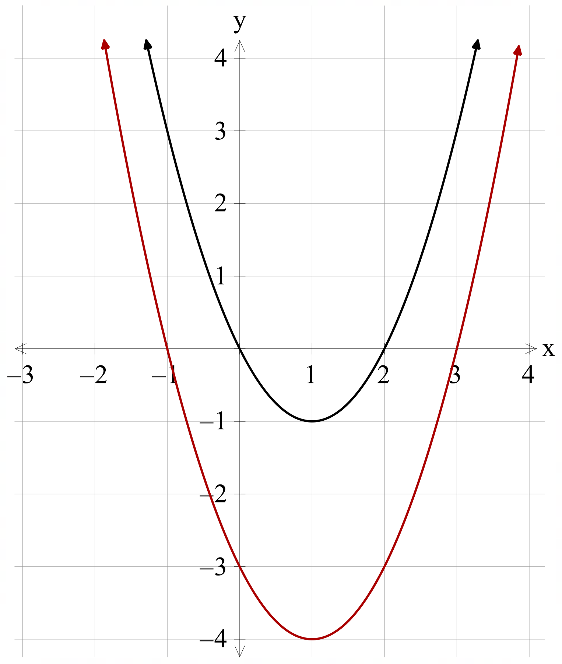
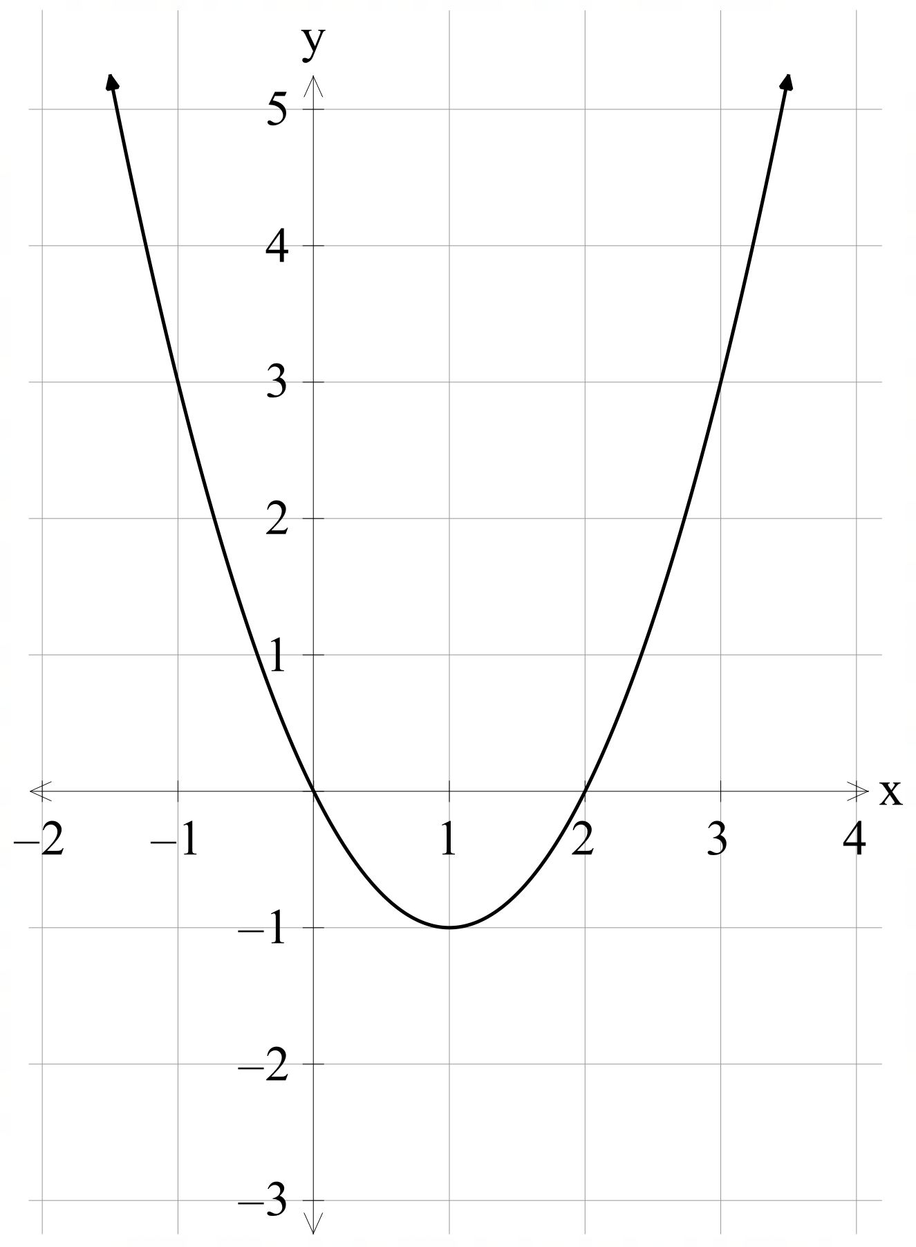
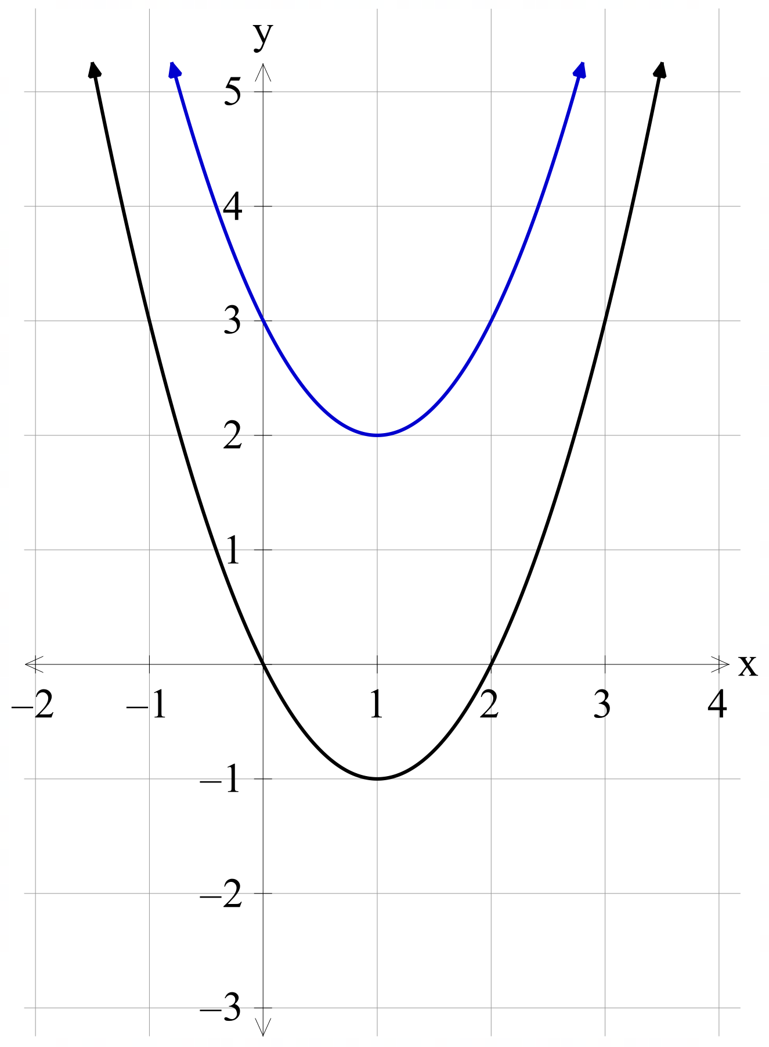
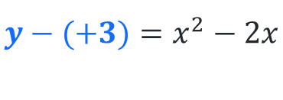
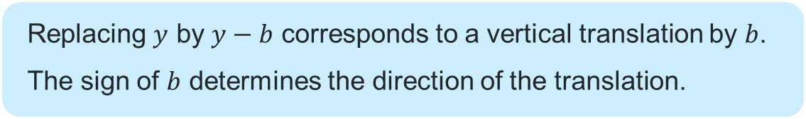

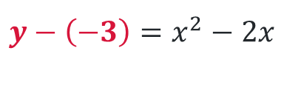
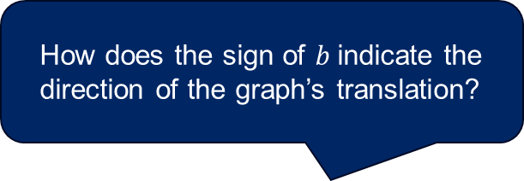
Vertical translations (1)
The equation of a graph
Replacing $y$ by $y−b$ corresponds to a vertical translation by $b$. The sign of $b$ determines the direction of the translation.
How does the sign of $b$indicate the direction of the graph’s translation?
$$y−\left(−3\right)=x^{2}−2x$$
$$y=x^{2}−2x$$
$$y−(+3)=x^{2}−2x$$
Why might we write the equation like this instead of simplifying it?
What does it show?

Slide 7
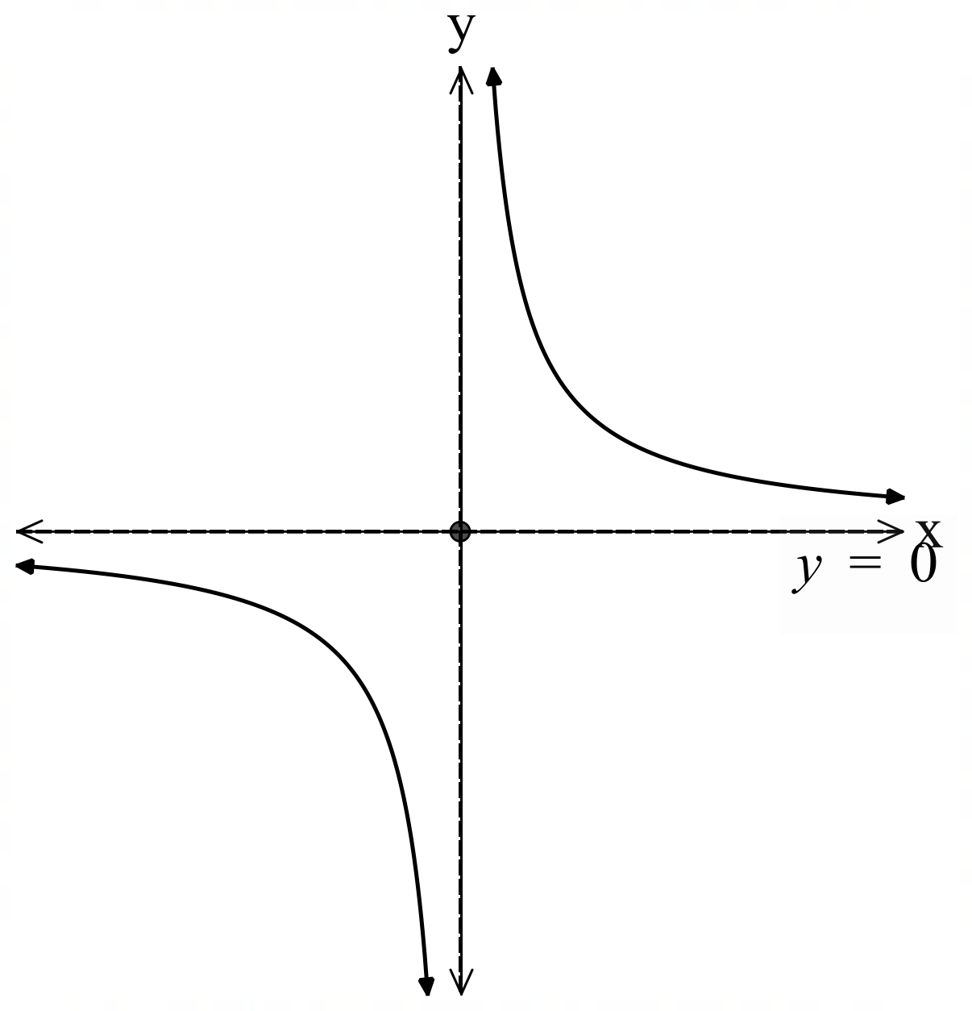
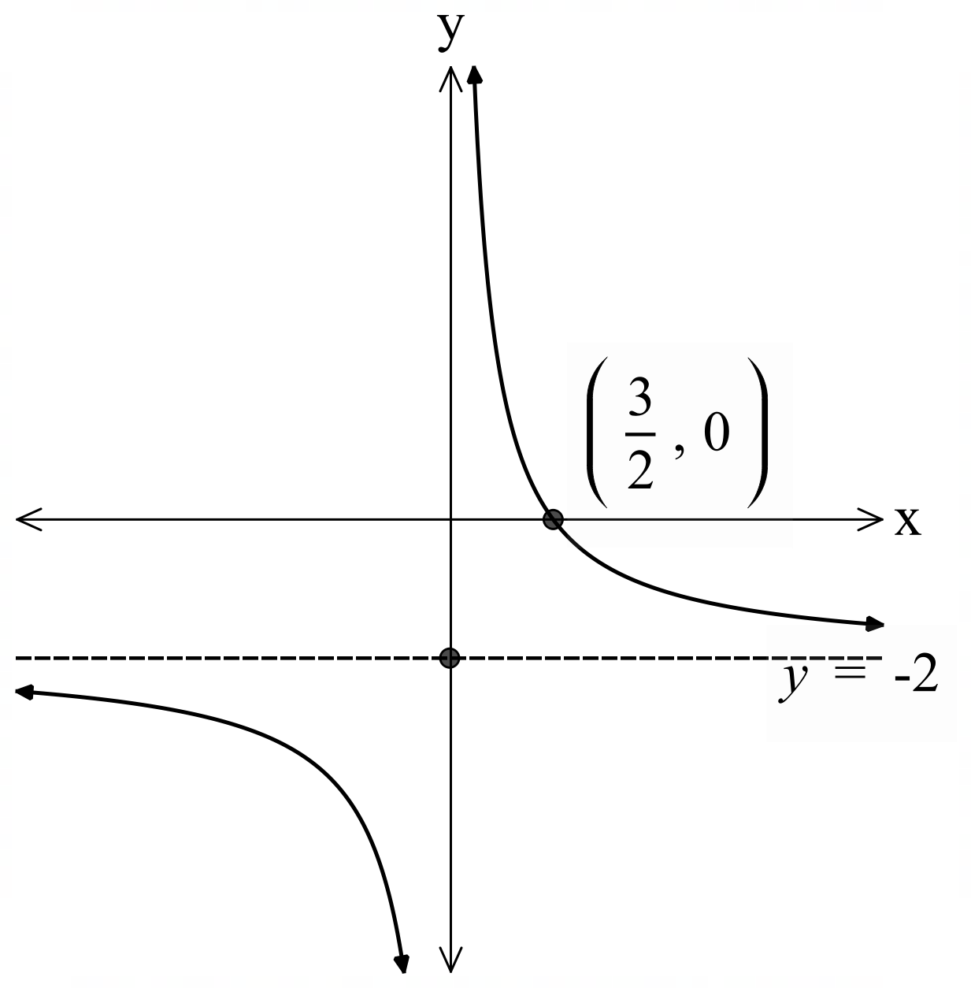


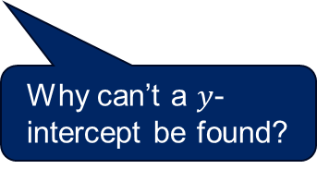

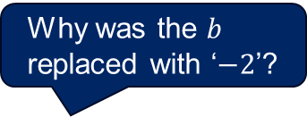


Vertical translations (2)
Graph of the original reciprocal function $y=\frac{3}{x}$.
Worked example 1
The graph of $y=\frac{3}{x}$ is translated 2 units down.
Write the equation of the new graph and sketch it.
Solution:
Graph of the new reciprocal function $y=\frac{3}{x}−2$.
Why was the $b$ replaced with ‘$−2$’?
Vertical translation, replace $y$ with $y−b$.
To translate 2 units down, replace $y$ with $y−(−2)$.
$$y−(−2)=\frac{3}{x}$$
$$y+2=\frac{3}{x}$$
$$y=\frac{3}{x}−2$$
$x$ intercepts, let $y=0$
$$0=\frac{3}{x}−2$$
$$\frac{3}{x}=2$$
$$x=\frac{3}{2}$$
Why can’t a $y$- intercept be found?
How was the asymptote affected by the translation?

Slide 8
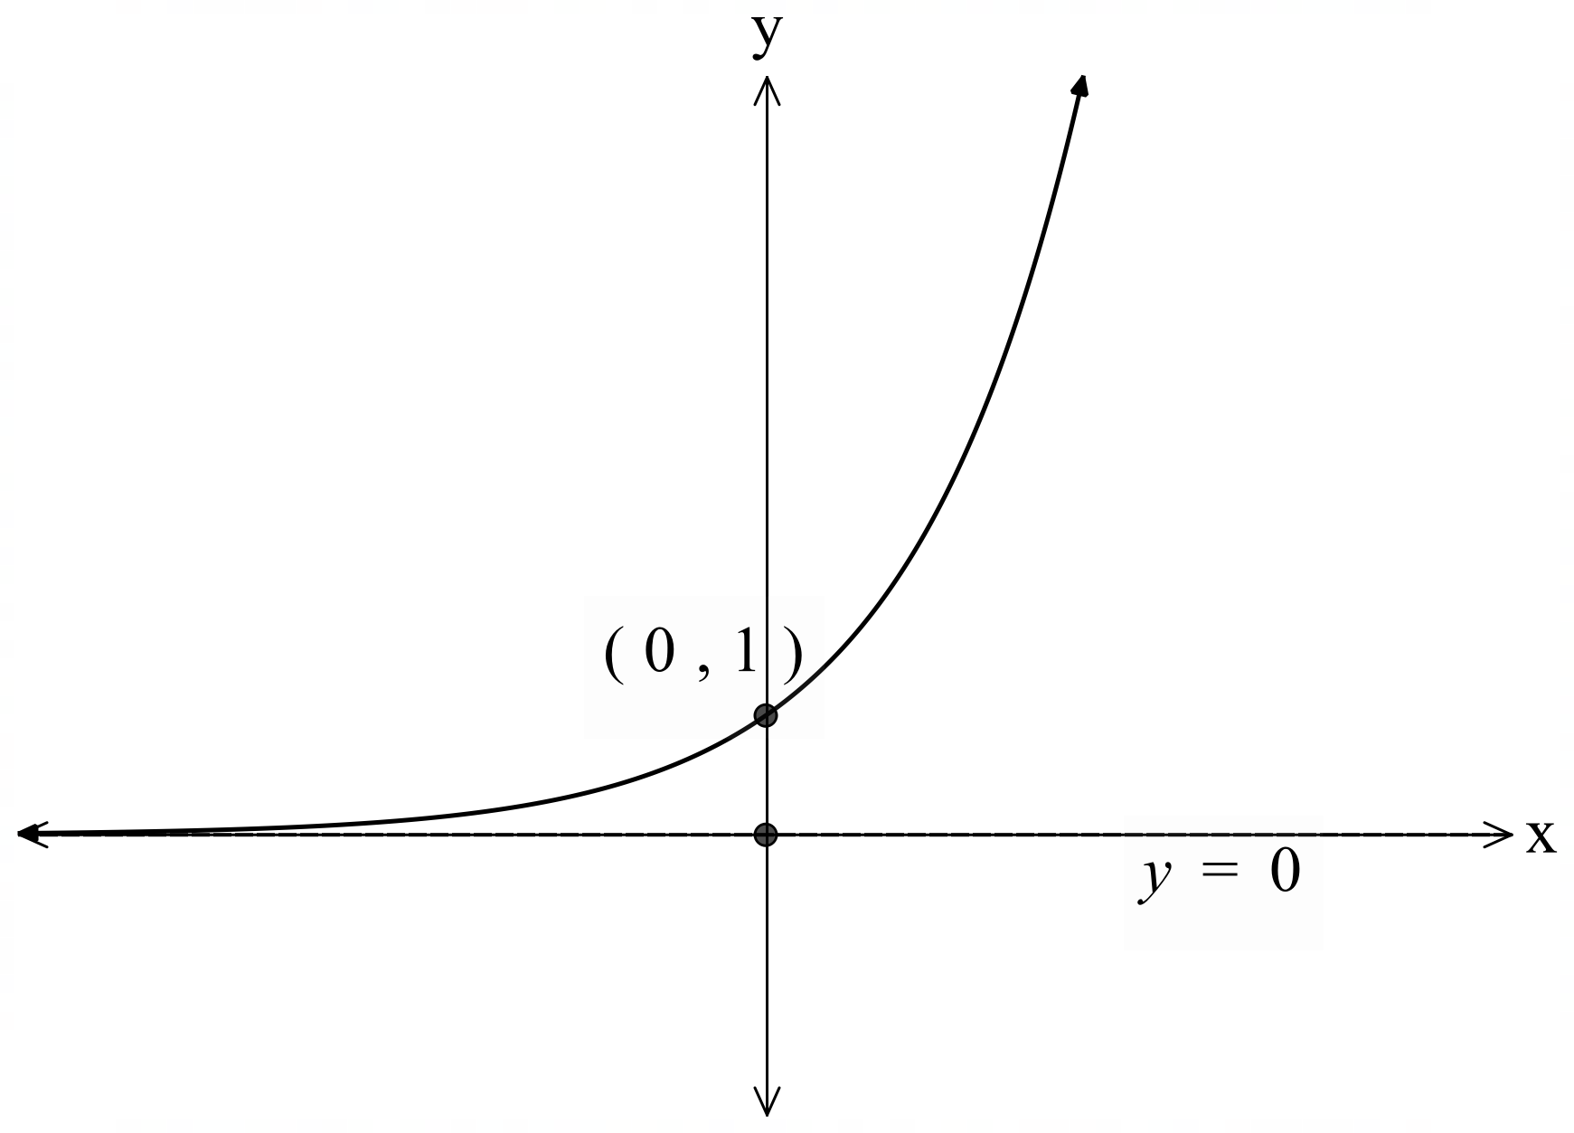
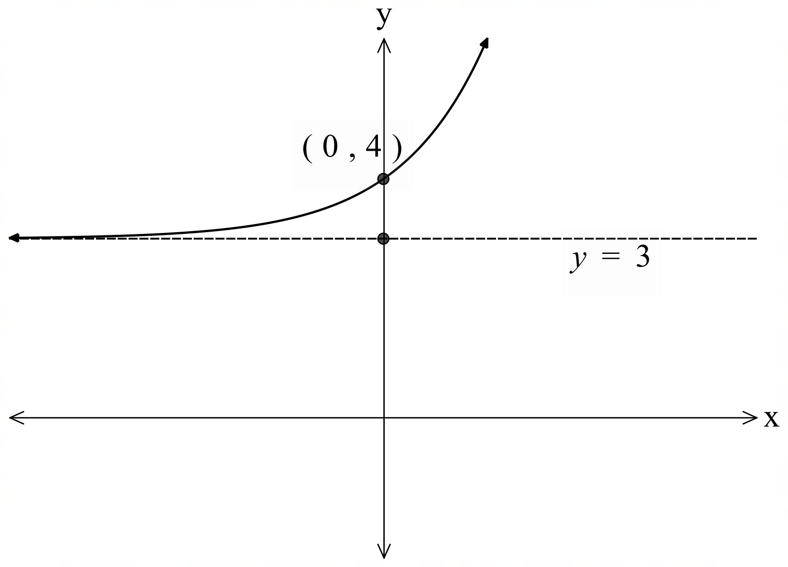

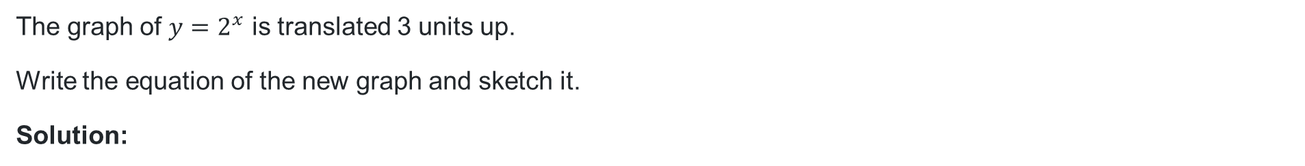
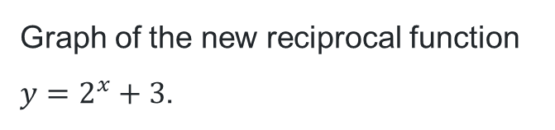
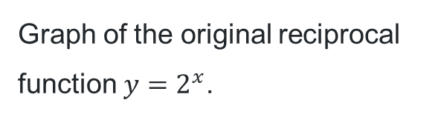
Vertical translations (3)
Graph of the original reciprocal function $y=2^{x}$.
Your turn – Question 1
The graph of $y=2^{x}$ is translated 3 units up.
Write the equation of the new graph and sketch it.
Solution:
Graph of the new reciprocal function $y=2^{x}+3$.
Vertical translation, replace $y$ with $y−b$.
To translate 3 units up, replace $y$ with $y−(3)$.
$$y−3=2^{x}$$
$$y=2^{x}+3$$
$y$- intercepts, let $x=0$
$$y=2^{0}+3$$
$y=4$

Slide 9
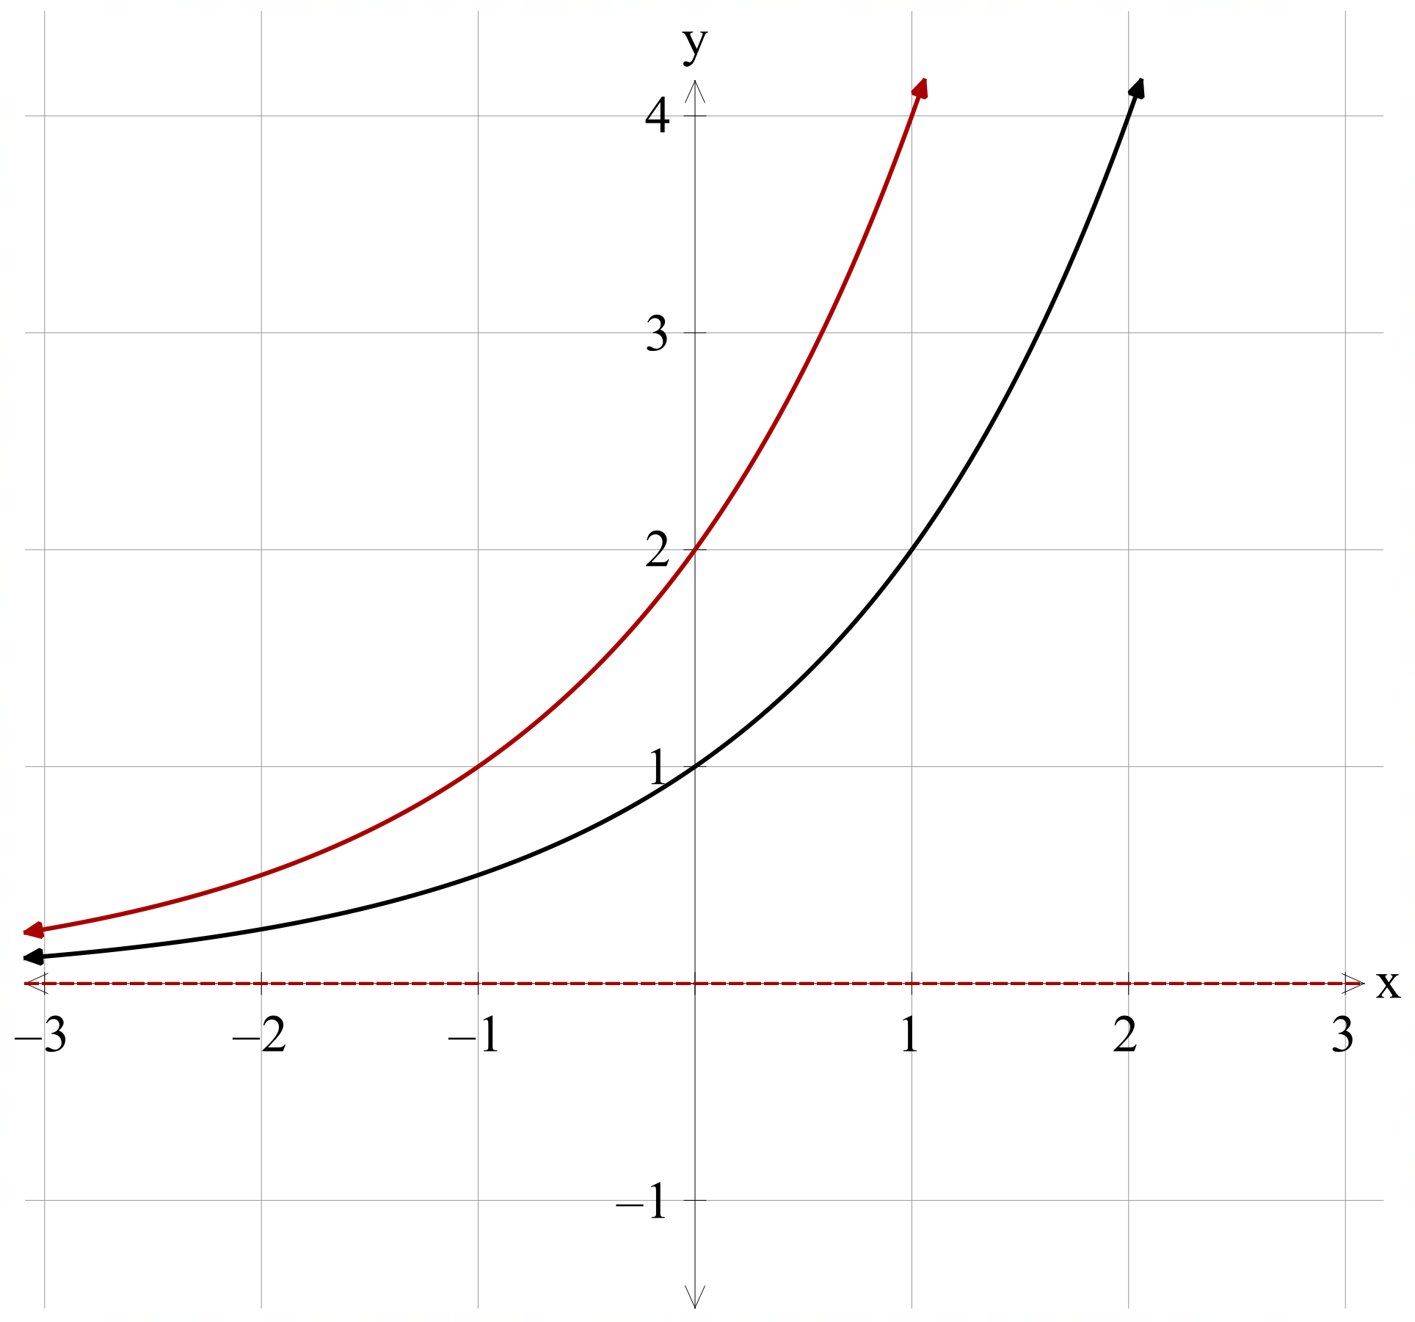
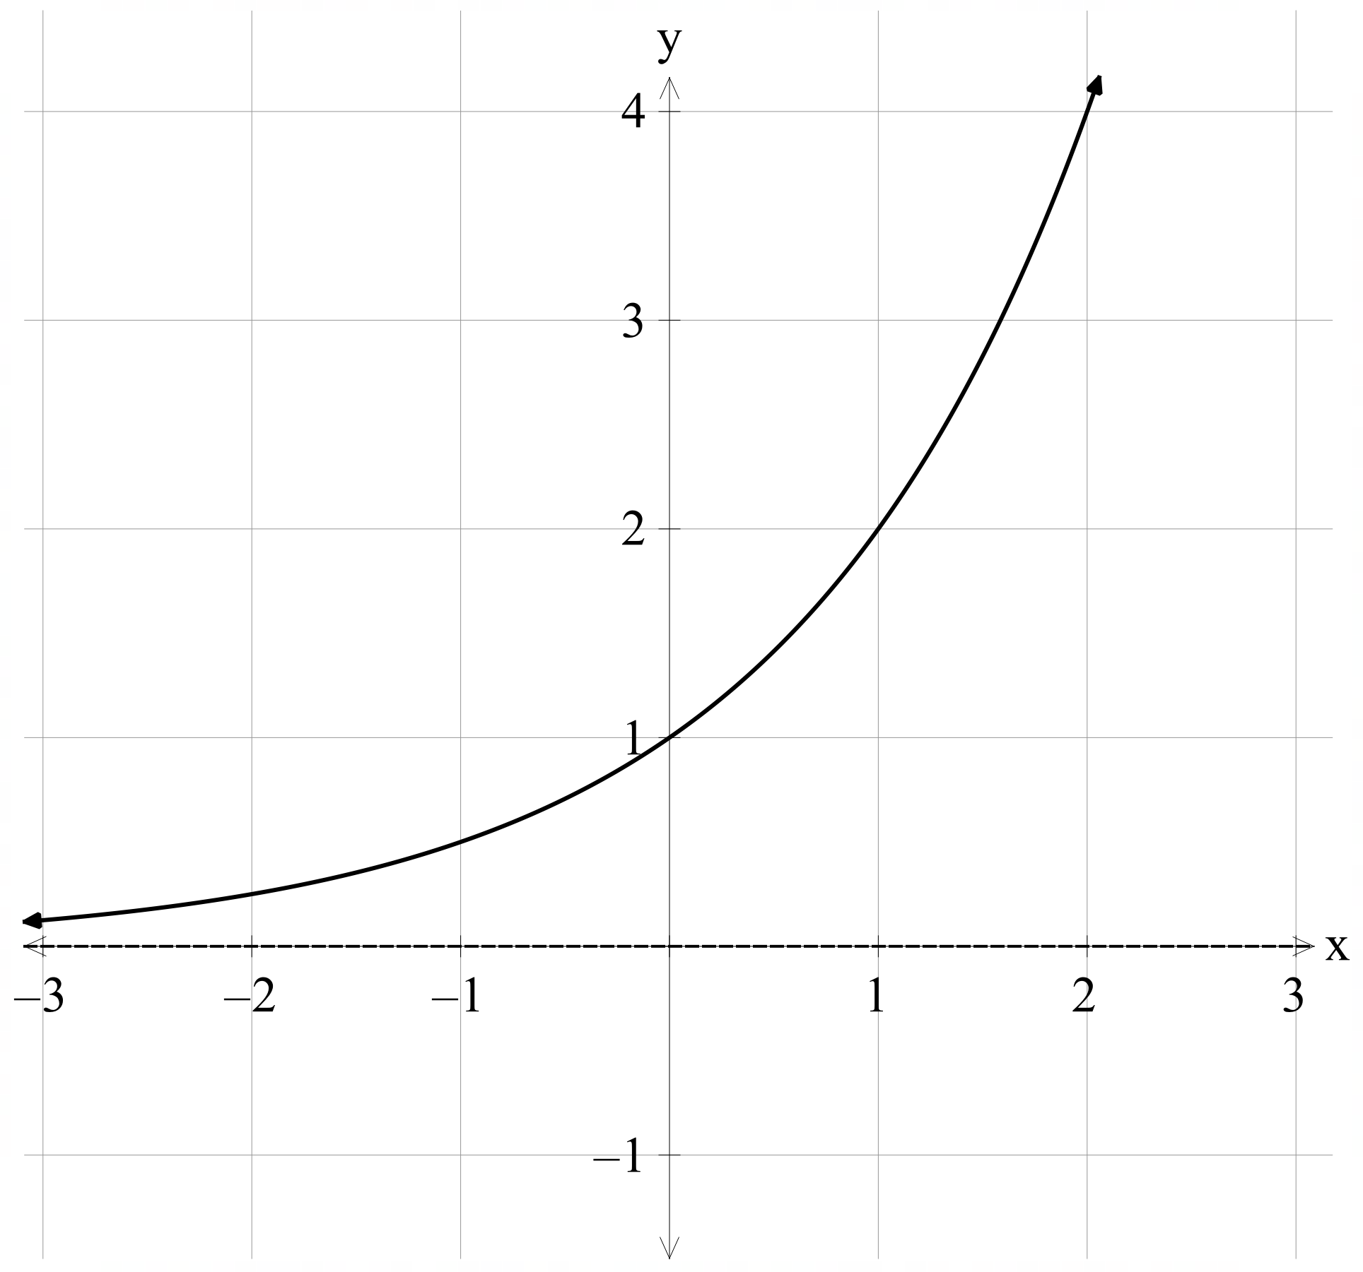
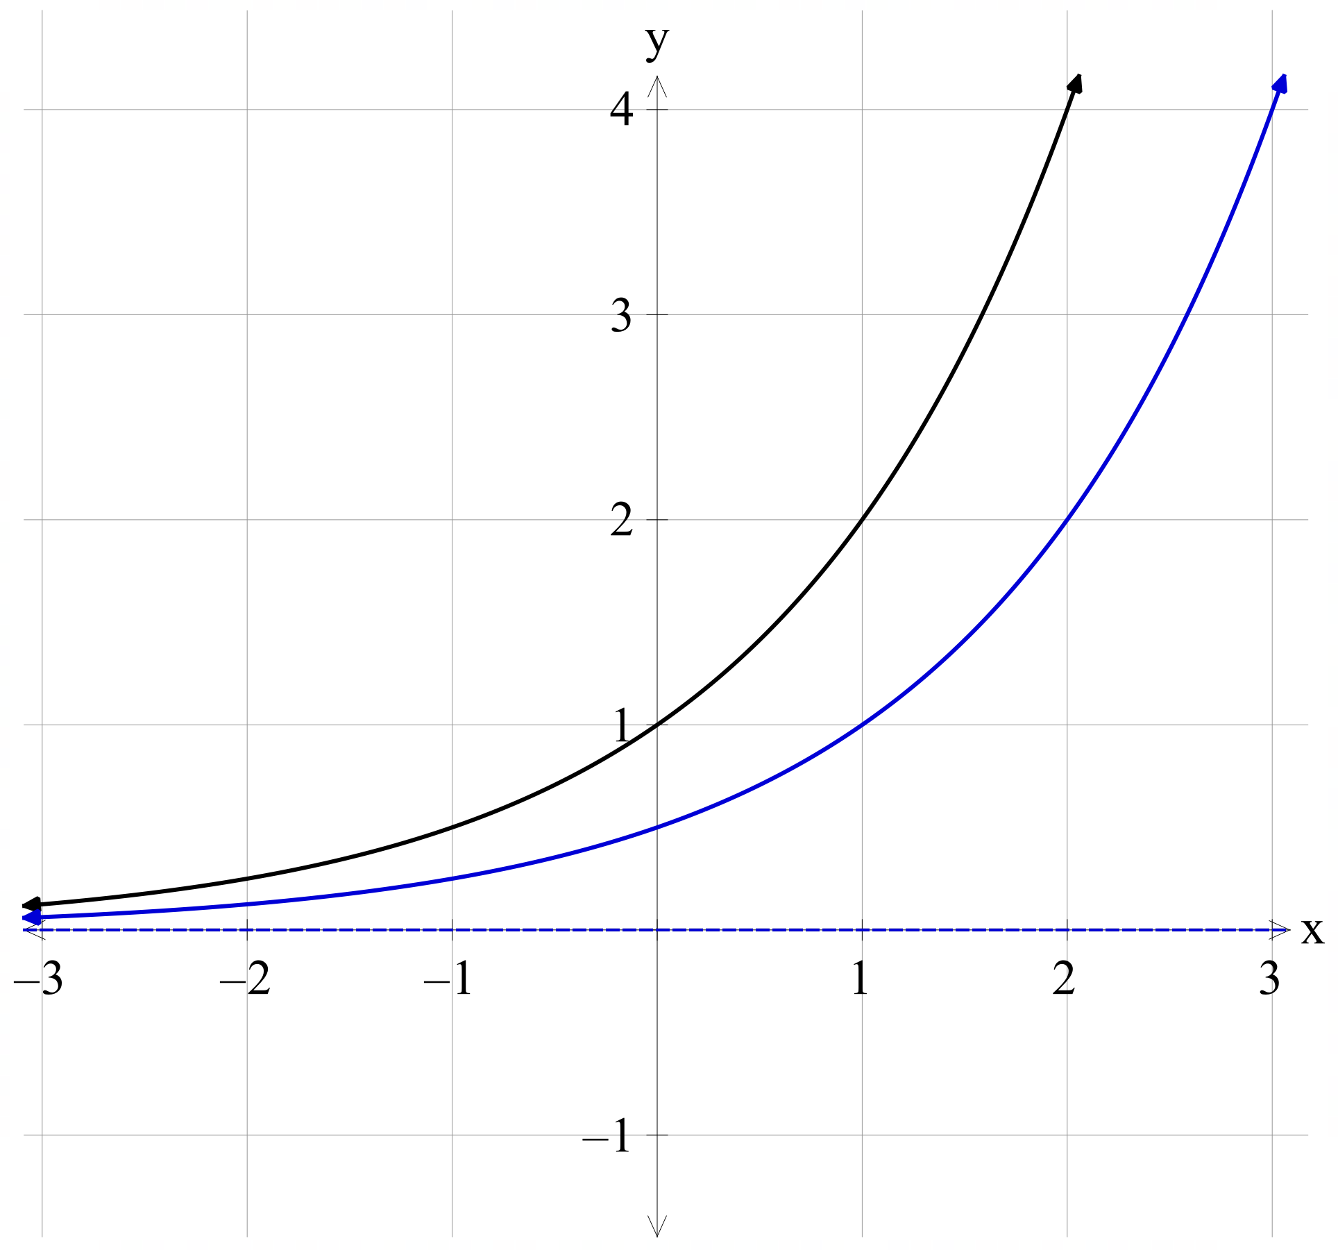
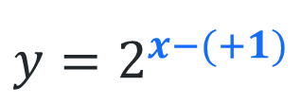
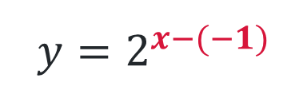
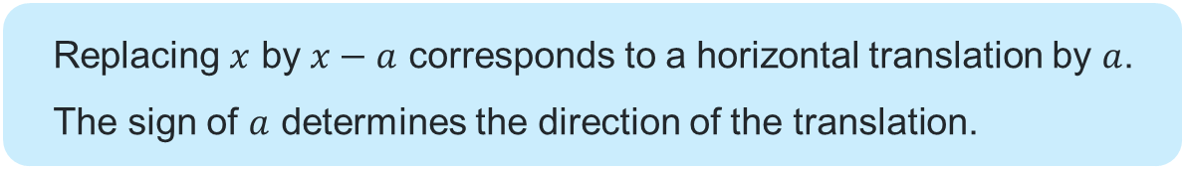
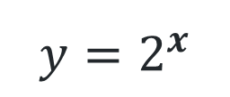
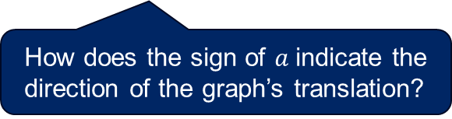
Horizontal translations (1)
The equation of a graph
Replacing $x$ by $x−a$ corresponds to a horizontal translation by $a$. The sign of $a$ determines the direction of the translation.
Why might someone write the equation like this instead of simplifying it? What does it show?
$$y=2^{x−(−1)}$$
$$y=2^{x}$$
$$y=2^{x−(+1)}$$
How does the sign of $a$indicate the direction of the graph’s translation?

Slide 10
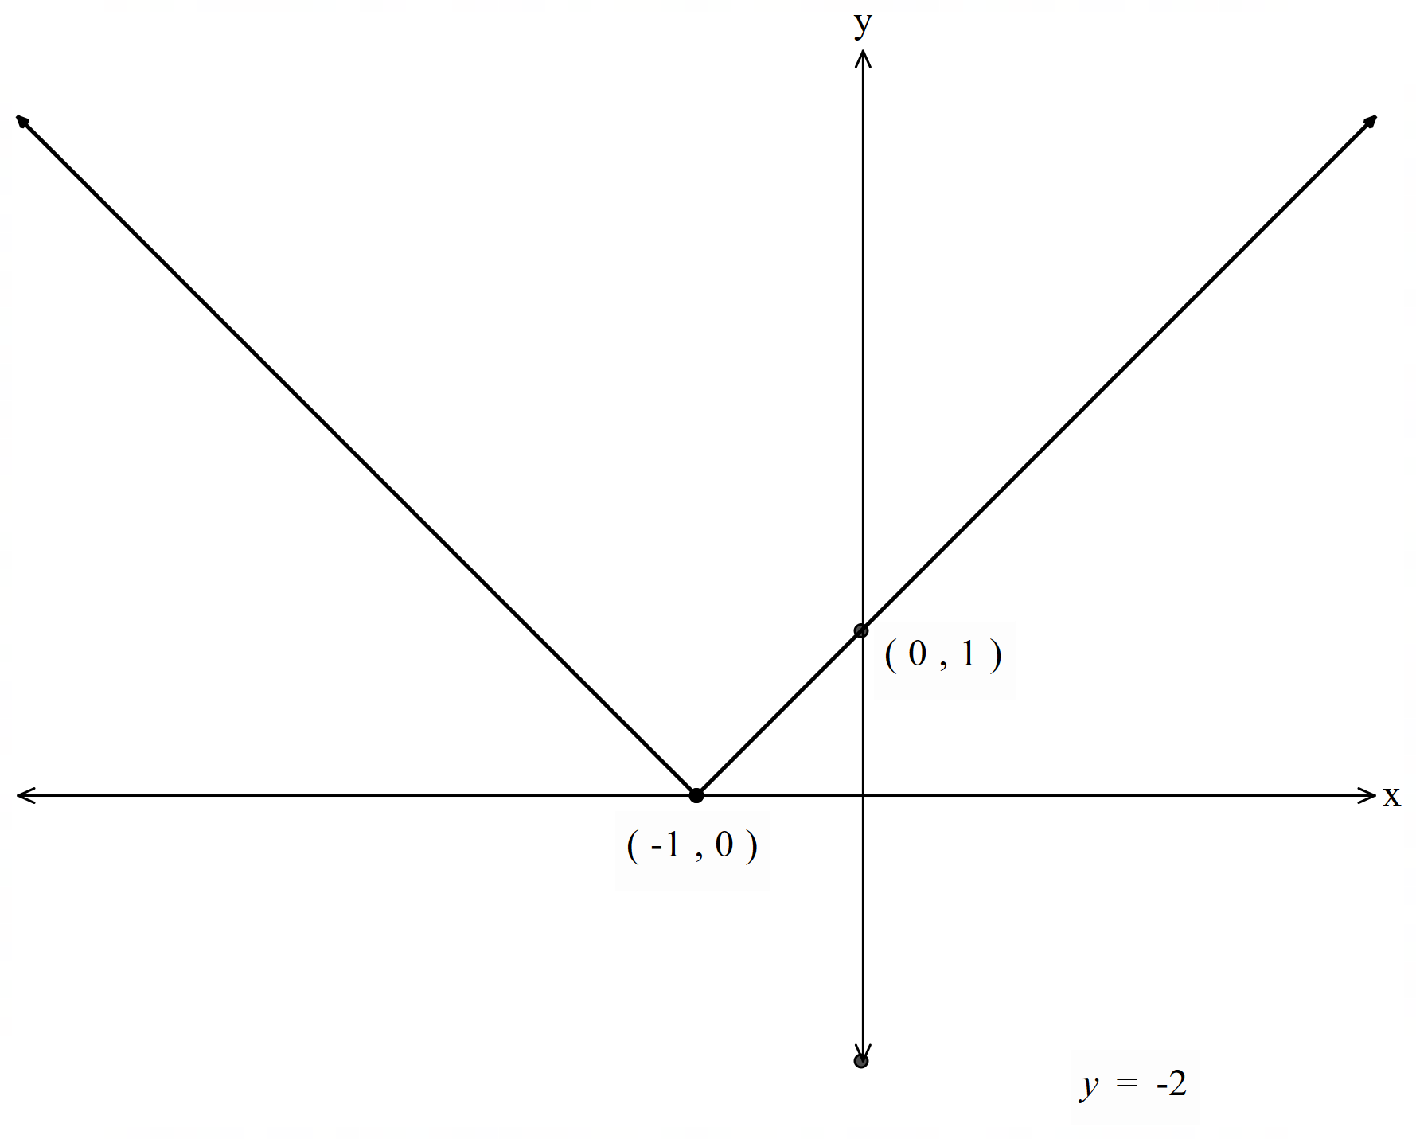
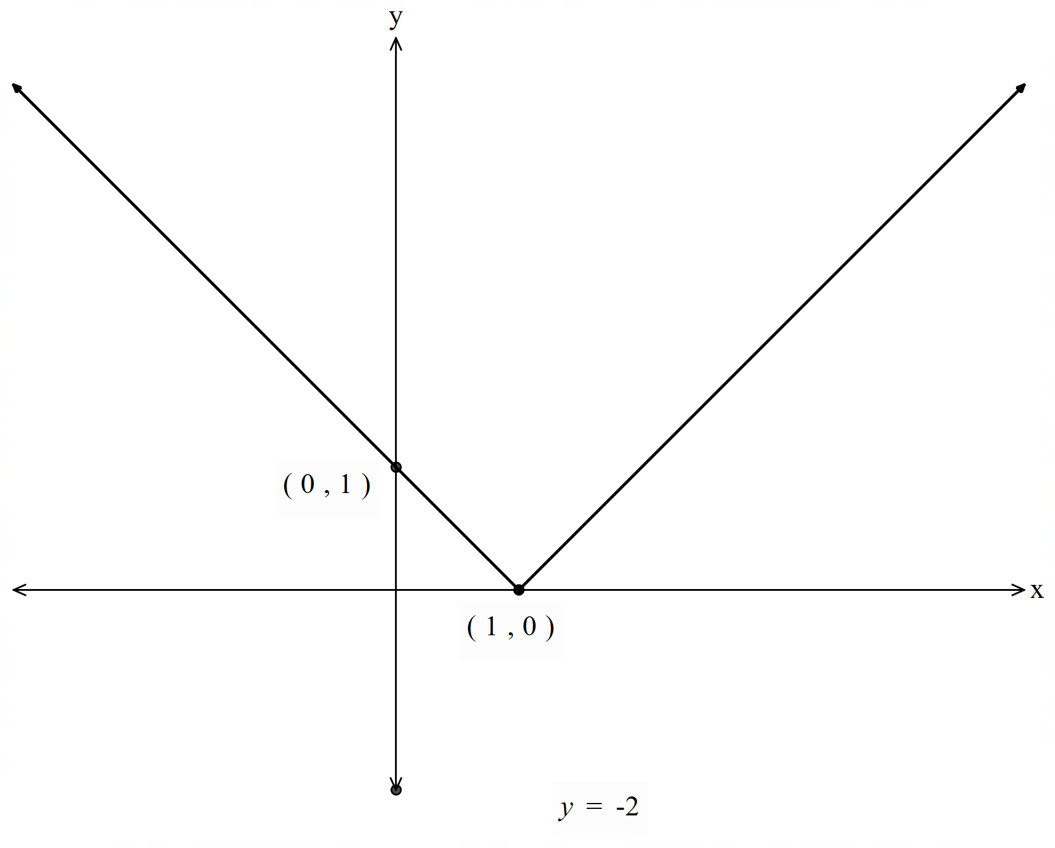
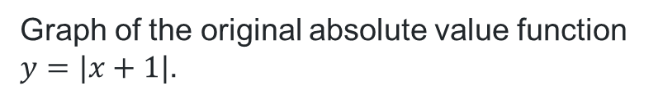
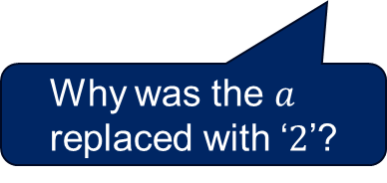
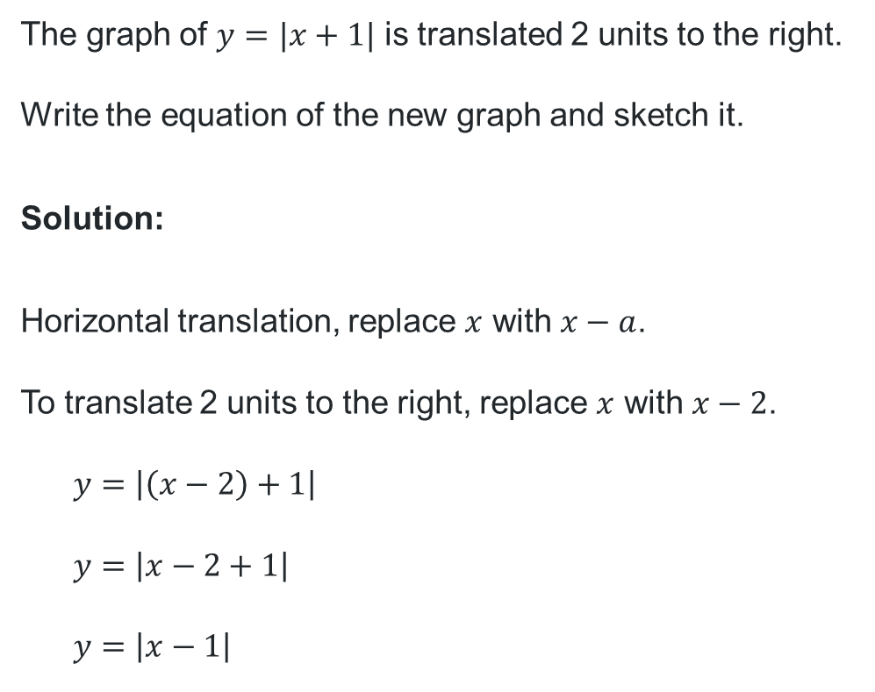
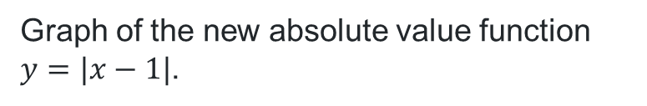
Horizontal translations (2)
Graph of the original absolute value function $y=|x+1|$.
Worked example 2
The graph of $y=|x+1|$ is translated 2 units to the right.
Write the equation of the new graph and sketch it.
Solution:
Horizontal translation, replace $x$ with $x−a$.
To translate 2 units to the right, replace $x$ with $x−2$.
$$y=\left|\left(x−2\right)+1\right|$$
$$y=\left|x−2+1\right|$$
$$y=\left|x−1\right|$$
Graph of the new absolute value function $y=|x−1|$.
Why was the $a$ replaced with ‘$2$’?
Could this graph have been drawn without first finding the new equation?

Slide 11
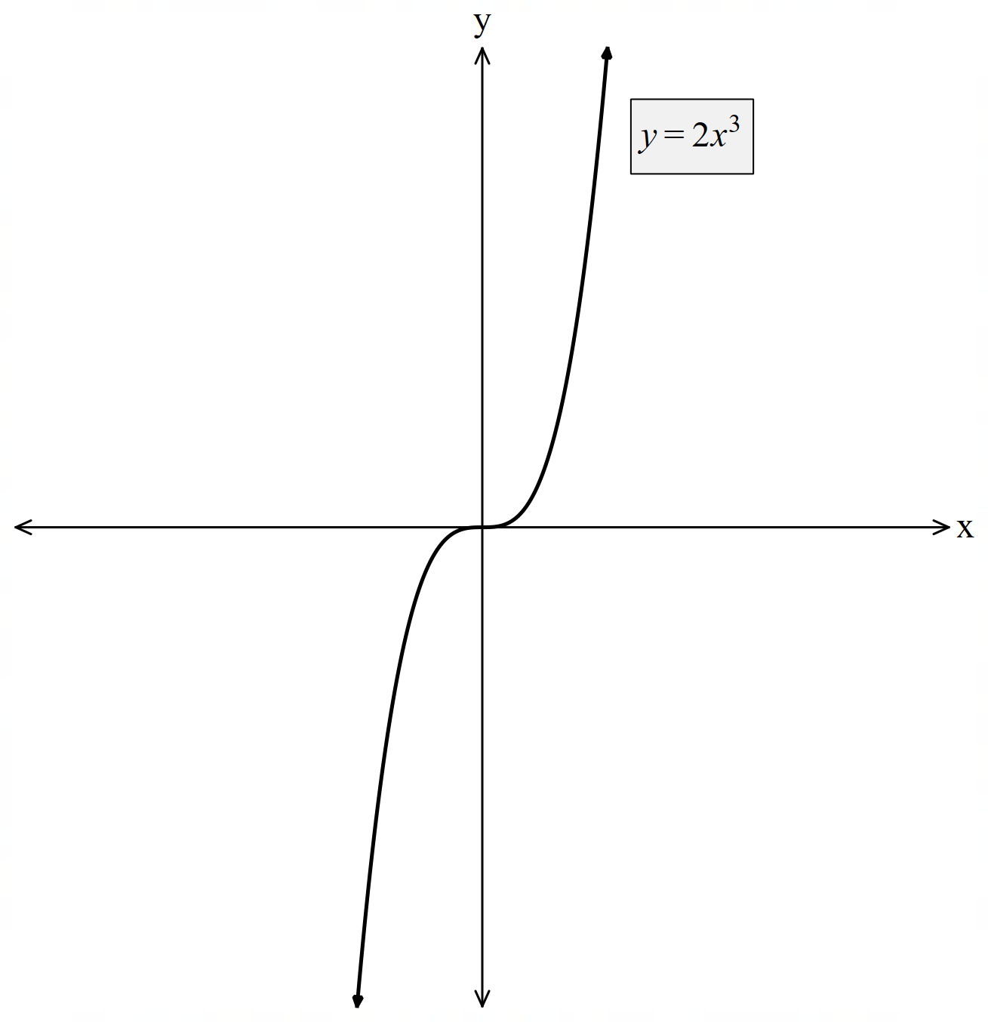
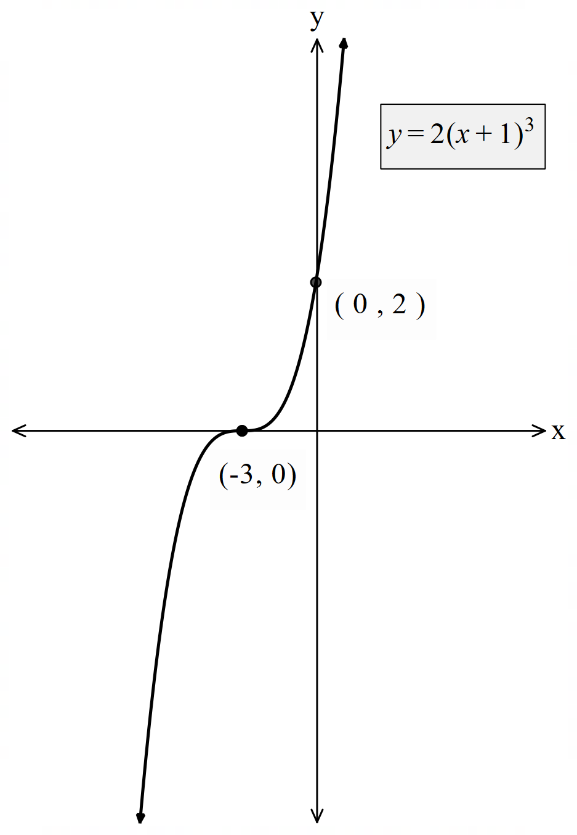
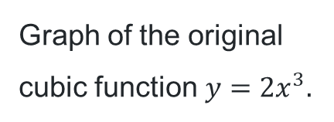
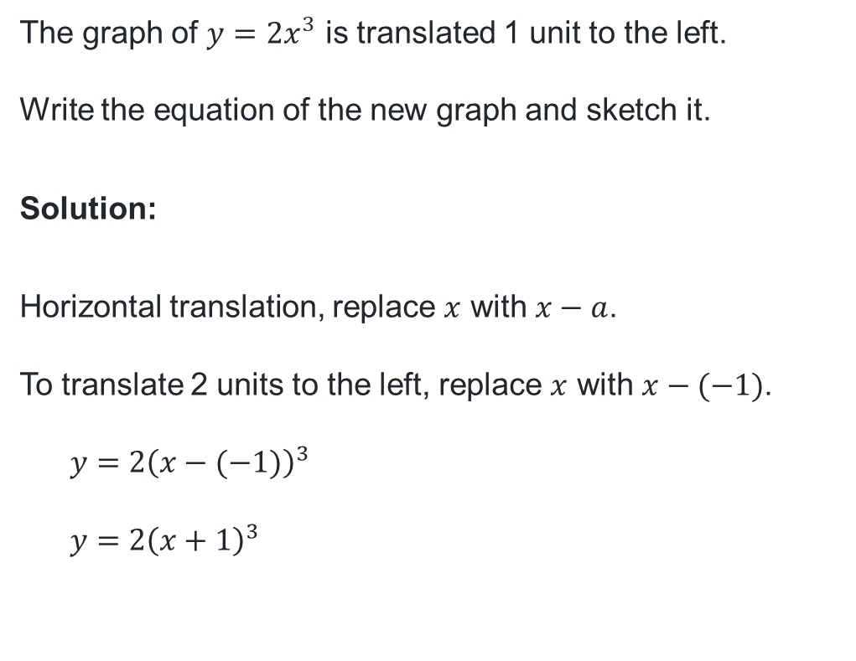
Horizontal translations (3)
Graph of the original cubic function$y=2x^{3}.$
Your turn – Question 2
The graph of $y=2x^{3}$ is translated 1 unit to the left.
Write the equation of the new graph and sketch it.
Solution:
Horizontal translation, replace $x$ with $x−a$.
To translate 2 units to the left, replace $x$ with $x−(−1)$.
$$y=2{\left(x−(−1)\right)}^{3}$$
$$y=2{\left(x+1\right)}^{3}$$
Graph of the new cubic function $y=2{\left(x+1\right)}^{3}$.

Slide 12
Independent practice

Slide 13
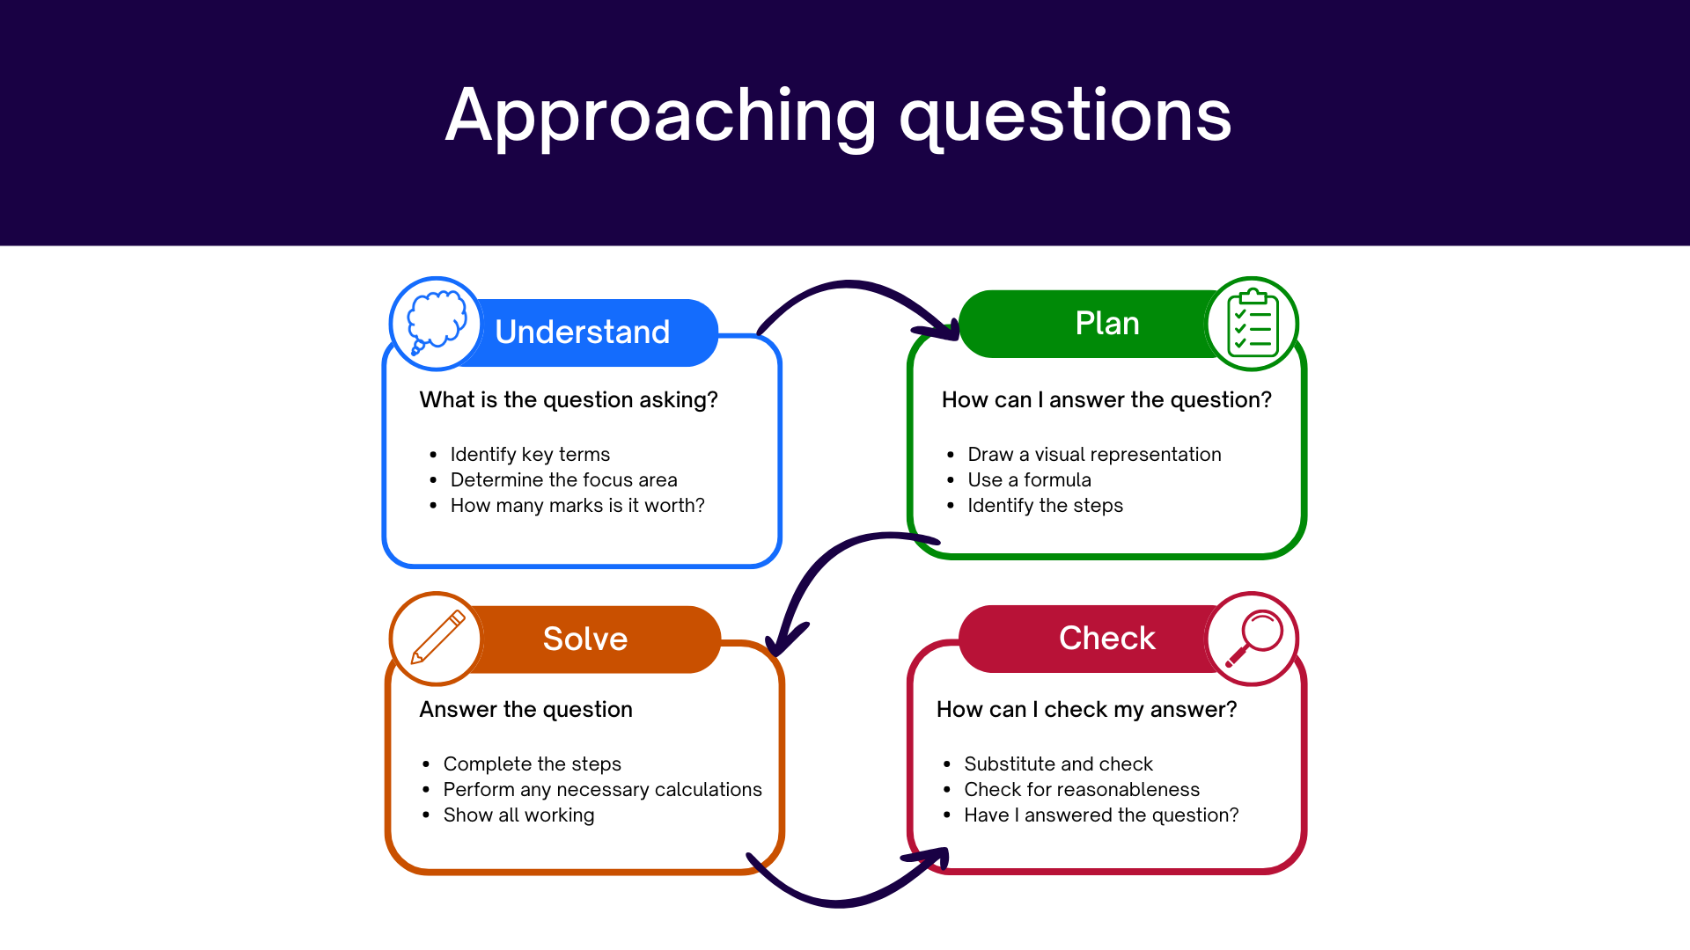
Approaching questions scaffold

Slide 14


Problem 1
The graph of the function $f\left(x\right)=x^{2}$ is translated $m$ units horizontally and $b$ units vertically.
The equation of the transformed function is $g\left(x\right)=x^{2}−8x+19$.
Find the values of $m$ and $b$ and describe the translation that has occurred.
Solution
Complete the square
$$g\left(x\right)=x^{2}−8x++19−$$
$$g\left(x\right)=x^{2}−8x+16+19−16$$
$$g\left(x\right)={\left(x−4\right)}^{2}+3$$
Rearrange, replacing $g(x)$ with $y$
$$g(x)−3={\left(x−4\right)}^{2}$$
$$y−3={\left(x−4\right)}^{2}$$
The graph has been translated up by 3 units, $∴b=3$
The graph has been translated right by 4 units, $∴m=4$

Slide 15


Problem 2 (1)
The graph of $y=f(x)$, where $f\left(x\right)=−\left|x−a\right|+c$, passes through the points $\left(1, 2\right)$and$(4, 5)$, as shown in the diagram.
Find the values of $a$ and $c$.

Slide 16

Problem 2 (2)
Marking criteria
Criteria | Marks
Provides correct solution | 2
Finds the value of $c$, or equivalent merit | 1

Slide 17


Problem 2 (3)
Solution – Option 1
The graph of $y=f(x)$, where $f\left(x\right)=−\left|x−a\right|+c$, passes through the points $\left(1, 2\right)$and$(4, 5)$.
Find the values of $a$ and $c$.
Solution:
Using the point $\left(4, 5\right)$ the graph of $y=−\left|x\right| \text{has} \text{been} \text{translated}\text{ 4 }\text{units} \text{to} \text{the} \text{right} \text{and}\text{ 5 }\text{units} \text{up}\text{.}$
$∴x$ has been replaced with $x−4$ and $y$ has been replaced with $y−5$.
$$y−5=−|x−4|$$
$$y=−\left|x−4\right|+5$$
$∴a=4$ and $c=5$

Slide 18


Problem 2 (4)
Looking at the right section, in the domain $x≥4:$
The gradient would be $−1$, equation of line:
$$y−5=−1\left(x−4\right)$$
$$y=−x+9$$
The right-side line is $y=−x+a+c$
$$∴−x+9=−x+a+c$$
$$a+c=9$$
Solve simultaneously
$$2c=10$$
$$c=5$$
$$a+5=9$$
$$a=4$$
$∴a=4$ and $c=5$
Solution – Option 2
$$f\left(x\right)=\left\{\begin{aligned}−\left(x−a\right)+c=−x+a+c \\ x−a+c,\end{aligned} \begin{matrix}x≥a \\ x<a\end{matrix}\right.$$
Looking at the left section, in the domain $x<4$:
$$m=\frac{5−2}{4−1}$$
$$m=1$$
$$y−2=1\left(x−1\right)$$
$$y=x−1+2$$
$$∴y=x+1$$
The left-side line is $y=x−a+c$
$$∴x−a+c=x+1$$
$$c−a=1$$
2
1
2
+
1

Slide 19
References
This presentation contains NSW Curriculum and syllabus content. The NSW Curriculum is developed by the NSW Education Standards Authority. This content is prepared by NESA for and on behalf of the Crown in the right of the State of New South Wales. The material is protected by Crown copyright.
Please refer to the NESA Copyright Disclaimer for more information https://educationstandards.nsw.edu.au/wps/portal/nesa/mini-footer/copyright.
NESA holds the only official and up-to-date versions of the NSW Curriculum and syllabus documents. Please visit the NSW Education Standards Authority (NESA) website https://educationstandards.nsw.edu.au/wps/portal/nesa/home and the NSW Curriculum website https://curriculum.nsw.edu.au.
Mathematics Advanced 11–12 Syllabus © NSW Education Standards Authority (NESA) for and on behalf of the Crown in right of the State of New South Wales, 2024.

Slide 20
Copyright
© State of New South Wales (Department of Education), 2025
The copyright material published in this resource is subject to the Copyright Act 1968 (Cth) and is owned by the NSW Department of Education or, where indicated, by a party other than the NSW Department of Education (third-party material).
Copyright material available in this resource and owned by the NSW Department of Education is licensed under a Creative Commons Attribution 4.0 International (CC BY 4.0) license.
This license allows you to share and adapt the material for any purpose, even commercially.
Attribution should be given to © State of New South Wales (Department of Education), 2025.
Material in this resource not available under a Creative Commons license:
the NSW Department of Education logo, other logos and trademark-protected material
Material owned by a third party that has been reproduced with permission. You will need to obtain permission from the third party to reuse its material.
Links to third-party material and websites
Please note that the provided (reading/viewing material/list/links/texts) are a suggestion only and implies no endorsement, by the New South Wales Department of Education, of any author, publisher, or book title. School principals and teachers are best placed to assess the suitability of resources that would complement the curriculum and reflect the needs and interests of their students.
If you use the links provided in this document to access a third-party’s website, you acknowledge that the terms of use, including licence terms set out on the third-party’s website apply to the use which may be made of the materials on that third-party website or where permitted by the Copyright Act 1968 (Cth). The department accepts no responsibility for content on third-party websites.

