Slide 1

Piecewise-defined functions
Mathematics Advanced – Stage 6 (Year 11)
Unit 4 – graphing transformations

Slide 2
Learning intentions and success criteria
Learning intention
To be able to interpret and construct piecewise-defined functions.
Success criteria
I can describe a piecewise-defined function.
I can identify the functions and domains that make up a piecewise-defined function.
I can determine whether a piecewise-defined function is continuous or discontinuous at a given point.
I can construct the graph of a piecewise-defined function.
Notes:
Notes for teachers:
Learning intentions and success criteria are best co-constructed with students. Adapt the learning intention as required and add matching success criteria.
For more information See ⁠AITSL or the NSW Department of Education explicit teaching strategies, ⁠Sharing learning intentions and ⁠Sharing success criteria
LISC is not necessarily presented at the beginning of the lesson. Teacher needs to consider most effectual time to introduce
LISC should be revisited during the lesson to support students' evaluation of their learning

Slide 3
Activating prior knowledge

Slide 4
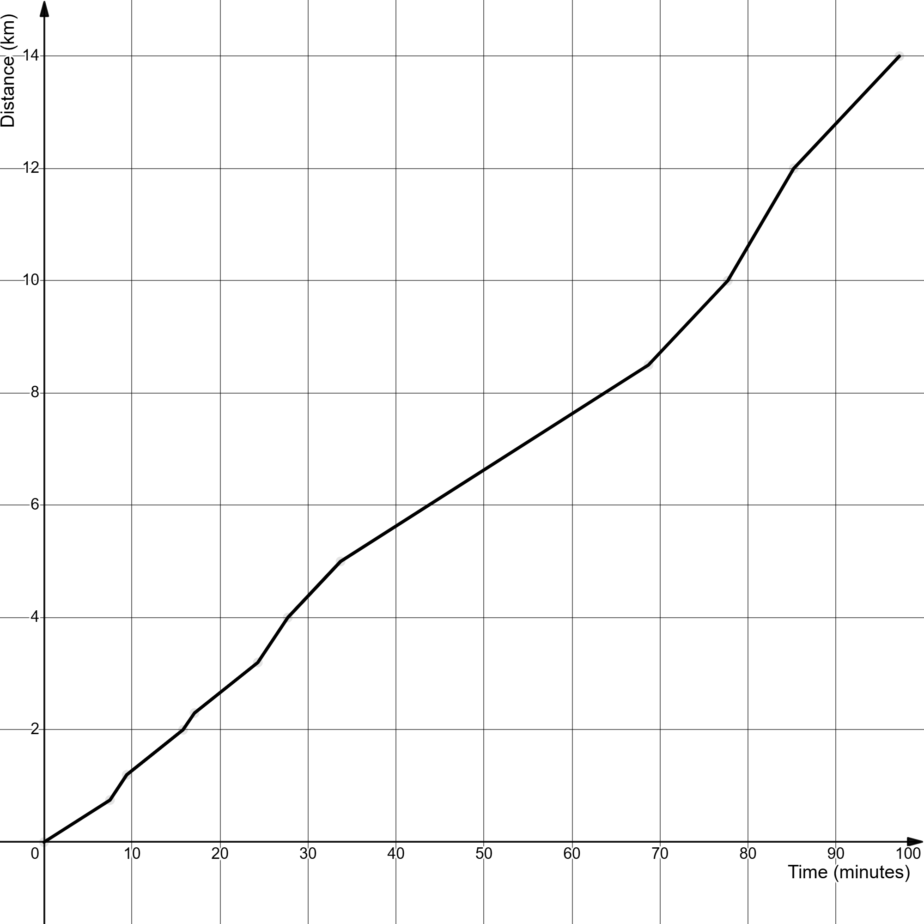
City to surf
Distance travelled

Slide 5
Connecting learning

Slide 6
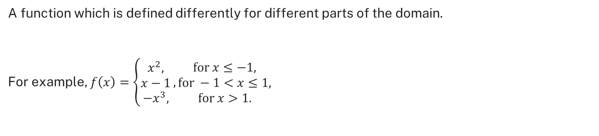
Piecewise-defined function (1)
NESA Glossary definition
A function which is defined differently for different parts of the domain.
For example, $f\left(x\right)=\left\{\begin{aligned}x^{2}, \\ x−1 \\ −x^{3},\end{aligned}\right., \begin{matrix}\text{f}\text{or} x≤−1, \\ \text{for} −1<x≤1, \\ \text{for} x>1.\end{matrix}$

Slide 7
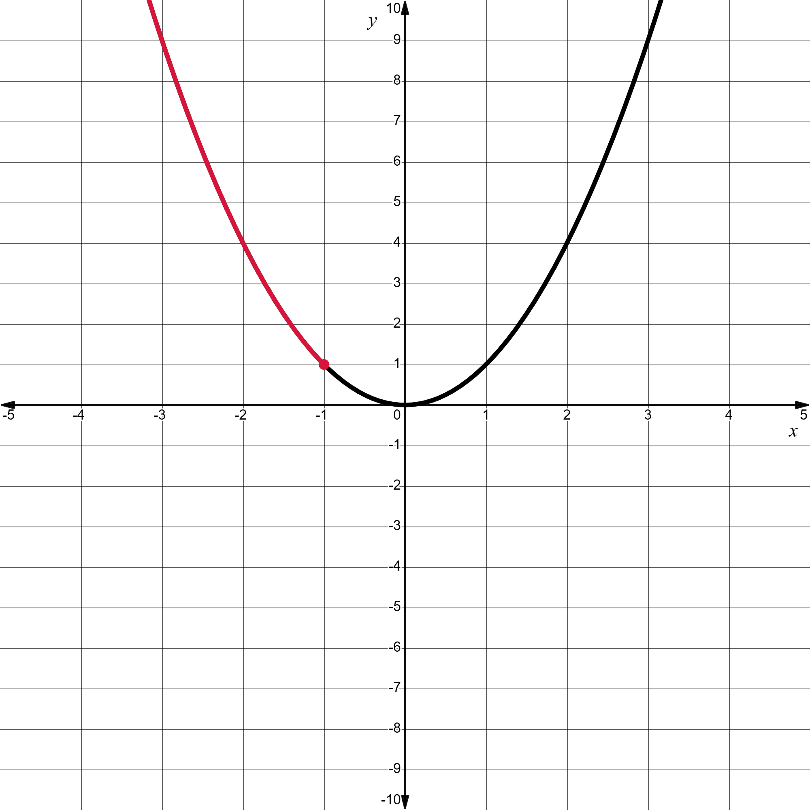
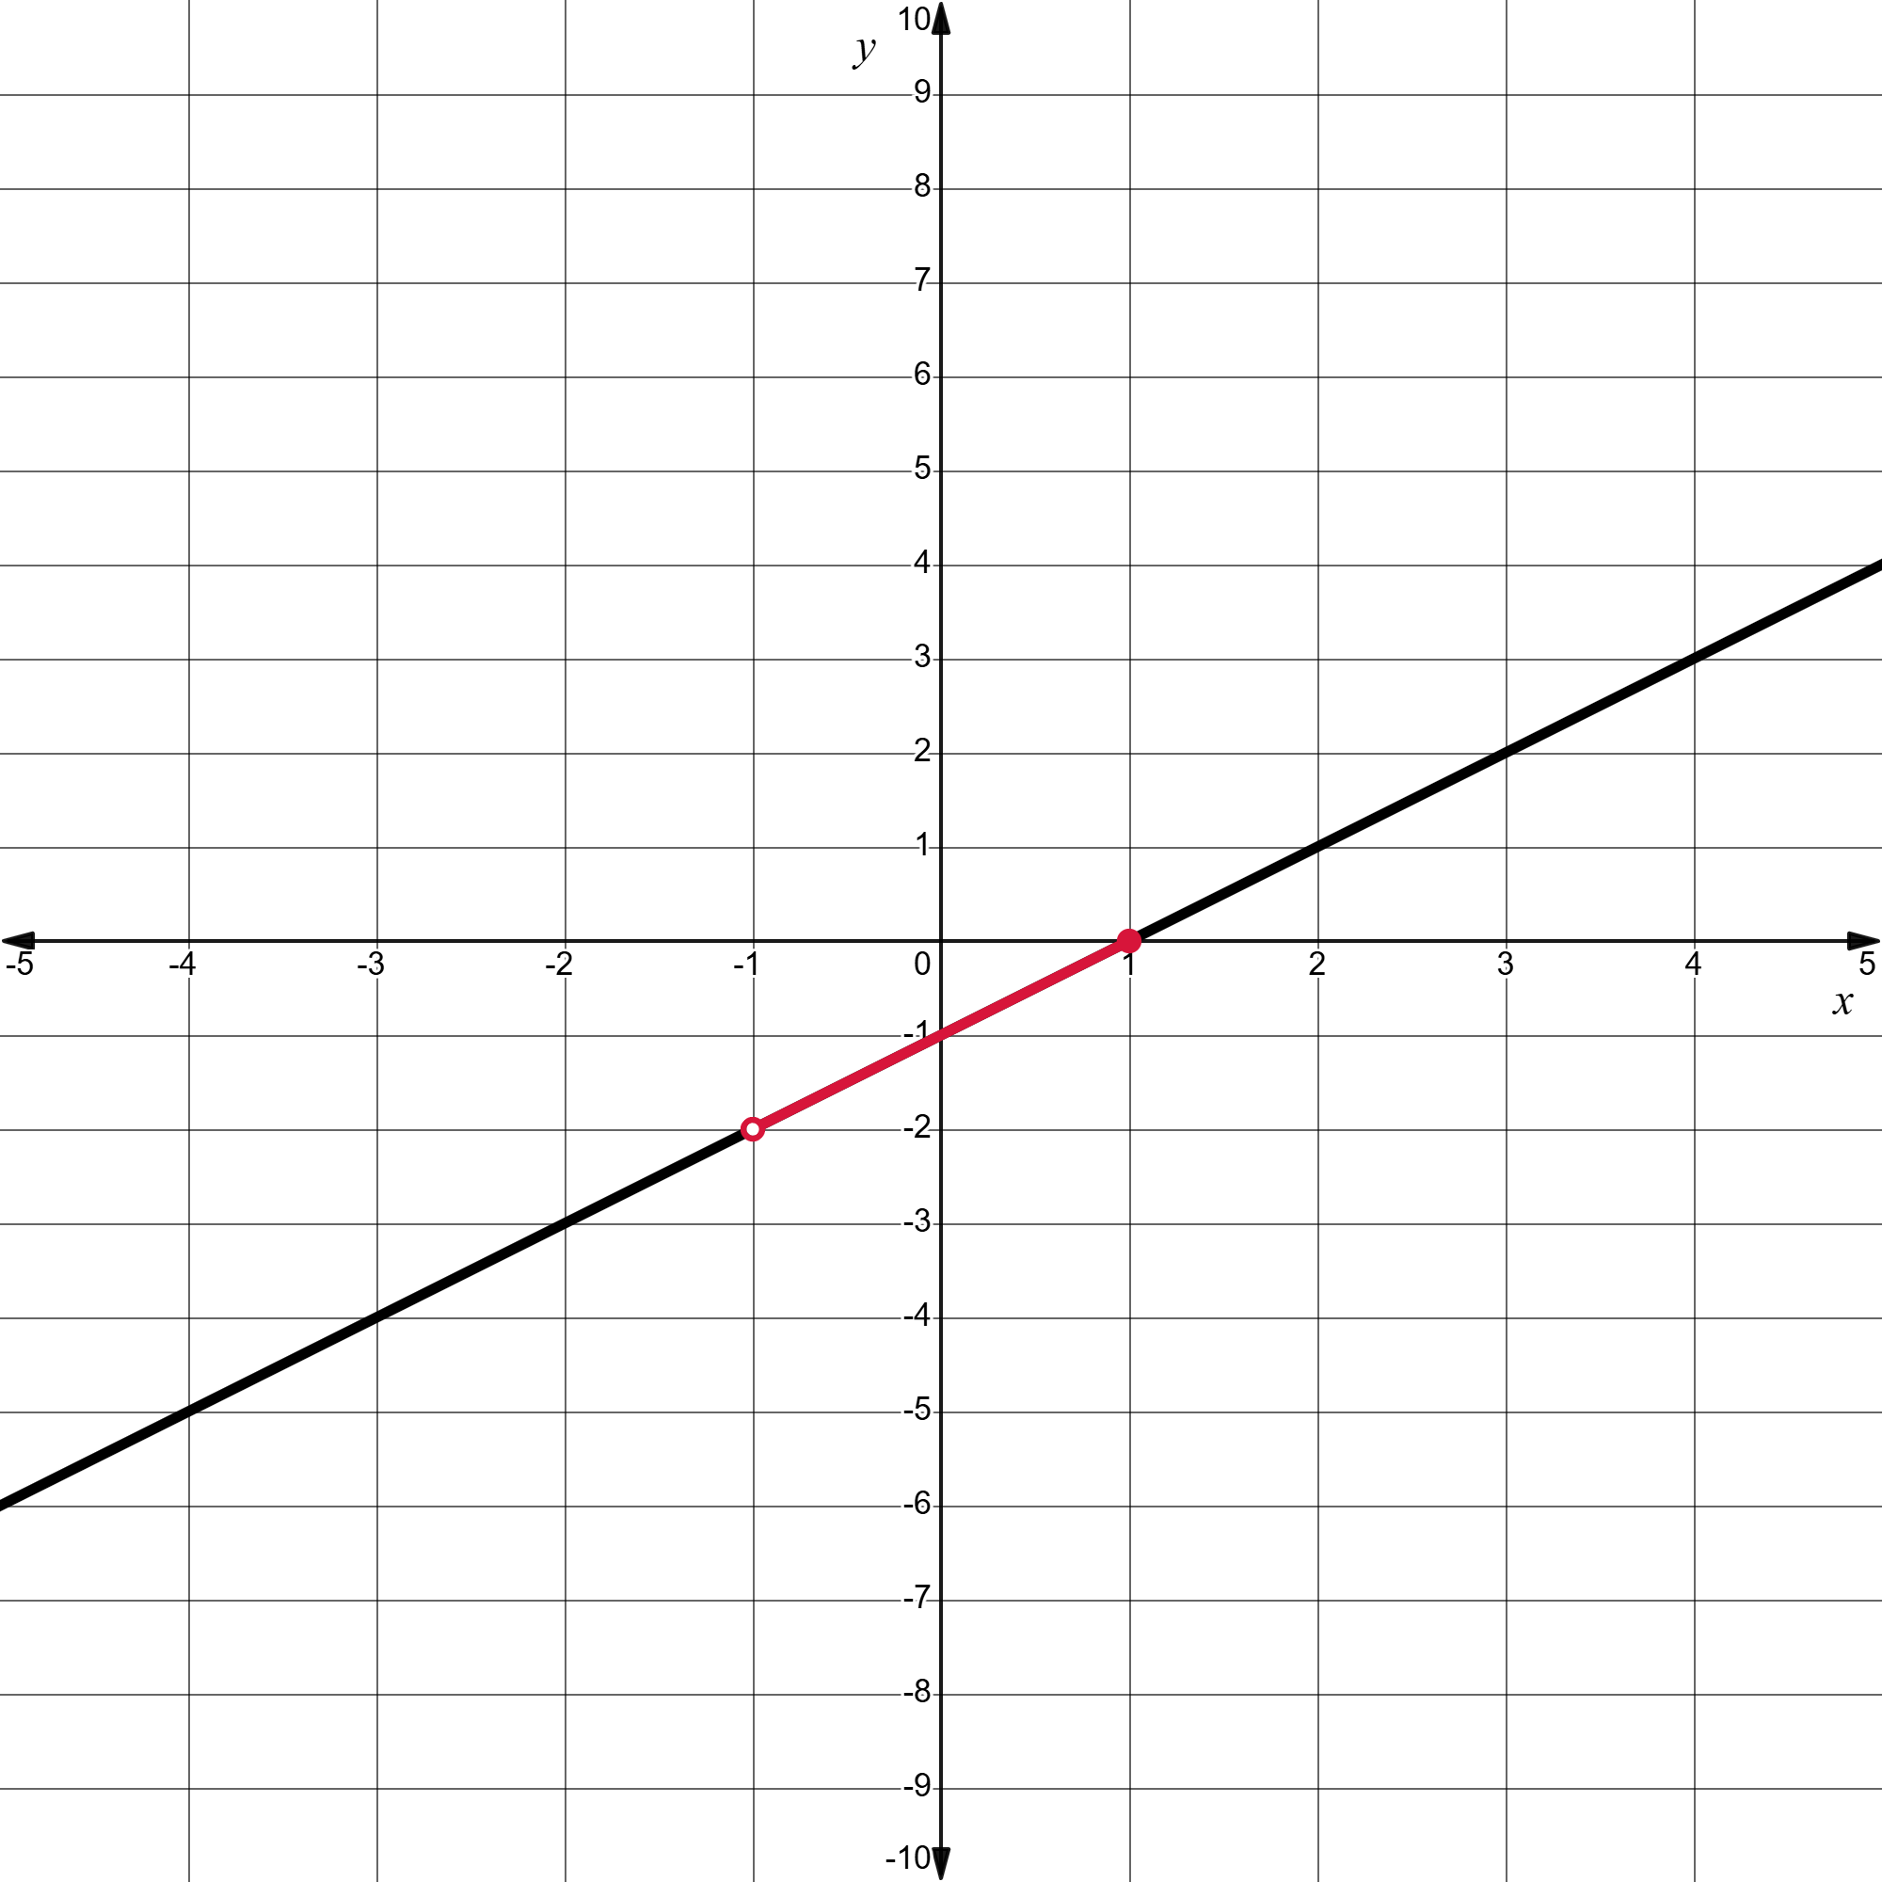
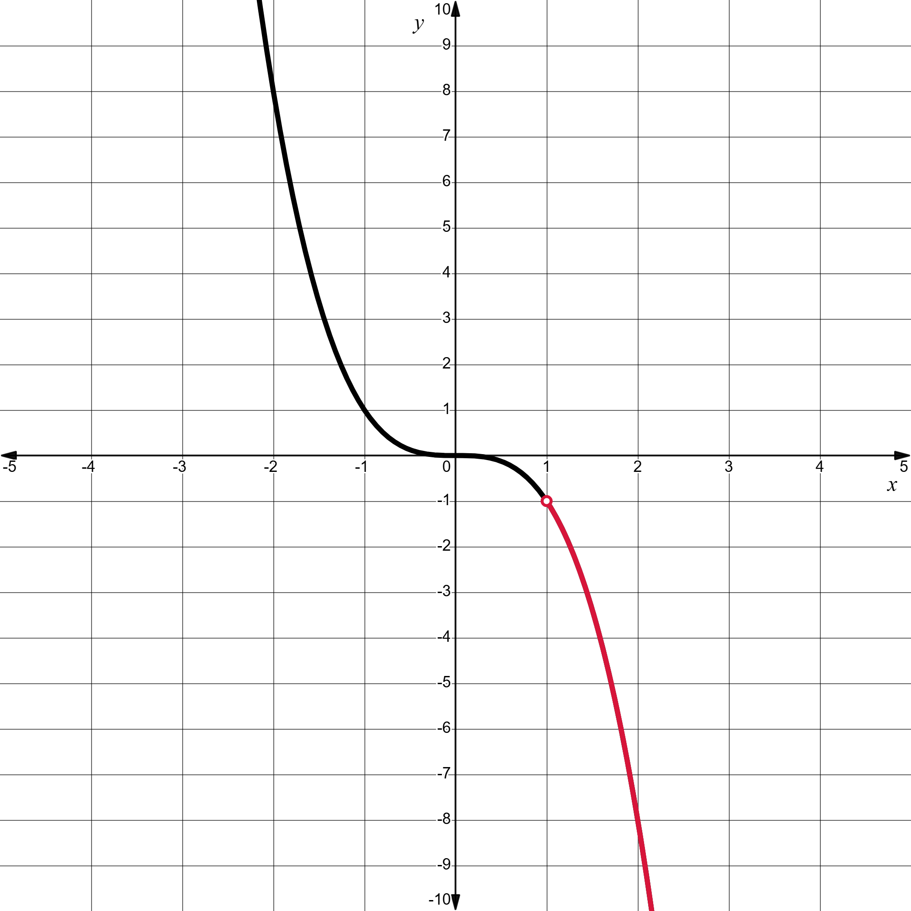
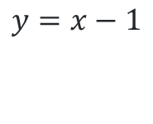
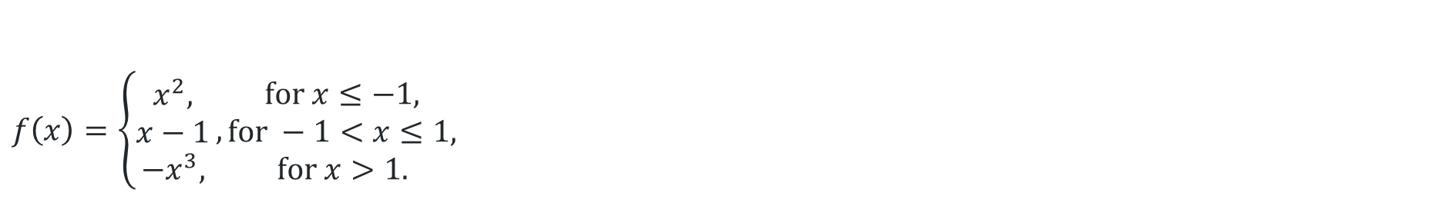

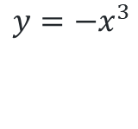
Piecewise-defined function (2)
$$f\left(x\right)=\left\{\begin{aligned}x^{2}, \\ x−1 \\ −x^{3},\end{aligned}\right., \begin{matrix}\text{f}\text{or} x≤−1, \\ \text{for} −1<x≤1, \\ \text{for} x>1.\end{matrix}$$
$$y=x^{2}$$
$$y=x−1$$
$$y={−x}^{3}$$

Slide 8
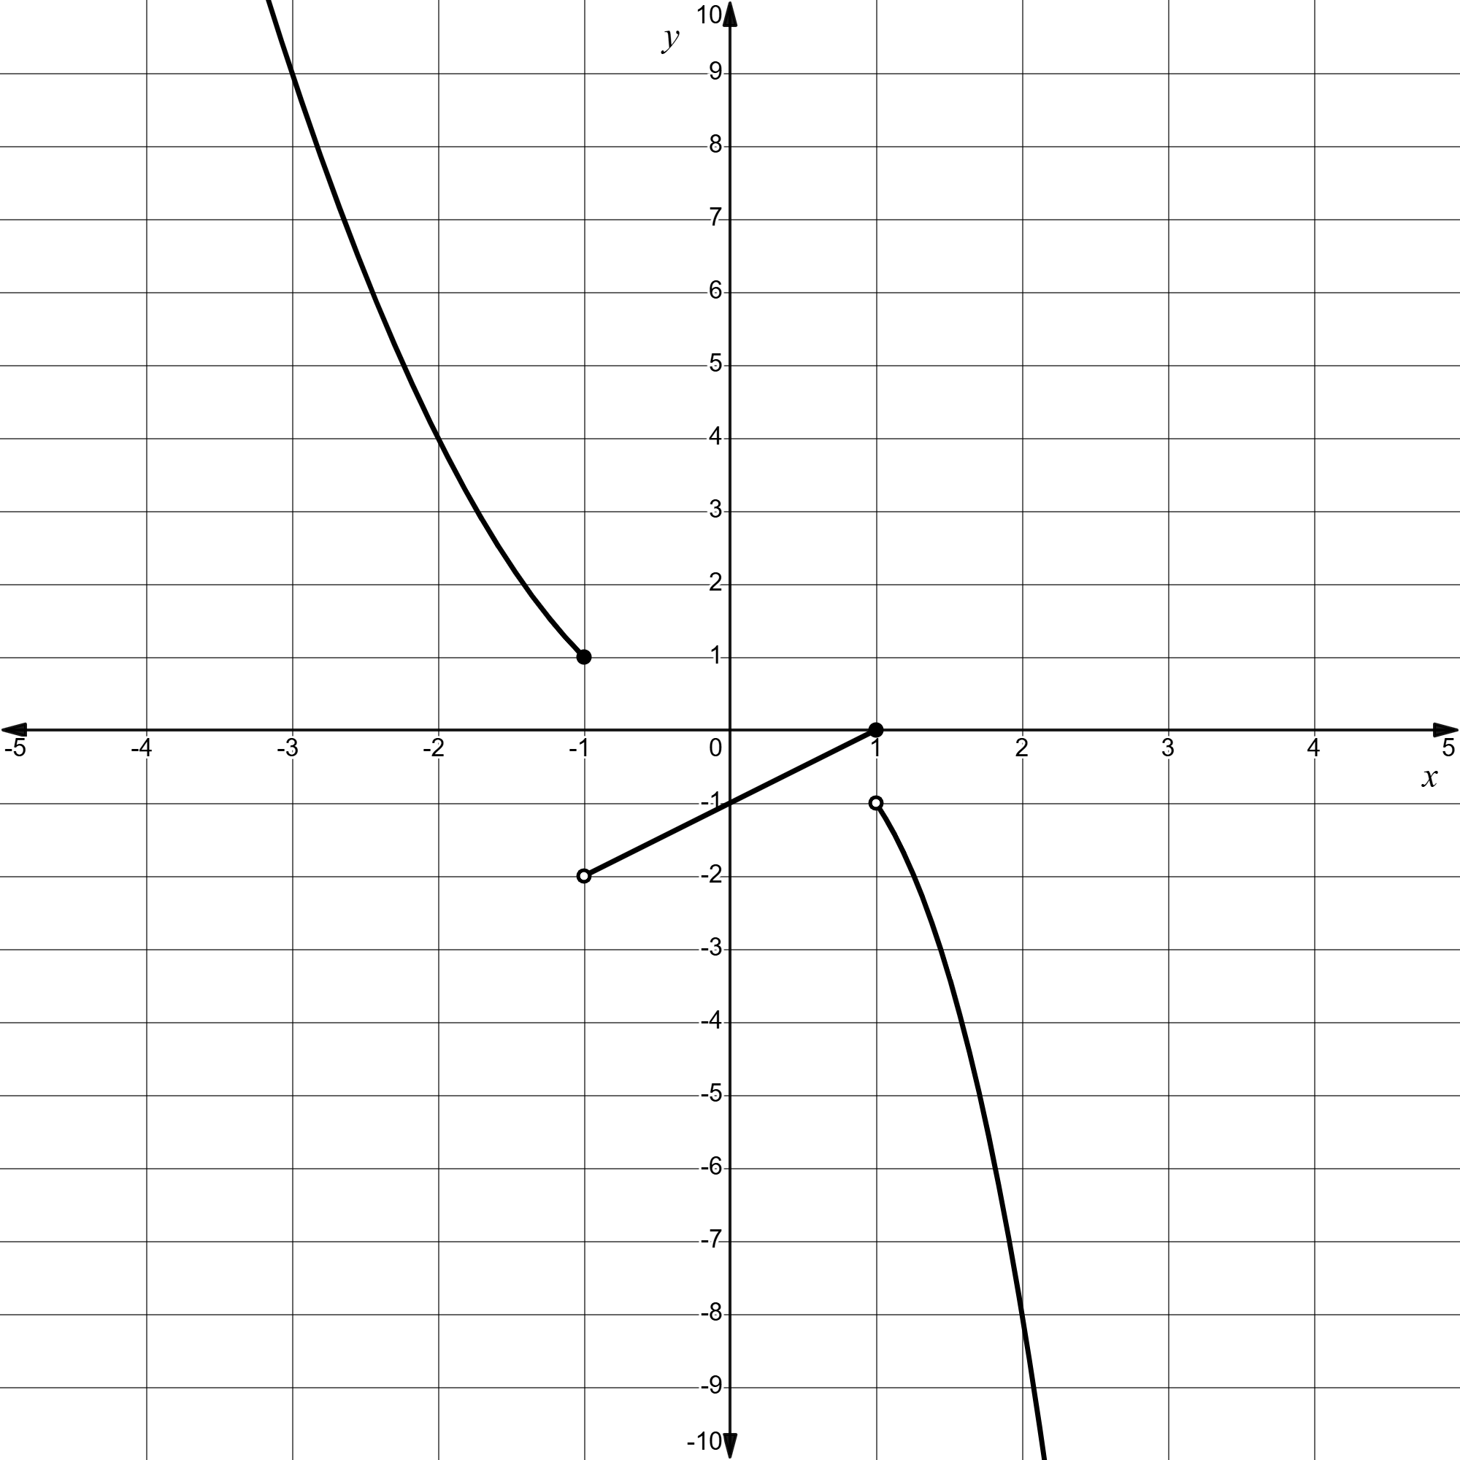
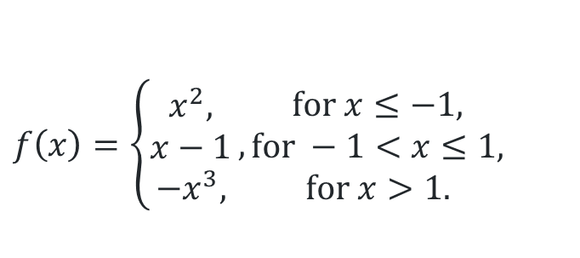
Piecewise-defined function (3)
How does the equation of the function relate to the graph?
$$f\left(x\right)=\left\{\begin{aligned}x^{2}, \\ x−1 \\ −x^{3},\end{aligned}\right., \begin{matrix}\text{f}\text{or} x≤−1, \\ \text{for} −1<x≤1, \\ \text{for} x>1.\end{matrix}$$
Could this graph be drawn without lifting your pen off the paper? Why or why not?
What might be the difference between open and closed circles on the graph?

Slide 9
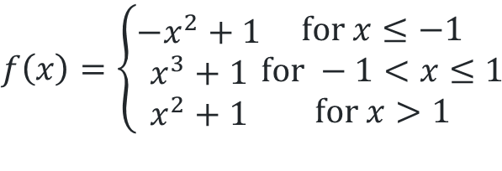
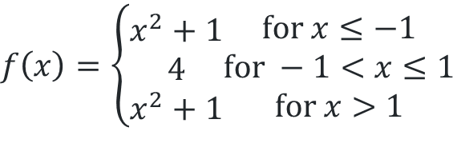
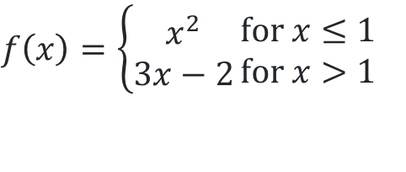
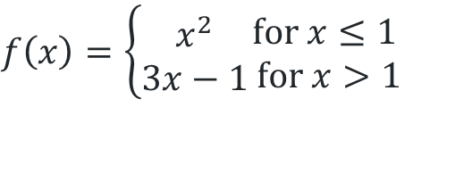
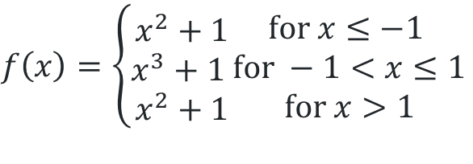
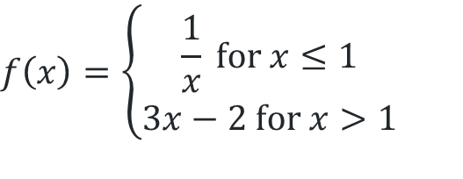
Solutions
Appendix A ‘Piecewise-defined functions’
$f\left(x\right)=\left\{\begin{aligned}x^{2} \\ 3x−2\end{aligned}\right.\begin{matrix}\text{f}\text{or} x≤1 \\ \text{for} x>1\end{matrix}$
$$f\left(x\right)=\left\{\begin{aligned}−x^{2}+1 \\ x^{3}+1 \\ x^{2}+1\end{aligned}\begin{matrix}\text{f}\text{or} x≤−1 \\ \text{for} −1<x≤1 \\ \text{for} x>1\end{matrix}\right.$$
$$f\left(x\right)=\left\{\begin{aligned}\frac{1}{x} \text{for} x≤1 \\ 3x−2 \text{for} x>1\end{aligned}\right.$$
$$f\left(x\right)=\left\{\begin{aligned}x^{2}+1 \\ x^{3}+1 \\ x^{2}+1\end{aligned}\begin{matrix}\text{f}\text{or} x≤−1 \\ \text{for} −1<x≤1 \\ \text{for} x>1\end{matrix}\right.$$
$$f\left(x\right)=\left\{\begin{aligned}x^{2} \\ 3x−1\end{aligned}\begin{matrix}\text{f}\text{or} x≤1 \\ \text{for} x>1\end{matrix}\right.$$
$$f\left(x\right)=\left\{\begin{aligned}x^{2}+1 \\ 4 \\ x^{2}+1\end{aligned}\begin{matrix}\text{f}\text{or} x≤−1 \\ \text{for} −1<x≤1 \\ \text{for} x>1\end{matrix}\right.$$

Slide 10
Releasing responsibility

Slide 11
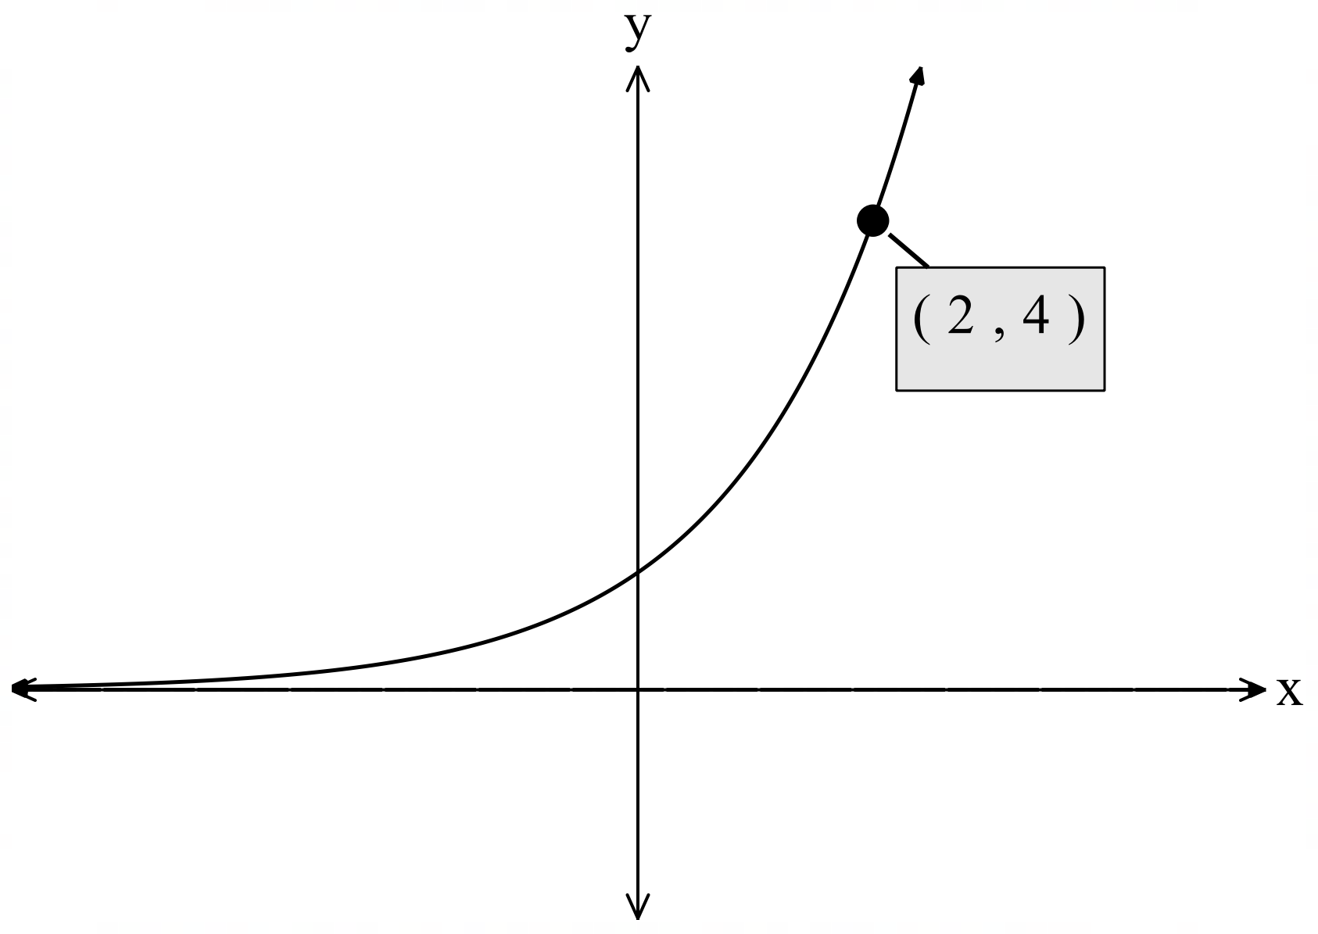

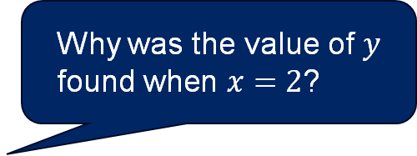
Graphing piecewise-defined function (1)
Worked example 1 – Part A first function
Graph the piecewise-defined function $f\left(x\right)=\left\{\begin{aligned}2^{x} \\ −\frac{1}{2}x+5 \end{aligned}\begin{matrix}\text{f}\text{or} x≤2 \\ \text{for} x>2\end{matrix}\right.$
For the exponential $y=2^{x}$
$y$- intercept at $y=2^{0}$.
$∴y$- intercept at $1$
Asymptote at $y=0$
When $x=2$, $y=2^{2}$.
$∴(2, 4)$ is the end point for the exponential.
Would this end point have an open or closed circle? How do you know?
Why was the value of $y$ found when $x=2$?
1

Slide 12
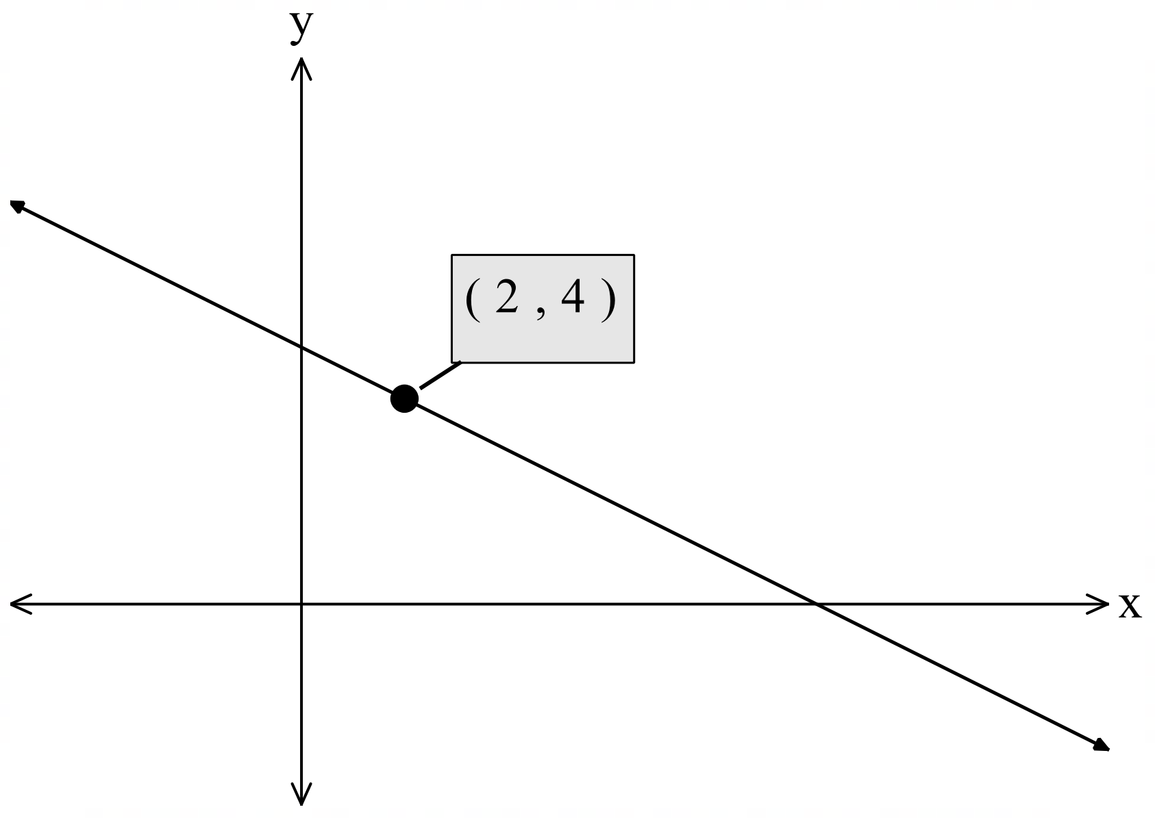

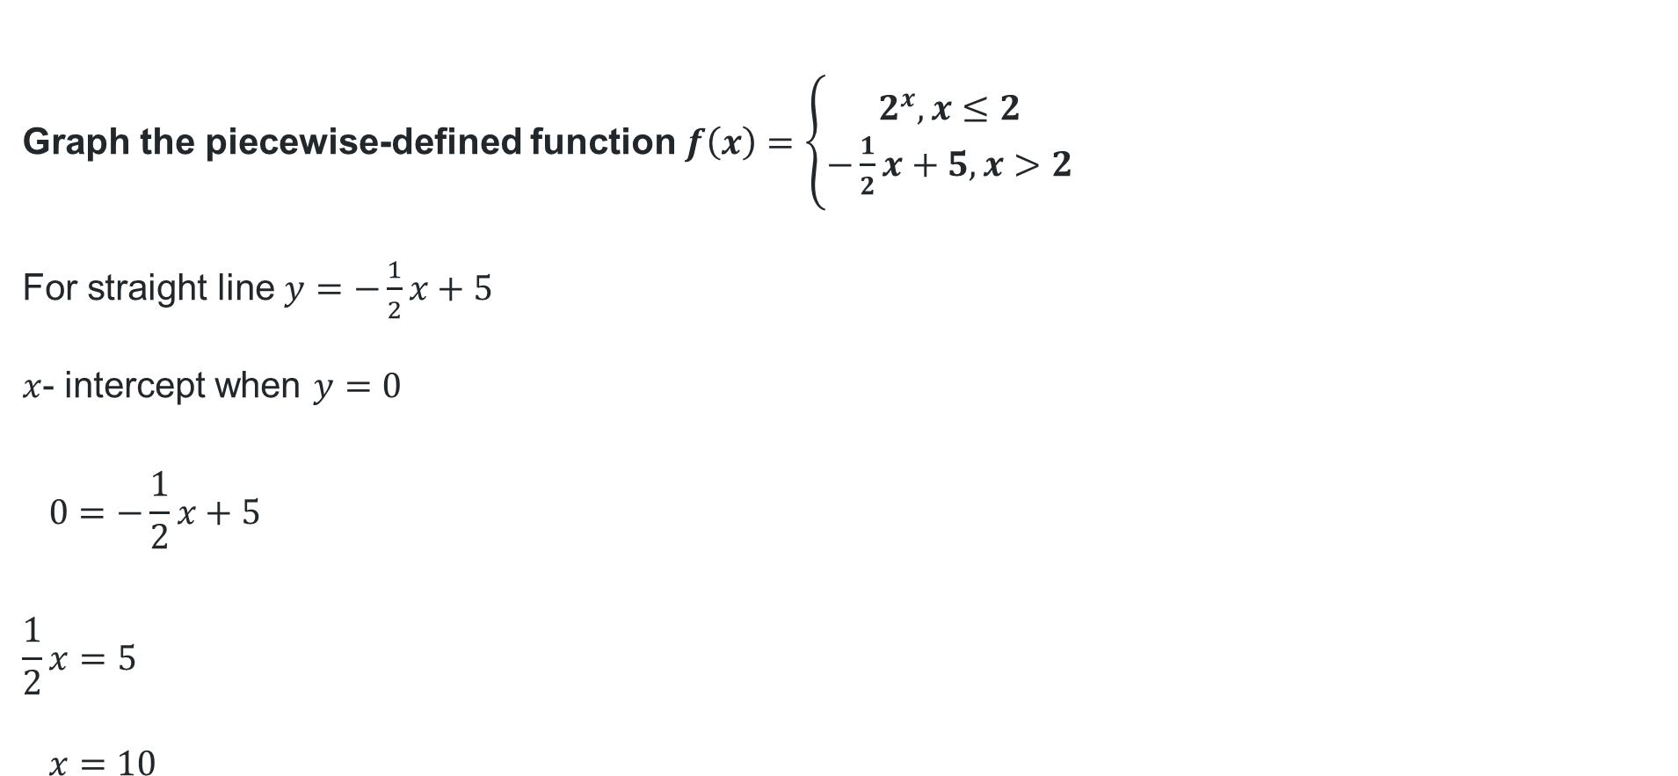
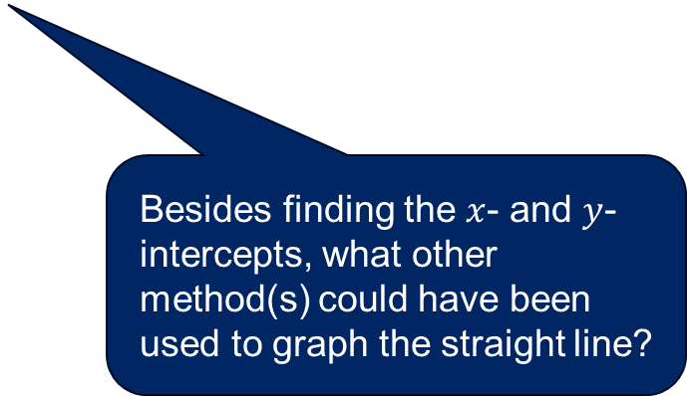
Graphing piecewise-defined function (2)
Worked example 1 – Part B second function
Graph the piecewise-defined function $f\left(x\right)=\left\{\begin{aligned}2^{x}, x≤2 \\ −\frac{1}{2}x+5, x>2\end{aligned}\right.$
For straight line $y=−\frac{1}{2}x+5$
$x$- intercept when $y=0$
$$0=−\frac{1}{2}x+5$$
$$\frac{1}{2}x=5$$
$$x=10$$
$y$- intercept at $y=−\frac{1}{2}\left(0\right)+5$.
$∴y$- intercept at $5$
When $x=2$, $y=−\frac{1}{2}\left(2\right)+5$
$∴(2, 4)$ is the end point.
5
10
Besides finding the $x$- and $y$- intercepts, what other method(s) could have been used to graph the straight line?

Slide 13
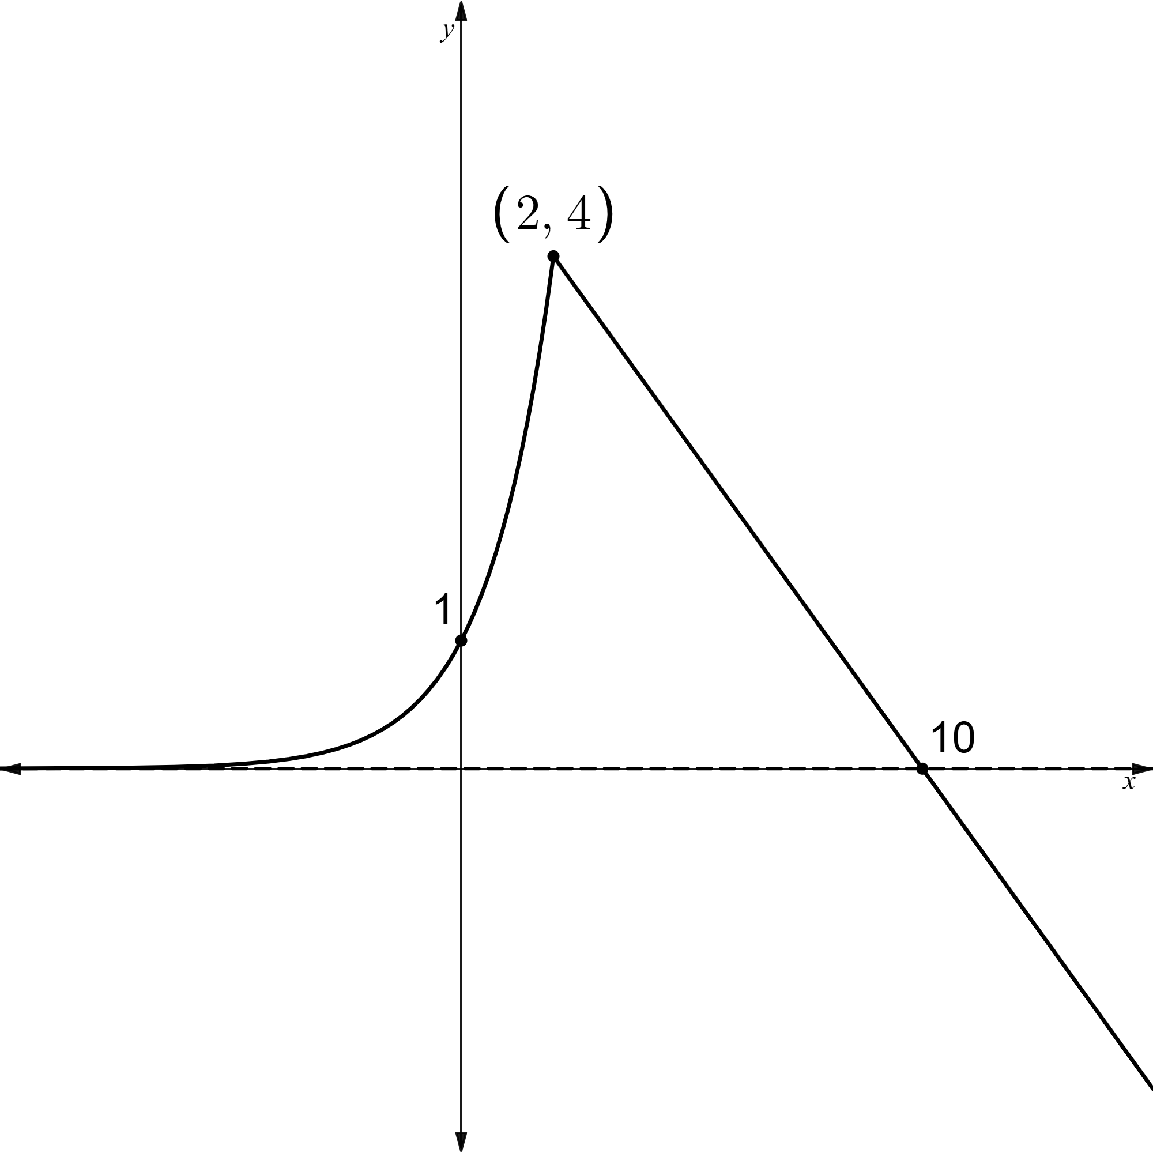
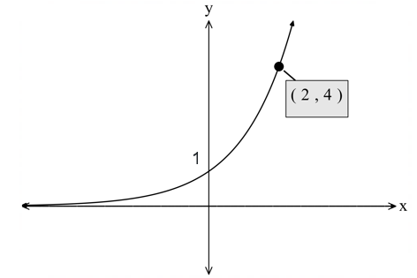
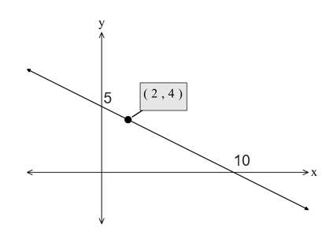

Graphing piecewise-defined function (3)
Worked example 1 – Part C final graph
Graph the piecewise-defined function $f\left(x\right)=\left\{\begin{aligned}2^{x}, x≤2 \\ −\frac{1}{2}x+5, x>2\end{aligned}\right.$
Is the piecewise-defined function continuous?
How do you know?

Slide 14
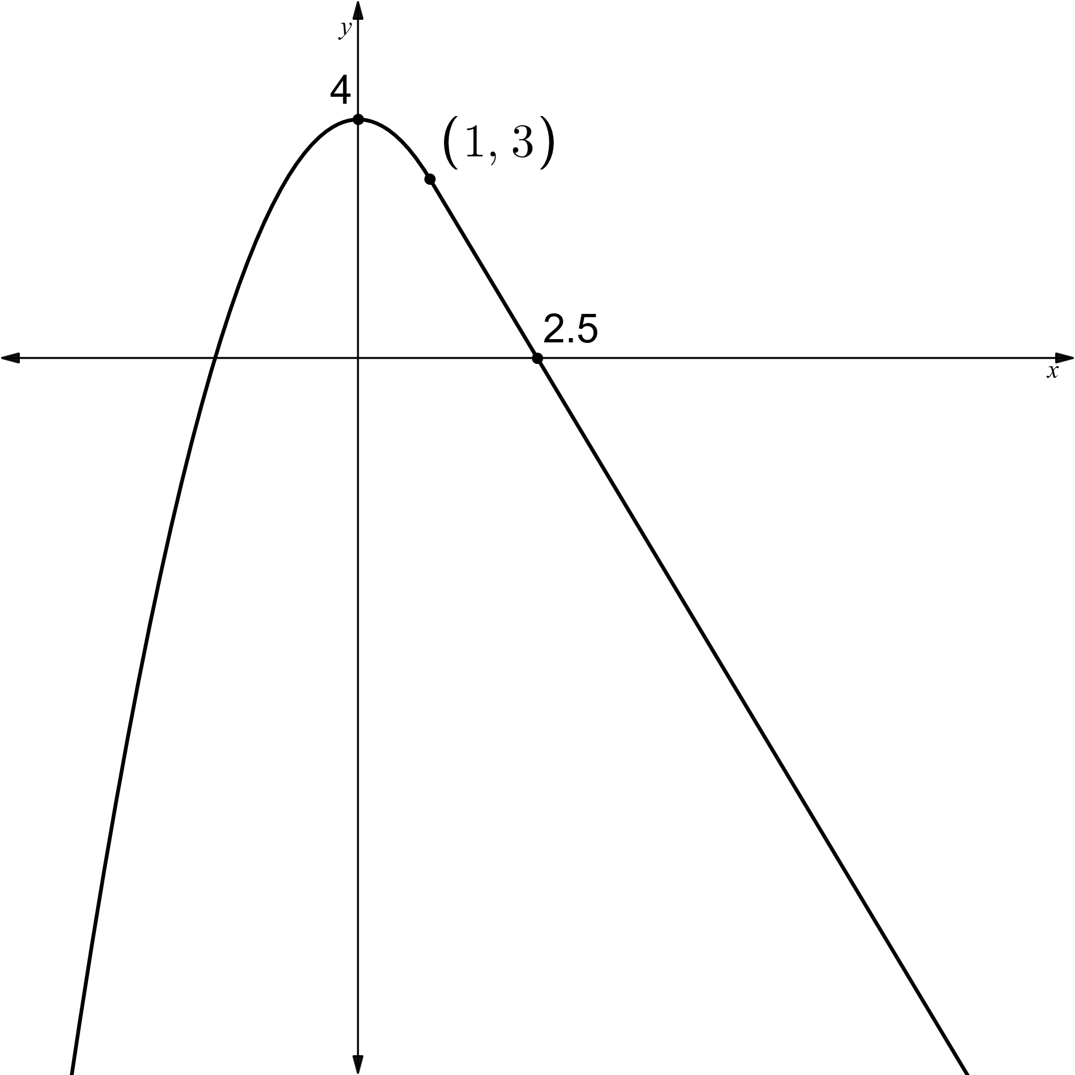

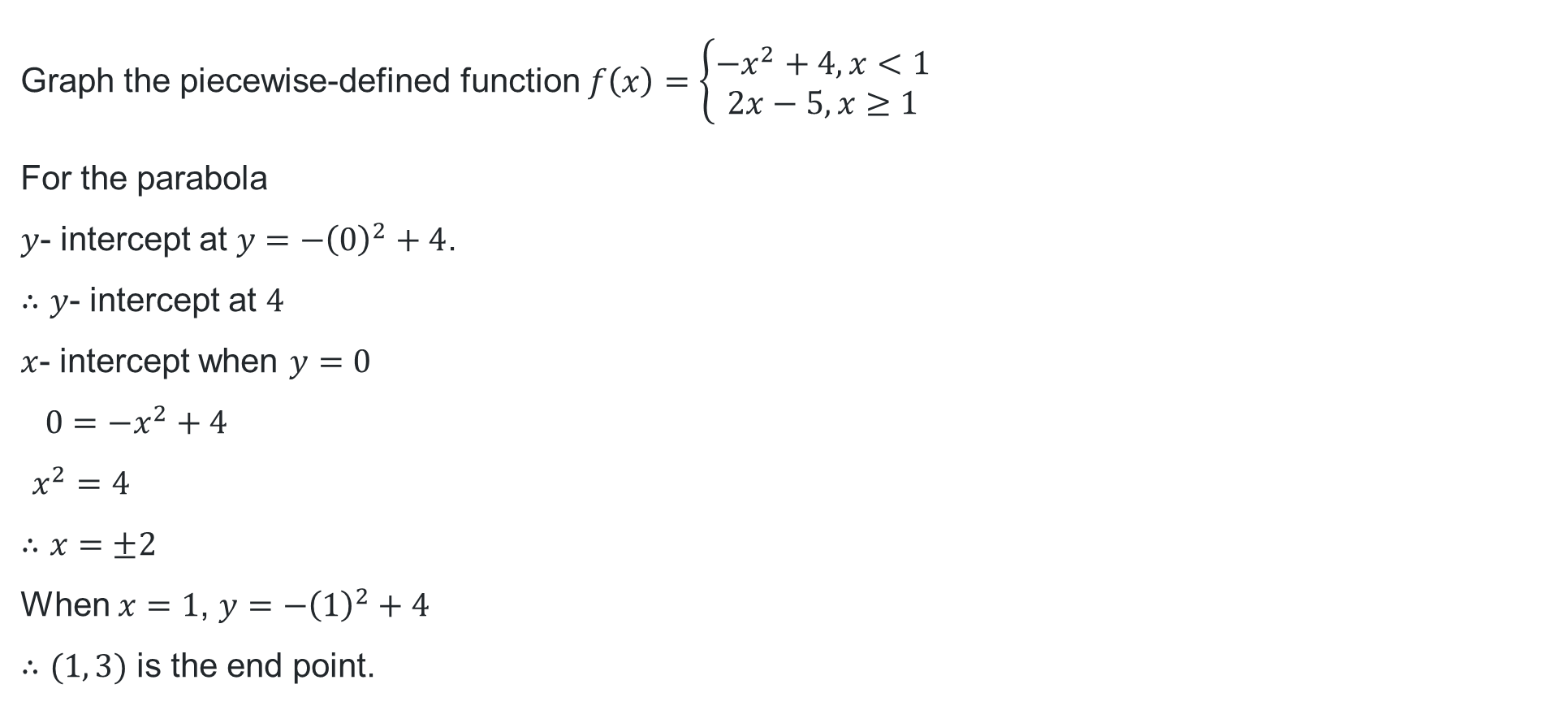
Graphing piecewise-defined function (4)
Your turn – Question 1
Graph the piecewise-defined function $f\left(x\right)=\left\{\begin{aligned}{−x}^{2}+4, x<1 \\ 2x−5, x≥1\end{aligned}\right.$
For the parabola
$y$- intercept at $y=−{\left(0\right)}^{2}+4$.
$∴y$- intercept at $4$
$x$- intercept when $y=0$
$$0=−x^{2}+4$$
$$x^{2}=4$$
$$∴x=±2$$
When $x=1$, $y=−{\left(1\right)}^{2}+4$
$∴(1, 3)$ is the end point.
For the straight line
$y$- intercept at $y=−2\left(0\right)+5$
$∴y$- intercept at $5$
$x$- intercept when $y=0$
$$0=−2x+5$$
$$2x=5$$
$$∴x=\frac{5}{2}$$
When $x=1, y=−2\left(1\right)+5$
$∴(1, 3)$ is the starting point.

Slide 15
References
This presentation contains NSW Curriculum and syllabus content. The NSW Curriculum is developed by the NSW Education Standards Authority. This content is prepared by NESA for and on behalf of the Crown in the right of the State of New South Wales. The material is protected by Crown copyright.
Please refer to the NESA Copyright Disclaimer for more information https://educationstandards.nsw.edu.au/wps/portal/nesa/mini-footer/copyright.
NESA holds the only official and up-to-date versions of the NSW Curriculum and syllabus documents. Please visit the NSW Education Standards Authority (NESA) website https://educationstandards.nsw.edu.au/wps/portal/nesa/home and the NSW Curriculum website https://curriculum.nsw.edu.au.
Mathematics Advanced 11–12 Syllabus © NSW Education Standards Authority (NESA) for and on behalf of the Crown in right of the State of New South Wales, 2024.

Slide 16
Copyright
© State of New South Wales (Department of Education), 2025
The copyright material published in this resource is subject to the Copyright Act 1968 (Cth) and is owned by the NSW Department of Education or, where indicated, by a party other than the NSW Department of Education (third-party material).
Copyright material available in this resource and owned by the NSW Department of Education is licensed under a Creative Commons Attribution 4.0 International (CC BY 4.0) license.
This license allows you to share and adapt the material for any purpose, even commercially.
Attribution should be given to © State of New South Wales (Department of Education), 2025.
Material in this resource not available under a Creative Commons license:
the NSW Department of Education logo, other logos and trademark-protected material
Material owned by a third party that has been reproduced with permission. You will need to obtain permission from the third party to reuse its material.
Links to third-party material and websites
Please note that the provided (reading/viewing material/list/links/texts) are a suggestion only and implies no endorsement, by the New South Wales Department of Education, of any author, publisher, or book title. School principals and teachers are best placed to assess the suitability of resources that would complement the curriculum and reflect the needs and interests of their students.
If you use the links provided in this document to access a third-party’s website, you acknowledge that the terms of use, including licence terms set out on the third-party’s website apply to the use which may be made of the materials on that third-party website or where permitted by the Copyright Act 1968 (Cth). The department accepts no responsibility for content on third-party websites.

