Slide 1
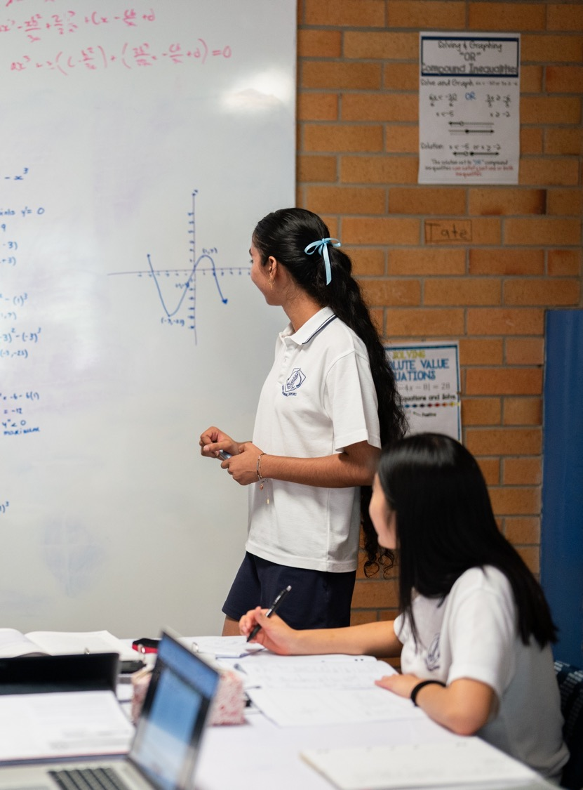
Modelling optimisation
Mathematics Advanced – Stage 6 (Year 12)
Differentiation applications

Slide 2
Learning intentions and success criteria
Learning intention
To be able to solve optimisation problems by using calculus.
Success criteria
I can define variables within the context of a problem.
I can create a function to represent the relationship between variables.
I can identify and justify appropriate domain restrictions based on the context of the problem.
I can interpret my solution in context and explain whether it represents the optimal outcome.

Slide 3
Retrieval practice

Slide 4
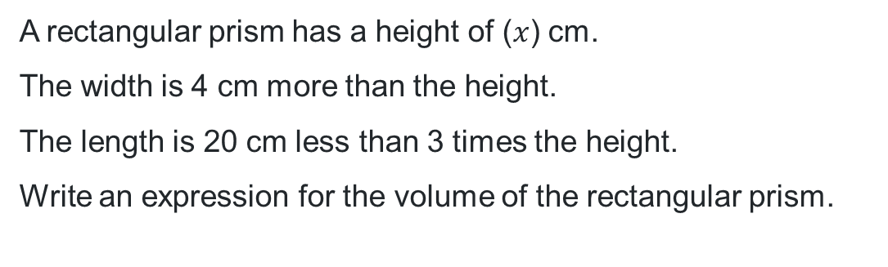




Finding expressions for volume
A rectangular prism has a height of ($x$) cm.
The width is 4 cm more than the height.
The length is 20 cm less than 3 times the height.
Write an expression for the volume of the rectangular prism.
$$x$$
$$x+4$$
$$3x−20$$
$$V=x(x+4)(3x−20)$$

Slide 5
Activating prior knowledge

Slide 6
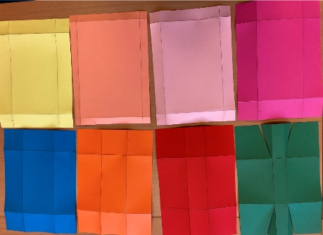
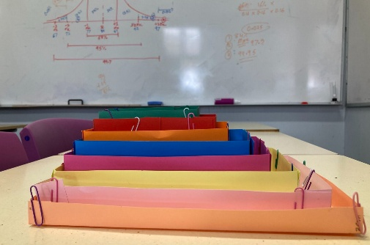
Making a popcorn container (1)

Slide 7
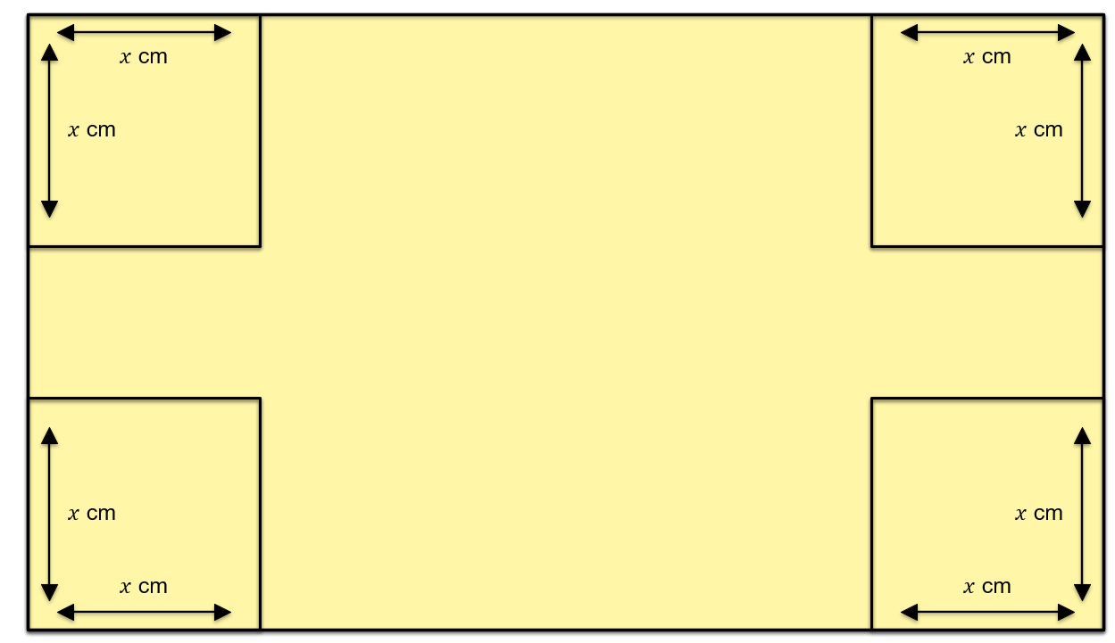
Making a popcorn container (2)
Paper length = 30 cm
Paper width = 21 cm

Slide 8
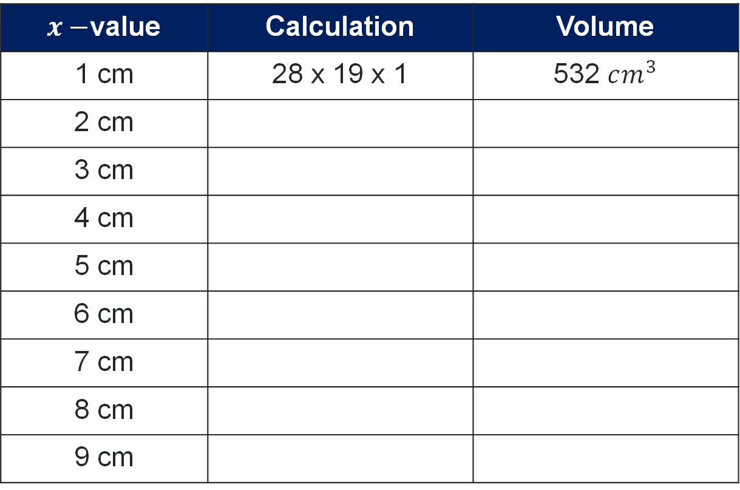
Container volumes
Volume = length x width x height
$x−$value | Calculation | Volume
1 cm | 28 x 19 x 1 | 532 $cm^{3}$
2 cm
3 cm
4 cm
5 cm
6 cm
7 cm
8 cm
9 cm

Slide 9
Connecting learning

Slide 10
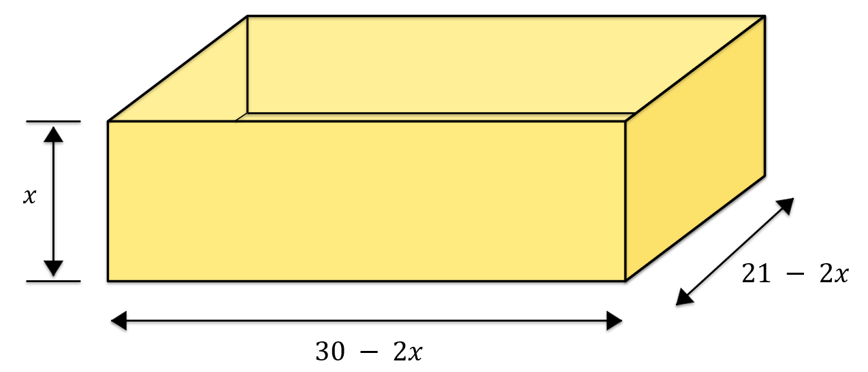
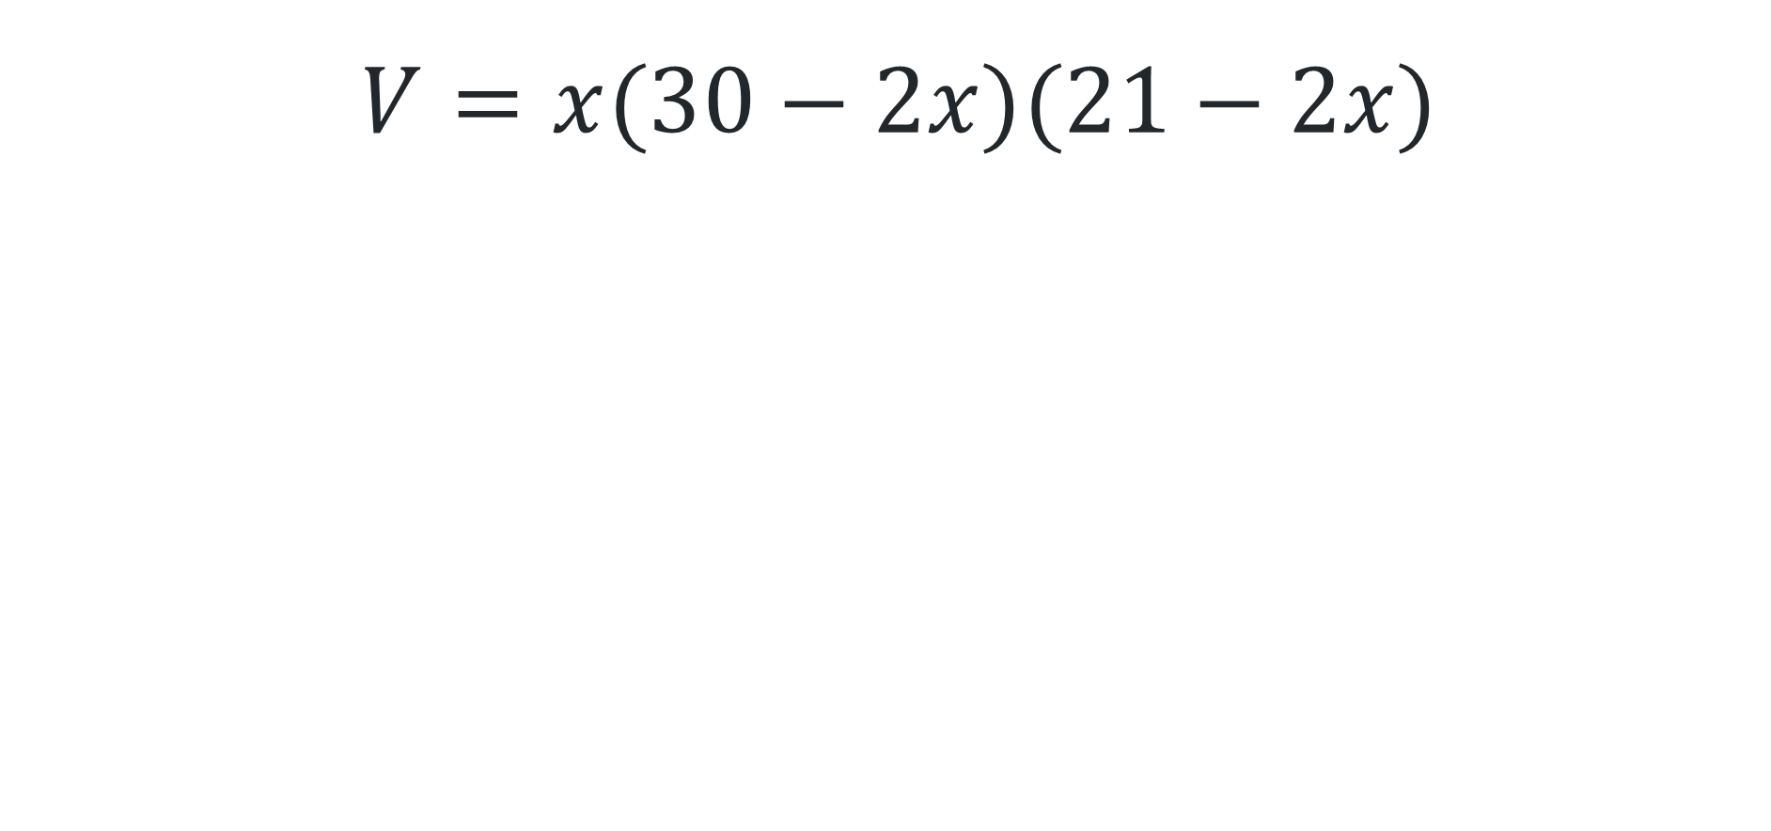
Formula
$V=x(30−2x)(21−2x)$

Slide 11
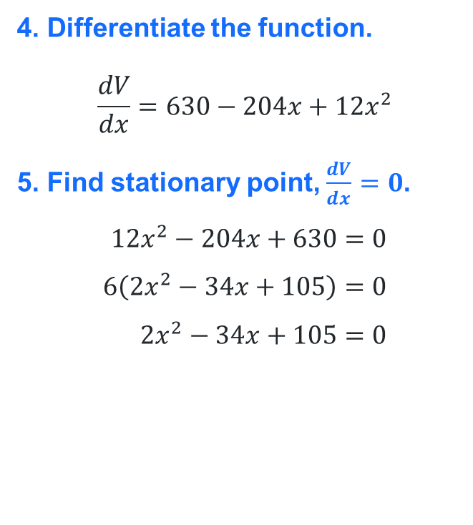
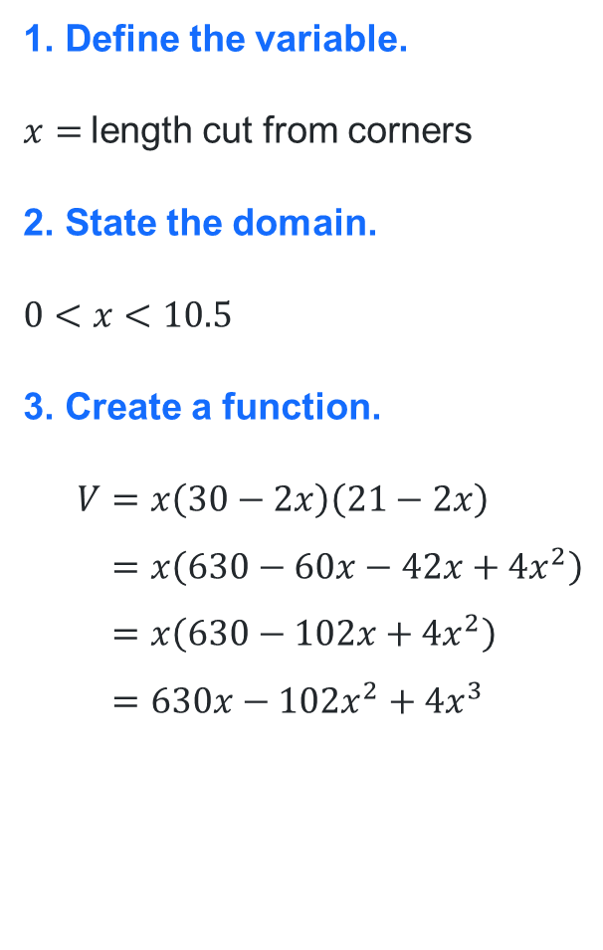
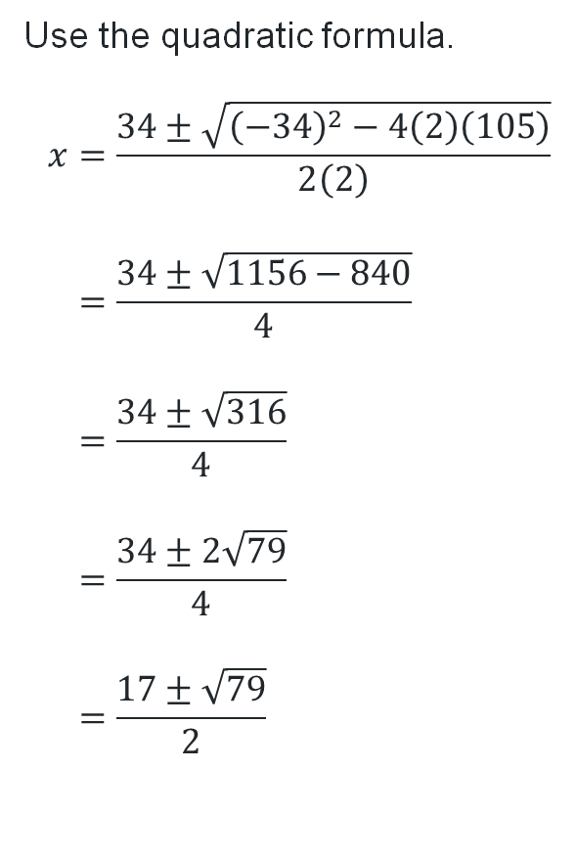
Solution for A4 (1)
1. Define the variable.
$x=$length cut from corners
2. State the domain.
$$0<x<10.5$$
3. Create a function.
$$V=x\left(30−2x\right)\left(21−2x\right) \\ =x\left(630−60x−42x+4x^{2}\right) \\ =x\left(630−102x+4x^{2}\right) \\ =630x−102x^{2}+4x^{3}$$
4. Differentiate the function.
$$\frac{dV}{dx}=630−204x+12x^{2}$$
5. Find stationary point, $\frac{dV}{dx}=0$.
$$12x^{2}−204x+630=0 \\ 6\left(2x^{2}−34x+105\right)=0 \\ 2x^{2}−34x+105=0$$
Use the quadratic formula$​​$.
$$x=\frac{34±\sqrt{{\left(−34\right)}^{2}−4\left(2\right)\left(105\right)}}{2\left(2\right)} \\ =\frac{34±\sqrt{1156−840}}{4} \\ =\frac{34±\sqrt{316}}{4} \\ =\frac{34±2\sqrt{79}}{4} \\ =\frac{17±\sqrt{79}}{2}$$

Slide 12
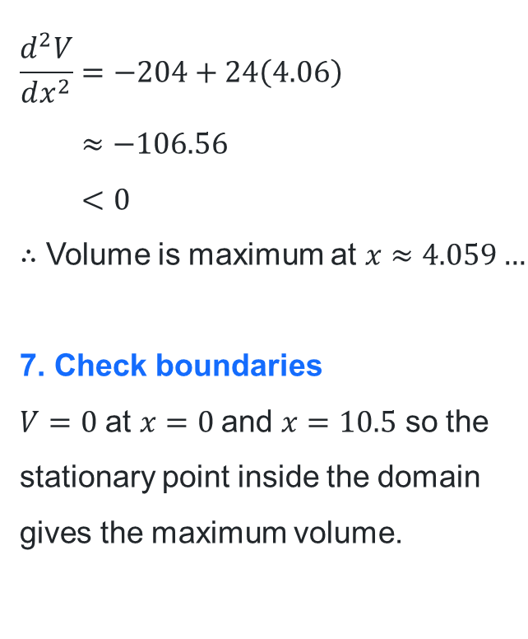
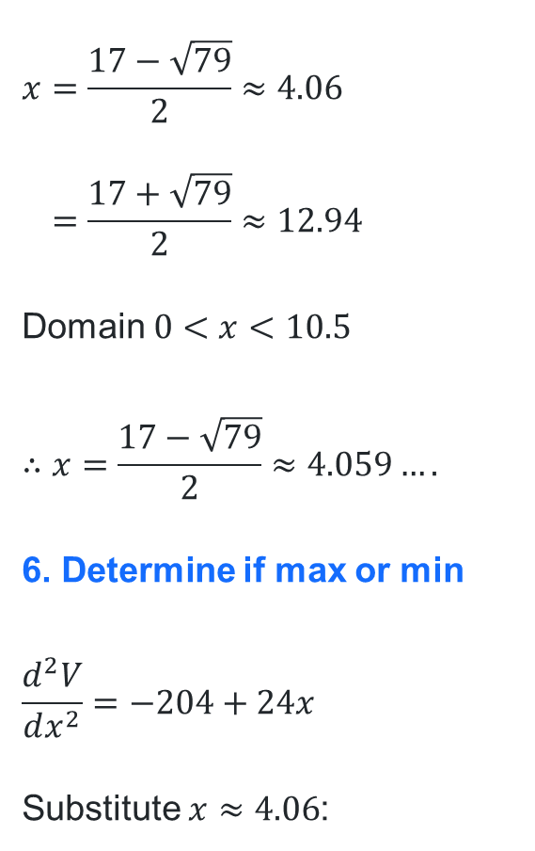
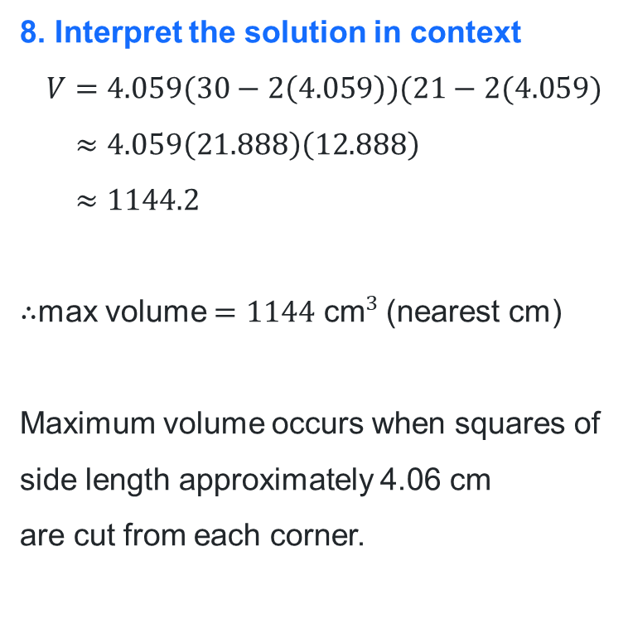
Solution for A4 (2)
$$x=\frac{17−\sqrt{79}}{2}≈4.06 \\ =\frac{17+\sqrt{79}}{2}≈12.94$$
Domain $0<x<10.5$
$$∴x=\frac{17−\sqrt{79}}{2}≈4.059….$$
6. Determine if max or min
$$\frac{d^{2}V}{dx^{2}}=−204+24x$$
Substitute $x≈4.06$:
$$\frac{d^{2}V}{dx^{2}}=−204+24\left(4.06\right) \\ ≈−106.56 \\ <0$$
$∴$ Volume is maximum at $x≈4.059…$
7. Check boundaries
$V=0$ at $x=0$and $x=10.5$ so the stationary point inside the domain gives the maximum volume.
8. Interpret the solution in context
$$V=4.059(30−2\left(4.059\right))(21−2(4.059) \\ ≈4.059\left(21.888\right)\left(12.888\right) \\ ≈1144.2$$
$∴$max volume $=1144{ \text{cm}}^{3}$(nearest cm)
Maximum volume occurs when squares of side length approximately 4.06 cm
are cut from each corner.

Slide 13
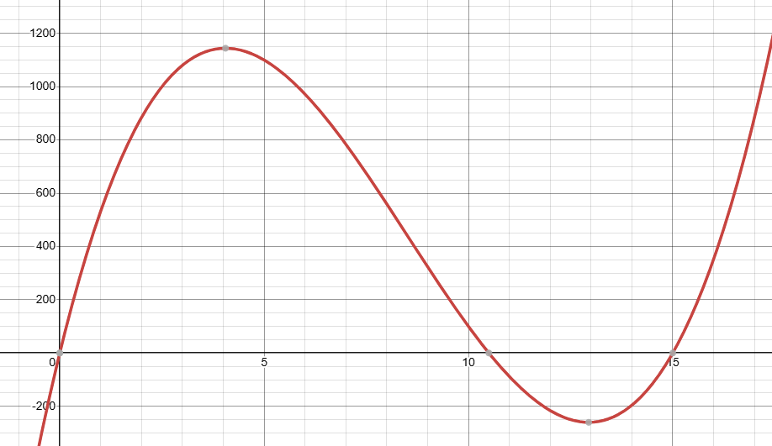
Solution for A4 (3)

Slide 14
Scenario
A4 paper measures 21 cm by 30cm. A3 paper measures 30 cm by 42 cm.
“A3 paper is twice the size of A4 paper, therefore if we make a box using A3 paper, it will hold double the volume of popcorn.”
Fred

Slide 15
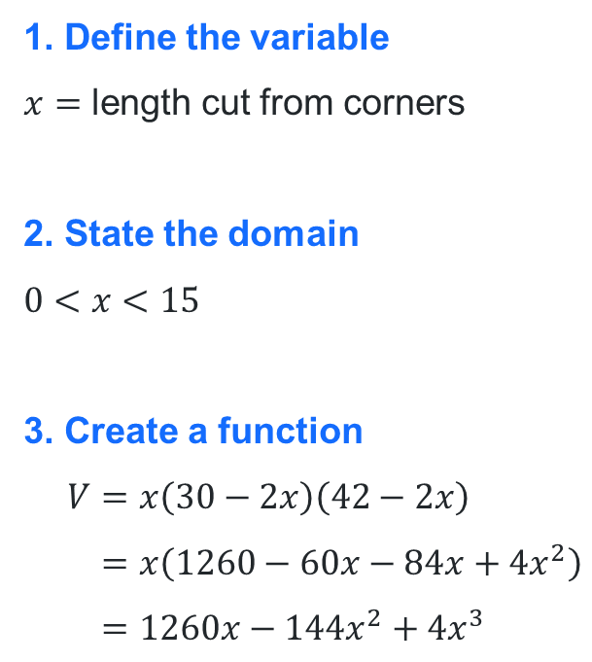
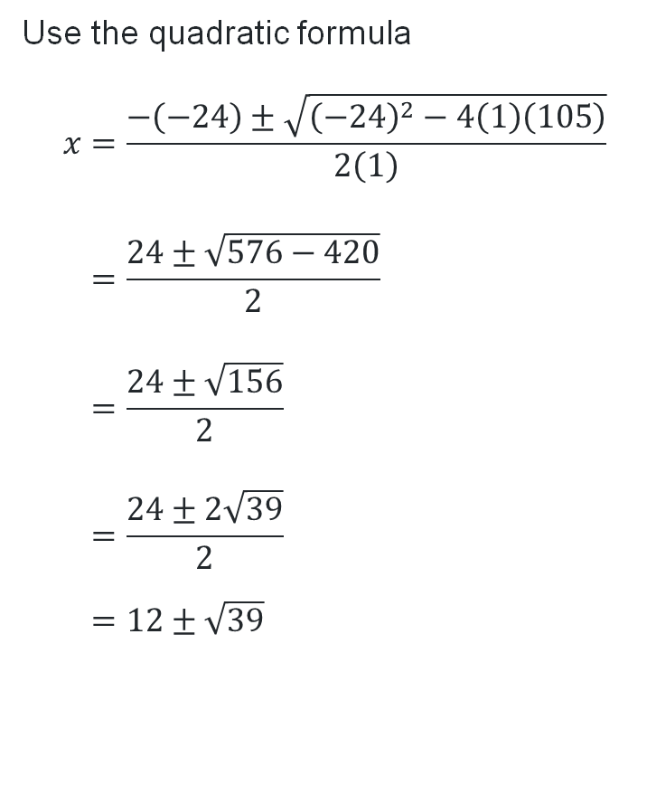
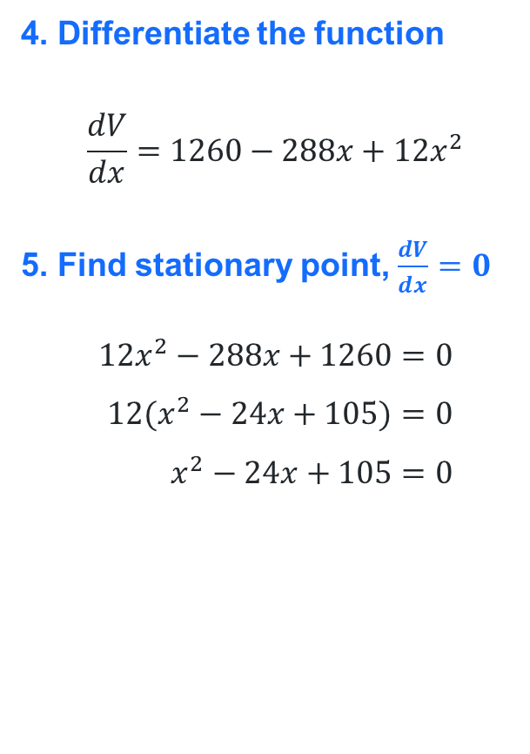
Solution for A3 (1)
1. Define the variable
$x=$ length cut from corners
2. State the domain
$$0<x<15$$
3. Create a function
$$V=x\left(30−2x\right)\left(42−2x\right) \\ =x\left(1260−60x−84x+4x^{2}\right) \\ =1260x−144x^{2}+4x^{3}$$
4. Differentiate the function
$$\frac{dV}{dx}=1260−288x+12x^{2}$$
5. Find stationary point, $\frac{dV}{dx}=0$
$$12x^{2}−288x+1260=0 \\ 12(x^{2}−24x+105)=0 \\ x^{2}−24x+105=0$$
Use the quadratic formula$​​$
$$x=\frac{−\left(−24\right)±\sqrt{{\left(−24\right)}^{2}−4\left(1\right)\left(105\right)}}{2\left(1\right)} \\ =\frac{24±\sqrt{576−420}}{2} \\ =\frac{24±\sqrt{156}}{2} \\ =\frac{24±2\sqrt{39}}{2} \\ =12±\sqrt{39}$$

Slide 16
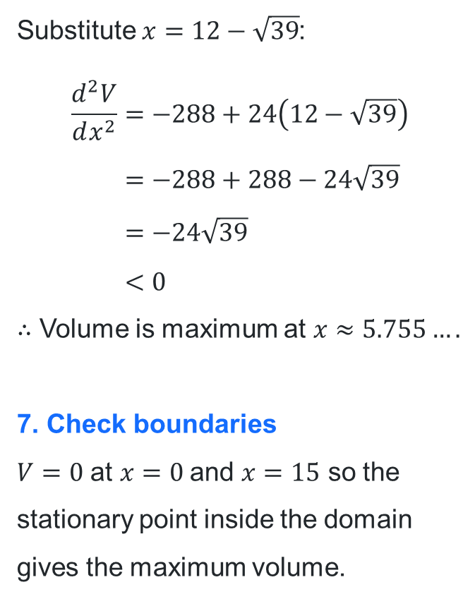
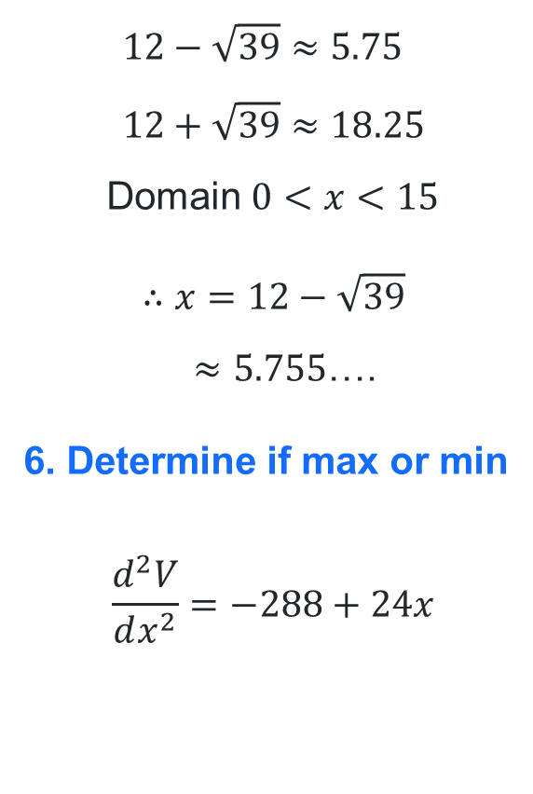
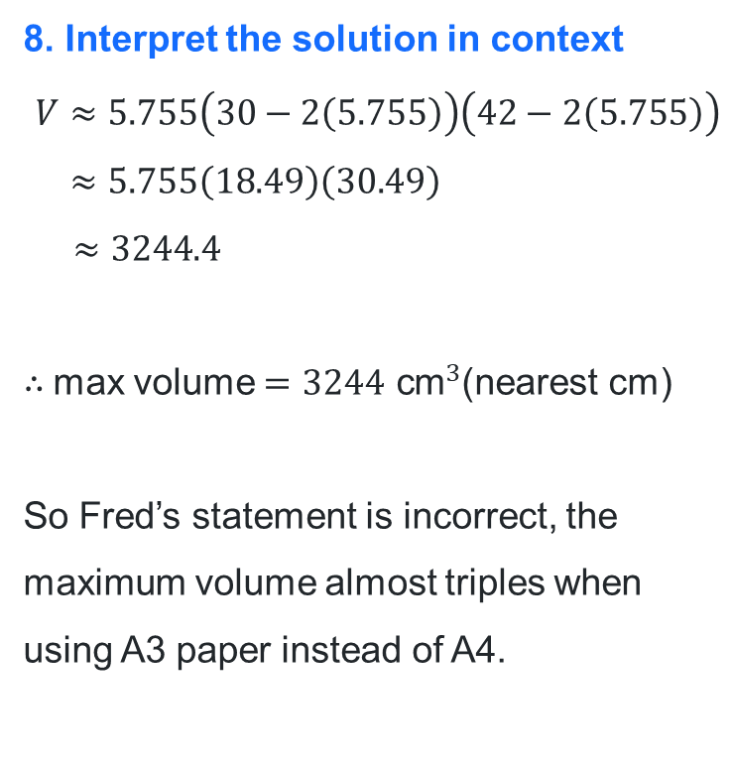
Solution for A3 (2)
$$12−\sqrt{39}≈5.75 \\ 12+\sqrt{39}≈18.25$$
Domain $0<x<15$
$$∴x=12−\sqrt{39}$$
$≈5.755$….
6. Determine if max or min
$$\frac{d^{2}V}{dx^{2}}=−288+24x$$
Substitute $x=12−\sqrt{39}$:
$$\frac{d^{2}V}{dx^{2}}=−288+24\left(12−\sqrt{39}\right) \\ =−288+288−24\sqrt{39} \\ =−24\sqrt{39} \\ <0$$
$∴$ Volume is maximum at $x≈5.755….$
7. Check boundaries
$V=0$ at $x=0$and $x=15$ so the stationary point inside the domain gives the maximum volume.
8. Interpret the solution in context
$$V≈5.755\left(30−2\left(5.755\right)\right)\left(42−2\left(5.755\right)\right) \\ ≈5.755\left(18.49\right)\left(30.49\right)$$
$≈3244$.4
$∴$max volume $=3244{ \text{cm}}^{3}$(nearest cm)
So Fred’s statement is incorrect, the maximum volume almost triples when using A3 paper instead of A4.

Slide 17
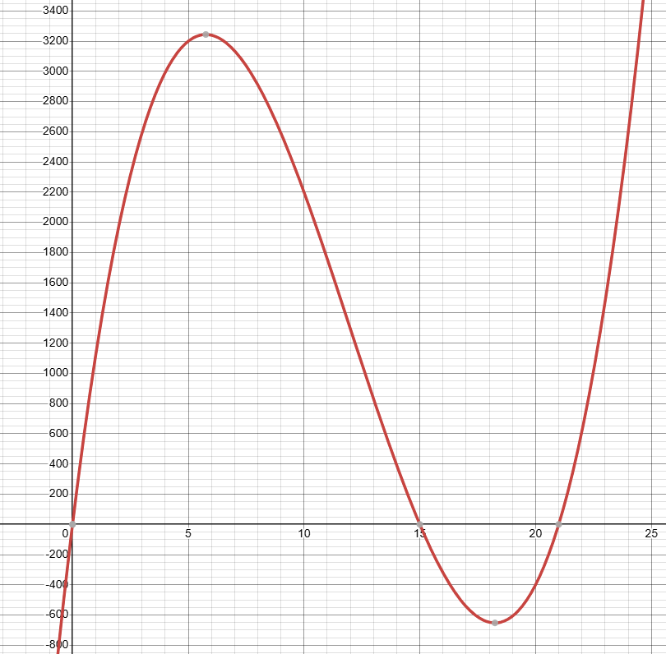
Solution for A3 (3)

Slide 18
Releasing responsibility

Slide 19
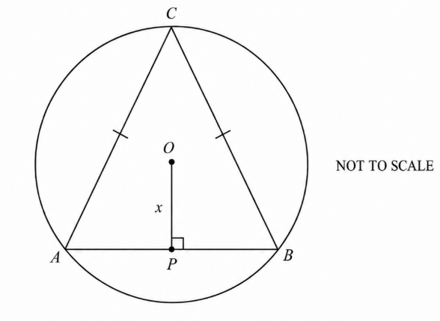
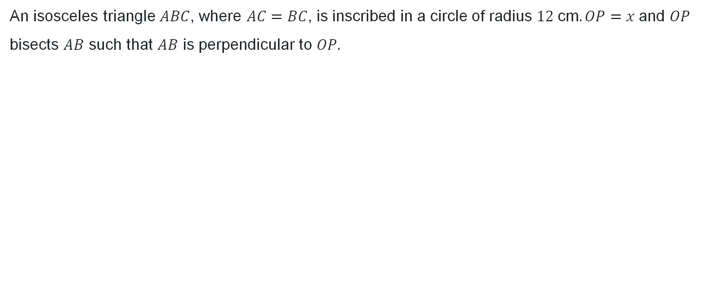
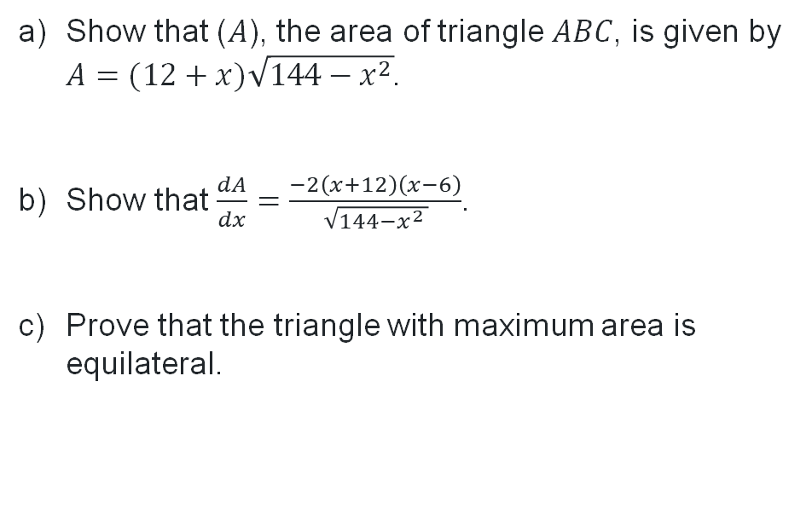
Worked example
An isosceles triangle $ABC$, where $AC=BC$, is inscribed in a circle of radius $12 \text{cm}. OP=x$and $OP$ bisects $AB$ such that $AB$ is perpendicular to $OP.$
Show that ($A$), the area of triangle $ABC$, is given by
$A=(12+x)\sqrt{144−x^{2}}$.
Show that $\frac{dA}{dx}=\frac{−2\left(x+12\right)\left(x−6\right)}{\sqrt{144−x^{2} }}$.
Prove that the triangle with maximum area is equilateral.

Slide 20
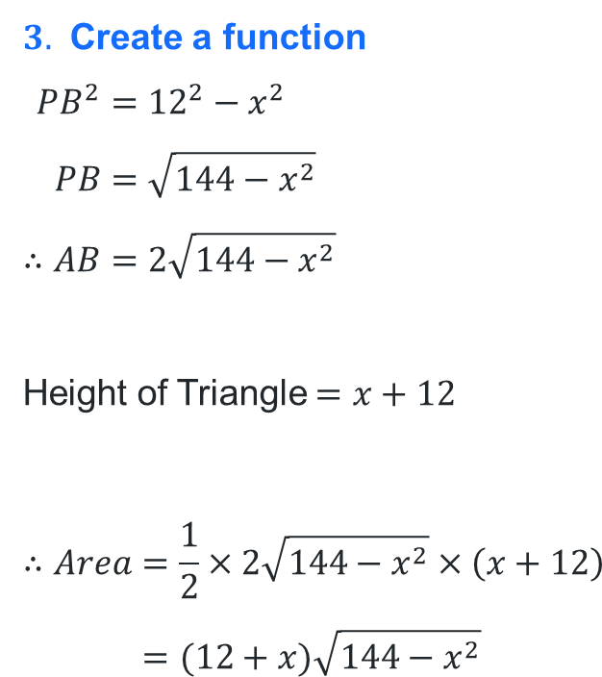
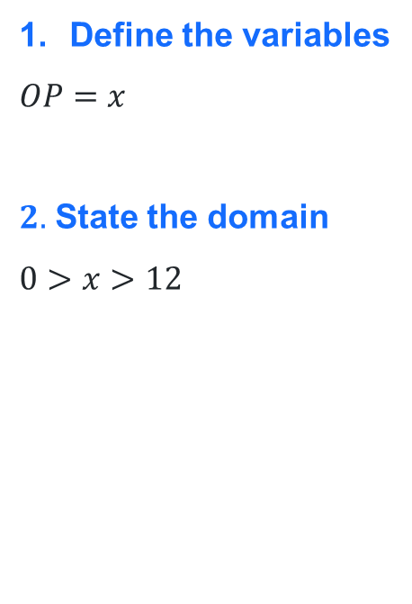

Part a Solution
Show that ($A$), the area of triangle $ABC$, is given by $A=(12+x)\sqrt{144−x^{2}.}$
Define the variables
$$OP=x$$
$2.$ State the domain
$$0>x>12$$
$3.$ Create a function
$$PB^{2}={12}^{2}−x^{2} \\ PB=\sqrt{144−x^{2}} \\ ∴AB=2\sqrt{144−x^{2}}$$
Height of Triangle $=x+12$
$$∴Area=\frac{1}{2}×2\sqrt{144−x^{2}}×\left(x+12\right) \\ =(12+x)\sqrt{144−x^{2}}$$
12cm
$$x$$

Slide 21
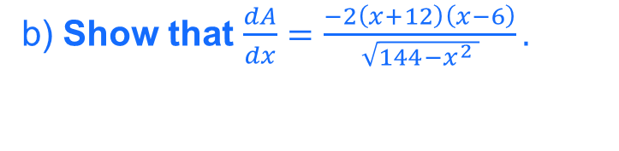
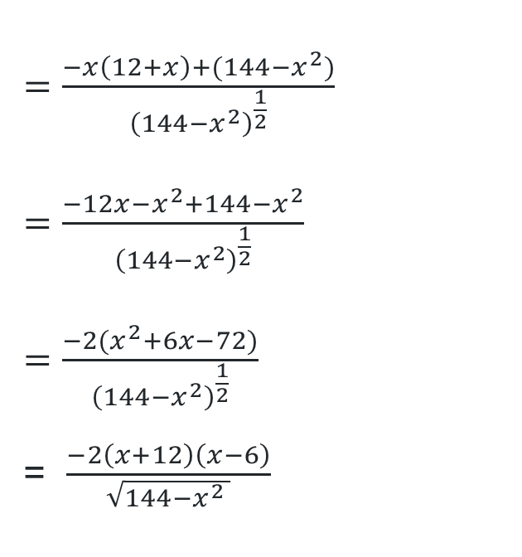
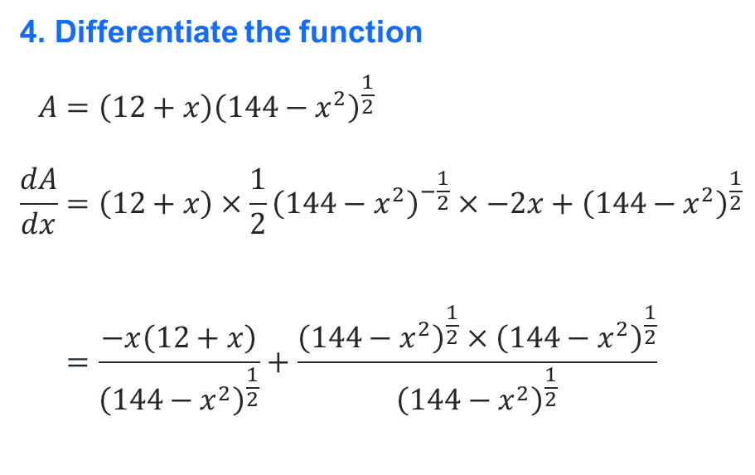
Part b solution
In a ‘show that’ question, even if you could not solve part a, use the given answer to complete part b
b) Show that $\frac{dA}{dx}=\frac{−2\left(x+12\right)\left(x−6\right)}{\sqrt{144−x^{2} }}.$
4. Differentiate the function
$$A=\left(12+x\right){\left(144−x^{2}\right)}^{\frac{1}{2}} \\ \frac{dA}{dx}=\left(12+x\right)×\frac{1}{2}{\left(144−x^{2}\right)}^{−\frac{1}{2}}×−2x+{\left(144−x^{2}\right)}^{\frac{1}{2}} \\ =\frac{−x\left(12+x\right)}{{\left(144−x^{2}\right)}^{\frac{1}{2}}}+\frac{{\left(144−x^{2}\right)}^{\frac{1}{2}}×{\left(144−x^{2}\right)}^{\frac{1}{2}}}{{\left(144−x^{2}\right)}^{\frac{1}{2}}}$$
$=\frac{−x\left(12+x\right)+(144−x^{2})}{{\left(144−x^{2}\right)}^{\frac{1}{2}}}$
$=$ $\frac{−12x−x^{2}+144−x^{2}}{{\left(144−x^{2}\right)}^{\frac{1}{2}}}$
$=$ $\frac{−2(x^{2}+6x−72)}{{\left(144−x^{2}\right)}^{\frac{1}{2}}}$
= $\frac{−2\left(x+12\right)\left(x−6\right)}{\sqrt{144−x^{2} }}$

Slide 22
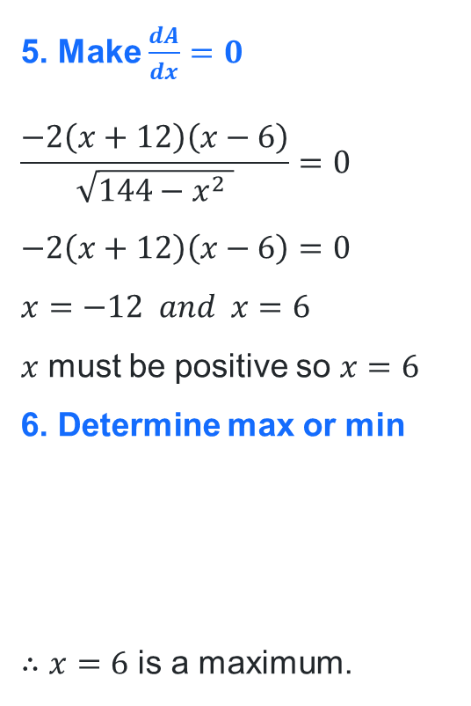
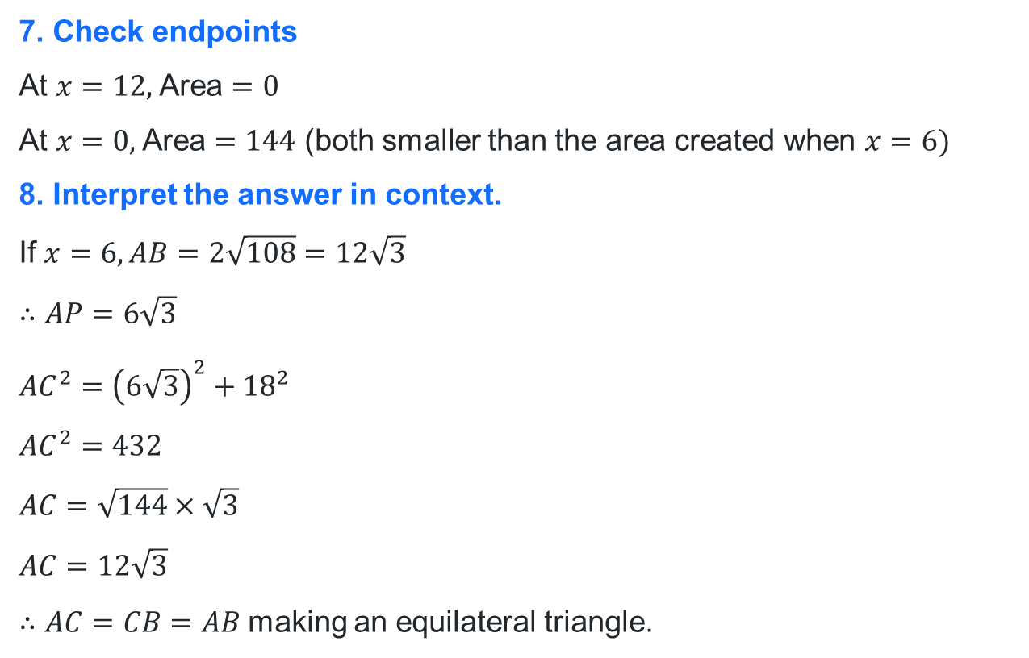
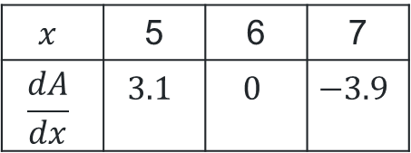
Part c solution
c) Prove that the triangle with maximum area is equilateral.
5. Make $\frac{dA}{dx}=0$
$$\frac{−2\left(x+12\right)\left(x−6\right)}{\sqrt{144−x^{2} }}=0 \\ −2\left(x+12\right)\left(x−6\right)=0$$
$$x=−12 and x=6$$
$x$ must be positive so $x=6$
6. Determine max or min
$∴x=6$ is a maximum.
7. Check endpoints
At $x=12,$Area $=0$
At $x=0,$Area $=144$ (both smaller than the area created when $x=6)$
8. Interpret the answer in context.
If $x=6, AB=2\sqrt{108}=12\sqrt{3}$
$$∴AP=6\sqrt{3}$$
$$AC^{2}={\left(6\sqrt{3}\right)}^{2}+{18}^{2}$$
$$AC^{2}=432$$
$$AC=\sqrt{144}×\sqrt{3}$$
$$AC=12\sqrt{3}$$
$∴AC=CB=AB$making an equilateral triangle.
$$x$$ | 5 | 6 | 7
$$\frac{dA}{dx}$$ | $$3.1$$ | $$0$$ | $$−3.9$$

Slide 23
Independent practice

Slide 24
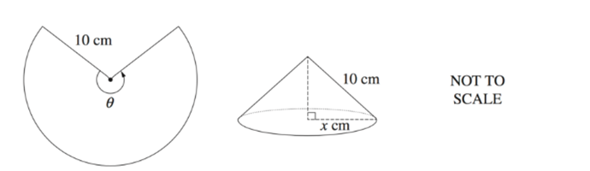
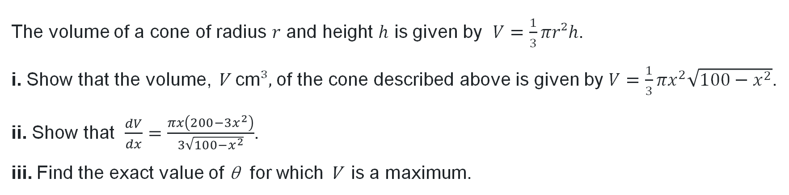
Optimisation relay (1)
Question a (2018 HSC)
A sector with radius 10 cm and angle θ is used to form the curved surface of a cone, as shown in the diagram.
The volume of a cone of radius $r$ and height $h$ is given by $V=\frac{1}{3}πr²h$.
i. Show that the volume, V cm³, of the cone described above is given by $V=\frac{1}{3}πx^{2}\sqrt{100−x^{2}}$.
ii. Show that $\frac{dV}{dx}=\frac{πx\left(200−3x^{2}\right)}{3\sqrt{100−x^{2}}}$.
iii. Find the exact value of θ for which V is a maximum.

Slide 25
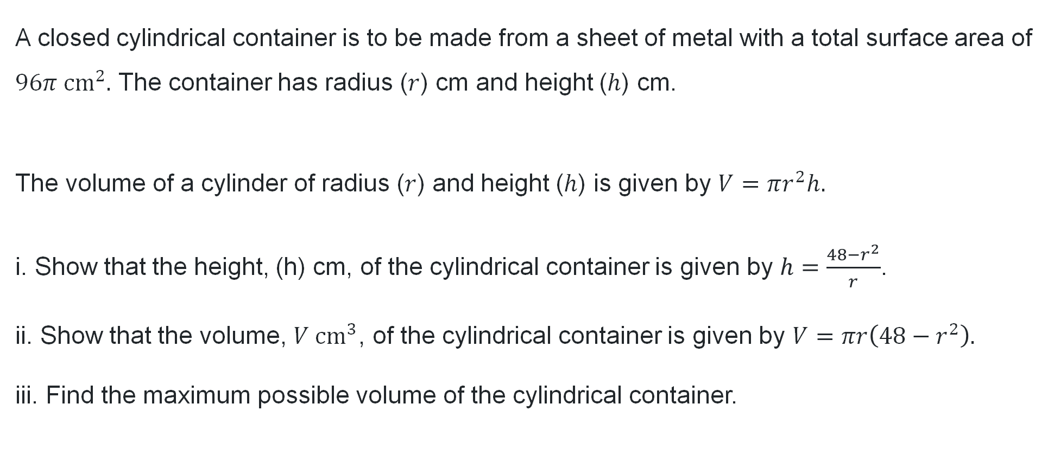
Optimisation relay (2)
Question b
A closed cylindrical container is to be made from a sheet of metal with a total surface area of $96π cm^{2}.$ The container has radius ($r$) cm and height ($h$) cm.
The volume of a cylinder of radius ($r$) and height ($h$) is given by $V=πr^{2}h.$
i. Show that the height, (h) cm, of the cylindrical container is given by $h=\frac{48−r^{2}}{r}$.
ii. Show that the volume, $V cm^{3}$, of the cylindrical container is given by $V=πr\left(48−r^{2}\right).$
iii. Find the maximum possible volume of the cylindrical container.

Slide 26
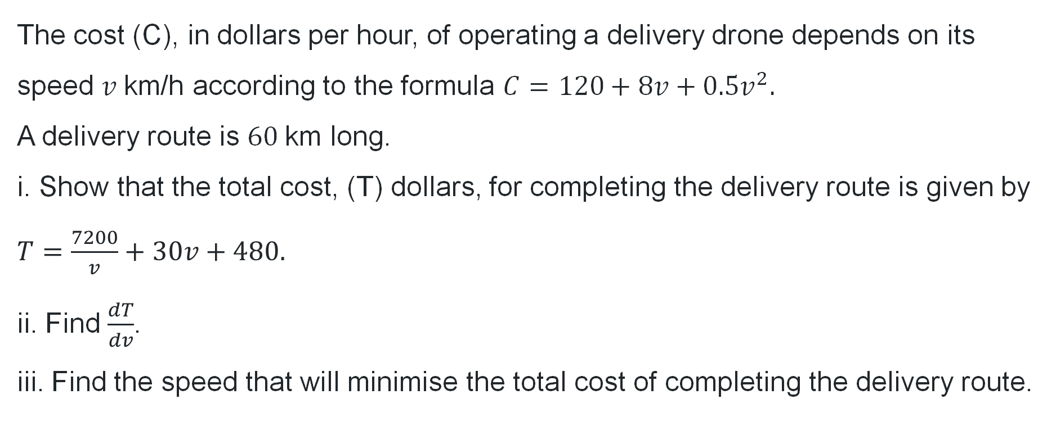
Optimisation relay (3)
Question c
The cost (C), in dollars per hour, of operating a delivery drone depends on its speed $v \text{km}\text{/}\text{h}$ according to the formula $C=120+8v+0.5v^{2}.$
A delivery route is $60 \text{km}$ long.
i. Show that the total cost, (T) dollars, for completing the delivery route is given by $T=\frac{7200}{v}+30v+480.$
ii. Find $\frac{dT}{dv}$.
iii. Find the speed that will minimise the total cost of completing the delivery route.

Slide 27
References
This presentation contains NSW Curriculum and syllabus content. The NSW Curriculum is developed by the NSW Education Standards Authority. This content is prepared by NESA for and on behalf of the Crown in the right of the State of New South Wales. The material is protected by Crown copyright.
Please refer to the NESA Copyright Disclaimer for more information https://educationstandards.nsw.edu.au/wps/portal/nesa/mini-footer/copyright.
NESA holds the only official and up-to-date versions of the NSW Curriculum and syllabus documents. Please visit the NSW Education Standards Authority (NESA) website https://educationstandards.nsw.edu.au/wps/portal/nesa/home and the NSW Curriculum website https://curriculum.nsw.edu.au.
Mathematics Advanced 11-12 Syllabus © NSW Education Standards Authority (NESA) for and on behalf of the Crown in right of the State of New South Wales, 2024.
Mathematics Advanced 2018 HSC paper © NSW Education Standards Authority (NESA) for and on behalf of the Crown in right of the State of New South Wales, 2018.
Mathematics Advanced 2006 HSC paper © NSW Education Standards Authority (NESA) for and on behalf of the Crown in right of the State of New South Wales, 2006.
.

Slide 28
Copyright
© State of New South Wales (Department of Education), 2026
The copyright material published in this resource is subject to the Copyright Act 1968 (Cth) and is owned by the NSW Department of Education or, where indicated, by a party other than the NSW Department of Education (third-party material).
Copyright material available in this resource and owned by the NSW Department of Education is licensed under a Creative Commons Attribution 4.0 International (CC BY 4.0) license.
This license allows you to share and adapt the material for any purpose, even commercially.
Attribution should be given to © State of New South Wales (Department of Education), 2026.
Material in this resource not available under a Creative Commons license:
the NSW Department of Education logo, other logos and trademark-protected material
Material owned by a third party that has been reproduced with permission. You will need to obtain permission from the third party to reuse its material.
Links to third-party material and websites
Please note that the provided (reading/viewing material/list/links/texts) are a suggestion only and implies no endorsement, by the New South Wales Department of Education, of any author, publisher, or book title. School principals and teachers are best placed to assess the suitability of resources that would complement the curriculum and reflect the needs and interests of their students.
If you use the links provided in this document to access a third-party’s website, you acknowledge that the terms of use, including licence terms set out on the third-party’s website apply to the use which may be made of the materials on that third-party website or where permitted by the Copyright Act 1968 (Cth). The department accepts no responsibility for content on third-party websites.

