Slide 1
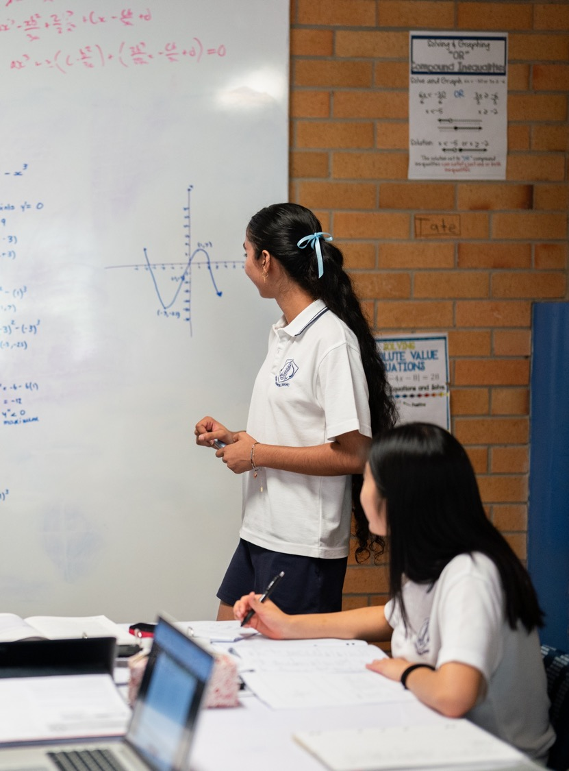
Global maximum and minimum
Mathematics Advanced – Stage 6 (Year 12)
Differentiation applications

Slide 2
Learning intentions and success criteria
Learning intention
To be able to determine the global maximum and minimum values of a function in a domain.
Success criteria
I can define a global maximum and minimum of a function.
I can identify all relevant points to test for the global maximum and minimum.
I can distinguish between local and global maxima and minima.

Slide 3
Activating prior knowledge

Slide 4
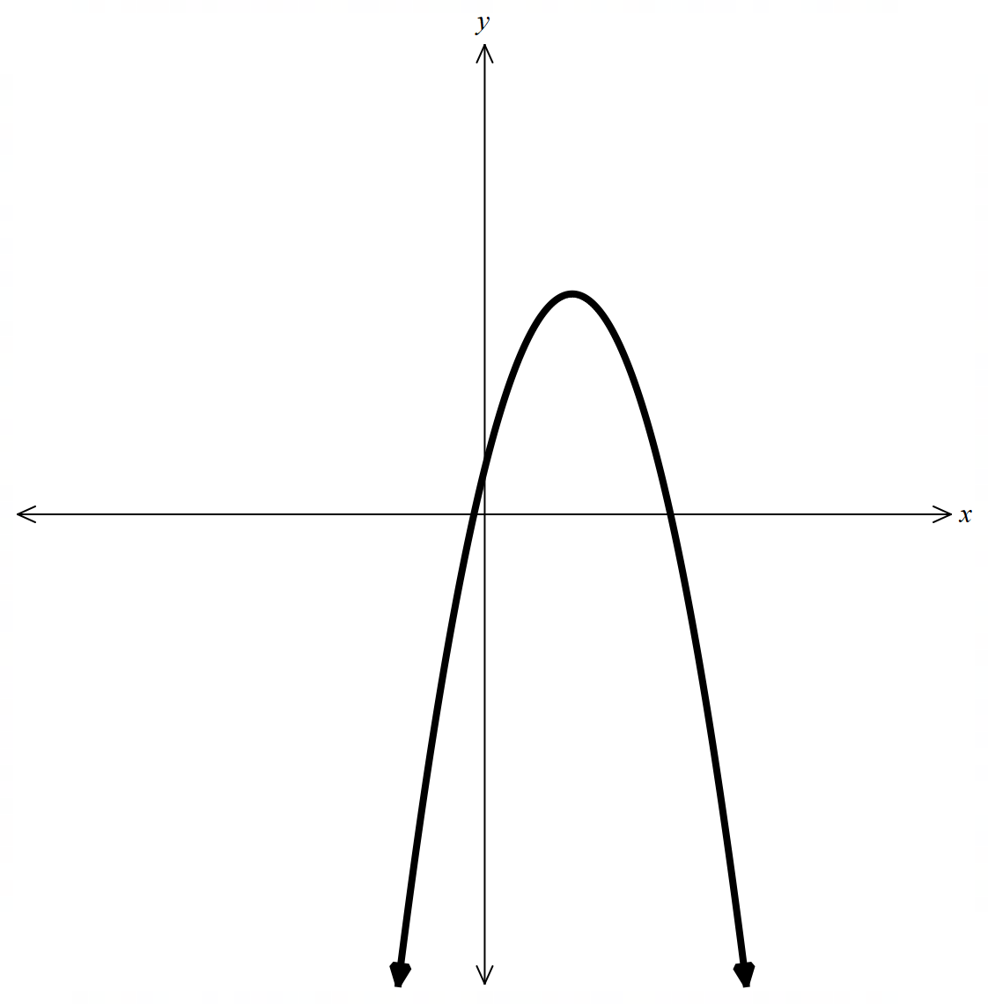
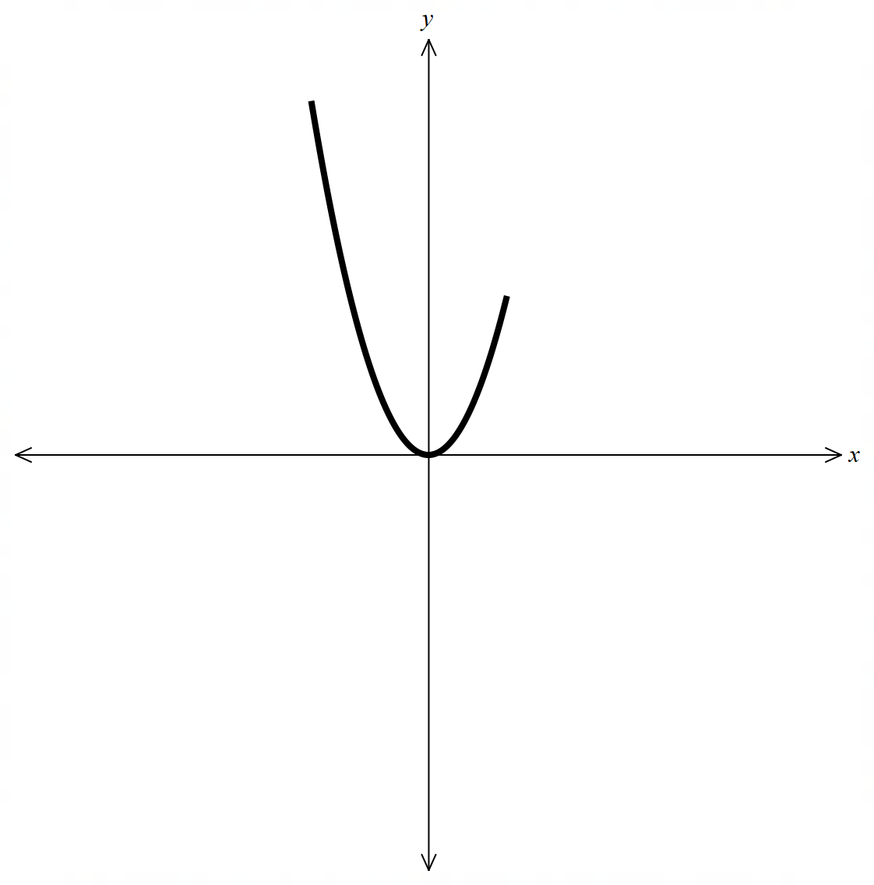
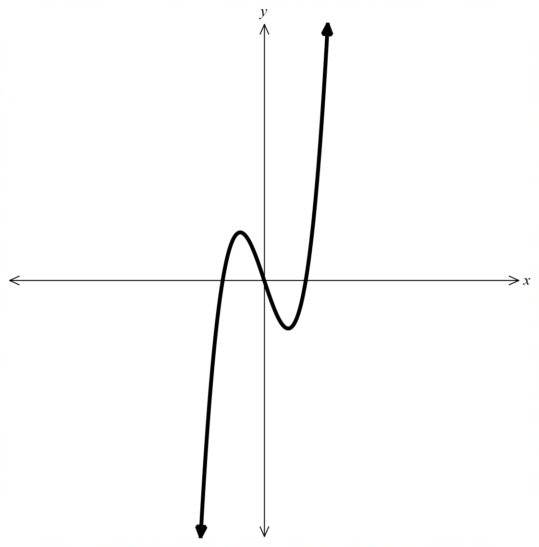
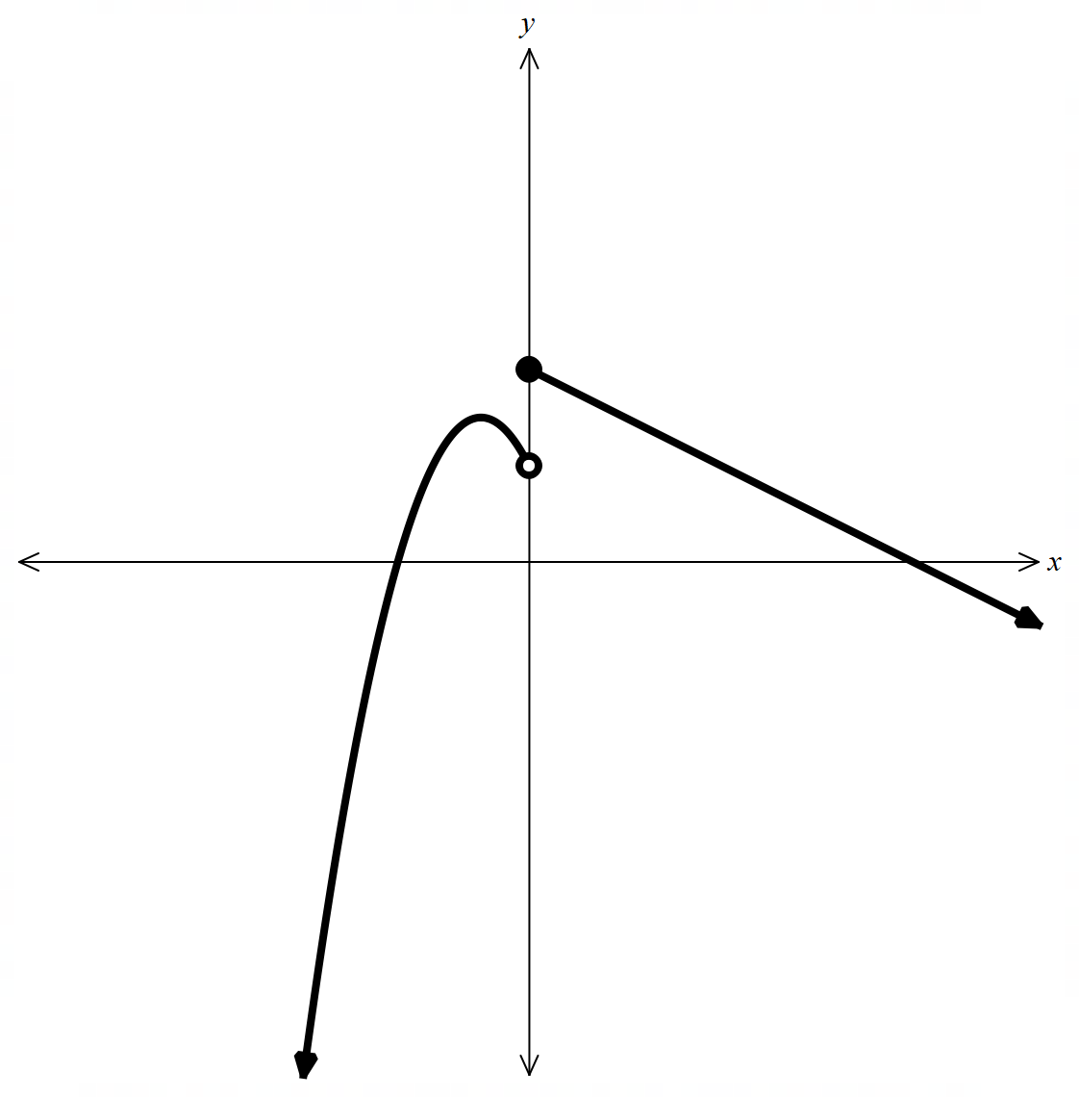
Which one doesn’t belong
A
B
C
D

Slide 5
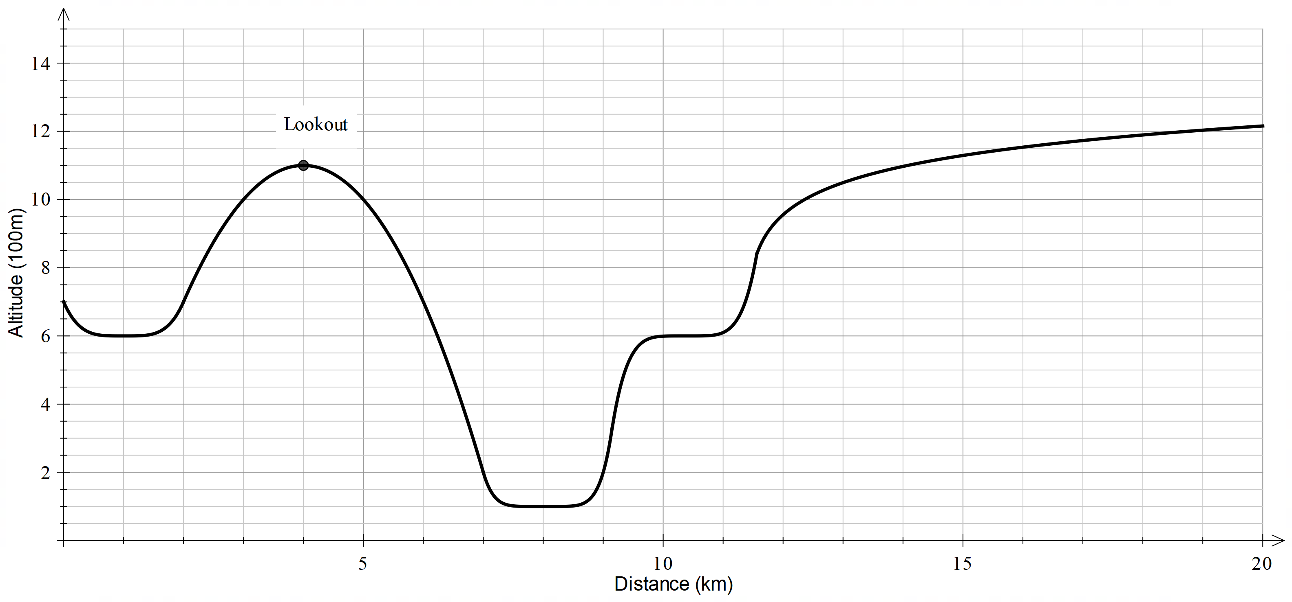
Hiker scenario (1)

Slide 6
Connecting learning

Slide 7

Hiker scenario (4)
Overall
Day 1
Day 2
Local maximum
Local minimum
Local minimum

Slide 8
Releasing responsibility

Slide 9
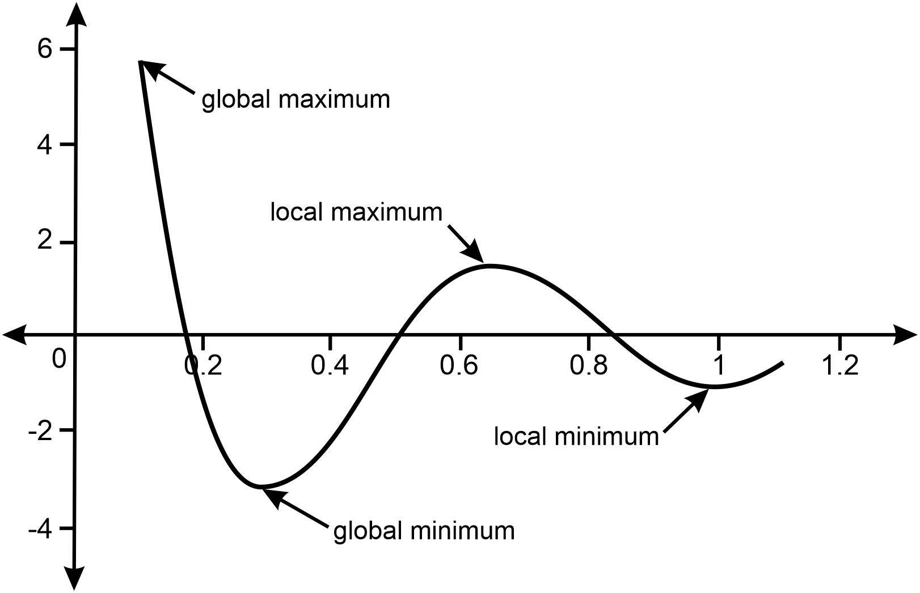
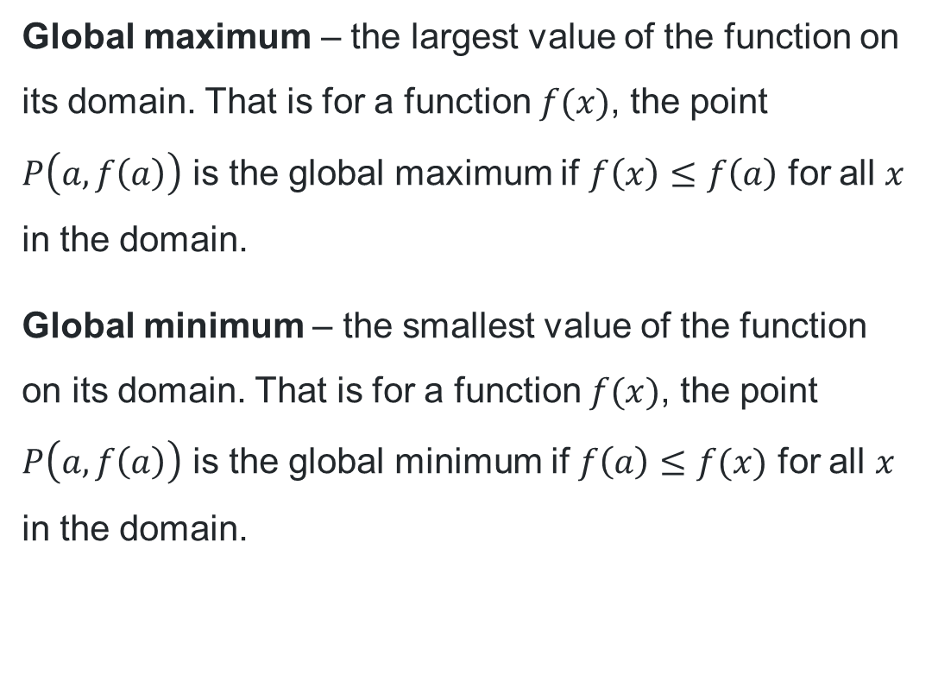
NESA definition
Global maximum and minimum
Global maximum – the largest value of the function on its domain. That is for a function $f(x)$, the point $P\left(a,f\left(a\right)\right)$ is the global maximum if $f\left(x\right)≤f\left(a\right)$ for all $x$ in the domain.
Global minimum – the smallest value of the function on its domain. That is for a function $f(x)$, the point $P\left(a,f\left(a\right)\right)$ is the global minimum if $f\left(a\right)≤f(x)$ for all $x$ in the domain.

Slide 10
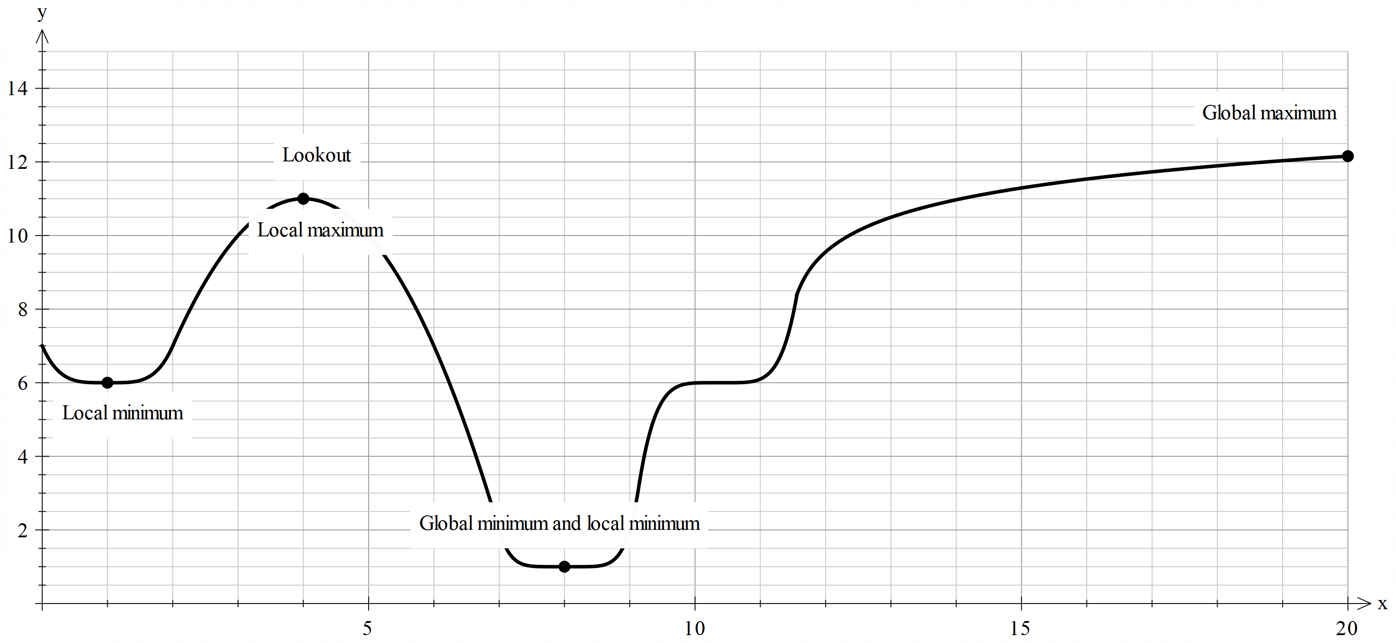
Hiking global maximum and minimum

Slide 11
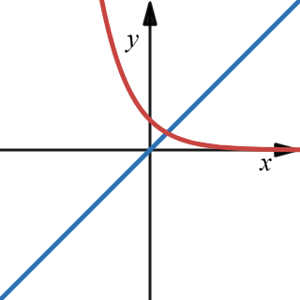
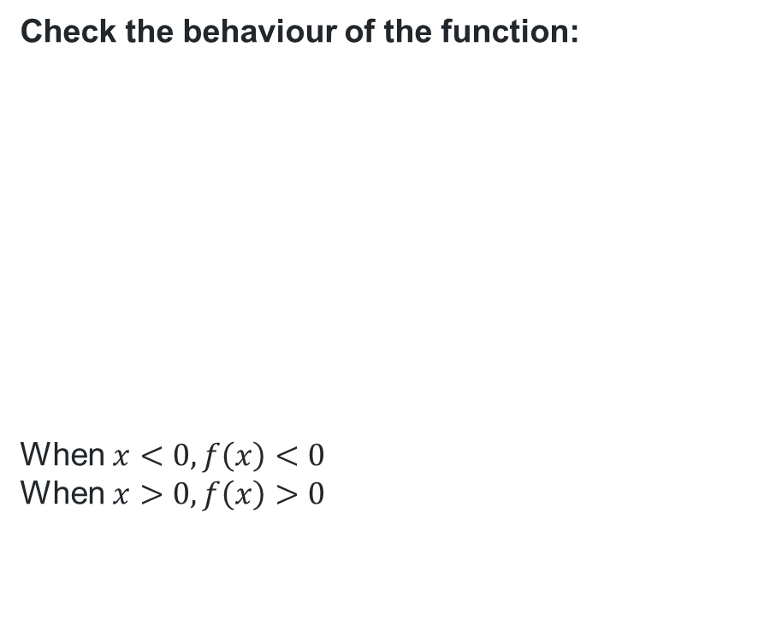
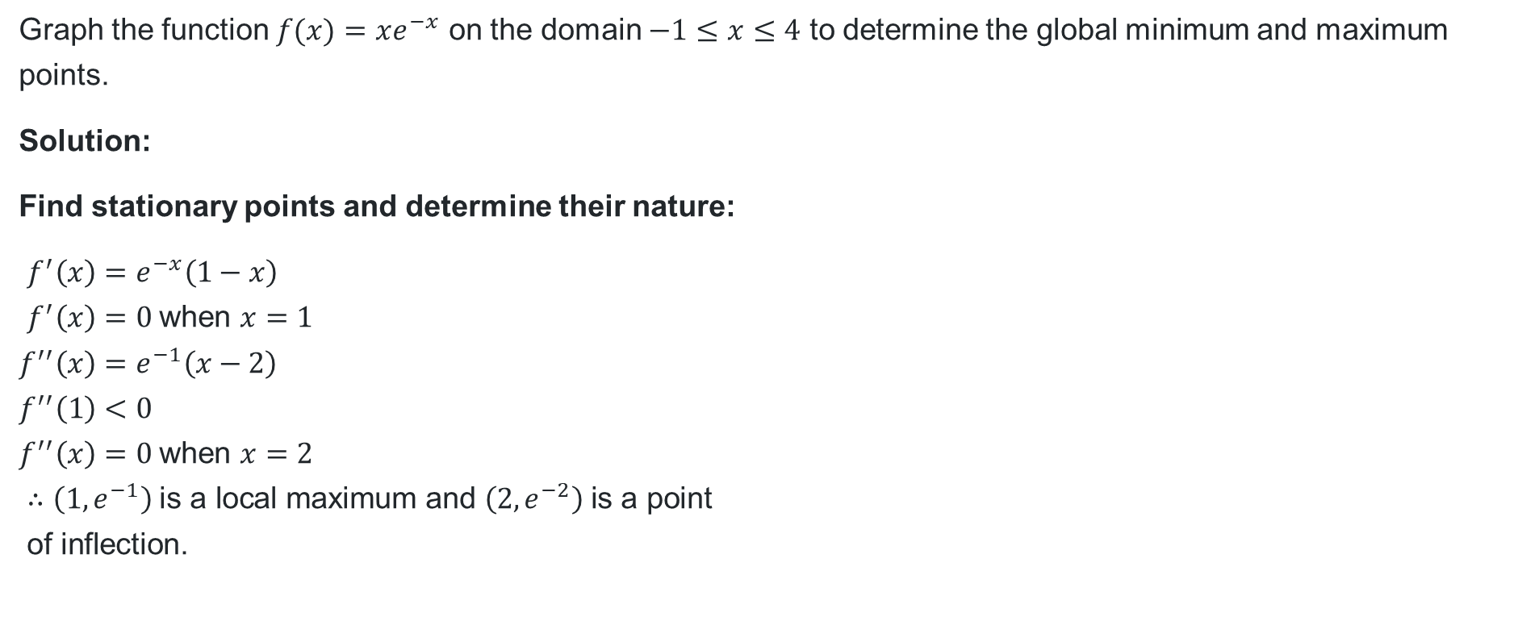
Worked example (1)
Question 1
Graph the function $f(x)=xe^{−x}$ on the domain $−1≤x≤4$ to determine the global minimum and maximum points.
Solution:
Find stationary points and determine their nature:
$$f^{′}\left(x\right)=e^{−x}\left(1−x\right) \\ f^{′}\left(x\right)=0 \text{when} x=1 \\ f^{′′}\left(x\right)=e^{−1}\left(x−2\right) \\ f^{′′}\left(1\right)<0 \\ f^{′′}\left(x\right)=0 \text{when} x=2 \\ ∴\left(1,e^{−1}\right) \text{is} \text{a} \text{local} \text{maximum} \text{and} \left(2,e^{−2}\right) \text{is} \text{a} \text{point} \\ \text{of} \text{inflection}\text{.}$$
Check the behaviour of the function:
When $x<0, f\left(x\right)<0$
When $x>0, f\left(x\right)>0$
What values could be chosen for a table of values to check the behaviour?
How does knowing the stationary point and point of inflection help to draw the graph?

Slide 12
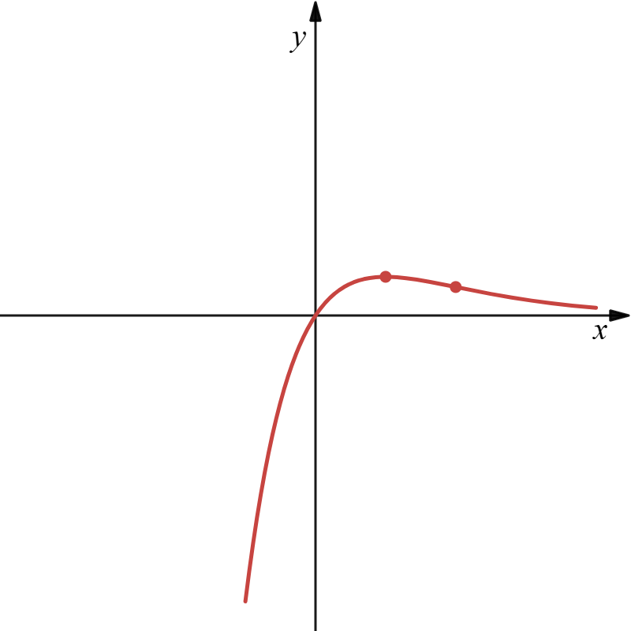
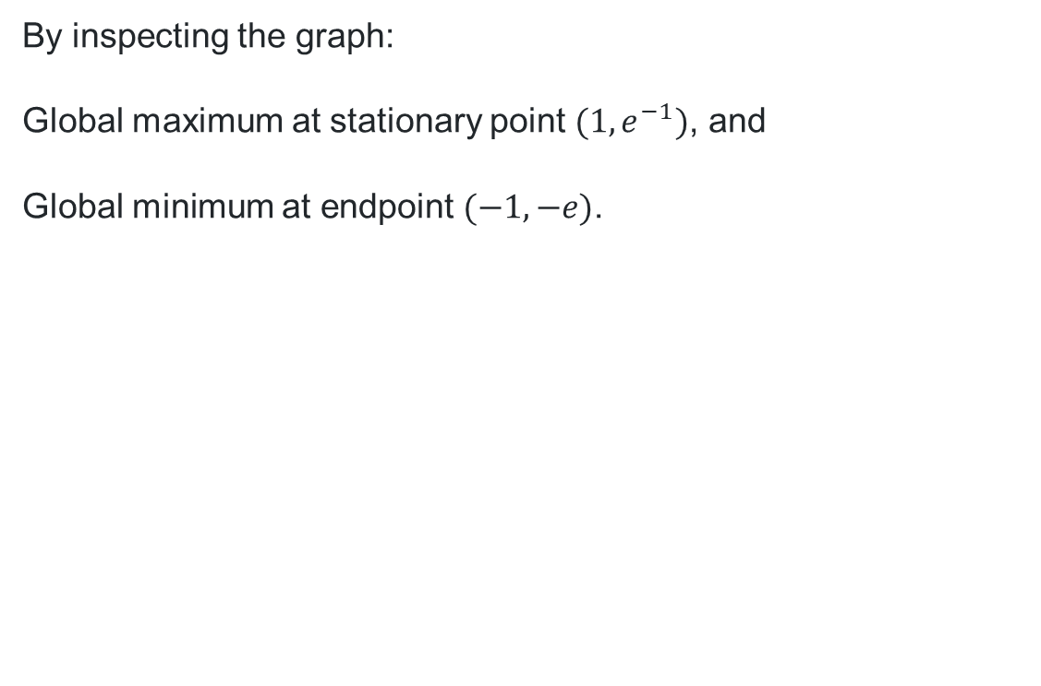
Worked example (2)
Question 1
Draw the function and determine global maximum and minimum:
By inspecting the graph:
Global maximum at stationary point $(1,e^{−1})$, and
Global minimum at endpoint $(−1,−e)$.
How might we verify this using the function?

Slide 13
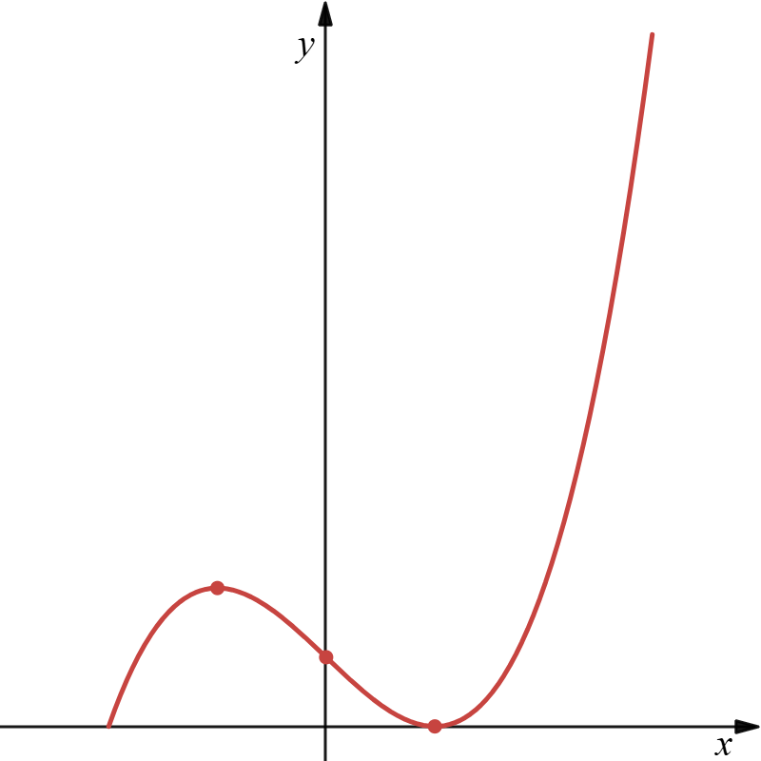
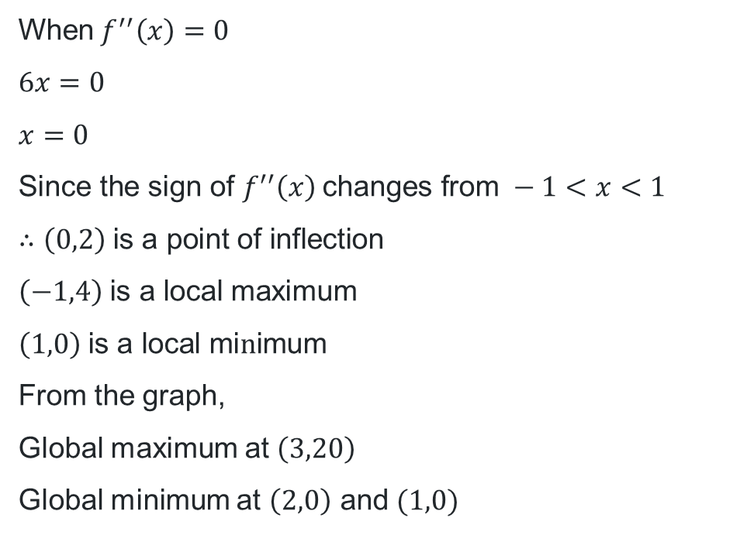
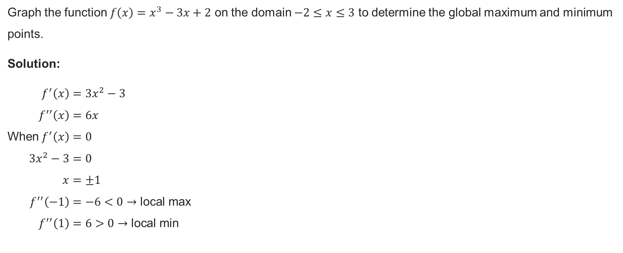
Your turn
Question 2
Graph the function $f\left(x\right)=x^{3}−3x+2$ on the domain $−2≤x≤3$ to determine the global maximum and minimum points.
Solution:
$$f^{′}\left(x\right)=3x^{2}−3 \\ f^{′′}\left(x\right)=6x \\ \text{When} f^{′}\left(x\right)=0 \\ 3x^{2}−3=0 \\ x=±1 \\ f^{′′}\left(−1\right)=−6<0→\text{local} \text{max} \\ f^{′′}\left(1\right)=6>0→\text{local} \text{min}$$
$$\text{When} f^{′′}\left(x\right)=0 \\ 6x=0 \\ x=0 \\ \text{Since} \text{the} \text{sign} \text{of} f^{′′}\left(x\right) \text{changes} \text{from} −1<x<1 \\ ∴\left(0,2\right) \text{is} \text{a} \text{point} \text{of} \text{inflection} \\ \left(−1,4\right) \text{is} \text{a} \text{local} \text{maximum} \\ \left(1,0\right) \text{is} \text{a} \text{local} \text{mi}n\text{imum}$$
From the graph,
Global maximum at $\left(3,20\right)$
Global minimum at $\left(2,0\right)$ and $(1,0)$

Slide 14
References
This presentation contains NSW Curriculum and syllabus content. The NSW Curriculum is developed by the NSW Education Standards Authority. This content is prepared by NESA for and on behalf of the Crown in the right of the State of New South Wales. The material is protected by Crown copyright.
Please refer to the NESA Copyright Disclaimer for more information https://educationstandards.nsw.edu.au/wps/portal/nesa/mini-footer/copyright.
NESA holds the only official and up-to-date versions of the NSW Curriculum and syllabus documents. Please visit the NSW Education Standards Authority (NESA) website https://educationstandards.nsw.edu.au/wps/portal/nesa/home and the NSW Curriculum website https://curriculum.nsw.edu.au.
Mathematics Advanced 11-12 Syllabus © NSW Education Standards Authority (NESA) for and on behalf of the Crown in right of the State of New South Wales, 2024.
.

Slide 15
Copyright
© State of New South Wales (Department of Education), 2026
The copyright material published in this resource is subject to the Copyright Act 1968 (Cth) and is owned by the NSW Department of Education or, where indicated, by a party other than the NSW Department of Education (third-party material).
Copyright material available in this resource and owned by the NSW Department of Education is licensed under a Creative Commons Attribution 4.0 International (CC BY 4.0) license.
This license allows you to share and adapt the material for any purpose, even commercially.
Attribution should be given to © State of New South Wales (Department of Education), 2026.
Material in this resource not available under a Creative Commons license:
the NSW Department of Education logo, other logos and trademark-protected material
Material owned by a third party that has been reproduced with permission. You will need to obtain permission from the third party to reuse its material.
Links to third-party material and websites
Please note that the provided (reading/viewing material/list/links/texts) are a suggestion only and implies no endorsement, by the New South Wales Department of Education, of any author, publisher, or book title. School principals and teachers are best placed to assess the suitability of resources that would complement the curriculum and reflect the needs and interests of their students.
If you use the links provided in this document to access a third-party’s website, you acknowledge that the terms of use, including licence terms set out on the third-party’s website apply to the use which may be made of the materials on that third-party website or where permitted by the Copyright Act 1968 (Cth). The department accepts no responsibility for content on third-party websites.

