Slide 1
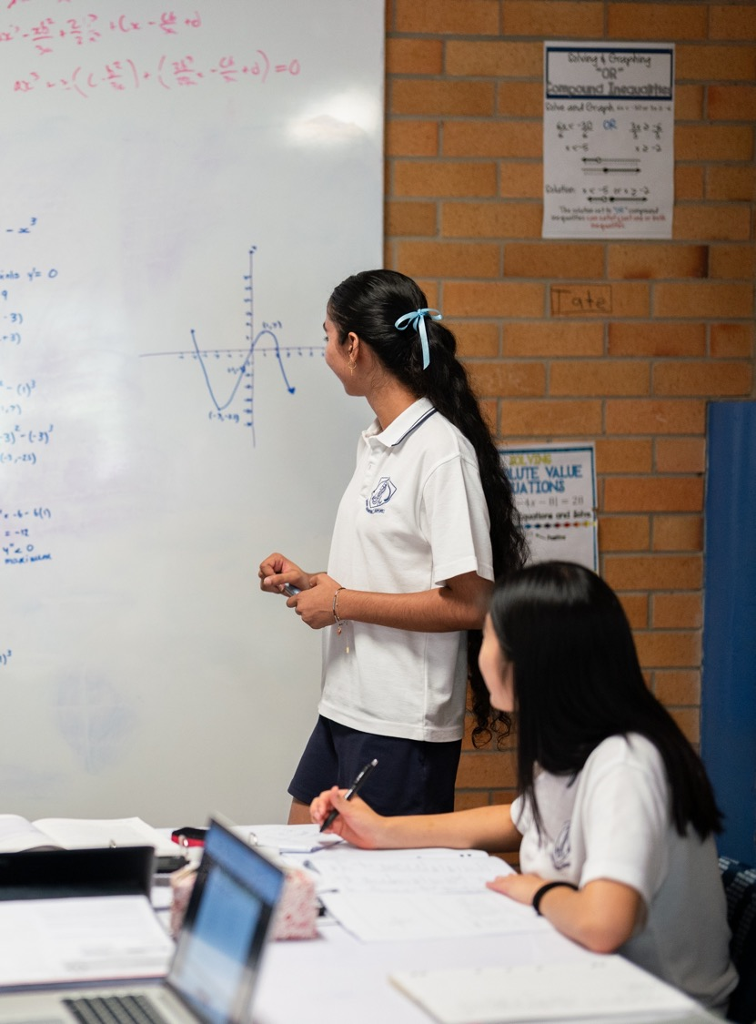
Graphing functions with calculus
Mathematics Advanced – Stage 6 (Year 12)
Differentiation applications

Slide 2
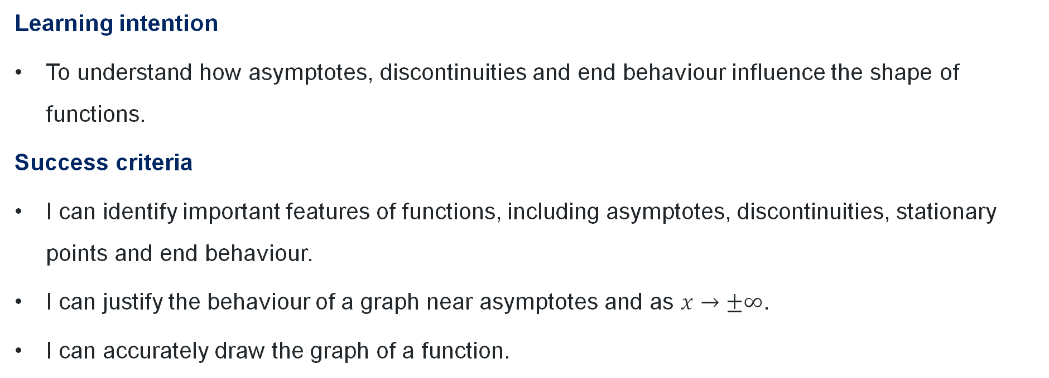
Learning intentions and success criteria
Learning intention
To understand how asymptotes, discontinuities and end behaviour influence the shape of functions.
Success criteria
I can identify important features of functions, including asymptotes, discontinuities, stationary points and end behaviour.
I can justify the behaviour of a graph near asymptotes and as $x→±∞$.
I can accurately draw the graph of a function.

Slide 3
Activating prior knowledge

Slide 4
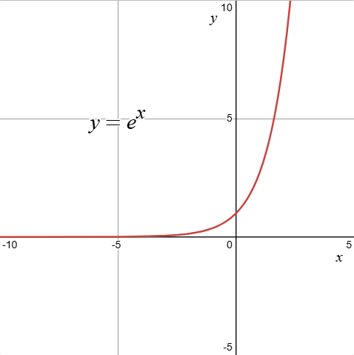
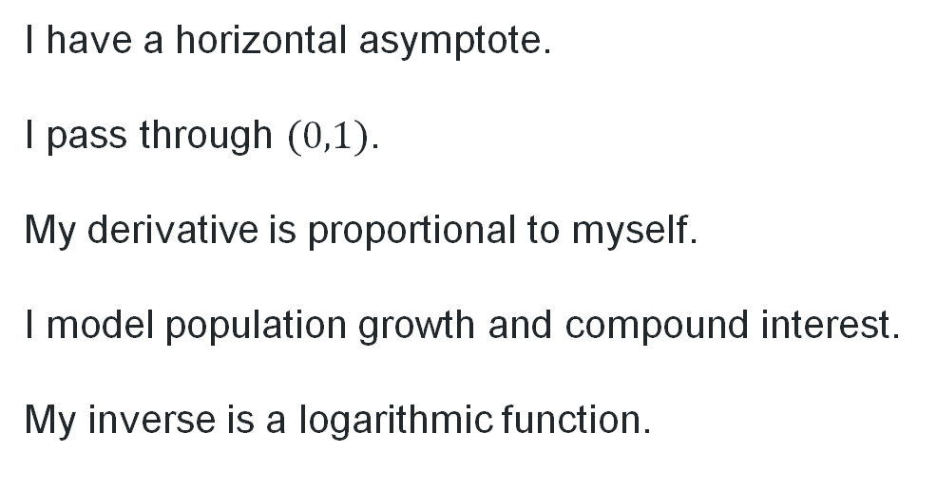
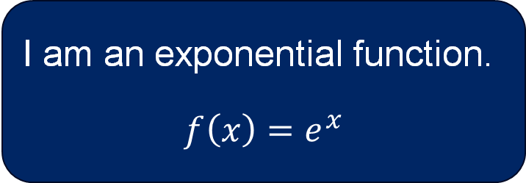
What function am I? (1)
I have a horizontal asymptote.
I pass through $(0,1)$.
My derivative is proportional to myself.
I model population growth and compound interest.
My inverse is a logarithmic function.
I am an exponential function.
$$f\left(x\right)=e^{x}$$

Slide 5
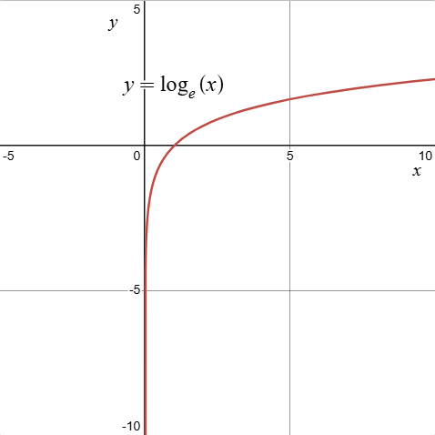
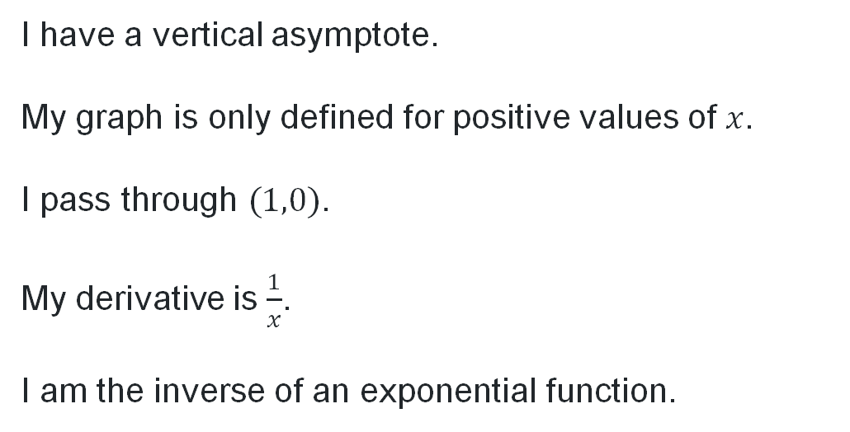
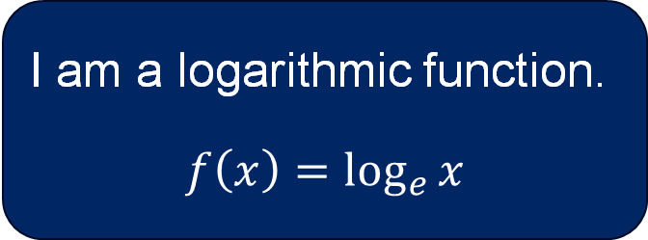
What function am I? (2)
I have a vertical asymptote.
My graph is only defined for positive values of $x$.
I pass through $(1,0)$.
My derivative is $\frac{1}{x}$.
I am the inverse of an exponential function.
I am a logarithmic function.
$$f\left(x\right)=\log_{e}{x}$$

Slide 6
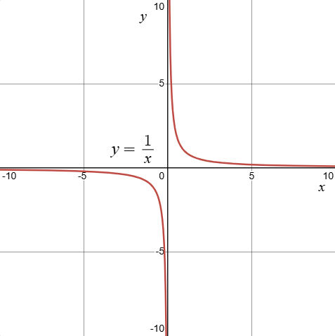
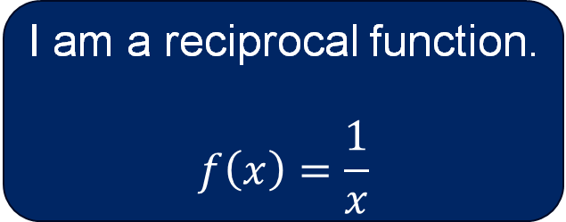
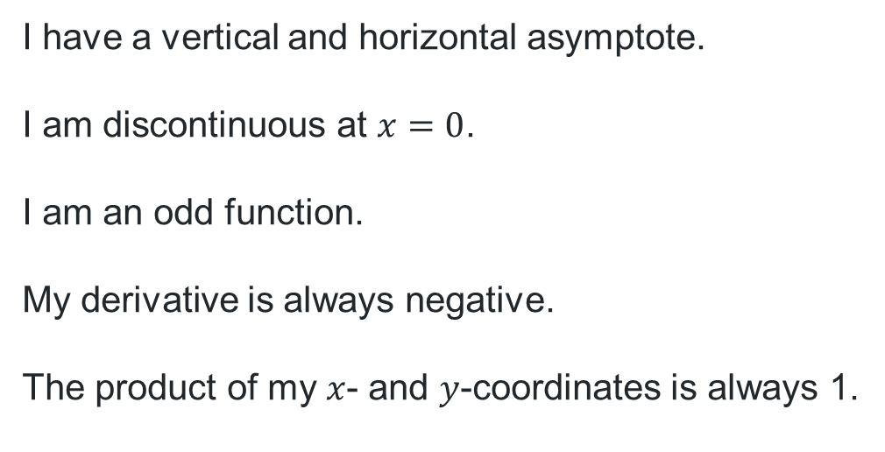
What function am I? (3)
I have a vertical and horizontal asymptote.
I am discontinuous at $x=0$.
I am an odd function.
My derivative is always negative.
The product of my $x$- and $y$-coordinates is always 1.
I am a reciprocal function.
$$f\left(x\right)=\frac{1}{x}$$

Slide 7
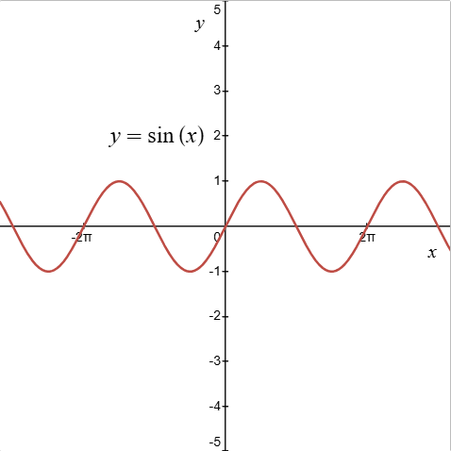
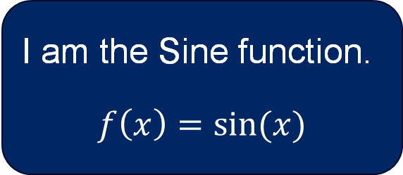
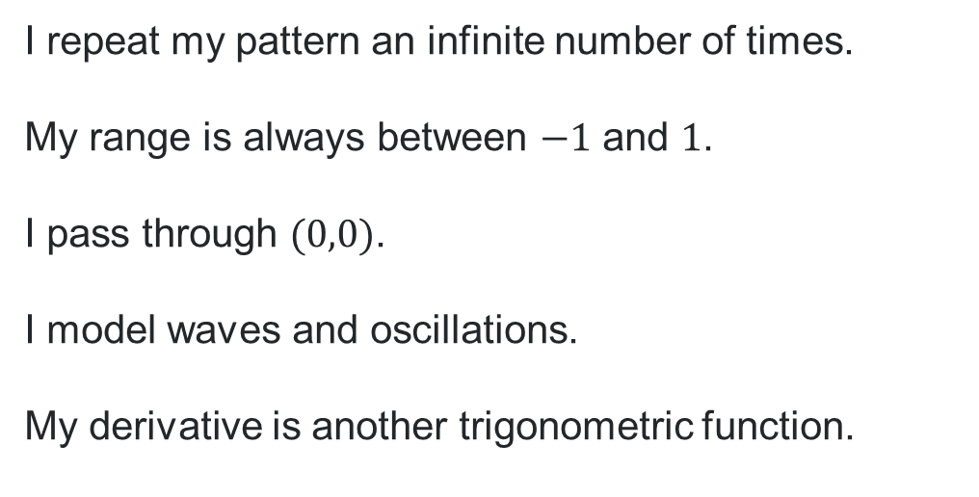
What function am I? (4)
I repeat my pattern an infinite number of times.
My range is always between $−1$ and $1$.
I pass through $(0,0)$.
I model waves and oscillations.
My derivative is another trigonometric function.
I am the Sine function.
$$f\left(x\right)=\sin{(x)}$$

Slide 8
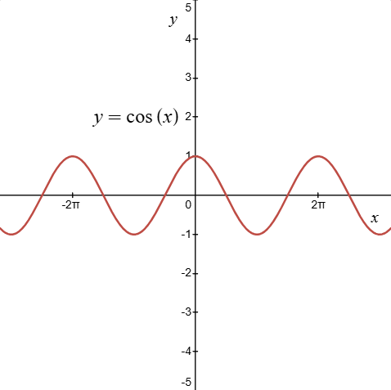
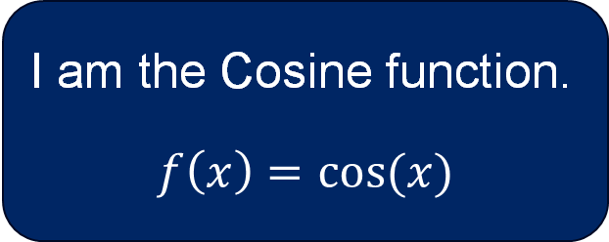
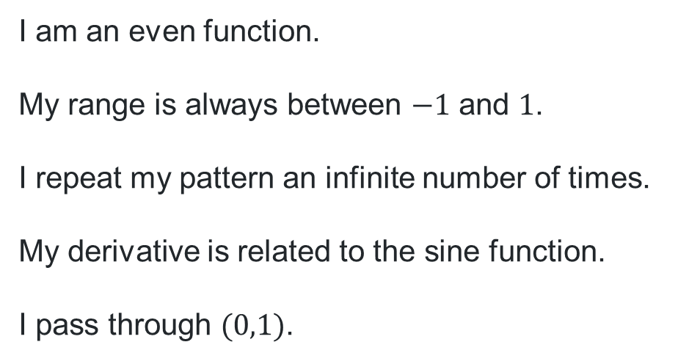
What function am I? (5)
I am an even function.
My range is always between $−1$ and $1$.
I repeat my pattern an infinite number of times.
My derivative is related to the sine function.
I pass through $(0,1)$.
I am the Cosine function.
$$f\left(x\right)=\cos{(x)}$$

Slide 9
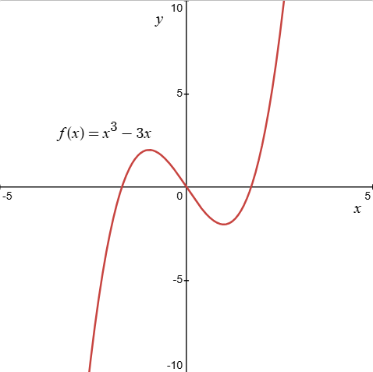
Graphs of the functions

Slide 10
Connecting learning

Slide 11




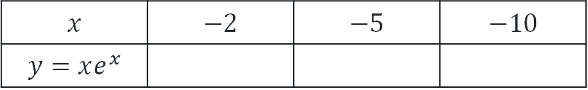

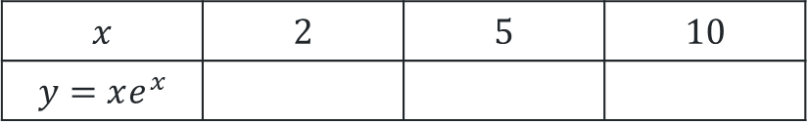

Graphing a function (2)
Graphing the function $y=xe^{x}$
Compete the table of values to help determine the shape of the function as $x→±∞$
$$x$$ | $$2$$ | $$5$$ | $$10$$
$$y=xe^{x}$$
$$≈14.78$$
$$≈742.07$$
$$≈220265$$
$$x$$ | $$−2$$ | $$−5$$ | $$−10$$
$$y=xe^{x}$$
$$≈−0.271$$
$$≈−0.034$$
$$≈−0.0005$$

Slide 12
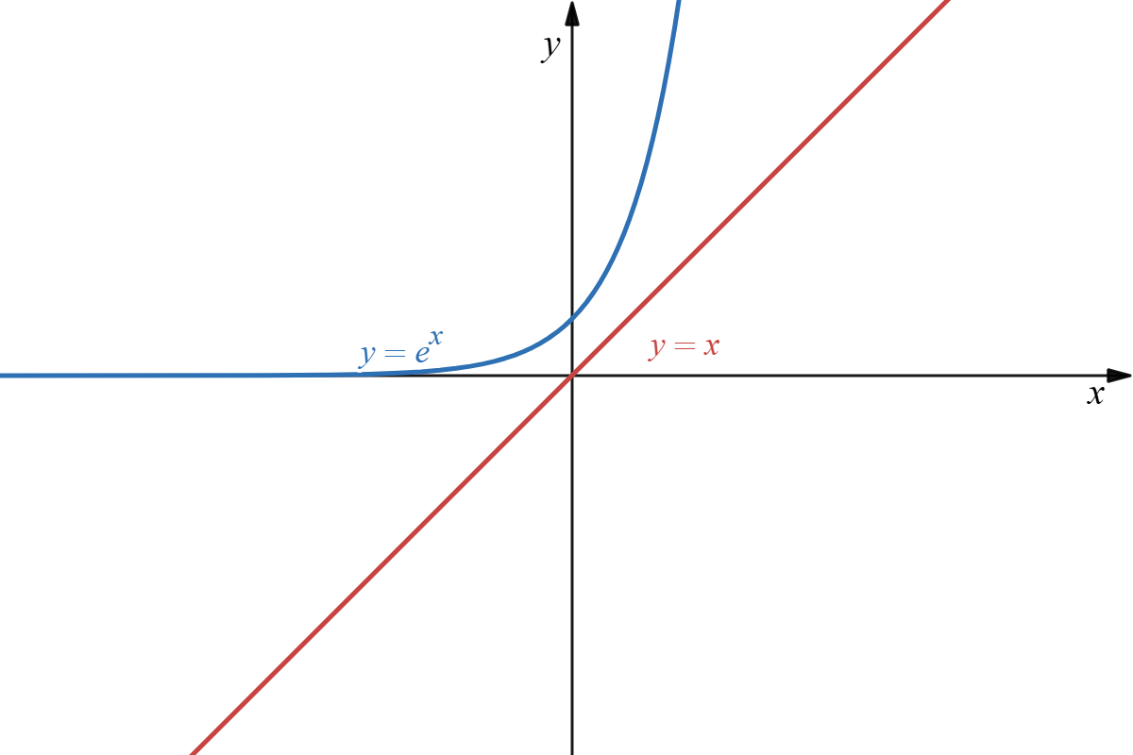
Graphing a function (1)
Graphing the function $y=xe^{x}$

Slide 13
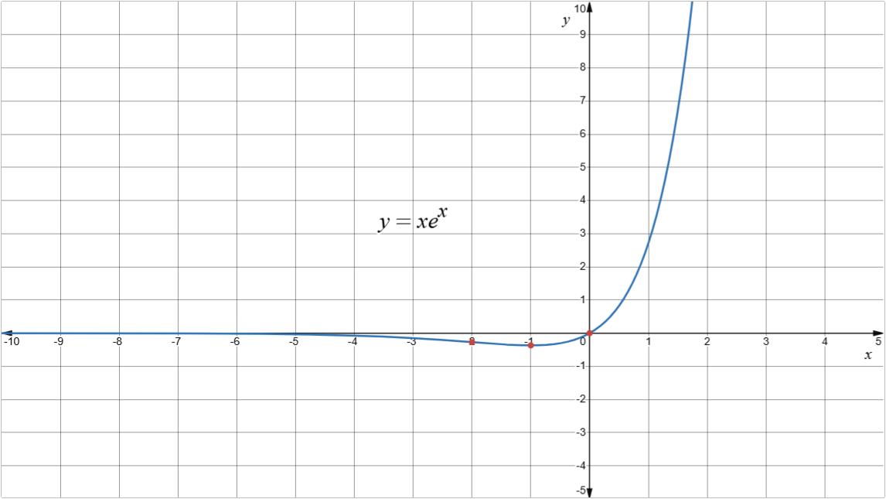
Graphing a function (3)
Graphing the function $y=xe^{x}$

Slide 14
Releasing responsibility

Slide 15
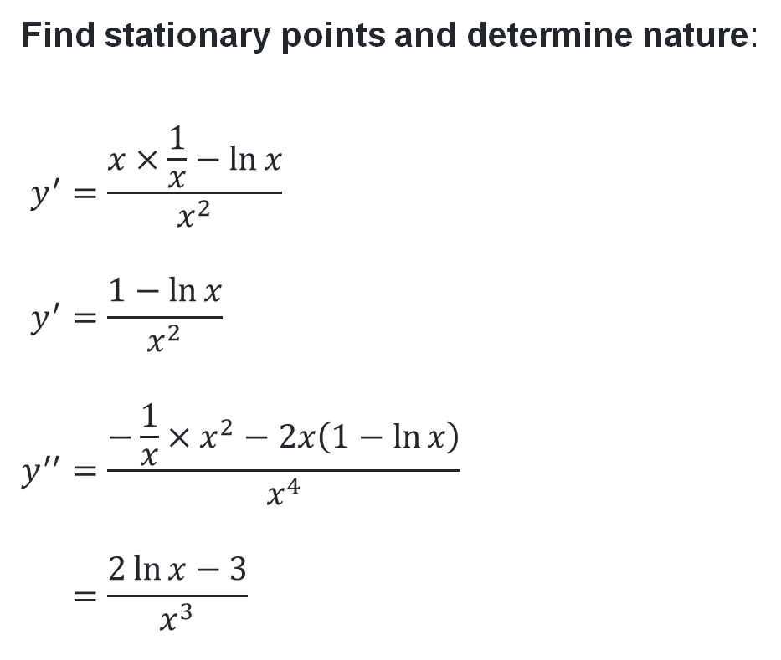
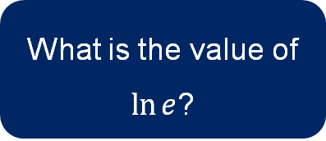
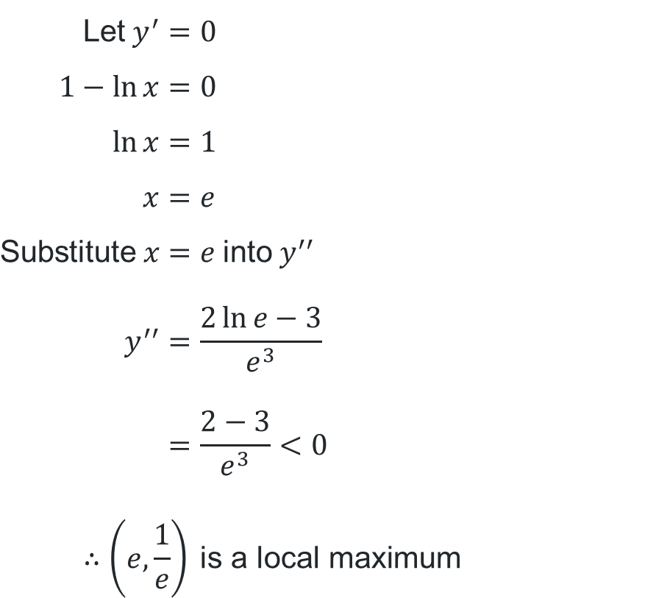
Worked example (1)
Graphing the function $y=\frac{\ln{x}}{x}$
Find stationary points and determine nature:
$$y^{′}=\frac{x×\frac{1}{x}−\ln{x}}{x^{2}} \\ y^{′}=\frac{1−\ln{x}}{x^{2}} \\ y^{′′}=\frac{−\frac{1}{x}×x^{2}−2x\left(1−\ln{x}\right)}{x^{4}} \\ =\frac{2\ln{x}−3}{x^{3}}$$
What happened to the denominator?
$$\text{Let} y^{′}=0 \\ 1−\ln{x}=0 \\ \ln{x}=1 \\ x=e \\ \text{Substitute} x=e \text{into} y^{′′} \\ y^{′′}=\frac{2\ln{e}−3}{e^{3}} \\ =\frac{2−3}{e^{3}}<0 \\ ∴\left(e,\frac{1}{e}\right) \text{is} \text{a} \text{local} \text{maximum}$$
What is the value of $\ln{e}$?

Slide 16

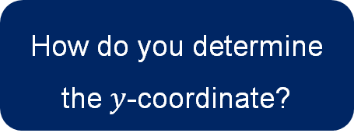
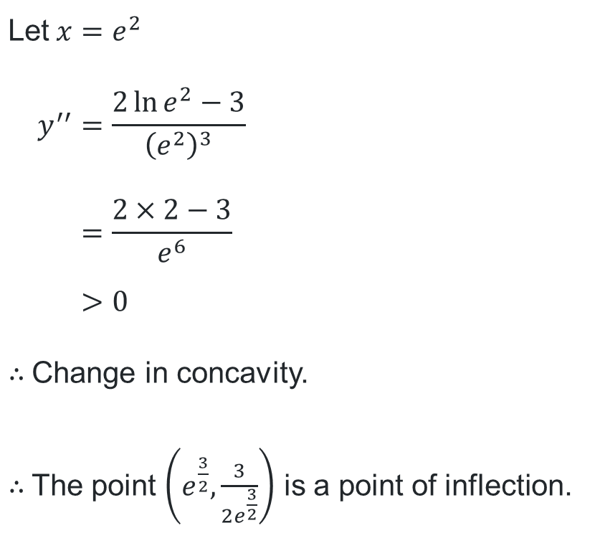
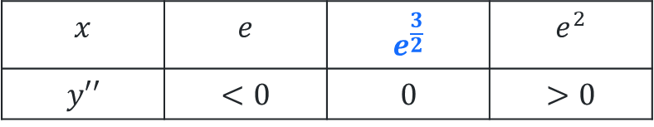
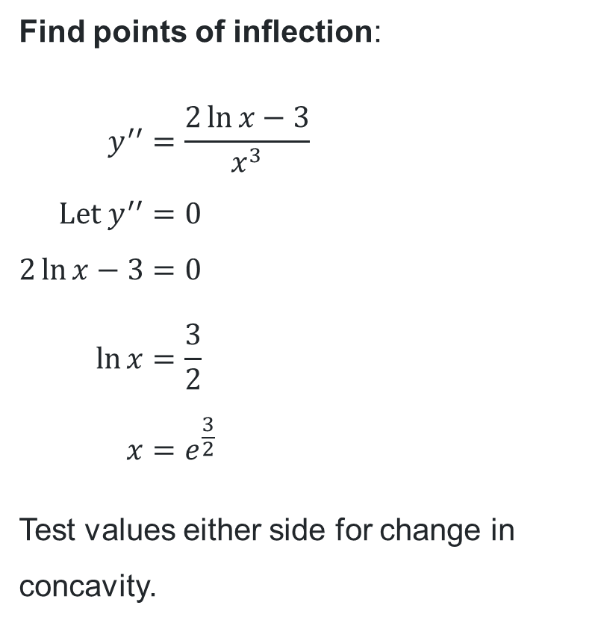
Worked example (2)
Graphing the function $y=\frac{\ln{x}}{x}$
$$x$$ | $$e$$ | $$e^{\frac{3}{2}}$$ | $$e^{2}$$
$$y′′$$ | $$<0$$ | $$0$$ | $$>0$$
Find points of inflection:
$$y^{′′}=\frac{2\ln{x}−3}{x^{3}} \\ \text{Let} y^{′′}=0 \\ 2\ln{x}−3=0 \\ \ln{x}=\frac{3}{2} \\ x=e^{\frac{3}{2}}$$
Test values either side for change in concavity.
$$\text{Let} x=e^{2} \\ y^{′′}=\frac{2\ln{e^{2}}−3}{{\left(e^{2}\right)}^{3}} \\ =\frac{2×2−3}{e^{6}} \\ >0$$
$∴$ Change in concavity.
$∴$ The point $\left(e^{\frac{3}{2}},\frac{3}{2e^{\frac{3}{2}}}\right)$ is a point of inflection.
How can you know that this is positive?
How do you determine the $y$-coordinate?

Slide 17
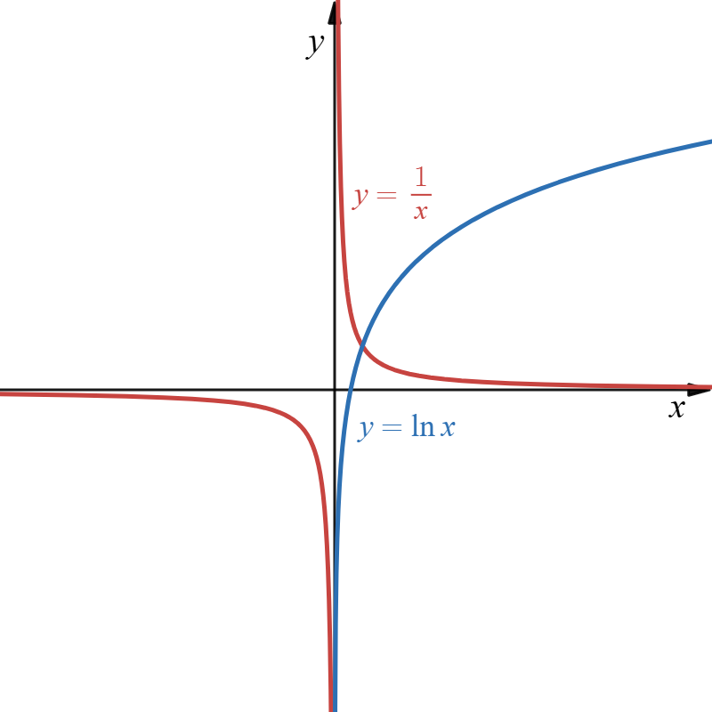
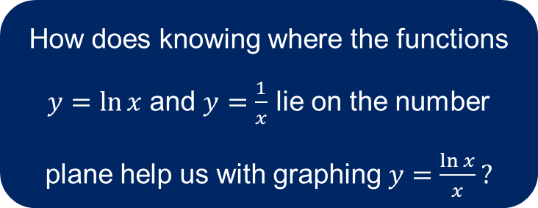
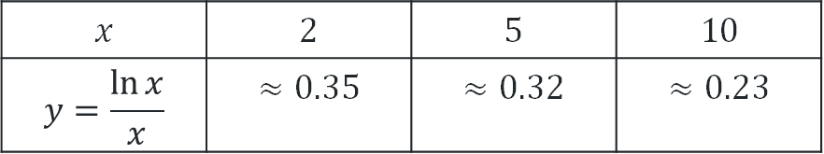
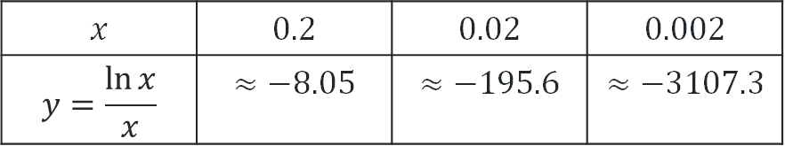
Worked example (3)
How does knowing where the functions $y=\ln{x}$ and $y=\frac{1}{x}$ lie on the number plane help us with graphing $y=\frac{\ln{x}}{x}?$
Graphing the function $y=\frac{\ln{x}}{x}$
Consider behaviour of the function:
$$x$$ | $$0.2$$ | $$0.02$$ | $$0.002$$
$$y=\frac{\ln{x}}{x}$$ | $$≈−8.05$$ | $$≈−195.6$$ | $$≈−3107.3$$
$$x$$ | $$2$$ | $$5$$ | $$10$$
$$y=\frac{\ln{x}}{x}$$ | $$≈0.35$$ | $$≈0.32$$ | $$≈0.23$$
What other information may help us determine how the graph looks?

Slide 18
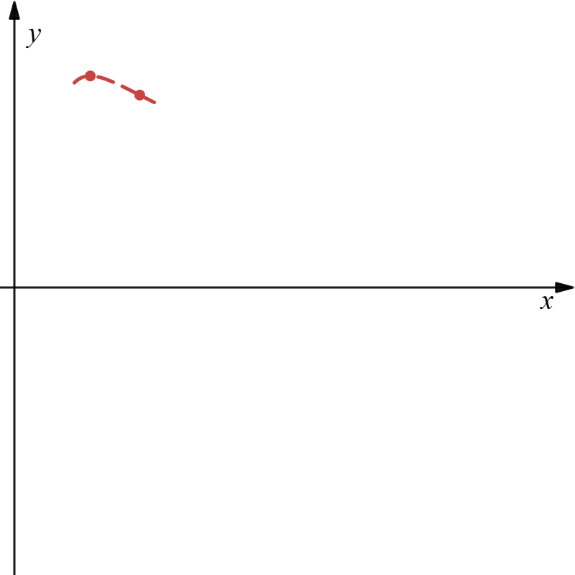
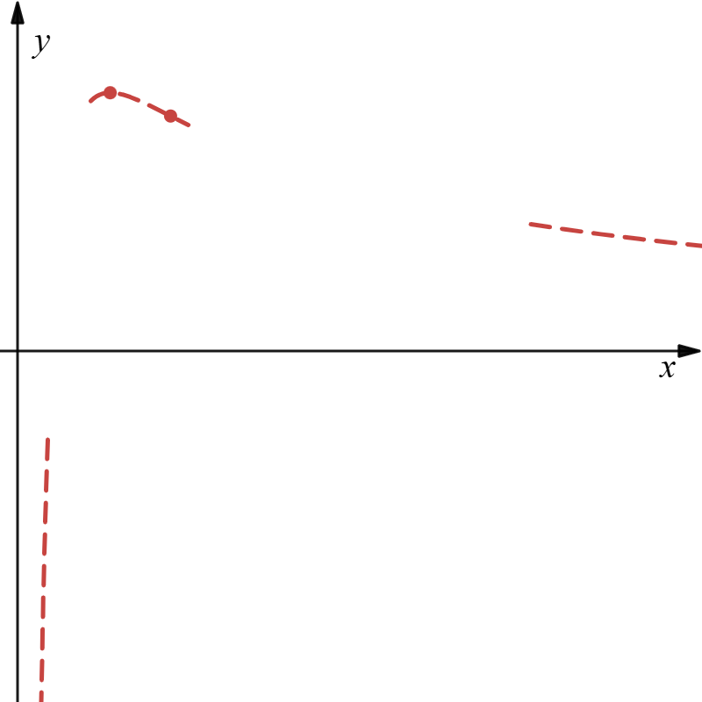
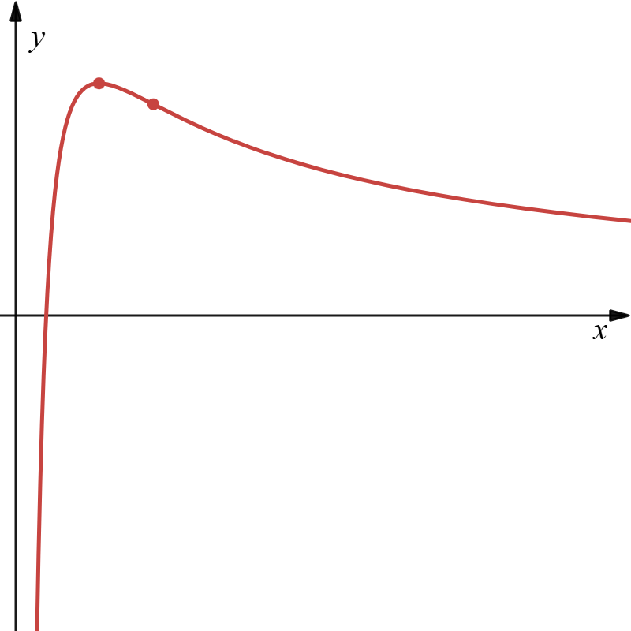
Worked example (4)
Graphing the function $y=\frac{\ln{x}}{x}$
Draw the graph:

Slide 19
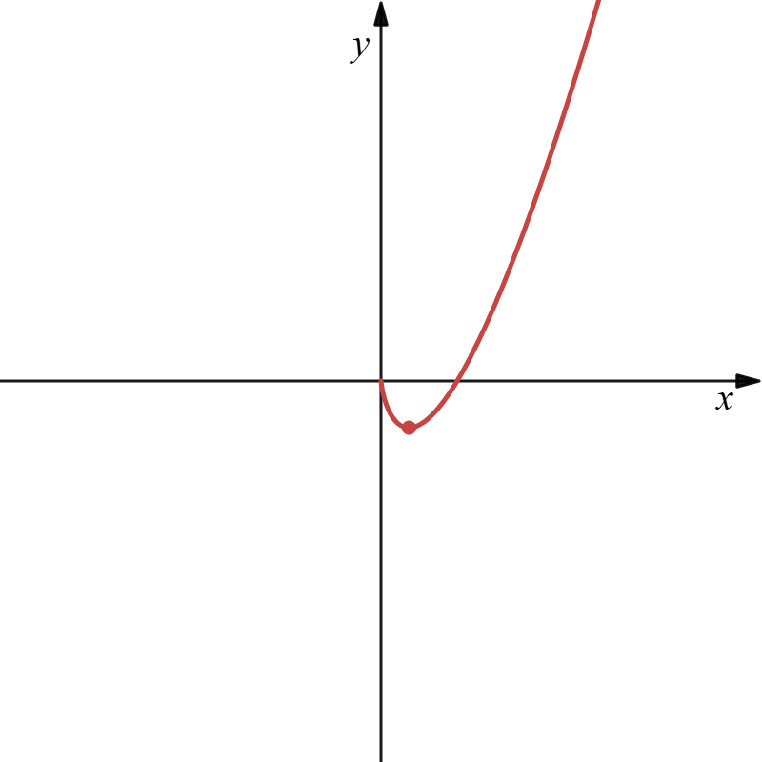
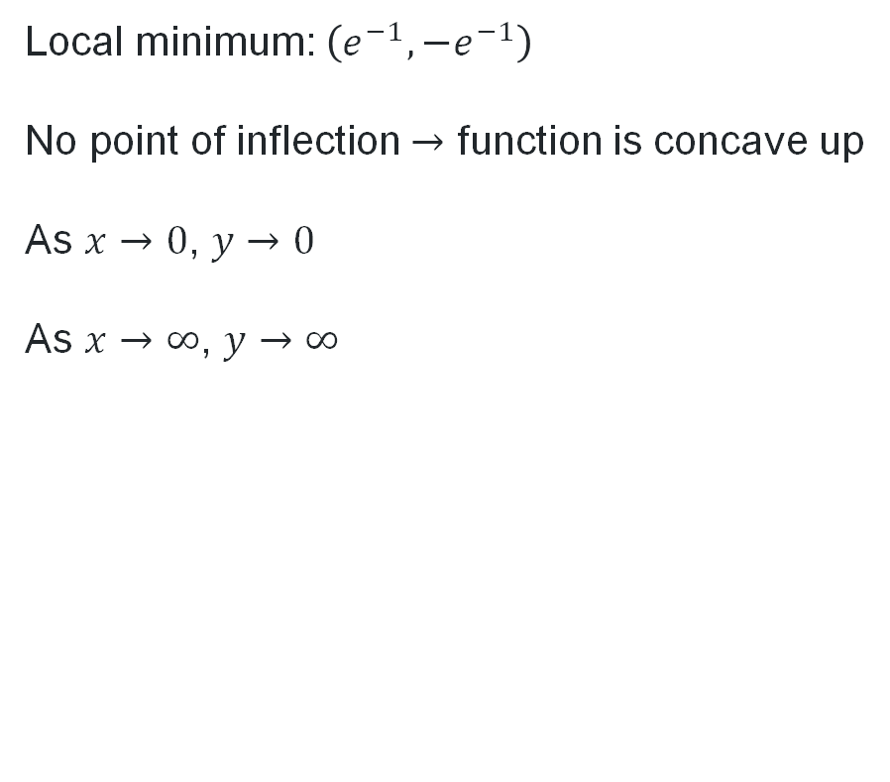
Your turn
Solution
Local minimum: $\left(e^{−1},−e^{−1}\right)$
No point of inflection $→$ function is concave up
As $x→0$, $y→0$
As $x→∞$, $y→∞$

Slide 20
Independent practice

Slide 21
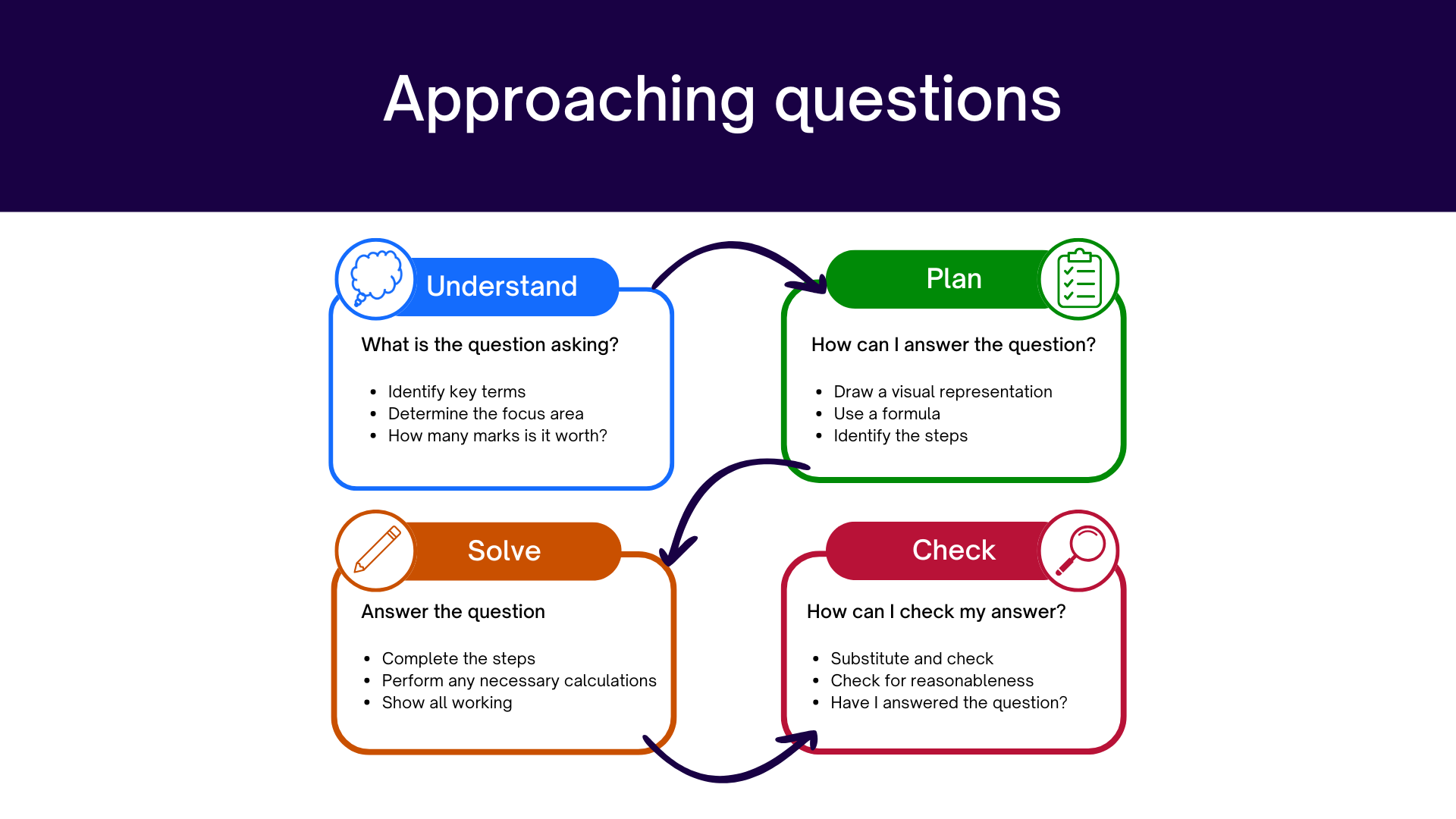
Approaching questions scaffold

Slide 22
References
This presentation contains NSW Curriculum and syllabus content. The NSW Curriculum is developed by the NSW Education Standards Authority. This content is prepared by NESA for and on behalf of the Crown in the right of the State of New South Wales. The material is protected by Crown copyright.
Please refer to the NESA Copyright Disclaimer for more information https://educationstandards.nsw.edu.au/wps/portal/nesa/mini-footer/copyright.
NESA holds the only official and up-to-date versions of the NSW Curriculum and syllabus documents. Please visit the NSW Education Standards Authority (NESA) website https://educationstandards.nsw.edu.au/wps/portal/nesa/home and the NSW Curriculum website https://curriculum.nsw.edu.au.
Mathematics Advanced 11-12 Syllabus © NSW Education Standards Authority (NESA) for and on behalf of the Crown in right of the State of New South Wales, 2024.
.

Slide 23
Copyright
© State of New South Wales (Department of Education), 2026
The copyright material published in this resource is subject to the Copyright Act 1968 (Cth) and is owned by the NSW Department of Education or, where indicated, by a party other than the NSW Department of Education (third-party material).
Copyright material available in this resource and owned by the NSW Department of Education is licensed under a Creative Commons Attribution 4.0 International (CC BY 4.0) license.
This license allows you to share and adapt the material for any purpose, even commercially.
Attribution should be given to © State of New South Wales (Department of Education), 2026.
Material in this resource not available under a Creative Commons license:
the NSW Department of Education logo, other logos and trademark-protected material
Material owned by a third party that has been reproduced with permission. You will need to obtain permission from the third party to reuse its material.
Links to third-party material and websites
Please note that the provided (reading/viewing material/list/links/texts) are a suggestion only and implies no endorsement, by the New South Wales Department of Education, of any author, publisher, or book title. School principals and teachers are best placed to assess the suitability of resources that would complement the curriculum and reflect the needs and interests of their students.
If you use the links provided in this document to access a third-party’s website, you acknowledge that the terms of use, including licence terms set out on the third-party’s website apply to the use which may be made of the materials on that third-party website or where permitted by the Copyright Act 1968 (Cth). The department accepts no responsibility for content on third-party websites.

