Slide 1
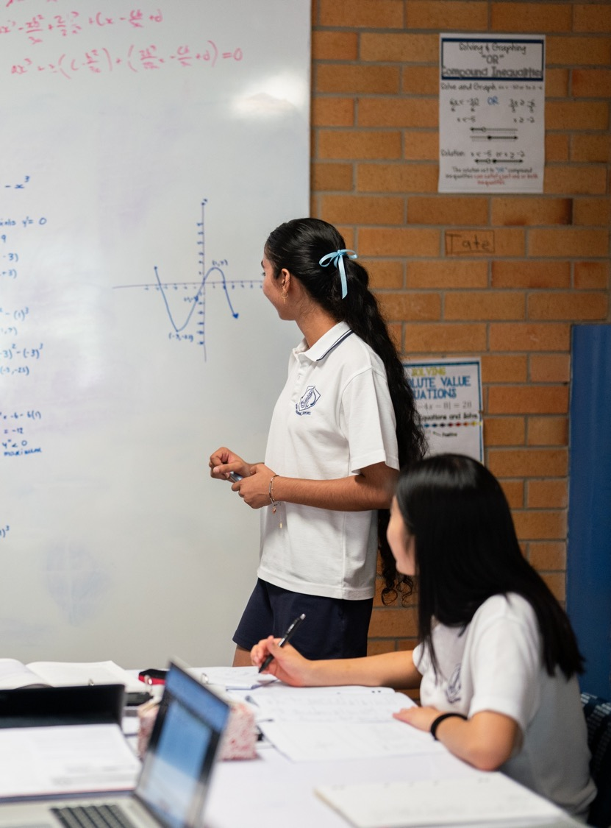
Introducing graphing with calculus
Mathematics Advanced – Stage 6 (Year 12)
Differentiation applications

Slide 2
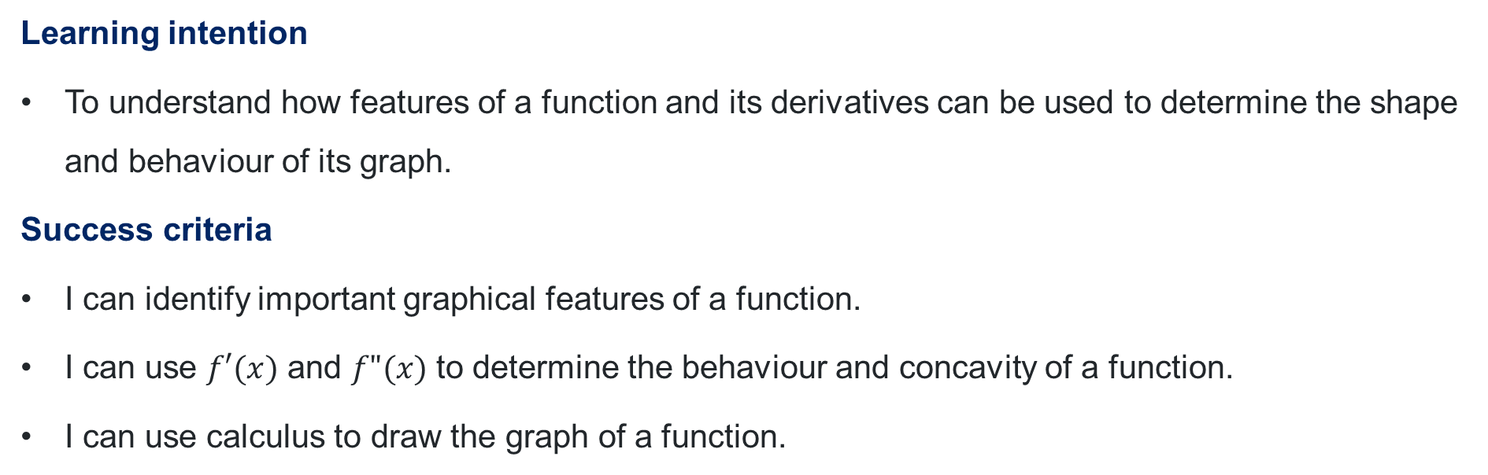
Learning intentions and success criteria
Learning intention
To understand how features of a function and its derivatives can be used to determine the shape and behaviour of its graph.
Success criteria
I can identify important graphical features of a function.
I can use $f′(x)$ and $f"(x)$ to determine the behaviour and concavity of a function.
I can use calculus to draw the graph of a function.

Slide 3
Retrieval practice

Slide 4
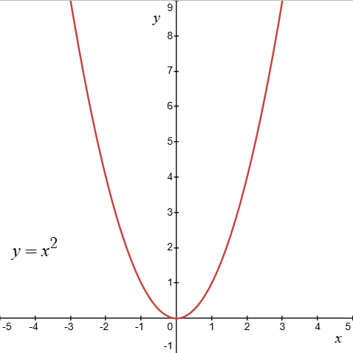
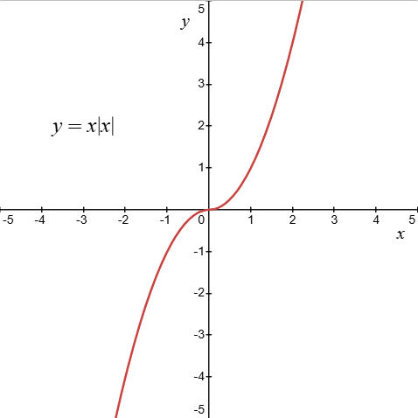
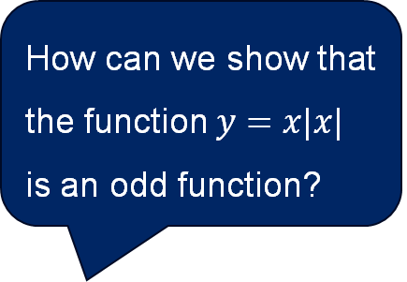
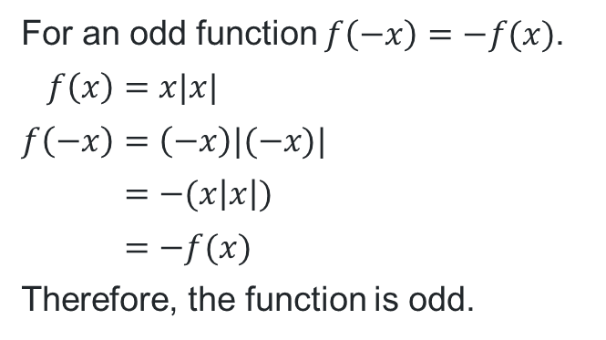
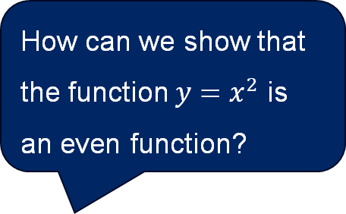
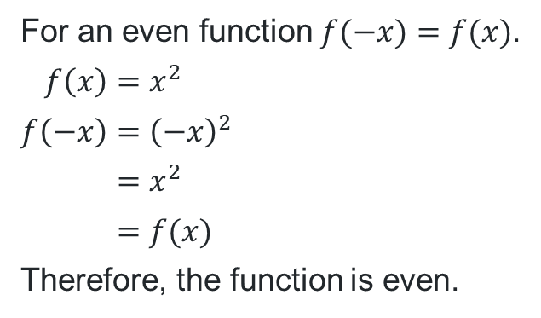
Odd and even functions
How can we show that the function $y=x^{2}$ is an even function?
How can we show that the function $y=x|x|$ is an odd function?
Why might it be useful to know if a function is odd or even?
For an even function $f(−x)=f(x)$.
$$f\left(x\right)=x^{2} \\ f\left(−x\right)={\left(−x\right)}^{2} \\ =x^{2} \\ =f(x)$$
Therefore, the function is even.
For an odd function $f\left(−x\right)=−f(x)$.
$$f\left(x\right)=x|x| \\ f\left(−x\right)=\left(−x\right)|(−x)| \\ =−(x\left|x\right|) \\ =−f(x)$$
Therefore, the function is odd.

Slide 5
Activating prior knowledge

Slide 6
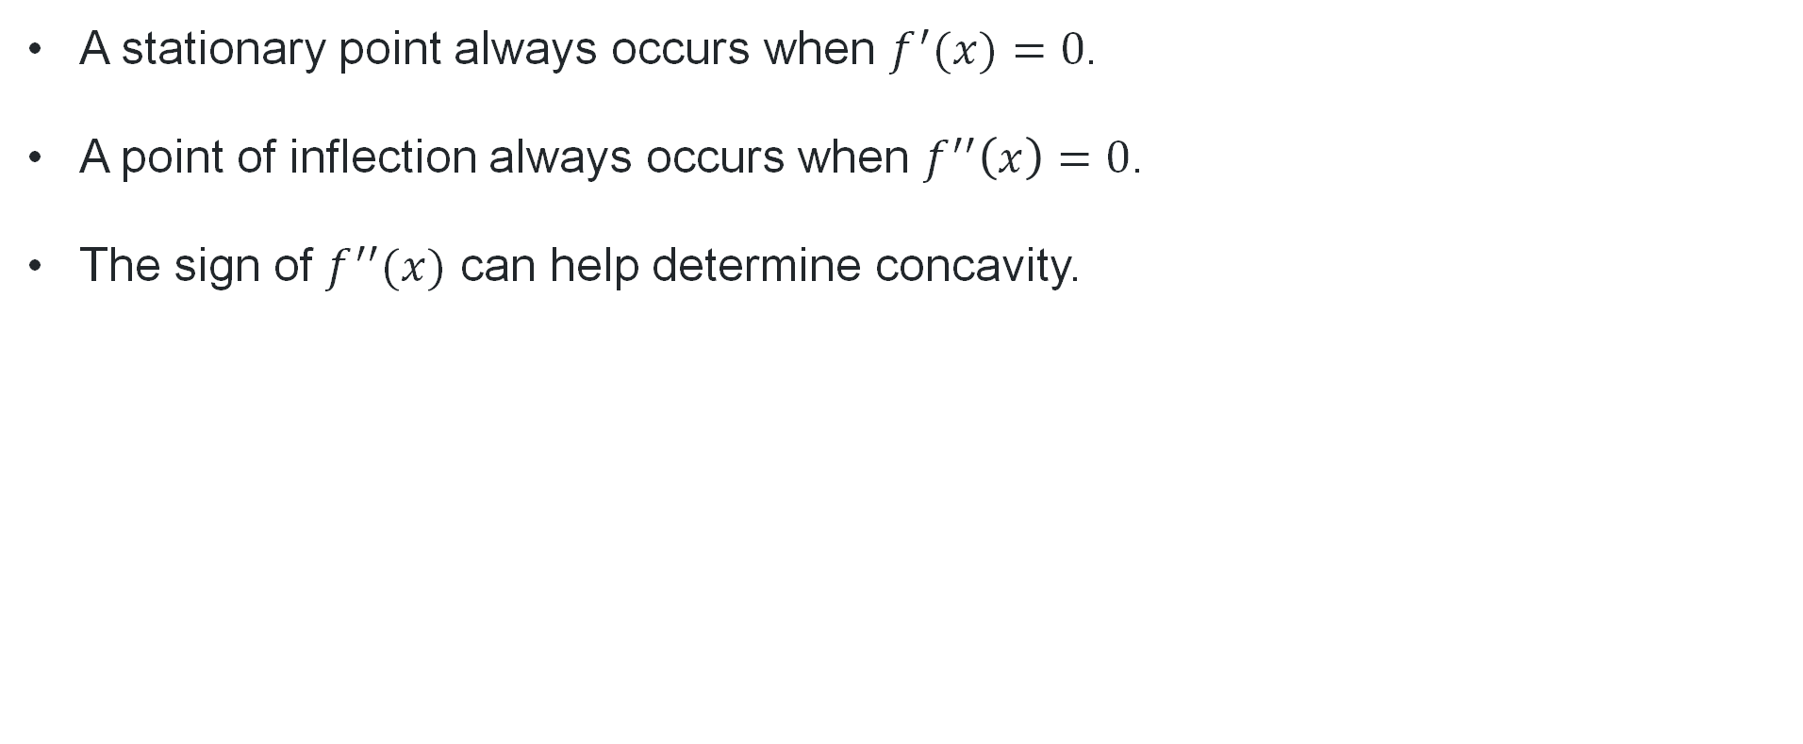
Two truths, one lie
Which one is the lie?
A stationary point always occurs when $f^{′}(x)=0$.
A point of inflection always occurs when $f^{′′}\left(x\right)=0$.
The sign of $f^{′′}(x)$ can help determine concavity.

Slide 7


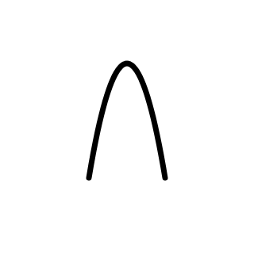
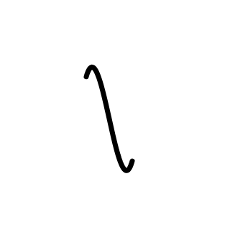
Feature of a function
Local maximum
Local minimum
Point of inflection
Horizontal point of inflection

Slide 8
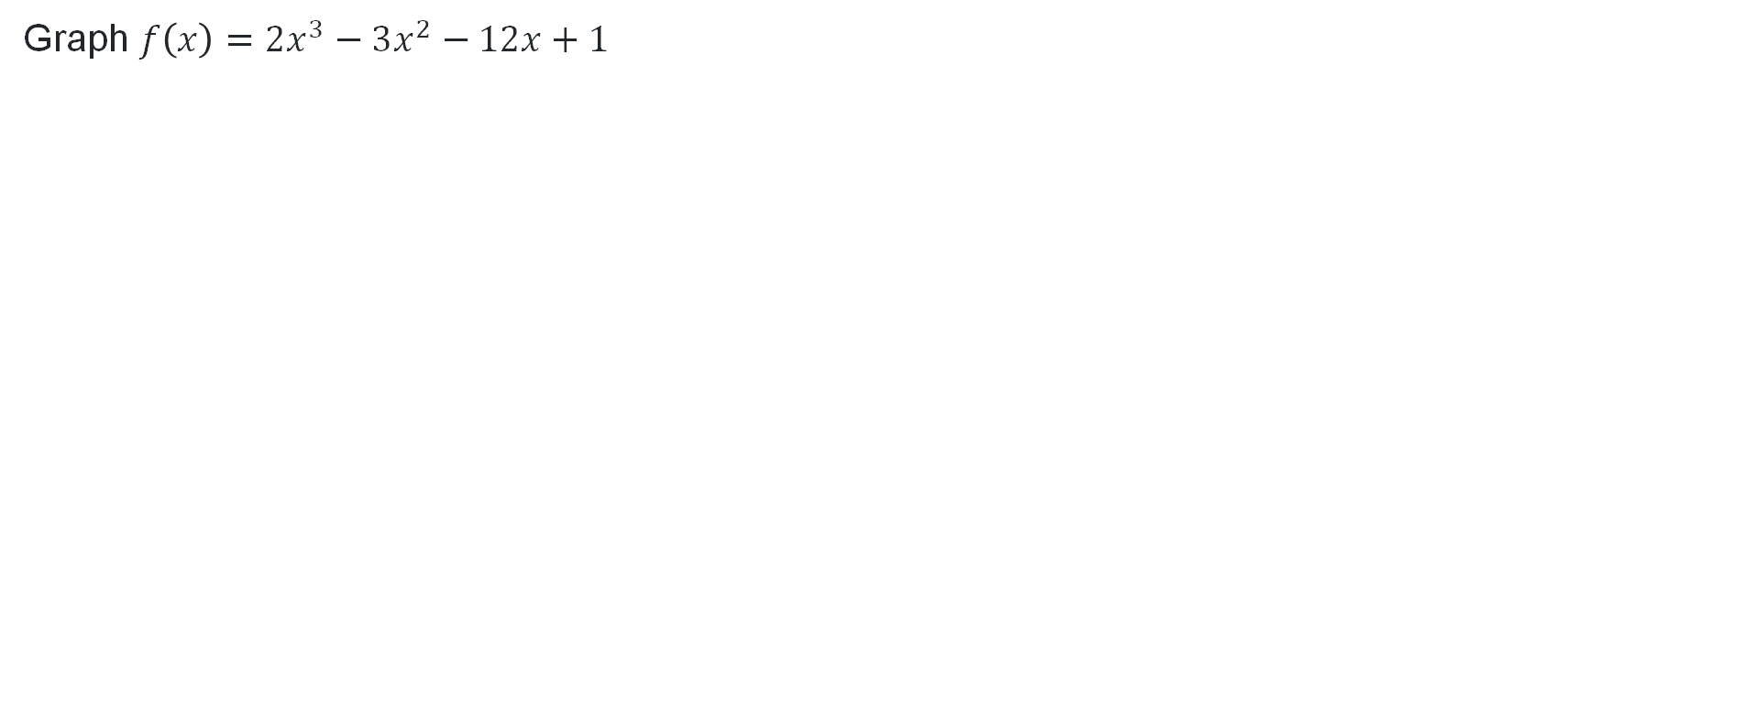
The graph of a function (1)
Graph $f\left(x\right)=2x^{3}−3x^{2}−12x+1$

Slide 9
Connecting learning

Slide 10
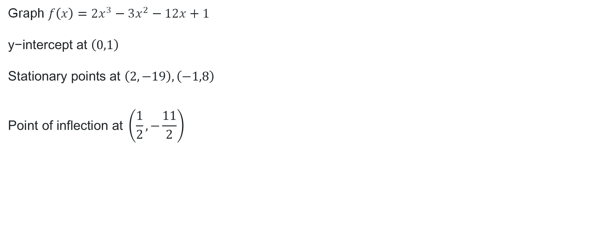
The graph of a function (2)
Graph $f\left(x\right)=2x^{3}−3x^{2}−12x+1$
$$\text{y}\text{−}\text{intercept} \text{at} \left(0,1\right)$$
$$\text{Stationary} \text{points} \text{at} \left(2,−19\right), \left(−1,8\right)$$
$$\text{Point} \text{of} \text{inflection} \text{at} \left(\frac{1}{2}, −\frac{11}{2}\right)$$

Slide 11
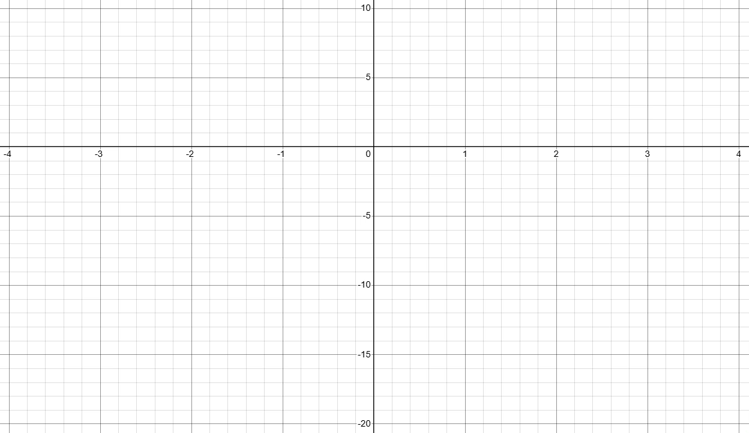
Graphing the function $f\left(x\right)=2x^{3}−3x^{2}−12x+1$

Slide 12
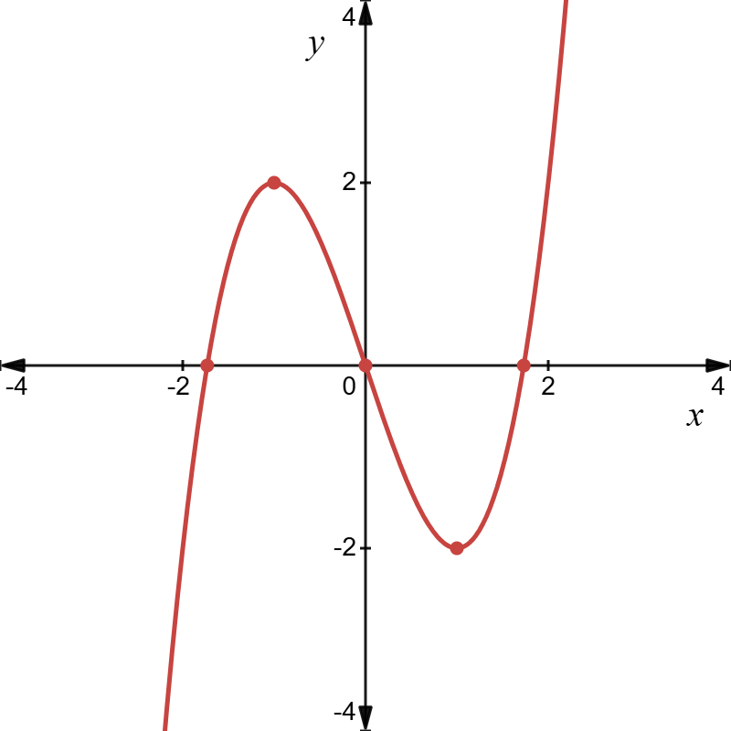
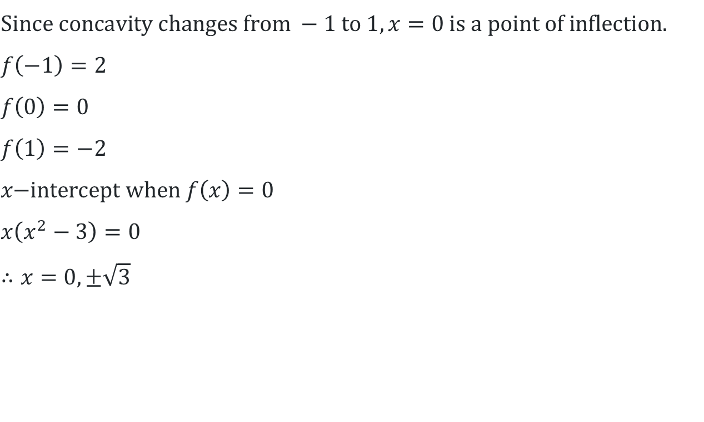
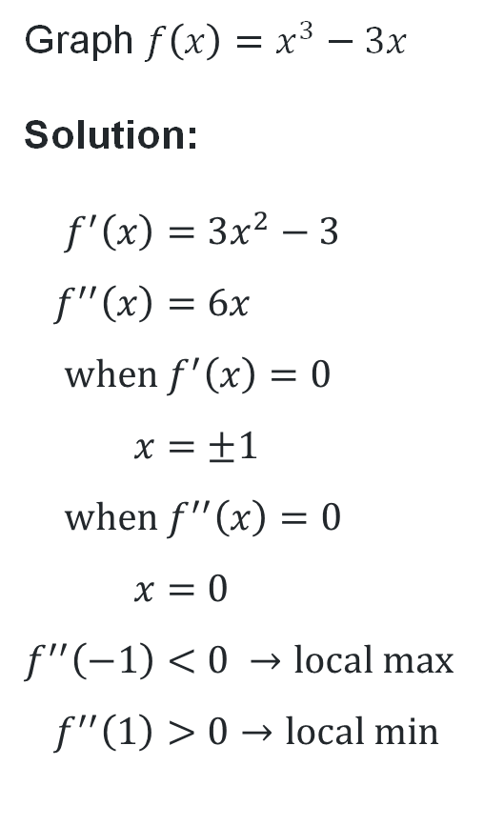
The graph of a function (3)
Graph $f\left(x\right)=x^{3}−3x$
Solution:
$$f^{′}\left(x\right)=3x^{2}−3 \\ f^{′′}\left(x\right)=6x \\ \text{when} f^{′}\left(x\right)=0 \\ x=±1 \\ \text{when} f^{′′}\left(x\right)=0 \\ x=0 \\ f^{′′}\left(−1\right)<0 →\text{local} \text{max} \\ f^{′′}\left(1\right)>0→\text{local} \text{min}$$
$$\text{S}\text{ince} \text{concavity} \text{changes} \text{from} −1 \text{to} 1, x=0 \text{is} \text{a} \text{point} \text{of} \text{inflection}\text{.} \\ f\left(−1\right)=2 \\ f\left(0\right)=0 \\ f\left(1\right)=−2 \\ x\text{−}\text{intercept} \text{when} f\left(x\right)=0 \\ x\left(x^{2}−3\right)=0 \\ ∴x=0,±\sqrt{3}$$
What do you notice about the symmetry of the function?

Slide 13
Releasing responsibility

Slide 14




Graph a function (1)
What do you need to know?
Can we find the $x$-intercepts?
Is the function odd, even or neither?
Where are the stationary points and what is their nature?
$$f\left(x\right)=−x^{3}−3x^{2}$$
$$f\left(x\right)={3x}^{5}−5x^{3}$$
Find the $y$-intercept.
Where are the points of inflection?

Slide 15
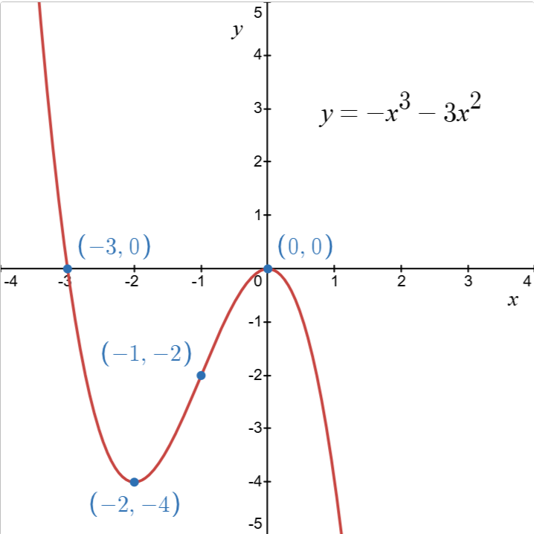
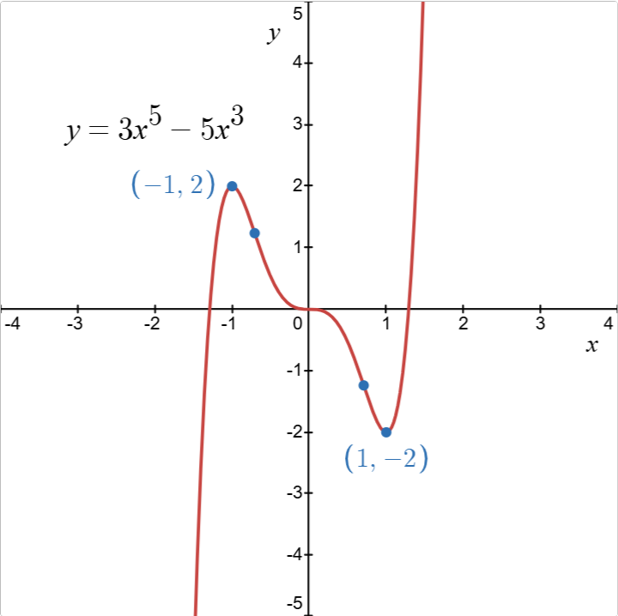
Graph the function (2)

Slide 16
Independent practice

Slide 17
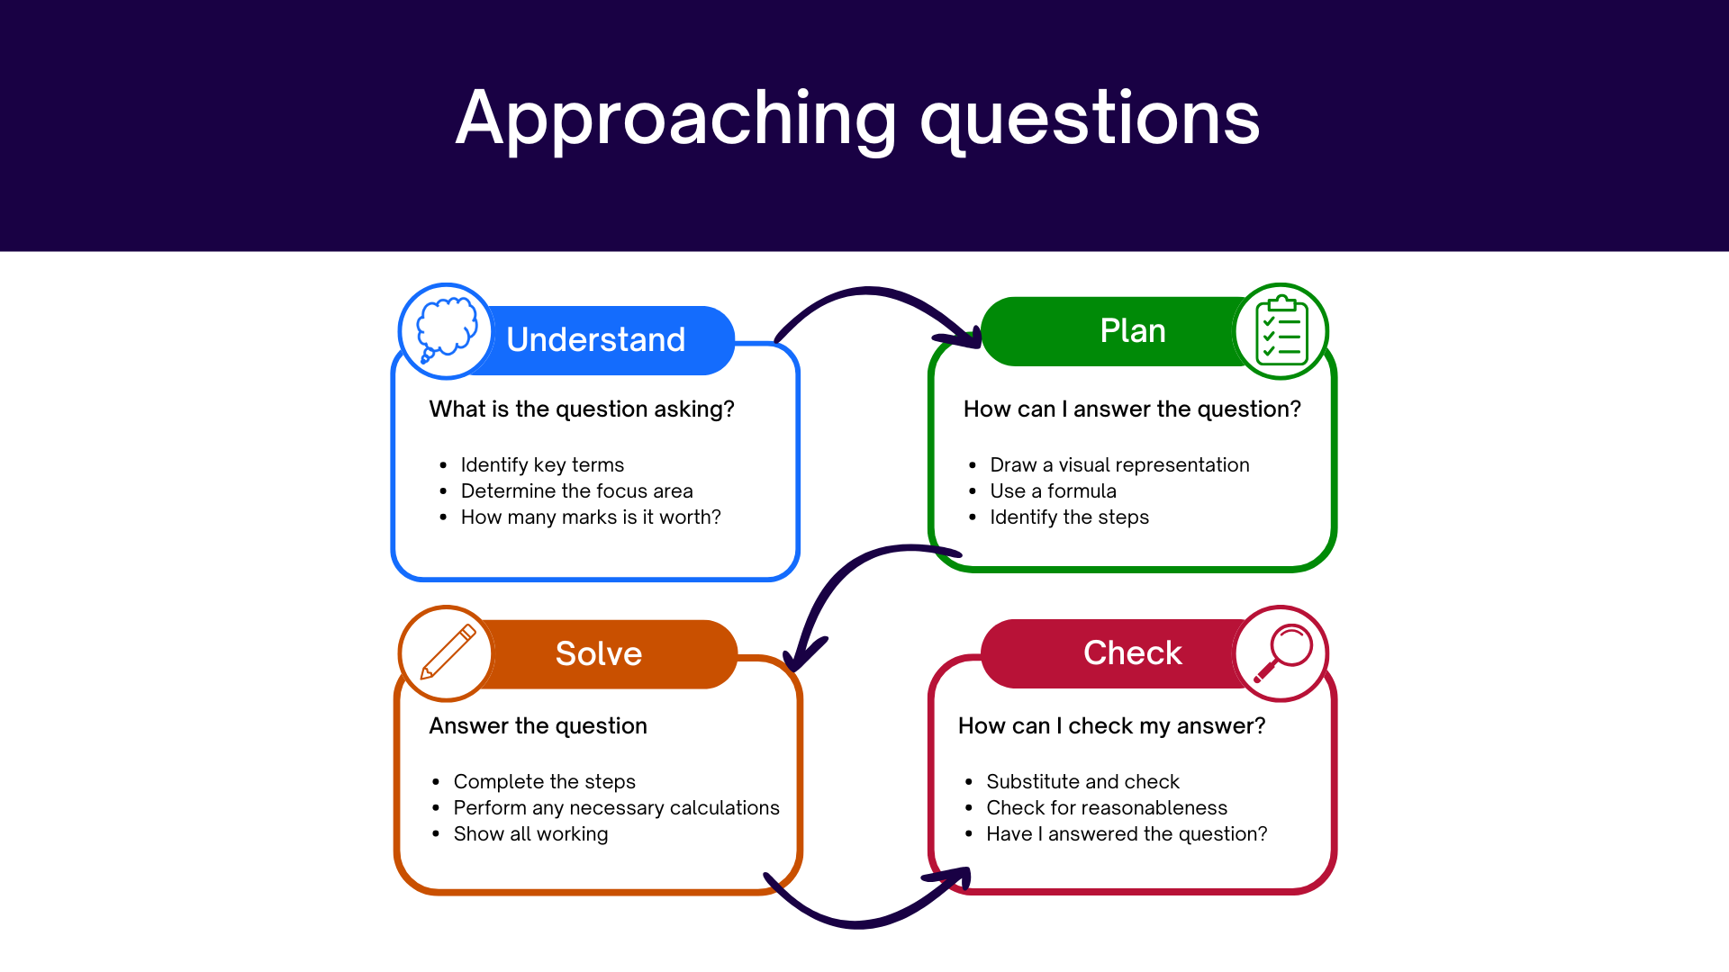
Approaching questions scaffold

Slide 18
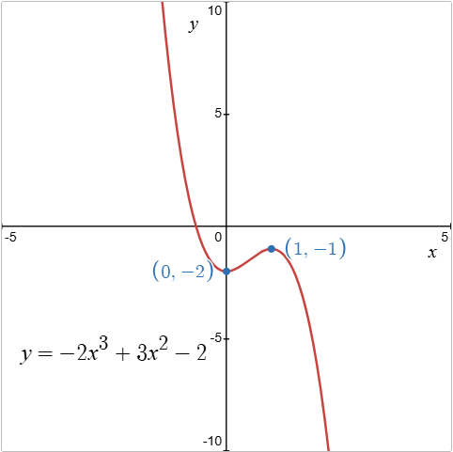
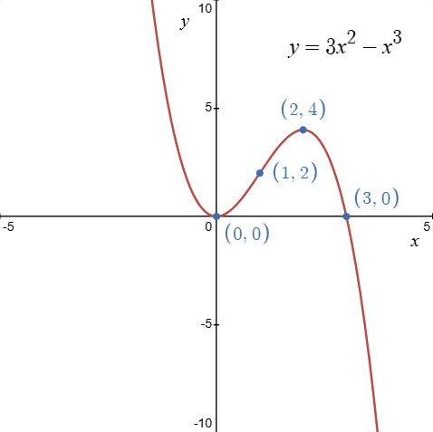
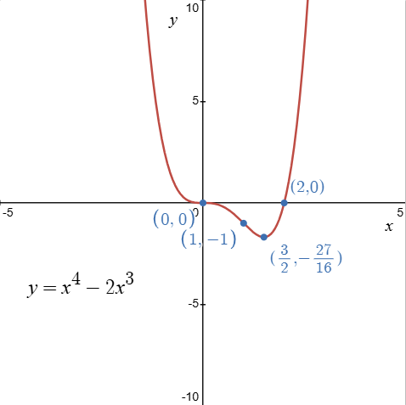
Graphs of the HSC style questions

Slide 19
References
This presentation contains NSW Curriculum and syllabus content. The NSW Curriculum is developed by the NSW Education Standards Authority. This content is prepared by NESA for and on behalf of the Crown in the right of the State of New South Wales. The material is protected by Crown copyright.
Please refer to the NESA Copyright Disclaimer for more information https://educationstandards.nsw.edu.au/wps/portal/nesa/mini-footer/copyright.
NESA holds the only official and up-to-date versions of the NSW Curriculum and syllabus documents. Please visit the NSW Education Standards Authority (NESA) website https://educationstandards.nsw.edu.au/wps/portal/nesa/home and the NSW Curriculum website https://curriculum.nsw.edu.au.
Mathematics Advanced 11-12 Syllabus © NSW Education Standards Authority (NESA) for and on behalf of the Crown in right of the State of New South Wales, 2024.
.

Slide 20
Copyright
© State of New South Wales (Department of Education), 2026
The copyright material published in this resource is subject to the Copyright Act 1968 (Cth) and is owned by the NSW Department of Education or, where indicated, by a party other than the NSW Department of Education (third-party material).
Copyright material available in this resource and owned by the NSW Department of Education is licensed under a Creative Commons Attribution 4.0 International (CC BY 4.0) license.
This license allows you to share and adapt the material for any purpose, even commercially.
Attribution should be given to © State of New South Wales (Department of Education), 2026.
Material in this resource not available under a Creative Commons license:
the NSW Department of Education logo, other logos and trademark-protected material
Material owned by a third party that has been reproduced with permission. You will need to obtain permission from the third party to reuse its material.
Links to third-party material and websites
Please note that the provided (reading/viewing material/list/links/texts) are a suggestion only and implies no endorsement, by the New South Wales Department of Education, of any author, publisher, or book title. School principals and teachers are best placed to assess the suitability of resources that would complement the curriculum and reflect the needs and interests of their students.
If you use the links provided in this document to access a third-party’s website, you acknowledge that the terms of use, including licence terms set out on the third-party’s website apply to the use which may be made of the materials on that third-party website or where permitted by the Copyright Act 1968 (Cth). The department accepts no responsibility for content on third-party websites.

