Slide 1
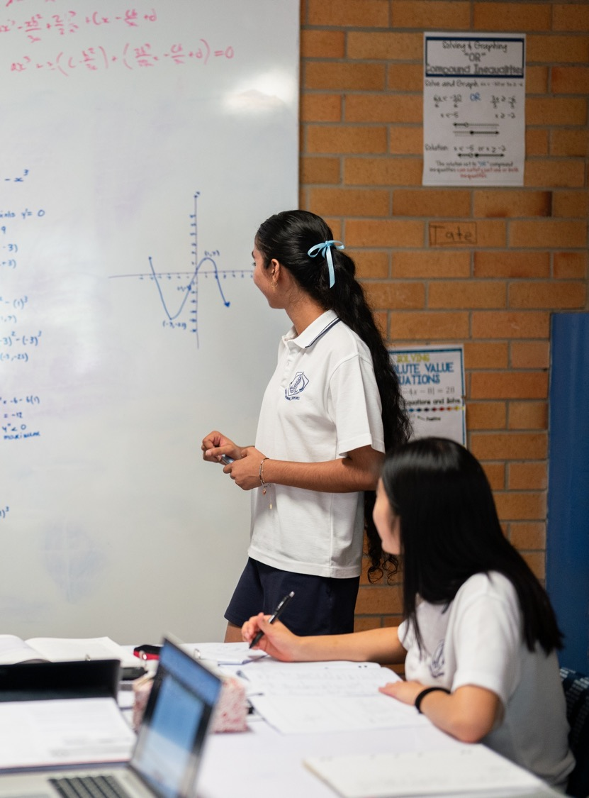
The second derivative and stationary points
Mathematics Advanced – Stage 6 (Year 12)
Differentiation applications

Slide 2
Learning intentions and success criteria
Learning intention
To understand how the second derivative can be used to classify stationary points.
Success criteria
I can interpret the sign of the second derivative.
I can classify stationary points using the second derivative.
I can identify when the second derivative test is inconclusive and explain why the first derivative test is needed.

Slide 3
Releasing responsibility

Slide 4
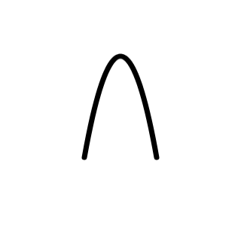
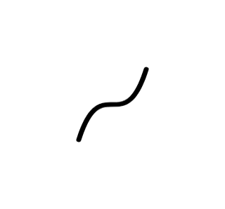
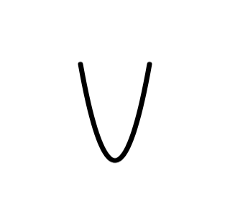
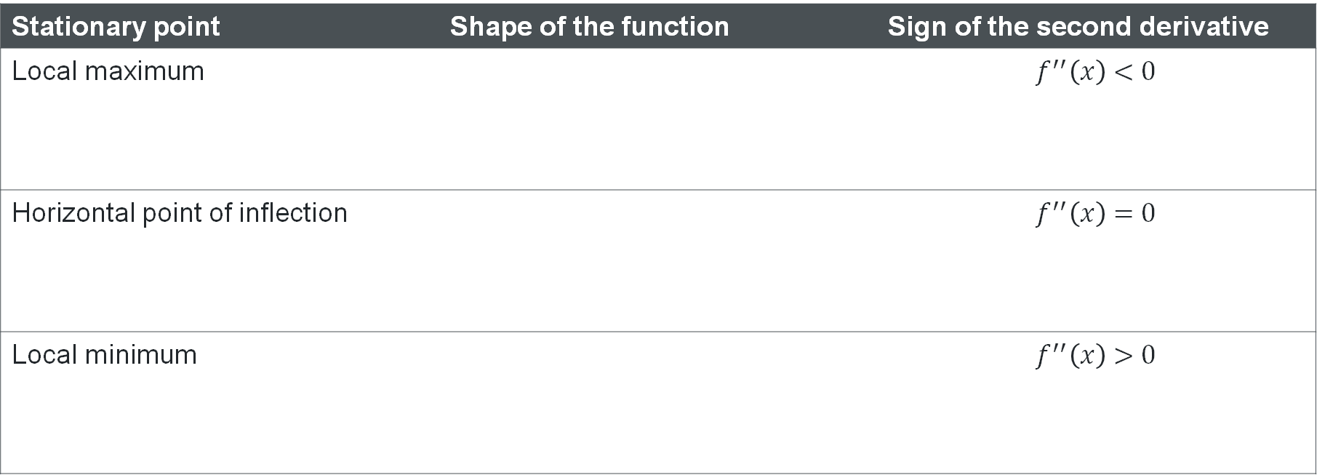
Stationary points and the second derivative
Stationary point | Shape of the function | Sign of the second derivative
Local maximum |  | $$f^{′′}\left(x\right)<0$$
Horizontal point of inflection |  | $$f^{′′}\left(x\right)=0$$
Local minimum |  | $$f^{′′}\left(x\right)>0$$
How does knowing the concavity help you to recall the sign of the second derivative?

Slide 5
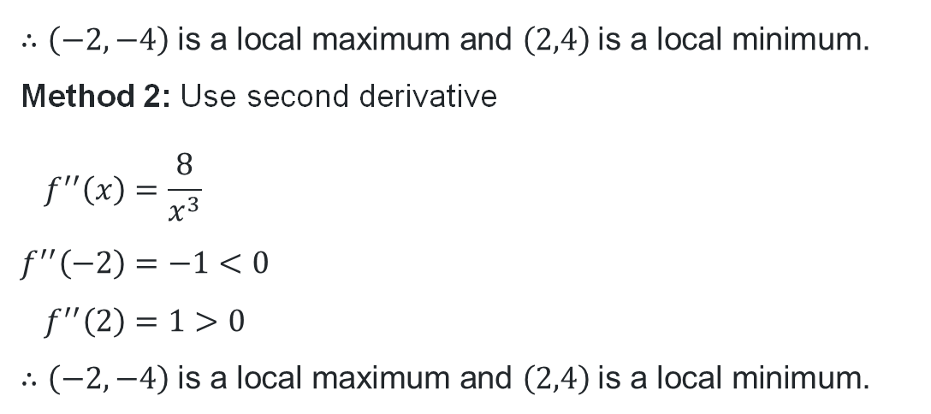
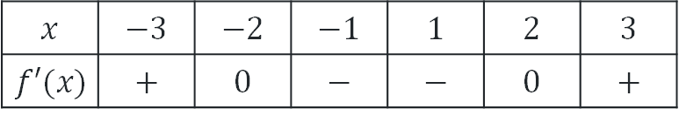
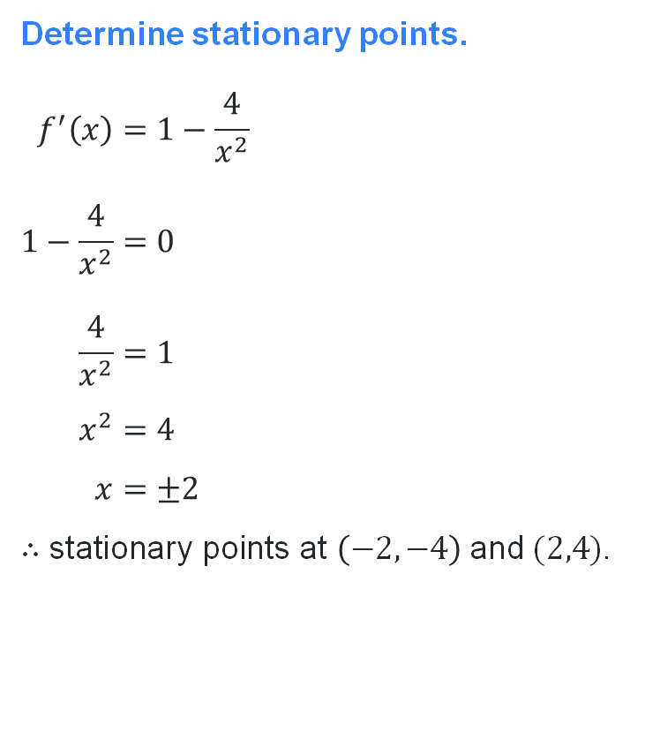
Worked example comparison
For $f\left(x\right)=x+\frac{4}{x}$, find the stationary points and determine their nature.
Determine stationary points.
$$f^{′}\left(x\right)=1−\frac{4}{x^{2}} \\ 1−\frac{4}{x^{2}}=0 \\ \frac{4}{x^{2}}=1 \\ x^{2}=4 \\ x=±2$$
$∴\text{stationary} \text{points} \text{at} \left(−2,−4\right) \text{and} (2,4)$.
Determine nature
Method 1: Use first derivative table of values
$$x$$ | $$−3$$ | $$−2$$ | $$−1$$ | $$1$$ | $$2$$ | $$3$$
$$f′(x)$$ | $$+$$ | $$0$$ | $$−$$ | $$−$$ | $$0$$ | $$+$$
$$∴\left(−2,−4\right) \text{is} \text{a} \text{local} \text{maximum} \text{and} \left(2,4\right) \text{is} \text{a} \text{local} \text{minimum}\text{.}$$
Method 2: Use second derivative
$$f^{′′}\left(x\right)=\frac{8}{x^{3}} \\ f^{′′}\left(−2\right)=−1<0 \\ f^{′′}\left(2\right)=1>0$$
$$∴\left(−2,−4\right) \text{is} \text{a} \text{local} \text{maximum} \text{and} \left(2,4\right) \text{is} \text{a} \text{local} \text{minimum}\text{.}$$

Slide 6
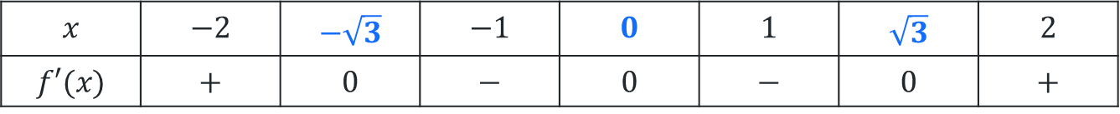
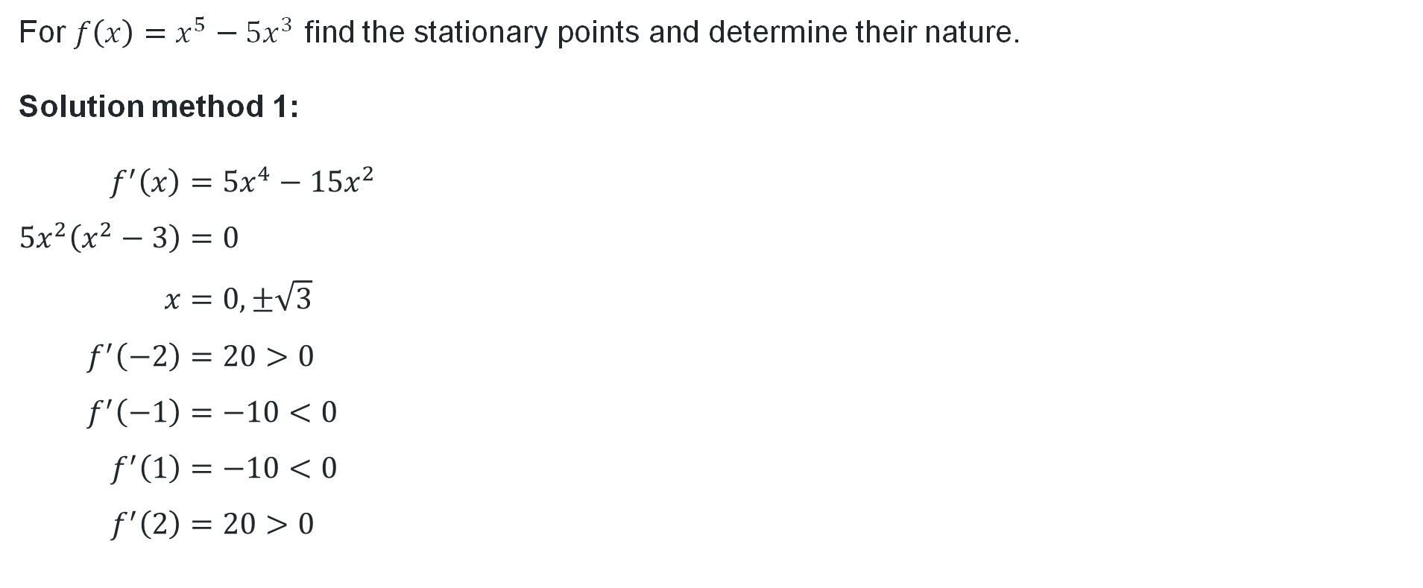
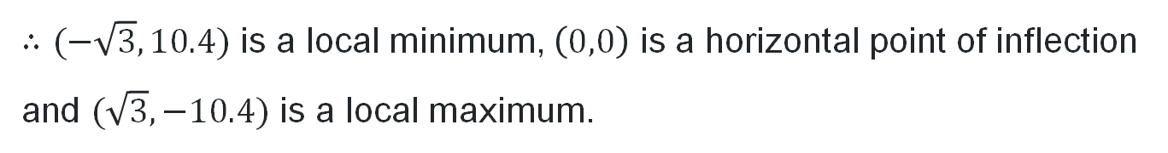
Your turn (1)
First derivative table of values
For $f\left(x\right)=x^{5}−5x^{3}$ find the stationary points and determine their nature.
Solution method 1:
$$f^{′}\left(x\right)=5x^{4}−15x^{2} \\ 5x^{2}\left(x^{2}−3\right)=0 \\ x=0, ±\sqrt{3} \\ f^{′}\left(−2\right)=20>0 \\ f^{′}\left(−1\right)=−10<0 \\ f^{′}\left(1\right)=−10<0 \\ f^{′}\left(2\right)=20>0$$
$$x$$ | $$−2$$ | $$−\sqrt{3}$$ | $$−1$$ | $$0$$ | $$1$$ | $$\sqrt{3}$$ | $$2$$
$$f′(x)$$ | $$+$$ | $$0$$ | $$−$$ | $$0$$ | $$−$$ | $$0$$ | $$+$$
$∴(−\sqrt{3},10.4)$ is a local minimum, $\left(0,0\right)$ is a horizontal point of inflection
and $(\sqrt{3},−10.4)$ is a local maximum.

Slide 7
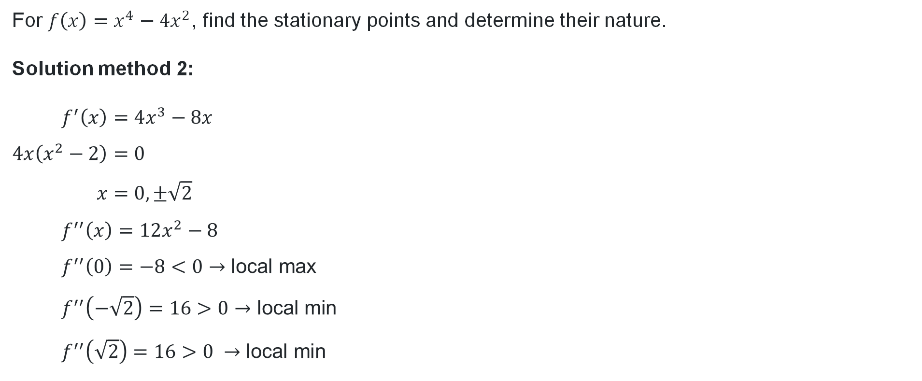
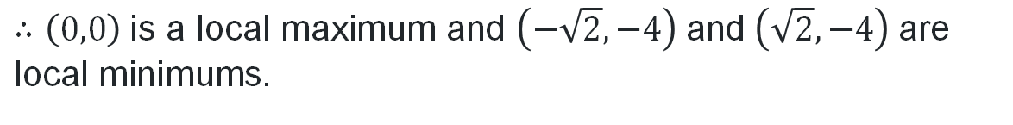
Your turn (2)
Second derivative
For $f\left(x\right)=x^{4}−4x^{2}$, find the stationary points and determine their nature.
Solution method 2:
$$f^{′}\left(x\right)=4x^{3}−8x \\ 4x\left(x^{2}−2\right)=0 \\ x=0,±\sqrt{2} \\ f^{′′}\left(x\right)=12x^{2}−8 \\ f^{′′}\left(0\right)=−8<0→\text{local} \text{max} \\ f^{′′}\left(−\sqrt{2}\right)=16>0→\text{local} \text{min} \\ f^{′′}\left(\sqrt{2}\right)=16>0 →\text{local} \text{min}$$
$$∴\left(0,0\right) \text{is} \text{a} \text{local} \text{maximum} \text{and} \left(−\sqrt{2},−4\right) \text{and} \left(\sqrt{2},−4\right) \text{are} \text{local} \text{minimums}\text{.}$$

Slide 8
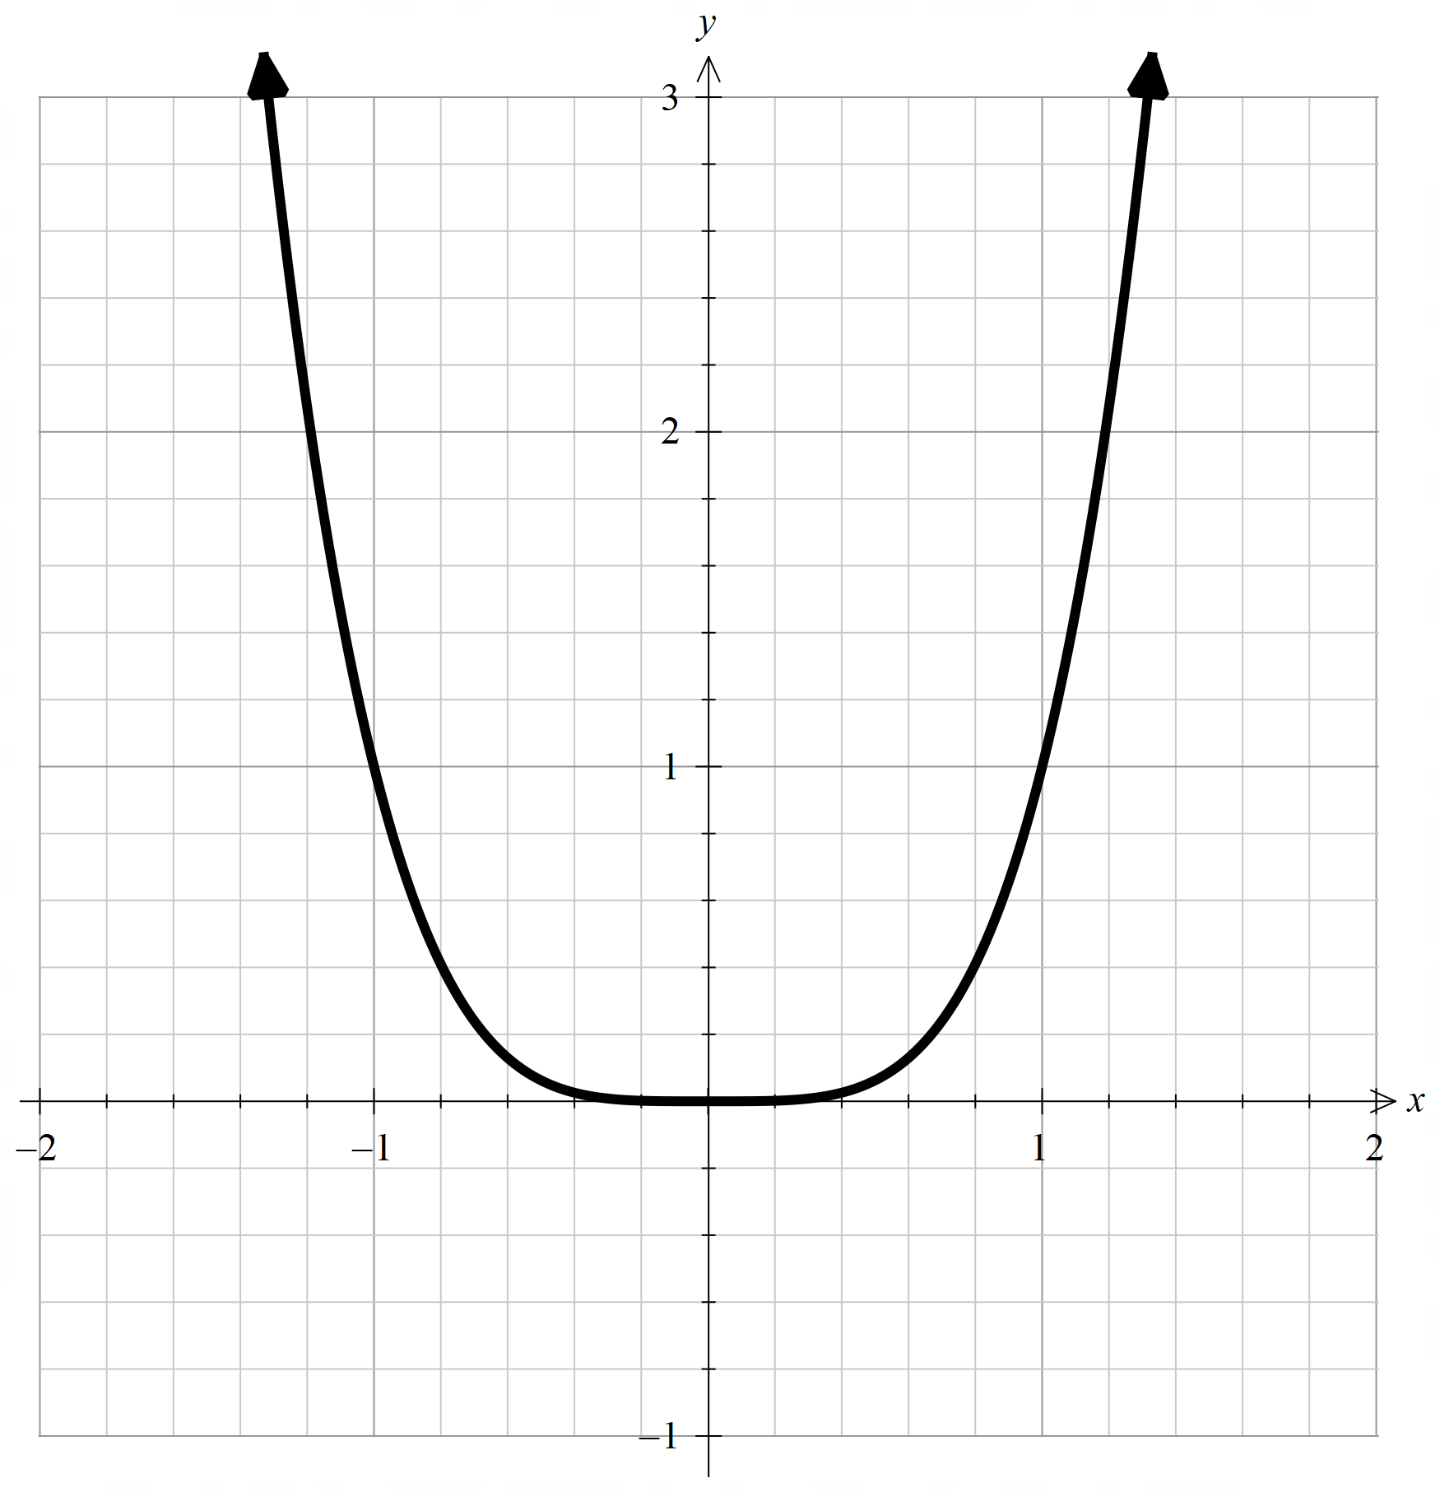
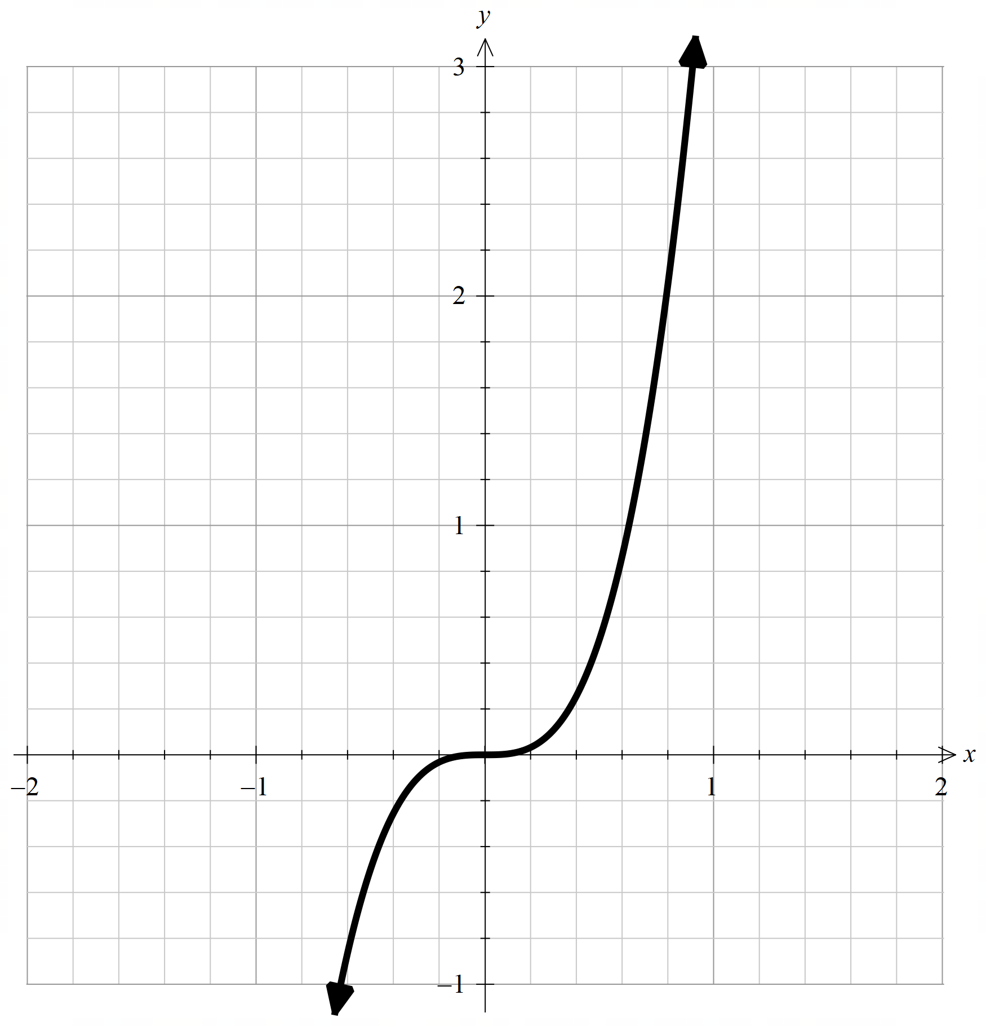
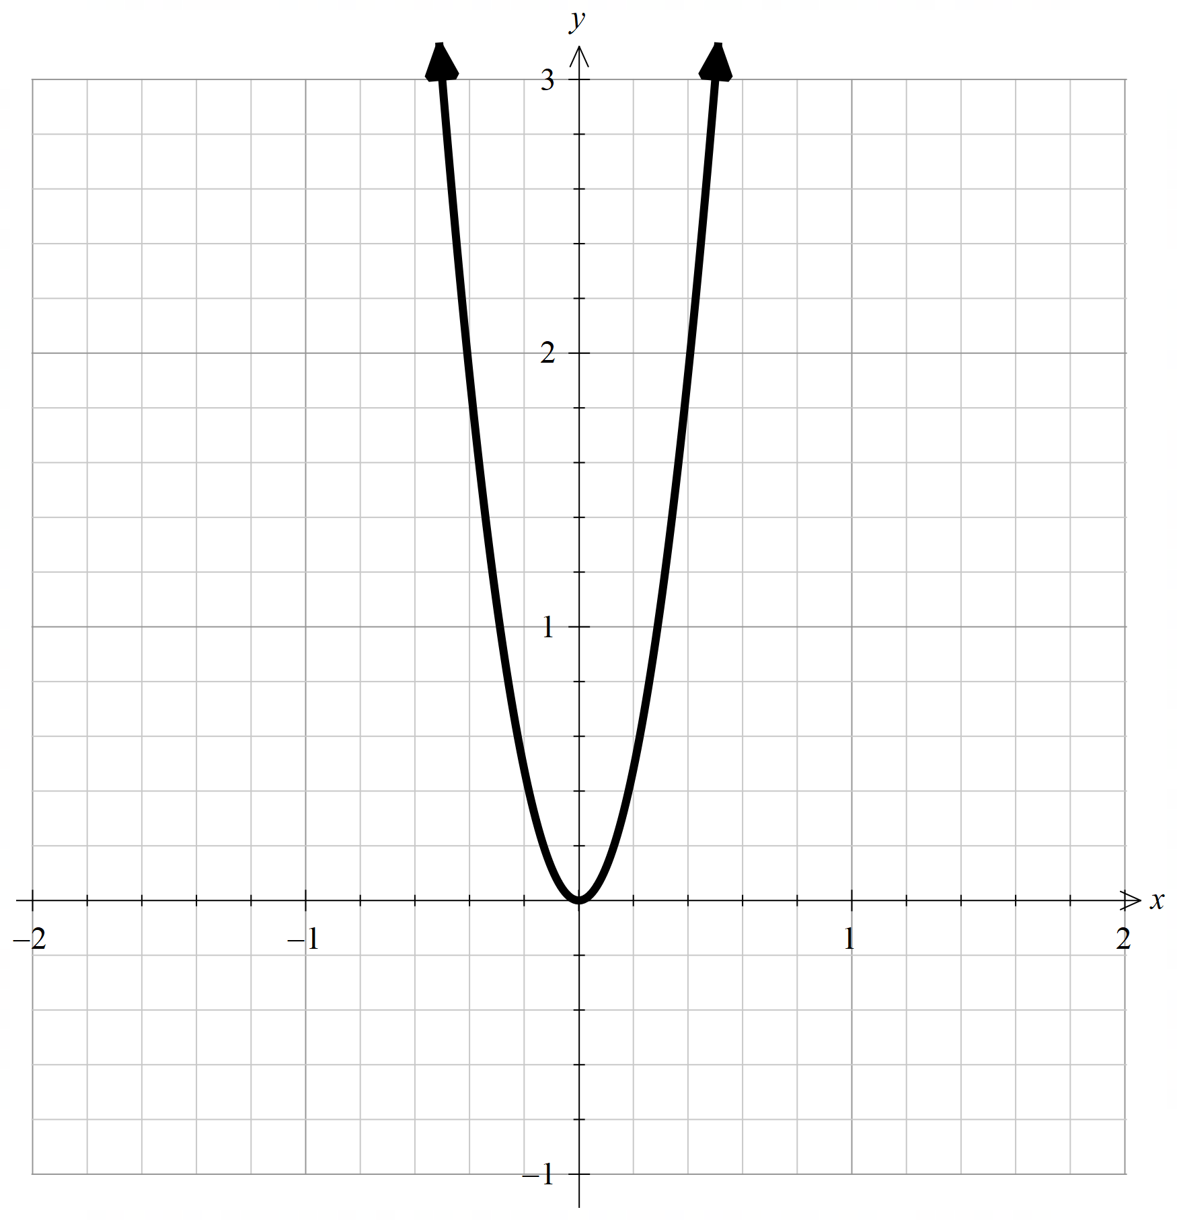



Special case
$$f\left(x\right)=x^{4}$$
$$f′\left(x\right)=4x^{3}$$
$$f′′\left(x\right)=12x^{2}$$

Slide 9
References
This presentation contains NSW Curriculum and syllabus content. The NSW Curriculum is developed by the NSW Education Standards Authority. This content is prepared by NESA for and on behalf of the Crown in the right of the State of New South Wales. The material is protected by Crown copyright.
Please refer to the NESA Copyright Disclaimer for more information https://educationstandards.nsw.edu.au/wps/portal/nesa/mini-footer/copyright.
NESA holds the only official and up-to-date versions of the NSW Curriculum and syllabus documents. Please visit the NSW Education Standards Authority (NESA) website https://educationstandards.nsw.edu.au/wps/portal/nesa/home and the NSW Curriculum website https://curriculum.nsw.edu.au.
Mathematics Advanced 11-12 Syllabus © NSW Education Standards Authority (NESA) for and on behalf of the Crown in right of the State of New South Wales, 2024.
.

Slide 10
Copyright
© State of New South Wales (Department of Education), 2026
The copyright material published in this resource is subject to the Copyright Act 1968 (Cth) and is owned by the NSW Department of Education or, where indicated, by a party other than the NSW Department of Education (third-party material).
Copyright material available in this resource and owned by the NSW Department of Education is licensed under a Creative Commons Attribution 4.0 International (CC BY 4.0) license.
This license allows you to share and adapt the material for any purpose, even commercially.
Attribution should be given to © State of New South Wales (Department of Education), 2026.
Material in this resource not available under a Creative Commons license:
the NSW Department of Education logo, other logos and trademark-protected material
Material owned by a third party that has been reproduced with permission. You will need to obtain permission from the third party to reuse its material.
Links to third-party material and websites
Please note that the provided (reading/viewing material/list/links/texts) are a suggestion only and implies no endorsement, by the New South Wales Department of Education, of any author, publisher, or book title. School principals and teachers are best placed to assess the suitability of resources that would complement the curriculum and reflect the needs and interests of their students.
If you use the links provided in this document to access a third-party’s website, you acknowledge that the terms of use, including licence terms set out on the third-party’s website apply to the use which may be made of the materials on that third-party website or where permitted by the Copyright Act 1968 (Cth). The department accepts no responsibility for content on third-party websites.

