Slide 1
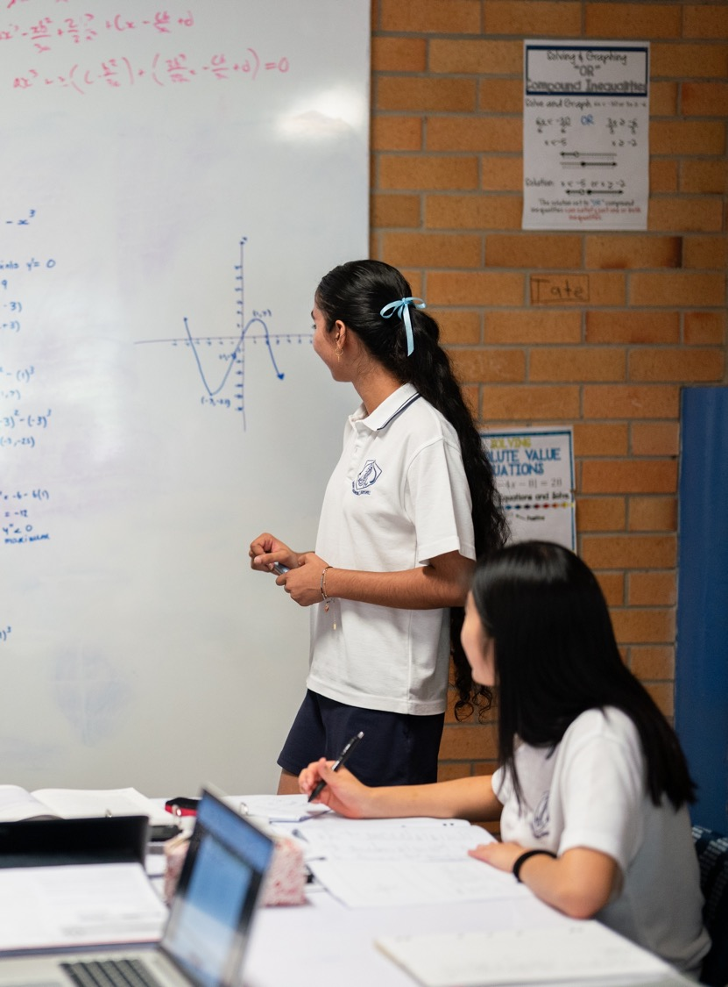
Introduction to the second derivative
Mathematics Advanced – Stage 6 (Year 12)
Differentiation applications

Slide 2
Activating prior knowledge

Slide 3
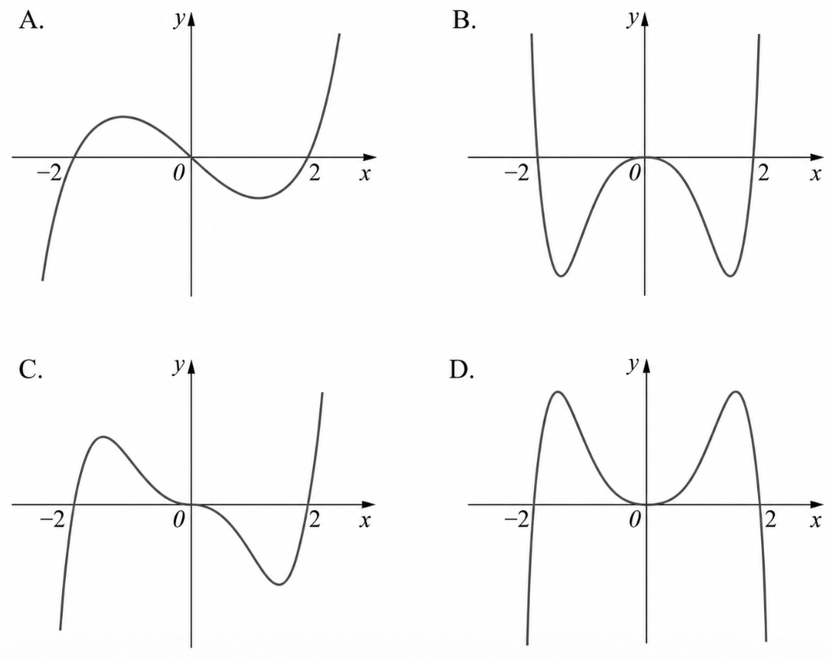
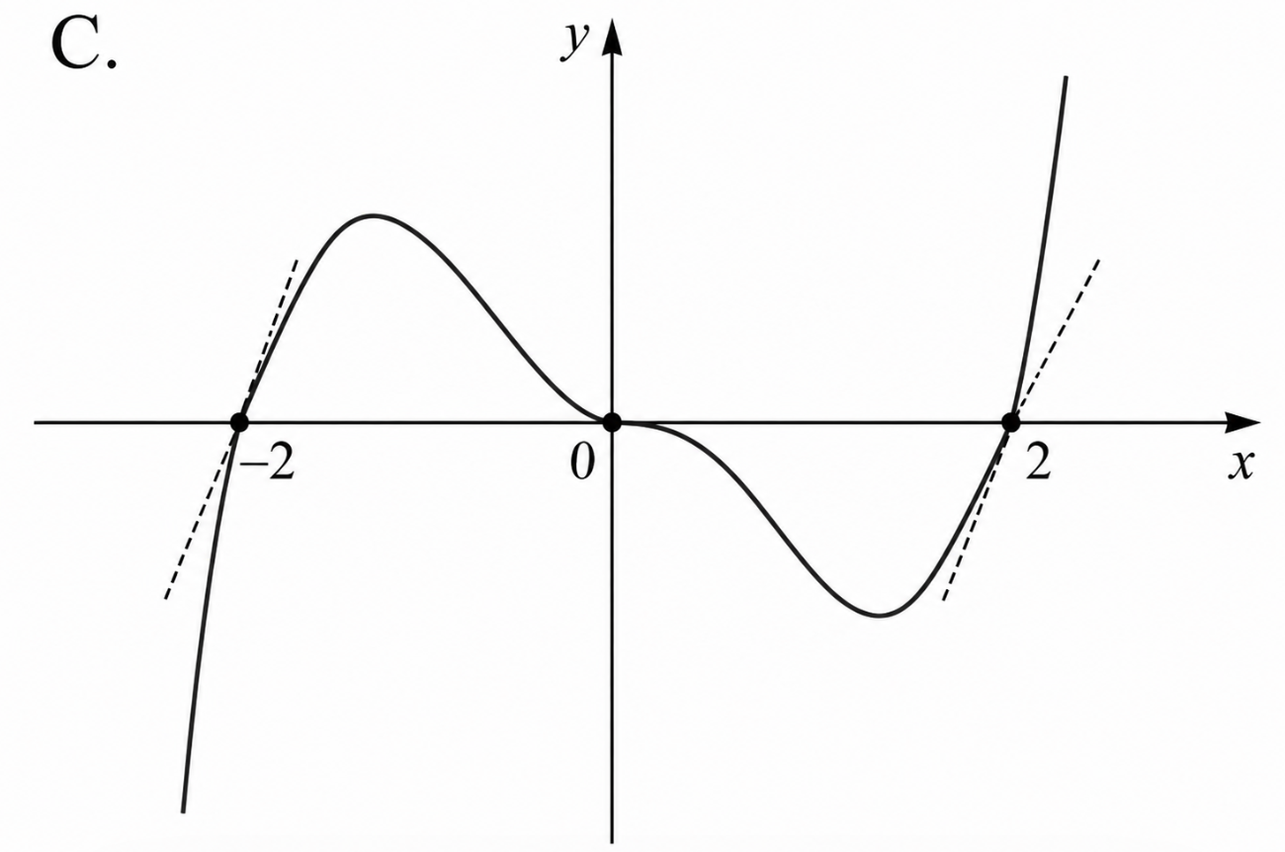
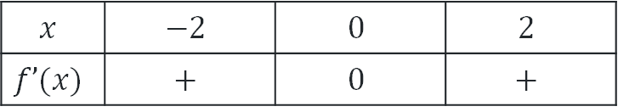
Which graph matches the table? (1)
The following table gives the sign of the first derivative of a function $y=f(x)$ for different values of $x.$
$$x$$ | $$−2$$ | $$0$$ | $$2$$
$$f’(x)$$ | $$+$$ | $$0$$ | $$+$$
Which of the following is a possible sketch of $y=f\left(x\right)?$
Solution

Slide 4
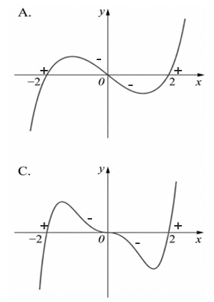
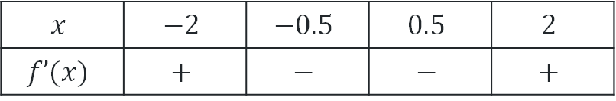
Which graph matches the table? (2)
The following table gives the sign of the first derivative of a function $y=f(x)$ for different values of $x.$
$$x$$ | $$−2$$ | $$−0.5$$ | $$0.5$$ | $$2$$
$$f’(x)$$ | $$+$$ | $$−$$ | $$−$$ | $$+$$
Which of the following is a possible sketch of $y=f\left(x\right)?$

Slide 5
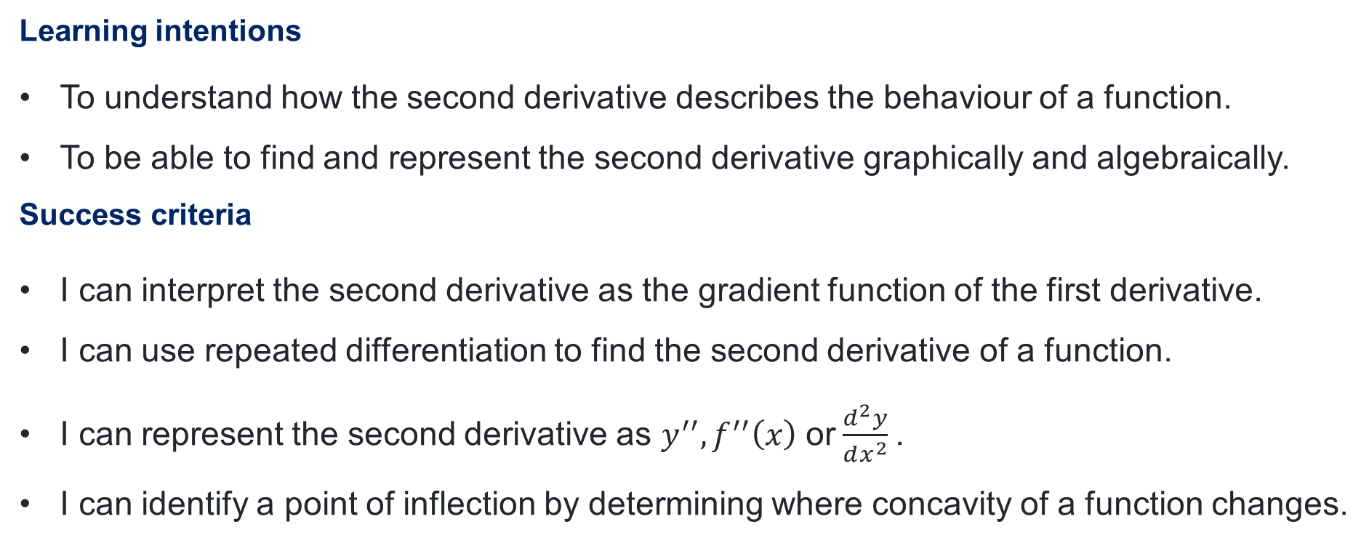
Learning intentions and success criteria
Learning intentions
To understand how the second derivative describes the behaviour of a function.
To be able to find and represent the second derivative graphically and algebraically.
Success criteria
I can interpret the second derivative as the gradient function of the first derivative.
I can use repeated differentiation to find the second derivative of a function.
I can represent the second derivative as $y^{′′}, f^{′′}\left(x\right)$or$\frac{d^{2}y}{dx^{2}}$.
I can identify a point of inflection by determining where concavity of a function changes.

Slide 6
Connecting learning

Slide 7
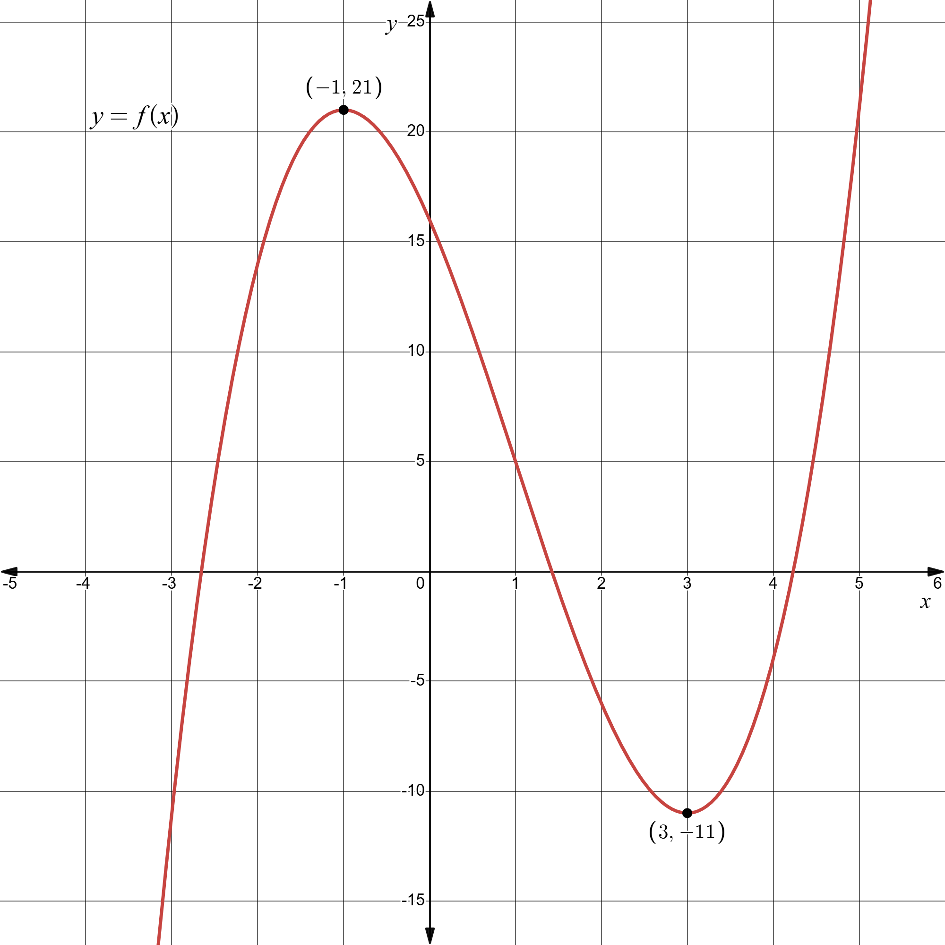
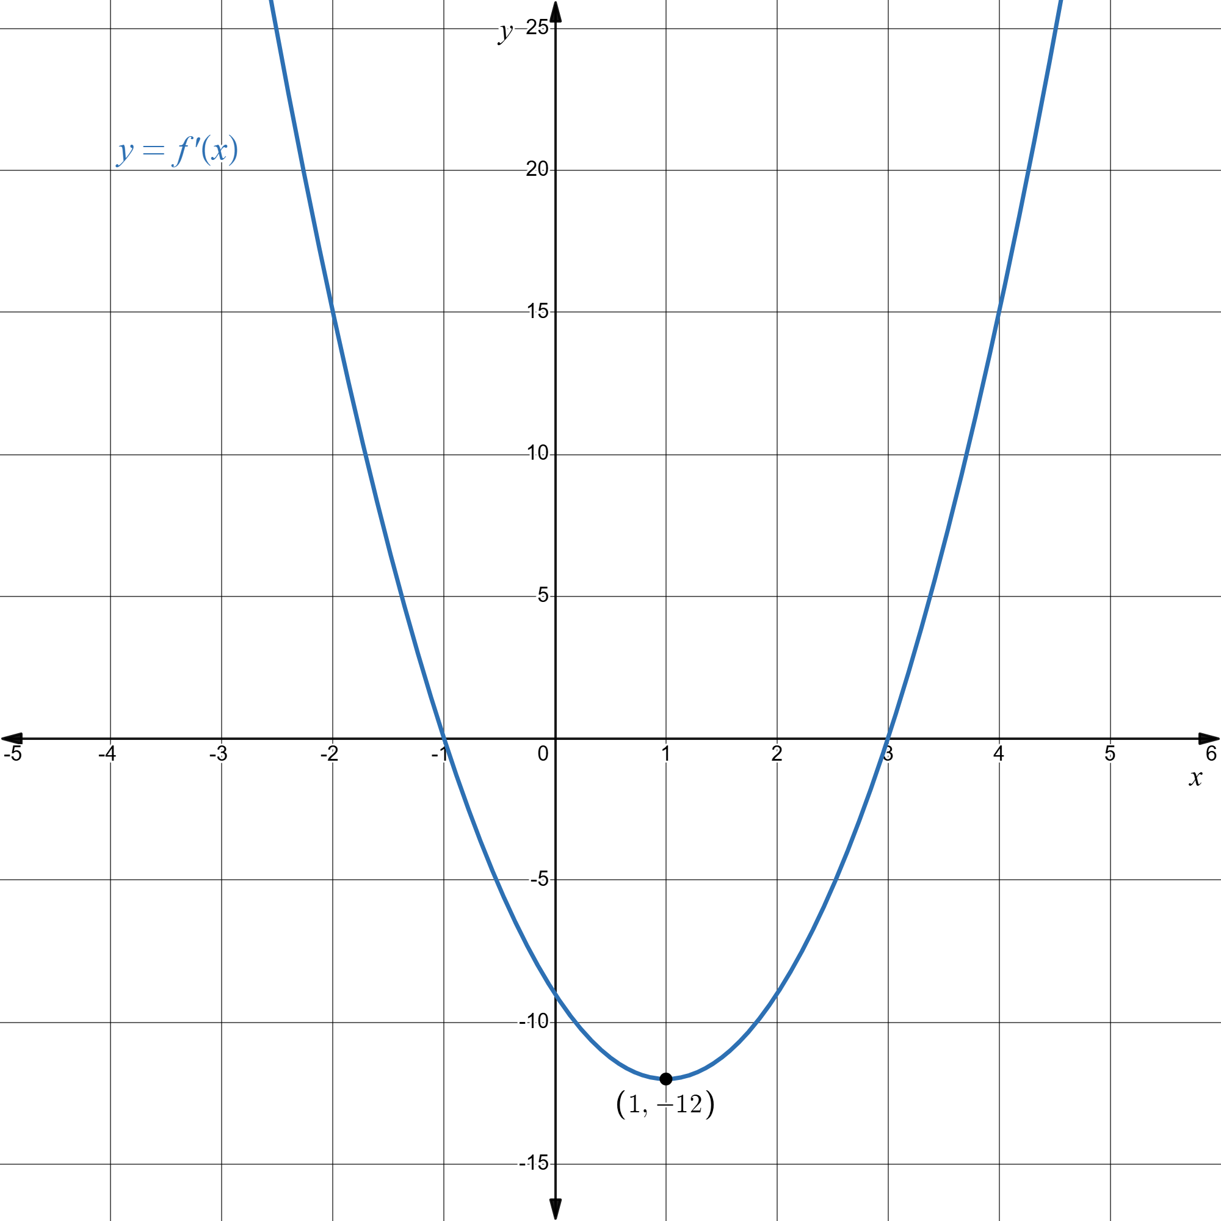
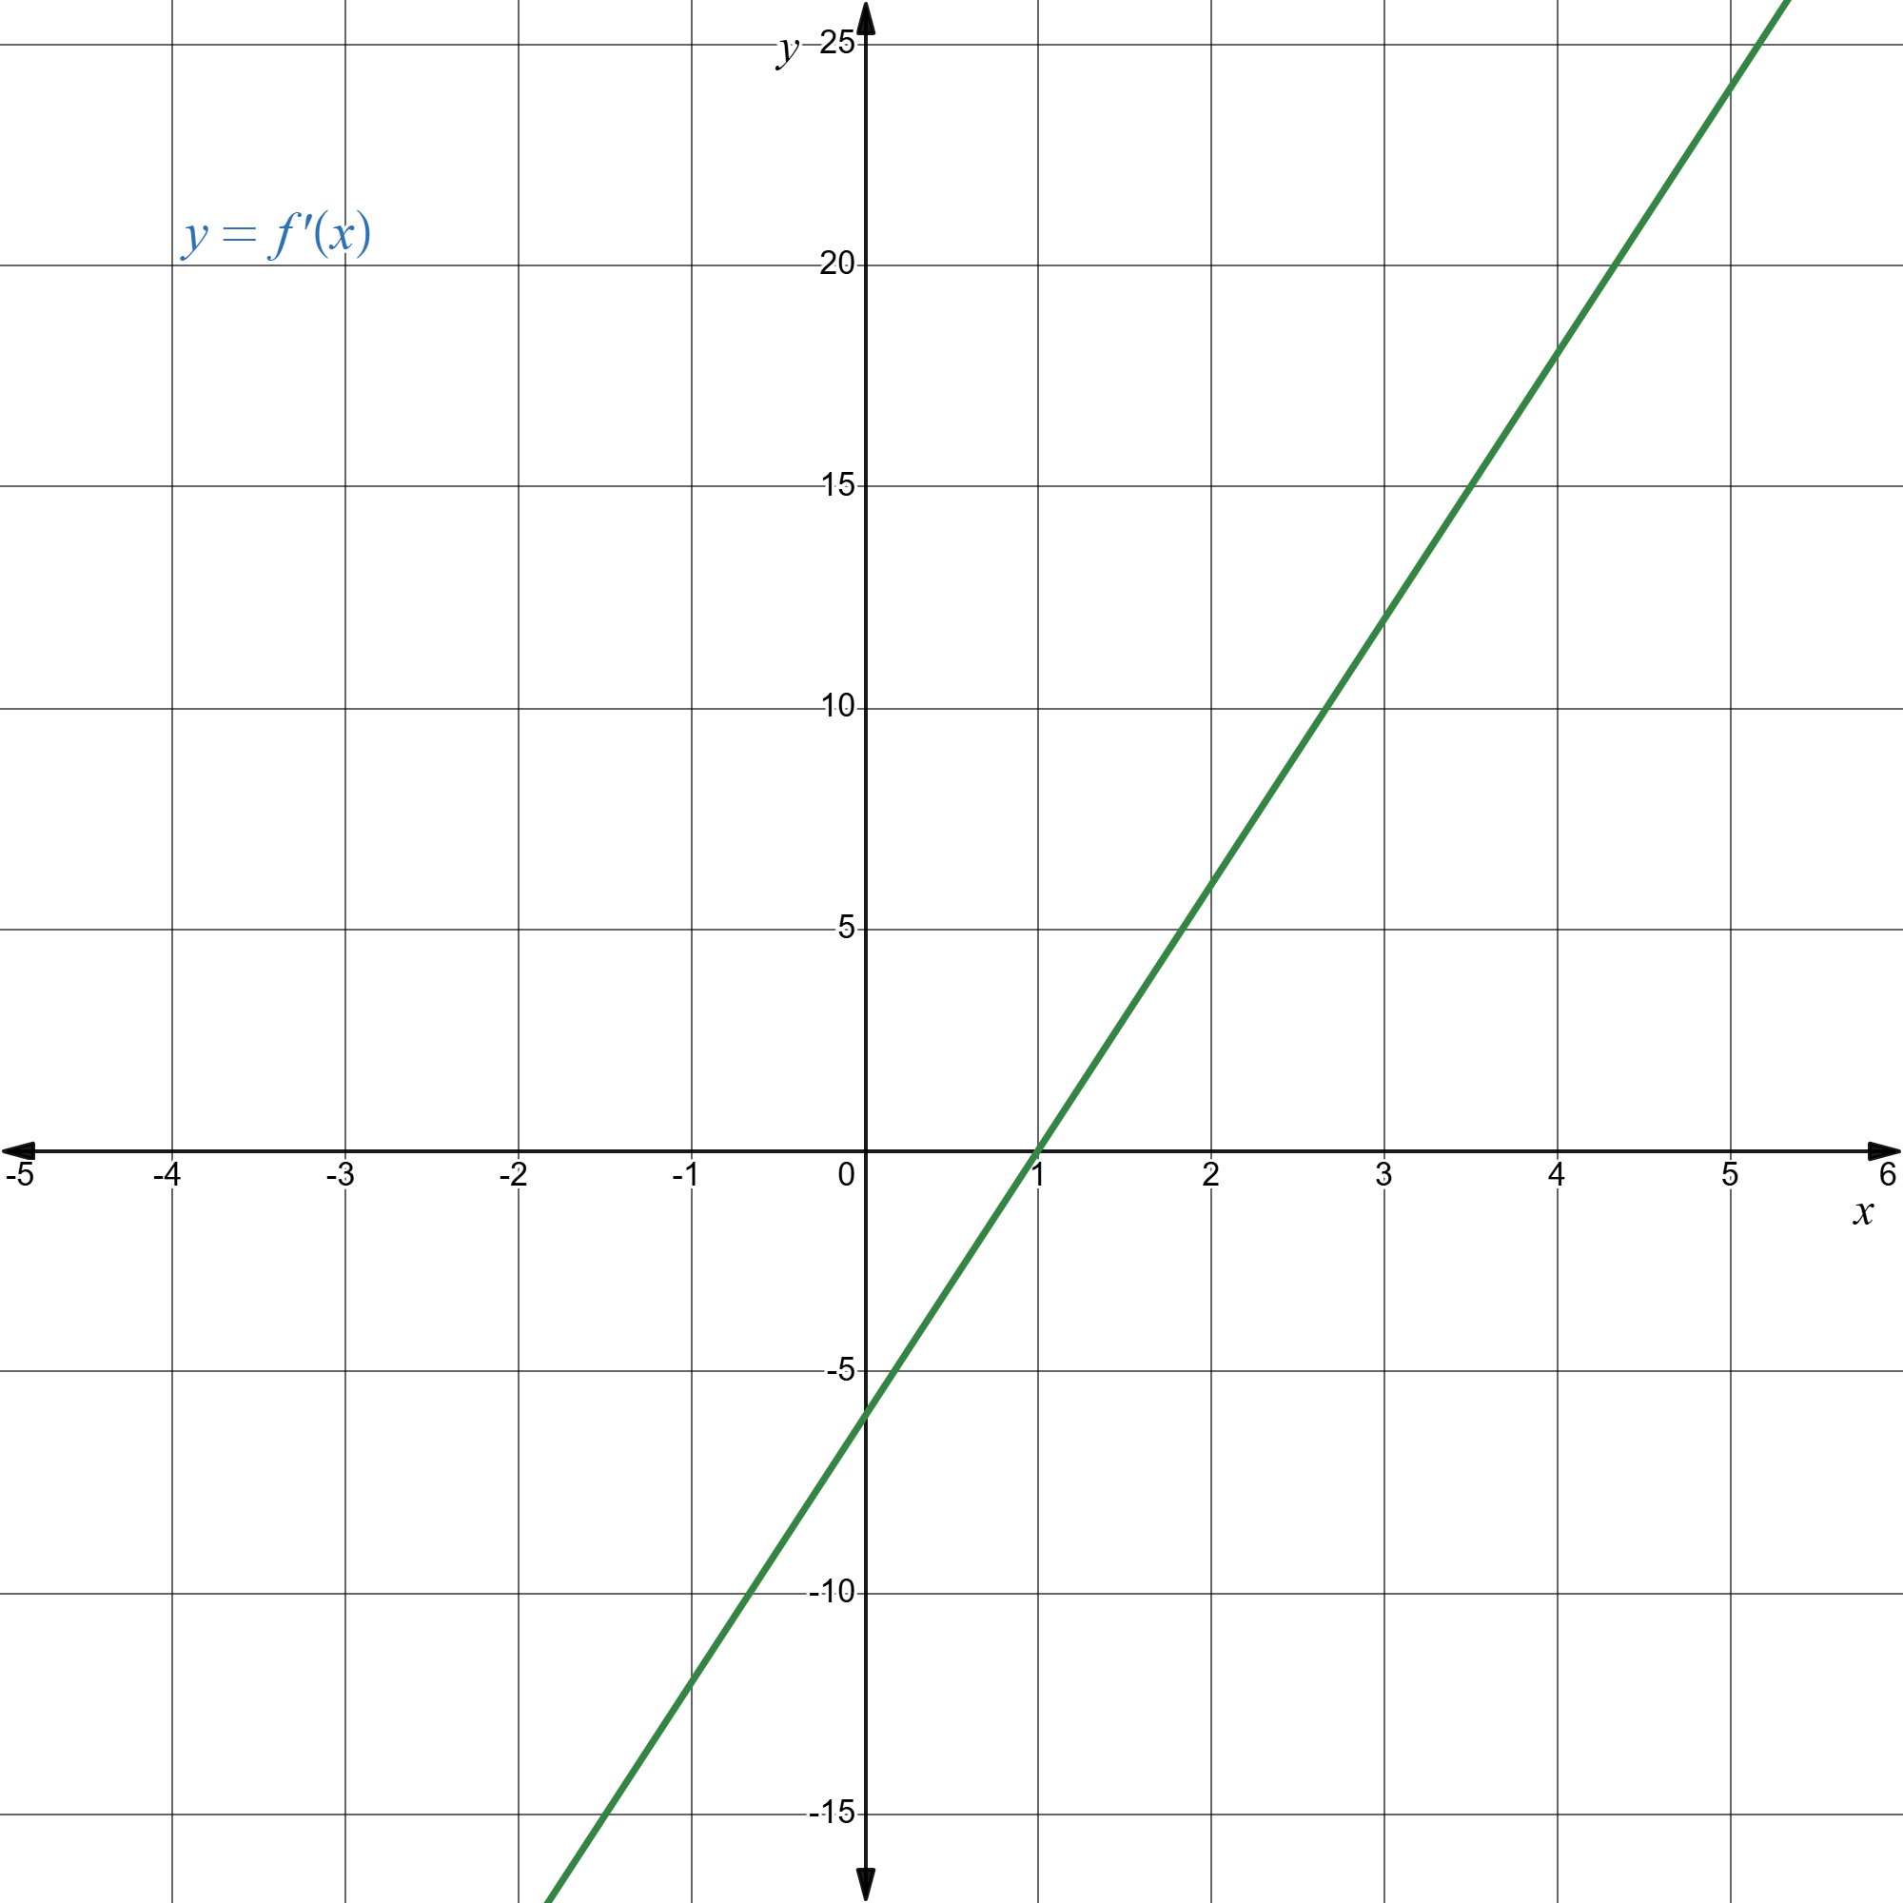
Gradient functions (1)
Function
First derivative
Second derivative
First derivative → gradient function of the original function
Second derivative → gradient function of the 1st derivative function

Slide 8
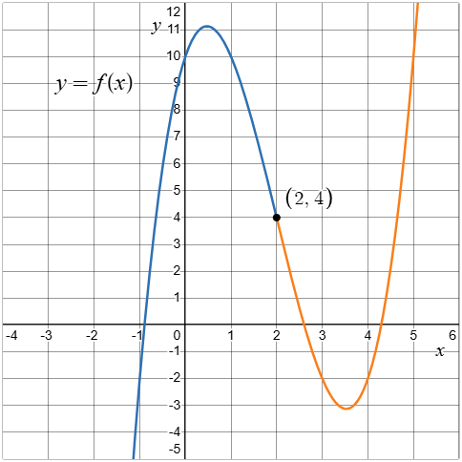
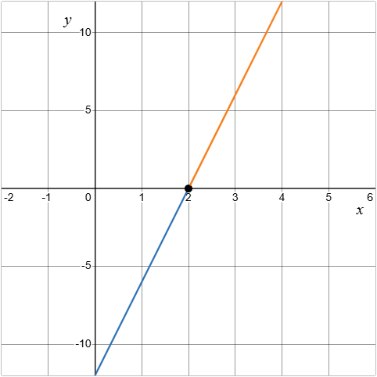

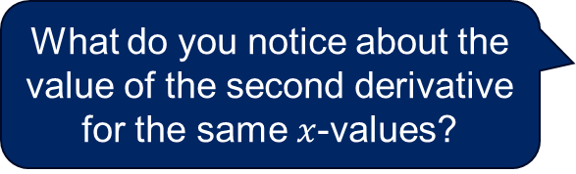
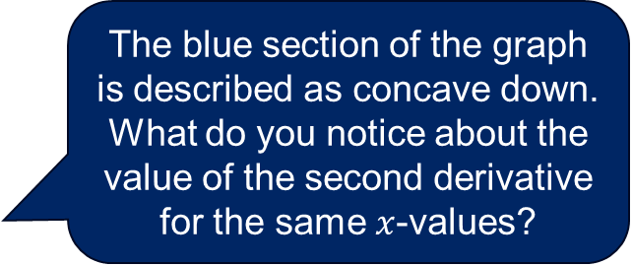
Connecting to concavity
Graph of $y=f(x)$
The blue section of the graph is described as concave down.
What do you notice about the value of the second derivative for the same $x$-values?
Graph of the second derivative
How might we describe the orange section of the graph?
What do you notice about the value of the second derivative for the same $x$-values?

Slide 9
Releasing responsibility

Slide 10
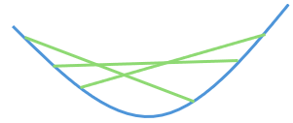
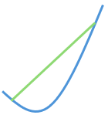
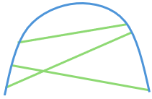
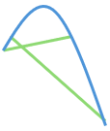
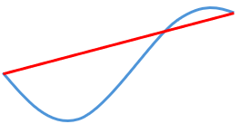
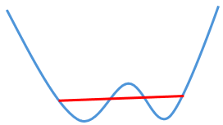
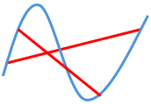
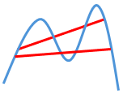
NESA definitions
Concave up
Concave down
A function for which all points on a graph between any 2 given points on the graph lie on or below the chord joining the given points.
A function in which all points on a graph between any 2 given points on the graph lie on or above the chord joining the given points.
The chord does not cross over the blue curve, so the section of the curve is concave up.
The chord does not cross over the blue curve, so the section of the curve is concave up.
The chord crosses over the blue curve, so the section of the curve is not concave up.
The chord crosses over the blue curve, so the section of the curve is not concave up.

Slide 11
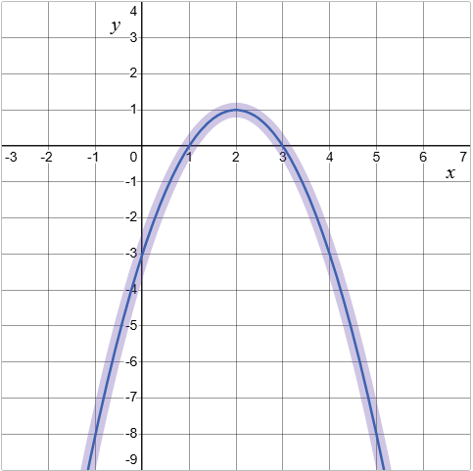
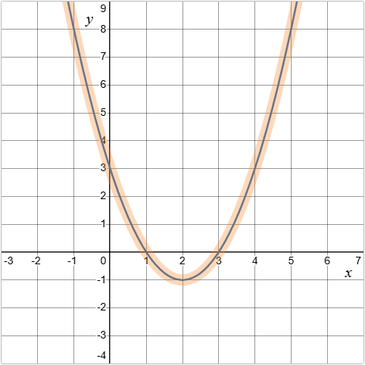
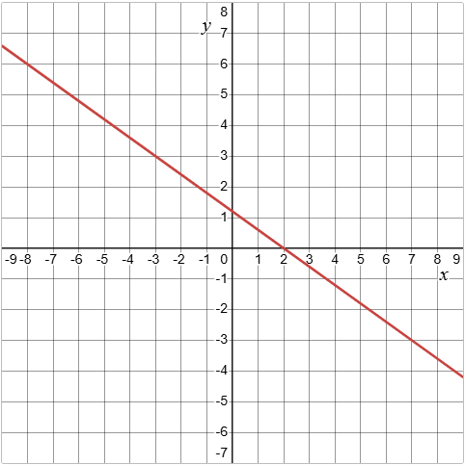
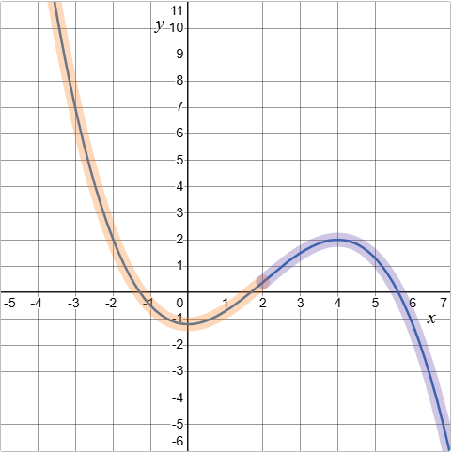
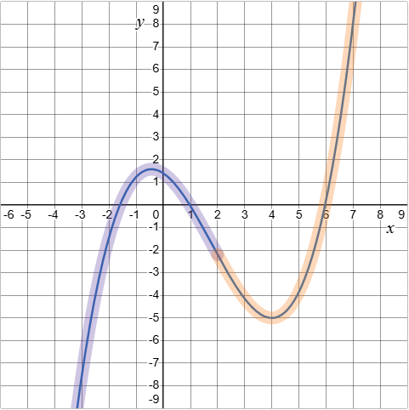
Concavity
A
B
Graph of the second derivative
C
D

Slide 12
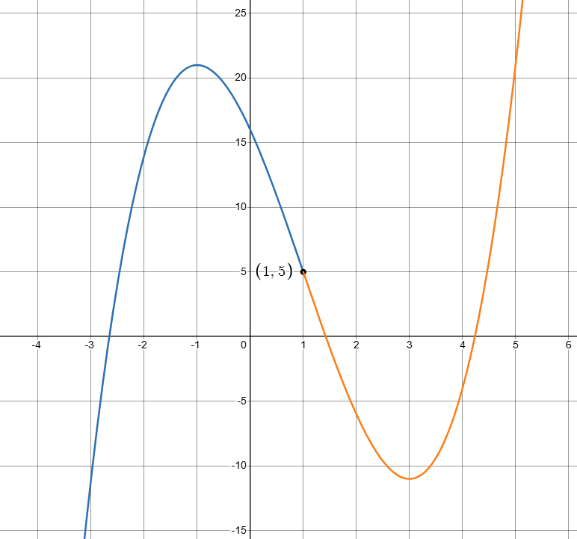
Shape of a graph
Point of inflection
A point on a curve where concavity changes.
Point of inflection

Slide 13

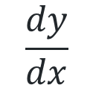




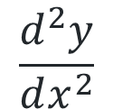

Derivative notation
Function | First derivative | Second derivative
$$y$$
$$\frac{dy}{dx}$$
$$\frac{d^{2}y}{dx^{2}}$$
$$y$$
$$y′$$
$$y′′$$
$$f(x)$$
$$f′(x)$$
$$f′′(x)$$
The second derivative is the rate of change of the first derivative.

Slide 14



Gradient functions (2)
Function
First derivative function
Second derivative function
$$f(x)=x^{3}−3x^{2}−9x+16$$
$$f′(x)=3x^{2}−6x−9$$
$$f′′(x)=6x−6$$

Slide 15
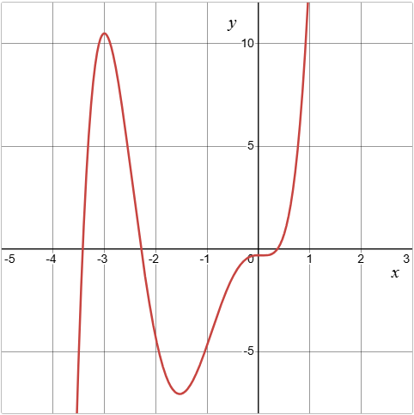
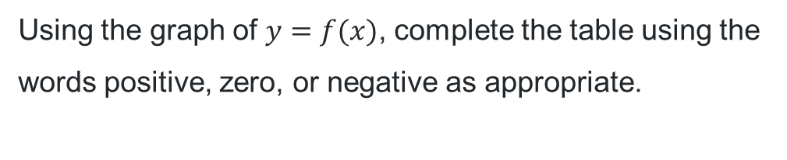
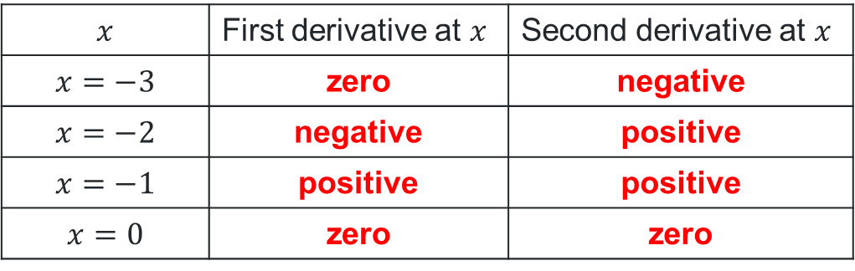
Table of derivatives
Worked example
Using the graph of $y=f(x)$, complete the table using the words positive, zero, or negative as appropriate.
What does the second derivative help us understand about a curve??
$$x$$ | First derivative at $x$ | Second derivative at $x$
$$x=−3$$ | zero | negative
$$x=−2$$ | negative | positive
$$x=−1$$ | positive | positive
$$x=0$$ | zero | zero
What does zero mean for the second derivative?
Why can both be zero?

Slide 16
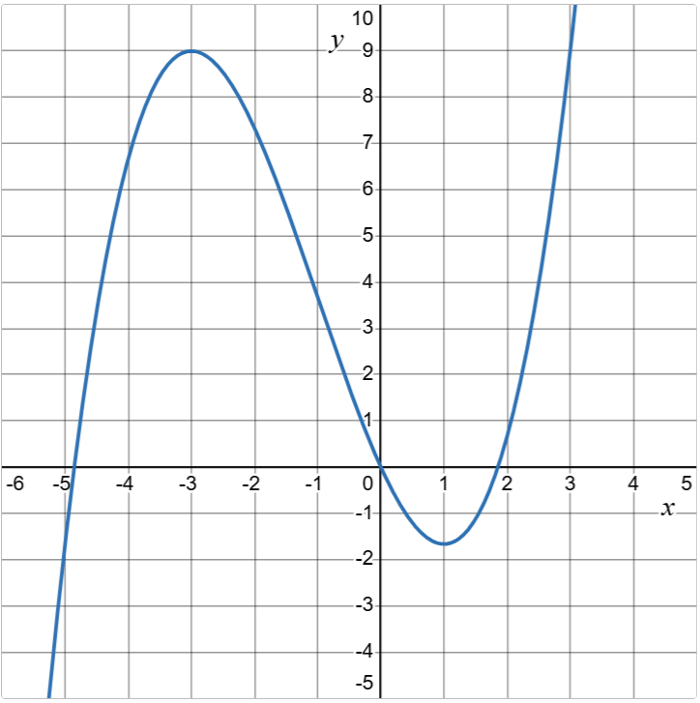
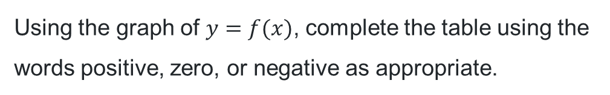
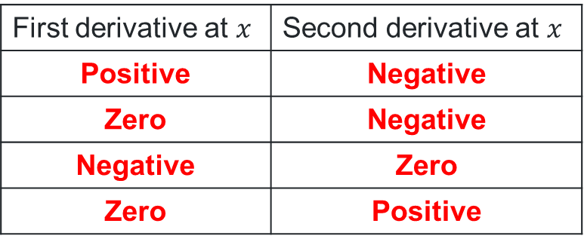
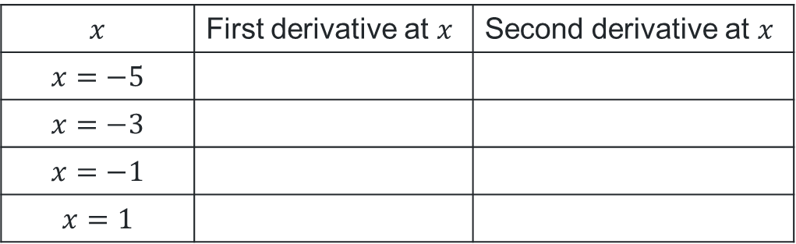
Table of derivatives (2)
Your turn
Using the graph of $y=f(x)$, complete the table using the words positive, zero, or negative as appropriate.
$$x$$ | First derivative at $x$ | Second derivative at $x$
$$x=−5$$
$$x=−3$$
$$x=−1$$
$$x=1$$
First derivative at $x$ | Second derivative at $x$
Positive | Negative
Zero | Negative
Negative | Zero
Zero | Positive

Slide 17
Independent Practice

Slide 18
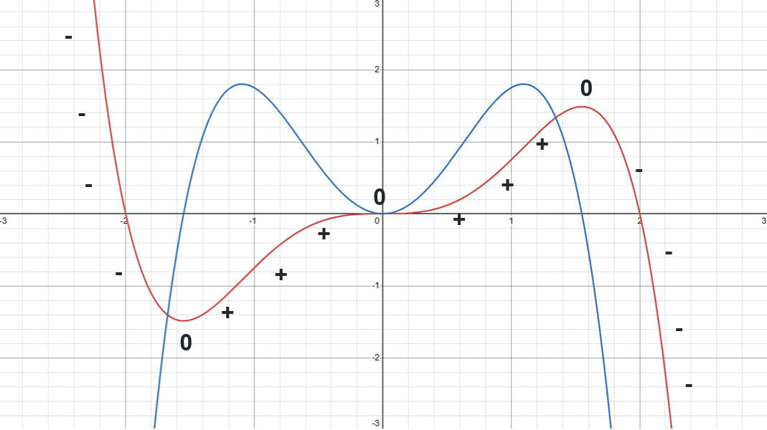
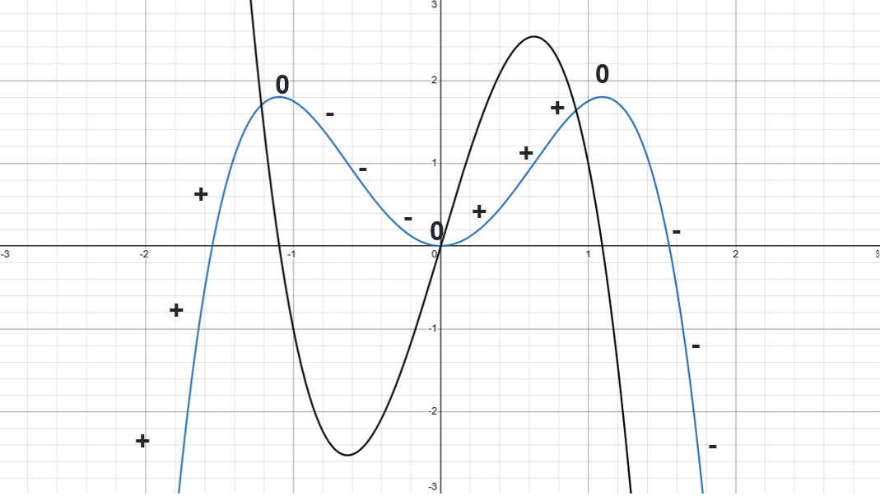


HSC style questions (1)
Question 1 solution
$y=f\left(x\right)$and$y=f′(x)$
$y=f^{′}\left(x\right)$and$y=f′′(x)$

Slide 19
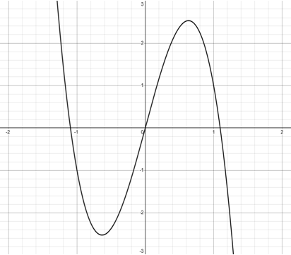

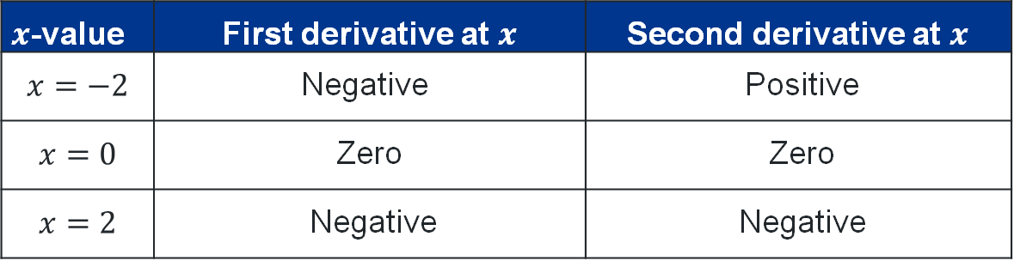
HSC style questions (2)
Question 1 solution continued
$$y=f′′(x)$$
$x$-value | First derivative at $x$ | Second derivative at $x$
$$x=−2$$ | Negative | Positive
$$x=0$$ | Zero | Zero
$$x=2$$ | Negative | Negative

Slide 20
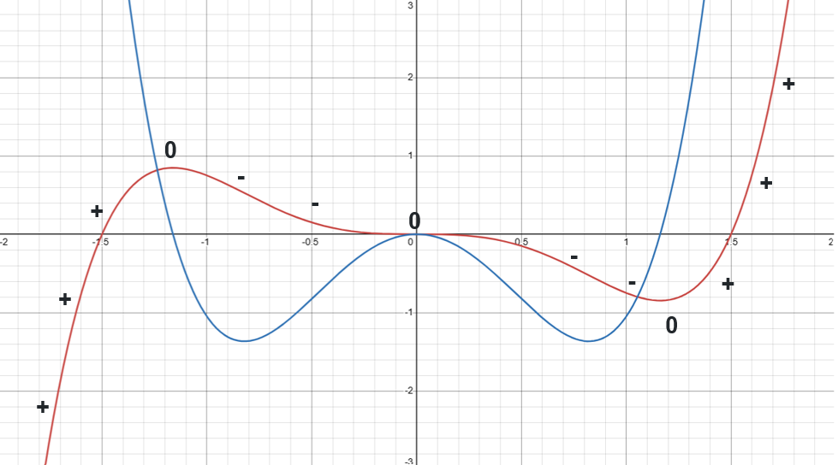
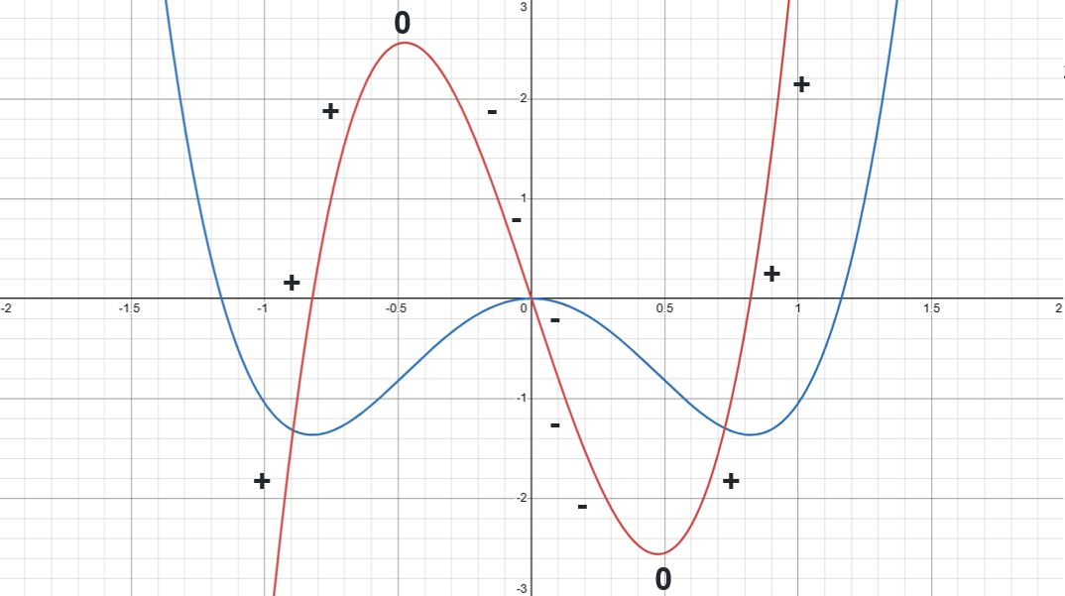

HSC style questions (3)
Question 2 solution
$y=f\left(x\right)$and$y=f′(x)$
$y=f^{′}\left(x\right)$ and$y=f′′(x)$

Slide 21
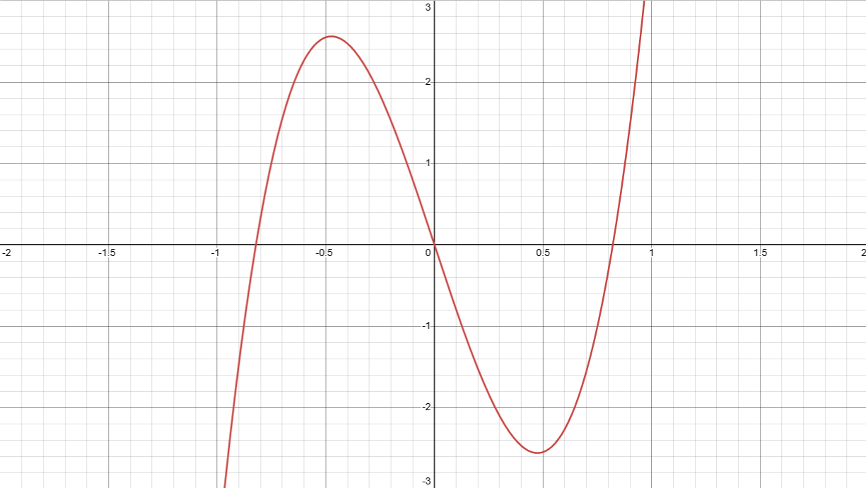

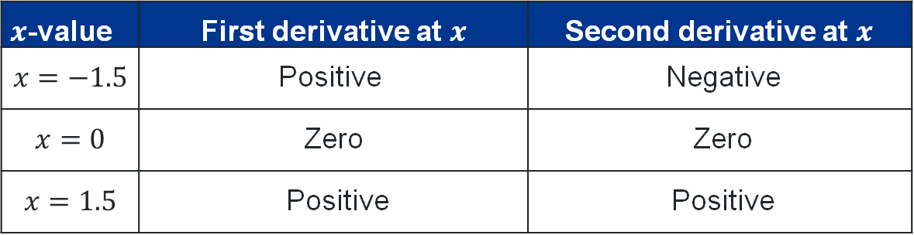
HSC style questions (4)
Question 2 solution continued
$$y=f′′(x)$$
$x$-value | First derivative at $x$ | Second derivative at $x$
$$x=−1.5$$ | Positive | Negative
$$x=0$$ | Zero | Zero
$$x=1.5$$ | Positive | Positive

Slide 22
References
This presentation contains NSW Curriculum and syllabus content. The NSW Curriculum is developed by the NSW Education Standards Authority. This content is prepared by NESA for and on behalf of the Crown in the right of the State of New South Wales. The material is protected by Crown copyright.
Please refer to the NESA Copyright Disclaimer for more information https://educationstandards.nsw.edu.au/wps/portal/nesa/mini-footer/copyright.
NESA holds the only official and up-to-date versions of the NSW Curriculum and syllabus documents. Please visit the NSW Education Standards Authority (NESA) website https://educationstandards.nsw.edu.au/wps/portal/nesa/home and the NSW Curriculum website https://curriculum.nsw.edu.au.
Mathematics Advanced 11-12 Syllabus © NSW Education Standards Authority (NESA) for and on behalf of the Crown in right of the State of New South Wales, 2024.
.

Slide 23
Copyright
© State of New South Wales (Department of Education), 2026
The copyright material published in this resource is subject to the Copyright Act 1968 (Cth) and is owned by the NSW Department of Education or, where indicated, by a party other than the NSW Department of Education (third-party material).
Copyright material available in this resource and owned by the NSW Department of Education is licensed under a Creative Commons Attribution 4.0 International (CC BY 4.0) license.
This license allows you to share and adapt the material for any purpose, even commercially.
Attribution should be given to © State of New South Wales (Department of Education), 2026.
Material in this resource not available under a Creative Commons license:
the NSW Department of Education logo, other logos and trademark-protected material
Material owned by a third party that has been reproduced with permission. You will need to obtain permission from the third party to reuse its material.
Links to third-party material and websites
Please note that the provided (reading/viewing material/list/links/texts) are a suggestion only and implies no endorsement, by the New South Wales Department of Education, of any author, publisher, or book title. School principals and teachers are best placed to assess the suitability of resources that would complement the curriculum and reflect the needs and interests of their students.
If you use the links provided in this document to access a third-party’s website, you acknowledge that the terms of use, including licence terms set out on the third-party’s website apply to the use which may be made of the materials on that third-party website or where permitted by the Copyright Act 1968 (Cth). The department accepts no responsibility for content on third-party websites.

