Slide 1
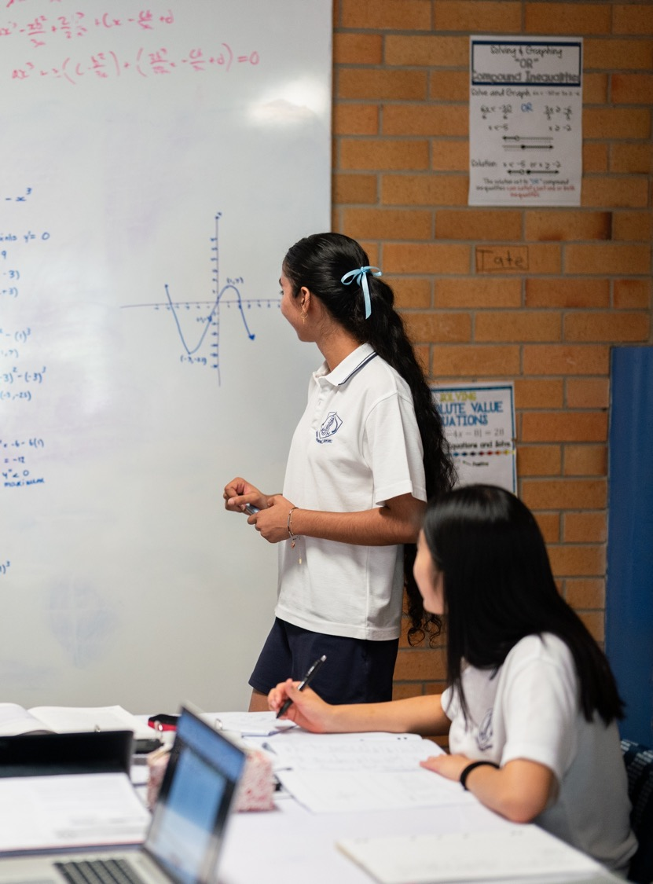
The first derivative and stationary points
Mathematics Advanced – Stage 6 (Year 12)
Differentiation applications

Slide 2
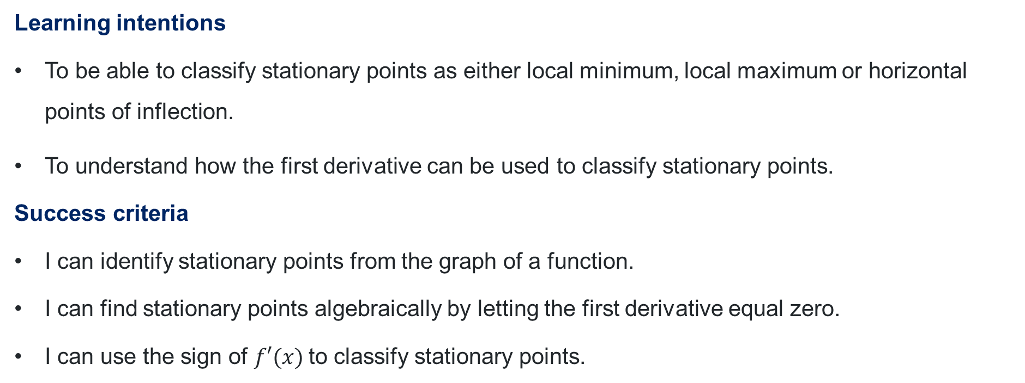
Learning intentions and success criteria
Learning intentions
To be able to classify stationary points as either local minimum, local maximum or horizontal points of inflection.
To understand how the first derivative can be used to classify stationary points.
Success criteria
I can identify stationary points from the graph of a function.
I can find stationary points algebraically by letting the first derivative equal zero.
I can use the sign of $f′(x)$to classify stationary points.

Slide 3
Activating prior knowledge

Slide 4
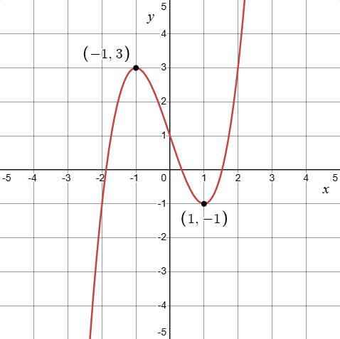
Features of a graph
Increasing, decreasing and stationary
For the graph shown:
Where are the stationary points?
When is the graph increasing?
When is the graph decreasing?
How do you know?

Slide 5
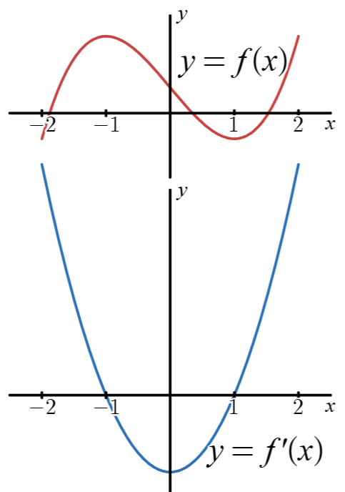
Graph of the gradient function
Compare the graphs
What do you notice?
What do you wonder?

Slide 6
Releasing responsibility

Slide 7
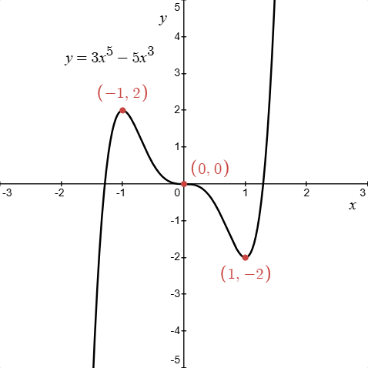
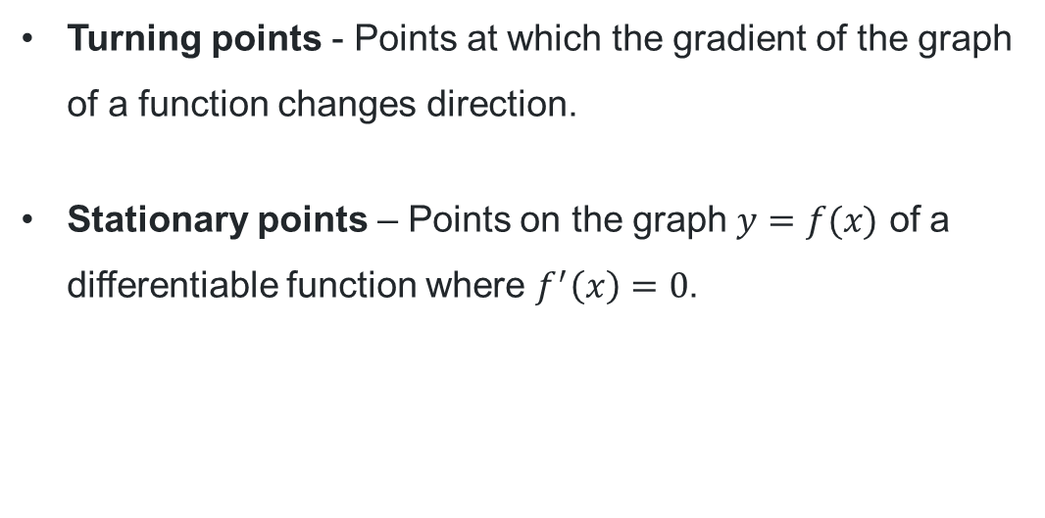
Defining stationary points (1)
Definitions
Turning points - Points at which the gradient of the graph of a function changes direction.
Stationary points – Points on the graph $y=f(x)$ of a differentiable function where $f^{′}\left(x\right)=0$.

Slide 8
Defining stationary points (2)
Definitions
Local maximum - A point on a function is a local maximum if its function value is larger than the function values near it.
Local minimum - A point on a function is a local minimum if its function value is smaller than the function values near it.
Horizontal point of inflection – A stationary point where there is no change in the sign of the gradient of the tangent to the curve on either side of the point.

Slide 9
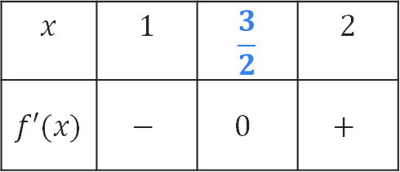

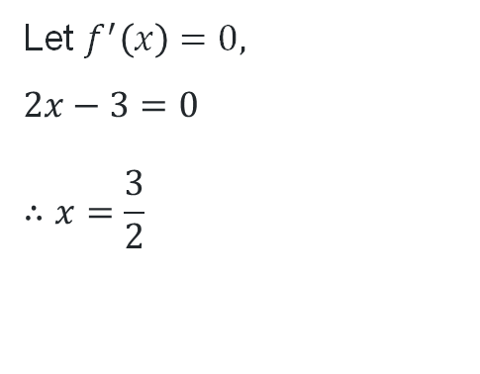
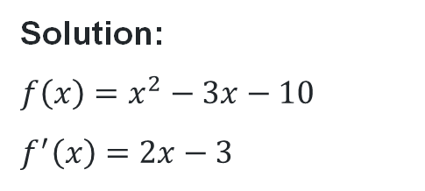
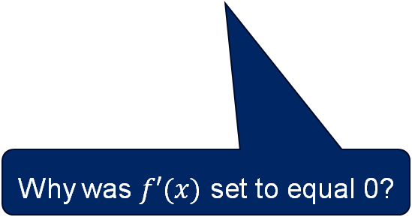
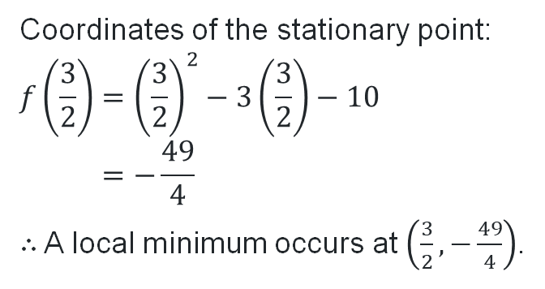
Stationary points (1)
Worked example 1
For the function $f\left(x\right)=x^{2}−3x−10$ find the stationary point and determine its nature.
Solution:
$$f\left(x\right)=x^{2}−3x−10$$
$$f^{′}\left(x\right)=2x−3$$
Test $f′(x)$ at $x=1$ and $x=2$.
Why were these values chosen?
$$x$$ | $$1$$ | $$\frac{3}{2}$$ | $$2$$
$$f′(x)$$ | $$−$$ | $$0$$ | $$+$$
Let $f^{′}\left(x\right)=0,$
$$2x−3=0$$
$$∴x=\frac{3}{2}$$
Coordinates of the stationary point:
$$f\left(\frac{3}{2}\right)={\left(\frac{3}{2}\right)}^{2}−3\left(\frac{3}{2}\right)−10 \\ =−\frac{49}{4}$$
$∴$ A local minimum occurs at $\left(\frac{3}{2},−\frac{49}{4}\right)$.
How do we know it’s a local minimum?
Why was $f′(x)$ set to equal 0?

Slide 10
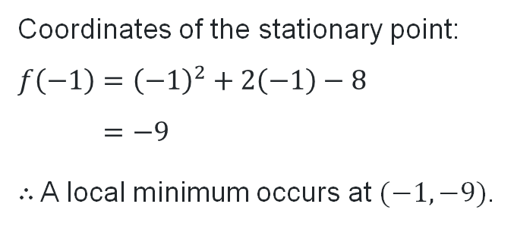
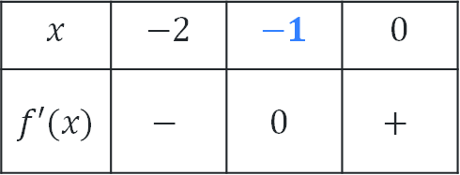
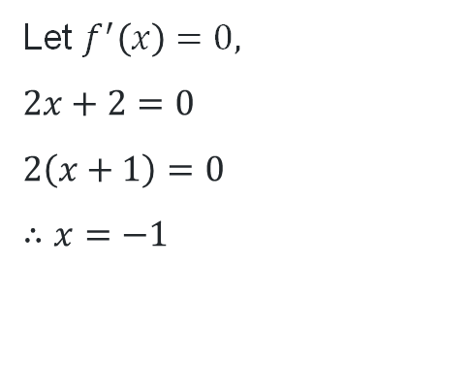

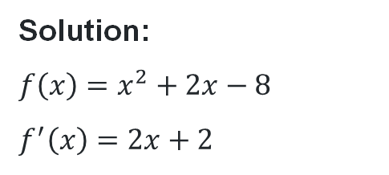
Stationary points (2)
Your turn – question 1
For the function $f\left(x\right)=x^{2}+2x−8$ find the stationary point and determine its nature.
Solution:
$$f\left(x\right)=x^{2}+2x−8$$
$$f^{′}\left(x\right)=2x+2$$
Test $f′(x)$ at $x=−2$ and $x=0$.
$$x$$ | $$−2$$ | $$−1$$ | $$0$$
$$f′(x)$$ | $$−$$ | $$0$$ | $$+$$
Let $f^{′}\left(x\right)=0,$
$$2x+2=0$$
$$2\left(x+1\right)=0$$
$$∴x=−1$$
Coordinates of the stationary point:
$$f\left(−1\right)={\left(−1\right)}^{2}+2\left(−1\right)−8 \\ =−9$$
$∴$ A local minimum occurs at $(−1,−9)$.

Slide 11
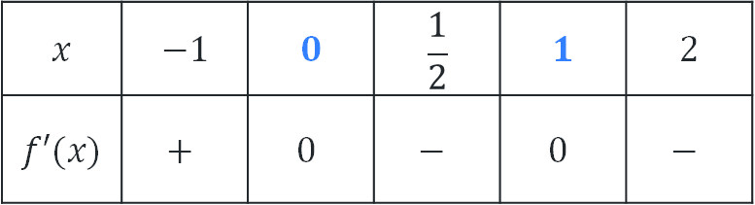

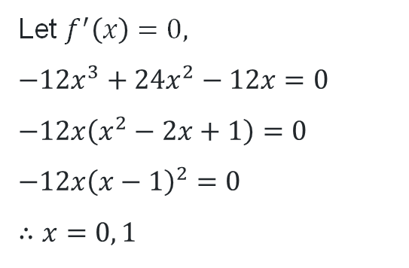
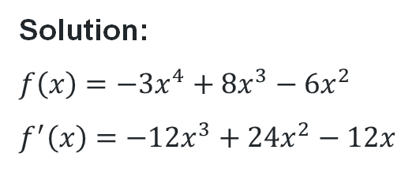
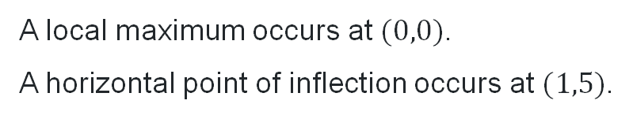
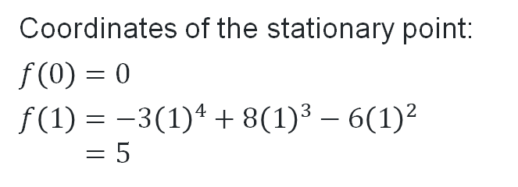
Stationary points (3)
Worked example 2
For the function $f\left(x\right)=−3x^{4}+8x^{3}−6x^{2}$, find the stationary points and determine their nature.
Test $f′(x)$ at $x=−1,\frac{1}{2}$ and $2$.
Why were these values chosen?
Solution:
$$f\left(x\right)=−3x^{4}+8x^{3}−6x^{2}$$
$$f^{′}\left(x\right)=−12x^{3}+24x^{2}−12x$$
$$x$$ | $$−1$$ | $$0$$ | $$\frac{1}{2}$$ | $$1$$ | $$2$$
$$f′(x)$$ | $$+$$ | $$0$$ | $$−$$ | $$0$$ | $$−$$
What does this table show?
Let $f^{′}\left(x\right)=0,$
$$−12x^{3}+24x^{2}−12x=0$$
$$−12x\left(x^{2}−2x+1\right)=0$$
$$−12x{\left(x−1\right)}^{2}=0$$
$$∴x=0, 1$$
Coordinates of the stationary point:
$$f\left(0\right)=0$$
$$f\left(1\right)=−3{\left(1\right)}^{4}+8{\left(1\right)}^{3}−6{\left(1\right)}^{2} \\ =5$$
How do we know their classification?
A local maximum occurs at $(0,0)$.
A horizontal point of inflection occurs at $(1,5)$.

Slide 12
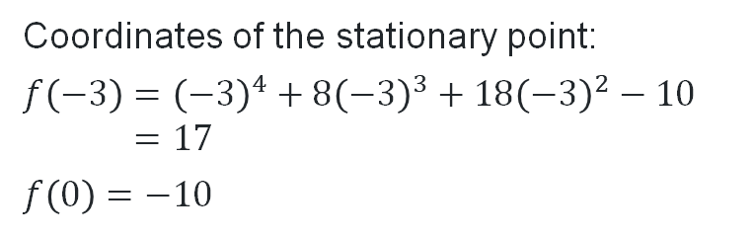
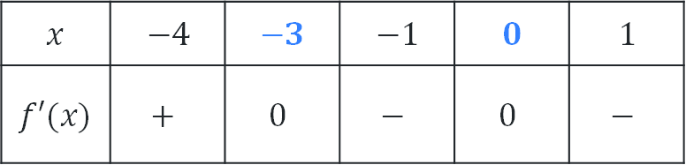

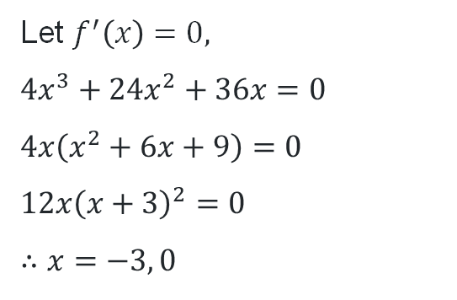
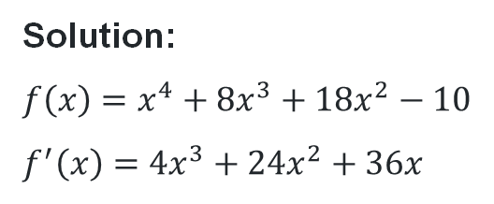
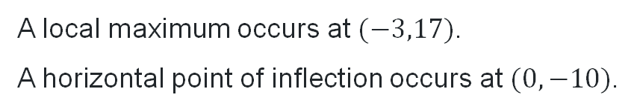
Stationary points (4)
Your turn – question 2
For the function $f\left(x\right)=x^{4}+8x^{3}+18x^{2}−10$, find the stationary points and determine their nature.
Solution:
$$f\left(x\right)=x^{4}+8x^{3}+18x^{2}−10$$
$$f^{′}\left(x\right)=4x^{3}+24x^{2}+36x$$
Test $f′(x)$ at $x=−4, −1$ and $1$.
$$x$$ | $$−4$$ | $$−3$$ | $$−1$$ | $$0$$ | $$1$$
$$f′(x)$$ | $$+$$ | $$0$$ | $$−$$ | $$0$$ | $$−$$
Let $f^{′}\left(x\right)=0,$
$$4x^{3}+24x^{2}+36x=0$$
$$4x\left(x^{2}+6x+9\right)=0$$
$$12x{\left(x+3\right)}^{2}=0$$
$$∴x=−3, 0$$
Coordinates of the stationary point:
$$f\left(−3\right)={\left(−3\right)}^{4}+8{\left(−3\right)}^{3}+18{\left(−3\right)}^{2}−10 \\ =17$$
$$f\left(0\right)=−10$$
A local maximum occurs at $(−3,17)$.
A horizontal point of inflection occurs at $(0,−10)$.

Slide 13
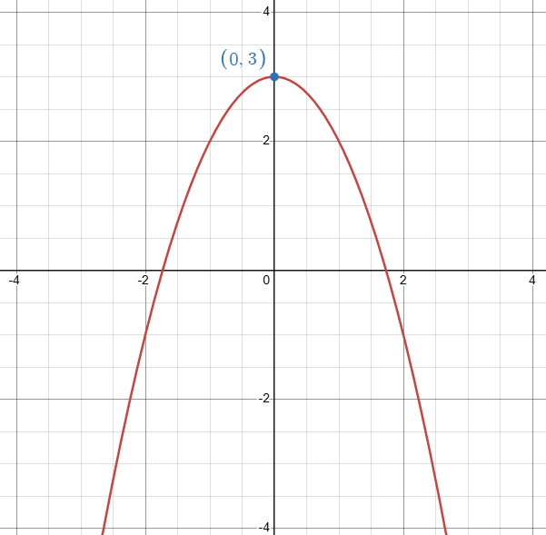
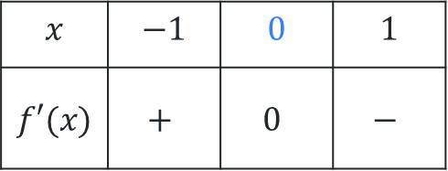
Classifying stationary points
Sign of the derivative
Jed said that the following table shows that the graph of the function $f(x)=−x^{2}+3$ has a stationary point at $x=0$ so the graph must have a local maximum at the origin.
$$x$$ | $$−1$$ | $$0$$ | $$1$$
$$f′(x)$$ | $$+$$ | $$0$$ | $$−$$
How can we explain why Jed is incorrect?

Slide 14


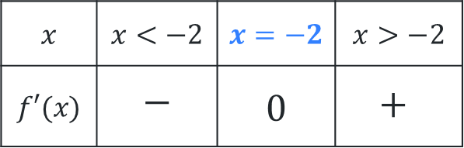
True or false?
Use a thumbs up if you think it’s true.
Use a thumbs down if you think it’s false.
For all stationary points, $f^{′}\left(x\right)=0$.
A horizontal point of inflection can be identified when there is a change in the sign of the derivative.
$$x$$ | $$x<−2$$ | $$x=−2$$ | $$x>−2$$
$$f′(x)$$ | $$−$$ | $$0$$ | $$+$$
This table represents a minimum turning point:

Slide 15
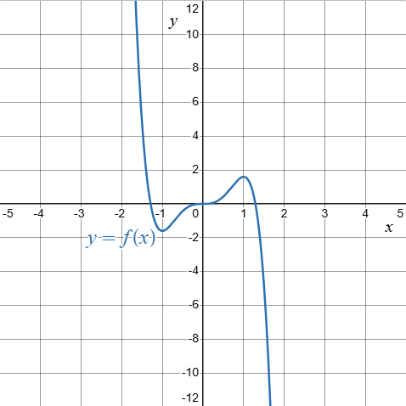
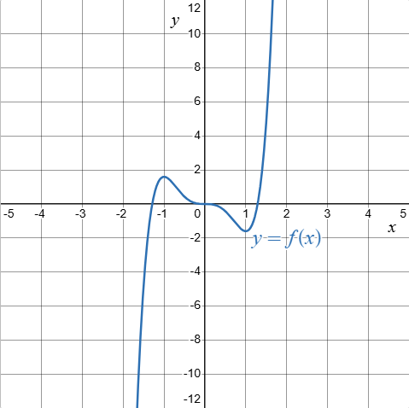
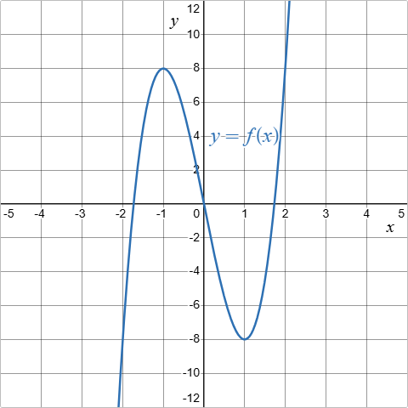
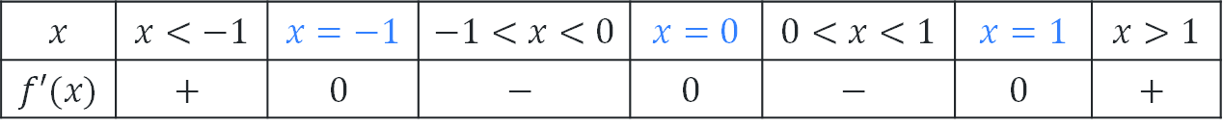
Sign of the tangent of the gradient to a curve
Which one?
$$x$$ | $$x<−1$$ | $$x=−1$$ | $$−1<x<0$$ | $$x=0$$ | $$0<x<1$$ | $$x=1$$ | $$x>1$$
$$f′(x)$$ | $$+$$ | $$0$$ | $$−$$ | $$0$$ | $$−$$ | $$0$$ | $$+$$
Which of the following graphs represent the table of the sign of the derivative?
Graph 1
Graph 2
Graph 3

Slide 16
References
This presentation contains NSW Curriculum and syllabus content. The NSW Curriculum is developed by the NSW Education Standards Authority. This content is prepared by NESA for and on behalf of the Crown in the right of the State of New South Wales. The material is protected by Crown copyright.
Please refer to the NESA Copyright Disclaimer for more information https://educationstandards.nsw.edu.au/wps/portal/nesa/mini-footer/copyright.
NESA holds the only official and up-to-date versions of the NSW Curriculum and syllabus documents. Please visit the NSW Education Standards Authority (NESA) website https://educationstandards.nsw.edu.au/wps/portal/nesa/home and the NSW Curriculum website https://curriculum.nsw.edu.au.
Mathematics Advanced 11-12 Syllabus © NSW Education Standards Authority (NESA) for and on behalf of the Crown in right of the State of New South Wales, 2024.
.

Slide 17
Copyright
© State of New South Wales (Department of Education), 2026
The copyright material published in this resource is subject to the Copyright Act 1968 (Cth) and is owned by the NSW Department of Education or, where indicated, by a party other than the NSW Department of Education (third-party material).
Copyright material available in this resource and owned by the NSW Department of Education is licensed under a Creative Commons Attribution 4.0 International (CC BY 4.0) license.
This license allows you to share and adapt the material for any purpose, even commercially.
Attribution should be given to © State of New South Wales (Department of Education), 2026.
Material in this resource not available under a Creative Commons license:
the NSW Department of Education logo, other logos and trademark-protected material
Material owned by a third party that has been reproduced with permission. You will need to obtain permission from the third party to reuse its material.
Links to third-party material and websites
Please note that the provided (reading/viewing material/list/links/texts) are a suggestion only and implies no endorsement, by the New South Wales Department of Education, of any author, publisher, or book title. School principals and teachers are best placed to assess the suitability of resources that would complement the curriculum and reflect the needs and interests of their students.
If you use the links provided in this document to access a third-party’s website, you acknowledge that the terms of use, including licence terms set out on the third-party’s website apply to the use which may be made of the materials on that third-party website or where permitted by the Copyright Act 1968 (Cth). The department accepts no responsibility for content on third-party websites.

